Slide 1
Nonresponse Bias Analyses for the National Health
and Nutrition Examination Survey (NHANES)
National Center for Health Statistics
Board of Scientific Counselors
September 5th 2019

Slide 2
Trends in Response Rates: NHANES 1999‒2018
15,000
100
80
88.7
Number HH Screened
Response Rate (%)
10,000
60
50.4
40
47.1
5,000
20
0
0
HH Screened (n)
Screened (%)
Interviewed (%)
MEC Examined (%)

Slide 3
Approaches to Assess Nonresponse Bias (Groves 2006)
Five approaches:
RR comparisons across subgroups
Comparisons to similar estimates from other sources
Studying variations within existing survey
Contrasting alternative post-survey adjustments for nonresponse
5.
Using sampling frame data or supplemental matched data
Coming in 2019
Reference: Groves RM. Nonresponse Rates and Nonresponse Bias in Household Surveys. Public opinion quarterly. 2006:646-675

Slide 4
Approaches to Assess Nonresponse Bias (Groves 2006)
Five approaches:
RR comparisons across subgroups
Bivariate analyses: examine differences in response status between groups
Classification Trees: evaluate the relationship between response status and multiple auxiliary variables
Comparisons to similar estimates from other sources
Studying variations within existing survey
Contrasting alternative post-survey adjustments for nonresponse
Using sampling frame data or supplemental matched data
Reference: Groves RM. Nonresponse Rates and Nonresponse Bias in Household Surveys. Public opinion quarterly. 2006:646-675

Slide 5
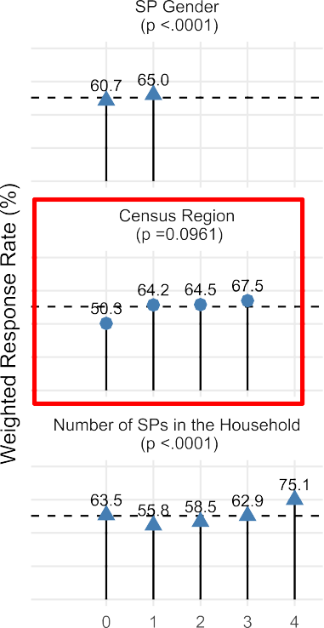
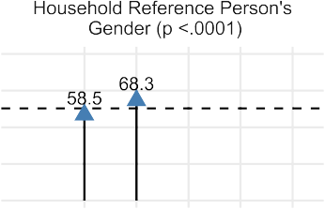
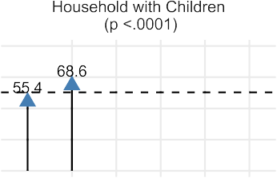
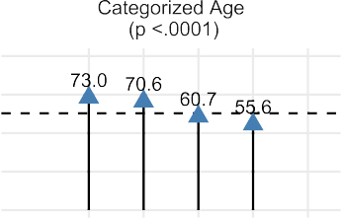
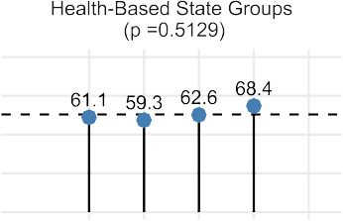
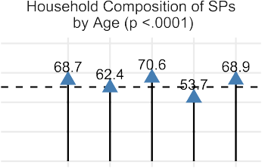
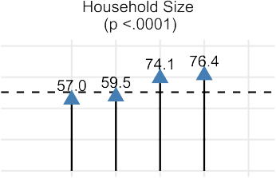
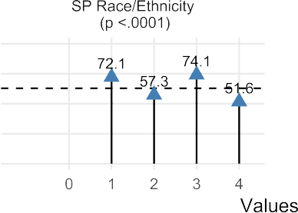
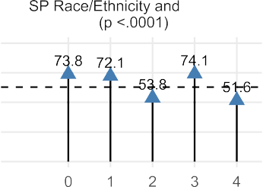
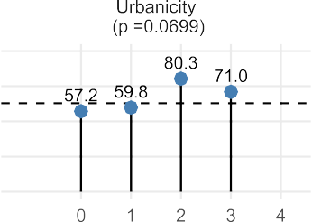
RR Comparisons Across Subgroups: NHANES 2015-2016
Results from Bivariate Analyses

Slide 6
Approaches to Assess Nonresponse Bias (Groves 2006)
Five approaches:
RR comparisons across subgroups
Comparisons to similar estimates from other sources
Studying variations within existing survey
Contrasting alternative post-survey adjustments for nonresponse
Using sampling frame data or supplemental matched data
Reference: Groves RM. Nonresponse Rates and Nonresponse Bias in Household Surveys. Public opinion quarterly. 2006:646-675

Slide 7
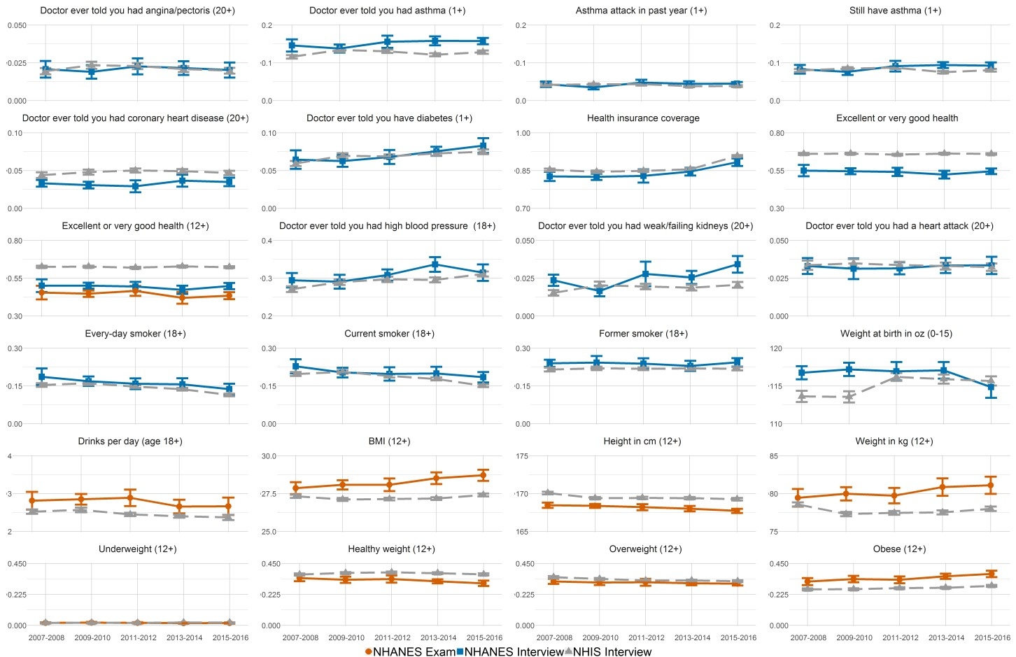
Comparisons to Similar Estimates From Other Sources
Comparisons to NHIS
Figure legend:
National Health Interview Survey (NHIS)
NHANES interview
NHANES exam

Slide 8
Approaches to Assess Nonresponse Bias (Groves 2006)
Five approaches:
RR comparisons across subgroups
Comparisons to similar estimates from other sources
Studying variations within existing survey
R-indicator analysis
Comparisons between easy versus hard to enroll respondents
Range of bias analyses
Contrasting alternative post-survey adjustments for nonresponse
Using sampling frame data or supplemental matched data
Reference: Groves RM. Nonresponse Rates and Nonresponse Bias in Household Surveys. Public opinion quarterly. 2006:646-675

Slide 9
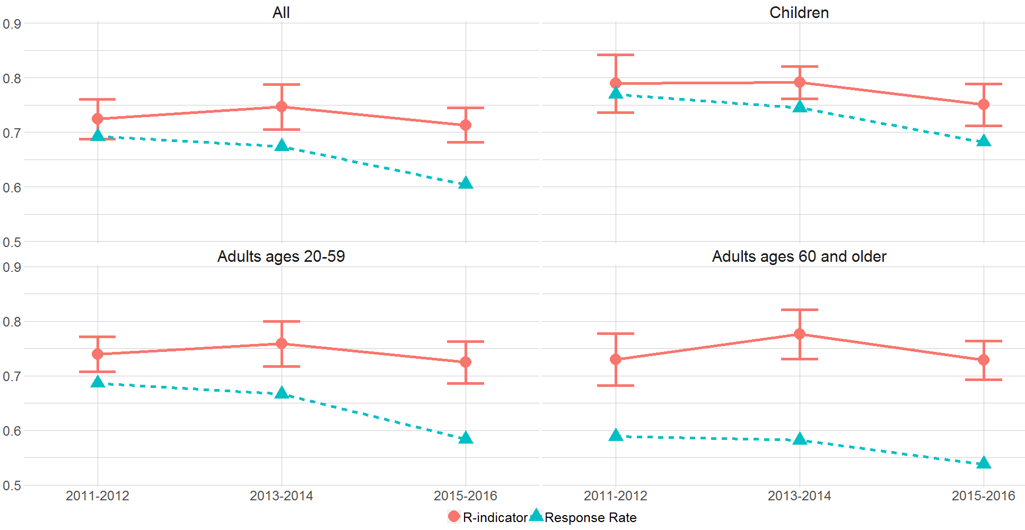
Studying variations within existing survey
R-Indicator Analysis
Weighted Response Rates and R-indicators by Survey Year

Slide 10
Approaches to Assess Nonresponse Bias (Groves 2006)
Five approaches:
RR comparisons across subgroups
Comparisons to similar estimates from other sources
Studying variations within existing survey
Contrasting alternative post-survey adjustments for nonresponse
Using sampling frame data or supplemental matched data
Reference: Groves RM. Nonresponse Rates and Nonresponse Bias in Household Surveys. Public opinion quarterly. 2006:646-675

Slide 11
Approaches to Assess Nonresponse Bias (Groves 2006)
Five approaches:
RR comparisons across subgroups
Comparisons to similar estimates from other sources
Studying variations within existing survey
Contrasting alternative post-survey adjustments for nonresponse
5.
Using sampling frame data or supplemental matched data
Coming in 2019
Reference: Groves RM. Nonresponse Rates and Nonresponse Bias in Household Surveys. Public opinion quarterly. 2006:646-675

Slide 12
NHANES Screener NRB Module
Health-related questions added to the screener in 2019 to help with NRB adjustments
General health status
Currently taking medications and how many
Diabetes
Hypertension

