Slide 1

Ryne Paulose, Camp Director
September 5, 2019

Slide 2
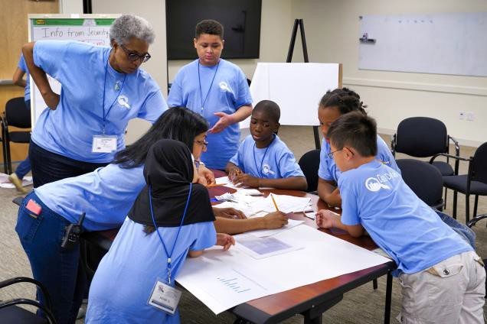
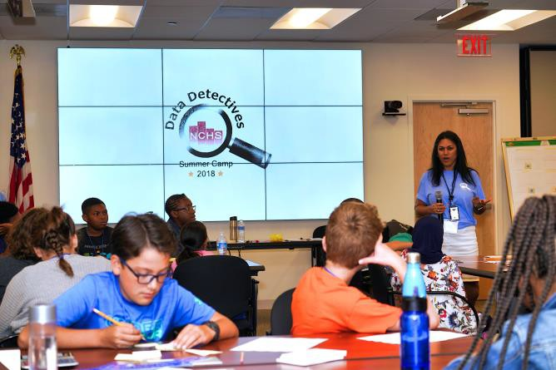
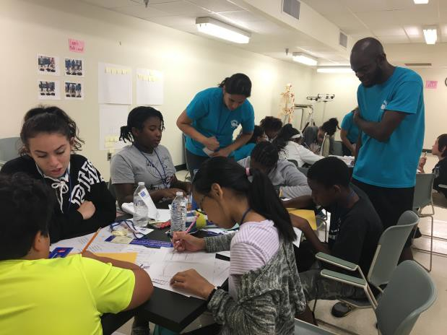
What is the Data Detectives Camp?
◆ One-week commuter STEM camp
◆ Focuses on statistics for middle school students
◆ Teaches statistics through a variety of fun, hands-on activities
◆ There is no fee for registering or attending the Camp

Slide 3
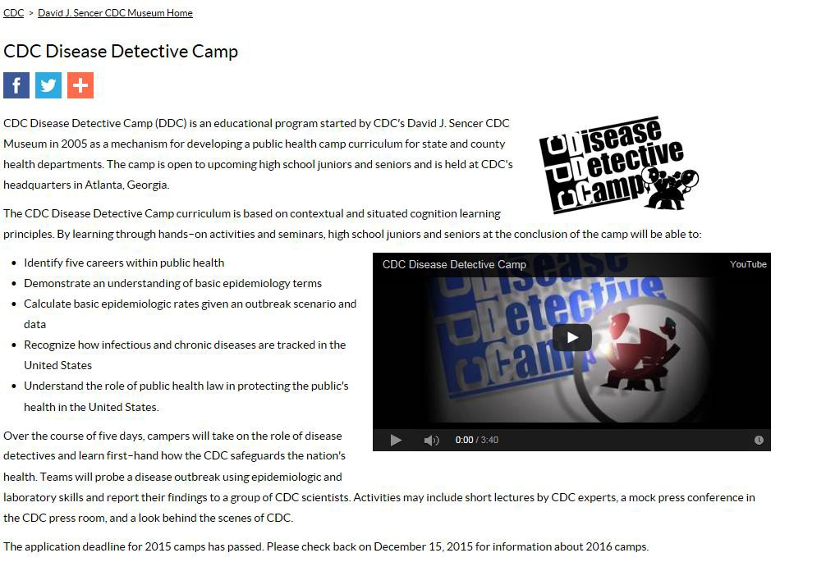
What generated the idea?

Slide 4




The people who let the idea to grow...
NCHS
◆ Susan Schneider / Lori Blahnik
◆ Nat Schenker
American Statistical Association
◆ Rebecca Nichols, Director of Education
CDC Disease Detectives
◆ Trudi Ellerman, Camp Director
UMD, School of Public Health
◆ Jane Clark, Dean
UMD, Joint Program in Survey Methodology
◆ Rick Valliant, Assistant Director JPSM
◆ Jody Williams, Program Coordinator

Slide 5

The people who developed the 1st camp...
NCHS
◆ Ryne Paulose, Lead
◆ Tunde Akinseye
◆ Brenda Baker
◆ Lori Blahnik
◆ Michele Chiappa
◆ Meena Khare
◆ Anthony Lipphardt
◆ Gladys Martinez
CDC Disease Detectives
◆ Trudi Ellerman, Camp Director
UMD, Joint Program in Survey Methodology
◆ Jody Williams, Program Coordinator
American Statistical Association
◆ Rebecca Nichols, Director of Education
◆ Donna LaLonde
UMD, School of Public Health
◆ Mark Brennerman, Director of Facilities
◆ Xin He, Professor

Slide 6


Our Partners have grown…
NCHS
◆ Ryne Paulose, Lead
◆ Martinez, Gladys
◆ Julianna Huard
◆ Tunde Akinseye
◆ Bianca Escobar
◆ Jennifer Moore
CDC Disease Detectives
◆ Trudi Ellerman
UMD, Joint Program in Survey Methodology
◆ Jody Williams
UMD, School of Public Health
◆ Xin He
American Statistical Association
◆ Rebecca Nichols
◆ Donna LaLonde
Bureau of Labor Statistics
◆ Tracy Jack
◆ Vanessa Newton
Bureau of Justice Statistics
◆ Jennifer Bronson

Slide 7
Our Partners have grown…
NCHS
◆ Ryne Paulose, Lead
◆ Martinez, Gladys
◆ Julianna Huard
◆ Tunde Akinseye
◆ Bianca Escobar
◆ Jennifer Moore
CDC Disease Detectives
◆ Trudi Ellerman
UMD, Joint Program in Survey Methodology
◆ Jody Williams
UMD, School of Public Health
◆ Xin He
American Statistical Association
◆ Rebecca Nichols
◆ Donna LaLonde
Bureau of Labor Statistics
◆ Tracy Jack
◆ Vanessa Newton
Bureau of Justice Statistics
◆ Jennifer Bronson

Slide 8
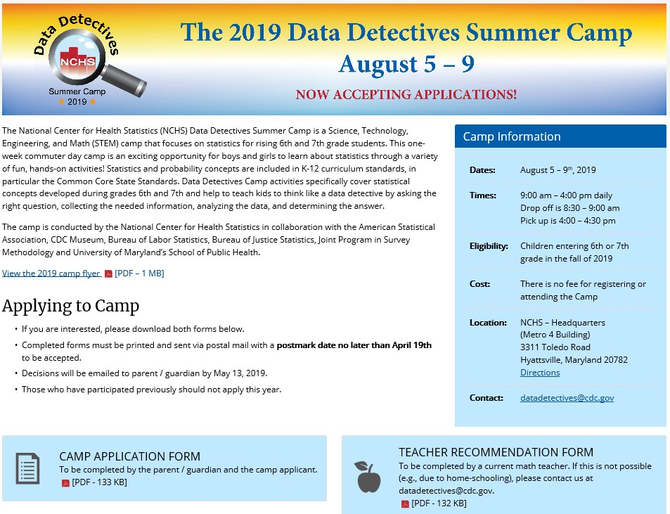


2019 NCHS Data Detectives Summer Camp

Slide 9
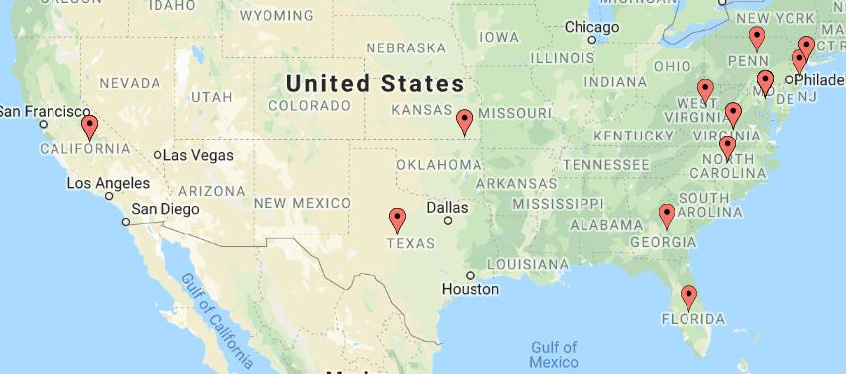
Applications Accepted 3/13/19 – 4/19/19
https://www.batchgeo.com/map/0f46dd2f6e7d2600ea9820a911ae0784

Slide 10
Application Review Process…Only 30 spots…
◆ All applications were reviewed by RP
◆ Incomplete and Late applications were excluded
◆ Remaining go for Committee Review
◆ 4 NCHS and 1 SPH person
◆ Evaluation based on parent/child responses, teacher
recommendation, and best “fit” for camp
◆ If more than 30 selected, all move to random selection
◆ Random Selection of 30
◆ Equal distribution by age and gender
◆ Acceptance letters to 30; Remaining on Waitlist

Slide 11
Acceptance Rates
2016 (n=201) |  | 2017 (n=101) | 2018 (n=129) | 2019 (n=101)
 | % | % | % | %
Accepted | 36 | 43 | 27 | 47
No | 36 | 57 | 38 | 23
Incomplete | 28 | 0 | 35 | 31
Notes:
2016 – accepted 6, 7, and 8th graders; 2017-19 – accepted only 6 and 7th graders 2016 and 2019 - Application included teacher recommendation

Slide 12
Examples of parent responses after
acceptance
Hello Datadetectives!!!!
I gladly accept admission for my daughter to attend your camp. Thank you for accepting her and can't wait for her to attend!
Hello Ryne: We were very excited to learn that you have a space for our son in this summer's Data Detectives Camp. He would love to participate! Please let us know what else we might need to do to finalize enrollment.
Yes we live in California. Either my husband or I (or both) will travel with her. We will find a hotel near NCHS to stay and work remotely while she attends the camp. We will tour around Washington DC and surrounding area either before or after the camp. She is very excited and looking forward to this camp!

Slide 13
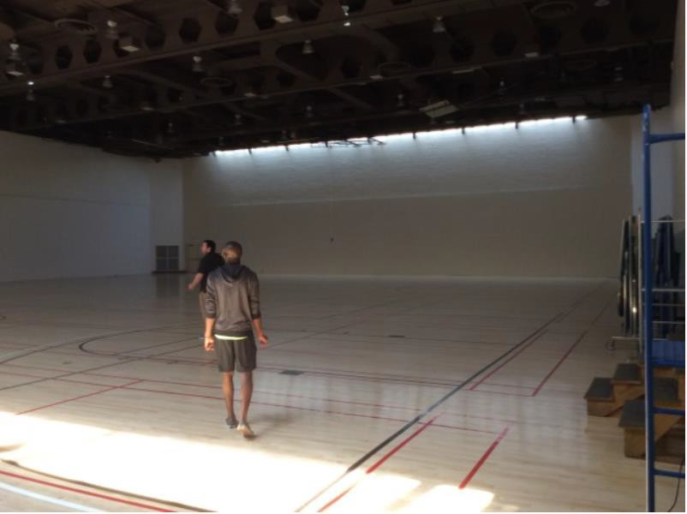
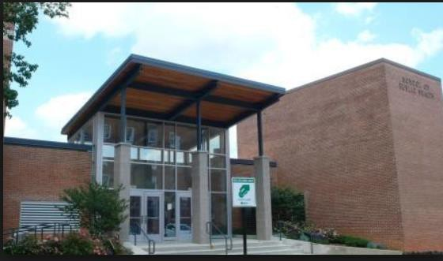
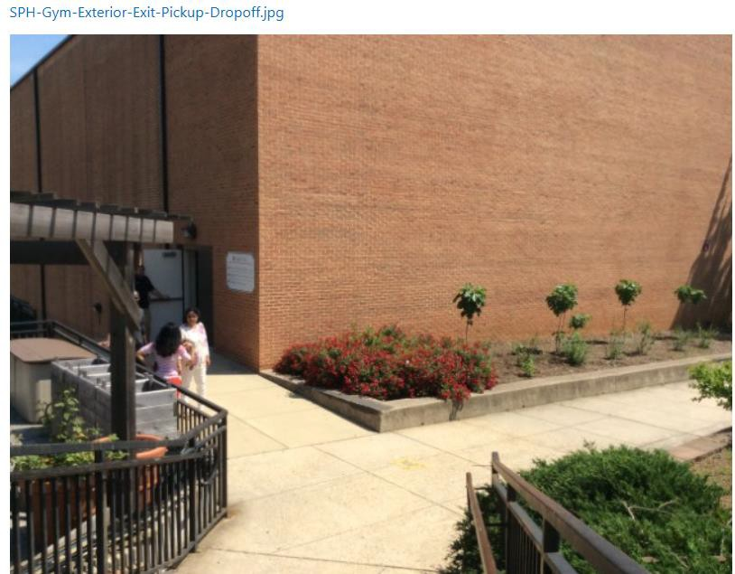
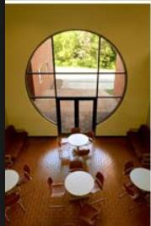
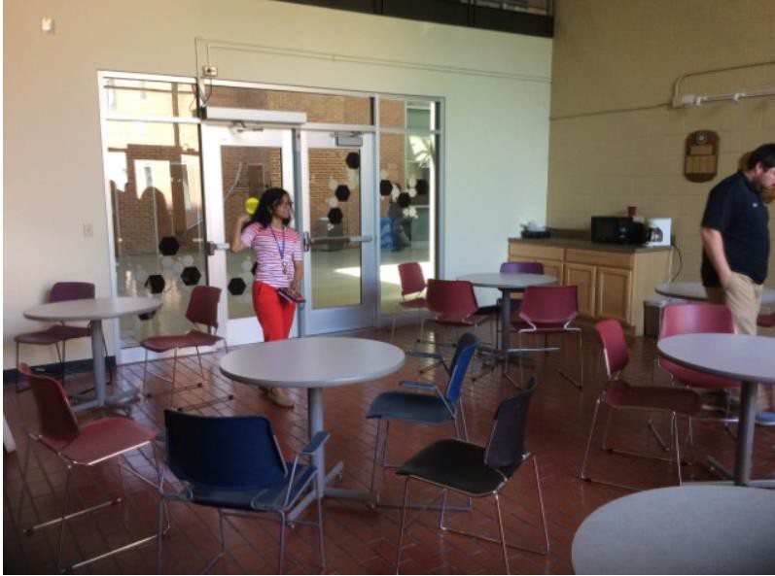
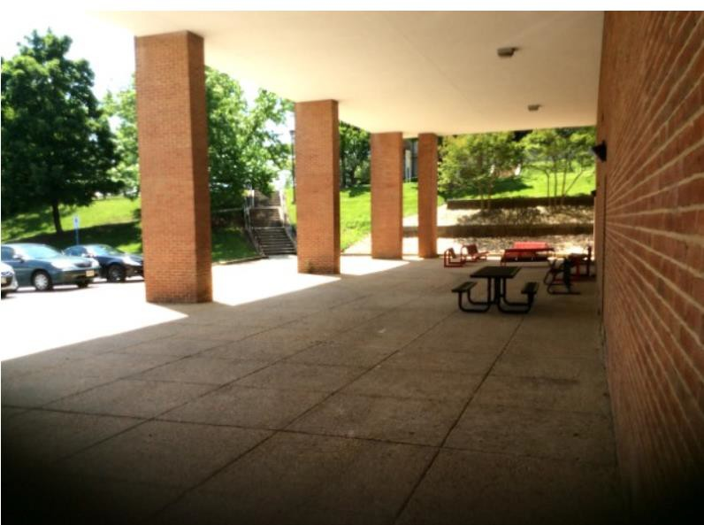
2016 & 2017 Venue –
UMD School of Public Health

Slide 14
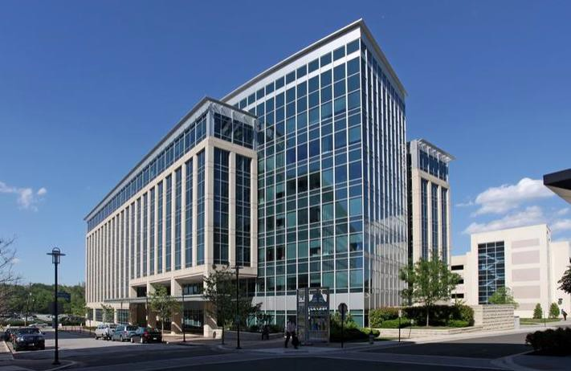
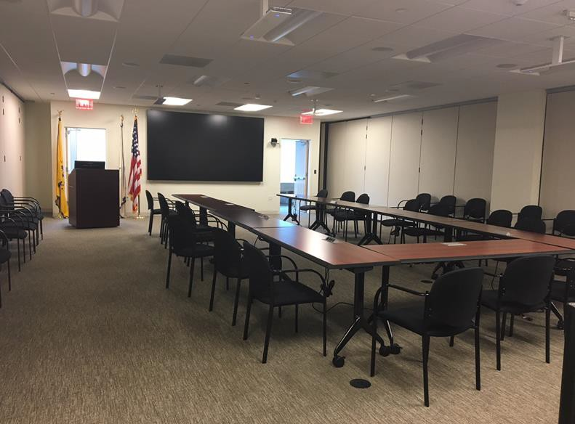
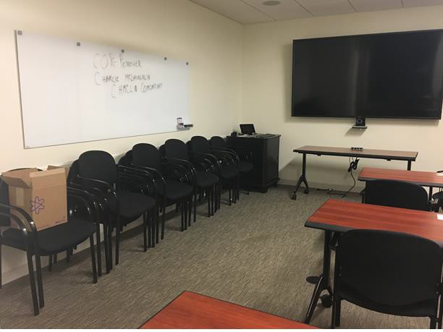
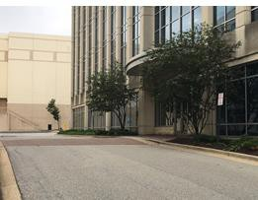
2018 & 2019 Venue –
National Center for Health Statistics

Slide 15
Statistical Activities
◆ Based on Common Core Standards¹ for Middle School
◆ Grade 6 – Distributions / Statistical Variability
◆ Grade 7 – Comparing Populations / Random Sampling
◆ Grade 8 – Bivariate Associations
◆ Use Guidelines for Assessment and Instruction in Statistics
Education (GAISE)² for every activity
◆ Formulate statistical question
◆ Collect the necessary data
◆ Analyze data
◆ Interpret data
www.corestandards.org http://www.amstat.org/education/gaise/index.cfm

Slide 16

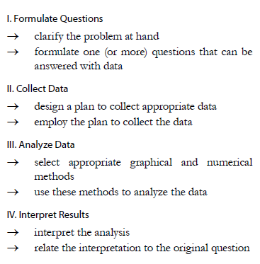
Guidelines for Assessment and
Instruction in Statistics Education (GAISE)
http://www.amstat.org/education/gaise/index.cfm

Slide 17
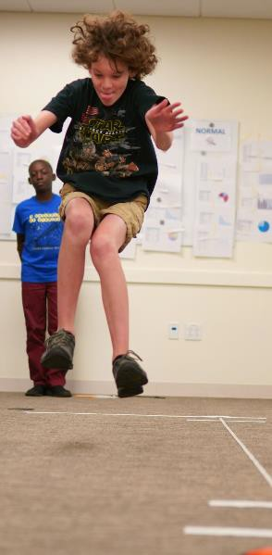
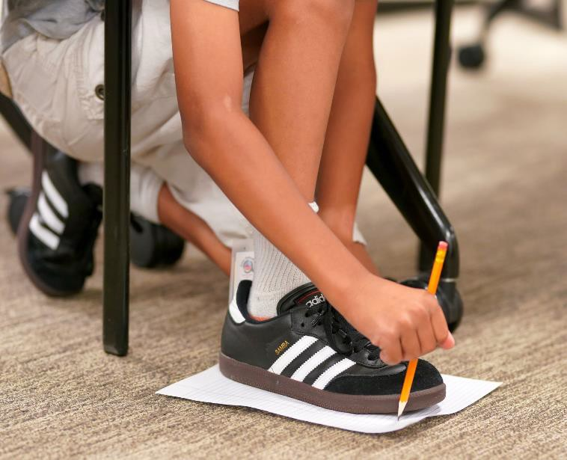
Morning Statistical Activities
◆ Continuous Data – foot
length, jump distance,
◆ Solving a case using data
MONDAY: Distributions | TUESDAY: Comparing populations | WEDNESDAY: Bivariate association | THURSDAY: Probability
Activity: The footprint on the sidewalk Formulate Q: Have class ask questions @ arm span. [Discuss how to ask a statistical question]. Collect Data Have each group determine how they will collect data on foot size. | Recap of previous day’s activities (5 mins) Activity: Continue with Gymkana activity from Monday - Time on Balance beam and Time hanging from parallel bars (Formulate Q and Collect Data already done). (30m) Analyze and Display Data: Each group will | Recap of previous day’s activities (5 mins) Activity: Foot Length & Time on parallel bars (45m) Formulate Q: have class pose questions @ relationship btn arm span & time. E.g., does longer arm span mean longer time? [Discuss | Recap of previous day’s activities (5 mins) Introduction of simple probability concepts: Describe basic concepts (15 mins) Question(s) of the day (?) Activity: ask students to determine the

Slide 18
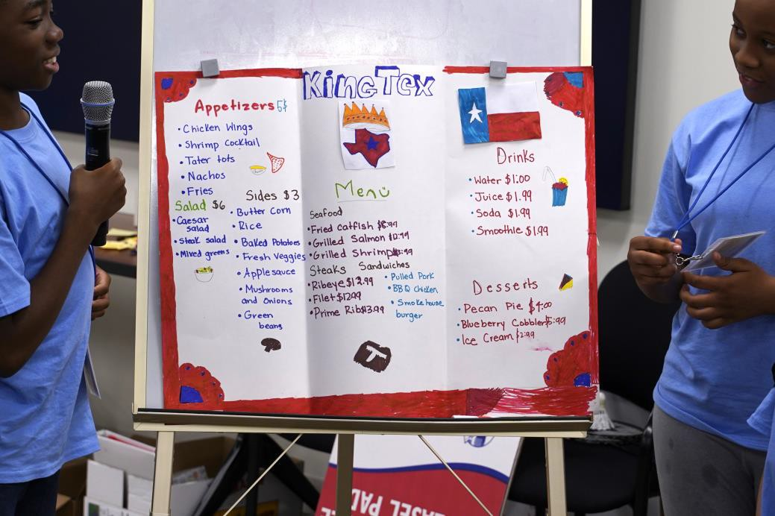
Afternoon Statistical Activities
◆ Categorical data – Food Preferences
◆ Creating a food menu for middle school
aged children
◆ Use Census@School to examine state
variation
MONDAY: Distributions | TUESDAY: Comparing populations | WEDNESDAY: Bivariate association | THURSDAY: Probability
Activity: FOOD PREFERENCE Formulate Q: Have class ask questions @ food preference. [Discuss how to ask a statistical question; discuss the variables; how do response options differ from morning]. Collect Data Have each group determine how they will collect data on food | Activity: Repeat with Vegetarian status, if time permits. Activity: Each group colors their map on the top 3 foods for their states | Activity: Describing relationship by exploring other factors) Formulate Q: What factors are related to the differences seen in food preference by state? Analyze & Display data: Posterboard with columns for categories of explanatory | Recap of previous day’s activities (5 mins) Activity: Restaurant menu Formulate Q: have class brainstorm on what they’ve learned that could be used to develop the ideal menu for middle schoolers CHALLENGE: Job (should you choose to

Slide 19
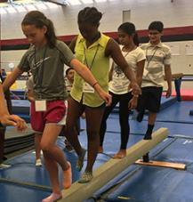
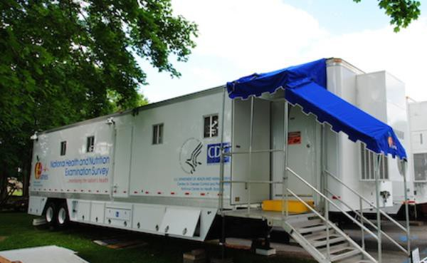
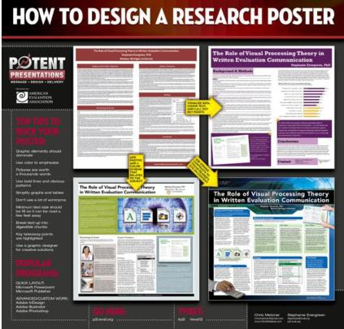



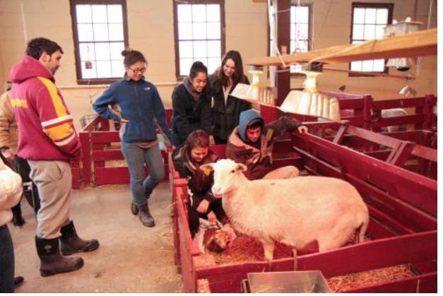
Extra Activities 2016 - 2019
◆ Modified Gymkana
◆ Ben Prescott, Assistant Director and coach, had campers obtain measurements on timed planks, standing jumps, and grip strength
◆ NHANES Exam Center
◆ Infectious Disease Epidemiologist, Dr. Geraldine McQuillan talked to students about NHANES ; NHANES Engineer, Vera Osidach provided tour of mini-MEC
◆ Graphic Artists
◆ NCHS Office of Information Services (Tommy Siebert / Dottie Day) showed how the NCHS graphic artists develop posters and other visuals for scientists
◆ Toastmasters
◆ Toastmasters member and Research Scientist, Renee Gindi, presented on tips to orally present your work
◆ Farm at College of Agriculture & Natural Resource

Slide 20

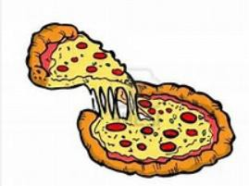



Last day of camp…
Team Practice
Presentations
PIZZA PARTY
Presentations
ICE CREAM SOCIAL
Awards
Certificates and photos Signing T-shirts

Slide 21
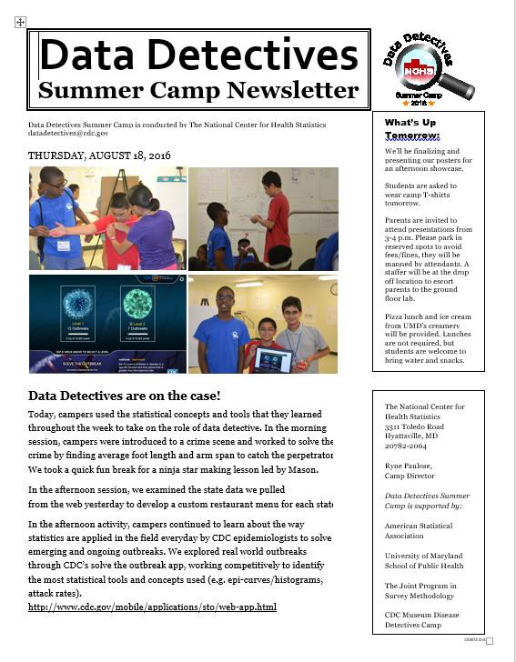
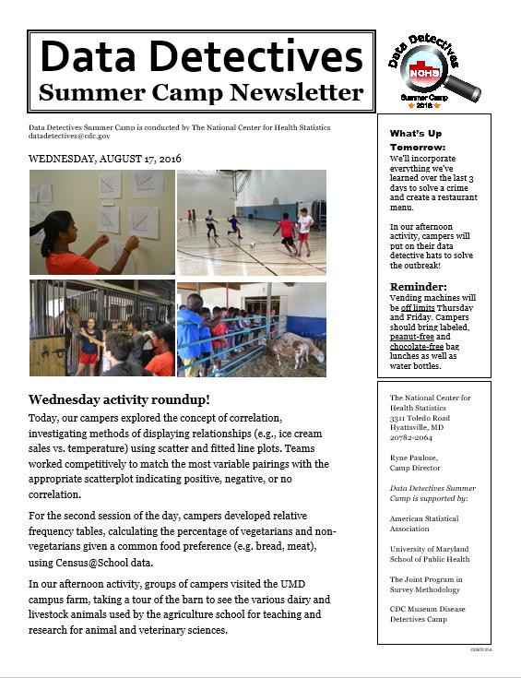
Daily Newsletter / Photos (2016-18)
21

Slide 22
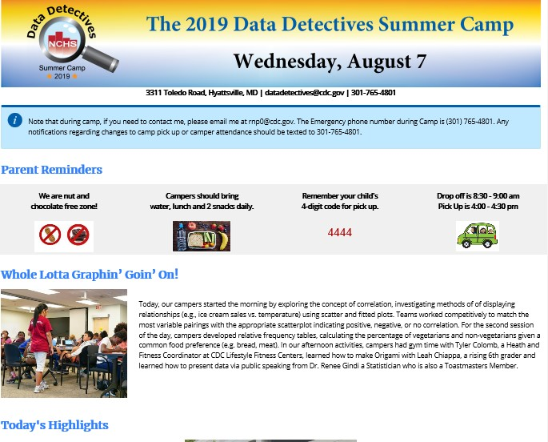

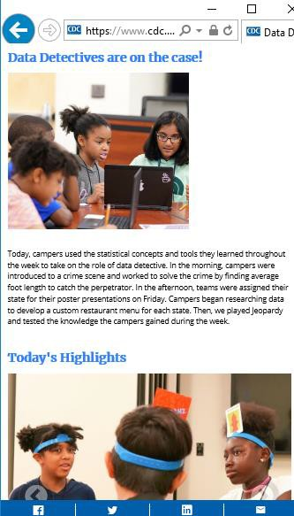
Newsletter replaced with Parent Webpage

Slide 23
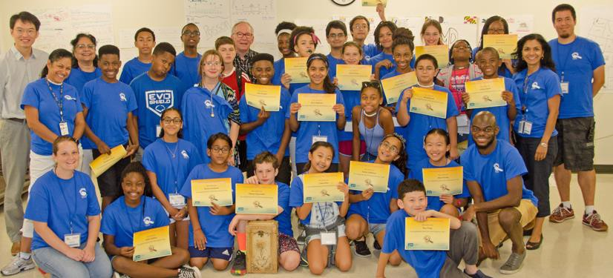
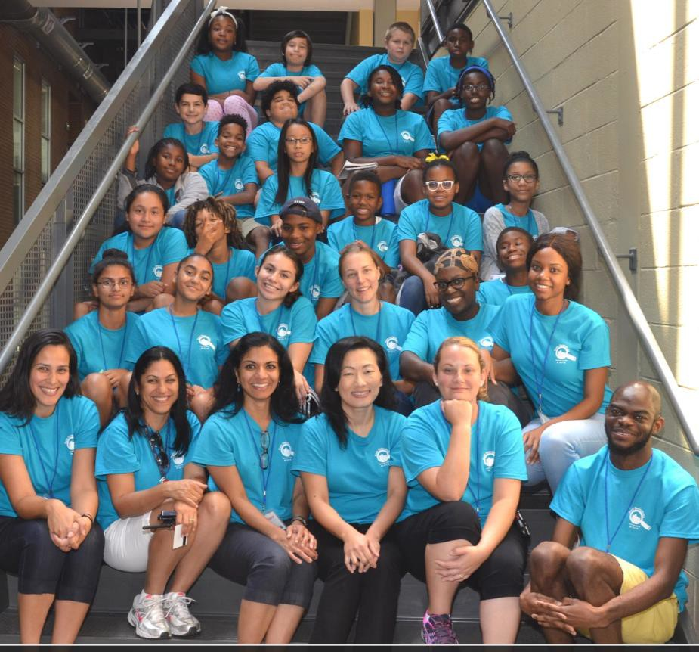
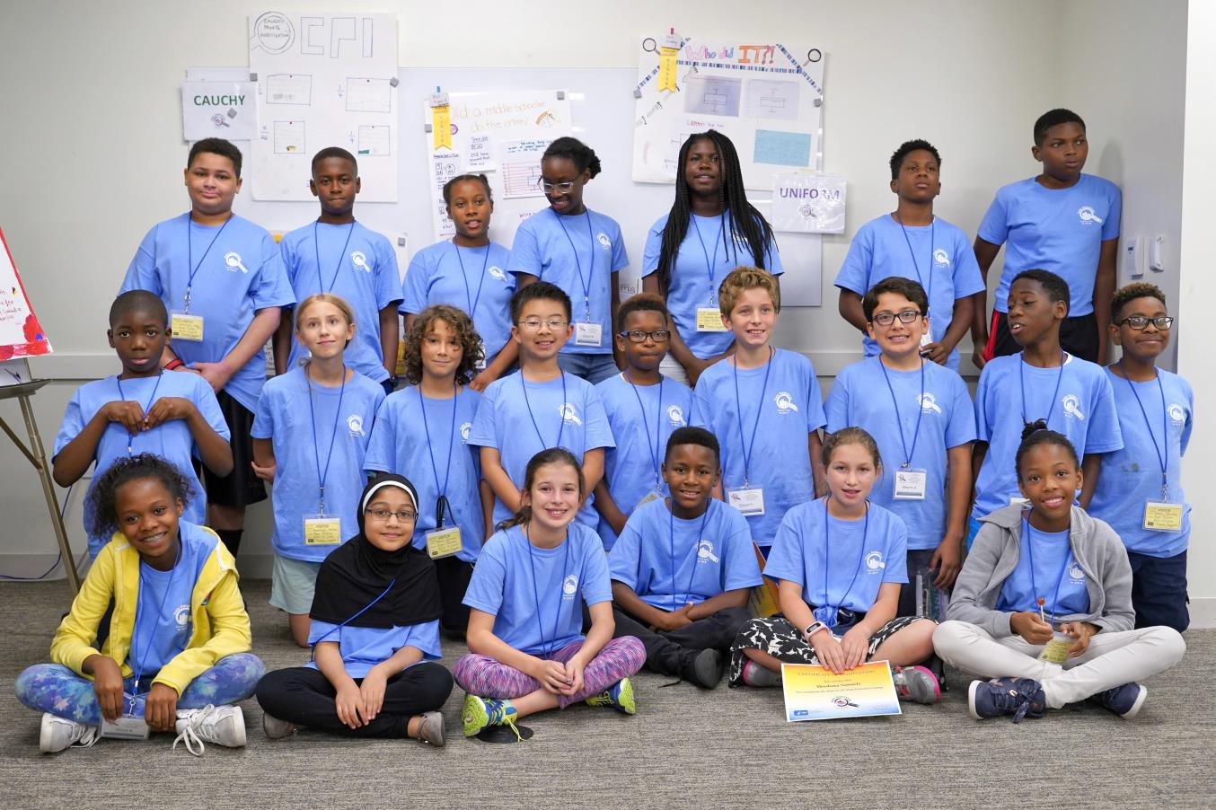
2017
2016
2018

Slide 24
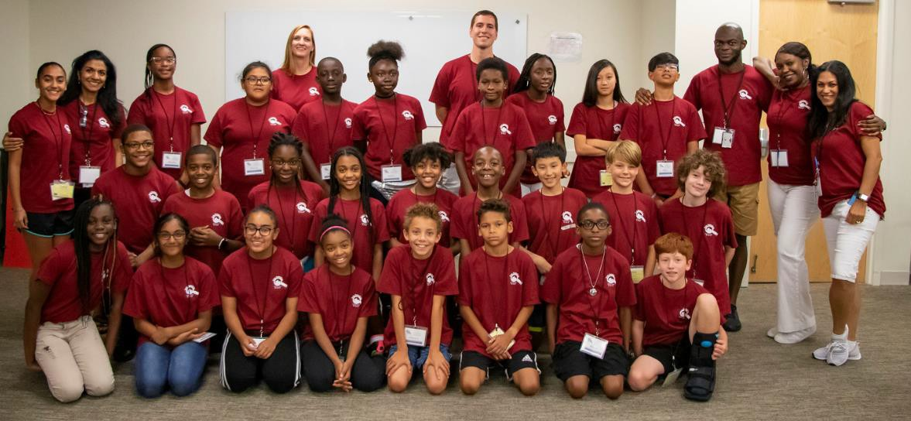

Slide 25
What’s next?
◆ Heading back to SPH
◆ Possibility of having 2 classes running concurrently
◆ A beginners and an advanced class
◆ Having a new Director with new ideas

