Slide 1
Maternal and Infant Characteristics Among Women with Coronavirus Disease (COVID-19) During Pregnancy for Selected Reporting Areas
Presented by: Michelle Osterman
Acknowledgments
Joyce Martin (Team Lead)
Claudia Valenzuela
Anne Driscoll
Birth Team, Reproductive Statistics Branch, Division of Vital Statistics
National Center for Health Statistics

Slide 2
Outline
History/purpose
Methods
Results

Slide 3
History/Purpose
Question
What impact does having COVID-19 during pregnancy have on the mother and newborn?
Goal
Assess impact of COVID-19 on pregnancy, childbirth, and newborns on an ongoing basis

Slide 4
History/Purpose (cont.)
In March 2020, RSB Natality team began efforts to encourage states to collect maternal COVID-19 status
Urgency of pandemic did not allow for new data items to be added to the U.S. Standard Certificate of Live Birth
Alternative approach needed to collect COVID-19 data
Worked through the national Birth Data Quality Workgroup to
Develop recommended question(s)
Develop alternative approaches
Encourage collection
Develop standards and processes for reporting

Slide 5
Data Collection
Some jurisdictions had the flexibility to modify electronic birth certificate reporting systems and add a maternal COVID-19 item
Others were able to link COVID-19 status information from infectious disease surveillance systems to birth certificates or to collect data through use of supplementary forms
All jurisdictions report maternal COVID-19 at any time during pregnancy

Slide 6
Recommended question options
INFECTIONS PRESENT AND/OR TREATED DURING THIS PREGNANY (Check all that apply)
Gonorrhea
Syphilis
Chlamydia
Hepatitis B
Hepatitis C
COVID-19 (confirmed or presumed)
None of the above
Did the mother have confirmed or presumed COVID-19 (SARS-CoV-2) at any time during this pregnancy?
Yes
No

Slide 7
Recommended question options (cont.)
INFECTIONS PRESENT AND/OR TREATED DURING THIS PREGNANY (Check all that apply)
Gonorrhea
Syphilis
Chlamydia
Hepatitis B
Hepatitis C
COVID-19 (confirmed or presumed)
None of the above
Did the mother have confirmed or presumed COVID-19 (SARS-CoV-2) at any time during this pregnancy?
Yes
No
If yes, specify the period(s) during which a confirmed or presumed diagnosis of COVID-19 was present:
First trimester
Second trimester
Third trimester
At delivery
Time of infection unknown

Slide 8
Methods
15 jurisdictions are currently providing data
Variable reporting period; reporting start dates vary by state, ranging from March through mid-June
Data for all 15 jurisdictions from June 19, 2020 – February 2021
Jurisdictions differ in how information on COVID-19 status was obtained
Some states report both presumed and confirmed maternal COVID-19; others report confirmed cases only
Reported cases of COVID-19 are linked to the standard birth record at NCHS using provisional 2020 and 2021 data

Slide 9
Reporting jurisdictions
Alabama
Alaska
Arkansas
California
District of Columbia
Idaho
Maine
Maryland
New Hampshire
North Dakota
Ohio
Oklahoma
Oregon
Tennessee
West Virginia

Slide 10
Birth COVID-19 Webpage
Results published on webpage on a bi-monthly basis
Comparisons made for COVID-19 vs. no COVID-19 by race and Hispanic origin
Maternal characteristics/outcomes
Age
Education
Medicaid as source of payment for the delivery
ICU admission
Infant outcomes
Preterm birth
Low birthweight
NICU admission
Infant living

Slide 11
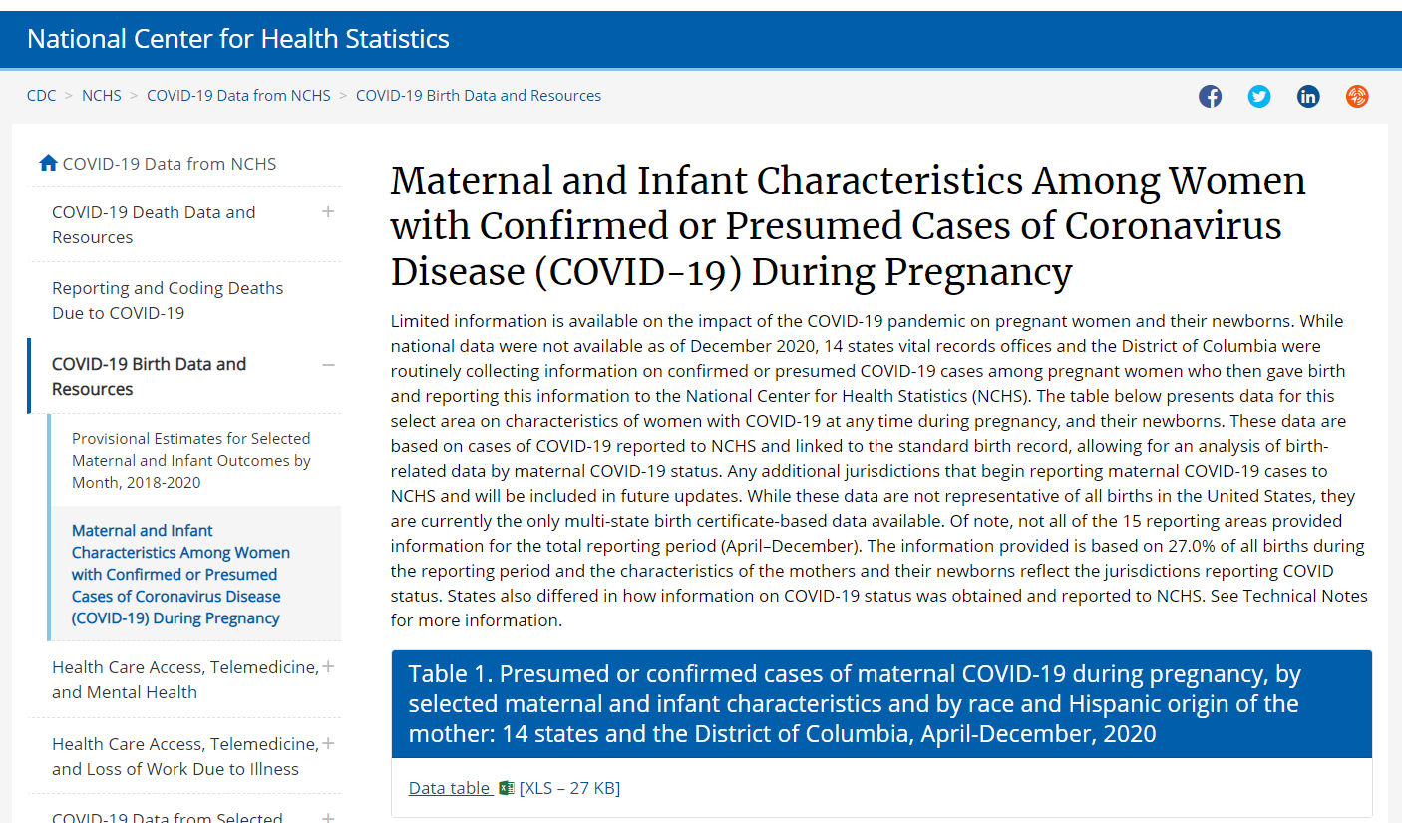
Birth COVID-19 Release Webpage
https://www.cdc.gov/nchs/covid19/technical-linkage.htm
Data published:
April through October
January 2021
April through December
March 2021
April through February
May 2021

Slide 12
Results
Maternal COVID-19 reporting area compared with all US births
27% of all U.S. births during the reporting period
Smaller proportion of births to non-Hispanic white, non-Hispanic black women
Larger proportion of births to Hispanic women
Lower preterm birth rate
 | United States | COVID-19 reporting area
Births to non-Hispanic white women | 51.6% | 50.3%
Births to non-Hispanic black women | 14.7% | 13.2%
Births to Hispanic women | 24.3% | 25.3%
Preterm birth rate | 10.03% | 9.83%

Slide 13
Results (cont.)
99.6% of all cases linked with full birth record
More than 23,000 births to moms with presumed or confirmed COVID-19
Approximately 750,000 births to moms without COVID-19

Slide 14
Results - Distributions
14 state and DC Maternal COVID-19 reporting area

Slide 15
Distribution of births by race and Hispanic origin and COVID-19 status: April 2020-February 2021
Non-Hispanic other
Non-Hispanic black
Non-Hispanic white
Hispanic
NOTES: COVID-19-Yes includes presumed or confirmed cases.
Non-Hispanic other includes: non-Hispanic Asian, non-Hispanic American Indian or Alaska Native, non-Hispanic Native Hawaiian or Pacific Islander, and non-Hispanic multiple race.

Slide 16
Distribution of births by maternal age and COVID-19 status: April 2020-February 2021
40 years or more
30-39 years
20-29 years
Under 20 years
NOTE: COVID-19 Yes includes presumed or confirmed cases.

Slide 17
Distribution of births by maternal education and COVID-19 status: April 2020-February 2021
Bachelor’s degree or higher
Associate degree
Some college
High School graduate or GED
Less than High School
NOTE: COVID-19 Yes includes presumed or confirmed cases. Includes women who may not have had time to complete their education.

Slide 18
Results - Outcomes
14 state and DC maternal COVID-19 reporting area

Slide 19
Maternal ICU admission by COVID-19 status and race and Hispanic origin: April 2020-February 2021
NOTE: COVID-19 Yes includes presumed or confirmed cases.

Slide 20
Preterm birth by COVID-19 status and race and Hispanic origin: April 2020-February 2021
All race and origins
Non-Hispanic white
Non-Hispanic black
Hispanic
Late preterm
(34 to 36 weeks)
Early preterm
(Less than 34 weeks)
NOTE: COVID-19 Yes includes presumed or confirmed cases. Gestational age based on obstetric estimate.

Slide 21
NICU admission by COVID-19 status and race and Hispanic origin: April 2020-February 2021
NOTE: COVID-19 Yes includes presumed or confirmed cases.

Slide 22
Limitations and Next Steps

Slide 23
Limitations
Not national data; not representative of entire U.S.; CA births over-represented
No information on when in pregnancy the mother had COVID-19
Some reporting areas did not report COVID-19 status for entire reporting period
For example, California began reporting on June 10; Oklahoma on June 19.
Different methods of reporting COVID-19 status
Surveillance vs. birth certificate
Confirmed only vs. presumed/confirmed
However, more complete national data do not currently exist

Slide 24
Next Steps
Continue to update the webpage release bi-monthly
Add more reporting areas
Perform more detailed analysis

