Slide 1
NCHS Website Modernization A Data Modernization Initiative (DMI) project
Dagny Olivares, MPA
Associate Director for Communication
NCHS Board of Scientific Counselors Meeting
October 22, 2021

Slide 2
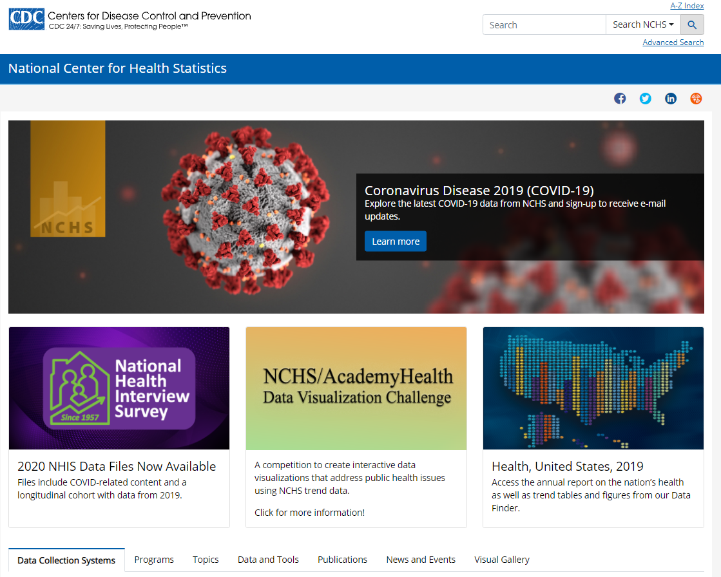
Current NCHS website
Purpose
Primary digital access point to the nation’s health statistics
Current state
Disconnected information
Obsolete formats
Data and resources are difficult to discover, access, and navigate

Slide 3
Website modernization project
Led by the NCHS Office of Information Services
Supported with DMI funds
Planned as a 2-year project
Partnered with the Geospatial Research, Analysis, and Services Program (GRASP) in ATSDR
Managed through contracts

Slide 4
Modernization objectives
Focus on digital and data-driven formats
Improve navigation and organization
Tailor site experience for all user types and proficiencies
Deliver relevant statistics from multiple sources on a wide range of topics
Ensure clear communication using plain language and appealing content
Increase visibility of tools and resources for data collection and research
Identify scalable platforms for data storage and transfer

Slide 5
Major project activities
Analyze current state and conduct environmental assessment
Provide digital strategy, recommendations, and implementation plan
Develop internal processes, systems, and trainings to support website
Create content, graphics, and other digital assets for the website
Build and launch website and supporting digital assets
Share and promote website
Conduct user testing and update website based on findings

Slide 6
What the BSC can do to help
Provide feedback now
Recommend sources for input and benchmarking
Participate in information gathering activities
Share and promote the new website

Slide 7
Questions

