Slide 1
Board of Scientific Counselors Update from the NCHS Director
Brian C. Moyer, Ph.D., NCHS Director
May 19, 2021

Slide 2
Welcome New Board Members/Farewell to Departing Board Members
BSC members rotating off the board:
Robert M. Hauser, Ph.D.
Linette T. Scott, M.D., M.P.H.
Gretchen Van Wye, Ph.D., M.A.
New BSC board members:
Bradley A. Malin, Ph.D.
Lucila Ohno-Machado, M.D., Ph.D.
C. Matthew Snipp, Ph.D.

Slide 3
We Appreciate You

Slide 4
Welcome Dan Jernigan
Congratulations to New (acting) Deputy Director
of Public Health Science and Surveillance
Role: Responsible for strengthening CDC’s scientific foundation
Focus is to provide leadership for CDC’s Data Modernization Initiative
Previously, Dr. Jernigan served as Director of the Influenza Division in CDC’s National Center for Influenza and Respiratory Diseases

Slide 5
Farewell Sayeedha Uddin

Slide 6
New Administration Priorities
COVID-19
Health Equity
Economy
Climate Change
Infrastructure: R&D for Race & Ethnicity

Slide 7
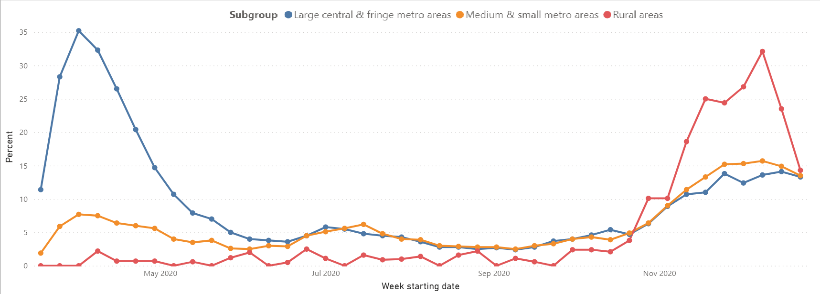
Recent Data on COVID-19
Inpatient Encounters with Confirmed COVID-19 by Urban-Rural Location
and Week, From Select Hospitals

Slide 8
Health Equity
CDC Director Walensky laid out agency’s priorities around Diversity and Inclusion and Health Equity Science.
Dr. Walensky declared racism a serious public health threat, it is a critical step in advancing health equity, diversity, and inclusion.
NCHS is actively involved in the CDC Diversity and Inclusion Executive Steering Committee (DIESC).
This work further promotes and ensures that our Center plays a pivotal role in building and maintaining a diverse workforce and that health-equity data are collected and disseminated broadly.
All NCHS data systems collect demographic data

Slide 9
2021 HHS Data Council Priorities
New Subcommittees
Harmonize collection and use of Data to Support Equity in Health and Human Services Efforts
Explore implications of making data open and safeguarding Personally Identifiable Information
Develop HHS data quality standards particularly in terms of blended data that could build on FCSM framework
Improve agency data through sharing and linkage of existing data sets
Examine data gaps as a result of pandemic and new data sources implemented during the Public Health Emergency

Slide 10
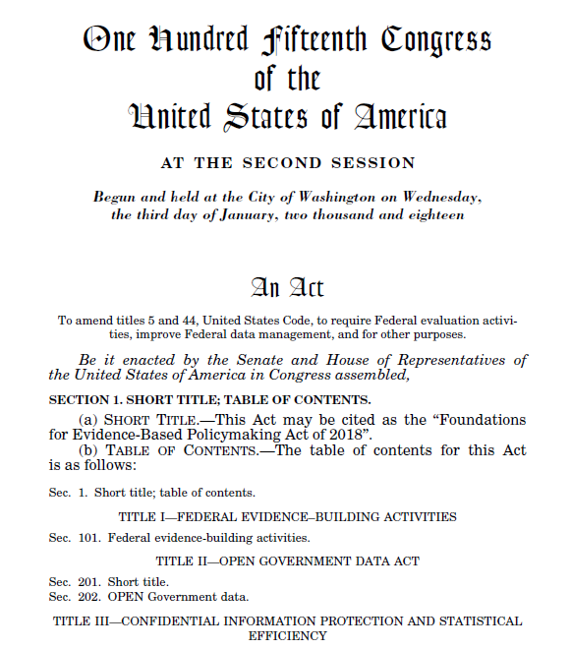
Evidence Act and the Standard Application Process
The Evidence Act requires statistical agencies to establish an identical application process to grant access to confidential data assets.
The Interagency Council on Statistical Policy, led by OMB, is going through an initial review process for the Standard Application Process Policy.
End goal is to provide consistent requirements for accessing protected data to encourage data analyses for evidence-building.

Slide 11
NCHS Budget Update
FY 2021 Estimate, Final TBD
Realignment: $14M from Surveillance, Epidemiology, & Public Health Informatics to the Health Statistics line item
FY21 Health Statistics Budget Authority Increase: $1M
“Additional Resources” include reimbursables from CDC and other agencies.

Slide 12
Recently Published Reports in Apr/May 2021
Upcoming Reports May/June 2021
Drug-involved Infant Deaths in the United States, 2015-2017 National Vital Statistics Report (June 3)
Maternal Mortality Rates in the United States 2019
Births: Provisional Data for 2020
Changes in Births to New York City Residents Occurring Outside New York City by Race and Hispanic Origin of the Mother: 2018-2019 and 2019-2020
Declines in Infant Mortality in Appalachia and the Delta, 1995-96 and 2017-18 (May 26)
Declines in Births by Months: United States, 2020 (June 23)
https://www.cdc.gov/nchs/pressroom/calendar/2021_schedule.htm

Slide 13
Discussion

