Slide 1
Board of Scientific Counselors Update
National Center for Health Statistics
Brian C. Moyer, Ph.D., NCHS Director
October 22, 2021

Slide 2
Advancing Knowledge About Health Equity
Welcome and Thank you to our Board Members!

Slide 3
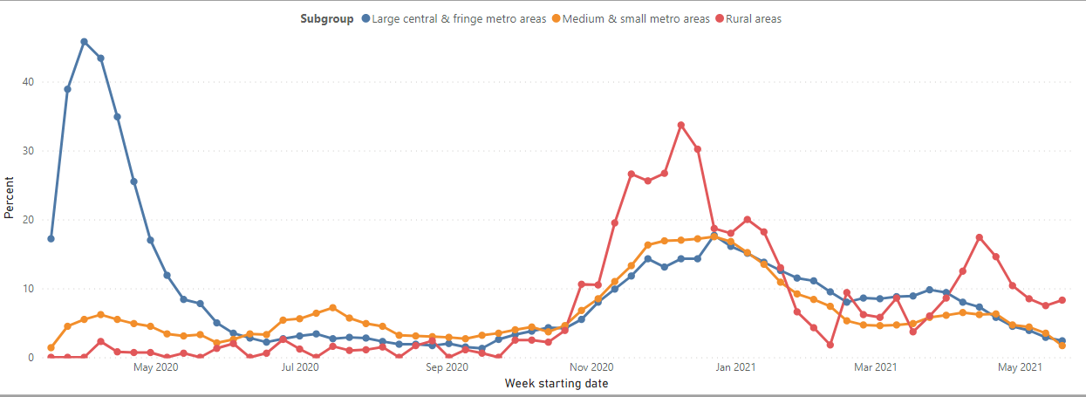
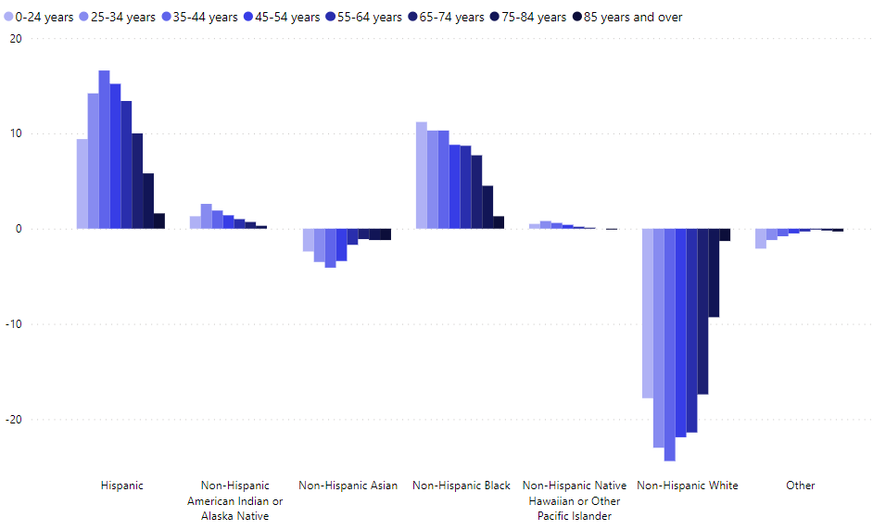
Recent Data Releases on COVID-19
Percentage of encounters with confirmed COVID-19 status by hospital urban-rural location
Age-specific differences in COVID-19 mortality and population distribution, grouped by race & Hispanic origin
Percent increase in total number of deaths in 2020 through October 9, 2021 vs. 2019 all cause and excluding COVID-19

Slide 4
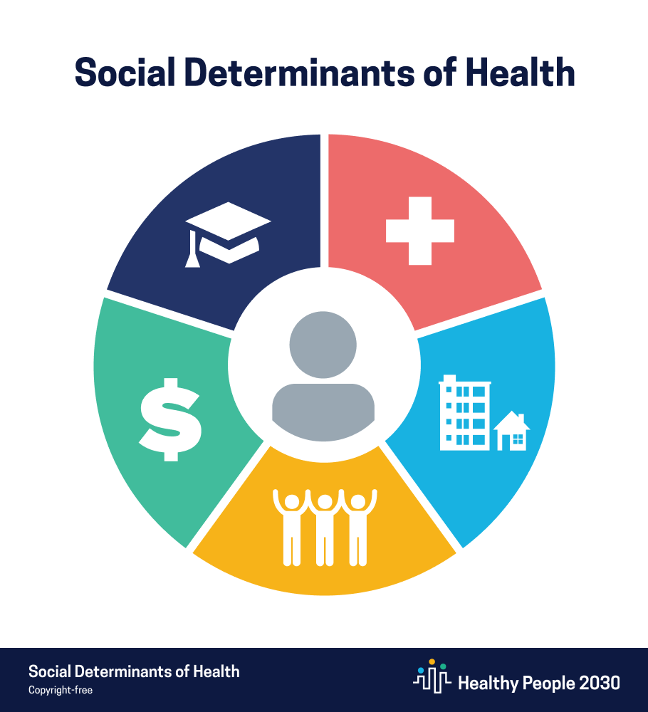
Cross-Cutting Work on the Social Determinants of Health
Expand data, data sources, and use of data science techniques to address Social Determinants of Health (SDOH)
Expand survey questions for analysis of SDOH and health outcomes
Conduct new question design and evaluation
Conduct new and updated data linkages
Improve access to new data sources for data users
Privacy Protecting Record Linkage
Synthetic data sets
Integrate SDOH data into cross-CDC and HHS evidence-building efforts
Collaborate with agencies on data linkage methodologies for broader access to HHS data assets

Slide 5
New Report on America's Children
Purpose:
To update well-being indicators and trends across economic, health, education, and other domains
Published:
September 2021
2021 Report Highlights:
Decrease in the percentage of children, ages 0 – 17, living in households with one or more housing problems
Increase in youth, ages 12- 17, with at least one major depressive episode
Click here to access the report

Slide 6
National Center for Epidemic Forecasting & Outbreak Analytics
The center will advance the use of modeling, forecasting, and outbreak analytics in public health communication and decision making.
Predict
Inform
Innovate
Generate forecasts and analyses for preparedness and response
Assess analytical products from outbreaks
Establish and maintain data architecture
Support decision-making in pandemics
Support decision-making in pandemics
Bring together next-generation data with interdisciplinary expertise and high-quality communications
Share timely information across government and with the public
Develop and fund priorities to improve outbreak forecasts and analyses
Invest in research and engineering
Partner with STLT, academia, private sector, and interagency
Develop innovation testbeds at STLT health departments and clinical settings

Slide 7
Purpose: To make recommendations on issues of access to data, how to facilitate data sharing, data linkage, and privacy enhancing techniques
Advisory Committee: Core Topics and Central Issues
Capacity needs for secure data access and record linkage
Areas for research and development on state-of-the-art data access and data protection methods
How to protect privacy when using personally identifiable information or confidential business information in support of evidence building
How to promote transparency and facilitate public engagement with the evidence building process
Agency needs for data management and data stewardship services
How to best facilitate the needs of researchers, evaluators, and other evidence builders through a national data service or similar approach

Slide 8
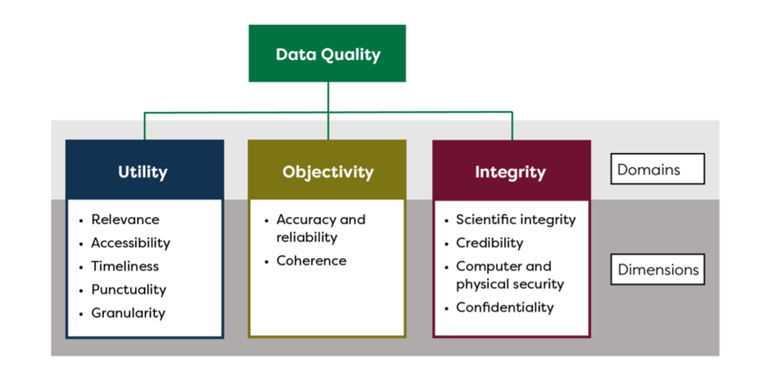
Federal Committee on Statistical Methodology (FCSM)
A Framework for Data Quality, released September 2020
Guides statistical agencies in data collection, data quality, and respondent confidentiality, especially in using “Big Data”
September 2021 workshop on “Leveraging the Data Quality Framework”
HHS Workgroup on using the Framework for HHS Blended Data
Next steps: Case-studies on the Framework’s application across scenarios
Data Protection Toolkit
Provides best practices for privacy protection across data types, as defined under the Evidence Act
New resources are added regularly on data sharing and protection
Interagency Council on Statistical Policy (ICSP)

Slide 9
NCHS Budget Update
Additional Resources in FY22: includes Data Modernization Initiative funding and collaborative initiatives across CDC and other agencies

Slide 10
Thank you for joining us!

