Slide 1
Breaking New Ground for the National Health Care Surveys: Preliminary COVID-19 Data Releases
Carol DeFrances, Ph.D.
Acting Director, Division of Health Care Statistics
Virtual Presentation to the
NCHS Board of Scientific Counselors
October 22, 2021

Slide 2
National Health Care Surveys Spectrum of Care
Ambulatory and Hospital Care
Long-Term Care
• Inpatient dept.
• Residential care • Adult day services
• Nursing homes • Home health
• Hospice care
• Physician offices
• Community health
centers
• Emergency dept.
• Outpatient dept.
• Ambulatory surgery
locations
• Inpatient dept.
• Residential care • Adult day services
• Nursing homes • Home health
• Hospice care
• Physician offices
• Community health
centers
• Emergency dept.
• Outpatient dept.
• Ambulatory surgery
locations
• Inpatient dept.
• Residential care • Adult day services
• Nursing homes • Home health
• Hospice care
• Physician offices
• Community health
centers
• Emergency dept.
• Outpatient dept.
• Ambulatory surgery
locations
• Residential care • Adult day services
• Nursing homes • Home health
• Hospice care
• Physician offices
• Community health
centers
• Emergency dept.
• Outpatient dept.
• Ambulatory surgery
locations
• Inpatient dept.
• Physician offices
• Community health
centers
• Emergency dept.
• Outpatient dept.
• Ambulatory surgery
locations
• Inpatient dept.
• Physician offices
• Community health
centers
• Inpatient dept.
National Study of Long-Term Care Providers (NSLTCP)
2012-2018
National Study of Long-Term Care Providers (NSLTCP)
2012-2018
National Study of Long-Term Care Providers (NSLTCP)
2012-2018
National Study of Long-Term Care Providers (NSLTCP)
2012-2018
National Hospital Ambulatory Medical Care Survey (NHAMCS)
1992-ongoing
National Hospital Discharge Survey (NHDS)
1965-2010
National Ambulatory Medical Care Survey (NAMCS)
1973-ongoing
National Hospital Ambulatory Medical Care Survey (NHAMCS)
1992-ongoing
National Hospital Discharge Survey (NHDS)
1965-2010
National Ambulatory Medical Care Survey (NAMCS)
1973-ongoing
National Hospital Ambulatory Medical Care Survey (NHAMCS)
1992-ongoing
National Hospital Discharge Survey (NHDS)
1965-2010
National Ambulatory Medical Care Survey (NAMCS)
1973-ongoing
National Hospital Discharge Survey (NHDS)
1965-2010
Plus...
• Inpatient rehab facilities
• LTC hospitals
Plus...
• Inpatient rehab facilities
• LTC hospitals
Plus...
• Inpatient rehab facilities
• LTC hospitals
Plus...
• Inpatient rehab facilities
• LTC hospitals
National Electronic Health Records Survey (NEHRS)
2008-2021
National Electronic Health Records Survey (NEHRS)
2008-2021
National Electronic Health Records Survey (NEHRS)
2008-2021
National Hospital Care Survey (NHCS)
2011-ongoing
National Hospital Care Survey (NHCS)
2011-ongoing
National Hospital Care Survey (NHCS)
2011-ongoing
National Post-Acute and Long-Term Care Study (NPALS)
2020-ongoing
National Post-Acute and Long-Term Care Study (NPALS)
2020-ongoing
National Post-Acute and Long-Term Care Study (NPALS)
2020-ongoing
National Post-Acute and Long-Term Care Study (NPALS)
2020-ongoing
2

Slide 3
Accomplishments
First-ever early release of preliminary data for the National Health Care Surveys covering 5 settings from 3 sectors:
National Hospital Care Survey (NHCS): Hospital inpatients & emergency departments (ED).
National Post-acute and Long-term Care Study (NPALS): Adult Day Services Centers (ADSC) & Residential Care Communities (RCC).
National Ambulatory Medical Care Survey (NAMCS): Office-based physicians (forthcoming).
ONLY data sources of COVID-19 related national estimates in ADSCs, RCCs, and office-based physician practices.
First look at the impact of COVID-19 in these settings and among these health care providers.

Slide 4
Main page to access all NCHS COVID-19 data:
https://www.cdc.gov/nchs/covid19/

Slide 5
National Hospital Care Survey (NHCS)
Purpose: Provide reliable and timely health care use data for hospital-based settings.
Sample: Non-federal, non-institutional hospitals with 6+ staffed inpatient beds.
Mode: Administrative claims data and electronic health record (EHR) data transmitted electronically to NCHS or its data collection agent.
Questionnaire: Annual Hospital Interview collects facility information needed for statistical weighting.
Data collection: January-December annually, restricted use files.
Sample size: 608 hospitals; all inpatient and ED encounters (i.e., entire calendar year) requested.
Unique feature: Personally identifiable information is collected, which allows data linkage across hospital settings and to external data sources such as the NDI, CMS, and HUD data.

Slide 6
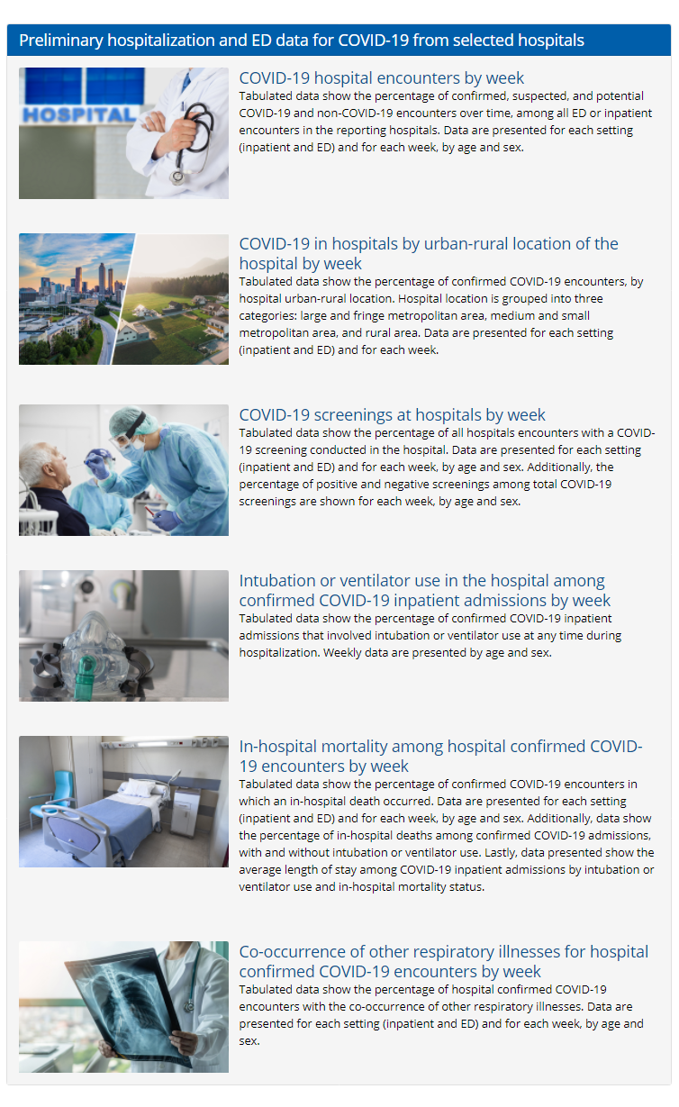
Preliminary 2020 data available by week released February 2021.
Preliminary January-May 2021 data added September 2021.
https://www.cdc.gov/nchs/covid19/nhcs.htm

Slide 7
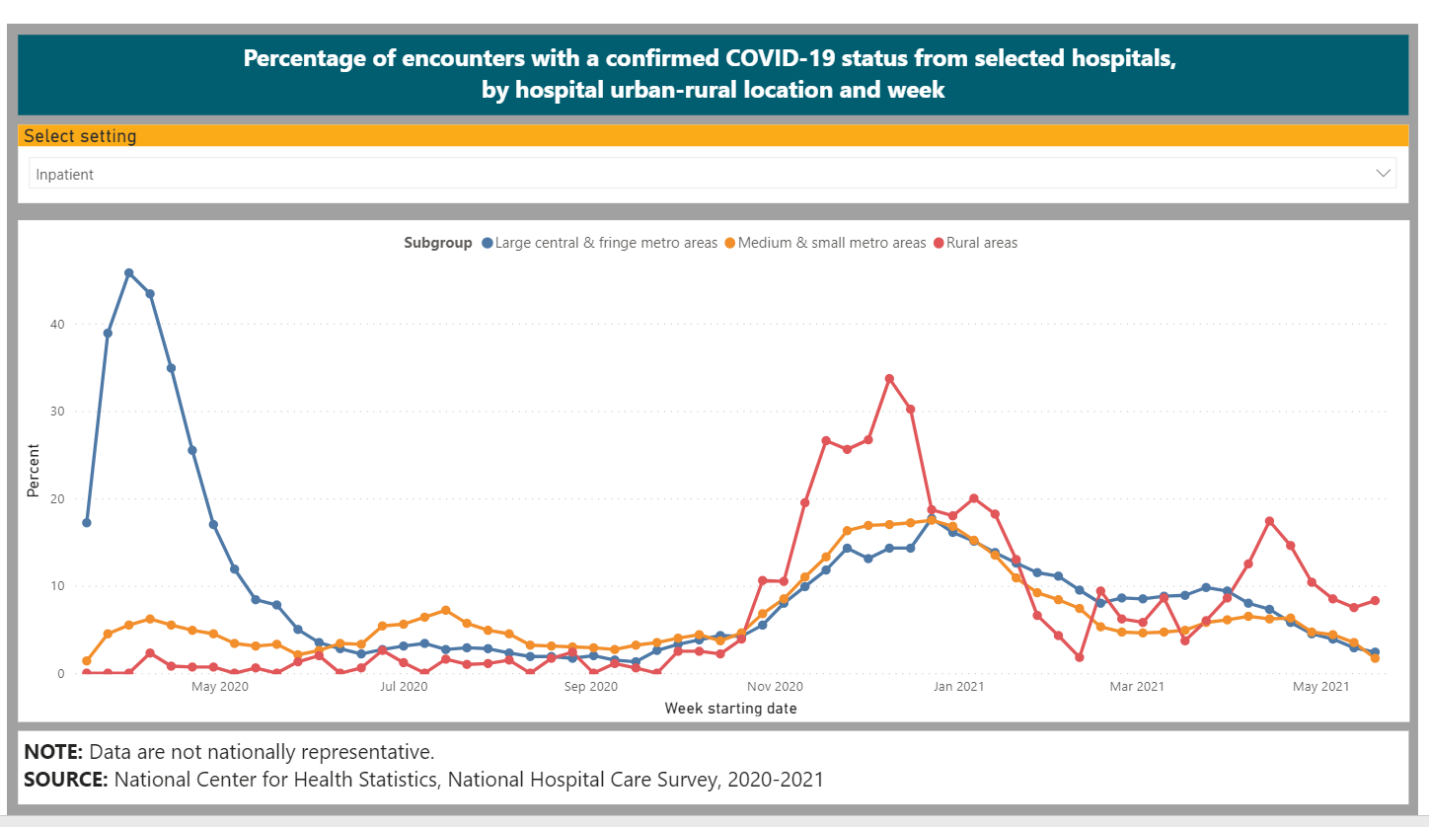
Example of NHCS preliminary data

Slide 8
National Post-Acute and Long-term Care Survey (NPALS)
Purpose: Monitors trends in the supply, provision, and use of the major sectors of paid, regulated long-term care services.
Sample: Adult day services center (ADSC) licensed by the state or certified to participate in Medicaid; Residential care communities (RCC) licensed or certified by the state, with 4 or more beds, providing two meals a day and around-the clock on-site supervision and help with activities of daily living.
Mode: CMS administrative data purchased for hospice agencies, nursing homes, home health agencies, inpatient rehabilitation hospitals and long-term care hospitals. Primary multi-mode data collection (web, mail, telephone follow-up) for ADSCs and RCCs.
Questionnaire: Provider questionnaire (provider and services user characteristics aggregated at the provider level). Services user questionnaire in alternate years.
Data collection: Every two years, public use files only in 2018 (NSLTCP) and restricted use files.
Sample size: ADSCs= ~5,550; RCCs=~11,600.

Slide 9
Preliminary data released August 2021
https://www.cdc.gov/nchs/covid19/npals.htm

Slide 10
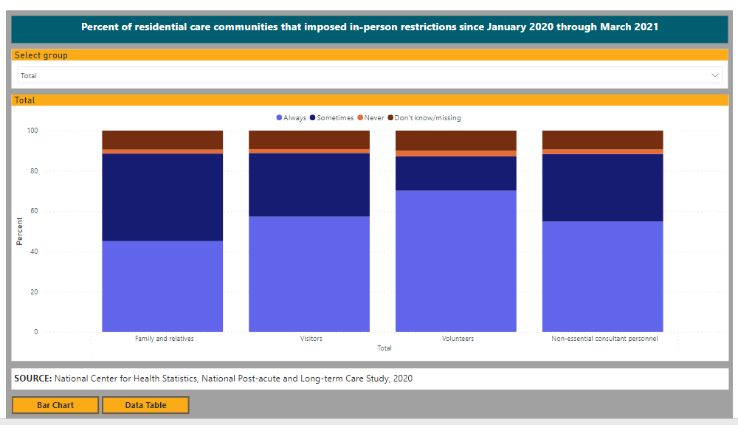
Example of preliminary data for RCCs

Slide 11
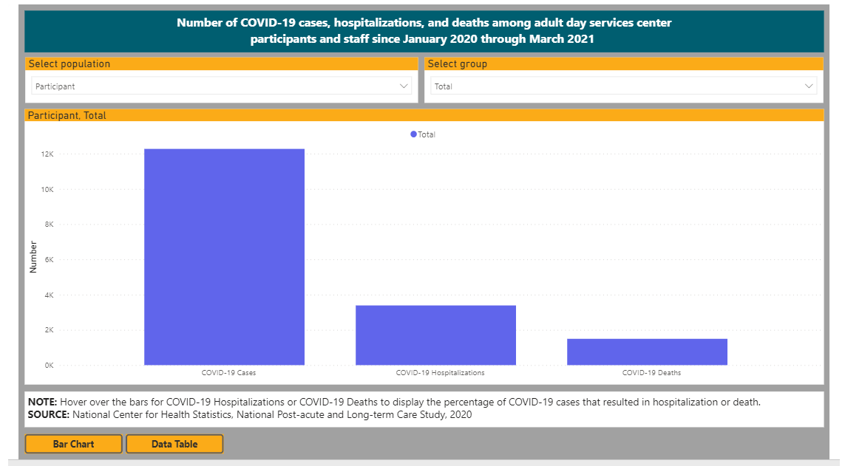
Example of preliminary data for ADSCs

Slide 12
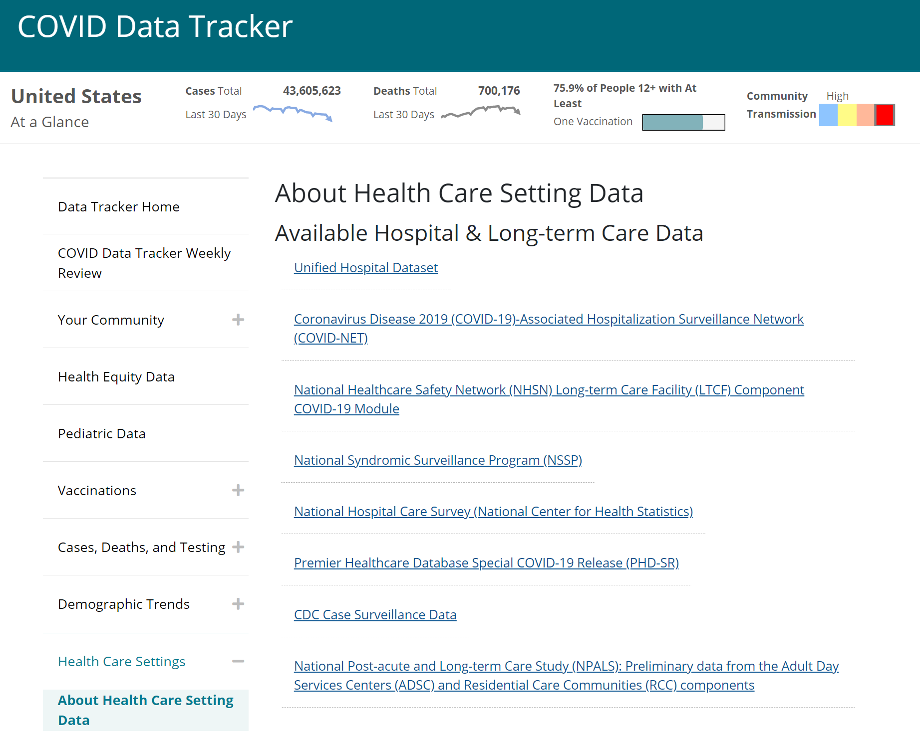
Links for preliminary NHCS and NPALS Data Added to CDC COVID Tracker Webpages

Slide 13
National Ambulatory Medical Care Survey (NAMCS)
Purpose: Designed to meet the need for objective, reliable information about the provision and use of ambulatory medical care services in the United States.
Sample: Physicians classified by the AMA and AOA as providing office-based care; not federally employed and not in the specialties of anesthesiology, radiology, or pathology. Community Health Centers from listing maintained by HRSA.
Mode: In-person induction interviews and on-site medical record abstraction for a sample of patient visits; conducted by U.S. Bureau of the Census field representatives (FRs).
Questionnaire: Computerized induction questionnaire obtains data about characteristics of the physician and practice. Standardized form used for record abstraction.
Data collection: Covers January–December annually, public and restricted use files.
Sample size: 3,000 office-based physicians, 104 community health centers.

Slide 14
Coming Soon…Physician Experiences Related to COVID-19

Slide 15
Moving forward
Plan to continue to release preliminary data and estimates on COVID-19 for NHCS, NPALS, and NAMCS office-based physicians.
Looking beyond COVID-19 to releasing preliminary data on other selected topics, including opioid-involved hospitalizations and other emergent topics.

Slide 16
Acknowledgment – Staff Who Worked On Preliminary COVID-19 Data
Division of Health Care Statistics
AHCSB
Josie Alford
Jill Ashman
Chris Cairns
Karishma Chari
Danielle Davis
Geoff Jackson
Zach Peters
Catherine Rappole
Loredana Santo
Susan Schappert
Brian Ward
LTCSB
Jessica Lendon
Zhaohui Lu
Amanuel Melekin
Vinnie Rome
Manisha Sengupta
Priyanka Singh
TSB
Iris Cheng (contractor)
Bibi Mir Mousavi (contractor)
Betsy Rechtsteiner
Alexander Schwartzman
Jamie Xu
Division of Research & Methodology
Vlad Beresovsky
Iris Shimizu
Office of Information Services
Anthony Lipphardt
Associate Director for Science (ADS)
Amy Branum, NCHS ADS
Alex Strashny, DHCS ADS
16

Slide 17
Thank You!
17

