Slide 1
Update on Division of Health Care Statistics (DHCS) Electronic Health Records Activities
Carol DeFrances, Ph.D.
Acting Director, DHCS
Presentation to the NCHS Board of Scientific Counselors
May 19, 2021

Slide 2
Division EHR Activities

Slide 3
Healthcare Electronic Health Records (HEHR) Cloud Migration
HEHR supports NHCS and NAMCS for collecting, integrating, harmonizing, storing, and processing of EHR and administrative claims data.
Imperative to migrate to a cloud to streamline the processes while minimizing costs of maintaining a large infrastructure.
Securely migrate HEHR platform to a cloud and adhere to all applicable privacy and security standards.
Ensure complete compliance with Confidential Information Protection and Statistical Efficiency Act (CIPSEA).
Possibly first CIPSEA-compliant cloud at NCHS
CIPSEA-PROTECTED
HEHR Cloud

Slide 4
Data Standards Work
HL7’s Consolidated Document Architecture (CDA)
  “Old” interoperability standard that will continue to be used for 3-5 years.
  HL7 National Health Care Surveys Implementation Guide – CDA Release 3 (2020)
    Aligns with USCDI Version 1.
Making EHR Data More Available to Research and Public Health (MedMorph) – PCORTF: 2020 – 2022
  Health Care Surveys are one of 3 core uses cases for MedMorph.
  MedMorph Reference Architecture Implementation Guide successful balloted through HL7, January 2021.
  Health Care Surveys FHIR Content IG to be balloted through HL7 September 2021.
    Aligns with USCDI Version 1 & 2; FHIR-based; uses EHRs standardized APIs.
    HCS FHIR Content IG & MedMorph Reference Architecture IG are designed to work together to move data from providers EHRs to a NCHS endpoint “without special effort.”

Slide 5
Exploring Collaboration with CDC to Obtain EHR Data
Pandemic-Ready Interoperability Modernization Effort (PRIME)
New multi-year collaboration between CDC and the U.S. Digital Service (USDS) to strengthen data quality and information technology systems in state and local health departments.
Data Modernization Initiative (DMI)
Explore coordinating EHR data collection efforts across CDC.
Balance different needs of timeliness and granularity of EHR data needed by CDC program and NCHS.
Demonstrate benefit of partnering with NCHS on EHR data collection.

Slide 6
Survey Specific EHR Activities

Slide 7
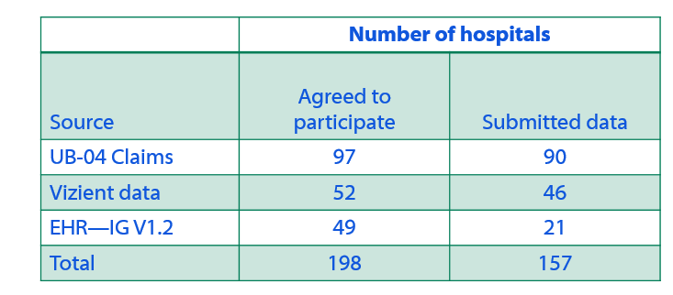

National Hospital Care Survey (NHCS)
Participation rates for 2020 – data collection closed March 31, 2020

Slide 8
NHCS (continued)
Purchase data to supplement 2020 data collection
American College of Emergency Physicians (ACEP)
Premier
Issues encountered with purchasing data
No PII → No data linkage
Cannot use certain purchased data in public use files or RDC files.
Can only use data for duration of the contract.
Conduct new methodological work
Use data collected directly from hospitals and purchased data for modelling of national estimates.
Explore use of synthetic data for public use and RDC files.

Slide 9

National Ambulatory Medical Care Survey (NAMCS)
Health Center Component
Work with HRSA to recruit 50 FQHCs or FQHC-LALs to transmit EHR data in IG 1.2 format to NCHS.
Provide up to $10,000 set-up free to activate interface/module on their system.
Still need OMB approval to commence data collection.
Provider Visit Data
Investigate where to purchase physician and other ambulatory provider data (e.g., IQVIA, American Board of Family Medicine).
Explore approaching larger provider networks (e.g., Kaiser, Mayo Clinic, UPMC) with CDC to collect EHR data.

Slide 10

National Post-Acute and Long-term Care Study (NPALS)
Discussions with ASPE and the ONC about EHR data available for long-term care sectors.
Exploring development of a FHIR Implementation Guide for residential care communities (RCCs) and adult day service centers (ADSCs).
Developed several potential pilot studies if funding becomes available:
Conduct an environmental scan to assess whether data elements collected through NPALS could be extracted directly from a commercial EHR platform/system, such as PointClickCare or MatrixCare.
Explore the availability of data through EHR transmission, the type of data available, and help build capacity for EHR data collection in the future.

Slide 11
Questions for BSC
Does anyone have experience or know of someone who has managed CIPSEA-protected data on a cloud? If so, what lessons learned can be shared with us?
Has anyone created or know of others who have created privacy and security controls for CIPSEA? If so, can they be shared with us?
What are potential EHR data sources for physician or other ambulatory providers? Residential care communities? Adult day service centers?

Slide 12
Thank you!!

