Slide 1
State-level Estimation Using the National Health Interview Survey (NHIS)
Stephen Blumberg
Director, Division of Health Interview Statistics
Meeting of the NCHS Board of Scientific Counselors
October 22, 2021

Slide 2
Recent State Estimates from the National Health Interview Survey
Health insurance coverage for 32 states
Household telephone service estimates for 50 states

Slide 3
A Brief History of State Estimates from the National Health Interview Survey
1960s -1980s: Ratio-adjusted synthetic estimates
1990s: Bayesian methods using hierarchical models

Slide 4
Milestones in State-level Health Insurance Estimates
2004: Direct “Early Release” estimates for 10 states
Based on data from one year
Expanded to 20 states from 2005-2010
2008: Direct estimates for 41 states
Based on pooled data from three years (2004-2006)
Estimates reported for states with 1000+ persons in pooled sample
Smoothed variance estimates using design effect estimated from the 10 most populous states
2014 and 2015: Direct estimates for all 50 states
Augmented sample size allowed for single-year estimates for all states
Otherwise, the number of states with estimates varied by annual survey sample size from 2011-2018, ranging from 17 to 45

Slide 5
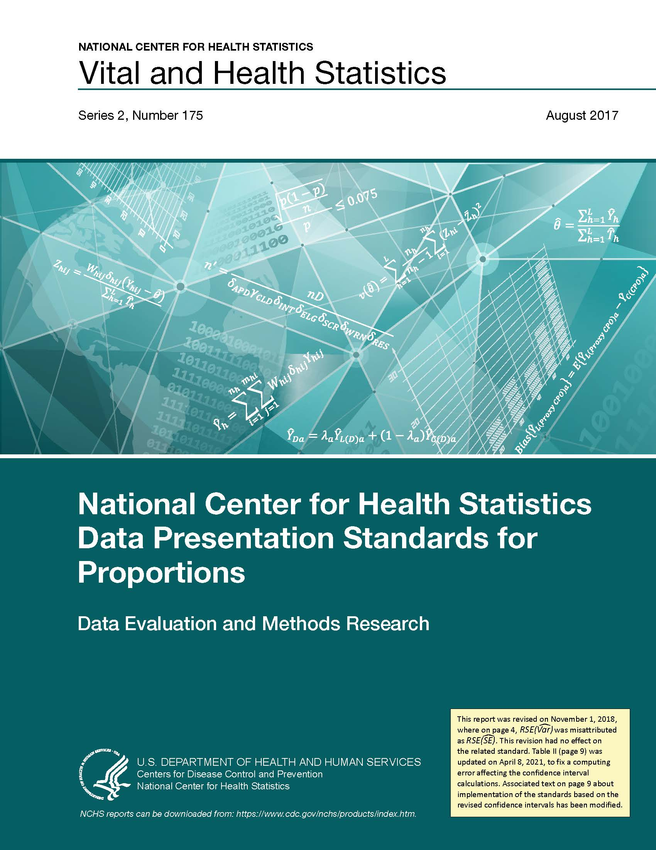
Recent Changes Impacting Ability to Produce Direct State Estimates
2019: NHIS questionnaire redesign
Person counts reduced even though household counts remained the same
2017: New NCHS data presentation standards
Added a standard regarding minimum degrees of freedom
2016: New NHIS sample design
Stratified, clustered sample with 534 clusters nationally
Clusters do not cross state lines
18 states have fewer than 8 clusters
Clusters remain unchanged over 10-year span of the design

Slide 6
Relaxing Requirement that Clusters Remain Unchanged
NHIS sample will be redesigned for 2025
One goal is to improve ability to produce state estimates
In 2022-2024, Census Bureau will examine impact of rotating clusters on costs and workforce retention
Pilot test in 6 states, 4 of them selected from those states with fewer than 8 clusters
States with estimates not shown are the 18 states with fewer than 8 clusters each
Figure Source: Cohen RA, Terlizzi EP, Cha AE, Martinez ME, Parsons VL, Wei R, He Y. Geographic variation in health insurance coverage: United States, 2019. National Health Statistics Reports; no 163. 2021.

Slide 7
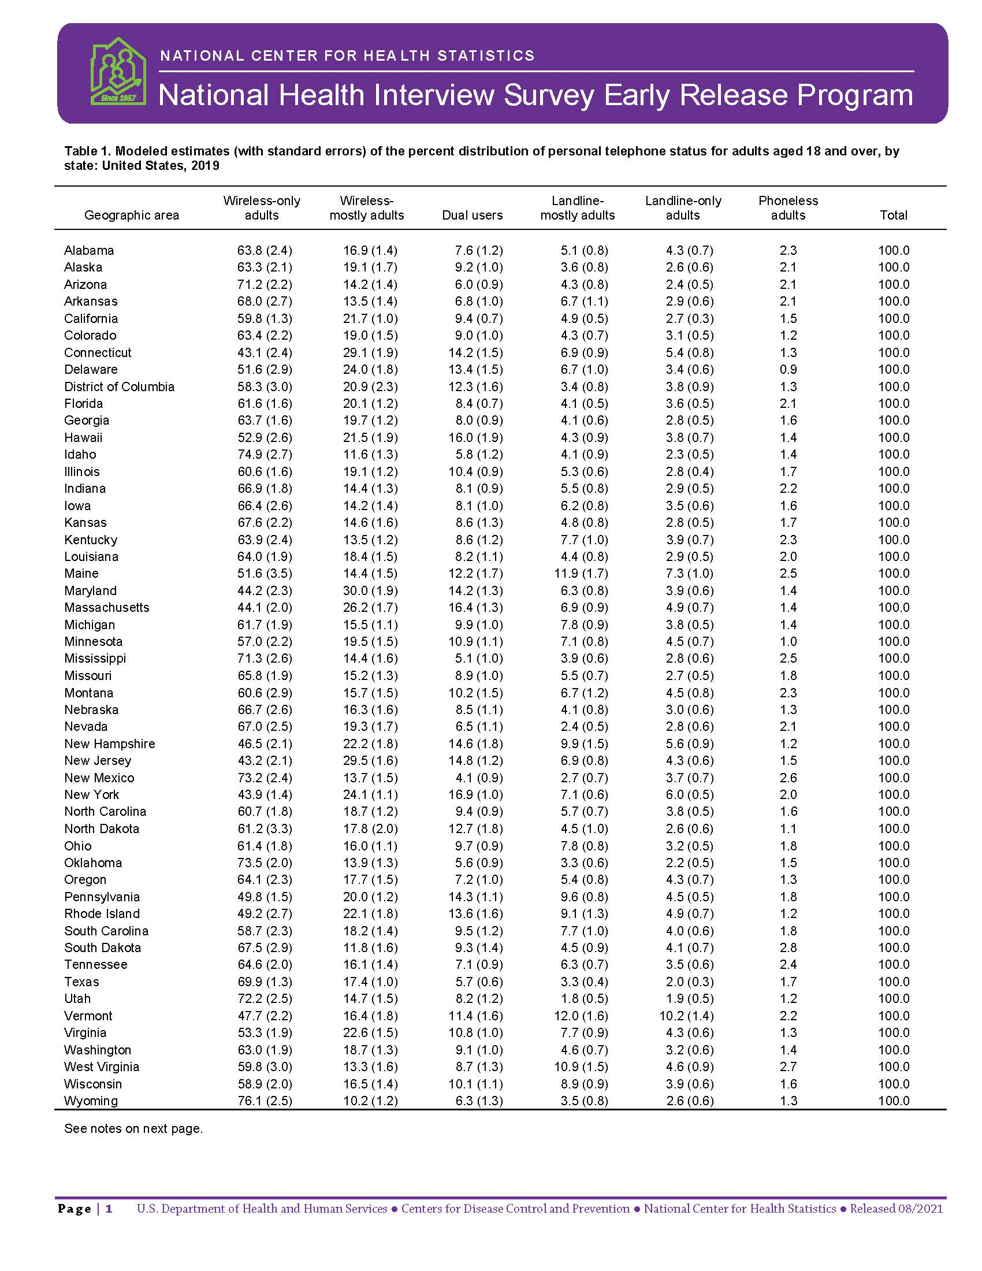
Model-Based Estimates
NCHS has published state-level telephone service estimates annually since 2011
Estimates of wireless-only, landline-only, and dual users for all 50 states and DC
Derived using a weighted combination of a direct NHIS estimate and a regression-synthetic estimator that uses data from NHIS and ACS
Developed and implemented every year by Nada Ganesh (NORC)

Slide 8
Small-Area Estimation Project: A Feasibility Study Recently launched with the Census Bureau’s Small Area Modeling and Development Branch
Project Goals
Develop models that will produce annual state-level small area estimates
If possible, develop models that will produce annual state-level small area estimates with demographic detail
Evaluate the performance of models that use publicly available auxiliary data compared with those that use restricted data
If possible, seek a generalizable framework for future small area estimates
Initially producing state-level estimates for four measures:
Foregone medical care due to cost; asthma; asthma episodes;
and self-reported worry, nervousness, or anxiety

Slide 9
Potential Topics for BSC Discussion
How best to achieve and evaluate state estimates
Value of state estimates from NHIS
Value of subgroup estimates within states, defined by geography or sociodemographic groups

