Slide 1
Modernizing the Mortality Data System --- Capturing Timely Opioid-related Death Data
Kate Brett, PhD
Division of Vital Statistics
May 10, 2019
National Center for Health Statistics
Centers for Disease Control and Prevention

Slide 2
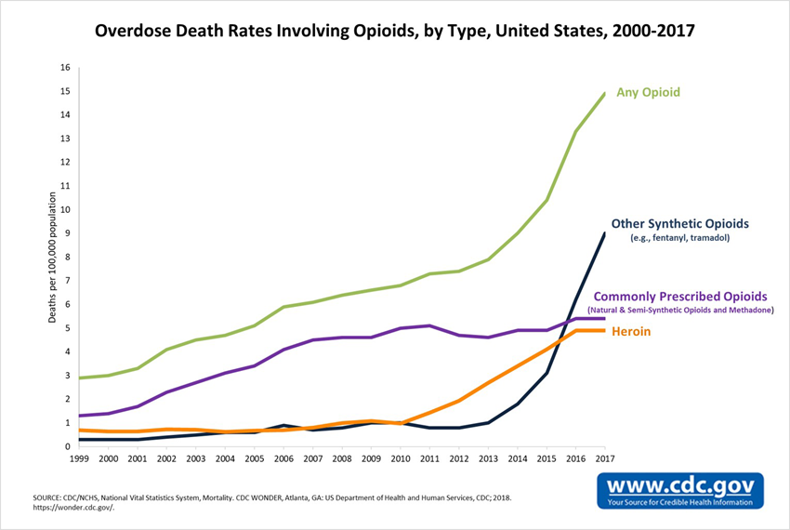
Rise in Opioid Overdose Deaths
Opioid overdoses have risen significantly over the past decade, accounting for approximately 47,600 deaths by 2017 (six times higher than 1999)
In 2017, the White House declared the opioid epidemic as a national public health emergency
HHS responded with a 5-point strategy to combat the crisis
  Better prevention, treatment and recovery services
  Better data
  Better pain management
  Better availability of overdose-reversing drugs
  Better research

Slide 3
Rise in Opioid Overdose Deaths
Opioid overdoses have risen significantly over the past decade, accounting for approximately 47,600 deaths by 2017 (six times higher than 1999)
In 2017, the White House declared the opioid epidemic as a national public health emergency
HHS responded with a 5-point strategy to combat the crisis
  Better prevention, treatment and recovery services
  Better data
  Better pain management
  Better availability of overdose-reversing drugs
  Better research

Slide 4
DVS Funding Addressing Opioid Mortality Data
Patient-Centered Outcomes Initiative (PCORI)….…………………$2,613,000
Strengthen opioid mortality data infrastructure for outcomes research
CDC Opioid Response Coordinating Unit (ORCU) FY18 #1……$1,930,000
Improve data processing and presentation by NCHS
CDC ORCU FY18 #2……….……………….………………………..……..….$5,900,000
Improve data processing and sharing in the jurisdictions
ORCU FY19……………………………………………………………………..…$11,500,000
Overall improvement of opioid overdose data in four areas:
State data infrastructure, data interoperability, NCHS IT, medical
examiner/coroner processes

Slide 5
Overview of projects being undertaken by DVS to improve death timeliness and quality

Slide 6
Modernize the Technology Capabilities of the National Vital Statistics System
  Incorporate natural language and machine learning techniques to increase the proportion of records that can be coded automatically
  Create supplemental drug data, beyond ICD-10 coding, by mining the literal text fields of mortality records
  Transition the NVSS from a batch processing to a system that can Receive, code, and return cause of death codes as individual record level transactions from states

Slide 7
Establish Nationally Approved HL7 FHIR Standards for Vital Records Death Reporting
  Contract for creation of implementation guide awarded
  Draft implementation guide developed
  HL7 Ballot Process: March-April 2019
  Connect-A-Thon trials of the data standards happen several times between 2018-2019
  Expand HL7 FHIR standard for mortality reporting to include
    Data sent back to jurisdictions
    Data obtained from medical examiners and coroners

Slide 8
Create Applications to Test FHIR Data Standards
  Reference implementation of an EDRS: Nightingale Project
  Testing framework for the development of systems that perform FHIR-based exchange of data: Canary
  Reference implementation of Medical Examiner/Coroner case management system: to be awarded

Slide 9
National Guidelines on Death Investigations, Evaluations and Certifications
  Update the guidelines produced by the National Association of Medical Examiners (NAME) in 2013
  Develop training materials and methodology for educating medical examiners and coroners about the new guidelines
  Develop criteria for identifying suspected drug overdose cases before ME/C investigation completed
  Develop recommendations for forensic toxicology practices for drug overdose investigation

Slide 10
Redesign Vital Statistics Rapid Release Program
Add additional demographic information to data releases
Add detailed drug type information

Slide 11
Align Changes with Needs of Researchers
Linkage with researchers and other users (PCORI)
  Communications with researchers and users
  Presentations at national meetings about the project and solicit any input
PCOR work group of the NCHS Board of Scientific Counselors (PCORI)
  Solicit input on issues that will affect the usability and usefulness of mortality data for the research community

Slide 12
State Projects
PCOR: 2 Implementer states funded
ORCU FY18:
  4 additional Implementer jurisdictions
  10 Interoperability jurisdictions
ORCU FY19 goals:
  All jurisdictions have operational EDRU
  Up to 10 additional jurisdictions to the Implementers’ Community

Slide 13
State Goals for Timely and Accurate Data
Goal #1: Transmit 80% of the mortality records to NCHS within 10 days of the date of the event

Slide 14
Timeliness Reporting
In 2012, we began an initiative to improve the timeliness of the transmission of mortality information to NCHS. The standard set for this initiative was for states to report 80% of their mortality records to NCHS within 10 days of the date of the event. This initiative was the foundation for DVS being capable of contributing to opioid mortality surveillance.

Slide 15
State Goals for Timely and Accurate Data
Goal #1: Transmit 80% of the mortality records to NCHS within 10 days of the date of the event
Goal #2: Transmit 90% of the drug overdose deaths to NCHS within 90 days of the date of the event

Slide 16
Percent of Drug Overdose Death Reported within 90 Days: Implementers’ Community:
10/1/2017-9/31/2018
Estimates are for 6 states in Implementers’ Community. Data presented are first date that a death record was submitted and was codable as a drug overdose death. The measure being used is a rolling 12 month average with a 6 month lag.

Slide 17
Opioid Project Goals for States:
Implementers’ Community
Goal #1: Transmit 80% of the mortality records to NCHS within 10 days of the date of the event
Goal #2: Transmit 90% of the drug overdose deaths to NCHS within 90 days of the date of the event
Goal #3: Use APIs to create bidirectional data interoperability
Jurisdictional electronic death registration system ↔ NCHS
Goal #4: Have capacity to transmit cause of death information to selected state surveillance systems within 2 days of coded data receipt from NCHS using API

Slide 18
Opioid Project Goals for States:
Interoperability Project
Goal #1: Transmit 80% of the mortality records to NCHS within 10 days of the date of the event
Goal #2: Transmit 90% of the drug overdose deaths to NCHS within 90 days of the date of the event
Goal #3: Transmit relevant death data to state injury surveillance systems within 2 days of coded data receipt from NCHS
Optional Scope 2: Transmit relevant death data to state cancer surveillance systems within 2 days of coded data receipt from NCHS

Slide 19
Follow-up on the BSC Recommendations for coding drugs from mortality literal text fields

Slide 20
Recommendations from BSC on Drug Coding - 1
A supplement is needed that leverages and maps to the existing International Statistical Classification of Diseases and Related Health Problems (ICD-10) coding schema to capture more diverse kinds of information.
  Goal: map to various systems currently being used in drug research
  DVS is pursuing a coding system that maps to the ICD-10 codes
  Envisioning mapping to other systems being used, such as those in National Violent Death Reporting System (NVDRS) and the State Unintentional Drug Overdose Reporting System (SUDORS)

Slide 21
Recommendations from BSC on Drug Coding - 2
Researchers want as much detail as possible on drugs related to deaths, but they want this information to be meaningful and truly related to the cause of death. Furthermore, they want to know where on the death certificate this information comes from.
  Working towards this effort using the coding system development
    Only drugs associated with death
    Linking drugs to location on death certificate

Slide 22
Recommendations from BSC on Drug Coding - 3
The system should be able to change quickly, and with adequate documentation and transparency.
  Drug coding system will be updated regularly from curated source materials provided by NLM and DOJ.
  Goal is to do continuous training of machine learning for new drugs as they are identified

Slide 23
Recommendations from BSC on Drug Coding - 4
NCHS’s list of drugs should be anchored in some standardized drug classification reference system (e.g., RxNorm or the Anatomical Therapeutic Chemical [ATC] system), which should be carefully selected according to NCHS’s needs.
  Have selected two data sources:
    RxNorm
    DOJ: Data from seized drugs and from “Orange” book of scheduled drugs

Slide 24
Recommendations from BSC on Drug Coding - 5
Users need to know how to ask questions about the data so that analyses are appropriate and reasonable.
  Plan to work on how to provide users with adequate information about data during upcoming BSC Workgroup meeting
    Dissemination of data documentation
    Potential need for webinars or other training opportunities
    Other options

Slide 25
Thank You!
Kate Brett
KBrett@cdc.gov
301-458-4113
Division of Vital Statistics
National Center for Health Statistics
Centers for Disease Control and Prevention

