Slide 1
Maternal deaths in the National Vital Statistics System
National Center for Health Statistics
Robert N. Anderson, PhD
Chief, Mortality Statistics Branch
Division of Vital Statistics
NCHS Board of Scientific Counselors
Hyattsville, MD
May 9-10, 2019

Slide 2
Vital Statistics Cooperative Program
Federal-State contractual arrangement
  50 States, New York City, District of Columbia and 5 US territories
  Federal government provides funding, coordination, and standards
  States maintain autonomy in their operations, but collect and provide data according to standard specifications and agreed upon timelines

Slide 3




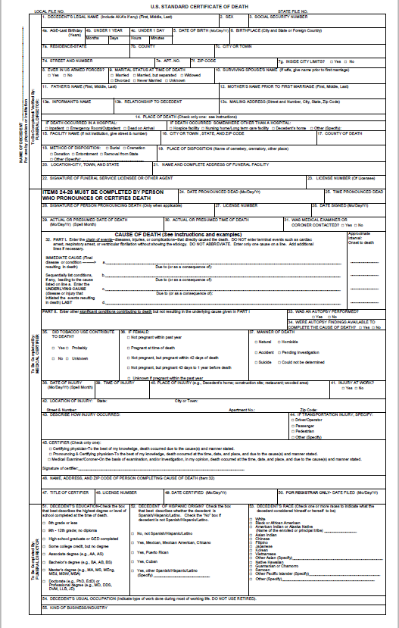





Medical
Physicians
Medical History
Analyses and Reports
Death Scene
NCHS NVSS Mortality
Autopsy
State
Registrar
Division of Vital Statistics
Medical Examiners & Coroners
Death Certificate
Toxicology
Demographic
RIP
Surveillance, Public Use, and Restricted Data
Funeral Home Directors
Demographic
Data

Slide 4
WHO definition of maternal death
Maternal death – the death of a woman while pregnant or within 42 days of termination of pregnancy, irrespective of the duration and the site of the pregnancy, from any cause related to or aggravated by the pregnancy or its management, but not from accidental or incidental causes
Late maternal death – The death of a woman from direct or indirect obstetric causes more than 42 days but less than 1 year after the end of pregnancy.
Maternal deaths coded to Chapter XV – Pregnancy, childbirth and the puerperium in ICD-10 (O00-O99)

Slide 5
ICD-10 Chapter XV – Pregnancy, childbirth and the puerperium
O00-O08 – Pregnancy with abortive outcome
O10-O16 – Edema, proteinuria and hypertensive disorders in pregnancy, childbirth and the puerperium
O20-O29 – Other maternal disorders predominantly related to pregnancy
O30-O48 – Maternal care related to the fetus and amniotic cavity and possible deliver problems
O60-O75 – Complications of labor and delivery
O80-O84 – Delivery
O85-O92 – Complications predominantly related to the puerperium
O94-O99 – Other obstetric conditions, not elsewhere classified

Slide 6
Direct vs. indirect maternal causes
Direct maternal causes (conditions caused by pregnancy, childbirth or the puerperium)
  Hemorrhage, embolism, eclampsia/preeclampsia, infection
Indirect maternal causes (conditions complicated or aggravated by pregnancy, childbirth or the puerperium)
  O98 – Maternal infectious and parasitic diseases classifiable elsewhere but complicating pregnancy, childbirth and the puerperium
    E.g., tuberculosis, STDs, HIV, viral hepatitis
  O99 – Other maternal diseases classifiable elsewhere but complicating pregnancy, childbirth and the puerperium
    E.g., anemia, some diseases of the endocrine, circulatory, respiratory and digestive systems

Slide 7
Pregnancy-related vs. pregnancy-associated
Pregnancy-related
  Death to a woman which occurs during or within one year of the end of a pregnancy from any cause related to or aggravated by the pregnancy or its management, but not from accidental or incidental causes
  Includes both maternal deaths and late maternal deaths (direct and indirect)
Pregnancy-associated
  Death to a woman from any cause, while she is pregnant or within 1 year of termination of pregnancy, regardless of duration and site of pregnancy
  Includes both pregnancy-related and incidental causes

Slide 8
Maternal mortality data in the NVSS
Research had showed underreporting of maternal deaths in the NVSS
Some states introduced pregnancy checkbox items to capture pregnancy or recent pregnancy to improve reporting
Lack of standardization among the various state death certificates
Addition of a pregnancy checkbox item on the 2003 revision of the US Standard Death Certificate

Slide 9
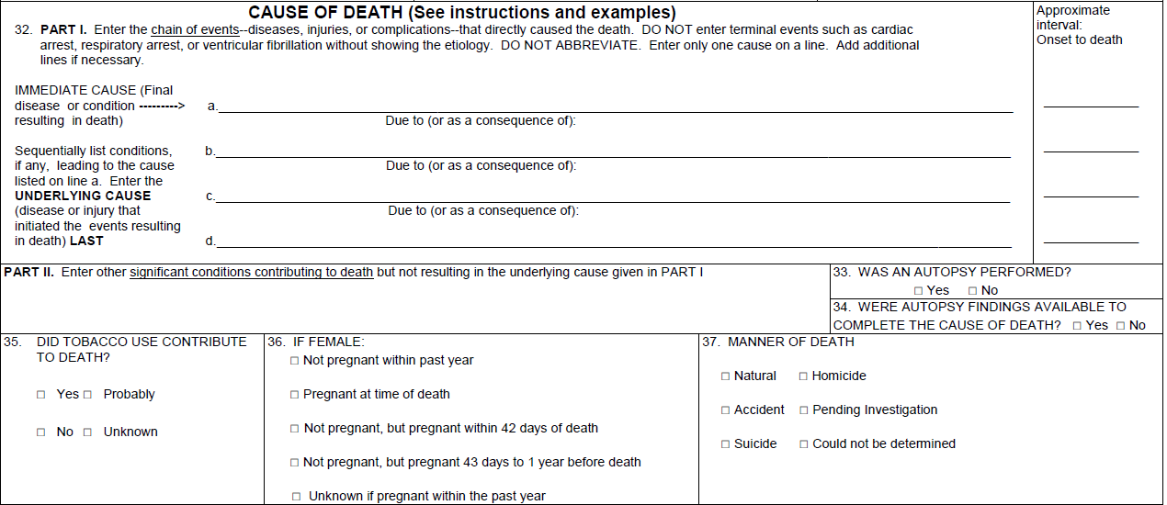
Cause of death section of the standard death certificate (2003 revision)
Causal sequence leading to death
Contributing conditions

Slide 10
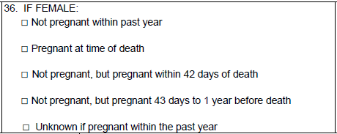
Pregnancy checkbox item on the 2003 revision of the US Standard Death Certificate

Slide 11
Implementation of the 2003 revision of the US Standard Death Certificate
Only 5 jurisdictions had a checkbox item consistent with the standard in 2003
Note: Out of 52 jurisdictions (50 states, NYC and DC). CA implemented the 2003 certificate, but without the standard pregnancy item.

Slide 12
Current rules for coding maternal deaths
For female decedents where there is an indication, either in the cause of death section (part I or II) or in the checkbox item, of a pregnancy or recent pregnancy, all medical conditions on the death certificate are coded to the O-chapter (Chapter XV) in ICD-10
  Those conditions indexed in ICD-10 (i.e., found in the index or specified in volume 1) are coded to the appropriate O-code
  Those conditions not indexed or not found in volume 1 are assigned to “other specified” categories:
    For direct obstetric causes or complications of direct obstetric causes, code O26.8 (Other specified pregnancy-related conditions)
    For indirect obstetric causes, code O99.8 (Other specified diseases and conditions complicating pregnancy, childbirth and the puerperium)

Slide 13
Coding with and without checkbox
Without checkbox With checkbox
I a) Chronic renal failure N18.9 O26.8
b) Hypertensive heart disease I11.9 O10.1
c)
II Coronary thrombosis I21.9 O99.4
Underlying cause I21.9 O10.1
I a) Hemorrhage R58 O46.9
b) Dissecting aortic aneurysm I71.0 O99.4
c) Arteriosclerosis I70.9 O99.4
II Old myocardial infarction I25.8 O99.4
Underlying cause I71.0 O46.9

Slide 14
Coding external causes
External causes of death (accidents, suicides and homicides) are not converted to O-codes
However, in some instances, a maternal underlying cause may nevertheless be the result
Without checkbox With checkbox
I a) Anoxic brain injury G93.1 O26.8
b) Fentanyl overdose T40.4/X42 T40.4/X42
c)
II Remote history of opiate abuse F11.1 T40.4 O99.3 T40.4
Injury description: Fentanyl overdose
Manner: Accident
Underlying cause X42 O26.8

Slide 15
Causes incidental to pregnancy
Causes incidental to pregnancy should not be counted as maternal as they are inconsistent with the WHO definition
WHO does not define what constitutes “incidental” other than injury-related causes
Coders are not really qualified to make this judgment, especially given the limited information reported on death certificates
To exclude incidental causes in the coding process, a list would be needed
However, such a list is proving difficult to create
  Are there diseases and conditions that are not complicated in some way by pregnancy?

Slide 16
Consequences of current coding procedure
In some cases, this procedure has had unintended consequences
  Some deaths due to external causes were coded as maternal
  In some cases, an underlying cause is selected that does not reflect the disease process and actual underlying cause
  Because the procedure casts a wide net, some deaths due to incidental causes, which should be excluded, are likely coded as maternal
  Many specific conditions are coded to ill-defined O-codes (e.g., O26.8 and O99) resulting in a loss of information for analysis

Slide 17
Pregnancy checkbox errors
Recent research has shown errors in the checkbox item
  Some maternal deaths are missed
  Some non-maternal deaths are misclassified as maternal
It is unclear exactly why the errors occur, but it may be simply random error in selecting the appropriate category
Most errors occur in the older ages (i.e., over 40)
  If the errors are random, they would tend to concentrate in the older population simply because there are more deaths among older women
  Assuming the error rate is constant across age groups, about 70% of errors would occur in the over 40 category
Net result is over-ascertainment of maternal deaths and a maternal mortality rate that is too high

Slide 18
Trend in maternal mortality rates: United States, 1999-2017
Note: MMR = maternal mortality rate. MMR includes all deaths coded to A34, O00-O95, O98-O99. Late MMR includes all deaths coded to O96-O97. PMSS (Pregnancy Mortality Surveillance System) includes pregnancy-related deaths (i.e., both maternal and late maternal deaths).

Slide 19
Publication of national maternal mortality rates
Largely because of concerns arising from the incremental implementation of the standard pregnancy checkbox item, NCHS ceased publication of national maternal mortality rates after 2007.
Plans were to resume once all jurisdictions had implemented the new certificate
More recent information regarding the checkbox errors have raised additional concerns about the accuracy of the data

Slide 20
Current strategy and plans
Plans are to resume publication of national maternal mortality rates with the release of the 2018 mortality data
This will involve the development of new rules for the coding of maternal deaths that mitigate errors
For maternal deaths, we also will change the way the multiple cause fields in the data file are organized so as to allow the analyst maximum flexibility in dealing with checkbox-only cases

Slide 21
Recoding maternal deaths as if there were no checkbox item
We have already recoded data for 2015 and 2016 as if the checkbox item did not exist
  A report is in preparation with an analysis of the effect of the checkbox on the maternal mortality rate
Plans are to recode data in the same way for 2003-2014, 2017-2019
These recoded data for 2003-2019 will be released and made available to researchers
This will increase the availability of trend data to evaluate the addition of the checkbox as there will be several years where all or most deaths will be coded under both sets of rules

Slide 22
Proposed changes in coding procedure (beginning 2018)
In checkbox-only cases, information from the checkbox will only modify the underlying cause…not other causes reported on the certificate
Further age restriction for application of the checkbox
  Currently, the age restriction is from age 10-54, i.e., the checkbox is only applied if the decedent is in this age range
  Plans are to further restrict this age range to 10-40 or 10-44 (decision has not yet been made)
  The age restriction will only affect the checkbox-only cases
  When obstetric conditions are reported on the death certificate, there will be no restriction in terms of age, i.e., maternal deaths due to an explicit obstetric condition will be counted regardless of age

Slide 23
Proposed changes in multiple cause fields (beginning 2018)
For checkbox-only cases that are coded as maternal deaths, only the underlying cause field will reflect an O-code
Multiple cause fields (entity and record axis) for these cases will reflect the data as reported
This will allow the analyst to identify the checkbox only cases in the data file and will avoid problems with ill-defined O-codes (e.g., O26.8 and O99.8)

Slide 24
Example of proposed checkbox-only record
I a) Hemorrhage R58
b) Dissecting aortic aneurysm I71.0
c) Arteriosclerosis I70.9
II Old myocardial infarction I25.8
Underlying cause I71.0 O99.4
Entity axis codes (first 2 positions indicate where the condition was reported, i.e., which line and where on the line)
11R58 21I710 31I709 61I258
Record axis codes (underlying cause is listed first with other codes listed alphanumerically after that)
O994 I258 I709 I7101 R58
Pregnancy checkbox = pregnant at time of death
“1” in the fifth position indicates that this code would be the underlying cause assuming no checkbox

Slide 25
Publication and data release plans
Report on the effect of the checkbox on 2015 and 2016 data is in preparation for publication this summer
Report on the new methodology for coding maternal deaths will be published along with the release of final 2018 mortality data
  Will show the trend coded with and without checkbox
  Will show differences in the two coding approaches
Final 2018 mortality data will include maternal deaths coded according to the new methodology
An official maternal mortality rate will be published in our annual report “Deaths: Final data for 2018”, which will include tables showing maternal deaths and mortality rates.

Slide 26
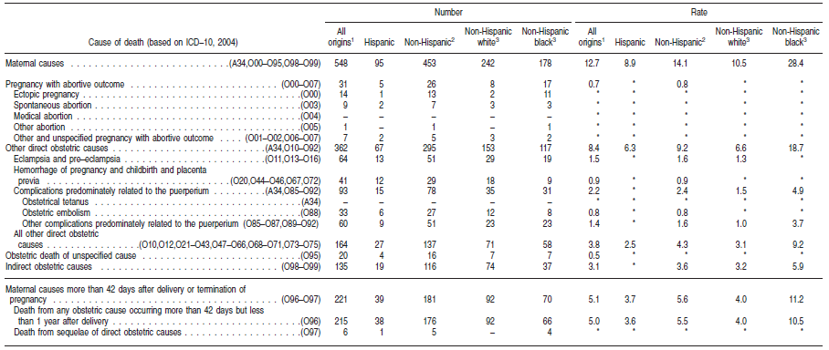
Tabulating maternal deaths and mortality rates
(from Deaths: Final data for 2007 – National Vital Statistics Reports vol 58, no 19)

Slide 27
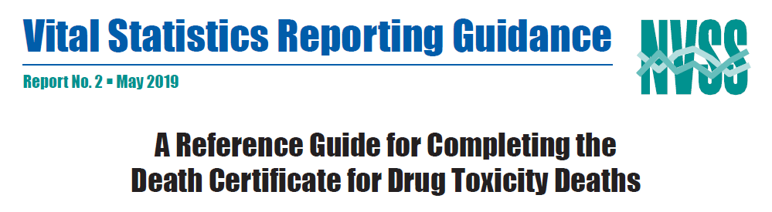
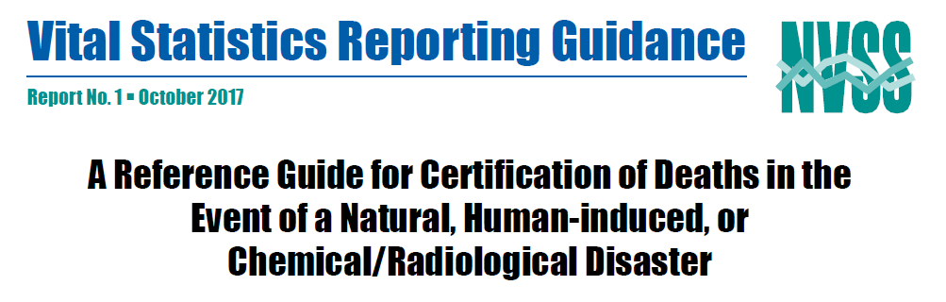
Guidance to certifiers
The Council of State and Territorial Epidemiologists (CSTE) has formed a workgroup on maternal mortality with the goal of producing a reference guide for certifying deaths associated with pregnancy
This effort involves staff from NCHS, CDC’s Division of Reproductive Health, CSTE, NAPHSIS and several states
The goal is to write and publish a reference guide in our Vital Statistics Reporting Guidance series in a format similar to those produced for drug overdoses and disasters by the end of 2019

Slide 28
Long term solution
Ideally, some effort to investigate all deaths to women of reproductive age is needed
  Linkages with birth and fetal death records to verify recent pregnancies
  Review of medical records for those where a recent pregnancy is reported to identify errors and determine whether the pregnancy was a factor or whether the cause was incidental
It is important that information from such investigations is reported on death certificates in a timely fashion so correct information can be included in national statistics

Slide 29
  Robert Anderson
  Phone: 301-458-4073
  RNAnderson@cdc.gov

