Slide 1


Board of Scientific Counselors
Jennifer Madans, PhD
Acting Director, National Center for Health Statistics
January 9, 2020

Slide 2
Administrative and Budget Updates

Slide 3
NCHS Budget
*Amount includes funding for administrative and business services through the CDC Working Capital Fund.
Not included: NCHS relies on an additional transfer from CDC’s Public Health and Scientific Services Account, about $14 million annually.

Slide 4
FY 2020 Appropriations
Appropriations allocates an additional $50 million to CDC for “Public Health Data Surveillance/IT Systems Modernization”
Joint Explanatory Statement: “CDC is directed to provide a multi-year plan, including at least five years of budget projections, as well as the innovation strategy for surveys conducted by the National Center for Health Statistics to the Committees no later than 120 days after enactment of this Act.”

Slide 5
Percentage of NCHS Data Collections Funded by Reimbursable Dollars in FY 2019

Slide 6
Additional NCHS Funding
Funding Type | FY 2018 | FY 2019 | FY 2020 (request)
Patient-Centered Outcomes Research (PCOR) Initiative* | $4,826,561 | $1,556,845 | $960,000
Opioid Response Coordinating Unit (ORCU) | $7,830,000 | $13,249,000 | $4,000,000
TOTAL | $12,656,561 | $14,805,845 | $4,960,000

Slide 7

A New Look for NCHS

Slide 8
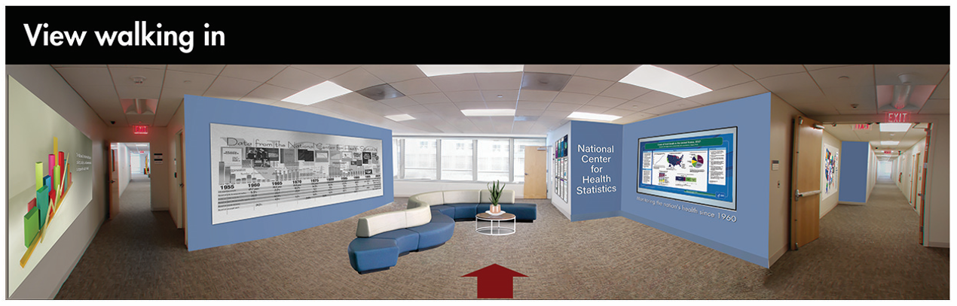

Slide 9


Slide 10
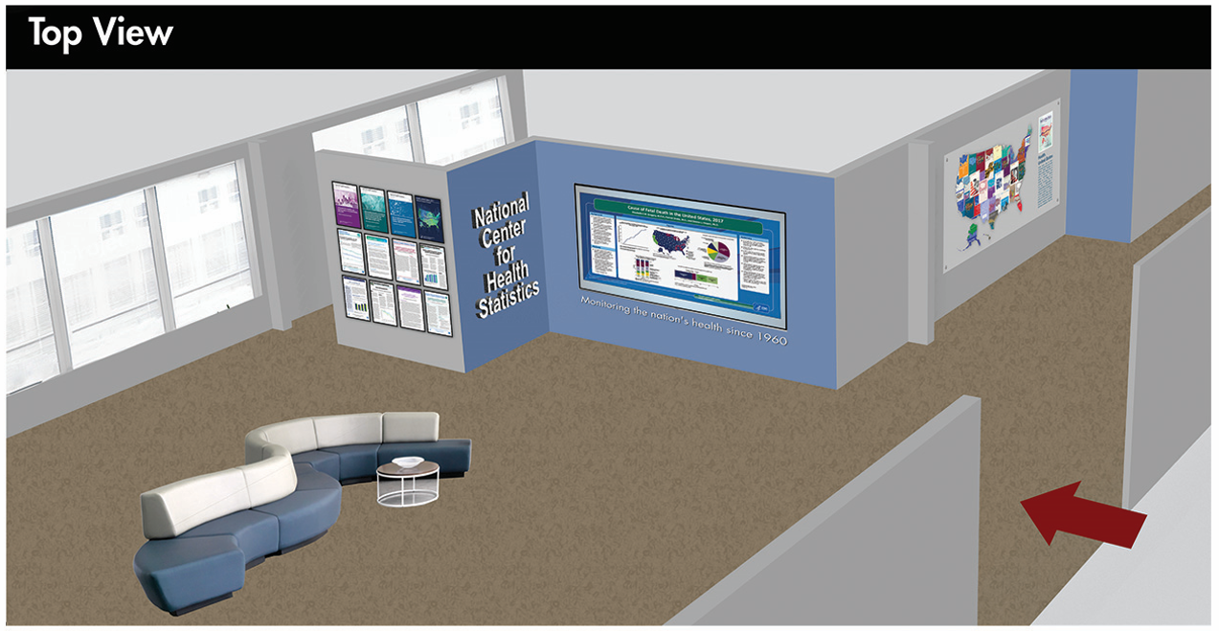

Slide 11
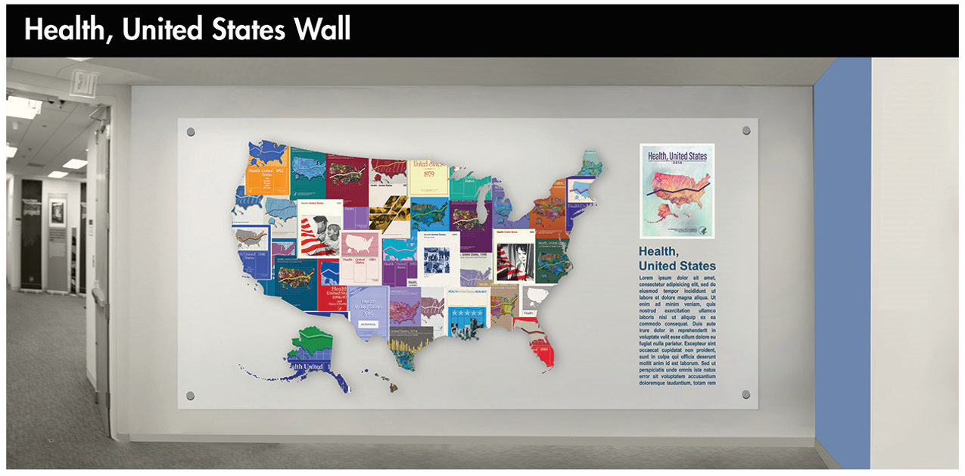

Slide 12
Program updates

Slide 13
Division of Vital Statistics (DVS): Maternal Mortality Data Release
NCHS will resume publication of maternal mortality statistics with release of the final 2018 mortality data on January 30, 2020
3 reports:
  Evaluation of the Pregnancy Status Checkbox on the Identification of Maternal Deaths – addresses the impact of the inclusion of a pregnancy status checkbox item on the U.S. Standard Certificate of Death on the number of deaths classified as maternal
  The Impact of the Pregnancy Checkbox and Misclassification on Maternal Mortality Trends in the US, 1999-2017 - models the impact of the staggered implementation of the pregnancy checkbox and potential outcome misclassification on MMRs and related trends
  Maternal mortality in the United States: Changes in coding, publication, and data release, 2018 – presents changes in how NCHS will code (using a new method), publish and release maternal mortality data along with official 2018 maternal mortality estimates

Slide 14
Planned Improvements in the Collection of Maternal Mortality Data
Understand errors in the pregnancy checkbox and how to correct these errors
  Examine existing EDR systems to see if improvements in design could help improve the data
  Develop web service designed to prompt the cause of death certifier to confirm the information provided in the checkbox item
Encourage cooperation between state vital records and state maternal and child health agencies
  Rapid assessment of deaths of women of reproductive age
  Linkages for deaths of women of reproductive age with birth and fetal death records
New information derived from the assessment must be incorporated in the vital statistics system

Slide 15

Division of Health Interview Statistics
2019 Redesigned National Health Interview Survey (NHIS)
Early Release Program plans to release preliminary estimates in late February or March 2020
Interactive data query system with preliminary 2019 estimates expected in Summer 2020 (NHIS 2015 – 2018 data will be released in early 2020 in the new data system)
Full-Year data release expected in/around September 2020
2020 NHIS and NHANES Innovation
Pilot Test to collect blood samples and anthropomorphic measurements from adult respondents of the NHIS
Results will feed into NHANES redesign

Slide 16

Division of Health and Nutrition Examination Survey (DHANES): Data Release
Over 60 2017 – 2018 data files are expected to be released in Q1 2020

Slide 17
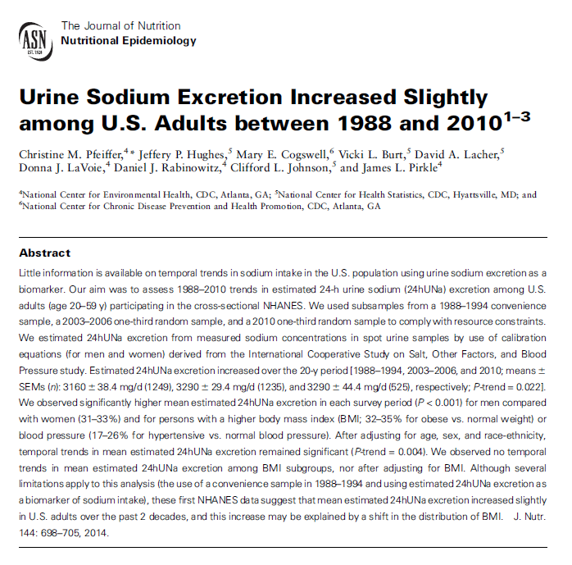
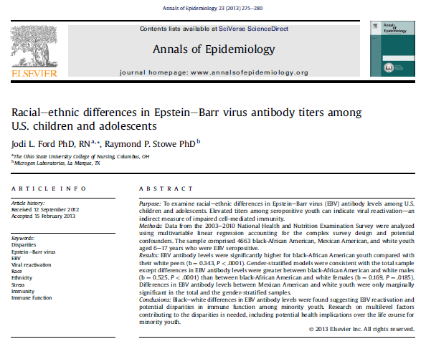
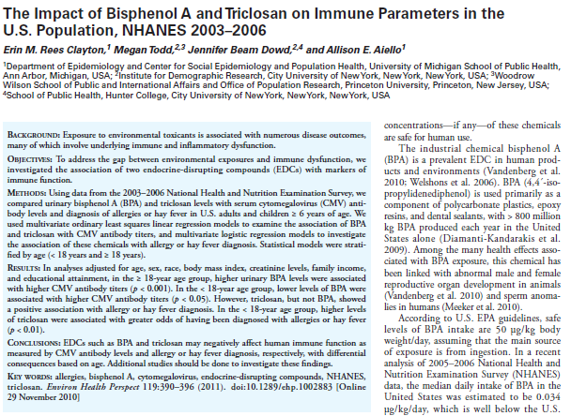
Division of Health and Nutrition Examination Survey (DHANES): NHANES Biospecimens
Nearly 400 publications have used NHANES biospecimen data
Biospecimens have been collected from NHANES participants since 1988
NHANES Cycle | Specimen Type
 | Pristine |  |  | Surplus |  |  | DNA
 | Sera | Plasma | Urine | Sera | Plasma | Urine
1988-1994 | X | … | … | X | … | … | X
1999-2000 | X | X | X | X | X | X | X
2001-2002 | X | X | X | X | X | X | X
2003-2004 | X | X | X | X | … | … | …
2005-2006 | X | X | X | X | … | … | …
2007-2008 | X | X | X | X | … | … | X
2009-2010 | X | X | X | X | … | … | X
2011-2012 | X | … | X | X | … | … | X
2013-2014 | X | … | X | X | … | … | …
2015-2016 | X | … | X | X | … | … | …
2017-2018 | X | … | X | X | … | … | …

Slide 18
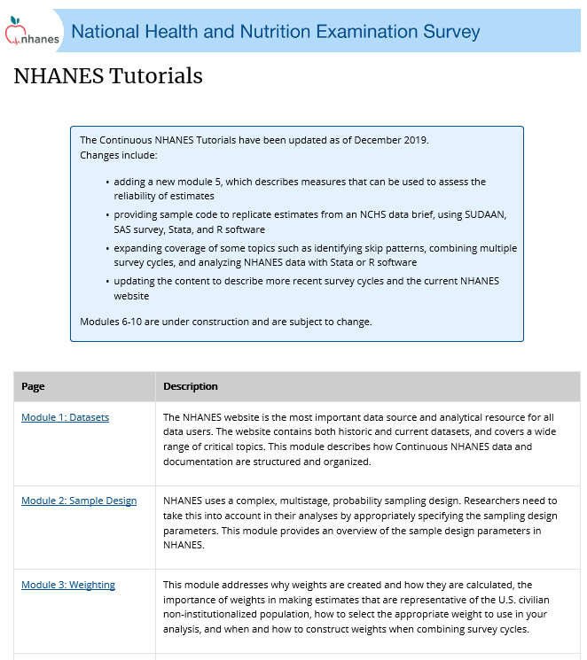
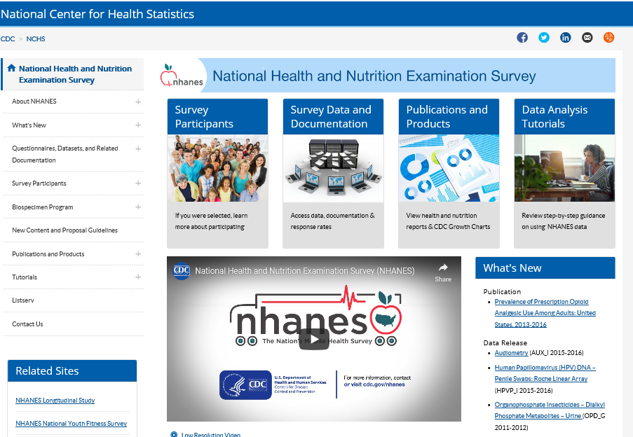

Division of Health and Nutrition Examination Survey (DHANES): Announcements
Updated Tutorial
New Personnel:
Operations Branch Chief: Jessica Graber, Ph.D.
Redesigned Homepage

Slide 19
Division of Health Care Statistics (DHCS)
2017 National Hospital Ambulatory Medical Care Survey (NHAMCS) Emergency Department (ED) Data Released in November 2019
NCHS National Post-Acute and Long-Term Care Study
  NPALS is here!: New name for the National Study of Long-Term Care Providers starting in January 2020
  Awarded survey contract to RTI International in September 2019

Slide 20
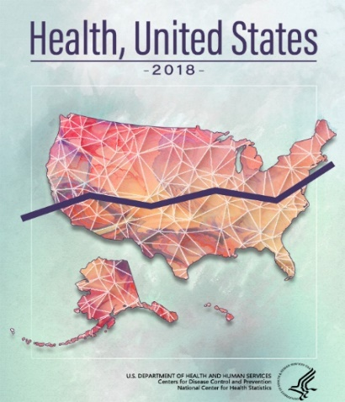
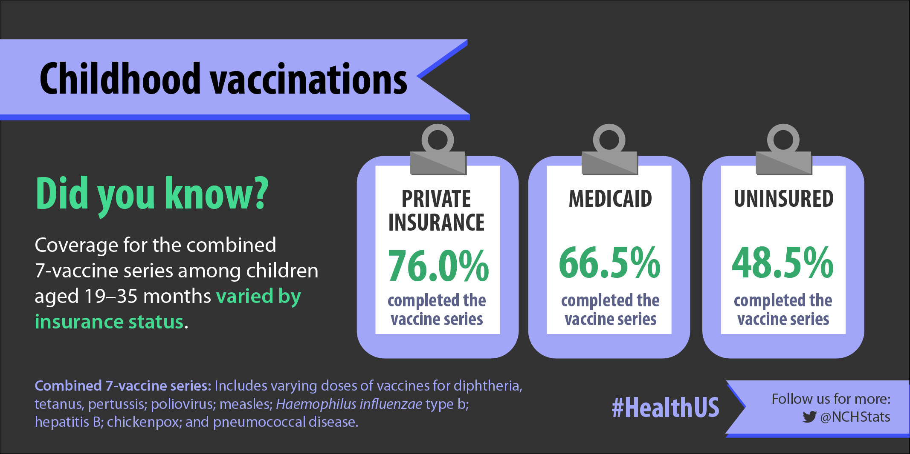
Division of Analysis and Epidemiology (DAE): Health, United States, 2018
Released online October 30, 2019
Within the first month, there were approximately:
  9,000 page views of the report homepage,
  2,200 downloads of the Chartbook PDF, and
  26,700 page views of the Data Finder
Hosted a public webinar to an audience of 100+ in November 2019
Report briefing to House and Senate Appropriations Committee’s Labor, Health, and Human Services subcommittee staff

Slide 21

DAE: Healthy People
Healthy People 2030
Departmental clearance of objectives completed (December 2019)
Scheduled release of HP2030 on March 31, 2020
Additional HP2030 measures and indicators on a rolling release in late 2020 or early 2021:
  Foundation Health Measures – Technical Advisory Panel meeting
  Leading Health Indicators – high-priority health issues and actions
Healthy People 2020
Processing of final data updates (early 2020)
Release of HP2020 Executive Summary (October 2020)
Release of HP2020 Final Review (late 2021)

Slide 22
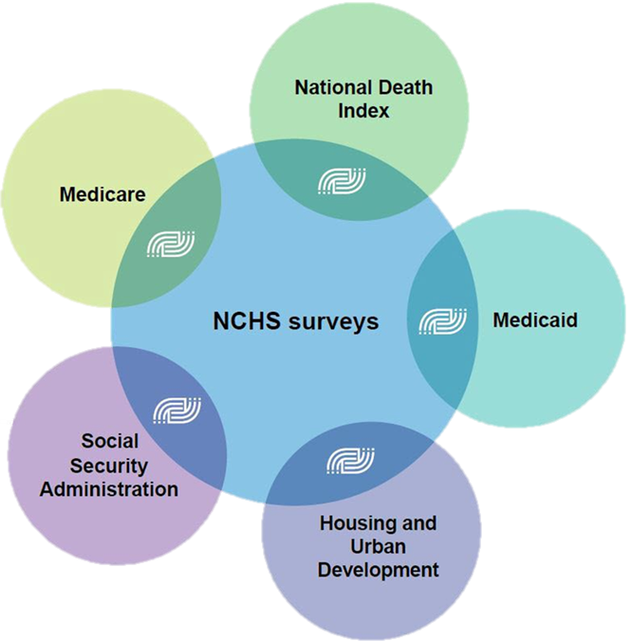
DAE: Data Linkages Program
2019 Data Releases:
  Public use linked mortality files
  Updated linked NCHS-Medicaid files
  Updated linked NCHS-HUD files
  National Hospital Care Survey data linked to NDI and CMS (funding from PCORTF)

Slide 23

Division of Research and Methodology (DRM)
Research Data Center (RDC)
Census is running two pilot projects related to accessing restricted-use data:
  Common application system for all statistical agencies - used for submission of requests for access to restricted-use data (in response to section 3583 of the Evidence Act)
  Virtual data enclave – to assess feasibility and develop lessons learned for future protocol establishment
Census Headquarters RDC recently closed
Washington, DC Federal Reserve Bank RDC opened in October 2019
Federal Statistical RDCs (FSRDC) Opening in Feb. 2020:
  Wasatch Front at the University of Utah
  University of Illinois Urbana-Champaign
NCHS RDC recently signed an agreement with EPA to make certain EPA restricted-use data available through the FSRDC system.

Slide 24
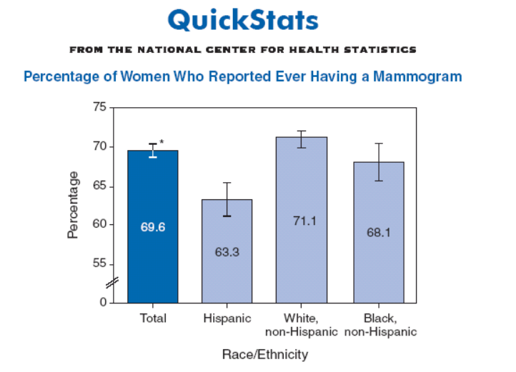
15th Anniversary of QuickStats
First NCHS QuickStats: January 14, 2005
Started in 2005
A single chart with a short, concise caption
Appears in CDC’s MMWR every week
Presents data from all NCHS data systems
Unique method to disseminate data
Easy to understand

Slide 25
QuickStats: Overview and Value to NCHS
694 QuickStats published
222 authors, mostly from NCHS (occasional collaboration with CDC or other federal agencies)
NCHS Data Division Representatives guide the process
Continuous presence in MMWR
Expand readership
Recognition by public health community/leaders
Awareness through social media
Creates data base of key findings for use by researchers, reporters, the public

Slide 26


Sandy Smith
NCHS QuickStats Authors

Slide 27
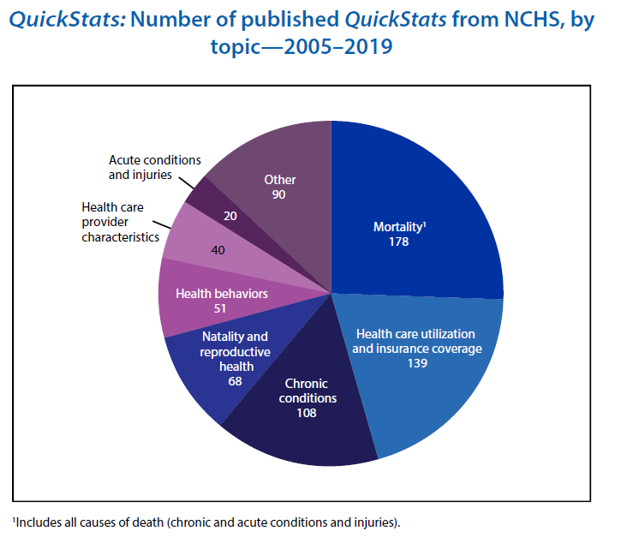
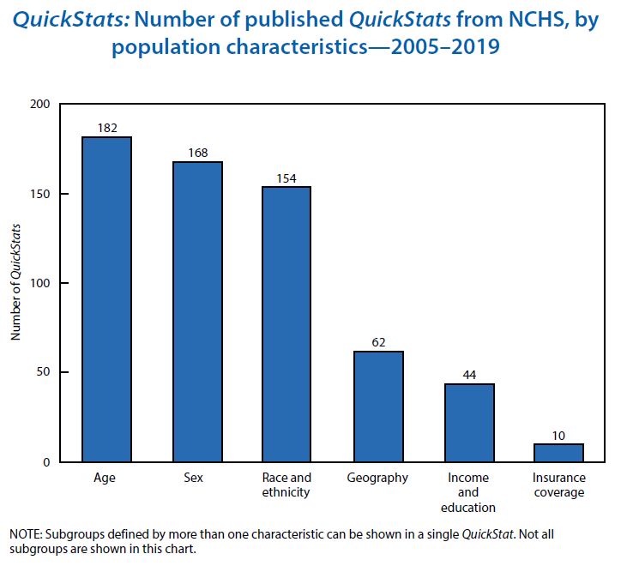
QuickStats: Celebrating 15 Years

Slide 28
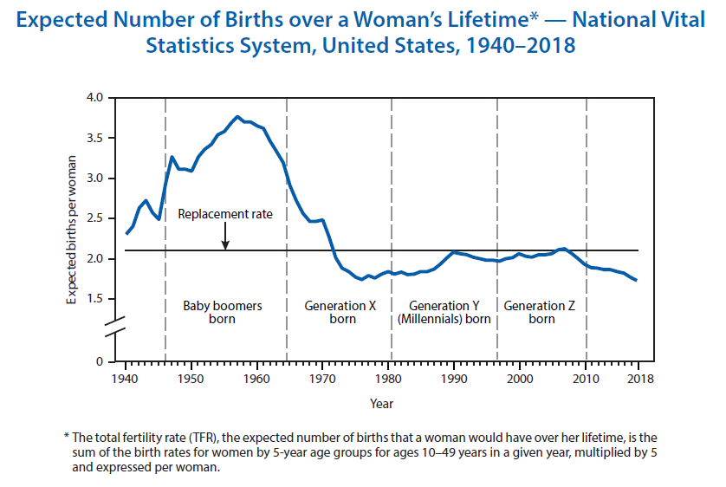
Latest QuickStats

Slide 29
NCHS Publications by Fiscal Year
Publications Type | Fiscal Year
 | 2011 | 2012 | 2013 | 2014 | 2015 | 2016 | 2017 | 2018 | 2019 | 2020*
Data Briefs | 30 | 31 | 23 | 37 | 50 | 42 | 28 | 34 | 29 | 3
Early Release | 11 | 15 | 14 | 12 | 9 | 0 | 0 | 9 | 11 | 0
Fact Sheets |  |  |  | 1 | 10 | 4 | 16 | 29 | 24 | 0
Health E-Stats | 5 | 6 | 3 | 5 | 4 | 8 | 1 | 6 | 1 | 2
Health, United States | 2 | 2 | 2 | 2 | 2 | 2 | 1 | 1 | 0 | 1
Healthy People, 2020 |  |  |  |  |  |  | 1 | 0 | 0 | 0
Misc. Reports | 1 | 0 | 2 | 1 | 0 | 0 | 0 | 0 | 0 | 0
NHSR | 16 | 15 | 11 | 9 | 7 | 13 | 9 | 12 | 10 | 6
NVSR | 8 | 13 | 8 | 10 | 17 | 7 | 8 | 8 | 14 | 2
Series Reports | 10 | 11 | 13 | 10 | 6 | 4 | 7 | 10 | 3 | 1
Statistical Note |  |  |  |  |  | 1 | 0 | 0 | 0 | 0
Vital Statistics Rapid Release Special Report |  |  |  |  |  |  | 1 | 4 | 1 | 0
Vital Statistics Reporting Guidance (VSRG) |  |  |  |  |  |  |  | 1 | 1 | 0
Visual Abstracts |  |  |  |  |  |  |  |  |  | 3
TOTALS | 83 | 93 | 76 | 87 | 105 | 81 | 72 | 114 | 94 | 18
Released by NCHS Office of Information Services
*As of December 10, 2019

Slide 30
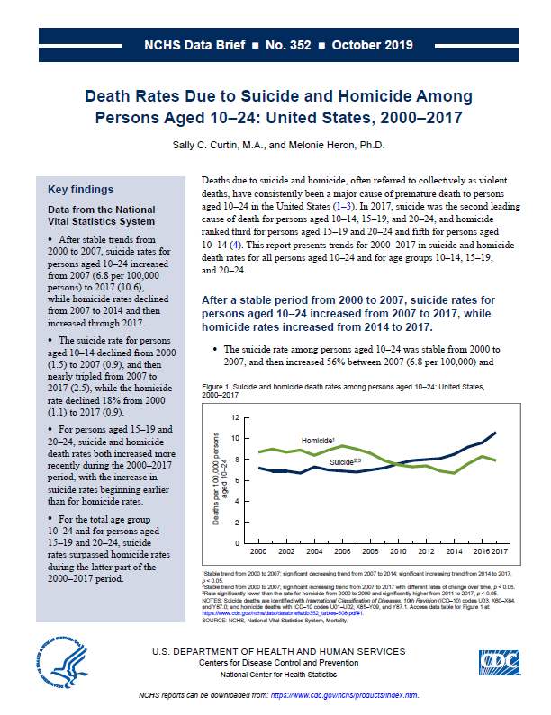
Data Briefs Since Last BSC
Is Twin Childbearing on the Decline? Twin Births in the United States, 2014 – 2018
  Following more than three decades of increases, the twin birth rate declined 4% during 2014–2018, to the lowest rate in more than a decade.
Death Rates Due to Suicide and Homicide Among Persons Aged 10 – 24: United States, 2000 – 2017
  After stable trends from 2000 to 2007, suicide rates for persons aged 10–24 increased from 2007 to 2017, while homicide rates declined from 2007 to 2014 and then increased through 2017.
Vision Testing Among Children Aged 3 – 5 Years in the United States, 2016 – 2017
  Children with private health insurance (66.7%) were more likely than both children with public coverage (61.2%) and uninsured children (43.3%) to have ever had a vision test.

Slide 31
Upcoming NCHS Reports
Human Papillomavirus Vaccination Among Adults Aged 18 – 26, 2013 – 2018 (released 1/7/2020)
Trend in Opioids Prescribed at Discharge From Emergency Departments Among Adults: United States 2006-2017 (released 1/8/2020)
Physician Office Visits at Which Benzodiazepines Were Prescribed: Findings From the 2014-2016 National Ambulatory Medical Care Survey
Demographic, Health Care, and Fertility-Related Characteristics of Adults Aged 18-44 Who Have Ever Been in Foster Care: United States, 2001-2017

Slide 32
Upcoming NCHS Reports cont.
Upcoming 2018 Mortality publications: January 30, 2020
Evaluation of the Pregnancy Status Checkbox on the Identification of Maternal Deaths
The Impact of the Pregnancy Checkbox and Misclassification on Maternal Mortality Trends in the US, 1999-2017
Maternal mortality in the United States: Changes in coding, publication, and data release, 2018
Mortality in the United States, 2018
Drug Overdose Deaths in the United States, 1999 – 2018
Life Expectancy in the U.S., 2018
Upcoming 2017-18 NHANES publications: Expected 2020 Quarter 1
NHANES Estimation Procedures, 2015-2018
Sampling Variability and Nonresponse Bias 2017-2018 NHANES
Hepatitis B Virus Infection and Vaccination
Obesity among adults and youth
Hypertension among adults
Non-high-density lipoprotein (HDL) and HDL cholesterol in adults

Slide 33



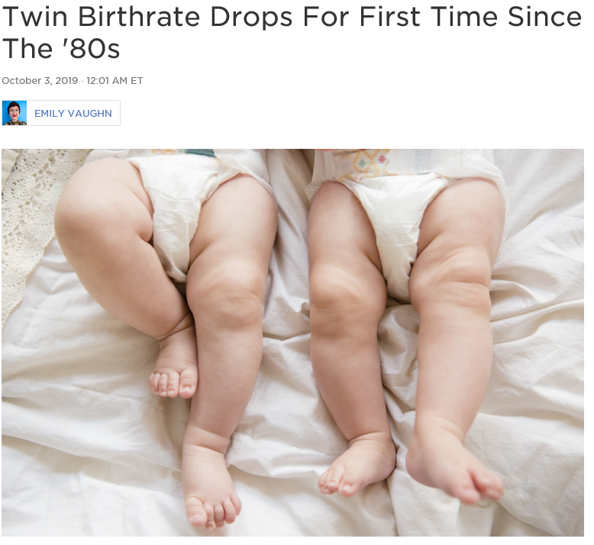



NCHS in the News

Slide 34







NCHS in the News

Slide 35
NCHS at the International Conference on Health Policy Statistics
NCHS Session on Linked Data for Evidence-Based Policymaking
Session Chair: Jennifer Madans
Presentations:
  Leveraging Linked Data for Evidence-Based Policymaking, by Lisa Mirel
  Identification of Opioid-Involved Health Outcomes Using Linked Hospital Care and Mortality Data, by Carol DeFrances
  On the Utility of Prediction Models in Large Government Surveys: Using Linked Administrative-Survey Data to Inform Analyses of More Contemporaneous Survey Data, by Yulei He (for Jennifer Rammon)
  Research Data Centers for Data Access, by Jennifer Parker

