Slide 1
NATIONAL HEALTH INTERVIEW SURVEY
QUESTIONNAIRE REDESIGN UPDATE
Stephen Blumberg, PhD
Director, Division of Health Interview Statistics
Aaron Maitland, PhD
Chief, Survey Planning and Special Surveys Branch
NCHS Board of Scientific Counselors Meeting
May 9, 2019

Slide 2
Why Redesign the Questionnaire?
Most recent major content redesign was 1997
Respondent burden increasing and response rates decreasing

Slide 3
Length of Completed Interviews, by Quarter:
NHIS, 2006, Q1 -- 2018, Q4 (October)

Slide 4
NHIS Family, Child, and Adult Response Rates,
NHIS 1997-2017

Slide 5
Goals of the 2019 Content Redesign
Improve the relevance of covered health topics, better meeting the needs of the Department of Health and Human Services and other data users
Harmonize overlapping content with other federal heath surveys
Reduce respondent burden and improve data quality
Shorten questionnaire and reduce variation in interview times
Eliminate or reduce content better covered by other methods

Slide 6
Annual Content
Plan 2019-2027
Annual core
  Key measures
  Sociodemographics
Rotating core
  Newer topic areas
  Expanded detail
  Varying periodicity
Sponsored supplements
  “Sustaining” sponsors
  1- or 2-year modules
  5 min or less
One adult and one child randomly selected from each household
  Demographics for all HH members
  Family info collected from sample adult and parent of sample child

Slide 7
Progress on the Redesign
Continued analysis of the impact of the redesign on the data collection process
Data collection with the redesigned instrument began in January of 2019
Advance letter experiment in quarter 2
Beginning to plan for documentation of the redesign

Slide 8
Length of Completed Interviews, by Quarter:
NHIS, 2006--2018

Slide 9
Householder Expressions of Time Constraints, by Production versus Redesign Instruments

Slide 10
Subjective Perceptions of Burden
Was there a difference in perceived burden between the old design and the redesign?
Subjective measures of burden capture the respondents’ perceptions of how burdensome the survey was to them.
  How burdensome was this survey to you? Would you say not at all burdensome, a little burdensome, moderately burdensome, very burdensome, or extremely burdensome?
  How easy or difficult was it for you to answer the questions in this survey? Would you say very easy, somewhat easy, somewhat difficult, or very difficult?
  How sensitive were the questions in this survey? Would you say not at all sensitive, a little sensitive, moderately sensitive, very sensitive, or extremely sensitive?

Slide 11
How burdensome was this survey to you?,
Production versus Redesigned Instrument: NHIS, 2018, Q4

Slide 12
Sample Adult and Sample Child Response Rates:
Quarter 4 of 2018 and Quarter 1 of 2019

Slide 13
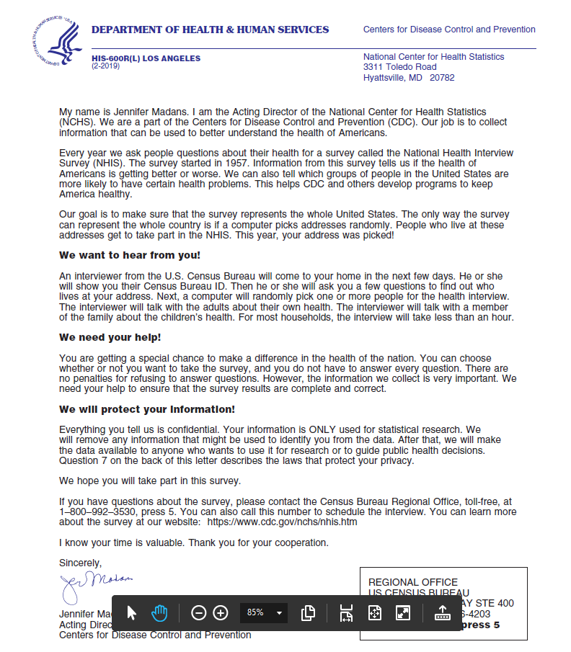
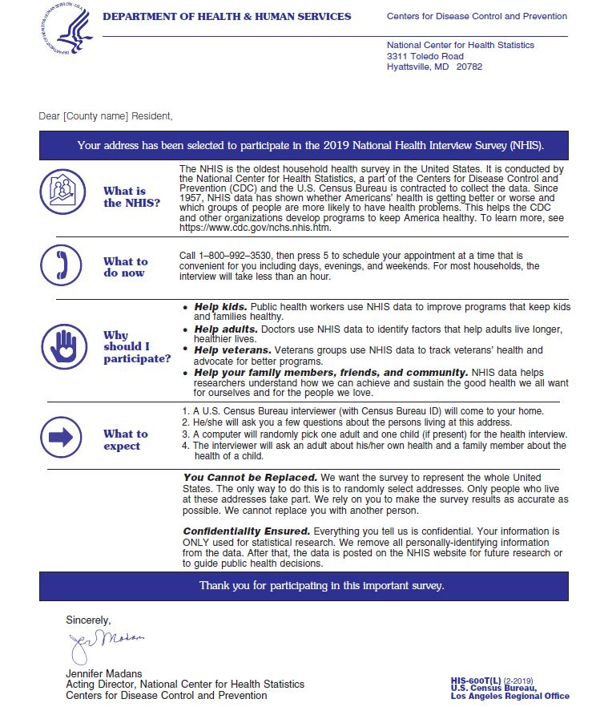
Current Advance Letter Redesigned Advance Letter
Results Next Time!

Slide 14
Next Steps
Continuing analysis of the bridge to look at differences in health estimates from the old design and the redesign
Redesign documentation
  Documentation of the process of redesigning the NHIS
    What were the different sources of input?
    How were decisions made about the content that was included? (e.g., what is annual core? rotating core?)
    How was the redesign developed and tested?
  What was the impact of the redesign on the NHIS?
    How did the redesign impact the data collection process?
    What was the impact of the redesign on health estimates?
We welcome any ideas for bridging analyses and documentation of the redesign!

Slide 15
Other Redesign Activities
Implementing new technologies to manage data and metadata
Identifying recodes and composite variables for inclusion on the data files
Determining ways to reduce the number of data files and simplify analyses for users
Evaluating disclosure risk and tradeoffs regarding the level of detail on public use data files
Building a data visualization system for summary health statistics
Redesigning the next early release (ER) reports

Slide 16
For More Information
https://www.cdc.gov/nchs/nhis/2019_quest_redesign.htm

