Slide 1
National Health and Nutrition Examination Survey (NHANES) 2019 – 2020
Ryne Paulose, M.A., Ph.D.
Acting NHANES Director
September 18, 2020
NCHS Board of Scientific Counselors Meeting

Slide 2
BSC Workgroup Meeting June 26th
Discussed completing NHANES 2019-2020 data collection and implications for starting NHANES 2021-2022

Slide 3
BSC Workgroup Meeting June 26th Tentative Opinions
NHANES should not complete additional sampling for the 2019-2020 data.
NHANES 2017-2018 and 2019-2020 data should be combined to generate a larger dataset supporting better estimates.
Weight the combined 2017-2020 data using the 2017-2018 strata as a starting point and evaluate against historically-based expectations.

Slide 4
After the BSC Workgroup meeting
No further consideration for completing the 2019-2020 sample
Began planning for 2021-2022 NHANES data collection
Began QC and editing of collected 2019-2020 data for combining with 2017-2018 data

Slide 5
NHANES Data 2017 – 2018 and 2019 – 2020

Slide 6
NHANES 2017 – 2018 Data Release
Percent of 2017-18 NHANES Data Files
Released, In Process, or Not Yet Ready (n=152)
First set of 2017–2018 data released in February 2020.
As of September 1, nearly two-thirds of all 2017-18 data files have been released.

Slide 7
NHANES 2019 – 2020 Data in process
Percent of 2019-20 NHANES Data Files
In Process (n=160)
Over one-quarter of the 2019-2020 data have begun or completed internal QC review and editing.

Slide 8
NHANES 2017 – 2020 Survey Weights

Slide 9
NHANES 2017 – 2020 Survey Weights
NCHS received draft weights September 2nd
Weight creation: Combined 2017-20 PSUs together, applied factors to account for not having a full sample, and then went through the same weighting process that was done for the final 2017-18 weights (V14).

Slide 10
Approach to creating the 2017 – 2020 sampling weights
 |  |  |  |  | GREG-Adjusted Weights
 | V2 | V3 | V5 | V6 | V7 | V8 | V7_b | V9 | V10 | V11 | V12 | V13 | V14 | 2017−2020
Added 18 PSUs from 2019-20 to the 2017-18 data collection |  |  |  |  |  |  |  |  |  |  |  |  |  | X
Created factors to adjust base weights for 48 completed PSUs in a 60-PSU sample design |  |  |  |  |  |  |  |  |  |  |  |  |  | X
GREG adjustment to income and population age 20+ |  |  |  |  | X | X | X | X | X | X | X | X
GREG adjustment to NCHS urbanicity |  |  |  |  |  |  |  |  |  |  | X | X
GREG adjustment to education |  |  |  |  |  |  |  |  |  | X | X
NR adjustment using same variables as in 2015-16 to create cells | X | X | X | X | X | X | X | X | X | X | X | X | X | X
Adding variables to include in NR adjustment |  | X | X | X | X | X | X | X | X | X | X | X | X | X
Adjusting NR separately within each PSU |  |  |  | X |  | X
Raking to 74 race/ethnicity/sex/age group cells | X | X | X | X | X | X |  | X | X | X | X | X | X | X
Raking to 32 race/ethnicity/sex/education cells |  | X | X | X | X | X |  | X |  |  |  | X | X | X
Raking to 16 race/ethnicity/PSU size cells |  |  | X | X |  | X |  | X
Raking to 47 race/ethnicity/sex/age group cells |  |  |  |  |  |  | X
Raking to 28 race/ethnicity/sex/education cells |  |  |  |  |  |  | X
Raking to 10 tract-level household income cells |  |  |  |  |  |  |  |  |  |  |  |  | X | X

Slide 11
Approach to creating the 2017 – 2020 sampling weights
 |  |  |  |  | GREG-Adjusted Weights
 | V2 | V3 | V5 | V6 | V7 | V8 | V7_b | V9 | V10 | V11 | V12 | V13 | V14 | 2017−2020
Added 18 PSUs from 2019-20 to the 2017-18 data collection |  |  |  |  |  |  |  |  |  |  |  |  |  | X
Created factors to adjust base weights for 48 completed PSUs in a 60-PSU sample design |  |  |  |  |  |  |  |  |  |  |  |  |  | X
GREG adjustment to income and population age 20+ |  |  |  |  | X | X | X | X | X | X | X | X
GREG adjustment to NCHS urbanicity |  |  |  |  |  |  |  |  |  |  | X | X
GREG adjustment to education |  |  |  |  |  |  |  |  |  | X | X
NR adjustment using same variables as in 2015-16 to create cells | X | X | X | X | X | X | X | X | X | X | X | X | X | X
Adding variables to include in NR adjustment |  | X | X | X | X | X | X | X | X | X | X | X | X | X
Adjusting NR separately within each PSU |  |  |  | X |  | X
Raking to 74 race/ethnicity/sex/age group cells | X | X | X | X | X | X |  | X | X | X | X | X | X | X
Raking to 32 race/ethnicity/sex/education cells |  | X | X | X | X | X |  | X |  |  |  | X | X | X
Raking to 16 race/ethnicity/PSU size cells |  |  | X | X |  | X |  | X
Raking to 47 race/ethnicity/sex/age group cells |  |  |  |  |  |  | X
Raking to 28 race/ethnicity/sex/education cells |  |  |  |  |  |  | X
Raking to 10 tract-level household income cells |  |  |  |  |  |  |  |  |  |  |  |  | X | X

Slide 12
Approach to creating the 2017 – 2020 sampling weights
 |  |  |  |  | GREG-Adjusted Weights
 | V2 | V3 | V5 | V6 | V7 | V8 | V7_b | V9 | V10 | V11 | V12 | V13 | V14 | 2017−2020
Added 18 PSUs from 2019-20 to the 2017-18 data collection |  |  |  |  |  |  |  |  |  |  |  |  |  | X
Created factors to adjust base weights for 48 completed PSUs in a 60-PSU sample design |  |  |  |  |  |  |  |  |  |  |  |  |  | X
GREG adjustment to income and population age 20+ |  |  |  |  | X | X | X | X | X | X | X | X
GREG adjustment to NCHS urbanicity |  |  |  |  |  |  |  |  |  |  | X | X
GREG adjustment to education |  |  |  |  |  |  |  |  |  | X | X
NR adjustment using same variables as in 2015-16 to create cells | X | X | X | X | X | X | X | X | X | X | X | X | X | X
Adding variables to include in NR adjustment |  | X | X | X | X | X | X | X | X | X | X | X | X | X
Adjusting NR separately within each PSU |  |  |  | X |  | X
Raking to 74 race/ethnicity/sex/age group cells | X | X | X | X | X | X |  | X | X | X | X | X | X | X
Raking to 32 race/ethnicity/sex/education cells |  | X | X | X | X | X |  | X |  |  |  | X | X | X
Raking to 16 race/ethnicity/PSU size cells |  |  | X | X |  | X |  | X
Raking to 47 race/ethnicity/sex/age group cells |  |  |  |  |  |  | X
Raking to 28 race/ethnicity/sex/education cells |  |  |  |  |  |  | X
Raking to 10 tract-level household income cells |  |  |  |  |  |  |  |  |  |  |  |  | X | X

Slide 13
Approach to creating the 2017 – 2020 sampling weights
 |  |  |  |  | GREG-Adjusted Weights
 | V2 | V3 | V5 | V6 | V7 | V8 | V7_b | V9 | V10 | V11 | V12 | V13 | V14 | 2017−2020
Added 18 PSUs from 2019-20 to the 2017-18 data collection |  |  |  |  |  |  |  |  |  |  |  |  |  | X
Created factors to adjust base weights for 48 completed PSUs in a 60-PSU sample design |  |  |  |  |  |  |  |  |  |  |  |  |  | X
GREG adjustment to income and population age 20+ |  |  |  |  | X | X | X | X | X | X | X | X
GREG adjustment to NCHS urbanicity |  |  |  |  |  |  |  |  |  |  | X | X
GREG adjustment to education |  |  |  |  |  |  |  |  |  | X | X
NR adjustment using same variables as in 2015-16 to create cells | X | X | X | X | X | X | X | X | X | X | X | X | X | X
Adding variables to include in NR adjustment |  | X | X | X | X | X | X | X | X | X | X | X | X | X
Adjusting NR separately within each PSU |  |  |  | X |  | X
Raking to 74 race/ethnicity/sex/age group cells | X | X | X | X | X | X |  | X | X | X | X | X | X | X
Raking to 32 race/ethnicity/sex/education cells |  | X | X | X | X | X |  | X |  |  |  | X | X | X
Raking to 16 race/ethnicity/PSU size cells |  |  | X | X |  | X |  | X
Raking to 47 race/ethnicity/sex/age group cells |  |  |  |  |  |  | X
Raking to 28 race/ethnicity/sex/education cells |  |  |  |  |  |  | X
Raking to 10 tract-level household income cells |  |  |  |  |  |  |  |  |  |  |  |  | X | X

Slide 14
How were these factors created?
Normally, a 4-year sample would have 60 PSUs divided evenly into 15 strata, with 4 PSUs in every stratum
But, because the 18 PSUs completed in 2019−2020 came from a different sample design, some of the 2017−2018 strata did not have any additional PSUs, and some had as many as 4 additional PSUs
As a result, the 48 total PSUs are divided into 15 strata, where the strata contain between 2 and 6 PSUs.
As a result, the factors were created as 4 divided by the number of PSUs in the stratum. For strata with only 2 PSUs, the factor would be 2. For strata with 6 PSUs, the factor would be 0.67.

Slide 15
QC of the 2017 − 2020 Sampling Weights
A similar approach to that used for the 2017−2018 NHANES non-response bias and sampling variability assessments:
Comparisons to ACS
Benchmarking to NHIS
Examinations of temporal trends in key health outcomes
Comparison of response rates across subgroups; R-indicator analyses; and level of effort analyses, etc.

Slide 16
Balanced on education and income, as expected, but off on population size

Slide 17
NHANES Data Release 2017 – 2020

Slide 18
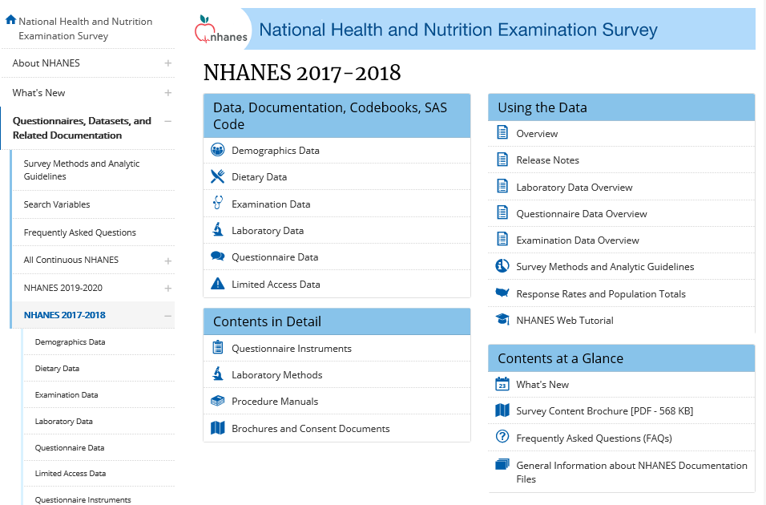

Slide 19
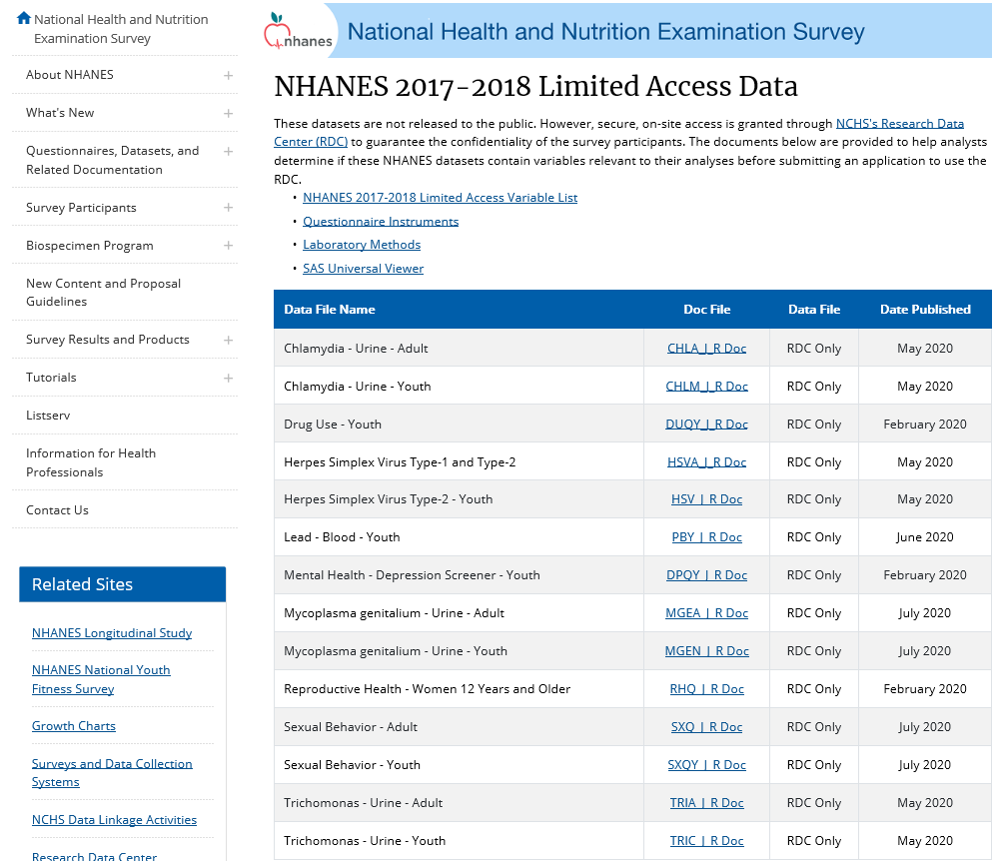

Slide 20
https://www.cdc.gov/rdc/

Slide 21
NHANES 2017 – 2020 Next Steps

Slide 22
NHANES next steps
Continue with the data QC and editing of 2017-18 and 2019-20 data
Continue with the evaluation of the 2017-20 survey weights
Develop a plan for data release through the RDC

Slide 23
NHANES 2021– 2022

Slide 24
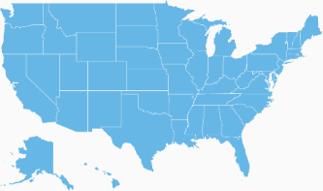
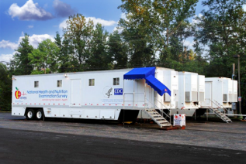
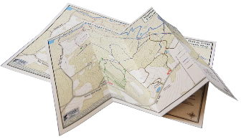
- 2 to 4 years
Sample Selection
1
Day 56
Stand closes
5
NHANES Operational Cycle
2
- 3 to 6 mo.
Field Listing
Day 14
MEC opens
4
3
Day 1
Stand Opens:
In-person screening and interviewing

Slide 25
NHANES 2021-2022: Various Restart Options
Start Date (for interviewing) | #PSUs | Target # examined | End Date (last exam)
April 1, 2021 | 30 | 10,000 | April 2023
May 14, 2021 | 30 | 10,000 | June 2023
July 2021 | 30 | 10,000 | July 2023
 | 28 | 10,000 | June 2023
 | 26 | 10,000 | April 2023

Slide 26
NHANES 2021-2022 : Various Restart Options
Start Date (for interviewing) | #PSUs | Target # examined | End Date (last exam)
April 1, 2021 | 30 | 10,000 | April 2023
May 14, 2021 | 30 | 10,000 | June 2023
July 2021 | 30 | 10,000 | July 2023
 | 28 | 10,000 | June 2023
 | 26 | 10,000 | April 2023
December 2021 /January 2022 | 15 | 5000 or more | January 2023 or later

Slide 27
Questions?
https://www.cdc.gov/nchs
https://www.cdc.gov/nchs/nhanes

