Slide 1
NHANES Reimagined for a Changing Data World
Ryne Paulose, M.A., Ph.D.
Acting NHANES Director
January 2020
Board of Scientific Counselors

Slide 2
NHANES: The Gold Standard
NHANES is the gold standard for numerous national data
Physical examinations
Standardized environment
Produces population-based prevalence estimates and trends on:
Health conditions and risk factors
Nutrition status and diet behavior
Prescription medication and dietary supplement use
Environmental exposures
Notes:
Through it’s physical examinations in standardized environments, NHANES is the gold standard for numerous national data.
NHANES provides the distribution of health characteristics
From outcomes, such as blood pressure, risk factors

Slide 3
NHANES: A Model of Broad and Deep Partnerships
Over the years, there have been more than two dozen partners with various degrees of collaboration
Notes:
We are a model of broad and deep partnerships and
Over the years, there have been more than 2 dozen partners
With various degrees of collaboration
From assisting on Survey Planning and content, with Data Quality and Subject Matter Expertise, or Providing Financial Support. They have also been involved as co-authors on various publications.

Slide 4
NHANES Impact
NHANES contribution to the health and nutritional status of Americans is extensive and long standing:
Provides critical data to inform public health, science, and policy;
Responsive to current and future data needs

Slide 5
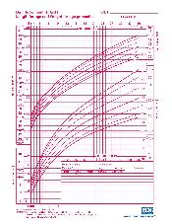
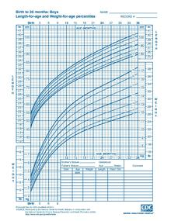
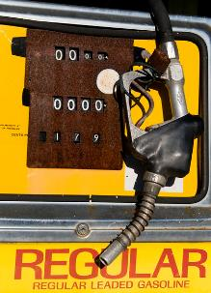
What if there was no NHANES?
We wouldn’t know …
If children are being exposed to lead, second hand smoke, and other harmful chemicals
If nutrient intakes are adequate
How babies and children grow
How high a chair seat should be
How much fuel is needed on passenger jets
If interventions to control diabetes/high blood pressure/cholesterol/hepatitis are working

Slide 6
Why Reimagine NHANES?

Slide 7
Opportunity for 2023 and beyond
Current data collection contract ends after the NHANES 2021-22 cycle
Need a new contract for NHANES 2023 and beyond
Take advantage of new data collection innovations

Slide 8
Limitations of Current Survey Design
15 locations per year, highly clustered sample
Data release timeliness - 15 locations per year and small sample sizes lead to potential disclosure risk, and require 2-year data release
Time burden on participant for screening, in-home interview, and MEC exam
Dependence on external funding by collaborators
Notes:
Current design is highly clustered, especially problematic for outcomes such as dietary intake and certain infectious diseases and env exposures. Similarities between participants in clusters, like a family, reduces the variability of their responses, compared w/ what would be expected from a random sample. This leads to a loss in statistical power to detect differences between groups.
Average Household is 40 m. Screener, family household, and other incidental times could add another 15-20m
Average MEC time is 2h 45m
About 40% of our operational budget is funded by collaborators
This funding is not always guaranteed

Slide 9
Considerations for NHANES Redesign

Slide 10
Main Considerations for NHANES Redesign
Maintain high quality, standardized data collection
De-cluster sample
Reduce SP burden
Increase budget control and stability
Notes:
We want NHANES to continue to do what it does best, and that is continue to collect high quality data that maintains us as the gold standard for national health measurement data.
Decrease clustering – current design is highly clustered, especially problematic for certain outcomes such as dietary intake and certain infectious diseases and env exposure. Similarities between participants in clusters, like a family, reduces the variability of their responses, compared w/ what would be expected from a random sample. This leads to a loss in statistical power to detect differences between groups. Increase in sample size would be needed to maintain the statistical power.
Increase effective sample size
Reduce SP burden – reducing traveling distance to MEC

Slide 11
Additional Considerations for NHANES Redesign
Maintain current flexibility for adding exams
Timeliness of data release
Total operational costs
Collaborators needs

Slide 12
Proposed NHANES 2023 Core Components

Slide 13
The Statistics That Only NHANES Can Deliver
Prevalence of chronic diseases, both undiagnosed and diagnosed
Obesity
Hypertension
Diabetes
Dyslipidemias
Dietary intakes and nutrition status
Population-based prevalence
Environmental exposures
Infectious diseases
Notes:
When we think about what should be defined as NHANES core components
We think about the statistics that only NHANES can deliver
This would be the…

Slide 14
Measures for NHANES Core
 | Interview | MEC - Exam | Lab (Phlebotomy / Urine)
Obesity |  | Height / Length Weight | Pregnancy
Hypertension |  | Blood Pressure
Diabetes |  |  | Plasma glucose Hemoglobin A1c
Dyslipidemias |  |  | Total Cholesterol / HDL LDL / Triglycerides
Dietary Intake / Nutrition Status | 30d Dietary Supplements | 24h Dietary Intake | CBC Biochemistry panel Iron / Folic Acid Vitamin D / Vitamin B12
Environmental Exposures |  |  | Lead / Mercury Volatile Organic Compounds Cotinine
Infectious diseases |  |  | Hepatitis A, B, C HSV 1 and 2 HPV
 | Interview | MEC - Exam | Lab (Phlebotomy / Urine)
Obesity |  | Height / Length Weight | Pregnancy
Hypertension |  | Blood Pressure
Diabetes |  |  | Plasma glucose Hemoglobin A1c
Dyslipidemias |  |  | Total Cholesterol / HDL LDL / Triglycerides
Dietary Intake / Nutrition Status | 30d Dietary Supplements | 24h Dietary Intake | CBC / Biochemistry panel Iron / Folic Acid Vitamin D / Vitamin B12 AGP / CRP
Environmental Exposures |  |  | Lead / Mercury Volatile Organic Compounds Cotinine
Infectious diseases |  |  | Hepatitis A, B, C HSV 1 and 2 HPV
 | Interview | MEC - Exam | Lab (Phlebotomy / Urine)
Obesity |  | Height / Length Weight | Pregnancy
Hypertension |  | Blood Pressure
Diabetes |  |  | Plasma glucose Hemoglobin A1c
Dyslipidemias |  |  | Total Cholesterol / HDL LDL / Triglycerides
Dietary Intake / Nutrition Status | 30d Dietary Supplements | 24h Dietary Intake | CBC Biochemistry panel Iron / Folic Acid Vitamin D / Vitamin B12
Environmental Exposures |  |  | Lead / Mercury Volatile Organic Compounds Cotinine
Infectious diseases |  |  | Hepatitis A, B, C HSV 1 and 2 HPV
 | Interview | MEC - Exam | Lab (Phlebotomy / Urine)
Obesity |  | Height / Length Weight | Pregnancy
Hypertension |  | Blood Pressure
Diabetes |  |  | Plasma glucose Hemoglobin A1c
Dyslipidemias |  |  | Total Cholesterol / HDL LDL / Triglycerides
Dietary Intake / Nutrition Status | 30d Dietary Supplements | 24h Dietary Intake | CBC Biochemistry panel Iron / Folic Acid Vitamin D / Vitamin B12
Environmental Exposures |  |  | Lead / Mercury Volatile Organic Compounds Cotinine
Infectious diseases |  |  | Hepatitis A, B, C HSV 1 and 2 HPV
 | Interview | MEC - Exam | Lab (Phlebotomy / Urine)
Obesity |  | Height / Length Weight | Pregnancy
Hypertension |  | Blood Pressure
Diabetes |  |  | Plasma glucose Hemoglobin A1c
Dyslipidemias |  |  | Total Cholesterol / HDL LDL / Triglycerides
Dietary Intake / Nutrition Status | 30d Dietary Supplements | 24h Dietary Intake | CBC Biochemistry panel Iron / Folic Acid Vitamin D / Vitamin B12
Environmental Exposures |  |  | Lead / Mercury Volatile Organic Compounds Cotinine
Infectious diseases |  |  | Hepatitis A, B, C HSV 1 and 2 HPV
 | Interview | MEC - Exam | Lab (Phlebotomy / Urine)
Obesity |  | Height / Length Weight | Pregnancy
Hypertension |  | Blood Pressure
Diabetes |  |  | Plasma glucose Hemoglobin A1c
Dyslipidemias |  |  | Total Cholesterol / HDL LDL / Triglycerides
Dietary Intake / Nutrition Status | 30d Dietary Supplements | 24h Dietary Intake | CBC Biochemistry panel Iron / Folic Acid Vitamin D / Vitamin B12
Environmental Exposures |  |  | Lead / Mercury Volatile Organic Compounds Cotinine
Infectious diseases |  |  | Hepatitis A, B, C HSV 1 and 2 HPV
 | Interview | MEC - Exam | Lab (Phlebotomy / Urine)
Obesity |  | Height / Length Weight | Pregnancy
Hypertension |  | Blood Pressure
Diabetes |  |  | Plasma glucose Hemoglobin A1c
Dyslipidemias |  |  | Total Cholesterol / HDL LDL / Triglycerides
Dietary Intake / Nutrition Status | 30d Dietary Supplements | 24h Dietary Intake | CBC Biochemistry panel Iron / Folic Acid Vitamin D / Vitamin B12
Environmental Exposures |  |  | Lead / Mercury Volatile Organic Compounds Cotinine
Infectious diseases |  |  | Hepatitis A, B, C HSV 1 and 2 HPV
 | Interview | MEC - Exam | Lab (Phlebotomy / Urine)
Obesity |  | Height / Length Weight | Pregnancy
Hypertension |  | Blood Pressure
Diabetes |  |  | Plasma glucose Hemoglobin A1c
Dyslipidemias |  |  | Total Cholesterol / HDL LDL / Triglycerides
Dietary Intake / Nutrition Status | 30d Dietary Supplements | 24h Dietary Intake | CBC Biochemistry panel Iron / Folic Acid Vitamin D / Vitamin B12
Environmental Exposures |  |  | Lead / Mercury Volatile Organic Compounds Cotinine
Infectious diseases |  |  | Hepatitis A, B, C HSV 1 and 2 HPV
Notes:
Test of inflammation = AGP – alpha 1 acid glycoprotein

Slide 15
Proposed NHANES 2023 Core Components
Height/length and weight
Blood pressure
24h dietary intake
30d dietary supplements
Phlebotomy and urine collection

Slide 16
NHANES 2023 Supplemental Components (examples)
Dental
Vision
Hearing
Spirometry
Bone mineral density (DXA)
Body composition (DXA)
Cardiovascular fitness
Grip strength
Liver elastography
Wearable technology

Slide 17
Where are we with the redesign?

Slide 18
Request for Information (RFI) – August 2017
…to obtain innovative/ "outside-the-box" ideas on the sample design and the data collection processes for the National Health and Nutrition Examination Survey…

Slide 19
Current Thinking: Increase the Number of PSUs
Current sample design is too restrictive
Small number of PSUs → high levels of design effects
Decrease clustering by increasing #PSUs → favorable impact on the effective sample size
Even with same # SPs, increasing # PSUs
Decreases design effect
Increases effective sample size

Slide 20
Current Thinking: Consider Replacing Mobile Exam Centers
To cover more PSUs, need to consider some changes
Currently we have 3 Mobile Examination Centers (MECs)
Each MEC is made up of 4 trailers
Trailers are towed behind motorized vehicles to a location
2 MECs are stationary collecting exam data for limited time at each location
We could consider…
Replacing MECs with mobile vans – increase flexibility, number of visited PSUs, prolong field time
Replacing MECs with fixed clinics. Sites could remain open for longer periods
A combination of in-home collections on a large sample, and smaller more specialized measures on a subsample

Slide 21
Current Thinking: Consider Replacing Mobile Exam Centers
Alternate modes (e.g., fixed sites or in-home exams) were examined
Lots of information on feasibility
Not much on data quality
Lab standardization was questionable
However, a mobile exam center allows
Standardized, controlled environment
Ensures high quality data collection
Could consider…
reducing to 2-trailer MEC
using self-motorized trailers

Slide 22
Potential Benefits of Self-Motorized Trailers
Increased flexibility in moving between locations, and within a location
Less dependence on hookups (water/sewer/electricity)
Reduction in advance arrangement costs

Slide 23
Potential Limitations of Self-Motorized Trailers
Reduction in space for exams that require room for equipment and adequate staff for assessment
Current trailer is each 48 or 52 feet
Self-motorized trailer – length of body is ~29 feet
Increased complexity with more exam teams concurrently in operation
Increased costs with more trailers and maintenance
Sound of generators may be disruptive to exam

Slide 24
Potential NHANES 2023 Design Under Consideration

Slide 25
NHANES 2023 Core Content with Rotating Supplemental Exams
Core content
Continuous data collection
Primarily funded by NCHS
Supplemental exams
Fewer exams at a time ↓ SP burden
Additional exams if external funding available

Slide 26
NHANES 2023 Sample
Still to be determined:
Oversampling age or race/ethnic subgroups
Number of PSUs
Number of examined SPs
1- or 2- year sample
Split sample or half sample for certain supplemental exams

Slide 27
Potential Design Being Considered
2-year design
~60 PSUs
~10,000 participants / 2 year
3-4 teams collecting data
In-home
30d Rx/Supplements
Self-motorized trailer
Height/length and weight
Blood pressure
Dietary Interview
Lab specimen collection & processing
Supplemental exams

Slide 28
Advantages
Maintain high quality data collection
De-cluster sample
- Increase effective sample size, increase precision
Reduce SP burden
Decrease exam time
Decrease travel distance to exam site
Increase budget control and stability
Increase flexibility for doing supplemental exams
- Additional coaches if funding available

Slide 29
Disadvantages
Design does not address response rates directly
Increase in operational flexibility may help RR
Shorter distance for participants to travel may help RR
Change in design, may affect trend analysis for certain measures
Reduction in exam content
Need for improved communication and coordination with collaborators on supplemental exam content
Notes:
But more importantly, increase the number of PSUs, which can have a major impact on the effective sample size.

Slide 30
Our Request to the BSC
How would you like to provide input on the design decisions?

Slide 31
Thank you

Slide 32
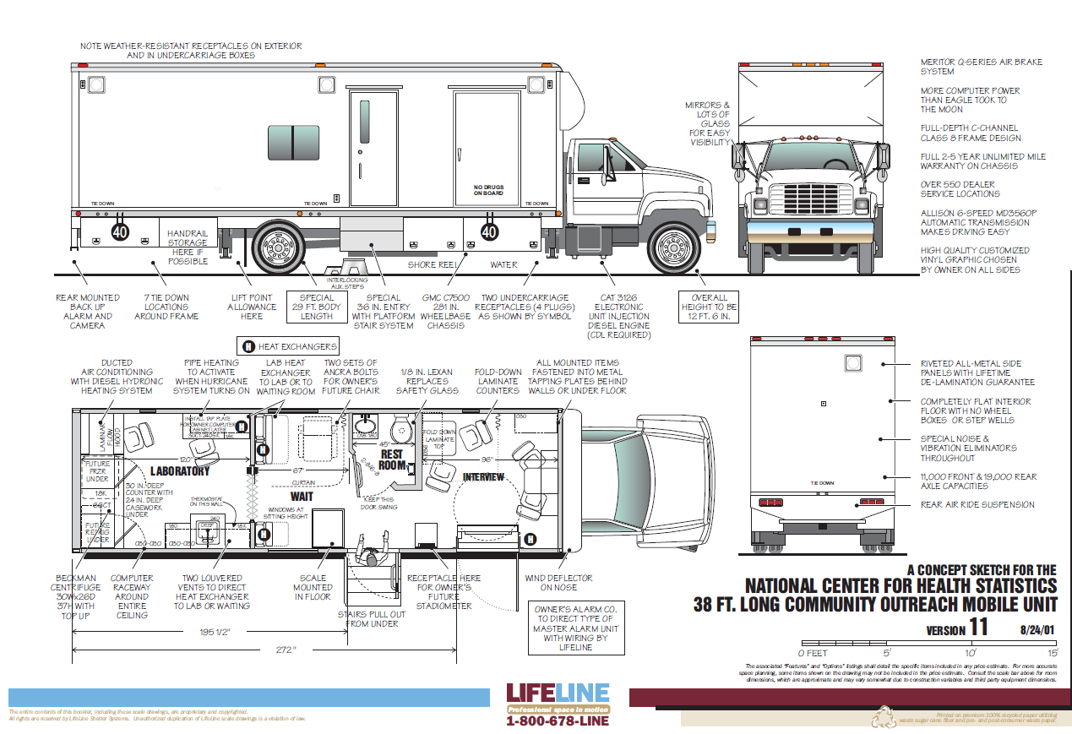
Self-Motorized Trailers

