Slide 1
Division of Research and Methodology’s Research and Development Survey
Jennifer D. Parker
Director, Division of Research and Methodology
Board of Scientific Counselors Meeting
September 17, 2020

Slide 2
Outline
Overview of the Research and Development Survey (RANDS)
Current RANDS research areas
RANDS during COVID-19
Future directions and questions for BSC

Slide 3
What are RANDS data?
Recruited commercial probability sampled survey panels
Not “opt-in” or convenience sample
Coverage, response, and mode differ between RANDS and NCHS’ household surveys
Also subject to greater sampling variability
Typically thought of as “web panels” but other modes are available
Why?
Relatively nimble and inexpensive platform for data collection

Slide 4
Purpose of RANDS
Question-response research
How can embedded experiments and probes complement and extend cognitive interviewing for identifying measurement error?
Estimation research
How do estimates from RANDS differ from those from NCHS core household surveys?
How can data from RANDS be combined with NCHS’ household surveys?
Resource for methodological research for external researchers
Public-use files and RDC files
Web page (and RANDS identifier) launched in April 2020

Slide 5
RANDS Program So Far…
First round fielded in 2015
To date, four rounds of collection completed, two are in the field, and we have one planned.
Completed:
RANDS 1 (NHIS), 2 (NHIS), and 3 (opioids and disability)
RANDS during COVID-19, Round 1
RANDS during COVID-19, Round 2
RANDS 4 (opioids and disability)
Planned:
RANDS 5 (NSFG)
RANDS during COVID-19, Round 3
RANDS 1 and 2 collected by Gallup; all later rounds by NORC

Slide 6
Adapting RANDS for Estimation: RANDS during COVID-19
Traditional NCHS surveys require advanced planning and cannot always adapt quickly to collect data on major events in real-time
RANDS, as a largely web-based survey, could provide some information on COVID-19 in a rapid and timely way
NCHS worked with the Office of Management and Budget to adapt the purpose of RANDS from a strictly methodological survey to one that could produce a limited set of experimental estimates
The new survey was named RANDS during COVID-19 to distinguish it from previous versions of RANDS

Slide 7
RANDS webpage launched in April 2020

Slide 8
RANDS Research
Measurement research goals:
Embedded split sample experiments of alternative questions
Extension of cognitive interview finding to embedded probes
Empirical research for specific questions
Estimations research goals:
Methods for adjusting or calibrating RANDS data with core NCHS surveys, including variance estimation and test statistics
Identification of reference periods for calibration data
Variable selection for successful adjustment
Over 30 presentations on both measurement and estimation topics
One published journal article, 2 ‘in press’ articles, 1 book chapter, 1 Q-bank report, and 3 JSM proceedings, two NCHS reports in clearance/publications

Slide 9
Question evaluation research: Results from cognitive interviewing study of general health status question
Phenomena considered by respondents
Health condition
Physical limitations
Dependence on medication
Health behavior
Healthy: regular exercise, proper nutrition
Unhealthy: smoking, overeating, alcohol consumption
Pain or discomfort
Figure 1. Visual representation of cognitive interviewing study findings for the general health question.

Slide 10
Question evaluation research: Embedded probes added to RANDS
In general, would you say your health is excellent, very good, good, fair or poor?
When you answered the previous question about your health, what did you think of? (Mark all that apply)
My diet and nutrition
My exercise habits
My smoking or drinking habits
My health problems or conditions
The amount of times I seek health care
The amount of pain or fatigue I have
My conversations with my doctor
Figure 2. Embedded Construct Probe for the RANDS General Health Question

Slide 11
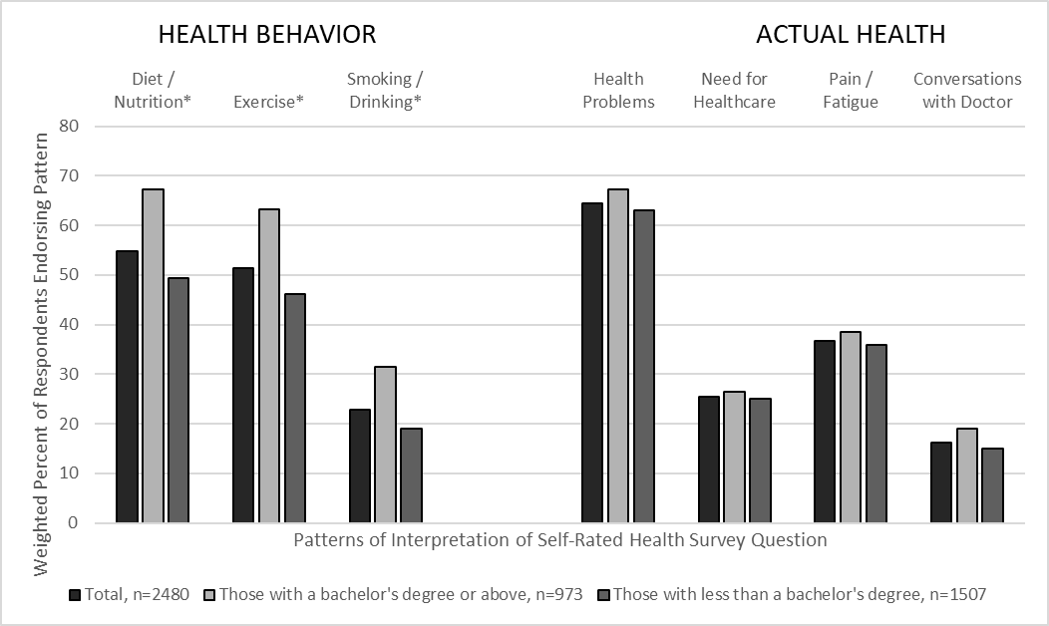
Question evaluation research: RANDS probe results of general health status question
Figure 3. Weighted percent estimates for patterns of interpretation used when answering self-rated health question, based on probe responses, by educational attainment (bachelor’s degree or higher compared to less than a bachelor’s degree): RANDS 2, 2016

Slide 12
Question evaluation research: Study of NHIS and National Survey on Drug Use and Health (NSDUH) past-year opioid use question
NHIS: During the past 12 months, have you taken any opioid pain relievers prescribed by a doctor, dentist or other health professional? Examples include hydrocodone, Vicodin, Norco, Lortab, oxycodone, OxyContin, Percocet and Percodan. Yes/No
NSDUH: Please look at the names of the pain relievers shown below. In the past 12 months, which, if any, of these pain relievers have you used? List of 40 medications…
OR
Please look at the names and pictures of the pain relievers shown below. Please note that some forms of these pain relievers may look different from the pictures, but you should include any form that you have used. In the past 12 months, which, if any, of these pain relievers have you used? List of 40 medications accompanying pictures of the individual pills…

Slide 13
Question evaluation research: Study of NHIS and NSDUH past-year opioid use question. Experimental framework
RANDS Sample
(n= 2646)
Group I
(n= 1286)
NHIS
(n= 1286)
Group II
(n= 1360)
NSDUH
No Pictures
(n= 706)
NSDUH
Pictures
(n= 641)
NSDUH
No Pictures
(n= 645)
NSDUH
Pictures
(n= 654)
NHIS
(n= 1360)
Figure 4. Visual representation of split sample experimental design for opioid use questions.
Estimated prevalence of past-year opioid use: NHIS: 22.5%; NSDUH: 29.4%

Slide 14
Estimation research: Comparison of RANDS 1, RANDS 2, with corresponding quarters from NHIS
Figure 5. Percent Estimates and 95% Confidence Intervals for Selected Health Variables from:
RANDS 1
NHIS 2015, 4th quarter
RANDS 2
NHIS 2016, 2nd quarter

Slide 15
Estimation research: Comparison of NHIS and RANDS estimates with and without propensity score adjustment
Figure 6. Estimates (%) of Selected Health Outcomes for RANDS 2, using:
NHIS 2016 Q2 weights
Gallup weights
Propensity adjusted weights

Slide 16
Additional RANDS research studies
Measurement research:
examination of closed and open-ended probes
effects of probes on question responses
possible, evaluation of natural language processing for open ended probes
Estimation research:
jackknife variance estimator for combined estimates
choice of reference survey
variable selection for adjustment and calibration models
development/assessment of alternative adjustment models

Slide 17
RANDS during COVID-19
Designed as two-round survey, with a longitudinal design
Web and phone mode, with a minimum sample size of 6,000 in the first round and 5,000 in the second round
Questionnaire includes the following constructs (* Indicates Variables for Experimental Estimates):
Health Status, Chronic Conditions, Depression and Anxiety
Loss of Work due to Illness with COVID-19*
Health Insurance and Health Care Access
Telemedicine Access and Use*
COVID-19 Related Health Care and Behaviors
Reduced Access to Health Care*

Slide 18
RANDS during COVID-19, continued
Round 1 collected in June 9-July 6 and Round 2 collected August 3-August 20.
Data from both the probability sampled panel (NORC Amerispeak) and the opt-in platform (NORC Dynata)
Round 1: probability-sampled: 6,800 interviews (completion rate 78.5%, 94% web); 6,220 Dynata
Round 2: probability-sampled 5,981 interviews (completion rate 69.1%, 93% web); 5,502 Dynata
5,452 Amerispeak completed both round 1 and round 2
Still a research survey
Evaluating of performance of COVID-19 questions
Comparison and calibration of opt-in and probability samples; phone and web samples
Methods for understanding differences between rounds

Slide 19
RANDS during COVID-19: Data Release
Experimental Estimates from Round 1 released on August 5, 2020 using the probability-sampled RANDS data
Work loss due to illness, telemedicine access and use, missed health care
Estimates shown by age group, race and Hispanic origin, sex, education, metro/non-metro status, one or more reported chronic conditions and selected chronic conditions (current asthma, diabetes, hypertension)
Estimates calibrated to 2018 NHIS on demographic and chronic health conditions
First time NCHS has released estimates labeled ‘experimental’

Slide 20
RANDS During COVID-19 – Round 1 Results
Notes:
Go to website

Slide 21
Telemedicine Use
Overall, 24.2% of adults in the U.S. scheduled one or more telemedicine appointments in the last two months
Figure 7. Percent of adults who scheduled one or more telemedicine appointments in last two months by age
Notes:
Show if website isn’t working

Slide 22
Reduced Access to Care by Type of Care
Certain types of care were impacted by the pandemic more than others
Figure 8. Percent* of adults unable to receive care for any reason and due to the pandemic, by type of care
*Percents compared to all other adults, including those who received care and those who didn’t seek care
Notes:
Show if website isn’t working

Slide 23
Question evaluation research: Telemedicine Access Question on RANDS during COVID 19
Wording
“In the last two months, has this provider offered you an appointment with a doctor, nurse, or other health professional by video or by phone?”
An open-ended web probe was added to the questionnaire following the survey question:
“How do you know whether your provider offers telemedicine, or not?”
Team of 4 CCQDER researchers coded the responses from both the probability and opt-in survey respondents
Initial results suggest measurement error in about 25% - 30% of respondents (not weighted), largely due to those who confused ‘offered’ with ‘use’ and those who knew about their provider having telemed options but were not specifically asked to set up an appt

Slide 24
Summary
RANDS is being used to evaluate survey questions and conduct measurement research using probes and split samples, extending current cognitive interviewing methods and tools
RANDS is being used to evaluate methods for combining external data with reference surveys for estimation
RANDS is being used to produce experimental estimates for COVID-19

Slide 25
Future directions
How can data from commercial panels best be used to support core data collections?
Are there other statistical, survey methodology, or data science questions that could be considered using the RANDS platform?
If we were to use RANDS for experimental estimates for other situations, are there other estimation, measurement, or communication issues we should consider?

Slide 26
Ending slide
Jennifer Parker
jdparker@cdc.gov
https://www.cdc.gov/nchs/rands/index.htm
https://www.cdc.gov/nchs/covid19/rands.htm

