Slide 1
Board of Scientific Counselors Update from the NCHS Director
Brian C. Moyer, Ph.D., NCHS Director
September 17, 2020

Slide 2
Planning for a More Modern NCHS
Data modernization
Harness new data sources and techniques
Expand the capacity and scope of statistical analysis
Connect data across the statistical system
Building an NCHS Workforce for the Future
Strategic Planning process underway
Bottom up and top down efforts
Seeking input from stakeholders

Slide 3
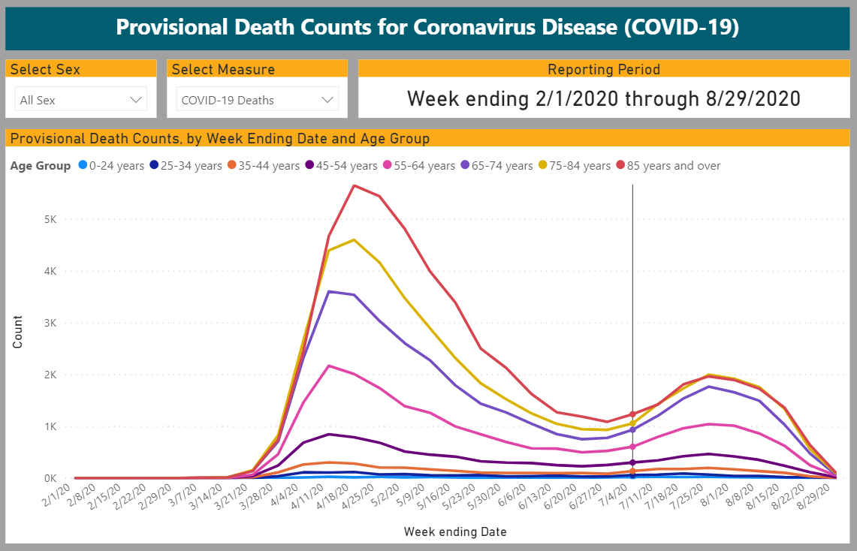
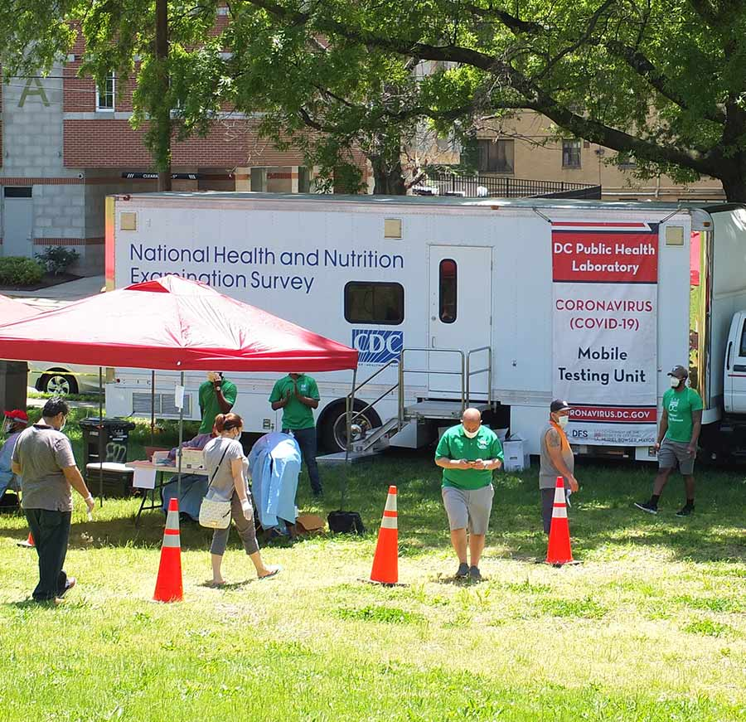
Communicating about NCHS Data

Slide 4
Recently Published Reports in Sept 2020
Non-Alcoholic Beverage Consumption Among Adults
Upcoming Reports in Sept 2020
4 reports on mental health symptoms and treatment from 2019 NHIS
Antidepressant Use Among Adults
Early Release of Estimates from the National Health Interview Survey, 2019
Trends and Patterns in Menarche
State Suicide Rates Among Adolescents and Young Adults
Quarterly Provisional Estimates for Selected Birth Indicators

Slide 5
Recent Webinars
The Latest Data and Reports from NHANES
RANDS during COVID-19
Upcoming Webinars
Sept 23: NHIS 2019 data release, with special focus on mental health
Healthy People 2030 release
Oct (TBD): NHIS 2019 redesign and use of the new data

Slide 6
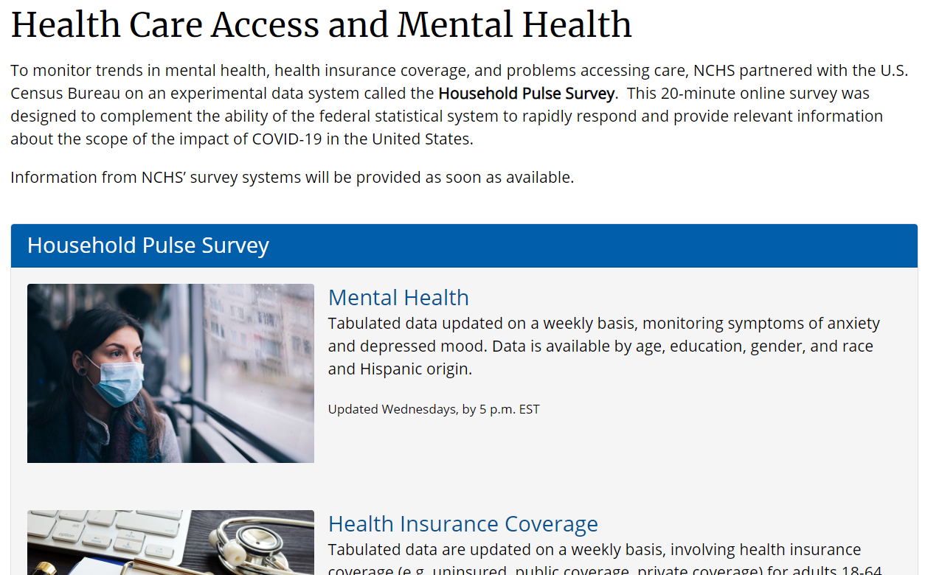
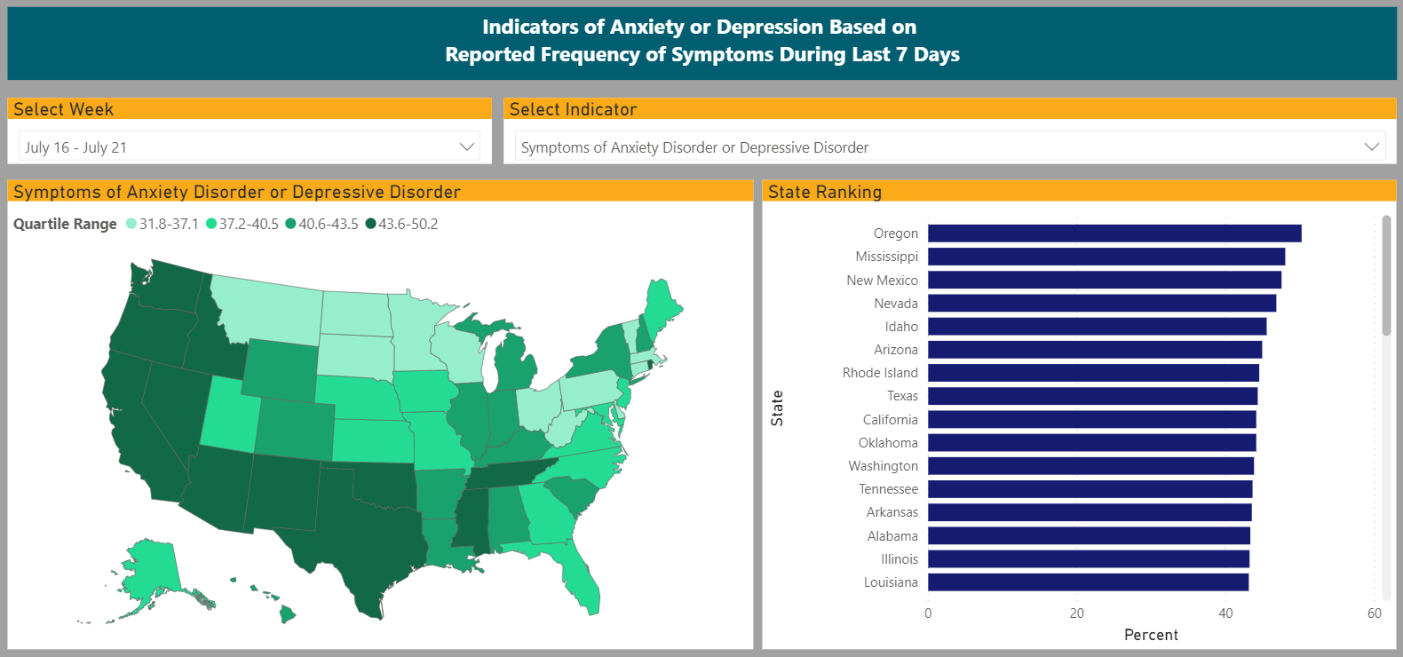
Household Pulse Survey
https://www.cdc.gov/nchs/covid19/health-care-access-and-mental-health.htm

Slide 7
Evidence-Based Policymaking Act
Commitment to a cross-government effort
Recent focus
New committees & workgroups
OMB guidance issued
Case Studies on data sharing,
linking, and privacy
Portals for improved data access

Slide 8
NCHS Budget Update
“Additional Resources” include reimbursables from other agencies.

Slide 9
Public Health Data Modernization Initiative
CDC Data Modernization Funding
FY 2020 Appropriations
CARES Act
FY 2021 House Mark-Up
Funded NCHS Projects
$50M*
In-home health examinations
Mortality data improvement
$500M
Future Areas for Investment & Growth
Data repository
Data science
Modeling and analysis
Race and ethnicity
$450M
*NCHS has received $3.4M of this total to date.

Slide 10
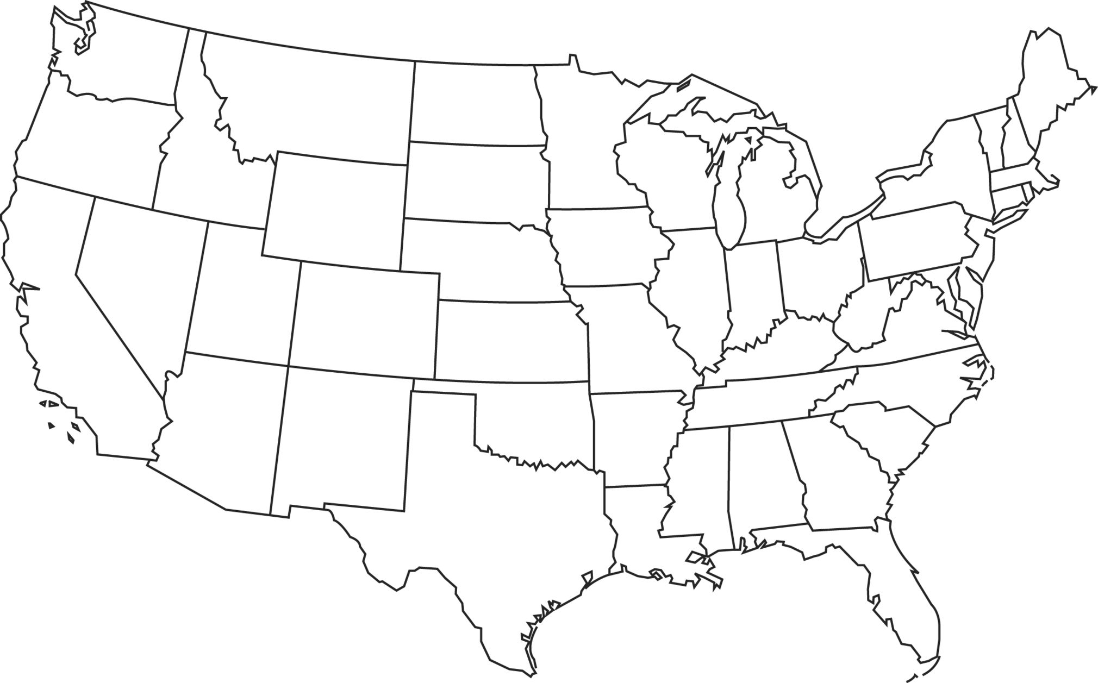
NCHS Staff Deployments
Contact tracing with state and local partners for Wisconsin’s first COVID-19 case
Airport Screening at Chicago O’Hare
Translated questionnaires and surveys into Spanish to reach Hispanic community in Prince George’s County, MD
Vital Statistics staff provided technical assistance to San Francisco region
Airport screening at LAX
Hotspot analysis in counties with increasing cases, analyzed drivers of accelerating trends
Contract tracing, coordination of data requests, and Long-Term Care facility needs assessments in Harlingen, TX
Airport screening at Miami International

Slide 11
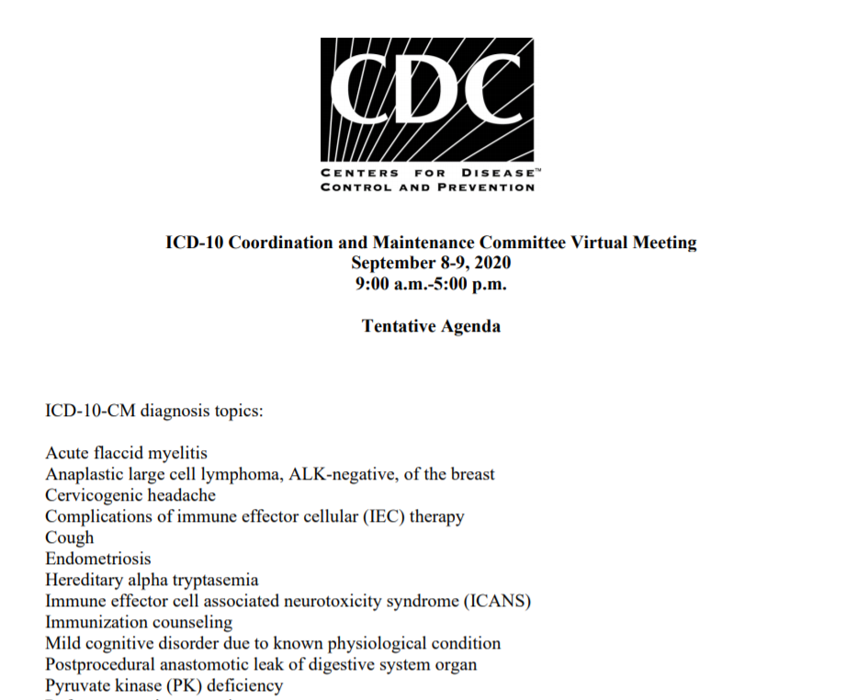
ICD-10-CM Meeting
On September 8 – 9, 2020 NCHS hosted an ICD-10 Coordination and Maintenance Committee Meeting to discuss various diagnosis coding topics, including COVID-19.

Slide 12
Virtual Data Detectives Camp
“I didn’t want it to end.”
“I will remember having fun.”
“It has been really neat to hear my kids discussing outliers, distributions, and such.”
“I have already recommended this camp; it is such a valuable opportunity to get kids interested in practical math skills.”

Slide 13
Thank you for your Advice and Service!
A special thank you to the departing BSC members
Ninez Ponce, M.P.P., Ph.D.
Mark Hayward, Ph.D.
Prashila Dullabh, M.D.
Darrell Gaskin, Ph.D.
Especially those who are serving beyond their term of service for one final meeting!!!!!!

Slide 14
Thank You, Chesley!

