Slide 1
Patient Centered Outcome Research Trust Fund Projects Updates: Division of Health Care Statistics
Geoff Jackson
Team Lead, Hospital Care Team
Division of Health Care Statistics
Presentation to the NCHS Board of Scientific Counselors
May 5, 2020

Slide 2
Division of Health Care Statistics PCORTF Project Status
FY18: Enhancing Identification of Opioid-Involved Health Outcomes Using Linked Hospital Care and Mortality Data
  2014 National Hospital Care Survey (NHCS) and National Death Index (NDI) linked data linked to the Drug Involved in Mortality (DIM) file. Development continues on the enhanced opioid-involved algorithm.
FY19: Identifying Co-Occurring Disorders among Opioid Users Using Linked Hospital Care and Mortality Data: Capstone to an Existing FY18 PCORTF Project
  Development of the co-occurring disorders algorithm happening co-currently with the opioid algorithm. Planning of validation study is underway.

Slide 3
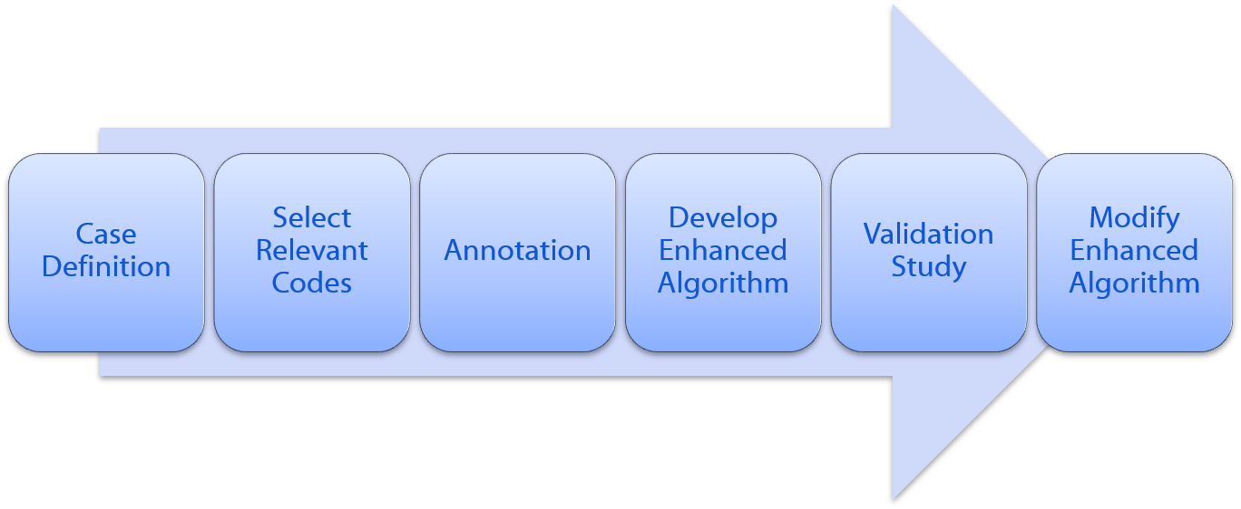
Enhanced Methodology Process for Identification of Opioids and Co-occurring Disorders (FY18 & F19)

Slide 4
Validation Study

Slide 5
Validation Study
Validate the results of the enhanced opioid-involved identification algorithms.
Manual abstraction of medical records for a sample of encounters identified by the sets of algorithms from data submitted by 9 NHCS participating hospitals.
Findings will be used to identify the highest performing iterations of both sets of algorithms.
Field in late 2020.
Developed abstraction form to standardize data collection.

Slide 6
Validation Study: Abstraction form
Will collect the following information at the time of the hospital encounter:
  Evidence of opioid use
  Drug testing
  Opioid administered and/or prescribed to the patient
  Was naloxone administered
  Evidence of a substance use disorder (SUD)
  Diagnosis related to a past or present anxiety or depressive disorder
  Treatment initiated for substance use disorder, anxiety disorder, and/or depressive disorder
Obtains information about the location of the evidence (e.g., labs, medication list or history of present illness)

Slide 7
Special BSC work group
On January 15, 2020 there was a special BSC work group meeting to discuss the validation study abstraction form and obtain feedback on the questionnaire design.

Slide 8
Summary of BSC work group feedback
Add the hospital setting to the encounter identification section.
Include a clarification of “past vs. present use” of opioids.
Add “fentanyl analogs” to the fentanyl category of medications taken.
Add medication list as a potential location for evidence of substance use.
Add a question confirming testing of substances used.
Add steroids, inhalants, and solvent inhalants to SUD list. Remove tricyclic antidepressants (TCAs) from SUD list.
Allow for the collection of interviewer notes.

Slide 9
PCORTF Dissemination Updates

Slide 10
Dissemination
On April 14, a virtual session at the 2020 National Rx Drug Abuse and Heroin Summit discussed the development of the enhanced opioid and co-occurring disorder algorithm and available research files.
Planning is still underway on the upcoming Research Data Center release of the 2016 linked file that contains the results of the enhanced opioid-identification algorithm.
  The file is delayed due to file access restrictions from teleworking, due to COVID-19.

Slide 11
Contact Information
Geoff Jackson
email: mlq2@cdc.gov
phone number: 301-458-4703

