Slide 1
Healthy People 2030 Launch
David Huang, PhD, MPH, CPH
Chief, Health Promotion Statistics Branch
Division of Analysis and Epidemiology
Board of Scientific Counselors Meeting
September 17, 2020

Slide 2
What is Healthy People?
Provides a strategic framework for a national prevention agenda that communicates a vision for improving health and achieving health equity
Identifies science-based, measurable objectives with targets to be achieved by the end of the decade
Requires tracking of data-driven outcomes to monitor progress and to motivate, guide, and focus action
Offers model for international, state, and local program planning
2
Notes:
2

Slide 3
Federally Led, Stakeholder-Driven with NCHS as a Key Partner
Secretary’s Advisory Committee
HHS
NCHS
ODPHP
Federal Interagency Workgroup
Topic Area Workgroups
State and Local Governments
(50 State Coordinators)
National-Level Stakeholders, Including Members of Healthy People Consortium
Community-Based Organizations, Community Health Clinics, Social Service Organizations, etc.
Individuals, Families, and Neighborhoods Across America
3

Slide 4
How is Healthy People used?
For research/assessment:
As a data source | 91%
To inform program planning to address health disparities | 82%
For comparison with organization data (e.g. benchmarking) | 80%
To develop community health improvement plans | 79%
To conduct community health assessments | 70%
For meeting national public health accreditation standards | 51%
For collaboration/outreach or education:
As a resource for building community partnerships for promoting health | 73%
As a learning tool for staff or students | 67%
For setting internal priorities:
As a framework for planning, goal-setting or decision making | 79%
To guide priorities for the organization/entity | 73%
As a guide for allocating resources in the organization/entity | 40%
Other uses:
To support applications for grants or other funding | 79%
To inform policy development | 70%
To create or inform quality improvement activities | 66%
Other, please specify | 29%
From Healthy People 2015 User Study by NORC, based on a sample of 573 Healthy People State Coordinators, Senior State/Territory Deputy Directors, Local Health Departments, Tribal entities, Tribal Area Health Boards, Consortium organizations, and Healthy People Webinar attendees
4

Slide 5
NCHS’ role in Healthy People
Methods and measures
Statistical approaches and target-setting methods
Data2030 (houses all HP2030 data)
Analysis and presentation of data
Expertise and technical assistance
5

Slide 6
Evolution of HP2030 Slate of Objectives
Number of Objectives
Healthy People 2020
FIW Review
Topic Area Workgroup Review
HP2030 Launch
1,111 (measurable)
~500
~400
355 (core)
6

Slide 7
What’s new in HP2030? A review of measures and data sources
Core objectives are measurable objectives of high national importance (i.e., direct impact on health, broad and comprehensive applicability, substantial burden, and/or national public health priority) that:
address health equity and/or health disparities
have baseline data, using data no older than 2015
have an assurance of at least two additional data points throughout the decade
have an approved data source (e.g., federal, publicly available, nationally representative).
7

Slide 8
What’s new in HP2030? Statistical rigor, more timely information
A more statistically rigorous set of core objectives
Nationally representative, publicly available, federal oversight
Consideration of methodological issues:
Population coverage, sample design
Response rates/non-response bias analyses
Wide usage in major indicator projects
Documentation completeness, no major methodological issues
More timely information on the HP2030 website
Data source criteria include frequency of data collection, timeliness of data
More frequent website data updates due to improvements in IT systems
8

Slide 9
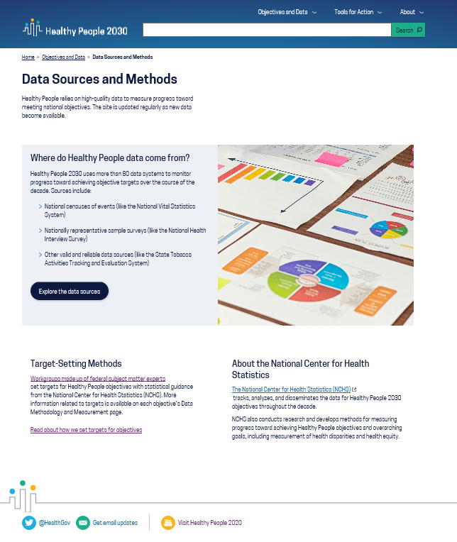
A new Data Sources and Methods Page
Data come from 81 data systems, including 49 from across HHS (e.g., NCHS, CDC, and NIH) and others from outside HHS (e.g., USDA, DOJ, EPA, ED, DOT, DOL, and Census)
Link to NCHS website for more information on NCHS, target-setting, and data sources
9

Slide 10
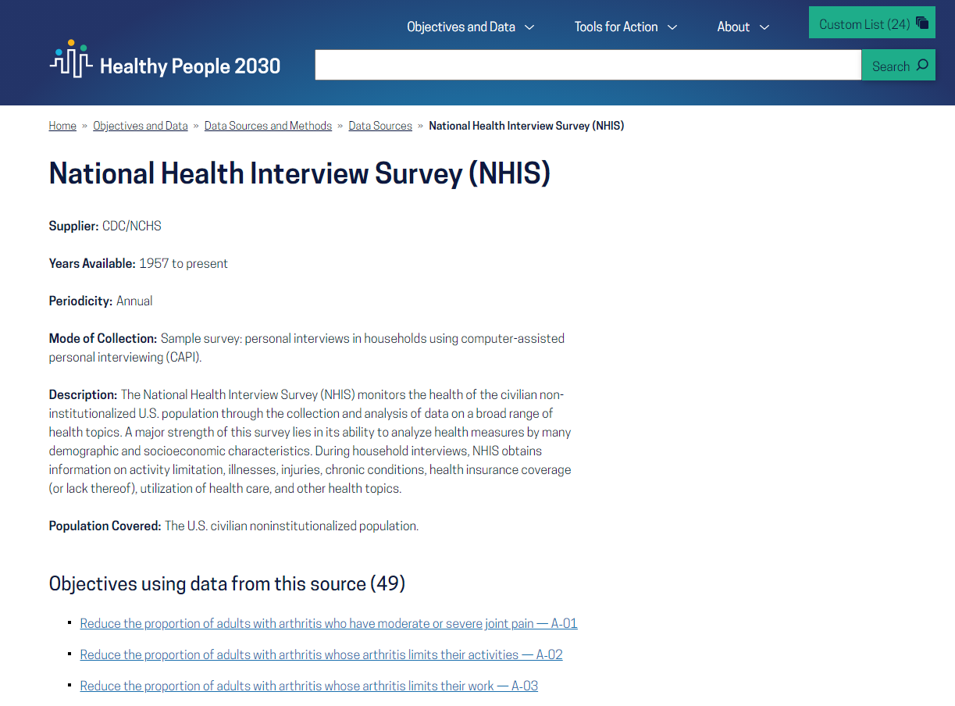
Data Sources Landing Page
Information about the data source
Links to objectives using data from this data source
10

Slide 11
Target setting in HP2030
Healthy People is unique among federal indicator initiatives in setting targets for objectives.
Stakeholders value targets for establishing and evaluating programs.
NCHS does not set targets but provides statistical guidance in target setting.
11

Slide 12
Making targets more transparent and systematic
HP2030 aims for greater transparency, and a more systematic approach, in target setting.
HP2030 Target-Setting Methods include:
New Target Setting Tools were created to help workgroups select among candidate targets generated using the four methods in the second column.
An NCHS Statistical Note documenting methods and tools, Target-Setting Methods in Healthy People 2030, will be released on September 21.
Maintain consistency with national programs, regulations, policies, or laws
Maintain baseline
Percent improvement
Percentage point improvement
Minimal statistical significance
Trend projection
12

Slide 13
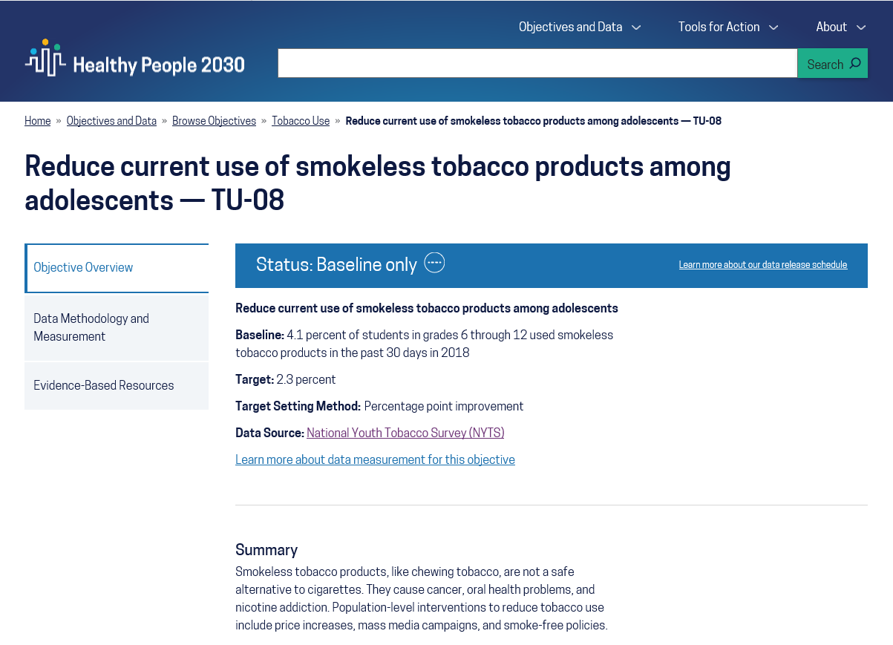
Highlights for core objectives
Baseline statement with year
Objective status to be updated throughout the decade
Target and target-setting method
Technical information about each data source
More about how the data are measured
13

Slide 14
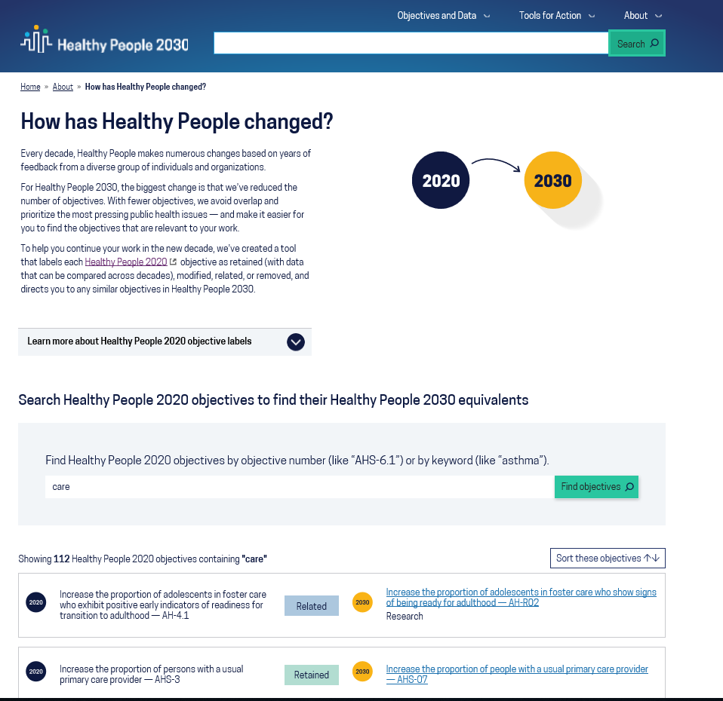
Crosswalk
Search by keyword or HP2020 objective number
Objective status (retained, modified, related, or removed)
HP2020 objective
HP2030 objective
14

Slide 15
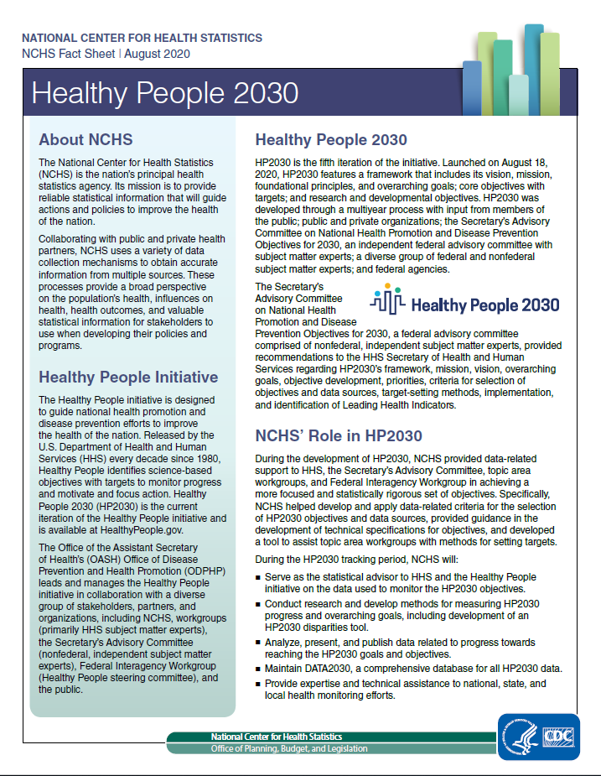
About the Launch
1,720 individuals watched the live HP2030 launch
More than 2,100 views of the HP2030 launch recording
Available at https://youtu.be/atDcD86ChC8
New HP2030 website
Available at https://health.gov/healthypeople
HP2030 Fact Sheet
Available at https://www.cdc.gov/nchs/about/factsheets/factsheet-hp2030.htm
15

Slide 16
HP2030 Data Template
Total
Sex
Male
Female
Race/Ethnicity
American Indian/Alaska Native only
Asian only
Native Hawaiian/Pacific Islander only
Black or African American only
White only
2 or more races
Hispanic or Latino
Not Hispanic or Latino
Black, not Hispanic or Latino
White, not Hispanic or Latino
Age (Standard groups by data system)
Educational Attainment
< High school
High school
Some college or Associates degree
4-year college degree or more
Family Income (percent poverty threshold)
<100
100-199
200-399
>=400
Health Insurance Status
Insured
Private
Public
Uninsured
Geographic Location or Region
Metropolitan
Nonmetropolitan
Marital Status
Married/Cohabiting partner
Divorced or Separated/Widowed
Never married
Country of Birth
US
Outside US
Veteran Status
Veteran
Non-Veteran
Disability Status
People with disabilities
People without disabilities
Sexual Orientation
Straight
Straight, Male
Straight, Female
Gay/Lesbian
Gay, Male
Gay/Lesbian, Female
Bisexual
Bisexual, Male
Bisexual, Female
Gender Identity (Standard groups by data system)
Notes:
If data are not collected, analyzed, or available for a particular demographic group by a data source, the demographic label will still be shown, and a symbol or acronym will be displayed to indicate the reason data are not shown.
With justification by the workgroup and approval by NCHS, additional population categories and subcategories may be included on a case-by-case basis.
16

Slide 17
Still to come…
 | HP2020 | HP2030
2020 | October: Release of HP2020 Executive Summary | September 21: Release of Target-Setting Methods in Healthy People 2030 (NCHS Statistical Note) Late October: Release at APHA Annual Meeting Leading Health Indicators (LHIs) Overall Health and Well-Being Measures (OHMs)
2021 | Release of HP2020 Final Review (NCHS Publication) Release of Progress Toward Elimination of Racial and Ethnic Health Disparities for Population-based Healthy People 2020 Objectives (NCHS Statistical Note) | Launch of DATA2030 (HP2030 Database) Subpopulation data Trend data Charting features
2021 and beyond | Archive of DATA2020 (HP2020 Database) on CDC WONDER | Disparities Tool State data and maps LHI and OHM features and data updates/releases HP2030 Progress Reviews HP2030 Midcourse Review HP2030 Final Review
17

Slide 18
Thank You!
Websites | HPSB Staff | HPSB Contractors
Healthy People Site: https://health.gov/healthypeople NCHS Healthy People Site: http://www.cdc.gov/nchs/healthy_people.htm NCHS Healthy People Publications: http://www.cdc.gov/nchs/products/hp_pubs.htm | Johanna Alfier Bryan Bassig Lesley Dobrzynski Robert Francis Leda Gurley LaJeana Hawkins Kate Hubbard Kimberly Hurvitz Elizabeth Jackson Sibeso Joyner Deepthi Kandi Mark Montgomery Cheryl Rose Asel Ryskulova Rashmi Tandon Ritu Tuteja | Richard Klein Makram Talih
18

