Slide 1
NCHS Website Modernization Project Assessment Findings and Implementation Priorities
Dagny Olivares, MPA
NCHS Associate Director for Communication
NCHS Board of Scientific Counselors Meeting
October 24, 2022

Slide 2
Agenda
Project background
Assessment and analysis findings
Recommendations and year-2 priorities
Discussion

Slide 3
Project Background

Slide 4
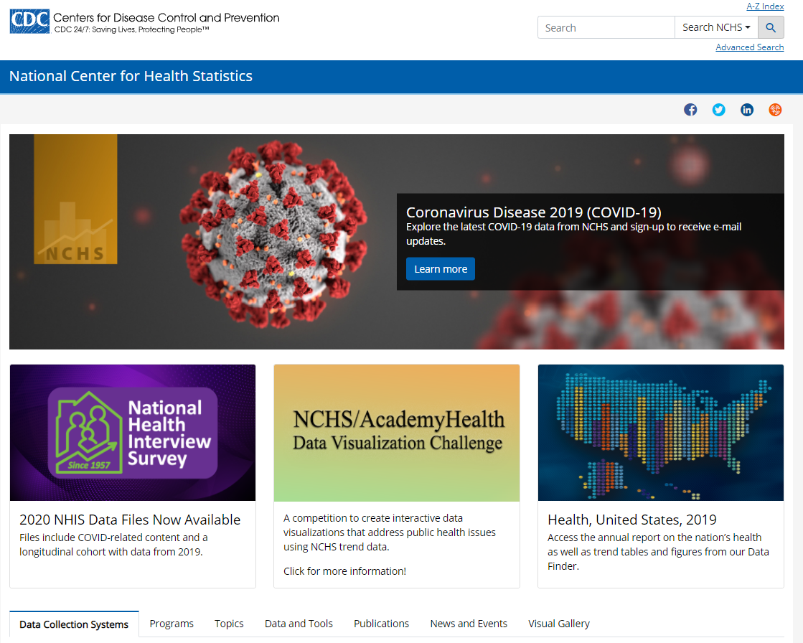
Current NCHS Website
Purpose
Primary digital access point to the nation’s health statistics
Current state
Disconnected information
Obsolete formats
Data and resources are difficult to discover, access, and navigate

Slide 5
Website Modernization Project
Led by the NCHS Office of Information Services
Supported with DMI funds
Planned as a 2-year project
Partnered with the Geospatial Research, Analysis, and Services Program (GRASP) in ATSDR
Managed through contracts

Slide 6
Modernization Objectives
Focus on digital and data-driven formats
Improve navigation and organization
Tailor site experience for all user types and proficiencies
Deliver relevant statistics from multiple sources on a wide range of topics
Ensure clear communication using plain language and appealing content
Increase visibility of tools and resources for data collection and research
Identify scalable platforms for data storage and transfer
Notes:
This project aims to improve:
Utility of NCHS statistics and products provided in digital- and data-driven formats
Navigability of digital assets without relying on user knowledge of specific data collection systems or analytic techniques
Discoverability of statistical data on relevant topics with seamless connections that cross NCHS programs, surveys, and mandates
Readability and understandability of NCHS web content
Timeliness of data updates
Visibility of NCHS assets that support data collection and analysis (e.g., the Collaborating Center for Questionnaire Design and Evaluation Research (CCQDER) and the Classification of Diseases, Functioning, and Disability program)
Appeal of NCHS content via engaging website layout and design elements
Accessibility of NCHS data, survey tools, and other resources through native features rather than through Section 508 remediation
Interoperability of health statistics through machine-readable data files
Sustainability of large data set storage and transfer, including data sets available on the NCHS File Transfer Protocol (FTP) site and data.cdc.gov
Value of NCHS social media channels and other digital assets

Slide 7
Major Project Activities
Analyze current state and conduct environmental assessment
Provide digital strategy, recommendations, and implementation plan
Develop internal processes, systems, and trainings to support website
Create content, graphics, and other digital assets for the website
Build and launch website and supporting digital assets
Share and promote website
Conduct user testing and update website based on findings

Slide 8
Years 1 and 2
Analyze & Assess NCHS & Peer Websites
Fall 2021–Spring 2022
Implement & Iterate New Structure & Pages
Winter 2022–Summer 2023
Develop & Prioritize Recommendations
Spring 2022–Summer 2022
Prototype & Finalize Structure, Content, & Design
Fall 2022–Spring 2023
Notes:
Year 1: Assessment and Planning
Year 2: Development and Implementation

Slide 9
Assessment and Analysis Findings

Slide 10
Initial Analysis and Assessment
Analysis of website heuristics, content, user experience, look and feel, structure, data presentation, functionality, and search engine optimization
Review of website survey results, metrics, and other existing inputs
Conversations with senior staff
Focus groups with program contacts
Interviews with contacts for key NCHS activities and CDC programs
Assessments of external benchmarking sites with 3 in-depth follow-ups

Slide 11
Key Findings: Content Review
Legend 0 = no
1 = somewhat/sometimes/infrequent
2 = yes/mostly always
Functional Area | Score | Summary
Originality and comprehensiveness | 1 | Original content sufficiently conveys information but is often outside the accepted range of word count.
Relevancy | 1 | Nearly 30% of web content is outdated or will become outdated in the next 6 months.
Readability | 0 | Nearly 80% of content is written at a high school or higher level.
Grammar and Mechanics | 2 | Overall, there are no mechanical errors or grammar mistakes.
Word/Image Comparison | 0 | Approximately 75% of the web pages have zero imagery or graphics.
Headlines | 2 | Most of the headlines accurately describe the page content.
URL | 1 | About 75% of URLs are long and not easy to remember. More than 50% of URLs match the web content.
Meta Descriptions | 1 | Meta descriptions are accurate but do not consistently use key words or language to improve Google SEO rankings or optimization.

Slide 12
Key Findings: User Experience and User Interface
Wide variations in user experiences, look and feel, inconsistent metadata, structures, SEO practices, and writing styles
No clear standardization or consistency (siloed content production)
Relevance and meaning of data unclear
Content lacks (or doesn’t highlight) expert analysis to put data in context
Organization inhibits discovery of new knowledge, insights from other sources
Presentation and quantity obscures accuracy and currency of different data
Lack of human-centered design based on user needs and behavior
Users unable to find information, move within the site, form a mental model
Inconsistent use of digital best practices and proven strategies
Current site reflects resource constraints on implementation and sustainability

Slide 13
Key Findings: Internal Interviews and Focus Groups
Need for content driven by a diverse set of user requirements
Most current web content is written for a highly technical audience
Opportunities to increase data visualization
Resource limitations necessitate strategic solutions (“more bang for our buck”)
Points of tension and challenges
Scoping website topics when our data covers basically every health topic
Gaining cross-program consensus for topics and content
Maintaining timely information without a single programmatic home
Ensuring users find current information
Archiving or removing outdated content

Slide 14
Key Findings: Internal Environmental Assessment
Websites: NCHS, COVID, NCHHSTP
Consistent branding (colors, icons, images) and user-driven organization
Data provision/display is challenging outside of applications, but improving
Metrics can inform continuous progress
Applications: WONDER, WISQARS
Require more resources (funding, people, time) than this project has
Would require several years to develop
Would require increase of resources beyond the current contract’s funding level
Current infrastructure and shared services can meet many NCHS needs
These criteria are unweighted. | 1. Website Structure | 2. Look/Feel | 3. Data Presentation | 4. Content | 5. Functionality | Overall Average
National Center for Health Statistics | 2 | 2 | 3 | 0 | 4 | 2.75
National Center for HIV, Viral Hepatitis, STD, and TB Prevention | 2 | 2 | 3 | 0 | 4 | 2.75
CDC COVID-19 | 5 | 5 | 5 | 0 | 4 | 4.75
Likert Scale from 1 (bad)–5 (good)

Slide 15
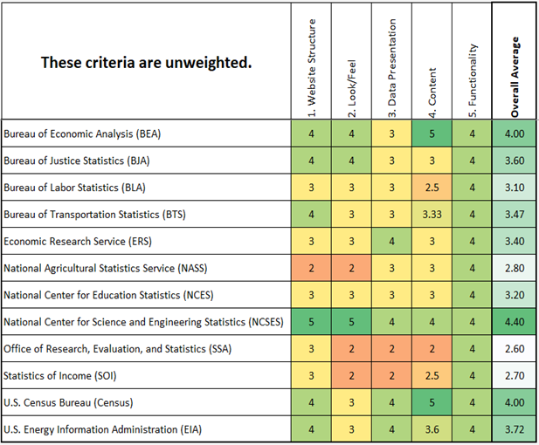
Key Findings: External Environmental Assessment
Website scan: 12 statistical agencies
High scores for
Strong, intuitive main navigation
Strategic design on home page
Topic landing pages, overview, articles,
Different paths for different audiences
Interviews: Census, BEA, NCSES
Changing audiences had new needs
Longer timelines for transformation
New staff positions for key roles
Condensed, topic-driven navigation
User experience monitored regularly to drive improvements and strategy
Likert Scale from 1 (bad)–5 (good)

Slide 16
Assessment Conclusions: Strengths and Gaps
Strengths
Highly functional; limited errors in terms of functionality
Data sets are available for public access or through the RDC for sensitive data
Existing shared web, data, and visualization services (OADC, data.cdc.gov, EDAV) mean fewer costly, maintenance-intense custom solutions needed
CDC content management system performs well and adding new capabilities
Gaps
Content doesn’t align with the needs of expanding audiences and new users
Unclear information doesn’t leverage digital writing and design best practices
User Experience is not intuitive, consistent, or easy to search
Inconsistent quality control without standardized procedures and training

Slide 17
Assessment Conclusions: Opportunities
Changes that can yield the most benefit
Improve content readability
Develop more intuitive site organization
Increase data storytelling
Leverage prebuilt data visualizations
Address new and evolving personas
Provide more tailored user journeys
Implement SEO best practices
Use meta data, URL length, page domain names, etc. more appropriately
Present information through a health equity lens
Develop workflow dashboards

Slide 18
Recommendations and Year-2 Priorities

Slide 19
Implementation Priorities for Aug. 2023 (slide 1 of 4)
Overhaul Website Information Architecture, Navigation, and Taxonomy
Create more data-driven, topic-based, audience-focused IA and navigation
Develop clear, consistent, validated, and optimized site-wide structure
Implement consistent site and assign topics and tags to scientific content
Assign topics and tags to scientific content (reports, dashboards, etc.)
Project scope does not include IA within applications
Develop Comprehensive Content Strategy
Define content development ownership and roles
Design and document content workflows
Produce and document guidelines, standards, policies, procedures
Support trainings and TA for key NCHS stakeholders on content governance
Notes:
How do we get to this unified NCHS vision? These are the building blocks that implement those solutions
Information Architecture Basics: https://www.usability.gov/what-and-why/information-architecture.html
Content Strategy Basics: https://www.usability.gov/what-and-why/content-strategy.html
Content encompasses four core elements:
Information – What are the actual contents of your message? It can be factual, practical, entertaining, informative, or some combination of the three.
Context – What is the content supposed to help you and the reader accomplish? Who is the target audience for this content? Why is it being published?
Medium – What channel are you publishing the content on, and how does that influence the overall message?
Form – Is the content text, graphic, audio, video, interactive, virtual/augmented reality, etc.?

Slide 20
Implementation Priorities for Aug. 2023 (2 of 4)
Improve User Experience
Redesign homepage and landing pages to focus on NCHS impact; our expertise, data, and products; and the high value they provide
Prioritize clarity over complexity, reduce distraction, and provide clear and simple meaning
Establish NCHS Digital Communication Strategist Role
Oversees content strategy development, implementation, and maintenance
Collaborates with programs to develop web strategy and content
Ensures consistency and fidelity to content strategy and adherence to web communication best practices
Provides digital guidance and consultation to NCHS programs
Notes:
User Experience Basics: https://www.usability.gov/what-and-why/user-experience.html
User Interface Design Basics: https://www.usability.gov/what-and-why/user-interface-design.html
User-Centered Design Basics: https://www.usability.gov/what-and-why/user-centered-design.html

Slide 21
Implementation Priorities for Aug. 2023 (3 of 4)
Develop an NCHS Digital Style Guide
Create a center-wide branding guide with sub-variations for key programs
Include best practices and guidance for visual graphics and media
Increase Use of Visuals and Graphics
Leverage to increase user understanding, engagement time, and satisfaction
Use images, diagrams, or multimedia to visually represent ideas in the content
Follow Clear Communication Principles
Translate technical content to increase user understanding and meet federal plain language requirements
Implement guidance and protocols to ensure use of best practices in digital content development
Notes:
CDC Digital Style Guide: https://intranet.cdc.gov/cdcweb/web/wcms.html
NCHS digital style guide would work within those larger parameters to establish NCHS-specific guidance, requirements, and templates that reinforce our brand, ensure consistent user experience, and optimize web design to meet our digital goals.
Visual Design Basics: https://www.usability.gov/what-and-why/visual-design.html
Clear Communication (https://www.cdc.gov/healthliteracy/basics.html)
Clear communication means presenting familiar concepts, words, numbers, and images in ways that make sense to the people who need the information.
Clear communication builds trust with your audience. When your audience trusts you, they’re more likely to follow your recommendations.
Clear communication advances health equity. Choosing to use jargon is an act of exclusion.
Plain language
Federal plain language laws and requirements: https://www.plainlanguage.gov/law/
Federal plain language guidelines: https://www.plainlanguage.gov/guidelines/
The Senate recently introduced a bill called the Clear and Concise Content Act. If passed, it would update the Plain Writing Act of 2010.

Slide 22
Implementation Priorities for Aug. 2023 (4 of 4)
Establish Website Management Processes
Develop and implement collaboration framework and governance processes
Implement tools to operationalize content governance
Implement Digital First Principles
Leverage off-the-shelf functionality of CDC’s web content management system
Increase the use of digital first formats for NCHS data, reports, and resources
Identify technology solution to facilitate transition of scientific reports publications from PDF to HTML (or HTML-like) format
Establish processes and protocols to support the creation and release of digital first products
Notes:
Digital First: https://intranet.cdc.gov/cdcweb/web/digital-first.html
Initial Digital First definition for NCHS Strategic Plan KPI: Product must provide content or key findings in HTML format and be optimized to support discovery, viewing across a variety of devices (with attention given to mobile), and sharing

Slide 23
Additional Recommendations Aspects of these recommendations may be completed if time allows
Document communication standards and framework for data visualizations
Increase use of data.cdc.gov to host and catalogue data sets
Leverage shared services for efficiency and cost effectiveness
Institute digital KPIs and ongoing metrics analysis rhythm
Modernize and optimize FastStats
Develop an SEO (search engine optimization) plan
Create NCHS website help section
Produce a series of short videos to assist with finding and using data
Integrate the NCHS blog into the main website
Use social media strategically and systematically
Notes:
Web Analytics Basics: https://www.usability.gov/what-and-why/web-analytics.html#:~:text=Web%20analytics%20is%20the%20collection,and%20improve%20the%20user%27s%20experience.
Search Engine Optimization (SEO): Techniques used to improve website positioning (ranking) on the web's search engines. The specific goal is to have the site listed among the first results for searches on particular keywords.

Slide 24
Discussion

Slide 25
Discussion Topics
How do you use the NCHS website (www.cdc.gov/nchs)?
Why do you visit the site?
How frequently do you visit the site?
Do you search for what you need, use bookmarks, navigate from main pages?
How would you define success for this NCHS website?
What should people be able to do when they visit the site?
What 1–2 tasks should a new user be able to accomplish?
Would you be willing to participate in or give feedback on specific modernization activities in 2023?
Examples: usability tests, use cases, user personas
Please email Rebecca if you are willing to participate or give feedback
Notes:
Do you go directly to the information you need (via search or bookmark), or do you navigate from the main home page or a section home page?

Slide 26
Closing slide with CDC contact information

