Slide 1
Modernizing the Mortality Data System --- Capturing Timely Opioid-related Death Data
National Center for Health Statistics
Kate Brett, PhD
Division of Vital Statistics
NCHS Board of Scientific Counselors
Hyattsville, MD
September 5-6, 2019

Slide 2
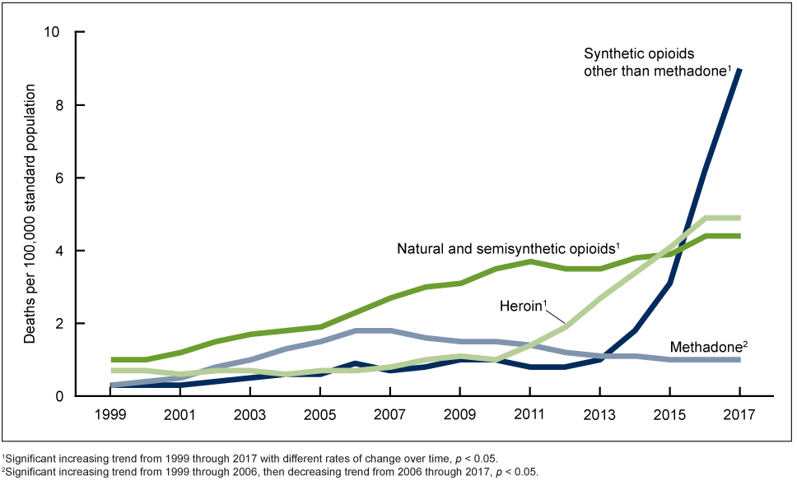
Rise in Opioid Overdose Deaths
Opioid overdoses have risen significantly over the past decade, accounting for more than 42,000 deaths by 2016 (five times higher than 1999)
In 2017, the White House declared the opioid epidemic as a national public health emergency
HHS responded with a 5-point strategy to combat the crisis
  Better prevention, treatment and recovery services
  Better data
  Better pain management
  Better availability of overdose-reversing drugs
  Better research
Age-adjusted drug overdose death rates by opioid category: US, 1999-2017
Hedegaard H, Miniño AM, Warner M. Drug overdose deaths in the United States, 1999–2017. NCHS Data Brief, no 329. Hyattsville, MD: National Center for Health Statistics. 2018.

Slide 3
DVS funding received to address opioid mortality data quality and timeliness
Patient-Centered Outcomes Initiative (PCORI)….……………..………$2,613,000
Strengthen opioid mortality data infrastructure for outcomes research
CDC Opioid Response Coordinating Unit (ORCU) FY18 #1……..…$1,930,000
Improve data processing and presentation within NCHS
CDC ORCU FY18 #2……….……………….………………………..……..…..….$5,900,000
Improve data processing and sharing in the jurisdictions
ORCU FY19………………………………………………………………………...…$11,500,000
Overall improvement of opioid overdose data in four areas:
State infrastructure, data interoperability, NCHS IT, medical
examiner/coroner processes

Slide 4
DVS projects undertaken to strengthen opioid overdose data
And thereby strengthen mortality data overall

Slide 5
Establish nationally approved HL7 FHIR standards for vital records death reporting
Draft implementation guide developed: Vital Records Mortality Reporting FHIR IG
HL7 Ballot Process: March-May 2019
Connectathon trials of the balloted data standards beginning with HL7 FHIR Connectathon Sept 14-15, 2019
Expand HL7 FHIR standard for mortality reporting to include
  Data sent back to jurisdictions
  Data obtained from medical examiners and coroners
Continue to pilot test data standards

Slide 6
Create applications to test FHIR data standards
Reference implementation of an EDRS: Nightingale Project
Testing framework for the development of systems that perform FHIR-based exchange of data: Canary
Award to develop reference implementation of Medical Examiner/Coroner case management system as well as the testing framework is being awarded this month

Slide 7
Modernize the technology capabilities of the National Vital Statistics System
Incorporate natural language and machine learning techniques to increase the proportion of records that can be coded automatically for cause of death
Create supplemental drug data, beyond ICD-10 coding, by mining the literal text fields of mortality records
Transition the NVSS processing system from batch to one that can receive, code, and return cause of death codes as individual record transactions from states

Slide 8
National guidelines on death investigations, evaluations and certifications
Update the guidelines produced by the National Association of Medical Examiners (NAME) in 2013
Develop training materials and methodology for educating medical examiners and coroners about the new guidelines
Develop recommendations for forensic toxicology practices for drug overdose investigation
Expand ability to work with the medical examiner/coroner community

Slide 9
Redesign Vital Statistics Rapid Release Program
Add additional demographic information to data releases
Add detailed drug type information
Publish papers documenting decision process

Slide 10
Align changes with needs of researchers and end-users
Communications with researchers and users
Presentations at national meetings to describe the project and solicit input
PCOR work group of the NCHS Board of Scientific Counselors
  Identify issues that will affect the usability and usefulness of drug overdose mortality data for the research community

Slide 11
State projects: Enhancing electronic death registration system (EDRS) use and utility
PCOR III: 2 states funded to pilot data interoperability
ORCU FY18:
  4 additional states to pilot data interoperability
  10 states to work on projects on data timeliness
ORCU FY19:
  Establish EDRS in all 50 states, DC, NYC, several territories
  5 additional states to pilot data interoperability
  8 states to work on expanding the use of EDRS

Slide 12
State Goals for Timely and Accurate Data
Goal #1: Transmit 80% of the mortality records to NCHS within 10 days of the date of the event
Goal #2: Transmit 90% of the drug overdose deaths to NCHS within 90 days of the date of the event

Slide 13
Reporting timeliness of mortality data

Slide 14
Percent of Drug Overdose Death Reported within 90 Days: Implementers’ Community, 2018
Estimates are for 6 states in Implementers’ Community. Data presented are first date that a death record was submitted and was codable as a drug overdose death. The measure being used is a rolling 12 month average with a 6 month lag. Report generated 7/3/2019.

Slide 15
State Projects to Increase Timeliness and Quality of Mortality Data
Establish EDRS in all jurisdictions
  Currently in 46 states, DC and NYC
  New projects will support 6 new jurisdictions
Promote FHIR-enabled interoperability of data
  Currently supporting 6 jurisdictions to pilot FHIR interoperability
  New projects in 5 additional jurisdictions
Encourage increased efforts to improve timeliness
  10 jurisdictions working on variety of topics
Expand use of EDRS within jurisdictions
  8 states with < 80% usage have newly funded projects

Slide 16
  Kate Brett
  Phone: 301-458-4113
  KBrett@cdc.gov

