Slide 1







High Impact Prevention: Science, Practice, and the Future of HIV
Jonathan Mermin, MD, MPH
National Center for HIV/AIDS, Viral Hepatitis, STD, and TB Prevention
Centers for Disease Control and Prevention
National HIV Prevention Conference
December 7, 2015
National Center for HIV/AIDS, Viral Hepatitis, STD, and TB Prevention
Office of Director
Notes:
An accessible version of this presentation is available at https://www.cdc.gov/nchhstp/highimpactprevention/NHPC-2015-presentation.html.

Slide 2

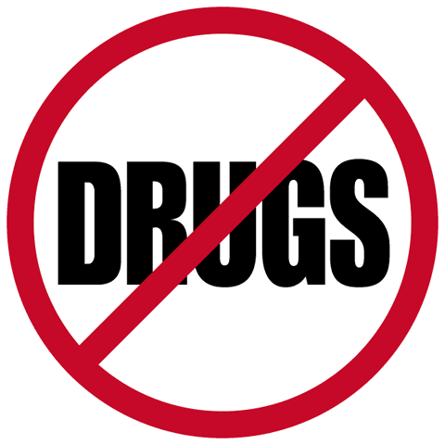

Why are we here when these are 100% effective?

Slide 3
Overview
Science and practice of High Impact Prevention
State of HIV epidemic including health equity
High Impact Prevention 2.0
Importance of monitoring and feedback

Slide 4
High Impact Prevention

Slide 5
Prevention with Positives
Prevention with Negatives
HIV testing, linkage to care and prevention services
Antiretroviral therapy
Retention in care and adherence
Partner services
Risk reduction interventions and condoms
STD screening and treatment
Perinatal transmission
Behavioral risk reduction interventions and condoms
Pre-exposure prophylaxis (PrEP)
Syringe services
Male circumcision
STD screening and treatment
Post-exposure prophylaxis
Not focused on HIV status
Sexual health education and social mobilization
Condom availability
Substance use, mental health, and social support

Slide 6
Combination prevention
Multiple disciplines and approaches
Biomedical interventions
Structural interventions
HIV testing and linkage to care
HIV prevention
Community interventions
Individual and small group Interventions

Slide 7
Combination prevention
Multiple disciplines and approaches
Biomedical interventions
Combining interventions
is not enough
Structural interventions
HIV testing and linkage to care
HIV prevention
All interventions
are not effective
All effective interventions
are not equal
Community interventions
Individual and small group Interventions

Slide 8
Strategy
Potential interventions
Implement and evaluate programs
HIGH-IMPACT PREVENTION
Assess efficacy and effectiveness
Prioritize interventions
Establish cost and cost effectiveness per
infections averted
and life-years saved
Determine feasibility of full scale implementation
Develop epidemic models to project impact of interventions

Slide 9
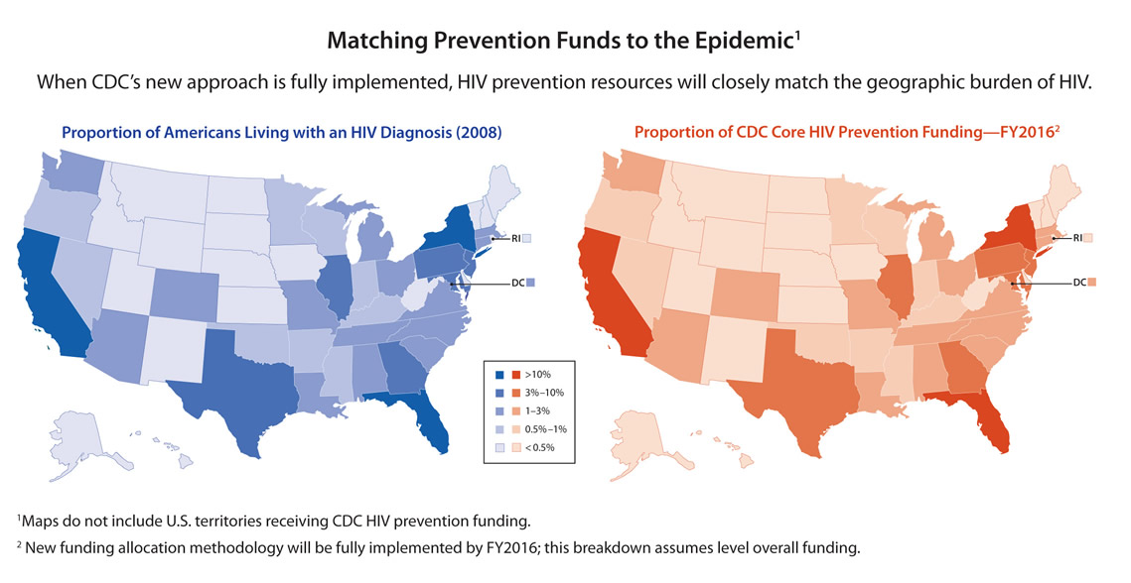
Aligning resources with the epidemic
CDC funding of state and local health departments
Proportion of Americans Diagnosed with HIV Who Live in Each State (2008)
Proportion of CDC Core HIV Prevention Funding—FY2016²
www.cdc.gov/hiv/strategy/hihp/healthDepartments/

Slide 10
Implementation of High Impact Prevention
Program shifts:
  Most activities focused on priority interventions
  Doubling of jurisdictions with integrated HIV prevention and care planning
  Increased activities with PLWHV and MSM, especially black MSM
  Funding for HE/RR reduced from 34% to 11%
  Focus on use of ACA and billing capacity
About 50% of jurisdictions receive no state HIV prevention resources
NASTAD National HIV Prevention Inventories 2013, 2014

Slide 11
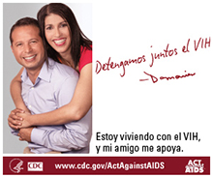
Reducing disparities is good public health
Care and Prevention in U.S. (CAPUS)
  Partnership with CDC, HHS offices, HRSA, SAMHSA
  $45M total funding over 3 years to 8 states
  Eligible states had highest HIV burden among African Americans and Latinos, high AIDS diagnosis rates
  Overcome social determinants that prevent people from reaching a suppressed viral load
  25% of resources for CBOs
YMSM and Transgender Persons of Color
  $11 million annually to 34 CBOs to improve care and prevention
  >3,000 new HIV diagnoses anticipated

Slide 12
Has it worked?

Slide 13
Selected program outcomes
States requiring reporting CD4 counts and viral loads increased from 19 in 2011 to 42 in 2015
Proportion of persons with HIV who know status highest ever at 87%
  CDC resources associated with over 1/3rd of HIV diagnoses
  CDC testing funding correlated with increase in proportion of persons tested for HIV (2.4% increase per $0.34 higher per capita funding)
Viral suppression among persons receiving care increased from 72% in 2009 to 80% in 2013
Krueger NHPC 2015; Hayek S J Public Health Manag Pract 2015 (epub); National HIV Prevention Progress Report, 2013; MMWR, June 26, 2015

Slide 14
Some indicators of success
2010-14, annual new HIV diagnoses decreased 9%
  6% reduction in men; 21% in women
  32% decrease in infections attributed to injection drug use
  2% decrease in young black MSM, following 114% increase during prior 5 years
Proportion of persons with HIV aware of status increased, so decreases not due to less testing
2010-2013, 9% less mortality--seen in all race/ethnic groups
  2008-12, mortality among African Americans diagnosed with HIV decreased 28%
  Hispanic/Latinos have lowest mortality among PLWH
HIV Surveillance Report, Volume 26, 2014, CDC

Slide 15
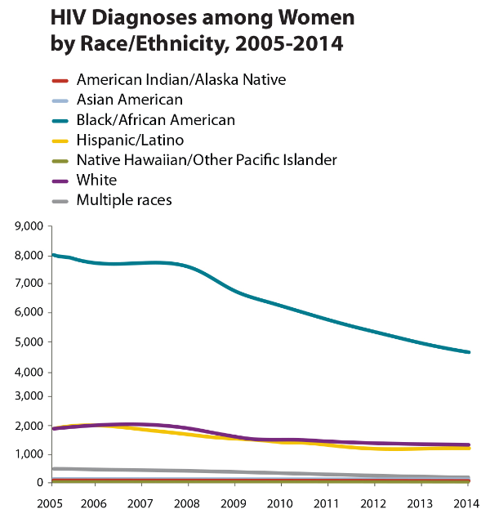
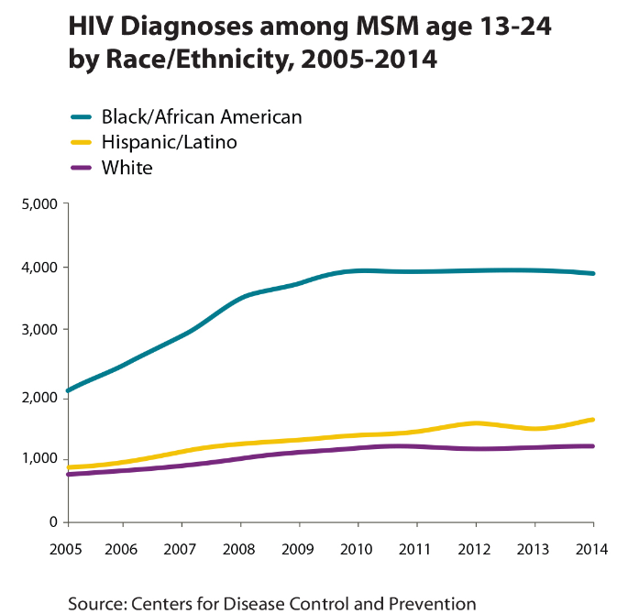
Trends in HIV disparities

Slide 16
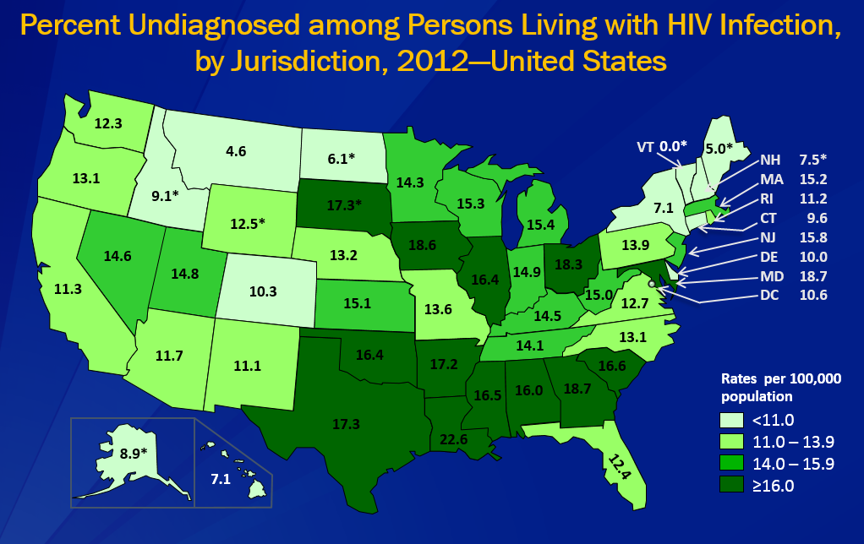
Major disparities persist
HIV prevalence associated with population density, poverty, education, employment, and homelessness, region of residence
For disproportionately affected populations, especially MSM and transgender persons, higher prevalence, increased sexual risk require improved coverage of ART, PrEP, education, support services
*Includes MSM/IDU; CDC surveillance report

Slide 17
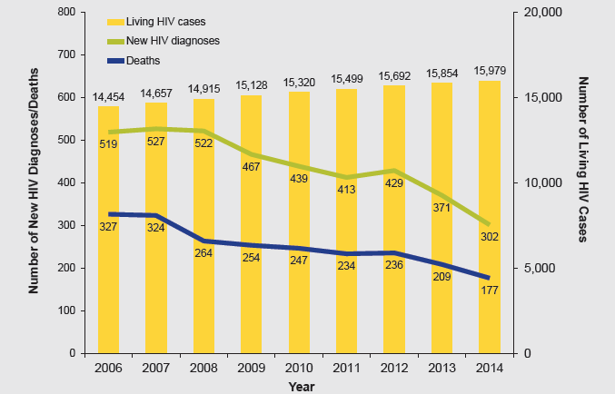

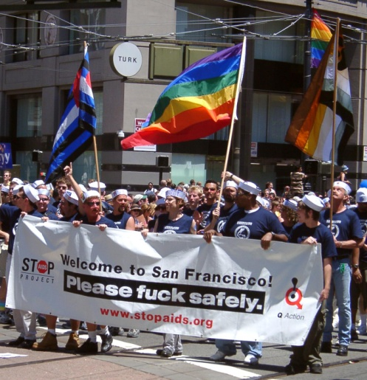
HIV prevalence, new diagnoses, and mortality, San Francisco, 2006-2014
Average time to viral suppression reduced from 218 days (2006-9) to 132 days (2010-13)
San Francisco Department of Public Health, HIV epidemiology annual report 2014; Pilcher IAS

Slide 18
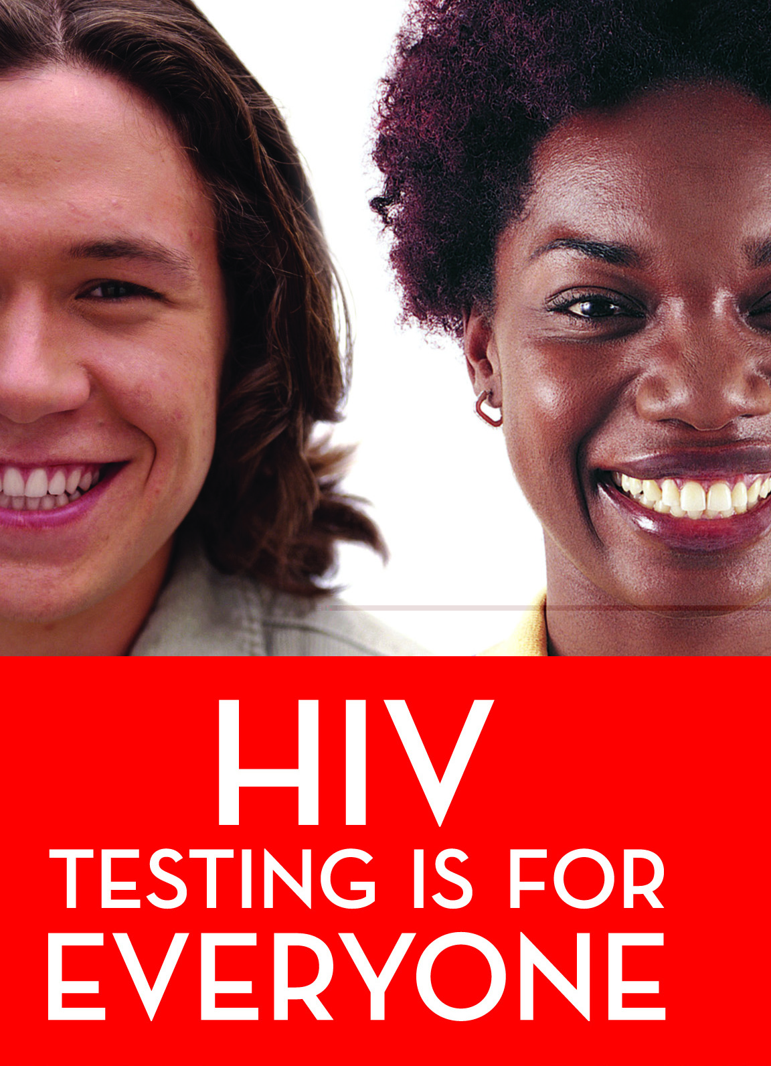
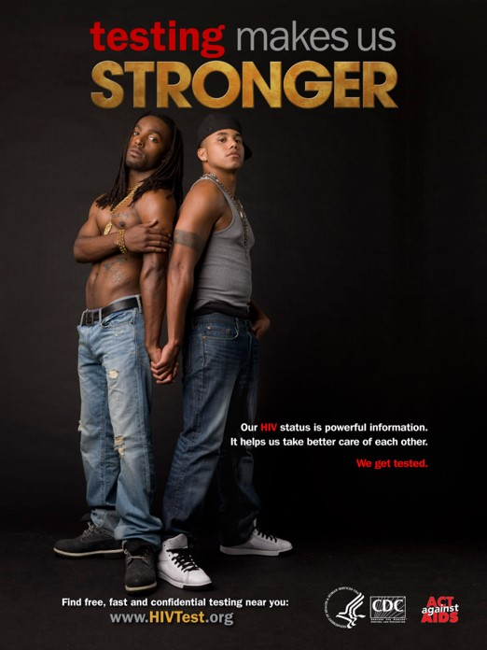



High Impact Prevention 2.0

Slide 19
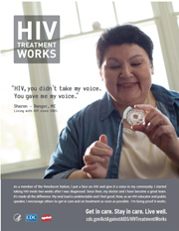
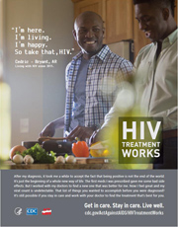
Antiretroviral treatment works
START trial
  ART at CD4 count >500 fewer severe adverse events and mortality than delaying therapy
  68% of primary endpoints occurred in persons with CD4>500
ART reduces transmission of HIV by >96%
NEJM, August 27, 2015

Slide 20
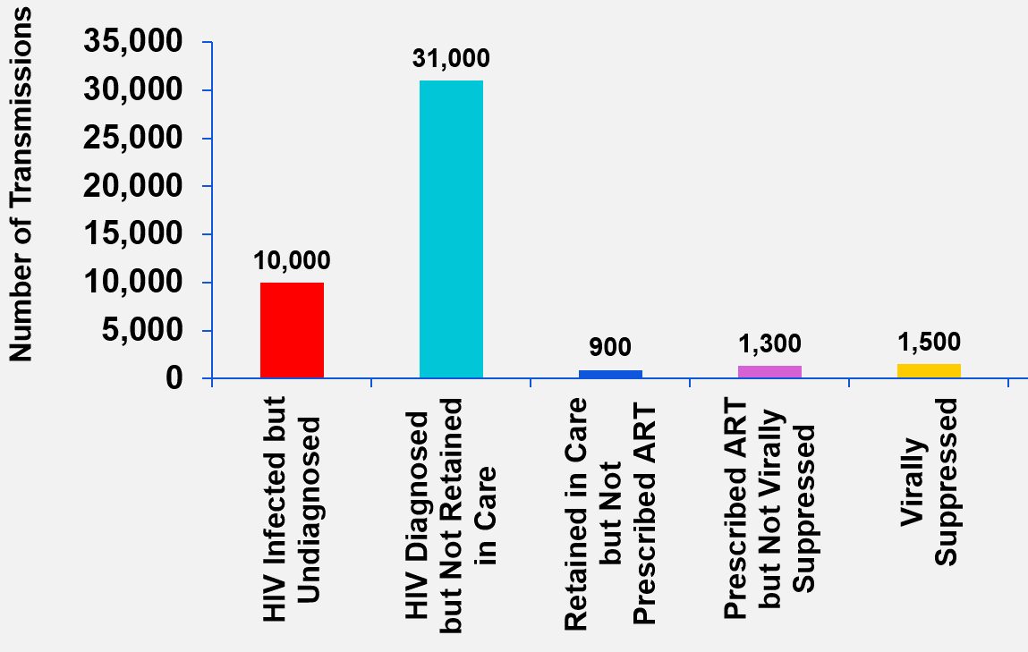
HIV transmission at each step of care continuum, United States
9 of 10 new infections transmitted by HIV-infected people who are undiagnosed or diagnosed but not in medical care
Frieden NEJM 2015
Notes:
The overall HIV prevalence rate for adults and adolescents was 448 per 100,000. You can see the highest rate is among blacks, followed by Hispanics, whites, American Indians/Alaska Natives, and Asians/Pacific Islanders. The HIV prevalence rate for blacks was almost 8 times as high as that of whites. The prevalence rate for hispanics was nearly 3 times the rate for whites.

Slide 21

Clinical Medicine, Community, and Public Health
COMMUNITY
All persons with HIV
All diagnosed persons
CLINICAL
MEDICINE
Any HIV care
Reduce Risk Behavior
Regular HIV care
Prescribed ART
PUBLIC HEALTH

Slide 22

Data to Care Strategy
Using CD4 count and viral load surveillance data to identify people who are not engaged in care or not receiving optimal care
  Never linked to care, dropped out of care
  Persistently low CD4 count or detectable viral load
Data are used for public health follow up
  Continuum of Care uses aggregate data for monitoring
  Data to Care helps people with HIV get the care, prevention, mental health, behavioral health, and social services they need
Sweeney P et al Milbank Quarterly 2013

Slide 23
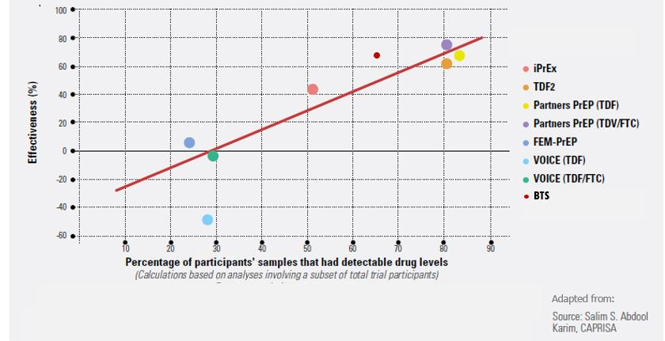
PrEP in practice
Randomized trials
When taken as directed, PrEP prevents >90% of sexually transmitted HIV
PrEP Demonstration Project
2 HIV infections with moderate adherence among MSM and transgender women
PrEP Use, Kaiser Permanent, San Francisco
No HIV infections despite high rates of STIs, risk behavior
HIV PrEP demonstration project for YMSM
56% of participants had protective drug level at first visit, but adherence declined
4 HIV infections; all had undetectable drug levels
PrEP empowers
IAS 2015; Volk CID 2015

Slide 24
Prevention as healthcare – Healthcare as prevention
How do we make HIV prevention services, including PrEP, a normative part of healthcare?
  HIV testing as routine as cholesterol testing
  Risk reduction as common as nutrition counseling, foot care for people with diabetes
Ensure reimbursement systems support routine HIV prevention services within clinics and by CBOs

Slide 25


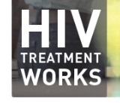
New activities
Community-based organization funding
  $216 million over 5 years; 137 organizations
  Highly affected jurisdictions and populations
  Support testing and continuum of care, empowering people to protect themselves, including PrEP
State and local health department funding focused on MSM and transgender persons of color
  1) Improve continuum of care, PrEP, risk reduction
  2) Data to Care

Slide 26
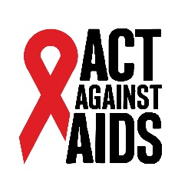
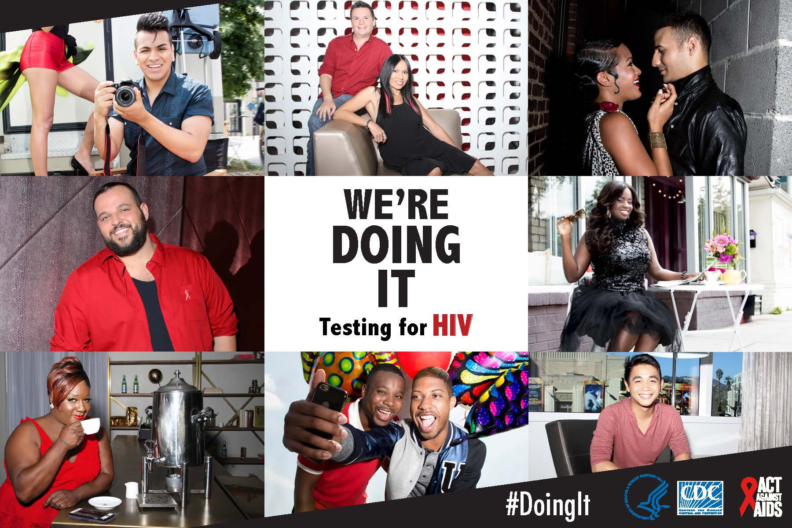
Act Against AIDS new National Testing Campaign
Notes:
I am pleased to announce that today, CDC, through the Act Against AIDS initiative is launching a new national Testing Campaign called “Doing It.”
CDC recommends that all Americans aged 13 to 64 get tested at least once for HIV as a routine part of medical care, and that those at high risk get tested at least once a year.
HIV testing is an important component of high impact HIV prevention.
Undiagnosed infection remains an significant factor fueling the HIV epidemic – one analysis found that 30 percent of new HIV infections can be attributed to transmission from people who did not know they were infected. Nearly one in eight Americans currently living with HIV do not know they are infected and may be unknowingly transmitting the virus to others.
Knowledge your HIV status is empowering. When people test negative, they can assess and modify their risk behaviors to help them stay uninfected. There are more tools available today to prevent HIV than ever before.
When someone tests positive, they can access life-saving medical care and treatment that allows them to stay healthy for many years, and also greatly reduces their risk of transmitting the virus.
You may have already seen some of the campaign creative throughout the hotel venue, but today marks the official launch of this new testing campaign. There will be a national press release, the onset of national media buys, and a campaign launch event at this evenings NGO/CBO village.
I am excited about this new resource to encourage all Americans—especially those at greatest risk for HIV to get tested for HIV.

Slide 27
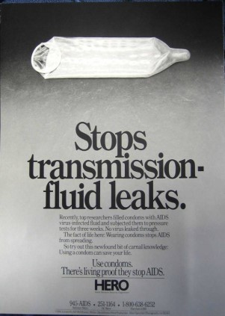
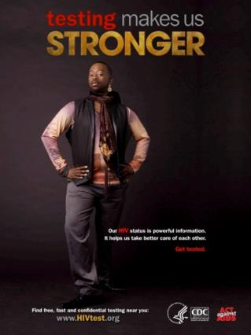

What is the new generation of risk messaging?
“Protection” is no longer restricted to condoms
No studies have assessed effectiveness of risk reduction for HIV-negative persons incorporating ART by partner, PrEP, nPEP, male circumcision, and serosorting
Few studies have assessed new approaches for persons with HIV and their partners

Slide 28
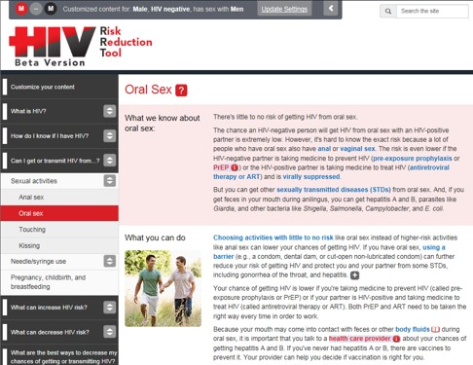
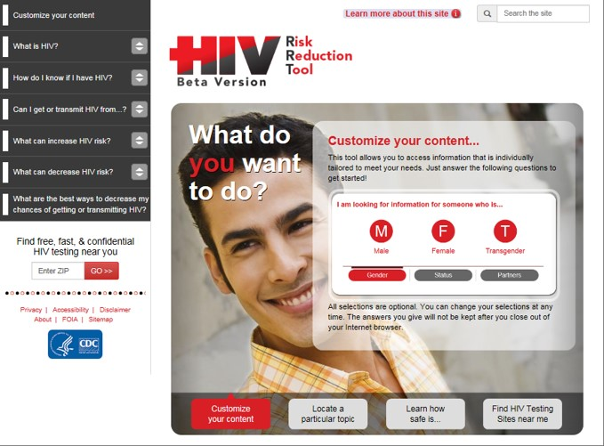
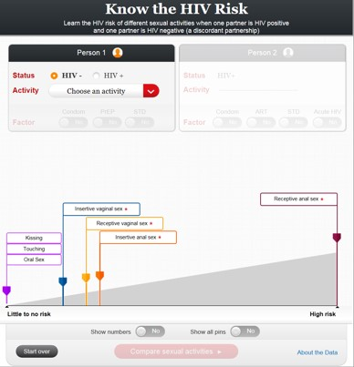
HIV Risk Reduction Tool
User-friendly tool for different audiences of risk estimates and HIV prevention messages incorporating ART, PrEP and new prevention tools
  Content structured to enable tailoring by user

Slide 29
Condom use
In national sample, >70% of adolescents reported condom use during last sex
  However, 22% of women and 25% of men of all ages reported condom use
  Use more than twice as likely with casual than “relationship” partner
Couples stop using condoms over time
  Men and women >5 times less likely to use condom if had sex >10 times previously
Among MSM, 68% of HIV transmission from main partner
  Higher number of sex acts, more frequent receptive role, and lower condom use
Reece J Sex Med 2010; 7 (suppl 5); Sanders J Sex Med 2010; 7 (suppl 5); Sullivan AIDS 2009

Slide 30
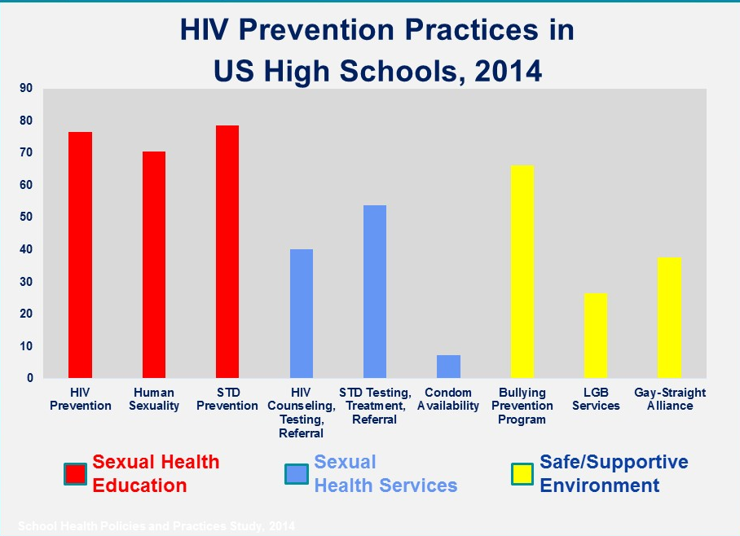
Sexual health education
Good sex education is a counter measure to false information
School Health Policies and Practices Study, 2014

Slide 31
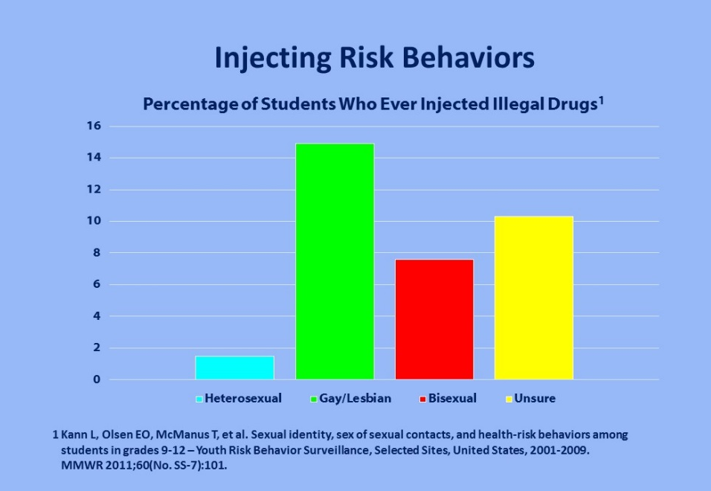
Substance abuse as risk for HIV, hepatitis, and STDs among teens
Teens have low risk of injecting drugs—fewer than 2% inject drugs
However, in selected states and cities that collect data, sexual minority youth rates of injection drug use up to 7 times greater than those of heterosexuals
Many studies show alcohol and drug use associated with HIV and STD risk behavior
Kann L, Olsen EO, McManus T, et al.. MMWR 2011;60(No. SS-7):101.
Notes:
Teenagers overall have very low rates of injecting drugs – fewer than 2%. However, our data demonstrates some alarming trends that we need to monitor.
First, in selected states and cities that collect these data, we see that among sexual minority youth rates of injection drug use are up to 7 times greater than those of their heterosexual counterparts.

Slide 32
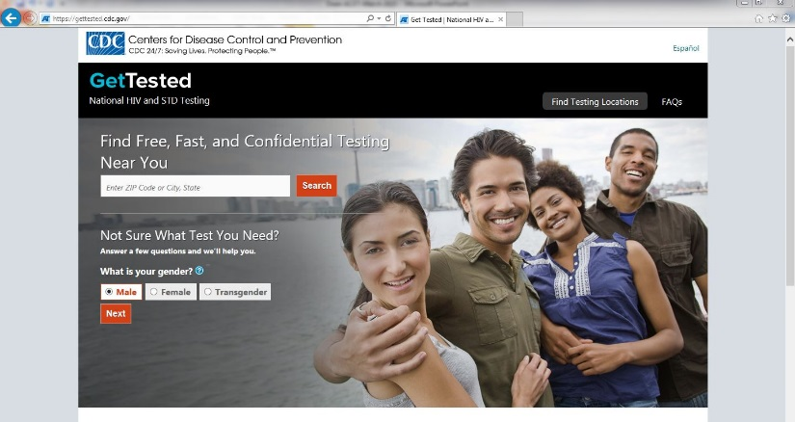
High Impact Program Coordination and Service Integration (HIP PCSI)
Examples
  Age-based screening for HIV and HCV using computerized clinical decision tools
  Annual STD screening of people with HIV
  STD diagnosis as potential indicator for PrEP, and provision of PrEP at STD clinics
  Integrated partner services
  HIV, HCV, and HBV screening and treatment at
  drug treatment centers

Slide 33
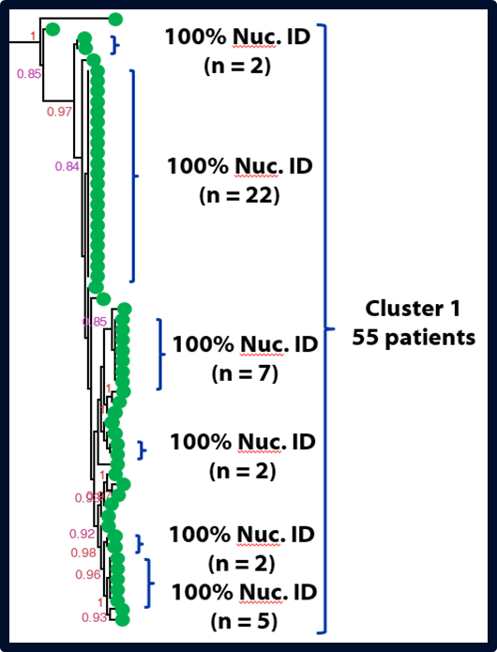

Molecular epidemiology
Helping with the basics
ART resistance testing routinely performed for new diagnoses
Reporting by 27 jurisdictions
Allows for rapid response to outbreaks and clusters including providing needed social, prevention, treatment services to sexual and drug using networks
Precedent with TB where 95% of all TB isolates tested and outbreaks rapidly identified

Slide 34
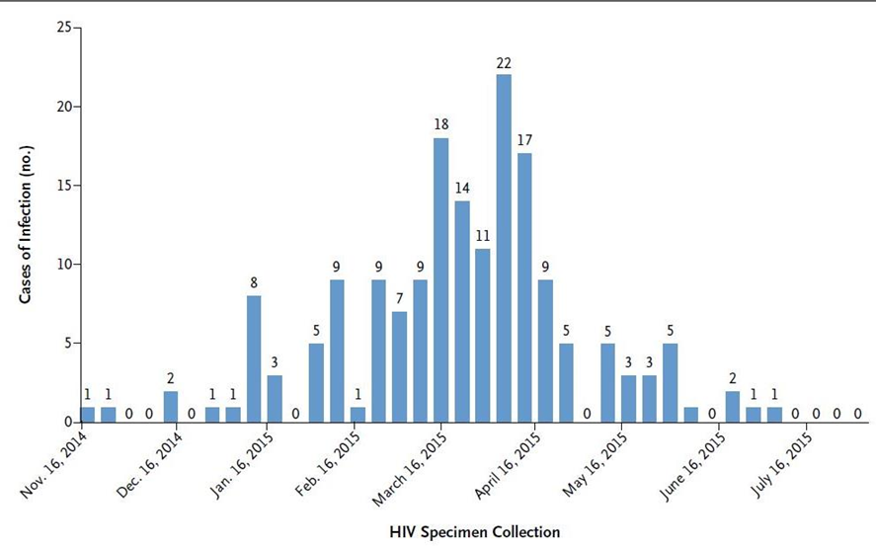
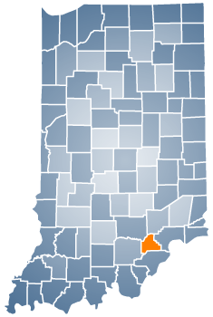
HIV and HCV in persons who inject drugs
Indiana community of 4,300
184 persons with HIV
Injecting oxymorphone
Majority of HIV infections recently acquired; all but 2 phylogenetically linked
Rapid response with contact tracing and testing, one-stop-shop for social services, syringe service program, HIV and HCV testing and treatment, medication-assisted therapy, educational campaign
Adams NEJM 2015

Slide 35
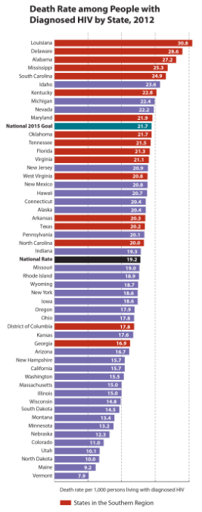
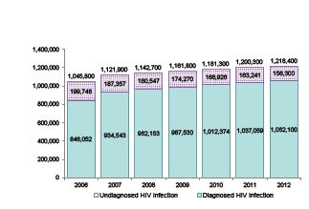
National and State Progress Reports
State HIV progress report
  National goals can be achieved
    2015 targets have already been met by one or more states
      In 5 states 90% or more of people living with HIV know their status, meeting the updated NHAS goal for 2020
  Uneven progress
    More than half of states improved on 6 of 11 indicators
    Large disparities continue to exist
Fewer People Have Undiagnosed HIV Infection

Slide 36
Think bigger, act faster
Achieving the prevention goals of National HIV/AIDS Strategy would avert tens of thousands of new infections and save billions of dollars
291,309 infections prevented, $127 billion saved in health care costs
Unpublished CDC Data, 2015

Slide 37
Conclusions
We have turned the corner on HIV, but we are far from achieving success
Prioritizing the tools and programs that will have the greatest impact is essential
New science, creative education, sound policy, and innovative programs can make easier, more effective choices
Future includes integration of treatment, PrEP, molecular epidemiology, and use of data to improve programs
Think bigger, act faster

Slide 38
Acknowledgments
Sara Bingham
Rich Wolitski
Eugene McCray
Stephanie Sansom
Irene Hall
Janet Cleveland
David Purcell
Stephanie Zaza
Nick DeLuca
Dawn Smith
Evin Jacobson
Patty Dietz
Norma Harris
Alexa Oster
John Brooks
The findings and conclusions in this presentation do not necessarily represent official position of CDC

