Slide 1
HIV Slide Set, 2016 Surveillance Data
Notes:
Division of HIV/AIDS Prevention scientific staff drafted these to highlight some of the most important data. In this notes area of the PowerPoint slides, each slide contains the title (with the variables selected), some contextual information, and links to additional data and information on the topic.
Note: Data displayed are for individuals 13 years of age or older, and therefore may not reflect the numbers and rates provided in the HIV Surveillance Reports which include data for children.
All of the NCHHSTP AtlasPlus maps are choropleth maps, which use sequential colors (e.g., light blue to dark blue) to display data that progress from low to high values. Typically, one uses light colors for low data values and dark colors for high data values.

Slide 2
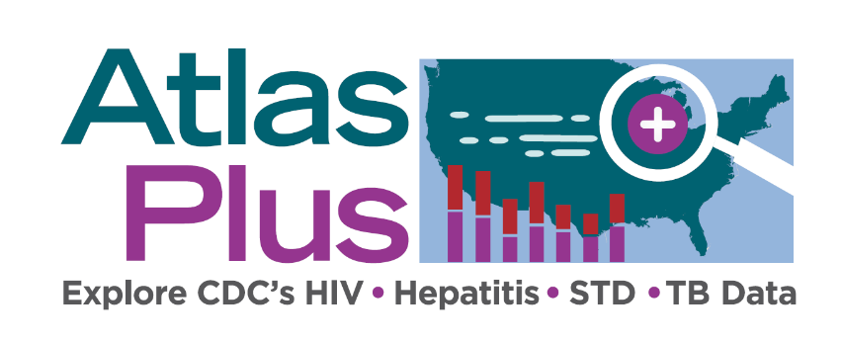
NCHHSTP AtlasPlus National Center for HIV/AIDS, Viral Hepatitis, STD and TB Prevention
The NCHHSTP AtlasPlus is an online, interactive tool that gives you the power to analyze, map, and create tables using HIV, viral hepatitis, STD, and TB data that are reported to CDC.
Using the NCHHSTP AtlasPlus, you can do the following:
Create custom maps and bar graphs using HIV, viral hepatitis, STD, or TB data (NCHHSTP AtlasPlus has 15 disease variables to explore).
View a list of diagnoses for most recent year and change from the previous year;
Create 2 side-by-side maps or charts (e.g., 2 diseases, 2 race/ethnicity groups, or 2 age groups);
Display changes over time and patterns across the United States (NCHHSTP AtlasPlus has 16 years of data for most variables);
Generate Charts:
Line graphs by year;
Pie charts for sex;
Bar charts for age, race/ethnicity, transmission category (HIV), U.S.-born and non-U.S.-born (TB); and
Bar charts for state and country.
Download data and export graphics.
Notes:
The NCHHSTP AtlasPlus is an online, interactive tool that gives you the power to analyze, map, and create tables using HIV, viral hepatitis, STD, and TB data that are reported to CDC.
Using the NCHHSTP AtlasPlus, you can do the following:
Create custom maps and bar graphs using HIV, viral hepatitis, STD, or TB data (NCHHSTP AtlasPlus has 15 disease variables to explore);
View a list of diagnoses for most recent year and change from the previous year;
Create 2 side-by-side maps or charts (e.g., 2 diseases, 2 race/ethnicity groups, or 2 age groups);
Display changes over time and patterns across the United States (NCHHSTP AtlasPlus has 16 years of data for most variables);
Generate Charts:
Line graphs by year;
Pie charts for sex;
Bar charts for age, race/ethnicity, transmission category (HIV), U.S.-born and non-U.S.-born (TB); and
Bar charts for state and country.
Download data and export graphics.

Slide 3
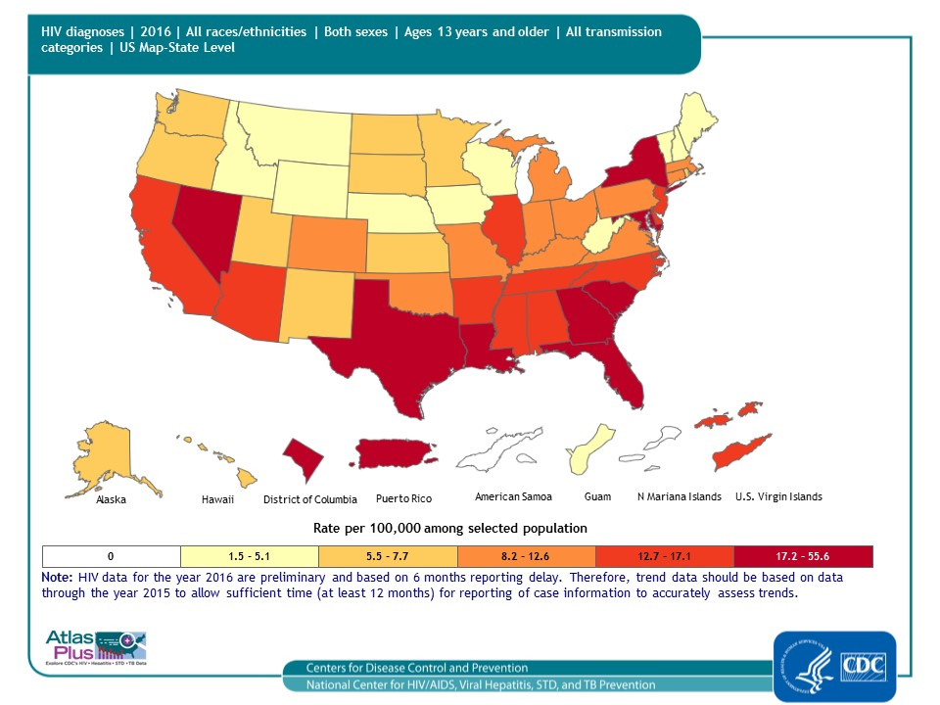
Notes:
Slide title: HIV diagnoses, 2016 — United States and 5 dependent areas, by state/area
Description: From 2011 through 2015, the annual number and rate of diagnoses of HIV infection among adults and adolescents remained stable in the United States and 5 dependent areas; in 2016, 39,782 persons were diagnosed with HIV infection. As seen in the map, the highest rates were in the southern and northeastern regions of the United States, Nevada and in Puerto Rico.
For more information: http://www.cdc.gov/hiv/library/reports/surveillance/index.html

Slide 4
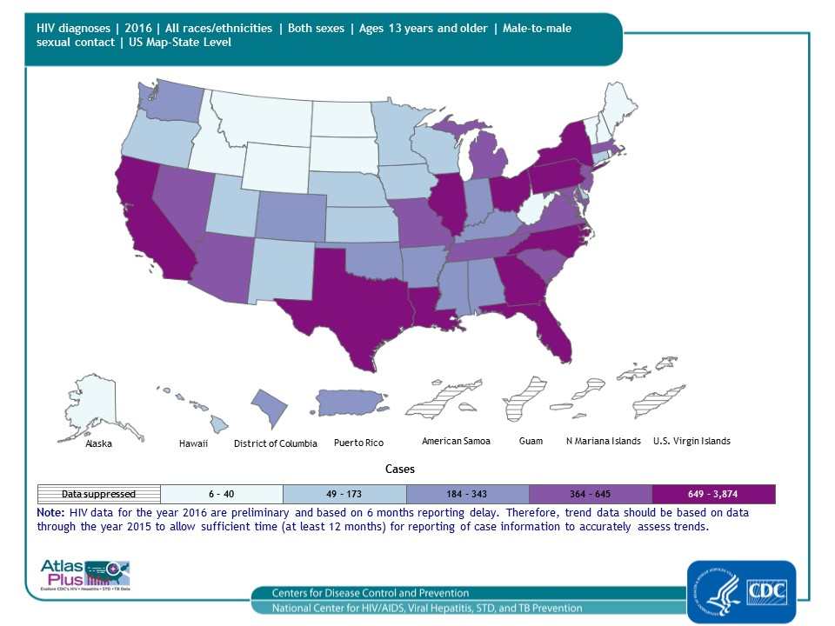
Notes:
Slide title: HIV diagnoses attributed to male-to-male sexual contact, 2016 — United States and 5 dependent areas, by state/area
Description: In 2016, diagnosed HIV infection attributed to male-to-male sexual contact (including persons with infection attributed to male-to-male sexual contact and injection drug use) accounted for approximately 70% of diagnosed HIV infections in the United States. As seen in the map, the highest number of cases were in the eastern United States, Texas, Illinois, and California.
For more information: http://www.cdc.gov/hiv/library/reports/surveillance/index.html

Slide 5
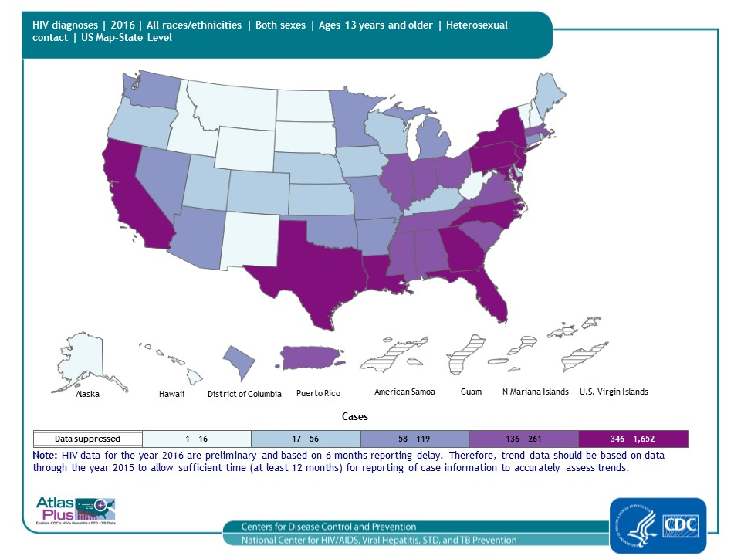
Notes:
Slide title: HIV diagnoses attributed to heterosexual contact, 2016 — United States and 5 dependent areas, by state/area
Description: In 2016, diagnosed HIV infection attributed to heterosexual contact accounted for approximately 24% of diagnosed HIV infections in the United States. As seen in the map, the highest number of cases were in the eastern United States, Texas, and California.
For more information: http://www.cdc.gov/hiv/library/reports/surveillance/index.html

Slide 6
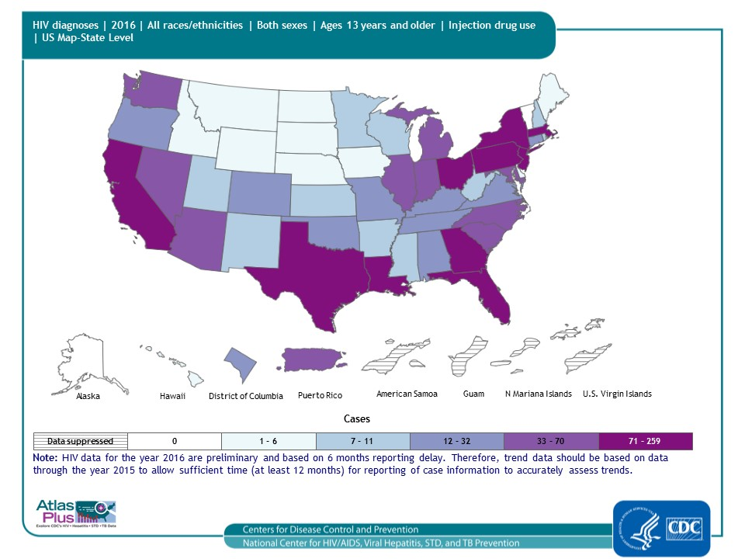
Notes:
Slide title: HIV diagnoses attributed to injection drug use, 2016 — United States and 5 dependent areas, by state/area
Description: In 2016, diagnosed HIV infection attributed to injection drug use (including persons with infection attributed to injection drug use and male-to-male sexual contact) accounted for approximately 9% of diagnosed HIV infections in the United States. As seen in the map, the highest number of cases were in the eastern United States, Texas, and California.
For more information: http://www.cdc.gov/hiv/library/reports/surveillance/index.html

Slide 7
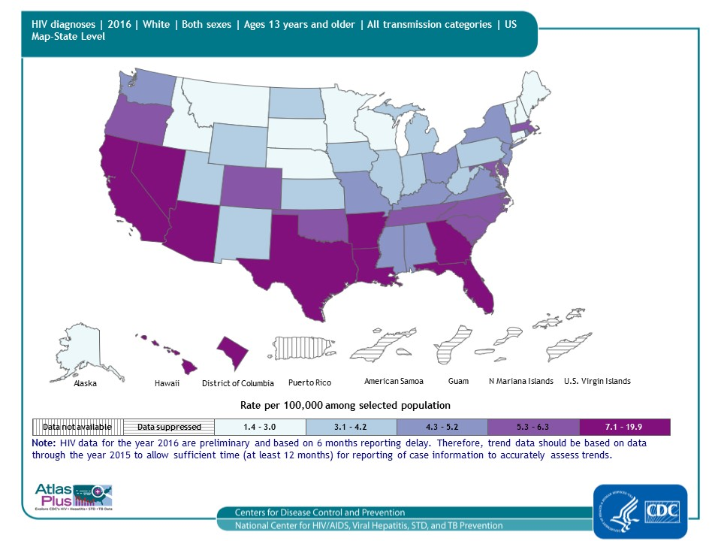
Notes:
Slide title: HIV diagnoses among Whites, 2016 — United States and Puerto Rico, by state
Description: In 2016, white adults and adolescents made up approximately 77% of the population of the United States but accounted for 26% of diagnoses of HIV infection. As seen in the map, the highest rates were in the southern and western regions of the United States.
For more information: http://www.cdc.gov/hiv/library/reports/surveillance/index.html

Slide 8
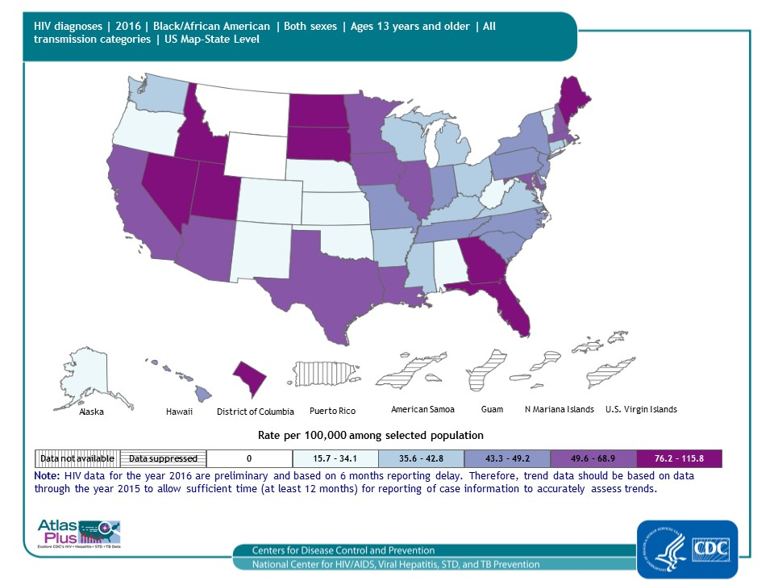
Notes:
Slide title: HIV diagnoses among blacks/African Americans, 2016 — United States and Puerto Rico, by state
Description: In 2016, the overall rate of diagnoses of HIV infection for black/African American adults and adolescents was 52.9 per 100,000 population in the United States. The rates of diagnoses of HIV infection for black/African American adults and adolescents ranged from 0.0 per 100,000 population in Montana and Wyoming to 115.8 per 100,000 population in Maine. The District of Columbia (i.e., Washington, DC) is a city; use caution when comparing the HIV diagnosis rate in DC with the rates in states
For more information: http://www.cdc.gov/hiv/library/reports/surveillance/index.html

Slide 9
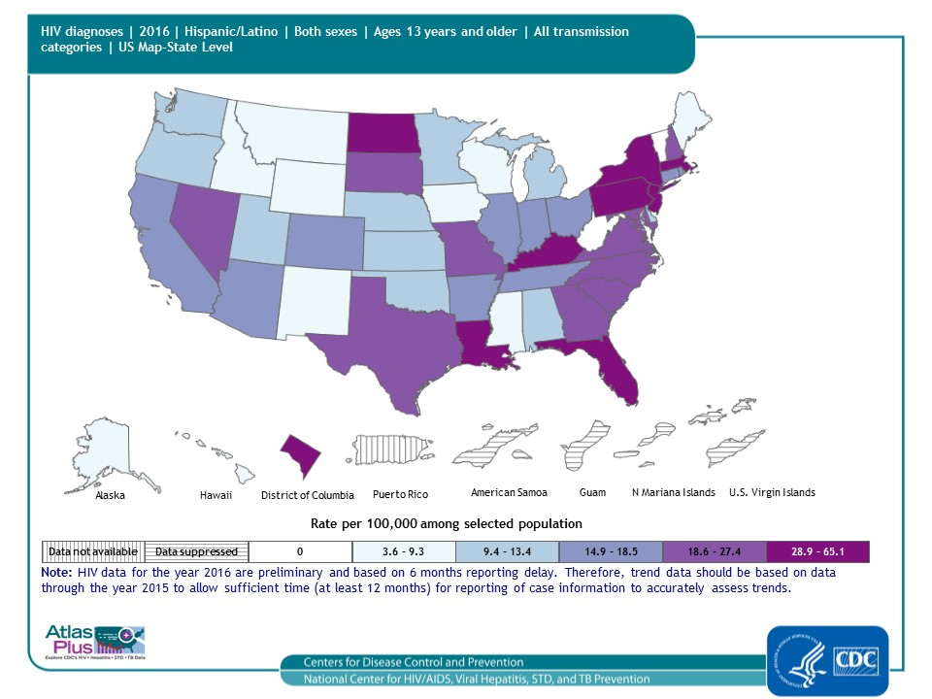
Notes:
Slide title: HIV diagnoses among Hispanics/Latinos, 2016 — United States and Puerto Rico, by state
Description: In 2016, Hispanic/Latino adults and adolescents made up 18% of the population of the United States but accounted for 25% of diagnoses of HIV infection. As seen in the map, the highest rates were in the southern and northeastern regions of the United States and North Dakota.
For more information: http://www.cdc.gov/hiv/library/reports/surveillance/index.html

Slide 10
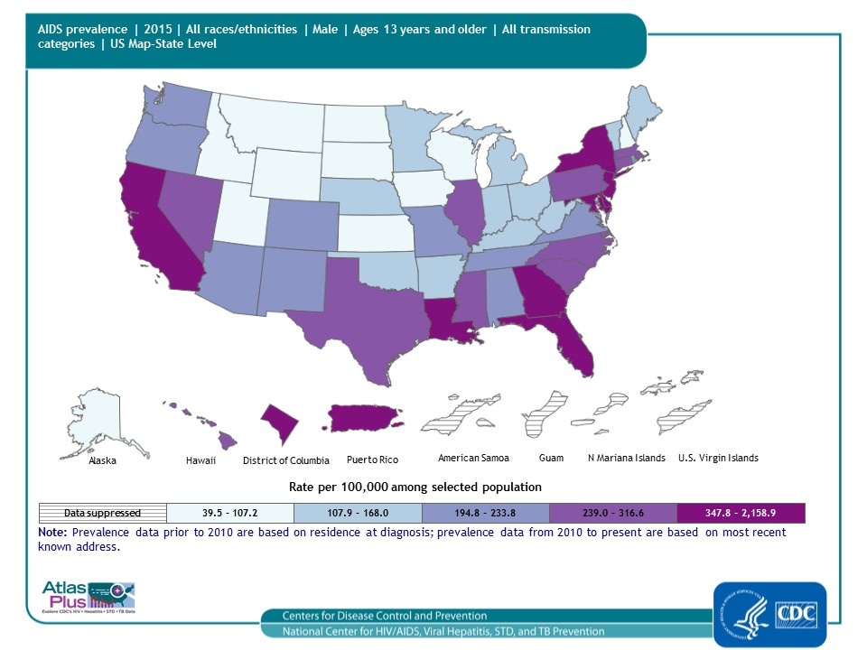
Notes:
Slide title: AIDS prevalence among males, year-end 2015 — United States and 5 dependent areas, by state
Description: At the end of 2015, adult and adolescent males represented approximately 76% of the adults and adolescents living with HIV infection ever classified as stage 3 (AIDS) in the United States. As seen in the map, the highest rates are in the southern and northeastern regions of the United States, California and Puerto Rico.
For more information: http://www.cdc.gov/hiv/library/reports/surveillance/index.html

Slide 11
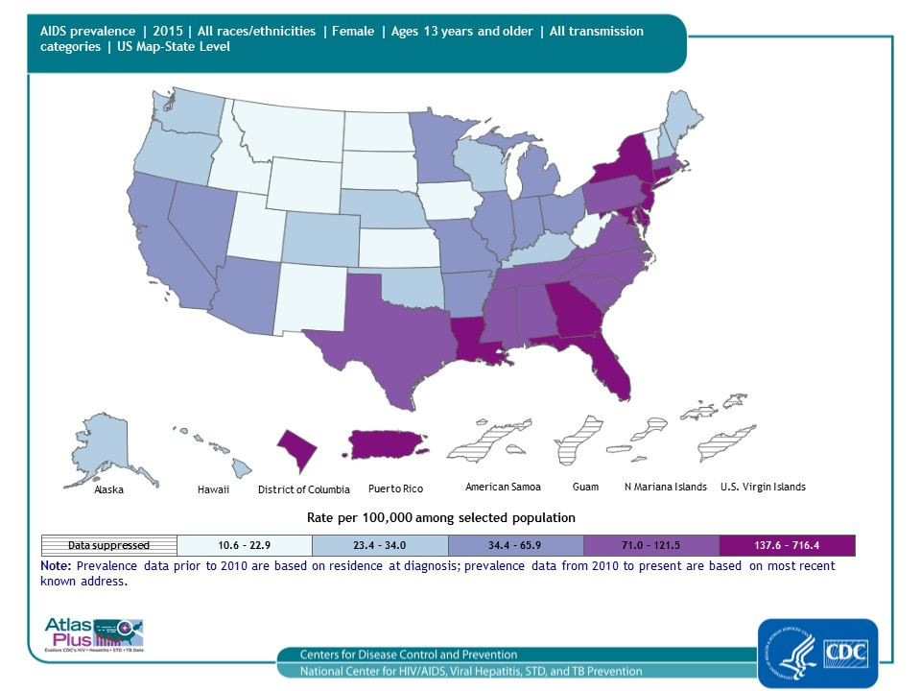
Notes:
Slide title: AIDS prevalence among females, year-end 2015 — United States and 5 dependent areas, by state
Description: At the end of 2015, adult and adolescent females represented approximately 24% of the adults and adolescents living with HIV infection ever classified as stage 3 (AIDS) in the United States. As seen in the map, the highest rates are in the southern and northeastern regions of the United States and Puerto Rico.
For more information: http://www.cdc.gov/hiv/library/reports/surveillance/index.html

Slide 13
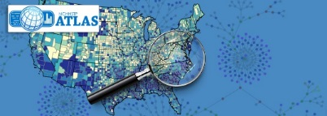
NCHHSTP Atlas National Center for HIV, Viral Hepatitis, STD and TB Prevention
To learn more about the diseases:
HIV
Acute Viral Hepatitis A, Acute Viral Hepatitis B, and Acute Viral Hepatitis C
Chlamydia, Gonorrhea, Syphilis
Tuberculosis (TB)
For data sources:
HIV Statistics and Surveillance
Viral Hepatitis Statistics and Surveillance
STD Data & Statistics
TB Data and Statistics
Contact Atlas

