Slide 1

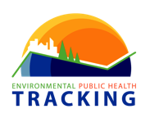
Introduction to
Environmental Public Health Tracking
Access the 508 accessible version of the document here: https://www.cdc.gov/nceh/tracking/tracking-intro.html
Centers for Disease Control and Prevention, Winter 2018
Disclaimer: The findings and conclusions in this report are those of the authors and do not necessarily represent the official position of the Centers for Disease Control and Prevention.

Slide 2
WELCOME
Essentials of Environmental Public Health Tracking is a learning module designed to:
  Provide you with information about how the environment affects public health and
  Teach you about the National Environmental Public Health Tracking Program and its flagship product, the Environmental Public Health Tracking Network.
Next

Slide 3
BEFORE WE BEGIN
This PowerPoint includes enhanced features including interactive knowledge checks.
Knowledge checks are included throughout the PowerPoint. You can answer knowledge check questions by clicking on a response option. A pop-up window will appear, indicating whether or not you were correct.
To advance slides, click the “Next” or “Move to next section” buttons.
Next

Slide 4
LEARNING OBJECTIVES
By the end of this module, you will be able to:
Define environmental health
Discuss environmental public health practice
Describe the relationship between the environment and health
Explain environmental public health surveillance
Describe the National Environmental Public Health Tracking Program
Identify types of environmental public health data available on the Tracking Network
List examples of applications of environmental public health tracking data
Next

Slide 5
INTRODUCTION
Next

Slide 6

THE ENVIRONMENT IS…
The air we breathe,
The water we drink,
The food we eat, and
The places where we live, work, and play.
Next

Slide 7
HEALTH AND THE ENVIRONMENT
There is a connection between the environment and the health of individuals and communities.
Likewise, people can affect the health of the environment.
Next

Slide 8
ENVIRONMENTAL HEALTH IS THE DISCIPLINE THAT…
Focuses on the inter-relationships between people and their environment,
Promotes human health and well-being, and
Fosters a safe and healthful environment.
Next

Slide 9
ENVIRONMENTAL HAZARDS
Next

Slide 10

WHAT ARE ENVIRONMENTAL HEALTH HAZARDS?
An environmental health hazard is a substance that has the ability to cause an adverse health event.
This includes physical, chemical, and biological factors that are external to a person.
Hazards can be natural or human-made.
Next

Slide 11
EXAMPLES OF ENVIRONMENTAL HAZARDS INCLUDE:
The most common environmental health hazards are air and water pollution.
Air contaminants
Toxic waste
Radiation
Disease-causing microorganisms and plants
Pesticides
Heavy metals
Chemicals in consumer products
Extreme temperatures and weather events
Next

Slide 12
ENVIRONMENTAL HEALTH PRACTICE
Next

Slide 13

ENVIRONMENTAL HEALTH PRACTITIONERS AIM TO REDUCE ENVIRONMENAL HAZARDS AND THEIR ADVERSE HEALTH EFFECTS THROUGH:
Conducting research
Developing standards, guidelines, and recommendations
Implementing interventions and programs to address environmental health issues
Next

Slide 14
ENVIRONMENTAL HEALTH EXAMPLE: ERIN BROCKOVICH
This is a real-life environmental health story about a woman who helped spearhead a case alleging contamination of drinking water with hexavalent chromium, which was suspected by residents of causing cancer in the southern California town of Hinkley.
Between 1952 and 1966, PG&E used hexavalent chromium in its cooling towers to fight corrosion. The wastewater dissolved the hexavalent chromium from the cooling towers and was discharged to unlined ponds at the site. Some of the wastewater percolated into the groundwater, affecting an area near the plant.
Next

Slide 15

ENVIRONMENTAL HEALTH EXAMPLE: ERIN BROCKOVICH
What she found out led to a record-breaking settlement for a group of class-action plaintiffs in 1996.
Though she was not an environmental health professional, Erin Brockovich did plenty of activities that are part of environmental health practice.
Next

Slide 16
ENVIRONMENAL HEALTH PRACTICES INCLUDE:
Collecting and monitoring data on environmental hazards and health effects
Identifying environmental hazards
Investigating environmental concerns
Stopping or lessening hazards
Assessing individuals’ exposure to hazards
Researching possible health effects related to exposures
Preventing and/or lessening health effects
Diagnosing and treating health effects
Next

Slide 17
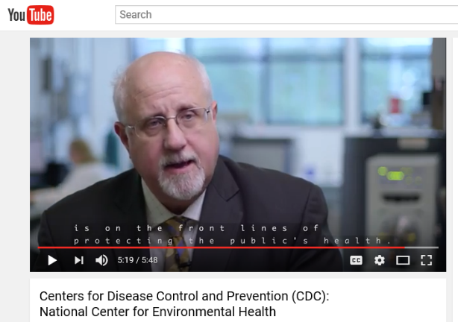
ENVIRONMENTAL PUBLIC HEALTH PRACTICE AT THE NATIONAL LEVEL
To give you a sense of the practice of environmental public health from a national perspective, watch this video from CDC’s National Center for Environmental Health about the work they do.
https://youtu.be/IAjkm_a4yv8
Next

Slide 18
ENVIRONMENTAL HAZARDS & HEALTH EFFECTS
Next

Slide 19
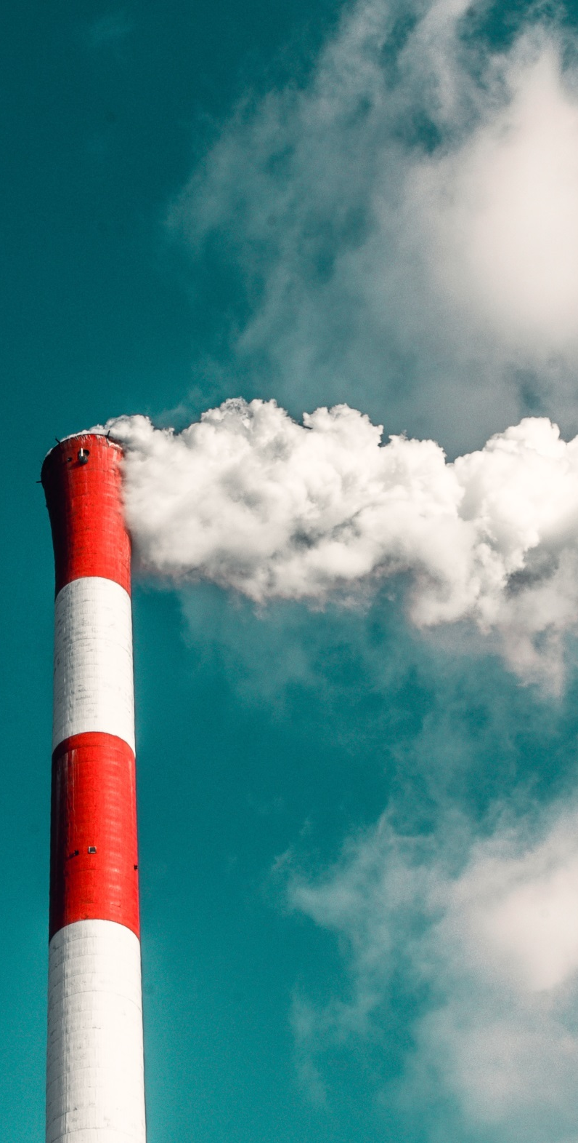
ENVIRONMENTAL HAZARDS CAN AFFECT HUMAN HEALTH
Environmental hazards—like water and air pollution, extreme weather, or chemical exposures—can affect human health in a number of ways, from contributing to chronic diseases like cancer or to acute illnesses like heat exhaustion.
Next

Slide 20
ENVIRONMENAL HEALTH IS COMPLEX.
There are gaps in information about how the environment affects human health.
Some health effects are known, others are suspected.
These health effects can be both short term (acute) and longer term (chronic).
Next

Slide 21
WE KNOW SOME THINGS ABOUT ENVIRONMENTAL HAZARDS AND HEALTH EFFECTS.
Science has proven some links between health conditions and the environment.
We know that:
Poor air quality can trigger asthma attacks.
Elevated blood lead levels in children can cause developmental disabilities.
Vulnerable populations like the elderly and infants are most at risk for heat-related illnesses during heat waves.
Extreme weather that causes power outages can lead to cases of carbon monoxide poisoning.
Next

Slide 22
MANY LINKS BETWEEN HEALTH CONDITIONS AND THE ENVIRONMENT ARE SUSPECTED BUT NOT YET PROVEN.
Health problems with suspected links to environmental issues include:
Certain cancers (i.e., bladder, liver)
Asthma and other respiratory diseases
Neurological diseases such as Parkinson’s disease, multiple sclerosis, or Alzheimer’s disease
Developmental disabilities such as cerebral palsy or autism
Next

Slide 23
AND, THERE IS A LOT THAT WE DON’T KNOW ABOUT THE RELATIONSHIPS BETWEEN ENVIRONMENTAL HAZARDS AND HEALTH.
More research is needed to determine how exposure is cause for health concern and what levels of exposure are safe.
For most chemicals, we do not know how low level environmental exposures affect our health.
Next

Slide 24
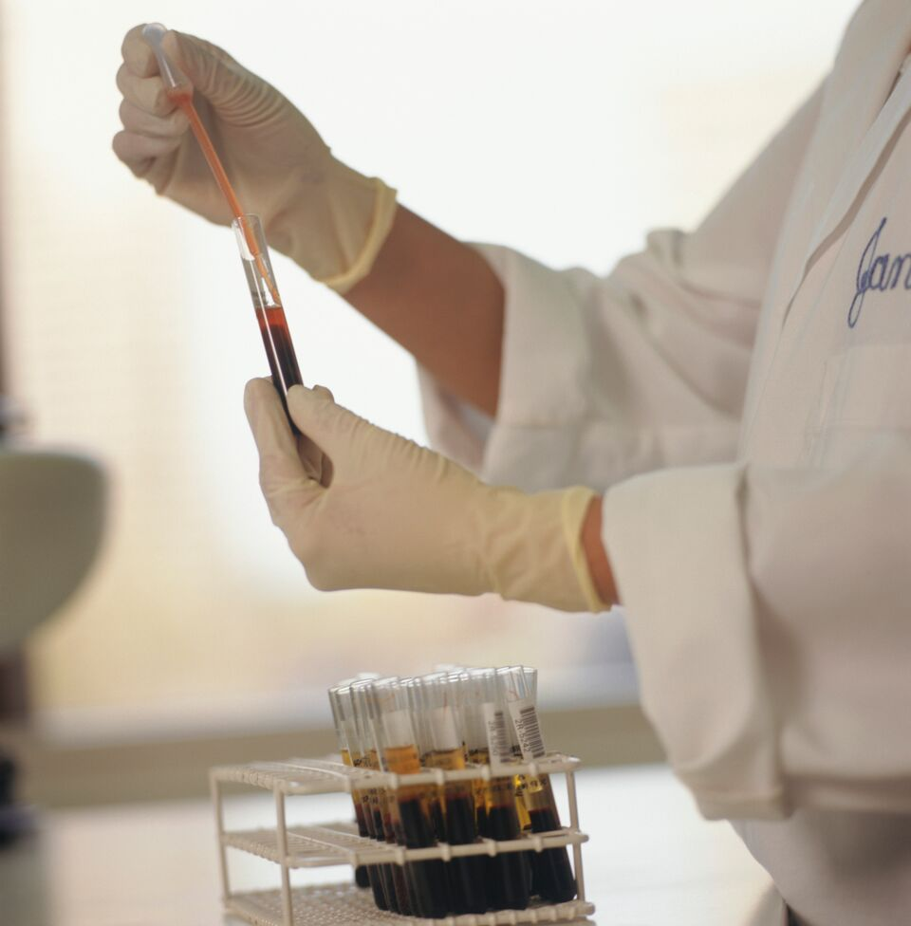
ASSESSING EXPOSURES
After being exposed to an environmental hazard, it may be possible to detect how much of a substance has gotten into a person’s body.
This is called biomonitoring.
Next

Slide 25
BIOMONITORING
Most biomonitoring involves measuring the amount of a chemical or its breakdown product (metabolite) that is in a small sample of a person's blood or urine.
The amount of the chemical or metabolite in a person’s blood or urine depends on the amount of the chemical that has entered that person’s body. Exposure pathways include eating, drinking, breathing, and touching.
This amount represents the amount of a chemical that entered the body from all sources and through all exposure pathways combined.
Next

Slide 26

IT’S IMPORTANT TO NOTE THAT BEING EXPOSED TO AN ENVIRONMENTAL HAZARD DOESN’T MEAN THAT A PERSON WILL HAVE A NEGATIVE HEALTH EFFECT.
Environmental Hazard
?
illness
injury
death
Exposure to
Hazard
Next

Slide 27
THE EFFECT OF AN ENVIRONMENTAL HAZARD ON INDIVIDUAL HEALTH IS INFLUENCED BY SEVERAL FACTORS:
DOSE
How much of the hazard a person is exposed to
PERSONAL
TRAITS
HEALTH
EFFECT
DURATION
Factors like age, diet, genetics, health status, lifestyle, and sex
How long a person was exposed
EXPOSURE
ROUTE
How a person came in contact with the hazard
(e.g., breathing, eating, drinking, touching)
Next

Slide 28
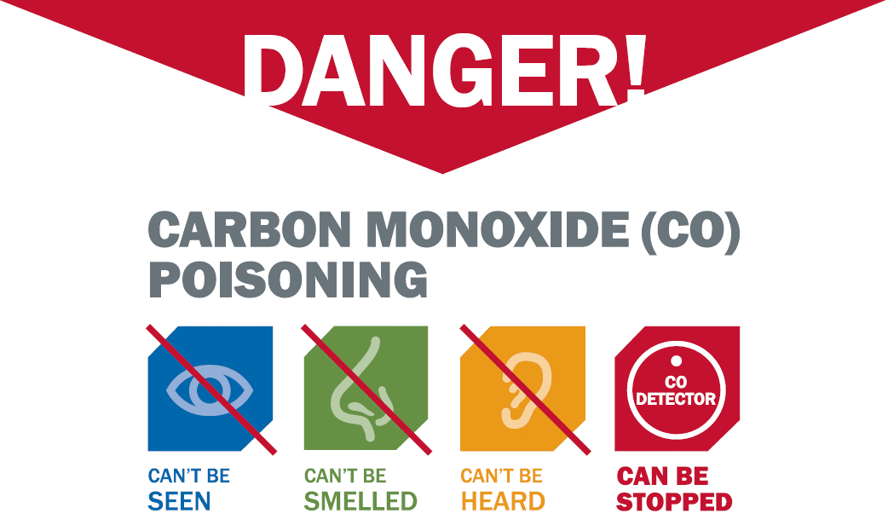
EXAMPLE: CARBON MONOXIDE POISONING
Populations are at increased risk for carbon monoxide poisoning during extreme weather events that can cause power outages.
Without power, people may use charcoal or gas grills indoors to cook or keep warm. Doing this may expose them to carbon monoxide (CO) through the air they breathe.
While everyone in the home may be exposed to the gas, not everyone will get CO poisoning.
The likelihood of poisoning depends on the amount of CO a person is exposed to, how long a person is exposed to CO, and an individual’s characteristics like age or having chronic health problems.
Learn more about CO poisoning, prevention, clinical management, and more.
Next
https://www.cdc.gov/co/

Slide 29
ENVIRONMENTAL HAZARDS AND HEALTH EFFECTS
The following diagram will help illustrate the point that being exposed to an environmental hazard does not mean that a person will become ill.
Likewise, being able to measure amounts of an environmental chemical in a person’s blood, saliva, urine, or other body fluids or tissues does not mean that a person will become sick.
Next

Slide 30
ENVIRONMENTAL HAZARDS AND HEALTH EFFECTS
YES
Environmental Hazard
Health Effect
Unknown Effect
Exposure to
Hazard
Measurable in the body?
No Health Effect
NO
Next

Slide 31
KNOWLEDGE CHECK
This PowerPoint has added interactive features.
Please click on the response you think best answers the question.
If you select the correct answer you will see a congratulatory pop-up! If you select the incorrect answer a pop-up with the correct answer will appear.
Next

Slide 32
KNOWLEDGE CHECK 1
Read each question and click on the best answer from the choices provided.
Which of the following is true about environmental health?
  There is a lot we do not understand about the connections between the environment and health.
  Environmental health effects are chronic only.
Unfortunately, that is incorrect.
The correct answer is A, “There is a lot we do not understand about the connections between the environment and health.”
Hit “Next” to proceed.
Unfortunately, that is incorrect.
The correct answer is A, “There is a lot we do not understand about the connections between the environment and health.”
Hit “Next” to proceed.
Unfortunately, that is incorrect.
The correct answer is A, “There is a lot we do not understand about the connections between the environment and health.”
Hit “Next” to proceed.
Unfortunately, that is incorrect.
The correct answer is A, “There is a lot we do not understand about the connections between the environment and health.”
Hit “Next” to proceed.
Correct! There is a lot we do not understand about the connections between the environment and health. Hit “Next” to proceed.
  The most common environmental hazards are air and noise pollution.
  For most chemicals, we know that low level environmental exposures affect our health.
  None of the above
Next

Slide 33
KNOWLEDGE CHECK 1
Read each question and click on the best answer from the choices provided.
Which of the following influence the effect an environmental hazard can have on an individual’s health?
  Personal traits
Unfortunately, that is incorrect.
The correct answer is E, “All of the above.”
Hit “Next” to proceed.
Unfortunately, that is incorrect.
The correct answer is E, “All of the above.”
Hit “Next” to proceed.
Unfortunately, that is incorrect.
The correct answer is E, “All of the above.”
Hit “Next” to proceed.
Correct, “All of the above”!
Hit “Next” to proceed.
Unfortunately, that is incorrect.
The correct answer is E, “All of the above.”
Hit “Next” to proceed.
  Dose
  Exposure route
Duration
  All of the above
Next

Slide 34
THE HEALTH-ENVIRONMENT CONNECTION
Next

Slide 35

UNDERSTANDING THE CONNECTION BETWEEN OUR ENVIRONMENT AND HEALTH IS IMPORTANT.
The more we know about the health consequences of an environmental hazard, the better we can protect public health through policies, education, and interventions.
Let’s take a closer look at the relationship between air pollution and health.
Next

Slide 36

Outdoor air quality
EXAMPLE: AIR POLLUTION AND HEALTH
Since the 1950s, air quality has been a major public health and environmental concern. Local, state, and national programs have helped us learn more about the problems and how to solve them.
National air quality has improved since the early 1990s, but many challenges remain in protecting public health and the environment from air quality problems.
Next

Slide 37
Particle pollution
EXAMPLE: AIR POLLUTION AND HEALTH
Particle pollution, or particulate matter, consists of particles that are in the air, including dust, dirt, soot and smoke, and little drops of liquid.
Some particles, such as soot or smoke, are large or dark enough to be seen. Other particles are so small that you cannot see them.
Particle pollution includes:
PM₁₀: coarse, inhalable particles with diameters 10 micrometers and smaller
PM_{2.5}: fine, inhalable particles with diameters that are generally 2.5 micrometers and smaller
Ultrafine particles that are smaller than 0.1 micrometers.
Next

Slide 38
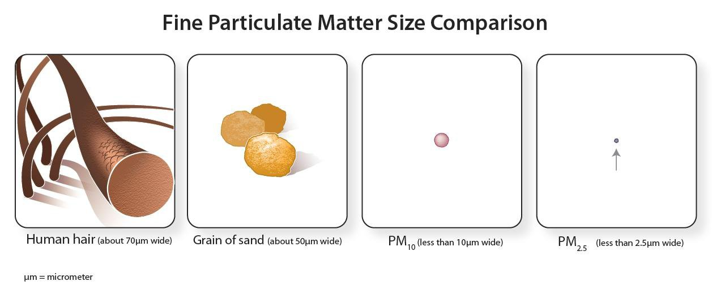
How big is particulate matter?
EXAMPLE: AIR POLLUTION AND HEALTH
Next

Slide 39
Sources of particulate matter
EXAMPLE: AIR POLLUTION AND HEALTH
The composition of these particles can vary based on location, season, and whether they are from primary or secondary sources.
Examples:
  Forest fires
  Road dust
  Electrical power plants
  Industrial processes
  Cars & trucks
Primary
Sources
Give off particulate matter directly
Secondary
Sources
Give off gases that react with sunlight and water in the air to form particles
Examples:
Coal-fired power plants
Car & truck exhaust
Next

Slide 40
Particulate matter & health
EXAMPLE: AIR POLLUTION AND HEALTH
Particles bigger than 10 micrometers can irritate your eyes, nose, and throat but do not usually reach your lungs.
Fine and ultrafine particles less than 2.5 micrometers (PM _{2.5} or smaller) are the most concerning because they are most likely to cause health problems. Their small size allows them to get into the deep part of your lungs and even into your blood.
Next

Slide 41
Particulate matter & health effects
EXAMPLE: AIR POLLUTION AND HEALTH
Being exposed to any kind of particulate matter has been linked to:
Increased emergency department visits and hospital stays for breathing and heart problems
Breathing problems
Exacerbated asthma symptoms
Adverse birth outcomes (e.g. low birth weight)
Decreased lung growth in children
Lung cancer
Early deaths
Next

Slide 42
People who are at the highest risk of being bothered by particulate matter include:
EXAMPLE: AIR POLLUTION AND HEALTH
People with heart or lung diseases will feel the effects of particulate matter sooner and at lower levels than less sensitive people.
Click on the population group to learn why their risk is higher.
Older adults may not know they have lung or heart disease. When particle levels are high, older adults are more likely than young adults to have to go to the hospital or die because the exposure to particle pollution has made their heart or lung disease worse.
People with heart or lung diseases
Older adults
Children are still growing and spend more time at high activity levels. When children come in contact with particle pollution over a long period of time they may have problems as their lungs and airways are developing. This exposure may put them at risk for lowered lung function and other respiratory problems later in life. Children are more likely than adults to have asthma and other respiratory problems that can worsen when particle pollution is high.
Children
Infants
Infants’ lungs continue to develop after birth and can be affected by air pollutants.
Next

Slide 43
Improving air quality improves health.
EXAMPLE: AIR POLLUTION AND HEALTH
Lowering particulate matter levels would prevent deaths, mostly from heart attacks and heart disease.
According to 2012 data, a 10% reduction in PM_{2.5} could prevent:
  376 deaths per year in a highly populated county, like Los Angeles County;
  Almost 1,500 deaths every year in California; and
  Over 12,700 deaths across the nation.
Next

Slide 44
Case Study
Next

Slide 45
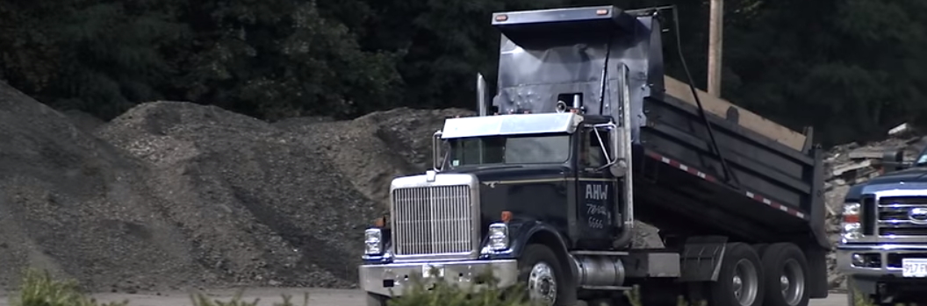
CASE STUDY: MASSACHUSETTS
Asphalt production releases several dangerous pollutants into the air. These pollutants are known to cause some cancers. For people living nearby, the pollutants might also aggravate respiratory conditions like asthma and chronic obstructive pulmonary disease.
Protecting air quality in Massachusetts
The Town of Norwood's Board of Health asked the Massachusetts Environmental Public Health Tracking Program for help in deciding whether to allow construction of a new asphalt plant within the town limits.
Data from the state tracking network informed policymakers about the potential effects of asphalt production on public health. Ultimately, based in part on the data and recommendations provided by the state tracking program, construction was approved. Norwood's Board of Health worked with the company to establish certain conditions for the site during development and operation that would help protect public health.
Next

Slide 46
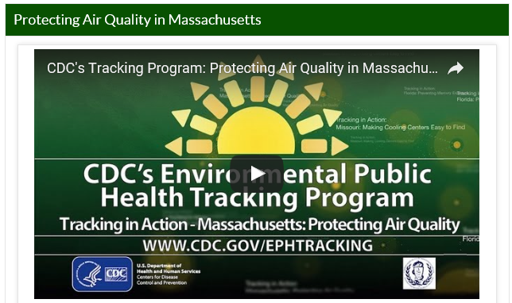
CASE STUDY: MASSACHUSETTS
https://youtu.be/9BVydjpKRH8
Watch this video to see how the Massachusetts Tracking Program worked with local health officials to protect air quality in Norwood with the arrival of a new asphalt plant. It's important to have data that can inform regulations maintaining public and environmental health.
Next

Slide 47
Knowledge Check
Next

Slide 48
KNOWLEDGE CHECK 2
Read each statement and click whether it is TRUE or FALSE.
National air quality has improved since the early 1990s, but many challenges remain in protecting public health and the environment from air quality problems.
Fine and ultrafine particles are not concerning because they are too small to cause health problems.
Correct! This statement is true.
Please answer the second question.
Unfortunately, that is incorrect. This statement is true.
Please answer the second question.
  True
  False
Correct! This statement is false.
Click “Next” to proceed.
Unfortunately, that is incorrect. This statement is false.
Click “Next” to proceed.
  True
  False
Next

Slide 49
Monitoring Environmental Health
Next

Slide 50
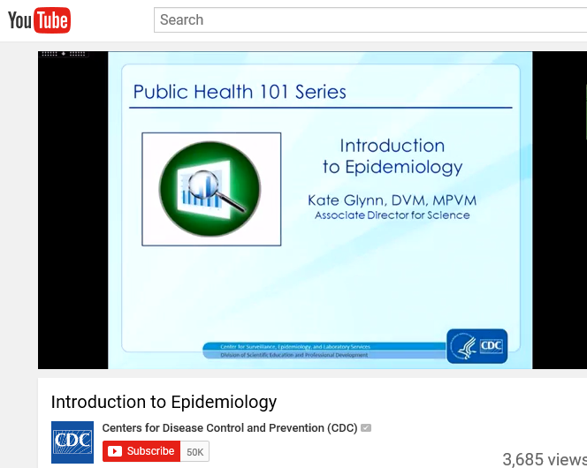
A KEY DISCIPLINE WITHIN PUBLIC HEALTH IS EPIDEMIOLOGY.
Epidemiology is defined by CDC as:
The study of the origin and causes of diseases in a community, and
The scientific method of investigation to get to the root of health problems and outbreaks in a community.
Watch this video to learn more about the basics of epidemiology from CDC’s Public Health 101 series:
https://youtu.be/4oaQUAnA6nY
Next
https://www.cdc.gov/publichealth101/index.html

Slide 51
ENVIRONMENTAL EPIDEMIOLOGY
Epidemiologists in environmental health…
Read about examples of CDC’s environmental epidemiology activities, such as:
E-cigarette study sparks national attention around e-cigarettes and nicotine toxicity
Rise in Colorado ED visits launches epi investigation associated with synthetic marijuana
Epi investigation finds steroid-laced vitamins and minerals; Purity First offers product recalls
  Identify the number of persons who have a particular disease or illness.
  Measure or estimate whether those persons have come in contact with an environmental hazard.
  Compare the number of persons who have a health problem to their potential exposure.
  Study the same kinds of health problems in people who have not come in contact with an environmental hazard and compare results to those who have not been exposed.
https://www.cdc.gov/nceh/tracking/successstories_combined.html
Next
Notes:
https://www.cdc.gov/nceh/hsb/success_stories/ecigarette_study.htm
https://www.cdc.gov/nceh/hsb/success_stories/synthetic_marijuana.htm
https://www.cdc.gov/nceh/hsb/success_stories/steroid_laced.htm

Slide 52

DATA ARE ESSENTIAL TO PUBLIC HEALTH.
As mentioned earlier, environmental causes of chronic diseases can be hard to identify. Measuring amounts of hazardous substances in our environment in a standard way, tracing the spread of these over time and area, seeing how they show up in human tissues, and understanding how they may cause illness is critical.
Next

Slide 53
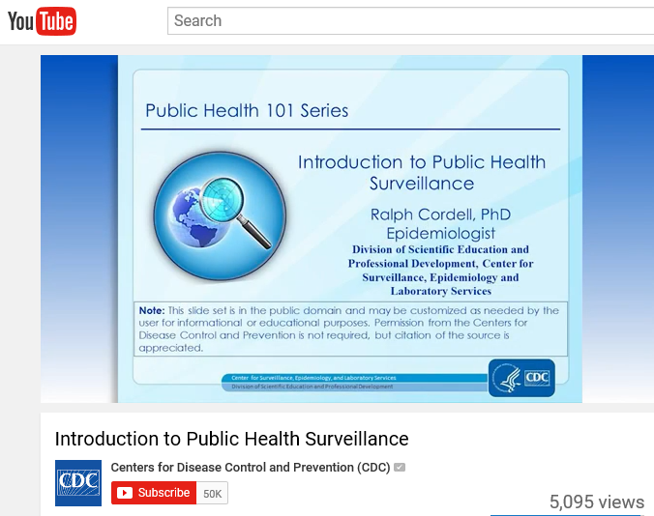
PUBLIC HEALTH SURVEILLANCE IS…
The continuous, systematic collection, analysis, and interpretation of health-related data needed for the planning, implementation, and evaluation of public health practice.
Watch this video to learn more about the basics of public health surveillance from CDC’s Public Health 101 series:
https://youtu.be/kATQimRXcs4
Next
https://www.cdc.gov/publichealth101/index.html

Slide 54

ENVIRONMENTAL PUBLIC HEALTH SURVEILLANCE DATA
There are several types of data that are important and useful to environmental public health practice. Click on a data source to learn more!
Environmental Hazard Data
Health
Data
Exposure Data
Population Data
Next

Slide 55
ENVIRONMENTAL HAZARD DATA
The main types of hazard data that systems contain include the following:
Site-specific
Environmental Monitoring
Site specific: Samples, observations, inspection reports, or source/compliance tests conducted at a specific location
Environmental monitoring: Periodic or continuous surveillance or testing
Data are gathered from fixed points within the environment (e.g., air monitoring stations, routine groundwater sampling, or monitoring of wells) to determine pollutant levels.
Modeling
Modeling: A mathematical method using known information to make simulations, estimates, or predictions about a system or condition
For example, modeled air data are used to estimate levels of ozone and particulate matter in the air. These data are applied to areas that don't have air quality monitors and to fill in time gaps when monitors may not be recording data.
Facility
Facility: Any facility that emits pollutants into the environment is required by law to keep detailed records of these emissions and to report them to the U.S. Environmental Protection Agency (EPA).
Extensive hazard data are generated from internal records of these facilities and from their publicly available reports.
Choose another type of data!
Move onto the next section.

Slide 56
HEALTH DATA
Health Data Sources
Census
Demographics, socioeconomics
Electronic medical records
National surveys
National Health and Nutrition Examination Survey (NHANES), Youth Risk Behavior Survey (YRBS)
Surveillance systems (state and national)
Disease registries, immunization records
Vital statistics
Births, deaths
Rich data exist on most health conditions—from chronic to acute illnesses to injuries and disabilities.
These data come from a variety of sources including the census, electronic medical records, national surveys, surveillance systems, and vital statistics.
Some data are collected by state agencies and some by federal agencies. It can be very difficult to compare data collected by different groups because the data may not be collected or analyzed the same way. There may also be privacy issues that prevent agencies from sharing data, especially health data.
Choose another type of data!
Move onto the next section.

Slide 57
EXPOSURE DATA
Biomonitoring Data Sources
National surveys
National Health and Nutrition Examination Survey (NHANES)
Reports
National Report on Human Exposure to Environmental Chemicals
Biomonitoring is critical in measuring the impact of environmental exposure on individuals.
Most biomonitoring involves measuring the amount of a chemical or its breakdown product (metabolite) that is in a small sample of a person's blood or urine.
Other biological substances that may be used in biomonitoring include hair, nails, semen, breast milk, saliva, or adipose tissue (fat).
Choose another type of data!
Move onto the next section.

Slide 58
POPULATION DATA
Population data include:
Demographics
Health status
Socioeconomic factors
Population characteristics can help predict the possible end results of health problems and the risk for certain diseases or of public health emergencies and associated risks.
They can also show how diseases can develop and change over time and from one place to another.
The main source of population data is the U.S. Census Bureau.
Choose another type of data!
Move onto the next section.

Slide 59
ACCESSING QUALITY AND COMPLETE ENVIRONMENTAL HEALTH DATA CAN BE DIFFICULT.
Environment and health data are often separated, both physically and philosophically.
However, CDC has addressed this challenge through the National Environmental Public Health Tracking Program.
Next

Slide 60
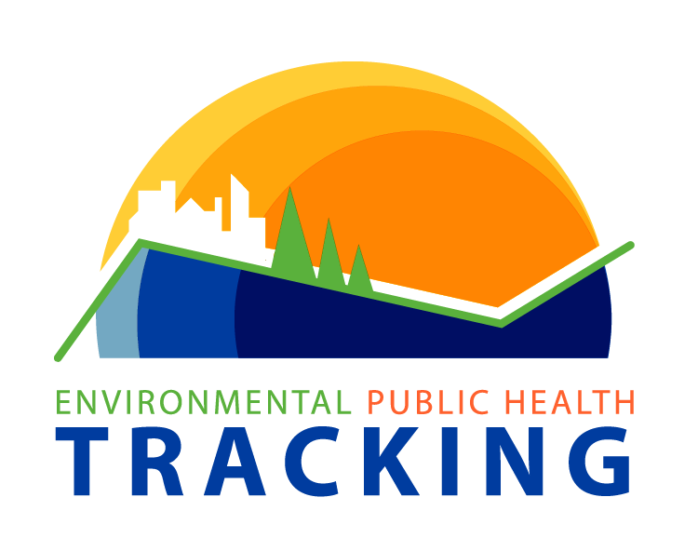
CDC’S ENVIRONMENTAL PUBLIC HEALTH TRACKING PROGRAM…
Connects environmental and public health data and information to drive innovative programs that improve health, save lives, and enable efficient use of resources.
Better information for better health
Next

Slide 61
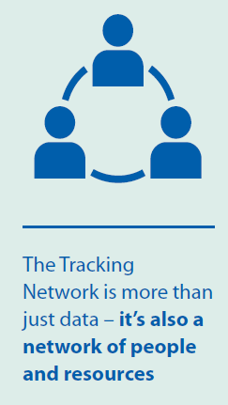
BETTER INFORMATION FOR BETTER HEALTH
At the local, state, and national levels, the Tracking Program uses a network of people and information systems to deliver a core set of health, exposure, and hazards data, information summaries, and tools to enable analysis, visualization, and reporting of insights drawn from data.
Next

Slide 62

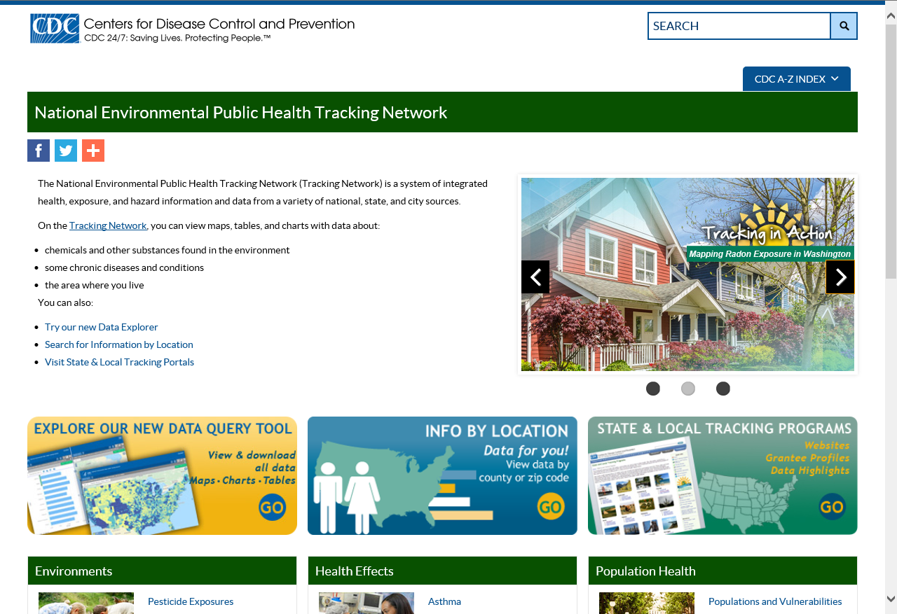
THE ENVIRONMENTAL PUBLIC HEALTH TRACKING NETWORK
The Environmental Public Health Tracking Network is a product of CDC's National Tracking Program.
www.cdc.gov/ephtracking
Next

Slide 63
ENVIRONMENTAL PUBLIC HEALTH SURVEILLANCE
CDC’s Environmental Public Health Tracking Network is an environmental public health surveillance system.
It is a dynamic, online system of integrated health, exposure, and hazard information and data from a variety of national, state, and city sources.
Next
https://www.cdc.gov/ephtracking

Slide 64
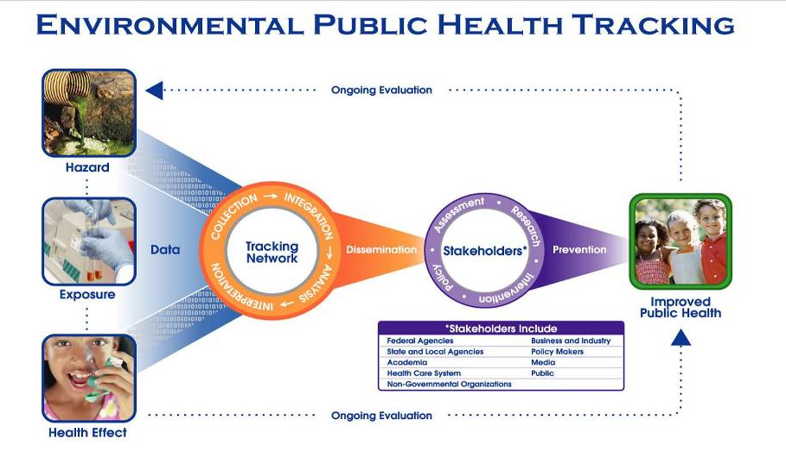
CONCEPTUAL MODEL
Hazard, exposure, and health effect data are standardized and integrated into the National Tracking Network. In many states and at the national level environmental and health data are kept in separate systems, which makes it difficult to combine them for meaningful analysis.
Once these data are integrated into one system, (orange circle), they can be analyzed, interpreted, and disseminated to the many stakeholders who want access to this type of information. Stakeholders (purple circle) include a wide variety of audiences.
Next

Slide 65

THE TRACKING NETWORK
https://www.youtube.com/watch?v=T1Ad79HGeJE
Next

Slide 66
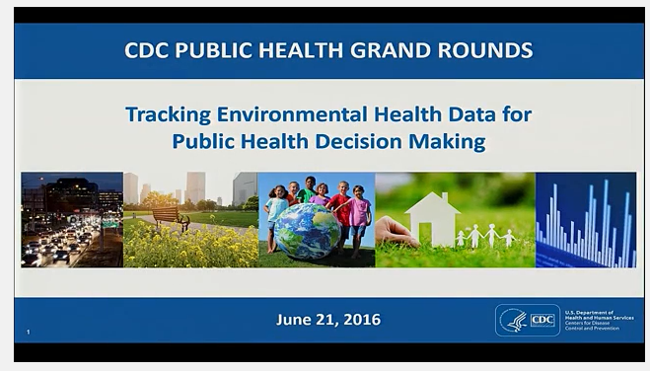
GOAL OF TRACKING
Tracking Environmental Health Data for Public Health Decision Making
Watch this CDC Public Health Grand Rounds Presentation to learn how the Tracking Program is addressing the lack of environmental health data and how the program has informed public health decision making and action at the state and local levels.
The overarching goal of the Tracking Network is to improve and protect public health by giving scientists, researchers, public health professionals, and policy makers access to data that were previously not available in standardized formats.
This allows them to monitor trends over time and to see where resources are needed for further research or public health interventions.
https://www.cdc.gov/cdcgrandrounds/archives/2016/June2016.htm
Next

Slide 67
THE TRACKING NETWORK IS IMPORTANT
Before Tracking | With Tracking
Simple questions could take months to answer | Can respond quickly-often within hours-to locate hazard sources or answer concerns
Environmental and health fields were often separated | These two worlds are brought together to the benefit of all
Focused mainly on acute events such as hazardous chemical releases or point-source pollution | Ability to trace amounts and geographic spread of pollutants over time, allowing monitoring of long-term trends and place those acute events in context
Environmental health surveillance was more difficult than infectious disease surveillance | The same "disease detective" skills can be applied to finding environmental causes of illnesses and then take preventive measures to protect the public's health
Next

Slide 68
Knowledge Check
Next

Slide 69
KNOWLEDGE CHECK 3
Read each statement and click whether it is TRUE or FALSE.
The overarching goal of the Tracking Network is to improve and protect public health by making data that were previously not available accessible in standardized formats.
Environmental hazard data may be modeled, monitored, site-specific, or facility.
Unfortunately, that is incorrect. This statement is true.
Please answer the next question.
Correct! This statement is true.
Click “Next” to proceed.
  True
  False
Correct! This statement is true.
Click “Next” to proceed.
Unfortunately, that is incorrect. This statement is true.
Click “Next” to proceed.
  True
  False
Next

Slide 70
Tracking Network Content
Next

Slide 71

TRACKING NETWORK DATA SOURCES
Tracking Network data come from a variety of national, state, and city sources.
Next

Slide 72

TRACKING GRANTEE DATA
Grantee health departments currently provide data on hospitalizations and emergency department visits, birth defects, and community drinking water.
In addition, some Tracking Fellowship recipients provide data on hospitalizations and emergency department visits.
Tracking Grantees
CDC funds state and local health departments to build and implement local tracking networks. These state and local data systems feed into the national Tracking Network.
https://ephtracking.cdc.gov/showStateTracking
Next
http://www.astho.org/Programs/Environmental-Health/Tracking-Environmental-Health-Hazards/

Slide 73
NATIONAL DATA SOURCES
CDC/ATSDR
Autism & Developmental Disabilities Monitoring Network
Behavioral Risk Factor Surveillance System
National Health & Nutrition Examination Survey
National Toxic Substance Incidence Program
National Vital Statistics System
United States Cancer Statistics
U.S. Government Agencies
Census Bureau
Department of Education
Environmental Protection Agency
Federal Emergency Management Agency
National Aeronautics & Space Administration
National Cancer Institute
National Center for Education Statistics
National Oceanic & Atmospheric Administration
Other
American Association of Poison Control Centers
NAVTEQ
Next

Slide 74
TYPES OF CONTENT ON THE TRACKING NETWORK
Environmental Hazard
Health Effects
Population Health
Next
Notes:
AUDIO SCRIPT: On the Tracking Network, you can view data and contextual information about:
Chemicals and other substances found in the environment
Some chronic diseases and conditions
The area where you live

Slide 75
ENVIRONMENTAL HAZARD DATA
Environmental hazard data play a vital role in tracking efforts.
Understanding the distribution and concentrations of pollutants in the environment increases public health professionals’ ability to understand the role these hazards play in peoples’ health and to develop ways to help people stay healthier.
Environmental Hazard Data
on the Tracking Network
Climate change
Community characteristics
Community design
Drought
Outdoor air quality
Pesticide exposures
Toxic substance releases
Water quality
Next
Notes:
AUDIO SCRIPT: There are several kinds of environmental hazard data on the Tracking Network. Let’s look at each one a little more closely.

Slide 76
CLIMATE CHANGE DATA
CDC's Tracking Network uses data from many sources to track the effects of climate change. While there are a number of indicators related to climate change, the Tracking Network currently has data on extreme heat and flood vulnerability.
CDC scientists are working with other organizations, agencies, and partners in the United States and around the world to monitor climate change and its health effects.
It is important to note that linking climate change to a specific health problem is difficult. For example, a person having a heart attack may have other health conditions not related to heat exposure. However, the information CDC has used is a good starting point to track how climate change can affect health.
Next

Slide 77
CLIMATE CHANGE DATA
CDC's Climate and Health Program looks for people in places who could be most affected by climate change.
The program uses forecasts of future climate change trends and studies how diseases have spread in similar conditions in the past to find and respond to possible health threats now and in the future.
Although scientific understanding of the effects of climate change is still emerging, there is a pressing need to prepare for potential health risks.
Next
http://www.cdc.gov/climateandhealth/default.htm

Slide 78
COMMUNITY CHARACTERISTICS DATA
Community characteristics can include information about an area's natural features, such as how much land is covered by forests or water, and its human-made features like types of housing and locations public service buildings.
The Tracking Network has data about some of these community characteristics.
Community characteristics data can be used with Tracking Network data on Populations and Vulnerabilities to plan effective public health responses to public health emergencies.
Next

Slide 79
COMMUNITY CHARACTERISTICS DATA
Understanding community characteristics, including resources and vulnerabilities, can help public health professionals:
  Identify threats, hazards, and at-risk populations.
  Evaluate potential impact of threats or hazards within the context of a community's population, climate, built environments, infrastructure, and resources.
  Determine potential resource needs and public health actions which could lessen or prevent sickness, injury, or death in the event of a public health emergency.
Next

Slide 80
COMMUNITY DESIGN DATA
Public health problems in the United States, such as motor vehicle-related injuries, obesity, physical inactivity, and breathing and heart problems related to air pollution, are all influenced by the design of our communities.
Designing communities that encourage healthy choices is critical to improving the health and quality of life of community members.
The Tracking Network has data on elements of community design including motor vehicle-related fatalities, types of transportation to work, and commute times, which can help inform community design decisions.
Next

Slide 81
DROUGHT DATA
Understanding drought trends is important for public health professionals, water and sanitation officials, and policy makers for community planning purposes.
Although many factors influence how drought will affect a community, drought trend data and other related indicators can be used to prepare for and prevent potential health risks.
The Tracking Network has data on drought duration and severity in the United States.
Next

Slide 82
OUTDOOR AIR QUALITY DATA
Tracking air pollution can help people understand how often they are exposed to unhealthy levels of air pollution.
Having these data can also help public health professionals or policymakers understand which areas may be most in need of prevention and control activities.
The Tracking Network hosts several types of air quality data.
Next

Slide 83
AIR QUALITY DATA: MONITORED AND MODELED
Monitored Data
The U.S. Environmental Protection Agency (EPA) provides air pollution data about ozone and particulate matter (PM_{2.5}) to CDC for the Tracking Network.
The EPA maintains a database called the Air Quality System (AQS) which contains data from approximately 4,000 monitoring stations around the country, mainly in urban areas. While data from the AQS is considered the "gold standard" for determining outdoor air pollution, the data are limited because the monitoring stations are usually in urban areas or cities and they only take air samples for some air pollutants every three days or during times of the year when air pollution is very high.
Modeled Data
CDC and EPA have worked together to develop a statistical model (Downscaler) to help fill in the AQS data gaps.
With modeled data, the Tracking Network is able to create indicators for counties that do not have monitors (excluding Alaska and Hawaii), and
fill in time gaps when monitors may not be recording data.
The best way to use modeled air data is in conjunction with actual monitoring data.
Next
http://airnow.gov/

Slide 84
AIR QUALITY DATA: NATIONAL-SCALE AIR TOXICS ASSESSMENT DATA
Another type of air quality data is from the National-Scale Air Toxics Assessment (NATA). NATA is EPA's ongoing comprehensive evaluation of air toxics in the United States. Data from this system are used to calculate the Tracking Network’s Air Toxics indicators for benzene and formaldehyde.
NATA was developed as a tool to inform both national and more localized efforts to collect air toxics information, characterize emissions, and help prioritize pollutants/geographic areas of interest for more refined data collection and analyses. The goal is to identify those air toxics which are of greatest potential concern in terms of contribution to population risk.
Next
http://www.epa.gov/nata/

Slide 85
AIR QUALITY DATA: ATMOSPHERIC REMOTE SENSING MODELED PM_{2.5}
A third type of air quality data comes from the National Aeronautics and Space Administration (NASA). NASA provides atmospheric sensing data from their satellites to CDC for this project.
Scientists from CDC, NASA, and Emory University are working together to determine how these data can be used with other air pollution monitoring data to measure fine particulate matter (PM_{2.5}) in outdoor air.
Next

Slide 86
AIR QUALITY DATA: MORTALITY BENEFITS OF REDUCING PM_{2.5} LEVELS
The next type of air quality data on the Tracking Network uses methods developed by the EPA and others to estimate how lowering air pollution levels can affect health. To calculate these estimates, CDC uses modeled air data for fine particulates, death data from CDC's National Center for Health Statistics, population data from the U.S. Census Bureau, and information about the relationship between change in air pollution and how that influences health effects from scientific literature.
These data summarize the estimated number of deaths prevented and percent change in deaths associated with lowering PM _{2.5} concentration levels. They can be used to help:
Identify areas where interventions to reduce air pollution could result in meaningful health improvements.
Inform policy or programmatic decisions about improving air quality, which can reduce illness and death.
Next

Slide 87
PESTICIDE EXPOSURE DATA
Scientists do not yet have a clear understanding of the chronic health effects of pesticide exposures.
However, pesticide exposure data on the Tracking Network can be used to estimate the extent of pesticide-related illnesses and identify trends and patterns of reported pesticide exposures over time and in different geographic regions.
The American Association of Poison Control Centers (AAPCC) works with the nation's poison centers throughout the United States to monitor poisonings and their sources.
https://www.aapcc.org/
The pesticide exposure data used on the Tracking Network come from the American Association of Poison Control Centers.
Next

Slide 88
TOXIC SUBSTANCE RELEASES DATA
Despite efforts to prevent toxic substance incidents, accidental releases occur routinely wherever substances are stored, used, or transported. These incidents can be harmful for human health and the environment.
The toxic substance release data on the Tracking Network are from the Agency for Toxic Substance and Disease Registry's (ATSDR) National Toxic Substance Incident Program (NTSIP).
https://www.atsdr.cdc.gov/ntsip/index.html
Next

Slide 89
TOXIC SUBSTANCE RELEASES DATA
Tracking Network data can be used to:
Track toxic substance release incidents reported by state health departments.
Monitor trends in acute toxic substance release incidents from various areas across the United States.
Examine patterns and trends in locations of reported toxic substance releases, types of industries and substances involved, contributing factors, and the resulting injuries and public health actions (e.g., evacuations, decontamination).
Better understand the causes of incidents and injures, which can help public health officials focus prevention efforts and prepare for future toxic substance emergencies.
Next

Slide 90
WATER QUALITY DATA
Drinking water quality is an important public health issue because contamination in a single system can expose many people at once.
Drinking water protection programs at the state and national levels play a critical role in ensuring high-quality drinking water and in protecting the public's health.
The Tracking Network has data and information about the levels of several contaminants that can be found in drinking water. While they are not gathered specifically to assess the level of exposure or to track changes in water quality over time, they can be used to determine the potential for public health impacts from contaminant levels of concern.
Next

Slide 91
HEALTH EFFECTS DATA
Health effect data also play a vital role in tracking efforts.
Understanding the trends in health effects related to environmental hazard exposures increases public health professionals’ ability to prioritize resources and plan interventions and programs to protect public health.
Health Effects Data
on the Tracking Network
Asthma
Birth defects
Cancer
Carbon monoxide poisoning
Childhood lead poisoning
Chronic Obstructive Pulmonary Disease
Developmental disabilities
Heart disease
Heat Stress Illness
Reproductive and birth outcomes
Next
Notes:
AUDIO SCRIPT: There are several kinds of health effect data on the Tracking Network. Let’s look at each one a little more closely.

Slide 92
ASTHMA DATA
The Tracking Network includes data on asthma hospitalizations and asthma prevalence, which is the number of people diagnosed with and living with asthma.
These data are useful in providing estimates about the geographic distribution and effects of asthma among different populations. They can be used to plan and evaluate asthma interventions.
Hospitalization data come from Tracking grantees and asthma prevalence data come from CDC’s Behavioral Risk Factor Surveillance System (BRFSS).
Next
https://www.cdc.gov/brfss/

Slide 93
BIRTH DEFECTS DATA
Birth defects data on the Tracking Network come from several grantee states.
Not every state collects birth defects data. Among the states that do collect birth defects data, not all of their surveillance systems collect data in the same way; so you should not compare information from one state to another.
Comparisons that can be made within a state include:
  Frequency of birth defects by area such as county,
  Frequency of birth defects over time, and
  Frequency of birth defects by race or ethnicity and changes in these measures over time.
Next

Slide 94
CANCER DATA
Cancer surveillance systems are the most well-established and extensive disease surveillance networks in the United States. The Tracking Network is making cancer incidence data easier to use by integrating the information with other health outcome data and environmental data.
In addition, the Tracking Network can add to existing public health surveillance of cancer by examining potential ecological relationships with environmental exposures.
Cancer data on the Tracking Network come from the National Cancer Institute’s Surveillance Epidemiology and End Results (SEER) Program and CDC’s National Program of Cancer Registries.
Next

Slide 95
CARBON MONOXIDE POISONING DATA
The Tracking Network uses several sources to get state and local data about carbon monoxide (CO) poisoning. These sources include Tracking grantees’ hospital and emergency department databases and death certificate data collected by CDC’s National Vital Statistics System.
Tracking CO poisoning in a standard way over time can help us:
  Better understand the health consequences of CO poisoning across the United States,
  Learn about the effects of long-term exposures to low levels of CO,
  Monitor trends,
  Identify high risk groups, and
  Determine the impact of public health policy aimed at preventing CO poisoning.
Next

Slide 96
CHILDHOOD LEAD POISONING DATA
The Tracking Network uses several sources to get state and local data about lead poisoning, including data collected by state and local childhood lead poisoning prevention programs. It provides information about blood lead testing and blood lead levels among children born in the same year, known as a birth cohort.
The Tracking Network also uses U.S. Census data to provide information about the number of homes built before 1950 and the poverty level in a specific area. Living in homes built before the 1950s and living in poverty have been identified as risk factors for elevated blood lead levels in children.
Having measures for blood lead levels and a measure for age of housing together on the Tracking Network can help assess testing within areas of high risk.
Next

Slide 97
CHRONIC OBSTRUCTIVE PULMONARY DISEASE (COPD) DATA
The Tracking Network uses data from the U.S. Census Bureau, hospital and emergency department databases provided by state and/or local health departments, and death certificates from CDC’s National Center for Health Statistics to calculate state and local data about COPD.
Tracking COPD in a standard way will help us:
  Assess the burden of COPD;
  Examine trends over time;
  Identify high-risk groups in need of targeted intervention;
  Assess geographic differences; and
  Enhance prevention, education, and evaluation efforts.
Next

Slide 98
DEVELOPMENTAL DISABILITIES DATA
No nationwide system actively tracks all developmental disabilities. The Tracking Network is currently using two developmental disabilities data sources: CDC's Autism and Developmental Disabilities Monitoring (ADDM) Network, and the Department of Education's Individuals with Disabilities Education Act (IDEA).
Although causes of specific developmental disabilities are often not known, these disabilities were chosen because some scientific evidence suggests environmental exposures may play a role in developing these conditions.
ADDM Network: Monitors autism spectrum disorders (ASDs) and other developmental disabilities for several locations across the country in order to estimate the population prevalence of ASDs among 8-year-old children.
IDEA: Provides an estimate of children who are receiving public special education services in the United States. IDEA data are collected for regulatory purposes and implementation varies from state to state.
Next

Slide 99
HEART DISEASE DATA
Currently, the United States does not have a single heart attack surveillance system, nor does a surveillance system exist for coronary heart disease in general.
The Tracking Network hosts mortality data for heart attack and ischemic heart disease from CDC’s National Center for Health Statistics as well as heart attack hospitalization data from Tracking grantees.
Tracking heart disease will help with:
  Examination of time trends;
  Identification of any seasonal patterns;
  Assessment of geographic differences;
  Evaluation of differences in heart disease by age, gender, and race/ethnicity; and
  Determination of populations in need of targeted interventions.
Next

Slide 100
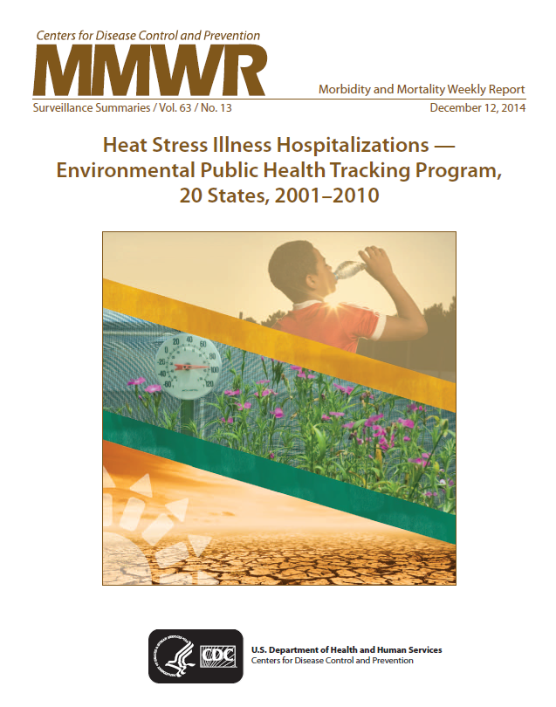
HEAT STRESS ILLNESS DATA
CDC tracks the effects of extreme heat by collecting and reviewing the number of health conditions reported from local hospitals and the number of deaths reported from state health departments.
Reviewing these national data helps public health professionals:
  Make comparisons between environmental conditions and health problems.
  Identify populations and areas with high risk for heat-associated death.
  Gain a better understanding of trends in heat-related deaths over time.
  Compare states and counties to plan interventions.
  Identify communities at risk and the groups of people that may be at risk.
This MMWR summarizes heat stress illness hospitalizations data from the Tracking Network.
Heat Stress Illness Hospitalizations - Environmental Public Health Tracking Program, 20 States, 2001-2010, MMWR. December 12, 2014 / 63(SS13);1-10.
https://www.cdc.gov/mmwr/preview/mmwrhtml/ss6313a1.htm
Next

Slide 101
REPRODUCTIVE AND BIRTH OUTCOMES DATA
In order to understand better the role that environmental exposures play in reproductive and infant health problems, the Tracking Network collects and displays data on:
Vital statistics data collected by CDC are used to estimate these measures.
Fertility and infertility
Infant and perinatal deaths
Sex ratio (the ratio of male to female births)
Premature births
Low birthweight
Next

Slide 102
POPULATION HEALTH DATA
Types of Population Health Data on the Tracking Network:
Biomonitoring: Population exposures
Lifestyle risk factors
Populations & Vulnerabilities
Population health data can provide context about relationships between exposures and health effects.
Information about age, sex, race, and behavior or lifestyle may help us understand why a person has a particular health problem.
Data sources for population characteristics data on the Tracking Network include CDC’s National Vital Statistics System and the U.S. Census Bureau.
Next
Notes:
AUDIO SCRIPT: There are several kinds of population health data on the Tracking Network. Let’s look at each one a little more closely.

Slide 103
BIOMONITORING DATA
Biomonitoring data come from CDC's National Health and Nutrition Examination Survey (NHANES).
Biomonitoring data can be used to:
  Find out what chemicals people are exposed to and the levels of the chemicals found.
  Evaluate prevention efforts.
  Determine if exposure levels are different among potentially vulnerable groups.
  The environmental chemicals included on the Tracking Network were selected for one or more of the following reasons:
  At least half of the U.S. population has enough of the specific chemical in their blood or urine to measure.
  They have widespread environmental sources of exposure.
  The data are related to other data on the Tracking Network or other environmental data sources such as drinking water or air quality data.
  We can likely reduce exposures to these chemicals through changes in policy, regulations, or personal behaviors.
Next
http://www.cdc.gov/nchs/nhanes.htm

Slide 104
LIFESTYLE RISK FACTORS DATA
When examining chronic diseases and their potential connection to the environment, it is important to consider other health risk factors that could play a role in their development.
These data can be used by public health professionals to:
Determine if certain health outcomes are related to the environment or if they could also be due to lifestyle risk factors such as smoking and lack of physical activity.
Determine the best public health actions to reduce modifiable lifestyle risk factors in their communities.
The lifestyle risk factor data available on the Tracking Network are collected as part of CDC's Behavioral Risk Factor Surveillance System (BRFSS).
Next
http://www.cdc.gov/brfss/index.html

Slide 105
POPULATIONS AND VULNERABILITIES DATA
Certain factors, like sex, age, or income can influence health, the risk for certain diseases, and the risk for being seriously affected by public health emergencies. The same is true for populations.
Knowing a population’s characteristics, including their vulnerabilities and resources, can help public health professionals determine possible effects of health problems or environmental conditions on disease trends and patterns over time and across locations.
These data can show which areas or population groups are likely to be:
At-risk for acute and chronic illnesses.
Exposed to different chemicals in the environment.
Race and ethnicity.
Affected by a public health emergency.
Next

Slide 106
POPULATIONS AND VULNERABILITIES DATA
Categories of population characteristics and vulnerabilities data
Demographics | Health Status | Socioeconomic Factors
Age English language proficiency Household type Population density Race and ethnicity Sex | Chronic health conditions Disabilities Health insurance status | Education level Employment status Household income Poverty status
Next

Slide 107
Knowledge Check
Next

Slide 108
KNOWLEDGE CHECK 4
Read each statement and click whether it is TRUE or FALSE.
The Tracking Network has data on all of the following environmental hazards EXCEPT:
  Climate
Correct, “Indoor air pollution”!
Hit “Next” to proceed.
Unfortunately, that is incorrect.
The correct answer is C, “Indoor air pollution.”
Hit “Next” to proceed.
Unfortunately, that is incorrect.
The correct answer is C, “Indoor air pollution.”
Hit “Next” to proceed.
  Community design
Unfortunately, that is incorrect.
The correct answer is C, “Indoor air pollution.”
Hit “Next” to proceed.
  Indoor air pollution
  Outdoor air pollution
Next

Slide 109
KNOWLEDGE CHECK 4
Read each statement and click whether it is TRUE or FALSE.
The Tracking Network has data on the following health effects:
  Adult lead poisoning, asthma, birth defects, heat stress illness
Correct, “Asthma, developmental disabilities, heart disease, heat stress illness”!
Hit “Next” to proceed.
Unfortunately, that is incorrect.
The correct answer is C, “Asthma, developmental disabilities, heart disease, heat stress illness.”
Hit “Next” to proceed.
Unfortunately, that is incorrect.
The correct answer is C, “Asthma, developmental disabilities, heart disease, heat stress illness.”
Hit “Next” to proceed.
Unfortunately, that is incorrect.
The correct answer is C, “Asthma, developmental disabilities, heart disease, heat stress illness.”
Hit “Next” to proceed.
  Cancer, COPD, chronic kidney disease, heart disease
  Asthma, developmental disabilities, heart disease, heat stress illness
  Birth defects, birth outcomes, cancer, foodborne illness
Next

Slide 110
KNOWLEDGE CHECK 4
Read each statement and click whether it is TRUE or FALSE.
Population health data on the Tracking Network include:
  Biomonitoring
Unfortunately, that is incorrect.
The correct answer is E, “All of the above.”
Hit “Next” to proceed.
Unfortunately, that is incorrect.
The correct answer is E, “All of the above.”
Hit “Next” to proceed.
Unfortunately, that is incorrect.
The correct answer is E, “All of the above.”
Hit “Next” to proceed.
Unfortunately, that is incorrect.
The correct answer is E, “All of the above.”
Hit “Next” to proceed.
  Demographics
Correct, “All of the above”!
Hit “Next” to proceed.
  Lifestyle risk factors
  All of the above
Next

Slide 111
Accessing the Tracking Network
Next

Slide 112
USING THE TRACKING NETWORK
On the Tracking Network, you can view maps, tables, and charts through the Data Explorer.
Contextual Information about each content area is also provided, covering:
  General information about the topic
  Exposure and risk information
  Prevention tips
  Information about why the topic is included on the Tracking Network
  Potential uses for the data
Next
www.cdc.gov/ephtracking

Slide 113
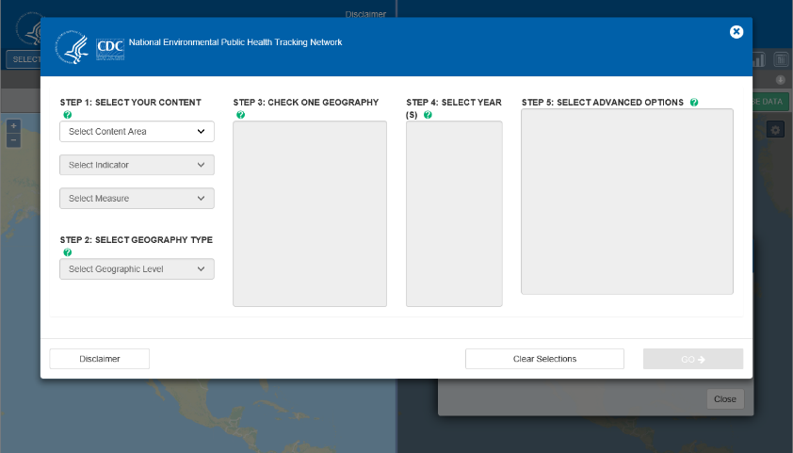
DATA EXPLORER
The Tracking Network’s Data Explorer allows you to access the hazard, health, and population data just described.
Next

Slide 114
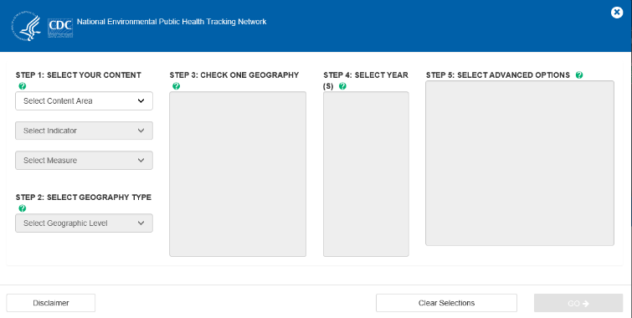
TO ACCESS THE DATA
The first step is to select your content.
  Select the content area you are interested in.
  Select an indicator.
  Select a measure.
CONTENT AREA
INDICATOR
MEASURE
Next
Notes:
CONTENT THAT WOULD APPEAR WHEN A USER CLICKS ON EACH WORD IN THE TRIANGLE
Content area: The health condition, hazard, or population characteristic. Examples: Asthma, Climate Change, Populations & Vulnerabilities
Indicator: An indicator is the specific type of data that helps describe the content area in more detail. Examples: incidence, prevalence, levels of contaminants, demographics.
Measure: Each indicator has at least one measure. A measure is a summary characteristic or statistic, such as a number, sum, percentage, or rate.

Slide 115
EXAMPLES
Content Area | Indicator | Measure
Asthma | Hospitalizations for Asthma | Crude Rate of Hospitalizations for Asthma per 10,000 population
Cancer | Incidence of Bladder Cancer | Annual Number of Cases of Bladder Cancer
Climate Change | Heat-Related Mortality | Number of Deaths due to Heat Stroke/Exhaustion by state, by month, by year
Heart Disease | Heart Attack Mortality | Number of deaths from heart attack among persons 35 and older
Pesticide Exposures | Reported pesticide exposures | Rate of reported exposures to all pesticides per 100,000 people
Population Characteristics | Demographic Measures | Number of People
Next

Slide 116
NEXT STEPS
Once you’ve selected your content, you will need to select the geography.
Next, select the timeframe.
Some of the data have advanced options, like breakdowns by age, race, or gender. Advanced options are selected last.
Next

Slide 117
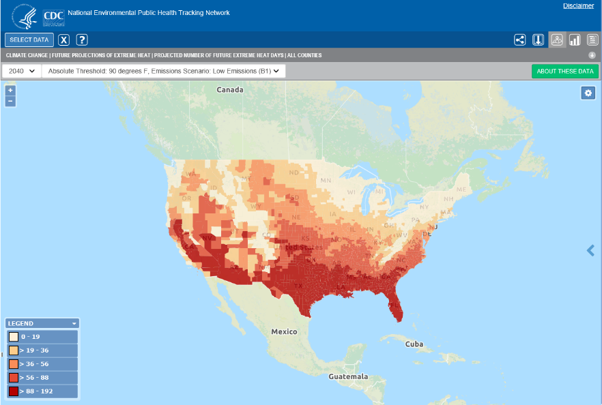
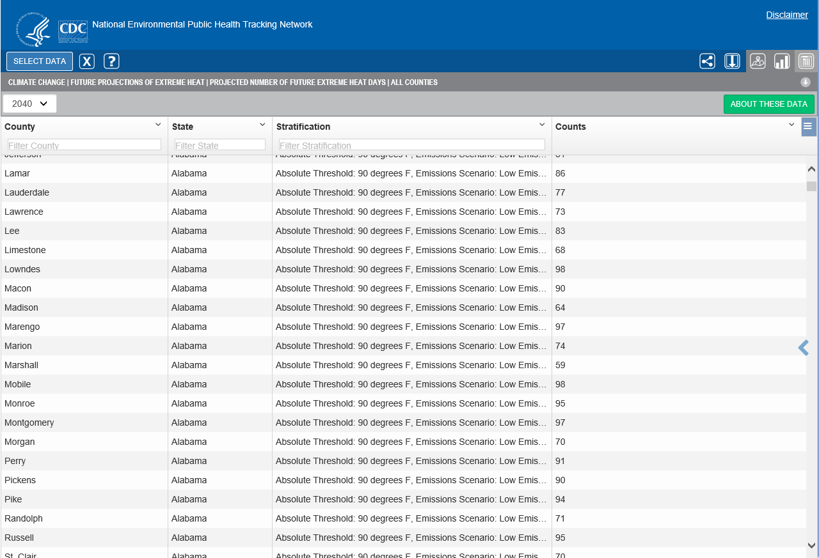
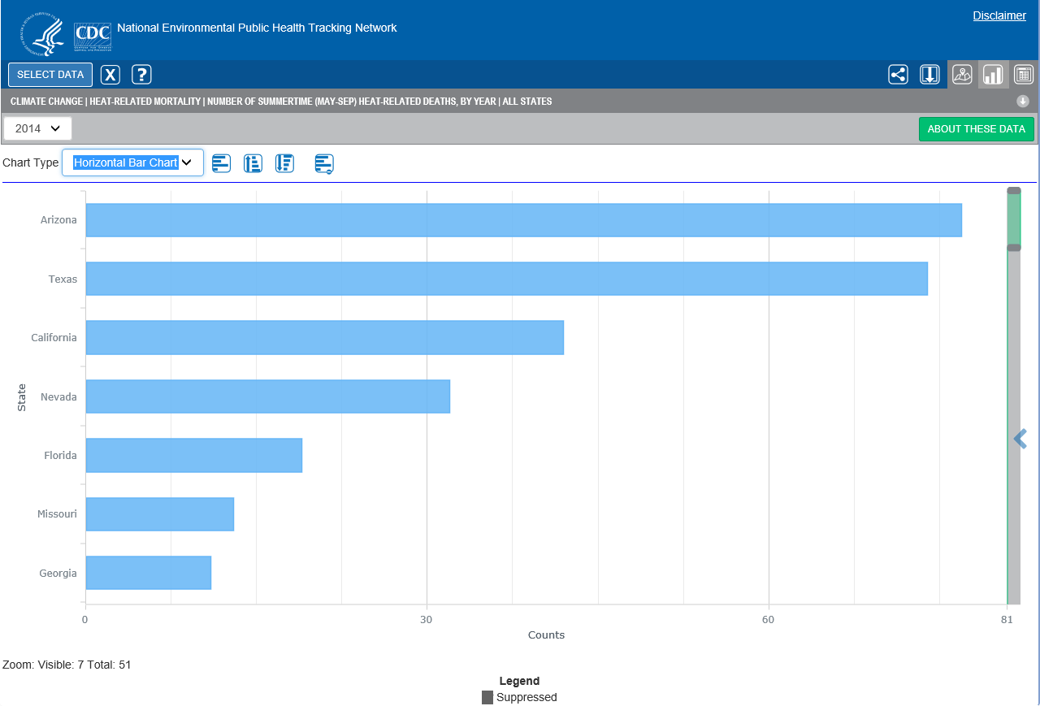
VIEWING THE DATA
Tracking Network data can be viewed in maps, tables, and charts.
Users can customize the maps, tables, and charts.
Examples include adjusting the zoom, changing map backgrounds and color schemes, sorting and hiding table columns, and selecting different chart types.
Next

Slide 118
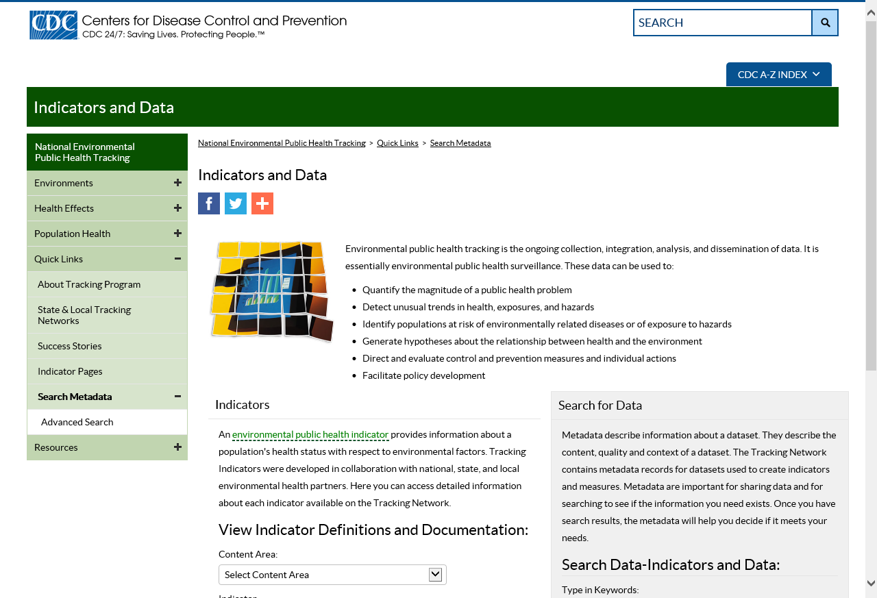
METADATA
The Tracking Network provides metadata, or data about the data, for all indicators.
Metadata describe the content, quality, and context of a dataset and provide links to additional information such as quality assurance documents and data dictionaries.
Once you have completed your search through the Data Explorer, the metadata will help you decide if it meets your needs.
Next

Slide 119
ADDITIONAL FEATURES
In addition to data and contextual information, the Tracking Network provides a number of tools to help users better understand and use environmental health data.
Some of the tools you will find are:
Info by Location
Health Impact Assessment (HIA) Toolkit
Next

Slide 120
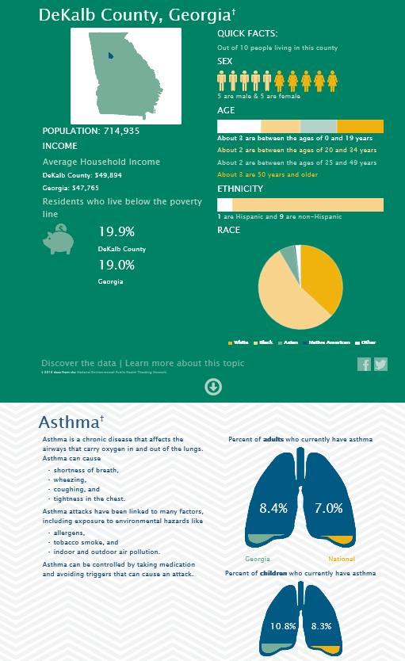
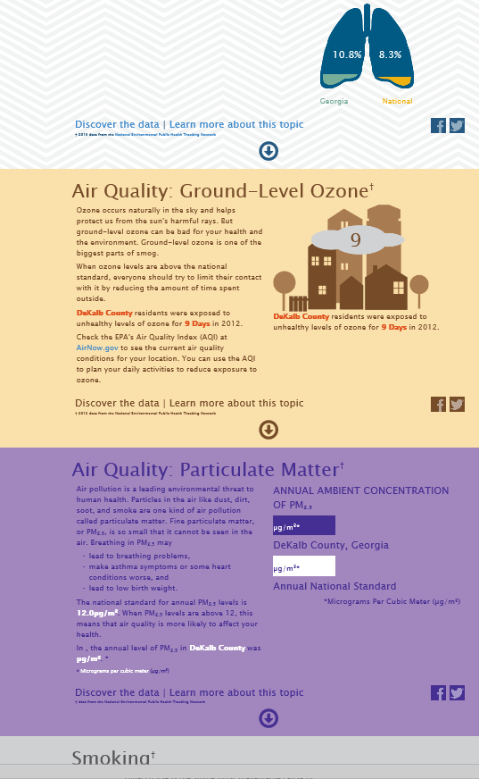
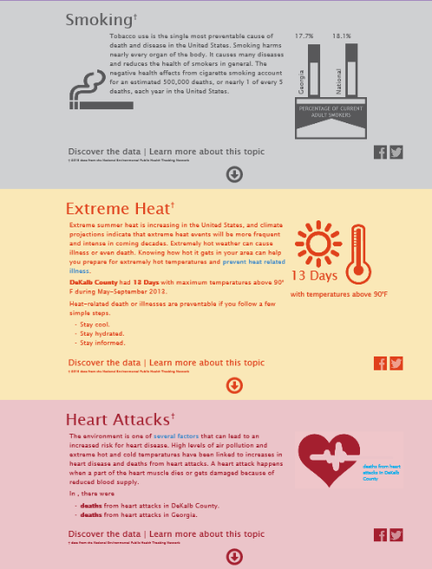
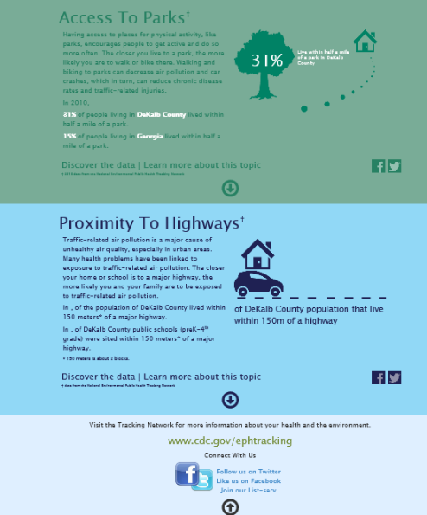
TOOLS: INFO BY LOCATION
Info by Location is a data tool that provides a snapshot of environmental health issues by county.
Data come from the Data Explorer but are presented in an infographic format.
Next

Slide 121
TOOLS: HEALTH IMPACT ASSESSMENT (HIA) TOOLKIT
Tracking Network data may be used in several HIA steps, including community engagement, scoping, assessment, and evaluation.
An HIA is a process to evaluate the potential positive and negative public health effects of a plan, project, or policy before it is approved, built, or implemented.
The Tracking Program has developed a data guide which provides suggestions for how to use data from the Tracking Network in an HIA.
Next

Slide 122
Tracking in Action
Next

Slide 123
WHY USE THE TRACKING NETWORK?
Search environment and health data easily in one place.
Find contextual information and resources about how the environment may be affecting public health.
Use that information for a range of personal and public health actions.
Next

Slide 124







USES FOR TRACKING NETWORK DATA
Direct and evaluate control and prevention measures and individual actions
Quantify the magnitude of a public health problem
Detect unusual trends in health, exposures, and hazards
Facilitate policy development
Educate the public so they can take action to protect their health and the health of their families
Identify populations at risk of environmentally related diseases or of exposure to hazards
Generate hypotheses about the relationship between health and the environment
Next

Slide 125
TRACKING IN ACTION
There are many examples of how environmental public health tracking data from the Tracking Network have been used to improve public health across the United States.
Let’s take a closer look at three examples from Tracking Program grantees.
Next

Slide 126
CASE STUDY: CALIFORNIA
Lack of Data Limits Delivery of Breast Cancer Services and Education
Breast cancer is a public health concern in California. Breast cancer data are usually analyzed and reported for the state as a whole or at the county level. Not having city or neighborhood level data makes it difficult for public health professionals and health care providers to identify specific areas that are most in need of breast cancer services.
CA Tracking Program Uses Small-Area Mapping
The California Tracking Program worked with an advisory group to determine that the best way to map breast cancer data for the state is to show data not limited by county boundaries.
Mapping data to smaller area showed places with elevated rates of invasive breast cancer, including portions of East Ventura and West Los Angeles. This was surprising because Ventura and Los Angeles Counties had not shown consistently elevated rates of invasive breast cancer when shown in previous county-level maps.
Next
http://www.cehtp.org/page/main

Slide 127
CASE STUDY: CALIFORNIA
Targeted Outreach and Education
for Underserved Patients
The Los Robles Hospital & Medical Center, located in East Ventura, used the mapping results to focus some of their outreach and education on low-income clients. They incorporated breast cancer–specific messages into other hospital education and outreach efforts. The tracking program’s maps helped them identify and focus efforts on meeting the needs of women in their community.
Small-Area Mapping Identifies Vulnerable Population
The tracking program enhanced the cancer data by providing and analyzing demographic data for the areas with elevated rates, which was a key recommendation from the advisory group.
Doing this highlighted that, compared to breast cancer patients across California, the women who were diagnosed with invasive breast cancer in the East Ventura/West Los Angeles area were more likely to be uninsured or receiving government assistance at the time of diagnosis.
Next

Slide 128
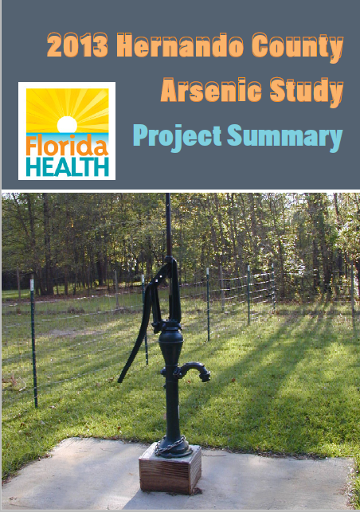
CASE STUDY: FLORIDA
The Florida Department of Health had been sampling drinking water wells in the central part of the state for arsenic based on suspected areas of concern. They found that about 1 out of every 3 Hernando County drinking water wells tested had elevated levels of arsenic.
As a result, the Florida Department of Health in Hernando County and the Florida Tracking Program conducted a year-long study in "hot spot" areas that had a higher risk of arsenic exposure from well water.
2013 Hernando County
Arsenic Study
Read the full report summarizing the Florida Tracking Program’s year-long study of arsenic exposure from well water.
Report found under “Notable Projects” on the left-hand side: https://www.floridatracking.com/healthtracking/default.htm
Next

Slide 129
CASE STUDY: FLORIDA
Florida Tracking Program Leads Study to Determine Health Risks
The Florida Tracking Program led the well water project in Hernando County with help from the local department of health. The study looked at whether using filters on kitchen water faucets could reduce a person’s exposure to arsenic.
Results from the study confirmed that using filters is an effective way to reduce exposure to elevated levels of arsenic. Also, study results showed that other exposures to arsenic in water from non-filtered locations in the home, such as bathrooms, did not significantly increase the level of arsenic found in a person’s body.
Study shows filters can reduce arsenic exposure
During the study, two households had such high levels of arsenic in their well water that they qualified for free bottled water or filters.
Before the study, these households were not aware of the high arsenic levels and the need for a filter to reduce exposure.
Al Gray, Environmental Manager at the Florida Department of Health in Hernando County, says that the strong collaborative relationships among the affected communities, the Florida Tracking Program, and local media contributed to the success of the study.
Next
https://www.floridatracking.com/healthtracking/

Slide 130
CASE STUDY: MISSOURI
The elderly are among the most vulnerable to heat illness during a heat wave. Knowing this has prompted public health practitioners to develop prevention messages, community outreach programs, and other interventions to help keep seniors safe during extreme heat events.
Making Missouri cooling centers easier to find
In the summer, cooling centers can be critical for keeping people, especially seniors, from getting heat related illnesses. The CDC-funded Missouri Environmental Public Health Tracking Program and the Division of Senior and Disability Services joined forces to develop an online map of cooling centers available to all Missourians. This interactive map allows Missouri residents to locate a cooling center close to their homes.
Next
https://ephtn.dhss.mo.gov/EPHTN_Data_Portal/index.php

Slide 131
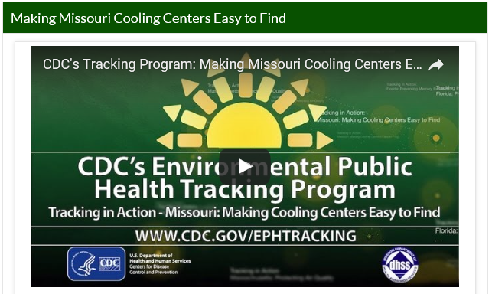
CASE STUDY: MISSOURI
Watch this video to see how the Missouri Tracking Program worked with local health officials to create an interactive, dynamic online map that makes cooling centers easy to find.
https://youtu.be/HE4yJYY4WH8
Next

Slide 132

BEYOND DATA: FACES OF TRACKING
The Tracking Network is more than just data – it’s also a network of people and resources that transform data into public health action.
Tracking programs provide essential environmental health infrastructure and expertise to keep communities safe and help improve where we live, work, and play.
Faces of Tracking showcases the people who have been impacted by Tracking, or have used Tracking data to enact public health change across the United States.
Next
https://www.cdc.gov/nceh/tracking/facesoftracking.htm

Slide 133
Review of Key Points
Next

Slide 134
REVIEW OF KEY POINTS
There is a connection between the environment and the health of individuals and communities.
Environmental health is the discipline that focuses on the interrelationships between people and their environment, promotes human health and well-being, and fosters a safe and healthful environment.
Environmental health practitioners aim to reduce environmental hazards and their adverse health effects through:
    Conducting research
    Developing standards, guidelines, and recommendations
    Implementing interventions and programs to address environmental health issues
There are gaps in information about how the environment affects human health. Some health effects are known, others are suspected.
Exposure to environmental hazards does not necessarily mean that a person will get sick.
Next

Slide 135
REVIEW OF KEY POINTS
The effect of an environmental hazard on individual health is influenced by several factors: dose, duration, exposure route, and personal traits.
The more we know about the health consequences of an environmental hazard, the better we can protect public health through policies, education, and interventions.
CDC’s Environmental Public Health Tracking Program connects environmental and public health data and information to drive innovative programs that improve health, save lives, and enable efficient use of resources.
The Tracking Program uses a network of people and information systems to deliver a core set of health, exposure, and hazards data, information summaries, and tools to enable analysis, visualization, and reporting of insights drawn from data.
Next

Slide 136
REVIEW OF KEY POINTS
The Environmental Public Health Tracking Network is a product of CDC's National Tracking Program. It is a dynamic, online system of integrated health, exposure, and hazard information and data from a variety of national, state, and city sources.
Content on the Tracking Network includes environmental hazards, health effects, and population health.
You can use the Tracking Network to:
  Search environment and health data easily in one place.
  Find contextual information and resources about how the environment may be affecting public health.
  Use that information for a range of personal and public health actions.
Next

Slide 137
REVIEW OF KEY POINTS
Examples of applications of Tracking Network data:
  Quantifying the magnitude of a public health problem
  Detecting unusual trends
  Identifying populations at risk
  Generating hypotheses
  Directing and evaluating control and prevention measures and individual actions
  Facilitating policy development
  Educating the public so they can take action to protect their health and the health of their families
Next

Slide 138
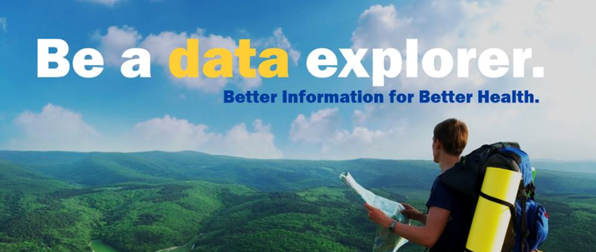
www.cdc.gov/ephtracking
For more information please contact Centers for Disease Control and Prevention
1600 Clifton Road NE, Atlanta, GA 30333
Telephone: 1-800-CDC-INFO (232-4636)/TTY: 1-888-232-6348
E-mail: cdcinfo@cdc.gov Web: www.cdc.gov

Slide 139
Follow us on social media!
Connect with us to learn about new data, tools, and resources available on the Tracking Network:
  Join our email listserv
  Twitter
  Facebook

