Slide 1
Hypospadias
Disclaimer: The findings and conclusions in this presentation have not been formally disseminated by the Centers for Disease Control and Prevention and should not be construed to represent any agency determination or policy.
Notes:
This presentation is about hypospadias, which is a congenital malformation of the urethra. The term congenital refers to a condition that occurs during intrauterine life and might be evident at birth or later in life.

Slide 2
Learning Objectives
By the end of this presentation, participants will be able to
Describe the clinical features of hypospadias
Understand the main epidemiological features of hypospadias
Apply tips for coding and reporting
Improve knowledge and practice of hypospadias surveillance
Hypospadias | 2
Notes:
By the end of this presentation, you will be able to describe the clinical manifestations of hypospadias, understand its main epidemiological features, apply tips for coding and reporting the condition, and improve your knowledge and practice of hypospadias surveillance.

Slide 3
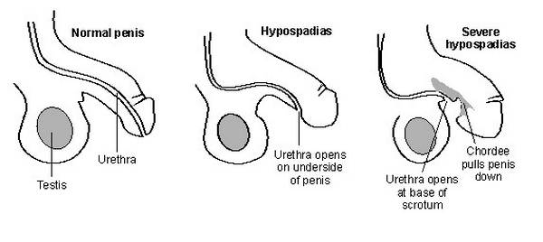
Hypospadias: Definition
Hypospadias is a common congenital anomaly of the male external genitalia, in which the urethral meatus (opening of the urethra) opens in the ventral side (underside) of the penis.
The shortening of the ventral side of the penis found in hypospadias can result in a penile curvature, known as chordee.
Hypospadias | 3
Notes:
Hypospadias is a common congenital anomaly of the male penile urethra. The opening of the urethra (or the urethral meatus), which is normally at the end of the penis, opens on the ventral side (underside) of the penis. In severe cases, the urethra opens at the base of the scrotum and the ventral side of the penis is shortened. The shortening of the ventral side of the penis found in hypospadias can result in a penile curvature, known as chordee. Indeed, chordee is a congenital condition resulting from abnormal development of the penis in which the head of the penis curves downward or upward, at the junction of the head and shaft of the penis. Typically, chordee is associated with hypospadias, but is may be present in boys with a normally positioned urethral meatus.

Slide 4
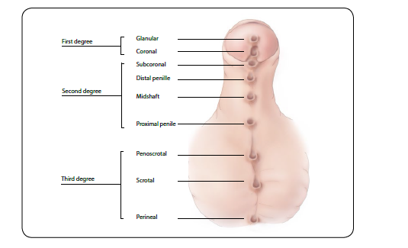
Clinical Subtypes
Hypospadias is commonly classified into one of three categories, according to the location of the urethral meatus in relation to the tip of the glans of the penis.
Note: All of these openings are not present in one single newborn. Typically, there will only be ONE opening.
Hypospadias | 4
Notes:
Hypospadias is classified according to the position of the meatus on the penis in first, second and third degree. In cases of first degree the urethral meatus is located on either the glans (glanular hypospadias) or the corona (coronal hypospadias). In cases of second degree, the urethral meatus is located in the balanopenile furrow or coronal sulcus (subcoronal hypospadias) or in the shaft of the penis (distal penile, midshaft, and proximal penile hypospadias). In cases of third degree, the urethral meatus is located in the junction of the penis and the scrotum (penoscrotal or scrotal hypospadias) or the perineum (perineoscrotal, perineal, or pseudovaginal hypospadias).

Slide 5
Main Features
Feature | Typical findings
Embryology | Development of male external genitalia is influenced by androgens secreted by fetal testes. The penile urethra is formed at the end of third month, while the most distal portion of the urethra is formed during the fourth month. Hypospadias is the result of failure of urethral folds to completely fuse.
Associated anomalies | Cryptorchidism and inguinal hernia are the most common. Occasionally associated with vesicoureteral reflux. May be part of recognized syndromes
Hypospadias | 5
Notes:
Hypospadias occurs during fetal development. The development of the penis is influenced by hormones secreted by the fetal testes. Fluctuations in these hormones can affect the development of the urethra and foreskin and lead to hypospadias. The reason for these fluctuations is not always clear and usually the cause is unknown. In addition, while hypospadias most often occurs as an isolated defect, it can be associated with other structural disorders such as undescended testicles (cryptorchidism), hernia in the groin area (inguinal hernia), or backflow of urine from the ureter to the bladder (vesicoureteral reflux). Hypospadias can also be part of recognized syndromes.

Slide 6
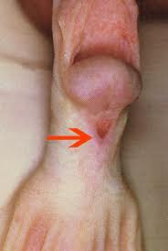
Clinical Features
Males with hypospadias typically have a redundancy of the prepuce on the dorsal side of penis and a deficiency on the ventral side.
Severe subtypes are often accompanied by chordee: ventral (downward) curve of the penis, which may result from cutaneous or fibrous restriction. Chordee may occur without hypospadias.
Redundancy
Chordee
Deficiency
Distal penile hypospadias
Hypospadias | 6
Notes:
Males with hypospadias typically have a redundancy of the prepuce on the dorsal side of penis and a deficiency on the ventral side. As stated earlier, hypospadias may be accompanied by chordee: ventral (downward) curve of the penis, which may result from cutaneous or fibrous restriction. However, it should be noted that chordee may occur without hypospadias.
(Note: “Severe subtypes,” as mentioned in the slide that follows, include perineal (pseudovaginal) hypospadias, which does not have chordee. On the other hand, sometimes chordee is associated even with first degree hypospadias. For this reason, I changed it to leave it open.)

Slide 7
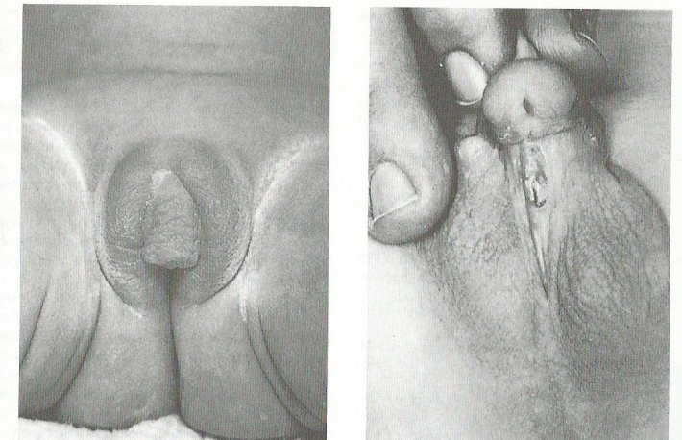
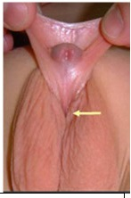
Additional Clinical Features
Severe subtypes (penoscrotal, scrotal and perineal) may appear as ambiguous genitalia. Hypospadias with separation of the scrotal sacs and absence of palpable testes bilaterally in a term infant should prompt an evaluation for ambiguous genitalia.
The differential diagnosis is based on detailed clinical workup
Ambiguous genitalia in a 46XX female with virilizing adrenal hyperplasia. The clitoris is enlarged, resembling a short penis with hypospadias, and the labia are rugated, resembling the scrotum.
Penoscrotal hypospadias
Photo courtesy of http://www.pediatricurologybook.com/hypospadias.html
Hypospadias | 7
Notes:
Severe subtypes, such as penoscrotal, scrotal, and perineal hypospadias, may appear as ambiguous genitalia. Hypospadias with separation of the scrotal sacs and absence of palpable testes bilaterally in a term infant should prompt an evaluation for ambiguous genitalia. Specialized workup is essential for accurate differential diagnosis.

Slide 8
Diagnosis
Hypospadias is usually easily recognized on physical examination at delivery or on autopsy. However, without a careful examination of the penis, less severe cases may be missed.
Prenatal diagnoses must be confirmed postnatally.
While the most severe cases of hypospadias might be diagnosed by prenatal ultrasound, they should not be included in surveillance data without postnatal confirmation.
Hypospadias | 8
Notes:
Hypospadias is usually easily diagnosed upon physical examination of the newborn at delivery or on autopsy. However, without a careful examination of the penis, less severe cases may be missed. All prenatal diagnosis of hypospadias should be confirmed postnatally. While some cases of hypospadias can be identified by a prenatal ultrasound, they should not be included in surveillance data without postnatal confirmation. Severe cases presenting as ambiguous genitalia require specialized work ups.

Slide 9
Tips for Reporting
Specify subtype of defect
Do not exclude mild (glanular and coronal) hypospadias
Use a standard drawing to specify the location of urethral opening, and if possible take a photograph
Report findings observed from surgery or autopsy
Describe any additional malformations if present
Hypospadias | 9
Notes:
When reporting hypospadias in the data collection form, be sure to specify the defect subtype. Do not exclude mild (glanular and coronal) hypospadias. Please use a standard drawing to specify the location of urethral opening, and if possible, take a photograph. Please report findings observed from surgery or autopsy and describe any additional malformations, if present.

Slide 10
Selected Epidemiological Features
Feature | Main Findings
Prevalence | Approximately 1 in 300 live male births. Prevalence has been increasing in the last 25 years in some countries
Variability of prevalence | Exclusion or under ascertainment of mild subtypes. In the U.S., higher prevalence among non-Hispanic whites compared to all other racial/ethnic groups.
Potential modifiable risk factors | Endocrine disruptors (e.g., pesticides); infertility and/or artificial reproductive technologies; anticonvulsants (e.g., valproate, carbamazepine); maternal hypertension, obesity and diabetes.
Hypospadias | 10
Notes:
Hypospadias is a common congenital malformation that occurs in approximately 1 in 300 live male births. An increase in the prevalence of hypospadias has been observed over the last 25 years in some countries, which might be due to improved ascertainment of milder subtypes of hypospadias. In the US, a higher prevalence of hypospadias is observed among non-Hispanic Whites compared to other racial/ethnic groups. A higher risk of hypospadias has been associated with endocrine disruptors, infertility, artificial reproductive technologies, some anticonvulsants, maternal hypertension, obesity, and diabetes.

Slide 11
ICD-10 RCPCH List and Coding of Hypospadias
Q54 Hypospadias Excludes: epispadias (Q64.0)
Q54.0 Hypospadias, balanic coronal glanular
Q54.1 Hypospadias, penile
Q54.2 Hypospadias, penoscrotal
Q54.3 Hypospadias, perineal
Q54.4 Congenital chordee (if isolated, exclude)
(Chordee associated with hypospadias is part of the typical phenotype, the code Q54.4 is not necessary)
Q54.8 Other hypospadias
Q54.9 Hypospadias, unspecified
Hypospadias | 11
Notes:
This slide lists the different ICD-10 RCPH codes for hypospadias. Please note that chordee should not be coded because when isolated it is considered a minor anomaly and when associated to hypospadias it is part of the phenotype.

Slide 12
Tips for Coding
The coding system does not provide codes for each specific subtype as described previously; could use a locally defined extension to code more precisely
Isolated chordee is a minor anomaly; it could be coded in programs that include minor anomalies
When ambiguous genitalia is coded, hypospadias should not be coded
Hypospadias | 12
Notes:
Please note that because the ICD-10 coding system does not provide codes for each specific subtype of hypospadias, locally defined extension codes could use to improve the coding precision. In programs that include minor anomalies, isolated chordee, a minor anomaly, could may be coded using an extension code s such as Q54.4. It is important to note that when ambiguous genitalia is coded, hypospadias should not be coded.

Slide 13
References
Slide 4: WHO/CDC/ICBDSR. Birth defects surveillance: a manual for programme managers. Geneva: World Health Organization; 2014.
Slide 10:
ICBDSR Annual Report 2012.
van der Zanden LF et al. Hum Reprod Update. 2012 May-Jun;18(3):260-83.
Alverson CJ et al. Presented at 2013 Annual Meeting of ICBDSR, San Jose, Costa Rica.
Paulozzi LJ, Erickson JD, Jackson RJ. Hypospadias trends in two US surveillance systems. Pediatrics 1997;100:831e4.
Fisch H, Hyun G, Hensle TW. Rising hypospadias rates: disproving a myth. J Pediatr Urol 2010;6:37e9.
Avilés et al. Risk factors, prevalence trend, and clustering of hypospadias cases in Puerto Rico. J Pediatr Urol. 2014 May 9.
Hypospadias | 13
Notes:
For your convenience, we have provided the references listed on slides 4 and 10.

Slide 14
Questions?
Hypospadias | 14
Notes:
Thank you very much for listening to this presentation. We hope you had enjoyed it. If you have questions please send an email to centre@icbdsr.org or to birthdefectscount@cdc.gov

