Slide 2
Learning Objectives
Discuss the evidence base and recommended educational therapies for children with ASD.
  List the key features of successful early educational programs for children with ASD.
  Describe the current evidence base for commonly used behavioral therapies.
  Understand the typical components of early intervention programs for children with ASD, age three years and younger.
  Understand the difference between diagnosis and eligibility for an individual educational plan (IEP) for children with ASD, age three years and older.
Provide ongoing support and management for children with ASD and their families regarding educational therapies.
  Identify the needs of families in the transition from Early Intervention to preschool.
  Understand the process for evaluating problem behaviors to develop a home treatment plan for children with ASD.

Slide 3
Part I
Tim, a 2 year, 5 months-old boy, is brought to your office by his parents for a follow-up visit…

Slide 4
What guidance would you provide Tim’s parents?

Slide 5

Early Intervention and Education
Observation: ABA, Stephon, 30 Mos.

Slide 6
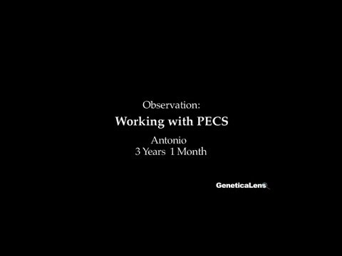
Early Intervention and Education
Observation: Working with PECS, Antonio, 3 Yrs 1 Month

Slide 7
What would you do next?

Slide 8
Part II
Tim is now 2 years, 11 months…

Slide 9
What would you tell Tim’s parents about the IEP meeting?

Slide 10
Early Intervention and Education
Part III - Epilogue
Tim is now 4 years old, and his parents return for a follow-up visit…

Slide 11
How would you apply the information in this case?
What did you learn through this case?

Slide 12
Potential Next Case:
Treatments for Autism Spectrum Disorder
Case Goals
Evaluate the etiology of changes to behavior and functioning in children with ASD and describe strategies to analyze the changes.
Develop knowledge regarding specific options to treat maladaptive behaviors in children with ASD.

