Slide 2
Learning Objectives
Discuss an abnormal screening result with parents that indicates concern that a child might have an autism diagnosis.
Know how to describe the difference between an abnormal screen and a diagnosis to a parent.
Identify reasons why parents may be reluctant to pursue a diagnostic evaluation after an abnormal autism screen.
Describe some important techniques that a physician should include when discussing an abnormal screen with different families.
Understand how to support a family when their child has been diagnosed with an ASD.
Describe specific techniques a physician can use to support a family whose child has been diagnosed with an ASD.
Identify various emotional responses parents may have after receiving an ASD diagnosis.
Name the stages of grief parents often experience when their child is diagnosed with a disability.

Slide 3
Part I
Thomas is a 27-month-old boy that you have followed since birth in your primary care continuity clinic…

Slide 4
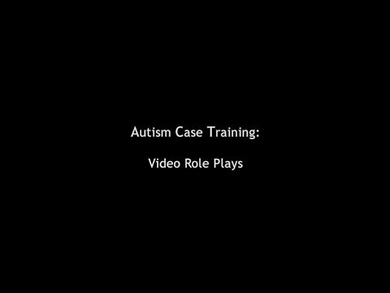
Video I

Slide 5
What stands out to you about this situation?

Slide 6
Part II (A)
Back in your office after the evaluation…

Slide 7
Video II (A)

Slide 8
What went well in this
interaction?
What didn’t go well?

Slide 9
Part II(B)
Back in your office after the evaluation…

Slide 10
Video II(B)

Slide 11
What went well in this interaction?
What didn’t go well?

Slide 12
How would you apply the information in this case? What did you learn through this case?

Slide 13
Potential Next Case: Making an Autism Diagnosis
Case Goals
Be familiar with the basic principles regarding the diagnosis and epidemiology of ASD.
Understand the diagnostic approach to evaluating a child with a suspected ASD.

