Slide 1
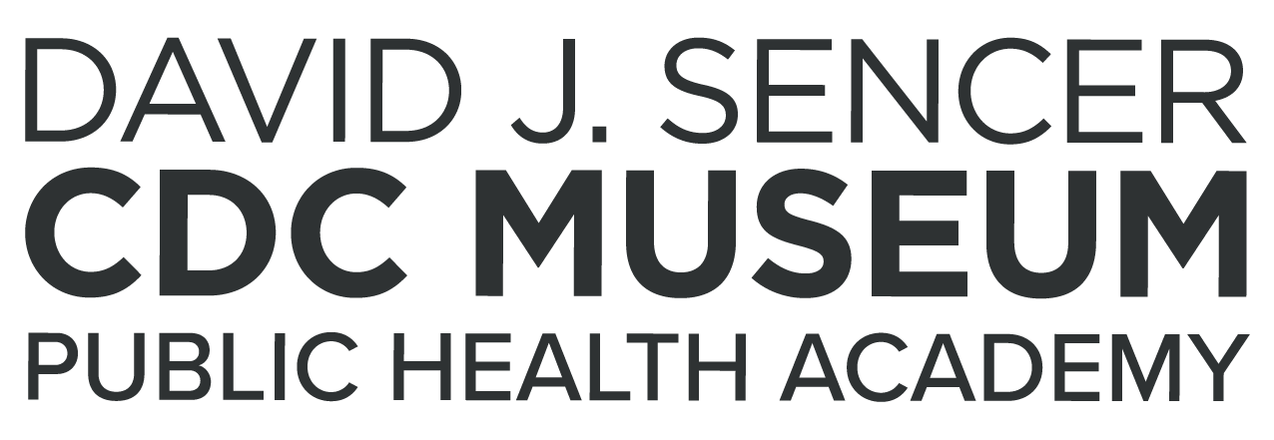
Masks Against COVID-19
Notes:
COVID-19 is a dangerous disease that spreads mainly from person to person through respiratory droplets. Wearing a mask in public spaces is a safe, easy, and effective strategy to stop the spread of coronavirus. Given this, what makes for the best face mask to protect yourself and others?
Note: These slides are made possible by the David J. Sencer CDC Museum Public Health Academy. https://www.cdc.gov/museum/education/lessons/

Slide 2
Terms to Know
 | how well something works; how effective something is
 | the virus that causes COVID-19 disease
 | a family of viruses characterized by a crown of spikes on the outside; includes respiratory diseases like MERS and SARS
 | different forms of a virus that occur as a result of random mutations
 | a disease outbreak that has spread over several countries or continents
 | provides a trigger to help the immune system build immunity to a disease
Word Bank
coronavirus
efficacy
pandemic
SARS-CoV-2
vaccine
variant
Notes:
Terms to Know
Coronavirus - a family of viruses characterized by a crown of spikes on the outside; this includes respiratory diseases like MERS and SARS, including SARS-CoV-2
Efficacy - how well something works; how effective something is
Pandemic - a disease outbreak that has spread over several countries or continents
SARS-CoV-2 - the virus that causes COVID-19 disease
Vaccine/Vaccination - a vaccine provides a trigger to help the immune system build immunity to a disease; vaccines allow the immune system to recognize a virus as a threat
Variant - different forms of the SARS-CoV-2 virus that occur as a result of random mutations; examples include B.1.351 (Beta), B.1.617.2 (Delta)

Slide 3
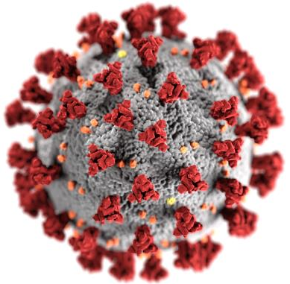
Understanding COVID-19
Coronaviruses are a type of virus with a crown of spike proteins sticking out
There are many types, including SARS, MERS, and viruses that cause colds
SARS-CoV-2 is the specific coronavirus that causes COVID-19
COVID-19 causes respiratory symptoms but can also harm other parts of the body
More than 4.5 million people have died from COVID-19 worldwide
Notes:
Coronaviruses are a large family of viruses that can infect people and many animals, including camels, cattle, cats, and bats. There are many types of coronaviruses, including some that give people a common head or chest cold. Other coronavirus diseases like severe acute respiratory syndrome (SARS) and Middle East respiratory syndrome (MERS) are extremely dangerous but are much less widespread than colds and COVID-19.
COVID-19 most often causes respiratory symptoms that can feel much like a cold, a flu, or pneumonia, but COVID-19 can also harm other parts of the body. Most people who catch COVID-19 have mild symptoms, but some people become severely ill. Older adults and people who have certain underlying medical conditions are at increased risk of severe illness from COVID-19. Hundreds of thousands of people have died from COVID-19 in the United States. Vaccines against COVID-19 are safe and effective.

Slide 4
Think About It
How can wearing a mask help stop the spread of viruses?
Are some types of masks better than others? Explain your answer.
What are some steps you could take to protect yourself and your community from COVID-19?

Slide 5
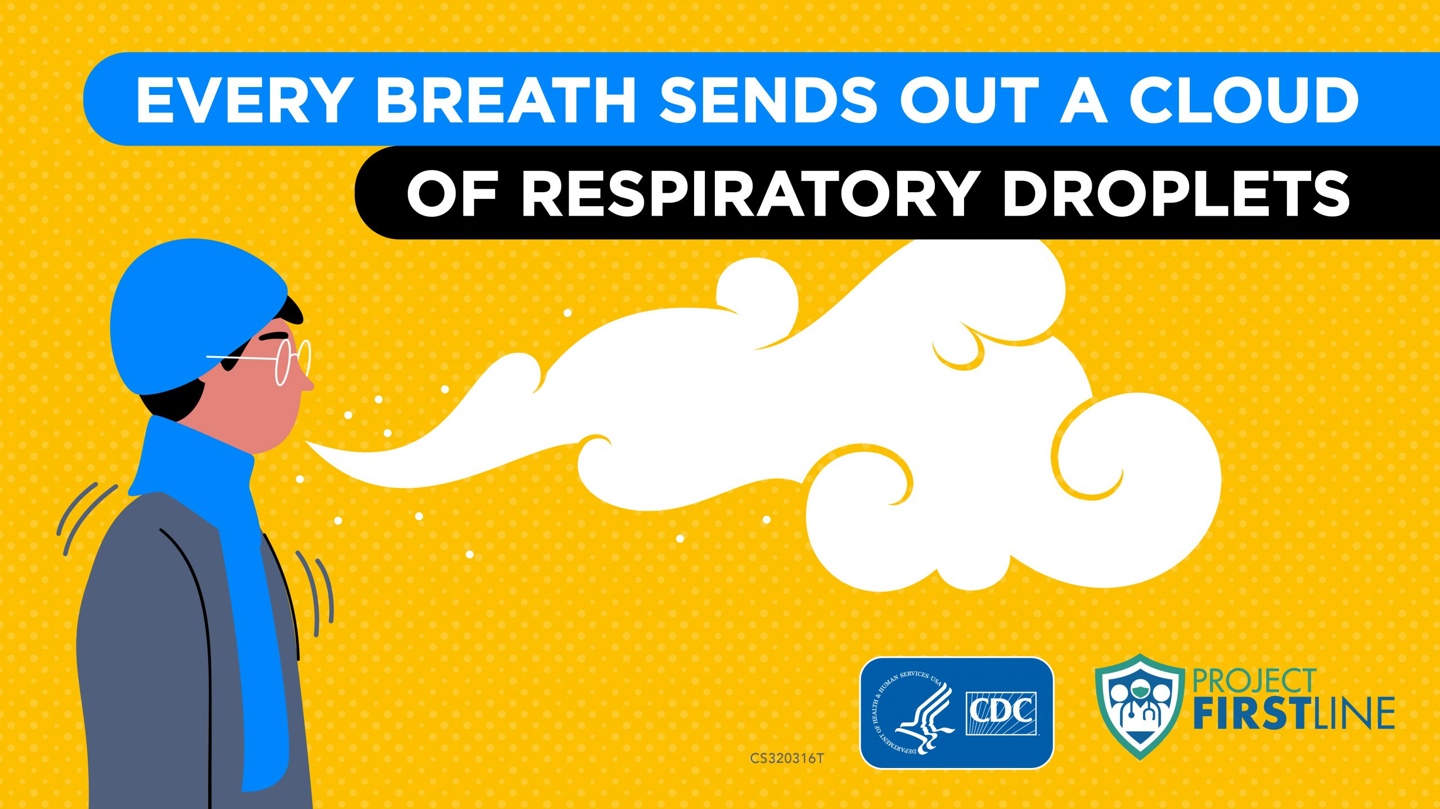
COVID-19 and CDC
COVID-19 spreads through respiratory droplets
Masks block respiratory droplets produced while breathing, talking, coughing, and sneezing
Many COVID-19 cases are asymptomatic; infected people may not know they are spreading the virus
Staying at least 6 feet apart also helps slow spread
Notes:
COVID-19 and the Centers for Disease Control and Prevention (CDC)
COVID-19 is a dangerous disease caused by a coronavirus discovered in December 2019 in Wuhan, China. It is very contagious and has quickly spread around the world. On February 11, 2020, the World Health Organization announced an official name for the disease: coronavirus disease 2019, abbreviated COVID-19. ‘CO’ stands for ‘corona,’ ‘VI’ for ‘virus,’ and ‘D’ for disease. The virus that causes COVID-19, SARS-CoV-2, is a coronavirus. The word corona means “crown” and refers to the appearance that coronaviruses get from the spike proteins sticking out of them like a crown. COVID-19 spreads mainly from person to person through respiratory droplets. Respiratory droplets travel into the air when you cough, sneeze, talk, shout, or sing. These droplets can then land in the mouths or noses of people who are near you, or they may breathe these droplets in.
Masks are a simple barrier to help prevent your respiratory droplets from reaching others. Studies show that masks reduce the spray of droplets when worn over the nose and mouth. You should wear a mask, even if you do not feel sick. This is because several studies have found that people with COVID-19 who never develop symptoms (asymptomatic) and those who are not yet showing symptoms (pre-symptomatic) can still spread the virus to other people. Wearing a mask helps protect those around you in case you are infected but are not showing symptoms.
It is especially important to wear a mask when you are indoors with people you do not live with and when you are unable to stay at least 6 feet apart, since COVID-19 spreads mainly among people who are in close contact with one another.

Slide 6
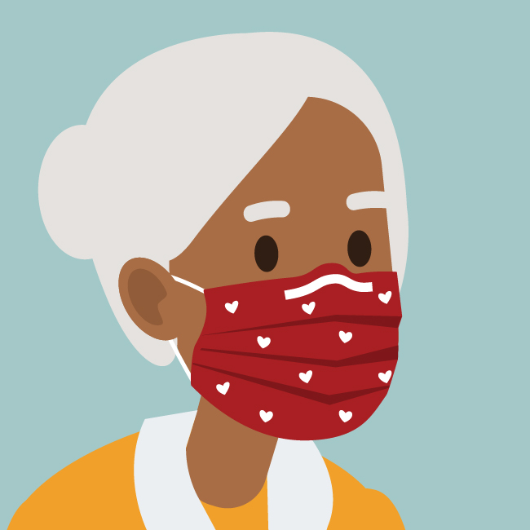
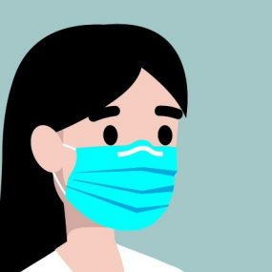
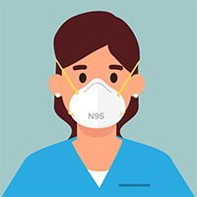
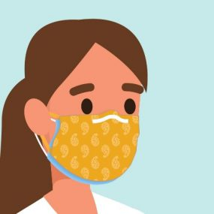
COVID-19 and CDC
Cloth Masks
Must use tightly woven fabric
Nose wires improve fit
Disposable Masks
Surgical masks
KN95 for individual use
N95 for healthcare professionals
Add cloth mask or mask fitter on top of disposable masks to improve fit
Notes:
There are two common types of masks for use by the general public.
Cloth masks can be made from a variety of fabrics, and many types of cloth masks are available. The best cloth masks are made of multiple layers of tightly woven, breathable fabric, have a nose wire, and block light when held up to a bright light source.
Disposable face masks are widely available. Common types are surgical, KN95, and N95. The best disposable masks include a description indicating multiple layers of non-woven material, contain a nose wire, and are designed and tested to ensure they perform at a consistent level to prevent the spread of COVID-19. N95 masks should be reserved for healthcare professionals.
The best protection against infection is vaccination. COVID-19 vaccination reduces the risk of COVID-19 and its potentially severe complications. All COVID-19 vaccines currently authorized for use in the United States helped protect people against COVID-19, including severe illness, in clinical trial settings. Millions of people in the United States have received COVID-19 vaccines since they were authorized for use by the Food and Drug Administration (FDA).

Slide 7
Think About It
What is the primary way that the SARS-CoV-2 virus spreads from person to person?
If a person’s mask drops below their nose, what happens to their respiratory droplets?
What are some reasons that people might have to choose masks instead of vaccination to protect them from COVID-19?

Slide 8
From the Expert
https://youtu.be/1LZZz1yMGvY
Notes:
From the Expert
Project Firstline is a video series from CDC to explain the basics of infection control to healthcare personnel. In this episode, listen to CDC infectious diseases doctor Dr. Abby Carlson explain the ways in which COVID-19 spreads.

Slide 9
Think About It
According to Dr. Carlson, what are other ways besides respiratory droplets that SARS-CoV-2 can be spread from person to person?
What are some problems you have encountered while wearing a face mask that you might want to fix in your design?
As new variants of COVID-19 emerge, the efficacy rates of vaccines may decrease. How will this affect communities? How might we respond to this change?

Slide 10
Give it a Try
Call to Action!
Test face masks.
Design a better face mask.
Share your findings.
Why do you think participation is important?
Notes:
Call to Action
In order to understand COVID-19 prevention, it is essential that people understand some simple ways to keep themselves safe. You can help people by following these three steps:
1. Test face masks. How do face masks affect how air is released through respiration? Conduct a simple experiment to see the difference between air movement with and without a face mask.
2. Design a better face mask. The fit of a face mask is a critical aspect that determines how effective it is against the virus. Can you use the engineering design process to create a mask that is comfortable, effective, and suitable for long term use?
3. Share your findings. One of the ways CDC communicates information is through social media. Your demonstrations can help CDC communicate the work they have done and are doing to improve mask use to help fight COVID-19.
Why Participate?
Your research and designs are important to help you and others understand the role face masks play in stopping the COVID-19 pandemic. Correct and consistent mask use is a critical step everyone can take to reduce their risk of getting and spreading COVID-19. Masks work best when everyone wears them, but not all masks provide the same protection. How well a mask fits, how well it filters the air, and how many layers it has are all important to consider when choosing which mask to wear. Wearing a mask around people who do not live with you or when someone in your house is sick is now even more critical with the increased spread of new COVID-19 variants, some of which appear to spread more easily and quickly than the original virus that causes COVID-19.
For more information about mask types, fitting, and efficacy studies, check out this report from CDC: https://www.cdc.gov/mmwr/volumes/70/wr/mm7007e1.htm

Slide 11
Use the Engineering Design Process
Define
Define the problem
Research
Do background research
Requirements
Specify requirements
Brainstorm
Develop solutions
Build
Build a prototype
Test and redesign
Test
Share
Communicate results

Slide 12
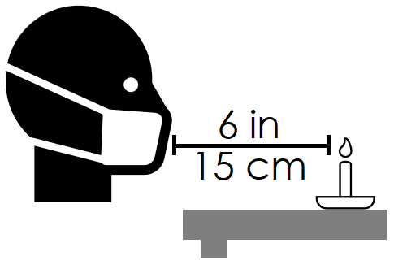
Give it a Try
1. Test Face Masks
Get 6 masks made of different materials
Light a candle 6 inches from edge of table
While wearing each of the 6 masks:
Read a paragraph from a book
Sing a verse of a song
Try to blow out candle
Record candle observations for each test
Notes:
Test Face Masks
Tools of the Trade
Several different masks and/or fabrics
Candle
Matches or lighter
Ruler
There are many different types of masks available, but some are more effective than others. To test the efficacy of mask materials, you will try to extinguish a candle flame while wearing masks made from different materials.
SAFETY FIRST! Since this experiment involves open flame, make sure that you have adult permission or supervision before beginning.
Here are some suggestions for face masks/materials that you might have at home:
Surgical mask
KN95 or N95 mask
Cloth face mask
T-shirt
Bandana
Neck gaiter
Cotton fabric
Polyester fabric
Consider trying a single layer of cloth, then folding it to make double or triple layer masks to see how the number of layers affects the results. Try using a variety of materials to capture the full spectrum of effectiveness and to see if your predictions are correct.
Test Your Mask Materials
Place a candle 6 inches (15 centimeters) from the edge of a table or counter. Make sure the area around and above the candle is clear of any flammable materials. Light the candle.
Without a face mask, perform these 3 tasks in front of the candle:
Read a paragraph from a book. (Make sure to keep the book clear of the flame!)
Sing a verse of a song. (“Twinkle, Twinkle, Little Star,” “Happy Birthday,” etc.)
Purse your lips and try to blow the candle out.
Record your results in the data table. Relight the candle in between tasks if it goes out.
Put on one of your face masks, repeat the tasks, and record results in the table.
Switch to a different face mask and repeat until you have tested all materials.
BONUS EXPERIMENT: If you have access to a pulse oximeter device, measure your oxygen saturation levels while wearing each of the different mask types.

Slide 13
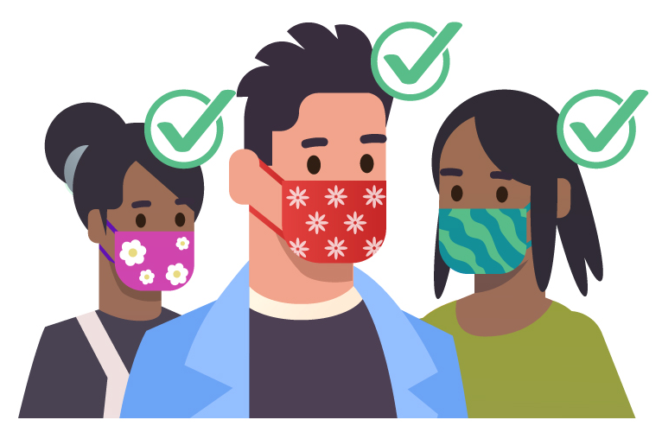
Give it a Try
2. Design a Better Face Mask
Use the results of your experiment to design a mask that fits well, is comfortable, and is effective at stopping respiratory particles
Test your newly designed mask
Notes:
Design a Better Face Mask
Beyond choosing a material that effectively blocks respiratory droplets, other factors contribute to the effectiveness of a mask. A good fit is important not only for sealing in respiratory droplets, but also because people don’t like wearing masks that are uncomfortable. An effective mask that doesn’t get worn is useless!
Here are some additional things you might want to consider when designing your face mask:
Does the mask completely cover your nose and mouth?
How tightly does the mask fit against the sides of your face?
How does the mask fit over the bridge of your nose?
When you talk, does the mask stay in place or slip down off your nose?
Does the mask hurt your ears after a long period of wearing it?
Do glasses fog up when you are wearing this mask?
Suggested Resources:
CDC guide to masks: https://www.cdc.gov/coronavirus/2019-ncov/prevent-getting-sick/about-face-coverings.html
Watch this video guide from the World Health Organization about how to find a mask that fits your face the best. https://youtu.be/aNUPVdJHeAQ
FDA guide to masks: https://www.fda.gov/medical-devices/coronavirus-covid-19-and-medical-devices/face-masks-including-surgical-masks-and-respirators-covid-19
Design Your Face Mask
Select your face mask material. You can start from scratch with cloth or try to improve the design of an existing disposable mask to improve comfort and fit. Draw a diagram of your face mask below. Label the materials used and any special features you will be adding for comfort or fit.
Test Your Face Mask
Perform the candle test with your mask to ensure that you cannot blow out the candle.
Check the fit of your mask. Look for gaps around the nose, chin, or sides of the face. Blow out air and feel for significant leaks around the edges.
Evaluate the comfort of the mask. Is it scratchy, tight, or otherwise uncomfortable?
Redesign your prototype if needed. Make sure it conforms to CDC guidelines before wearing it out in public. No mask is perfect against coronavirus but wearing one will significantly reduce your risk of catching or transmitting the virus.

Slide 14
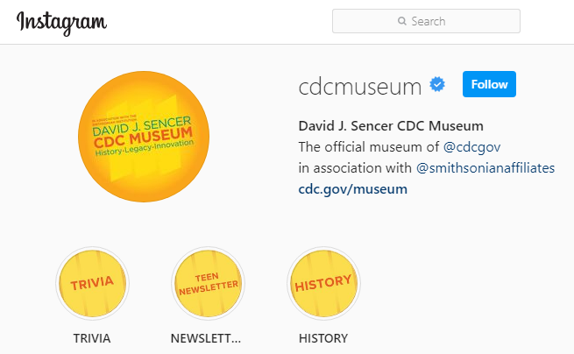
Give it a Try
3. Share Your Findings
Instagram @CDCmuseum
Notes:
Share Your Findings
The David J. Sencer CDC Museum uses award-winning exhibits and innovative programming to educate visitors about the value of public health and presents the rich heritage and vast accomplishments of CDC. Your demonstration could be a valuable contribution! Share your demonstration with the CDC Museum on Instagram using @CDCmuseum.

Slide 15
Questions?

