Slide 1
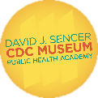
Contact Tracing
Notes:
Public health surveillance is the ongoing, systematic collection, analysis, interpretation, and dissemination of health data to help guide public health decision making and action. Contact tracing is one method of conducting surveillance and allows scientists to gather data about infections and how they may spread.
Note: These slides are made possible by the David J. Sencer CDC Museum Public Health Academy. https://www.cdc.gov/museum/education/lessons/

Slide 2
Terms to Know
 | anyone who was close to a person who is infected with a virus
 | the earliest known or suspected case of disease infection in an outbreak
 | collecting/analyzing data about a disease to monitor trends and outbreaks
 | patients who are infected with a disease who do not show symptoms
 | identifying people who have been in contact with someone diagnosed with an infectious disease
 | placing people with confirmed or suspected infection in isolation to prevent disease spread
 | patients who are infected with a disease and are showing symptoms
 | spreading a disease from one individual to another
Word Bank
asymptomatic
close contact
contact tracing
index case
quarantine
surveillance
symptomatic
transmission
Notes:
Terms to Know
Asymptomatic - patients who are infected with a disease who do not show symptoms
Close contact - anyone who was close to a person who is infected with a virus and is therefore at higher risk of becoming infected themselves
Contact tracing - the process of identifying people who have recently been in contact with someone diagnosed with an infectious disease
Index case - the earliest known or suspected case of disease infection in an outbreak
Quarantine - placing people with confirmed or suspected infection in isolation to prevent the spread of infectious disease
Surveillance - collecting/analyzing data about a disease to monitor trends and outbreaks
Symptomatic - patients who are infected with a disease and are showing symptoms
Transmission - spreading a disease from one individual to another

Slide 3
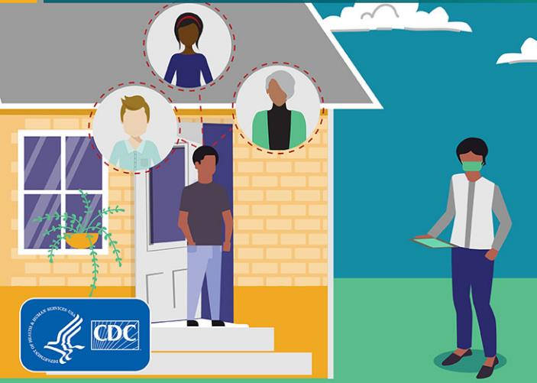
Understanding Contact Tracing
Contact tracing is the process of identifying people who have recently been in contact with someone diagnosed with an infectious disease
Close contacts of infected individuals need to take precautions to avoid infecting others if they become ill
Contact tracers check up on close contacts frequently during disease incubation period to monitor for developing illness
Notes:
What is Contact Tracing?
Contact tracing is the process of identifying people who have recently been in contact with someone diagnosed with an infectious disease. Once a person tests positive for a disease, they will be asked to list the people they have been in contact with and the places they visited during the period in which they were contagious. The patient’s contacts will be notified by the health department or by contact tracers who will explain what precautions they need to take and for how long. This may include a quarantine period during which the person should avoid contact with others. During the disease’s incubation period, contact tracers will continue to check on the close contacts to see if they have developed symptoms or tested positive for the disease.

Slide 4
Think About It
What experiences have you had with contact tracing in your community?
What difficulties do you think contact tracers might have when attempting to contact people after a disease diagnosis?
Why might quarantining after a disease exposure be difficult for some people?

Slide 5
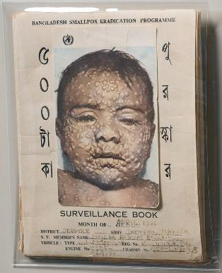
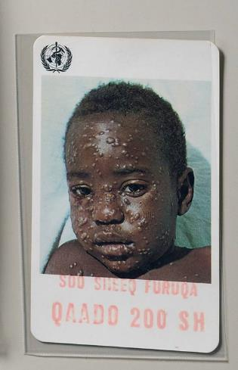
Contact Tracing and CDC
Smallpox eradication in 1960s and 1970s
Eradication efforts used ring vaccination technique due to shortage of vaccine
Smallpox cases were identified
Close contacts of those patients were located, vaccinated, and monitored for signs of illness during possible incubation period
Close contacts spent 3+ hours with patient or were within 6 feet of any patient with a rash
Ring vaccination technique was later used for other disease outbreaks
Notes:
Contact Tracing and the Centers for Disease Control and Prevention (CDC)
Contact tracing is the process of quickly identifying, assessing, and managing people who have been exposed to a disease to prevent additional transmission. Contact tracing has been used by CDC and its partners as part of successful strategies to stop disease epidemics like smallpox, Ebola, and now the COVID-19 pandemic.
Smallpox was eradicated globally in 1980 using a strategy called ring vaccination. In this strategy, the close contacts of confirmed smallpox patients were vaccinated first, then the contacts of those contacts. This way, everyone who had been, or could have been, exposed to a patient with smallpox received the vaccine. Close contacts included household family members, people who spent 3+ hours with the patient, and people who were within 6 feet of a patient with a rash. Close contacts were vaccinated and monitored for fever and other symptoms daily for 14-18 days.

Slide 6
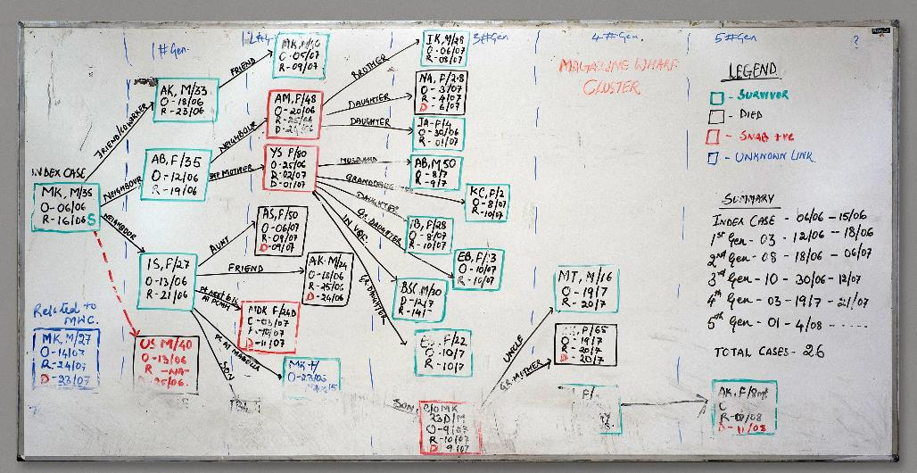
Contact Tracing and CDC
2014-16 West Africa Ebola outbreak
Contact tracing was challenging in rural areas
Contact tracers followed ambulances to locate cases
Contact tracers identified sanitation needs in communities in addition to case finding and monitoring
Contact tracing is used today to monitor COVID-19 and help slow its spread
Notes:
During the 2014-16 Ebola outbreak in West Africa, the RITE (Rapid Isolation and Treatment of Ebola) team members used contact tracing to identify new Ebola cases quickly and to isolate patients as soon as they showed symptoms. This increased patients’ chances of survival and prevented spread to others. Even one missed contact could mean Ebola would continue to spread, because sick people need care from others.
Neil Vora, a CDC responder, said of his time working in Liberia, “We would follow ambulances that were called to pick up patients with suspected Ebola cases. We would keep our distance and observe how they collected patients and would make corrections to any lapse in infection control. As soon as the ambulance left, we would start the contact tracing investigation.”
Satish Pillai, a CDC medical officer in Liberia, worked with RITE to help health systems that were not prepared for an influx of Ebola cases and had limited knowledge of the virus and its symptoms. “Cases of Ebola in Liberia were showing up in remote areas. In many instances, someone who contracted Ebola in the capital city of Monrovia brought it back to their community,” said Satish. “This led to sustained transmission of the virus that was hard to stop because it was so difficult to reach these communities.” Contact tracing in rural communities was particularly essential because they lacked treatment facilities. RITE teams not only worked on active case finding and contact tracing, but also identified the basic sanitation and food needs.
Today, contact tracing is being used to fight COVID-19 globally. In addition to masks, social distancing, hand washing, and vaccination, contact tracing is another tool we can use to stop the spread of COVID-19. Because COVID-19 often has asymptomatic carriers, contact tracing is especially important. By identifying and isolating cases of COVID-19 in communities before they can spread to others, we can prevent new infections.

Slide 7
Think About It
What are some reasons why contact tracing is more difficult in remote areas?
If contact tracers miss one close contact, what are possible consequences?
What skills do you think contact tracers need most?

Slide 8
From the Expert
https://youtu.be/f0Q0yA_jJ2U
Notes:
From the Expert:
Contact tracing has been an important tool for epidemiologists who are trying to stop a disease outbreak in its tracks. Watch the video linked below for more information about how contact tracing was used to help stop the 2014-16 Ebola outbreak in West Africa. CDC activated its Emergency Operations Center in July 2014 to help coordinate technical assistance and disease control activities with partners. CDC personnel deployed to West Africa to assist with response efforts, including surveillance, contact tracing, data management, laboratory testing, and health education. CDC staff also provided support with logistics, staffing, communication, analytics, and management. https://youtu.be/f0Q0yA_jJ2U

Slide 9
Think About It
During the 2014-16 Ebola outbreak, how did CDC help with contact tracing?
Why do you think the first 2-3 days after infection is the critical window for contact tracing to occur?
How are schools in the United States using contact tracing to keep students safe?

Slide 10
Give it a Try
Call to Action!
Conduct a disease transmission experiment.
Plan a contact tracing interview.
Share your findings.
Why do you think participation is important?
Notes:
Call to Action In order to understand contact tracing, it is essential that people know its purpose and how it is performed. You can help people by following these three steps:
1. Conduct a disease transmission experiment. In this experiment, you will analyze disease test results and draw a map to identify the index cases for a disease outbreak. By using contact tracing, you should be able to trace this outbreak back to its source.
2. Plan a contact tracing interview. Conducting contact tracing interviews is a skill that requires a lot of knowledge and preparation. Given some background information on a person who has recently tested positive for COVID-19, come up with an interview plan.
3. Share your findings. One of the ways CDC communicates information is through social media. Your demonstrations can help CDC communicate the work they have done and are doing to improve contact tracing of COVID-19 cases.
Why Participate? A Message from CDC
Contact tracing is a fundamental tool for stopping disease outbreaks. One barrier that public health officials experience is an inability to reach positive cases by phone. The majority of Americans are reluctant to answer phone calls from unknown numbers due to the abundance of scam and spam phone calls. Those who can be reached are often unwilling to share information about the places and people they have visited due to privacy concerns. Convincing people with COVID-19 to quarantine for 14 days can also be a challenge for financial or social reasons. In order to conduct effective contact tracing, health officials must engage people in all three activities: speaking, sharing, and quarantining. By exploring contact tracing further and sharing your expertise with others, you can change attitudes and open minds about engaging with public health officials to help stop the spread of COVID-19.

Slide 11
Use the Engineering Design Process
Define
Define the problem
Research
Do background research
Requirements
Specify requirements
Brainstorm
Develop solutions
Build
Build a prototype
Test and redesign
Test
Share
Communicate results

Slide 12
Give it a Try
1. Conduct a Disease Transmission Experiment
Set up 12 cups – 11 filled with water and 1 filled with an “infectious disease”
Pair up the cups and mix the liquids in each cup between partner cups
Record pairings and continue mixing for 3 total rounds
At the end, perform a test to see which cups became infected during the trades
Locate your index cases using contact tracing
Notes:
Conduct a Disease Transmission Experiment
In this activity, you will be modeling disease transmission using baking soda or vinegar to represent a disease. Starting with one infected person, you will observe how the disease spreads through a population and conduct contact tracing to identify index cases. You will identify infected individuals using a color-changing pH indicator. To complete this activity, you will need the following:
Tools of the Trade
Water
Baking soda or vinegar
12 disposable bathroom cups, 3 oz. (or other small cups/containers)
permanent marker
pH Indicator (see note and recipes below)
What are pH indicators?
Some substances naturally change color with changes in pH. These pH indicators are useful for estimating the pH of a solution based on its color. Any color change you observe indicates a substance that is not pure water. You can purchase indicators locally from aquarium or pool stores or get them online. You can also easily make your own from certain food items – see the two recipes you can use here! Whatever you choose, you’ll only need a few drops of indicator for each cup.
Try these natural pH indicator recipes!
Red Cabbage Juice: Put a handful of red cabbage into a blender with about 2 cups of water. Blend until cabbage is fully blended. Strain using a fine mesh strainer or coffee filter. Collect the juice to use as your pH indicator. If you do not have a blender, you can also chop cabbage and boil it for ~15 minutes. Strain out the leaves and cool to use the juice as an indicator.
Blueberry Juice: Mash a handful of blueberries with a spoon or potato masher. Add a little water and boil for 5-10 minutes to extract color. Strain the mixture using a fine mesh strainer or coffee filter and use the juice as your pH indicator.
Instructions
Fill 11 cups about ⅓ full of water. In the 12th cup, add your disease – either the baking soda or vinegar. If using baking soda, fill ⅓ full of water, add about ½ teaspoon baking soda, and stir until well dissolved. If using vinegar, fill cup ⅓ full with vinegar.
Mix up the cups so that you do not know which cup contains the disease mixture.
Number your cups from 1-12 using a permanent marker. If you are using a container that is not disposable, use masking tape or another method to number them.
Round 1: Group your cups into 6 random pairs. Pour each pair of cups into each other and mix back and forth 2-3 times. Then divide the mixture again by putting half of the solution back in each cup. Record the pairings in the chart on the top of the next page.
Round 2: Mix up your cups and make new partners. Do not repeat any groups from round 1. Mix your liquids, divide back in half, and record the pairings.
Round 3: Mix up your cups and make new partners. Do not repeat any groups from round 1 or 2. Mix your liquids, divide back in half, and record the pairings.
Add a few drops of your pH indicator to each cup. If a color change occurs, your cup has tested positive for the disease we are studying. Record your results in the chart on the next page.
Use the results of your activity to identify your initial index cases. Due to the limitations of this experiment, you will not be able to find a single initial index case, but you should be able to narrow it down to 2 individuals.
Stuck? Cut out the 12 person cards and move them around to help you better visualize it.
Start by writing your positive pairs in the bottom row and work your way up to the top.

Slide 13
Give it a Try
2. Plan a Contact Tracing Interview
Read the background info about David, a man who has recently tested positive for COVID-19
Conduct a contact tracing interview with David to identify close contacts
Make recommendations to David to help him recover from the disease and to prevent the spread of COVID-19
Notes:
Plan a Contact Tracing Interview
Case investigation and contact tracing, a core disease control measure employed by local and state health department personnel for decades, are key strategies for preventing further spread of COVID-19. Immediate action is needed. Communities must scale up and train a large workforce and work collaboratively across public and private agencies to stop the transmission of COVID-19. Case investigation and contact tracing are a specialized skills. To be done effectively, they require people with the training, supervision, and access to social and medical support for patients and contacts. Your task is to plan a contact tracing interview with a patient who has recently been diagnosed with COVID-19.
Background information
David is a 42-year-old man who started feeling ill on July 13 and tested positive for COVID-19 on July 14. He is married with three kids (ages 4, 12, and 19) and lives with his wife (age 46) and mother-in-law (age 71). His 4-year-old daughter attends daycare during the week. His 12-year-old son is out of school for the summer and spends most days playing at friends’ houses. His 19-year-old daughter is in college and is taking summer classes while living in a dorm on campus. His wife works full time in an office building but has just returned from a trip visiting relatives in another state. His mother-in-law lives with them and has some health problems, including diabetes and chronic congestive heart failure. She frequently attends events at the local senior center down the road from their house. While he generally works from home, he occasionally has to go into the office to meet with co-workers in person.
When David got tested, they gave him a flier containing a form that asked him to consider all of his activities for the previous 10 days. They informed him that a contact tracer from the local health department will be following up to ask him further questions about his activities and to determine if he has any close contacts who need to be notified and possibly tested. David’s form responses are included on the next pages of this document.
Conduct an Interview
Use David’s form responses to plan your phone interview with him. Here are the general steps to conducting an interview with a patient:
Introduce yourself to the patient and explain the purpose of your call
Collect demographic information from patient
Assess patient’s overall health and COVID-19 symptoms and provide self-care information
Develop a plan to monitor patient’s health and respond to changes in health status
Review isolation procedures and provide resources
Identify close contacts and routes of exposure
Prompt for questions and provide contact information
More detailed interview tips including sample questions, sentence starters, and advice for creating open channels of communication are available here: https://www.cdc.gov/coronavirus/2019-ncov/php/contact-tracing/case-investigator-guide.html
Based on David’s background information, what questions do you have for him?
What specific recommendations do you have for David based on his background information?
Recruit a friend or family member to role play with you as David. If you enjoy this activity, more practice training scenarios are available here: https://www.cdc.gov/coronavirus/2019-ncov/downloads/php/contact-tracing/COVID19-Contact-Tracing-Scene-508.pdf

Slide 14
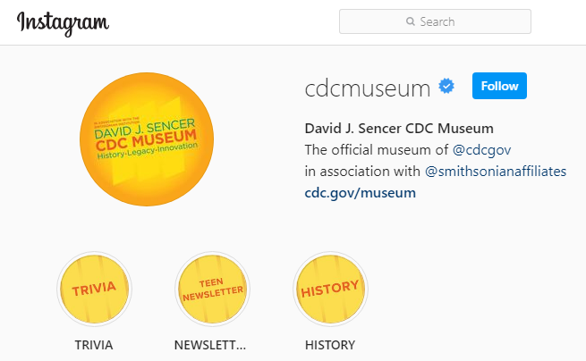
Give it a Try
3. Share Your Findings
Instagram @CDCmuseum
Notes:
Share Your Findings
The David J. Sencer CDC Museum uses award-winning exhibits and innovative programming to educate visitors about the value of public health and presents the rich heritage and vast accomplishments of CDC. Your demonstration could be a valuable contribution! Share your demonstration with the CDC Museum on Instagram using @CDCmuseum.

Slide 15
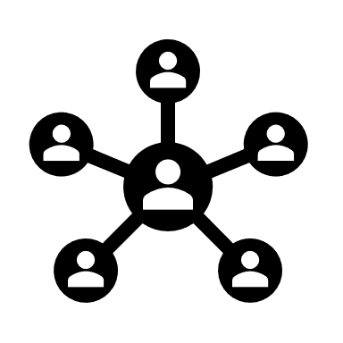
Questions?

