Slide 1
IPC for Marburg Virus Disease (MVD):
Preparing Your Facility for Identification of Potential MVD patients
Healthcare Settings with Limited to Intermediate Resources
Updated: March 2023
Notes:
Intended Audience: This presentation focuses on what facilities management personnel need to know to prevent Marburg virus disease from entering healthcare facilities. See <HCW Slide Deck 1: Identify, Isolate, Inform> [link] for details on what healthcare workers should know to assist the process of identifying and isolating suspect Marburg virus disease cases.
Please note that the IPC for Marburg virus disease topics are presented in sequence, with the expectation that participants will progress through the series. You may, however, mix and match content to meet participant needs, and you may need to adjust the sample script below accordingly.
Estimated time with audience participation: 20 minutes
Script:
Welcome! Today we'll be focusing on how to prepare your facility to identify, or screen, for potential patients with Marburg virus disease. Screening is a key strategy for preventing Marburg virus disease from entering your healthcare facility and is crucial to help protect you, others in your facility, and your friends and family from Marburg virus disease.

Slide 2
Learning Objectives
After this presentation, participants will be able to
  Explain why screening for Marburg virus disease is important
  Describe best practices for setting up a Marburg virus disease screening area
Notes:
Script:
We have two learning objectives for today. By the end of this session, you should be able to explain why screening for Marburg virus disease is important for everyone entering your facility and describe best practices for setting up a screening area to identify patients who might have Marburg virus disease.

Slide 3
Discuss
Why is it important to keep people who are suspected of having Marburg virus disease separate from other patients in a healthcare facility?
Notes:
Activating background knowledge:
A key benefit of working with adult learners is that they likely already have some knowledge or experience related to the topic you are teaching. Use this as an opportunity to let students share what they already know to prime them for learning related ideas.
Script:
Let’s start with a question. Why is it important to keep people who are suspected of having Marburg virus disease separate from other patients in a healthcare facility?
[Allow participants 2-3 minutes to discuss as a large group or in small groups.]

Slide 4
Early identification and separation of suspected Marburg virus disease patients prevents bringing unrecognized Marburg virus disease into your healthcare setting.
This protects…
YOU
Your co-workers & patients
Your community
Notes:
[You may wish to adapt the script for this slide based on what participants said to answer the question on the previous slide.]
Script:
If a person with undiagnosed Marburg virus disease were to be allowed into a healthcare facility, they could spread Marburg virus disease to patients nearby and to the staff that cares for them. Early identification and separation of suspected Marburg virus disease patients prevents bringing unrecognized Marburg virus disease into the healthcare setting, which protects you, your co-workers, and your patients. By keeping yourself healthy, you also avoid spreading illness to your family and friends. So, keeping Marburg virus disease patients separate in a healthcare facility helps protect you, your co-workers and patients, and your community.

Slide 5
Key Strategies to Prevent Introduction of Marburg virus disease in Health Facilities:
Identify
Isolate
Inform
Notes:
Script:
There are 3 key strategies to prevent the introduction of Marburg virus disease in healthcare facilities:
Identifying people who might be ill with Marburg virus disease before they enter the facility.
Isolating suspected Marburg virus disease patients from others.
And informing the necessary authorities at your facility.
These things are the most important things you can do at your healthcare facility to help protect yourself and your community
Today, we’ll focus on how facilities can prepare for the first strategy here: identifying people who might be ill with Marburg virus disease.

Slide 6
Setting Up a Screening Area
Notes:
Script:
First, we’ll talk about what screening is exactly, and then we’ll get into the details of setting up a screening area.

Slide 7
Identify
Screening is the process to identify patients who might be infectious so that they can be promptly isolated and referred for testing and care at a facility intended for that purpose.
Screening involves 2 parts:
Temperature check
Questionnaire of signs, symptoms, and risk factors
Notes:
Script:
The process of identifying people potentially ill with Marburg virus disease is called screening. Screening is like a sorting process. It operates like a sieve, separating the people who probably have a condition from those who probably do not. Screening allows patients suspected of having Marburg virus disease to be promptly isolated and referred for testing and care at a facility intended for that purpose.
In areas with Marburg virus disease transmission, screening involves looking for Marburg virus disease symptoms and determining risk factors early in the care process. It can be done with a non-contact thermometer and a questionnaire.

Slide 8
Key Points for Screening for Marburg Virus Disease
Screening should take place at the point of entry of a healthcare facility.
The screening area should be set up so that ALL people can be screened prior to entering
  This includes patients, healthcare workers, and accompanying family members
Notes:
Script:
When creating a screening area in your facility, keep in mind that screening should take place at the point of entry of your healthcare facility, and ALL people will need to be screened including patients, healthcare workers, and family members that accompany patients. If your facility has multiple entrances, you may need to close some entrances so that people can only enter where they will be screened.

Slide 9
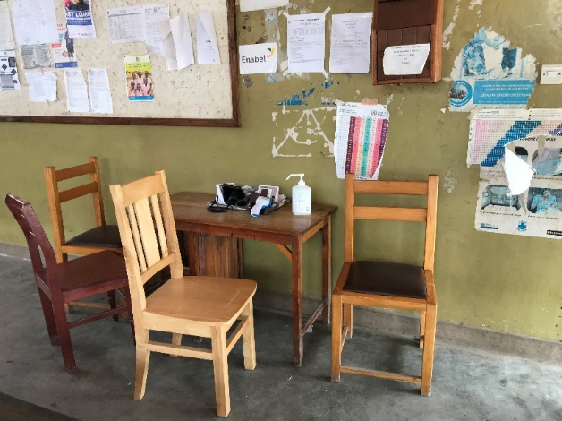
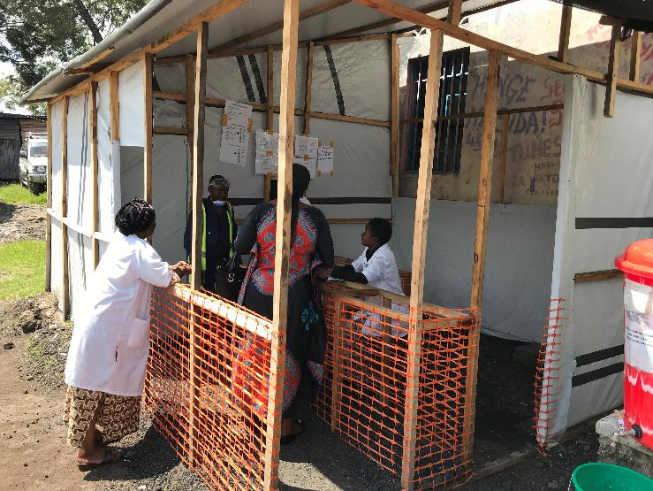
Creating a Screening Area
Tailor the screening area to facility design and resources.
  Construction of infrastructure is NOT required
  May be as simple as two chairs separated by a table
At least 1 meter distance maintained (except during temperature check) based on WHO recommendations
Notes:
Script:
The screening area should be tailored to the facility design and resources available. This means screening areas may look different at different facilities. Creating a screening area can be simple. It does NOT require the construction of infrastructure. It can be just two chairs separated by a table as long as there is room for the screener to keep at least 1 meter’s distance from the person being screened.
The pictures on this slide show two examples of what a screening area might look like. The first shows an area constructed specifically for screening while the second shows chairs separated by a table at the entry of a facility. While these screening areas are very different, both can function equally well for screening patients.
Having a screening area for EVERYONE who enters your facility is crucial. However, the process of screening effectively and using appropriate precautions is more important than the place where screening occurs.

Slide 10

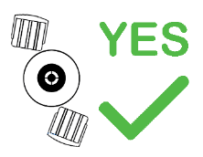
Screening Area Setup
For screener safety, screeners should be able to:
Maintain a distance (at least 1 meter per WHO recommendation) from the person being screened.
Avoid direct face-to-face interaction
  If possible, place plexiglass between screener and person being screened
  Angle any chairs away from each other
Notes:
Script:
As mentioned in the previous slide, per recommendation of the World Health Organization, for safety during screening activities, healthcare workers should be able to maintain a distance of at least 1 meter between themselves and the person being screened. If the facility cannot be arranged so that this distance can be maintained, healthcare workers will need to wear personal protective equipment, or PPE, while screening.
For healthcare worker protection, direct face-to-face interaction with people being screened should also be avoided to protect mucous membranes – eyes, nose, and mouth. Your facility may place plexiglass at the screening station between the screener and the person being screened. If that is not an option at your facility, angling chairs away from each other, as seen in this image, is a simple and effective way to achieve this.

Slide 11
Screening Area Supplies
The screening area should have
Hand hygiene station with liquid soap for handwashing (alternative is alcohol-based hand rub) with paper or cloth towels
Waste bins: a general (non-biohazard) waste bin
Notes:
Script:
People who are screening will need to perform hand hygiene often, so every screening area should have a hand hygiene station with soap and water for handwashing and paper or cloth towels to dry hands or, as an alternative, alcohol-based hand rub.
The screening area should also have a waste bin for general, non-biohazard waste.

Slide 12
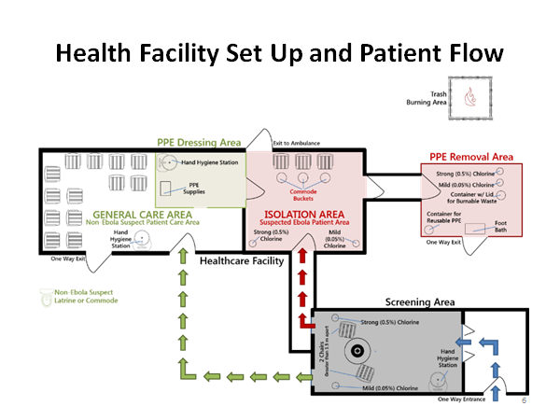

Example Facility Setup
Non-Marburg Suspect Patient Care Area
Suspected Marburg Patient Area
Screening Area
Screening Station
Hand Hygiene Stations
Notes:
Script:
This is one example of what facility setup could look like. Let’s focus right now on the screening area in the bottom right corner. Remember that your screening area may look different from this one because it will be tailored to the design of your facility and the available resources.
Notice that the only entry to this facility is through the screening area, so everyone that enters can be screened.
Notice that the person screening can be separated from the person being screened with a table so that they can maintain proper space.
Also notice the hand hygiene station.
Finally, notice that once screened, people who pass the screening may proceed to the general care area while those suspected of having Marburg virus disease are sent directly to a separate isolation area.
If, like in this facility, people need to go outside to get from the screening area to the general care area, you may need to mark off this area with fencing or tape to keep out people who have not yet been screened.
We will talk more in our next session about setting up an isolation area at your facility.

Slide 13
Reflection
How is the screening area for Marburg virus disease different from other screening areas you might have had to set up in the past?
What challenges have you encountered in the past with creating screening areas? Or, if you have never had to do this before, what challenges do you anticipate encountering?
Notes:
Reflection: Encourages participants to apply, analyze, and/or evaluate what they’ve learned, which helps them to deepen their understanding of the topic and also allows you to check their comprehension of what’s been discussed.
Personalization: Helps participants think about how what they have learned applies to their specific situations. Connecting learning to personal experiences helps learners to better understand and remember the ideas taught.
Script:
Now that you’re familiar with how to set up a screening area for Marburg virus disease in a healthcare facility, let’s think about how this might work in your facility.
If you’ve ever needed to screen people entering your facility, how is the screening area setup for Marburg virus disease similar to or different from other screening areas set up in the past (for example, COVID-19)?
[Give participants a few minutes to discuss in small groups or as a large group.]
What challenges has your facility encountered in the past with creating screening areas? If you haven’t experienced this before, what challenges do you imagine the facility might have?
[List challenges as participants mention them. Then, ask the group to offer suggestions for ways they might overcome those challenges. Answers will vary. You may also offer suggestions as you see fit. Recommended time for this discussion is 7-10 minutes. You may choose to keep this conversation short due to time constraints or to extend it if time allows.]

Slide 14
Key Takeaways
Proper screening prevents unrecognized patients with Marburg virus disease from entering a healthcare facility. This protects you, your patients, and your community.
Screening should take place at the point of entry of a healthcare facility.
The screening area should be set up so that ALL people are screened prior to entering
Notes:
Script:
To wrap up today’s session, let’s review some key points. First, proper screening is one of the most important things you can do at your healthcare facility to protect yourself and your community. Screening prevents unrecognized Marburg virus disease from entering a healthcare facility. This protects you, your patients, and your community.
Screening should take place at the point of entry of a healthcare facility.
And the screening area should be set up so that ALL people are screened prior to entering

Slide 15
Thank you!

