Slide 1
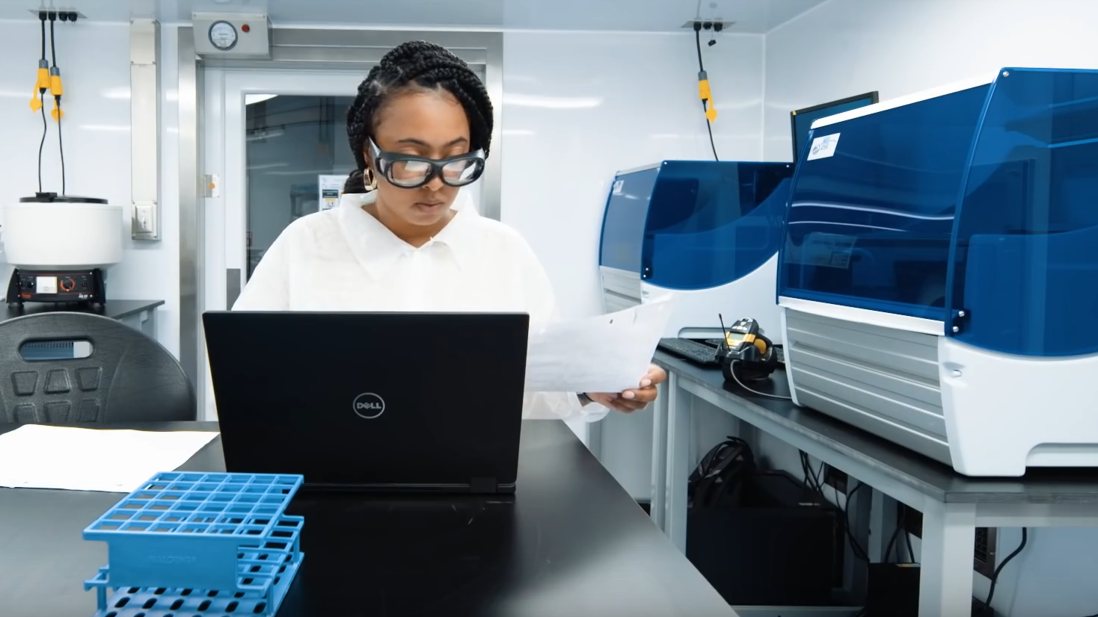

LABORATORY LEADERSHIP SERVICE
LABORATORY LEADERSHIP SERVICE
Training Disease Detectives and laboratory leaders
Notes:
Thanks for opportunity to talk today – excited to share about the LLS program, some recent changes we’ve made, and ways that the program can help you prepare a competitive application.
I’ll also take a moment throughout to highlight some of our fellows, like here – CO 2018 Brandi Freeman on a response deployment to USVI PHL.

Slide 2
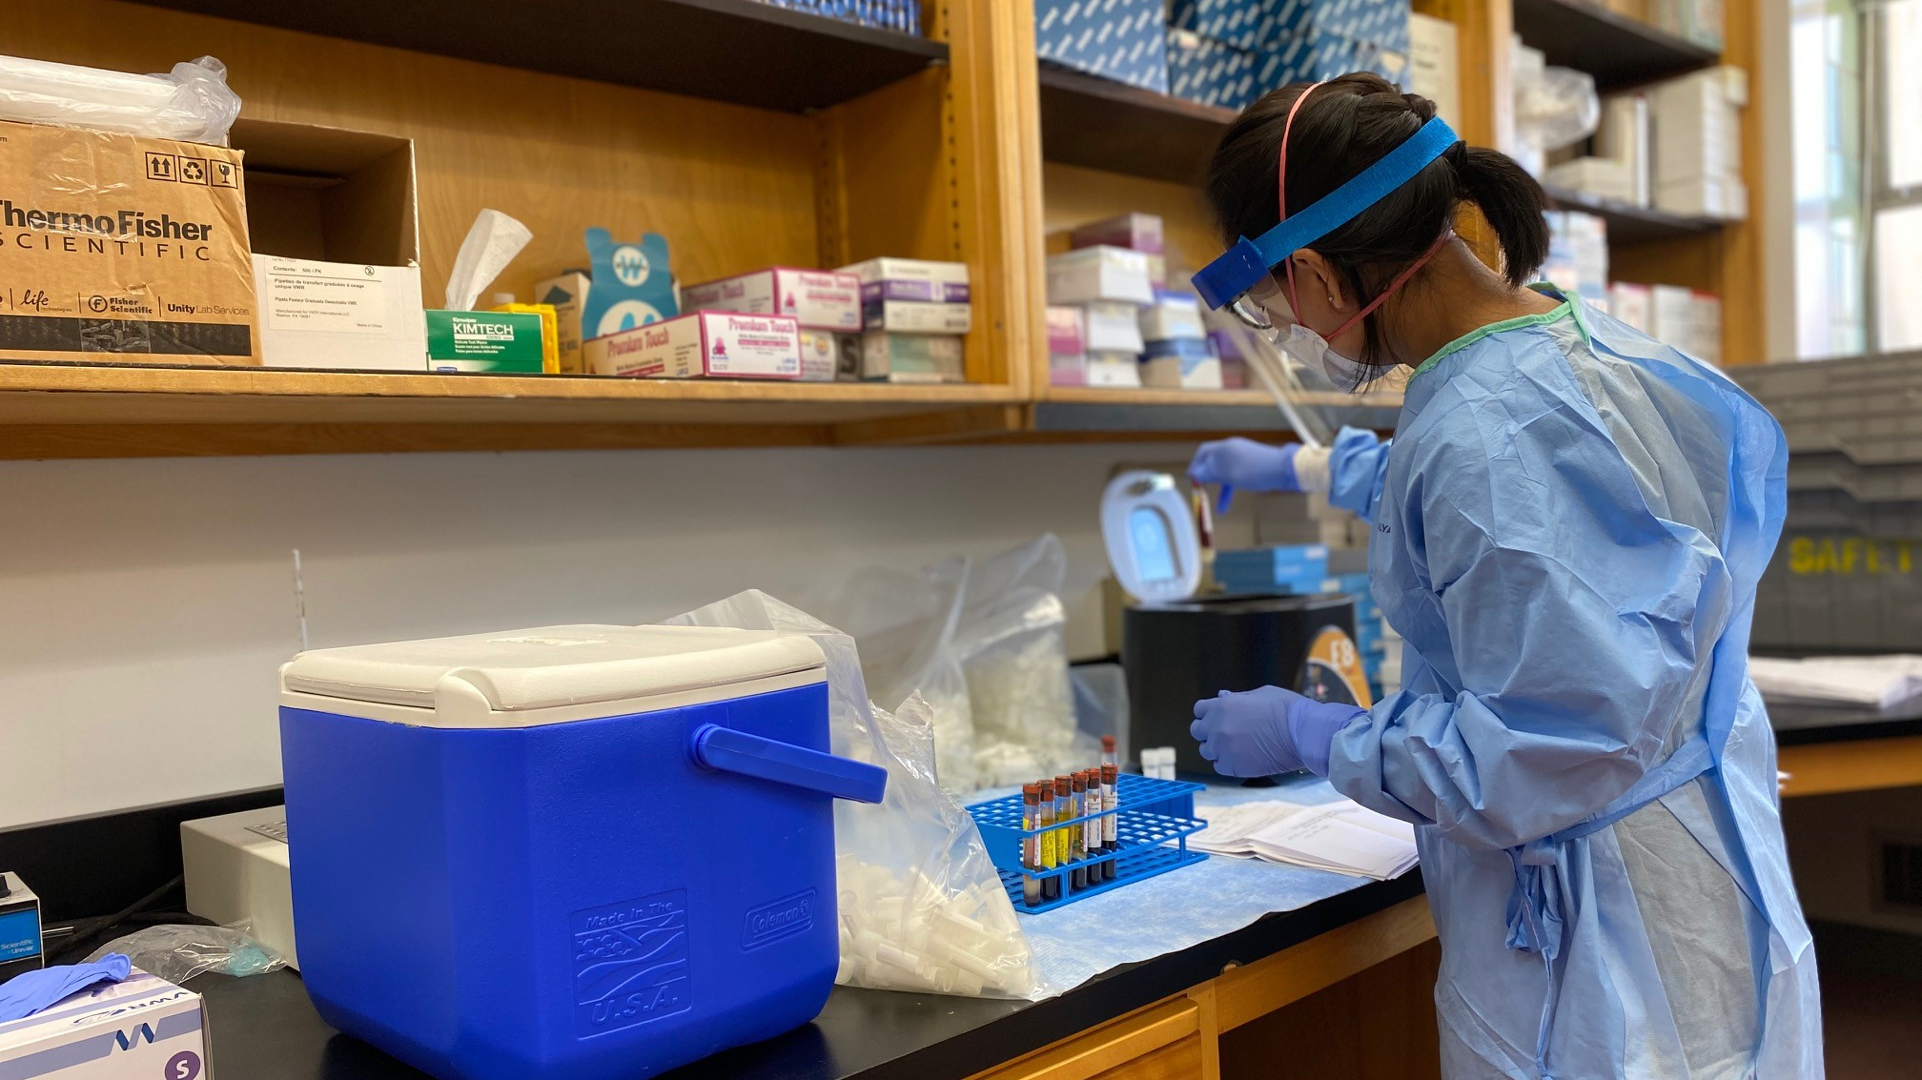
LLS is a 2-year competency-based, service-learning fellowship
LLS is a 2-year competency-based, service-learning fellowship.
Notes:
LLS is a 2-year fellowship for doctoral level scientists
LLS training and experiences are based on competencies deemed critical for success as a leader in the public health laboratory workforce.
Competencies were developed in collaboration with APHL, the Association for Public Health Laboratories and include applied research, lab safety and quality, bioinformatics, lab management, and communications.
Curriculum is designed to weave leadership experience and training throughout all of the competencies.
Fellows complete Core activities of Learning, or CALs, throughout their fellowship to build proficiency and skill within these competency domains.
Find more information on LLS competencies and CALs on the LLS website under What Fellows Learn.
Shown in this slide is Class of 2022 fellow Christine Lee, partnering with the Wisconsin State Public Health Laboratory to implement a COVID-19 field testing strategy on a college campus.

Slide 3


Train, Serve, Retain
91%
7
Classes
47
Fellows
Public Health
Train, Serve, Retain
Notes:
LLS seeks to train fellows through service and retain them in public health
7 classes over 6 years, matriculating 47 fellows
Program will expand with the class of 2022, adding 25 more in July
Over 90% of LLS fellows remain in public health. 61% of grads accepted positions at CDC
Interest is increasing for post-LLS positions in jurisdictional laboratories

Slide 4
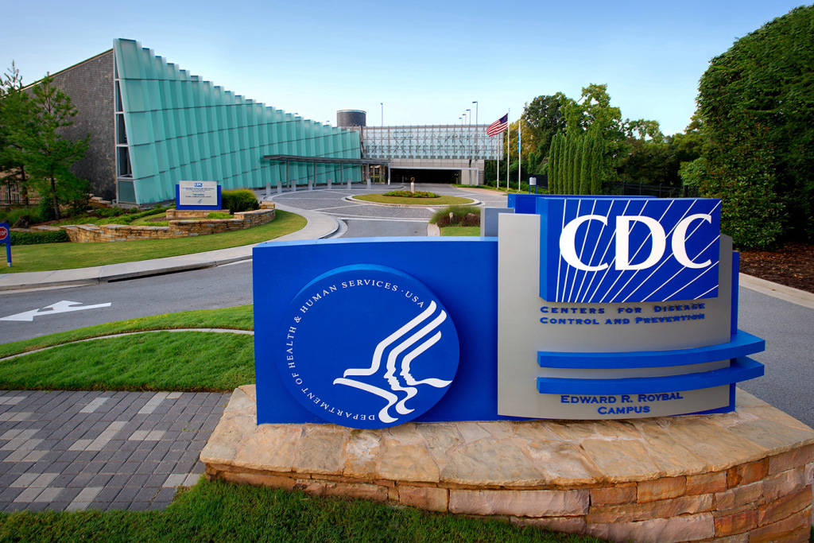
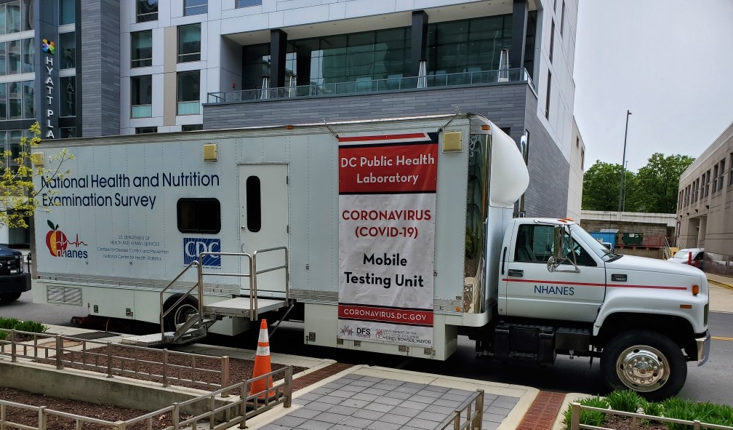
LLS fellows train at public health laboratories around the country
LLS fellows train at public health laboratories around the country.
Notes:
Fellows are hosted in CDC or other jurisdictional public health labs. CDC labs include those at Atlanta headquarters or others throughout the country
We more than doubled the LLS class size with the Class of 2022 (25 fellows) and seek to sustain these numbers. We can only do that if we have host site labs’ support.
LLS communicates to applicants that public health doesn’t just happen at CDC, but also on the frontlines in our nation’s state, local, territorial, and tribal public health labs and health departments
Applicants are encouraged to be open to both headquarters and field placements;
For the class of 2022, half of the assignments are in the field, including 10 with state and local public health labs

Slide 5
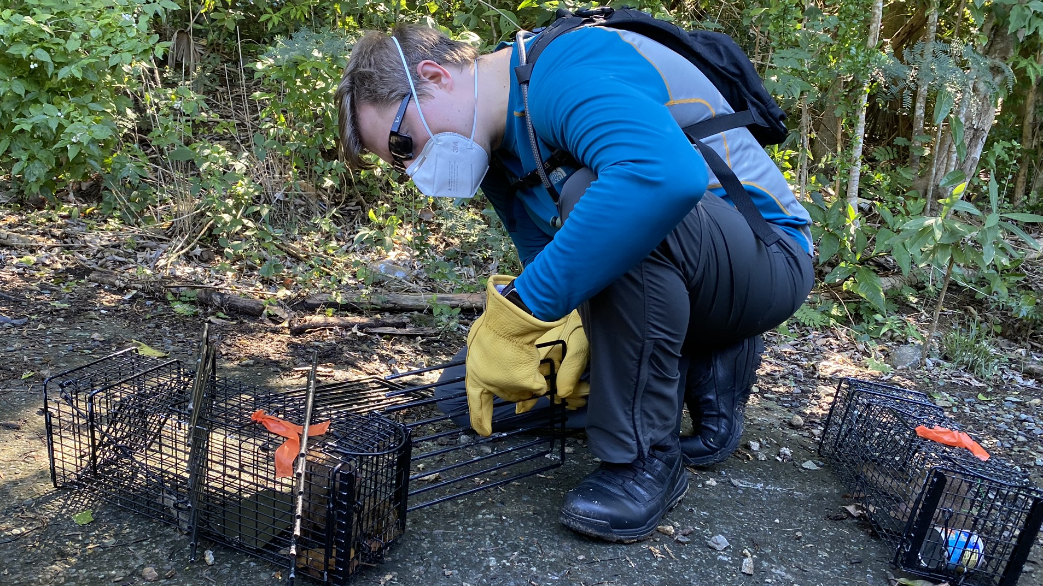

91% experiential. 9% didactic
91% experiential
9% didactic
Notes:
LLS training is largely on the job, experiential, and service-based.
On a near-daily basis, fellows support the mission objectives of their host labs through whether through research contributions, conducting risk assessments, supporting laboratory operations, or other routine, yet high-performance activities. And they also provide service to the nation’s public health needs through support of CDC and local jurisdiction’s initiatives.
Class of 2019 fellow Nicholas Wiese is trapping mongoose for rabies testing in the US Virgin Islands.

Slide 6
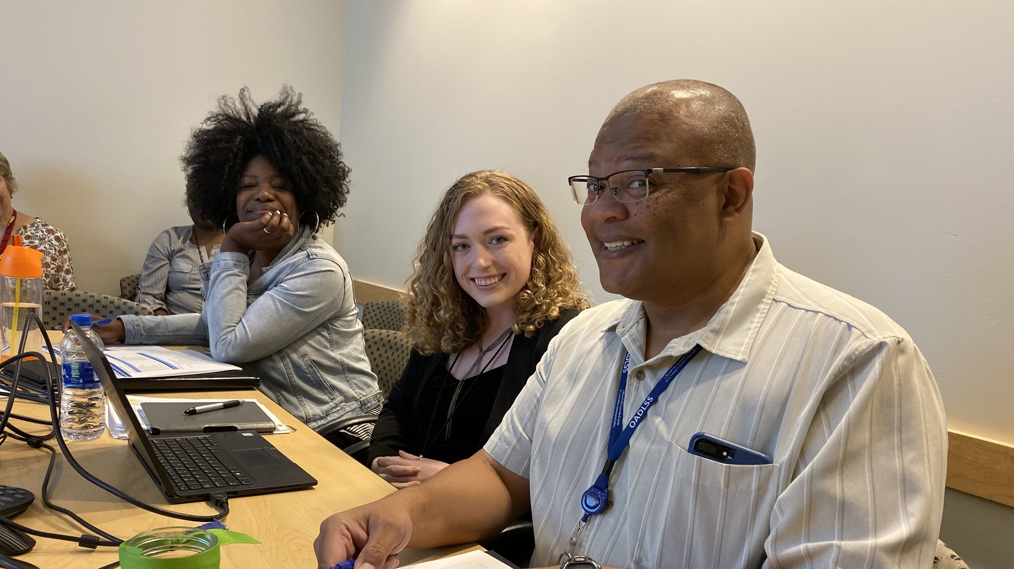
LLS fellows provide service to their host site laboratory at no cost
LLS fellows provide service to their host site laboratory at no cost.
Notes:
Service and service-learning are LLS cornerstones.
A key benefit to a host site lab is that a PhD level scientist, who has been vetted through a rigorous application process, can join your team at not cost to you.
Although LLS garners attention for its deployment, the magic of LLS is in the day-to-day - the high caliber and challenging activities at a fellow’s host site, the ability to engage with public health leadership at all levels across multiple agencies and those partnerships they are building in the process.
Mentorship and supervision in their host sites, from leaders and subject matter experts dedicated to fellows’ professional development, is critical to the success of the program and the fellows’ experience
Shown here is class of 2018 fellow Shelby Chastain Potts meeting with her supervisor and CDC’s lead lab quality expert, Ron Alford, on the right -

Slide 7
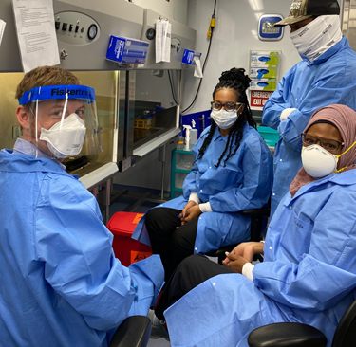
LLS deploys to provide critical lab support and expertise.
Notes:
Service learning can come the form of deployments. LLS asks that host site laboratories commit to supporting their fellow’s participation in a field response. LLS fellows are expected to be able to deploy to the field to support CDC’s mission, to meet the critical needs of a partnering public health laboratory through a Lab-Aid, provide lab support to an Epi-Aid, or deploy on behalf of their host site.
These experiences are highly beneficial to the fellow’s professional development and also give them experience they often apply back to their host site projects or duties
The LLS program requires supervisory approval for LLS Lab-Aid or Joint Epi-Aid (with EIS partners) deployments.
LLS is mindful of the commitment fellows have to their host sites and

Slide 8

Fellows consistently deliver on high impact, complex activities and projects
WHO Headquarters
Geneva, Switzerland
Fellows consistently deliver on high impact, complex activities and projects.
Notes:
Historically, fellows have participated in a variety of service-based activities, not necessarily associated with a deployment, that provide unique leadership training opportunities.
Many of these are a part of their daily duties with their host lab assignments, supported through training provided by the LLS program and curriculum.
The goal is to challenge fellows to not just complete an activity, but to take a leadership role in that activity. These situational leadership training opportunities have included :
Developing and implementing quality management system protocols for a mobile COVID-19 testing unit in DC
Creating laboratorian competency assessment procedures for inactivating pox and rabies virus
Serving as the Emergency Operations Center (EOC) coordinator for a Center-level measles response
Leading a large, complex field validation study for the BinaxNow COVID Ag test in MA to help inform state testing policies
Or as shown here, with Christina Carlson, CO 2018 alum, serving as a consultant to the WHO on global guidance for lab biosafety and biosecurity
The LLS program is happy to meet with host sites to discuss projects. We challenge you to challenge the fellow.
Fellows are bright, talented scientists who are seeking the opportunity to do great things and make a difference.
LLS fellows have a track record of elevating even the mundane projects to a level of greatness with their skill, innovation, and work ethic.
LLS would love to partner with host sites to see what’s possible.

Slide 9


Fellows consistently deliver on high impact, complex activities and projects
LLS provides administrative and financial support for fellows.
LLS Program
Host Site
Host Site
Salary and benefits
Onboarding
Computer
Required travel logistics
Program support
Space and supplies
Lab-specific training
Dedicated time
Response opportunities
Notes:
Overview of roles and responsibilities of the LLS program vs. the host site.
Note listed is conference travel.
Field fellows in jurisdictional laborarories receive an annual stipend of $1500 for conference travel.
For CDC-based fellows (HQ or field), they are presenting work on behalf of their host site, then the expectation is that host CIO supports the travel and registration.
We do ask that fellows have the opportunity to attend or participate in at least one conference during their fellowship term. We look for this commitment in the host site’s application.
As budget allows, LLS will attempt to support registration to the APHL annual conference.

Slide 10
Let’s talk about the application process.

Slide 11



These 3 criteria support a competitive application
These 3 criteria support a competitive application
Understanding LLS’s program goals and CALs
Experience mentoring post-doctoral scientists
Leadership approval of your application
Notes:
The criteria to apply for and host an LLS fellow are:
Understand the Core Activities of Learning. We should be able to outline how fellows will complete CALs through reviewing the projects proposed in your application. Program happy to chat. Don’t have to be listed out per se.
You should have experience mentoring post-doctoral scientists
You’ll also need the Laboratory Director Support (SPHLs)
CIO Authority Approval for CDC Labs. This can be the branch chief, division director, etc.
Fellows should have a primary supervisor, and at least one secondary supervisor. It’s not uncommon to have more than one secondary supervisor. The primary supervisor should have experience mentoring and supervising PhD scientists. We do ask on the application whether the secondary supervisor can sub as primary supervisor if needed which makes for an easy transition for both the program and LLS fellow if the primary supervisor moves to another position (which has happened).

Slide 12

There are 3 sections of the LLS host site application
There are 3 sections of the LLS host site application.
Host site overview
Supervisor profile
LLS Fellow projects and opportunities
Notes:
Host site overview or profile - basic information such as your name and host site agency location. Particularly if you are a field site or a CDC lab outside ATL, it might be helpful (for when applicants see it) to give an overview of selling points to the area, or even to your lab
Host Site Supervisors profile is key.
Supervisor Experience – experience mentoring doctoral level students. Where did they end up?
Supervisory Plan (which is new this year). The plan should outline each supervisor’s role on the team; communication methods and meeting frequency with the fellow, and how the team will facilitate engagement of the fellow with others, including senior leadership, in the host site.
For the LLS application
LLS position description – list consultants which are individuals that will provide substantial advice or trainings to a LLS fellow during the fellowship, former fellows you’ve supervised (whether ORISE, LLS, EIS, etc.), and the routine laboratory work that your lab performs.
You will also need to describe:
Projects that will support the candidate gaining leadership and management skills. The applied research project is key for a competitive application – because so many of a fellow’s training requirements stem from this. It should be defined – something that can be completed ideally, within a year to 18months year and a half, so that the fellow has time to complete other related CALs. The more ideal projects are those that are ready to roll – not ones that require or are dependent upon another lab member’s work, clinical specimens from a study that is not already underway, etc.
The breadth of work or opportunities (technical and soft skills) that the fellow can experience. Where are there leadership opportunities? Exposure to leadership examples?
Special skills useful for this position assignment or required.
Position Environment
Staff and other resources available
Workplace support that will be provided
Travel Opportunities
Percentage of travel that your position assignment will provide for the candidate. Candidates, as well as the program, look for direct mention of whether you can support conference travel.
Will the projects or lab’s mission objectives require or permit any TDY travel or deployments?

Slide 13




We made changes to streamline host site application processes and prioritize partnerships with you
We made changes to streamline host site application processes and prioritize partnerships with you.
No LOI
Pre-Match
Coaching
New Applicant Eligibility Criteria
Notes:
Letter of intent, LOI, is no longer required. Previously, the application process for non-Atlanta labs involved a cumbersome process of first submitting a letter of intent to apply and then subject to a site visit. We aren’t doing this anymore. All labs, CDC, HQ, field, will undergo the same application process with the same opening date for applications.
We’re also excited to pilot a pre-match process this year. Our partner program, EIS, has long had this approach to help match their officers with sites who are clearly strong host sites, but haven’t matched in the past. We recognized the same need in our program and excited to launch. I’ll share more details in the following slides.
Application coaching is now standard for the program and application. Host site applicants just need to let us know when you’d like to chat. The LLS program’s goal is to make the host site of the application process as transparent as possible. We’re here to help.
And as an aside, we’ve also adjusted our fellow applicant eligibility criteria. 2 years of post doc experience is no longer required. This indirectly impacts host labs by providing a larger candidate pool and higher probability of matching with more labs.

Slide 14


We made changes to streamline host site application processes and prioritize partnerships with you
Successful host site applications lead to interviews with eligible LLS fellow candidates before final match.
Pre
Match
Matched
Class of
2022
Interviews
Application
Review
Regular
Match
Notes:
The LLS program does not select a class, then match, but rather has pools of both fellow applicants and competent host site labs who, as the last stage of our selection process, have the opportunity to interview with each other.
Overview of the host site application process:
Hopefully host sites elect to meet with the LLS program while developing their application to receive coaching or general insights on current program priorities that could be included
Submitted applications are reviewed by a panel. Host sites that receive a high quality rating during this review advance to the next stage, with is interviews. The ideal is that the panel review is a formality, given that all labs are receiving coaching and application support. The goal is to provide as many labs as possible the opportunity to interview with candidates.
Host labs that advance to interviews are eligible to be matched with a fellow. If your application is selected to advance to match, candidates will review your position description (essentially your entire application) and select which sites they would like to interview with. We ask that you interview with all candidates that have selected your site for an interview.
New for the Class of 2022 was “pre-match” (discussed more on the next slide). These interviews occur first, then the regular match interviews.
After each set, candidate fellows rank the labs they interviewed with. The labs rate the respective fellows.
LLS uses a statistical algorithm to establish a rank-order based on the strength of the match. We place as many fellows as we can based on that rank order, as budget permits.

Slide 15
Labs identified as priority placements are eligible for pre-match
Labs identified as priority placements are eligible for pre-match.
Indicate eligibility when applying
Interview advantage for labs
Incentive for fellows
Regular match still possible
Notes:
Pre-match is offered as a means to place fellows in host sites where there is a priority need for a fellow.
Pre-match was first offered for the Class of 2022 and priority placements were needed for state and local laboratories. To meet this need, state and local labs who advanced to match in the past but not assigned a fellow were eligible for pre-match.
For the Class of 2023, we are currently evaluating agency and public health workforce needs and priorities to identify pre-match eligible labs.
Pre-match will also be offered to a CDC laboratory that opts to sponsor, or pay for, its own fellow (similar to the EIS). If you are a CDC laboratory interested in this route, please reach out to me or the LLS program so we can square away those details.
Should a pre-match lab either not identify a suitable fellow or not match during this phase, then that lab will advance to the regular match process with the larger pool of fellows.
Labs meeting the criteria will indicate their eligibility when prompted during the routine application process.
Candidate fellows are told that these placements are priority and matches are binding. They will learn about the advantage of interviewing early with a smaller pool applicants and these specific pre match laboratories, as this increases their likelihood of securing a spot in an LLS class that is known to have limited space.

Slide 16
LLS program provides application coaching for host site laboratories
LLS program provides application coaching for host site laboratories.
Impress the review panel
Appeal to candidates
Increase chances of match
Notes:
Host site application coaching is valuable and effective, even for repeat host sites.
Fellow candidates review host labs’ applications to decide who they would like to interview with in the match.
A host site’s application must hold merit for the application review panel but also appeal and communicate the strengths of your lab to a candidate fellow.
LLS program provides coaching and application review to both increase likelihood of advancing to match and garner the interest of as many candidates as possible for interviews during match. This increases the likelihood of matching with a fellow.
Coaching or even just a consult is not required, but highly encouraged (particularly for new applicants).
For labs that have applied in the past, the LLS program can pull feedback from the review panel to share.
There is no secrecy. The program’s goal is to adopt a fully transparent process and approach for host sites. We cannot develop great fellows without great host sites. We would love to better support you.
The LLS program is readily available to answer questions even as host sites actively work through the application. We’re here as a resource, please don’t hesitate to call on us.

Slide 17
LLS program provides application coaching for host site laboratories
Fellow candidates no longer need two years of post-doctoral experience.
Larger applicant pools
Start scientists in public health
Revamped recruitment
Notes:
For the Class of 2022, LLS no longer required candidates to have post-doctoral experience.
While not directly related to you as a potential host site, it is still relevant.
This changed resulted in larger applicant pools, which provided more matching options to our host sites.
LLS was able to engage PhDs at a time when we can direct their career paths more readily towards public health.
Regardless of post-doctoral experience, all candidates are subject to a rigorous application cycle.
Approximately 1/3 of the matched class of 2022 can be attributed to the new, expanded eligibility criteria that eliminated the requirement of 2 years post-doc experience. Anecdotally, these fellows were also among the highest rated by host sites (a proxy for the quality of a candidate).

Slide 18
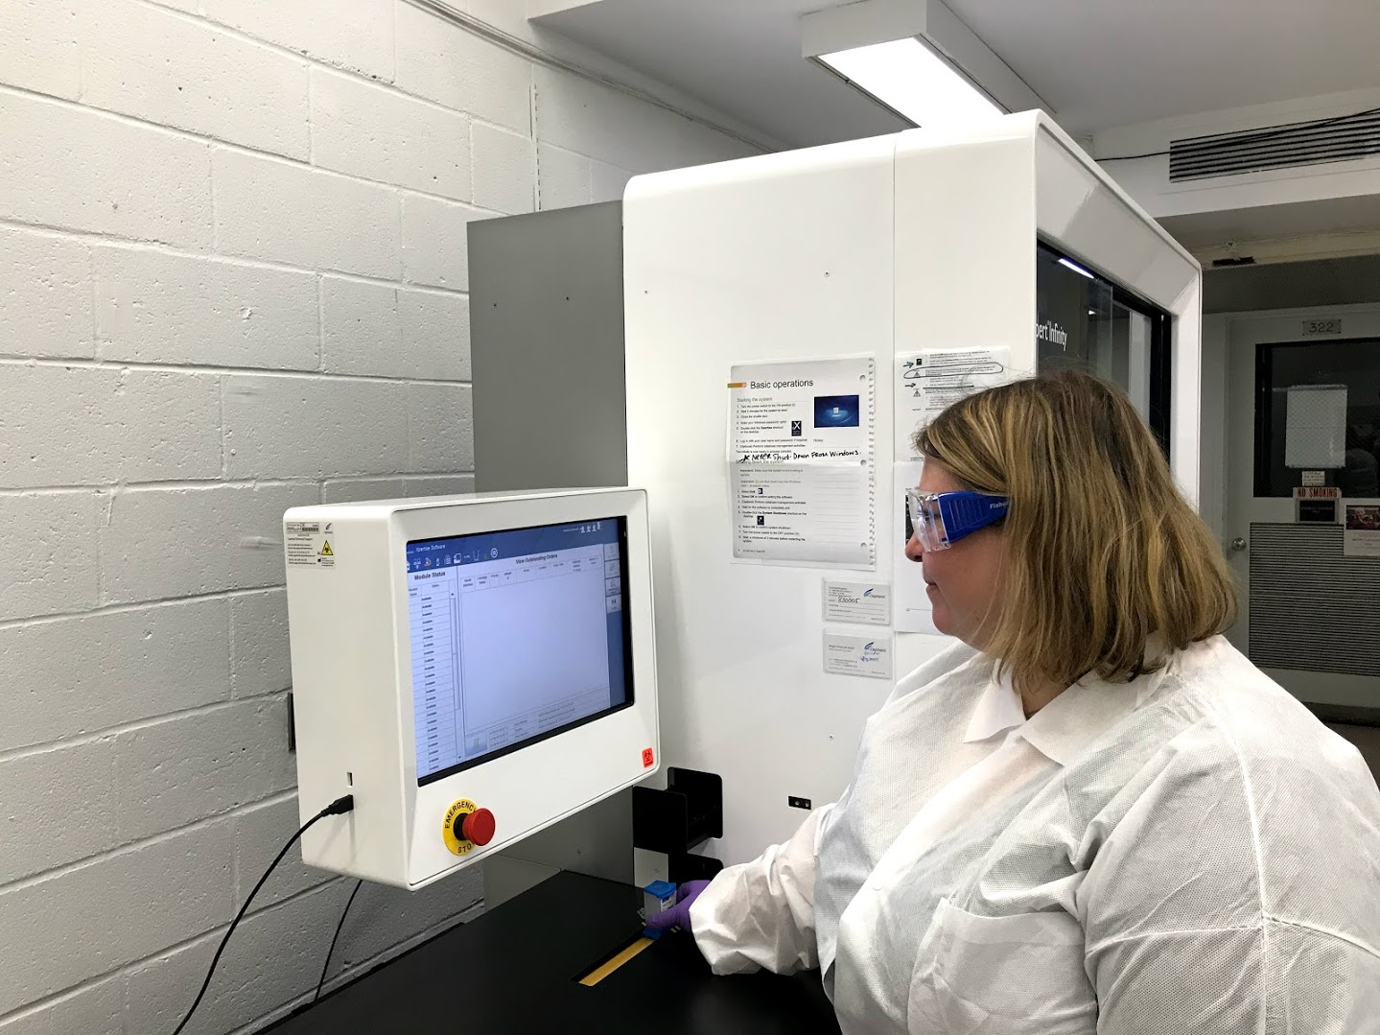
Add a PhD scientist to your team, share your expertise, and help train a future lab leader
Add a PhD scientist to your team, share your expertise, and help train a future lab leader.
Notes:
For a host site lab, you gain a high-caliber scientist with an eager mind for additional experience who can positively contribute to your workforce – they can and do hit the deck running and do extraordinary work.
LLS will cover the cost.
Host site supervisors are able to share their wisdom and experience and have an immeasurable impact on an LLS fellow

Slide 19
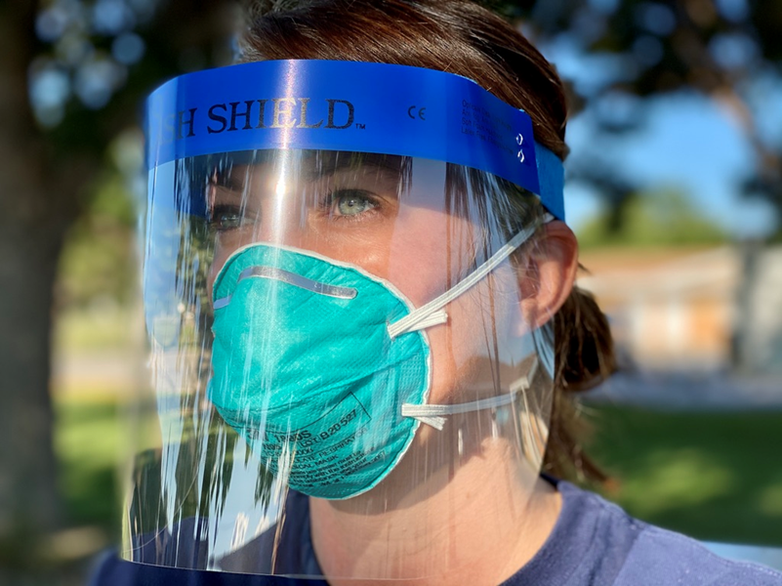
Ready to make a difference?
Ready to make a difference?
Notes:
As a host site laboratory, or even as a partner to our curriculum and training, you make a difference in these fellows’ lives and careers.
Your experience, knowledge, and leadership is critical for the success of this program
Please apply to host a fellow!

Slide 20
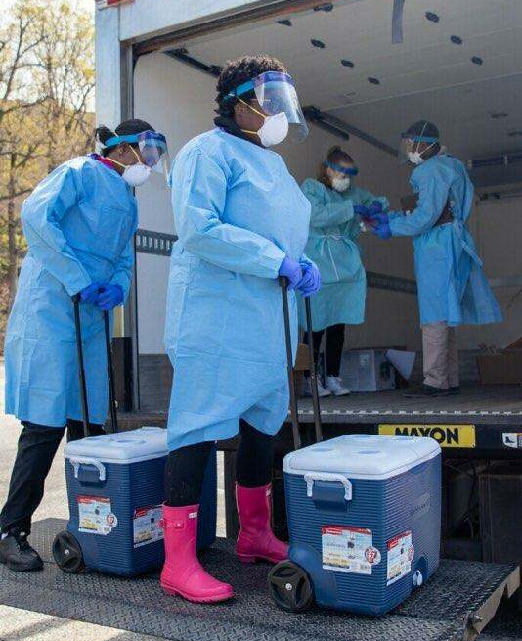
CLASS OF 2023 Laboratory Host Sites
CLASS OF 2023
Laboratory Host Sites
Application period open
April 1 – June 3
www.cdc.gov/lls
thenning@cdc.gov

