Slide 1
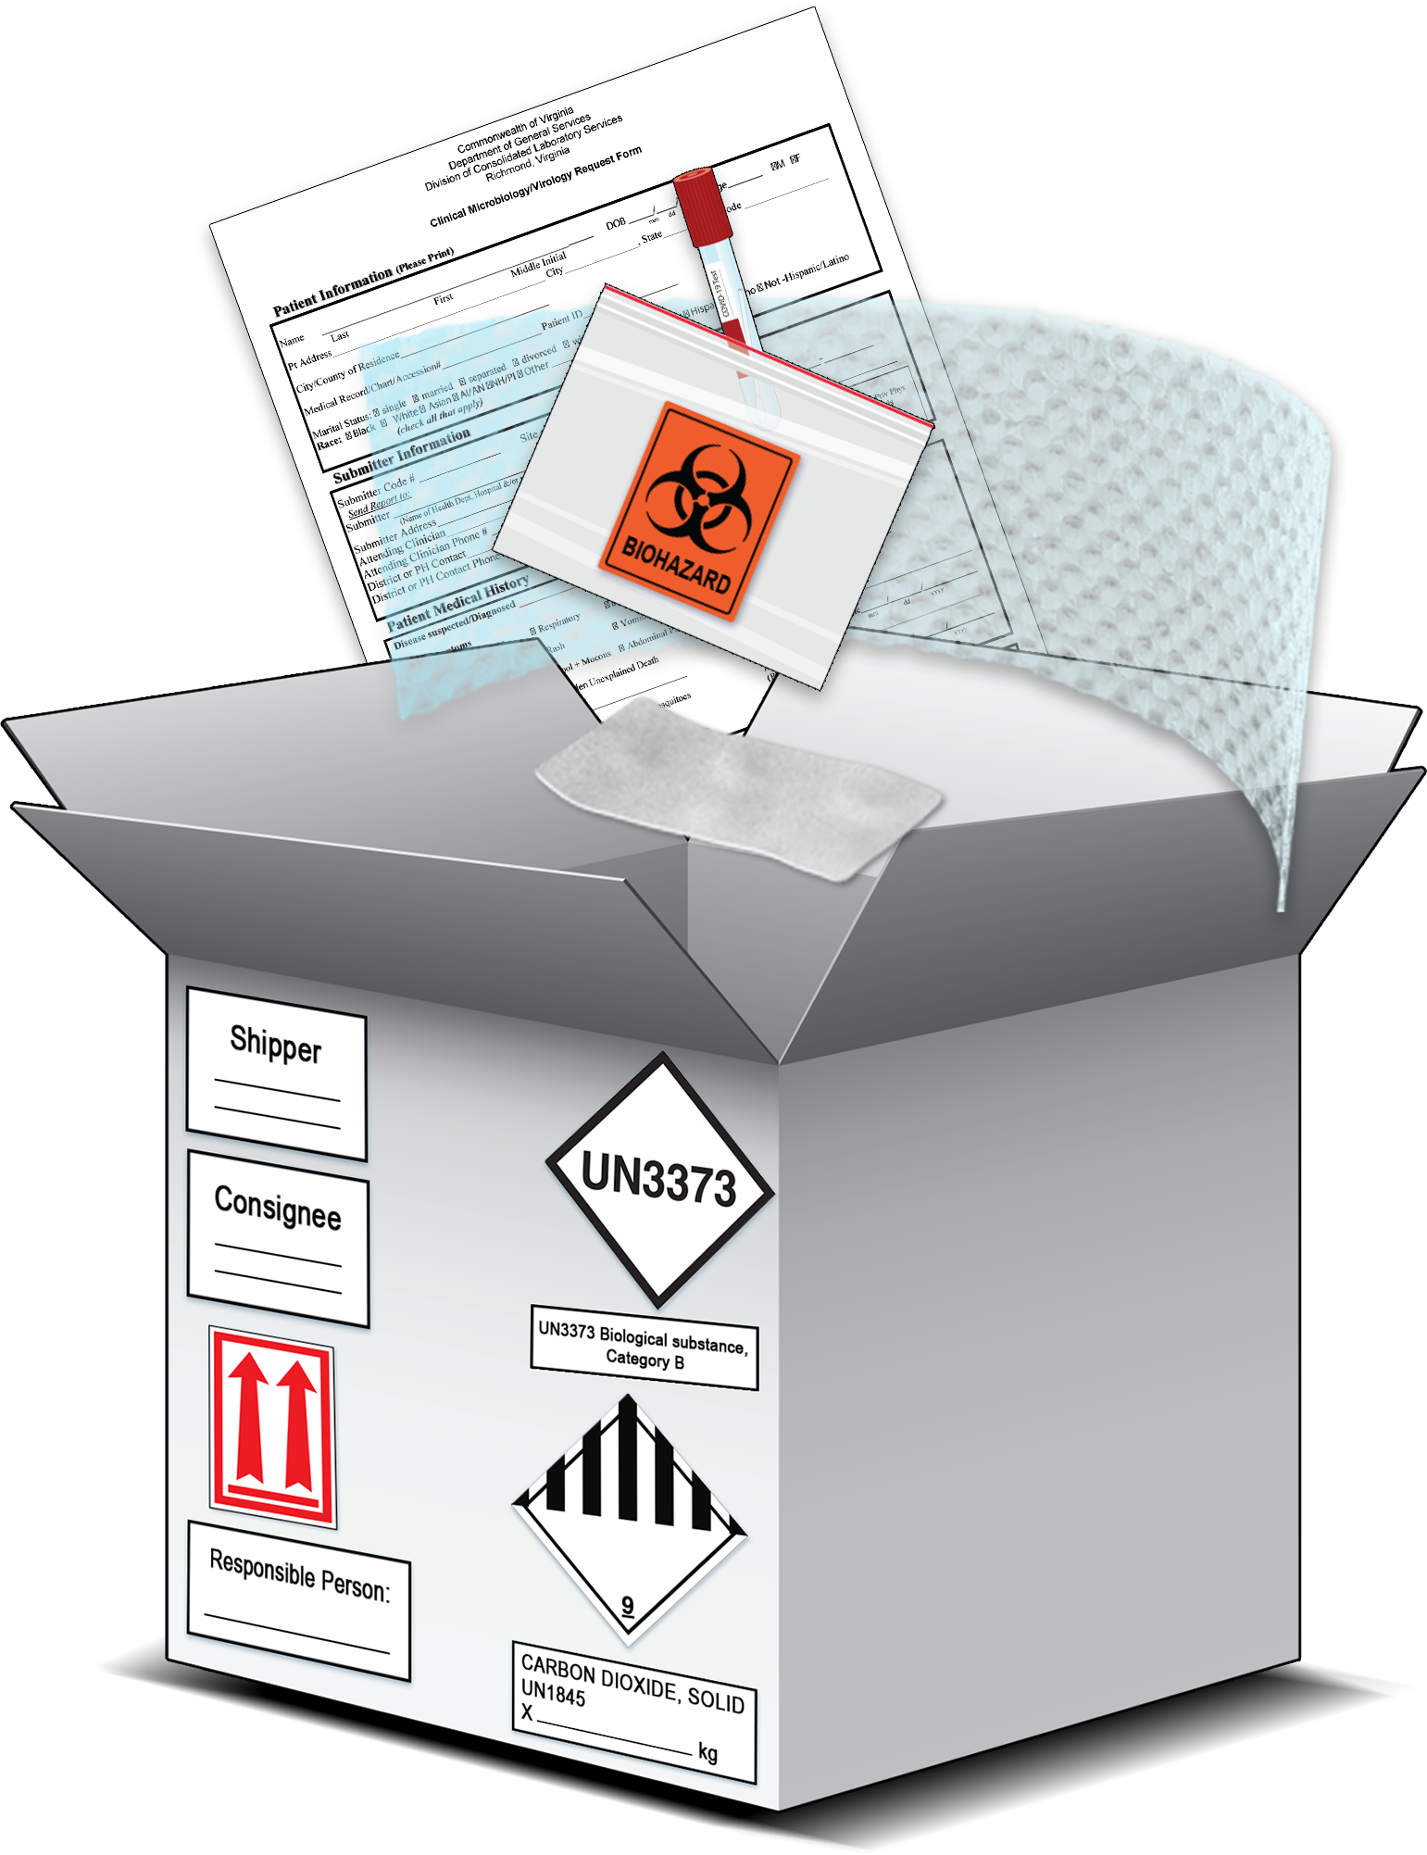
SARS-CoV-2 Specimens:
Packing and Shipping
Personnel must be trained to pack and ship suspected or confirmed SARS-CoV-2 specimens according to the regulations and in a manner that corresponds to their function-specific responsibilities. This job aid is not a substitute for the required training to pack and ship infectious substances, but instead serves as a quick reference guide adapted from the CDC Laboratory Training course
Packing and Shipping Dangerous Goods: What the Laboratory Staff Must Know.

Slide 2
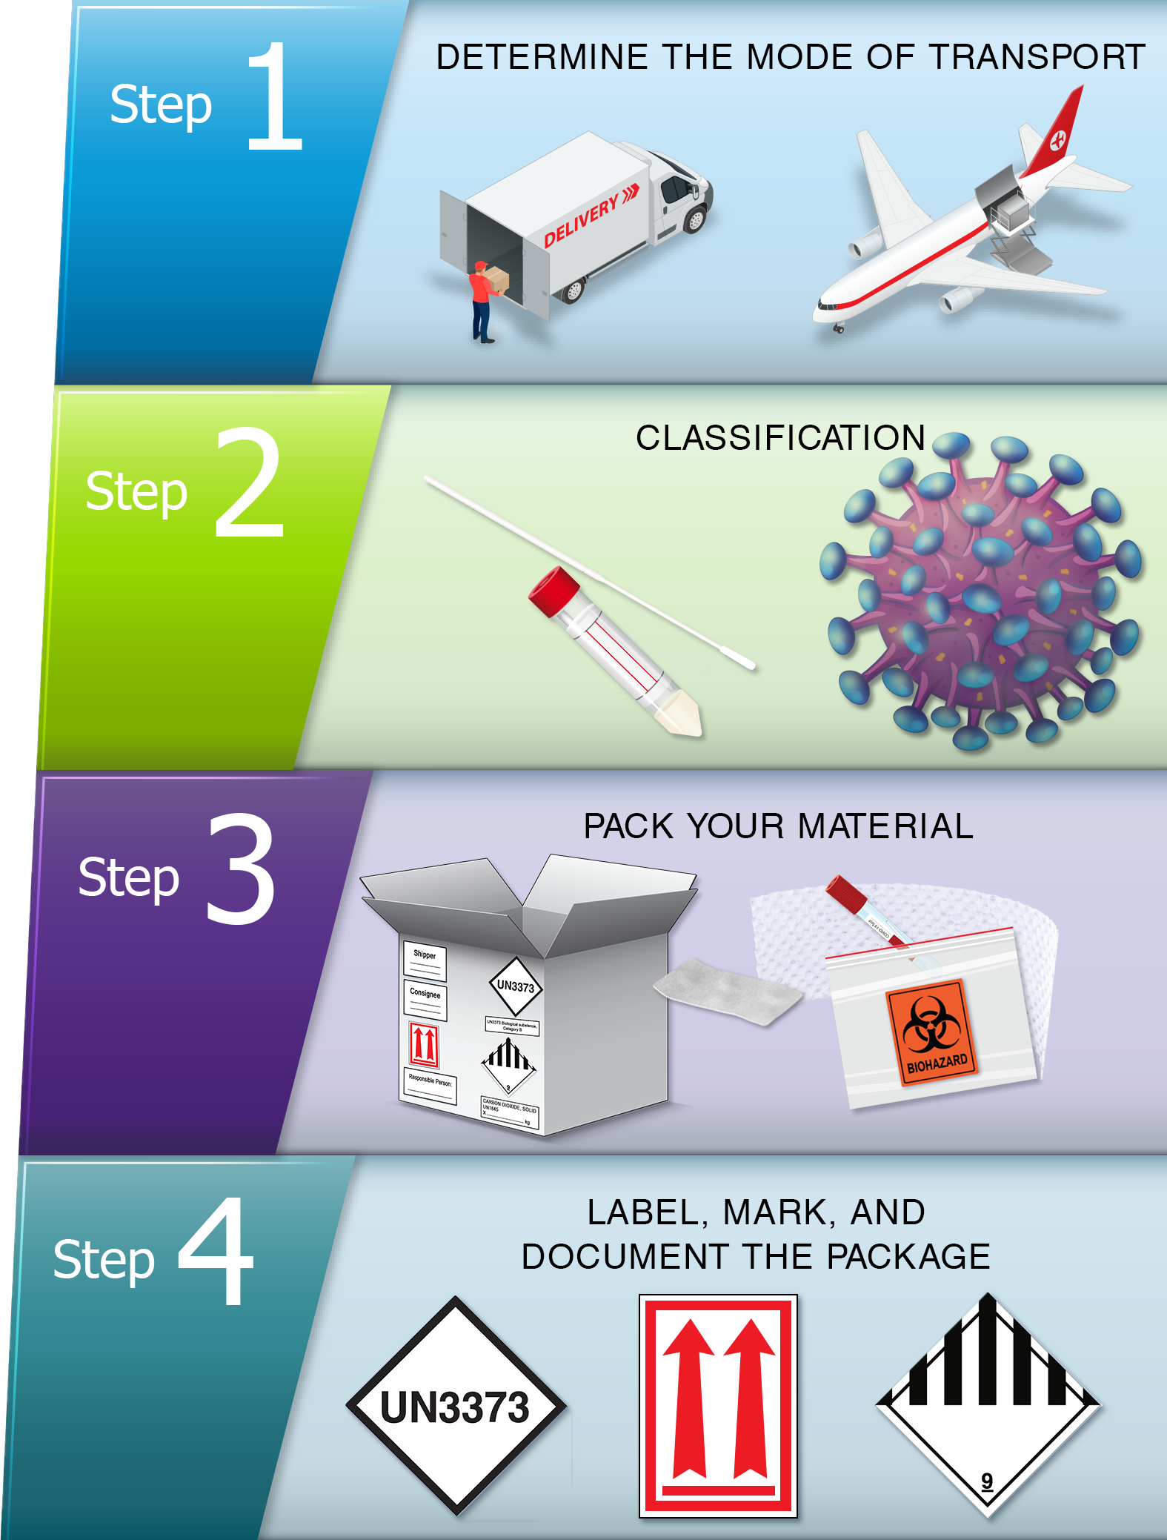
Packing and Shipping Process Job Aid Overview
This job aid describes a practical four-step method to packing and shipping suspected or confirmed SARS-CoV-2 specimens as UN 3373 Biological Substance, Category B. This process is designed to systematically think through the requirements needed for transportation and provide quick-reference job aids to apply in the workplace.
Step 1: Determine the mode of transport for the package
Step 2: Determine the classification of a substance
Step 3: Pack the Material
Step 4: Label, mark, and document the package
Notes:
Recommendations are in accordance with the current edition of the International Air Transport Association (IATA) Dangerous Goods Regulations and U.S. Department of Transportation (DOT) Transporting Infectious Substances Safely.

Slide 3
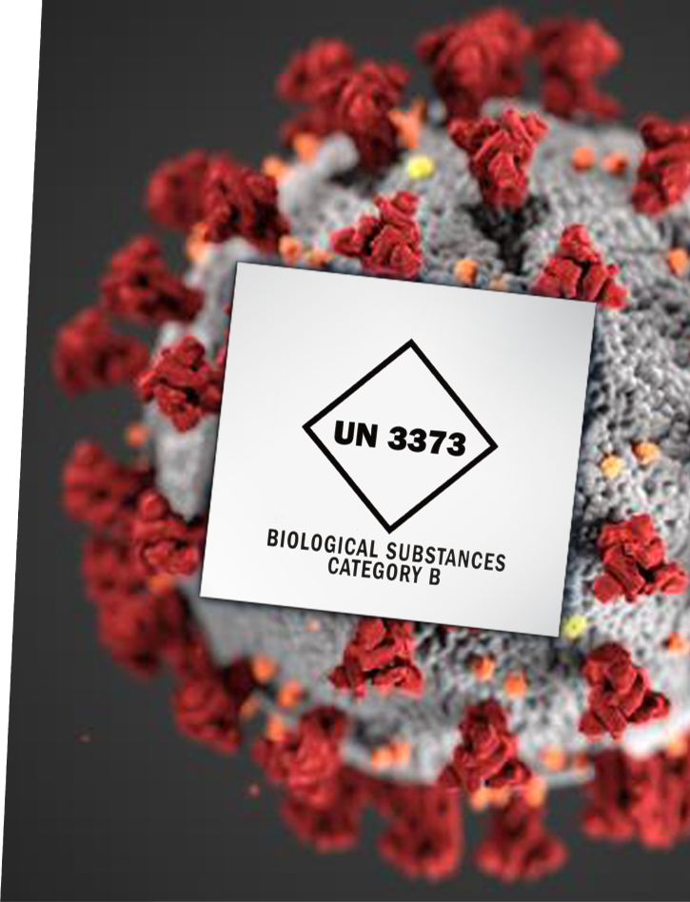
Scenario
This scenario will be referenced throughout the job aid to walk through the four-step method of packing and shipping suspected or confirmed SARS-CoV-2 specimens.
“A 65-year-old patient requests a COVID-19 test from their physician. The patient is experiencing chills, body aches, and cough, and had a close encounter in the last three days with a friend who was recently diagnosed with SARS-CoV-2. The physician's office collects a nasopharyngeal (NP) swab and contacts the state public health laboratory who requests that all specimens be sent to the designated laboratory for testing within 24 hours or overnight. The physician's team contacts an air transport company* to ship the specimen via priority air overnight to the designated laboratory at the requested frozen temperature (<0ºC).”
Notes:
*The air transport company must be an IATA member airline such as FedEx or UPS.

Slide 4
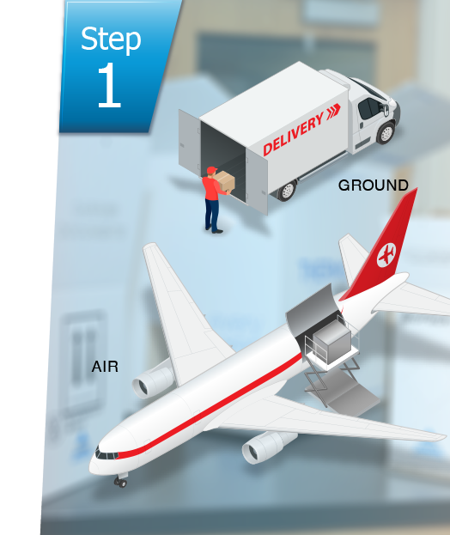
Scenario Step 1: Determine the Mode of Transport
Step 1 is to determine the mode of transportation and associated regulations. The state public health laboratory requested that all specimens be sent to a designated laboratory for testing. The physician's team contacts an air transport company to ship the specimen(s) priority air overnight to the designated laboratory. The person shipping the specimen should reference the IATA Dangerous Goods Regulations as the mode of transportation will be AIR.
Notes:
Additional guidance on packing and shipping infectious substances regulations:
IATA Novel Coronavirus (COVID-19) Guidance for Operators (https://www.iata.org/contentassets/5b7bfb49568442049a384623cefb3cea/covid-19-guidance.pdf)

Slide 5
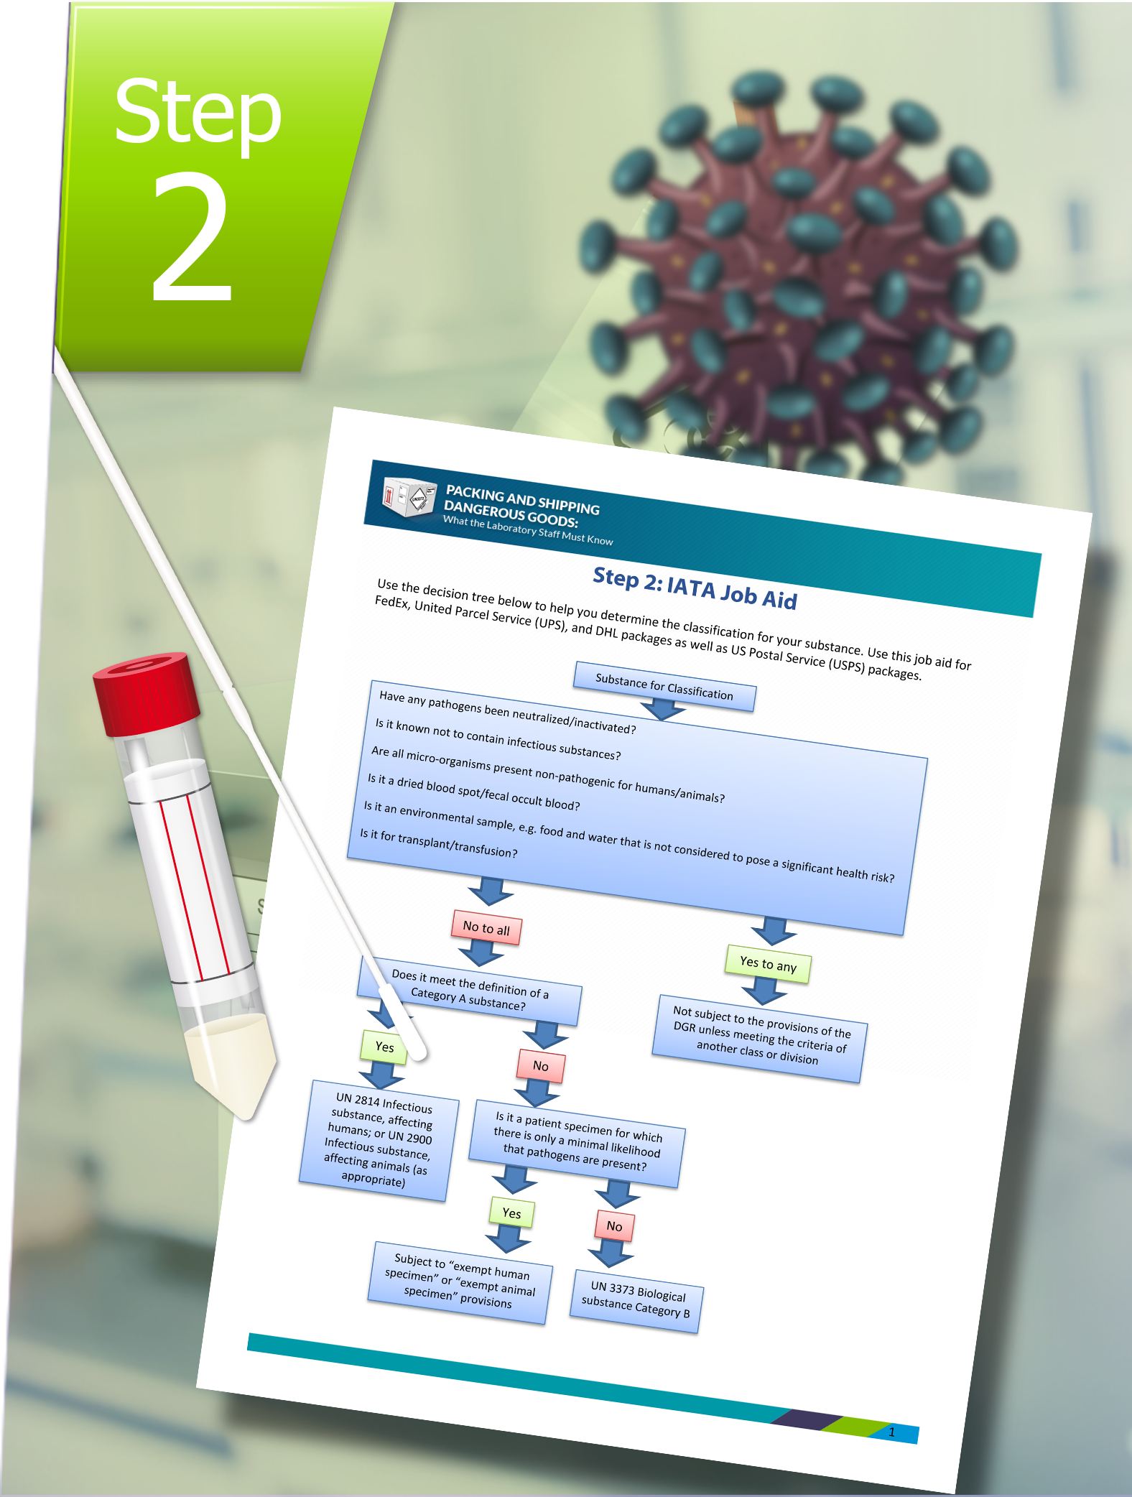
Scenario Step 2: Determine the Classification
For this scenario, suspected or confirmed SARS-CoV-2 specimens should be packed and shipped as UN 3373 Biological Substance, Category B*, in accordance with the current edition of the International Air Transport Association (IATA) Dangerous Goods Regulations and U.S. Department of Transportation (DOT) Transporting Infectious Substances Safely.
Notes:
Biological substances are classified as “Category B” if they are not in a form generally capable of causing permanent disability or life-threatening or fatal disease when exposure occurs. This applies to both human and animal specimens. Category B substances are assigned to UN 3373.
The job aid below provides guidance on determining the classification of a specimen:
IATA Decision Tree and Indicative List Job Aid (https://www.cdc.gov/labtraining/docs/job_aids/packing_and_shipping/Step_2_IATA_Job_Aid_508.pdf)
*Unless the countries of origin, transit, or destination have issued national recommendations defining them otherwise.

Slide 6
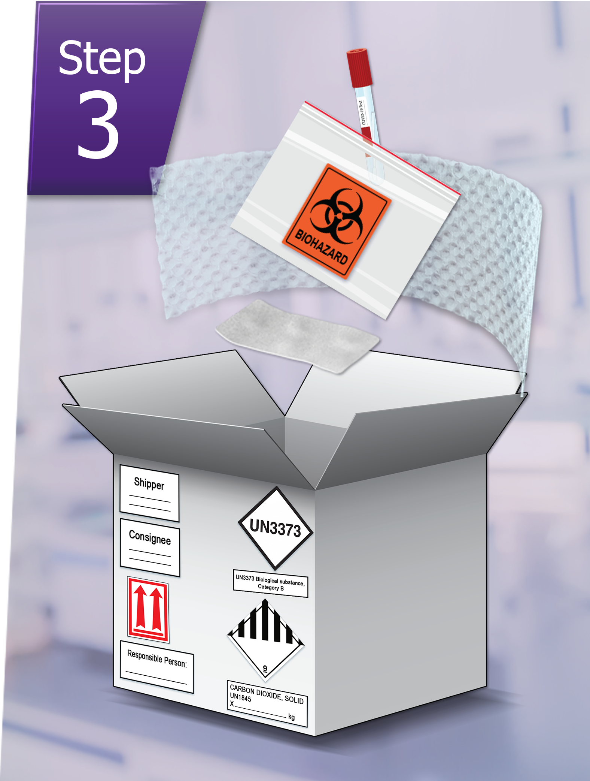
Scenario Step 3: Pack the Material
According to the packing instructions (PI) regulations, the shipper is responsible for all aspects of packing the dangerous goods. All suspected or confirmed SARS-CoV-2 specimens must be triple-packed with primary, secondary, and outer packaging. For this scenario, the shipper would:
Place the specimen into a leak-proof, sift-proof glass, metal, or plastic primary receptacle.
Cushion each primary receptacle with absorbent materials and place it into a leak-proof, sift-proof 95 kPa bag or tube that can absorb the entire volume of the substance.
Surface decontaminate the secondary packaging and move it to a “clean” zone.
Secure the secondary packaging in rigid outer packaging, then add dry ice or gel packs.
If dry ice is used, the outer packaging must be designed and constructed to permit the release of carbon dioxide gas to prevent the build-up of pressure.
Notes:
The job aid below provides guidance on packing requirements for each classification:
Step 3: Packing Category B Specimens – Page 2 (https://www.cdc.gov/labtraining/docs/job_aids/packing_and_shipping/Step_3_Packing_Category_A_and_B_and_Exempt_Human_and_Exempt_Animal_Specimens_Job_Aid_508.pdf)

Slide 7
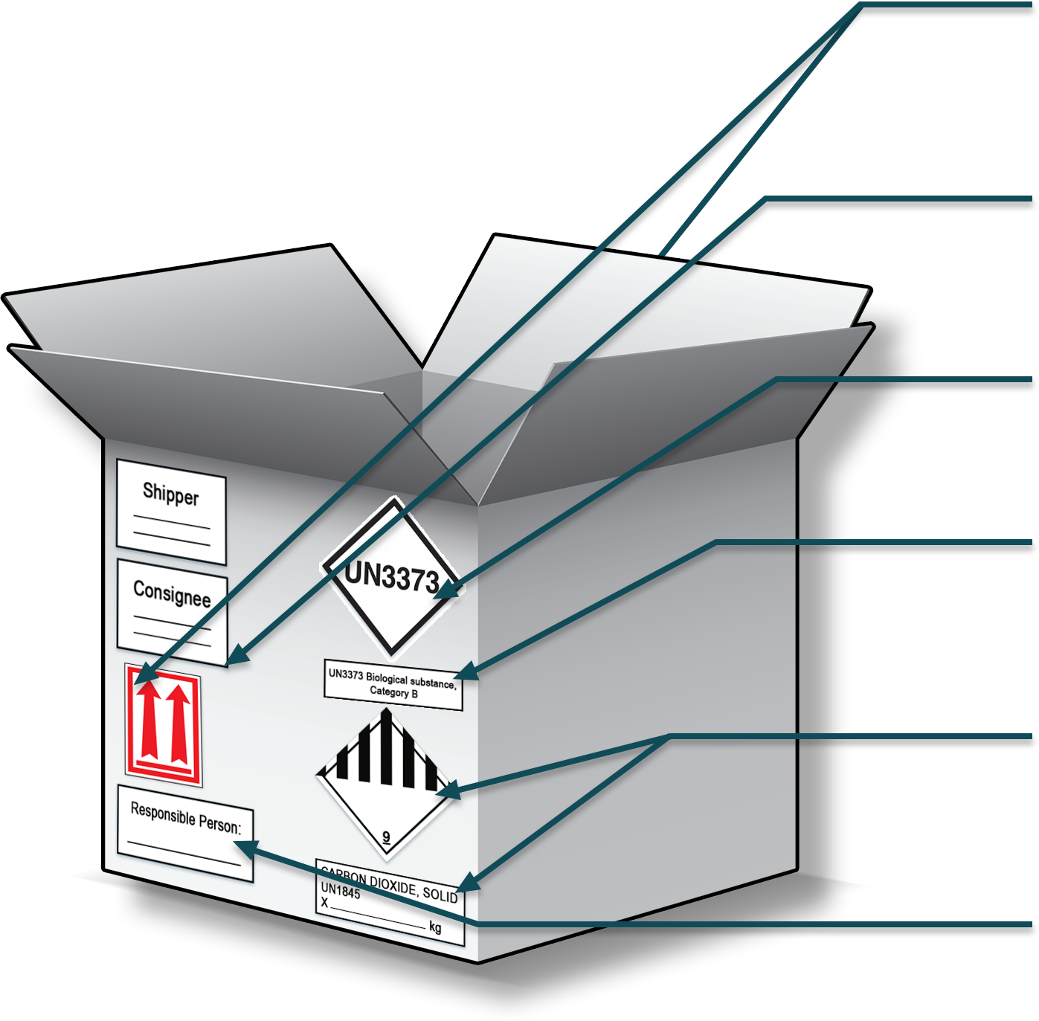
Shipper and Consignee Information
The shipper and consignee's name and address must appear on all dangerous goods packages.
Scenario Step 4: Mark, Label & Document the Package
The following markings and labels should be used when shipping the suspected or confirmed SARS-CoV-2 specimen by Air:
Package Orientation Labels
The arrows help personnel know which way is up when handling your package. Place the arrows on TWO opposing sides of the package in the same orientation as the primary packaging.
UN 3373 Mark
UN3373 is a diamond-shaped mark used when shipping Category B substances. It must be displayed on the outer package near the proper shipping name.
Proper Shipping Name
The proper shipping name is the specific name from the list of dangerous goods used to describe the hazard properties and the composition of dangerous goods.
Class 9 Label, Proper Shipping Name, UN 1845 Mark and Net Weight of Dry Ice in Kg.
Packages including dry ice must include additional pieces of information. Generally, this is a single label but can also be found as two individual labels.
Responsible Person Contact Information
A responsible person's name and telephone number are required for shipment of all dangerous goods. The responsible person must be aware of the package contents.

Slide 8
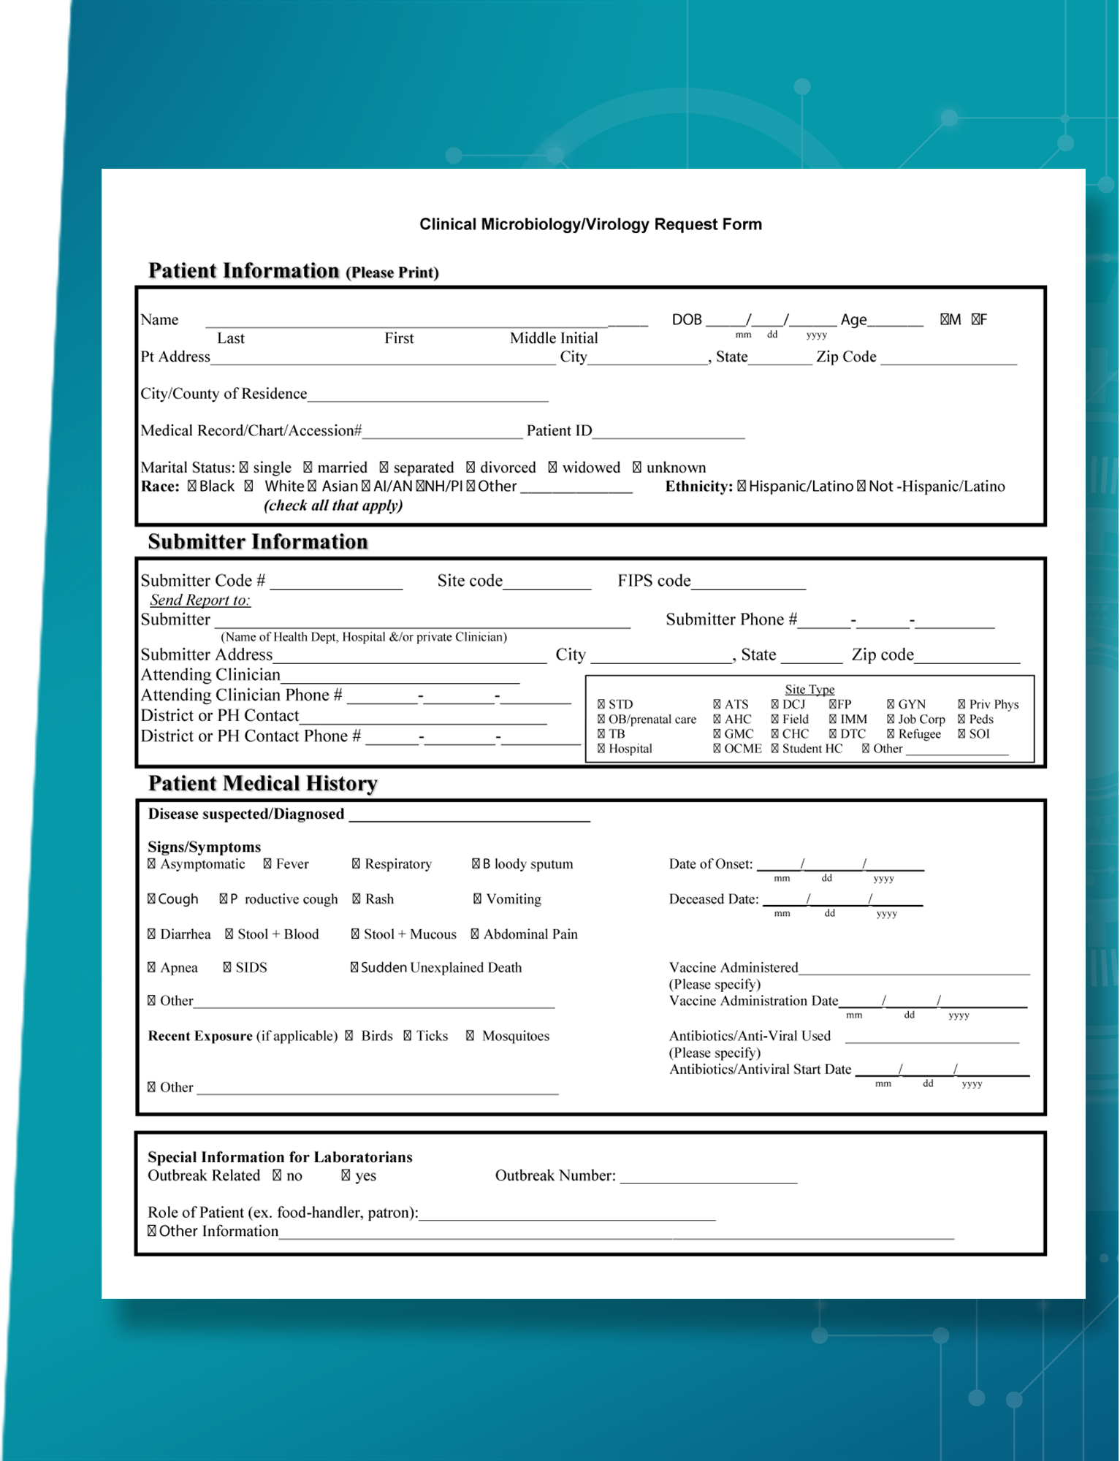
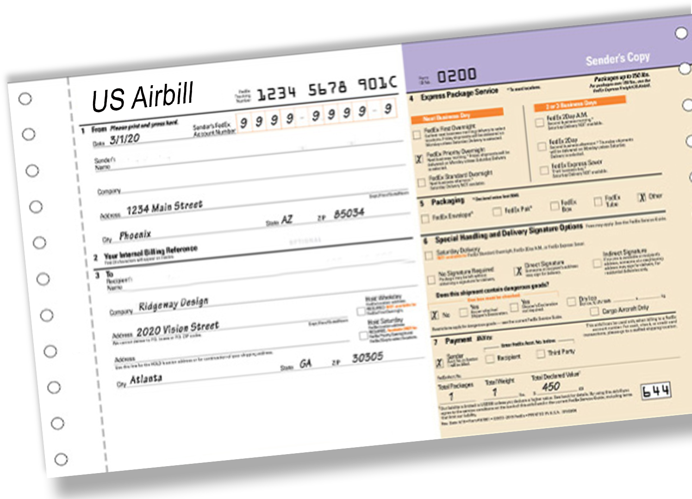
Scenario Step 4: Mark, Label & Document the Package
For this scenario, the following documentation should be used when shipping the suspected SARS-CoV-2 patient specimen by Air:
Itemized List of Contents
An itemized list of contents includes the contents of the primary packaging. This must be enclosed between the secondary and outer packaging.
Air Waybill
The Air Waybill is a critical document that constitutes the contract between the shipper and the carrier airline. It is required for all shipments of dangerous goods by air. The Air Waybill must be attached to the outer packaging.
Notes:
The job aid below provides guidance to determine required labeling, marking, and documentation for the package, based on the mode of transportation and classification:
Step 4: Labeling, Marking, and Documenting Requirements – Page 4 (https://www.cdc.gov/labtraining/docs/job_aids/packing_and_shipping/Step_4_Labeling_Marking_and_Documenting_Requirements_Job_Aid_508.pdf)

Slide 9
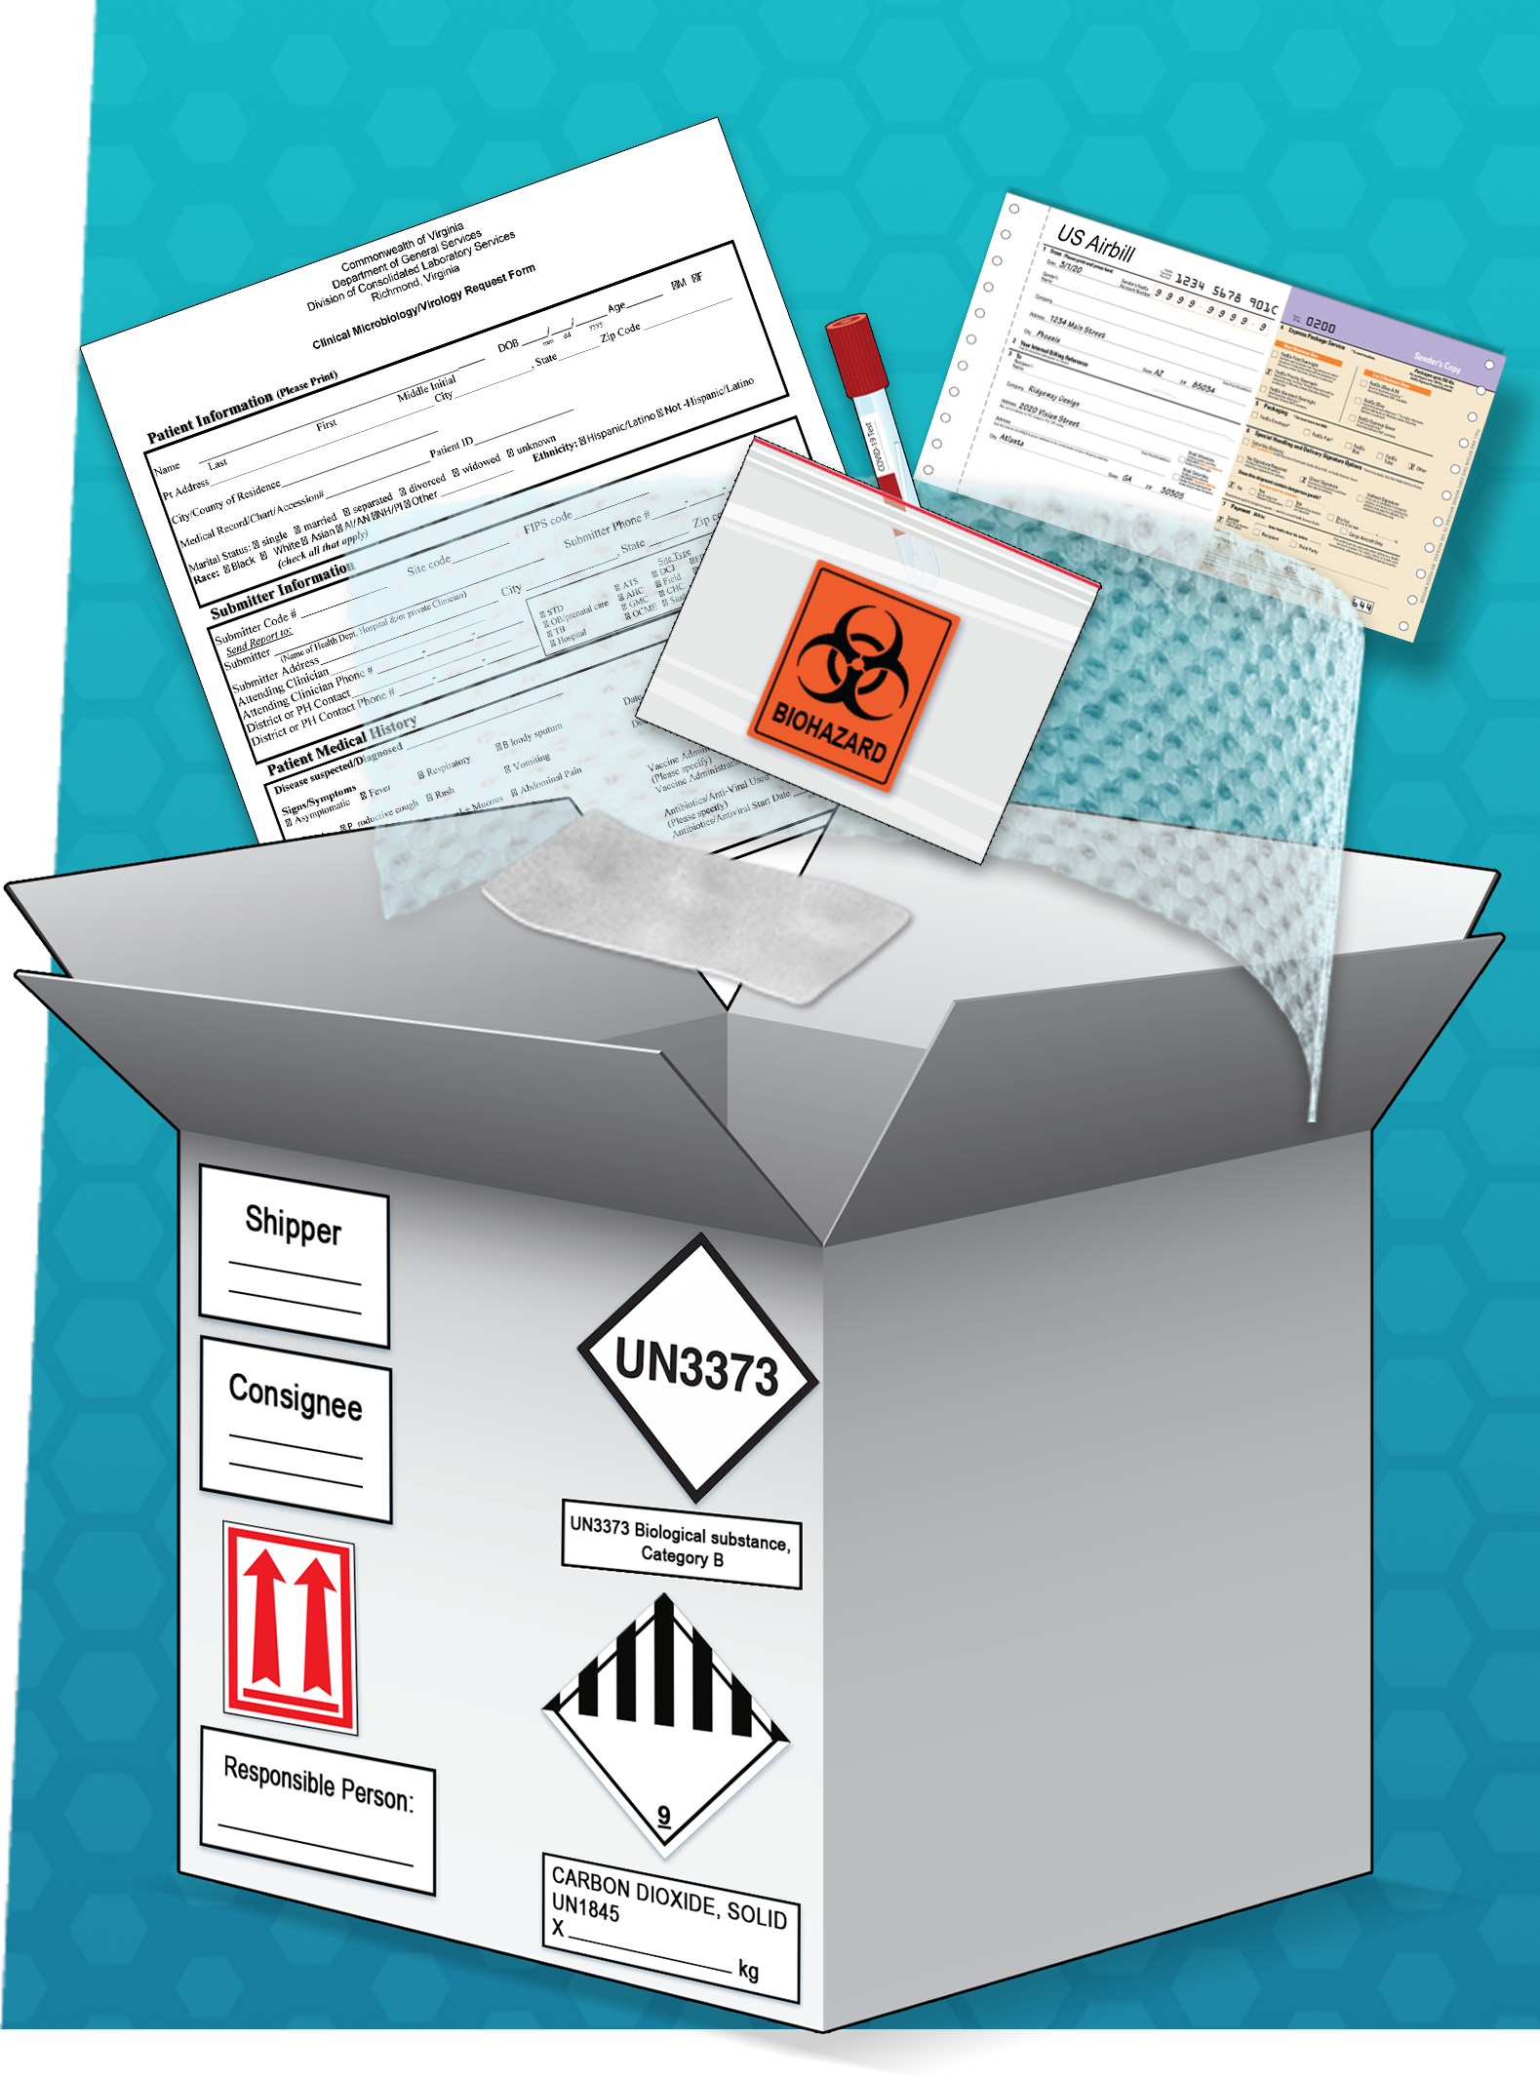
Packing and Shipping Process SARS-CoV-2 Specimen Packing Overview
Biological substance Category B packaging checklist:
Leak-proof/ sift-proof primary receptacle
Cushioning and absorbent materials for liquid specimens that can absorb the entire volume of the substance
Leak-proof/ sift-proof 95 kPa bag or tube secondary packaging
Rigid outer packaging
UN3373 mark
Proper shipping name
Shipper and consignee addresses
Responsible person contact information on outer packaging or written documentation
Biohazard symbol on primary or secondary packaging if the substance contains blood or is contaminated with human blood
Itemized list of contents between secondary and outer packaging
Air Waybill (air transport only)
Packages including dry ice must include additional pieces of information

Slide 10
SARS-CoV-2 Specimens: Packing and Shipping
Resources
CDC Laboratory Training. Packing and Shipping Dangerous Goods: What the Laboratory Staff Must Know. Updated February 24, 2021. https://www.cdc.gov/labtraining/training-courses/packing-shipping-division-6.2-materials.html. Accessed April 20, 2021.
Centers for Disease Control and Prevention. Interim Guidelines for Collecting and Handling of Clinical Specimens for COVID-19 Testing. Updated February 26, 2021. https://www.cdc.gov/coronavirus/2019-ncov/lab/guidelines-clinical-specimens.html. Accessed April 20, 2021.
Federal Express. Hazardous Materials (FedEx Ground): How to Ship Service Guide. Updated 2021. https://www.fedex.com/en-us/service-guide/hazardous-materials/how-to-ship.html Accessed on April 21, 2021.
International Air Transport Association. IATA Dangerous Goods Regulations, 61st Edition. 61st ed. Montreal, Geneva: International Air Transport Association, 2019.
United States Postal Service. Publication 52, Hazardous, Restricted, and Perishable Mail. Updated 2020. https://pe.usps.com/text/pub52/welcome.htm. Accessed April 21, 2021.
United Parcel Service. Infectious Substances. Updated 2021. https://www.ups.com/us/en/help-center/packaging-and-supplies/special-care-shipments/hazardous-materials.page Accessed on April 21, 2021.
US Department of Transportation. Hazardous Materials Regulations (HMR) Title 49 CFR Parts 100-185. Updated April 21, 2021. https://www.ecfr.gov/cgi-bin/text-idx?SID=7026294a5d8c1c05daff2cdafe1a8a4e&mc=true&tpl=/ecfrbrowse/Title49/49tab_02.tpl. Accessed April 22, 2021.

