Slide 1
National HIV Behavioral Surveillance among Transgender Women (NHBS-Trans) Surveillance Special Report
HIV Infection, Risk, Prevention, and Testing Behaviors Among Transgender Women—National HIV Behavioral Surveillance, 7 U.S. Cities, 2019–2020. HIV Surveillance Special Report 27.
Notes:
Transgender women are at high risk for HIV infection. Evidence suggests that in relation to their population size, transgender women are among the groups most affected by HIV in the U.S. Because of this, transgender women were included as an additional population in the National HIV Behavioral Surveillance system. The presentation details the findings from these efforts contained in a Special Report that was released April 15, 2021.

Slide 2
Project Description
Notes:
Project Description.

Slide 3
NHBS-Trans, 2019-2020
Goal: conduct an HIV-related bio-behavioral survey to monitor behavioral risks, prevention usage, and HIV prevalence
Transgender women
Minority HIV/AIDS Fund
(formerly Secretary’s Minority AIDS Initiative Fund)
https://www.cdc.gov/hiv/statistics/systems/nhbs/additional-populations.html#NHBS-Trans
Notes:
The goal of NHBS-Trans was to conduct an HIV-related bio-behavioral survey to monitor behavioral risks, prevention usage, and HIV prevalence
The target population was transgender women who are persons assigned male at birth but identify as women or transgender women.
Funding was awarded through the Minority HIV/AIDS Fund, formerly the Secretary’s Minority AIDS Initiative Fund. In the application for funding, a specific focus on the recruitment of Black and Latina transgender women was proposed.
Along with this main goal, there were two additional goals:
To develop best practices for conducting bio-behavioral surveillance with this population and
To provide a platform for the funded-health departments to work on community engagement

Slide 4
NHBS-Trans project areas, 2019-2020
Seattle
New York City
San Francisco
Philadelphia
Los Angeles
Atlanta
New Orleans
Notes:
The 7 NHBS project areas shown on the map were funded to conduct in NHBS-Trans data collection during 2019-2020. The sample size goal was for each project area to recruit 200 participants.

Slide 5
Results
Notes:
Results.

Slide 6
Demographics, n=1,608
Race/Ethnicity
American Indian/Alaska Native | 1%
Asian | 2%
Black/African American | 35%
Hispanic/Latina | 40%
Native Hawaiian/Other Pacific Islander | 3%
White | 11%
Multiple Races | 8%
Notes:
This slide shows some basic demographics for the 1,608 participants included in this surveillance report.
A majority of the participants were Black/African American or Hispanic/Latina.
There was representation across a wide range of age groups.
Current gender identity reported by participants: the gender identity question in the survey provided the response options in this chart: woman, man, transgender woman, transgender man, and a gender not listed here. This was a select-all-that-apply response set, so the numbers here do not sum to 100%. In order to participate in NHBS-Trans, a participant needed to report a current identity of either woman or transgender woman.

Slide 7
Socioeconomic factors
were living at or below the Federal poverty level*
experienced homelessness in the past 12 months
exchanged sex for money or drugs in the past 12 months
*HHS poverty guidelines: https://www.govinfo.gov/content/pkg/FR-2018-01-18/pdf/2018-00814.pdf
Notes:
Among NHBS-Trans participants, 63% were living at or below the Federal poverty level; 42% had experienced homelessness in the past 12 months; and 34% exchanged sex for money or drugs in the past 12 months.

Slide 8
Participants tested positive for HIV
42%
tested positive for HIV
including
17%
35%
62%
of Black/African American
participants
of Hispanic/Latina
participants
of White
participants
Data include all participants with a valid NHBS HIV test result.
Notes:
Among NHBS-Trans participants, 42% tested positive for HIV: 62% of Black/African American participants tested positive for HIV; 35% of Hispanic/Latina participants tested positive for HIV; 17% of white participants tested positive for HIV.

Slide 9
HIV testing
4% never tested for HIV
14% tested for HIV
more than one year ago
82% tested for HIV
in the past 12 months
Data include all participants who did not report a previous HIV-positive test result and participants who received their first HIV-positive test result less than 12 months before interview.
Notes:
Among participants who did not report a previous HIV-positive test or who received their 1st HIV-positive test result less than 12 months before interview: 82% tested for HIV in the past 12 months; 14% tested for HIV more than one year ago; and 4% never tested for HIV.

Slide 10
Sex behaviors in the past 12 months
23% reported no
anal sex
86% reported no
vaginal sex
Notes:
These charts depict data on anal and vaginal sex reported by participants.
The bar represents the percentage of respondents that reported any condomless sex with a sex partner in the past 12 months and the teal portion represents those who always used condoms.
Top three rows about anal sex are mutually exclusive, with 23% reporting no anal sex.
Bottom three rows about vaginal sex are mutually exclusive, with 86% reporting no vaginal sex.

Slide 11
Preexposure Prophylaxis (PrEP) use and awareness among HIV-negative participants
NHBS-MSM 2017: HIV Infection Risk, Prevention, and Testing Behaviors Among Men Who Have Sex With Men—National HIV Behavioral Surveillance, 23 U.S. Cities, 2017
NHBS-HET 2019: HIV Infection, Risk, Prevention, and Testing Behaviors among Heterosexually Active Adults at Increased Risk for HIV Infection—National HIV Behavioral Surveillance: 23 U.S. Cities, 2019
Notes:
PrEP use and awareness among HIV-negative NHBS-Trans participants were 32% and 92% respectively, which was nearly identical to PrEP use and awareness in the same 7 cities among men who have sex with men in 2017 (NHBS-MSM). In 2019 among heterosexually active persons at increased risk for HIV (NHBS-HET), less than 1% reported PrEP use and 37% reported PrEP awareness.
CDC’s clinical guidance recommends the use of PrEP for persons at increased risk of acquiring HIV, including sexually active transgender persons. Previous studies among transgender women reveal high knowledge of PrEP but very low uptake and cited several barriers, including medical mistrust due to experiences of transphobia, lack of trans-inclusive PrEP marketing, and a concern about drug interactions between hormones and PrEP.

Slide 12
Currently taking antiretrovirals (ART)
Medical Monitoring Project 2018-2019: Behavioral and Clinical Characteristics of Persons with Diagnosed HIV Infection—Medical Monitoring Project, United States, 2018 Cycle (June 2018–May 2019)
Notes:
Among HIV-positive respondents interviewed as part of NHBS-Trans, 90% of were taking antiretrovirals (ART) at the time of the survey; similarly, 93% of respondents interviewed as part of the Medical Monitoring Project (MMP) in 2018-2019 were taking ART at the time of the survey. MMP samples adults with diagnosed HIV aged 18 years of age or older. In the 2018-2019 sample, 75% identified as male; 23% identified as female; 2% identified as transgender.

Slide 13
Hormone use for gender affirmation
were taking hormones
wanted to but were not taking hormones
8%
did not want to take hormones
Notes:
Among NHBS-Trans participants, 72% were taking hormones for gender affirmation at the time of the survey, 20% wanted to take hormones, and 8% did not want to take hormones.
Access to gender-affirming medical treatment may improve uptake of HIV treatment and prevention. Previous studies have found that unmet needs for gender affirmation, including not being on hormones, may impact or delay HIV treatment (Rosen JG, Malik M, Cooney EE, et al. Antiretroviral treatment interruptions among Black and Latina transgender women living with HIV: Characterizing co-occurring, multilevel factors using the Gender Affirmation Framework. AIDS Behav 2019;23(9):2588-2599.; Baguso GN, Turner CM, Santos GM, et al. Successes and final challenges along the HIV care continuum with transwomen in San Francisco. J Int AIDS Soc 2019;22(4):e25270.).
Thus, access to gender affirming care may be critical in improving HIV outcomes among transgender women.

Slide 14
Abuse and harassment in the past 12 months
Notes:
Among NHBS-Trans participants, 54% reported being verbally abused or harassed in the past 12 months; 27% reported being physically abused or harassed in the past 12 months; 15% reported being physically abused or harassed by a sexual partner in the past 12 months; and 15% of participants reported being forced to have sex in the last 12 months.

Slide 15
Suicidal ideation and behavior in the past 12 months
Notes:
This slide presents suicidal ideation and behavior by HIV status:
Among HIV-negative participants, 22% seriously thought about suicide, 9% made plans for suicide, and 6% attempted suicide.
Among HIV-positive participants, 12% seriously thought about suicide, 4% made plans for suicide, and 3% attempted suicide.
Previously published estimates of suicidality among transgender persons are high. The 2015 U.S. Transgender Survey found that 40% of transgender people attempted suicide in their lifetime and 7% attempted suicide in the past year (James SE, Herman JL, Rankin S, Keisling M, Mottet L, Anafi M. The Report of the 2015 U.S. Transgender Survey. Washington, DC: National Center for Transgender Equality; 2016. https://www.transequality.org/sites/default/files/docs/USTS-Full-Report-FINAL.PDF. Accessed March 29, 2021).
It is possible that services and resources available to transgender women with HIV play a protective role against suicidality.
Gender affirmation may also lower suicidality among transgender women (Lelutin-Weinberger C, English D, Sandanapitchai P. The roles of gender affirmation and discrimination in the resilience of transgender individuals in the US. Behav Med 2020:46(3-4):175-188).

Slide 16
Key Takeaways
Notes:
Key Takeaways.

Slide 17
What did we learn in NHBS-Trans?
Transgender women need to be a priority population
HIV prevalence was high
Result of complex layering of syndemics*
Social and economic factors
*Singer M, Bulled N, Ostrach B, Mendenhall E. Syndemics and the biosocial conception of health. Lancet. 2017 Mar 4;389(10072):941-950.
Notes:
NHBS-Trans has reaffirmed that transgender women need to be a priority population in our fight against HIV. HIV prevalence was extraordinarily high and the challenges that this population faces are unique and monumental. The HIV epidemic among transgender women is the result of a complex layering of syndemics and there is still a lot more to understand. These data shed light on the social and economic factors that are contributing to this unacceptable disparity.

Slide 18
Data to action
The need for a strong foundation
Data collection
Connection
to the
community
Notes:
This data collection would not have been successful without a strong connection to the community in each project area. Project area staff spent a full year identifying and hiring staff and learning about their communities. They assembled community advisory boards and worked to strengthen relationships between trans communities and their health department. Buy-in from stakeholders was critical to get this project off the ground and to the success of the project.

Slide 19
Transgender and gender non-conforming (TGNC) staff integration
Project site staff included TGNC people at nearly every level
Benefits to the project
Community buy-in
Provide same-day, Community Advisory Board-level insights
Benefits to communities
Employment and training opportunities to people in communities disproportionately impacted by unemployment, low income, and job discrimination
Over 20 TGNC staff across all project sites
Many transitioned to full-time employment after NHBS-Trans
Notes:
Staff for every project area included transgender and gender non-conforming (TGNC) people, oftentimes making up the majority of front-line staff, and in many cases serving managerial roles.
Unsurprisingly, there were many benefits to integrating TGNC community members into the data collection efforts, most notable among which are:
Increased community buy in, in some cases overcoming and reversing hesitancy to engage with public health work
On-site insight – when questions arose about best practices for working with TGNC people, TGNC staff members offered answers that otherwise would require a CAB meeting to obtain
Employment and resume building opportunities for members of a community beset by unemployment, low income and job discrimination
Potential pathways to full time employment for several staff

Slide 20
Data Dissemination
Notes:
Data dissemination.

Slide 21
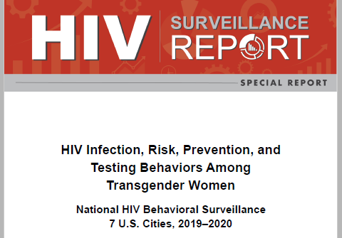
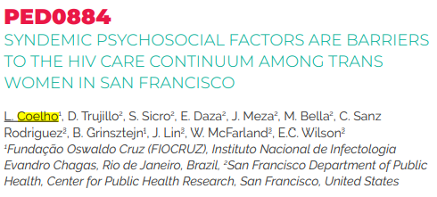
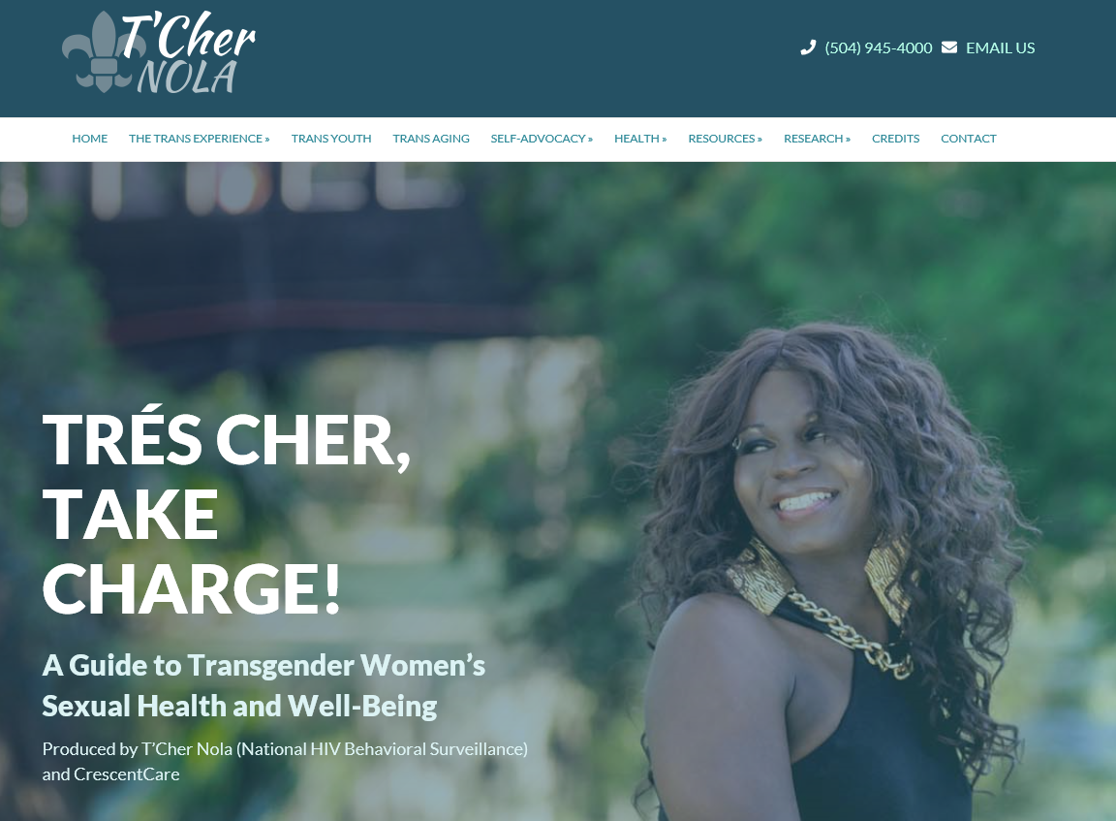
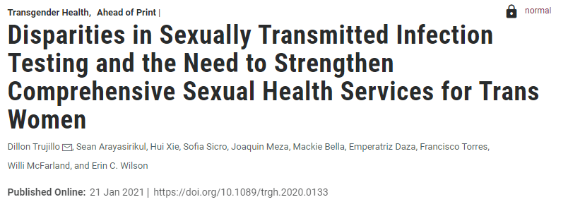
Data dissemination examples
https://tcher.cc
Notes:
CDC, along with local project areas, is now looking to dissemination of these valuable data. The HIV Surveillance Special Report is the first release of aggregate data and there are several additional analyses currently underway. Project areas have published manuscripts and shared scientific presentations.
Throughout the preparation for this project, project areas investigated a variety of methods for sharing data, understanding the importance of returning findings back to the community. There have been efforts in ongoing community engagement – local data analysis presentations tailored to the priorities of local trans stakeholders, and a website out of New Orleans meant to communicate directly with trans women and trans feminine people in the New Orleans area – making sure that the people who provided these data are positioned to receive and benefit from it.

Slide 22
Acknowledgements
NHBS-Trans Study Group
Atlanta, GA: Pascale Wortley, Genetha Mustaafaa, Brittany Taylor
Los Angeles, CA: Ekow Kwa Sey, Gia Olaes, Yingbo Ma
New Orleans, LA: William T. Robinson, Narquis Barak, Jasmine Davis
New York City, NY: Sarah Braunstein, Alexis Rivera, Jasmine Lopez
Philadelphia, PA: Kathleen A. Brady, Tanner Nassau, Andrea Harrington
San Francisco, CA: Erin Wilson, Dillon Trujillo, Sofia Sicro
Seattle, WA: Sara Glick, Aleks Martin, Jennifer Reuer
Community Advisory Boards and participants
Notes:
We would like to acknowledge the NHBS-Trans Study Group in the 7 participating cities and the community advisory boards and participants.

Slide 23
Questions?
NHBS@CDC.GOV
The findings and conclusions in this presentation are those of the authors and do not necessarily represent the official position of the Centers for Disease Control And Prevention.
Notes:
For questions about this presentation contact NHBS@CDC.GOV.
The findings and conclusions in this presentation are those of the authors and do not necessarily represent the official position of the Centers for Disease Control And Prevention.

