Slide 1
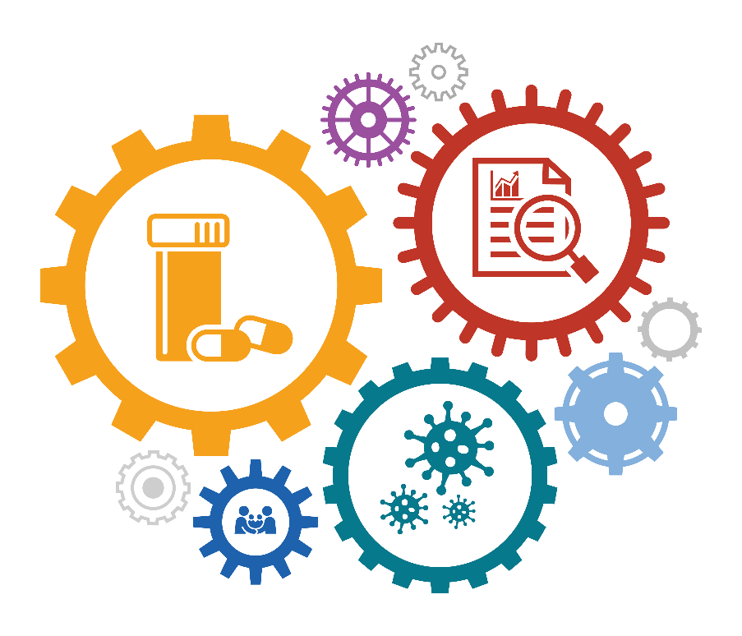
HIV Data in Action Using HIV data to prevent infections and improve health
Notes:
Welcome, and thank you for joining us to talk about HIV data in action and how we use HIV data to prevent infections and improve health. Over the next 20 minutes, we’ll talk about how, in this era of better than ever treatment and prevention options, the HIV prevention landscape is changing, and how we are integrating traditional public health practice and new technology, including the use of molecular data, into HIV prevention and care efforts.

Slide 2
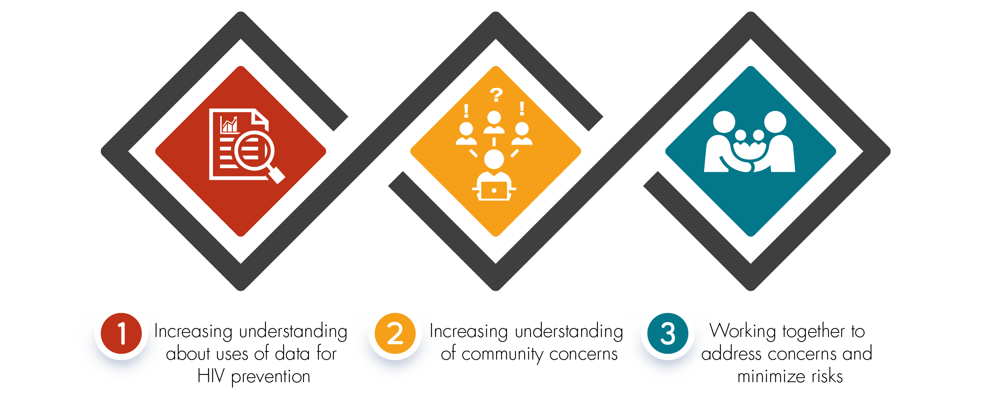
Community Engagement
Purpose:
Notes:
CDC has provided guidance for including communities in planning for HIV prevention programs since 1993. Existing HIV programs were shaped with significant input from communities.
[CLICK]
CDC and state and local health departments continue to support engagement with communities and partners in prevention with three aims in mind:
First, to increase our partners’ understanding about how and why we use data for HIV prevention purposes;
Second, to increase public health agency understanding of community concerns related to the new ways we are using data; and
Last, to identify ways that we can work together to address these concerns and minimize risks associated with these practices.

Slide 3
HIV Prevention Landscape
Notes:
First, a bit of background about the HIV prevention landscape.

Slide 4
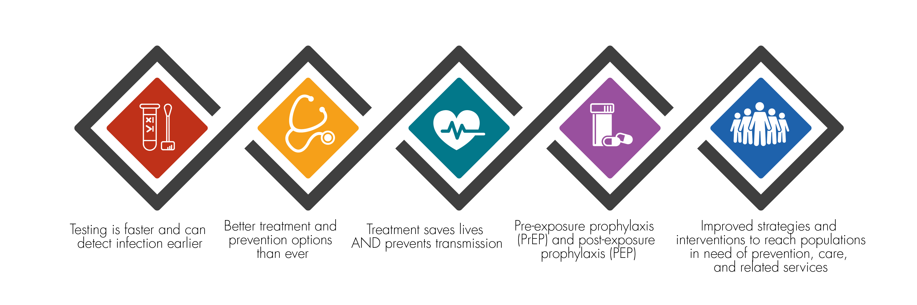
Evolution of HIV Prevention
Notes:
We are at an exciting time in HIV prevention. Testing is faster and can detect infection earlier. If that test is positive, we have improved treatment options that can save lives and prevent future transmissions. For those that are negative but are at risk, we have effective prevention options, including PrEP and PEP, condom distribution, and syringe service programs. And we now have improved strategies and interventions to reach populations in need of prevention, care, and related services.

Slide 5
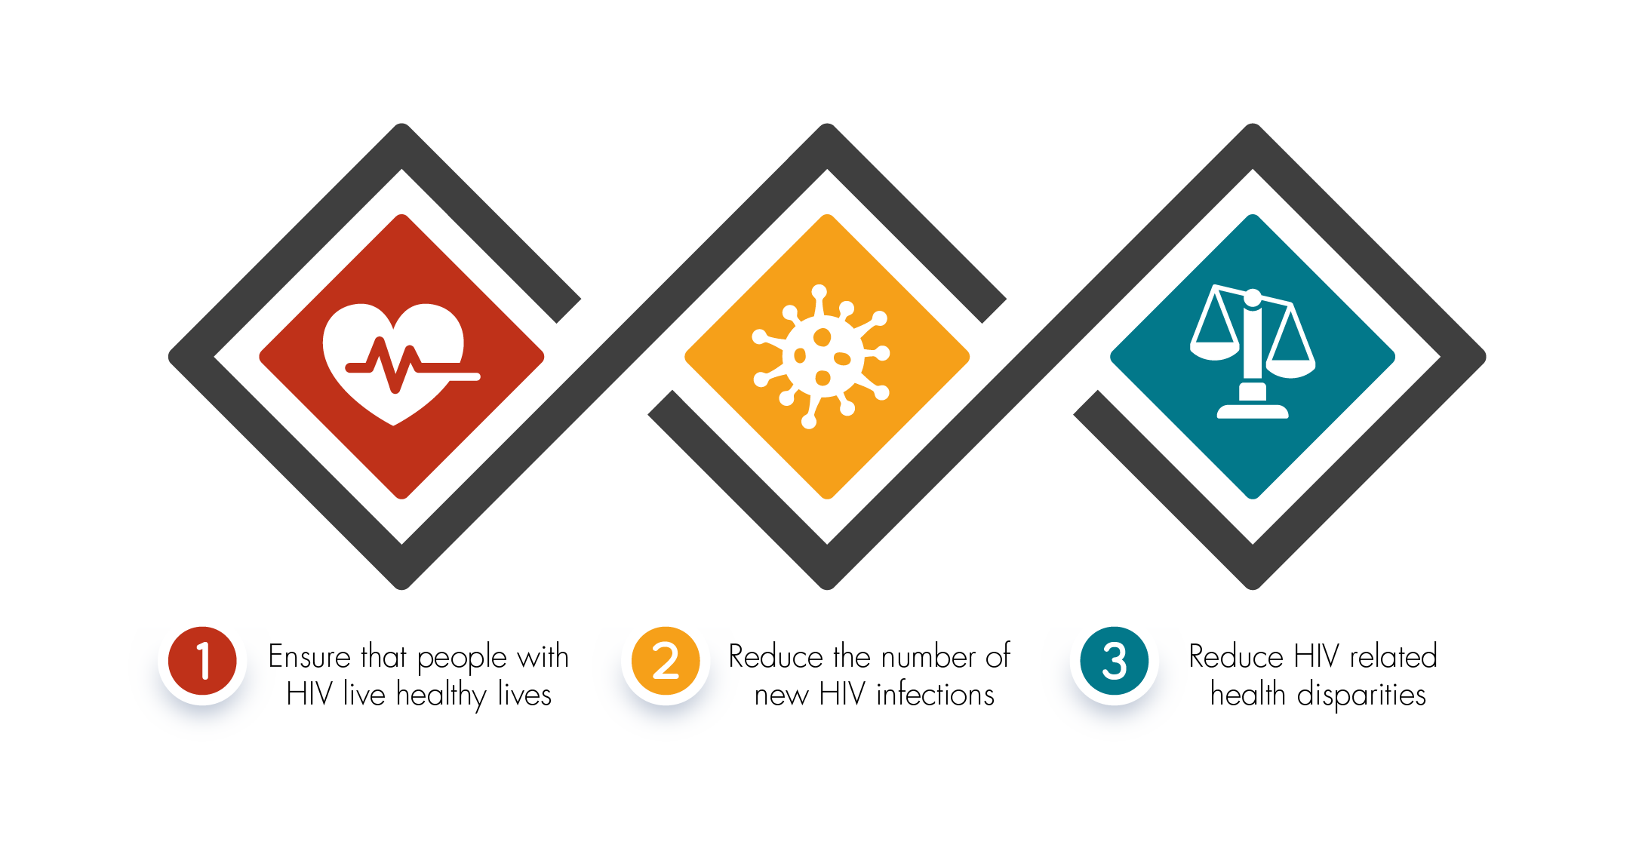
Working Together, We Can Achieve HIV Prevention Goals
Notes:
We all share these HIV prevention goals, which include ensuring that people with HIV live healthy lives, reducing the number of new HIV infections, and reducing HIV-related health disparities. As I just mentioned, we have some great prevention options. However, we still have some major challenges. Some groups are at very high risk of getting HIV during their lifetime; for example, communities of color, gay, bisexual, and other men who have sex with men, and people who inject drugs. We also know that we have groups at risk for outbreaks. People’s health is on the line, and to achieve these prevention goals, we need to use all tools available to us.

Slide 6
Traditional Public Health Practice
Notes:
Let’s start by talking about traditional public health practice.

Slide 7
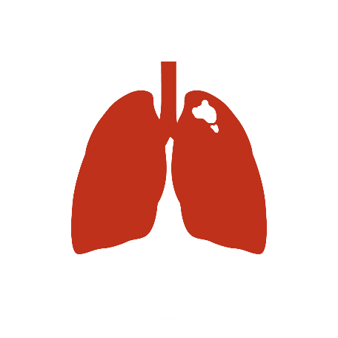
Public Health Monitoring Leads to Action
Monitoring and reporting of illness and other health conditions
Called public health surveillance
Notes:
Public health helps people and communities. [CLICK] In order to understand public health problems, CDC and health departments monitor and report illness and other health conditions. This is called public health surveillance. The word surveillance can have different meanings in different situations, but public health surveillance has a very different goal than some other types of surveillance, and the information health departments gather guides public health policy and prevention strategies to keep people healthy.
Public health surveillance has been used for more than 100 years for a wide variety of conditions, like [CLICK] foodborne illness, [CLICK] cancer, and [CLICK] tuberculosis.

Slide 8
What Does Public Health Surveillance Do?
Detect developing outbreaks
Help people at risk to stay well
Target limited resources to the people and areas that need them most
Notes:
This monitoring is important for detecting developing outbreaks. For example, public health data help to find outbreaks associated with contaminated food and keep the food supply safe.
[CLICK] It’s also important for helping people at risk to stay well. For example, when public health identifies a community with increases in tuberculosis, it can help to get testing and treatment to the people who need it.
[CLICK] Overall, public health surveillance helps us to target limited resources to the people and areas that need them most. For example, public health data help to identify states with high rates of drug overdoses. Those states can then work to prevent overdoses and treat opioid use disorder.
Without public health surveillance, our society couldn’t prevent illness or provide care as effectively.

Slide 9
Integrating New Technology
Notes:
Public health surveillance systems have evolved over the past century, with the availability of new technologies.

Slide 10
HIV Public Health Data Collection Has Evolved Over Time
Notes:
The public health data that we collect through HIV surveillance systems have evolved over time, and how we use those data –including the extent to which data are used for public health prevention and response activities– has also evolved, along with our understanding of HIV treatment and prevention. From early on, public health data were the best source of information to describe who was being affected by HIV and where the virus was spreading.

Slide 11
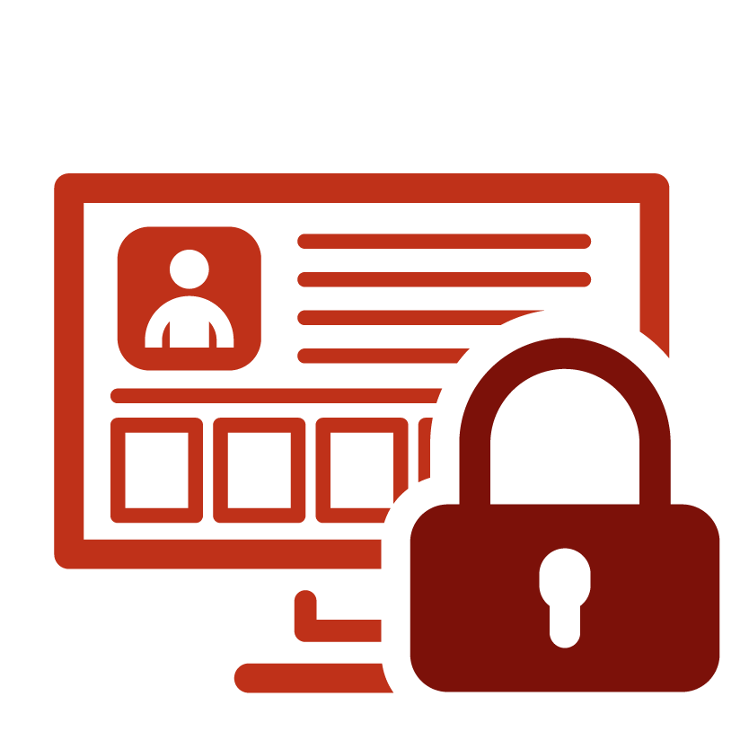
HIV Public Health Data Are Strictly Protected
Notes:
Until effective antiretroviral treatment became available, individuals recognized few benefits from health departments collecting HIV data. HIV is highly stigmatized, and people often faced serious social and personal risks, including loss of employment and health insurance. Without good antiretroviral treatment available, the risks of loss of confidentiality outweighed the benefits. These issues were central to the debates around name-based reporting of HIV to health departments throughout the 1990s.
In response to these concerns, [CLICK] CDC and health departments implemented unprecedented strict policies and procedures to ensure security and confidentiality of the HIV data, beyond what was required for other reportable conditions. The use of these data was severely restricted. Because of community input, coupled with the fact that there weren’t good prevention and treatment options, most programs did not use the data to implement individual-level prevention efforts.

Slide 12
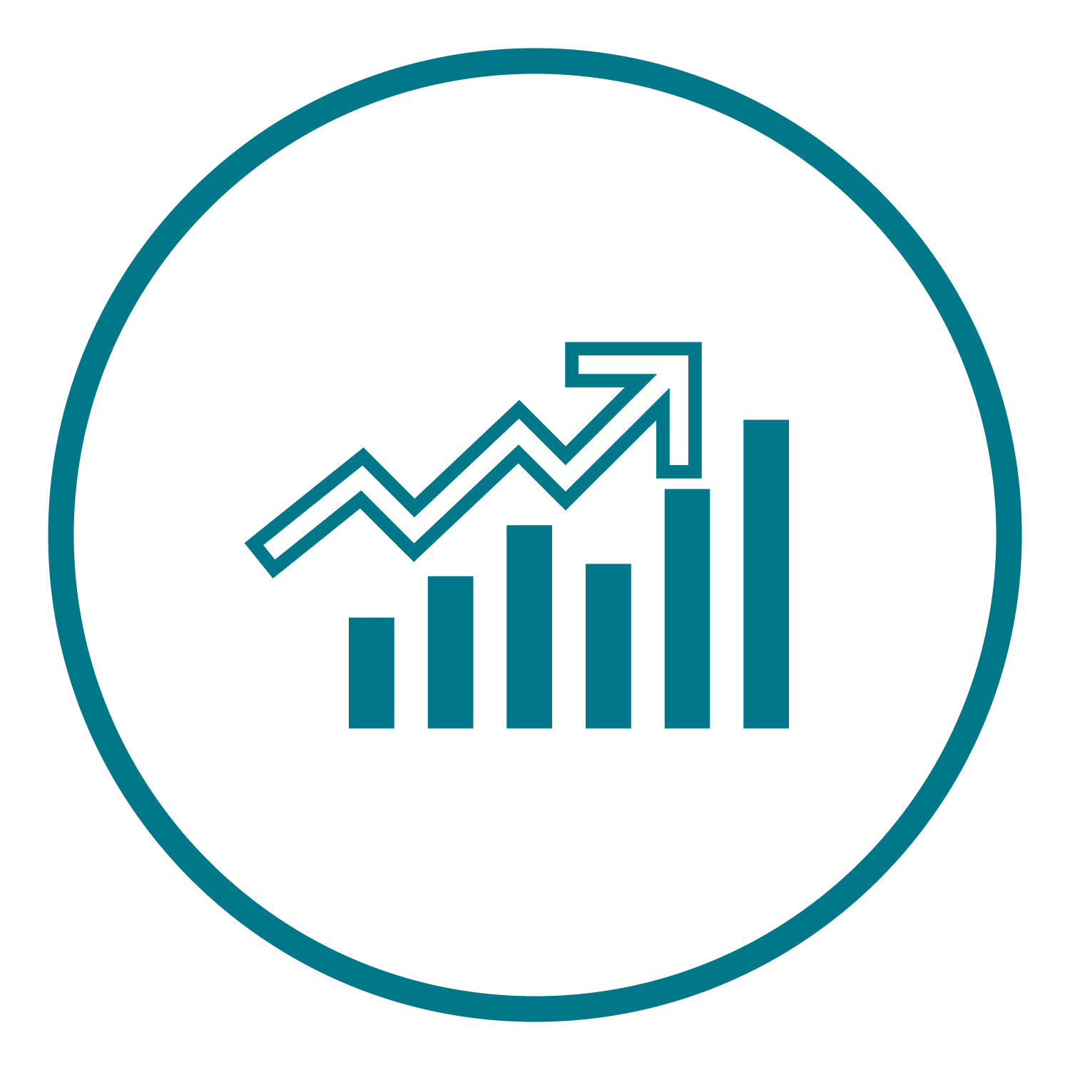
How Do We Use Public Health Data?
Notes:
So let’s talk a bit about how we use HIV public health data. As a result of strict data use policies, our initial uses of public health HIV data were primarily focused on describing populations… [CLICK ON IMAGE TO BE TAKEN TO A WEB PAGE OUTSIDE OF POWERPOINT]
Although the data are not real, imagine for a moment that each dot on this slide represents a person with newly diagnosed HIV infection. Public health data help us to better understand who is being affected by HIV—for instance…
[CLICK age at diagnosis] How old they were when they found out they had HIV. Here we can see that a lot of people are in their 20s when they find out that they have HIV.
[CLICK race/ethnicity] Their race/ethnicity. This is how we can learn that some groups are disproportionately affected by HIV
[CLICK region] We can also look at what part of the country they live in [PAUSE]
[CLICK transmission category] Or how they likely acquired HIV [PAUSE]
This information can help us to better understand what types of prevention are needed, by whom, and where. It’s also important in identifying disparities, whether those disparities are occurring among racial/ethnic groups, certain parts of the country, or LGBT populations…and this is important in allowing us to determine when certain groups need additional support to overcome barriers they might be facing.
We also know that public health data need to evolve over time. [CLICK sex at birth] For a long time, our reports of public health data have focused on sex at birth. However, we have been working to collect improved data on gender identity [CLICK gender identity], which allows us to better understand the needs of transgender populations.
Additionally, as our prevention options have broadened, we have begun using public health data in new ways. [Click care] Health departments can now use public health data to identify people who appear not to be receiving HIV care. They may need additional support to access HIV care and succeed at maintaining viral suppression. This is sometimes called Data to Care.
[Click year] We can also use public health data to determine when there might be an increase in HIV transmission. For example, we might find that a particular county, which typically has only a few new HIV diagnoses in a typical year, all of a sudden has a lot more than expected. This might signal that there is an outbreak, perhaps like the outbreak of HIV that occurred among people who inject drugs in Scott County, Indiana, in 2015. This would be a signal that public health should respond to try to stop HIV transmission.
[Click none] Now, we have a new tool for identifying situations where there is increased transmission. [Click color by cluster] We can use laboratory information to identify when there are groups of infections that are very similar, much like public health does when looking at outbreaks of tuberculosis or foodborne illness. [Click sort by cluster] For example, here you can see several clusters, or groups of similar infections. For HIV, when we find a group of similar infections, it suggests that they are all part of a common network. These similarities also tell us that HIV likely spread quickly through this network. So let’s zoom in on one of these networks.

Slide 13
Network Where HIV is Spreading Quickly
Notes:
Better understanding these networks can help us to see what resources are needed and target our outreach efforts. For instance, by finding people who might be in the network, we can make extra efforts to test and offer treatment to people who… [CLICK]

Slide 14
Network Where HIV is Spreading Quickly
Notes:
…who might not have known they had HIV or…[CLICK]

Slide 15
Network Where HIV is Spreading Quickly
Notes:
…help people who are at high risk of acquiring HIV to avoid getting it. We can also work to understand what barriers may exist and identify ways to help reduce these barriers so that people can get the prevention and care that they need.

Slide 16
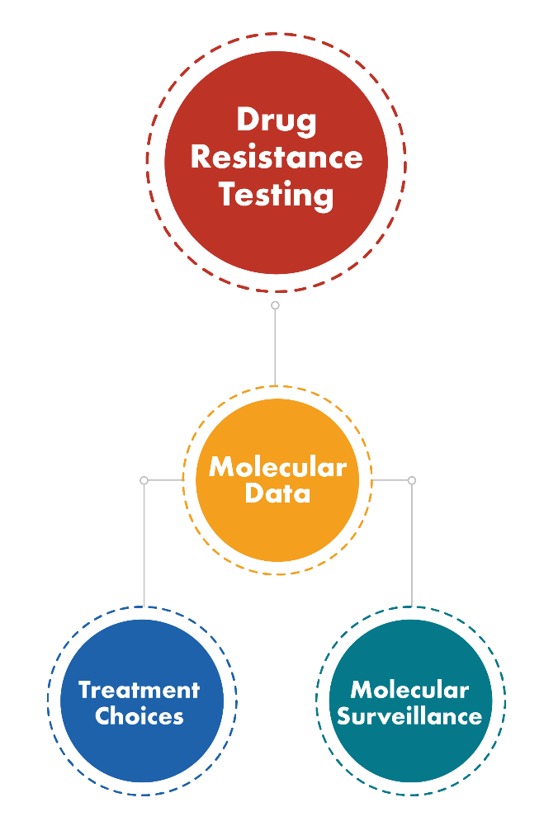
What Data Do We Use to Find These Networks?
As part of HIV care, health care providers order testing to learn what treatments will work best for a person’s HIV strain
Called drug resistance testing
This testing involves determining the genetic sequence of the virus (NOT the person)
We sometimes call this ‘molecular data’
Checking for drug resistance in the population
Notes:
So we just saw how we can use laboratory data to identify networks in which HIV is spreading rapidly.
What exactly are these lab data? [CLICK] Well, as part of HIV care, health care providers order testing to learn which treatments will work best for a person’s HIV strain. This is called drug-resistance testing, [CLICK] and it involves determining the genetic sequence of the virus (not the person). We sometimes call this ‘molecular data.’ This information helps the provider to make treatment choices, and you might have heard people refer to the collection of this information by public health as ‘molecular surveillance.’
[CLICK] Drug resistance testing is also important for monitoring drug resistance in the population. If many people develop resistance to commonly used drugs, it can make HIV more difficult to treat.

Slide 17
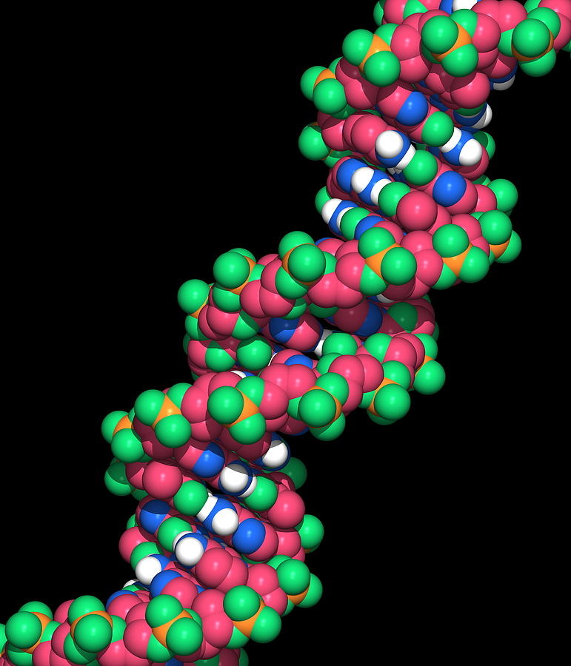
How Are Molecular Data Used?
HIV mutates over time
Leads to changes in the genetic sequence of the virus
Public health agencies analyze the sequences, or molecular data, to find large groups of infections that are very similar
Indicates that HIV is spreading quickly
Notes:
These molecular data can be used to help inform public health activities. HIV mutates, and it mutates a little bit differently in each person. These mutations add up and over time, lead to changes in the genetic sequence of the virus.
[CLICK] Public health agencies can analyze the sequences, or molecular data, to find groups of infections that are very similar. This indicates that HIV is spreading quickly, because it hasn’t had time to change much between transmissions.
In fact, we have found that HIV is spreading 10 times faster in these networks, compared to the average.

Slide 18
What Public Health Agencies Do With Molecular Data
Reach out to these networks
Provide the services they need
Understand barriers to care and prevention
Develop approaches to overcome barriers
Notes:
We can then reach out to those networks to provide the services that people need, understand barriers to care and prevention, and develop approaches to overcome them. This can be done through a variety of methods, such as social network strategies, which involve people recruiting people that they know for services like testing and PrEP.

Slide 19
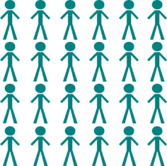
Example 1: San Antonio, Texas
Molecular cluster members:
n=24
Notes:
We’ve already seen some examples of how identifying networks of rapid transmission using molecular data can strengthen prevention efforts. [CLICK] For example, in 2017 Texas identified a large group of Latino gay and bisexual men in San Antonio with similar HIV strains. 24 men were initially identified as having similar strains of HIV. [CLICK]

Slide 20
Example 1: San Antonio, Texas
Molecular cluster members:
n=24
Other people who were sexual or needle sharing partners of initial 24 persons or their partners:
n=87
Notes:
After CDC and the health department followed up, another 87 people were identified as being sexual or needle sharing partners.

Slide 21
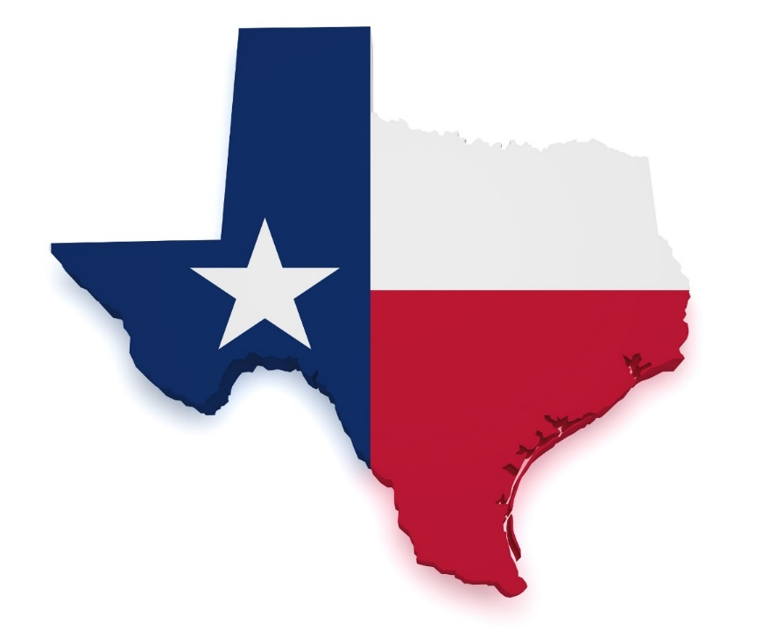
Example 1 (continued): An opportunity to identify and address gaps in prevention
Health alert to providers educated on HIV diagnostic testing and acute infection
Health alert educated on PrEP, funds redirected to scale up access to PrEP in specific regions of the city
New coalition of community, providers, and public health → sign-on as a Fast Track City
Efforts to reduce stigma, improve care, eliminate new cases of HIV
Notes:
Additional information gathered by the health department revealed that HIV testing wasn’t always conducted according to guidelines, and as a result, providers had missed some opportunities to diagnose people at the stage of acute infection, resulting in delayed treatment. In response, the health department sent an alert to providers clarifying the guidelines for, and importance of, HIV diagnostic testing and acute infection.
The investigation also highlighted a lack of access to PrEP for many who could benefit from it, so the health alert sent out also worked to increase awareness of PrEP. In addition, health department funds were redirected to increase access to PrEP in specific areas of the city.
Responding to this situation brought together a new coalition made up of community members, providers, and public health staff in San Antonio, and as a result the coalition provided the support that enabled San Antonio to sign on as a Fast Track City, with commitment from the Mayor and City Council to working together to reduce stigma, improve care, and eliminate new cases of HIV.
So these are things that health departments are already working on… making sure that people are educated about HIV, and that prevention services are reaching the right populations. This is an example of cluster detection leading to an opportunity to detect gaps in those services, and how the HD can redirect efforts to make sure that the services are reaching the populations that need them most.

Slide 22
Example 2: West Virginia
Increase in HIV diagnoses among gay and bisexual men in an area
with typically few HIV diagnoses.
where injection drug use is common.
Concerned about possibility of HIV spread into communities of people who inject drugs
Conducted in-depth interviews
Relocated HIV testing sites
Increased awareness of HIV testing
Established syringe service programs
Notes:
Sometimes we identify a possible increase in transmission by seeing an increase of cases of HIV. Here’s one example of that scenario. The West Virginia Health Department identified an increase in HIV diagnoses among gay and bisexual men in a part of the state that typically has few HIV diagnoses. Because injection drug use is common in the area, the health department was also concerned that HIV might spread into communities of people who inject drugs, so, with help from CDC, they conducted in-depth interviews. Molecular data were also used to help better understand the increase.
As a result of what they learned, they increased access to HIV testing by relocating some testing sites, and increased awareness of the need for testing through radio and social media ads. The HD also established syringe service programs in counties that did not previously have them.

Slide 23
Example 3: Medium-sized city in Northeastern state
Healthcare provider called health department to report concern about increased diagnoses among heterosexuals
Laboratory (molecular) data showed rapid transmission
Health department established PrEP provider in region
Held a regional provider meeting
Expanded HIV testing in jails and reproductive health clinics
Notes:
Descriptions of the previous two examples have been published. The following two have not, so we did not name the jurisdiction.
Sometimes, it’s actually a healthcare provider that identifies a possible increase in transmission. In this example, which occurred in a medium-sized city in a northeastern state, a healthcare provider called the health department to report concern about increased diagnoses among heterosexuals. Laboratory data showed rapid transmission among this group. As a result of the findings, the health department worked to establish a PrEP provider in the region, held a regional provider meeting, and expanded HIV testing in jails and reproductive health clinics.

Slide 24
Example 4: Midwestern state
Laboratory (molecular) data identified growing network of rapid transmission
Virally suppressed, but continued to grow
Health department and HIV providers in the area worked with their patients to increase testing, linkage to care, prevention
Notes:
In this example, which occurred in a Midwestern state, laboratory data identified a growing network of rapid transmission. The thing that was surprising was that, even though everyone in the network was virally suppressed, it continued to grow. This suggested that there might be additional people who hadn’t yet found out they had HIV, so the health department and HIV providers worked with their patients to encourage them to help increase testing, linkage to care, and prevention among people in their social networks.

Slide 25
Community Concerns and Engagement
Notes:
As we’ve been working on cluster detection and response activities, we’ve recognized the need for more community engagement, and we’ve heard some concerns, which we’d like to discuss.

Slide 26
Public Trust is the Foundation of our Work
Benefit to the public:
This is how we understand HIV in the United States
Build programs to serve groups of people living with or at risk of HIV
Identify health inequity and work to end it
Reach out to people who need additional support or services
Public health agencies collect data and use it to improve health
Protect the data and ensure it is used for the health of individuals and the community

Slide 27
Ways That Public Health Agencies Protect Personal Information
State and local HDs have a public health need to collect personal information on people with reportable illnesses
CDC requires policies and procedures to safeguard the data
Secure data systems, accessible only to those who need it
Require annual data security training and confidentiality agreement
As a rule, personally identifiable information (name, address, phone number, social security number, etc.) is NOT sent to CDC
We are committed to maintaining high ethical standards and minimizing any risk that public health data could be misused or misinterpreted
Notes:
State and local health departments have a duty to improve the public’s health, and as part of that responsibility they collect personal information when people are diagnosed with reportable illnesses, including HIV. These agencies have many protections in place to safeguard people’s information. Some of these policies and procedures to protect the data are required by CDC, and health departments have additional protections in place specific to their area.
Whether at CDC or your local health department, we keep all HIV public health information on secure data systems, and only allow people to access information if they need to know it to do their job.
We also require that people with access to the data complete a data security training annually and sign a binding confidentiality agreement.
Personally identifiable information, such as name, address, or phone number, is not sent to CDC.

Slide 28
Questions and Concerns Raised
Extent to which public health activities will be conducted in ways that are culturally sensitive and non-coercive
Level of protections for public health data
Protection against use in criminal cases
CDC and health department plans for engaging the community
Notes:
It is our goal to use these data to help improve people’s health. We’ve been talking with a variety of people about this work, and there have been a number of questions and concerns raised, [CLICK] including the extent to which public health activities will be conducted in ways that are culturally sensitive and non-coercive, which is certainly our goal, [CLICK]. People have also raised questions about the levels of protections for public health data. People need to feel sure their data are protected from improper use. Data held by CDC are is maintained securely according to strict guidelines and regulations, and we require that state health departments maintain their HIV data securely as well. We have heard your concerns that molecular analysis could tell who infected whom and be used in criminal proceedings. We are emphasizing that health departments need to assess their existing data protections, ensure they are adequate to protect against non-public health purposes, and to assess whether their jurisdiction has criminal exposure laws. Many of these laws were passed before we had the tools and evidence on ways to decrease risk of transmission, and they are now outdated.
Currently, our molecular technology and analysis cannot tell us who infected whom. We can only tell that the viruses are closely related. Right now, we don’t want or need molecular analysis to provide a direction. We need it to detect growing networks of rapid transmission, [CLICK] and we are interested in protecting the data against use in criminal cases. [CLICK] Finally, people have wondered how CDC and health departments will engage the community.

Slide 29
Community Engagement is Critical
Inform community of program
Engage stakeholders
Hear community priorities and ideas
Identify ways that we can partner with community
Honor past processes and agreements with community
Notes:
Community engagement is critical. We always recommend that health departments engage their communities around the work that they are doing, because we know that we are all working toward the same goals and that community members have a lot to offer. Given that cluster detection and response is new and there is still a lot to be worked out, engaging community is particularly important.
[CLICK] Community engagement aims to inform community of the program, engage stakeholders, and hear their priorities and ideas. This offers the opportunity of building support, and also of identifying ways that we can partner with communities to achieve our common goals. It also honors past processes and agreements with communities.

Slide 30
Community Engagement by Health Departments
Health departments engage their communities in development of prevention plans and priorities
Variety of methods
Prevention and care planning groups
Meetings with care providers, community-based organizations, and other stakeholders
Community advisory boards (CABs)
Notes:
All health departments engage their communities in the development of prevention plans and priorities. Health departments use a variety of methods to do so, including prevention and care planning groups, meetings with local health care providers, community-based organizations, and other stakeholders, and community advisory boards.
CDC is also conducting some community engagement, and it’s possible that you may have participated in one of those sessions.

Slide 31
We Can End New HIV Transmission
Exciting time in HIV treatment and prevention: can detect infection, and networks of infection, earlier than ever – saving lives and preventing transmission
CDC is committed to
Using both traditional public health tools and the new tools in our toolbox to end HIV
Responsible use of the data
Hearing concerns and working with community to address them
Using the data we have to more effectively reach and serve more people with or at risk for HIV
Notes:
We’d like to close by saying that we can end
[CLICK] We are at an exciting time in HIV treatment and prevention. We can detect infection, and networks of infection earlier than ever – saving lives and preventing transmission.
[CLICK] CDC is committed to using both traditional public health tools and the new tools in our toolbox to end HIV.
We are also committed to responsible use of the data, to hearing your concerns and working with community to address them, and to using the data we have to more effectively reach and serve more people with or at risk for HIV.

Slide 32
Discussion & Feedback
Notes:
Now we’ll begin the discussion portion of our webinar. First, we’d like to use an online polling system, Mentimeter, to get the conversation started.
If you have questions, type them into the chat box.

