Slide 1
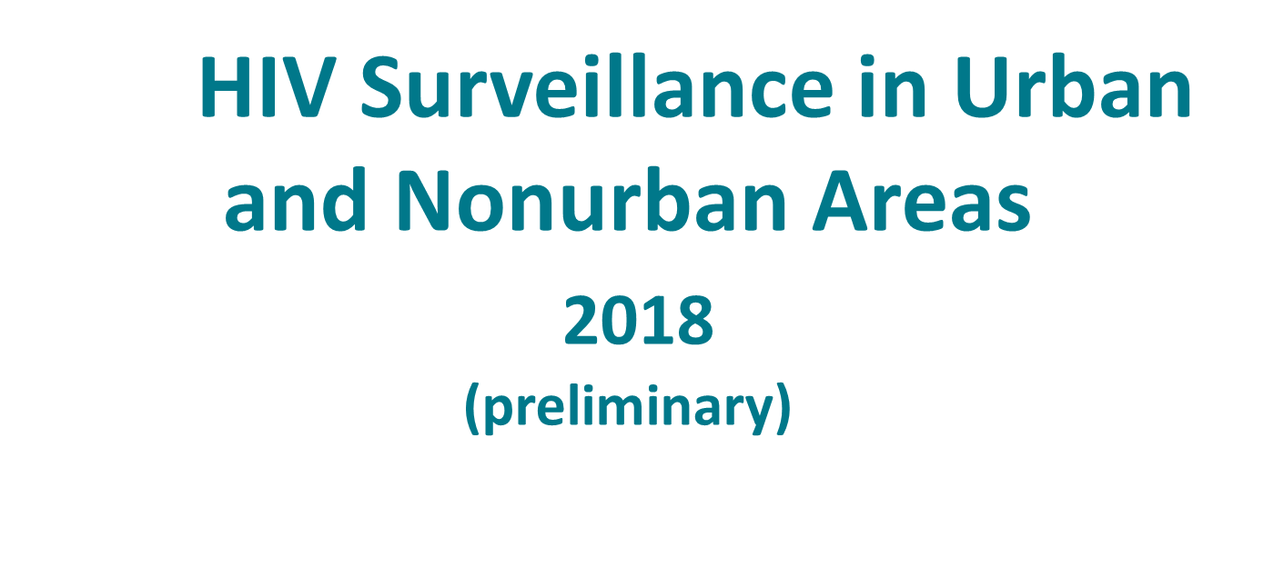
Division of HIV/AIDS Prevention
Notes:
HIV Surveillance in Urban and Nonurban Areas, 2018 (preliminary).
For all slides in this series, the following notes apply:
Data for the year 2018 are preliminary and based on 6 months reporting delay. Therefore, trend data are only displayed through the year 2017 to allow sufficient time (at least 12 months) for reporting of case information to accurately assess trends.
Numbers and rates of diagnosed HIV infection and diagnosed infections classified as stage 3 (AIDS) are based on data from 50 states and the District of Columbia. Stage 3 (AIDS) refer specifically to persons with diagnosed HIV whose infection was classified as stage 3 (AIDS) during a given year (for diagnoses) or whose infection has ever been classified as stage 3 (AIDS) (for prevalence and deaths).
Rates for transmission category are not provided because of the absence of denominator data from the U.S. Census Bureau.
The standard used for reporting trends in numbers and rates is based on an increase or a decrease of 5% or more during the specified time frame (e.g., when comparing 2010 and 2017).
Data are presented for diagnoses of HIV infection reported to CDC through June 2019.
Data re-release agreements between CDC and state/local HIV surveillance programs require certain levels of cell suppression at the state and county level in order to ensure confidentiality of personally identifiable information.

Slide 2
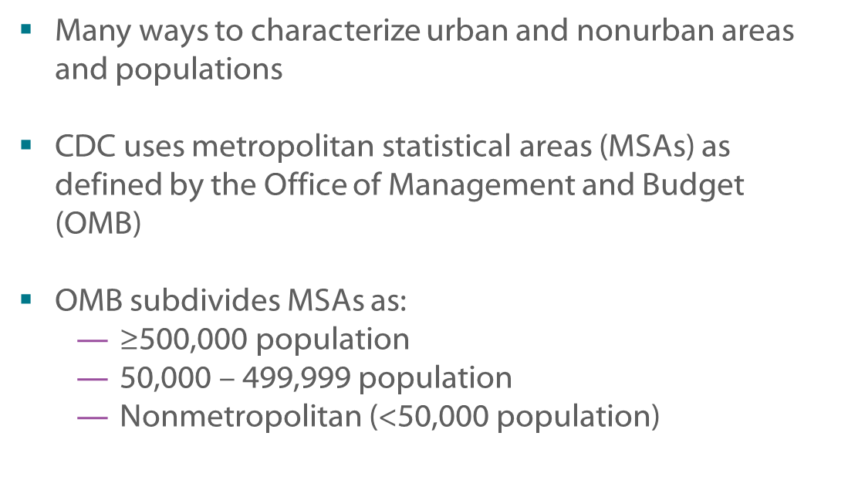
HIV Infection in Urban and Nonurban Areas
Notes:
There are many classifications for areas and populations (urban and nonurban). Although each classification system differs slightly, most places designated urban by one system are also designated urban by the others. Some systems distinguish larger and smaller metropolitan areas, some consider proximity to metropolitan areas, and others consider the economic and social integration in a core area of high population. The Centers for Disease Control and Prevention uses the Office of Management and Budget’s system, which designates metropolitan statistical areas (MSAs). Areas are divided into MSAs of populations of 500,000 or more; 50,000 to 499,999; and nonmetropolitan (less than 50,000). This slide series excludes cases reported from U.S. dependent areas because they are not included in the regional classification system used here.

Slide 3
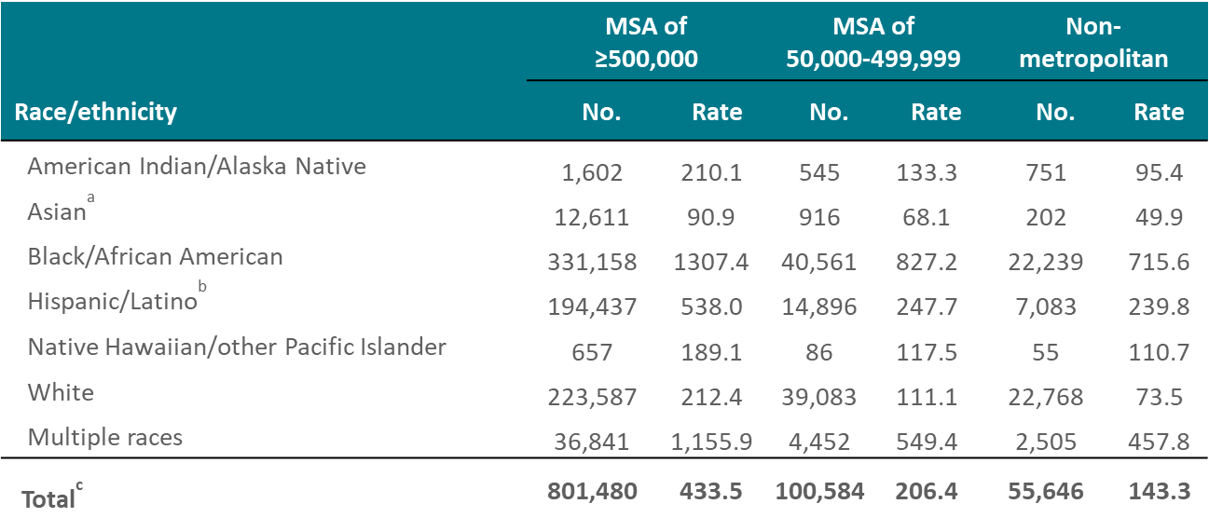
Adults and Adolescents Living with Diagnosed HIV Infection, by Population of Area of Residence and Race/Ethnicity, Year-end 2017—United States
Note. Data are based on address of residence as of December 31, 2017 (i.e., most recent known address). Data exclude persons whose county of residence is unknown.
ª Includes Asian/Pacific Islander legacy cases.
^{b} Hispanics/Latinos can be of any race.
^{c} Includes persons whose race/ethnicity is unknown.
Notes:
This slide presents the numbers and rates of adults and adolescents living with diagnosed HIV infection at the end of 2017 in the United States, by race/ethnicity and population of area of residence. Blacks/African Americans represent the largest numbers of adults and adolescents living with diagnosed HIV infection in both metropolitan (population of 500,000 or more) and smaller metropolitan (50,000-499,000) areas, while whites represent the largest number in non-metropolitan areas. Blacks/African Americans represent the highest rates of adults and adolescents living with diagnosed HIV infection across all three population categories. In each racial/ethnic group, the numbers and rates of diagnoses of HIV infection were highest in areas with populations of 500,000 or more.
Data are based on address of residence as of December 31, 2017 (i.e., most recent known address). Data exclude persons whose county of residence is unknown.
The Asian category includes Asian/Pacific Islander legacy cases (cases that were diagnosed and reported under the pre-1997 Office of Management and Budget race/ethnicity classification system).
Hispanics/Latinos can be of any race.
Persons living with diagnosed HIV infection are classified as adult or adolescent based on age at year-end 2017.

Slide 4
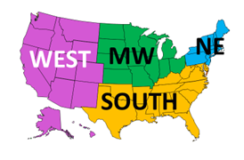
U.S. Census Bureau Regions of the United States
Notes:
This slide presents the 50 states (and the District of Columbia) that are included in each of four regions of the United States as defined by the US Census Bureau.
Regions of residence are defined as follows:
Northeast—Connecticut, Maine, Massachusetts, New Hampshire, New Jersey, New York, Pennsylvania, Rhode Island, Vermont Midwest—Illinois, Indiana, Iowa, Kansas, Michigan, Minnesota, Missouri, Nebraska, North Dakota, Ohio, South Dakota, Wisconsin South—Alabama, Arkansas, Delaware, District of Columbia, Florida, Georgia, Kentucky, Louisiana, Maryland, Mississippi, North Carolina, Oklahoma, South Carolina, Tennessee, Texas, Virginia, West Virginia West—Alaska, Arizona, California, Colorado, Hawaii, Idaho, Montana, Nevada, New Mexico, Oregon, Utah, Washington, Wyoming

Slide 5
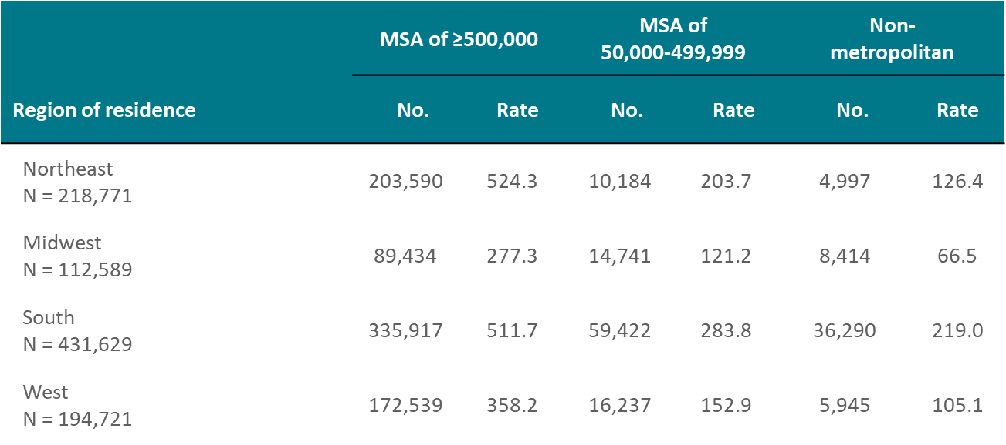
Adults and Adolescents Living with Diagnosed HIV Infection, by Population of Area of Residence and Region, Year-end 2017—United States
Note. Data are based on address of residence as of December 31, 2017 (i.e., most recent known address). Data exclude persons whose county of residence is unknown. Rates are per 100,000 population.
Notes:
In each region of the United States, the majority of adults and adolescents living with diagnosed HIV infection at the end of 2017 were from metropolitan areas with populations of 500,000 or more. The South had the largest number of persons living with diagnosed HIV infection overall, and the largest numbers across all three population categories. The South also had the highest rates in metropolitan areas with population 50,000-499,999 and nonmetropolitan areas, while the Northeast had the highest rate in areas with populations of 500,000 or more. Although metropolitan areas with populations of more than 500,000 have the largest number of persons living with diagnosed HIV infection, smaller metropolitan and nonmetropolitan areas, particularly in the South, account for a large percentage of persons living with diagnosed HIV infection.
Data are based on address of residence as of December 31, 2017 (i.e., most recent known address). Data exclude persons whose county of residence is unknown.
Inter-region comparisons of numbers of adults and adolescents living with diagnosed HIV infection should be made cautiously because the four regions vary by number of jurisdictions and by population size.
Regions of residence are defined as follows:
Northeast—Connecticut, Maine, Massachusetts, New Hampshire, New Jersey, New York, Pennsylvania, Rhode Island, Vermont Midwest—Illinois, Indiana, Iowa, Kansas, Michigan, Minnesota, Missouri, Nebraska, North Dakota, Ohio, South Dakota, Wisconsin South—Alabama, Arkansas, Delaware, District of Columbia, Florida, Georgia, Kentucky, Louisiana, Maryland, Mississippi, North Carolina, Oklahoma, South Carolina, Tennessee, Texas, Virginia, West Virginia West—Alaska, Arizona, California, Colorado, Hawaii, Idaho, Montana, Nevada, New Mexico, Oregon, Utah, Washington, Wyoming
Persons living with diagnosed HIV infection are classified as adult or adolescent based on age at year-end 2017.

Slide 6
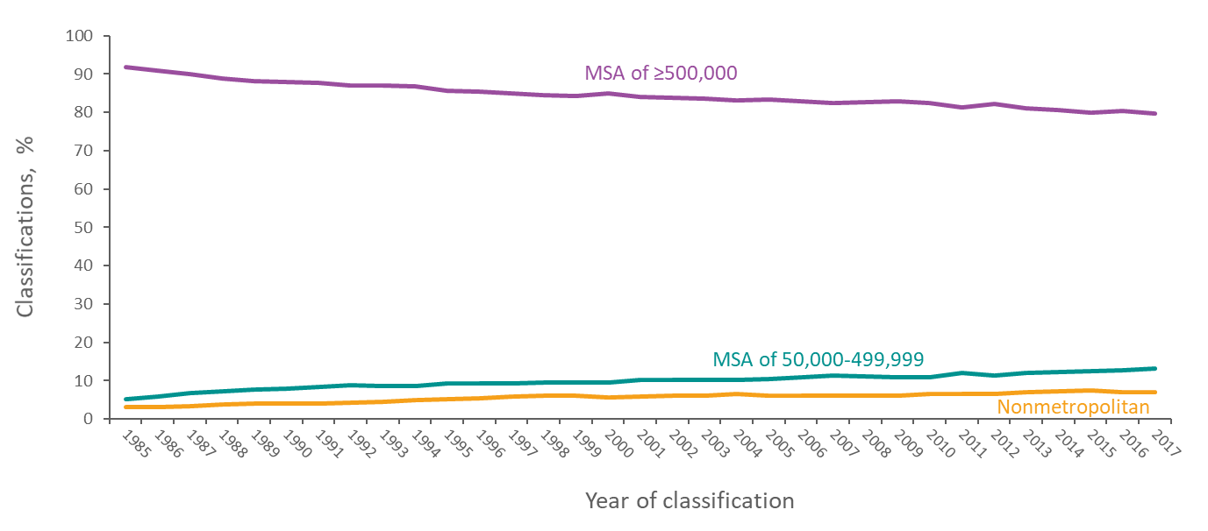
Percentages of Stage 3 (AIDS) Classifications among Adults and Adolescents with Diagnosed HIV Infection, by Population of Area of Residence and Year of Classification, 1985–2017—United States
Note. Data exclude persons whose county of residence is unknown.
Notes:
The percentage of HIV infections classified as stage 3 (AIDS) among adults and adolescents residing in areas of the United States with populations of 500,000 or more has decreased slowly since 1985. In 1985, 92% of all stage 3 (AIDS) classifications among adults and adolescents were in areas with populations of 500,000 or more, and in 2017, 80% of stage 3 (AIDS) classifications among adults and adolescents were in these areas. The decreasing trend in stage 3 (AIDS) classifications in the largest MSAs reflects the national trend of less immunosuppression at diagnosis, and a decreasing trend in the duration between the time of initial infection and diagnosis.
The inverse relationship between trends in areas with populations of 500,000 or more and less densely populated areas is in general due to introduction of HIV into heavily urbanized areas before introduction into suburban and rural areas. With less experience with HIV infection, residents of and clinicians in less urbanized areas may lag behind their more urban counterparts with respect to awareness of individual HIV risk and benefits of prevention steps such as routine HIV testing and PrEP access. Variations in population growth rates by area and population size also affect trends in percentage of infections by area.
Data exclude persons whose county of residence is unknown.

Slide 7
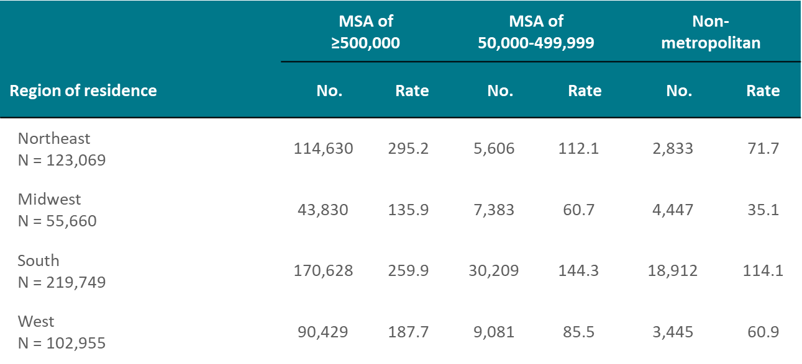
Adults and Adolescents Living with Diagnosed HIV Infection Ever Classified as Stage 3 (AIDS), by Population of Area of Residence and Region, Year-end 2017 United States
Note. Data are based on address of residence as of December 31, 2017 (i.e., most recent known address). Data exclude persons whose county of residence is unknown. Rates are per 100,000 population.
Notes:
In each region of the United States, the majority of adults and adolescents living with diagnosed HIV infection ever classified as stage 3 (AIDS) at the end of 2017 were from metropolitan areas with populations of 500,000 or more; the fewest were from nonmetropolitan areas. The South had the largest number of persons living with HIV ever classified as stage 3 (AIDS), and the largest numbers across all three population size categories. The South also had the highest rates in metropolitan areas with populations of 50,000-499,999 and for non-metropolitan areas, while the Northeast had the highest rate for metropolitan areas with populations of 500,000 or more. Although metropolitan areas with populations of 500,000 or more have the largest number of persons living with HIV ever classified as stage 3 (AIDS), smaller metropolitan and nonmetropolitan areas, particularly in the South, account for a large percentage of persons living with HIV ever classified as stage 3 (AIDS) compared to other regions of the United States.
Data are based on address of residence as of December 31, 2017 (i.e., most recent known address). Data exclude persons whose county of residence is unknown.
Inter-region comparisons of numbers and rates of persons living with diagnosed HIV infection ever classified as stage 3 (AIDS) should be made cautiously because the four regions vary by number of jurisdictions and by population size.
Regions of residence are defined as follows:
Northeast—Connecticut, Maine, Massachusetts, New Hampshire, New Jersey, New York, Pennsylvania, Rhode Island, Vermont Midwest—Illinois, Indiana, Iowa, Kansas, Michigan, Minnesota, Missouri, Nebraska, North Dakota, Ohio, South Dakota, Wisconsin South—Alabama, Arkansas, Delaware, District of Columbia, Florida, Georgia, Kentucky, Louisiana, Maryland, Mississippi, North Carolina, Oklahoma, South Carolina, Tennessee, Texas, Virginia, West Virginia West—Alaska, Arizona, California, Colorado, Hawaii, Idaho, Montana, Nevada, New Mexico, Oregon, Utah, Washington, Wyoming
Persons living with diagnosed HIV infection ever classified as stage 3 (AIDS) are classified as adult or adolescent based on age at end of 2017.

Slide 8
Diagnoses of HIV Infection among Adults and Adolescents by Population of Area of Residence, 2018—United States
Note. Data for the year 2018 are considered preliminary and based on 6 months reporting delay. Data exclude persons whose county of residence is unknown. Rates are per 100,000 population.
Notes:
The majority of adults and adolescents with HIV diagnosed in 2018 resided in metropolitan areas with populations of 500,000 or more in the United States. The rate (per 100,000 population) of diagnosis of HIV infection was highest (16.1) among adults and adolescents residing in metropolitan areas with populations of 500,000 or more compared with adults and adolescents residing in areas with smaller populations at the time of diagnosis.
Data for the year 2018 are considered preliminary and based on 6 months reporting delay. Data exclude persons whose county of residence is unknown.

Slide 9
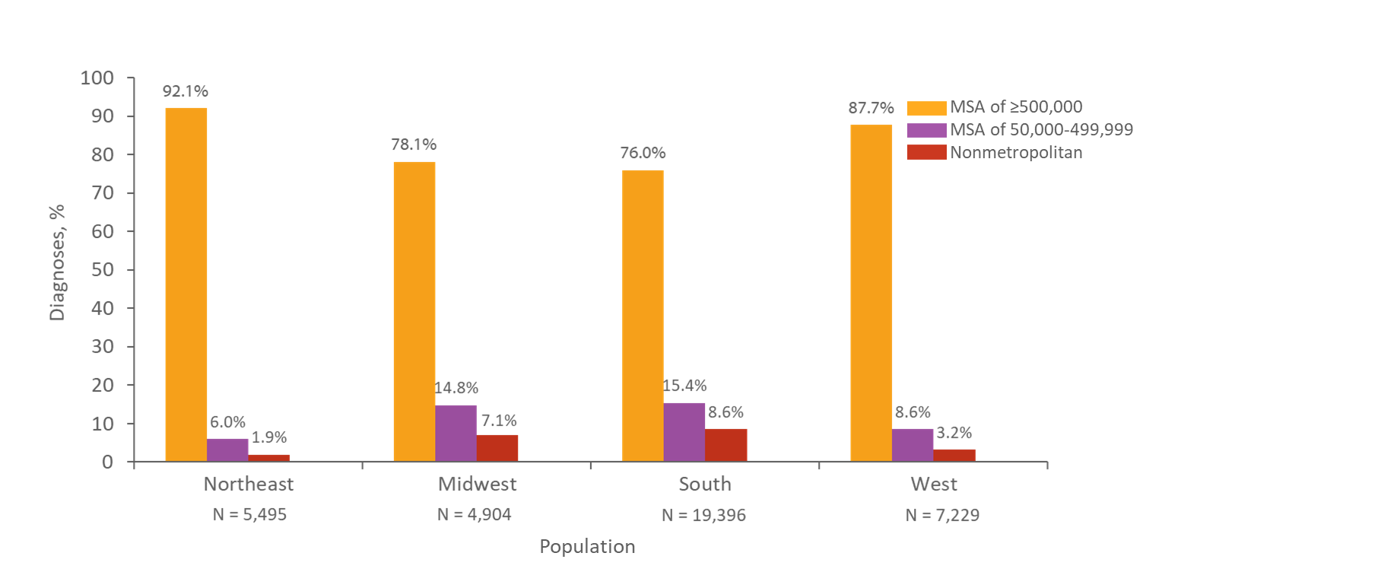
Percentages of Diagnoses of HIV Infection among Adults and Adolescents by Region and Population of Area of Residence, 2018—United States
Note. Data for the year 2018 are considered preliminary and based on 6 months reporting delay. Data exclude persons whose county of residence is unknown.
Notes:
The majority of adults and adolescents with HIV diagnosed in 2018 resided in metropolitan areas with a population of 500,000 or more; the South had the largest number of HIV diagnoses. The distribution of HIV diagnoses in the South shows large percentages in smaller metropolitan (50,000–499,999) and nonmetropolitan areas, compared with other regions of the United States.
Data for the year 2018 are considered preliminary and based on 6 months reporting delay. Data exclude persons whose county of residence is unknown.
Inter-region comparisons of diagnosed HIV infections should be made cautiously because the four regions vary by number of jurisdictions and by population size.
Regions of residence are defined as follows:
Northeast—Connecticut, Maine, Massachusetts, New Hampshire, New Jersey, New York, Pennsylvania, Rhode Island, Vermont Midwest—Illinois, Indiana, Iowa, Kansas, Michigan, Minnesota, Missouri, Nebraska, North Dakota, Ohio, South Dakota, Wisconsin South—Alabama, Arkansas, Delaware, District of Columbia, Florida, Georgia, Kentucky, Louisiana, Maryland, Mississippi, North Carolina, Oklahoma, South Carolina, Tennessee, Texas, Virginia, West Virginia West—Alaska, Arizona, California, Colorado, Hawaii, Idaho, Montana, Nevada, New Mexico, Oregon, Utah, Washington, Wyoming

Slide 10
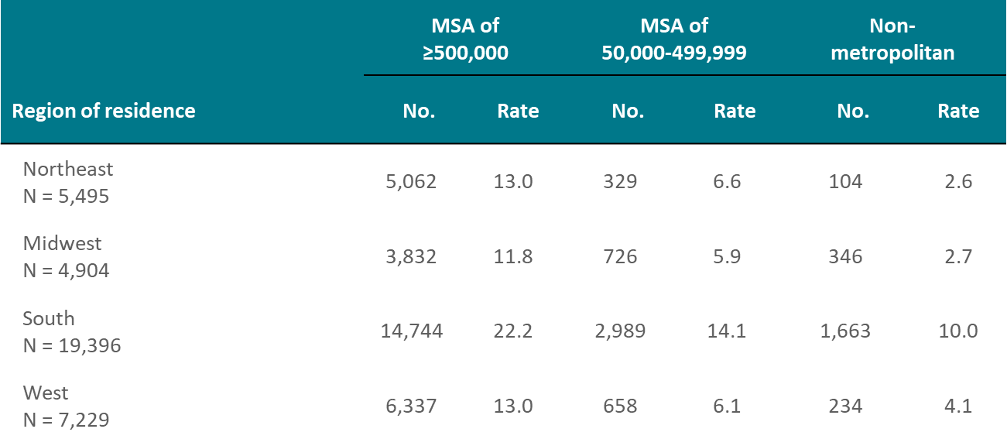
Diagnoses of HIV Infections among Adults and Adolescents, by Population of Area of Residence and Region, 2018—United States
Note. Data for the year 2018 are considered preliminary and based on 6 months reporting delay. Data exclude persons whose county of residence is unknown. Rates are per 100,000 population.
Notes:
This slide presents numbers and rates (per 100,000 population) of diagnoses of HIV infection among adults and adolescents in 2018 for each region by population size category. The highest rate for each region is found in metropolitan areas with a population of more than 500,000. The South had the highest numbers and rates of HIV diagnoses in each of the population categories.
Data for the year 2018 are considered preliminary and based on 6 months reporting delay. Data exclude persons whose county of residence is unknown.
Inter-region comparisons of numbers of diagnosed HIV infections should be made cautiously because the four regions vary by number of jurisdictions and by population size.
Regions of residence are defined as follows:
Northeast—Connecticut, Maine, Massachusetts, New Hampshire, New Jersey, New York, Pennsylvania, Rhode Island, Vermont Midwest—Illinois, Indiana, Iowa, Kansas, Michigan, Minnesota, Missouri, Nebraska, North Dakota, Ohio, South Dakota, Wisconsin South—Alabama, Arkansas, Delaware, District of Columbia, Florida, Georgia, Kentucky, Louisiana, Maryland, Mississippi, North Carolina, Oklahoma, South Carolina, Tennessee, Texas, Virginia, West Virginia West—Alaska, Arizona, California, Colorado, Hawaii, Idaho, Montana, Nevada, New Mexico, Oregon, Utah, Washington, Wyoming

Slide 11
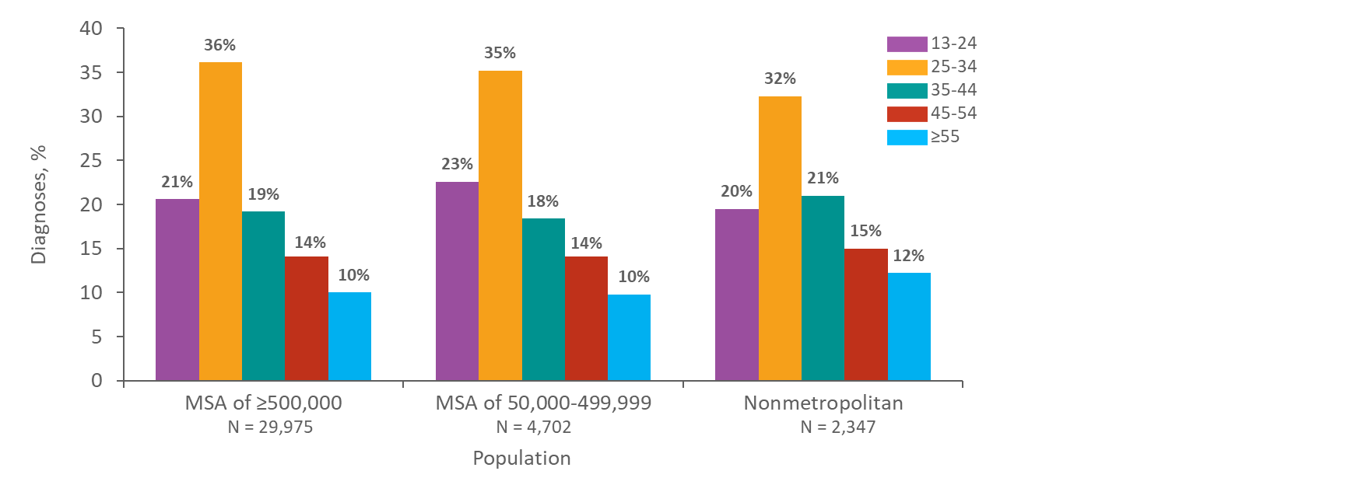
Percentages of Diagnoses of HIV Infection among Adults and Adolescents by Population of Area of Residence and Age at Diagnosis, 2018—United States
Note. Data for the year 2018 are considered preliminary and based on 6 months reporting delay. Data exclude persons whose county of residence is unknown.
Notes:
This slide presents the percentage distribution of diagnoses of HIV infection for 2018 among adults and adolescents by age at diagnosis and by population of area of residence in the United States.
In each population category, approximately 32–36% of diagnoses of HIV infection were among adults aged 25–34 years at diagnosis, 20–23% were among persons aged 13–24 years, 18–21% were among adults aged 35–44 years, and 14–15% were among adults aged 45–54 years. Approximately 10–12% of diagnoses in each population category were among adults aged 55 years and older at diagnosis.
Data for the year 2018 are considered preliminary and based on 6 months reporting delay. Data exclude persons whose county of residence is unknown.

Slide 12
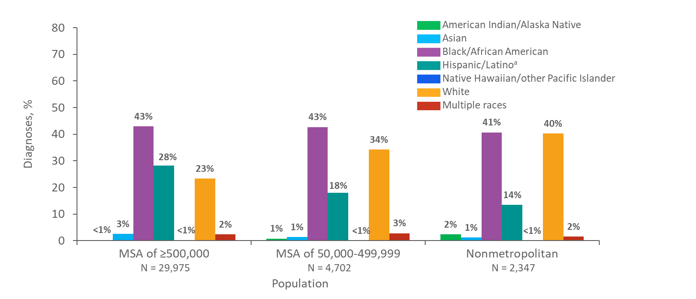
Percentages of Diagnoses of HIV Infection among Adults and Adolescents, by Population of Area of Residence and Race/Ethnicity, 2018—United States
Note. Data for the year 2018 are considered preliminary and based on 6 months reporting delay. Data exclude persons whose county of residence is unknown.
ª Hispanics/Latinos can be of any race.
Notes:
The majority of adults and adolescents with HIV infection diagnosed in 2018 resided in metropolitan areas with populations of 500,000 or more in the United States. Blacks/African Americans accounted for the largest percentage of diagnoses of HIV infection regardless of the population of area of residence at diagnosis. Whites accounted for a smaller percentage (23%) of diagnoses of HIV infection in metropolitan areas with populations 500,000 or more than in areas with smaller populations. Hispanics/Latinos accounted for a larger percentage (28%) of diagnoses of HIV infection in metropolitan areas with populations of 500,000 or more than in areas with smaller populations.
Data for the year 2018 are considered preliminary and based on 6 months reporting delay. Data exclude persons whose county of residence is unknown.
Hispanics/Latinos can be of any race.

Slide 13
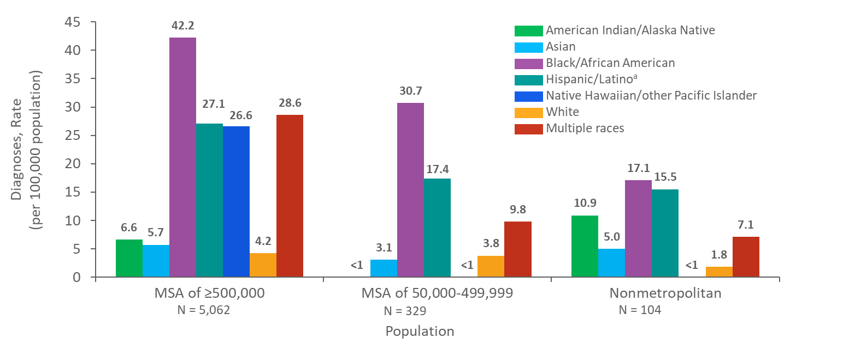
Rates of Diagnoses of HIV Infection among Adults and Adolescents, by Population of Area of Residence and Race/Ethnicity, 2018—Northeast Region, United States
Note. Data for the year 2018 are considered preliminary and based on 6 months reporting delay. Data exclude persons whose county of residence is unknown.
ª Hispanics/Latinos can be of any race.
Notes:
In 2018, in the Northeast region of the United States, the highest rates (per 100,000 population) of diagnoses of HIV infection in each population size category were among blacks/African Americans. The rates of HIV diagnoses among blacks/African Americans, Hispanics/Latinos, and whites decreased as population size decreased. The rate of HIV diagnoses among persons of multiple races was highest in the MSA of 500,000 or more. The rates in American Indian/Alaska Natives, Asians, Native Hawaiians/other Pacific Islanders, and persons of multiple races should be interpreted with caution, because both the population sizes and numbers of HIV diagnoses in these groups were small.
Data for the year 2018 are considered preliminary and based on 6 months reporting delay. Data exclude persons whose county of residence is unknown.
The Northeast region of the United States includes Connecticut, Maine, Massachusetts, New Hampshire, New Jersey, New York, Pennsylvania, Rhode Island, and Vermont.
Hispanics/Latinos can be of any race.

Slide 14
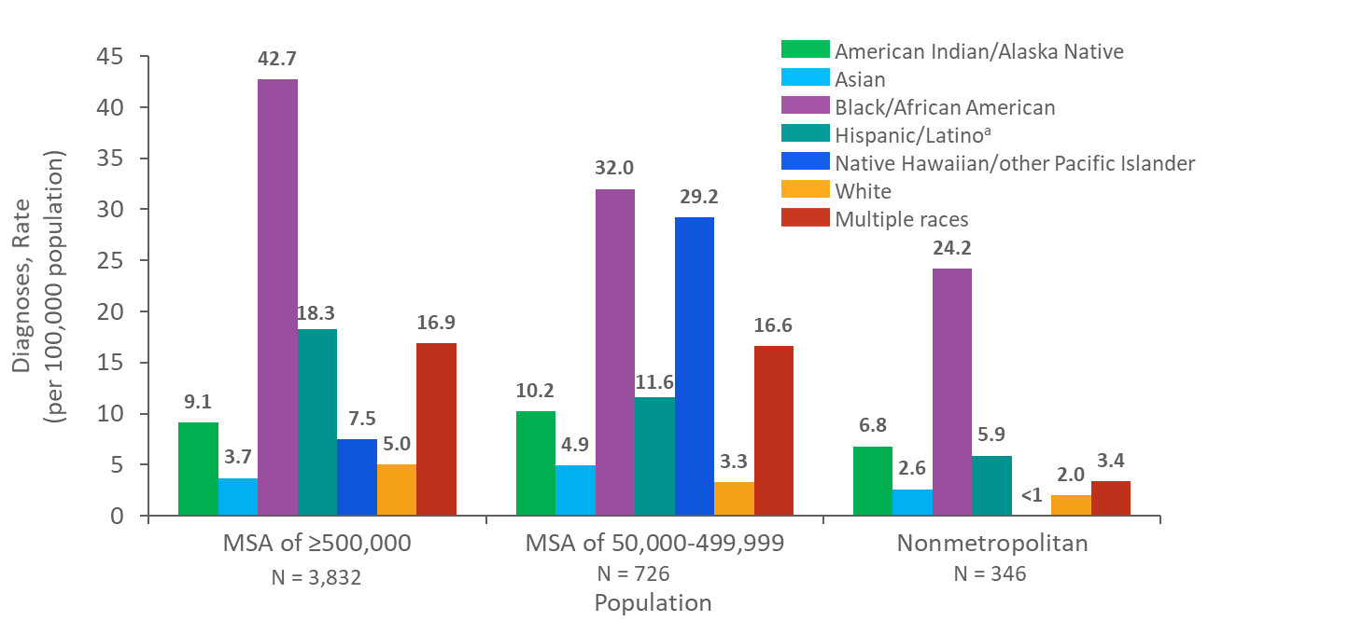
Rates of Diagnoses of HIV Infection among Adults and Adolescents, by Population of Area of Residence and Race/Ethnicity, 2018—Midwest Region, United States
Note. Data for the year 2018 are considered preliminary and based on 6 months reporting delay. Data exclude persons whose county of residence is unknown.
ª Hispanics/Latinos can be of any race.
Notes:
In 2018, in the Midwest region of the United States, the highest rates (per 100,000 population) of diagnoses of HIV infection in each population size category were among blacks/African Americans. The rates of HIV diagnoses among blacks/African Americans, Hispanics/Latinos, and whites decreased as population size decreased. The rates in American Indian/Alaska Natives, Asians, Native Hawaiians/other Pacific Islanders, and persons of multiple races should be interpreted with caution, because both the population sizes and numbers of HIV diagnoses in these groups were small.
Data for the year 2018 are considered preliminary and based on 6 months reporting delay. Data exclude persons whose county of residence is unknown.
The Midwest region of the United States includes Illinois, Indiana, Iowa, Kansas, Michigan, Minnesota, Missouri, Nebraska, North Dakota, Ohio, South Dakota, and Wisconsin.
Hispanics/Latinos can be of any race.

Slide 15
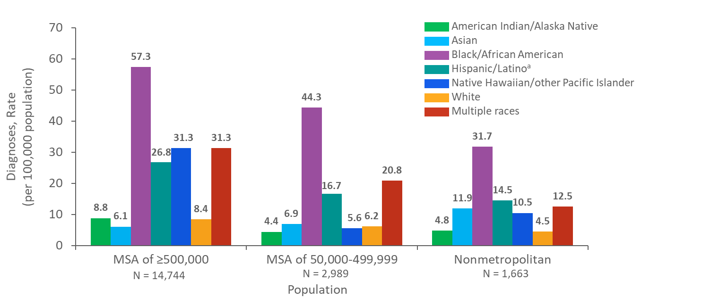
Rates of Diagnoses of HIV Infection among Adults and Adolescents, by Population of Area of Residence and Race/Ethnicity, 2018—South Region, United States
Note. Data for the year 2018 are considered preliminary and based on 6 months reporting delay. Data exclude persons whose county of residence is unknown.
ª Hispanics/Latinos can be of any race.
Notes:
In 2018, in the South region of the United States, the highest rates (per 100,000 population) of diagnoses of HIV infection in each population size category were among blacks/African Americans. The rates of HIV diagnoses among blacks/African Americans, Hispanics/Latinos, and whites decreased as the population size decreased. The rate of HIV diagnoses among persons of multiple races was highest in the MSA of 500,000 or more. The rates in American Indian/Alaska Natives, Asians, and Native Hawaiians/other Pacific Islanders, and persons of multiple races should be interpreted with caution, because both the population sizes and numbers of HIV diagnoses in these groups were small.
Data for the year 2018 are considered preliminary and based on 6 months reporting delay. Data exclude persons whose county of residence is unknown.
The South region of the United States includes Alabama, Arkansas, Delaware, District of Columbia, Florida, Georgia, Kentucky, Louisiana, Maryland, Mississippi, North Carolina, Oklahoma, South Carolina, Tennessee, Texas, Virginia, and West Virginia.
Hispanics/Latinos can be of any race.

Slide 16
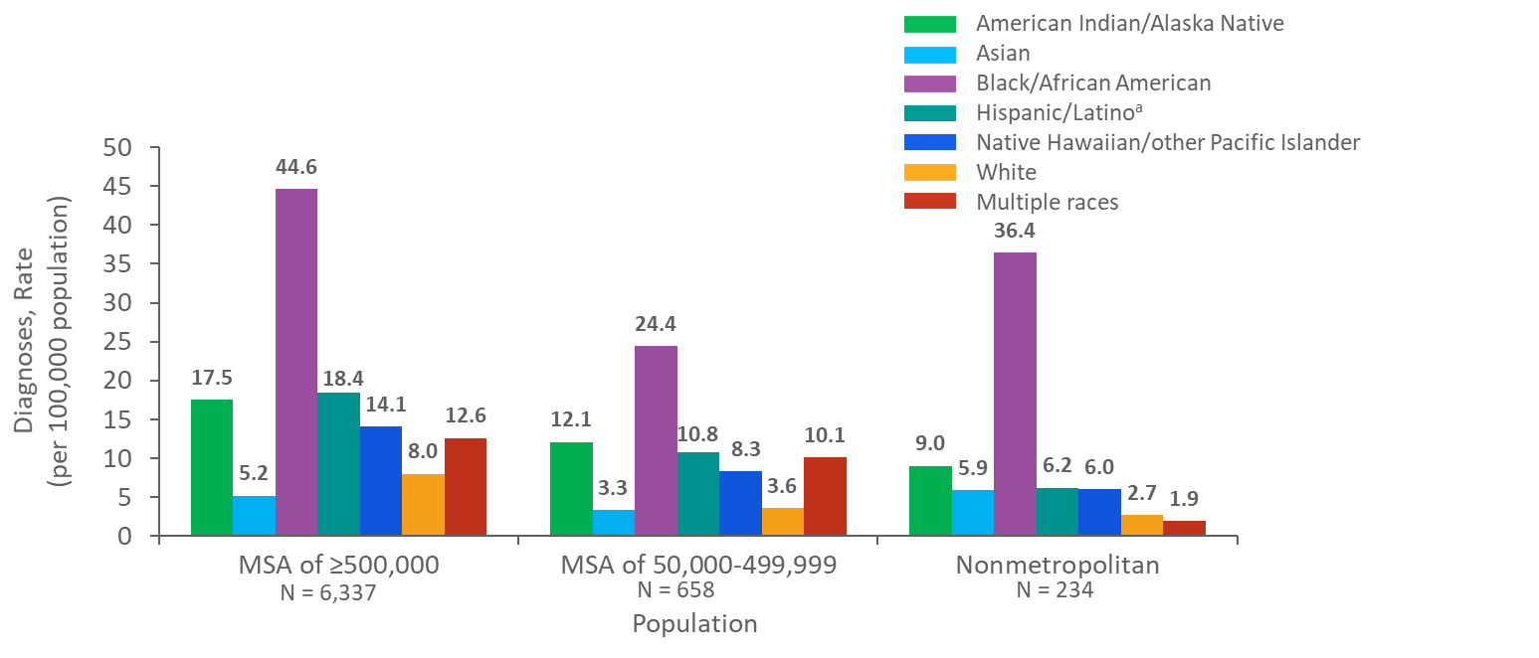
Rates of Diagnoses of HIV Infection among Adults and Adolescents, by Population of Area of Residence and Race/Ethnicity, 2018—West Region, United States
Note. Data for the year 2018 are considered preliminary and based on 6 months reporting delay. Data exclude persons whose county of residence is unknown.
ª Hispanics/Latinos can be of any race.
Notes:
In 2018, in the West region of the United States, the highest rates (per 100,000 population) of diagnoses of HIV infection in each population category were among blacks/African Americans. The rates of HIV diagnoses among blacks/African Americans, Hispanics/Latinos, and whites decreased as population size decreased. The rates in American Indian/Alaska Natives, Asians, Native Hawaiians/other Pacific Islanders, and persons of multiple races should be interpreted with caution, because both the population sizes and numbers of HIV diagnoses in these groups were small.
Data for the year 2018 are considered preliminary and based on 6 months reporting delay. Data exclude persons whose county of residence is unknown.
The West region of the United States includes Alaska, Arizona, California, Colorado, Hawaii, Idaho, Montana, Nevada, New Mexico, Oregon, Utah, Washington, and Wyoming.
Hispanics/Latinos can be of any race.

Slide 17
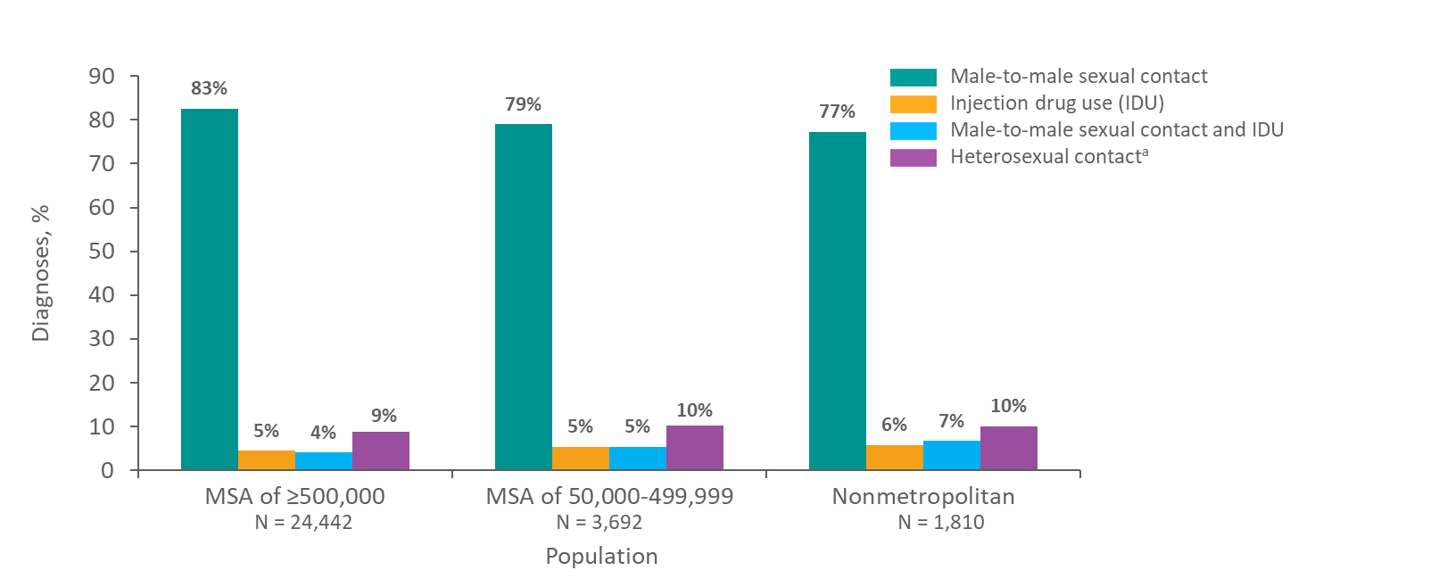
Percentages of Diagnoses of HIV Infection among Male Adults and Adolescents, by Population of Area of Residence and Transmission Category, 2018—United States
Note. Data for the year 2018 are considered preliminary and based on 6 months reporting delay. Data exclude persons whose county of residence is unknown. Data have been statistically adjusted to account for missing transmission category. “Other” transmission category not displayed as it comprises less than 1% of cases.
ª Heterosexual contact with a person known to have, or to be at high risk for, HIV infection.
Notes:
In each of the population size categories in the United States, 77–83% of diagnoses of HIV infection among males during 2018 were among those with infections attributed to male-to-male sexual contact. Approximately 9–10% of males in each population size category had diagnosed HIV infections attributed to heterosexual contact.
The “Other” transmission category (not displayed) comprises less than 1% of cases. The category includes hemophilia, blood transfusion, perinatal exposure, and risk factor not reported or not identified.
Data for the year 2018 are preliminary and based on 6 months reporting delay. Data exclude persons whose county of residence is unknown. Data have been statistically adjusted to account for missing transmission category.
Heterosexual contact is with a person known to have, or to be at high risk for, HIV infection.

Slide 18
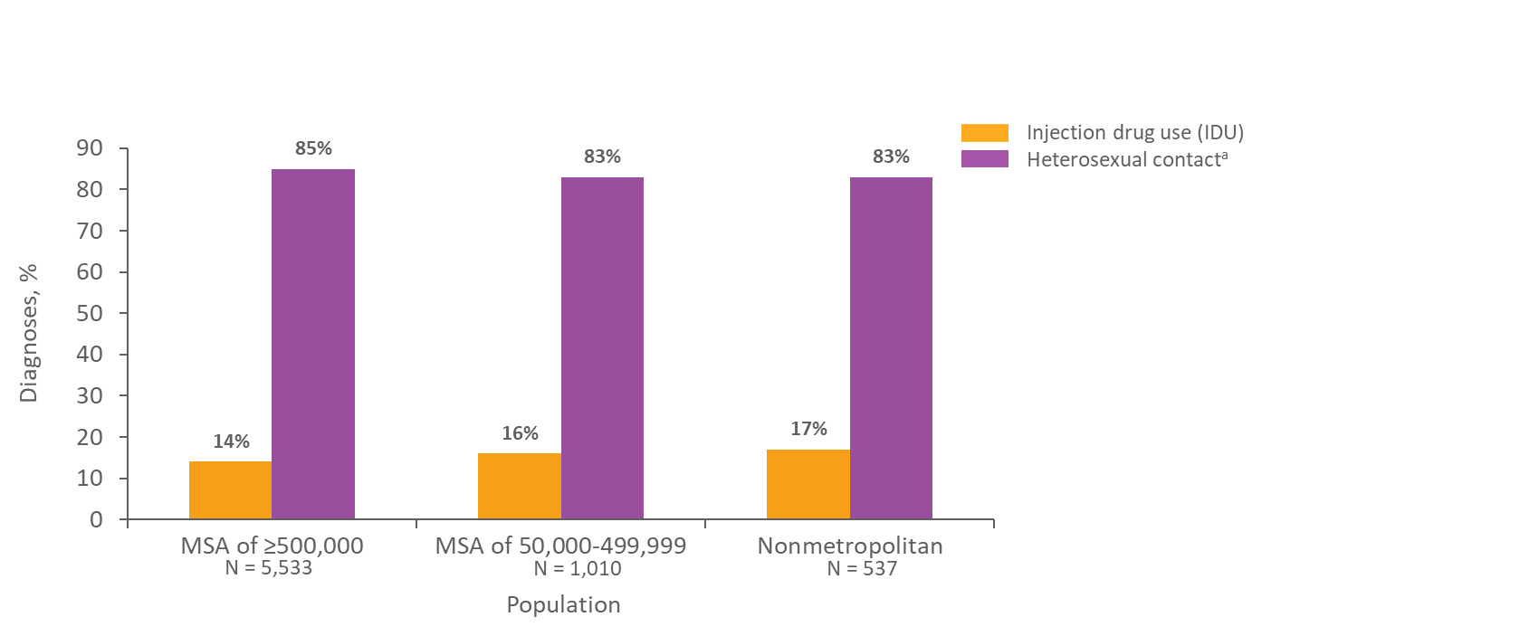
Percentages of Diagnoses of HIV Infection among Female Adults and Adolescents, by Population of Area of Residence and Transmission Category, 2018—United States
Note. Data for the year 2018 are considered preliminary and based on 6 months reporting delay. Data exclude persons whose county of residence is unknown. Data have been statistically adjusted to account for missing transmission category. “Other” transmission category not displayed as it comprises less than 1% of cases.
ª Heterosexual contact with a person known to have, or to be at high risk for, HIV infection.
Notes:
In each of the population size categories in the United States, 83–85% of diagnoses of HIV infection among females during 2018 were among those with infections attributed to heterosexual contact. Approximately 14–17% of females in each population size category had diagnosed HIV infections attributed to injection drug use. The overall pattern of the distribution of transmission category did not differ by the population of area of residence at the time of diagnosis.
The “Other” transmission category (not displayed) comprises less than 1% of cases. The category includes hemophilia, blood transfusion, perinatal exposure, and risk factor not reported or not identified.
Data for the year 2018 are preliminary and based on 6 months reporting delay. Data exclude persons whose county of residence is unknown. Data have been statistically adjusted to account for missing transmission category.
Heterosexual contact is with a person known to have, or to be at high risk for, HIV infection.

Slide 19
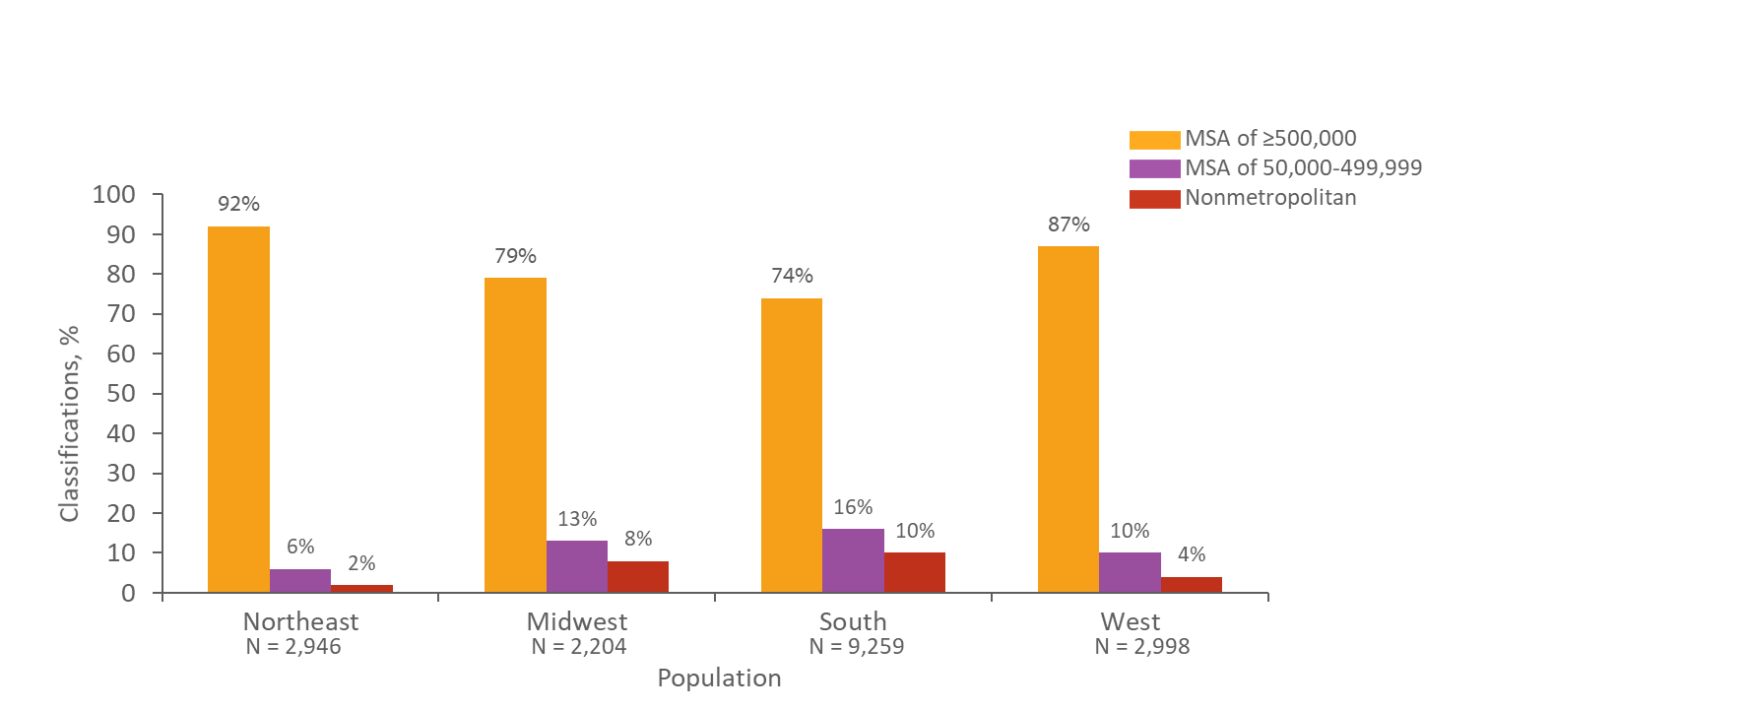
Percentages of Stage 3 (AIDS) Classifications among Adults and Adolescents with Diagnosed HIV Infection, by Region and Population of Area of Residence, 2018 United States
Note. Data for the year 2018 are considered preliminary and based on 6 months reporting delay. Data exclude persons whose county of residence is unknown.
Notes:
In 2018, the majority of stage 3 (AIDS) classifications among adults and adolescents with diagnosed HIV infection were in metropolitan areas with a population of 500,000 or more; the South had the largest numbers of stage 3 (AIDS) classifications. The distribution of stage 3 (AIDS) classifications in the South shows larger percentages in smaller metropolitan (50,000–499,999) and nonmetropolitan areas compared to other regions of the United States.
Data for the year 2018 are considered preliminary and based on 6 months reporting delay. Data exclude persons whose county of residence is unknown.
Inter-region comparisons of stage 3 (AIDS) classifications should be made cautiously because the four regions vary by number of jurisdictions and by population size.
Regions of residence are defined as follows:
Northeast—Connecticut, Maine, Massachusetts, New Hampshire, New Jersey, New York, Pennsylvania, Rhode Island, Vermont Midwest—Illinois, Indiana, Iowa, Kansas, Michigan, Minnesota, Missouri, Nebraska, North Dakota, Ohio, South Dakota, Wisconsin South—Alabama, Arkansas, Delaware, District of Columbia, Florida, Georgia, Kentucky, Louisiana, Maryland, Mississippi, North Carolina, Oklahoma, South Carolina, Tennessee, Texas, Virginia, West Virginia West—Alaska, Arizona, California, Colorado, Hawaii, Idaho, Montana, Nevada, New Mexico, Oregon, Utah, Washington, Wyoming

Slide 20
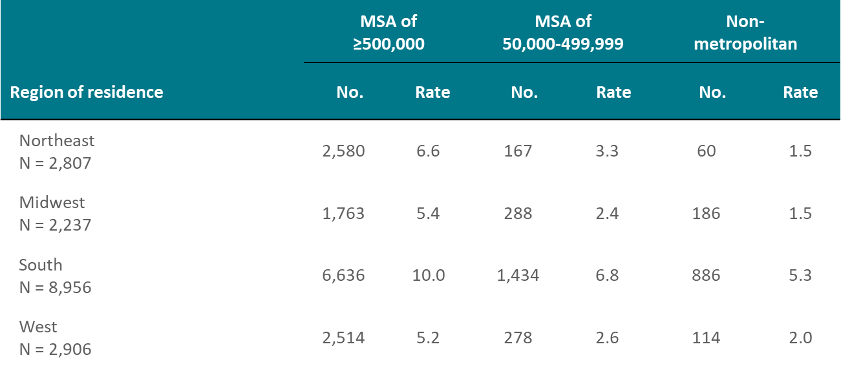
Stage 3 (AIDS) Classifications among Adults and Adolescents with Diagnosed HIV Infection, by Population of Area of Residence and Region, 2018—United States
Note. Data for the year 2018 are considered preliminary and based on 6 months reporting delay. Data exclude persons whose county of residence is unknown. Rates are per 100,000 population.
Notes:
Numbers and rates (per 100,000 population) of stage 3 (AIDS) classifications in 2018 among adults and adolescents with diagnosed HIV infection are shown for each region of residence by population category. The highest rate for each region is found in metropolitan areas with a population of 500,000 or more. The South had the largest overall number of stage 3 (AIDS) classifications, and also had the highest numbers and rates of stage 3 (AIDS) classifications across all three population categories.
Data for the year 2018 are considered preliminary and based on 6 months reporting delay. Data exclude persons whose county of residence is unknown.
Inter-region comparisons of stage 3 (AIDS) classifications should be made cautiously, because the four regions vary by number of jurisdictions and by population size.
Regions of residence are defined as follows:
Northeast—Connecticut, Maine, Massachusetts, New Hampshire, New Jersey, New York, Pennsylvania, Rhode Island, Vermont Midwest—Illinois, Indiana, Iowa, Kansas, Michigan, Minnesota, Missouri, Nebraska, North Dakota, Ohio, South Dakota, Wisconsin South—Alabama, Arkansas, Delaware, District of Columbia, Florida, Georgia, Kentucky, Louisiana, Maryland, Mississippi, North Carolina, Oklahoma, South Carolina, Tennessee, Texas, Virginia, West Virginia West—Alaska, Arizona, California, Colorado, Hawaii, Idaho, Montana, Nevada, New Mexico, Oregon, Utah, Washington, Wyoming

Slide 21
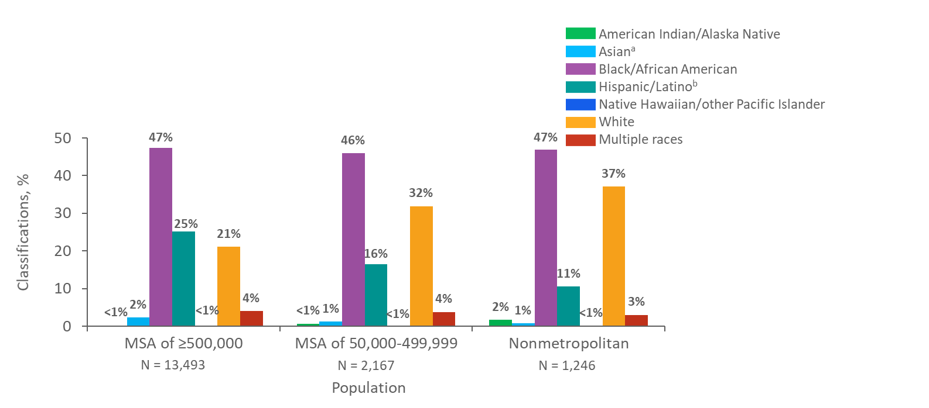
Percentages of Stage 3 (AIDS) Classifications among Adults and Adolescents with Diagnosed HIV Infection, by Population of Area of Residence and Race/Ethnicity 2018—United States
Note. Data for the year 2018 are considered preliminary and based on 6 months reporting delay. Data exclude persons whose county of residence is unknown.
ª Includes Asian/Pacific Islander legacy cases.
^{b} Hispanics/Latinos can be of any race.
Notes:
The majority of adults and adolescents with HIV infection classified as stage 3 (AIDS) in 2018 resided in metropolitan areas with populations of 500,000 or more. Blacks/African Americans accounted for the largest percentage of stage 3 (AIDS) classifications regardless of the population size category. Hispanics/Latinos accounted for a larger percentage (25%) of stage 3 (AIDS) classifications in metropolitan areas with populations of 500,000 or more than in areas with smaller populations. Whites accounted for a smaller percentage (21%) of stage 3 (AIDS) classifications in metropolitan areas with populations of 500,000 or more compared to areas with smaller populations. The rates in American Indian/Alaska Natives, Asians, Native Hawaiians/other Pacific Islanders, and persons of multiple races should be interpreted with caution, because both the population sizes and numbers of stage 3 (AIDS) classifications in these groups were small.
Data for the year 2018 are considered preliminary and based on 6 months reporting delay. Data exclude persons whose county of residence is unknown.
The Asian category includes Asian/Pacific Islander legacy cases (cases that were diagnosed and reported under the pre-1997 Office of Management and Budget race/ethnicity classification system).
Hispanics/Latinos can be of any race.

Slide 22
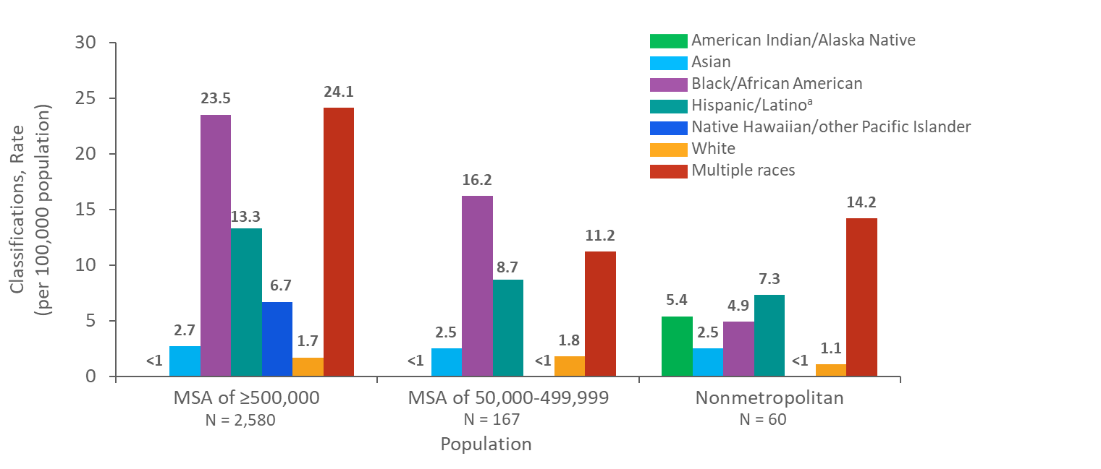
Rates of Stage 3 (AIDS) Classifications among Adults and Adolescents with Diagnosed HIV Infection, by Population of Area of Residence and Race/Ethnicity, 2018 Northeast Region, United States
Note. Data for the year 2018 are considered preliminary and based on 6 months reporting delay. Data exclude persons whose county of residence is unknown.
ª Includes Asian/Pacific Islander legacy cases.
^{b} Hispanics/Latinos can be of any race.
Notes:
In 2018, in the Northeast region of the United States, the highest rate (per 100,000 population) of stage 3 (AIDS) classifications in large metropolitan areas (500,000 or more) was among persons of multiple races, although this rate should be interpreted with caution. The exception was in smaller metropolitan populations (50,000-499,999) where blacks/African Americans had the highest rate of diagnoses of stage 3 (AIDS) classifications. The rates of stage 3 (AIDS) classifications among blacks/African Americans and Hispanics/Latinos decreased as the population size decreased. The rates in American Indian/Alaska Natives, Asians, Native Hawaiians/other Pacific Islanders, and persons of multiple races should be interpreted with caution, because both the population sizes and numbers of stage 3 (AIDS) classifications in these groups were small.
Data for the year 2018 are considered preliminary and based on 6 months reporting delay. Data exclude persons whose county of residence is unknown.
The Northeast region of the United States includes Connecticut, Maine, Massachusetts, New Hampshire, New Jersey, New York, Pennsylvania, Rhode Island, and Vermont.
The Asian category includes Asian/Pacific Islander legacy cases (cases that were diagnosed and reported under the pre-1997 Office of Management and Budget race/ethnicity classification system).
Hispanics/Latinos can be of any race.

Slide 23
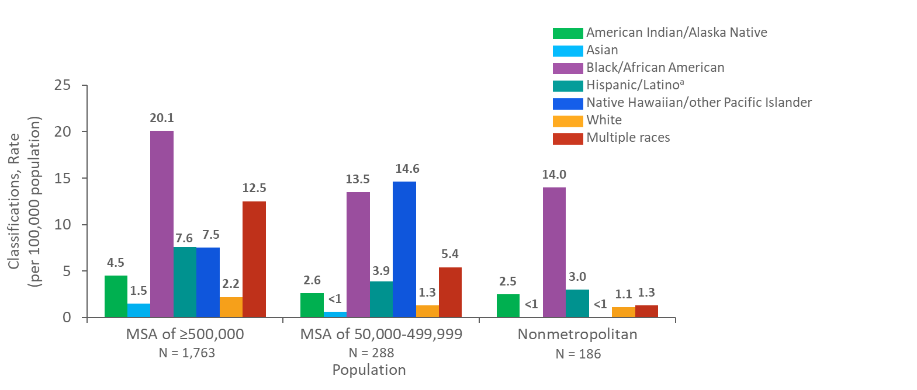
Rates of Stage 3 (AIDS) Classifications among Adults and Adolescents with Diagnosed HIV Infection, by Population of Area of Residence and Race/Ethnicity, 2018 Midwest Region, United States
Note. Data for the year 2018 are considered preliminary and based on 6 months reporting delay. Data exclude persons whose county of residence is unknown.
ª Includes Asian/Pacific Islander legacy cases.
^{b} Hispanics/Latinos can be of any race.
Notes:
In 2018, in the Midwest region of the United States, the highest rates (per 100,000 population) of stage 3 (AIDS) classifications in each population size category were among blacks/African Americans. The exception was in non-metropolitan populations where Native Hawaiians/other Pacific Islanders had the highest rate of stage 3 (AIDS) classifications, although this rate should be interpreted with caution. The rates of stage 3 (AIDS) classifications among Hispanics/Latinos and whites decreased as population size decreased. The rates in American Indian/Alaska Natives, Asians, Native Hawaiians/other Pacific Islanders, and persons of multiple races should be interpreted with caution, because both the population sizes and numbers of stage 3 (AIDS) classifications in these groups were small.
Data for the year 2018 are considered preliminary and based on 6 months reporting delay. Data exclude persons whose county of residence is unknown.
The Midwest region of the United States includes Illinois, Indiana, Iowa, Kansas, Michigan, Minnesota, Missouri, Nebraska, North Dakota, Ohio, South Dakota, and Wisconsin.
The Asian category includes Asian/Pacific Islander legacy cases (cases that were diagnosed and reported under the pre-1997 Office of Management and Budget race/ethnicity classification system).
Hispanics/Latinos can be of any race.

Slide 24
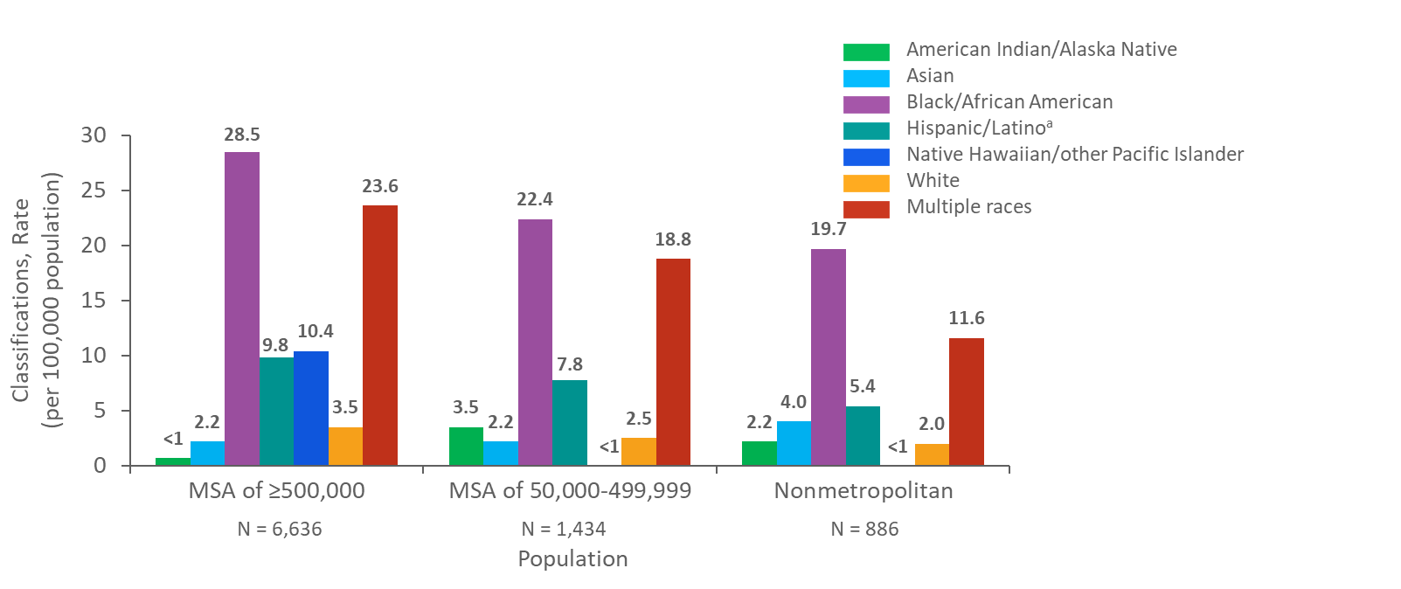
Rates of Stage 3 (AIDS) Classifications among Adults and Adolescents with Diagnosed HIV Infection, by Population of Area of Residence and Race/Ethnicity, 2018 South Region, United States
Note. Data for the year 2018 are considered preliminary and based on 6 months reporting delay. Data exclude persons whose county of residence is unknown.
ª Includes Asian/Pacific Islander legacy cases.
^{b} Hispanics/Latinos can be of any race.
Notes:
In 2018, in the South region of the United States, the highest rates (per 100,000 population) of stage 3 (AIDS) classifications in each population size category were among blacks/African Americans. The rates of stage 3 (AIDS) classifications among blacks/African Americans, Hispanic/Latinos, and whites decreased as population size decreased. The rates in American Indian/Alaska Natives, Asians, Native Hawaiians/other Pacific Islanders, and persons of multiple races should be interpreted with caution, because both the population sizes and numbers of stage 3 (AIDS) classifications in these groups were small.
Data for the year 2018 are considered preliminary and based on 6 months reporting delay. Data exclude persons whose county of residence is unknown.
The South region of the United States includes Alabama, Arkansas, Delaware, District of Columbia, Florida, Georgia, Kentucky, Louisiana, Maryland, Mississippi, North Carolina, Oklahoma, South Carolina, Tennessee, Texas, Virginia, and West Virginia.
The Asian category includes Asian/Pacific Islander legacy cases (cases that were diagnosed and reported under the pre-1997 Office of Management and Budget race/ethnicity classification system).
Hispanics/Latinos can be of any race.

Slide 25
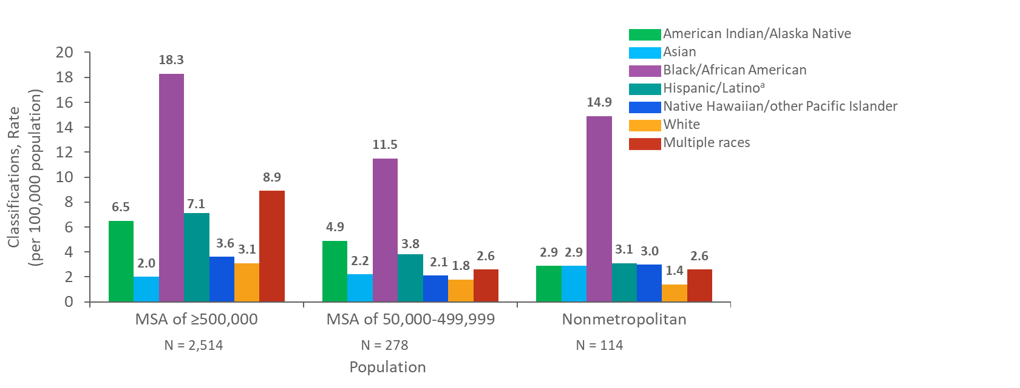
Rates of Stage 3 (AIDS) Classifications among Adults and Adolescents with Diagnosed HIV Infection, by Population of Area of Residence and Race/Ethnicity, 2018 West Region, United States
Note. Data for the year 2018 are considered preliminary and based on 6 months reporting delay. Data exclude persons whose county of residence is unknown.
ª Includes Asian/Pacific Islander legacy cases.
^{b} Hispanics/Latinos can be of any race.
Notes:
In 2018, in the West region of the United States, the highest rates (per 100,000 population) of stage 3 (AIDS) classifications in each population size category were among blacks/African Americans. The rates of stage 3 (AIDS) classifications among blacks/African Americans, Hispanics/Latinos, and whites were highest in metropolitan areas with populations of 500,000 or more. The rates in American Indian/Alaska Natives, Asians, Native Hawaiians/other Pacific Islanders, and persons of multiple races should be interpreted with caution, because both the population sizes and numbers of stage 3 (AIDS) classifications in these groups were small.
Data for the year 2018 are considered preliminary and based on 6 months reporting delay. Data exclude persons whose county of residence is unknown.
The West region of the United States includes Alaska, Arizona, California, Colorado, Hawaii, Idaho, Montana, Nevada, New Mexico, Oregon, Utah, Washington, and Wyoming.
The Asian category includes Asian/Pacific Islander legacy cases (cases that were diagnosed and reported under the pre-1997 Office of Management and Budget race/ethnicity classification system).
Hispanics/Latinos can be of any race.

