Slide 1
Division of HIV/AIDS Prevention
Pediatric HIV Surveillance 2018 (preliminary)
Notes:
Pediatric HIV Surveillance.
For all slides in this series, the following notes apply:
The Pediatric HIV Surveillance slide set presents and interprets trends in HIV diagnoses for 2010–2017 and provides preliminary data, based on a 6-month reporting delay, for 2018. The standard used for reporting trends in numbers and rates is based on an increase or a decrease of 5% or more during the specified time frame (e.g., when comparing 2010 and 2017).
Beginning in 2020, CDC will transition to publishing this slide set earlier in the calendar year and will include data reported to CDC’s National HIV Surveillance System through December 31 of the prior year (instead of June 30). The use of data reported to CDC through December will allow for a 12-month reporting lag. In early 2020, CDC will release an update to the 2018 data that will present and interpret trends in HIV diagnoses through 2018. Future editions of this slide set will be published according to the new time line.
Numbers and rates of diagnosed HIV infection and diagnosed infections classified as stage 3 (AIDS) are based on data from 50 states, the District of Columbia, and 6 U.S. dependent areas.
Rates for transmission category are not provided because of the absence of denominator data from the U.S. Census Bureau.
Rates are not calculated by race/ethnicity for the 6 U.S. dependent areas because the U.S. Census Bureau does not collect information from all U.S. dependent areas.
Data are presented for diagnoses of HIV infection reported to CDC through June 2019.
Data re-release agreements between CDC and state/local HIV surveillance programs require certain levels of cell suppression at the state and county levels in order to ensure confidentiality of personally identifiable information.

Slide 2
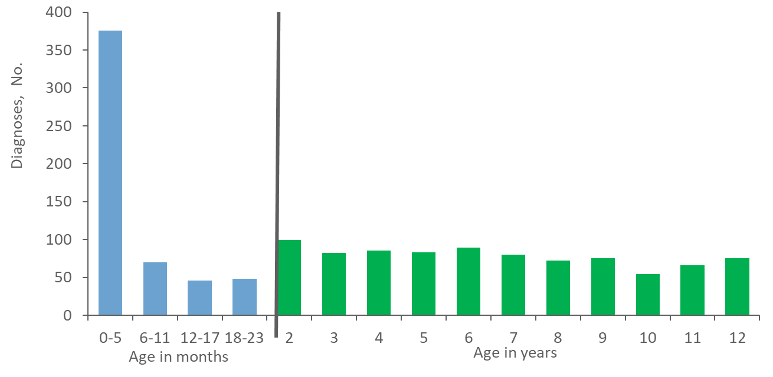
Diagnoses of HIV Infection among Children Aged <13 Years, by Age at Diagnosis, 2010–2017—United States and 6 Dependent Areas N = 1,418
Notes:
This slide presents diagnoses of HIV infection among children less than 13 years of age from 2010 through 2017 in the United States and 6 dependent areas.
During 2010 through 2017 in the United States and 6 dependent areas, there were a total of 1,418 children (aged <13 years) plus 4 cases with missing months of data, who received a diagnosis of HIV infection. Approximately 27% of children (aged <13 years) had their HIV infection diagnosed within the first 6 months of life (i.e., 0-5 months), and an additional 5% during months 6-11.
Please use caution when interpreting trend data for children aged <13 with diagnosed HIV infection: the numbers are small.

Slide 3
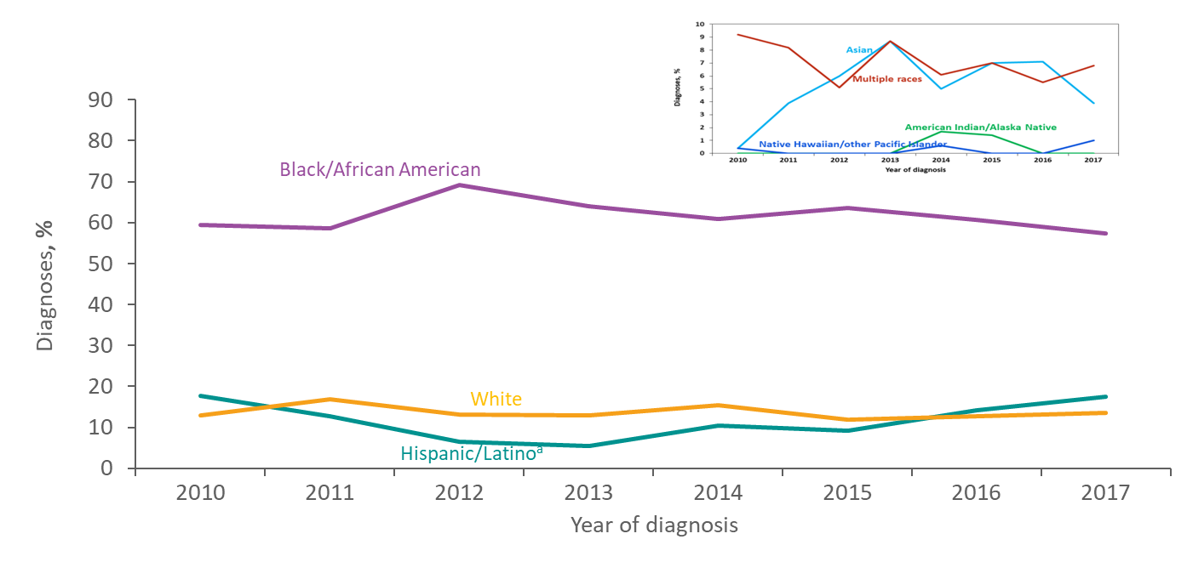
Diagnoses of HIV Infection among Children Aged <13 Years, by Race/Ethnicity, 2010-2017—United States and 6 Dependent Areas N =1,418
ª Hispanics/Latinos can be of any race.
Notes:
This slide presents the distribution of diagnoses of HIV infection among children less than 13 years of age, by race/ethnicity from 2010-2017 in the United States and 6 dependent areas.
HIV disproportionately affects black/African American children in the United States. During 2010 through 2017 in the United States and 6 dependent areas, the percentage of diagnosed HIV infection in black/African American children aged <13 years ranged from 59% to 69%. Over the period from 2010 to 2017, percentages of HIV diagnoses among children remained relatively stable among whites and Hispanic/Latinos.
Hispanics/Latinos can be of any race.
Please use caution when interpreting trend data for children aged <13 years with diagnosed HIV infection: the numbers are small.

Slide 4
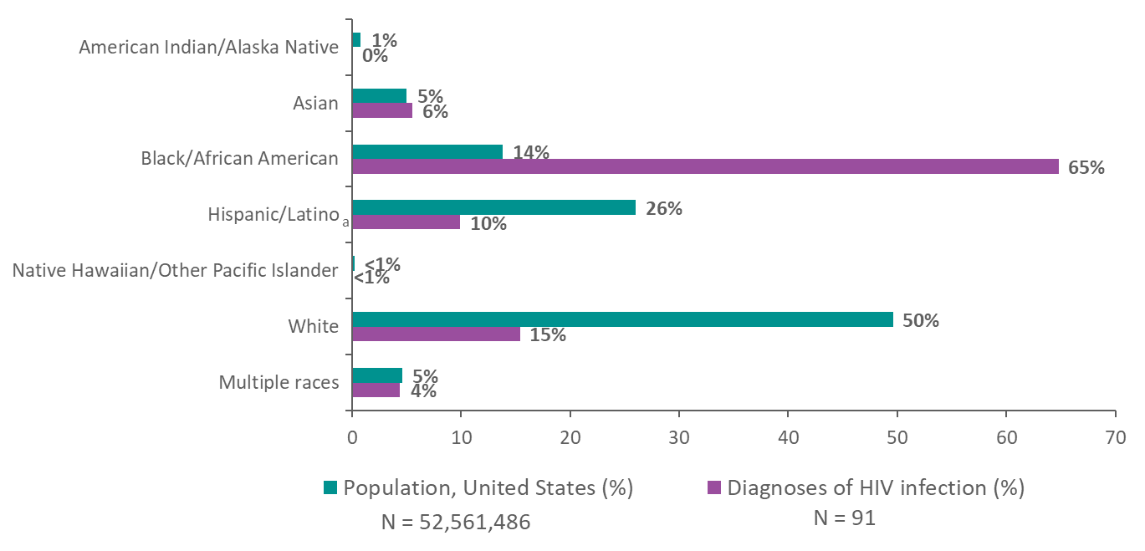
Diagnoses of HIV Infection and Population in Children Aged <13 Years by Race/Ethnicity, 2018—United States
Note. Data for the year 2018 are preliminary and based on 6 months reporting delay.
ª Hispanics/Latinos can be of any race.
Notes:
This slide presents the comparison of the racial/ethnic distribution among children less than 13 years of age with HIV infection diagnosed in 2018 and the general U.S. population.
The lower bar illustrates the distribution of diagnoses of HIV infection in 2018 among children aged <13 years by race/ethnicity in the United States. The upper bar shows the distribution of the population in the United States of children aged <13 years by race/ethnicity in 2018.
In 2018, blacks/African Americans made up approximately 14% of the population of children in the United States but accounted for 65% of diagnoses of HIV infection among children. Hispanics/Latinos made up 26% of the population of children in the United States but accounted for 10% of diagnoses of HIV infection. Whites made up 50% of the population of children but accounted for 15% of diagnoses of HIV infection in children.
Data by race/ethnicity are not provided for the 6 U.S. dependent areas because the U.S. Census Bureau does not collect information from all U.S. dependent areas.
Data for the year 2018 are preliminary and based on 6 months reporting delay.
Hispanics/Latinos can be of any race.

Slide 5
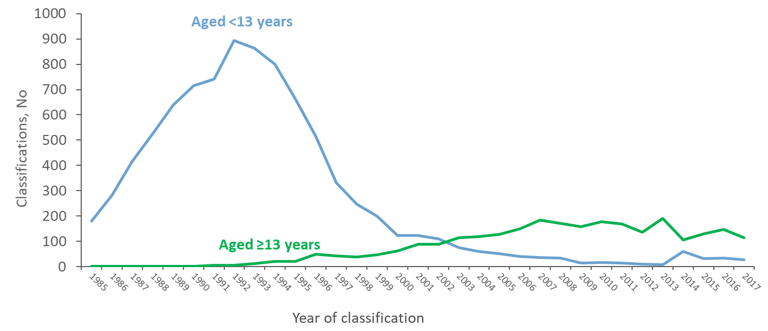
Stage 3 (AIDS) Classifications among Persons with Perinatally Acquired HIV Infection, 1985–2017—United States and 6 Dependent Areas
Notes:
This slide presents trends from 1985 through 2017 in the numbers of stage 3 (AIDS) classifications among persons with perinatally acquired HIV infection in the United States and 6 dependent areas.
The blue line represents the annual numbers of perinatally infected children with HIV infection classified as stage 3 (AIDS) when they were less than 13 years of age; the green line represents the annual numbers of persons with perinatally acquired HIV infection classified as stage 3 (AIDS) at the age of 13 or older.
The blue line shows that the number of persons less than 13 years of age with diagnosed perinatally acquired HIV infection classified as stage 3 (AIDS) has been decreasing since 1992, although in 2014, stage 3 (AIDS) classifications in children less than 13 years increased to 60. The increase in 2014 may be attributed to the revision to the HIV surveillance case definition in 2014. Implementation of CD4-based criteria for stage 3 (AIDS) among children resulted in a large increase in the num­ber of stage 3 (AIDS) classifications among pediatric cases diagnosed during 2014. Before implementation of the 2014 revised case definition, an OI diagnosis was required for a pediatric case to meet the criteria for stage 3 classification.
The green line shows that there have been gradual increases in stage 3 (AIDS) classifications among persons with diagnosed perinatally acquired HIV infection after a person has aged to adolescence or adulthood.
Please use caution when interpreting trend data for children aged <13 years with diagnosed HIV infection: the numbers are small.

Slide 6
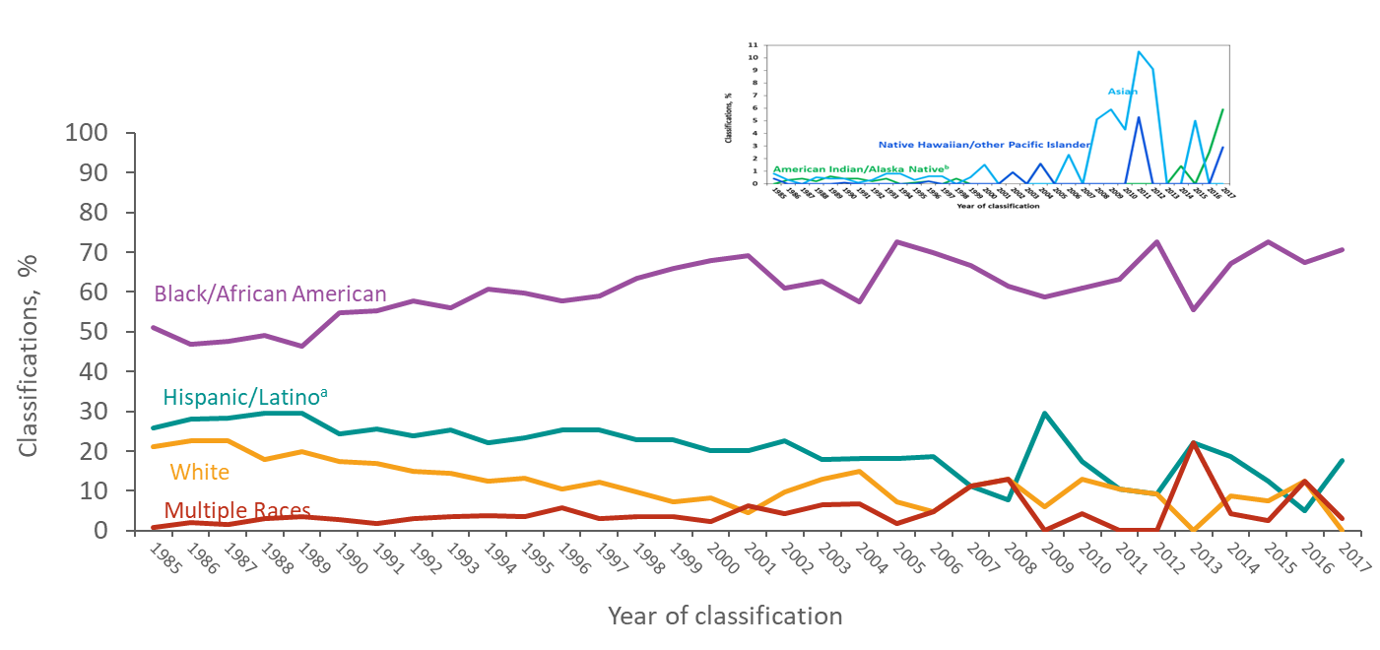
Percentages of Stage 3 (AIDS) Classifications among Children Aged <13 Years with Diagnosed HIV Infection, by Race/Ethnicity and Year of Classification, 1985–2017—United States and 6 Dependent Areas
ª Hispanics/Latinos can be of any race.
Notes:
This slide presents the percentages of stage 3 (AIDS) classifications from 1985 through 2017 among children aged less than 13 years in the United States and 6 dependent areas.
Black/African American children are disproportionately affected by stage 3 (AIDS) compared to children of other races and ethnicities. Although the percentages of stage 3 (AIDS) classifications among children have varied over the years for each race/ethnicity, the percentage of black/African American children with HIV infection classified as stage 3 (AIDS) has been consistently higher than that of any other race/ethnicity.
Implementation of CD4-based criteria for stage 3 (AIDS) among children resulted in a large increase in the num­ber of stage 3 (AIDS) classifications among pediatric cases diagnosed during 2014. Before implementation of the 2014 revised case definition, an OI diagnosis was required for a pediatric case to meet the criteria for stage 3 classification.
Hispanics/Latinos can be of any race.
Please use caution when interpreting trend data for children aged <13 years with diagnosed HIV infection: the numbers are small.

Slide 7
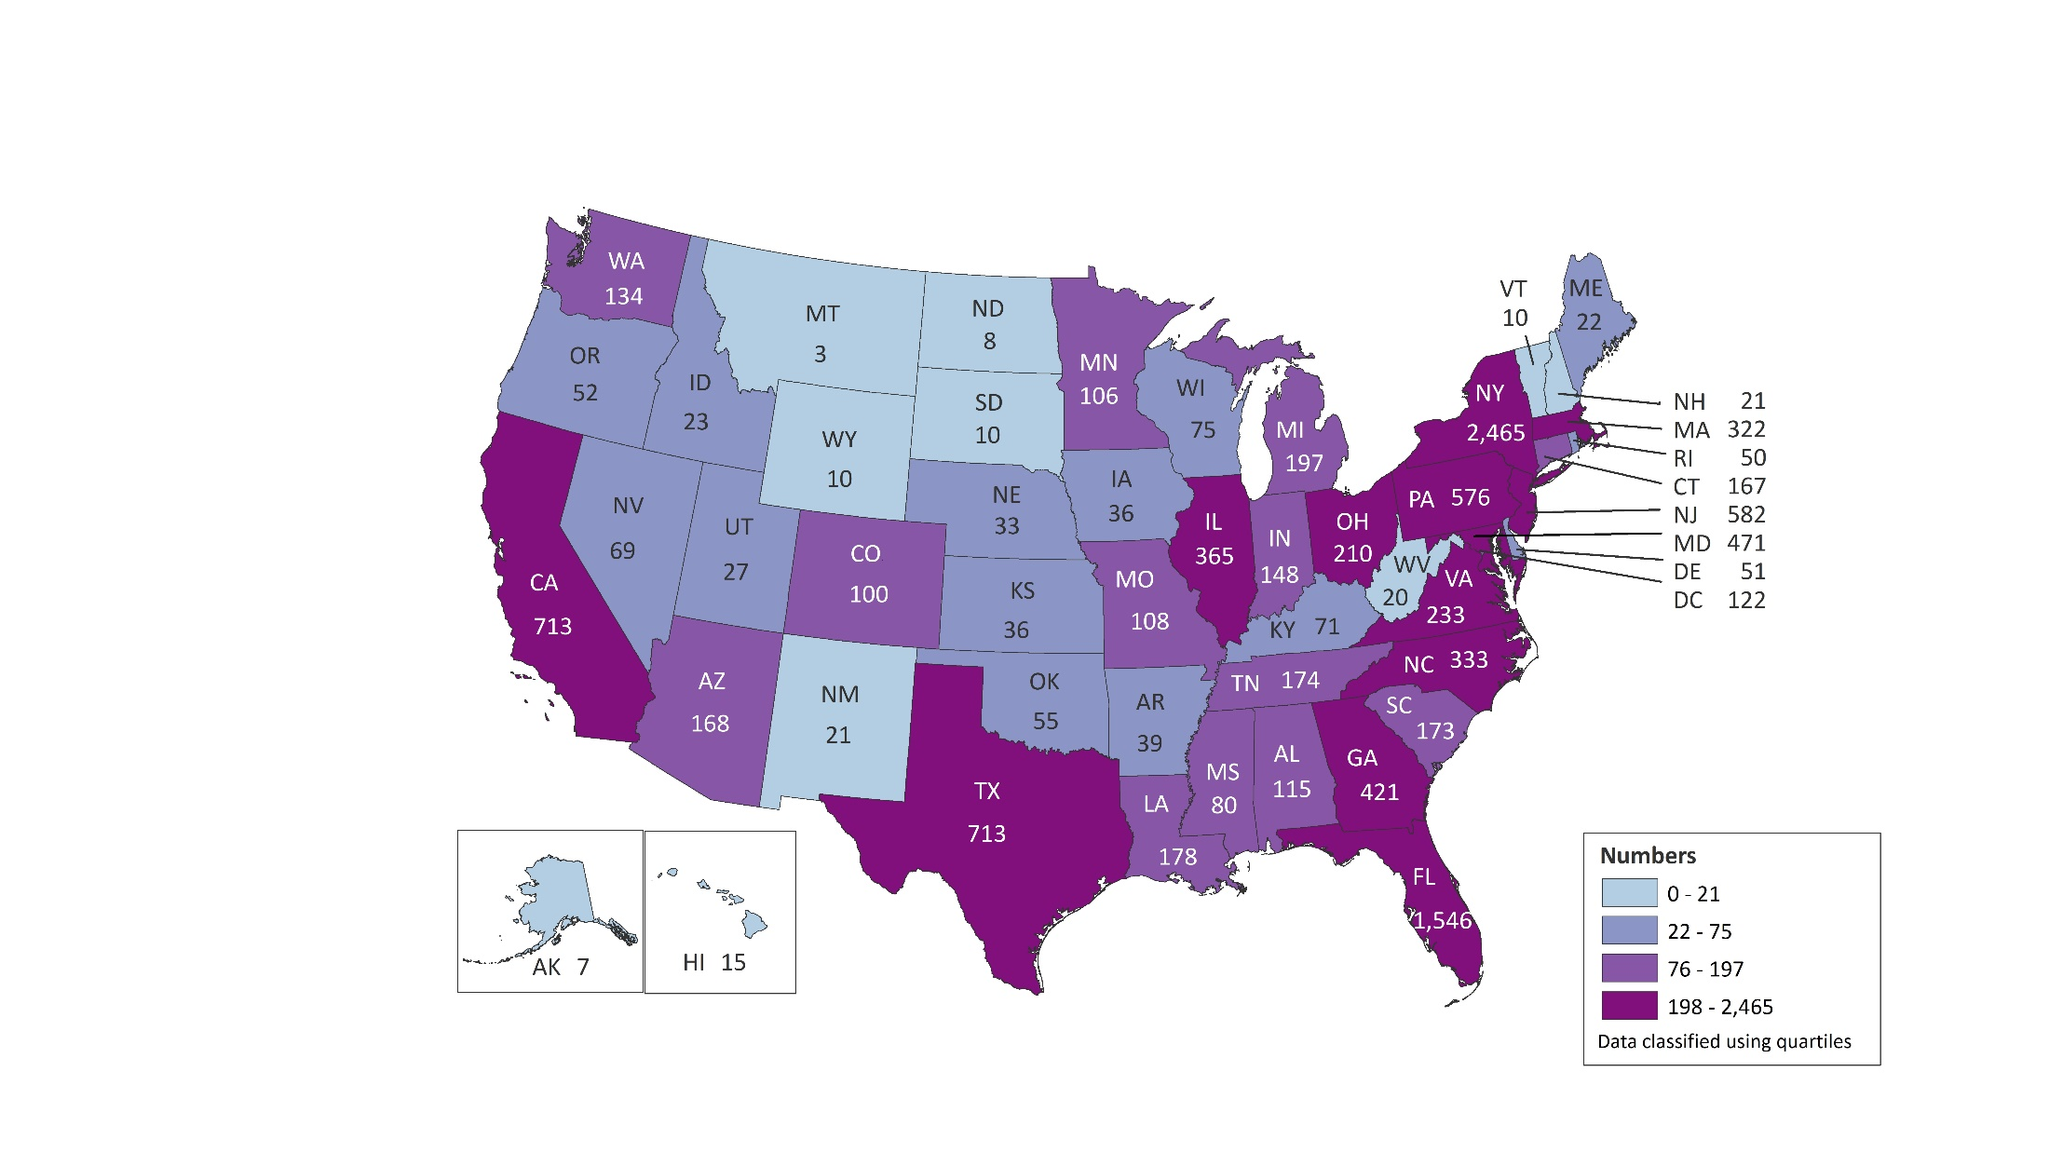
Persons Living with Diagnosed Perinatally Acquired HIV Infection, Year-end 2017—United States and 6 Dependent Areas N = 11,924
American Samoa
Guam
Northern Mariana Islands
Puerto Rico
Republic of Palau
U.S. Virgin Islands
0
2
0
230
0
8
Note. Data are based on address of residence as of December 31, 2017 (i.e., most recent known address).
Notes:
This slide presents the number of persons living with diagnosed perinatally acquired HIV infection at the end of 2017 in the United States and 6 dependent areas.
At the end of 2017, there were 11,924 persons with diagnosed perinatally acquired HIV infection living in the United States and 6 dependent areas. The numbers of persons living with diagnosed perinatally acquired HIV infections ranged from zero in American Samoa, the Northern Mariana Islands, and the Republic of Palau to 2,465 in New York.
The District of Columbia (i.e., Washington, DC) is a city; use caution when comparing persons living with diagnosed HIV infection in DC with the numbers in states.
Data are based on address of residence as of December 31, 2017 (i.e., most recent known address).
Data reflect all persons (i.e., children, adolescents, and adults) with diagnosed perinatally acquired HIV infection who were alive at year-end 2017, regardless of their age at year-end 2017.
.

Slide 8
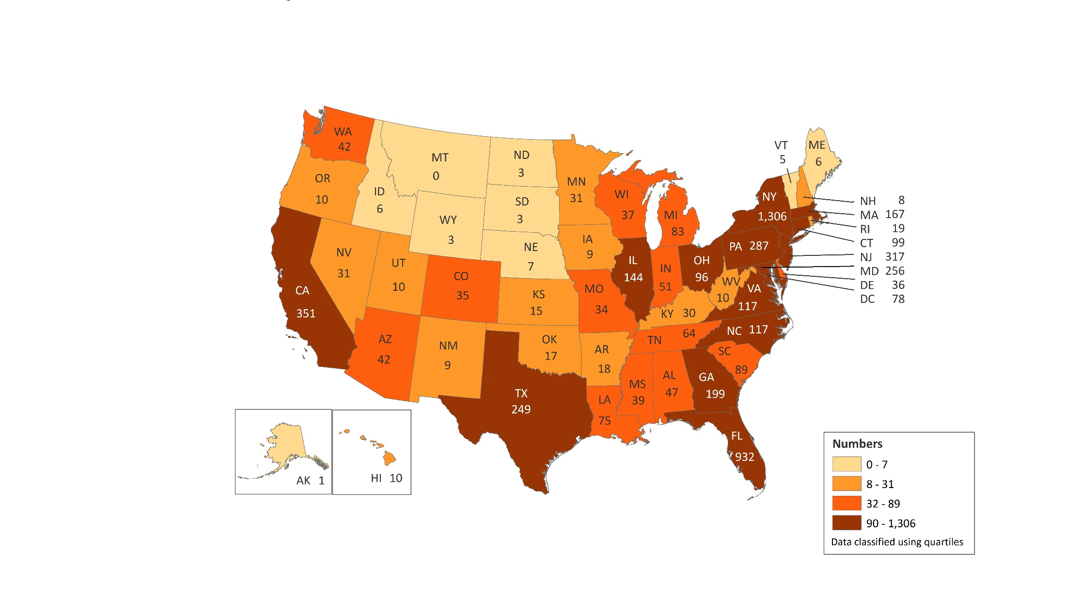
Persons Living with Diagnosed Perinatally Acquired HIV Infection Ever Classified as Stage 3 (AIDS), Year-end 2017—United States and 6 Dependent Areas N = 5,793
American Samoa
Guam
Northern Mariana Islands
Puerto Rico
Republic of Palau
U.S. Virgin Islands
0
1
0
137
0
5
Note. Data are based on address of residence as of December 31, 2017 (i.e., most recent known address).
Notes:
This slide presents the number of persons living with diagnosed perinatally acquired HIV infection ever classified as Stage 3 (AIDS) at year-end 2016 in the United States and 6 dependent areas.
At the end of 2017, there were 5,793 persons living with diagnosed perinatally acquired HIV ever classified as stage 3 (AIDS) in the United States and 6 dependent areas. The numbers of persons living with perinatally acquired HIV infection ever classified as stage 3 (AIDS) ranged from zero in American Samoa, the Northern Mariana Islands, the Republic of Palau, and Montana to 1,306 in New York.
The District of Columbia (i.e., Washington, DC) is a city; use caution when comparing numbers of persons living with diagnosed HIV infection in DC with the numbers in states.
Data are based on address of residence as of December 31, 2017 (i.e., most recent known address).
Data reflect persons (i.e., children, adolescents, and adults) with diagnosed perinatally acquired HIV infection who were alive at year-end 2017, regardless of their age at year-end 2017.

Slide 9
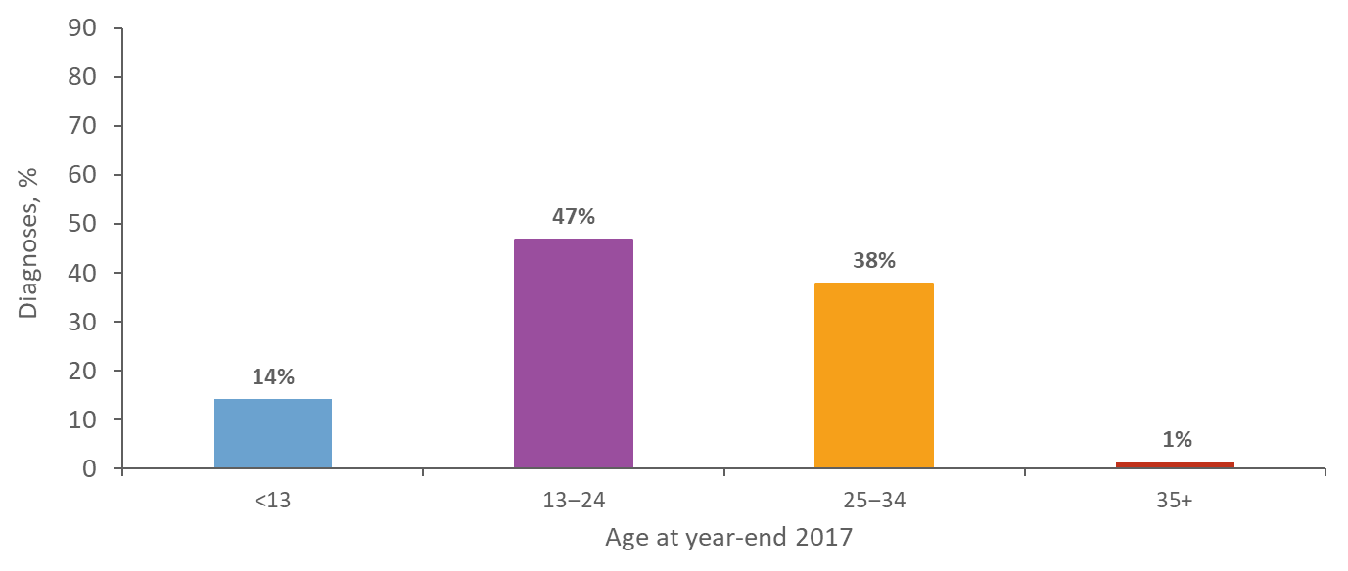
Age Distribution of Persons Living with Diagnosed Perinatally Acquired HIV Infection, Year-end 2017—United States and 6 Dependent Areas N = 11,924
Notes:
This slide presents the age distribution of persons living with diagnosed perinatally acquired HIV infection at the end of 2017 in United States and 6 dependent areas.
At the end of 2017, the majority (47%) of persons living with diagnosed perinatally acquired HIV infection were those aged 13-24 years, followed by 38% who were aged 25-34 years, 14% who were less than 13 years of age, and 1% who were age 35 years and older.

Slide 10
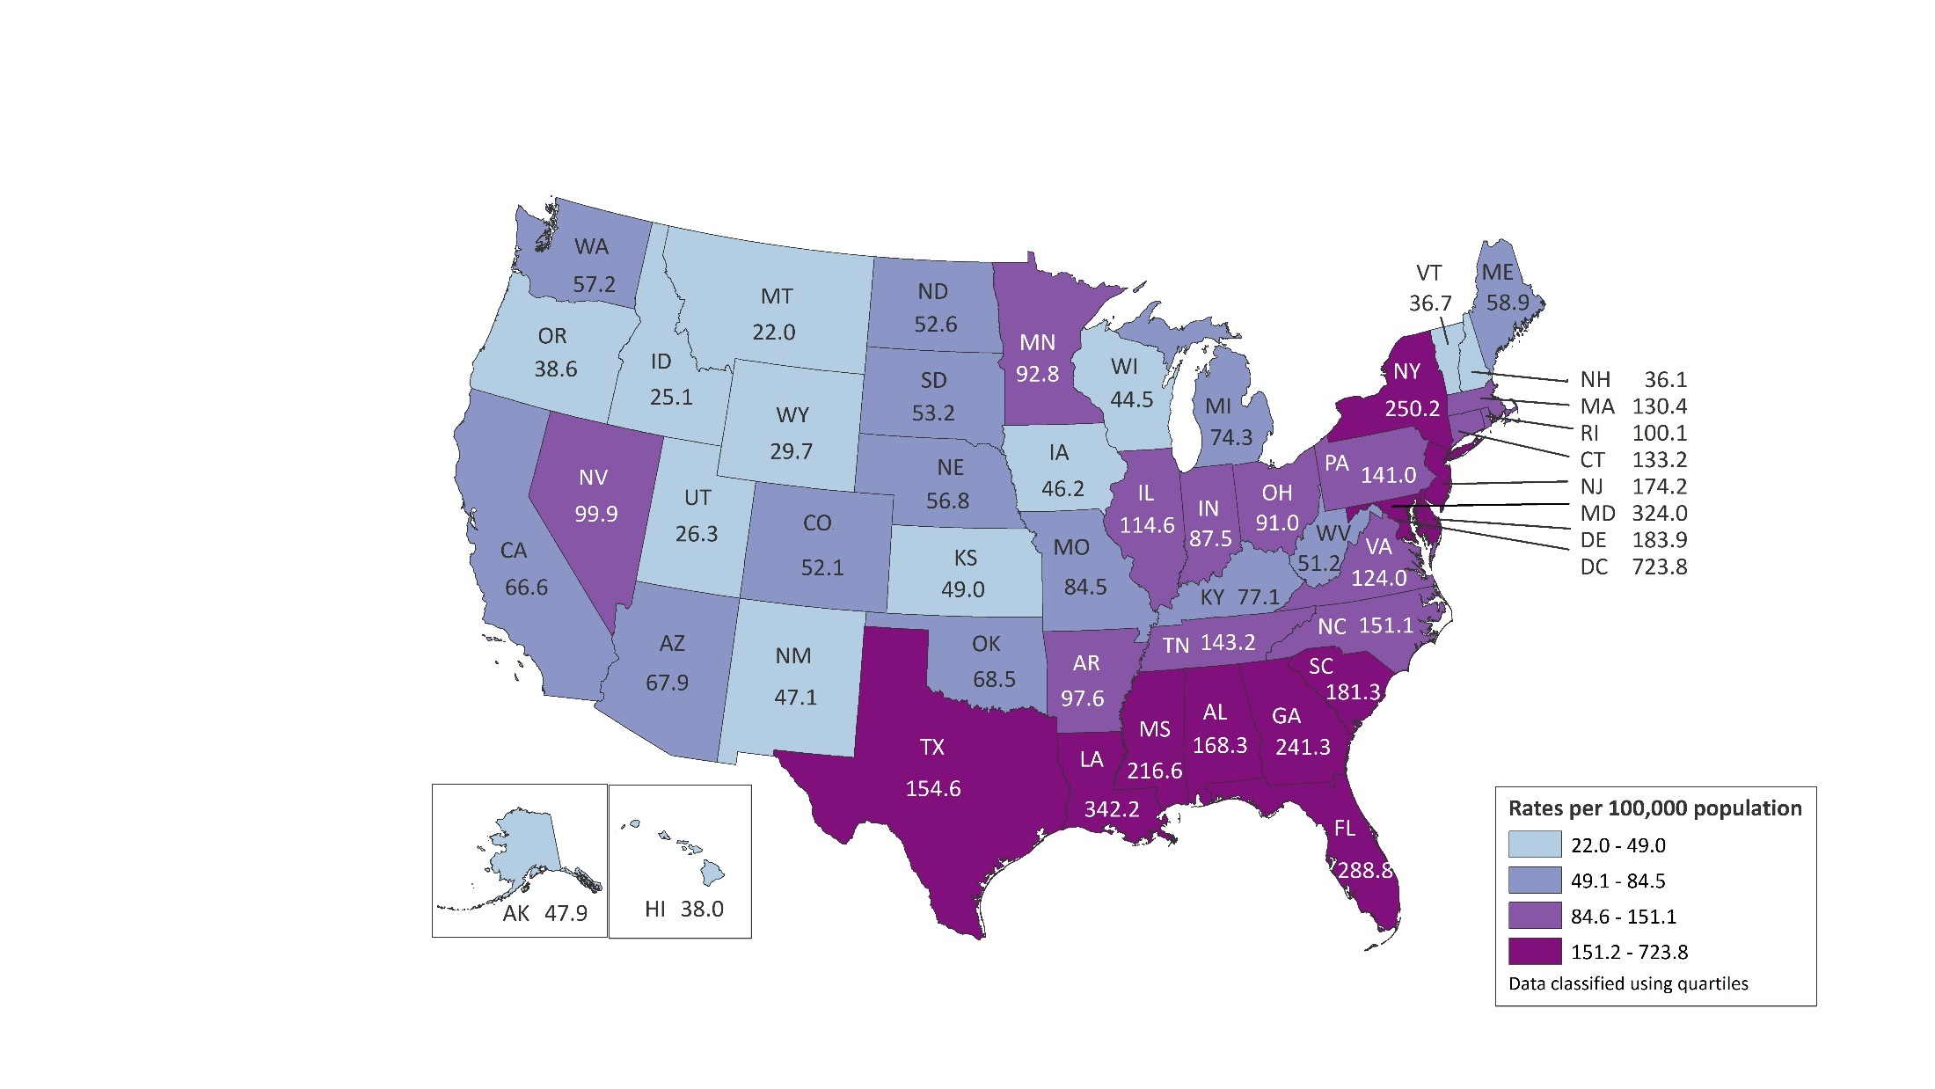
Rates of Females Aged 15−44 Years Living with Diagnosed HIV Infection by Area of Residence, 2017—United States and Puerto Rico N = 88,338 Total Rate: 137.0
Puerto Rico
197.8
Notes:
This slide presents the distribution of females aged 15-44 years living with diagnosed HIV infection during 2017, by area of residence in the United States and Puerto Rico.
In the United States and Puerto Rico, the prevalence of diagnosed HIV infection among females aged 15-44 years was 137.0 per 100,000 population in 2017. The prevalence rates of diagnosed HIV infection among females ranged from 22.0 per 100,000 in Montana to 723.8 per 100,000 in the District of Columbia (i.e., Washington, DC).
The District of Columbia is a city; use caution when comparing the HIV diagnosis rate in DC with the rates in states.

Slide 11
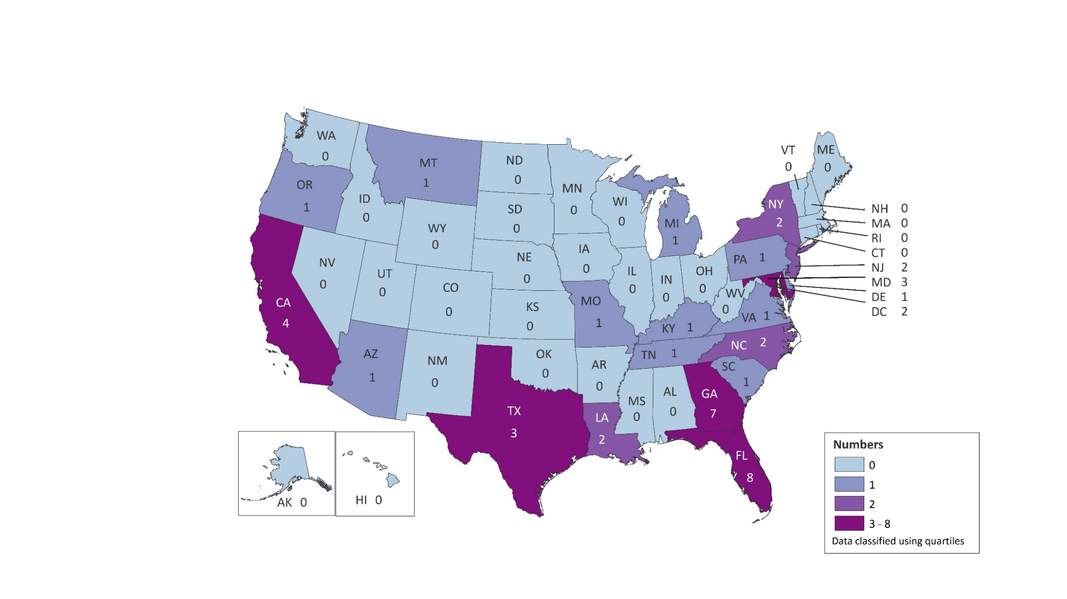
Diagnoses of Perinatally Acquired HIV Infection among Children Born During 2016, by Area of Residence—United States and Puerto Rico N = 46
Puerto Rico
0
Notes:
This slide presents diagnoses of perinatally acquired HIV infection among children born during 2016, by area of residence in the United States and Puerto Rico.
A total of 46 children born during 2016 had diagnosed HIV infection that was attributed to perinatal transmission in the United States and Puerto Rico.
Florida and Georgia reported the largest numbers of diagnosed HIV infections attributed to perinatal transmission in infants born in 2016. Thirty-one areas (31 areas) reported no perinatally acquired infections among infants born in 2016.
The District of Columbia (i.e., Washington, DC) is a city; use caution when comparing numbers of HIV diagnoses in DC with the numbers in states.
Because of delays in the reporting of births and diagnoses of HIV infection attributed to perinatal exposure, the exclusion of data for the most recent 2 years allowed ≥30 months for data to be reported to CDC.
Data reflect all infants with diagnosed perinatally acquired HIV infection who were born in the United States and 6 dependent areas during 2016, regardless of year of diagnosis.

Slide 12
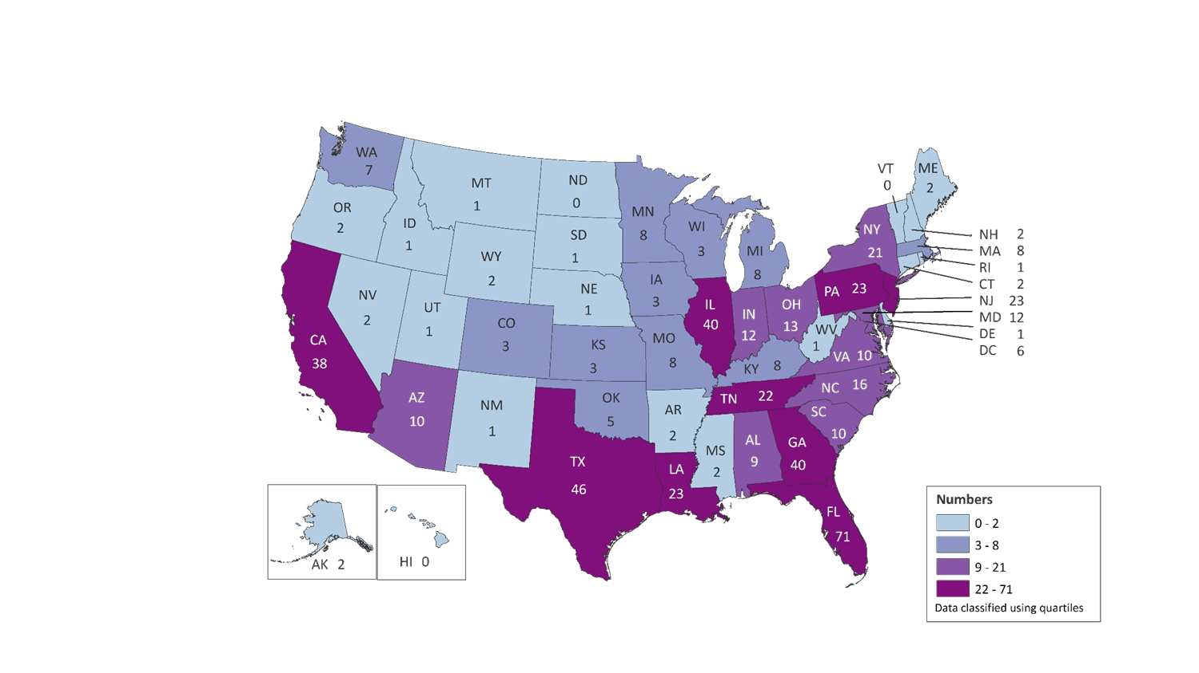
Diagnoses of Perinatally Acquired HIV Infection among Children, Birth Years 2010–2016, by Area of Residence—United States and Puerto Rico N = 538
Puerto Rico
2
Note. Data for children residing in, but born outside of, the United States and Puerto Rico are included.
Notes:
This slide presents diagnoses of perinatally acquired HIV infection among children born between 2010 and 2016, by area of residence in the United States and Puerto Rico.
A total of 538 children born during 2010-2016 had perinatally acquired HIV infection in the United States and Puerto Rico. Florida (71), Texas (46), Illinois (40), Georgia (40), and California (38) reported the largest numbers of infants with perinatally acquired infection who were born during 2010-2016. Hawaii, North Dakota, and Vermont reported no perinatally acquired HIV infections.
The District of Columbia (i.e., Washington, DC) is a city; use caution when comparing numbers of HIV diagnoses in DC with the numbers in states.
Because of delays in the reporting of births and diagnoses of HIV infection attributed to perinatal exposure, the exclusion of data for the most recent 2 years allowed ≥30 months for data to be reported to CDC.
Data reflect all infants with perinatally acquired HIV infection diagnosed in the United States and Puerto Rico. Data for children residing in, but born outside of, the United States and Puerto Rico are included.

Slide 13
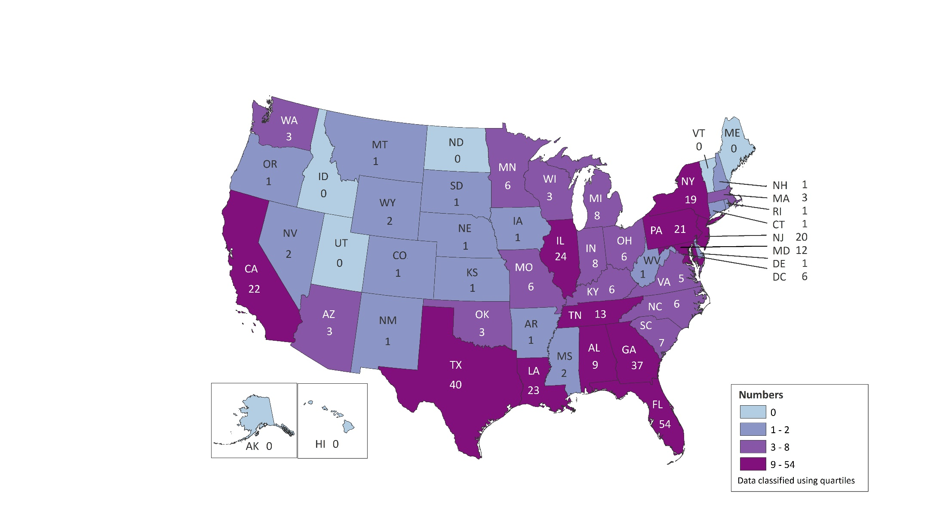
Diagnoses of Perinatally Acquired HIV Infection among Children Born in the United States and Puerto Rico, Birth Years 2010–2016, by Area of Residence N = 407
Puerto Rico
1
Notes:
This slide presents the diagnoses of perinatally acquired HIV infection among children born between 2010 and 2016, by area of residence in the United States and Puerto Rico.
A total of 407 children born in the United States and Puerto Rico during 2010-2016 had perinatally acquired HIV infection. Florida (54), Texas (40), and Georgia (37) reported the largest numbers of infants with diagnosed perinatally acquired HIV infection who were born during 2010-2016. Alaska, Hawaii, Idaho, Maine, North Dakota, Utah, and Vermont reported no diagnoses of perinatally acquired HIV infection.
The District of Columbia (i.e., Washington, DC) is a city; use caution when comparing numbers of HIV diagnoses in DC with the numbers in states.
Because of delays in the reporting of births and diagnoses of HIV infection attributed to perinatal exposure, the exclusion of data for the most recent 2 years allowed ≥30 months for data to be reported to CDC.
Data reflect all infants with diagnosed perinatally acquired HIV infection who were born in the United States and Puerto Rico during 2010-2016, regardless of year of diagnosis.

Slide 14
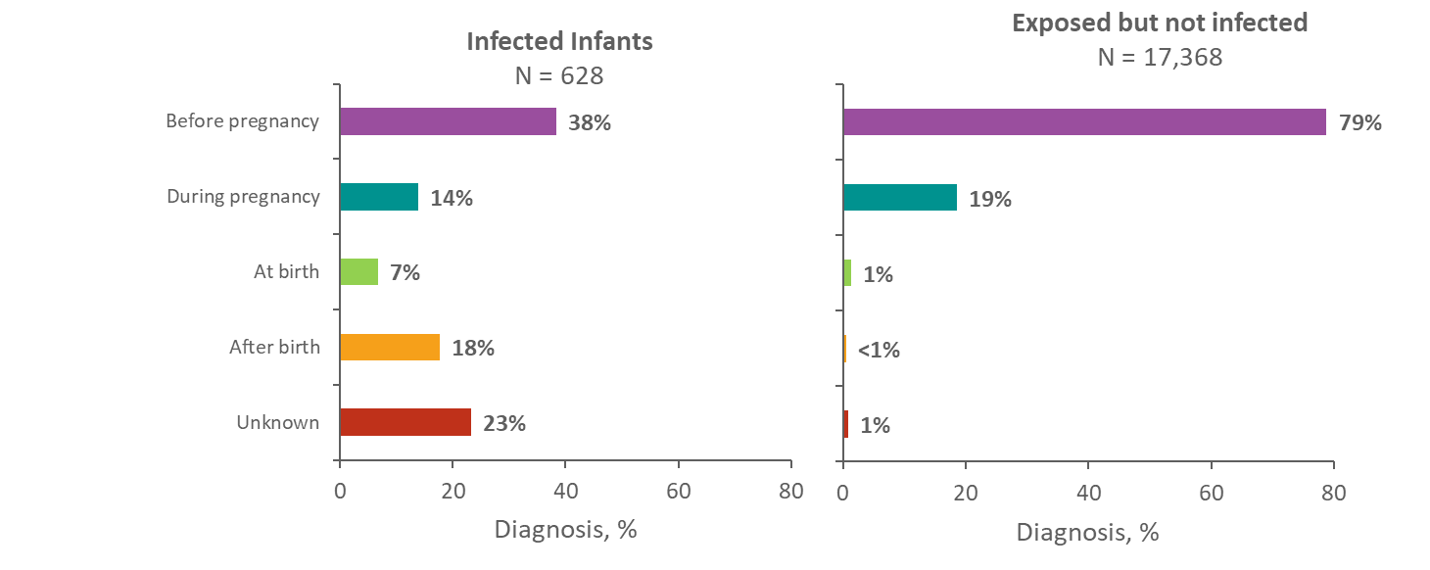
Time of Maternal HIV Testing among Children with Diagnosed Perinatally Acquired HIV Infection and Children Exposed to HIV, Birth Years 2010–2016—United States and Puerto Rico
Notes:
This slide presents the time of maternal HIV testing among children with diagnosed perinatally acquired HIV infection and children exposed to HIV born during 2010 through 2016 in the United States and Puerto Rico.
It is important for pregnant women with HIV to know their HIV infection status in order to make informed decisions about antiretroviral therapy to reduce perinatal transmission of HIV to their infants. In 1995, the first recommendations for HIV counseling and voluntary testing for pregnant women were published. In 2006, CDC released revised recommendations for HIV testing which specified that opt-out HIV screening should be included in the routine panel of prenatal screening tests for all pregnant women.
Among the 628 children born during 2010-2016 in the United States and Puerto Rico with diagnosed perinatally acquired HIV, 38% were born to mothers who were tested before pregnancy, 14% were born to mothers who were tested during pregnancy, and 7% to mothers tested at the time of birth. An additional 18% of children with diagnosed perinatally acquired HIV infection were born to mothers who were tested after the child’s birth, and 23% were born to mothers whose time of maternal HIV testing was unknown.
Among the 17,368 children born during 2010-2016 in the United States and Puerto Rico who were exposed but not perinatally infected with HIV, the majority (79%) of children were born to mothers who were tested before pregnancy, while 19% were born to mothers who were tested during pregnancy, 1% to mothers tested at the time of birth, less than 1% to mothers tested after birth, and 1% were born to mothers whose time of maternal HIV testing was unknown.
The number of areas contributing exposure data varied by year. Because not all jurisdictions have exposure reporting in place, the number presented likely underestimates the number of exposed infants in the United States and Puerto Rico. Because of delays in the reporting of births and diagnoses of HIV infection attributed to perinatal exposure, the exclusion of data for the most recent 2 years allowed ≥30 months for data to be reported to CDC.

