Slide 1
HIV Mortality 2020
Division of HIV Prevention
Notes:
This slide set presents data on HIV-related mortality through 2020.

Slide 2
HIV Mortality Slides
An analysis of trends in rates and distributions of deaths in the United States, focusing on deaths with human immunodeficiency virus (HIV) disease as the underlying cause and deaths among persons with diagnosed HIV infection ever classified as stage 3 (acquired immunodeficiency syndrome, [AIDS]).
Data were compiled from death certificates from all 50 states and the District of Columbia by the CDC’s National Center for Health Statistics (NCHS) for the years 1987−2020 and downloaded from the CDC WONDER Online Database https://wonder.cdc.gov/.
For more information, see the NCHS Web site: http://www.cdc.gov/nchs/deaths.htm
Notes:
The slides in this series are based on data compiled by the National Center for Health Statistics (NCHS) from death certificates of US residents in the 50 states and the District of Columbia for the years 1987-2020 and downloaded from the CDC WONDER Online Database https://wonder.cdc.gov/ . The underlying cause of each death is selected from the conditions reported by physicians, medical examiners, and coroners in the cause-of-death section of the death certificate. When more than one condition is reported, the underlying cause is determined by using a set of standardized rules promulgated as part of the International Classification of Diseases (ICD). Changes in these rules often accompany a revision of the ICD. Beginning with 1999 deaths, the 10th revision of the ICD (ICD-10) changed the rules for selecting the underlying cause of death in the United States. For these slides, to make the data for the years before 1999 comparable with the data for later years, a simplified version of ICD-10 rules was used to modify the cause-specific numbers of deaths that occurred before 1999, which had been initially determined by ICD-9 rules. Additional information on the nature and sources of death-certificate data on causes of death may be found at the NCHS website. These data from NCHS are the sole source of information on all causes of death in the national population, allowing comparison of deaths due to HIV disease and deaths due to other causes.
Data re-release agreements between CDC and state/local HIV surveillance programs require certain levels of cell suppression at the state and county level to ensure confidentiality of personally identifiable information. For details on reporting of sex and race/ethnicity, please see NCHS’s Funeral Director’s Handbook on Death Registration and Fetal Death Reporting (https://www.cdc.gov/nchs/data/nvss/handbook/2019-Funeral-Directors-Handbook-508.pdf).

Slide 3
HIV Mortality Slides
Deaths due to HIV disease
are not exactly the same as
deaths of persons with diagnosed HIV infection ever classified as stage 3 (AIDS)
Due to HIV disease
Stage 3 (AIDS)
Notes:
Deaths with HIV disease as the underlying cause, as reported on death certificates, are not exactly the same as deaths of persons with diagnosed HIV infection ever classified as stage 3 (AIDS) reported to the HIV surveillance systems of health departments. The crescent shape on the right includes the deaths of persons with diagnosed HIV infection ever classified as stage 3 (AIDS). These deaths can be attributed to causes unrelated to HIV infection (such as lung cancer or motor vehicle accidents). Because of improved treatment, survival after a stage 3 (AIDS) classification has become longer, allowing a greater percentage of deaths of persons with diagnosed HIV infection ever classified as stage 3 (AIDS) to result from other causes.
The crescent shape on the left represents deaths attributed to HIV disease as the underlying cause for persons whose conditions did not meet the surveillance case definition for stage 3 (AIDS). The stage 3 (AIDS) case definition requires either documentation of a low CD4 T-lymphocyte count or diagnosis of one of the approximately two dozen AIDS-defining illnesses. (The exact number of possible AIDS-defining illnesses depends on how they are split or grouped together). If surveillance data on the CD4 count are missing and no AIDS-defining illness was diagnosed, these persons cannot be counted among those with stage 3 (AIDS) even though their deaths were attributed to HIV disease on their death certificates.

Slide 4
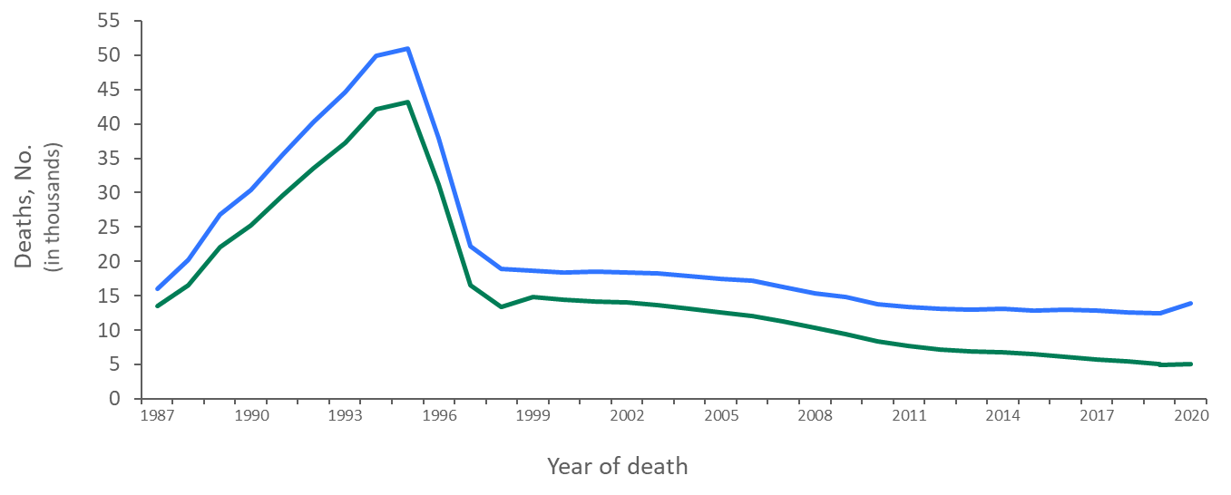
Comparison of Deaths among Persons with HIV Infection Ever Classified as Stage 3 (AIDS) in National HIV Surveillance System and Deaths Reported in Death Certificates in which HIV Disease was the Underlying Cause of Death, 1987−2020—United States
Infection ever classified as stage 3 (AIDS)
Due to HIV (ICD-10)*
Note. For comparison with data for 1999 and later years, data for 1987−1998 were modified to account for ICD-10 rules instead of ICD-9 rules.
Notes:
The annual number of deaths of persons with HIV infection ever classified as stage 3 (AIDS) (some of which were not caused by HIV disease), as reported to the National HIV Surveillance System through December 31, 2021, ranged from being 15% to 63% (depending on the year) greater than the number of deaths attributed to HIV disease in death certificate data (by ICD-10 rules for selecting the underlying cause of death).
In 2020, there were 13,877 deaths (all causes, including COVID-19) among persons with HIV infection ever classified as stage 3 (AIDS). The cumulative number (1987‒2020) of deaths (all causes) among persons with HIV infection ever classified as stage 3 (AIDS) was 729,118. In 2020, there were 5,115 deaths that were attributed to HIV infection. The cumulative number (1987‒2020) of deaths attributable to HIV was 534,793.
The blue line represents data from the National HIV Surveillance System.
The green line represents data from death certificate data compiled by the National Center for Health Statistics and downloaded from the CDC WONDER Online Database https://wonder.cdc.gov/.

Slide 5
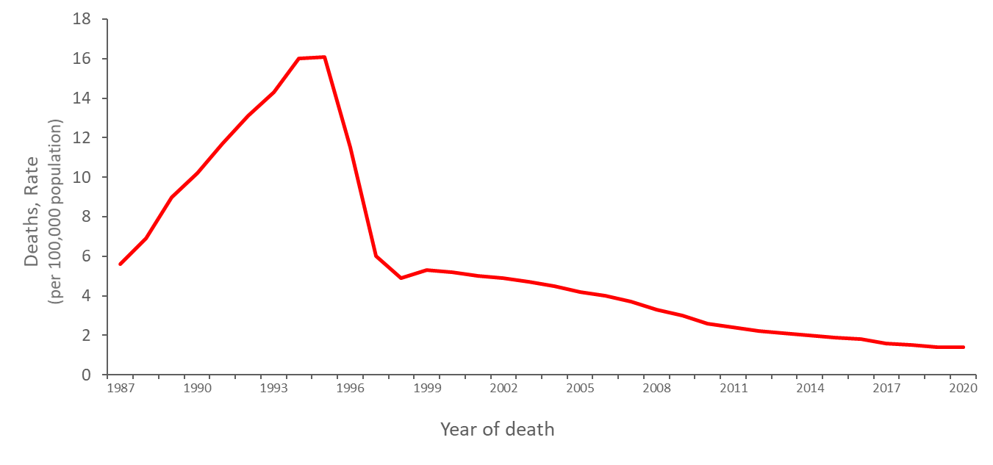
Trends in Annual Age-Adjusted* Rates of Death with HIV Disease as the Underlying Cause, 1987−2020—United States
Note. For comparison with data for 1999 and later years, data for 1987−1998 were modified to account for ICD-10 rules instead of ICD-9 rules.
*Standard: age distribution of 2000 US population.
Notes:
The age-adjusted rate of death with HIV disease as the underlying cause increased almost linearly from 6 deaths per 100,000 population in 1987 to 16 deaths per 100,000 population in 1994 and 1995, then decreased to 6 deaths per 100,000 population in 1997. Thereafter, the rate almost leveled off at about 5 deaths per 100,000 population up to 2003, after which it decreased slowly through 2020. The age-adjusted HIV death rate decreased 29% from 1995 to 1996, 48% from 1996 to 1997, and 18% from 1997 to 1998. After 1998, the annual percentage decrease ranged from 2% to 13%.
The decrease in the rate in 1996 and 1997 was largely due to improvements in antiretroviral therapy. Prophylactic medications for opportunistic infections and the prevention of HIV infection may also have contributed to this decrease. The slowing of the rate of decrease after 1998 may reflect a lack of access to or effectiveness of therapy among some persons. Possible reasons for this include delay in diagnosis of HIV infection until symptoms have occurred, inadequate treatment after diagnosis, difficulty in adherence to medication regimens, and development of viral resistance to therapy. Other barriers to effective therapy include failure to be linked to care or continuously engaged in care after diagnosis.
To eliminate the effect of changes in the age distribution of the population, rates have been adjusted to appear as though the age distribution of the population in every year was the same as that of the US population in 2000 (the Public Health Service standard for age-adjustment). For comparison with data for 1999 and later, data for the years before 1999 were modified to appear as if the underlying cause had been selected according to ICD-10 rules instead of ICD-9 rules.
The data for this slide come from death certificate data compiled by the National Center for Health Statistics and downloaded from the CDC WONDER Online Database https://wonder.cdc.gov/.

Slide 6
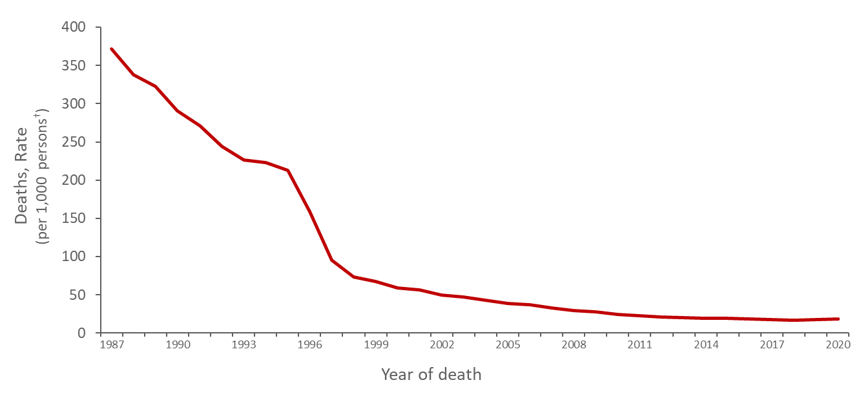
Trends in Annual Age-Adjusted* Rates† of Death among Persons with Diagnosed HIV Infection Ever Classified as Stage 3 (AIDS), 1987−2020—United States
*Standard: age distribution of 2000 US population.
†Per 1,000 persons with diagnosed HIV infection ever classified as stage 3 (AIDS).
Notes:
This slide on deaths among persons with diagnosed HIV infection ever classified as stage 3 (AIDS) (some of which were not caused by HIV disease) uses data as reported to the National HIV Surveillance System through December 31, 2021. The age-adjusted rate of death among persons with infection ever classified as stage 3 (AIDS) decreased from 372 deaths per 1,000 persons with infection ever classified as stage 3 (AIDS) in 1987 to 213 deaths per 1,000 persons with infection ever classified as stage 3 (AIDS) in 1995. The rate then decreased sharply to 96 per 1,000 in 1997, after which it decreased slowly through 2019 to 17 deaths per 1,000. There was a slight increase in the rate of death among person with HIV infection ever classified as stage 3 (AIDS) in 2020, at 19 deaths per 1,000. This increase may be attributed to deaths with an underlying cause of COVID-19.
The decrease in the rate of death among persons with diagnosed HIV infection ever classified as stage 3 (AIDS) during 1987—1995 was due partly to antiretroviral therapy less potent than highly active antiretroviral therapy (HAART), which was introduced in 1996 (e.g., monotherapy with zidovudine, or combination therapy with two nucleoside reverse transcriptase inhibitors [NRTIs] but no protease inhibitor). The rapid decrease in the death rate in 1996 and 1997 was largely due to the use of HAART.
To control for changes in the age distribution of the population, the death rates were age-standardized to the US Census population in 2000.
The data for this slide come from the National HIV Surveillance System.

Slide 7
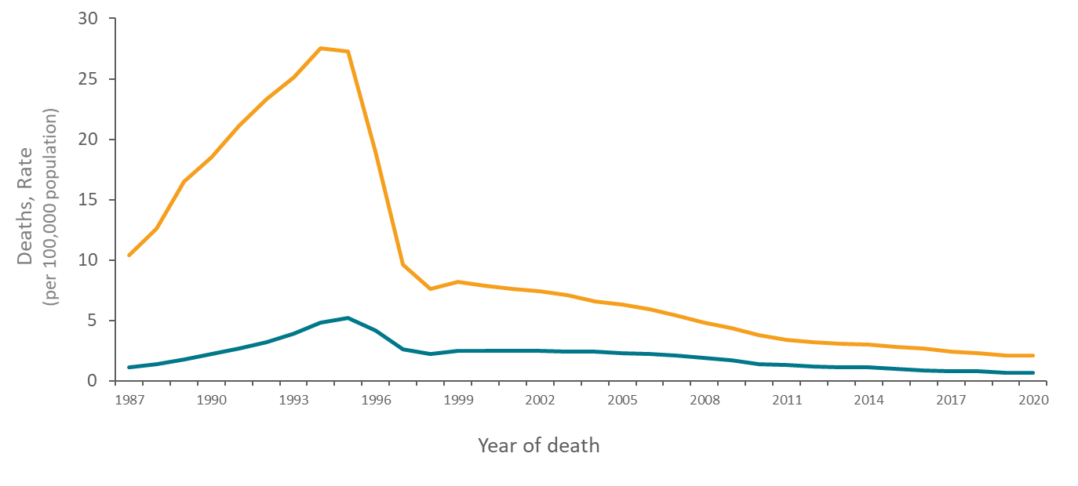
Trends in Annual Age-Adjusted* Rates of Death with HIV Disease as the Underlying Cause, by Sex, 1987−2020—United States
Males
Females
Note. For comparison with data for 1999 and later years, data for 1987−1998 were modified to account for ICD-10 rules instead of ICD-9 rules.
*Standard: age distribution of 2000 US population.
Notes:
In the United States, the rate of death with HIV disease as the underlying cause among males has always been several times the rate among females, but the ratio of these rates has decreased from approximately 10-to-1 in 1987 to 3-to-1 in 1998 and later years.
For both sexes, the rates of death with HIV disease as the underlying cause were highest in 1994 and 1995. After 1997, the average death rate among females has been about 2.0 deaths per 100,000 population. The rate among males continued to decrease slowly every year: from 1998 through 2020, the average annual percentage decrease was about 6%.
The data for this slide come from death certificate data compiled by the National Center for Health Statistics and downloaded from the CDC WONDER Online Database https://wonder.cdc.gov/.
For details on reporting of sex and race/ethnicity, please see NCHS’s Funeral Director’s Handbook on Death Registration and Fetal Death Reporting (https://www.cdc.gov/nchs/data/nvss/handbook/2019-Funeral-Directors-Handbook-508.pdf).

Slide 8
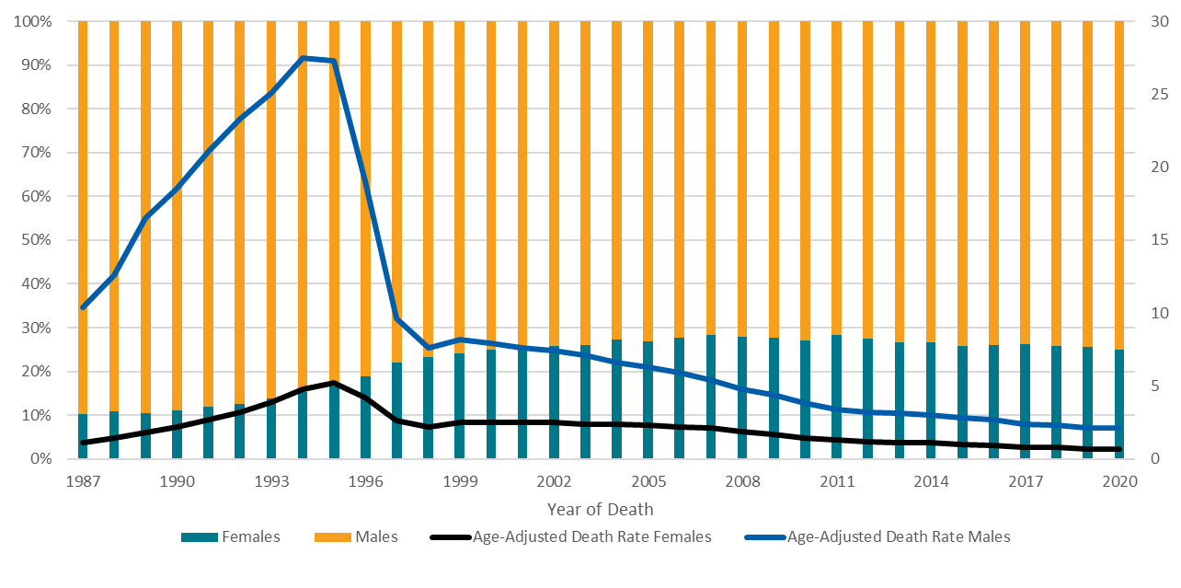
Trends in Annual Age-Adjusted* Rates of Death and the Percentage Distribution of Deaths with HIV Disease as the Underlying Cause, by Sex, 1987–2020—United States
Deaths, Rate
(per 100,000 population)
Deaths, Percentage
Note. For comparison with data for 1999 and later years, data for 1987−1998 were modified to account for ICD-10 rules instead of ICD-9 rules.
*Standard: age distribution of 2000 US population.
Notes:
Another way to look at sex differences in HIV-related mortality trends is to examine the annual percentage distribution of deaths by sex. From 1987 through 2020, the percentage of females among persons who died of HIV disease increased from 10% to 25%.
The data for this slide come from death certificate data compiled by the National Center for Health Statistics and downloaded from the CDC WONDER Online Database https://wonder.cdc.gov/.
For details on reporting of sex and race/ethnicity, please see NCHS’s Funeral Director’s Handbook on Death Registration and Fetal Death Reporting (https://www.cdc.gov/nchs/data/nvss/handbook/2019-Funeral-Directors-Handbook-508.pdf).

Slide 9
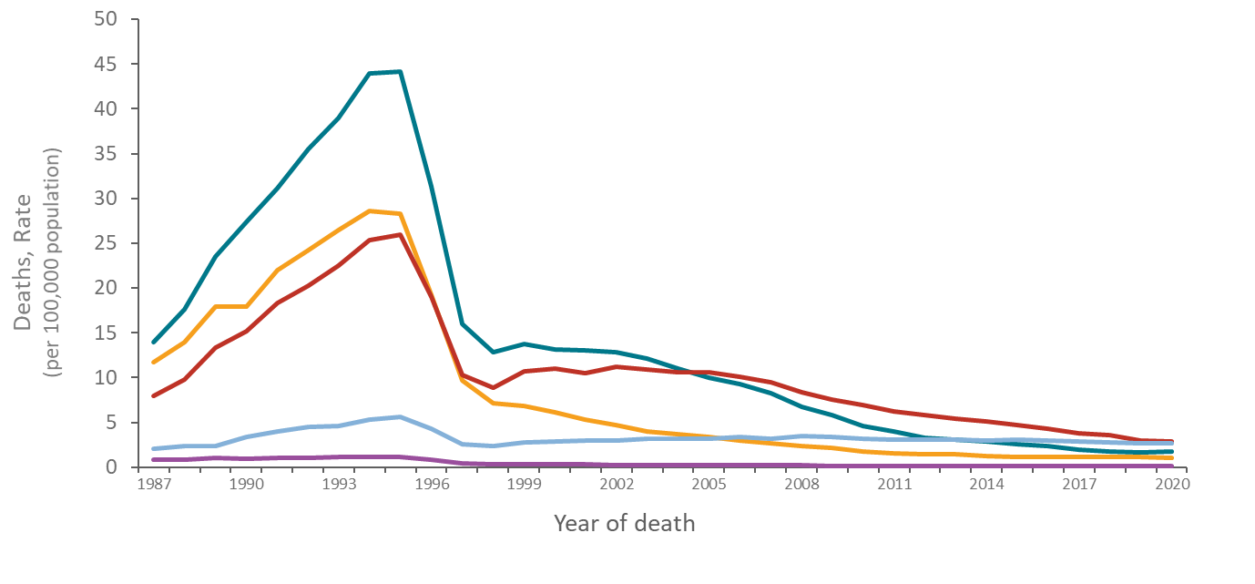
Trends in Annual Rates of Death with HIV Disease as the Underlying Cause, by Age Group, 1987–2020—United States
35–44 years
25–34 years
45–54 years
≥55 years
≤24 years
Note. For comparison with data for 1999 and later years, data for 1987−1998 were modified to account for ICD-10 rules instead of ICD-9 rules.
Notes:
Trends in the rate of death with HIV disease as the underlying cause have varied by age group. From 1995 through 1997, the rate of death dropped most rapidly among persons aged 25–34 and 35–44 years. After 1997, the rate of death continued to decline in these age groups and among persons aged 45-54 years but was nearly level in other age groups.
The data for this slide come from death certificate data compiled by the National Center for Health Statistics and downloaded from the CDC WONDER Online Database https://wonder.cdc.gov/.

Slide 10
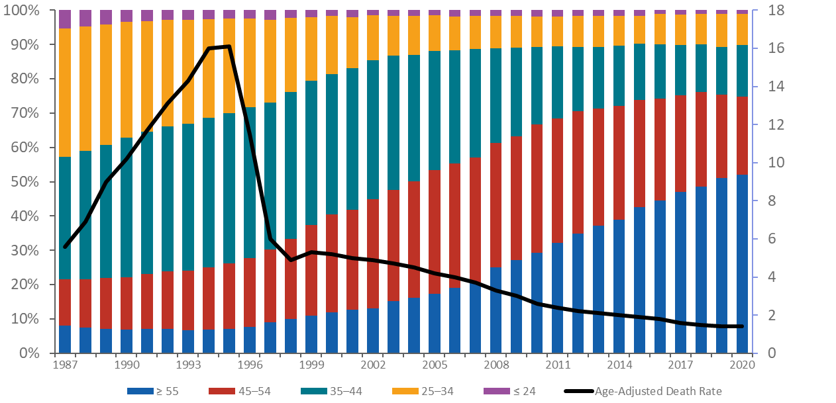
Trends in Annual Age-Adjusted* Rates of Death and the Percentage Distribution of Deaths with HIV Disease as the Underlying Cause, by Age Group, 1987−2020—United States
Deaths, Rate
(per 100,000)
Deaths, Percentage
Note. For comparison with data for 1999 and later years, data for 1987−1998 were modified to account for ICD-10 rules instead of ICD-9 rules.
*Standard: age distribution of 2000 US population.
Year of death
Notes:
From 1987 through 2020, the percentage of deaths with HIV disease as the underlying cause among persons younger than 35 years of age (represented by the top two components of the bars in the graph) decreased from 43% to 10%, while the percentage of deaths among older persons, particularly those 45 years or older (represented by the bottom two components of the bars), increased from 22% to 75%. One reason for these changes may be the longer survival of persons with HIV, allowing death to be postponed to older ages. An increase in the percentage of older age groups in the general population could also have affected these trends. Chronic diseases associated with advancing age might contribute to the risk or severity of complications of HIV disease.
From 1987 through 1993, 73% to 74% of deaths with HIV disease as the underlying cause were among persons 25 to 44 years of age (represented by the orange and teal components of the bars). After 1993, the percentage of deaths at 25 to 44 years of age began to decrease, reaching 24% by 2020.
The data for this slide come from death certificate data compiled by the National Center for Health Statistics and downloaded from the CDC WONDER Online Database https://wonder.cdc.gov/.

Slide 11
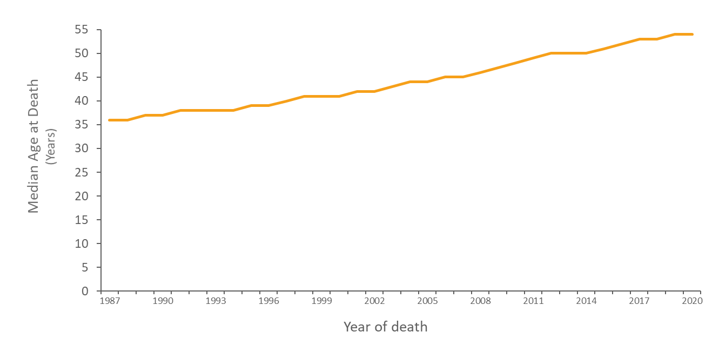
Median Age at Death with HIV Disease as the Underlying Cause 1987−2020—United States
Note. For comparison with data for 1999 and later years, data for 1987−1998 were modified to account for ICD-10 rules instead of ICD-9 rules.
Notes:
The median age at deaths with HIV disease as the underlying cause increased almost linearly from 36 years in 1987 to 54 years in 2020. This reflects the postponement to older ages of deaths attributed to HIV disease that were not entirely prevented by improved treatment.
The data for this slide come from death certificate data compiled by the National Center for Health Statistics and downloaded from the CDC WONDER Online Database https://wonder.cdc.gov/.

Slide 12
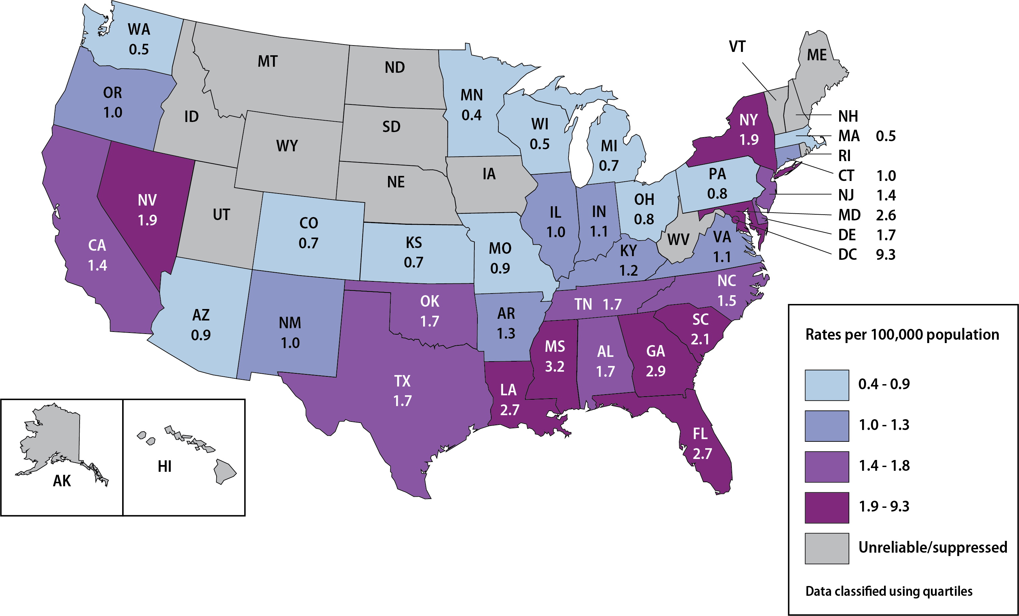
Age-Adjusted* Rates† of Death with HIV Disease as the Underlying Cause in the General Population, by State, 2020—United States
§
*Standard: age distribution of 2000 US population.
†Per 100,000 population.
§Death rates are not shown when unreliable (rate is calculated with a numerator of 20 or less) or suppressed (the data meet the criteria for confidentiality constraints).
Notes:
Rates of deaths with HIV disease as the underlying cause were highest in the District of Columbia, states along the Gulf Coast (Florida, Louisiana and Mississippi), Georgia, South Carolina, Maryland, Nevada, and New York.
Data are Suppressed when the data meet the criteria for confidentiality constraints.
Death rates are considered Unreliable when the rate is calculated with a numerator of 20 or less.
The data for this slide come from death certificate data compiled by the National Center for Health Statistics and downloaded from the CDC WONDER Online Database https://wonder.cdc.gov/.

Slide 13
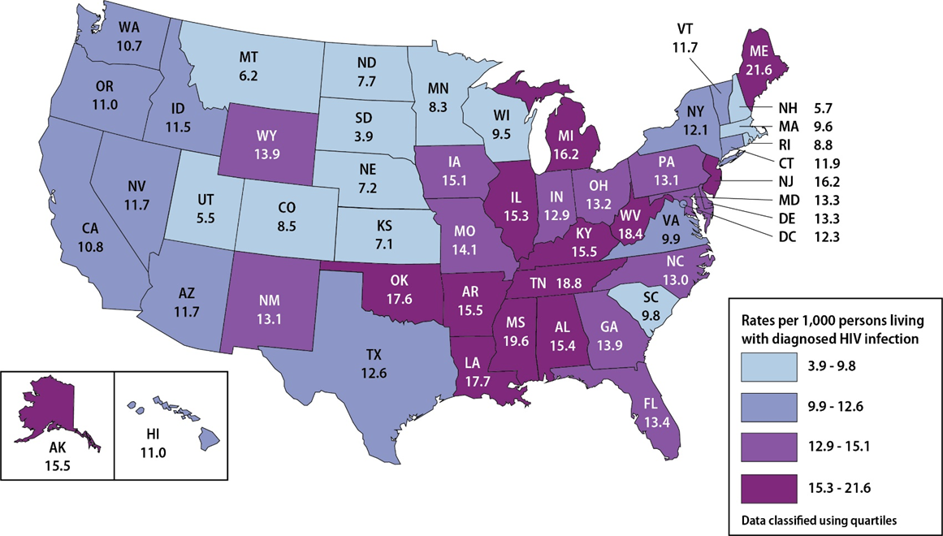
Age-Adjusted* Rates† of All-Cause Death among Persons with HIV by State 2020—United States
*Standard: age distribution of 2000 US population.
†Per 1,000 persons living with diagnosed HIV infection.
Notes:
This slide uses data reported to the National HIV Surveillance System through December 31, 2021, and represents the deaths of persons with diagnosed HIV infection due to any underlying cause. To control for geographic differences in the prevalence of HIV, the death rates were based on denominators consisting of numbers of persons with a diagnosis of HIV infection, rather than the general populations of the states. The rates were highest in Alabama, Alaska, Arkansas, Illinois, Kentucky, Louisiana, Maine, Michigan, Mississippi, New Jersey, Oklahoma, Tennessee, and West Virginia.
The differences in the rates among states may reflect differences in the extent to which persons with HIV residing in those states received an HIV diagnosis soon after contracting HIV, and if persons were prescribed timely, effective, and affordable treatment to which they diligently adhered.
The data for this slide come from the National HIV Surveillance System.

Slide 14
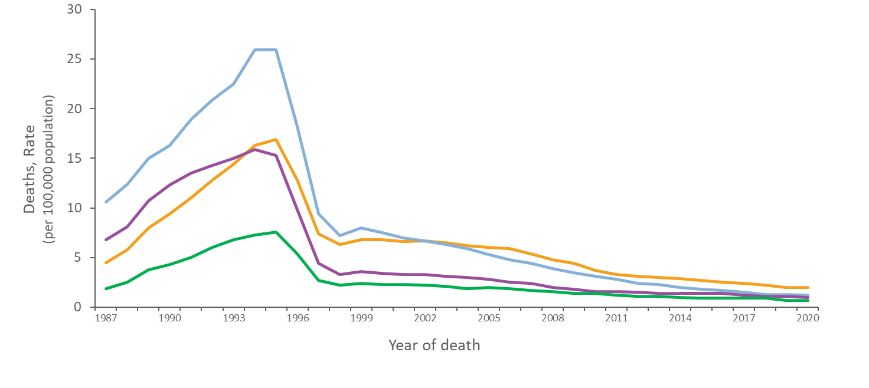
Trends in Age-Adjusted* Annual Rates of Death with HIV Disease as the Underlying Cause, by Geographic Region, 1987–2020—United States
Northeast
West
South
Midwest
Note. For comparison with data for 1999 and later years, data for 1987−1998 were modified to account for ICD-10 rules instead of ICD-9 rules.
*Standard: age distribution of 2000 US population.
Notes:
In all four U.S. Census regions of the United States, the age-adjusted rate of death due to HIV disease increased until 1994 or 1995, and then rapidly decreased in 1996 and 1997, coinciding with the increase in the use of highly active antiretroviral therapy (HAART). The rate in each region leveled after 1998. The rate increased most slowly in the West and most rapidly in the South through 1995. As a result, the rate in the South exceeded the rate in the West by 1994. After 1995, the rate decreased more slowly in the South than in the other regions, with the rate in the South exceeding the rate in the Northeast after 2003.
The data for this slide come from death certificate data compiled by the National Center for Health Statistics and downloaded from the CDC WONDER Online Database https://wonder.cdc.gov/.
Midwest: Illinois, Indiana, Iowa, Kansas, Michigan, Minnesota, Missouri, Nebraska, North Dakota, Ohio, South Dakota, and Wisconsin.
Northeast: Connecticut, Maine, Massachusetts, New Hampshire, New Jersey, New York, Pennsylvania, Rhode Island, Vermont.
South: Alabama, Arkansas, Delaware, District of Columbia, Florida, Georgia, Kentucky, Louisiana, Maryland, Mississippi, North Carolina, Oklahoma, South Carolina, Tennessee, Texas, Virginia, and West Virginia.
West: Alaska, Arizona, California, Colorado, Hawaii, Idaho, Montana, Nevada, New Mexico, Oregon, Utah, Washington, and Wyoming

Slide 15
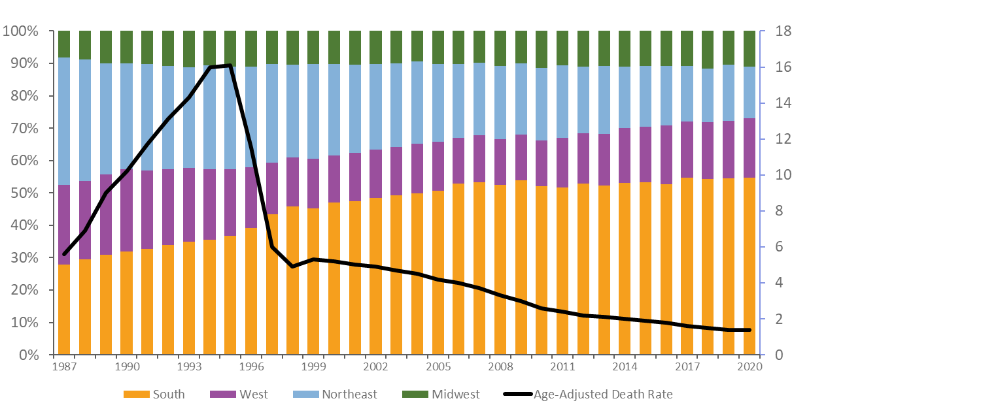
Trends in Annual Age-Adjusted* Rates of Death and the Percentage Distribution of Deaths with HIV Disease as the Underlying Cause, by Geographic Region, 1987−2020—United States
Deaths, Rate
(per 100,000 population)
Deaths, Percentage
Year of death
Note. For comparison with data for 1999 and later years, data for 1987−1998 were modified to account for ICD-10 rules instead of ICD-9 rules.
*Standard: age distribution of 2000 US population.
Notes:
Of persons who died of HIV disease from 1987 through 2020, the percentage who resided in the South increased from 28% to 55%, while the percentage in the Northeast decreased from 39% to 16%, and the percentage in the West decreased from 24% to 18%. The percentage in the Midwest has been relatively stable, ranging from 8% to 12%, and at 11% in 2020.
The data for this slide come from death certificate data compiled by the National Center for Health Statistics and downloaded from the CDC WONDER Online Database https://wonder.cdc.gov/.
Midwest: Illinois, Indiana, Iowa, Kansas, Michigan, Minnesota, Missouri, Nebraska, North Dakota, Ohio, South Dakota, and Wisconsin.
Northeast: Connecticut, Maine, Massachusetts, New Hampshire, New Jersey, New York, Pennsylvania, Rhode Island, Vermont
South: Alabama, Arkansas, Delaware, District of Columbia, Florida, Georgia, Kentucky, Louisiana, Maryland, Mississippi, North Carolina, Oklahoma, South Carolina, Tennessee, Texas, Virginia, and West Virginia.
West: Alaska, Arizona, California, Colorado, Hawaii, Idaho, Montana, Nevada, New Mexico, Oregon, Utah, Washington, and Wyoming.

Slide 16
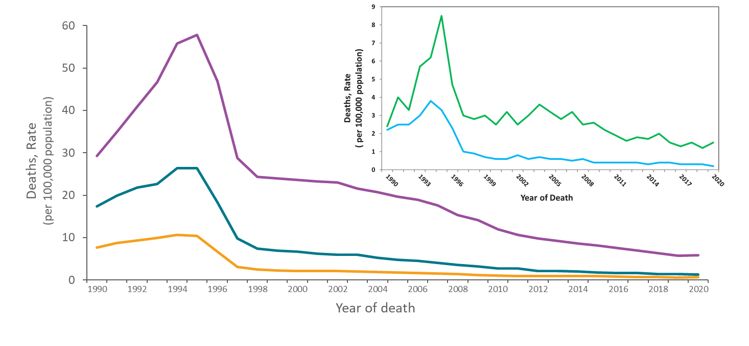
Trends in Age-Adjusted* Annual Rates of Death with HIV Disease as the Underlying Cause, by Race/Ethnicity, 1990–2020—United States
Black/African American
American Indian/Alaska Native
Asian/Pacific Islander
Hispanic/Latino**
White
Note. For comparison with data for 1999 and later years, data for 1990−1998 were modified to account for ICD-10 rules instead of ICD-9 rules.
*Standard age distribution of 2000 US population.
**Hispanic/Latino persons can be of any race.
Notes:
The age-adjusted rate of death with HIV disease as the underlying cause has been highest among Black or African American persons and second highest among Hispanic or Latino persons.
In every racial/ethnic group, the rate decreased greatly from 1995 through 1998. Among Black/African American persons, however, the percentage decrease in the rate from 1995 to 1998 was lower (58%) compared to a 67% decrease among American Indian/Alaska Native persons, a 73% decrease among Asian/Pacific Islander persons, a 72% decrease among Hispanic/Latino persons, and a 76% decrease among White persons.
Hispanic/Latino persons can be of any race.
For the calculation of national death rates by race and ethnicity, data for a few states were excluded for the years when death certificates for those states did not collect information on Hispanic/Latino ethnicity. The states for which data were omitted were: Connecticut and Louisiana in 1990, New Hampshire through 1992, and Oklahoma through 1996.
The data for this slide come from death certificate data compiled by the National Center for Health Statistics (NCHS). Data for years 1990-1998 were requested from NCHS and analyzed by CDC’s HIV Surveillance Branch. Data for years 1999-2020 were published and downloaded from the CDC WONDER Online Database https://wonder.cdc.gov/.
For details on reporting of sex and race/ethnicity, please see NCHS’s Funeral Director’s Handbook on Death Registration and Fetal Death Reporting (https://www.cdc.gov/nchs/data/nvss/handbook/2019-Funeral-Directors-Handbook-508.pdf).

Slide 17
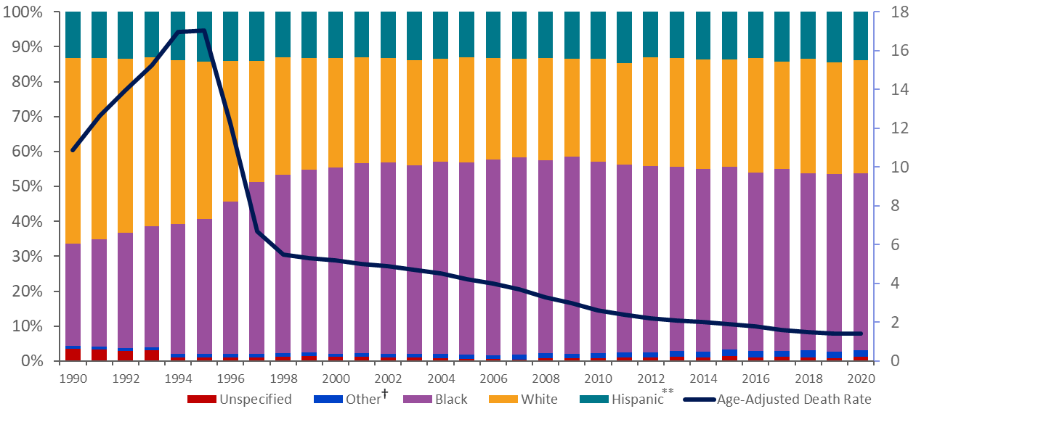
Trends in Annual Age-Adjusted* Rates of Death and the Percentage Distribution of Deaths with HIV Disease as the Underlying Cause, by Race/Ethnicity, 1990−2020—United States
Deaths, Rate
(per 100,000 population)
Deaths, Percentage
Year of death
Note. For comparison with data for 1999 and later years, data for 1990−1998 were modified to account for ICD-10 rules instead of ICD-9 rules.
*Standard: age distribution of 2000 US population.
** Hispanic/Latino persons can be of any race.
†Asian/Pacific Islander persons and American Indian/Alaska Native persons.
Notes:
From 1990 through 2020, the percentage of Black/African Americans among persons who died of HIV disease as the underlying cause increased from 29% to 51%, while the percentage of White persons decreased from 53% to 32%. This shift in the racial/ethnic distribution of deaths accelerated from 1996 through 1998, coincident with the increasing use of highly active antiretroviral therapy, suggesting that the shift may have resulted in part from differential access to therapy. For all years, the percentage of Hispanic/Latino persons was stable, ranging from approximately 13% to 15%, and the percentage of persons in other racial/ethnic groups (including Asian/Pacific Islander persons and American Indian/Alaska Native persons) was stable, ranging from 1% to 2%. In addition, the percentage of persons of unspecified race/ethnicity decreased from 4% to around 1%.
Hispanic/Latino persons can be of any race.
For the calculation of the national percentage of deaths by race and ethnicity, data for a few states were excluded for the years when death certificates for those states did not collect information on Hispanic/Latino ethnicity. The states for which data were omitted are Connecticut and Louisiana in 1990, New Hampshire through 1992, and Oklahoma through 1996.
The data for this slide come from death certificate data compiled by the National Center for Health Statistics and downloaded from the CDC WONDER Online Database https://wonder.cdc.gov/.
For details on reporting of sex and race/ethnicity, please see NCHS’s Funeral Director’s Handbook on Death Registration and Fetal Death Reporting (https://www.cdc.gov/nchs/data/nvss/handbook/2019-Funeral-Directors-Handbook-508.pdf).

Slide 18
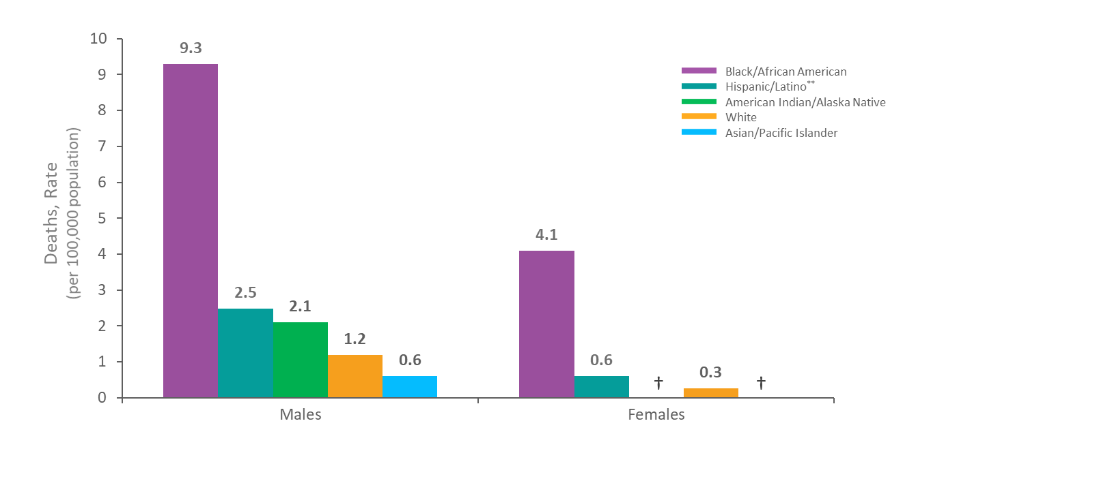
Age-Adjusted* Average Annual Rate of Death with HIV Disease as the Underlying Cause by Sex and Race/Ethnicity, 2016−2020—United States
*Standard age distribution of 2000 US population
† Unreliable rate due to a numerator of less than 20 deaths.
**Hispanic/Latino persons can be of any race.
Notes:
For both males and females, in the most recent 5 years for which data were available, the rates of death with HIV disease as the underlying cause among Black/African American persons were higher than the rates among Hispanic/Latino persons, which were higher than the rates among the remaining racial/ethnic groups. The rate among Black/African American females was higher than the rate among males in every racial/ethnic group, except Black/African American males. Among males, the rate among Asian/Pacific Islander persons were lower than the rates in each of the four other groups, including White persons, and the rate among American Indian/Alaska Native males was higher than the rate among White males.
Hispanic/Latino persons can be of any race.
Death rates are considered unreliable when the rate is calculated with a numerator of 20 or less.
Unreliable annual age-adjusted rates among American Indian/Alaska Native and Asian/Pacific Islander females.
The data for this slide come from death certificate data compiled by the National Center for Health Statistics and downloaded from the CDC WONDER Online Database https://wonder.cdc.gov/.
For details on reporting of sex and race/ethnicity, please see NCHS’s Funeral Director’s Handbook on Death Registration and Fetal Death Reporting (https://www.cdc.gov/nchs/data/nvss/handbook/2019-Funeral-Directors-Handbook-508.pdf).

Slide 19
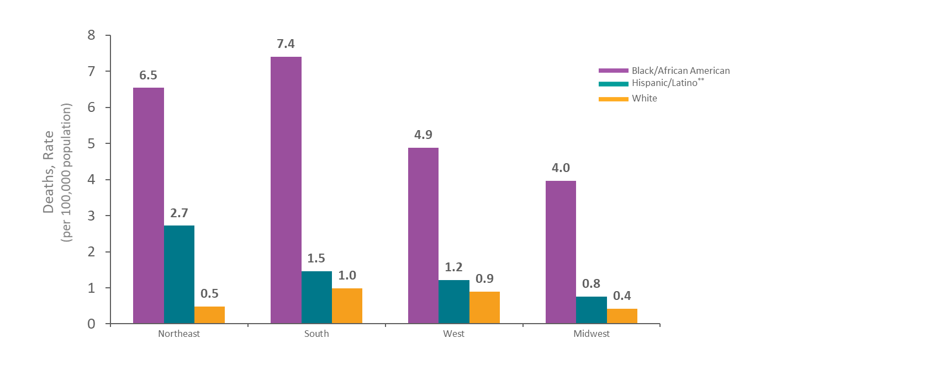
Age-Adjusted* Average Annual Rate of Death with HIV Disease as the Underlying Cause by Race/Ethnicity and Geographic Region, 2016−2020—United States
Region
*Standard age distribution of 2000 US population
**Hispanic/Latino persons can be of any race.
Notes:
This graph illustrates rates of death with HIV disease as the underlying cause by geographic region and race/ethnicity in the most recent five years for which data were available. Black/African American persons had the highest rate in each of the four regions. The rates among Black/African American persons were similar and higher in the Northeast and South than in the other two regions. The rates among Hispanic/Latino persons varied by region, but the rates among White persons did not vary significantly by region, except for being lower in the Midwest than elsewhere.
Only in the Northeast was the rate among Hispanic/Latino persons several times as high as the rate among White persons. In the West, the rate among Hispanic/Latino persons was slightly higher than the rate among White persons.
Hispanic/Latino persons can be of any race.
Data for American Indian/Alaska Native persons and Asian/Pacific Islander persons were either unreliable or suppressed for years 2016-2020. Data are suppressed when the data meet the criteria for confidentiality constraints. Death rates are flagged as unreliable when the rate is calculated with a numerator of 20 or less.
The data for this slide come from death certificate data compiled by the National Center for Health Statistics and downloaded from the CDC WONDER Online Database https://wonder.cdc.gov/.
For details on reporting of sex and race/ethnicity, please see NCHS’s Funeral Director’s Handbook on Death Registration and Fetal Death Reporting (https://www.cdc.gov/nchs/data/nvss/handbook/2019-Funeral-Directors-Handbook-508.pdf).
Midwest: Illinois, Indiana, Iowa, Kansas, Michigan, Minnesota, Missouri, Nebraska, North Dakota, Ohio, South Dakota, and Wisconsin.
Northeast: Connecticut, Maine, Massachusetts, New Hampshire, New Jersey, New York, Pennsylvania, Rhode Island, Vermont.
South: Alabama, Arkansas, Delaware, District of Columbia, Florida, Georgia, Kentucky, Louisiana, Maryland, Mississippi, North Carolina, Oklahoma, South Carolina, Tennessee, Texas, Virginia, and West Virginia.
West: Alaska, Arizona, California, Colorado, Hawaii, Idaho, Montana, Nevada, New Mexico, Oregon, Utah, Washington, and Wyoming.

Slide 20
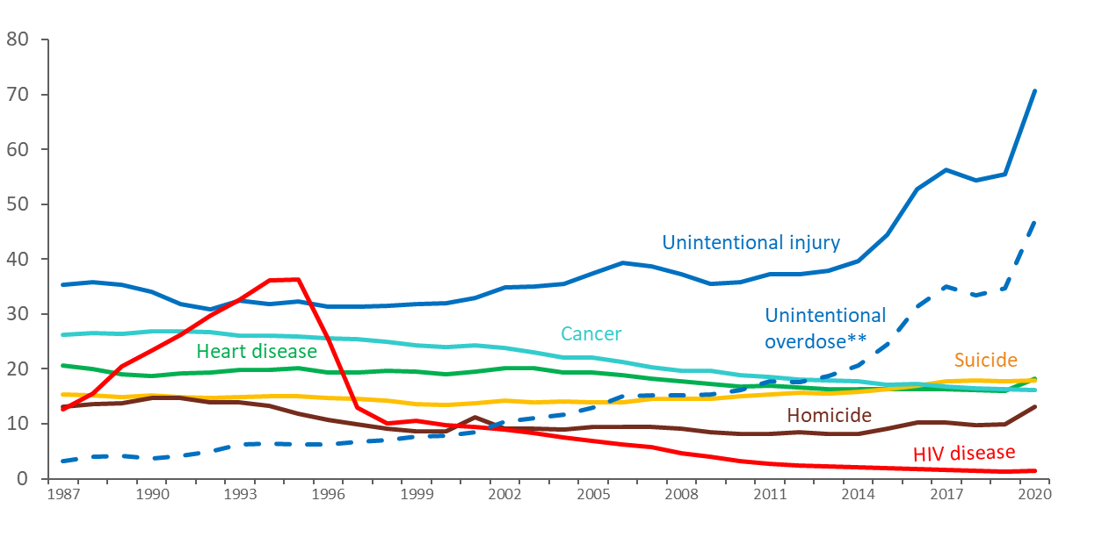
Trends in Annual Rates of Death with HIV Disease as the Underlying Cause versus the 5 Leading Causes among Persons Aged 25–44 Years, 1987–2020—United States
Deaths, Rate
(per 100,000 population)
Year of death
Note. For comparison with data for 1999 and later years, data for 1990−1998 were modified to account for ICD-10 rules instead of ICD-9 rules.
** Deaths with an underlying cause of unintentional overdose are a subset of deaths with an underlying cause of unintentional injury.
Notes:
Focusing on persons aged 25 to 44 years emphasizes the importance of HIV disease among causes of death. Compared with rates among other age groups, the rate of death with HIV disease as the underlying cause is relatively high in this age group, but rates of death due to other causes are relatively low.
HIV disease was the leading cause of death among persons 25 to 44 years old in 1994 and 1995. In 1995, HIV disease caused about 30,500 deaths, or 19% of all deaths in this age group. The rank of HIV disease fell to 3rd place from 1997 through 1998, to 5th place in 1999 and 2000, to 6th place from 2001, eventually falling to 12th place in 2020 causing about 1,200 deaths, or less than 1% of all deaths in this age group.
The rate of death with an underlying cause of unintentional injury has increased significantly from 1987 to 2020 among all persons aged 25 to 44 years. In 2020, there were 62,372 deaths due to unintentional injury, accounting for 35% of deaths, and a rate of 70.7 deaths per 100,000 persons aged 25 to 44. The rate of deaths due to unintentional overdose (defined as deaths due to unintentional or accidental poisoning by and exposure to noxious substances), a subset of the deaths with an underlying cause of unintentional injury, has also significantly increased from 1987 to 2020. Approximately 66% (41,436 deaths) of the deaths caused by unintentional injury had an underlying cause of unintentional overdose in 2020.
The data for this slide come from death certificate data compiled by the National Center for Health Statistics and downloaded from the CDC WONDER Online Database https://wonder.cdc.gov/.

Slide 21
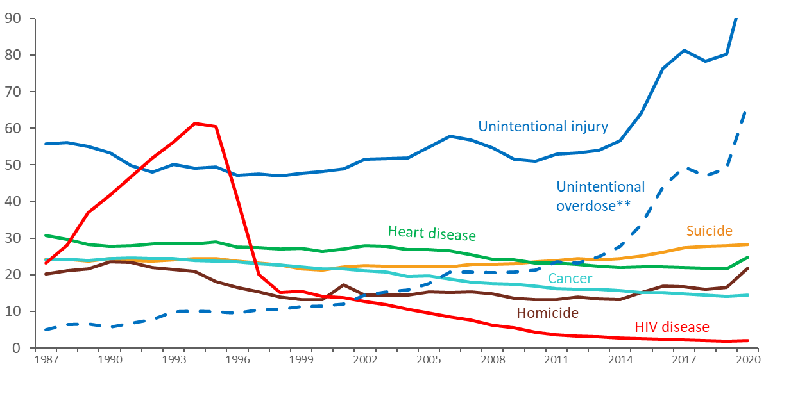
Trends in Annual Rates of Death with HIV Disease as the Underlying Cause versus the 5 Leading Causes among Males Aged 25–44 Years, 1987–2020—United States
Deaths, Rate
(per 100,000 population)
Year of death
Note. For comparison with data for 1999 and later years, data for 1990−1998 were modified to account for ICD-10 rules instead of ICD-9 rules.
** Deaths with an underlying cause of unintentional overdose are a subset of deaths with an underlying cause of unintentional injury.
Notes:
Among males aged 25 to 44 years, HIV disease was the leading cause of death from 1992 through 1996. Then the rank of HIV disease fell to 3rd place from 1997 and 1998, to 5th place in 1999, then fell to 11th place in 2020 causing almost 900 deaths, or less than 1% of all deaths in this age group.
The rate of death with an underlying cause of unintentional injury has increased significantly from 1987 to 2020 among males aged 25 to 44 years. In 2020, there were 45,492 deaths due to unintentional injury, accounting for 38% of deaths, and a rate of 102.3 deaths per 100,000 males aged 25 to 44. The rate of deaths due to unintentional overdose (defined as deaths due to unintentional or accidental poisoning by and exposure to noxious substances), a subset of the deaths with an underlying cause of unintentional injury, has also significantly increased from 1987 to 2020. Approximately 65% (29,727 deaths) of the deaths caused by unintentional injury had an underlying cause of unintentional overdose in 2020.
The data for this slide come from death certificate data compiled by the National Center for Health Statistics and downloaded from the CDC WONDER Online Database https://wonder.cdc.gov/.
For details on reporting of sex and race/ethnicity, please see NCHS’s Funeral Director’s Handbook on Death Registration and Fetal Death Reporting (https://www.cdc.gov/nchs/data/nvss/handbook/2019-Funeral-Directors-Handbook-508.pdf).

Slide 22
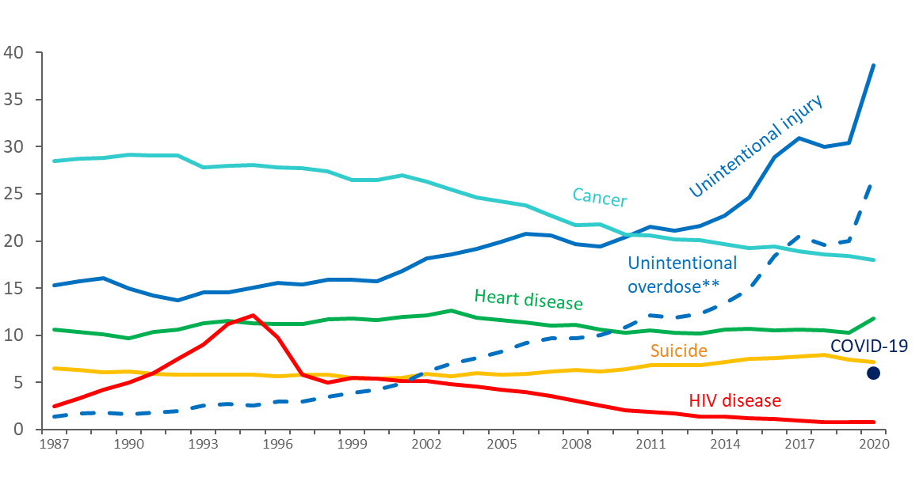
Trends in Annual Rates of Death with HIV Disease as the Underlying Cause versus the 5 Leading Causes among Females Aged 25–44 Years, 1987–2020—United States
Deaths, Rate
(per 100,000 population)
Year of death
Note. For comparison with data for 1999 and later years, data for 1990−1998 were modified to account for ICD-10 rules instead of ICD-9 rules.
** Deaths with an underlying cause of unintentional overdose are a subset of deaths with an underlying cause of unintentional injury.
Notes:
Among females aged 25 to 44 years, HIV disease was the leading cause of death in 1995, when HIV disease caused more than 5,000 deaths, or 11% of all deaths in this group. Thereafter, the rate of death due to HIV disease dropped to about the same as the rate due to suicide in the late 1990’s and early 2000’s and is currently lower than both the rate of suicide and chronic liver disease. From 1998 through 2007, HIV disease caused about 2,000 deaths per year, or about 5% of all deaths in this group. From 2008 through 2009, HIV disease caused about 1,000 deaths per year. In 2020, HIV disease fell to 16th place and caused 345 deaths, or less than 1% of all deaths in this group.
The rate of death with an underlying cause of unintentional injury has increased significantly from 1987 to 2020 among females aged 25 to 44 years. In 2020, there were 16,880 deaths due to unintentional injury, accounting for 29% of deaths, and a rate of 38.6 deaths per 100,000 females aged 25 to 44. The rate of deaths due to unintentional overdose (defined as deaths due to unintentional or accidental poisoning by and exposure to noxious substances), a subset of the deaths with an underlying cause of unintentional injury, has also significantly increased from 1987 to 2020. Approximately 69% (11,709 deaths) of the deaths caused by unintentional injury had an underlying cause of unintentional overdose in 2020.
Deaths attributed to COVID-19 were among the top 5 leading causes in 2020 for this group. No deaths in the United States were attributed to COVID-19 as the underlying cause before 2020.
The data for this slide come from death certificate data compiled by the National Center for Health Statistics and downloaded from the CDC WONDER Online Database https://wonder.cdc.gov/.
For details on reporting of sex and race/ethnicity, please see NCHS’s Funeral Director’s Handbook on Death Registration and Fetal Death Reporting (https://www.cdc.gov/nchs/data/nvss/handbook/2019-Funeral-Directors-Handbook-508.pdf).

Slide 23
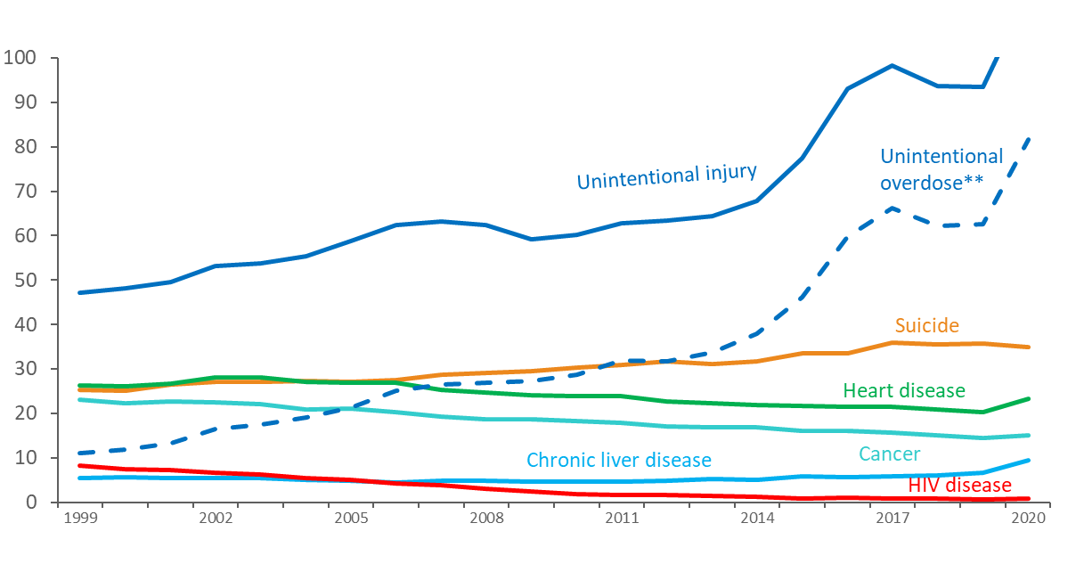
Trends in Annual Rates of Death with HIV Disease as the Underlying Cause versus the 5 Leading Causes among White* Males Aged 25–44 Years 1999–2020—United States
Deaths, Rate
(per 100,000 population)
Year of death
*Does not include persons of Hispanic/Latino ethnicity.
** Deaths with an underlying cause of unintentional overdose are a subset of deaths with an underlying cause of unintentional injury.
Notes:
Among White males aged 25 to 44 years, the rate of death with HIV disease as the underlying cause of death was ranked as the 5th leading cause of death in 1999 and 2000, falling to 9th from 2009 through 2012. The rate of HIV disease as the underlying cause of death continued to fall and was ranked 15th among all causes of death in 2020, when it caused about 200 deaths, or less than 1% of all deaths in this group.
Does not include persons of Hispanic/Latino ethnicity.
The data for this slide come from death certificate data compiled by the National Center for Health Statistics and downloaded from the CDC WONDER Online Database https://wonder.cdc.gov/.
For details on reporting of sex and race/ethnicity, please see NCHS’s Funeral Director’s Handbook on Death Registration and Fetal Death Reporting (https://www.cdc.gov/nchs/data/nvss/handbook/2019-Funeral-Directors-Handbook-508.pdf).

Slide 24
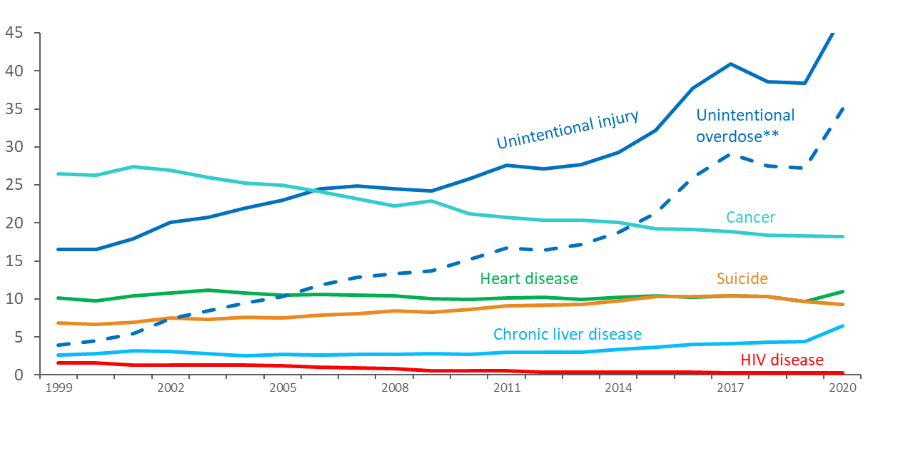
Trends in Annual Rates of Death with HIV Disease as the Underlying Cause versus the 5 Leading Causes among White* Females Aged 25–44 Years 1999–2020—United States
Deaths, Rate
(per 100,000 population)
Year of death
*Does not include persons of Hispanic/Latino ethnicity.
** Deaths with an underlying cause of unintentional overdose are a subset of deaths with an underlying cause of unintentional injury.
Notes:
Among White females aged 25 to 44 years, the rate of death with HIV disease as the underlying cause of death was ranked as the 9th leading cause of death in 1999 and 2000, falling to 10th in 2001 then 11th in 2002. The rate of HIV disease as the underlying cause of death continued to fall and was ranked 20th among all causes of death in 2020, when it caused 64 deaths, or less than 1% of all deaths in this group.
Does not include persons of Hispanic/Latino ethnicity.
The data for this slide come from death certificate data compiled by the National Center for Health Statistics and downloaded from the CDC WONDER Online Database https://wonder.cdc.gov/.
For details on reporting of sex and race/ethnicity, please see NCHS’s Funeral Director’s Handbook on Death Registration and Fetal Death Reporting (https://www.cdc.gov/nchs/data/nvss/handbook/2019-Funeral-Directors-Handbook-508.pdf).

Slide 25
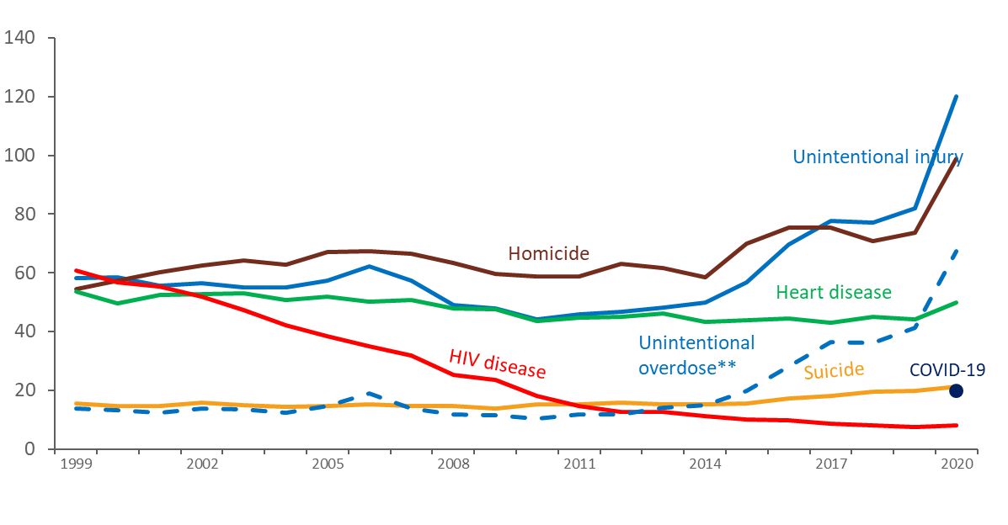
Trends in Annual Rates of Death with HIV Disease as the Underlying Cause versus the 5 Leading Causes among Black/African American* Males Aged 25–44 Years 1999–2020—United States
Deaths, Rate
(per 100,000 population)
Year of death
*Does not include persons of Hispanic/Latino ethnicity.
** Deaths with an underlying cause of unintentional overdose are a subset of deaths with an underlying cause of unintentional injury.
Notes:
Among Black/African American males aged 25 to 44 years, HIV disease was the leading cause of death in 1999, falling to 3rd in 2000 and 2001. The rate of HIV disease as the underlying cause of death continued to fall and was ranked 8th among all causes of death in 2020, when HIV disease caused about 500 deaths, or about 2% of all deaths in this group.
Deaths attributed to COVID-19 were among the top 5 leading causes in 2020 for this group. No deaths in the United States were attributed to COVID-19 as the underlying cause before 2020.
Does not include persons of Hispanic/Latino ethnicity.
The data for this slide come from death certificate data compiled by the National Center for Health Statistics and downloaded from the CDC WONDER Online Database https://wonder.cdc.gov/.
For details on reporting of sex and race/ethnicity, please see NCHS’s Funeral Director’s Handbook on Death Registration and Fetal Death Reporting (https://www.cdc.gov/nchs/data/nvss/handbook/2019-Funeral-Directors-Handbook-508.pdf).

Slide 26
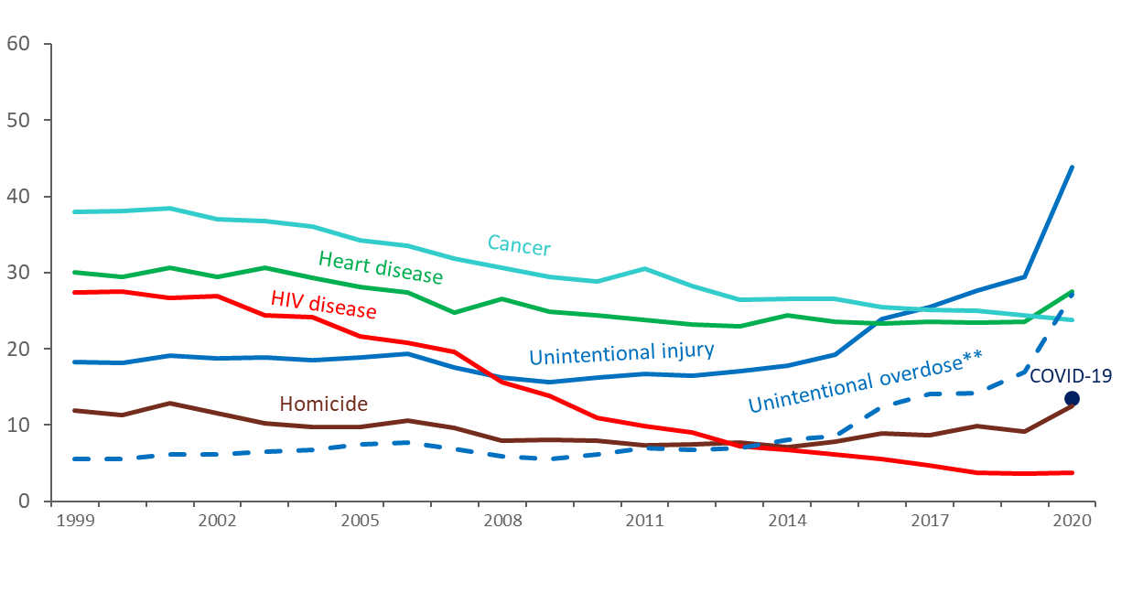
Trends in Annual Rates of Death due to HIV Disease as the Underlying Cause versus the 5 Leading Causes among Black/African American* Females Aged 25–44 Years 1999–2020—United States
Deaths, Rate
(per 100,000 population)
Year of death
*Does not include persons of Hispanic/Latino ethnicity.
** Deaths with an underlying cause of unintentional overdose are a subset of deaths with an underlying cause of unintentional injury.
Notes:
Among Black/African American females aged 25 to 44 years, the rate of death with HIV disease as the underlying cause was the 3rd leading cause of death in 1999 through 2007. The rate of HIV disease as the underlying cause of death continued to fall and was ranked 10th among all causes of death in 2020, when it caused 245 deaths, or about 2% of all deaths in this group.
Deaths attributed to COVID-19 were among the top 5 leading causes in 2020 for this group. No deaths in the United States were attributed to COVID-19 as the underlying cause before 2020.
Does not include persons of Hispanic/Latino ethnicity.
The data for this slide come from death certificate data compiled by the National Center for Health Statistics and downloaded from the CDC WONDER Online Database https://wonder.cdc.gov/.
For details on reporting of sex and race/ethnicity, please see NCHS’s Funeral Director’s Handbook on Death Registration and Fetal Death Reporting (https://www.cdc.gov/nchs/data/nvss/handbook/2019-Funeral-Directors-Handbook-508.pdf).

Slide 27
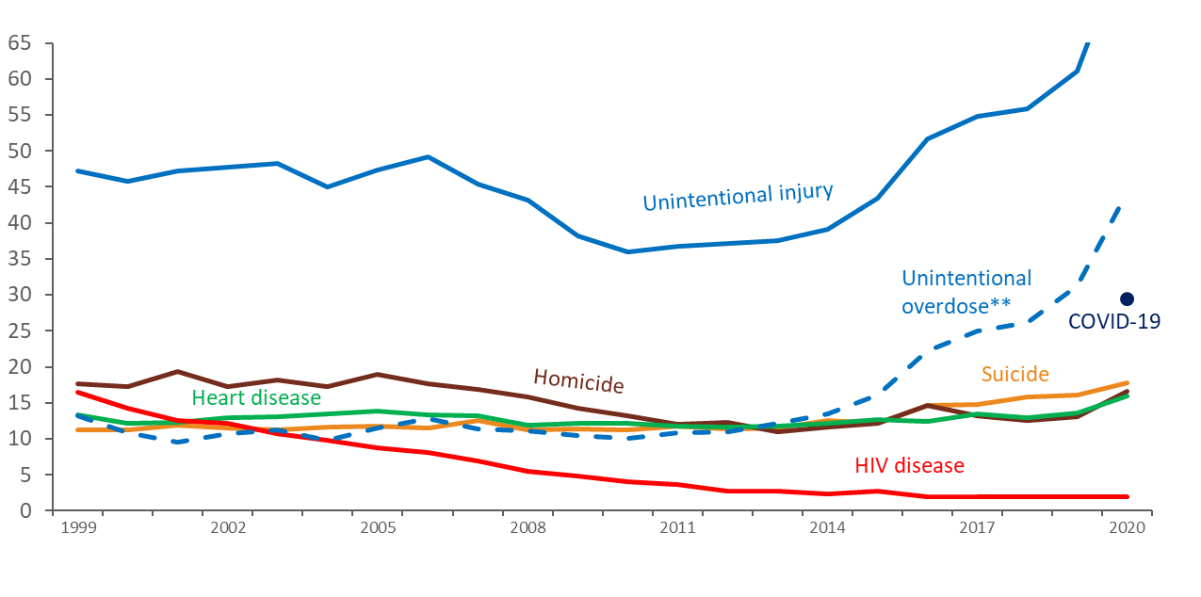
Trends in Annual Rates of Death with HIV Disease as the Underlying Cause versus the 5 Leading Causes among Hispanic/Latino* Males Aged 25–44 Years 1999–2020—United States
Deaths, Rate
(per 100,000 population)
Year of death
*Hispanic/Latino persons can be of any race.
** Deaths with an underlying cause of unintentional overdose are a subset of deaths with an underlying cause of unintentional injury
Notes:
Among Hispanic/Latino males aged 25 to 44 years, HIV disease was the 3rd leading cause of death in 1999 and 2000, falling to 4th in 2001. The rate of HIV disease as the underlying cause of death continued to fall and was ranked 11th among all causes of death in 2020, when it caused 177 deaths, or about 1% of all deaths in the group.
Deaths attributed to COVID-19 were among the top 5 leading causes in 2020 for this group. No deaths in the United States were attributed to COVID-19 as the underlying cause before 2020.
Hispanic/Latino persons can be of any race.
The data for this slide come from death certificate data compiled by the National Center for Health Statistics and downloaded from the CDC WONDER Online Database https://wonder.cdc.gov/.
For details on reporting of sex and race/ethnicity, please see NCHS’s Funeral Director’s Handbook on Death Registration and Fetal Death Reporting (https://www.cdc.gov/nchs/data/nvss/handbook/2019-Funeral-Directors-Handbook-508.pdf).

Slide 28
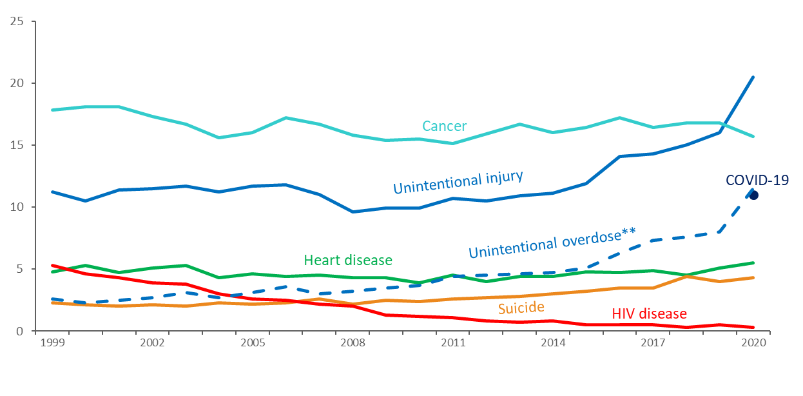
Trends in Annual Rates of Death due to HIV Disease as the Underlying Cause versus the 5 Leading Causes among Hispanic/Latino* Females, Aged 25–44 Years 1999–2020—United States
Deaths, Rate
(per 100,000 population)
Year of death
*Hispanic/Latino persons can be of any race.
** Deaths with an underlying cause of unintentional overdose are a subset of deaths with an underlying cause of unintentional injury
Notes:
Among Hispanic/Latino females aged 25 to 44 years, HIV disease was the 3rd leading cause of death in 1999, falling to 4th in 2000. The rate of HIV disease as the underlying cause of death continued to fall and was ranked 18th among all causes of death in 2020, when it caused 23 deaths, or less than 1% of all deaths in the group.
Deaths attributed to COVID-19 were among the top 5 leading causes in 2020 for this group. No deaths in the United States were attributed to COVID-19 as the underlying cause before 2020.
Hispanic/Latino persons can be of any race.
The data for this slide come from death certificate data compiled by the National Center for Health Statistics and downloaded from the CDC WONDER Online Database https://wonder.cdc.gov/.
For details on reporting of sex and race/ethnicity, please see NCHS’s Funeral Director’s Handbook on Death Registration and Fetal Death Reporting (https://www.cdc.gov/nchs/data/nvss/handbook/2019-Funeral-Directors-Handbook-508.pdf).

Slide 29
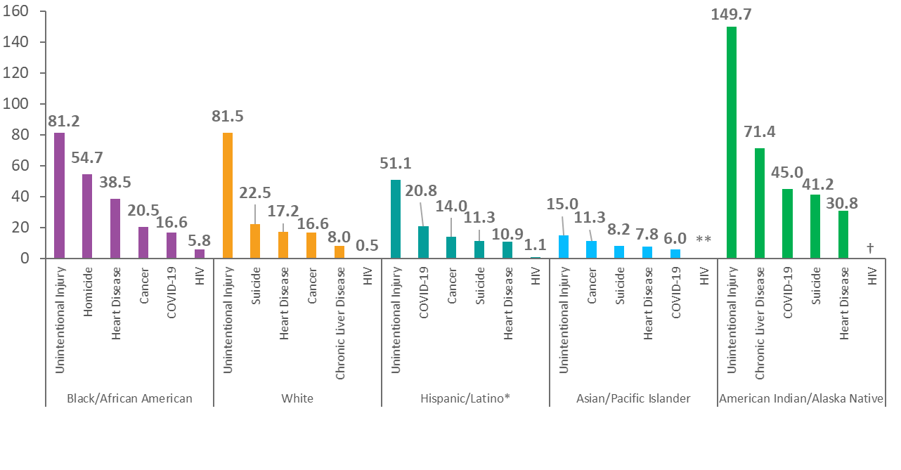
Annual Rate of Death with HIV Disease as the Underlying Cause versus the 5 Leading Causes among Persons Aged 25–44 Years, By Race/Ethnicity 2020—United States
Deaths, Rate
(per 100,000 population)
*Hispanic/Latino persons can be of any race.
**Rate of death is less than 0.5 deaths per 100,000 persons.
† Unreliable rate due to a numerator of less than 20 deaths.
Notes:
Unintentional Injury was the highest underlying cause of death among all race/ethnicity groups aged 25 to 44 years in 2020, accounting for 62,372 deaths, or about 35% of deaths in this age group. Deaths due to unintentional injury impacted American Indian/Alaska Native persons aged 25-44 the greatest, at a rate of 149.7 deaths per 100,000 persons. Deaths with an underlying cause of HIV disease continue to disproportionally affect Black/African American persons, with an overall rate of 5.8 deaths per 100,000 persons in 2020.
In 2020, COVID-19 was among the leading causes of death for all race/ethnicity groups aged 24-44 years except White persons. Deaths due to COVID-19 among Black/African persons aged 25-44 years were disproportionate, at a rate of 16.6 deaths per 100,000.
Death rates are considered unreliable when the rate is calculated with a numerator of 20 or less.
Hispanic/Latino persons can be of any race.
The data for this slide come from death certificate data compiled by the National Center for Health Statistics and downloaded from the CDC WONDER Online Database https://wonder.cdc.gov/.
For details on reporting of sex and race/ethnicity, please see NCHS’s Funeral Director’s Handbook on Death Registration and Fetal Death Reporting (https://www.cdc.gov/nchs/data/nvss/handbook/2019-Funeral-Directors-Handbook-508.pdf).

Slide 30
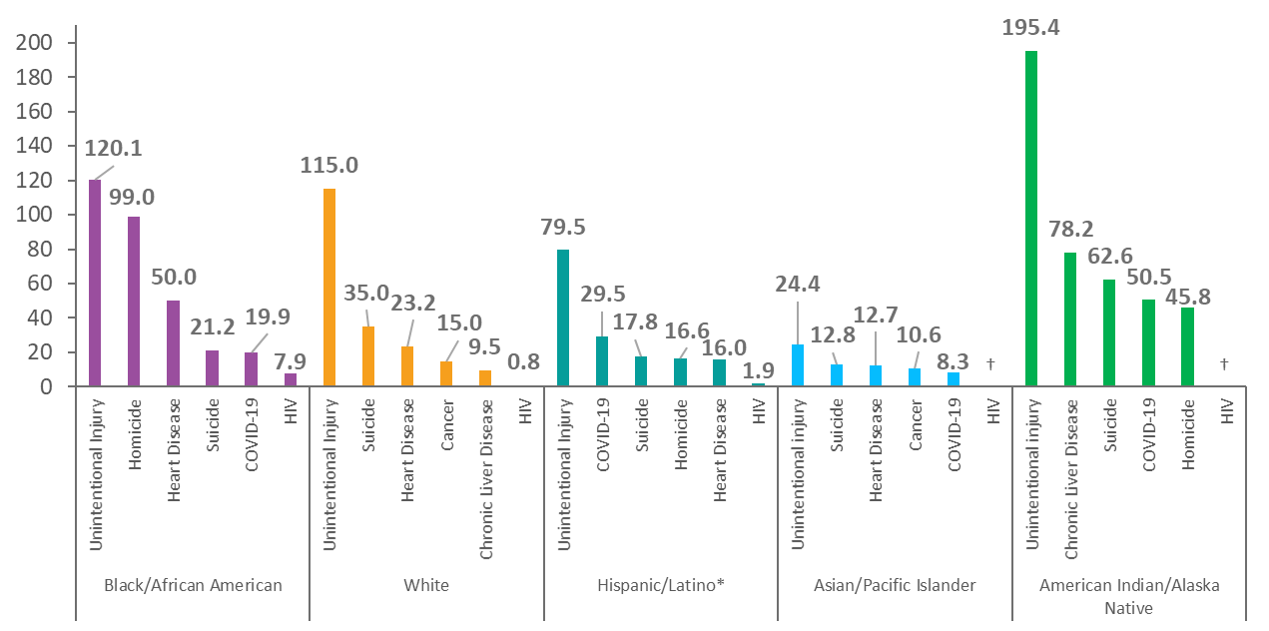
Annual Rate of Death with HIV Disease as the Underlying Cause versus the 5 Leading Causes among Males Aged 25–44 Years, By Race/Ethnicity 2020—United States
Deaths, Rate
(per 100,000 population)
*Hispanic/Latino persons can be of any race.
† Unreliable rate estimate due to a numerator of less than 20 deaths.
Notes:
Unintentional Injury was the highest underlying cause of death among all males in all race/ethnicity groups aged 25 to 44 years in 2020, accounting for 45,492 deaths, or about 38% of the deaths in this group. Deaths due to unintentional injury impacted American Indian/Alaska Native males aged 25-44 the greatest, at a rate of 195.4 deaths per 100,000 persons. Deaths with an underlying cause of HIV disease are disproportionate among Black/African American males, with an overall rate of 7.9 deaths per 100,000 persons in 2020.
Death rates are considered unreliable when the rate is calculated with a numerator of 20 or less.
Hispanic/Latino persons can be of any race.
The data for this slide come from death certificate data compiled by the National Center for Health Statistics and downloaded from the CDC WONDER Online Database https://wonder.cdc.gov/.
For details on reporting of sex and race/ethnicity, please see NCHS’s Funeral Director’s Handbook on Death Registration and Fetal Death Reporting (https://www.cdc.gov/nchs/data/nvss/handbook/2019-Funeral-Directors-Handbook-508.pdf).

Slide 31
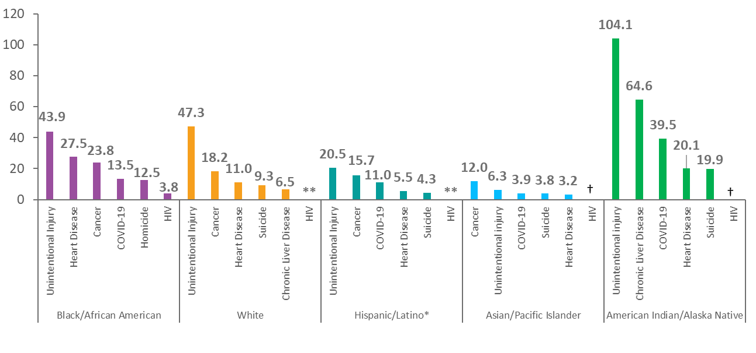
Annual Rate of Death with HIV Disease as the Underlying Cause versus the 5 Leading Causes among Females Aged 25–44 Years, By Race/Ethnicity, 2020—United States
Deaths, Rate
(per 100,000 population)
*Hispanic/Latino persons can be of any race.
**Rate of death is less than 0.5 deaths per 100,000 persons.
† Unreliable rate due to a numerator of less than 20 deaths.
Notes:
Unintentional Injury was the highest underlying cause of death among all females of all race/ethnicity groups aged 25 to 44 years in 2020, accounting for 62,372 deaths, or about 35% of deaths in this group. Deaths with an underlying cause of HIV disease are disproportional among Black/African American females, with an overall rate of 3.8 deaths per 100,000 persons in 2020.
Death rates are considered unreliable when the rate is calculated with a numerator of 20 or less.
Hispanic/Latino persons can be of any race.
The data for this slide come from death certificate data compiled by the National Center for Health Statistics and downloaded from the CDC WONDER Online Database https://wonder.cdc.gov/.
For details on reporting of sex and race/ethnicity, please see NCHS’s Funeral Director’s Handbook on Death Registration and Fetal Death Reporting (https://www.cdc.gov/nchs/data/nvss/handbook/2019-Funeral-Directors-Handbook-508.pdf).

Slide 32
Conclusions
After rapidly increasing since the 1980s, the annual rate of death due to HIV disease peaked in 1994 or 1995 (depending on the demographic group), decreased rapidly through 1997, and continued to decrease much more slowly thereafter.
Persons dying of HIV disease increasingly consist of:
males (75% in 2020) (
Black/African American persons (51% in 2020)
residents of the South (55% in 2020)
persons 45 years of age or older (75% in 2020) (71% in 2013)
HIV disease continues to remain among the leading causes of death among all persons aged 25 to 44 years, ranking 12th in 2020.
HIV disease an underlying cause of death is particularly high among Black/African American persons aged 25 to 44 years, ranking the 8th leading cause among Black males and the 10th leading cause among Black females in 2020.

