Slide 1
Diagnoses of HIV Infection among Adults and Adolescents in Metropolitan Statistical Areas United States and Puerto Rico, 2017
Division of HIV/AIDS Prevention
Notes:
Diagnoses of HIV Infection among Adults and Adolescents in Metropolitan Statistical Areas, United States and Puerto Rico, 2017
For all slides in this series, the following notes apply:
Numbers and rates of diagnosed HIV infection are based on data from 50 states, the District of Columbia, and Puerto Rico.
Rates for transmission category are not provided because of the absence of denominator data from the U.S. Census Bureau.
Rates are calculated per 100,000 population.
Data are presented for diagnoses of HIV infection reported to CDC through December 2018.

Slide 2
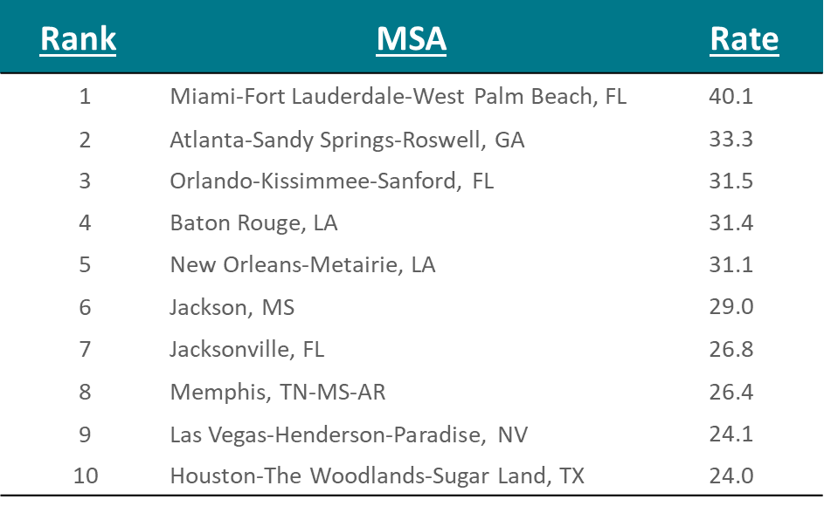
Rates of Diagnoses of HIV Infection among Adults and Adolescents, by Metropolitan Statistical Area of Residence—United States and Puerto Rico, 2017
Note. Data are based on residence at HIV diagnosis. Data exclude persons whose county of residence is unknown. Rates are per 100,000 population.
Notes:
This slide presents rates (per 100,000 population) of diagnoses of HIV infection among adults and adolescents in 2017, by metropolitan statistical area (MSA), in the United States and Puerto Rico.
Nine of the 10 MSAs with the highest rates of diagnoses of HIV infection are located in the South region of the United States.
Data are based on residence at HIV diagnosis. Data exclude persons whose county of residence is unknown. Rates are per 100,000 population.

Slide 3
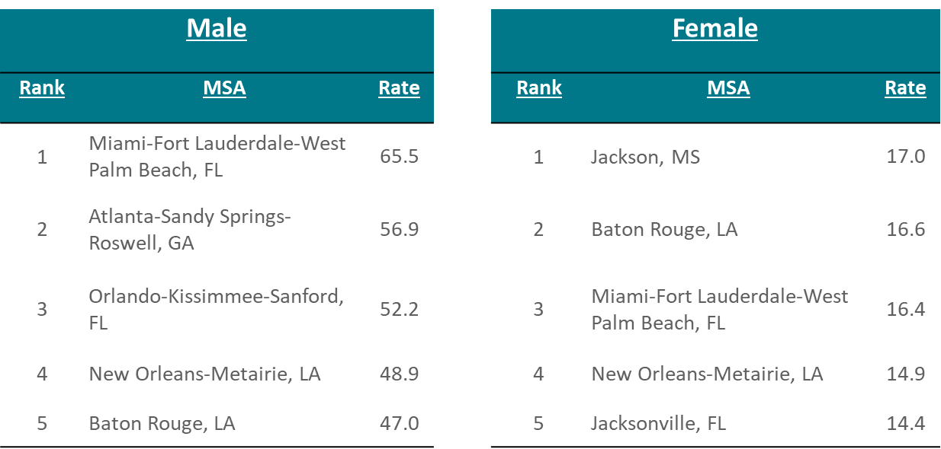
Rates of Diagnoses of HIV infection among Adults and Adolescents, by Metropolitan Statistical Area and Sex—United States and Puerto Rico, 2017
Note. Data are based on residence at HIV diagnosis. Data exclude persons whose county of residence is unknown. Rates are per 100,000 population.
Notes:
This slide presents rates (per 100,000 population) of diagnoses of HIV infection among adults and adolescents in 2017, by metropolitan statistical area (MSA) and sex, in the United States and Puerto Rico.
The five MSAs with the highest rates of diagnoses of HIV infection, among both males and females, are located in the South region of the United States.
Data are based on residence at HIV diagnosis. Data exclude persons whose county of residence is unknown. Rates are per 100,000 population.

Slide 4
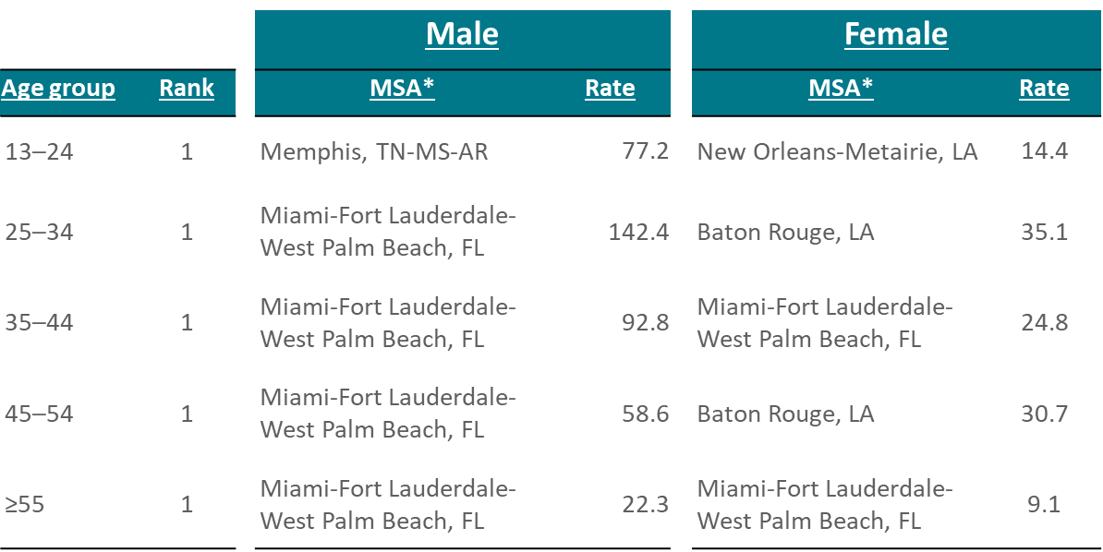
Rates of Diagnoses of HIV Infection among Adults and Adolescents, by Metropolitan Statistical Area, Sex, and Age—United States and Puerto Rico, 2017
Note Data are based on residence at HIV diagnosis. Data exclude persons whose county of residence is unknown. Rates are per 100,000 population.
*Ranks number 1 for the specified age group.
Notes:
This slide presents rates (per 100,000 population) of diagnoses of HIV infection among adults and adolescents in 2017, by metropolitan statistical area (MSA), sex, and age, in the United States and Puerto Rico.
The MSAs and rates presented are the highest (ranked number 1) for the specified age group.
Among adult and adolescent males, the highest rate of HIV diagnoses for all age groups were located in the South region of the United States in Miami-Fort Lauderdale-West Palm Beach, FL, for all age groups except males age 13-24, for which the highest rates were in Memphis, TN-MS-AR.
Among adult and adolescent females, the MSAs with the highest rate of HIV diagnoses for all age groups were located in the South region of the United States (New Orleans-Metairie, LA, Baton Rouge, LA, Miami-Fort Lauderdale-West Palm Beach, FL, Baton Rouge, LA, Miami-Fort Lauderdale-West Palm Beach, FL, respectively).
Data are based on residence at HIV diagnosis. Data exclude persons whose county of residence is unknown. Rates are per 100,000 population.

Slide 5
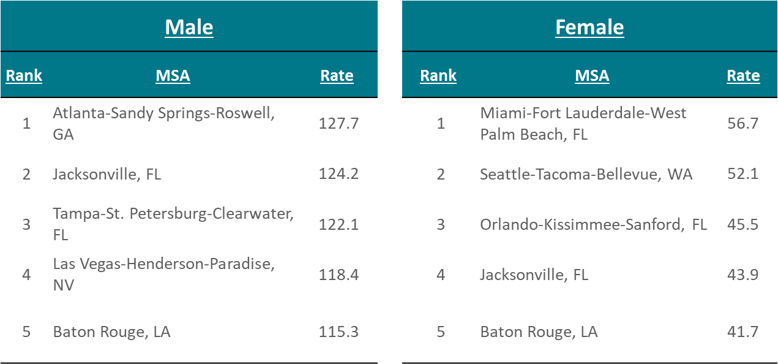
Rates of Diagnoses of HIV Infection among Black/African American Adults and Adolescents, by Metropolitan Statistical Area and Sex, United States and Puerto Rico, 2017
Note Data are based on residence at HIV diagnosis. Data exclude persons whose county of residence is unknown. Rates are per 100,000 population.
Notes:
This slide presents rates (per 100,000 population) of diagnoses of HIV infection among black/African American adults and adolescents in 2017, by metropolitan statistical area (MSA) and sex, in the United States and Puerto Rico.
Four of the five MSAs with the highest rates of diagnoses of HIV infection among both black/African American males and females are located in the South region of the United States.
Data are based on residence at HIV diagnosis. Data exclude persons whose county of residence is unknown. Rates are per 100,000 population.

Slide 6
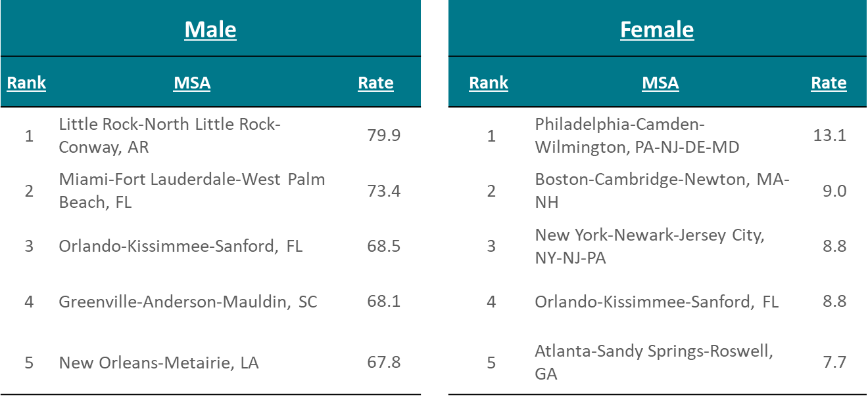
Rates of Diagnoses of HIV Infection among Hispanic/Latinoª Adults and Adolescents, by Metropolitan Statistical Area and Sex—United States and Puerto Rico, 2017
Note. Data are based on residence at HIV diagnosis. Data exclude persons whose county of residence is unknown. Rates are per 100,000 population.
ª Hispanics/Latinos can be of any race.
Notes:
This slide presents rates of diagnoses of HIV Infection among Hispanic/Latino adults and adolescents in 2017, by metropolitan statistical area (MSA) and sex, in the United States and Puerto Rico.
MSAs in the South region of the United States accounted for some of the highest rates of diagnoses HIV infection among Hispanic/Latino males.
Data are based on residence at HIV diagnosis. Data exclude persons whose county of residence is unknown. Rates are per 100,000 population.
ª Hispanics/Latinos can be of any race.

Slide 7
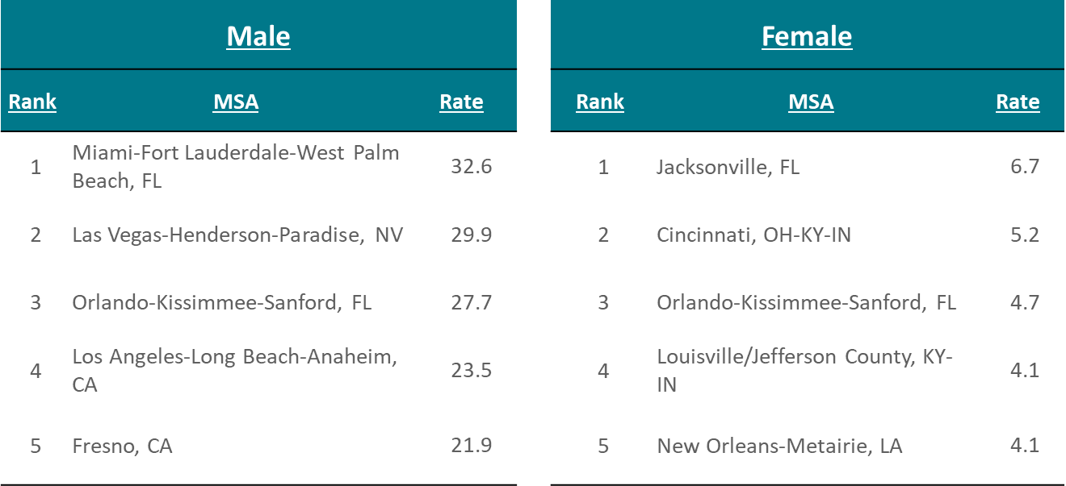
Rates of Diagnoses of HIV Infection among White Adults and Adolescents, by Metropolitan Statistical Area and Sex—United States and Puerto Rico, 2017
Note. Data are based on residence at HIV diagnosis. Data exclude persons whose county of residence is unknown. Rates are per 100,000 population.
Notes:
This slide presents rates of diagnoses of HIV Infection among white adults and adolescents in 2017, by metropolitan statistical area (MSA) and sex, in the United States and Puerto Rico.
MSAs in the West region of the United States accounted for some of the highest rates of diagnosed HIV infection among white males (accounting for three of the five MSAs with the highest HIV diagnosis rates).
MSAs associated with states within the South region accounted for some of the highest rates of diagnoses HIV infection among white females (accounting for four of the five MSAs with the highest HIV diagnosis rates).
Data are based on residence at HIV diagnosis. Data exclude persons whose county of residence is unknown. Rates are per 100,000 population.

Slide 8
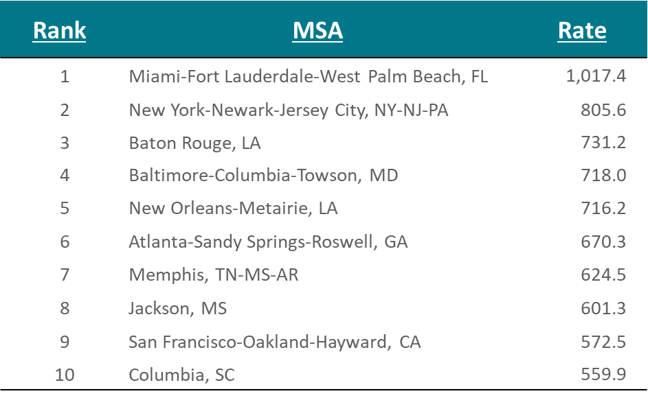
Rates of Adults and Adolescents Living with Diagnosed HIV Infection, by Metropolitan Statistical Area of Residence—United States and Puerto Rico, Year-end 2016
Note. Data are based on residence at the end of the specified year (i.e., most recent known address). Data exclude persons whose county of residence is unknown. Rates are per 100,000 population.
Notes:
This slide presents rates of adults and adolescents living with diagnosed HIV infection, by metropolitan statistical area (MSA) of residence, in the United States and Puerto Rico at year-end 2016. MSAs located in the South region of the United States accounted for some the highest rates of adults and adolescents living with diagnosed HIV infection (accounting for eight of the 10 MSAs with the highest rates of HIV infection).
Data are based on residence at the end of the specified year (i.e., most recent known address). Data exclude persons whose county of residence is unknown. Rates are per 100,000 population.

Slide 9
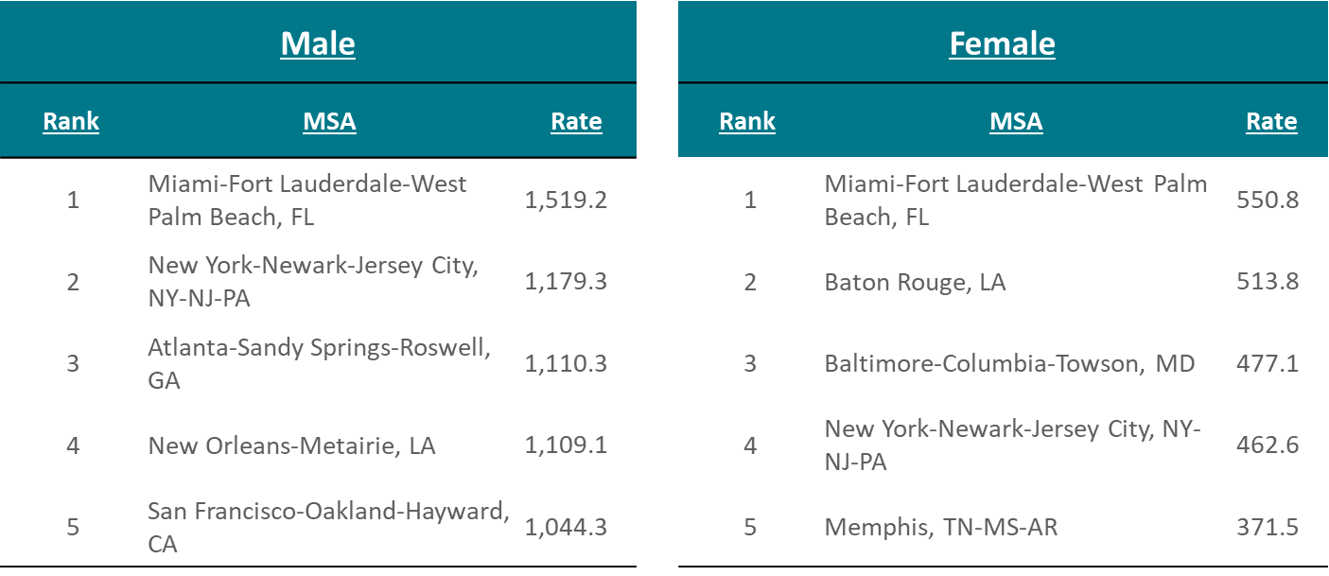
Rates of Adults and Adolescents Living with Diagnosed HIV Infection, by Metropolitan Statistical Area and Sex—United States and Puerto Rico, Year-end 2016
Note Data are based on residence at the end of the specified year (i.e., most recent known address). Data exclude persons whose county of residence is unknown. Rates are per 100,000 population.
Notes:
This slide presents rates of adults and adolescent living with diagnosed HIV infection, by metropolitan statistical area (MSA) and sex, in the United States and Puerto Rico at year-end 2016. MSAs in the South region of the United States accounted for the highest rates of adult and adolescent males living with diagnosed HIV infection (accounting for three of the five MSAs with the highest rates). MSAs in the South region of the United States accounted for the highest rates of adult and adolescent females living with diagnosed HIV infection (accounting for four of the five MSAs with the highest rates).
Data are based on residence at the end of the specified year (i.e., most recent known address). Data exclude persons whose county of residence is unknown. Rates are per 100,000 population.

Slide 10
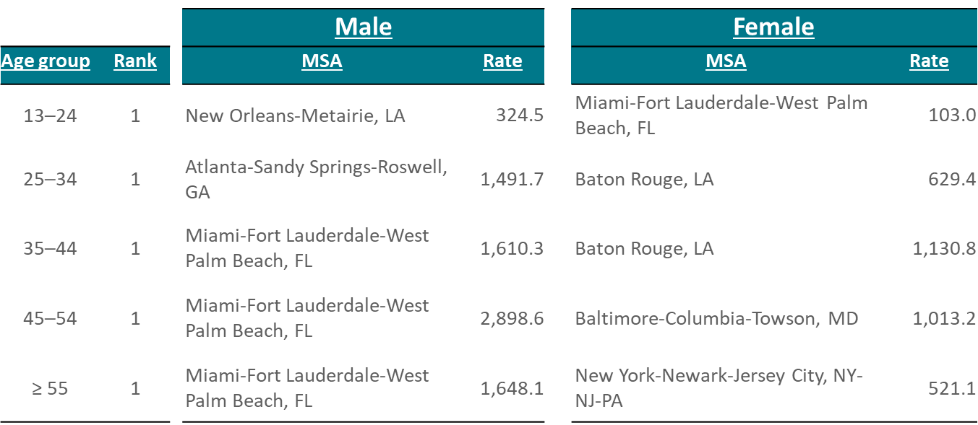
Rates of Adults and Adolescents Living with Diagnosed HIV Infection, by Metropolitan Statistical Area, Sex, and Age—United States and Puerto Rico, Year-end 2016
Note. Data are based on residence at the end of the specified year (i.e., most recent known address). Data exclude persons whose county of residence is unknown. Rates are per 100,000 population.
Notes:
This slide presents rates of adults and adolescents living with diagnosed HIV infection, by metropolitan statistical area (MSA), sex, and age, in the United States and Puerto Rico at year-end 2016.
The highest rates of male adults and adolescents living with diagnosed HIV infection were in Miami-Fort Lauderdale-West Palm Beach, FL, for all age groups except males age 13-24 and 25-34 years, for which the highest rates were in New Orleans-Metairie, LA and Atlanta-Sandy Springs-Roswell, GA, respectively.
The MSAs with the highest rates for females age 13-24, 25-34, 35-44, and 45-54 years living with diagnosed HIV infection were in MSAs located in the South region of the United States (Miami-Fort Lauderdale-West Palm Beach, FL, Baton Rouge, LA, Baton Rouge, LA, Baltimore-Columbia-Towson, MD, respectively). The highest rate for females age 55 years and older was located in the Northeast region of the United States in New York-Newark-Jersey City, NY-NJ-PA.
Data are based on residence at the end of the specified year (i.e., most recent known address). Data exclude persons whose county of residence is unknown. Rates are per 100,000 population.

Slide 11
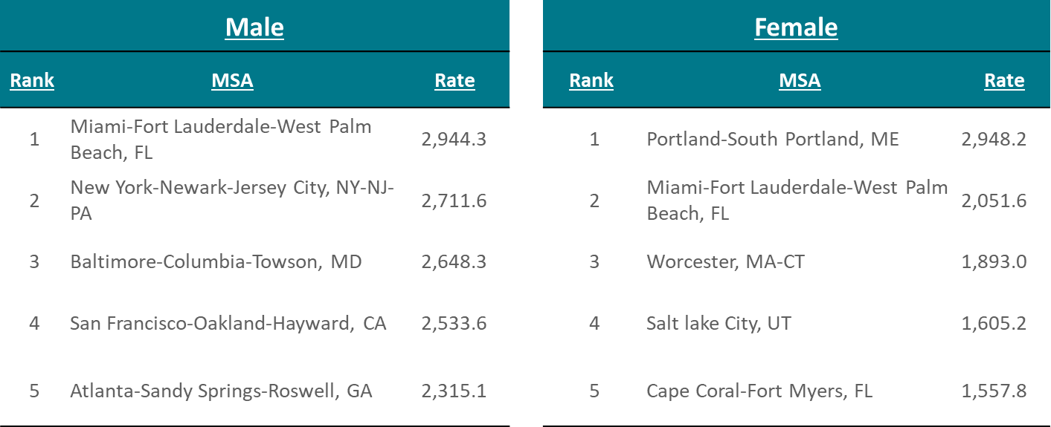
Rates of Black/African American Adults and Adolescents Living with Diagnosed HIV Infection, by Metropolitan Statistical Area and Sex—United States and Puerto Rico Year-end 2016
Note. Data are based on residence at the end of the specified year (i.e., most recent known address). Data exclude persons whose county of residence is unknown. Rates are per 100,000 population.
Notes:
This slide presents rates of black/African American adults and adolescents living with diagnosed HIV infection, by metropolitan statistical area (MSA) and sex, in the United States and Puerto Rico at year-end 2016.
The highest rate for black/African American male adults and adolescents living with diagnosed HIV infection was in Miami-Fort Lauderdale-West Palm Beach, FL (2,944.3). The highest rate for black/African American female adults and adolescents living with diagnosed HIV infection was in Portland-South Portland, ME (2,948.2).
Data are based on residence at the end of the specified year (i.e., most recent known address). Data exclude persons whose county of residence is unknown. Rates are per 100,000 population.

Slide 12
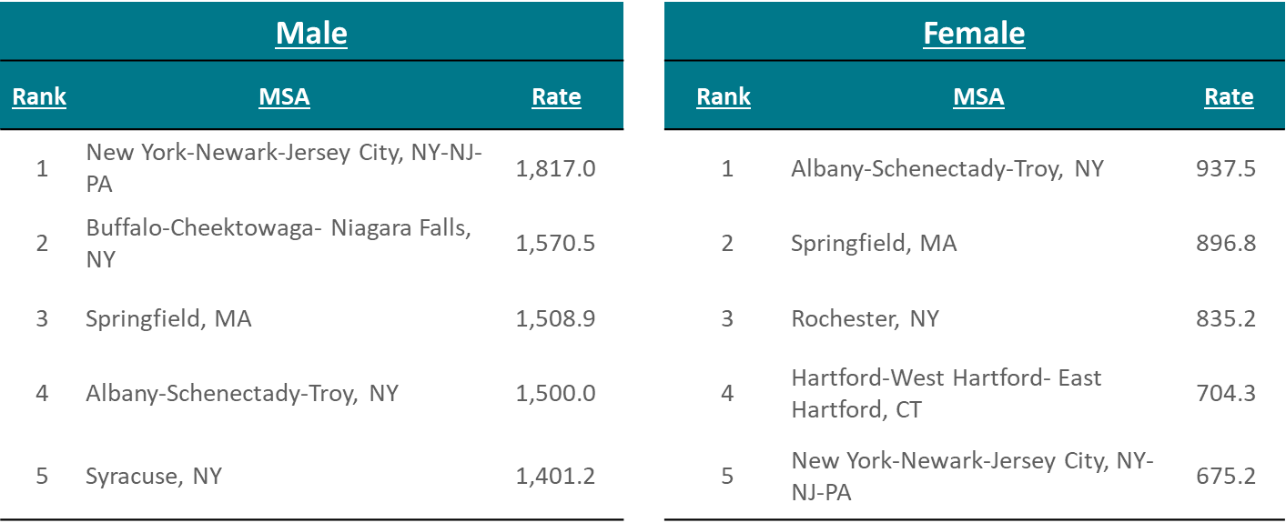
Rates of Hispanic/Latino Adultsª and Adolescents Living with Diagnosed HIV Infection, by Metropolitan Statistical Area and Sex—United States and Puerto Rico, Year-end 2016
Note. Data are based on residence at the end of the specified year (i.e., most recent known address). Data exclude persons whose county of residence is unknown. Rates are per 100,000 population.
ª Hispanics/Latinos can be of any race.
Notes:
This slide presents rates of Hispanic/Latino adults and adolescents living with diagnosed HIV infection, by metropolitan statistical area (MSA) and sex, in the United States and Puerto Rico at year-end 2016.
MSAs in the Northeast region of the United States accounted for the highest rates of Hispanic/Latino adult and adolescent males living with diagnosed HIV infection (accounting for all five of the MSAs with the highest rates). Similarly, MSAs in the Northeast region of the United States accounted for the highest rates of Hispanic/Latino females living with diagnosed HIV infection (accounting for all five of the MSAs with the highest rates).
Data are based on residence at the end of the specified year (i.e., most recent known address). Data exclude persons whose county of residence is unknown. Rates are per 100,000 population.
ª Hispanics/Latinos can be of any race.

Slide 13
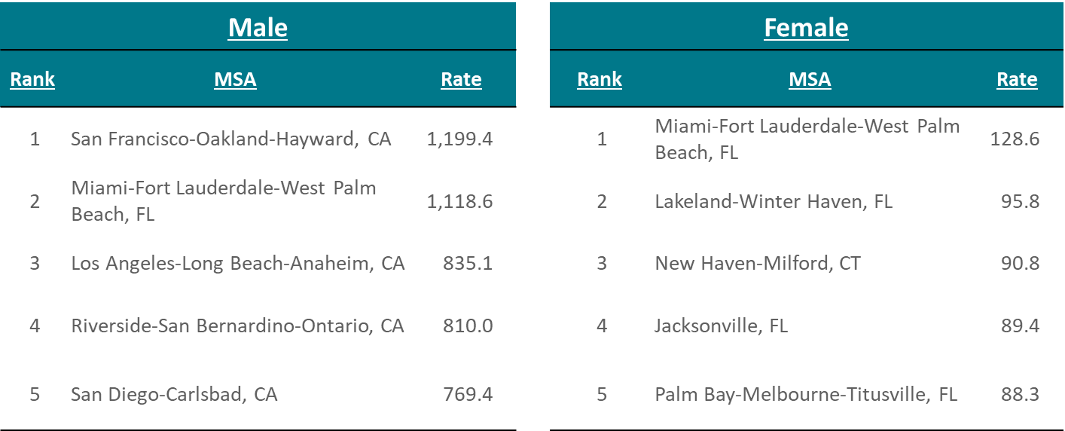
Rates of White Adults and Adolescents Living with Diagnosed HIV Infection, by Metropolitan Statistical Area and Sex—United States and Puerto Rico, Year-end 2016
Note. Data are based on residence at the end of the specified year (i.e., most recent known address). Data exclude persons whose county of residence is unknown. Rates are per 100,000 population.
Notes:
This slide presents rates of white adults and adolescents living with diagnosed HIV infection, by metropolitan statistical area (MSA) and sex, in the United States and Puerto Rico at year-end 2016.
MSAs in the West region of the United States accounted for some of the highest rates of white adult and adolescent males living with diagnosed HIV infection (accounting for four of five MSAs with the highest rates). MSAs in the South region of the United States accounted for the highest rates of white adult and adolescent females living with diagnosed HIV infection (accounting for four of five MSAs with the highest rates).
Data are based on residence at the end of the specified year (i.e., most recent known address). Data exclude persons whose county of residence is unknown. Rates are per 100,000 population.

Slide 14
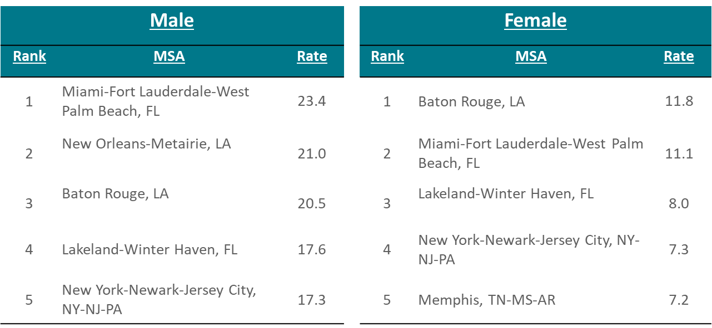
Rates of Deaths among Adults and Adolescents with Diagnosed HIV Infection, by Metropolitan Statistical Area and Sex—United States and Puerto Rico, 2016
Note. Deaths of persons with diagnosed HIV infection may be due to any cause. Data are based on residence at death. Rates are per 100,000 population.
Notes:
This slide presents rates of deaths in 2016 among adults and adolescents with diagnosed HIV infection, by metropolitan statistical area (MSA) and sex. The highest rates of deaths among persons with diagnosed HIV infection for both male and female categories were among MSAs located in the South region of the United States.
Deaths of persons with diagnosed HIV infection may be due to any cause. Data are based on residence at death. Rates are per 100,000 population.

