Slide 1
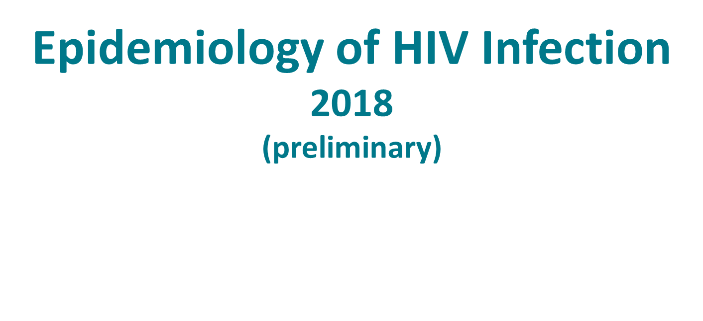
Notes:
Epidemiology of HIV Infection, 2018.
For all slides in this series, the following notes apply:
The Epidemiology of HIV Infection slide set presents and interprets trends in HIV diagnoses for 2013–2017 and provides preliminary data, based on a 6-month reporting delay, for 2018. The standard used for reporting trends in numbers and rates is based on an increase or a decrease of 5% or more during the specified time frame (e.g., when comparing 2010 and 2017).
Beginning in 2020, CDC will transition to publishing this slide set earlier in the calendar year and will include data reported to CDC’s National HIV Surveillance System through December 31 of the prior year (instead of June 30). The use of data reported to CDC through December will allow for a 12-month reporting lag. In early 2020, CDC will release an update to the 2018 data that will present and interpret trends in HIV diagnoses through 2018. Future editions of this slide set will be published according to the new time line.
Numbers and rates of diagnosed HIV infection and diagnosed infections classified as stage 3 (AIDS) are based on data from 50 states, the District of Columbia, and 6 U.S. dependent areas.
Rates for transmission category are not provided because of the absence of denominator data from the U.S. Census Bureau.
Rates are not calculated by race/ethnicity for the 6 U.S. dependent areas because the U.S. Census Bureau does not collect information from all U.S. dependent areas.
Data are presented for diagnoses of HIV infection reported to CDC through June 2019.
Data re-release agreements between CDC and state/local HIV surveillance programs require certain levels of cell suppression at the state and county level in order to ensure confidentiality of personally identifiable information.

Slide 2
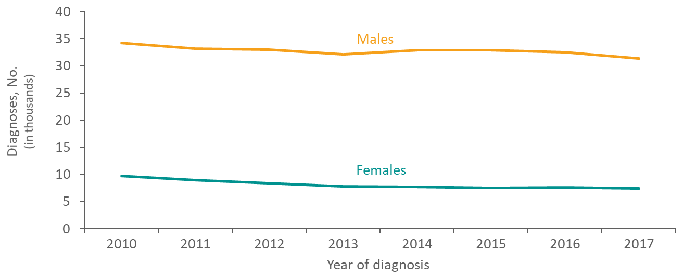
Diagnoses of HIV Infection among Adults and Adolescents, by Sex 2010–2017—United States and 6 Dependent Areas
Notes:
From 2010 through 2017, in the United States and 6 dependent areas, the number of diagnoses of HIV infection among female and male adults and adolescents decreased. In 2017, 38,686 adults and adolescents received a diagnosis of HIV infection; of these, 81% of diagnoses were among males and 19% were among females.

Slide 3
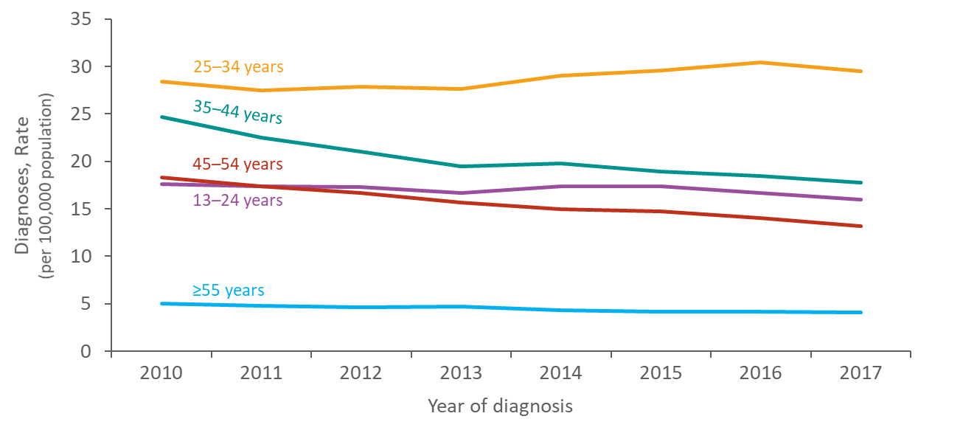
Rates of Diagnoses of HIV Infection among Adults and Adolescents by Age at Diagnosis, 2010–2017—United States
Notes:
This slide presents the rates of diagnoses of HIV infection by age group among adults and adolescents in the United States from 2010 though 2017.
Persons aged 25–34 years accounted for the highest rates of diagnoses of HIV infection each year; whereas, persons aged ≥55 years accounted for the lowest rates of diagnoses of HIV infection each year.
From 2010 though 2017, rates of diagnoses of HIV infection decreased among persons aged 35–44 years (-24%), 45–54 years (-20%), and ≥55 years (-16%). Rates remained stable among persons aged 13–24 years and 25–34 years.

Slide 4
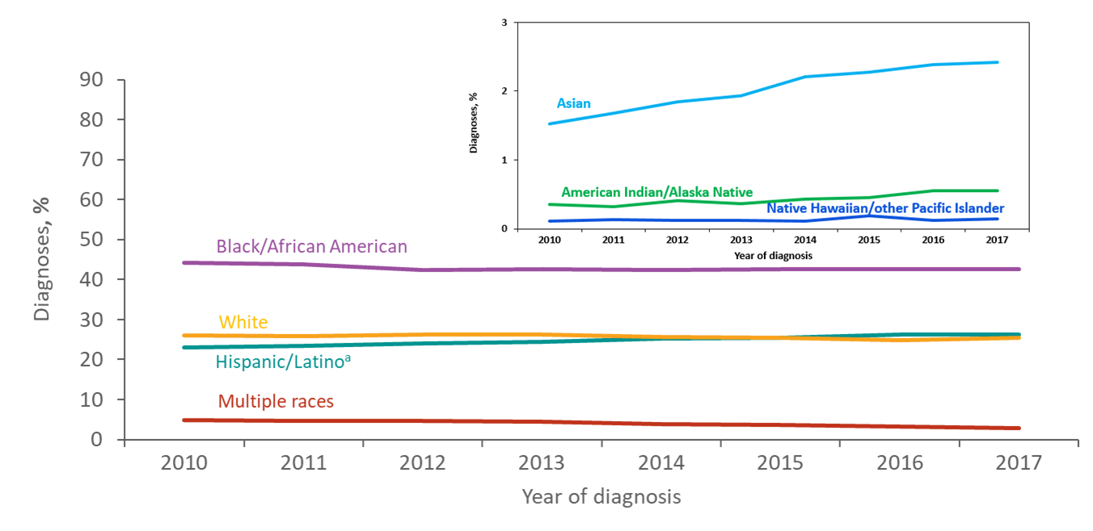
Diagnoses of HIV Infection among Adults and Adolescents, by Race/Ethnicity 2010–2017—United States and 6 Dependent Areas
ª Hispanics/Latinos can be of any race.
Notes:
From 2010 through 2017, blacks/African Americans accounted for the largest percentage of diagnoses of HIV infections each year in the United States and 6 dependent areas.
In 2017, 44% of diagnoses were among blacks/African Americans, 27% among Hispanics/Latinos, 26% among whites, 3% each among persons of multiple races and Asians, and less than 1% each for American Indians/Alaska Natives and Native Hawaiians/other Pacific Islanders. In 2017, the proportion of diagnoses that were among Hispanics/Latinos was greater than the proportion of diagnoses that were among whites.
Hispanics/Latinos can be of any race.

Slide 5
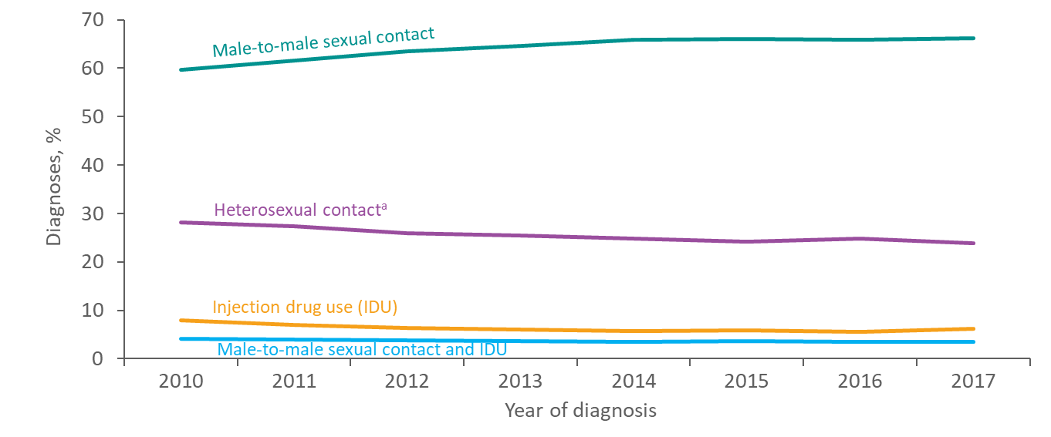
Diagnoses of HIV Infection among Adults and Adolescents, by Transmission Category, 2010–2017—United States and 6 Dependent Areas
Note. Data have been statistically adjusted to account for missing transmission category. “Other” transmission category not displayed as it comprises less than 1% of cases.
ª Heterosexual contact with a person known to have, or to be at high risk for, HIV infection.
Notes:
This slide presents the percentage distribution of adults and adolescents with diagnosed HIV infection from 2010 through 2017, by transmission category, for the United States and 6 dependent areas.
The percentage of adults and adolescents with diagnosed HIV infection attributed to male-to-male sexual contact increased from 60% in 2010 to 66% in 2017. The percentages of diagnosed HIV infections attributed to injection drug use, male-to-male sexual contact and injection drug use, and heterosexual contact decreased from 2010 through 2017. The “Other” transmission category is not displayed as it comprises less than 1% of cases. The category includes hemophilia, blood transfusion, perinatal exposure, and risk factor not reported or not identified.
Data have been statistically adjusted to account for missing transmission category.
Heterosexual contact is with a person known to have, or to be at high risk for, HIV infection.

Slide 6
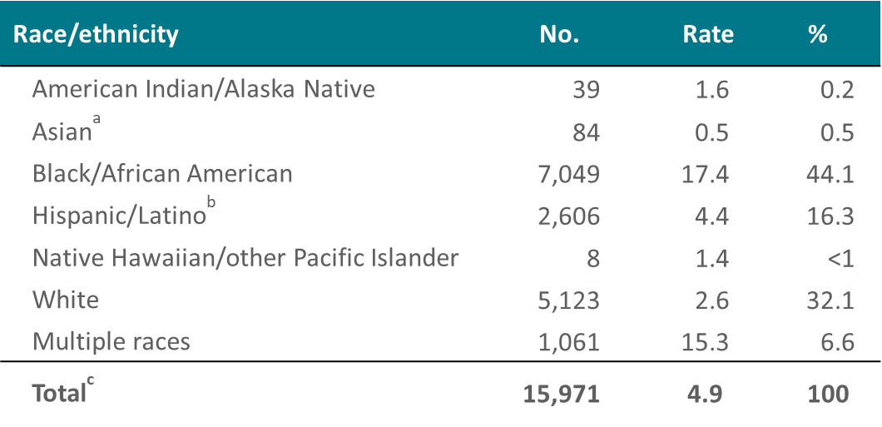
Deaths of Persons with Diagnosed HIV Infection by Race/Ethnicity, 2017—United States
Note. Deaths of persons with diagnosed HIV infection may be due to any cause. Rates are per 100,000 population.
ª Includes Asian/Pacific Islander legacy cases.
^{b} Hispanics/Latinos can be of any race.
^{C} Includes one person whose race/ethnicity is unknown.
Notes:
During 2017, there were 15,971 deaths of persons with diagnosed HIV infection. Of these, blacks/African Americans had the highest rate (17.4 deaths per 100,000 population) and accounted for approximately 44% of deaths of persons with diagnosed HIV infection. Hispanics/Latinos accounted for approximately 16% of deaths in 2017, with a rate of 4.4 per 100,000 population. Whites accounted for 32% of deaths, with a rate of 2.6 per 100,000 population.
Relatively few deaths occurred among persons of other races; the rate per 100,000 population of deaths was 15.3 for persons of multiple races, 1.6 for American Indians/Alaska Natives, 1.4 for Native Hawaiians/other Pacific Islanders, and 0.5 for Asians.
Deaths of persons with diagnosed HIV infection may be due to any cause (may or may not be HIV-related).
The Asian category includes Asian/Pacific Islander legacy cases (cases that were diagnosed and reported under the pre-1997 Office of Management and Budget race/ethnicity classification system).
Hispanics/Latinos can be of any race.
The total includes one person whose race/ethnicity is unknown.

Slide 7
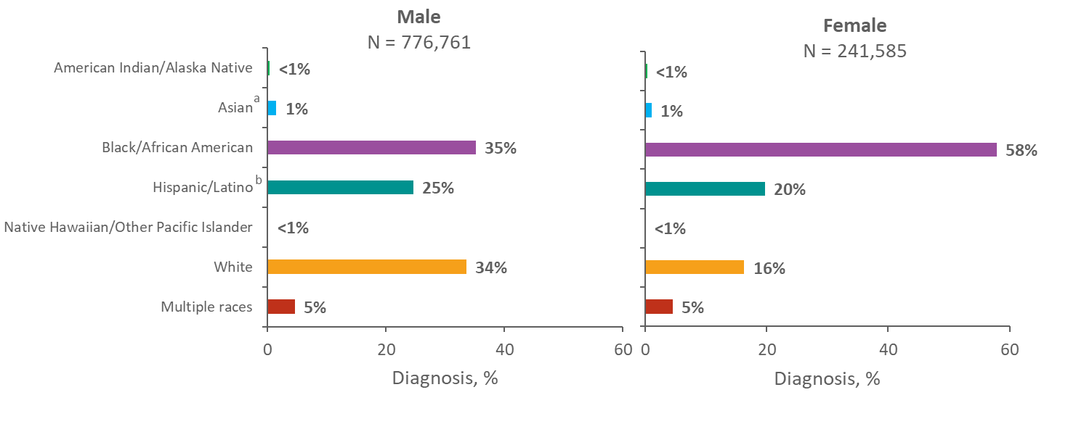
Adults and Adolescents Living with Diagnosed HIV Infection, by Sex and Race/Ethnicity, Year-end 2017—United States and 6 Dependent Areas
Note. Unknown race/ethnicity is not displayed because it comprises less than 1% of cases.
ª Includes Asian/Pacific Islander legacy cases.
^{b} Hispanics/Latinos can be of any race.
Notes:
At the end of 2017, 1,018,346 adults and adolescents were living with diagnosed HIV infection in the United States and 6 dependent areas.
Among the 776,761 males living with diagnosed HIV infection, 35% were black/African American, 34% were white, and 25% were Hispanic/Latino. Approximately 5% were males of multiple races and approximately 1% were Asian. Less than 1% each were American Indian/Alaska Native and Native Hawaiian/other Pacific Islander.
Among the 241,585 females living with diagnosed HIV infection, 58% were black/African American, 20% were Hispanic/Latino, and 16% were white. Approximately 5% were females of multiple races and approximately 1% were Asian. Less than 1% each were American Indian/Alaska Native and Native Hawaiian/other Pacific Islander.
The Asian category includes Asian/Pacific Islander legacy cases (cases that were diagnosed and reported under the pre-1997 Office of Management and Budget race/ethnicity classification system). Hispanics/Latinos can be of any race. Unknown race/ethnicity is not displayed because it comprises less than 1% of cases.
Persons living with diagnosed HIV infection are classified as adult or adolescent based on age at year-end 2017.

Slide 8
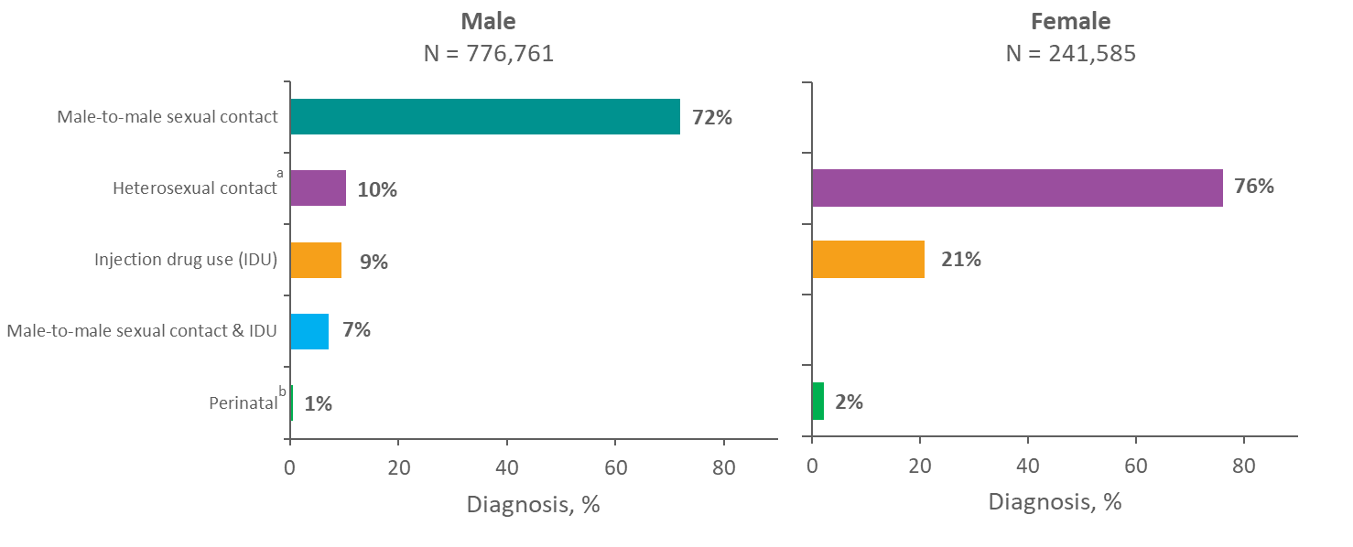
Adults and Adolescents Living with Diagnosed HIV Infection, by Sex and Transmission Category, Year-end 2017—United States and 6 Dependent Areas
Note. Data have been statistically adjusted to account for missing transmission category. “Other” transmission category not displayed as it comprises 1% or less of cases.
ª Heterosexual contact with a person known to have, or to be at high risk for, HIV infection.
^{b} Perinatal includes persons whose infections were attributed to perinatal transmission, but were aged 13 years and older at the end of 2017.
Notes:
This slide presents the percentage distribution of adults and adolescents living with diagnosed HIV infection by sex and transmission category at the end of 2017 in the United States and 6 dependent areas.
Among the 776,761 male adults and adolescents living with diagnosed HIV infection at the end of 2017, 72% of infections were attributed to male-to-male sexual contact. Approximately 10% to heterosexual contact, 9% of infections were attributed to injection drug use, 7% to male-to-male sexual contact and injection drug use, and 1% of males had infection attributed to perinatal exposure.
Among the 241,585 female adults and adolescents living with diagnosed HIV infection at the end of 2017, 76% of infections were attributed to heterosexual contact, 21% to injection drug use, and 2% of females had infection attributed to perinatal exposure.
The “Other” transmission category is not displayed as it comprises 1% or less of cases. The category includes hemophilia, blood transfusion, and risk factor not reported or not identified.
Data have been statistically adjusted to account for missing transmission category.
Heterosexual contact is with a person known to have, or to be at high risk for, HIV infection.
Perinatal includes persons whose infections were attributed to perinatal transmission, but were aged 13 years and older at the end of 2017.
Persons living with diagnosed HIV infection are classified as adult or adolescent based on age at year-end 2017.

Slide 9
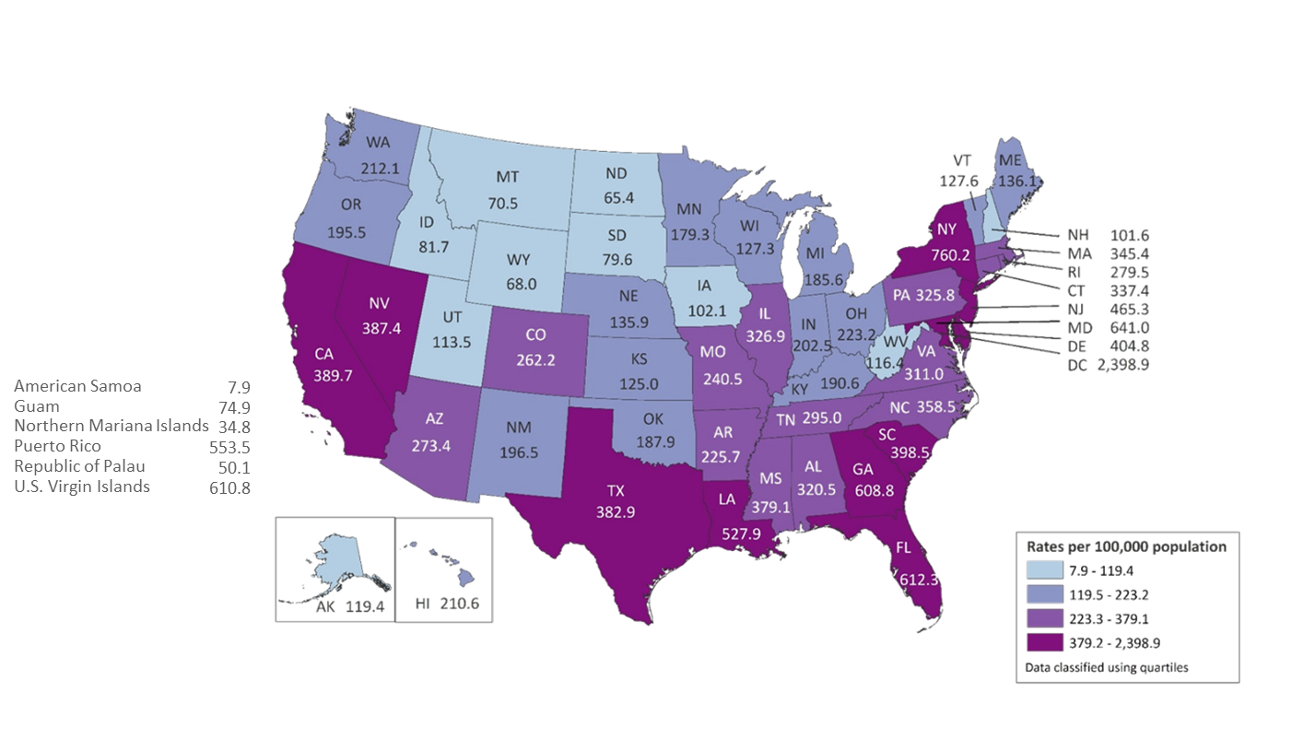
Rates of Adults and Adolescents Living with Diagnosed HIV Infection Year-end 2017—United States and 6 Dependent Areas N = 1,018,346 Total Rate = 369.4
Note. Data are based on address of residence as of December 31, 2017 (i.e., most recent known address).
Notes:
This slide presents rates (per 100,000 population) of adults and adolescents living with diagnosed HIV infection at the end of 2017 in the United States and 6 dependent areas.
Areas with the highest rates of persons living with diagnosed HIV infection at the end of 2017 were the District of Columbia (2,398.9), New York (760.2), Maryland (641.0), Florida (612.3), and the U.S. Virgin Islands (610.8).
The District of Columbia (i.e., Washington, DC) is a city; use caution when comparing the rate of persons living with diagnosed HIV infection in DC with the rates in states.
Data are based on address of residence as of December 31, 2017 (i.e., most recent known address).
Persons living with a diagnosis of HIV infection are classified as adult or adolescent based on age at year-end 2017.

Slide 10
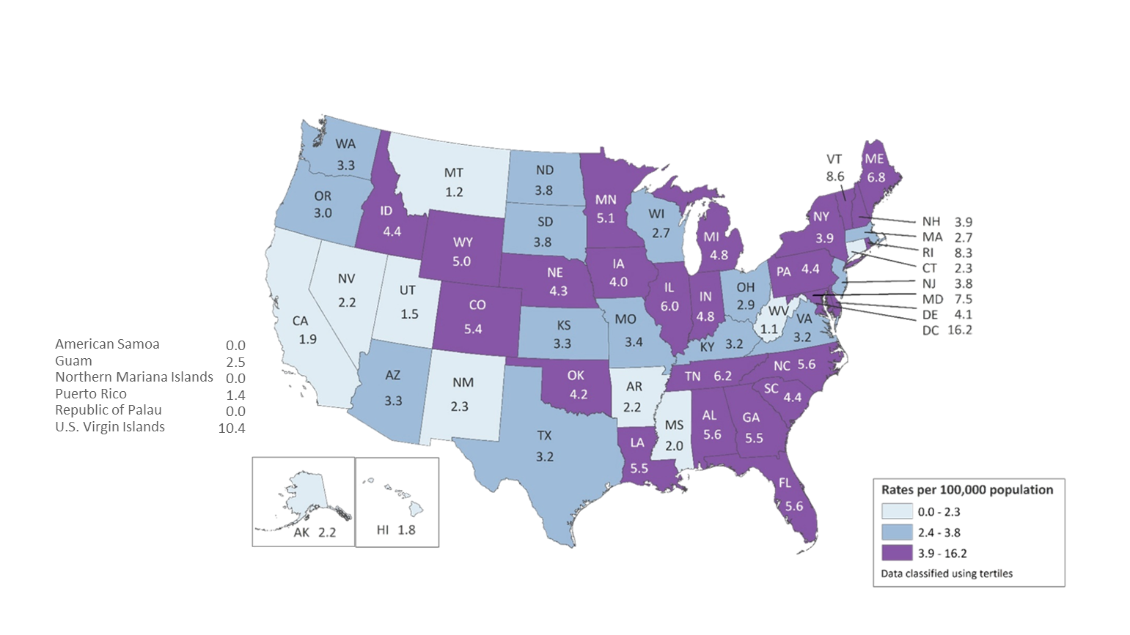
Rates of Children Aged <13 Years Living with Diagnosed HIV Infection Year-end 2017—United States and 6 Dependent Areas N = 2,073 Total Rate = 3.9
Note. Data are based on address of residence as of December 31, 2017 (i.e., most recent known address).
Notes:
This slide presents rates (per 100,000 population) of children living with diagnosed HIV infection at the end of 2017 in the United States and 6 dependent areas.
Areas with the highest rates of children living with diagnosed HIV infection at the end of 2017 were the District of Columbia (16.2), the U.S. Virgin Islands (10.4), Vermont (8.6), Rhode Island (8.3), Maryland (7.5), and Maine (6.8).
The District of Columbia (i.e., Washington, DC) is a city; use caution when comparing the rate of persons living with diagnosed HIV infection in DC with the rates in states.
Data are based on address of residence as of December 31, 2017 (i.e., most recent known address).
Persons living with a diagnosis of HIV infection are classified as children based on age at year-end 2017.

Slide 11
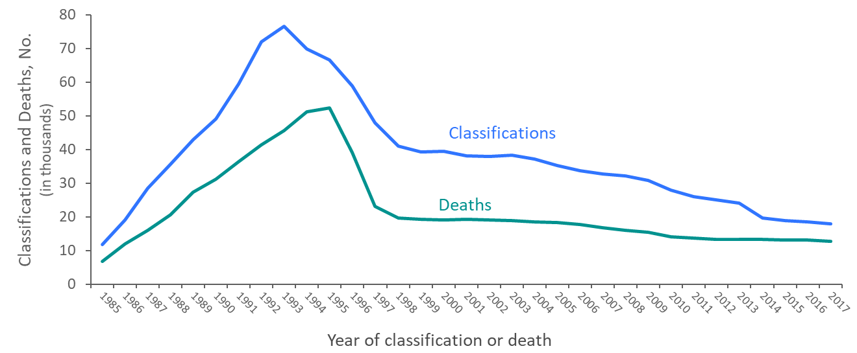
Stage 3 (AIDS) Classifications and Deaths of Persons with Diagnosed HIV Infection Ever Classified as Stage 3 (AIDS), among Adults and Adolescents, 1985–2017 United States and 6 Dependent Areas
Note. Deaths of persons with HIV infection, stage 3 (AIDS) may be due to any cause.
Notes:
The upper curve on the line graph represents the number of stage 3 (AIDS) classifications among adults and adolescents with diagnosed HIV infection in the United States and dependent areas, by year of classification from 1985 through 2017; the lower curve represents the number of deaths of adults and adolescents with diagnosed HIV infection ever classified with stage 3 (AIDS), by year of death from 1985 through 2017. The peak in stage 3 (AIDS) in 1993 can be associated with the expansion of the HIV surveillance case definition implemented in January 1993. The overall declines in stage 3 (AIDS) and deaths of persons with stage 3 (AIDS) are due in part to the success of highly active antiretroviral therapies, introduced in 1996.
In recent years, stage 3 (AIDS) classifications and deaths of persons with stage 3 (AIDS) have continued to decline.
Deaths of persons with stage 3 (AIDS) may be due to any cause (may not be HIV-related). Deaths of persons with stage 3 (AIDS) are classified as adult or adolescent based on age at death.

Slide 12
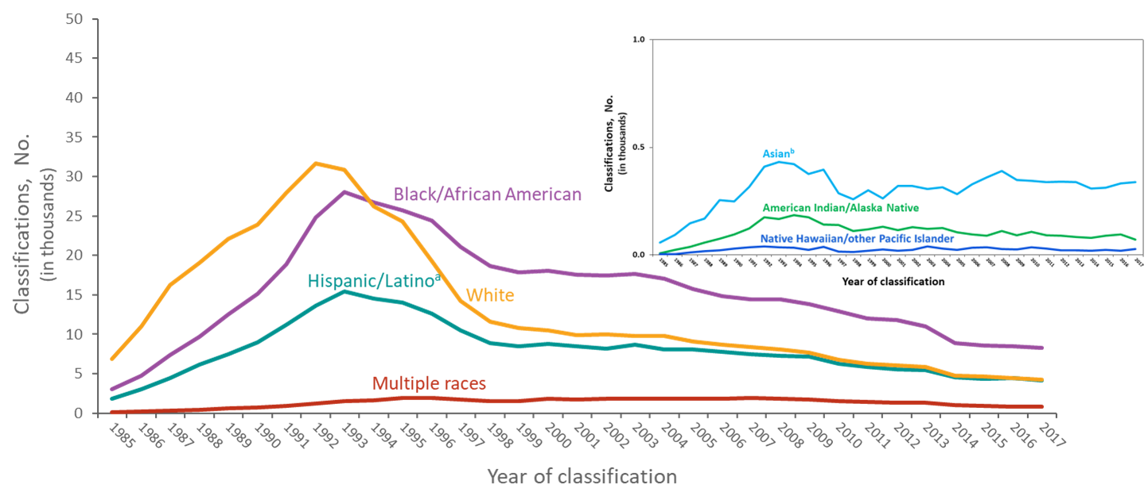
Stage 3 (AIDS) Classifications among Adults and Adolescents with Diagnosed HIV Infection, by Race/Ethnicity and Year of Classification, 1985–2017—United States and 6 Dependent Areas
Note. Unknown race/ethnicity is not displayed because it comprises less than 1% of cases.
ª Hispanics/Latinos can be of any race.
^{b} Includes Asian/Pacific Islander legacy cases.
Notes:
During the early 1990’s the numbers of HIV infections classified as stage 3 (AIDS) among whites, blacks/African Americans and Hispanics/Latinos increased, peaked during 1992–1993, and then decreased since that time. However, decreases were not consistent across races/ethnicities: stage 3 (AIDS) among blacks/African Americans surpassed whites for the first time in 1994 and has remained higher than all races/ethnicities since that time.
The Asian category includes Asian/Pacific Islander legacy cases (cases that were diagnosed and reported under the pre-1997 Office of Management and Budget race/ethnicity classification system). Hispanics/Latinos can be of any race. Unknown race/ethnicity is not displayed because it comprises less than 1% of cases.

Slide 13
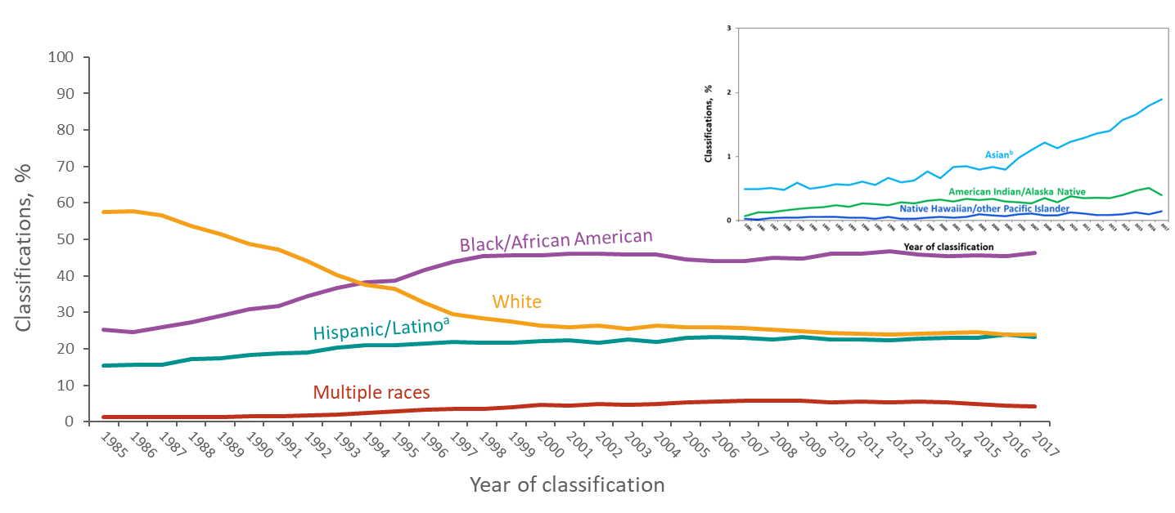
Percentages of Stage 3 (AIDS) Classifications among Adults and Adolescents with Diagnosed HIV Infection, by Race/Ethnicity and Year of Classification 1985–2017—United States and 6 Dependent Areas
Note. Unknown race/ethnicity is not displayed because it comprises less than 1% of cases.
ª Hispanics/Latinos can be of any race.
^{b} Includes Asian/Pacific Islander legacy cases.
Notes:
The percentage distribution of HIV infections classified as stage 3 (AIDS) among racial/ethnic groups has changed since 1985. Among persons with infection classified as stage 3 (AIDS), the percentage that were white has decreased while the percentage that were black/African American and Hispanic/Latino has increased.
Of persons with infection classified as stage 3 (AIDS) in the United States and dependent areas in 2017, 46% were black/African American, 24% were white, 23% were Hispanic/Latino, 4% were persons of multiple races, 2% were Asian, and less than 1% each were American Indian/Alaska Native and Native Hawaiian/other Pacific Islander.
The Asian category includes Asian/Pacific Islander legacy cases (cases that were diagnosed and reported under the pre-1997 Office of Management and Budget race/ethnicity classification system). Hispanics/Latinos can be of any race. Unknown race/ethnicity is not displayed because it comprises less than 1% of cases.

Slide 14
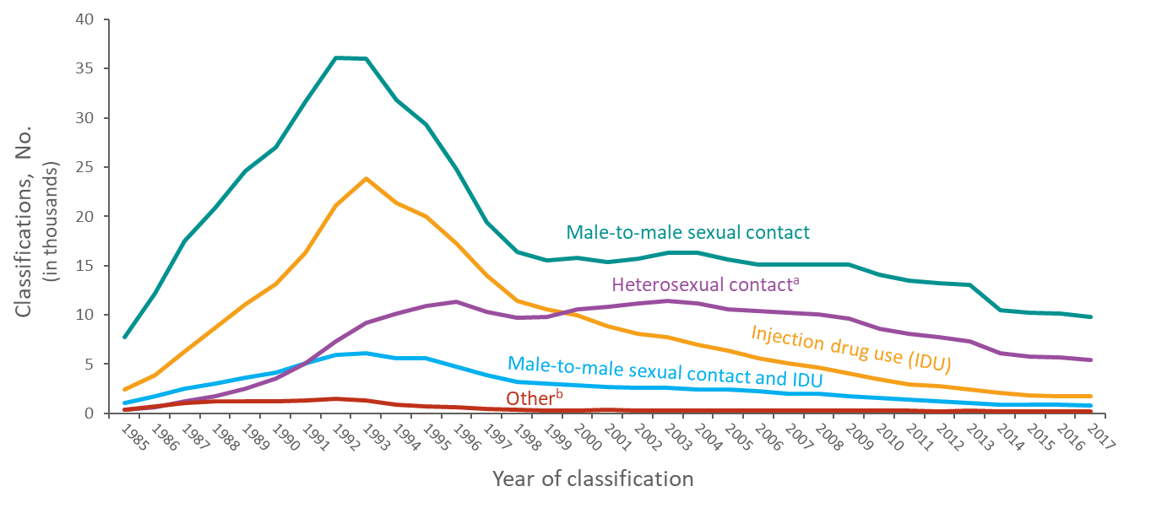
Stage 3 (AIDS) Classifications among Adults and Adolescents with Diagnosed HIV Infection, by Transmission Category and Year of Classification, 1985–2017 United States and 6 Dependent Areas
Note. Data have been statistically adjusted to account for missing transmission category.
ª Heterosexual contact with a person known to have, or to be at high risk for, HIV infection.
^{b} Includes hemophilia, blood transfusion, perinatal exposure, and risk factor not reported or not identified.
Notes:
Despite decreases, the number of HIV infections classified as stage 3 (AIDS) among persons with infection attributed to male-to-male sexual contact continues to represent the highest number of stage 3 (AIDS) classifications each year. Stage 3 (AIDS) classifications among persons with HIV infection attributed to injection drug use peaked in 1993 and have continued to decline since then. Stage 3 (AIDS) classifications among persons with HIV infection attributed to heterosexual contact increased through the mid-1990s and then remained stable until classifications started to decrease in 2004. Stage 3 (AIDS) among persons with HIV infection attributed to heterosexual contact surpassed the number of those attributed to injection drug use for the first time in 2000 and have continued to account for the second highest number of infections classified as stage 3 (AIDS) annually since that time.
Data have been statistically adjusted to account for missing transmission category.
Heterosexual contact is with a person known to have, or to be at high risk for, HIV infection.
The “Other” category includes hemophilia, blood transfusion, perinatal exposure, and risk factor not reported or not identified.

Slide 15
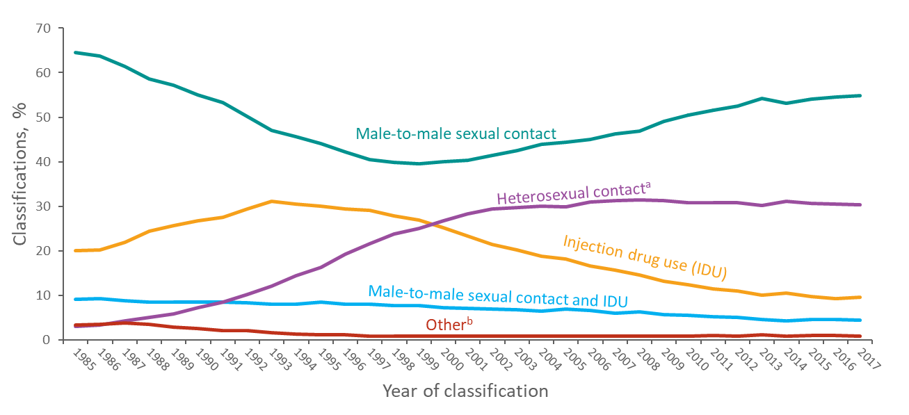
Percentages of Stage 3 (AIDS) Classifications among Adults and Adolescents with Diagnosed HIV Infection, by Transmission Category and Year of Classification 1985–2017—United States and 6 Dependent Areas
Note. Data have been statistically adjusted to account for missing transmission category.
ª Heterosexual contact with a person known to have, or to be at high risk for, HIV infection.
^{b} Includes hemophilia, blood transfusion, perinatal exposure, and risk factor not reported or not identified.
Notes:
The percentage distribution of HIV infections classified as stage 3 (AIDS) by transmission category has shifted since 1985. In 1985, male-to-male sexual contact accounted for approximately 65% of all stage 3 (AIDS) classifications; this percentage reached its lowest point in 1999 at 40%. Since then, the percentage among persons with HIV infection attributed to male-to-male sexual contact has increased and in 2017 this transmission category accounted for 55% of all infections classified as stage 3 (AIDS).
The percentage of stage 3 (AIDS) classifications among persons with HIV infection attributed to injection drug use increased from 20% to 31% during 1985–1993 and decreased since that time, accounting for 10% in 2017.
The percentage of stage 3 (AIDS) classifications among persons with HIV infection attributed to male-to-male sexual contact and injection drug use decreased from 9% in 1985 to 4% in 2017.
The percentage of stage 3 (AIDS) classifications among persons with HIV infection attributed to heterosexual contact increased from 3% in 1985 to 30% in 2017.
The remaining stage 3 (AIDS) classifications were among persons with HIV infection attributed to other transmission categories which include hemophilia, blood transfusion, perinatal exposure, and risk factor not reported or not identified.
Data have been statistically adjusted to account for missing transmission category.
Heterosexual contact is with a person known to have, or to be at high risk for, HIV infection.

Slide 16
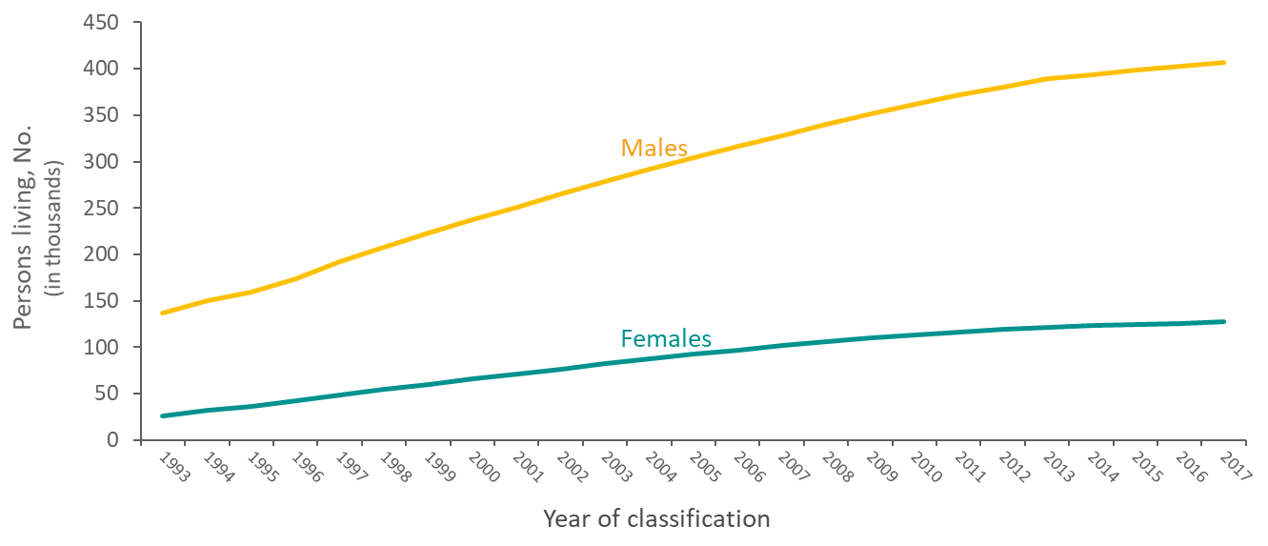
Adults and Adolescents Living with Diagnosed HIV Infection Ever Classified as Stage 3 (AIDS), by Sex, 1993–2017—United States and 6 Dependent Areas
Notes:
This slide presents increases in the number of adults and adolescents living with diagnosed HIV infection ever classified as stage 3 (AIDS) in the United States and dependent areas from 1993 through the end of 2016, by sex. The increase is due primarily to the widespread use of highly active antiretroviral therapy, introduced in 1996, which has delayed the progression of HIV infection to death. At the end of 2017, approximately 533,556 adults and adolescents were living with HIV infection ever classified as stage 3 (AIDS); of these, 76% were male and 24% were female.
Persons living with HIV infection ever classified as stage 3 (AIDS) are classified as adult or adolescent based on age at end of 2017.

Slide 17
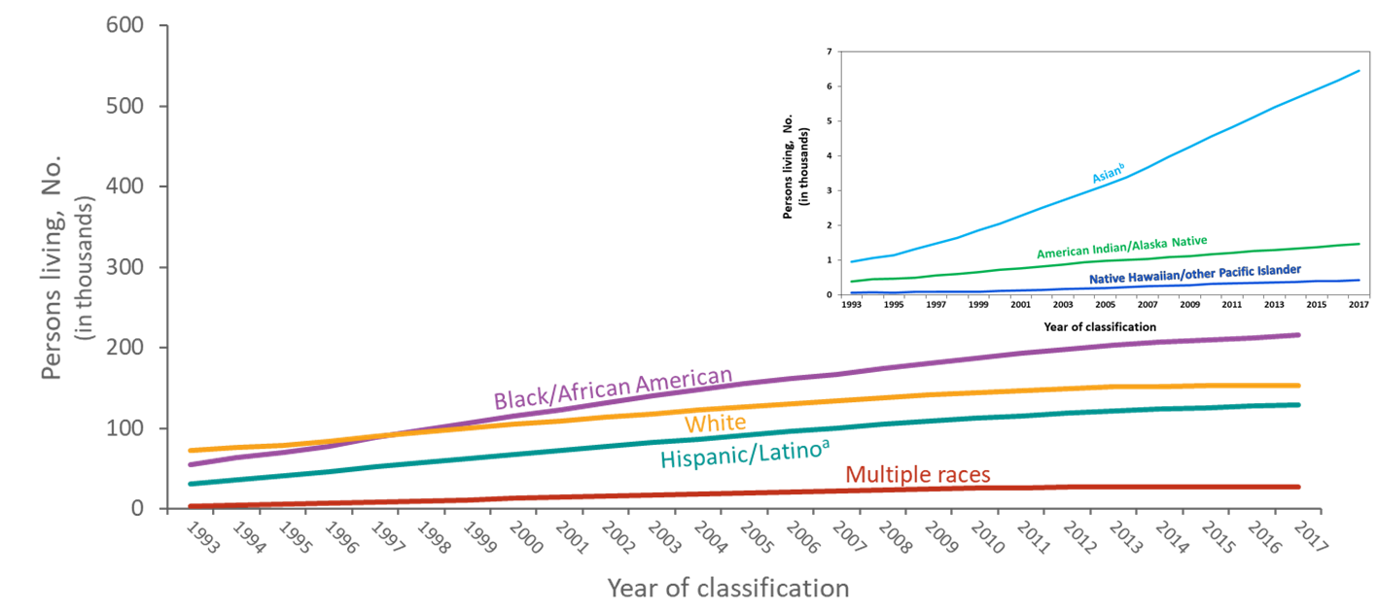
Adults and Adolescents Living with Diagnosed HIV Infection Ever Classified as Stage 3 (AIDS), by Race/Ethnicity, 1993–2017—United States and 6 Dependent Areas
Note. Unknown race/ethnicity is not displayed because it comprises less than 1% of cases.
ª Hispanics/Latinos can be of any race.
^{b} Includes Asian/Pacific Islander legacy cases.
Notes:
The number of adults and adolescents living with diagnosed HIV infection ever classified as stage 3 (AIDS) in the United States and dependent areas increased from 163,139 at year-end 1993 to 533,556 at year-end 2017. Increases in the number of persons living with infection ever classified as stage 3 (AIDS) occurred in all racial/ethnic groups.
From 1993 through 2017, the number of blacks/African Americans living with infection ever classified as stage 3 (AIDS) increased from 54,466 to 215,298. At the end of 1998, the number of blacks/African Americans living with infection ever classified as stage 3 (AIDS) exceeded the number of whites for the first time.
From 1993 through 2017, the number of whites living with infection ever classified as stage 3 (AIDS) increased from 72,461 to 153,331; the number of Hispanics/Latinos increased from 31,242 to 129,458; the number of persons of multiple races increased from 3,537 to 27,076; the number of Asians increased from 960 to 6,455; the number of American Indians/Alaska Natives increased from 392 to 1,473; and the number of Native Hawaiians/other Pacific Islanders increased from 71 to 425.
The Asian category includes Asian/Pacific Islander legacy cases (cases that were diagnosed and reported under the pre-1997 Office of Management and Budget race/ethnicity classification system).
Hispanics/Latinos can be of any race.
Unknown race/ethnicity is not displayed because it comprises less than 1% of cases.

Slide 18
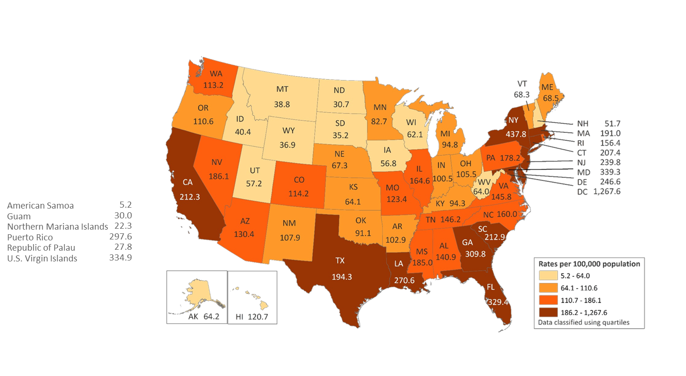
Rates of Adults and Adolescents Living with Diagnosed HIV Infection Ever Classified as Stage 3 (AIDS), Year-end 2017—United States and 6 Dependent Areas N = 533,556 Total Rate = 193.6
Note. Data are based on address of residence as of December 31, 2017 (i.e., most recent known address).
Notes:
In the United States and dependent areas, the rate of adults and adolescents living with diagnosed HIV infection ever classified as stage 3 (AIDS) was 193.6 per 100,000 population at the end of 2017. Areas with the highest rates were the District of Columbia (1,267.6), New York (437.8), Maryland (339.3), U.S. Virgin Islands (334.9), Florida (329.4), Georgia (309.8), and Puerto Rico (297.6).
The District of Columbia (i.e., Washington, DC) is a city; use caution when comparing the rate of persons living with infection ever classified as stage 3 (AIDS) in DC with the rates in states.
Data are based on address of residence as of December 31, 2017 (i.e., most recent known address).
Persons living with infection ever classified as stage 3 (AIDS) are classified as adult or adolescent based on age at end of 2017.

Slide 19
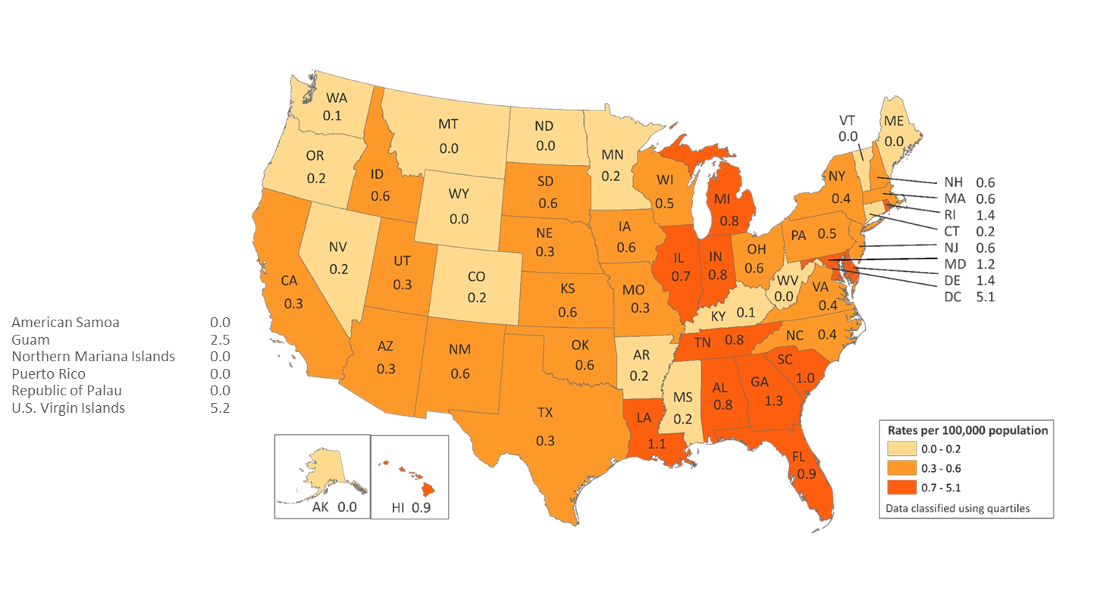
Rates of Children Aged <13 Years Living with Diagnosed HIV Infection Ever Classified as Stage 3 (AIDS), Year-end 2017—United States and 6 Dependent Areas N = 284 Total Rate = 0.5
Note. Data are based on address of residence as of December 31, 2017 (i.e., most recent known address).
Notes:
In the United States and dependent areas, the rate of children living with diagnosed HIV infection ever classified as stage 3 (AIDS) was 0.5 per 100,000 population at the end of 2017. Areas with the highest rate were the U.S. Virgin Islands (5.2), District of Columbia (5.1), Guam (2.5), Delaware (1.4), and Rhode Island (1.4).
The District of Columbia (i.e., Washington, DC) is a city; use caution when comparing the rate of persons living with infection ever classified as stage 3 (AIDS) in DC with the rates in states.
Data are based on address of residence as of December 31, 2017 (i.e., most recent known address).
Persons living with infection ever classified as stage 3 (AIDS) are classified as children based on age at year-end 2017.

Slide 20
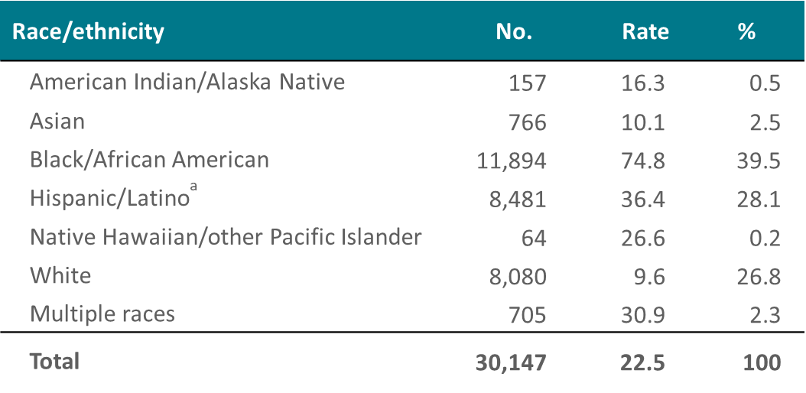
Diagnoses of HIV Infection among Male Adults and Adolescents by Race/Ethnicity, 2018—United States
Note. Data for the year 2018 are considered preliminary and based on 6 months reporting delay. Rates are per 100,000 population.
ª Hispanics/Latinos can be of any race.
Notes:
This slide presents the numbers and rates of diagnoses of HIV infection among male adults and adolescents in the United States in 2018.
In 2018, the rate (per 100,000 population) of diagnoses of HIV infection among black/African American males (74.8) was nearly 8 times as high as the rate for whites (9.6) and more than 2 times as high as the rate for Hispanics/Latinos (36.4).
Relatively few diagnoses of HIV infection were among American Indian/Alaska Native, Asian, and Native Hawaiian/other Pacific Islander males, and males of multiple races; however, the rates for males of multiple races (30.9), Native Hawaiian/other Pacific Islander males (26.6), American Indian/Alaska Native males (16.3), and Asian males (10.1) were higher than that for white males.
Data for the year 2018 are considered preliminary and based on 6 months reporting delay.
Hispanics/Latinos can be of any race.

Slide 21
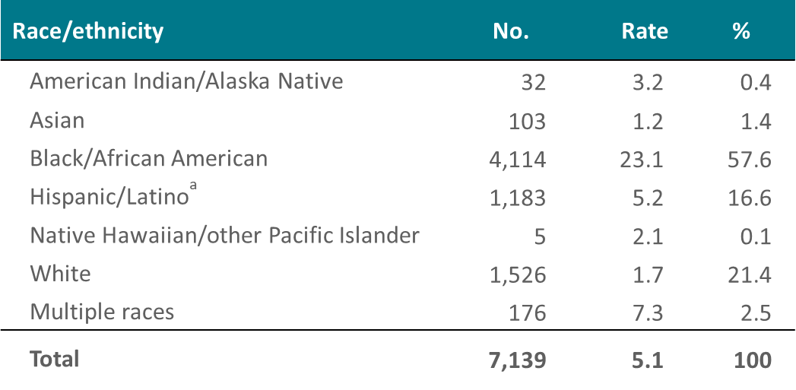
Diagnoses of HIV Infection among Female Adults and Adolescents by Race/Ethnicity, 2018—United States
Note. Data for the year 2018 are considered preliminary and based on 6 months reporting delay. Rates are per 100,000 population.
ª Hispanics/Latinos can be of any race.
Notes:
This slide presents the numbers and rates of diagnoses of HIV infection among female adults and adolescents in the United States in 2018.
In 2018, the rate (per 100,000 population) of diagnoses of HIV infection among black/African American females (23.1) was nearly 14 times as high as the rate for white females (1.7) and more than 4 times as high as the rate for Hispanic/Latino females (5.2).
Relatively few diagnoses of HIV infection were among American Indian/Alaska Native, Asian, and Native Hawaiian/other Pacific Islander females, and females of multiple races; however, the rates for females of multiple races (7.3), Native Hawaiian/other Pacific Islander females (2.1), and American Indian/Alaska Native females (3.2) were all higher than that for white females. The rate among Asians was 1.2 in 2018.
Data for the year 2018 are considered preliminary and based on 6 months reporting delay.
Hispanics/Latinos can be of any race.

Slide 22
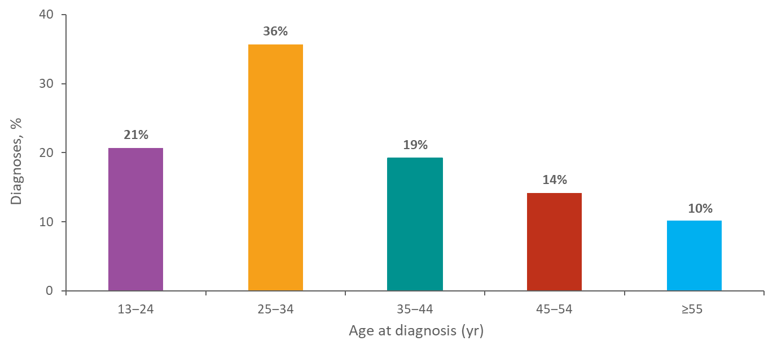
Diagnoses of HIV Infection among Adults and Adolescents by Age at Diagnosis, 2018—United States N = 37,286
Note. Data for the year 2018 are considered preliminary and based on 6 months reporting delay.
Notes:
This slide presents percentages of diagnoses of HIV infection by age group for 2018 in the United States. Of the 37,286 diagnoses of HIV infection among adults and adolescents, 36% were among persons aged 25–34 years, 21% among persons aged 13–24 years, 19% among persons aged 35–44 years, 14% among persons aged 45–54 years, and 10% among persons aged ≥55 years.
Data for the year 2018 are considered preliminary and based on 6 months reporting delay.

Slide 23
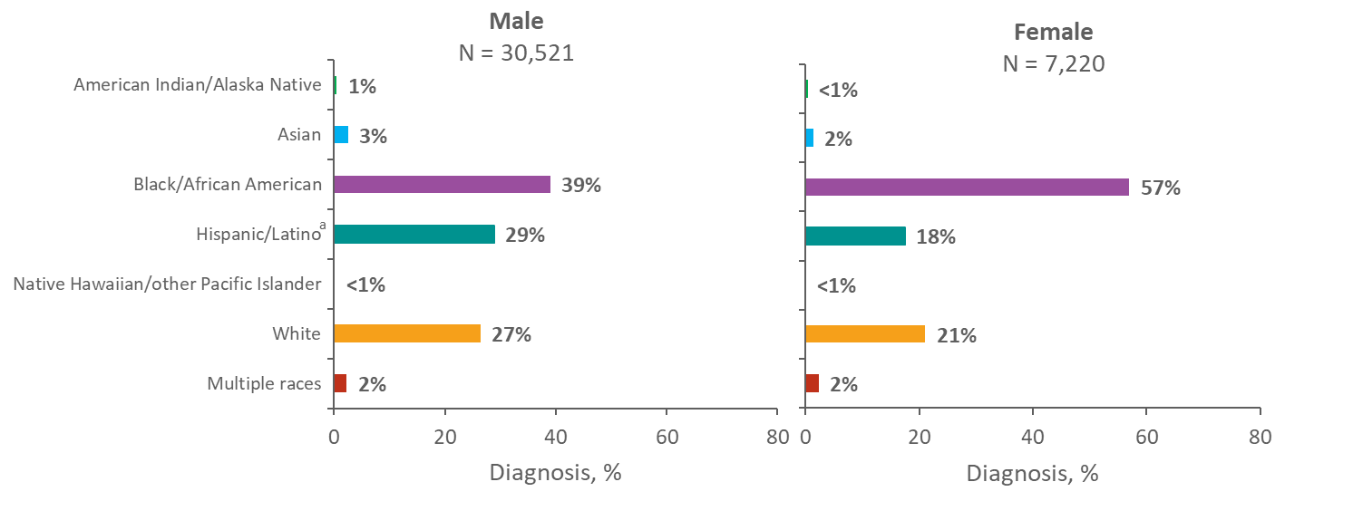
Diagnoses of HIV Infection among Adults and Adolescents by Sex and Race/Ethnicity, 2018—United States and 6 Dependent Areas
Note. Data for the year 2018 are considered preliminary and based on 6 months reporting delay.
ª Hispanics/Latinos can be of any race.
Notes:
In 2018, of the 30,521 diagnoses of HIV infection among male adults and adolescents in the United States and 6 dependent areas, 39% were among blacks/African Americans, 29% among Hispanics/Latinos, 27% among whites, 3% among Asians, 2% among males of multiple races, 1% among American Indians/Alaska Natives, and less than 1% among Native Hawaiians/other Pacific Islanders.
Of the 7,220 diagnoses among female adults and adolescents in 2018, 57% were among blacks/African Americans, 21% among whites, and 18% among Hispanics/Latinos. Approximately 2% each were among females of multiple races and Asians, and less than 1% each were among American Indians/Alaska Natives and Native Hawaiians/other Pacific Islanders.
Data for the year 2018 are considered preliminary and based on 6 months reporting delay.
Hispanics/Latinos can be of any race.

Slide 24
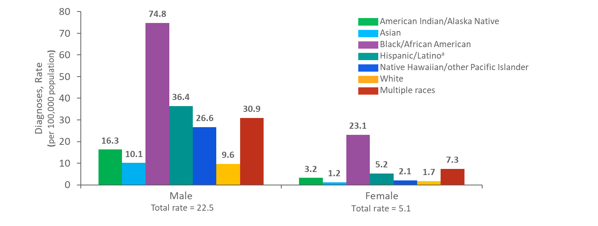
Rates of Diagnoses of HIV Infection among Adults and Adolescents by Sex and Race/Ethnicity, 2018—United States
Note. Data for the year 2018 are considered preliminary and based on 6 months reporting delay.
ª Hispanics/Latinos can be of any race.
Notes:
This slide presents a comparison of the rates of diagnoses of HIV infection between males and females by race/ethnicity in the United States. In 2018, blacks/African Americans accounted for the highest rates of diagnoses of HIV infection for males (74.8 per 100,000 population) and for females (23.1 per 100,000 population).
Data for the year 2018 are considered preliminary and based on 6 months reporting delay.
Hispanics/Latinos can be of any race.

Slide 25
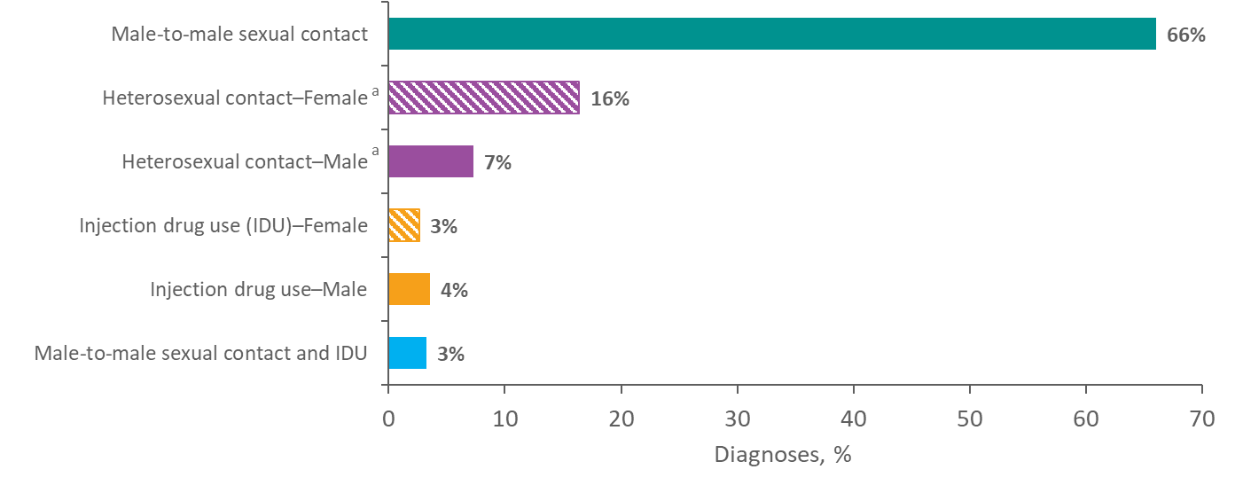
Diagnoses of HIV Infection among Adults and Adolescents, by Transmission Category, 2018—United States and 6 Dependent Areas N = 37,741
Note. Data for the year 2018 are considered preliminary and based on 6 months reporting delay. Data have been statistically adjusted to account for missing transmission category. “Other” transmission category not displayed as it comprises less than 1% of cases.
ª Heterosexual contact with a person known to have, or to be at high risk for, HIV infection.
Notes:
In 2018, among adults and adolescents with diagnosed HIV infection in the United States and 6 dependent areas, approximately 66% of all diagnosed infections were attributed to male-to-male sexual contact. Approximately 16% of all diagnosed infections were among females with infection attributed to heterosexual contact, 7% among males with infection attributed to heterosexual contact, 4% among males with infection attributed to injection drug use, and 3% among females with infection attributed to injection drug use. Approximately 3% of diagnosed infections were attributed to male-to-male sexual contact and injection drug use. The “Other” transmission category is not displayed as it comprises less than 1% of cases. The category includes hemophilia, blood transfusion, perinatal exposure, and risk factor not reported or not identified.
Data for the year 2018 are considered preliminary and based on 6 months reporting delay. Data have been statistically adjusted to account for missing transmission category.
Heterosexual contact is with a person known to have, or to be at high risk for, HIV infection.

Slide 26
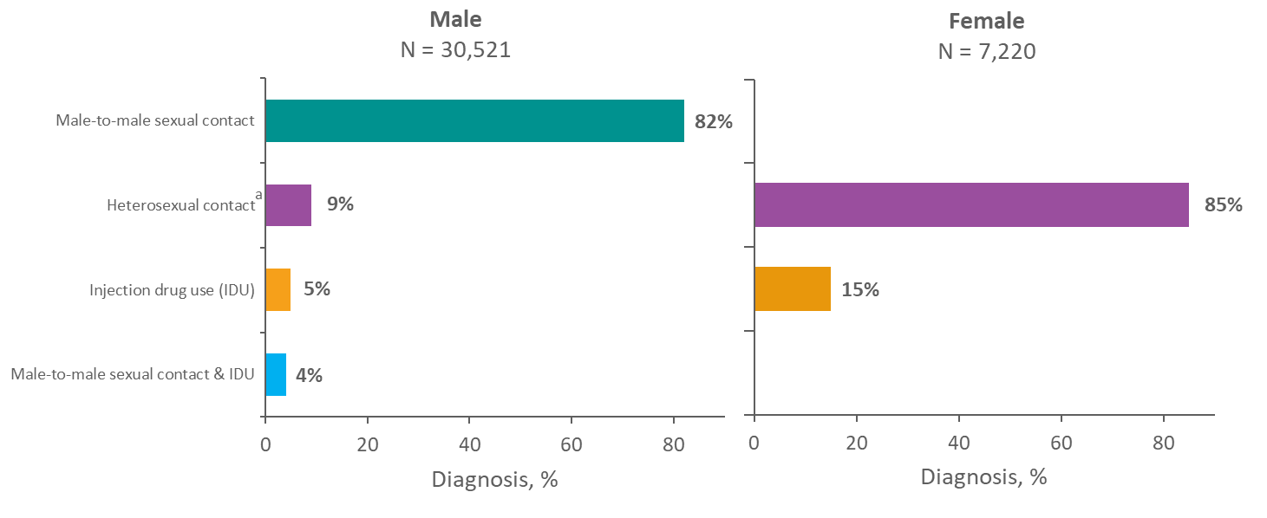
Diagnoses of HIV Infection among Adults and Adolescents, by Sex and Transmission Category, 2018—United States and 6 Dependent Areas
Note. Data for the year 2018 are considered preliminary and based on 6 months reporting delay. Data have been statistically adjusted to account for missing transmission category. “Other” transmission category not displayed as it comprises less than 1% of cases.
ª Heterosexual contact with a person known to have, or to be at high risk for, HIV infection.
Notes:
In 2018, among male adults and adolescents with diagnosed HIV infection in the United States and 6 dependent areas, approximately 82% of infections were attributed to male-to-male sexual contact, 9% to heterosexual contact, 5% to injection drug use, and 4% to male-to-male sexual contact and injection drug use.
Among female adults and adolescents, approximately 85% of diagnosed HIV infections were attributed to heterosexual contact and 15% were attributed to injection drug use.
The “Other” transmission category is not displayed as it comprises less than 1% of cases. The category includes hemophilia, blood transfusion, perinatal exposure, and risk factor not reported or not identified.
Data for the year 2018 are considered preliminary and based on 6 months reporting delay. Data have been statistically adjusted to account for missing transmission category.
Heterosexual contact is with a person known to have, or to be at high risk for, HIV infection.

Slide 27
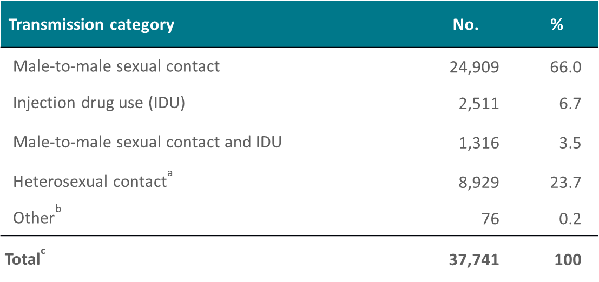
Diagnoses of HIV Infection among Adults and Adolescents, by Transmission Category 2018—United States and 6 Dependent Areas
Note. Data for the year 2018 are considered preliminary and based on 6 months reporting delay. Data have been statistically adjusted to account for missing transmission category.
ª Heterosexual contact with a person known to have, or to be at high risk for, HIV infection.
^{b} Includes hemophilia, blood transfusion, perinatal exposure, and risk factor not reported or not identified.
^{c} Because column totals for numbers were calculated independently of the values for the subpopulations, the values in each column may not sum to the column total.
Notes:
This slide presents the numbers and percentages of diagnoses of HIV infection in 2018 by transmission category, in the United States and 6 dependent areas.
Of the 37,741 HIV infections diagnosed in 2018 among adults and adolescents, approximately 66% were attributed to male-to-male sexual contact. In addition, approximately 4% of diagnosed infections were attributed to male-to-male sexual contact and injection drug use.
Injection drug use accounted for approximately 7% of diagnosed HIV infection, and heterosexual contact accounted for 24%. The “Other” transmission category comprises less than 1% of cases. The category includes hemophilia, blood transfusion, perinatal exposure, and risk factor not reported or not identified.
Data for the year 2018 are considered preliminary and based on 6 months reporting delay. Data have been statistically adjusted to account for missing transmission category. Because column totals for numbers were calculated independently of the values for the subpopulations, the values in each column may not sum to the column total.
Heterosexual contact is with a person known to have, or to be at high risk for, HIV infection.

Slide 28
Diagnosed HIV Infections Attributed to Male-to-Male Sexual Contact by Race/Ethnicity, 2018—United States and 6 Dependent Areas
Note. Data for the year 2018 are considered preliminary and based on 6 months reporting delay. Data have been statistically adjusted to account for missing transmission category.
ª Hispanics/Latinos can be of any race.
^{b} Because column totals for numbers were calculated independently of the values for the subpopulations, the values in each column may not sum to the column total.
Notes:
In 2018, approximately 24,909 diagnosed HIV infections in United States and 6 dependent areas were attributed to male-to-male sexual contact. Of these, 38% were among blacks/African Americans, 30% among Hispanics/Latinos, 26% among whites, 3% among Asians, 2% among persons of multiple races, and 1% among American Indians/Alaska Natives. Native Hawaiians/other Pacific Islanders accounted for less than 1% of diagnosed infections.
Data for the year 2018 are considered preliminary and based on 6 months reporting delay. Data have been statistically adjusted to account for missing transmission category. Because column totals for numbers were calculated independently of the values for the subpopulations, the values in each column may not sum to the column total.
Hispanics/Latinos can be of any race.

Slide 29
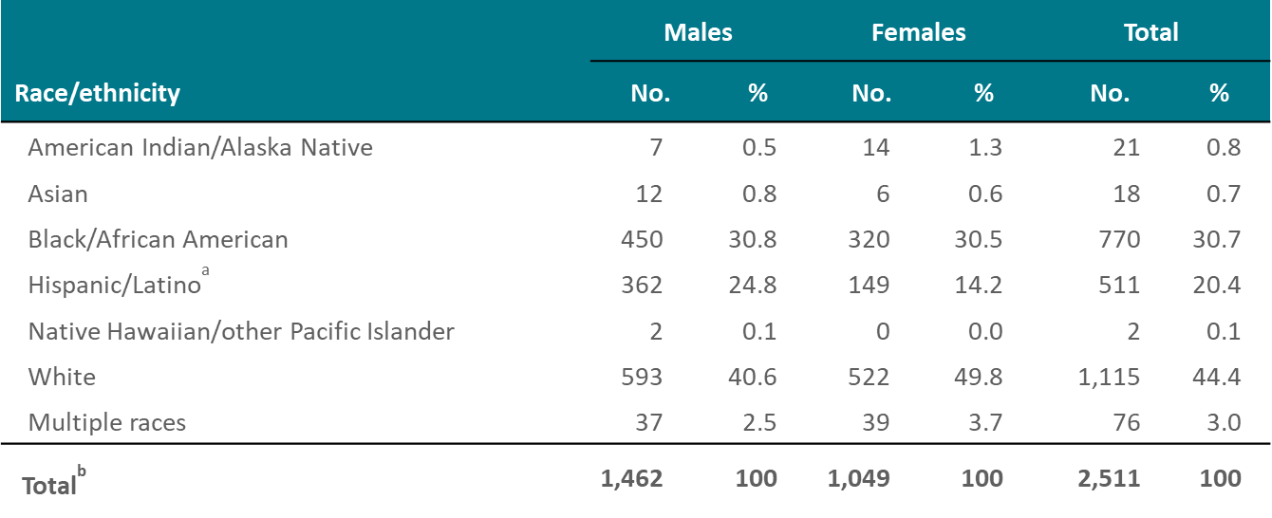
Diagnosed HIV Infections Attributed to Injection Drug Use, by Sex and Race/Ethnicity, 2018—United States and 6 Dependent Areas
Note. Data for the year 2018 are considered preliminary and based on 6 months reporting delay. Data have been statistically adjusted to account for missing transmission category.
ª Hispanics/Latinos can be of any race.
^{b} Because column totals for numbers were calculated independently of the values for the subpopulations, the values in each column may not sum to the column total.
Notes:
In 2018, approximately 2,511 diagnosed HIV infections in the United States and 6 dependent areas were attributed to injection drug use.
Overall, over one-third of diagnosed HIV infections attributed to injection drug use were among whites (44%). When separated by sex, 41% of males and 50% of females were white. Blacks/African Americans accounted for 31% of infections for both males and females. Hispanics/Latinos accounted for 25% of infections for males and 14% for females.
Persons of multiple races accounted for 3% of diagnosed infections for males and 4% for females. American Indians/Alaska Natives accounted for 1% for both males and females. Asians accounted for 1% for both males and females. Native Hawaiians/other Pacific Islanders accounted for less than 1% for both males and females.
Data for the year 2018 are considered preliminary and based on 6 months reporting delay. Data have been statistically adjusted to account for missing transmission category. Because column totals for numbers were calculated independently of the values for the subpopulations, the values in each column may not sum to the column total.
Hispanics/Latinos can be of any race.

Slide 30
Diagnosed HIV Infections Attributed to Male-to-Male Sexual Contact and Injection Drug Use, by Race/Ethnicity, 2018—United States and 6 Dependent Areas
Note. Data for the year 2018 are considered preliminary and based on 6 months reporting delay. Data have been statistically adjusted to account for missing transmission category.
ª Hispanics/Latinos can be of any race.
^{b} Because column totals for numbers were calculated independently of the values for the subpopulations, the values in each column may not sum to the column total.
Notes:
In 2018, approximately 1,316 diagnosed HIV infections in the United States and 6 dependent areas were attributed to male-to-male sexual contact and injection drug use.
The highest percentage of diagnosed HIV infections attributed to male-to-male sexual contact and injection drug use were among whites (49%). Approximately 25% were among Hispanics/Latinos, 20% among blacks/African Americans, 4% among males of multiple races, 2% among American Indians/Alaska Natives, and 1% among Asians. Native Hawaiians/other Pacific Islanders accounted for approximately 1% or less of infections.
Data for the year 2018 are considered preliminary and based on 6 months reporting delay. Data have been statistically adjusted to account for missing transmission category. Because column totals for numbers were calculated independently of the values for the subpopulations, the values in each column may not sum to the column total.
Hispanics/Latinos can be of any race.

Slide 31
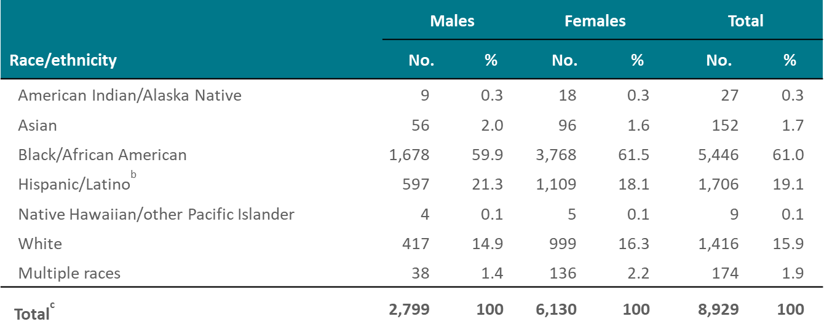
Diagnosed HIV Infections Attributed to Heterosexual Contactª, by Sex and Race/Ethnicity, 2018—United States and 6 Dependent Areas
Note. Data for the year 2018 are considered preliminary and based on 6 months reporting delay. Data have been statistically adjusted to account for missing transmission category.
ª Heterosexual contact with a person known to have, or to be at high risk for, HIV infection.
^{b} Hispanics/Latinos can be of any race.
^{c} Because column totals for numbers were calculated independently of the values for the subpopulations, the values in each column may not sum to the column total.
Notes:
In 2018, approximately 8,929 diagnosed HIV infections in the United States and 6 dependent areas were attributed to heterosexual contact.
Overall, approximately 61% of diagnosed HIV infections attributed to heterosexual contact were among blacks/African Americans. HIV infection attributed to heterosexual contact when separated by sex also shows approximately 60% of males and 62% of females with diagnosed infection were black/African American. Hispanics/Latinos accounted for 21% of infections for males and 18% for females. Whites accounted for 15% of infections for males and 16% for females.
Persons of multiple races accounted for approximately 1% for males and 2% for females of diagnosed infections. Asians accounted for approximately 2% each for males and females. American Indians/Alaska Natives and Native Hawaiians/other Pacific Islanders accounted for less than 1% each for males and females.
Data for the year 2018 are considered preliminary and based on 6 months reporting delay. Data have been statistically adjusted to account for missing transmission category. Because column totals for numbers were calculated independently of the values for the subpopulations, the values in each column may not sum to the column total.
Heterosexual contact is with a person known to have, or to be at high risk for, HIV infection.
Hispanics/Latinos can be of any race.

Slide 32
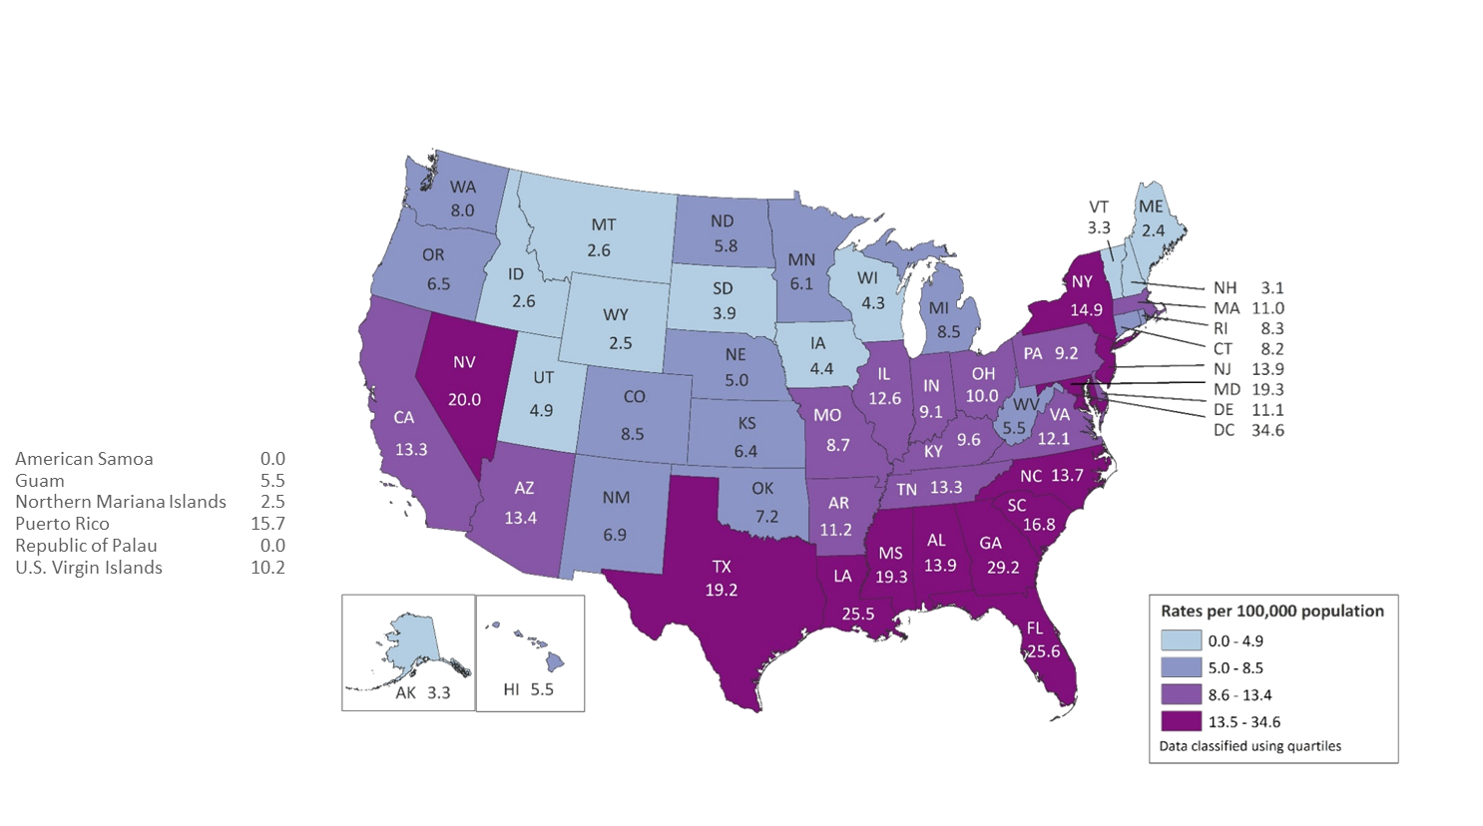
Rates of Diagnoses of HIV Infection among Adults and Adolescents 2018—United States and 6 Dependent Areas N = 37,741 Total Rate = 13.6
Note. Data for the year 2018 are considered preliminary and based on 6 months reporting delay.
Notes:
In the United States and 6 dependent areas, the rate of diagnoses of HIV infection among adults and adolescents was 13.6 per 100,000 population in 2018. The rate of diagnoses of HIV infection for adults and adolescents ranged from zero per 100,000 in American Samoa and the Republic of Palau to 34.6 per 100,000 in the District of Columbia.
The District of Columbia (i.e., Washington, DC) is a city; use caution when comparing the HIV diagnosis rate in DC with the rates in states.
Data for the year 2018 are considered preliminary and based on 6 months reporting delay.

Slide 33
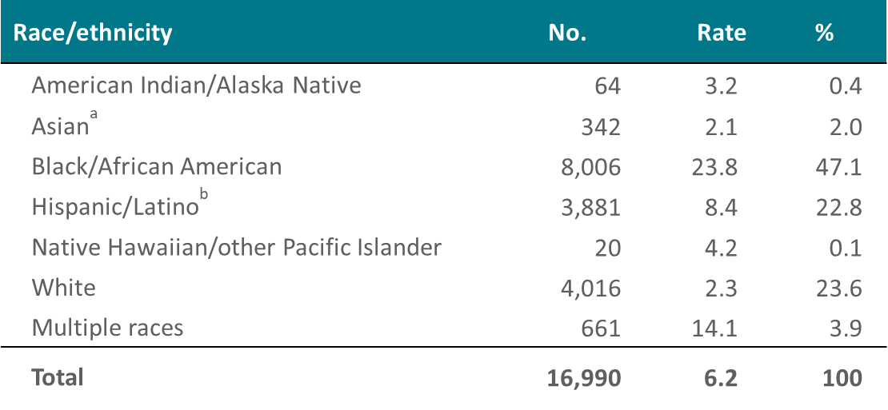
Stage 3 (AIDS) Classifications among Adults and Adolescents with Diagnosed HIV Infection, by Race/Ethnicity, 2018—United States
Note. Data for the year 2018 are considered preliminary and based on 6 months reporting delay. Rates are per 100,000 population.
ª Includes Asian/Pacific Islander legacy cases.
^{b} Hispanics/Latinos can be of any race.
Notes:
The rate (per 100,000 population) of stage 3 (AIDS) classifications among adults and adolescents with HIV infection in 2018 for blacks/African Americans (23.8) was approximately 11 times as high as the rate for whites (2.3) and nearly 3 times as high as the rate for Hispanics/Latinos (8.4).
Relatively few cases were diagnosed among Asians, American Indians/Alaska Natives, Native Hawaiians/other Pacific Islanders, and persons of multiple races, although the rates for persons of multiple races (14.1), Native Hawaiians/other Pacific Islanders (4.2), and American Indians/Alaska Natives (3.2) were higher than that for whites. The rate among Asians was 2.1 in 2018.
The Asian category includes Asian/Pacific Islander legacy cases (cases that were diagnosed and reported under the pre-1997 Office of Management and Budget race/ethnicity classification system).
Data for the year 2018 are considered preliminary and based on 6 months reporting delay.
Hispanics/Latinos can be of any race.

Slide 34
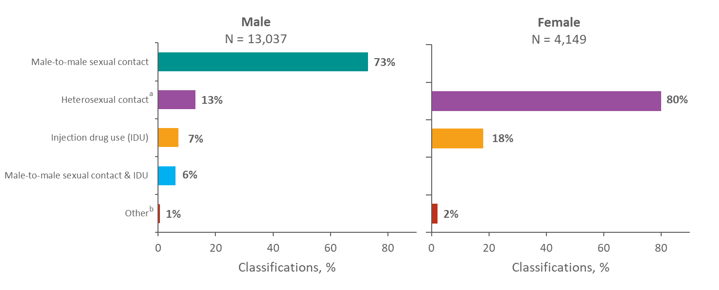
Stage 3 (AIDS) Classifications among Adults and Adolescents with Diagnosed HIV Infection, by Sex and Transmission Category, 2018—United States and 6 Dependent Areas
Note. Data for the year 2018 are considered preliminary and based on 6 months reporting delay. Data have been statistically adjusted to account for missing transmission category.
ª Heterosexual contact with a person known to have, or to be at high risk for, HIV infection.
^{b} Includes hemophilia, blood transfusion, perinatal exposure, and risk factor not reported or not identified.
Notes:
Of diagnoses of HIV infection classified as stage 3 (AIDS) in 2018 among male adults and adolescents, 73% of HIV infections were attributed to male-to-male sexual contact and 13% were attributed to heterosexual contact. Approximately 7% of HIV infections were attributed to injection drug use, 6% were attributed to male-to-male sexual contact and injection drug use, and 1% were attributed to other transmission categories.
Most (80%) of the infections classified as stage 3 (AIDS) in 2018 among female adults and adolescents were attributed to heterosexual contact, approximately 18% were attributed to injection drug use, and 2% were attributed to other transmission categories.
Data for the year 2018 are considered preliminary and based on 6 months reporting delay. Data have been statistically adjusted to account for missing transmission category.
Heterosexual contact is with a person known to have, or to be at high risk for, HIV infection.
The “Other” category includes hemophilia, blood transfusion, perinatal exposure, and risk factor not reported or not identified.

Slide 35
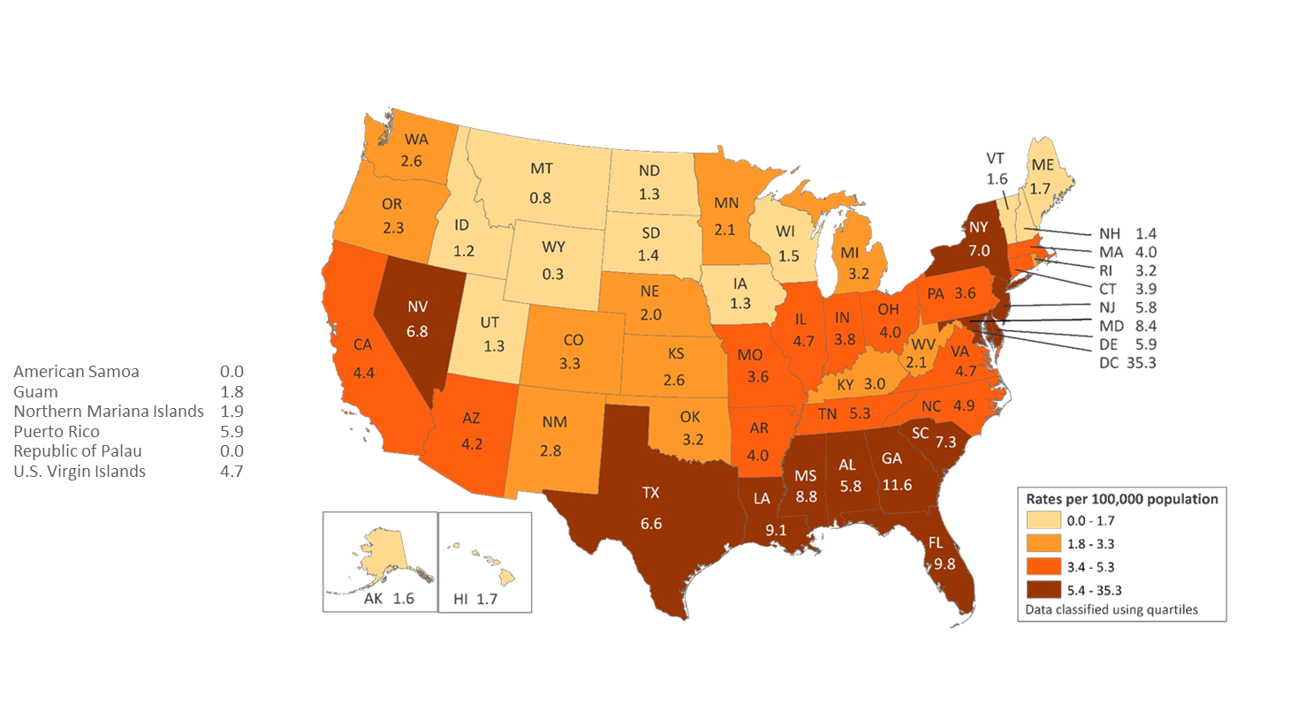
Rates of Diagnosed HIV Infection Classified as Stage 3 (AIDS) 2018—United States and 6 Dependent Areas N = 17,228 Total Rate = 5.2
Note. Data for the year 2018 are considered preliminary and based on 6 months reporting delay.
Notes:
The rates (per 100,000 population) of stage 3 (AIDS) classifications in 2018 for persons (all ages) with diagnosed HIV infection are shown for each state, the District of Columbia, American Samoa, Guam, the Northern Mariana Islands, Puerto Rico, the Republic of Palau, and the U.S. Virgin Islands.
Areas with the highest rates of stage 3 (AIDS) in 2018 were the District of Columbia (35.3), Georgia (11.6), Florida (9.8), and Louisiana (9.1).
The District of Columbia (i.e., Washington, DC) is a city; use caution when comparing the stage 3 (AIDS) rate in DC with the rates in states.
Data for the year 2018 are considered preliminary and based on 6 months reporting delay.

