Slide 1
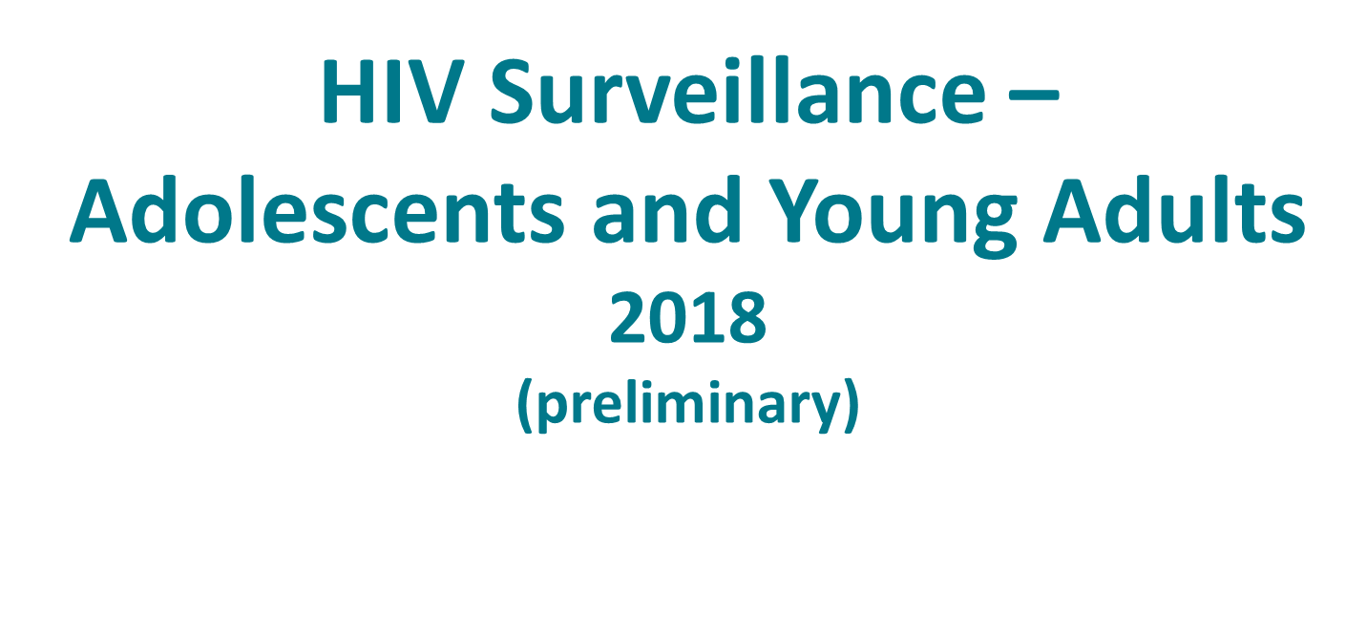
Division of HIV/AIDS Prevention
Notes:
HIV Surveillance among Adolescents and Young Adults.
For all slides in this series, the following notes apply:
The HIV Surveillance among Adolescents and Young Adults slide set presents and interprets trends in HIV diagnoses for 2010–2017 and provides preliminary data, based on a 6-month reporting delay, for 2018. The standard used for reporting trends in numbers and rates is based on an increase or a decrease of 5% or more during the specified time frame (e.g., when comparing 2010 and 2017).
Beginning in 2020, CDC will transition to publishing this slide set earlier in the calendar year and will include data reported to CDC’s National HIV Surveillance System through December 31 of the prior year (instead of June 30). The use of data reported to CDC through December will allow for a 12-month reporting lag. In early 2020, CDC will release an update to the 2018 data that will present and interpret trends in HIV diagnoses through 2018. Future editions of this slide set will be published according to the new time line.
Numbers and rates of diagnosed HIV infection and diagnosed infections classified as stage 3 (AIDS) are based on data from 50 states, the District of Columbia, and 6 U.S. dependent areas.
Rates for transmission category are not provided because of the absence of denominator data from the U.S. Census Bureau.
Rates are not calculated by race/ethnicity for the 6 U.S. dependent areas because the U.S. Census Bureau does not collect information from all U.S. dependent areas.
Data are presented for diagnoses of HIV infection reported to CDC through June 2019.
Data re-release agreements between CDC and state/local HIV surveillance programs require certain levels of cell suppression at the state and county levels in order to ensure confidentiality of personally identifiable information.

Slide 2
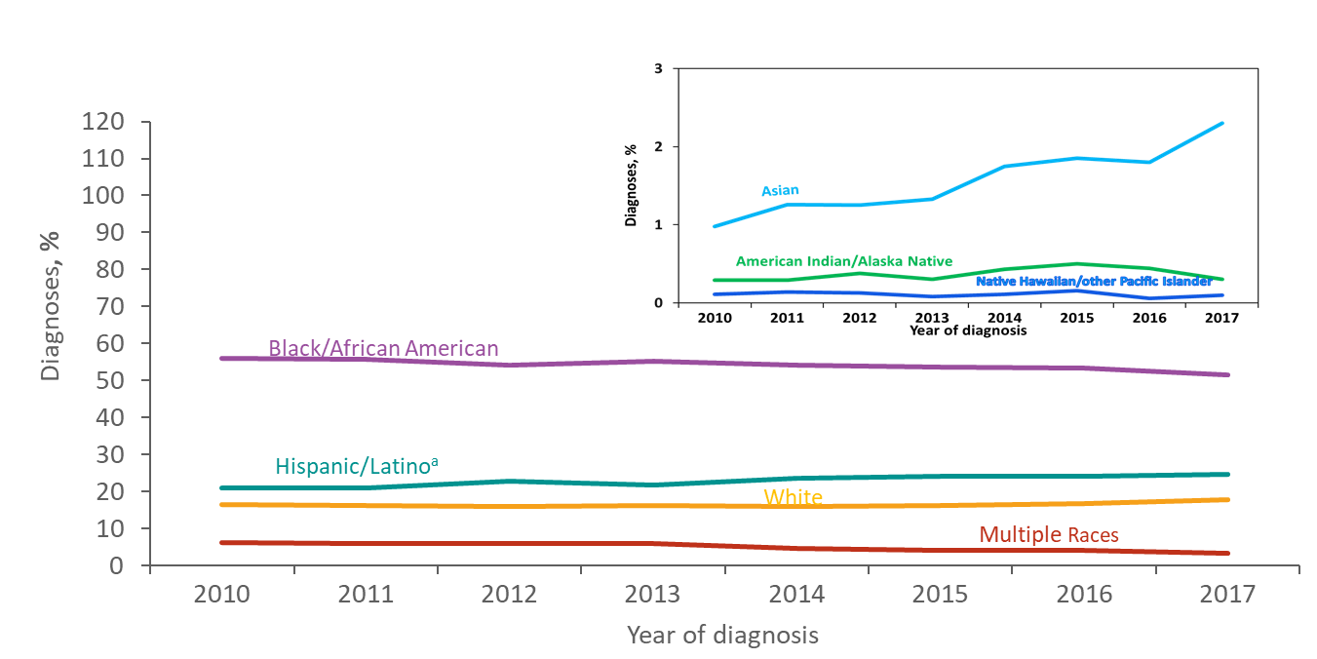
Diagnoses of HIV Infection among Adolescents and Young Adults Aged 13–24 years, by Race/Ethnicity, 2010–2017—United States and 6 Dependent Areas
ª Hispanics/Latinos can be of any race.
Notes:
This slide presents the distribution of diagnoses of HIV infection by race/ethnicity for adolescents and young adults aged 13–24 years with HIV diagnosed from 2010 through 2017 in the United States and 6 dependent areas.
From 2010 through 2017, blacks/African Americans accounted for more than 50% of diagnoses of HIV infection each year among adolescents and young adults aged 13–24 years in the United States and 6 dependent areas. In 2017, of persons aged 13–24 years with diagnosed HIV infection, 52% were black/African American, 25% were Hispanic/Latino, 18% were white, 3% were persons of multiple races, 2% were Asian, and less than 1% were American Indian/Alaska Native and Native Hawaiian/other Pacific Islander.
Hispanics/Latinos can be of any race.

Slide 3
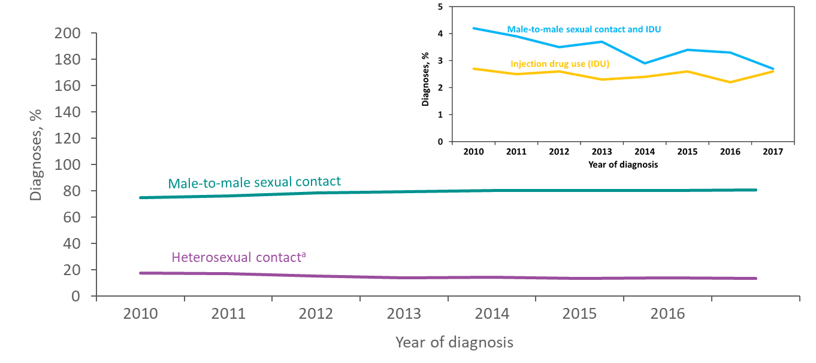
Diagnoses of HIV Infection among Adolescents and Young Adults Aged 13–24 Years, by Transmission Category, 2010–2017—United States and 6 Dependent Areas
Note. Data have been statistically adjusted to account for missing transmission category. “Other” transmission category not displayed as it comprises less than 1% of cases.
ª Heterosexual contact is with a person known to have, or to be at high risk for, HIV infection.
Notes:
This slide presents the distribution of diagnoses of HIV infection by transmission category for adolescents and young adults aged 13–24 years with HIV diagnosed from 2010 through 2017 in the United States and 6 dependent areas.
Among adolescents and young adults, the percentage of diagnosed HIV infections attributed to male-to-male sexual contact increased from 75% in 2010 to 81% in 2017. The percentage of diagnosed HIV infections attributed to heterosexual contact decreased from 18% to 14% during this time. The percentage of diagnosed HIV infections attributed to injection drug use alone, and male-to-male sexual contact and injection drug use also decreased from 2010 through 2017. The “Other” transmission category is not displayed as it comprises less than 1% of cases. The category includes hemophilia, perinatal exposure, and risk factors not reported or identified.
Data have been statistically adjusted to account for missing transmission category.
Heterosexual contact is with a person known to have, or to be at high risk for, HIV infection.

Slide 4
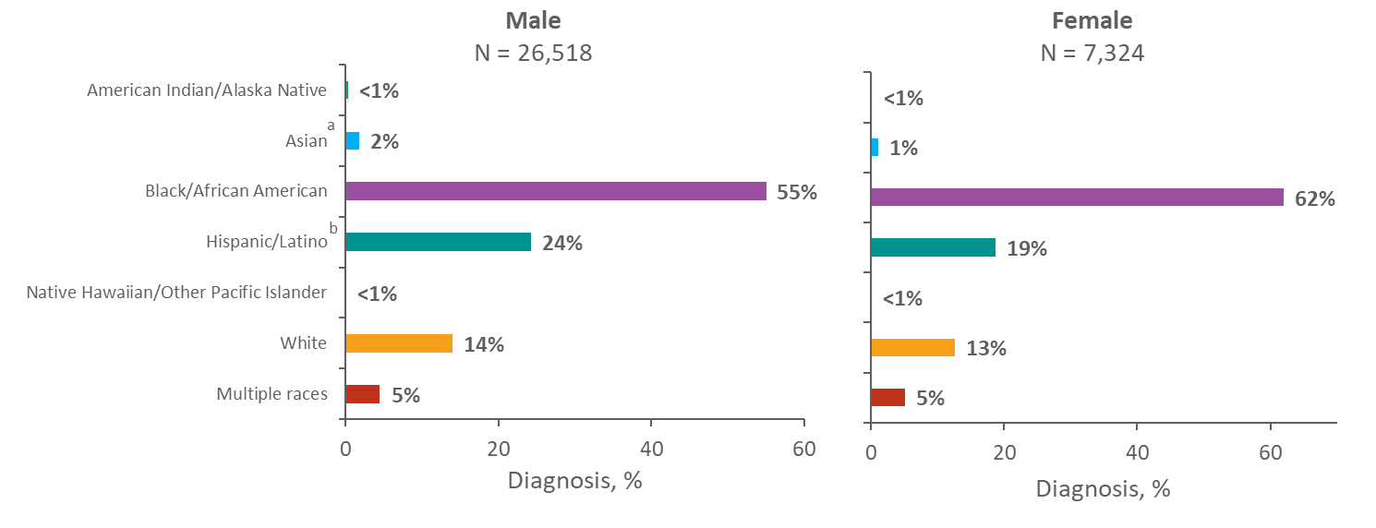
Adolescents and Young Adults Aged 13–24 Years Living with Diagnosed HIV Infection, by Sex and Race/Ethnicity, Year-end 2017—United States and 6 Dependent Areas
ª Includes Asian/Pacific Islander legacy cases.
^{b} Hispanics/Latinos can be of any race.
Notes:
This slide presents the distribution of adolescents and young adults aged 13–24 years living with diagnosed HIV infection at the end of 2017 by race/ethnicity in the United States and 6 dependent areas.
At the end of 2017, 33,842 adolescents and young adults 13–24 years of age were living with diagnosed HIV infection in the United States and 6 dependent areas.
Of the 26,518 male adolescents and young adults living with diagnosed HIV infection, 55% were black/African American, 24% were Hispanic/Latino, 14% were white, 5% were of multiple races, and 2% were Asian. Less than 1% each were American Indian/Alaska Native and Native Hawaiian/other Pacific Islander.
Among female adolescents and young adults living with diagnosed HIV infection, 62% were black/African American, 19% were Hispanic/Latino, 13% were white, 5% were of multiple races, and 1% were Asian. Less than 1% each were American Indian/Alaska Native and Native Hawaiian/other Pacific Islander.
The Asian category includes Asian/Pacific Islander legacy cases (cases that were diagnosed and reported under the pre-1997 Office of Management and Budget race/ethnicity classification system).
Hispanics/Latinos can be of any race.
Persons living with diagnosed HIV infection are classified as adult or adolescent based on age at year-end 2017.

Slide 5
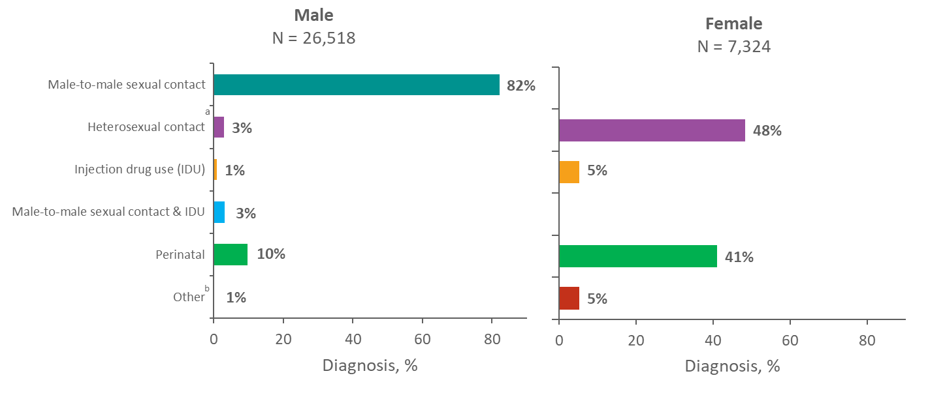
Adolescents and Young Adults Aged 13–24 Years Living with Diagnosed HIV Infection by Sex and Transmission Category, Year-end 2017—United States and 6 Dependent Areas
Note. Data have been statistically adjusted to account for missing transmission category. “Other” transmission category not displayed as it comprises 1% or less of cases.
ª Heterosexual contact with a person known to have, or to be at high risk for, HIV infection.
^{b} Includes hemophilia, blood transfusion, and risk factor not reported or not identified.
Notes:
This slide presents the distribution of adolescents and young adults aged 13–24 years living with diagnosed HIV infection at the end of 2017 by sex and transmission category in the United States and 6 dependent areas.
Among male adolescents and young adults living with diagnosed HIV infection, 82% of infections were attributed to male-to-male sexual contact, 10% had infection attributed to perinatal exposure, 3% to heterosexual contact, 3% to male-to-male sexual contact and injection drug use, 1% to injection drug use, and 1% had infection attributed to other transmission categories.
Among female adolescents and young adults living with diagnosed HIV infection at the end of 2017, 48% of infections were attributed to heterosexual contact, 41% had infection attributed to perinatal exposure, 5% to injection drug use, and 5% had infection attributed to other transmission categories..
Heterosexual contact is with a person known to have, or to be at high risk for, HIV infection.
Perinatal exposure includes persons who were exposed to HIV perinatally and received a diagnosis after birth, but were aged 13 years and older at the end of 2017. The “Other” transmission category includes hemophilia, blood transfusion, and risk factor not reported or not identified.
Data have been statistically adjusted to account for missing transmission category.
Persons living with diagnosed HIV infection are classified as adult or adolescent based on age at year-end 2017.

Slide 6
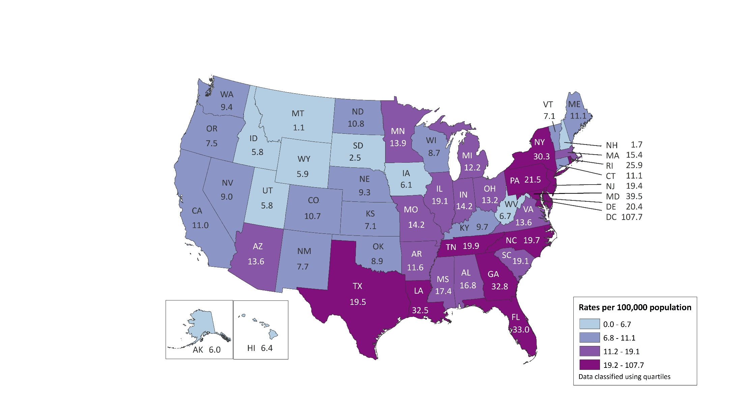
Rates of Adolescents Aged 13–19 Years Living with Diagnosed HIV Infection Year-end 2017—United States and 6 Dependent Areas N = 5,222 Total Rate = 17.6
American Samoa
Guam
Northern Mariana Islands
Puerto Rico
Republic of Palau
U.S. Virgin Islands
0.0
5.0
0.0
14.6
0.0
34.3
Note. Data are based on address of residence as of December 31, 2017 (i.e., most recent known address).
Notes:
This slide presents the distribution of diagnoses of HIV infection among adolescents aged 13–19 years living with diagnosed HIV infection at the end of 2017 in the United States and 6 dependent areas.
At the end of 2017, there were 5,222 adolescents aged 13–19 years living with diagnosed HIV infection in the United States and 6 dependent areas. The prevalence of diagnosed HIV infection among adolescents was 17.6 per 100,000 population. The prevalence of diagnosed HIV infection among adolescents at the end of 2017 was highest in the District of Columbia (107.7), Maryland (39.5), U.S. Virgin Islands (34.3), Florida (33.0), Georgia (32.8), Louisiana (32.5), and New York (30.3).
The District of Columbia (i.e., Washington, DC) is a city; please use caution when comparing the rate of persons living with diagnosed HIV infection in DC with the rates in states.
Data are based on address of residence as of December 31, 2017 (i.e., most recent known address).
Persons living with a diagnosis of HIV infection are classified as adolescents based on age at year-end 2017.

Slide 7
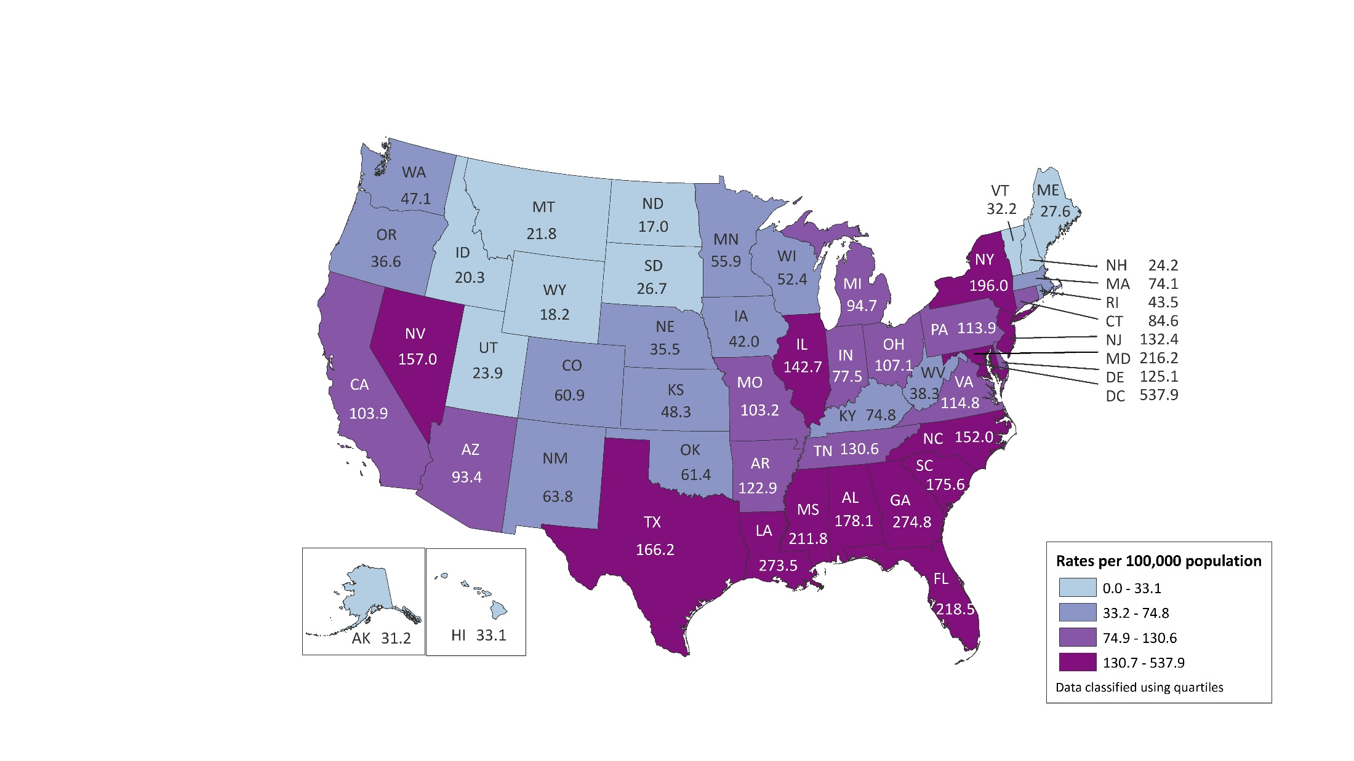
Rates of Young Adults Aged 20–24 Years Living with Diagnosed HIV Infection Year-end 2017—United States and 6 Dependent Areas N = 28,620 Total Rate = 128.2
American Samoa
Guam
Northern Mariana Islands
Puerto Rico
Republic of Palau
U.S. Virgin Islands
0.0
7.5
54.0
125.4
0.0
83.9
Note. Data are based on address of residence as of December 31, 2017 (i.e., most recent known address).
Notes:
This slide presents the distribution of diagnoses of HIV infection among adolescents aged 20–24 years living with diagnosed HIV infection at the end of 2017 in the United States and 6 dependent areas.
At the end of 2017, there were 28,620 young adults aged 20–24 years living with diagnosed HIV infection in the United States and 6 dependent areas. The prevalence of diagnosed HIV infection among young adults was 128.2 per 100,000 population. The prevalence of diagnosed HIV infection among young adults at the end of 2017 was highest in District of Columbia (537.9), Georgia (274.8), Louisiana (273.5 ), Florida (218.5), Maryland (216.2), and Mississippi (211.8). The majority of states with rates of young adults living with diagnosed HIV infection over 100.0 per 100,000 population were in the South.
The District of Columbia (i.e., Washington, DC) is a city; use caution when comparing the rate of persons living with diagnosed HIV infection in DC with the rates in states.
Data are based on address of residence as of December 31, 2017 (i.e., most recent known address).
Persons living with a diagnosis of HIV infection are classified as young adults based on age at year-end 2016.

Slide 8
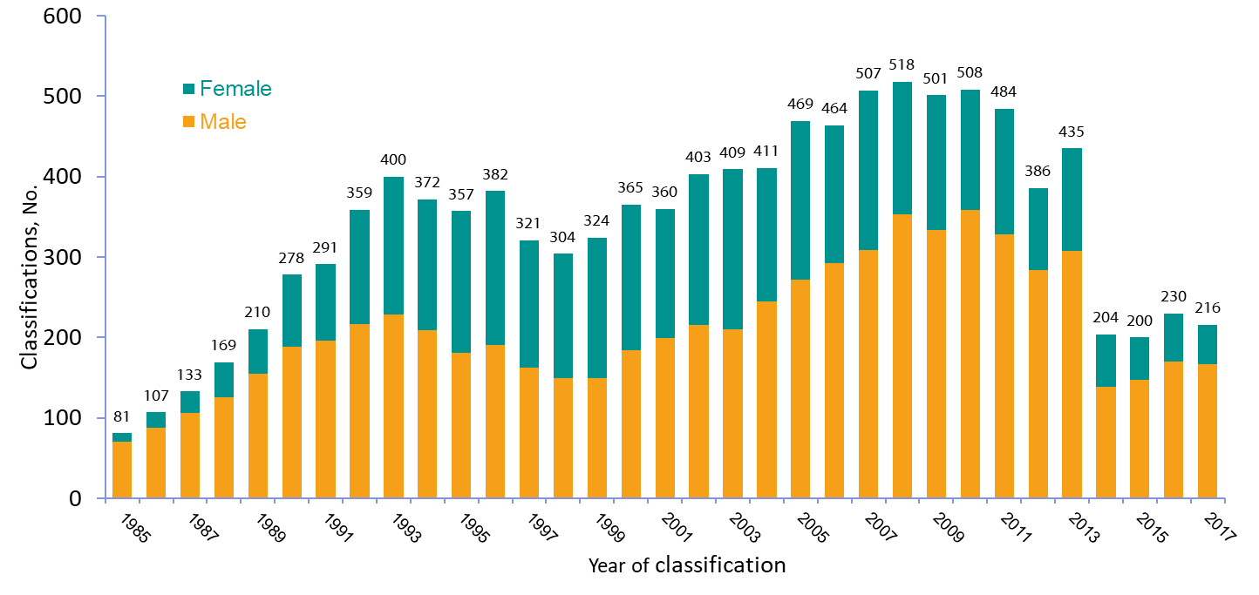
Stage 3 (AIDS) Classifications among Adolescents Aged 13–19 Years, by Sex and Year of Classification, 1985–2017—United States and 6 Dependent Areas
Notes:
This slide presents the number of adolescents aged 13–19 years with diagnosed HIV infection classified as stage 3 (AIDS) in the United States and 6 dependent areas from 1985–2017, by sex.
From 1985 through 2017, 11,158 adolescents aged 13–19 years had HIV infection that was classified as stage 3 (AIDS) in the United States and 6 dependent areas. In earlier years, most stage 3 (AIDS) classifications among adolescents were in males; over time, the male-to-female ratio decreased. In 2017, 216 adolescents were classified as stage 3 (AIDS); of these, 167 (77%) were male and 49 (23%) were female.

Slide 9
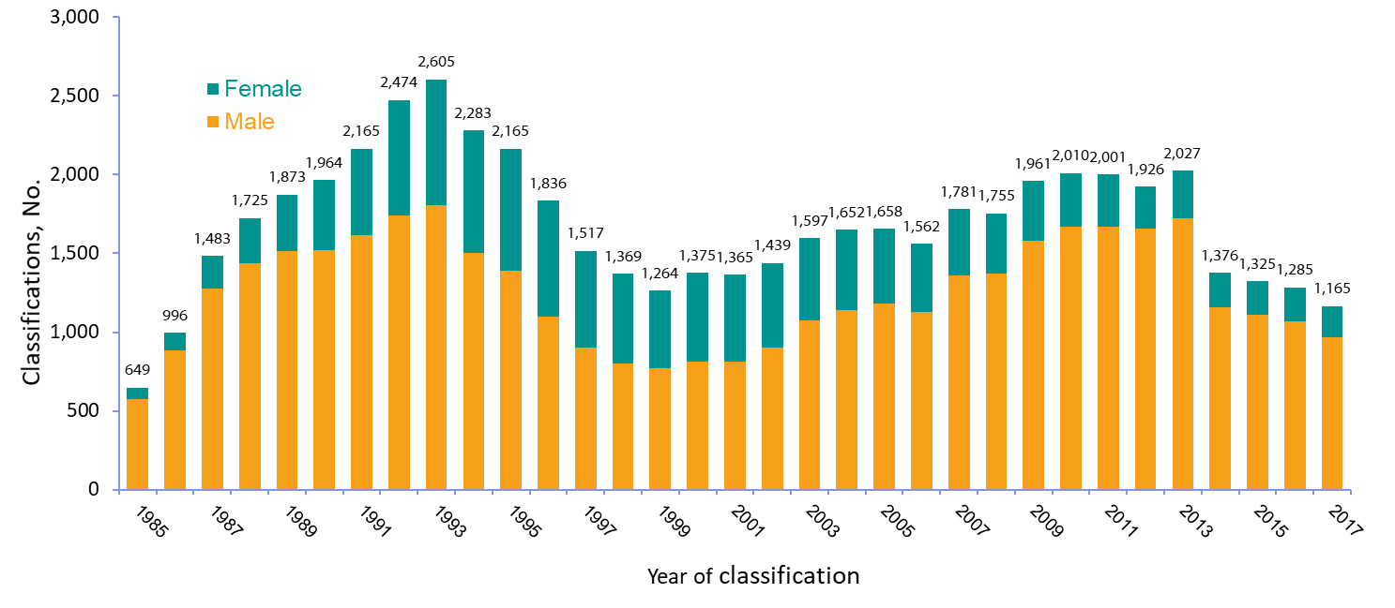
Stage 3 (AIDS) Classifications Among Young Adults Aged 20–24 Years, by Sex and Year of Classification, 1985–2017—United States and 6 Dependent Areas
Notes:
This slide presents the number of adolescents aged 20–24 years with diagnosed HIV infection classified as stage 3 (AIDS) in the United States and 6 dependent areas from 1985–2017, by sex.
From 1985 through 2017, a total of 55,628 young adults aged 20–24 years had HIV infection that was classified as stage 3 (AIDS) in the United States and 6 dependent areas. In 1985, 88% of stage 3 (AIDS) in young adults 20–24 years of age were in males. The percentage of stage 3 (AIDS) classifications in females peaked in 1993 at 31% and has decreased since that time. In 2017, 17% of the 1,165 stage 3 (AIDS) classifications in young adults were in females.

Slide 10
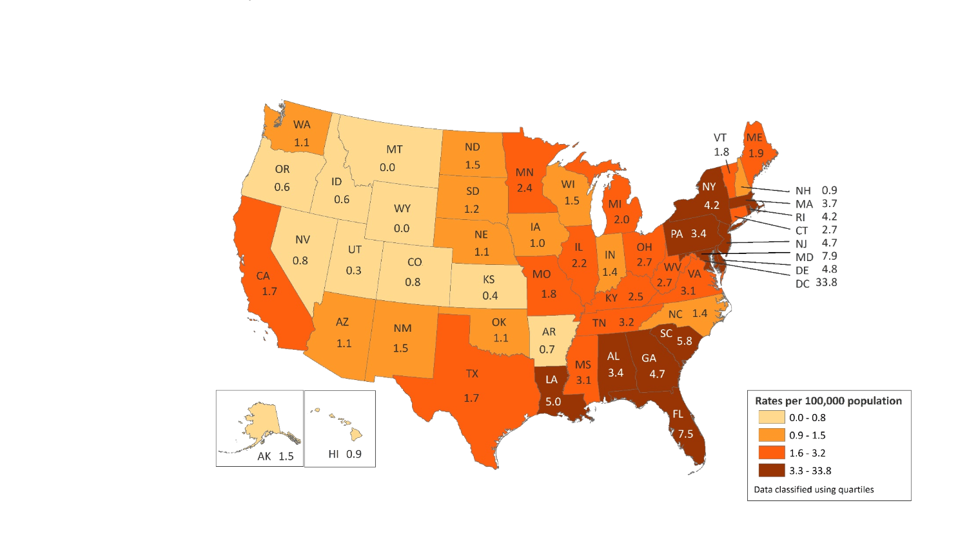
Rates of Adolescents Aged 13–19 Years Living with Diagnosed HIV Infection Ever Classified as Stage 3 (AIDS), Year-end 2017—United States and 6 Dependent Areas N = 834 Total Rate = 2.8
0.0
0.0
0.0
3.7
0.0
0.0
American Samoa
Guam
Northern Mariana Islands
Puerto Rico
Republic of Palau
U.S. Virgin Islands
Note. Data are based on address of residence as of December 31, 2017 (i.e., most recent known address).
Notes:
This slide presents the distribution of adolescents aged 13–19 years living with diagnosed HIV infection ever classified as stage 3 (AIDS) at the end of 2017 in the United States and 6 dependent areas.
At the end of 2017, approximately 834 adolescents aged 13–19 years were living with diagnosed HIV infection ever classified as stage 3 (AIDS) in the United States and 6 dependent areas. The overall rate of stage 3 (AIDS) classifications among adolescents living with diagnosed HIV infection ever classified as stage 3 (AIDS) was 2.8 per 100,000 population. The highest rate of stage 3 (AIDS) classification in adolescents was in the District of Columbia (33.8).
The District of Columbia (i.e., Washington, DC) is a city; use caution when comparing the rate of persons living with diagnosed HIV infection ever classified as stage 3 (AIDS) in DC with the rates in states.
Data are based on address of residence as of December 31, 2017 (i.e., most recent known address).
Persons living with diagnosed HIV infection ever classified stage 3 (AIDS) are classified as adolescent based on age at year-end of 2017.

Slide 11
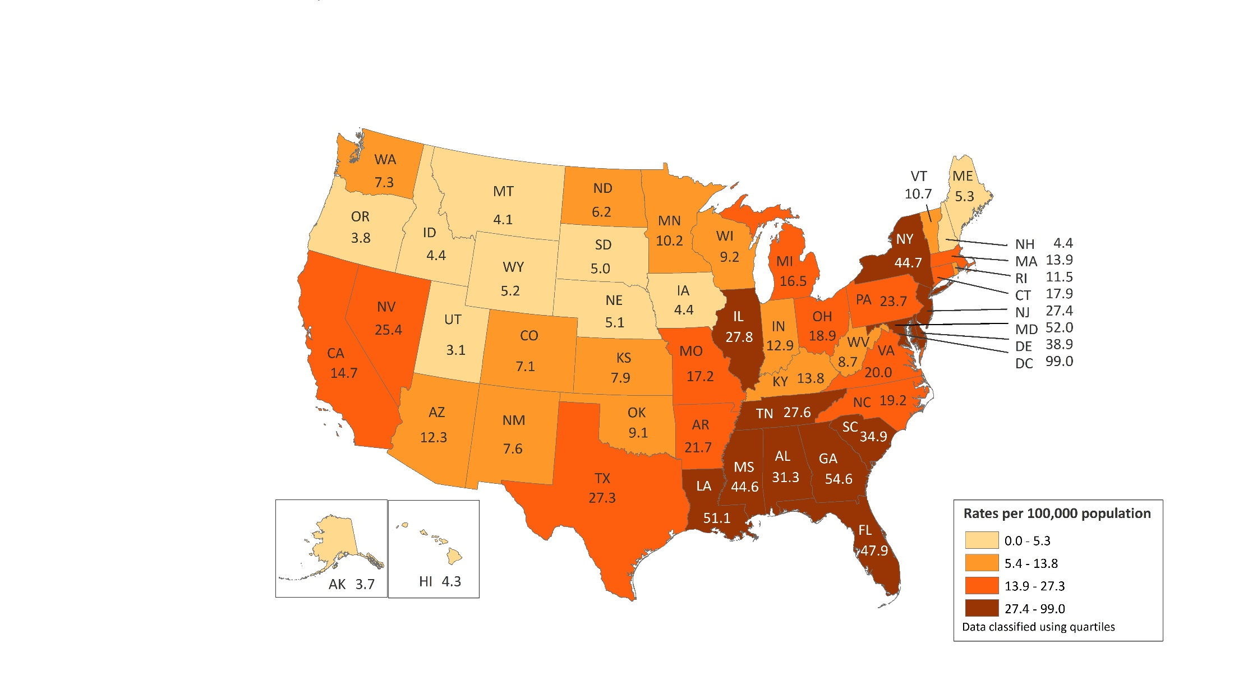
Rates of Young Adults Aged 20–24 Years Living with Diagnosed HIV Infection Ever Classified as Stage 3 (AIDS), Year-end 2017—United States and 6 Dependent Areas N = 5,306 Total Rate = 23.8
0.0
0.0
27.0
29.6
0.0
16.8
American Samoa
Guam
Northern Mariana Islands
Puerto Rico
Republic of Palau
U.S. Virgin Islands
Note. Data are based on address of residence as of December 31, 2017 (i.e., most recent known address).
Notes:
This slide presents the distribution of adolescents aged 20–24 years living with diagnosed HIV infection ever classified as stage 3 (AIDS) at the end of 2017 in the United States and 6 dependent areas.
At the end of 2017, approximately 5,306 young adults aged 20–24 years were living with diagnosed HIV infection ever classified as stage 3 (AIDS) in the United States and 6 dependent areas. The overall rate of stage 3 (AIDS) classifications among young adults living with stage 3 (AIDS) was 23.8 per 100,000 population. The highest rates of stage 3 (AIDS) classifications in young adults were in the District of Columbia (99.0), Georgia (54.6), Maryland (52.0 ), and Louisiana (51.1).
The District of Columbia (i.e., Washington, DC) is a city; use caution when comparing the rate of persons living with diagnosed HIV infection ever classified as stage 3 (AIDS) in DC with the rates in states.
Data are based on address of residence as of December 31, 2017 (i.e., most recent known address).
Persons living with diagnosed HIV infection ever classified as stage 3 (AIDS) are classified as young adults based on age at year-end 2017.

Slide 12
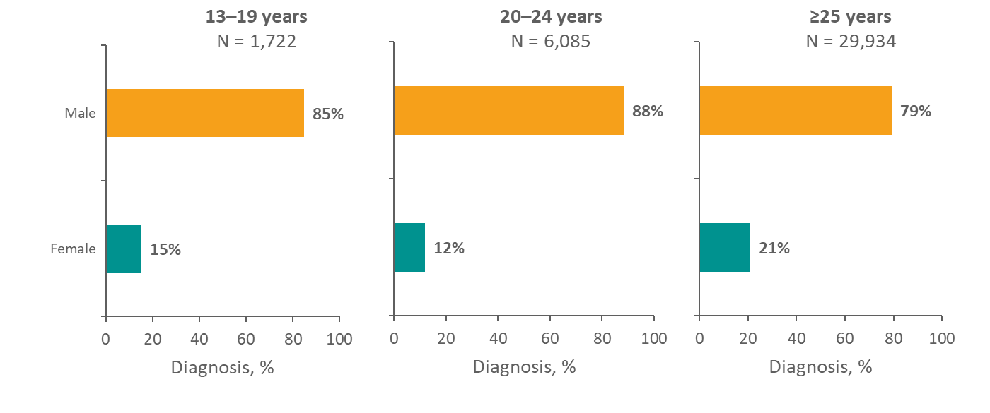
Diagnoses of HIV Infection among Persons Aged 13 Years and Older, by Sex and and Age Group, 2018—United States and 6 Dependent Areas
Note. Data for the year 2018 are considered preliminary and based on 6 months reporting delay.
Notes:
This slide presents the distribution of diagnoses of HIV infection by sex and various age groups during 2018 in the United State and 6 dependent areas.
In 2018, females accounted for 15% of adolescents aged 13–19 years with diagnosed HIV infection, compared with 12% of young adults aged 20–24 years and 21% of adults aged 25 years and older.
Data for the year 2018 are considered preliminary and based on 6 months reporting delay. Age group assigned based on age at diagnosis.

Slide 13
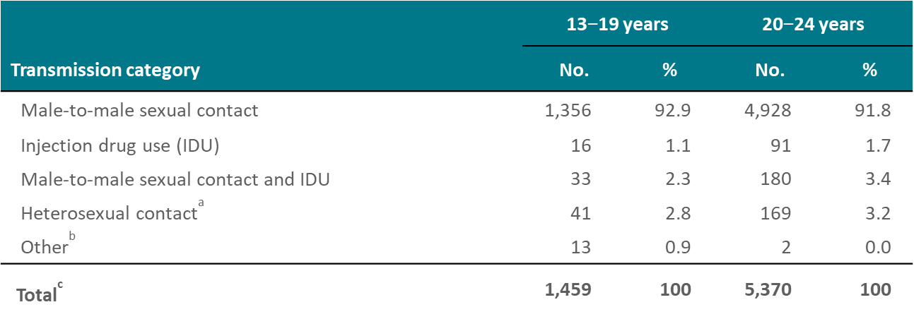
Diagnoses of HIV Infection Among Male Adolescents and Young Adults, by Age Group and Transmission Category, 2018—United States and 6 Dependent Areas
Note. Data for the year 2018 are considered preliminary and based on 6 months reporting delay. Data have been statistically adjusted to account for missing transmission category.
ª Heterosexual contact with a person known to have, or to be at high risk for, HIV infection.
^{b} Includes hemophilia, blood transfusion, perinatal exposure, and risk factor not reported or not identified.
^{c} Because column totals for numbers were calculated independently of the values for the subpopulations, the values in each column may not sum to the column total.
Notes:
This slide presents the numbers and percentages of diagnoses of HIV infection among male adolescents aged 13–19 years and young male adults aged 20–24 years by age group and transmission category during 2018 in the United States and 6 dependent areas.
In 2018, in both age groups, the majority of diagnosed HIV infections were attributed to male-to-male sexual contact: 93% in males aged 13–19, and 92% in males aged 20–24 years.
Data for the year 2018 are considered preliminary and based on 6 months reporting delay. Data have been statistically adjusted to account for missing transmission category. Age group assigned based on age at diagnosis.
Heterosexual contact is with a person known to have, or to be at high risk for, HIV infection.

Slide 14
Diagnoses of HIV Infection Among Female Adolescents and Young Adults, by Age Group and Transmission Category, 2018—United States and 6 Dependent Areas
Note. Data for the year 2018 are considered preliminary and based on 6 months reporting delay. Data have been statistically adjusted to account for missing transmission category.
ª Heterosexual contact with a person known to have, or to be at high risk for, HIV infection.
^{b} Includes hemophilia, blood transfusion, perinatal exposure, and risk factor not reported or not identified.
^{c} Because column totals for numbers were calculated independently of the values for the subpopulations, the values in each column may not sum to the column total.
Notes:
This slide presents the numbers and percentages of diagnoses of HIV infection among female adolescents aged 13–19 years and young female adults aged 20–24 years by age group and transmission category during 2018 in the United States and 6 dependent areas.
In 2018, in both age groups, the majority of diagnosed HIV infections were attributed to heterosexual contact: 86% in females aged 13–19 years, and 85% in females aged 20–24 years.
Data for the year 2018 are considered preliminary and based on 6 months reporting delay. Data have been statistically adjusted to account for missing transmission category. Age group assigned based on age at diagnosis.
Heterosexual contact is with a person known to have, or to be at high risk for, HIV infection.

Slide 15
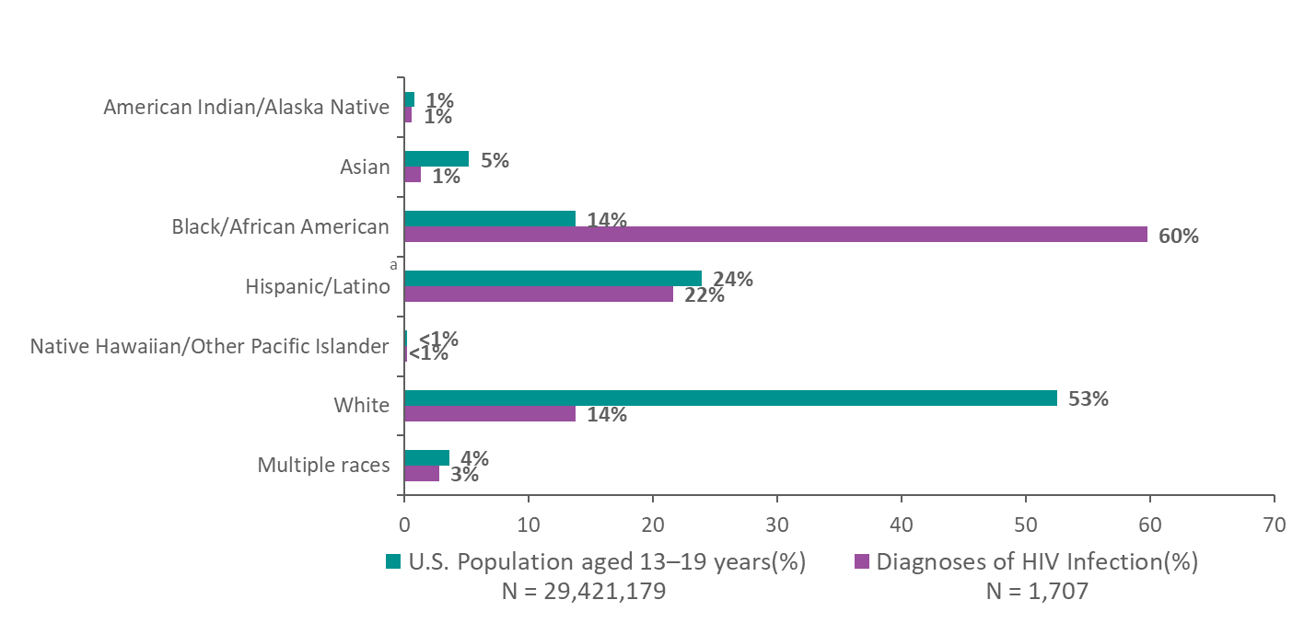
Diagnoses of HIV Infection and Population among Adolescents Aged 13–19 Years, by Race/Ethnicity, 2018—United States
Note. Data for the year 2018 are considered preliminary and based on 6 months reporting delay.
ª Hispanics/Latinos can be of any race.
Notes:
This slide presents the comparison of the racial/ethnic distribution of HIV diagnoses among adolescents aged 13–19 years and the general adolescent population aged 13–19 years in 2018.
The lower bar illustrates the percentage distribution of diagnoses of HIV infection among adolescents aged 13–19 years in 2018 by race/ethnicity in the United States. The upper bar shows the percentage distribution of the adolescent population aged 13–19 years in 2018 in the United States.
Black/African American adolescents aged 13–19 years have been disproportionately affected by HIV. In 2018, in the United States, 14% of adolescents were black/African American, yet 60% of diagnoses of HIV infection in 13–19 year olds were in black/African American adolescents.
Data for the year 2018 are considered preliminary and based on 6 months reporting delay.
Hispanics/Latinos can be of any race.

Slide 16
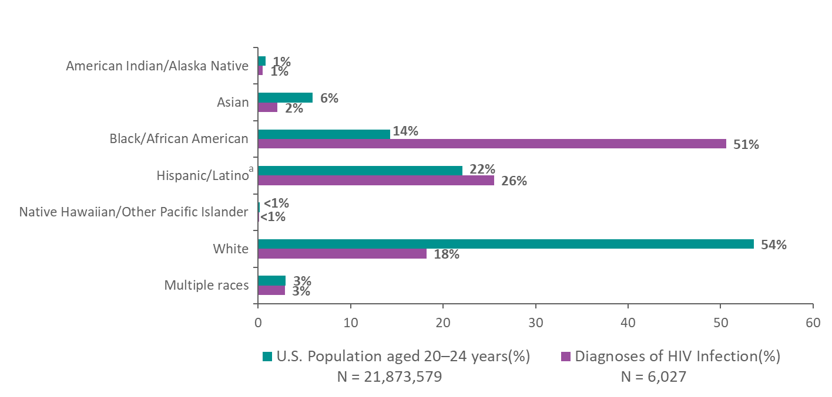
Diagnoses of HIV Infection and Population among Young Adults Aged 20–24 Years, by Race/Ethnicity 2018—United States
Note. Data for the year 2018 are considered preliminary and based on 6 months reporting delay.
ª Hispanics/Latinos can be of any race.
Notes:
This slide presents the comparison of the racial/ethnic distribution of HIV diagnoses among young adults aged 20–24 years and the general young adult population aged 20–24 years in 2017.
The lower bar illustrates the percentage distribution of diagnoses of HIV infection among young adults aged 20–24 years in 2018, by race/ethnicity in the United States. The upper bar shows the percentage distribution of the young adult population aged 20–24 of the United States in 2018.
Black/African American young adults aged 20–24 years have been disproportionately affected by HIV. In 2018, in the United States, 14% of young adults aged 20–24 years were black/African American, yet 51% of diagnoses of HIV infection in 20–24 year olds were in blacks/African Americans.
Data for the year 2018 are considered preliminary and based on 6 months reporting delay.
Hispanics/Latinos can be of any race.

Slide 17
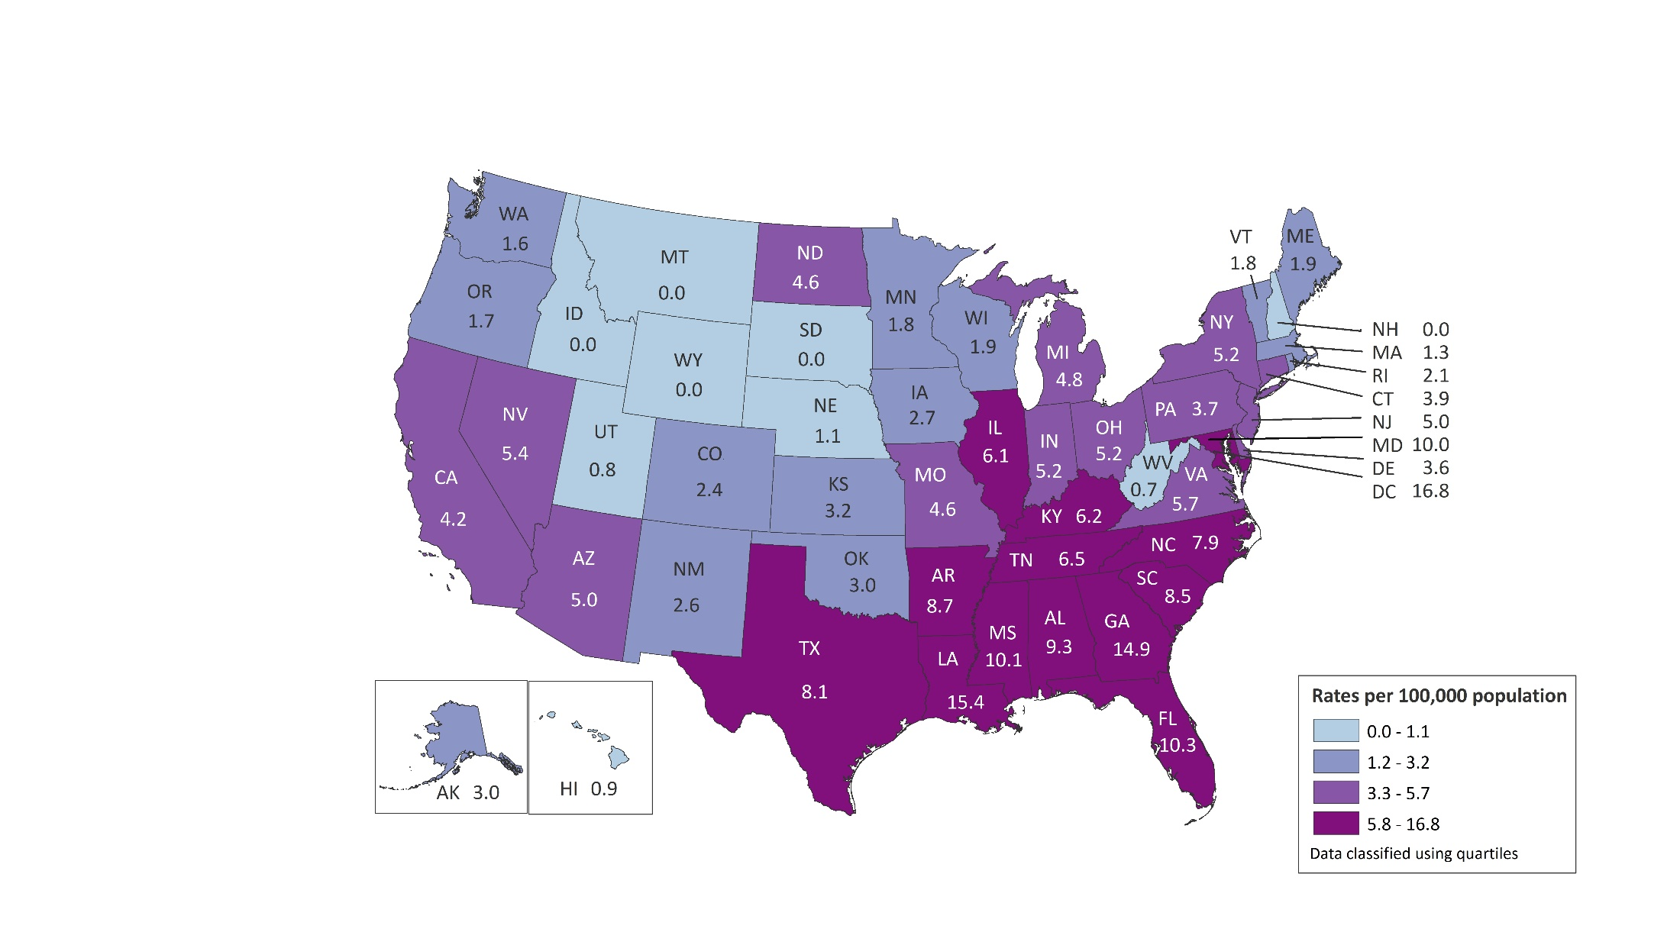
Rates of Diagnoses of HIV Infection among Adolescents Aged 13–19 Years 2018—United States and 6 Dependent Areas N = 1,722 Total Rate = 5.8
0.0
0.0
0.0
5.3
0.0
0.0
American Samoa
Guam
Northern Mariana Islands
Puerto Rico
Republic of Palau
U.S. Virgin Islands
Note. Data for the year 2018 are considered preliminary and based on 6 months reporting delay.
Notes:
This slide presents the distribution of diagnoses of HIV infection among adolescents aged 13–19 years during 2018 in the United States and 6 dependent Areas.
In 2018, there were 1,722 adolescents aged 13–19 years with HIV infection diagnosed in the United States and 6 dependent areas. The rate of diagnoses of HIV infection in adolescents was 5.8 per 100,000 population. The rates of diagnoses of HIV infection among adolescents in 2017 were highest in the District of Columbia (16.8), Louisiana (15.4), and Georgia (14.9),
The District of Columbia (i.e., Washington, DC) is a city; use caution when comparing the HIV diagnosis rate in DC with the rates in states.
Data for the year 2018 are considered preliminary and based on 6 months reporting delay.

Slide 18
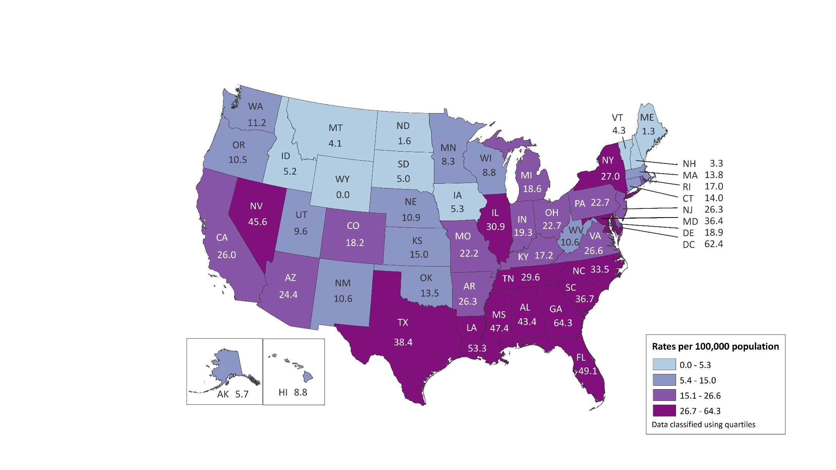
Rates of Diagnoses of HIV Infection among Young Adults Aged 20–24 Years 2018—United States and 6 Dependent Areas N = 6,085 Total Rate = 27.5
0.0
0.0
0.0
26.6
0.0
0.0
American Samoa
Guam
Northern Mariana Islands
Puerto Rico
Republic of Palau
U.S. Virgin Islands
Note. Data for the year 2018 are considered preliminary and based on 6 months reporting delay.
Notes:
This slide presents the distribution of diagnoses of HIV infection among adolescents aged 20–24 years during 2017 in the United States and 6 dependent Areas.
In 2018, there were 6,085 young adults aged 20–24 years with HIV infection diagnosed in the United States and 6 dependent areas. The rate of diagnoses of HIV infection in young adults was 27.5 per 100,000 population. The rates of diagnoses of HIV infection among young adults in 2018 were highest in the District of Columbia (62.4) and the South, specifically, Georgia (64.3), Louisiana (53.3), Florida (49.1), and Mississippi (47.4).
The District of Columbia (i.e., Washington, DC) is a city; use caution when comparing the HIV diagnosis rate in DC with the rates in states.
Data for the year 2018 are considered preliminary and based on 6 months reporting delay.

Slide 19
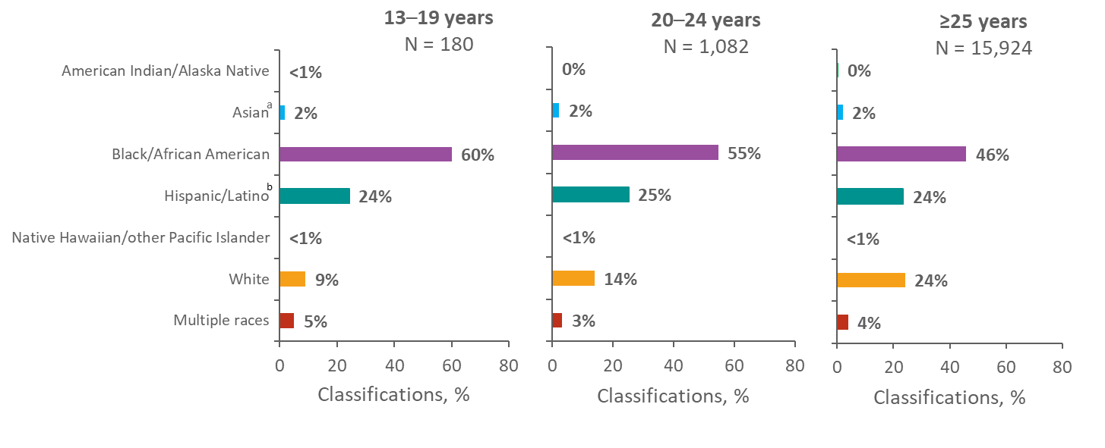
Stage 3 (AIDS) Classifications among Persons Aged 13 Years and Older with Diagnosed HIV Infection, by Race/Ethnicity and Age Group, 2018 United States and 6 Dependent Areas
Note. Data for the year 2018 are considered preliminary and based on 6 months reporting delay.
ª Includes Asian/Pacific Islander legacy cases.
^{b} Hispanics/Latinos can be of any race.
Notes:
This slide compares the racial/ethnic distributions of stage 3 (AIDS) classifications among adolescents 13–19 years of age, young adults 20–24 years of age, and adults 25 years and older during 2018 in the United States and 6 dependent areas.
In all three age groups, blacks/African Americans had the largest percentage of stage 3 (AIDS) classifications, although the percentage decreased as age group increased: 60% in persons aged 13–19 years, 55% in persons aged 20–24 years, and 46% in persons aged 25 years and older. Hispanics/Latinos accounted for 24% of stage 3 (AIDS) classifications in persons aged 13–19, for 25% in persons aged 20–24 years, and for 24% in persons aged 25 years and older. The percentage of stage 3 (AIDS) classifications among whites in 2018 increased as age group increased: 9% in persons aged 13–19 years, 14% in persons aged 20–24 years, and 24% in persons aged 25 years and older.
Data for the year 2018 are considered preliminary and based on 6 months reporting delay.
The Asian category includes Asian/Pacific Islander legacy cases (cases that were diagnosed and reported under the pre-1997 Office of Management and Budget race/ethnicity classification system).
Hispanics/Latinos can be of any race.

Slide 20
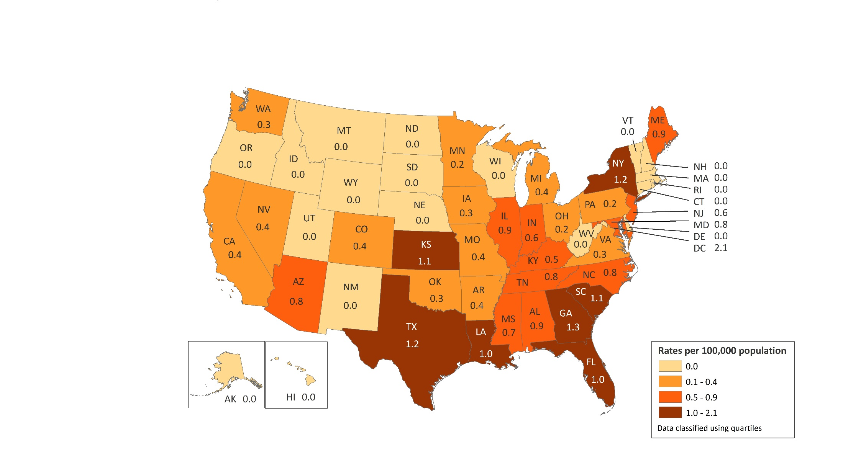
Rates of Diagnosed HIV Infection Classified as Stage 3 (AIDS) among Adolescents Aged 13–19 Years, 2018—United States and 6 Dependent Areas N = 180 Total Rate = 0.6
American Samoa 0.0
Guam 0.0
Northern Mariana Islands 0.0
Puerto Rico 0.0
Republic of Palau 0.0
U.S. Virgin Islands 0.0
Note. Data for the year 2018 are preliminary and based on 6 months reporting delay.
Notes:
This slide present the distribution of diagnosed HIV infection classified as stage 3 (AIDS) among adolescents aged 13–19 years during 2018 in the United States and 6 dependent areas.
In 2018, there were 180 stage 3 (AIDS) classifications in adolescents aged 13–19 years in the United States and 6 dependent areas. The overall rate of adolescents with diagnosed HIV classified as stage 3 (AIDS) was 0.6 per 100,000 population. The highest rates of stage 3 (AIDS) classifications in adolescents were in the District of Columbia (2.1), Georgia (1.3), New York (1.2) and Texas (1.2).
The District of Columbia (i.e., Washington, DC) is a city; use caution when comparing the stage 3 (AIDS) rate in DC with the rates in states.
Data for the year 2018 are considered preliminary and based on 6 months reporting delay.

Slide 21
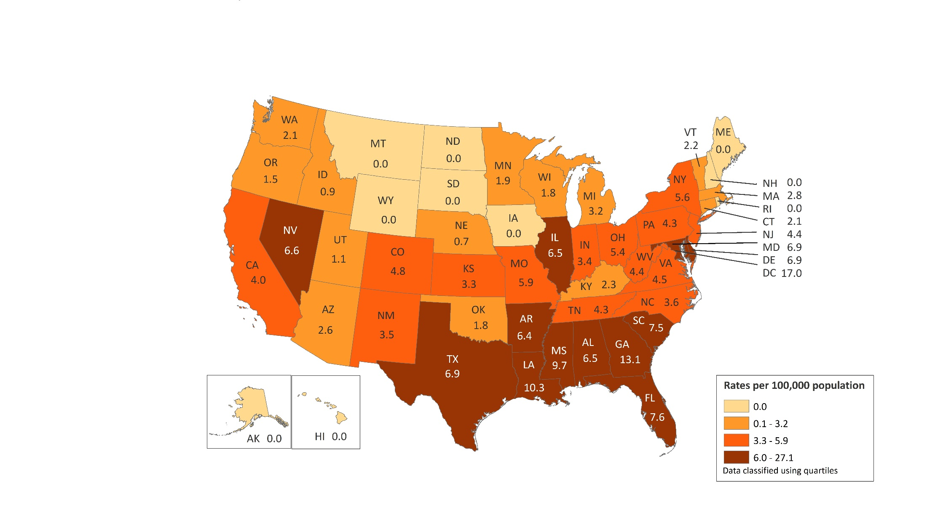
Rates of Diagnosed HIV Infection Classified as Stage 3 (AIDS) among Young Adults Aged 20–24 Years, 2018—United States and 6 Dependent Areas N = 1,082 Total Rate = 4.9
American Samoa
Guam
Northern Mariana Islands
Puerto Rico
Republic of Palau
U.S. Virgin Islands
0.0
0.0
27.1
3.7
0.0
17.4
Note. Data for the year 2017 are considered preliminary and based on 6 months reporting delay.
Notes:
This slide present the distribution of diagnosed HIV infection classified as stage 3 (AIDS) among adolescents aged 20–24 years during 2018 in the United States and 6 dependent areas.
In 2018, there were 1,082 stage 3 (AIDS) classifications in young adults 20–24 years of age in the United States and 6 dependent areas. The overall rate of young adults with diagnosed HIV infection classified as stage 3 (AIDS) was 4.9 per 100,000 population. The highest rate of stage 3 (AIDS) classifications in young adults were in Northern Mariana Islands (27.1), U.S Virgin Islands (17.4), District of Columbia (17.0), Georgia (13.1), and Louisiana (10.3).
The District of Columbia (i.e., Washington, DC) is a city; use caution when comparing the stage 3 (AIDS) rate in DC with the rates in states.
Data for the year 2018 are considered preliminary and based on 6 months reporting delay.

