Slide 1
Notes:
HIV Infection, Stage 3 (AIDS).
For all slides in this series, the following notes apply:
All data presented in this slide set were reported to CDC through December 31, 2021 and are considered provisional and subject to change as additional reports are submitted for HIV cases and as HIV surveillance data quality improves with further evaluation of the surveillance system and data repository. Because reporting delays can impact the reliability of data presented in this report, caution should be applied when interpreting the results. Data for 2020 should be interpreted with caution due to the impact of the COVID-19 pandemic on access to HIV testing, care-related services, and case surveillance activities in state/local jurisdictions.
Numbers, percentages, and rates of diagnosed infections classified as stage 3 (AIDS) are based on data from 50 states, the District of Columbia, and 6 U.S. dependent areas.
Rates for transmission category are not provided because of the absence of denominator data from the U.S. Census Bureau.
Rates are not calculated by race/ethnicity for the 6 U.S. dependent areas because the U.S. Census Bureau does not collect information from all U.S. dependent areas.
Additional stage 3 (AIDS) data for 1985 through the most recent year are available via NCHHSTP AtlasPlus (https://www.cdc.gov/nchhstp/atlas/index.htm).
Data re-release agreements between CDC and state/local HIV surveillance programs require certain levels of cell suppression at the state and county level in order to ensure confidentiality of personally identifiable information.

Slide 2
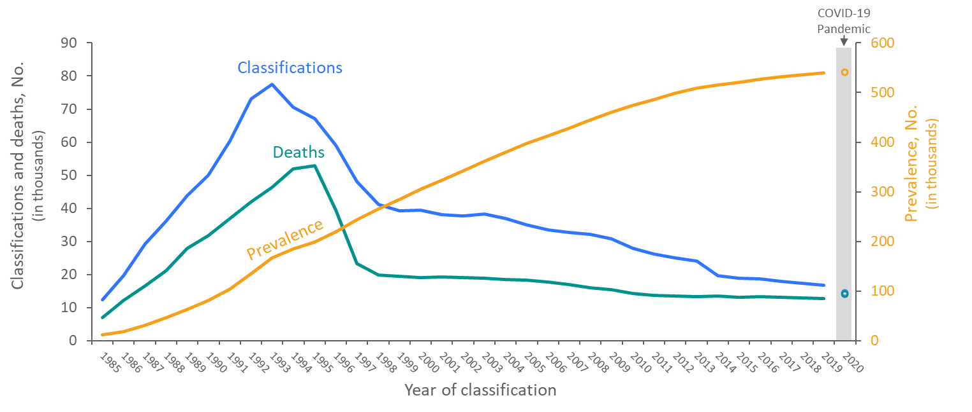
Stage 3 (AIDS) Classifications, Deaths, and Persons Living with Diagnosed HIV Infection Ever Classified as Stage 3 (AIDS), 1985–2020 (COVID-19 Pandemic) United States and 6 Dependent Areas
Note. Deaths of persons with HIV infection, stage 3 (AIDS) may be due to any cause. Data include persons of all ages. Data for the year 2020 are preliminary and based on deaths reported to CDC as of December 2021. Data for 2020 should be interpreted with caution due to the impact of the COVID-19 pandemic on access to HIV testing, care-related services, and case surveillance activities in state/local jurisdictions.
Notes:
This slide presents from 1985 through 2020 in the United States and 6 dependent areas trends in the numbers of stage 3 (AIDS) classifications, deaths of persons with diagnosed HIV infection ever classified as stage 3 (AIDS), and persons living with diagnosed HIV infection ever classified as stage 3 (AIDS) (i.e., prevalence) among persons of all ages. Stage 3 (AIDS) classifications and deaths of persons with stage 3 (AIDS) increased sharply during the beginning of the epidemic from 1985 through the mid-1990s. The overall declines in stage 3 (AIDS) classifications and deaths of persons with stage 3 (AIDS) since the mid-1990s are due to breakthroughs in early detection of HIV infection, improved screening technologies, advances in antiretroviral and combination drug therapies, prophylactic medications against opportunistic infections, and HIV prevention awareness campaigns. The prevalence of stage 3 (AIDS) has steadily increased throughout 1985–2020.
Deaths of persons with stage 3 (AIDS) may be due to any cause (may not be HIV-related). Data include persons of all ages. Data for the year 2020 are preliminary and based on deaths reported to CDC as of December 2021. Data for 2020 should be interpreted with caution due to the impact of the COVID-19 pandemic on access to HIV testing, care-related services, and case surveillance activities in state/local jurisdictions.

Slide 3
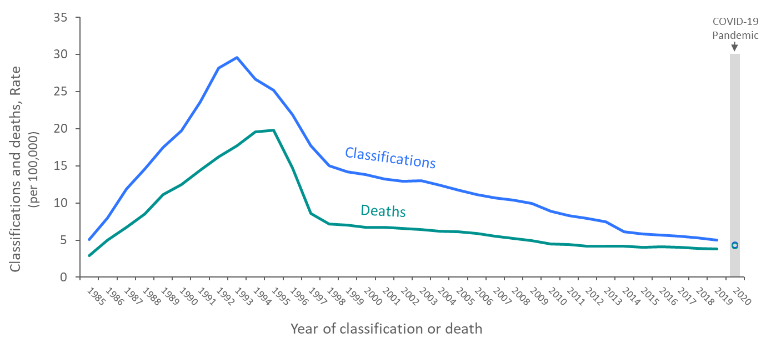
Rates of Stage 3 (AIDS) Classifications and Deaths of Persons with Diagnosed HIV Infection Ever Classified as Stage 3 (AIDS), 1985–2020 (COVID-19 Pandemic) United States and 6 Dependent Areas
Note. Deaths of persons with HIV infection, stage 3 (AIDS) may be due to any cause. Data include persons of all ages. Data for 2020 should be interpreted with caution due to the impact of the COVID-19 pandemic on access to HIV testing, care-related services, and case surveillance activities in state/local jurisdictions.
Notes:
This slide presents from 1985 through 2020 in the United States and 6 dependent areas trends in the rates of stage 3 (AIDS) classifications and deaths of persons with diagnosed HIV infection ever classified as stage 3 (AIDS) among persons of all ages. Rates of stage 3 (AIDS) classifications and rates of deaths of persons with stage 3 (AIDS) increased during the beginning of the epidemic from 1985 through the mid-1990s. The overall declines in rates of stage 3 (AIDS) classifications and rates of deaths of persons with stage 3 (AIDS) since the mid-1990s are due to breakthroughs in early detection of HIV infection, improved screening technologies, advances in antiretroviral and combination drug therapies, prophylactic medications against opportunistic infections, and HIV prevention awareness campaigns.
Deaths of persons with stage 3 (AIDS) may be due to any cause (may not be HIV-related). Deaths of persons with stage 3 (AIDS) are classified as adult or adolescent based on age at stage 3 classification or death. Data include persons of all ages. Data for 2020 should be interpreted with caution due to the impact of the COVID-19 pandemic on access to HIV testing, care-related services, and case surveillance activities in state/local jurisdictions.

Slide 4
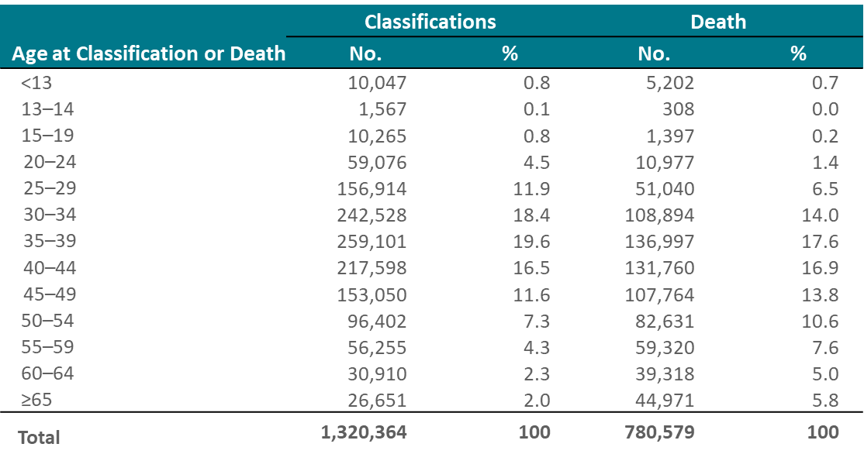
Stage 3 (AIDS) Classifications and Deaths of Persons with Stage 3 (AIDS), by Age
at Classification or Death, Cumulative as of Year-End 2020 — United States and 6 Dependent Areas
Note. Deaths of persons with HIV infection, stage 3 (AIDS) may be due to any cause. Cumulative data are from the beginning of the epidemic through 2020. Data for 2020 should be interpreted with caution due to the impact of the COVID-19 pandemic on access to HIV testing, care-related services, and case surveillance activities in state/local jurisdictions.
Notes:
This slide presents for the United States and 6 dependent areas, the numbers of stage 3 (AIDS) classifications and deaths among persons of all ages with stage 3 (AIDS), by age at classification or death and cumulative as of year-end 2020. By year-2020, there were 1,320,364 stage 3 (AIDS) classifications and 780,579 deaths among persons with Stage 3 (AIDS).
As of year-end 2020, 19.6% of cumulative stage 3 (AIDS) classifications were among persons aged 35–39 years, followed by persons aged 30–34 years (18.4%) and persons aged 40–44 years (16.5%). For cumulative stage 3 (AIDS) deaths, 17.6% were among persons aged 35–39 years, followed by persons aged 40–44 years (16.9%) and persons aged 30–34 years (14.0%).
Deaths of persons with HIV infection, stage 3 (AIDS) may be due to any cause. Cumulative data are from the beginning of the epidemic through 2020. Data for 2020 should be interpreted with caution due to the impact of the COVID-19 pandemic on access to HIV testing, care-related services, and case surveillance activities in state/local jurisdictions.

Slide 5
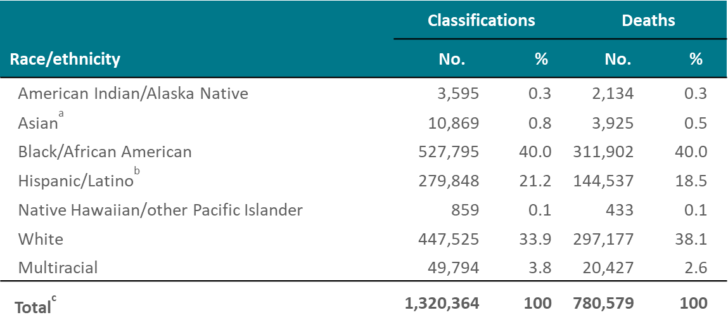
Stage 3 (AIDS) Classifications and Deaths of Persons with Stage 3 (AIDS), by Race/Ethnicity, Cumulative as of Year-End 2020 — United States and 6 Dependent Areas
Note. Deaths of persons with HIV infection, stage 3 (AIDS) may be due to any cause. Cumulative data are from the beginning of the epidemic through 2020. Data for 2020 should be interpreted with caution due to the impact of the COVID-19 pandemic on access to HIV testing, care-related services, and case surveillance activities in state/local jurisdictions.
ª Includes Asian/Pacific Islander legacy cases
^{b} Hispanic/Latino persons can be of any race.
^{c} Data include persons of all ages and persons whose race/ethnicity is unknown.
Notes:
This slide presents for the United States and 6 dependent areas the numbers of stage 3 (AIDS) classifications and deaths of persons with stage 3 (AIDS), by race/ethnicity and cumulative as of year-end 2020. By year-2020, there were 1,320,364 stage 3 (AIDS) classifications and 780,579 deaths among persons with Stage 3 (AIDS).
As of year-end 2020, Black/African American persons accounted for the largest percentages for both cumulative stage 3 (AIDS) classifications (40.0%) and deaths of persons with stage 3 (AIDS) (40.0%), followed by White persons for cumulative stage 3 (AIDS) classifications (33.9%) and deaths of persons with stage 3 (AIDS) (38.1%).
Deaths of persons with HIV infection, stage 3 (AIDS) may be due to any cause. Cumulative data are from the beginning of the epidemic through 2020. Data for 2020 should be interpreted with caution due to the impact of the COVID-19 pandemic on access to HIV testing, care-related services, and case surveillance activities in state/local jurisdictions.
The Asian category includes Asian/Pacific Islander legacy cases (cases that were diagnosed and reported under the pre-1997 Office of Management and Budget race/ethnicity classification system).
Hispanic/Latino persons can be of any race.
Total includes persons whose race/ethnicity is unknown

Slide 6
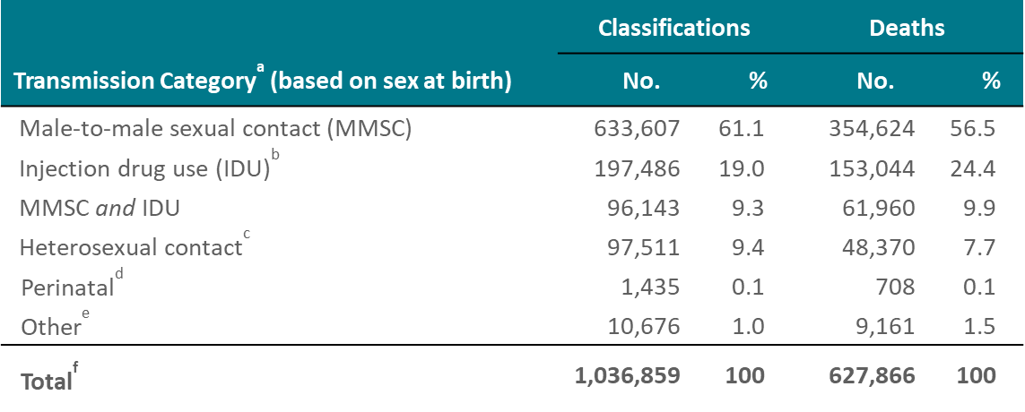
Stage 3 (AIDS) Classifications and Deaths of Persons with Stage 3 (AIDS) among Males (Based on Sex Assigned at Birth) Aged ≥13 Years, by Transmission Category, Cumulative as of Year-End 2020—United States and 6 Dependent Areas
Note. Deaths of persons with HIV infection, stage 3 (AIDS) may be due to any cause. Data have been statistically adjusted to account for missing transmission category. Cumulative data are from the beginning of the epidemic through 2020. Data for 2020 should be interpreted with caution due to the impact of the COVID-19 pandemic on access to HIV testing, care-related services, and case surveillance activities in state/local jurisdictions.
ª Transmission category is classified based on a hierarchy of the risk factors most likely responsible for HIV transmission; classification is determined based on the person’s sex assigned at birth. Data have been statistically adjusted to account for missing transmission category, therefore values may not sum to column subtotals and total.
^{b} Includes persons who injected nonprescription drugs or who injected prescription drugs for nonmedical purposes.
^{c} Sexual contact with a person known to have, or with a risk factor for, HIV infection.
^{d} Individuals were aged ≥13 years at time of stage 3 classification or death.
^{e} Other risk factors including hemophilia, blood transfusion, and risk factor not reported or not identified.
^{f} Because column totals for numbers were calculated independently of the values for the subpopulations, the values in each column may not sum to the column total.
Notes:
This slide presents for the United States and 6 dependent areas the numbers of stage 3 (AIDS) classifications and deaths of persons with stage 3 (AIDS) among males aged ≥13 years, by transmission category and cumulative as of year-end 2020. By year-2020, among males aged ≥13 years, there were 1,036,859 stage 3 (AIDS) classifications and 627,866 deaths among persons with Stage 3 (AIDS).
As of year-end 2020, males with HIV infection attributed to male-to-male sexual contact (MMSC) accounted for the largest percentages for both cumulative stage 3 (AIDS) classifications (61.1%) and deaths of persons with stage 3 (AIDS) (56.5%), followed by males with infection attributed to injection drug use (IDU) for cumulative stage 3 (AIDS) classifications (19.0%) and deaths of persons with stage 3 (AIDS) (24.4%).
Deaths of persons with HIV infection, stage 3 (AIDS) may be due to any cause. Data have been statistically adjusted to account for missing transmission category. Cumulative data are from the beginning of the epidemic through 2020. Data for 2020 should be interpreted with caution due to the impact of the COVID-19 pandemic on access to HIV testing, care-related services, and case surveillance activities in state/local jurisdictions.
Transmission category is classified based on a hierarchy of the risk factors most likely responsible for HIV transmission; classification is determined based on the person’s sex assigned at birth. Data have been statistically adjusted to account for missing transmission category, therefore values may not sum to column subtotals and total.
Injection drug use (IDU) includes persons who injected nonprescription drugs or who injected prescription drugs for nonmedical purposes.
Heterosexual contact is with a person known to have, or with a risk factor for, HIV infection.
Perinatal exposure includes persons who were exposed to HIV perinatally and were aged ≥13 years at time of stage 3 classification or death.
Other risk factors combined, including hemophilia, blood transfusion, and risk factor not reported or not identified.
Because column totals for numbers were calculated independently of the values for the subpopulations, the values in each column may not sum to the column total.

Slide 7
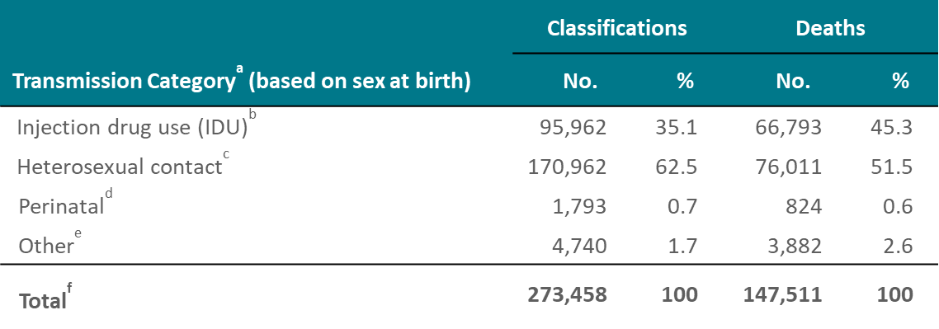
Stage 3 (AIDS) Classifications and Deaths of Persons with Stage 3 (AIDS) among Females (Based on Sex Assigned at Birth) Aged ≥13 Years, by Transmission Category, Cumulative as of Year-End 2020 —United States and 6 Dependent Areas
Note. Deaths of persons with HIV infection, stage 3 (AIDS) may be due to any cause. Data have been statistically adjusted to account for missing transmission category. Cumulative data are from the beginning of the epidemic through 2020. Data for 2020 should be interpreted with caution due to the impact of the COVID-19 pandemic on access to HIV testing, care-related services, and case surveillance activities in state/local jurisdictions.
ª Transmission category is classified based on a hierarchy of the risk factors most likely responsible for HIV transmission; classification is determined based on the person’s sex assigned at birth. Data have been statistically adjusted to account for missing transmission category, therefore values may not sum to column subtotals and total.
^{b} Includes persons who injected nonprescription drugs or who injected prescription drugs for nonmedical purposes.
^{c} Sexual contact with a person known to have, or with a risk factor for, HIV infection.
^{d} Individuals were aged ≥13 years at time of stage 3 classification or death.
^{e} Other risk factors including hemophilia, blood transfusion, and risk factor not reported or not identified.
^{f} Because column totals for numbers were calculated independently of the values for the subpopulations, the values in each column may not sum to the column total.
Notes:
This slide presents for the United States and 6 dependent areas the numbers of stage 3 (AIDS) classifications and deaths of persons with stage 3 (AIDS) among females aged ≥13 years, by transmission category and cumulative as of year-end 2020. By year-2020, among females aged ≥13 years, there were 273,458 stage 3 (AIDS) classifications and 147,511 deaths among persons with Stage 3 (AIDS).
As of year-end 2020, females with HIV infection attributed to heterosexual contact accounted for the large percentages of both cumulative stage 3 (AIDS) classifications (62.5%) and deaths of persons with stage 3 (AIDS) (51.5%), followed by females with infection attributed to injection drug use (IDU) for cumulative stage 3 (AIDS) classifications (35.1%) and deaths of persons with stage 3 (AIDS) (45.3%).
Deaths of persons with HIV infection, stage 3 (AIDS) may be due to any cause. Data have been statistically adjusted to account for missing transmission category. Cumulative data are from the beginning of the epidemic through 2020. Data for 2020 should be interpreted with caution due to the impact of the COVID-19 pandemic on access to HIV testing, care-related services, and case surveillance activities in state/local jurisdictions.
Transmission category is classified based on a hierarchy of the risk factors most likely responsible for HIV transmission; classification is determined based on the person’s sex assigned at birth. Data have been statistically adjusted to account for missing transmission category, therefore values may not sum to column subtotals and total.
Injection drug use (IDU) includes persons who injected nonprescription drugs or who injected prescription drugs for nonmedical purposes.
Heterosexual contact is with a person known to have, or with a risk factor for, HIV infection.
Perinatal exposure includes persons who were exposed to HIV perinatally and were aged ≥13 years at time of stage 3 classification or death.
Other risk factors combined, including hemophilia, blood transfusion, and risk factor not reported or not identified.
Because column totals for numbers were calculated independently of the values for the subpopulations, the values in each column may not sum to the column total.

Slide 8
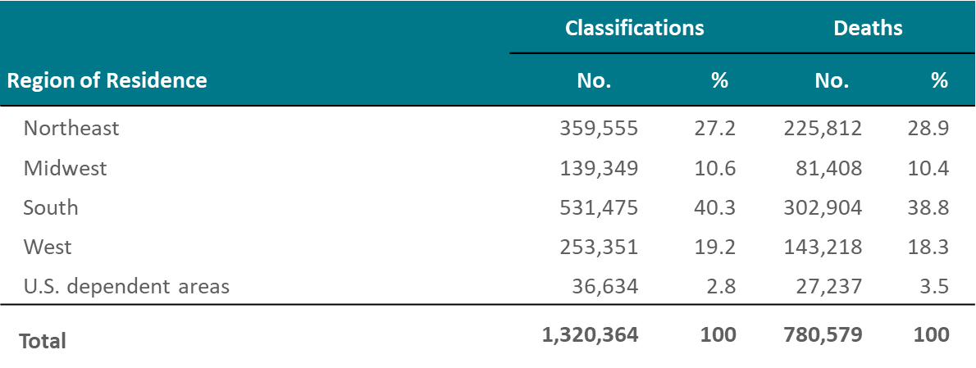
Stage 3 (AIDS) Classifications and Deaths of Persons with Stage 3 (AIDS), by Region of Residence, Cumulative as of Year-End 2020 — United States and 6 Dependent Areas
Note. Data are based on residence at time of stage 3 (AIDS) classification or death. Deaths of persons with HIV infection, stage 3 (AIDS) may be due to any cause. Data include persons of all ages. Cumulative data are from the beginning of the epidemic through 2020. Data for 2020 should be interpreted with caution due to the impact of the COVID-19 pandemic on access to HIV testing, care-related services, and case surveillance activities in state/local jurisdictions.
Notes:
This slide presents for the United States and 6 dependent areas the numbers of stage 3 (AIDS) classifications and deaths among persons of all ages with stage 3 (AIDS), by region of residence and cumulative as of year-end 2020. By year-2020, there were 1,320,364 stage 3 (AIDS) classifications and 780,579 deaths among persons with stage 3 (AIDS).
As of year-end 2020, persons in the South accounted for the largest percentages for both cumulative stage 3 (AIDS) classifications (40.3%) and deaths of persons with stage 3 (AIDS) classifications (38.8%), followed by persons in the Northeast for cumulative stage 3 (AIDS) classifications (27.2%) and deaths of persons with stage 3 (AIDS) (28.9%).
Regions of residence are defined as follows:
Northeast—Connecticut, Maine, Massachusetts, New Hampshire, New Jersey, New York, Pennsylvania, Rhode Island, Vermont Midwest—Illinois, Indiana, Iowa, Kansas, Michigan, Minnesota, Missouri, Nebraska, North Dakota, Ohio, South Dakota, Wisconsin South—Alabama, Arkansas, Delaware, District of Columbia, Florida, Georgia, Kentucky, Louisiana, Maryland, Mississippi, North Carolina, Oklahoma, South Carolina, Tennessee, Texas, Virginia, West Virginia West—Alaska, Arizona, California, Colorado, Hawaii, Idaho, Montana, Nevada, New Mexico, Oregon, Utah, Washington, Wyoming
Data are based on residence at time of stage 3 (AIDS) classification or death. Deaths of persons with HIV infection, stage 3 (AIDS) may be due to any cause. Cumulative data are from the beginning of the epidemic through 2020. Data for 2020 should be interpreted with caution due to the impact of the COVID-19 pandemic on access to HIV testing, care-related services, and case surveillance activities in state/local jurisdictions.

Slide 9
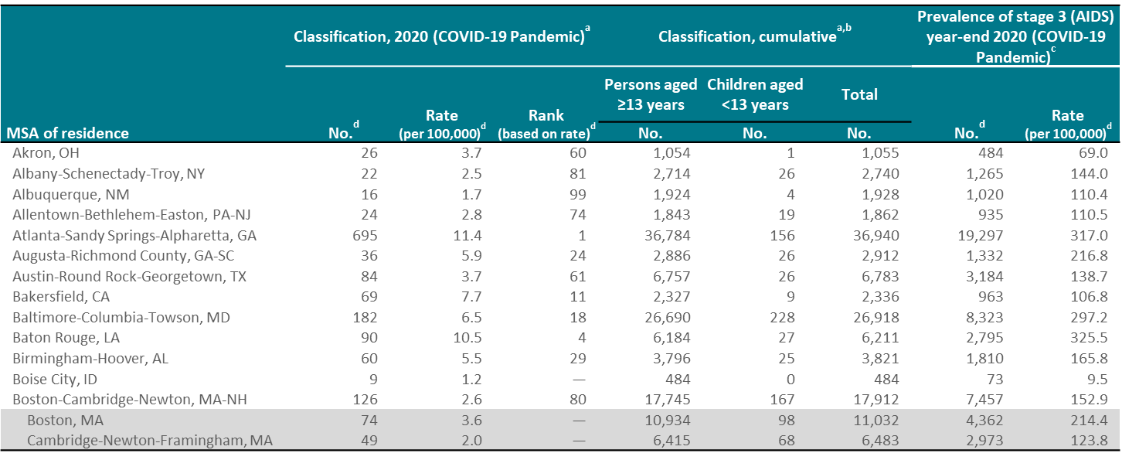
Stage 3 (AIDS), 2020 and cumulative, and persons living with diagnosed HIV infection ever classified as stage 3 (AIDS) (prevalence), year-end 2020 by metropolitan statistical area of residence (COVID-19 Pandemic) —United States and Puerto Rico (Slide 1 of 10)
Note. Ranks were not assigned to MSAs with rates that were based on reported numbers less than 12. Data for 2020 should be interpreted with caution due to the impact of the COVID-19 pandemic on access to HIV testing, care-related services, and case surveillance activities in state/local jurisdictions.
ª Data are based on residence at time of classification. ^{b} From the beginning of the epidemic through 2020.
^{c} Data are based on address of residence at the end of the specified year (i.e., most recent known address). ^{d} Data include persons of all ages.
Notes:
These slides present the numbers and rates of classifications and prevalence in the United States and Puerto Rico for areas with populations of 500,000 or more (metropolitan statistical areas [MSAs]). The Boston-Cambridge-Newton, MA-NH; New York-Newark-Jersey City, NY-NJ-PA; and San Francisco-Oakland-Berkeley, CA MSAs include 1 division with a population less than 500,000. Therefore, data presented for divisions in these 3 MSAs do not sum to the MSA totals.
MSA definitions for this report can be found at http://www.census.gov/programs-surveys/metro-micro.html.
Data for 2020 should be interpreted with caution due to the impact of the COVID-19 pandemic on access to HIV testing, care-related services, and case surveillance activities in state/local jurisdictions.
Numbers less than 12, and rates based on these numbers, should be interpreted with caution.

Slide 10
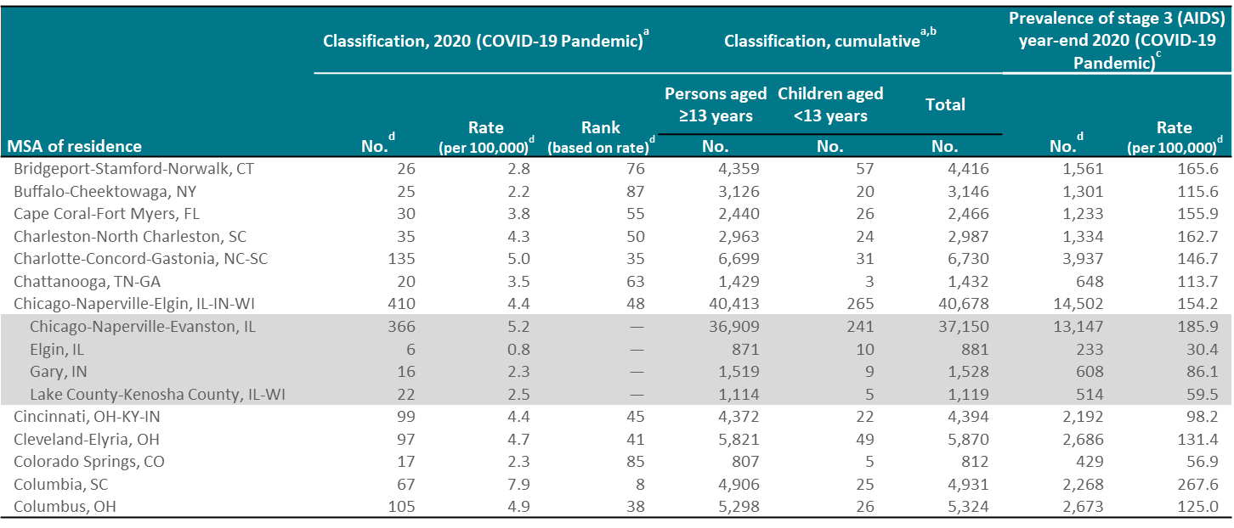
Stage 3 (AIDS), 2020 and cumulative, and persons living with diagnosed HIV infection ever classified as stage 3 (AIDS) (prevalence), year-end 2020 by metropolitan statistical area of residence (COVID-19 Pandemic) —United States and Puerto Rico (Slide 2 of 10)
Note. Ranks were not assigned to MSAs with rates that were based on reported numbers less than 12. Data for 2020 should be interpreted with caution due to the impact of the COVID-19 pandemic on access to HIV testing, care-related services, and case surveillance activities in state/local jurisdictions.
ª Data are based on residence at time of classification. ^{b} From the beginning of the epidemic through 2020.
^{c} Data are based on address of residence at the end of the specified year (i.e., most recent known address). ^{d} Data include persons of all ages.
Notes:
These slides present the numbers and rates of classifications and prevalence in the United States and Puerto Rico for areas with populations of 500,000 or more (metropolitan statistical areas [MSAs]). The Boston-Cambridge-Newton, MA-NH; New York-Newark-Jersey City, NY-NJ-PA; and San Francisco-Oakland-Berkeley, CA MSAs include 1 division with a population less than 500,000. Therefore, data presented for divisions in these 3 MSAs do not sum to the MSA totals.
MSA definitions for this report can be found at http://www.census.gov/programs-surveys/metro-micro.html.
Data for 2020 should be interpreted with caution due to the impact of the COVID-19 pandemic on access to HIV testing, care-related services, and case surveillance activities in state/local jurisdictions.
Numbers less than 12, and rates based on these numbers, should be interpreted with caution.

Slide 11
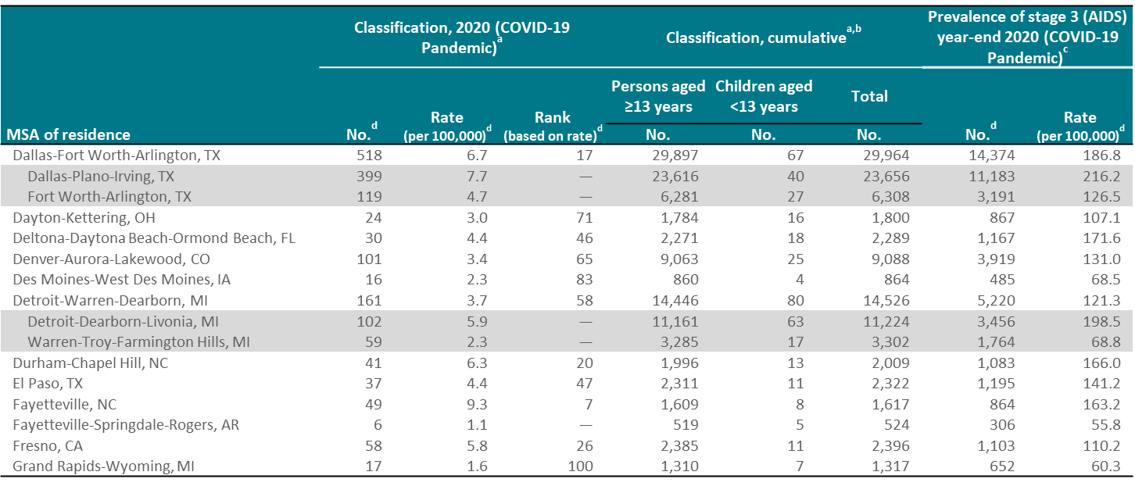
Stage 3 (AIDS), 2020 and cumulative, and persons living with diagnosed HIV infection ever classified as stage 3 (AIDS) (prevalence), year-end 2020 by metropolitan statistical area of residence (COVID-19 Pandemic) —United States and Puerto Rico (Slide 3 of 10)
Note. Ranks were not assigned to MSAs with rates that were based on reported numbers less than 12. Data for 2020 should be interpreted with caution due to the impact of the COVID-19 pandemic on access to HIV testing, care-related services, and case surveillance activities in state/local jurisdictions.
ª Data are based on residence at time of classification. ^{b} From the beginning of the epidemic through 2020.
^{c} Data are based on address of residence at the end of the specified year (i.e., most recent known address). ^{d} Data include persons of all ages.
Notes:
These slides present the numbers and rates of classifications and prevalence in the United States and Puerto Rico for areas with populations of 500,000 or more (metropolitan statistical areas [MSAs]). The Boston-Cambridge-Newton, MA-NH; New York-Newark-Jersey City, NY-NJ-PA; and San Francisco-Oakland-Berkeley, CA MSAs include 1 division with a population less than 500,000. Therefore, data presented for divisions in these 3 MSAs do not sum to the MSA totals.
MSA definitions for this report can be found at http://www.census.gov/programs-surveys/metro-micro.html.
Data for 2020 should be interpreted with caution due to the impact of the COVID-19 pandemic on access to HIV testing, care-related services, and case surveillance activities in state/local jurisdictions.
Numbers less than 12, and rates based on these numbers, should be interpreted with caution.

Slide 12
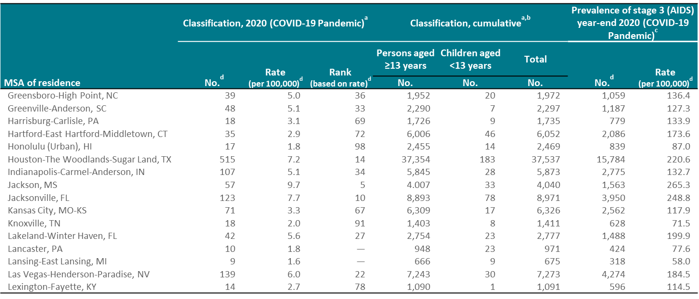
Stage 3 (AIDS), 2020 and cumulative, and persons living with diagnosed HIV infection ever classified as stage 3 (AIDS) (prevalence), year-end 2020 by metropolitan statistical area of residence (COVID-19 Pandemic) —United States and Puerto Rico (Slide 4 of 10)
Note. Ranks were not assigned to MSAs with rates that were based on reported numbers less than 12. Data for 2020 should be interpreted with caution due to the impact of the COVID-19 pandemic on access to HIV testing, care-related services, and case surveillance activities in state/local jurisdictions.
ª Data are based on residence at time of classification. ^{b} From the beginning of the epidemic through 2020.
^{c} Data are based on address of residence at the end of the specified year (i.e., most recent known address). ^{d} Data include persons of all ages.
Notes:
These slides present the numbers and rates of classifications and prevalence in the United States and Puerto Rico for areas with populations of 500,000 or more (metropolitan statistical areas [MSAs]). The Boston-Cambridge-Newton, MA-NH; New York-Newark-Jersey City, NY-NJ-PA; and San Francisco-Oakland-Berkeley, CA MSAs include 1 division with a population less than 500,000. Therefore, data presented for divisions in these 3 MSAs do not sum to the MSA totals.
MSA definitions for this report can be found at http://www.census.gov/programs-surveys/metro-micro.html.
Data for 2020 should be interpreted with caution due to the impact of the COVID-19 pandemic on access to HIV testing, care-related services, and case surveillance activities in state/local jurisdictions.
Numbers less than 12, and rates based on these numbers, should be interpreted with caution.

Slide 13
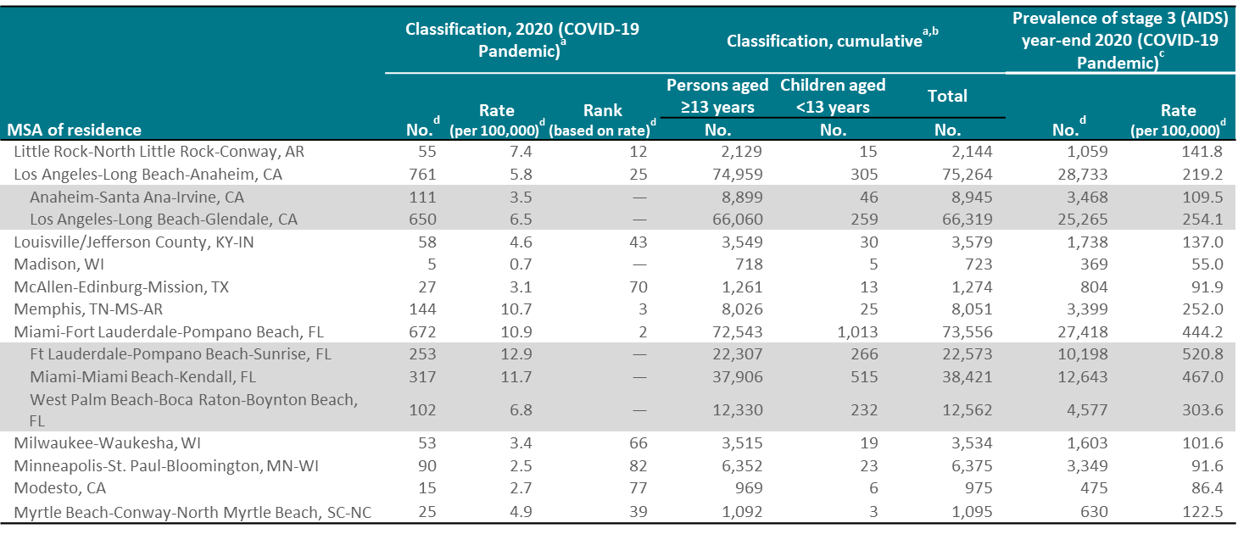
Stage 3 (AIDS), 2020 and cumulative, and persons living with diagnosed HIV infection ever classified as stage 3 (AIDS) (prevalence), year-end 2020 by metropolitan statistical area of residence (COVID-19 Pandemic) —United States and Puerto Rico (Slide 5 of 10)
Note. Ranks were not assigned to MSAs with rates that were based on reported numbers less than 12. Data for 2020 should be interpreted with caution due to the impact of the COVID-19 pandemic on access to HIV testing, care-related services, and case surveillance activities in state/local jurisdictions.
ª Data are based on residence at time of classification. ^{b} From the beginning of the epidemic through 2020.
^{c} Data are based on address of residence at the end of the specified year (i.e., most recent known address). ^{d} Data include persons of all ages.
Notes:
These slides present the numbers and rates of classifications and prevalence in the United States and Puerto Rico for areas with populations of 500,000 or more (metropolitan statistical areas [MSAs]). The Boston-Cambridge-Newton, MA-NH; New York-Newark-Jersey City, NY-NJ-PA; and San Francisco-Oakland-Berkeley, CA MSAs include 1 division with a population less than 500,000. Therefore, data presented for divisions in these 3 MSAs do not sum to the MSA totals.
MSA definitions for this report can be found at http://www.census.gov/programs-surveys/metro-micro.html.
Data for 2020 should be interpreted with caution due to the impact of the COVID-19 pandemic on access to HIV testing, care-related services, and case surveillance activities in state/local jurisdictions.
Numbers less than 12, and rates based on these numbers, should be interpreted with caution.

Slide 14
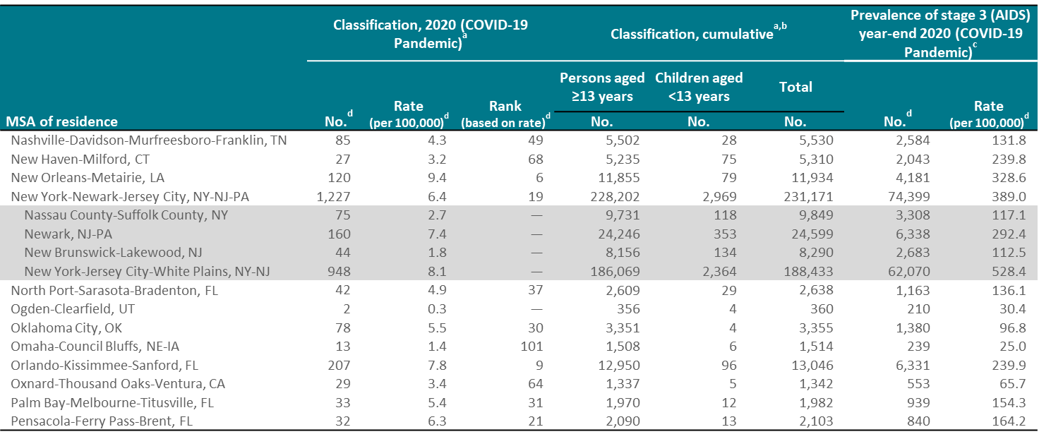
Stage 3 (AIDS), 2020 and cumulative, and persons living with diagnosed HIV infection ever classified as stage 3 (AIDS) (prevalence), year-end 2020 by metropolitan statistical area of residence (COVID-19 Pandemic) —United States and Puerto Rico (Slide 6 of 10)
Note. Ranks were not assigned to MSAs with rates that were based on reported numbers less than 12. Data for 2020 should be interpreted with caution due to the impact of the COVID-19 pandemic on access to HIV testing, care-related services, and case surveillance activities in state/local jurisdictions.
ª Data are based on residence at time of classification. ^{b} From the beginning of the epidemic through 2020.
^{c} Data are based on address of residence at the end of the specified year (i.e., most recent known address). ^{d} Data include persons of all ages.
Notes:
These slides present the numbers and rates of classifications and prevalence in the United States and Puerto Rico for areas with populations of 500,000 or more (metropolitan statistical areas [MSAs]). The Boston-Cambridge-Newton, MA-NH; New York-Newark-Jersey City, NY-NJ-PA; and San Francisco-Oakland-Berkeley, CA MSAs include 1 division with a population less than 500,000. Therefore, data presented for divisions in these 3 MSAs do not sum to the MSA totals.
MSA definitions for this report can be found at http://www.census.gov/programs-surveys/metro-micro.html.
Data for 2020 should be interpreted with caution due to the impact of the COVID-19 pandemic on access to HIV testing, care-related services, and case surveillance activities in state/local jurisdictions.
Numbers less than 12, and rates based on these numbers, should be interpreted with caution.

Slide 15
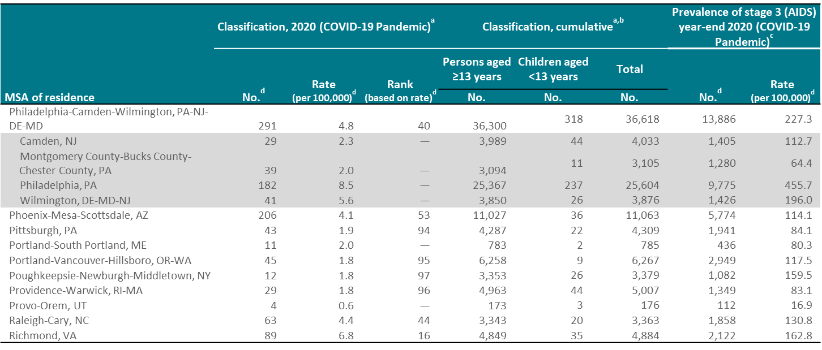
Stage 3 (AIDS), 2020 and cumulative, and persons living with diagnosed HIV infection ever classified as stage 3 (AIDS) (prevalence), year-end 2020 by metropolitan statistical area of residence (COVID-19 Pandemic) —United States and Puerto Rico (Slide 7 of 10)
Note. Ranks were not assigned to MSAs with rates that were based on reported numbers less than 12. Data for 2020 should be interpreted with caution due to the impact of the COVID-19 pandemic on access to HIV testing, care-related services, and case surveillance activities in state/local jurisdictions.
ª Data are based on residence at time of classification. ^{b} From the beginning of the epidemic through 2020.
^{c} Data are based on address of residence at the end of the specified year (i.e., most recent known address). ^{d} Data include persons of all ages.
Notes:
These slides present the numbers and rates of classifications and prevalence in the United States and Puerto Rico for areas with populations of 500,000 or more (metropolitan statistical areas [MSAs]). The Boston-Cambridge-Newton, MA-NH; New York-Newark-Jersey City, NY-NJ-PA; and San Francisco-Oakland-Berkeley, CA MSAs include 1 division with a population less than 500,000. Therefore, data presented for divisions in these 3 MSAs do not sum to the MSA totals.
MSA definitions for this report can be found at http://www.census.gov/programs-surveys/metro-micro.html.
Data for 2020 should be interpreted with caution due to the impact of the COVID-19 pandemic on access to HIV testing, care-related services, and case surveillance activities in state/local jurisdictions.
Numbers less than 12, and rates based on these numbers, should be interpreted with caution.

Slide 16
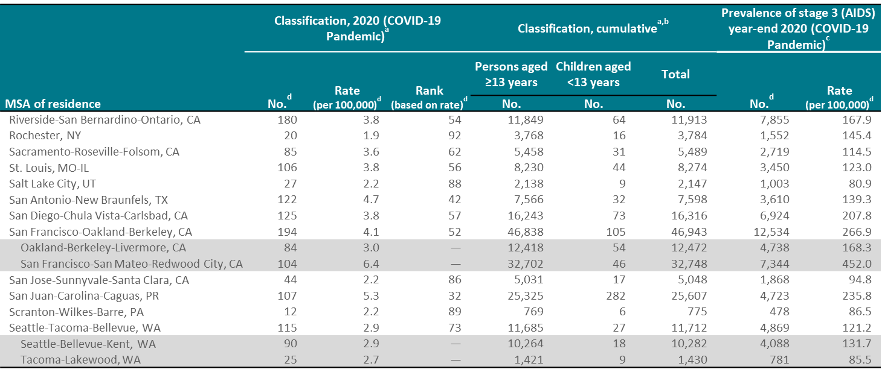
Stage 3 (AIDS), 2020 and cumulative, and persons living with diagnosed HIV infection ever classified as stage 3 (AIDS) (prevalence), year-end 2020 by metropolitan statistical area of residence (COVID-19 Pandemic) —United States and Puerto Rico (Slide 8 of 10)
Note. Ranks were not assigned to MSAs with rates that were based on reported numbers less than 12. Data for 2020 should be interpreted with caution due to the impact of the COVID-19 pandemic on access to HIV testing, care-related services, and case surveillance activities in state/local jurisdictions.
ª Data are based on residence at time of classification. ^{b} From the beginning of the epidemic through 2020.
^{c} Data are based on address of residence at the end of the specified year (i.e., most recent known address). ^{d} Data include persons of all ages.
Notes:
These slides present the numbers and rates of classifications and prevalence in the United States and Puerto Rico for areas with populations of 500,000 or more (metropolitan statistical areas [MSAs]). The Boston-Cambridge-Newton, MA-NH; New York-Newark-Jersey City, NY-NJ-PA; and San Francisco-Oakland-Berkeley, CA MSAs include 1 division with a population less than 500,000. Therefore, data presented for divisions in these 3 MSAs do not sum to the MSA totals.
MSA definitions for this report can be found at http://www.census.gov/programs-surveys/metro-micro.html.
Data for 2020 should be interpreted with caution due to the impact of the COVID-19 pandemic on access to HIV testing, care-related services, and case surveillance activities in state/local jurisdictions.
Numbers less than 12, and rates based on these numbers, should be interpreted with caution.

Slide 17
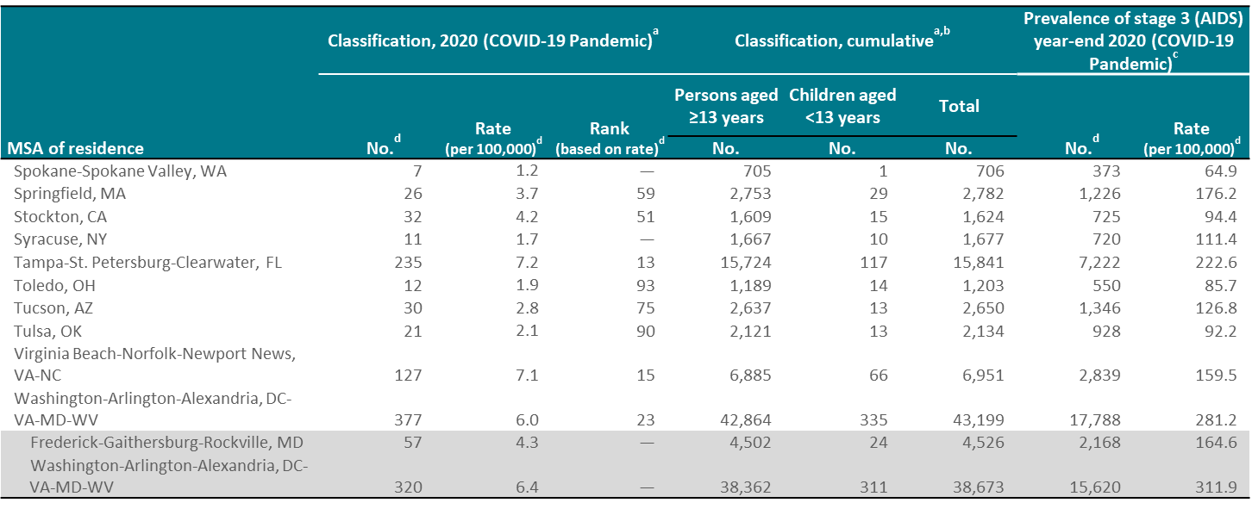
Stage 3 (AIDS), 2020 and cumulative, and persons living with diagnosed HIV infection ever classified as stage 3 (AIDS) (prevalence), year-end 2020 by metropolitan statistical area of residence (COVID-19 Pandemic) —United States and Puerto Rico (Slide 9 of 10)
Note. Ranks were not assigned to MSAs with rates that were based on reported numbers less than 12. Data for 2020 should be interpreted with caution due to the impact of the COVID-19 pandemic on access to HIV testing, care-related services, and case surveillance activities in state/local jurisdictions.
ª Data are based on residence at time of classification. ^{b} From the beginning of the epidemic through 2020.
^{c} Data are based on address of residence at the end of the specified year (i.e., most recent known address). ^{d} Data include persons of all ages
Notes:
These slides present the numbers and rates of classifications and prevalence in the United States and Puerto Rico for areas with populations of 500,000 or more (metropolitan statistical areas [MSAs]). The Boston-Cambridge-Newton, MA-NH; New York-Newark-Jersey City, NY-NJ-PA; and San Francisco-Oakland-Berkeley, CA MSAs include 1 division with a population less than 500,000. Therefore, data presented for divisions in these 3 MSAs do not sum to the MSA totals.
MSA definitions for this report can be found at http://www.census.gov/programs-surveys/metro-micro.html.
Data for 2020 should be interpreted with caution due to the impact of the COVID-19 pandemic on access to HIV testing, care-related services, and case surveillance activities in state/local jurisdictions.
Numbers less than 12, and rates based on these numbers, should be interpreted with caution.

Slide 18
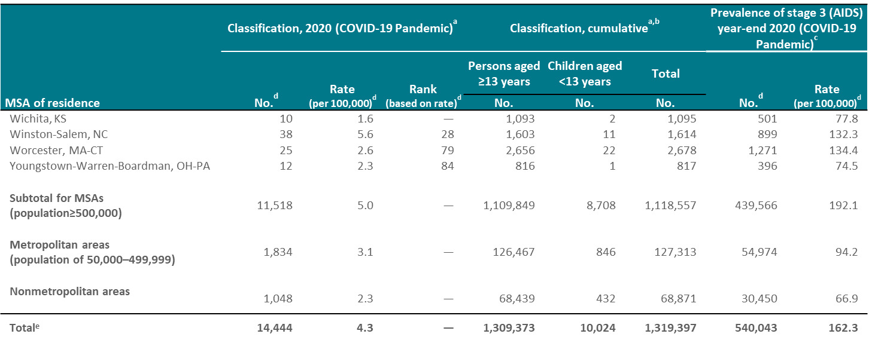
Stage 3 (AIDS), 2020 and cumulative, and persons living with diagnosed HIV infection ever classified as stage 3 (AIDS) (prevalence), year-end 2020 by metropolitan statistical area of residence (COVID-19 Pandemic) —United States and Puerto Rico (Slide 10 of 10)
Note. Ranks were not assigned to MSAs with rates that were based on reported numbers less than 12. Data for 2020 should be interpreted with caution due to the impact of the COVID-19 pandemic on access to HIV testing, care-related services, and case surveillance activities in state/local jurisdictions.
ª Data are based on residence at time of classification. ^{b} From the beginning of the epidemic through 2020.
^{c} Data are based on address of residence at the end of the specified year (i.e., most recent known address). ^{d} Data include persons of all ages.
^{e} Includes persons whose county of residence is unknown.
Notes:
These slides present the numbers and rates of classifications and prevalence in the United States and Puerto Rico for areas with populations of 500,000 or more (metropolitan statistical areas [MSAs]). The Boston-Cambridge-Newton, MA-NH; New York-Newark-Jersey City, NY-NJ-PA; and San Francisco-Oakland-Berkeley, CA MSAs include 1 division with a population less than 500,000. Therefore, data presented for divisions in these 3 MSAs do not sum to the MSA totals.
MSA definitions for this report can be found at http://www.census.gov/programs-surveys/metro-micro.html.
Data for 2020 should be interpreted with caution due to the impact of the COVID-19 pandemic on access to HIV testing, care-related services, and case surveillance activities in state/local jurisdictions.
Numbers less than 12, and rates based on these numbers, should be interpreted with caution.
Total includes persons whose county of residence is unknown.

