Slide 1
Selected National HIV Prevention and Care Outcomes
Notes:
Title Slide: Selected National HIV Prevention and Care Outcomes
Data presented in this slide set can be found at this link http://www.cdc.gov/hiv/library/reports/hiv-surveillance.html in the following HIV Surveillance Supplemental Reports:
Monitoring selected national HIV prevention and care objectives by using HIV surveillance data—United States and 6 dependent areas, 2017.
Estimated HIV incidence and prevalence in the United States, 2010–2016.

Slide 2
Selected National HIV Prevention and Care Outcomes
Used to gauge progress towards national HIV prevention and care goals and direct resources most effectively
Monitor steps required from the time a person receives an HIV diagnosis to achieving viral suppression:
  Diagnosis of HIV infection
  Linked to care
  Receipt of care
  Retained in care
  Virally suppressed

Slide 3
National Indicators
Represents the best available data for measuring progress
Uses National HIV Surveillance System (NHSS) data
  Timely and routine
  Can stratify by demographic characteristics
  Allow states the ability to monitor their progress toward national goals in their jurisdictions using prioritized data sources available at the state level
Uses different denominators for each measure

Slide 4
Calculation of Indicators
The following indicators only use data from areas with complete reporting of CD4 and viral load test results to CDC (41 states and the District of Columbia):
  Linkage to care (within 1 month)
  Receipt of care
  Retention in care
  Viral suppression

Slide 5
Calculation of Indicators
Linkage to care
  Numerator: Persons aged ≥13 years with HIV diagnosed during 2017 and who had ≥1 viral load (VL) or CD4 test within 1 month of HIV diagnosis
  Denominator: Persons aged ≥13 years with HIV infection diagnosed during 2017 (41 states and the District of Columbia)

Slide 6
Calculation of Indicators
Receipt of care, Retention in care, Viral suppression
  Numerator:
    Receipt of care: Persons with ≥1 test (CD4 or VL) in 2016
    Retention in care: Persons with ≥2 tests (CD4 or VL) ≥3 months apart in 2016
    Viral suppression: Persons with <200 copies/mL on their most recent VL test in 2016
  Denominator: Persons aged ≥13 years with HIV diagnosed by the end of 2015 and alive at year-end 2016 (41 states and the District of Columbia)

Slide 7
HIV Surveillance Reporting Areas with Complete Reporting of CD4 and Viral Load Test Results to CDC, as of December 2018
Note. Complete reporting was defined as: The jurisdiction’s laws/regulations required the reporting of all CD4 and viral load results to the state or local health department. Laboratories that perform HIV-related testing for the jurisdiction had reported a minimum of 95% of HIV-related test results to the state or local health department. As of December 31, 2018, the jurisdiction had reported (to CDC) at least 95% of all CD4 and viral load test results received from January 2016 through September 2018.
Notes:
Forty-one states and the District of Columbia had complete reporting of CD4 and viral load test results, and were included in analyses of linkage to care, receipt of and retention in care, and viral suppression.
Complete reporting was defined as: The jurisdiction’s laws/regulations required the reporting of all CD4 and viral load results to the state or local health department. Laboratories that perform HIV-related testing for the jurisdiction had reported a minimum of 95% of HIV-related test results to the state or local health department. As of December 31, 2018, the jurisdiction had reported (to CDC) at least 95% of all CD4 and viral load test results received from January 2016 through September 2018.
The following 41 states had complete reporting of CD4 and viral load results: Alabama, Alaska, California, Colorado, Connecticut, Delaware, Florida, Georgia, Hawaii, Illinois, Indiana, Iowa, Louisiana, Maine, Maryland, Massachusetts, Michigan, Minnesota, Mississippi, Missouri, Montana, Nebraska, New Hampshire, New Mexico, New York, North Carolina, North Dakota, Ohio, Oklahoma, Oregon, Rhode Island, South Carolina, South Dakota, Tennessee, Texas, Utah, Virginia, Washington, West Virginia, Wisconsin, and Wyoming.

Slide 8
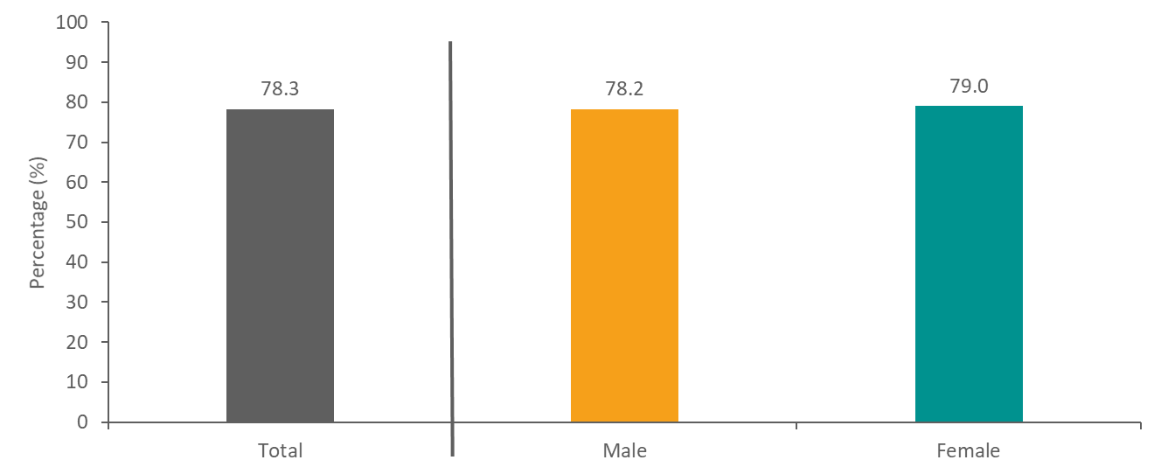
Linkage to HIV Medical Care within 1 Month after HIV Diagnosis during 2017, among Persons Aged ≥13 Years, by Sex—41 States and the District of Columbia
Note. Linkage to HIV medical care was defined as having a CD4 or VL test ≤1 month after HIV diagnosis.
Notes:
This graph presents the percentage of persons with HIV infection diagnosed during 2017 who were linked to care within 1 month of diagnosis. Overall, 78.3% of persons with HIV diagnosed in 2017 were linked to care within 1 month. Linkage to care was similar among females (79.0%) and males (78.2%).
Linkage was defined as having at least one CD4 or viral load test within 1 month of diagnosis. The estimates for linkage are based on data from 42 areas with complete reporting of CD4 and viral load test results to CDC as of December 2018.
The following 41 states had complete reporting of CD4 and viral load results: Alabama, Alaska, California, Colorado, Connecticut, Delaware, Florida, Georgia, Hawaii, Illinois, Indiana, Iowa, Louisiana, Maine, Maryland, Massachusetts, Michigan, Minnesota, Mississippi, Missouri, Montana, Nebraska, New Hampshire, New Mexico, New York, North Carolina, North Dakota, Ohio, Oklahoma, Oregon, Rhode Island, South Carolina, South Dakota, Tennessee, Texas, Utah, Virginia, Washington, West Virginia, Wisconsin, and Wyoming.

Slide 9
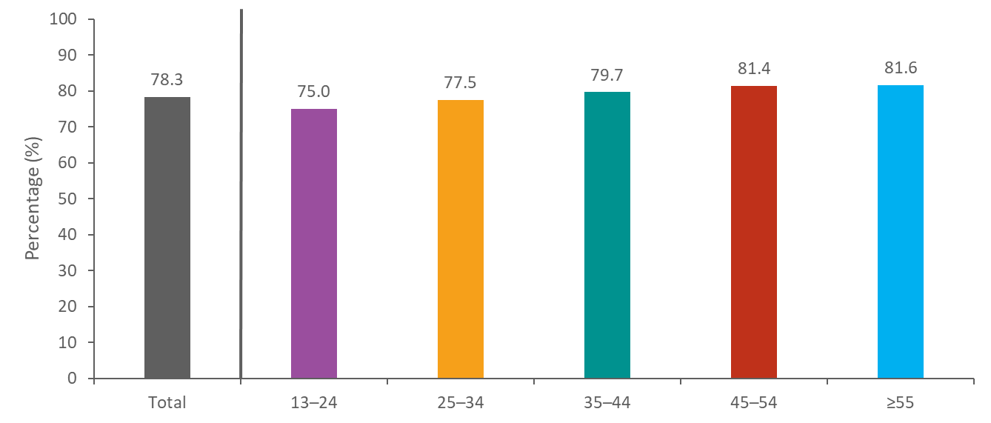
Linkage to HIV Medical Care within 1 Month after HIV Diagnosis during 2017, among Persons Aged ≥13 Years, by Age—41 States and the District of Columbia
Note. Linkage to HIV medical care was defined as having a CD4 or VL test ≤1 month after HIV diagnosis.
Notes:
This graph presents the percentage of persons with HIV diagnosed during 2017 who were linked to care within 1 month of diagnosis by age group. The percentage of persons linked to care increased with age. Among persons aged 13 to 24 years, 75.0% were linked to care within 1 month of diagnosis, while 81.6% of persons aged 55 years or older were linked within 1 month.
Linkage was defined as having at least one CD4 or viral load test within 1 month of diagnosis. The estimates for linkage are based on data from 42 areas with complete reporting of CD4 and viral load results to CDC as of December 2018.
The following 41 states had complete reporting of CD4 and viral load results: Alabama, Alaska, California, Colorado, Connecticut, Delaware, Florida, Georgia, Hawaii, Illinois, Indiana, Iowa, Louisiana, Maine, Maryland, Massachusetts, Michigan, Minnesota, Mississippi, Missouri, Montana, Nebraska, New Hampshire, New Mexico, New York, North Carolina, North Dakota, Ohio, Oklahoma, Oregon, Rhode Island, South Carolina, South Dakota, Tennessee, Texas, Utah, Virginia, Washington, West Virginia, Wisconsin, and Wyoming.

Slide 10
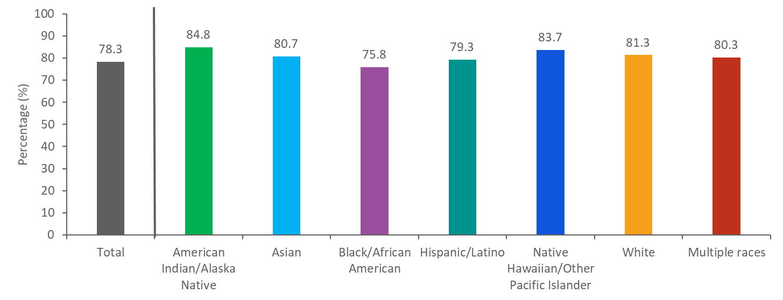
Linkage to HIV Medical Care within 1 Month after HIV Diagnosis during 2017, among Persons Aged ≥13 Years, by Race/Ethnicity—41 States and the District of Columbia
Note. Linkage to HIV medical care was defined as having a CD4 or VL test ≤1 month after HIV diagnosis. Hispanics/Latinos can be of any race.
Notes:
This graph presents percentages of persons with HV diagnosed during 2017 who were linked to care within 1 month of diagnosis by race/ethnicity. Linkage to care within 1 month was highest among persons of American Indians/Alaska Natives (84.8%), followed by Native Hawaiian/other Pacific Islanders (83.7%), whites (81.3%), Asians (80.7%), multiple races (80.3%), Hispanics/Latinos (79.3%), and blacks/African Americans (75.8%). Caution should be used when interpreting data for American Indians/Alaska Natives and Native Hawaiians/other Pacific Islanders because percentages were calculated based on small numbers.
Linkage was defined as having at least one CD4 or viral load test within 1 month of diagnosis. The estimates for linkage are based on data from 42 areas with complete reporting of CD4 and viral load results to CDC as of December 2018. Hispanics/Latinos can be of any race.
The following 41 states had complete reporting of CD4 and viral load results: Alabama, Alaska, California, Colorado, Connecticut, Delaware, Florida, Georgia, Hawaii, Illinois, Indiana, Iowa, Louisiana, Maine, Maryland, Massachusetts, Michigan, Minnesota, Mississippi, Missouri, Montana, Nebraska, New Hampshire, New Mexico, New York, North Carolina, North Dakota, Ohio, Oklahoma, Oregon, Rhode Island, South Carolina, South Dakota, Tennessee, Texas, Utah, Virginia, Washington, West Virginia, Wisconsin, and Wyoming.

Slide 11
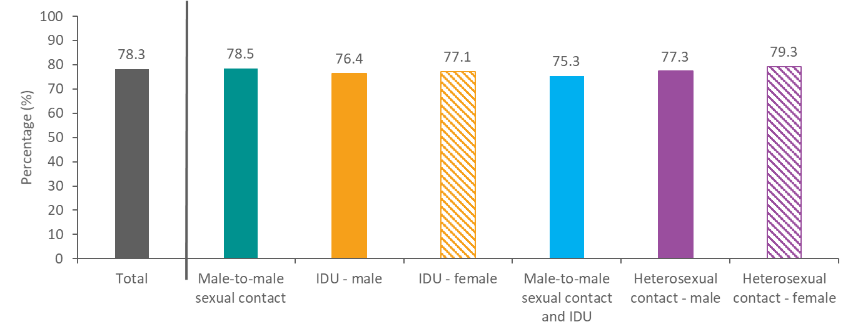
Linkage to HIV Medical Care within 1 Month after HIV Diagnosis during 2017, among Persons Aged ≥13 Years, by Transmission Category—41 States and the District of Columbia
Note. Linkage to HIV medical care was defined as having a CD4 or VL test ≤1 month after HIV diagnosis. Heterosexual contact is with a person known to have, or be at high risk for, HIV infection. IDU, injection drug use
Notes:
This graph presents percentages of persons with HIV diagnosed during 2017 who were linked to care within 1 month of diagnosis by transmission category. Linkage to care within 1 month was highest among females with infection attributed to heterosexual contact (79.3%), followed by males with infection attributed to male-to-male sexual contact (78.5%), males with infection attributed to heterosexual contact (77.3%), females with infection attributed to injection drug use (77.1%), males with infection attributed to injection drug use (76.4%), and males with infection attributed to male-to-male sexual contact and injection drug use (75.3%).
Linkage was defined as having at least one CD4 or viral load test within 1 month of diagnosis. The estimates for linkage are based on data from 42 areas with complete reporting of CD4 and viral load test results to CDC as of December 2018.
Heterosexual contact is with a person known to have, or be at high risk for, HIV infection. IDU, injection drug use
The following 41 states had complete reporting of CD4 and viral load results: Alabama, Alaska, California, Colorado, Connecticut, Delaware, Florida, Georgia, Hawaii, Illinois, Indiana, Iowa, Louisiana, Maine, Maryland, Massachusetts, Michigan, Minnesota, Mississippi, Missouri, Montana, Nebraska, New Hampshire, New Mexico, New York, North Carolina, North Dakota, Ohio, Oklahoma, Oregon, Rhode Island, South Carolina, South Dakota, Tennessee, Texas, Utah, Virginia, Washington, West Virginia, Wisconsin, and Wyoming.

Slide 12
Linkage to HIV Medical Care within 1 Month after HIV Diagnosis during 2017, among Persons Aged ≥13 Years—41 States and the District of Columbia
Note. Linkage to HIV medical care was defined as having a CD4 or VL test ≤1 month after HIV diagnosis. Residence was based on residence at diagnosis.
Notes:
This map presents percentages of persons linked to HIV medical care within 1 month of diagnosis during 2017 by jurisdiction. The 10 states (Alaska, Iowa, Maine, Massachusetts, Minnesota, North Dakota, Rhode Island, Utah, Washington, and Wyoming) in the lightest shade had the highest percentages (≥87.2) of persons linked within 1 month of diagnosis. The 11 states (Alabama, California, Indiana, Mississippi, Missouri, North Carolina, Oklahoma, Tennessee, Texas, Virginia, and West Virginia) in the darkest shade had the lowest percentages (≤77.6) of persons linked within 1 month of diagnosis.
Linkage to HIV medical care was defined as having a CD4 or VL test ≤1 month after HIV diagnosis. Residence was based on residence at diagnosis.

Slide 13
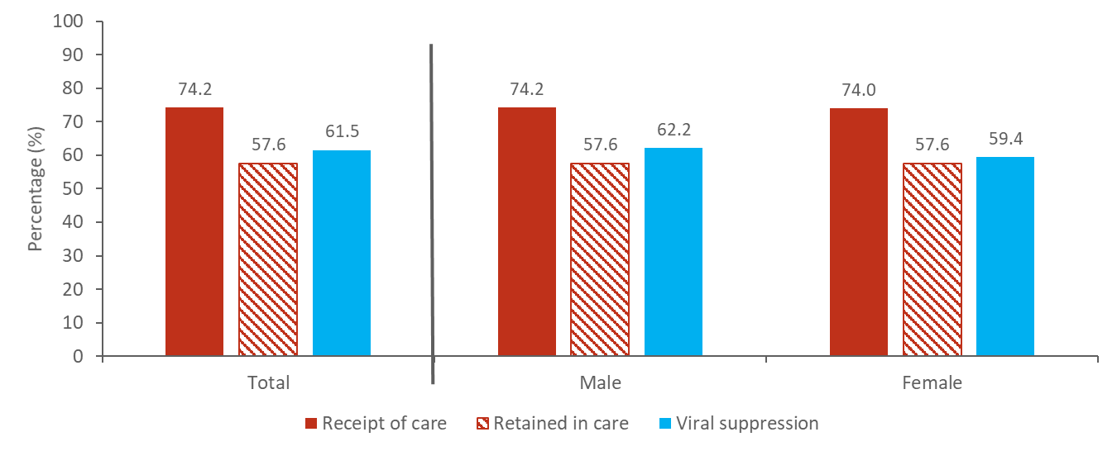
Receipt of HIV Medical Care, Retention in care, and Viral Suppression among Persons Aged ≥13 Years Living with Diagnosed HIV Infection, by Sex
2016—41 States and the District of Columbia
Note. Receipt of medical care was defined as ≥1 test (CD4 or VL) in 2016. Retained in continuous medical care was defined as ≥2 tests (CD4 or VL) ≥3 months apart in 2016. Viral suppression was defined as <200 copies/mL on the most recent VL test in 2016.
Notes:
This graph presents three of the indicators for HIV care outcomes – receipt of care, retention in continuous care, and viral suppression. Overall, 74.2% of persons living with diagnosed HIV received care in 2016, 57.6% were retained in care, and 61.5% had evidence of viral suppression. Receipt of care was similar among males (74.2%) and females (74.0%). Retention in care was also similar among males (57.6%) and females (57.6%). Viral suppression was slightly higher among males (62.2%) than females (59.4%).
Receipt of medical care was defined as ≥1 test (CD4 or VL) in 2016. Retained in continuous medical care was defined as ≥2 tests (CD4 or VL) ≥3 months apart in 2016. Viral suppression was defined as <200 copies/mL on the most recent VL test in 2016.
The percentages for receipt of care, retention in care, and viral suppression are based on data from 42 areas with complete reporting of CD4 and viral load test results to CDC as of December 2018.
The following 41 states had complete reporting of CD4 and viral load results: Alabama, Alaska, California, Colorado, Connecticut, Delaware, Florida, Georgia, Hawaii, Illinois, Indiana, Iowa, Louisiana, Maine, Maryland, Massachusetts, Michigan, Minnesota, Mississippi, Missouri, Montana, Nebraska, New Hampshire, New Mexico, New York, North Carolina, North Dakota, Ohio, Oklahoma, Oregon, Rhode Island, South Carolina, South Dakota, Tennessee, Texas, Utah, Virginia, Washington, West Virginia, Wisconsin, and Wyoming.

Slide 14
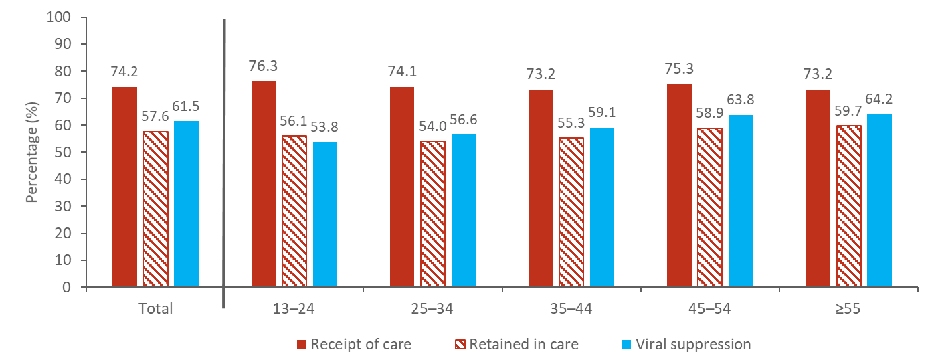
Receipt of HIV Medical Care, Retention in care, and Viral Suppression among Persons Aged ≥13 Years Living with Diagnosed HIV Infection, by Age
2016—41 States and the District of Columbia
Note. Receipt of medical care was defined as ≥1 test (CD4 or VL) in 2016. Retained in continuous medical care was defined as ≥2 tests (CD4 or VL) ≥3 months apart in 2016. Viral suppression was defined as <200 copies/mL on the most recent VL test in 2016.
Notes:
This graph presents three of the indicators for HIV care outcomes – receipt of care, retention in continuous care, and viral suppression – by age group. There was little variation in receipt of care and retention in continuous care across age groups. The age group with the highest percentage of persons receiving care was 13-24 year olds (76.3%) while the lowest percentage of persons receiving care was 35-44 years (73.2%) and persons ≥55 years (73.2%). The age group with the highest percentage for retention in care was among persons ≥55 years (59.7%) while the age group with the lowest retention in continuous care was 25-34 years (54.0%). Viral suppression increased with age with persons 55 years and older having the highest (64.2%) and persons aged 13-24 years having the lowest (53.8%).
Receipt of medical care was defined as ≥1 test (CD4 or VL) in 2016. Retained in continuous medical care was defined as ≥2 tests (CD4 or VL) ≥3 months apart in 2016. Viral suppression was defined as <200 copies/mL on the most recent VL test in 2016.
The percentages for receipt of care, retention in care, and viral suppression are based on data from 42 areas with complete reporting of CD4 and viral load test results to CDC as of December 2018.
The following 41 states had complete reporting of CD4 and viral load results: Alabama, Alaska, California, Colorado, Connecticut, Delaware, Florida, Georgia, Hawaii, Illinois, Indiana, Iowa, Louisiana, Maine, Maryland, Massachusetts, Michigan, Minnesota, Mississippi, Missouri, Montana, Nebraska, New Hampshire, New Mexico, New York, North Carolina, North Dakota, Ohio, Oklahoma, Oregon, Rhode Island, South Carolina, South Dakota, Tennessee, Texas, Utah, Virginia, Washington, West Virginia, Wisconsin, and Wyoming.

Slide 15
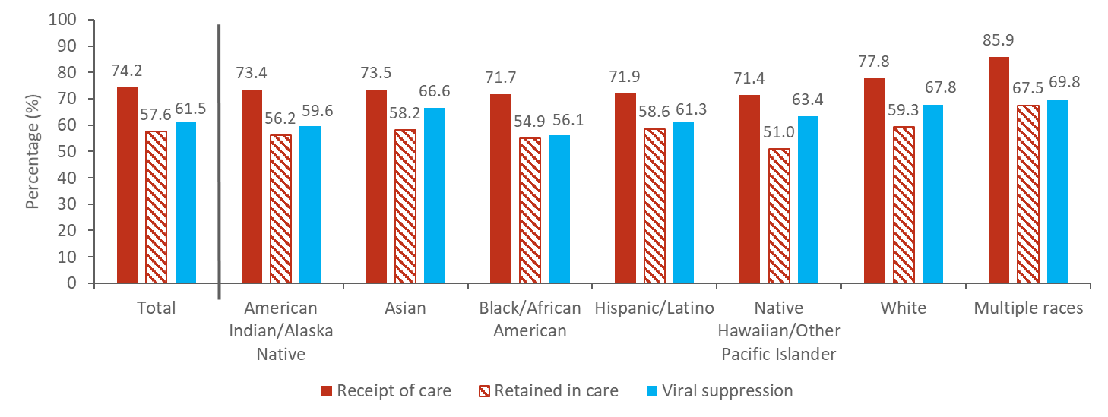
Receipt of HIV Medical Care, Retention in Care, and Viral Suppression among Persons Aged ≥13 Years Living with Diagnosed HIV Infection, by Race/Ethnicity 2016—41 States and the District of Columbia
Note. Receipt of medical care was defined as ≥1 test (CD4 or VL) in 2016. Retained in continuous medical care was defined as ≥2 tests (CD4 or VL) ≥3 months apart in 2016. Viral suppression was defined as <200 copies/mL on the most recent VL test in 2016. Asian includes Asian/Pacific Islander legacy cases. Hispanics/Latinos can be of any race.
Notes:
This graph presents three of the indicators for HIV care outcomes – receipt of care, retention in care, and viral suppression – by race/ethnicity. Persons of multiple races had the highest percentage for receipt of care (85.9%), followed by whites (77.8%), Asians (73.5%), American Indians/Alaska Natives (73.4%), Hispanics/Latinos (71.9%), blacks/African Americans (71.7%), and Native Hawaiians/other Pacific Islanders (71.4%). Persons of multiple races had the highest retention in care (67.5%), followed by whites (59.3%), Hispanics/Latinos (58.6%), Asians (58.2%), American Indians/Alaska Natives (56.2%), blacks/African Americans (54.9%), and Native Hawaiians/other Pacific Islanders (51.0%). Persons of multiple races also had the highest viral suppression (69.8%), followed by whites (67.8%), Asians (66.6%), Native Hawaiians/other Pacific Islanders (63.4%), Hispanics/Latinos (61.3%), American Indians/Alaska Natives (59.6%), and blacks/African Americans (56.1%).
Receipt of medical care was defined as ≥1 test (CD4 or VL) in 2016. Retained in continuous medical care was defined as ≥2 tests (CD4 or VL) ≥3 months apart in 2016. Viral suppression was defined as <200 copies/mL on the most recent VL test in 2016. Asian includes Asian/Pacific Islander legacy cases. Hispanics/Latinos can be of any race. Caution should be used when interpreting data for Native Hawaiians/other Pacific Islanders as percentages were calculated based on small numbers.
The estimates for receipt of care, retention in care, and viral suppression are based on data from 42 areas with complete reporting of CD4 and viral load results to CDC as of December 2018.
The following 41 states had complete reporting of CD4 and viral load results: Alabama, Alaska, California, Colorado, Connecticut, Delaware, Florida, Georgia, Hawaii, Illinois, Indiana, Iowa, Louisiana, Maine, Maryland, Massachusetts, Michigan, Minnesota, Mississippi, Missouri, Montana, Nebraska, New Hampshire, New Mexico, New York, North Carolina, North Dakota, Ohio, Oklahoma, Oregon, Rhode Island, South Carolina, South Dakota, Tennessee, Texas, Utah, Virginia, Washington, West Virginia, Wisconsin, and Wyoming.

Slide 16
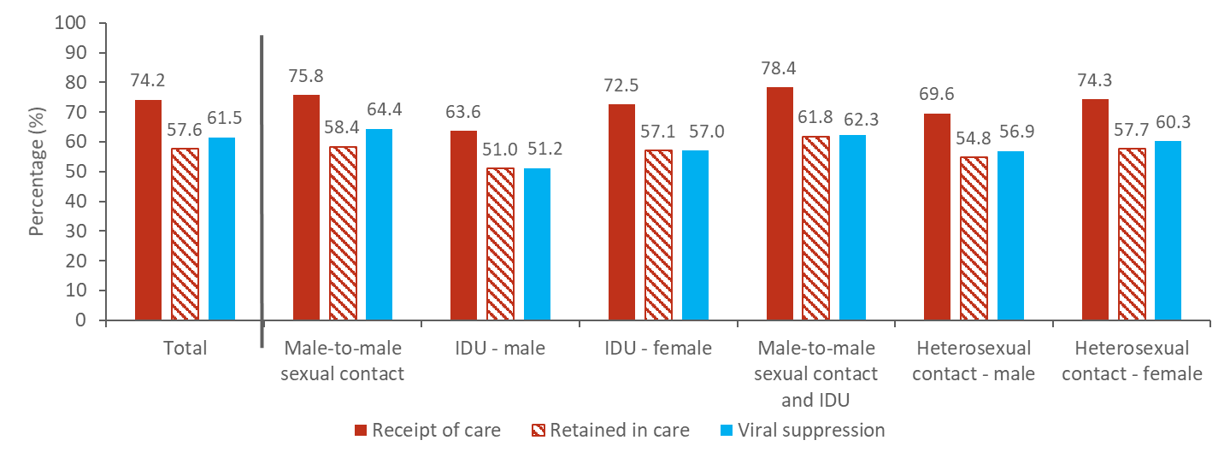
Receipt of HIV Medical Care, Retention in Care, and Viral Suppression among Persons Aged ≥13 Years Living with Diagnosed HIV Infection, by Transmission Category, 2016—41 States and the District of Columbia
Note. Receipt of medical care was defined as ≥1 test (CD4 or VL) in 2016. Retained in continuous medical care was defined as ≥2 tests (CD4 or VL) ≥3 months apart in 2016. Viral suppression was defined as <200 copies/mL on the most recent VL test in 2016. Heterosexual contact is with a person known to have, or be at high risk for, HIV infection. IDU, injection drug use
Notes:
This graph presents three of the indicators for HIV care outcomes – receipt of care, retention in care, and viral suppression – by transmission category. Males with infection attributed to male-to-male sexual contact and injection drug use had the highest receipt of medical care (78.4%), followed by males with infection attributed to male-to-male sexual contact (75.8%), females with infection attributed to heterosexual contact (74.3%), females with infection attributed to injection drug use (72.5%), males with infection attributed to heterosexual contact (69.6%), and males with infection attributed to injection drug use (63.6%).
Males with infection attributed to male-to-male sexual contact and injection drug use had the highest retention in continuous medical care (61.8%), followed by males with infection attributed to male-to-male sexual contact (58.4%), females with infection attributed to heterosexual contact (57.7%), females with infection attributed to injection drug use (57.1%), males with infection attributed to heterosexual contact (54.8%), and males with infection attributed to injection drug use (51.0%).
Males with infection attributed to male-to-male sexual contact had the highest viral suppression (64.4%), followed by males with infection attributed to male-to-male sexual contact and injection drug use (62.3%), females with infection attributed to heterosexual contact (60.3%), females with infection attributed to injection drug use (57.0%), males with infection attributed to heterosexual contact (56.9%), and males with infection attributed to injection drug use (51.2%).
Receipt of medical care was defined as ≥1 test (CD4 or VL) in 2016. Retained in continuous medical care was defined as ≥2 tests (CD4 or VL) ≥3 months apart in 2016. Viral suppression was defined as <200 copies/mL on the most recent VL test in 2016. Heterosexual contact is with a person known to have, or be at high risk for, HIV infection.
The estimates for receipt of care, retention in care, and viral suppression are based on data from 42 areas with complete reporting of CD4 and viral load test results to CDC as of December 2018.
The following 41 states had complete reporting of CD4 and viral load results: Alabama, Alaska, California, Colorado, Connecticut, Delaware, Florida, Georgia, Hawaii, Illinois, Indiana, Iowa, Louisiana, Maine, Maryland, Massachusetts, Michigan, Minnesota, Mississippi, Missouri, Montana, Nebraska, New Hampshire, New Mexico, New York, North Carolina, North Dakota, Ohio, Oklahoma, Oregon, Rhode Island, South Carolina, South Dakota, Tennessee, Texas, Utah, Virginia, Washington, West Virginia, Wisconsin, and Wyoming.

Slide 17
Receipt of HIV Medical Care among Persons Aged ≥13 Years Living with Diagnosed HIV Infection, 2016—41 States and the District of Columbia
Note. Receipt of HIV medical care was defined as ≥1 test (CD4 or VL) in 2016. Residence was based on most recent known address as of year-end 2016.
Notes:
This map presents percentages of persons receiving HIV medical care during 2016 by jurisdiction. The 10 states (Alaska, Iowa, Maine, Michigan, Montana, North Dakota, Oregon, Rhode Island, Washington, and Wyoming) in the lightest shade had the highest percentages (≥80.6) of persons receiving care. The 10 states (Colorado, Georgia, Illinois, Maryland, Mississippi, New York, Ohio, South Dakota, Utah, and Virginia) and the District of Columbia (D.C.) in the darkest shade had the lowest percentages (≤73.0) of persons receiving care.
Receipt of HIV medical care was defined as ≥1 tests (CD4 or VL) in 2016. Residence was based on most recent known address as of year-end 2016.

Slide 18
Retention in HIV Medical Care among Persons Aged ≥13 Years Living with Diagnosed HIV Infection, 2016—41 States and the District of Columbia
Note. Retained in continuous medical care was defined as ≥2 tests (CD4 or VL) ≥3 months apart in 2016. Residence was based on most recent known address as of year-end 2016.
Notes:
This map presents percentages of persons retained in HIV medical care during 2016 by jurisdiction. The 10 states (Iowa, Maine, Massachusetts, Montana, New Mexico, Oregon, South Carolina, Washington, Wisconsin, and Wyoming) in the lightest shade had the highest percentages (≥61.7) of persons retained in care. The 10 states (Colorado, Illinois, Maryland, Minnesota, Nebraska, Ohio, South Dakota, Utah, Virginia, and West Virginia) and the District of Columbia (D.C.) in the darkest shade had the lowest percentages (≤52.5) of persons retained in care.
Retained in continuous medical care was defined as ≥2 tests (CD4 or VL) ≥3 months apart in 2016. Residence was based on most recent known address as of year-end 2016.

Slide 19
Viral Suppression among Persons Aged ≥13 Years Living with Diagnosed HIV Infection, 2016—41 States and the District of Columbia
Note. Viral suppression was defined as <200 copies/mL on the most recent VL test in 2016. Residence was based on most recent known address as of year-end 2016.
Notes:
This map presents percentages of persons virally suppressed during 2016 by jurisdiction. The 10 states (Alaska, Iowa, Maine, Michigan, Montana, New Mexico, North Dakota, Rhode Island, Washington, and Wisconsin) in the lightest shade had the highest percentages (≥68.5) of persons virally suppressed. The 10 states (Colorado, Illinois, Maryland, Mississippi, Ohio, Oregon, South Dakota, Tennessee, Utah, Virginia) and the District of Columbia (D.C.) in the darkest shade had the lowest percentages (≤56.4) of persons virally suppressed.
Viral suppression was defined as <200 copies/mL on the most recent VL test in 2016. Residence was based on most recent known address as of year-end 2016.

Slide 20
Prevalence-Based Care Continuum
Describes the number of people at each step of the continuum as a percentage of the total number of people living with HIV (diagnosed or undiagnosed)
Denominator: Estimated number of persons aged ≥13 years living with diagnosed or undiagnosed HIV infection year-end 2016
  Calculated using the first CD4 test after HIV diagnosis and a CD4 depletion model indicating disease progression*
Numerator: Extrapolated from the 42 jurisdictions with complete CD4 and viral load reporting
  Apply percentage from 42 jurisdictions to the total number of people living with diagnosed HIV in the United States
* Song R, Hall HI, Green TA, Szwarcwald CL, Pantazis N. Using CD4 data to estimate HIV incidence, prevalence, and percent of undiagnosed infections in the United States. J Acquir Immune Defic Syndr 2017;74(1):3–9. doi:10.1097/QAI.0000000000001151.

Slide 21
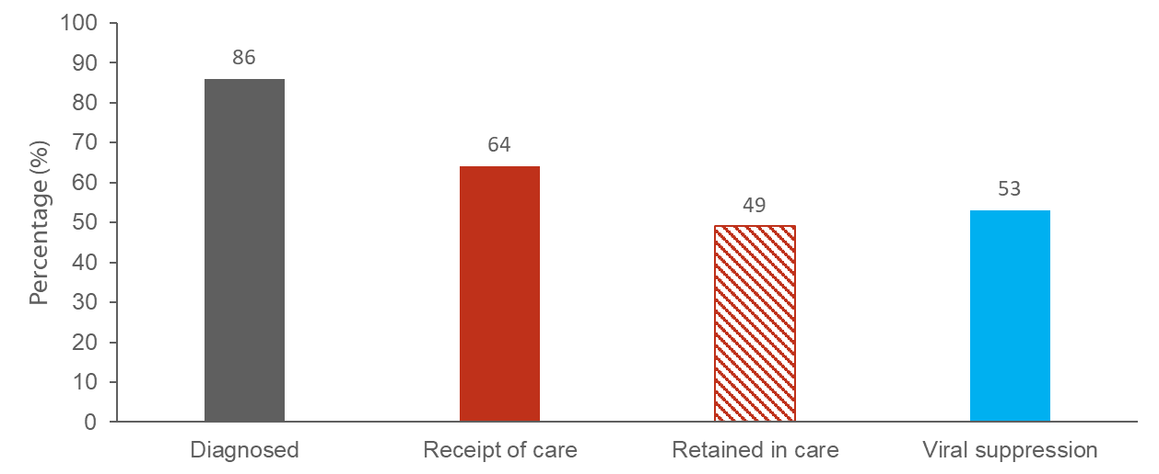
Persons Living with Diagnosed or Undiagnosed HIV Infection
HIV Care Continuum Outcomes, 2016—United States
Note. Receipt of medical care was defined as ≥1 test (CD4 or VL) in 2016. Retained in continuous medical care was defined as ≥2 tests (CD4 or VL) ≥3 months apart in 2016. Viral suppression was defined as <200 copies/mL on the most recent VL test in 2016.
Notes:
This slide presents the prevalence-based HIV care continuum for 2016 for persons living with diagnosed or undiagnosed HIV infection in the United States. Among the estimated 1.1 million people living with HIV in the United States, 86% have received a diagnosis, 64% received HIV medical care in 2016, 49% were receiving continuous care, and 53% were virally suppressed.
Receipt of medical care was defined as ≥1 test (CD4 or VL) in 2016. Retained in continuous medical care was defined as ≥2 tests (CD4 or VL) ≥3 months apart in 2016. Viral suppression was defined as <200 copies/mL on the most recent VL test in 2016.

Slide 22
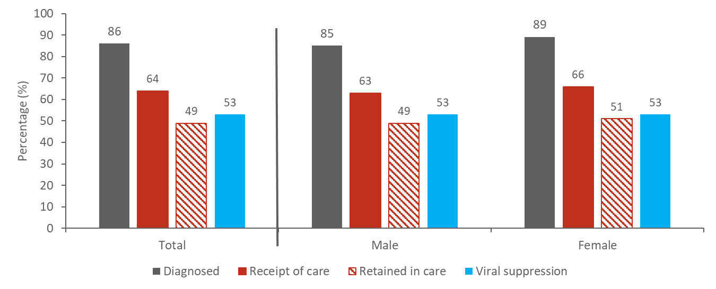
Persons Living with Diagnosed or Undiagnosed HIV Infection
HIV Care Continuum Outcomes, by Sex, 2016—United States
Note. Receipt of medical care was defined as ≥1 test (CD4 or VL) in 2016. Retained in continuous medical care was defined as ≥2 tests (CD4 or VL) ≥3 months apart in 2016. Viral suppression was defined as <200 copies/mL on the most recent VL test in 2016.
Notes:
This slide presents the prevalence-based HIV care continuum for 2016 for persons living with diagnosed or undiagnosed HIV infection in the United States by sex. Among males living with HIV in the United States, 85% have received a diagnosis, 63% received HIV medical care in 2016, 49% were receiving continuous care, and 53% were virally suppressed. Among females living with HIV in the United States, 89% have received a diagnosis, 66% received HIV medical care in 2016, 51% were receiving continuous care, and 53% were virally suppressed.
Receipt of medical care was defined as ≥1 test (CD4 or VL) in 2016. Retained in continuous medical care was defined as ≥2 tests (CD4 or VL) ≥3 months apart in 2016. Viral suppression was defined as <200 copies/mL on the most recent VL test in 2016.

Slide 23
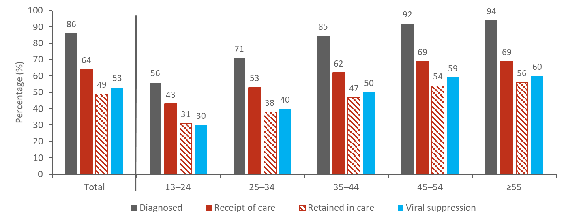
Persons Living with Diagnosed or Undiagnosed HIV Infection
HIV Care Continuum Outcomes, by Age, 2016—United States
Note. Receipt of medical care was defined as ≥1 test (CD4 or VL) in 2016. Retained in continuous medical care was defined as ≥2 tests (CD4 or VL) ≥3 months apart in 2016. Viral suppression was defined as <200 copies/mL on the most recent VL test in 2016.
Notes:
This slide presents the prevalence-based HIV care continuum for 2016 for persons living with diagnosed or undiagnosed HIV infection in the United States by age. Among 13-24 year olds living with HIV in the United States, 56% have received a diagnosis, 43% received HIV medical care in 2016, 31% were receiving continuous care, and 30% were virally suppressed. Among 25-34 year olds living with HIV in the United States, 71% have received a diagnosis, 53% received HIV medical care in 2016, 38% were receiving continuous care, and 40% were virally suppressed. Among 35-44 year olds living with HIV in the United States, 85% have received a diagnosis, 62% received HIV medical care in 2016, 47% were receiving continuous care, and 50% were virally suppressed. Among 45-54 year olds living with HIV in the United States, 92% have received a diagnosis, 69% received HIV medical care in 2016, 54% were receiving continuous care, and 59% were virally suppressed. Among people 55 years and older living with HIV in the United States, 94% have received a diagnosis, 69% received HIV medical care in 2016, 56% were receiving continuous care, and 60% were virally suppressed.
Receipt of medical care was defined as ≥1 test (CD4 or VL) in 2016. Retained in continuous medical care was defined as ≥2 tests (CD4 or VL) ≥3 months apart in 2016. Viral suppression was defined as <200 copies/mL on the most recent VL test in 2016.

Slide 24
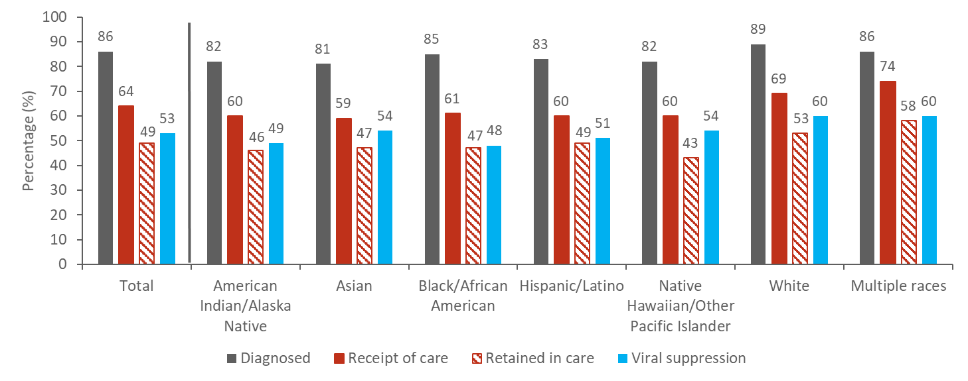
Persons Living with Diagnosed or Undiagnosed HIV Infection
HIV Care Continuum Outcomes, by Race/Ethnicity, 2016—United States
Note. Receipt of medical care was defined as ≥1 test (CD4 or VL) in 2016. Retained in continuous medical care was defined as ≥2 tests (CD4 or VL) ≥3 months apart in 2016. Viral suppression was defined as <200 copies/mL on the most recent VL test in 2016. Asian includes Asian/Pacific Islander legacy cases. Hispanics/Latinos can be of any race.
Notes:
This slide presents the prevalence-based HIV care continuum for 2016 for persons living with diagnosed or undiagnosed HIV infection in the United States by race/ethnicity. Among American Indians/Alaska Natives living with HIV in the United States, 82% have received a diagnosis, 60% received HIV medical care in 2016, 46% were receiving continuous care, and 49% were virally suppressed. Among Asians living with HIV in the United States, 81% have received a diagnosis, 59% received HIV medical care in 2016, 47% were receiving continuous care, and 54% were virally suppressed. Among Blacks/African Americans living with HIV in the United States, 85% have received a diagnosis, 61% received HIV medical care in 2016, 47% were receiving continuous care, and 48% were virally suppressed. Among Hispanics/Latinos living with HIV in the United States, 83% have received a diagnosis, 60% received HIV medical care in 2016, 49% were receiving continuous care, and 51% were virally suppressed. Among Native Hawaiians/other Pacific Islanders living with HIV in the United States, 82% have received a diagnosis, 60% received HIV medical care in 2016, 43% were receiving continuous care, and 54% were virally suppressed. Among Whites living with HIV in the United States, 89% have received a diagnosis, 69% received HIV medical care in 2016, 53% were receiving continuous care, and 60% were virally suppressed. Among people of multiple races living with HIV in the United States, 86% have received a diagnosis, 74% received HIV medical care in 2016, 58% were receiving continuous care, and 60% were virally suppressed.
Receipt of medical care was defined as ≥1 test (CD4 or VL) in 2016. Retained in continuous medical care was defined as ≥2 tests (CD4 or VL) ≥3 months apart in 2016. Viral suppression was defined as <200 copies/mL on the most recent VL test in 2016. Asian includes Asian/Pacific Islander legacy cases. Hispanics/Latinos can be of any race.

Slide 25
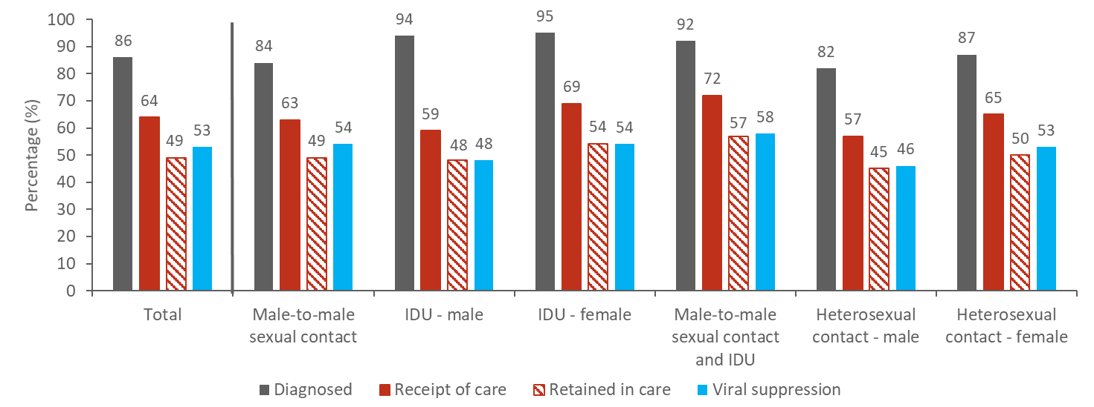
Persons Living with Diagnosed or Undiagnosed HIV Infection
HIV Care Continuum Outcomes, by Transmission Category, 2016—United States
Note. Receipt of medical care was defined as ≥1 test (CD4 or VL) in 2016. Retained in continuous medical care was defined as ≥2 tests (CD4 or VL) ≥3 months apart in 2016. Viral suppression was defined as <200 copies/mL on the most recent VL test in 2016. Heterosexual contact is with a person known to have, or be at high risk for, HIV infection. IDU, injection drug use
Notes:
This slide presents the prevalence-based HIV care continuum for 2016 for persons living with diagnosed or undiagnosed HIV infection in the United States by transmission category. Among males living with HIV attributed to male-to-male sexual contact, 84% have received a diagnosis, 63% received HIV medical care in 2016, 49% were receiving continuous care, and 54% were virally suppressed. Among males living with HIV attributed to injection drug use, 94% have received a diagnosis, 59% received HIV medical care in 2016, 48% were receiving continuous care, and 48% were virally suppressed. Among females living with HIV attributed to injection drug use, 95% have received a diagnosis, 69% received HIV medical care in 2016, 54% were receiving continuous care, and 54% were virally suppressed. Among males living with HIV attributed to male-to-male sexual contact and injection drug use, 92% have received a diagnosis, 72% received HIV medical care in 2016, 57% were receiving continuous care, and 58% were virally suppressed. Among males living with HIV attributed to heterosexual sexual contact, 82% have received a diagnosis, 57% received HIV medical care in 2016, 45% were receiving continuous care, and 46% were virally suppressed. Among females living with HIV attributed to heterosexual sexual contact, 87% have received a diagnosis, 65% received HIV medical care in 2016, 50% were receiving continuous care, and 53% were virally suppressed.
Receipt of medical care was defined as ≥1 test (CD4 or VL) in 2016. Retained in continuous medical care was defined as ≥2 tests (CD4 or VL) ≥3 months apart in 2016. Viral suppression was defined as <200 copies/mL on the most recent VL test in 2016. Heterosexual contact is with a person known to have, or be at high risk for, HIV infection. IDU, injection drug use

