Slide 1
Estimated HIV Incidence and Prevalence in the United States, 2010–2019
Notes:
Estimated HIV Incidence and Prevalence in the United States, 2010–2019
For all slides in this series, the following notes apply:
All data in this report (except numbers of diagnosed cases) are estimated (i.e., have been statistically adjusted).
Estimates of HIV incidence and persons living with HIV infection (diagnosed and undiagnosed; prevalence) were based on HIV surveillance data from the 50 states, the District of Columbia, and Puerto Rico for persons aged ≥13 years. Numbers of persons aged ≥13 years living with diagnosed infection are reported numbers, not estimates. These numbers are based on diagnosed cases with vital status information reported to CDC through December 2020.
Differences in estimated numbers of HIV infections for the years 2010 and 2019 were assessed by the z test. Differences were deemed statistically significant when P <.05. Differences that were not statistically significant were deemed ‘stable’.
Prevalence estimates for the year 2019 are preliminary and based on deaths reported to CDC through December 2020.
All data presented in this slide set are from the same dataset (reported to CDC through December 2020) and CD4 depletion model used for the HIV Supplemental Surveillance Report “Estimated HIV Incidence and Prevalence in the United States 2015–2019”. Please see the Commentary and Technical Notes for information on the methods used to produce the estimates. The report can be found at: https://www.cdc.gov/hiv/library/reports/hiv-surveillance.html

Slide 2
Estimates of HIV Incidence and Prevalence
Based on National HIV Surveillance System (NHSS) data reported through December 2020
Data from the 50 states and District of Columbia (and for jurisdiction-level estimates only, Puerto Rico)
Data for adults and adolescents aged ≥13 years
Calculated using the first CD4 test after HIV diagnosis and a CD4 depletion model indicating disease progression*
Provides the following estimates:
HIV incidence
HIV prevalence (persons living with diagnosed or undiagnosed infection)
Percentage of diagnosed HIV infection
* Song R, Hall HI, Green TA, Szwarcwald CL, Pantazis N. Using CD4 data to estimate HIV incidence, prevalence, and percent of undiagnosed infections in the United States. J Acquir Immune Defic Syndr 2017;74(1):3–9. doi:10.1097/QAI.0000000000001151.
Notes:
HIV incidence and prevalence estimates were calculated using data reported to the National HIV Surveillance System (NHSS) through December 2020 from the 50 states and the District of Columbia (and for jurisdiction-level estimates only, Puerto Rico) for adults and adolescents aged ≥13 years.
Estimates were calculated using the first CD4 test after HIV diagnosis and a CD4 depletion model indicating disease progression.
This CD4 model was used to provide estimates of HIV incidence, HIV prevalence (persons living with diagnosed or undiagnosed infection), and the percentage of diagnosed HIV infection.
All data presented in this slide set are from the same dataset (reported to CDC through December 2020) and CD4 model used for the HIV Supplemental Surveillance Report “Estimated HIV Incidence and Prevalence in the United States 2015–2019”. Please see the Commentary and Technical Notes for information on the methods used to produce the estimates. The report can be found at: https://www.cdc.gov/hiv/library/reports/hiv-surveillance.html

Slide 3
Estimates of HIV Incidence
Incidence measures the number of HIV infections that occurred during a specified time (e.g., year).
Diagnoses during a specified time refer to infections among persons who may have been infected for a number of years.
Incidence estimates can be used to assess changes in characteristics of persons most at risk for acquiring HIV infection.
Notes:
Incidence measures the number of infections that occurred during a specified time (e.g., year). Diagnoses during a specified time refer to infections among persons who may have been infected for a number of years.
Incidence estimates can be used to assess changes in characteristics of persons most at risk for acquiring HIV infection.
All data presented in this slide set are from the same dataset (reported to CDC through December 2020) and CD4 model used for the HIV Supplemental Surveillance Report “Estimated HIV Incidence and Prevalence in the United States 2015–2019”. Please see the Commentary and Technical Notes for information on the methods used to produce the estimates. The report can be found at: https://www.cdc.gov/hiv/library/reports/hiv-surveillance.html

Slide 4
Estimates of HIV Prevalence
Prevalence refers to the number of persons living with HIV at a given time regardless of the time of infection or whether the person has received a diagnosis.
Prevalence and the percentage of diagnosed infections reflect the number of persons in need of care and treatment services for HIV infection.
Calculation of percentage of diagnosed HIV
Numerator: Persons aged ≥13 years living with diagnosed HIV infection year-end 2019
Denominator: Estimated number of persons aged ≥13 years living with diagnosed or undiagnosed HIV infection year-end 2019
Estimates for the year 2019 are preliminary and based on deaths reported to CDC through December 2020.
Notes:
Prevalence refers to the number of persons living with HIV at a given time regardless of the time of infection or whether the person has received a diagnosis.
Prevalence and the percentage of diagnosed infections reflect the number of persons in need of care and treatment services for HIV infection.
For the calculation of percentage of diagnosed HIV, the numerator is the number of persons aged ≥13 years living with diagnosed HIV infection year-end 2018; the denominator is the estimated number of persons aged ≥13 years living with diagnosed or undiagnosed HIV infection year-end 2019.
Estimates for the year 2019 are preliminary and based on deaths reported to CDC through December 2020.
All data presented in this slide set are from the same dataset (reported to CDC through December 2020) and CD4 model used for the HIV Supplemental Surveillance Report “Estimated HIV Incidence and Prevalence in the United States 2015–2019”. Please see the Commentary and Technical Notes for information on the methods used to produce the estimates. The report can be found at: https://www.cdc.gov/hiv/library/reports/hiv-surveillance.html

Slide 5
Reliability Standards
Relative standard errors (RSEs) were calculated for the incidence and prevalence estimates and used to determine reliability.
All highlights are based on reliable estimates (RSE <30%).
Estimates with RSEs of 30%–50% are displayed with a footnote that they should be used with caution.
Estimates with RSEs of >50% are statistically unreliable and thus are not shown.
Notes:
Relative standard errors (RSEs) were calculated for the incidence and prevalence estimates and used to determine reliability.
All highlights are based on reliable estimates (RSE <30%).
Estimates with RSEs of 30%–50% are displayed with a footnote that they should be used with caution.
Estimates with RSEs of >50% are statistically unreliable and thus not shown.
All data presented in this slide set are from the same dataset (reported to CDC through December 2020) and CD4 model used for the HIV Supplemental Surveillance Report “Estimated HIV Incidence and Prevalence in the United States 2015–2019”. Please see the Commentary and Technical Notes for information on the methods used to produce the estimates. The report can be found at: https://www.cdc.gov/hiv/library/reports/hiv-surveillance.html

Slide 6
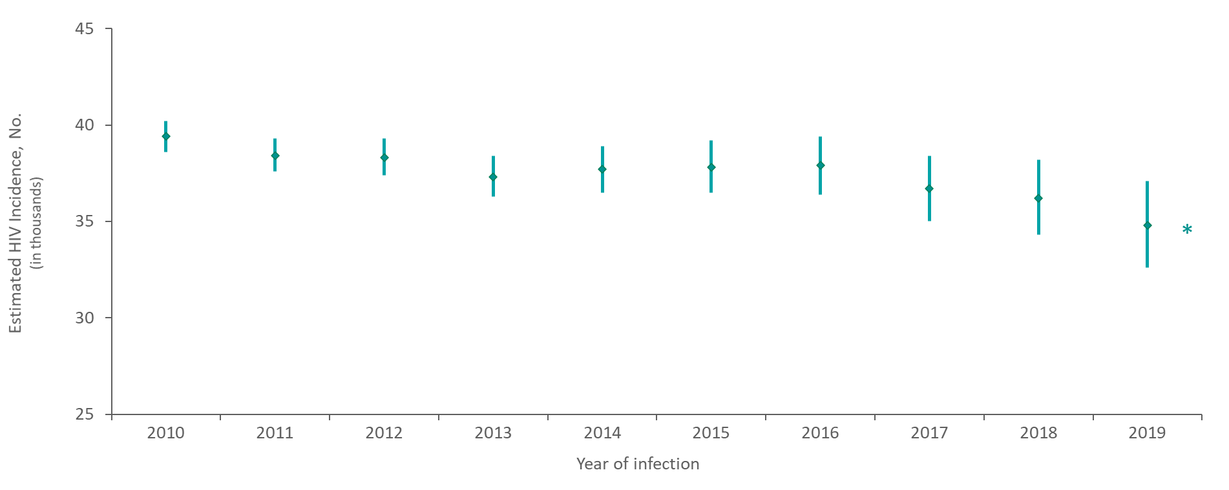
Estimated HIV Incidence among Persons Aged ≥13 Years 2010–2019—United States
Note. Estimates were derived from a CD4 depletion model using HIV surveillance data. Bars indicate the range of the lower and upper bounds of the 95% confidence intervals for the point estimate.
* Difference from the 2010 estimate was deemed statistically significant (P < .05).
Notes:
In the United States, estimated HIV incidence among persons aged ≥13 years decreased (−12%) from 2010 to 2019.
Estimates were derived from a CD4 depletion model using HIV surveillance data. Estimates are rounded to the nearest 100 for estimates >1,000 and to the nearest 10 for estimates ≤1,000 to reflect model uncertainty.
Bars indicate the range of the lower and upper bounds of the 95% confidence intervals for the point estimate.
An asterisk (*) next to the trend line indicates that the difference in the estimate for 2019 from the 2010 estimate was deemed statistically significant (P < .05). Differences that were not statistically significant were deemed ‘stable’.
All data presented in this slide set are from the same dataset (reported to CDC through December 2020) and CD4 model used for the HIV Supplemental Surveillance Report “Estimated HIV Incidence and Prevalence in the United States 2015–2019”. Please see the Commentary and Technical Notes for information on the methods used to produce the estimates. The report can be found at: https://www.cdc.gov/hiv/library/reports/hiv-surveillance.html

Slide 7
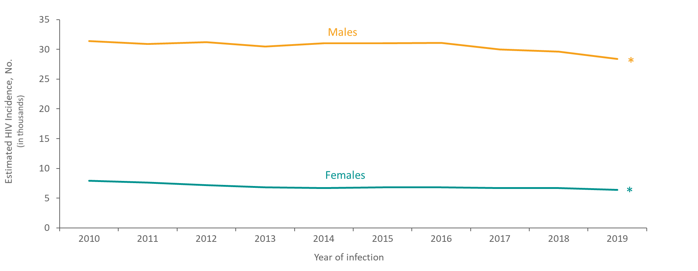
Estimated HIV Incidence among Persons Aged ≥13 Years, by Sex at Birth 2010–2019—United States
Note. Estimates were derived from a CD4 depletion model using HIV surveillance data.
* Difference from the 2010 estimate was deemed statistically significant (P < .05).
Notes:
This slide presents estimated HIV incidence among persons ≥13 years by sex at birth in the United States from 2010 through 2019.
The annual number of HIV infections among persons aged ≥13 years in 2019, compared with 2010, decreased among males and females (−10% and −19%, respectively).
In 2019, of the estimated 34,800 HIV infections among persons aged ≥13 years, 82% were among males and 18% were among females.
Estimates were derived from a CD4 depletion model using HIV surveillance data. Estimates are rounded to the nearest 100 for estimates >1,000 and to the nearest 10 for estimates ≤1,000 to reflect model uncertainty.
An asterisk (*) next to the trend line indicates that the difference in the estimate for 2019 from the 2010 estimate was deemed statistically significant (P < .05). Differences that were not statistically significant were deemed ‘stable’.
All data presented in this slide set are from the same dataset (reported to CDC through December 2020) and CD4 model used for the HIV Supplemental Surveillance Report “Estimated HIV Incidence and Prevalence in the United States 2015–2019”. Please see the Commentary and Technical Notes for information on the methods used to produce the estimates. The report can be found at: https://www.cdc.gov/hiv/library/reports/hiv-surveillance.html

Slide 8
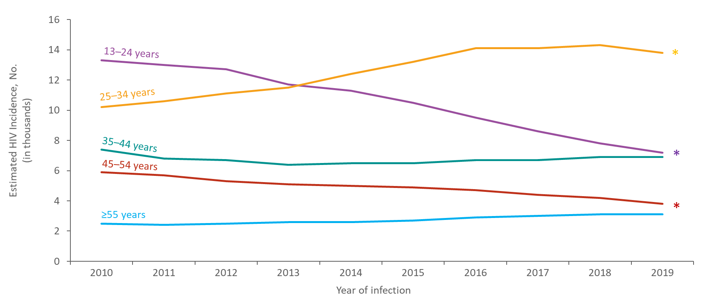
Estimated HIV Incidence among Persons Aged ≥13 Years, by Age 2010–2019—United States
Note. Estimates were derived from a CD4 depletion model using HIV surveillance data.
* Difference from the 2010 estimate was deemed statistically significant (P < .05).
Notes:
This slide presents estimated HIV incidence among persons ≥13 years by age in the United States from 2010 through 2019.
The annual number of HIV infections in 2019, compared with 2010, increased among persons aged 25–34 years (35%), but decreased among persons aged 13–24 (−46%) and 45–54 years (−36%). The number of infections in 2010 and 2019 remained stable among persons aged 35–44 and ≥55 years.
In 2019, persons aged 25–34 years accounted for the largest percentage (40%) of HIV infections; whereas persons aged ≥55 years accounted for the smallest percentage (9%) of HIV infections.
Estimates were derived from a CD4 depletion model using HIV surveillance data. Estimates are rounded to the nearest 100 for estimates >1,000 and to the nearest 10 for estimates ≤1,000 to reflect model uncertainty.
An asterisk (*) next to the trend line indicates that the difference in the estimate for 2019 from the 2010 estimate was deemed statistically significant (P < .05). Differences that were not statistically significant were deemed ‘stable’.
All data presented in this slide set are from the same dataset (reported to CDC through December 2020) and CD4 model used for the HIV Supplemental Surveillance Report “Estimated HIV Incidence and Prevalence in the United States 2015–2019”. Please see the Commentary and Technical Notes for information on the methods used to produce the estimates. The report can be found at: https://www.cdc.gov/hiv/library/reports/hiv-surveillance.html

Slide 9
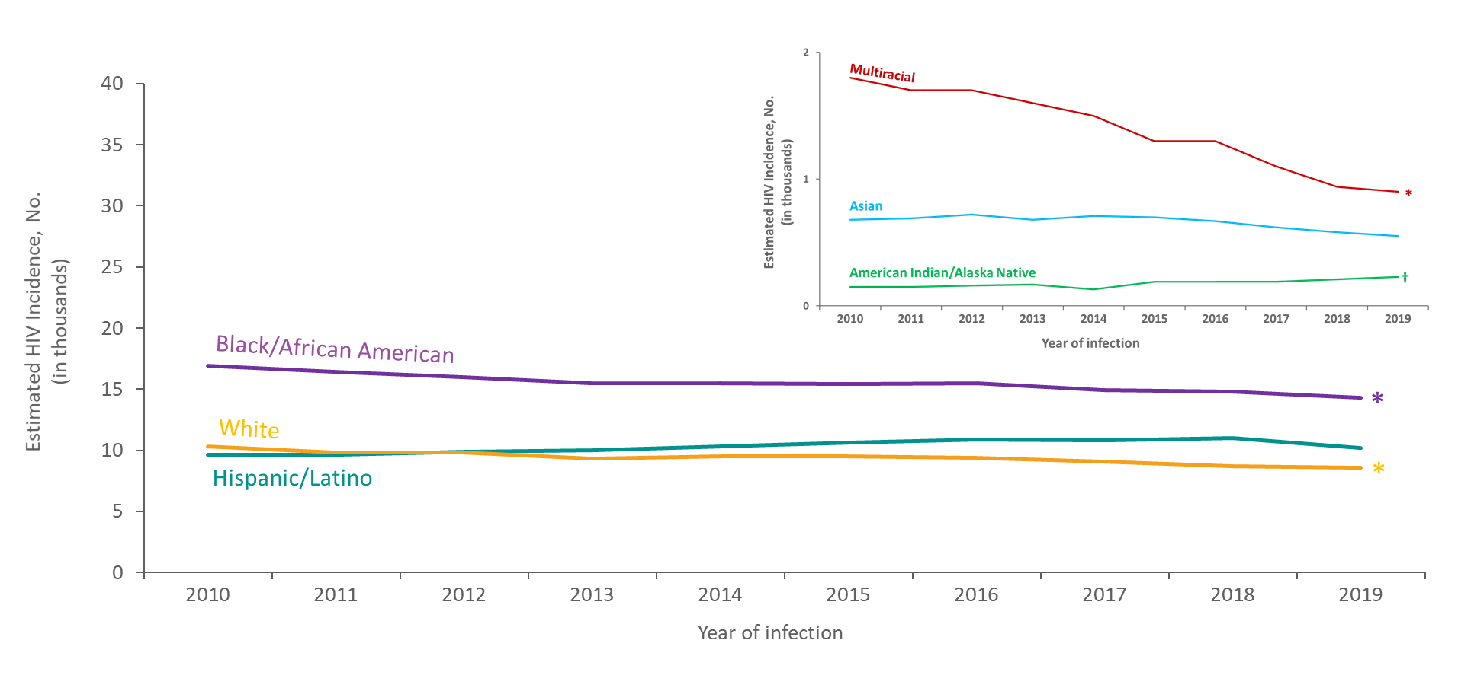
Estimated HIV Incidence among Persons Aged ≥13 Years, by Race/Ethnicity 2010–2019—United States
Note. Estimates were derived from a CD4 depletion model using HIV surveillance data. Hispanic/Latino persons can be of any race.
* Difference from the 2010 estimate was deemed statistically significant (P < .05).
† Estimates should be used with caution; relative standard errors are 30%–50%.
Notes:
This slide presents estimated HIV incidence among persons ≥13 years by race/ethnicity in the United States from 2010 through 2019.
From 2010 through 2019, Black/African American persons accounted for the highest number of HIV infections each year in the United States.
The annual number of HIV infections in 2019, compared with 2010, decreased among Black/African American persons (−15%), White persons (−17%), and multiracial persons (−50%). The annual number of infections remained stable for Hispanic/Latino and Asian persons.
In 2019, 41% of HIV infections were among Black/African American persons, 29% among Hispanic/Latino persons, 25% among White persons, 3% among multiracial persons, 2% among Asian persons, and 1% for American Indian/Alaska Native persons.
Estimates were derived from a CD4 depletion model using HIV surveillance data. Estimates are rounded to the nearest 100 for estimates >1,000 and to the nearest 10 for estimates ≤1,000 to reflect model uncertainty.
Hispanic/Latino persons can be of any race.
An asterisk (*) next to the trend line indicates that the difference in the estimate for 2019 from the 2010 estimate was deemed statistically significant (P < .05). Differences that were not statistically significant were deemed ‘stable’.
Estimates for American Indian/Alaskan Native persons should be used with caution because the RSEs are 30%–50%.
Estimates are not provided for Native Hawaiian/other Pacific Islander persons because the RSEs are >50%.
All data presented in this slide set are from the same dataset (reported to CDC through December 2020) and CD4 model used for the HIV Supplemental Surveillance Report “Estimated HIV Incidence and Prevalence in the United States 2015–2019”. Please see the Commentary and Technical Notes for information on the methods used to produce the estimates. The report can be found at: https://www.cdc.gov/hiv/library/reports/hiv-surveillance.html

Slide 10
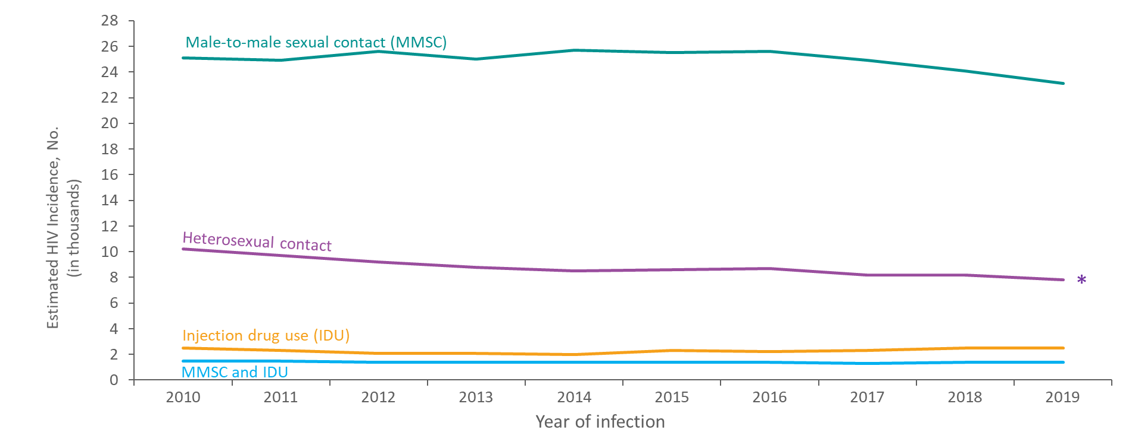
Estimated HIV Incidence among Persons Aged ≥13 Years, by Transmission Category 2010–2019—United States
Note. Estimates were derived from a CD4 depletion model using HIV surveillance data. Data have been statistically adjusted to account for missing transmission category. Heterosexual contact is with a person known to have, or with a risk factor for, HIV infection.
* Difference from the 2010 estimate was deemed statistically significant (P < .05).
Notes:
This slide presents estimated HIV incidence among persons aged ≥13 years by transmission category in the United States from 2010 through 2019. .
The annual number of HIV infections in 2019, compared with 2010, decreased among persons with infection attributed to heterosexual contact (−24%). The annual numbers remained stable among persons with infection attributed to injection drug use (IDU), male-to-male sexual contact (MMSC), and MMSC and IDU.
In 2019, the largest percentage of HIV infections were attributed to MMSC (66%), followed by heterosexual contact (22%).
Estimates were derived from a CD4 depletion model using HIV surveillance data. Estimates are rounded to the nearest 100 for estimates >1,000 and to the nearest 10 for estimates ≤1,000 to reflect model uncertainty. Data have been statistically adjusted to account for missing transmission category.
Heterosexual contact is with a person known to have, or with a risk factor for, HIV infection.
An asterisk (*) next to the trend line indicates that the difference in the estimate for 2019 from the 2010 estimate was deemed statistically significant (P < .05). Differences that were not statistically significant were deemed ‘stable’.
All data presented in this slide set are from the same dataset (reported to CDC through December 2020) and CD4 model used for the HIV Supplemental Surveillance Report “Estimated HIV Incidence and Prevalence in the United States 2015–2019”. Please see the Commentary and Technical Notes for information on the methods used to produce the estimates. The report can be found at: https://www.cdc.gov/hiv/library/reports/hiv-surveillance.html

Slide 11
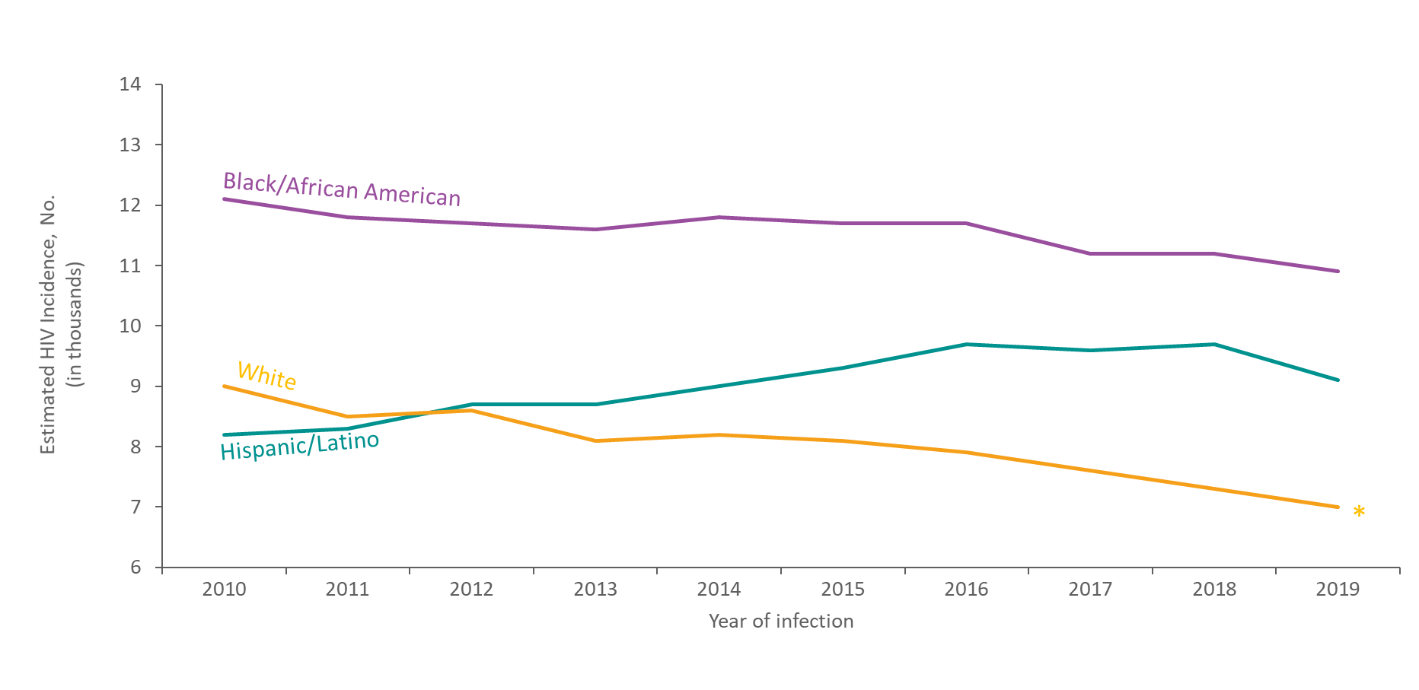
Estimated HIV Incidence among Males Aged ≥13 Years by Race/Ethnicity, 2010–2019—United States
Note. Estimates were derived from a CD4 depletion model using HIV surveillance data. Hispanic/Latino males can be of any race.
* Difference from the 2010 estimate was deemed statistically significant (P < .05).
Notes:
This slide presents estimated HIV incidence among males aged ≥13 years by race/ethnicity in the United States from 2010 through 2019.
Among males, the annual number of HIV infections in 2019, compared with 2010, decreased among White males (−22%). The number of infections in 2010 and 2019 remained stable among Hispanic/Latino and Black/African American males.
In 2019, Black/African American males accounted for the largest percentage of HIV infections among males (38%).
Estimates were derived from a CD4 depletion model using HIV surveillance data. Estimates are rounded to the nearest 100 for estimates >1,000 and to the nearest 10 for estimates ≤1,000 to reflect model uncertainty.
Hispanic/Latino males can be of any race.
An asterisk (*) next to the trend line indicates that the difference in the estimate for 2019 from the 2010 estimate was deemed statistically significant (P < .05). Differences that were not statistically significant were deemed ‘stable’.
Data for other races are not shown because estimates do not meet the standard of reliability.
All data presented in this slide set are from the same dataset (reported to CDC through December 2020) and CD4 model used for the HIV Supplemental Surveillance Report “Estimated HIV Incidence and Prevalence in the United States 2015–2019”. Please see the Commentary and Technical Notes for information on the methods used to produce the estimates. The report can be found at: https://www.cdc.gov/hiv/library/reports/hiv-surveillance.html

Slide 12
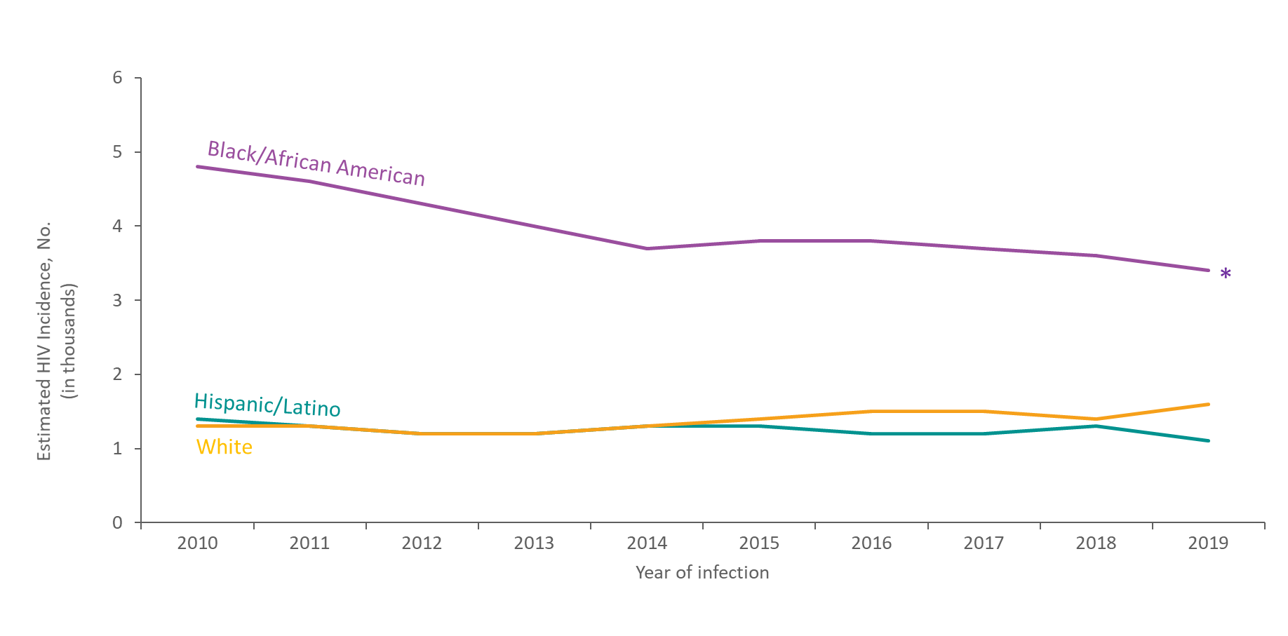
Estimated HIV Incidence among Females Aged ≥13 Years by Race/Ethnicity, 2010–2019—United States
Note. Estimates were derived from a CD4 depletion model using HIV surveillance data. Hispanic/Latino females can be of any race.
* Difference from the 2010 estimate was deemed statistically significant (P < .05).
Notes:
This slide presents estimated HIV incidence among females aged ≥13 years by race/ethnicity in the United States from 2010 through 2019.
Among females, the annual number of HIV infections in 2019, compared with 2010, decreased among Black/African American females (−29%). The number of infections in 2010 and 2019 remained stable among Hispanic/Latino and White females.
In 2019, Black/African American females accounted for the largest percentage of HIV infections among females (53%).
Estimates were derived from a CD4 depletion model using HIV surveillance data. Estimates are rounded to the nearest 100 for estimates >1,000 and to the nearest 10 for estimates ≤1,000 to reflect model uncertainty.
Hispanic/Latino females can be of any race.
Data for other races are not shown because estimates do not meet the standard of reliability.
An asterisk (*) next to the trend line indicates that the difference in the estimate for 2019 from the 2010 estimate was deemed statistically significant (P < .05). Differences that were not statistically significant were deemed ‘stable’.
All data presented in this slide set are from the same dataset (reported to CDC through December 2020) and CD4 model used for the HIV Supplemental Surveillance Report “Estimated HIV Incidence and Prevalence in the United States 2015–2019”. Please see the Commentary and Technical Notes for information on the methods used to produce the estimates. The report can be found at: https://www.cdc.gov/hiv/library/reports/hiv-surveillance.html

Slide 13
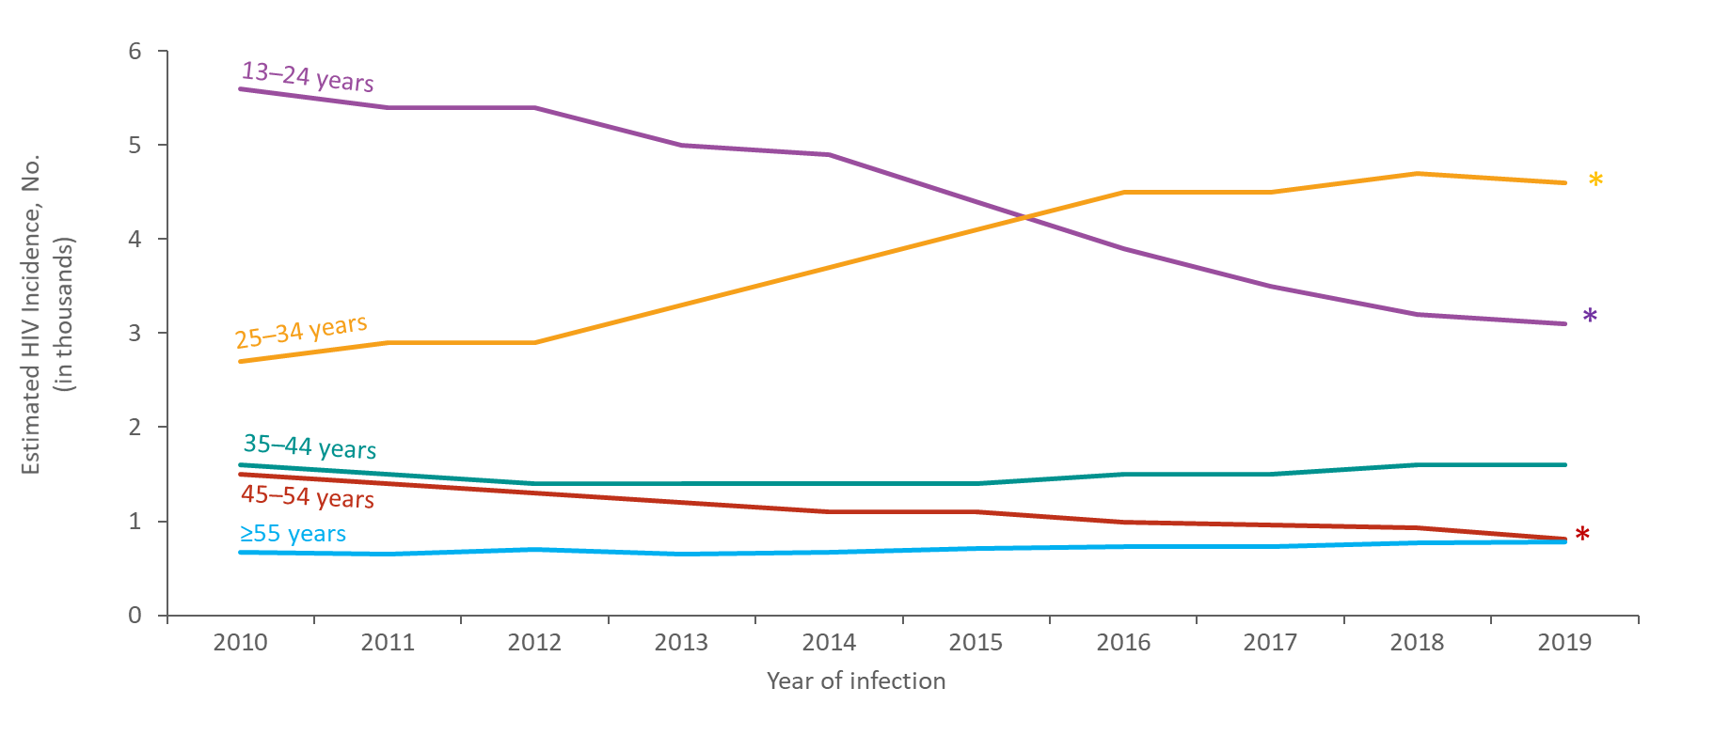
Estimated HIV Incidence among Black/African American Males Aged ≥13 Years, by Age, 2010–2019—United States
Note. Estimates were derived from a CD4 depletion model using HIV surveillance data.
* Difference from the 2010 estimate was deemed statistically significant (P < .05).
Notes:
This slide presents estimated HIV incidence among Black/African American males aged ≥13 years by age in the United States from 2010 through 2019.
The annual number of HIV infections in 2019, compared with 2010, increased among Black/African American males aged 25–34 years (70%), but decreased among those aged 13–24 years (−45%) and 45–54 years (−46%); numbers remained stable among those aged 35–44 and ≥55 years.
In 2019, the largest percentage of HIV infections among Black/African American males was among those aged 25–34 years (42%), followed by those aged 13–24 years (28%).
Estimates were derived from a CD4 depletion model using HIV surveillance data. Estimates are rounded to the nearest 100 for estimates >1,000 and to the nearest 10 for estimates ≤1,000 to reflect model uncertainty.
An asterisk (*) next to the trend line indicates that the difference in the estimate for 2019 from the 2010 estimate was deemed statistically significant (P < .05). Differences that were not statistically significant were deemed ‘stable’.
All data presented in this slide set are from the same dataset (reported to CDC through December 2020) and CD4 model used for the HIV Supplemental Surveillance Report “Estimated HIV Incidence and Prevalence in the United States 2015–2019”. Please see the Commentary and Technical Notes for information on the methods used to produce the estimates. The report can be found at: https://www.cdc.gov/hiv/library/reports/hiv-surveillance.html

Slide 14
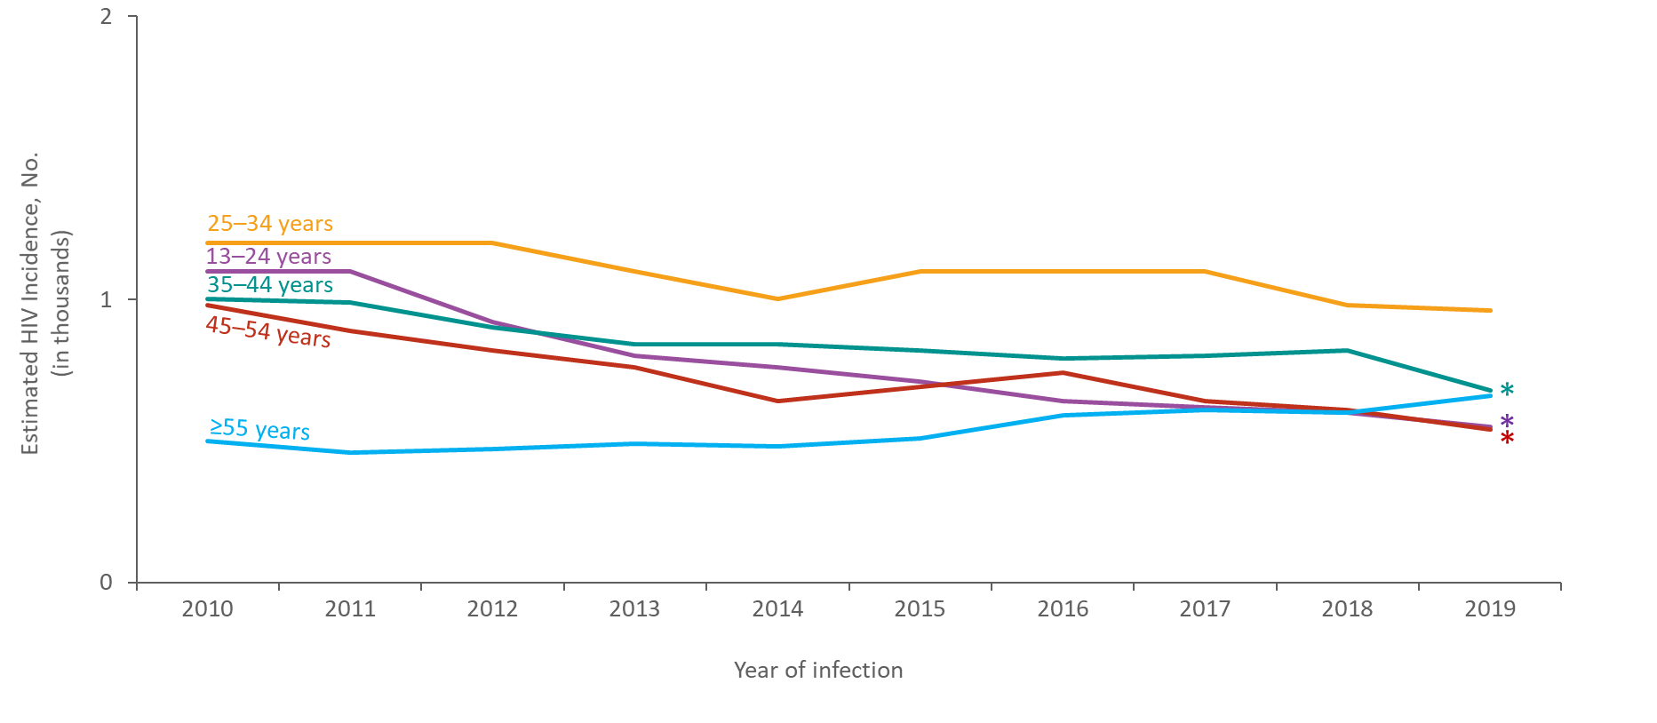
Estimated HIV Incidence among Black/African American Females Aged ≥13 Years, by Age, 2010–2019—United States
Note. Estimates were derived from a CD4 depletion model using HIV surveillance data.
* Difference from the 2010 estimate was deemed statistically significant (P < .05).`
Notes:
This slide presents estimated HIV incidence among Black/African American females aged ≥13 years by age in the United States from 2010 through 2019.
The annual number of HIV infections in 2019, compared with 2010, decreased among Black/African American females aged 13–24 years (−50%), 35–44 years (−32%), and 45–54 years (−45%); numbers remained stable among those aged 25–34 and ≥55 years.
In 2019, the largest percentage of HIV infections among Black/African American females was among those aged 25–34 years (28%), followed by those aged 35–44 years (20%).
Estimates were derived from a CD4 depletion model using HIV surveillance data. Estimates are rounded to the nearest 100 for estimates >1,000 and to the nearest 10 for estimates ≤1,000 to reflect model uncertainty.
An asterisk (*) next to the trend line indicates that the difference in the estimate for 2019 from the 2010 estimate was deemed statistically significant (P < .05). Differences that were not statistically significant were deemed ‘stable’.
All data presented in this slide set are from the same dataset (reported to CDC through December 2020) and CD4 model used for the HIV Supplemental Surveillance Report “Estimated HIV Incidence and Prevalence in the United States 2015–2019”. Please see the Commentary and Technical Notes for information on the methods used to produce the estimates. The report can be found at: https://www.cdc.gov/hiv/library/reports/hiv-surveillance.html

Slide 15
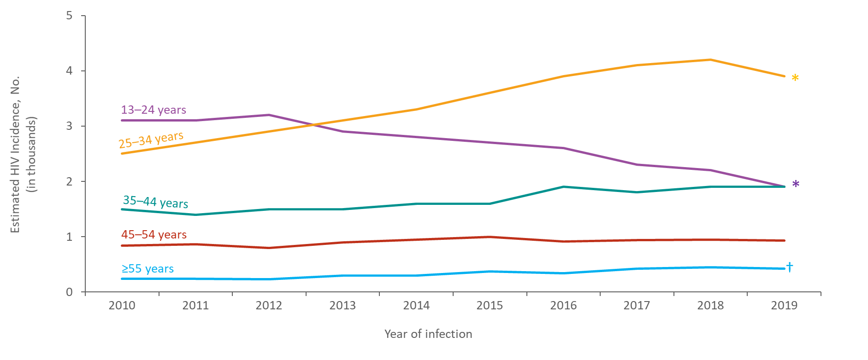
Estimated HIV Incidence among Hispanic/Latino Males Aged ≥13 Years by Age, 2010–2019—United States
Note. Estimates were derived from a CD4 depletion model using HIV surveillance data. Hispanic/Latino males can be of any race.
*Difference from the 2010 estimate was deemed statistically significant (P < .05).
†Estimates should be used with caution; relative standard errors are 30%–50%.
Notes:
This slide presents estimated HIV incidence among Hispanic/Latino males ≥13 years by age in the United States from 2010 through 2019.
The annual number of HIV infections in 2019, compared with 2010, increased among Hispanic/Latino males aged 25–34 years (56%), but decreased among those aged 13–24 years (−39%); numbers remained stable among those aged 35–44, 45–54, and ≥55 years.
In 2019, the largest percentage of HIV infections among Hispanic/Latino males was among those aged 25–34 years (43%), followed by those aged 13–24 and 35–44 years (21%).
Estimates were derived from a CD4 depletion model using HIV surveillance data. Estimates are rounded to the nearest 100 for estimates >1,000 and to the nearest 10 for estimates ≤1,000 to reflect model uncertainty.
Hispanic/Latino males can be of any race.
An asterisk (*) next to the trend line indicates that the difference in the estimate for 2019 from the 2010 estimate was deemed statistically significant (P < .05). Differences that were not statistically significant were deemed ‘stable’.
Estimates for Hispanic/Latino males aged ≥55 years should be used with caution because the RSEs are 30%–50%.
All data presented in this slide set are from the same dataset (reported to CDC through December 2020) and CD4 model used for the HIV Supplemental Surveillance Report “Estimated HIV Incidence and Prevalence in the United States 2015–2019”. Please see the Commentary and Technical Notes for information on the methods used to produce the estimates. The report can be found at: https://www.cdc.gov/hiv/library/reports/hiv-surveillance.html

Slide 16
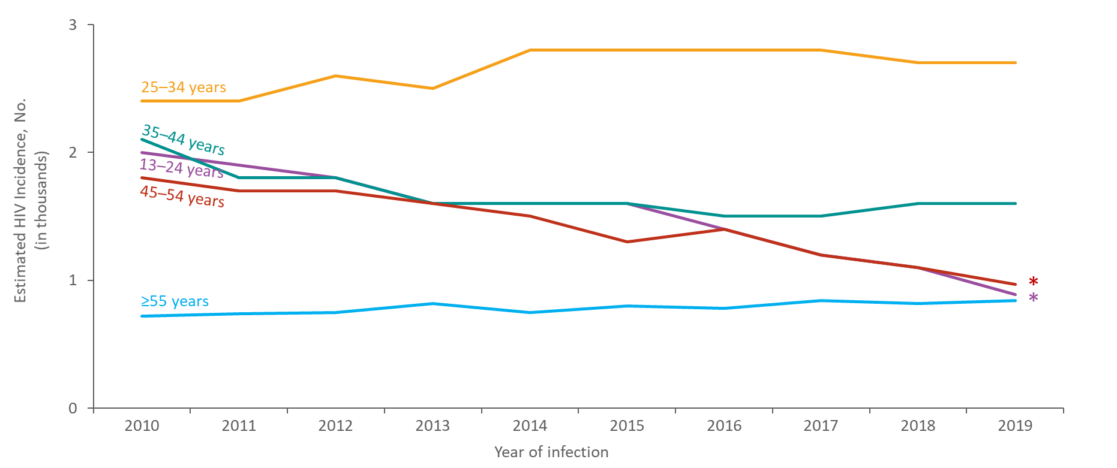
Estimated HIV Incidence among White Males Aged ≥13 Years by Age, 2010–2019—United States
Note. Estimates were derived from a CD4 depletion model using HIV surveillance data.
*Difference from the 2010 estimate was deemed statistically significant (P < .05).
Notes:
This slide presents estimated HIV incidence among White males aged ≥13 years by age in the United States from 2010 through 2019.
In 2019, compared with 2010, the annual number of HIV infections decreased among White males aged 13–24 years (−56%) and 45–54 years (−46%). The annual numbers of HIV infections remained stable among those aged 25–34, 35–44 and ≥55 years.
In 2019, the largest percentage of HIV infections among White males was among those aged 25–34 years (39%), followed by those aged 35–44 years (23%).
Estimates were derived from a CD4 depletion model using HIV surveillance data. Estimates are rounded to the nearest 100 for estimates >1,000 and to the nearest 10 for estimates ≤1,000 to reflect model uncertainty.
An asterisk (*) next to the trend line indicates that the difference in the estimate for 2019 from the 2010 estimate was deemed statistically significant (P < .05). Differences that were not statistically significant were deemed ‘stable’.
All data presented in this slide set are from the same dataset (reported to CDC through December 2020) and CD4 model used for the HIV Supplemental Surveillance Report “Estimated HIV Incidence and Prevalence in the United States 2015–2019”. Please see the Commentary and Technical Notes for information on the methods used to produce the estimates. The report can be found at: https://www.cdc.gov/hiv/library/reports/hiv-surveillance.html

Slide 17
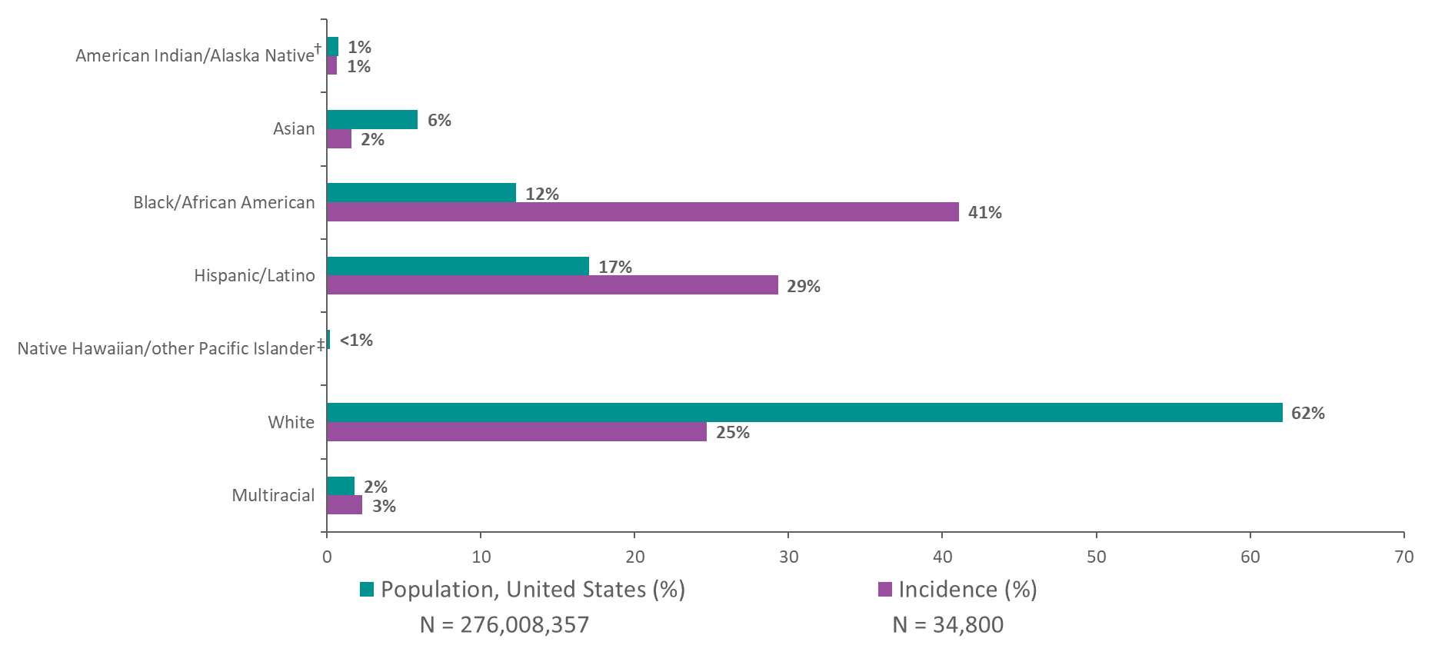
Estimated HIV Incidence and Population among Persons Aged ≥13 Years by Race/Ethnicity, 2019—United States
Note. Estimates were derived from a CD4 depletion model using HIV surveillance data. Hispanic/Latino persons can be of any race.
† Estimate should be used with caution; relative standard error is 30%–50%.
‡ Incidence estimate is not provided for Native Hawaiians/other Pacific Islanders; relative standard error is >50%.
Notes:
This slide presents the comparison of the racial/ethnic distribution in the United States among persons aged ≥13 years estimated to be infected with HIV in 2019 and the racial/ethnic distribution of the general population.
The lower bar illustrates the distribution of estimated numbers of HIV infections in 2019 by race/ethnicity in the United States. The upper bar shows the distribution of the population in the United States by race/ethnicity in 2019.
In 2019, Black/African American persons made up approximately 12% of the population of the United States but accounted for 41% of HIV infections. White persons made up 62% of the population of the United States but accounted for 25% of HIV infections. Hispanic/Latino persons made up 17% of the population of the United States but accounted for 29% of HIV infections.
Estimates were derived from a CD4 depletion model using HIV surveillance data. Estimates are rounded to the nearest 100 for estimates >1,000 and to the nearest 10 for estimates ≤1,000 to reflect model uncertainty.
Hispanic/Latino persons can be of any race.
The estimated HIV incidence for American Indian/Alaskan Native persons should be used with caution because the RSE is 30%–50% .
Incidence estimate is not provided for Native Hawaiian/other Pacific Islander persons because the RSE is >50%.
All data presented in this slide set are from the same dataset (reported to CDC through December 2020) and CD4 model used for the HIV Supplemental Surveillance Report “Estimated HIV Incidence and Prevalence in the United States 2015–2019”. Please see the Commentary and Technical Notes for information on the methods used to produce the estimates. The report can be found at: https://www.cdc.gov/hiv/library/reports/hiv-surveillance.html

Slide 18
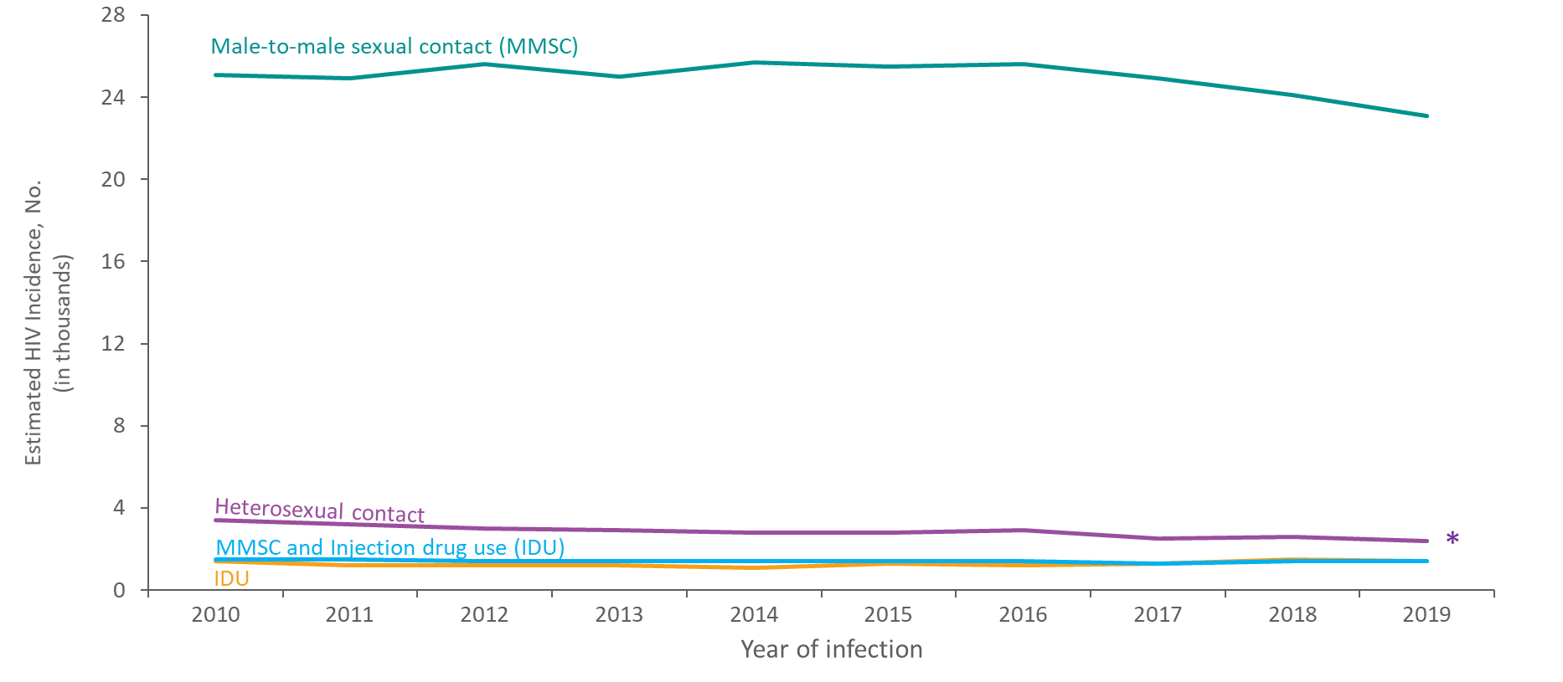
Estimated HIV Incidence among Males Aged ≥13 Years by Transmission Category, 2010–2019—United States
Note. Estimates were derived from a CD4 depletion model using HIV surveillance data. Data have been statistically adjusted to account for missing transmission category. Heterosexual contact is with a person known to have, or with a risk factor for, HIV infection.
* Difference from the 2010 estimate was deemed statistically significant (P < .05).
Notes:
This slide presents estimated HIV incidence among males aged ≥13 years by transmission category in the United States from 2010 through 2019.
The annual number of HIV infections in 2019, compared to 2010, decreased among males with infection attributed to heterosexual contact (−29%). The number of infections remained stable among males with infection attributed to male-to-male sexual contact (MMSC), MMSC and injection drug use (IDU), and IDU.
In 2019, the largest percentages of HIV infections among males was among those with infection attributed to male-to-male sexual contact (81%).
Estimates were derived from a CD4 depletion model using HIV surveillance data. Estimates are rounded to the nearest 100 for estimates >1,000 and to the nearest 10 for estimates ≤1,000 to reflect model uncertainty. Data have been statistically adjusted to account for missing transmission category.
Heterosexual contact is with a person known to have, or with a risk factor for, HIV infection.
An asterisk (*) next to the trend line indicates that the difference in the estimate for 2019 from the 2010 estimate was deemed statistically significant (P < .05). Differences that were not statistically significant were deemed ‘stable’.
All data presented in this slide set are from the same dataset (reported to CDC through December 2020) and CD4 model used for the HIV Supplemental Surveillance Report “Estimated HIV Incidence and Prevalence in the United States 2015–2019”. Please see the Commentary and Technical Notes for information on the methods used to produce the estimates. The report can be found at: https://www.cdc.gov/hiv/library/reports/hiv-surveillance.html

Slide 19
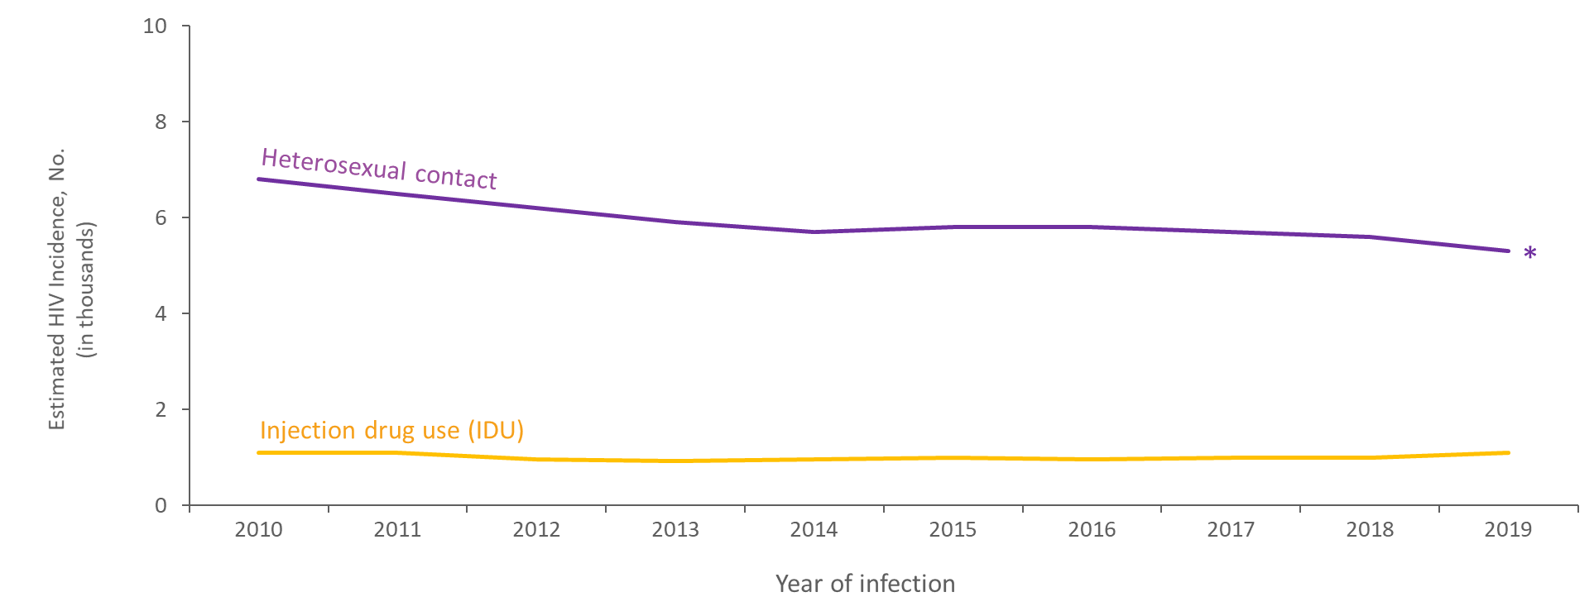
Estimated HIV Incidence among Females Aged ≥13 Years by Transmission Category, 2010–2019—United States
Note. Estimates were derived from a CD4 depletion model using HIV surveillance data. Data have been statistically adjusted to account for missing transmission category. Heterosexual contact is with a person known to have, or with a risk factor for, HIV infection.
* Difference from the 2010 estimate was deemed statistically significant (P < .05).
Notes:
This slide presents estimated HIV incidence among females ≥13 years by transmission category in the United States from 2010 through 2019.
The estimated annual number of HIV infections in 2019, compared with 2010, decreased among females with infection attributed to heterosexual contact (−22%), but remained stable among those with infection attributed to injection drug use (IDU).
In 2019, the percentages of HIV infections were attributed to heterosexual contact (83%), followed by IDU (17%).
Estimates were derived from a CD4 depletion model using HIV surveillance data. Estimates are rounded to the nearest 100 for estimates >1,000 and to the nearest 10 for estimates ≤1,000 to reflect model uncertainty. Data have been statistically adjusted to account for missing transmission category.
Heterosexual contact is with a person known to have, or with a risk factor for, HIV infection.
An asterisk (*) next to the trend line indicates that the difference in the estimate for 2019 from the 2010 estimate was deemed statistically significant (P < .05). Differences that were not statistically significant were deemed ‘stable’.
All data presented in this slide set are from the same dataset (reported to CDC through December 2020) and CD4 model used for the HIV Supplemental Surveillance Report “Estimated HIV Incidence and Prevalence in the United States 2015–2019”. Please see the Commentary and Technical Notes for information on the methods used to produce the estimates. The report can be found at: https://www.cdc.gov/hiv/library/reports/hiv-surveillance.html

Slide 20
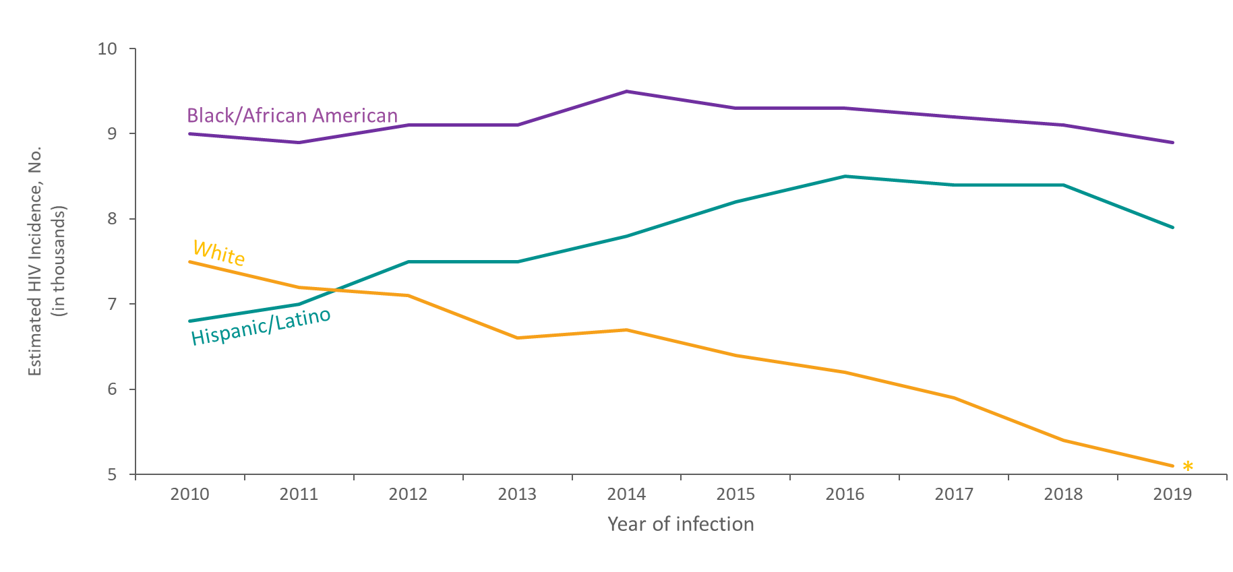
Estimated HIV Incidence among Men Who Have Sex with Men Aged ≥13 Years by Race/Ethnicity, 2010–2019—United States
Note. Estimates were derived from a CD4 depletion model using HIV surveillance data. Data have been statistically adjusted to account for missing transmission category. Data on men who have sex with men do not include men with HIV infection attributed to male-to-male sexual contact and injection drug use. Hispanic/Latino males can be of any race.
*Difference from the 2010 estimate was deemed statistically significant (P < .05).
Notes:
This slide presents estimated HIV incidence among men who have sex with men (MSM) aged ≥13 years by race/ethnicity in the United States from 2010 through 2019.
The annual number of HIV infections in 2019, compared with 2010, increased among decreased among White MSM (−32%). The number of infections remained stable among Hispanic/Latino and Black/African American MSM.
In 2019, Black/African American MSM had the largest percentage (39%) of HIV infections among all MSM.
Estimates were derived from a CD4 depletion model using HIV surveillance data. Estimates are rounded to the nearest 100 for estimates >1,000 and to the nearest 10 for estimates ≤1,000 to reflect model uncertainty. Data have been statistically adjusted to account for missing transmission category.
Data on men who have sex with men do not include men with HIV infection attributed to male-to-male sexual contact and injection drug use.
Hispanic/Latino males can be of any race.
An asterisk (*) next to the trend line indicates that the difference in the estimate for 2019 from the 2010 estimate was deemed statistically significant (P < .05). Differences that were not statistically significant were deemed ‘stable’.
All data presented in this slide set are from the same dataset (reported to CDC through December 2020) and CD4 model used for the HIV Supplemental Surveillance Report “Estimated HIV Incidence and Prevalence in the United States 2015–2019”. Please see the Commentary and Technical Notes for information on the methods used to produce the estimates. The report can be found at: https://www.cdc.gov/hiv/library/reports/hiv-surveillance.html

Slide 21
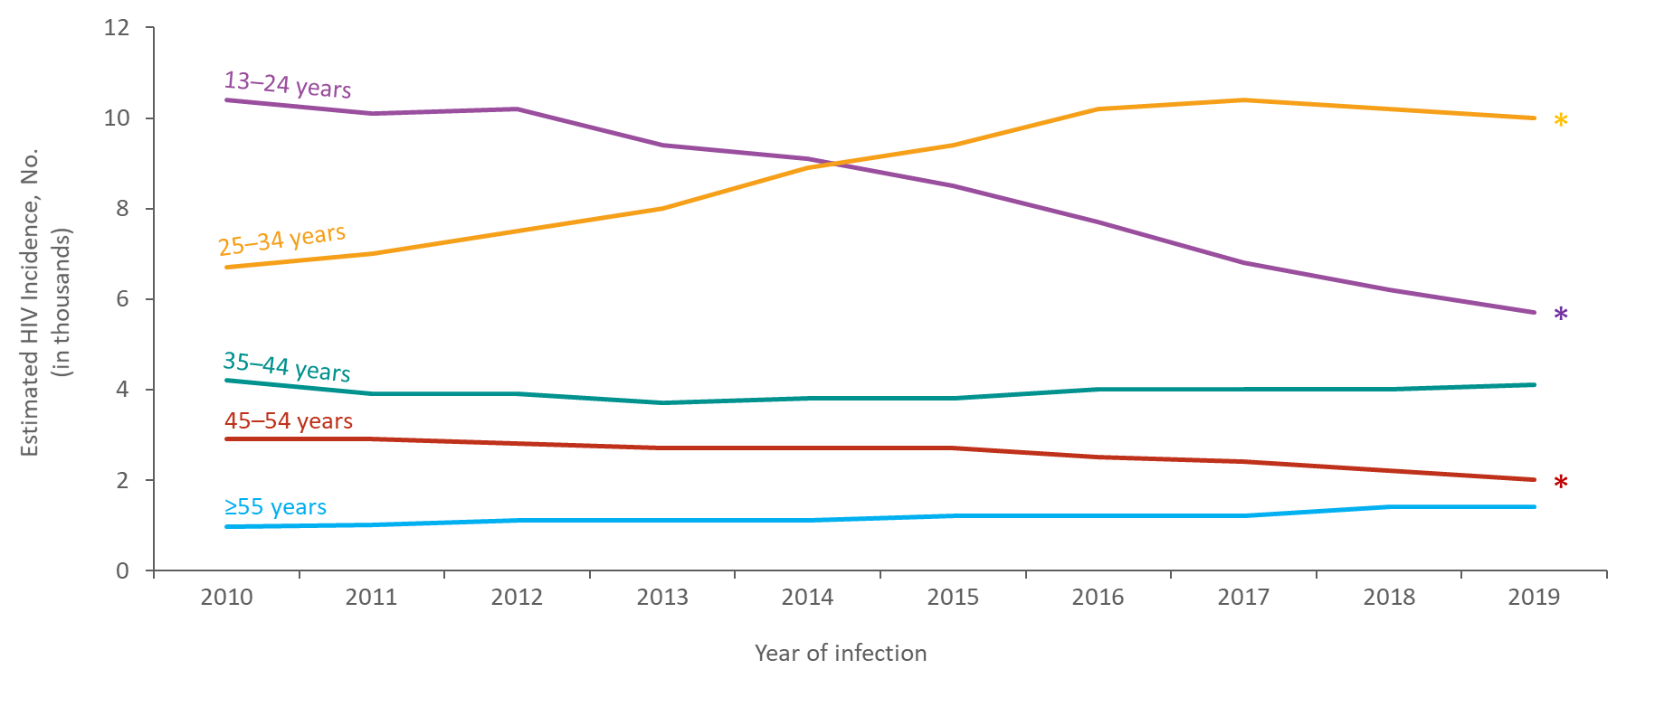
Estimated HIV Incidence among Men who Have Sex with Men Aged ≥13 Years, by Age, 2010–2019—United States
Note. Estimates were derived from a CD4 depletion model using HIV surveillance data. Data have been statistically adjusted to account for missing transmission category. Data on men who have sex with men do not include men with HIV infection attributed to male-to-male sexual contact and injection drug use.
*Difference from the 2010 estimate was deemed statistically significant (P < .05).
Notes:
This slide presents estimated HIV incidence among men who have sex with men (MSM) aged ≥13 years by age in the United States from 2010 through 2019.
The annual number of HIV infections in 2019, compared with 2010, increased among MSM aged 25–34 years (49%), but decreased among MSM aged 13–24 years (−45%) and 45–54 years (−31%). The number of infections remained stable among MSM aged 35–44 and ≥55 years.
In 2019, the largest percentage of HIV infections among MSM was among those aged 25–34 years (43%), followed by those aged 13–24 years (25%).
Estimates were derived from a CD4 depletion model using HIV surveillance data. Estimates are rounded to the nearest 100 for estimates >1,000 and to the nearest 10 for estimates ≤1,000 to reflect model uncertainty. Data have been statistically adjusted to account for missing transmission category.
Data on men who have sex with men do not include men with HIV infection attributed to male-to-male sexual contact and injection drug use.
An asterisk (*) next to the trend line indicates that the difference in the estimate for 2019 from the 2010 estimate was deemed statistically significant (P < .05). Differences that were not statistically significant were deemed ‘stable’.
All data presented in this slide set are from the same dataset (reported to CDC through December 2020) and CD4 model used for the HIV Supplemental Surveillance Report “Estimated HIV Incidence and Prevalence in the United States 2015–2019”. Please see the Commentary and Technical Notes for information on the methods used to produce the estimates. The report can be found at: https://www.cdc.gov/hiv/library/reports/hiv-surveillance.html

Slide 22
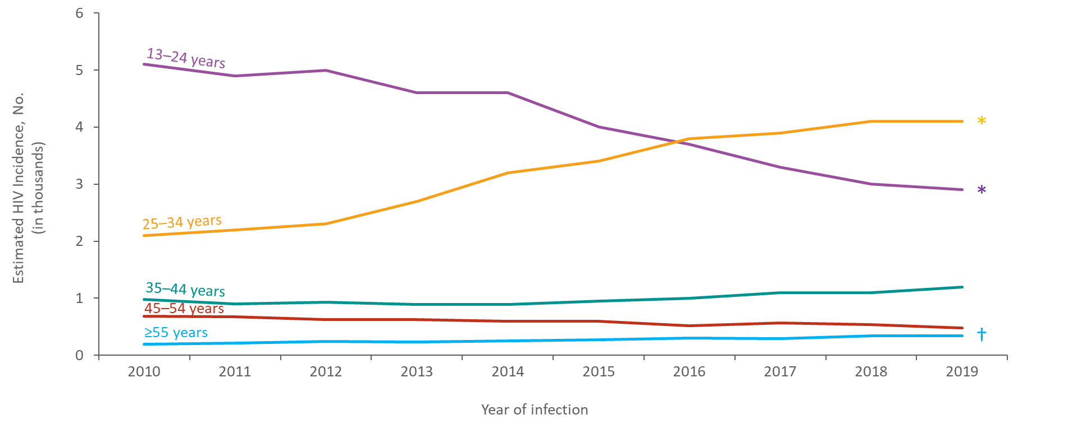
Estimated HIV Incidence among Black/African American Men who Have Sex with Men Aged ≥13 Years, by Age, 2010–2019—United States
Note. Estimates were derived from a CD4 depletion model using HIV surveillance data. Data have been statistically adjusted to account for missing transmission category. Data on men who have sex with men do not include men with HIV infection attributed to male-to-male sexual contact and injection drug use.
* Difference from the 2010 estimate was deemed statistically significant (P < .05).
†Estimates should be used with caution; relative standard errors are 30%–50%.
Notes:
This slide presents estimated HIV incidence among Black/African American men who have sex with men (MSM) aged ≥13 years by age in the United States from 2010 through 2019.
The annual number of HIV infections in 2019, compared with 2010, increased among Black/African American MSM aged 25–34 years (95%), but decreased among those aged 13–24 years (−43%); numbers remained stable among those aged 35–44 and 45–54 years.
In 2019, the largest percentage of HIV infections among Black/African American MSM was among those aged 25–34 years (46%), followed by those aged 13–24 years (33%).
Estimates were derived from a CD4 depletion model using HIV surveillance data. Estimates are rounded to the nearest 100 for estimates >1,000 and to the nearest 10 for estimates ≤1,000 to reflect model uncertainty. Data have been statistically adjusted to account for missing transmission category.
Data on men who have sex with men do not include men with HIV infection attributed to male-to-male sexual contact and injection drug use.
An asterisk (*) next to the trend line indicates that the difference in the estimate for 2019 from the 2010 estimate was deemed statistically significant (P < .05). Differences that were not statistically significant were deemed ‘stable’.
Estimates for black/African American MSM aged ≥55 years should be used with caution because the RSEs are 30%–50%.
All data presented in this slide set are from the same dataset (reported to CDC through December 2020) and CD4 model used for the HIV Supplemental Surveillance Report “Estimated HIV Incidence and Prevalence in the United States 2015–2019”. Please see the Commentary and Technical Notes for information on the methods used to produce the estimates. The report can be found at: https://www.cdc.gov/hiv/library/reports/hiv-surveillance.html

Slide 23
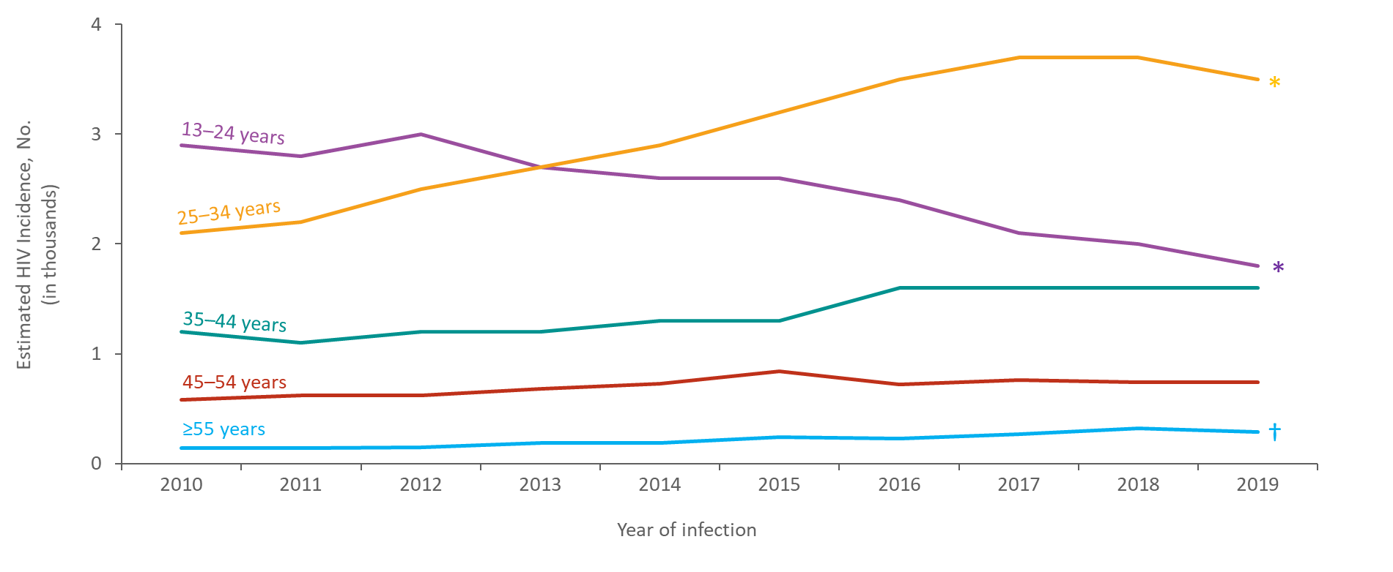
Estimated HIV Incidence among Hispanic/Latino Men who Have Sex with Men Aged ≥13 Years, by Age, 2010–2019—United States
Note. Estimates were derived from a CD4 depletion model using HIV surveillance data. Data have been statistically adjusted to account for missing transmission category. Data on men who have sex with men do not include men with HIV infection attributed to male-to-male sexual contact and injection drug use. Hispanic/Latino males can be of any race.
* Difference from the 2010 estimate was deemed statistically significant (P < .05).
† Estimates should be used with caution; relative standard errors are 30%–50%.
Notes:
This slide presents estimated HIV incidence among Hispanic/Latino men who have sex with men (MSM) aged ≥13 years by age in the United States from 2010 through 2019.
The annual number of HIV infections in 2019, compared with 2010, increased among Hispanic/Latino MSM aged 25–34 years (67%), but decreased among those aged 13–24 years (−38%); numbers remained stable among those aged 35–44 and 45–54 years.
In 2019 the largest percentage of HIV infections among Hispanic/Latino MSM was among those aged 25–34 years (44%), followed by those aged 13–24 years (23%).
Estimates were derived from a CD4 depletion model using HIV surveillance data. Estimates are rounded to the nearest 100 for estimates >1,000 and to the nearest 10 for estimates ≤1,000 to reflect model uncertainty. Data have been statistically adjusted to account for missing transmission category.
Data on men who have sex with men do not include men with HIV infection attributed to male-to-male sexual contact and injection drug use. Hispanic/Latino persons can be of any race.
An asterisk (*) next to the trend line indicates that the difference in the estimate for 2019 from the 2010 estimate was deemed statistically significant (P < .05). Differences that were not statistically significant were deemed ‘stable’.
Estimates for Hispanic/Latino MSM aged ≥55 years should be used with caution because the RSEs are 30%–50%.
All data presented in this slide set are from the same dataset (reported to CDC through December 2020) and CD4 model used for the HIV Supplemental Surveillance Report “Estimated HIV Incidence and Prevalence in the United States 2015–2019”. Please see the Commentary and Technical Notes for information on the methods used to produce the estimates. The report can be found at: https://www.cdc.gov/hiv/library/reports/hiv-surveillance.html

Slide 24
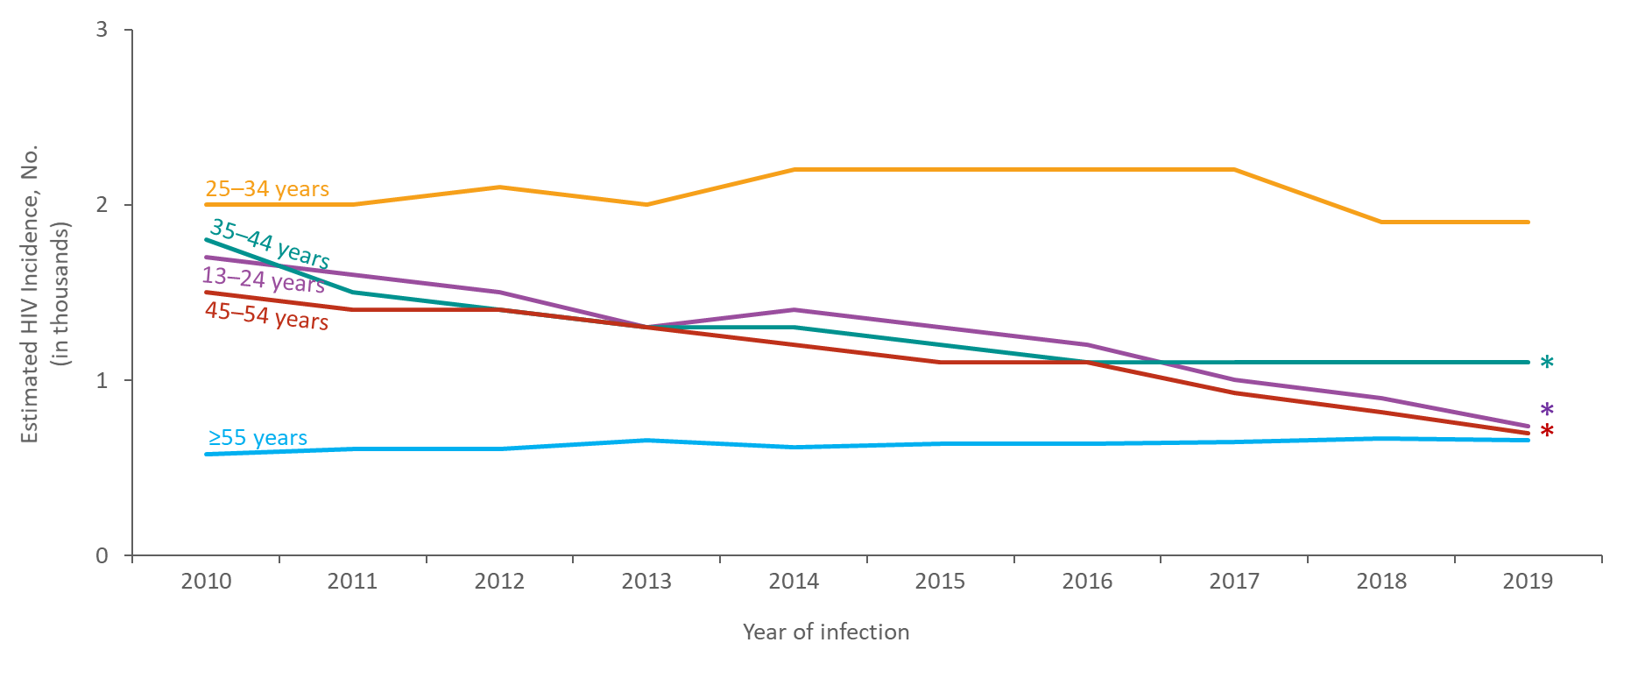
Estimated HIV Incidence among White Men who Have Sex with Men Aged ≥13 Years, by Age, 2010–2019—United States
Note. Estimates were derived from a CD4 depletion model using HIV surveillance data. Data have been statistically adjusted to account for missing transmission category. Data on men who have sex with men do not include men with HIV infection attributed to male-to-male sexual contact and injection drug use.
* Difference from the 2010 estimate was deemed statistically significant (P < .05).
Notes:
This slide presents estimated HIV incidence among white men who have sex with men (MSM) aged ≥13 years by age in the United States from 2010 through 2019.
The annual number of HIV infections in 2019, compared with 2010, decreased among White MSM aged 13–24 years (−56%), 35–44 years (−39%), and 45–54 years (−53%); numbers remained stable among White MSM aged 25–34 and ≥55 years.
In 2019, the largest percentage of HIV infections among White MSM was among those aged 25–34 years (37%), followed by those aged 35–44 years (22%).
Estimates were derived from a CD4 depletion model using HIV surveillance data. Estimates are rounded to the nearest 100 for estimates >1,000 and to the nearest 10 for estimates ≤1,000 to reflect model uncertainty. Data have been statistically adjusted to account for missing transmission category.
Data on men who have sex with men do not include men with HIV infection attributed to male-to-male sexual contact and injection drug use.
An asterisk (*) next to the trend line indicates that the difference in the estimate for 2019 from the 2010 estimate was deemed statistically significant (P < .05). Differences that were not statistically significant were deemed ‘stable’.
All data presented in this slide set are from the same dataset (reported to CDC through December 20120 and CD4 model used for the HIV Supplemental Surveillance Report “Estimated HIV Incidence and Prevalence in the United States 2015–2019”. Please see the Commentary and Technical Notes for information on the methods used to produce the estimates. The report can be found at: https://www.cdc.gov/hiv/library/reports/hiv-surveillance.html

Slide 25
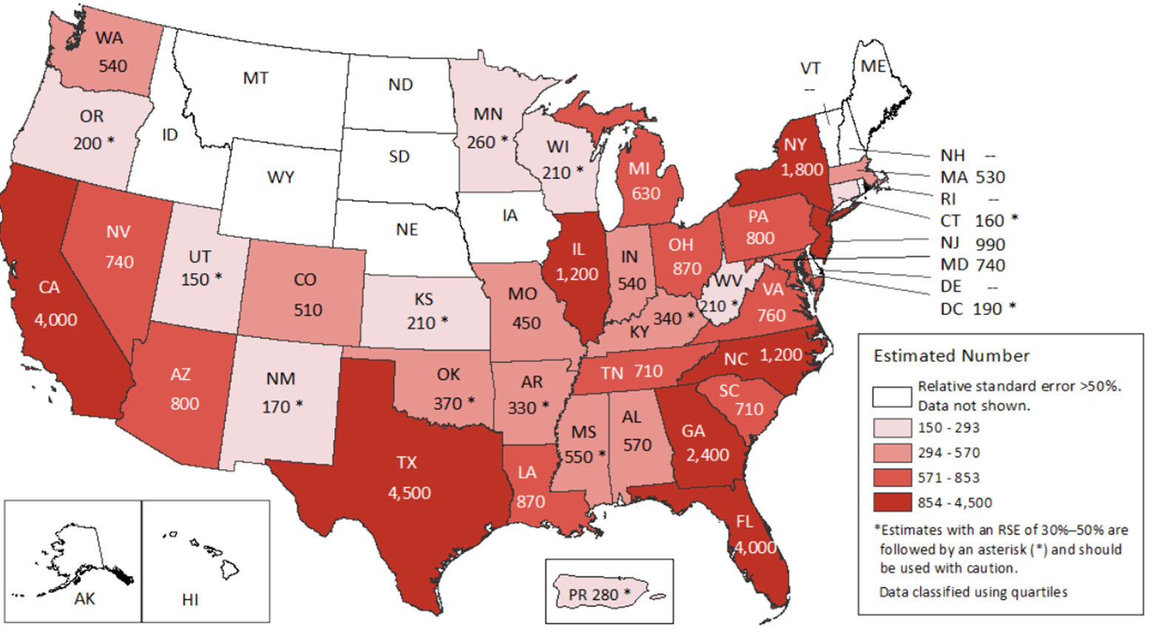
Estimated HIV Incidence among Persons Aged ≥13 Years, by Area of Residence 2019—United States and Puerto Rico Total = 34,800 †
Note. Estimates were derived from a CD4 depletion model using HIV surveillance data. Estimates rounded to the nearest 100 for estimates >1,000 and to the nearest 10 for estimates ≤1,000 to reflect model uncertainty.
†Total estimate for the United States does not include data for Puerto Rico.
Notes:
This map presents estimates of HIV incidence for persons aged ≥13 years in the United States for 2019. HIV incidence was highest in California, Florida, Georgia, Illinois, New York, North Carolina, and Texas.; these states accounted for approximately 55% of the estimated numbers of HIV infections.
Estimates were derived from a CD4 depletion model using HIV surveillance data. Estimates were rounded to the nearest 100 for estimates >1,000 and to the nearest 10 for estimates ≤1,000 to reflect model uncertainty. Estimates with a relative standard error (RSE) of 30%–50% are followed by an asterisk (*) and should be used with caution. Estimates with an RSE of >50% are not shown.
Estimates for the following jurisdictions should be interpreted with caution because they do not have laws requiring complete reporting of laboratory data or have incomplete reporting. Areas without laws: Idaho and New Jersey. Areas with incomplete reporting: Kansas, Kentucky, Pennsylvania, Vermont, and Puerto Rico.
All data presented in this slide set are from the same dataset (reported to CDC through December 2020) and CD4 model used for the HIV Supplemental Surveillance Report “Estimated HIV Incidence and Prevalence in the United States 2015–2019”. Please see the Commentary and Technical Notes for information on the methods used to produce the estimates. The report can be found at: https://www.cdc.gov/hiv/library/reports/hiv-surveillance.html

Slide 26
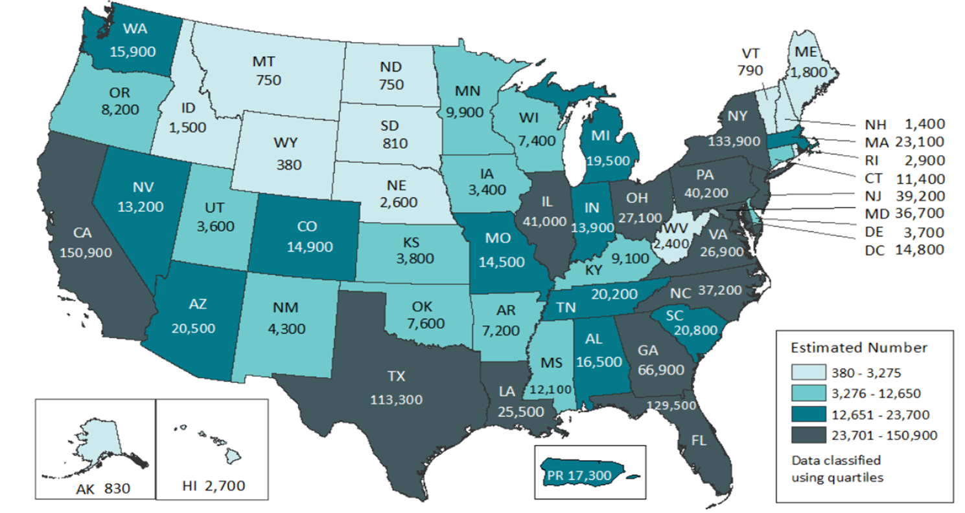
Estimated HIV Prevalence among Persons Aged ≥13 years, by Area of Residence 2019—United States and Puerto Rico Total = 1,189,700 †
Note. Estimates were derived from a CD4 depletion model using HIV surveillance data. Estimates rounded to the nearest 100 for estimates >1,000 and to the nearest 10 for estimates ≤1,000 to reflect model uncertainty. Estimates for the year 2019 are preliminary and based on deaths reported to CDC through December 2020. Estimates should be interpreted with caution due to incomplete death ascertainment for Kansas, Massachusetts, Mississippi, Nevada, North Dakota, and Vermont.
†Total estimate for the United States does not include data for Puerto Rico.
Notes:
This map presents estimates of HIV prevalence for persons aged ≥13 years in the United States for 2019. HIV prevalence was highest in California, Florida, Georgia,, Illinois, Louisiana, Maryland, New Jersey, New York, North Carolina, Pennsylvania, Texas, Ohio, and Virginia.
Five states accounted for approximately 50% of persons living with HIV infection: California, Florida, Georgia, New York, and Texas.
Estimates for the year 2019 are preliminary and based on deaths reported to CDC through December 2020. Estimates for Kansas, Massachusetts, Mississippi, Nevada, North Dakota, and Vermont should be interpreted with caution due to incomplete death ascertainment.
Estimates were derived from a CD4 depletion model using HIV surveillance data. Estimates were rounded to the nearest 100 for estimates >1,000 and to the nearest 10 for estimates ≤1,000 to reflect model uncertainty.
Estimates for the following jurisdictions should be interpreted with caution because they do not have laws requiring complete reporting of laboratory data or have incomplete reporting. Areas without laws: Idaho and New Jersey. Areas with incomplete reporting: Kansas, Kentucky, Pennsylvania, Puerto Rico, and Vermont.
All data presented in this slide set are from the same dataset (reported to CDC through December 2020) and CD4 model used for the HIV Supplemental Surveillance Report “Estimated HIV Incidence and Prevalence in the United States 2015–2019”. Please see the Commentary and Technical Notes for information on the methods used to produce the estimates. The report can be found at: https://www.cdc.gov/hiv/library/reports/hiv-surveillance.html

Slide 27
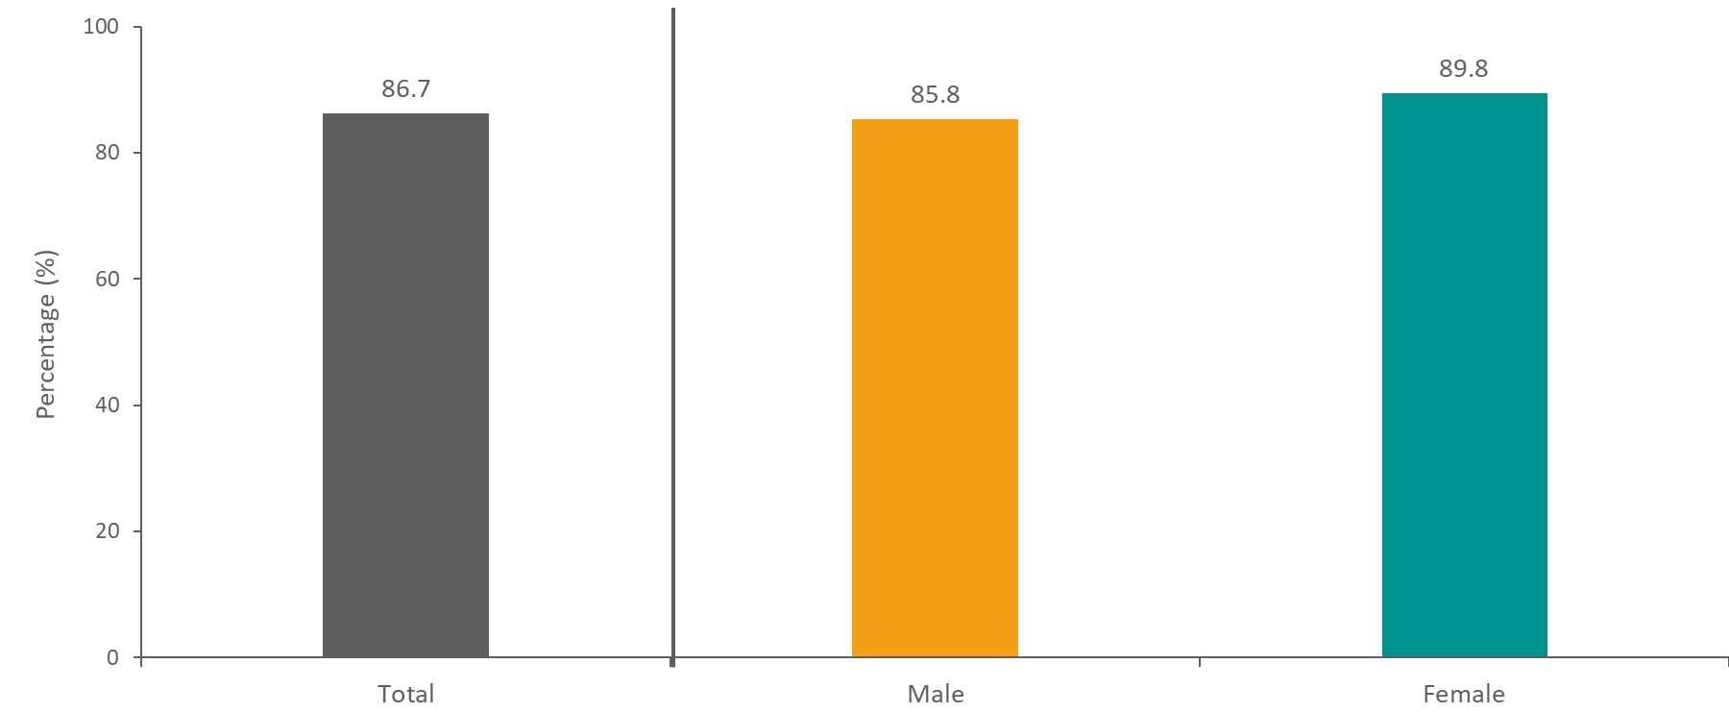
Diagnosed Infection among Persons Aged ≥13 Years Living with Diagnosed or Undiagnosed HIV Infection, by Sex, 2019—United States
Note. Estimates were derived from a CD4 depletion model using HIV surveillance data. Estimates for the year 2019 are preliminary and based on deaths reported to CDC through December 2020.
Notes:
This graph presents percentages of persons aged ≥13 years with diagnosed HIV infection among estimated numbers of persons living with diagnosed or undiagnosed HIV in the United States at the end of 2019. Overall, an estimated 86.7% of persons living with HIV had received a diagnosis. The percentage of persons with diagnosed HIV was slightly higher among females (89.8%) than males (85.8%).
Estimates for the year 2019 are preliminary and based on deaths reported to CDC through December 2020.
Estimates were derived from a CD4 depletion model using HIV surveillance data.
All data presented in this slide set are from the same dataset (reported to CDC through December 2020) and CD4 model used for the HIV Supplemental Surveillance Report “Estimated HIV Incidence and Prevalence in the United States 2015–2019”. Please see the Commentary and Technical Notes for information on the methods used to produce the estimates. The report can be found at: https://www.cdc.gov/hiv/library/reports/hiv-surveillance.html

Slide 28
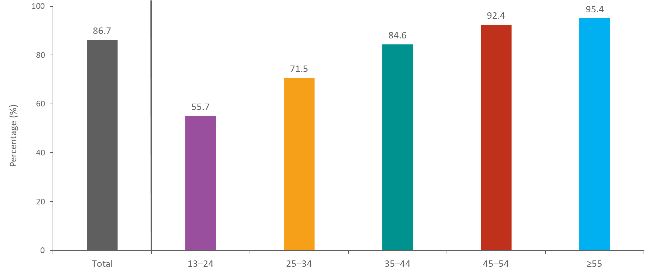
Diagnosed Infection among Persons Aged ≥13 Years Living with Diagnosed or Undiagnosed HIV Infection, by Age, 2019—United States
Note. Estimates were derived from a CD4 depletion model using HIV surveillance data. Estimates for the year 2019 are preliminary and based on deaths reported to CDC through December 2020.
Notes:
This graph presents percentages of persons aged ≥13 years with diagnosed HIV infection among estimated numbers of persons living with diagnosed or undiagnosed infection by age in the United States at the end of 2019. The percentage of persons with diagnosed HIV increased with age. Only 55.7% of persons aged 13 to 24 years had received a diagnosis, while 95.4% of persons aged ≥55 years had received a diagnosis.
Estimates for the year 2019 are preliminary and based on deaths reported to CDC through December 2020.
Estimates were derived from a CD4 depletion model using HIV surveillance data.
All data presented in this slide set are from the same dataset (reported to CDC through December 2020) and CD4 model used for the HIV Supplemental Surveillance Report “Estimated HIV Incidence and Prevalence in the United States 2015–2019”. Please see the Commentary and Technical Notes for information on the methods used to produce the estimates. The report can be found at: https://www.cdc.gov/hiv/library/reports/hiv-surveillance.html

Slide 29
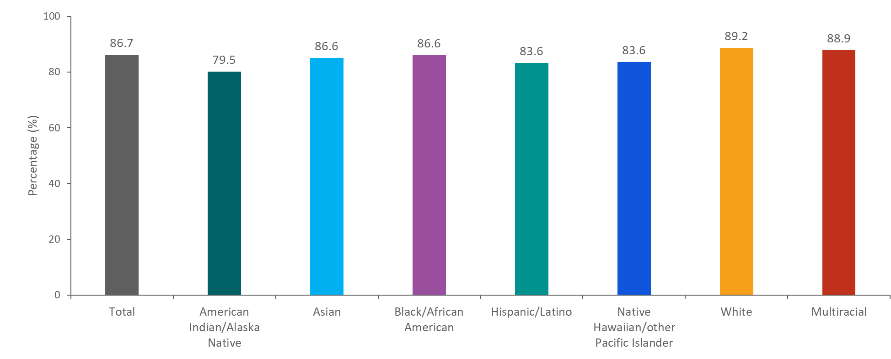
Diagnosed Infection among Persons Aged ≥13 Years Living with Diagnosed or Undiagnosed HIV Infection, by Race/Ethnicity, 2019—United States
Note. Estimates were derived from a CD4 depletion model using HIV surveillance data. Asian persons includes Asian/Pacific Islander legacy cases. Hispanic/Latino persons can be of any race. Estimates for the year 2019 are preliminary and based on deaths reported to CDC through December 2020.
Notes:
This graph presents percentages of persons aged ≥13 years with diagnosed HIV among estimated numbers of persons living with diagnosed or undiagnosed infection by race/ethnicity in the United States at the end of 2019. The percentage of diagnosed infection was highest among White persons (89.2%), followed by persons of multiple races (88.9%), Black/African American persons (86.6%), Asian persons (86.6%), Hispanic/Latino persons (83.6%), Native Hawaiian/other Pacific Islander persons (83.6%)s, and American Indian/Alaskan Native persons (79.5%).
Estimates for the year 2019 are preliminary and based on deaths reported to CDC through December 2020.
Estimates were derived from a CD4 depletion model using HIV surveillance data. Asian persons include Asian/Pacific Islander legacy cases. Hispanic/Latino persons can be of any race.
All data presented in this slide set are from the same dataset (reported to CDC through December 2020) and CD4 model used for the HIV Supplemental Surveillance Report “Estimated HIV Incidence and Prevalence in the United States 2015–2019”. Please see the Commentary and Technical Notes for information on the methods used to produce the estimates. The report can be found at: https://www.cdc.gov/hiv/library/reports/hiv-surveillance.html

Slide 30
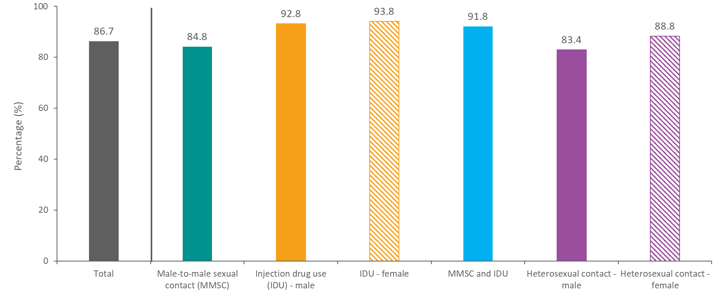
Diagnosed Infection among Persons Aged ≥13 Years Living with Diagnosed or Undiagnosed HIV Infection, by Transmission Category, 2019—United States
Note. Estimates were derived from a CD4 depletion model using HIV surveillance data. Data have been statistically adjusted to account for missing transmission category. Heterosexual contact is with a person known to have, or with a risk factor for, HIV infection. Estimates for the year 2019 are preliminary and based on deaths reported to CDC through December 2020.
Notes:
This graph presents percentages of persons aged ≥13 years with diagnosed HIV among estimated numbers of persons living with diagnosed or undiagnosed infection by transmission category in the United States at the end of 2019. The percentage of diagnosed infection was highest among females with infection attributed to injection drug use (IDU) (93.8%), followed by males with infection attributed to IDU (92.8%), males with infection attributed to male-to-male sexual contact (MMSC) and IDU (91.8%), females with infection attributed to heterosexual contact (88.8%), males with infection attributed to MMSC (84.8%), and males with infection attributed to heterosexual contact (83.4%).
Estimates for the year 2019 are preliminary and based on deaths reported to CDC through December 2020.
Estimates were derived from a CD4 depletion model using HIV surveillance data. Data have been statistically adjusted to account for missing transmission category. Heterosexual contact is with a person known to have, or with a risk factor for, HIV infection. IDU, injection drug use.
All data presented in this slide set are from the same dataset (reported to CDC through December 2020) and CD4 model used for the HIV Supplemental Surveillance Report “Estimated HIV Incidence and Prevalence in the United States 2015–2019”. Please see the Commentary and Technical Notes for information on the methods used to produce the estimates. The report can be found at: https://www.cdc.gov/hiv/library/reports/hiv-surveillance.html

Slide 31
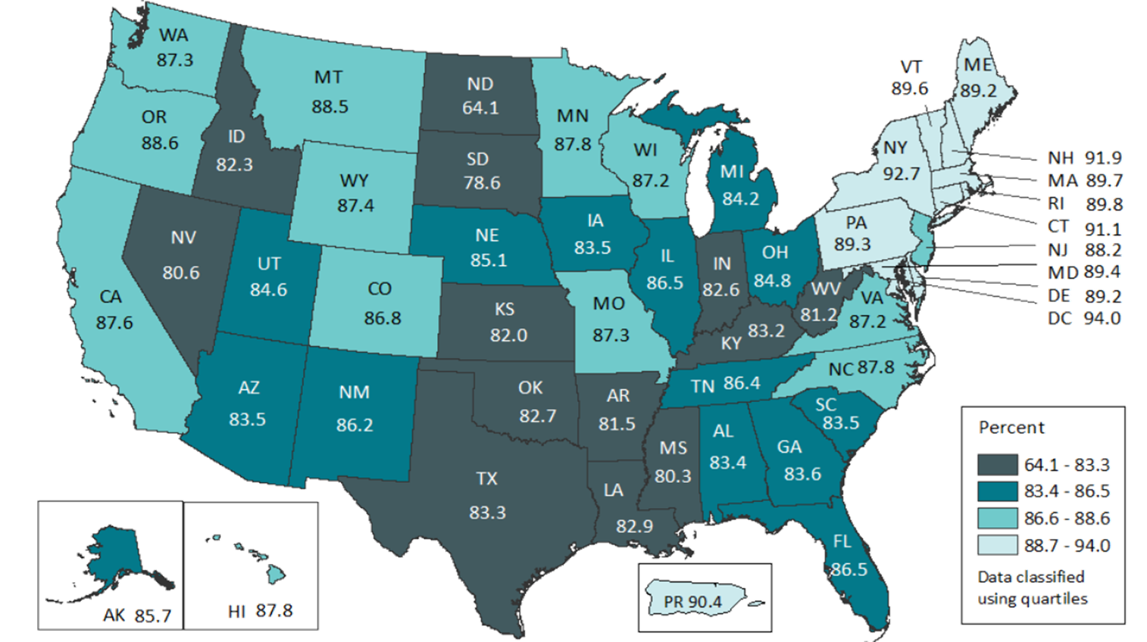
Diagnosed Infection among Persons Aged ≥13 Years Living with Diagnosed or Undiagnosed HIV Infection, 2019—United States and Puerto Rico Total = 86.7% †
Note. Estimates were derived from a CD4 depletion model using HIV surveillance data. Estimates for the year 2019 are preliminary and based on deaths reported to CDC through December 2020. Estimates for Kansas, Massachusetts, Mississippi, North Dakota, Nevada, and Vermont should be interpreted with caution due to incomplete death ascertainment.
†Total estimate for the United States does not include data for Puerto Rico.
Notes:
This map presents percentages of persons aged ≥13 years with diagnosed HIV among persons living with diagnosed or undiagnosed infection at the end of 2019. Twelve jurisdictions (Connecticut, Delaware, District of Columbia, Maine, Maryland, Massachusetts, New Hampshire, New York, Pennsylvania, Puerto Rico, Rhode Island, and Vermont) in the lightest shade had the largest percentages (≥89.2) of persons living with diagnosed HIV.
Estimates for the year 2019 are preliminary and based on deaths reported to CDC through December 2020. Estimates for Kansas, Massachusetts, Mississippi, North Dakota, Nevada, and Vermont should be interpreted with caution due to incomplete death ascertainment.
Estimates were derived from a CD4 depletion model using HIV surveillance data.
Estimates for the following jurisdictions should be interpreted with caution because they do not have laws requiring complete reporting of laboratory data or have incomplete reporting. Areas without laws: Idaho and New Jersey. Areas with incomplete reporting: Kansas, Kentucky, Pennsylvania, Puerto Rico, and Vermont.
All data presented in this slide set are from the same dataset (reported to CDC through December 2020) and CD4 model used for the HIV Supplemental Surveillance Report “Estimated HIV Incidence and Prevalence in the United States 2015–2019”. Please see the Commentary and Technical Notes for information on the methods used to produce the estimates. The report can be found at: https://www.cdc.gov/hiv/library/reports/hiv-surveillance.html

