Slide 1
Trends in HIV Infection Stage 3 (AIDS) 2018 (Updated)
Division of HIV/AIDS Prevention
Notes:
Trends in HIV Infection, Stage 3 (AIDS).
For all slides in this series, the following notes apply:
Beginning in 2020, CDC has transitioned to publishing this slide set earlier in the calendar year and will include data reported to CDC’s National HIV Surveillance System through December 31 of the prior year (instead of June 30). The use of data reported to CDC through December will allow for a 12-month reporting lag.
Numbers and rates of diagnosed infections classified as stage 3 (AIDS) are based on data from 50 states, the District of Columbia, and 6 U.S. dependent areas.
Rates for transmission category are not provided because of the absence of denominator data from the U.S. Census Bureau.
Rates are not calculated by race/ethnicity for the 6 U.S. dependent areas because the U.S. Census Bureau does not collect information from all U.S. dependent areas.
Data are presented for diagnoses of HIV infection reported to CDC through December 2019.
Death and prevalence data for the year 2018 are preliminary and based on deaths reported to CDC as of December 2019.
Data re-release agreements between CDC and state/local HIV surveillance programs require certain levels of cell suppression at the state and county level in order to ensure confidentiality of personally identifiable information.

Slide 2
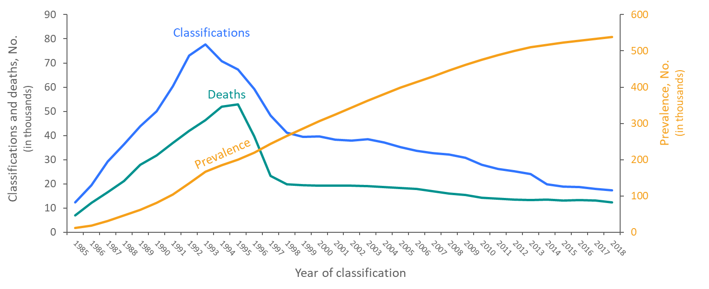
Stage 3 (AIDS) Classifications, Deaths, and Persons Living with Diagnosed HIV Infection Ever Classified as Stage 3 (AIDS), 1985–2018—United States and 6 Dependent Areas
Note. Deaths of persons with HIV infection, stage 3 (AIDS) may be due to any cause.
Notes:
This slide presents from 1985 through 2018 in the United States and 6 dependent areas trends in the numbers of stage 3 (AIDS) classifications, deaths of persons with diagnosed HIV infection ever classified as stage 3 (AIDS), and persons living with diagnosed HIV infection ever classified as stage 3 (AIDS) (i.e., prevalence) among persons of all ages. Stage 3 (AIDS) classifications and deaths of persons with stage 3 (AIDS) increased during the beginning of the epidemic. The overall declines in stage 3 (AIDS) classifications and deaths of persons with stage 3 (AIDS) are due to breakthroughs in early detection of HIV infection, improved screening technologies, advances in antiretroviral and combination drug therapies, prophylactic medications against opportunistic infections, and HIV prevention awareness campaigns. The prevalence of stage 3 (AIDS) has steadily increased throughout 1985–2018.
Deaths of persons with stage 3 (AIDS) may be due to any cause (may not be HIV-related).

Slide 3
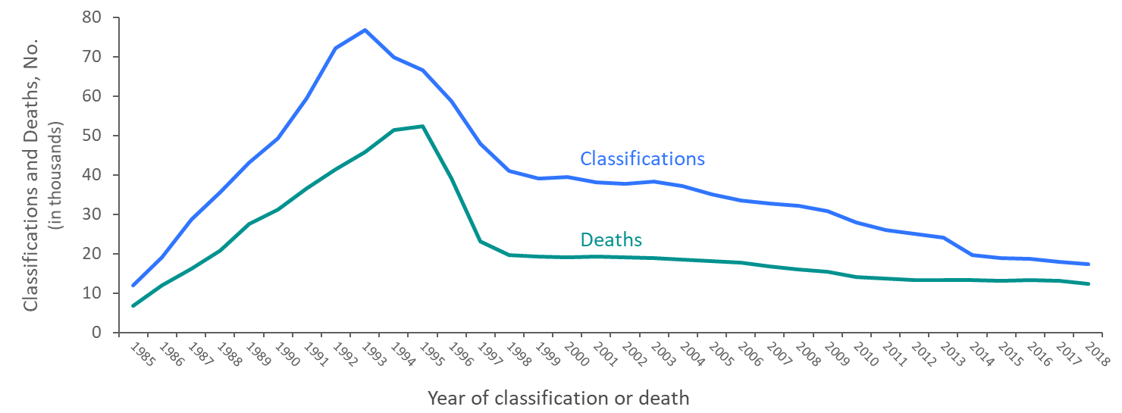
Stage 3 (AIDS) Classifications and Deaths of Persons with Diagnosed HIV Infection Ever Classified as Stage 3 (AIDS) among Adults and Adolescents 1985–2018—United States and 6 Dependent Areas
Note. Deaths of persons with HIV infection, stage 3 (AIDS) may be due to any cause.
Notes:
This slide presents from 1985 through 2018 in the United States and 6 dependent areas trends in the numbers of stage 3 (AIDS) classifications among adults and adolescents, and deaths of adults and adolescents with diagnosed HIV infection ever classified as stage 3 (AIDS). The overall declines in stage 3 (AIDS) classifications and deaths of persons with stage 3 (AIDS) are due to breakthroughs in early detection of HIV infection, improved screening technologies, advances in antiretroviral and combination drug therapies, prophylactic medications against opportunistic infections, and HIV prevention awareness campaigns.
The upper curve on the line graph represents the number of stage 3 (AIDS) classifications among adults and adolescents with diagnosed HIV infection in the United States and dependent areas, by year of classification from 1985 through 2018; the lower curve represents the number of deaths of adults and adolescents with diagnosed HIV infection ever classified with stage 3 (AIDS), by year of death from 1985 through 2018.
In recent years, stage 3 (AIDS) classifications and deaths of persons with stage 3 (AIDS) have remained stable.
Deaths of persons with stage 3 (AIDS) may be due to any cause (may not be HIV-related). Deaths of persons with stage 3 (AIDS) are classified as adult or adolescent based on age at death.

Slide 4
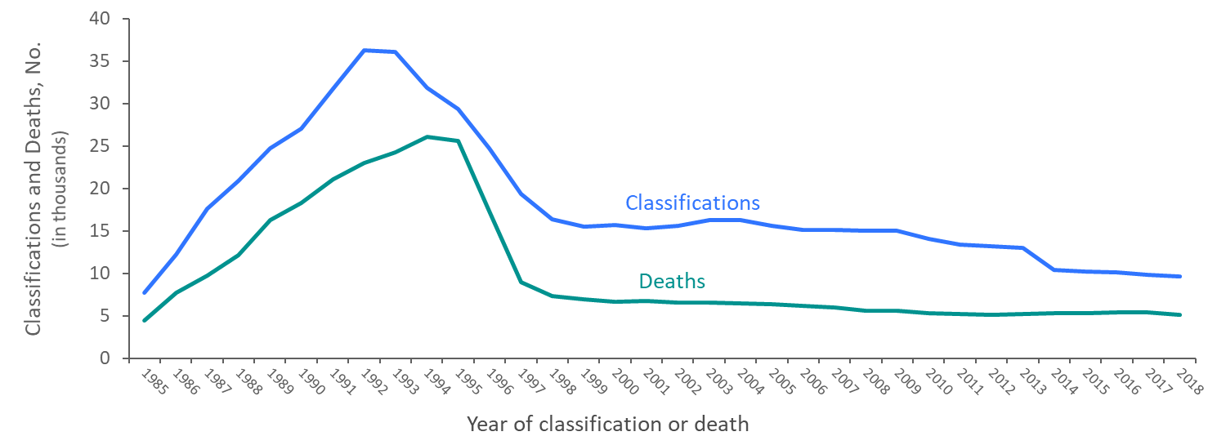
Stage 3 (AIDS) Classifications and Deaths of Persons with Stage 3 (AIDS) among Male Adults and Adolescents with Diagnosed HIV Infection Attributed to Male-to-Male Sexual Contact 1985–2018—United States and 6 Dependent Areas
Note. Deaths of persons with HIV infection, stage 3 (AIDS) may be due to any cause. Data have been statistically adjusted to account for missing transmission category. Data do not include males with HIV infection attributed to male-to-male sexual contact and injection drug use.
Notes:
This slide presents from 1985 through 2018 in the United States and 6 dependent areas trends in the numbers of stage 3 (AIDS) classifications and deaths of male adults and adolescents with stage 3 (AIDS) whose diagnosed HIV infection was attributed to male-to-male sexual contact.
Stage 3 (AIDS) classifications and deaths in males with HIV infection ever classified as stage 3 (AIDS), whose diagnosed HIV infection was attributed to male-to-male sexual contact, have declined steadily since 1999.
Deaths of persons with stage 3 (AIDS) may be due to any cause (may not be HIV-related). Persons with stage 3 (AIDS) who have died are classified as adult or adolescent based on age at death.
Data have been statistically adjusted to account for missing transmission category. Data on males with diagnosed HIV infection attributed to male-to-male sexual contact do not include males with infection attributed to male-to-male sexual contact and injection drug use.

Slide 5
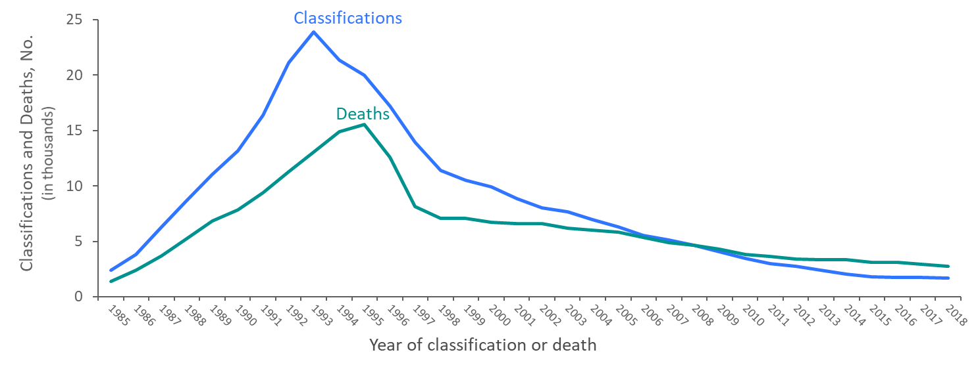
Stage 3 (AIDS) Classifications and Deaths of Persons with Stage 3 (AIDS) among Adults and Adolescents with Diagnosed HIV Infection Attributed to Injection Drug Use, 1985–2018—United States and 6 Dependent Areas
Note. Deaths of persons with HIV infection, stage 3 (AIDS) may be due to any cause. Data have been statistically adjusted to account for missing transmission category. Data do not include males with HIV infection attributed to male-to-male sexual contact and injection drug use.
Notes:
This slide presents from 1985 through 2018 in the United States and 6 dependent areas trends in the numbers of stage 3 (AIDS) classifications and deaths of adults and adolescents with diagnosed HIV ever classified as stage 3 (AIDS) whose HIV infection was attributed to injection drug use.
Stage 3 (AIDS) classifications and deaths of persons with stage 3 (AIDS) whose diagnosed HIV infection was attributed to injection drug use have declined steadily since 1998. The number of stage 3 (AIDS) classifications among this population fell below the number of deaths for the first time in 2009.
Deaths of persons with stage 3 (AIDS) may be due to any cause (may not be HIV-related). Persons with stage 3 (AIDS) who have died are classified as adult or adolescent based on age at death.
Data have been statistically adjusted to account for missing transmission category. Data on males with diagnosed HIV infection attributed to injection drug use do not include males with infection attributed to male-to-male sexual contact and injection drug use.

Slide 6
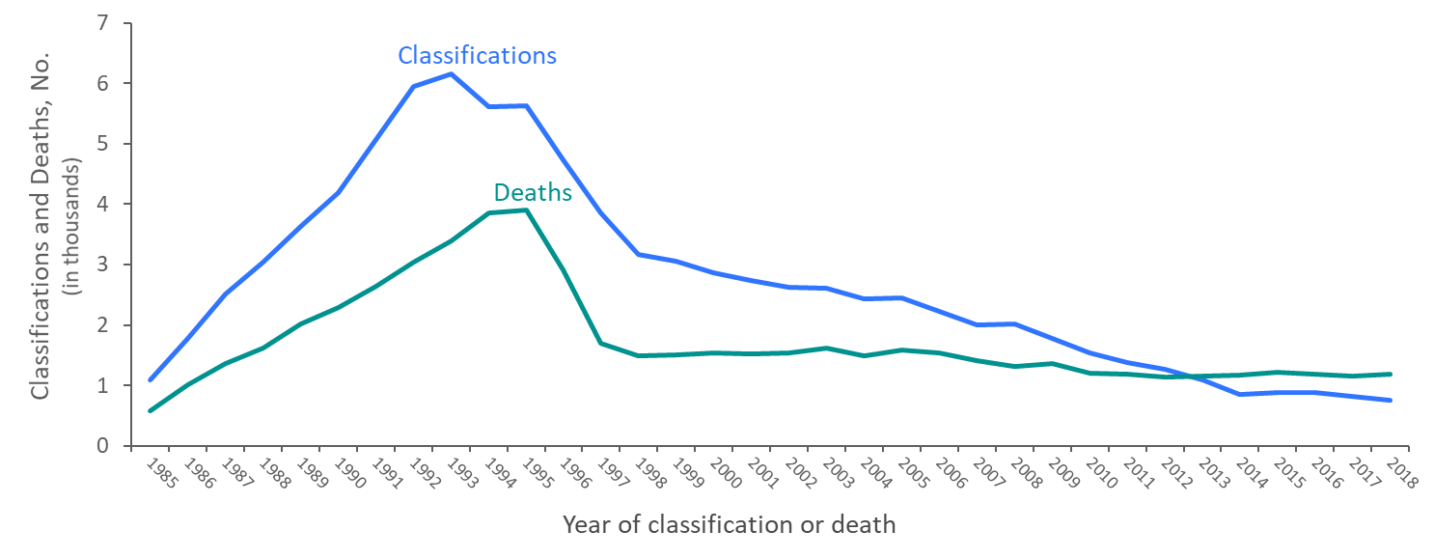
Stage 3 (AIDS) Classifications and Deaths of Persons with Stage 3 (AIDS) among Male Adults and Adolescents with Diagnosed HIV Infection Attributed to Male-to-Male Sexual Contact and Injection Drug Use, 1985–2018—United States and 6 Dependent Areas
Note. Deaths of persons with HIV infection, stage 3 (AIDS) may be due to any cause. Data have been statistically adjusted to account for missing transmission category.
Notes:
This slide presents from 1985 through 2018 in the United States and 6 dependent areas trends in the numbers of stage 3 (AIDS) classifications and deaths of persons with stage 3 (AIDS) among male adults and adolescents whose diagnosed HIV infection was attributed to male-to-male sexual contact and injection drug use.
Stage 3 (AIDS) classifications in males with HIV infection attributed to male-to-male sexual contact and injection drug use have declined slowly since 1998, while deaths have remained relatively stable.
Deaths of persons with stage 3 (AIDS) may be due to any cause (may not be HIV-related). Persons with stage 3 (AIDS) who have died are classified as adult or adolescent based on age at death.
Data have been statistically adjusted to account for missing transmission category.

Slide 7
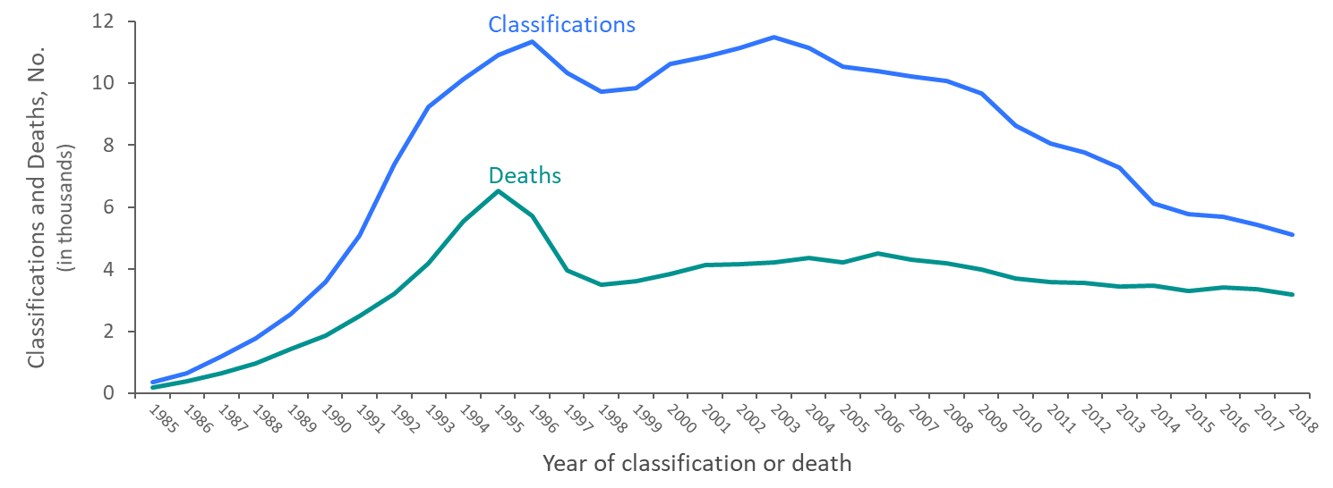
Stage 3 (AIDS) Classifications and Deaths of Persons with Stage 3 (AIDS) among Adults and Adolescents with Diagnosed HIV Infection Attributed to Heterosexual Contactª , 1985–2018—United States and 6 Dependent Areas
Note. Deaths of persons with HIV infection, stage 3 (AIDS) may be due to any cause. Data have been statistically adjusted to account for missing transmission category.
ª Heterosexual contact with a person known to have, or to be at high risk for, HIV infection.
Notes:
This slide presents from 1985 through 2018 in the United States and 6 dependent areas trends in the numbers of stage 3 (AIDS) classifications and deaths of adults and adolescents with HIV ever classified as stage 3 (AIDS) whose diagnosed HIV infection was attributed to heterosexual contact.
Though small declines in stage 3 (AIDS) classifications and deaths of persons with stage 3 (AIDS) were evident after the introduction of highly active antiretroviral therapies in 1996, stage 3 (AIDS) classifications among persons with diagnosed HIV infection attributed to heterosexual contact gradually increased from 1998 through 2003, and have slowly decreased since that time. Deaths also gradually increased from 1998 through 2006, and have slowly decreased since that time among persons with HIV infection attributed to heterosexual contact.
Deaths of persons with stage 3 (AIDS) may be due to any cause (may not be HIV-related). Persons with stage 3 (AIDS) who have died are classified as adult or adolescent based on age at death.
Data have been statistically adjusted to account for missing transmission category. Heterosexual contact is with a person known to have, or to be at high risk for, HIV infection.

Slide 8
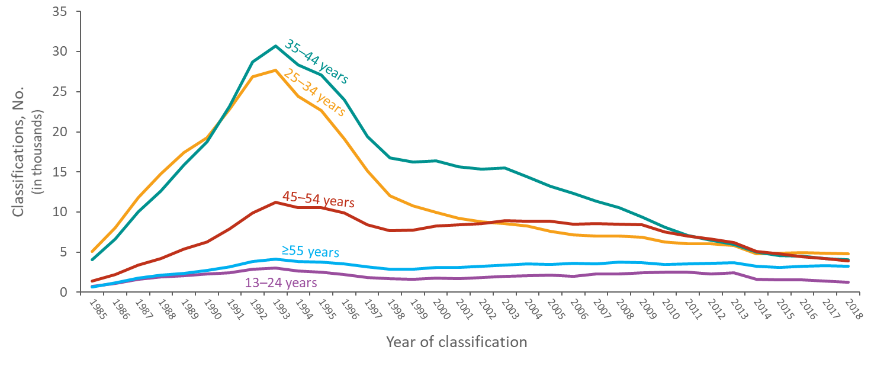
Stage 3 (AIDS) Classifications among Adults and Adolescents with Diagnosed HIV Infection, by Age and Year of Classification, 1985–2018 United States and 6 Dependent Areas
Notes:
This slide presents from 1985 through 2018 in the United States and 6 dependent areas trends in the numbers of stage 3 (AIDS) classifications by age group among adults and adolescents.
From 1985 through the early 1990’s the numbers of HIV infections classified as stage 3 (AIDS) among all age groups increased. During the early 1990’s the numbers of HIV infections classified as stage 3 (AIDS) among all age groups peaked during 1992–1993. Stage 3 (AIDS) classifications by each age group have declined steadily since 1993. The number of stage 3 (AIDS) classifications among adults and adolescents aged 35–44 years was the largest from 1991 through 2011. In most recent years, 2014 through 2018, the number of stage 3 (AIDS) classifications among adults and adolescents aged 25–34 years surpassed those aged 35–44 years as the largest age group.

Slide 9
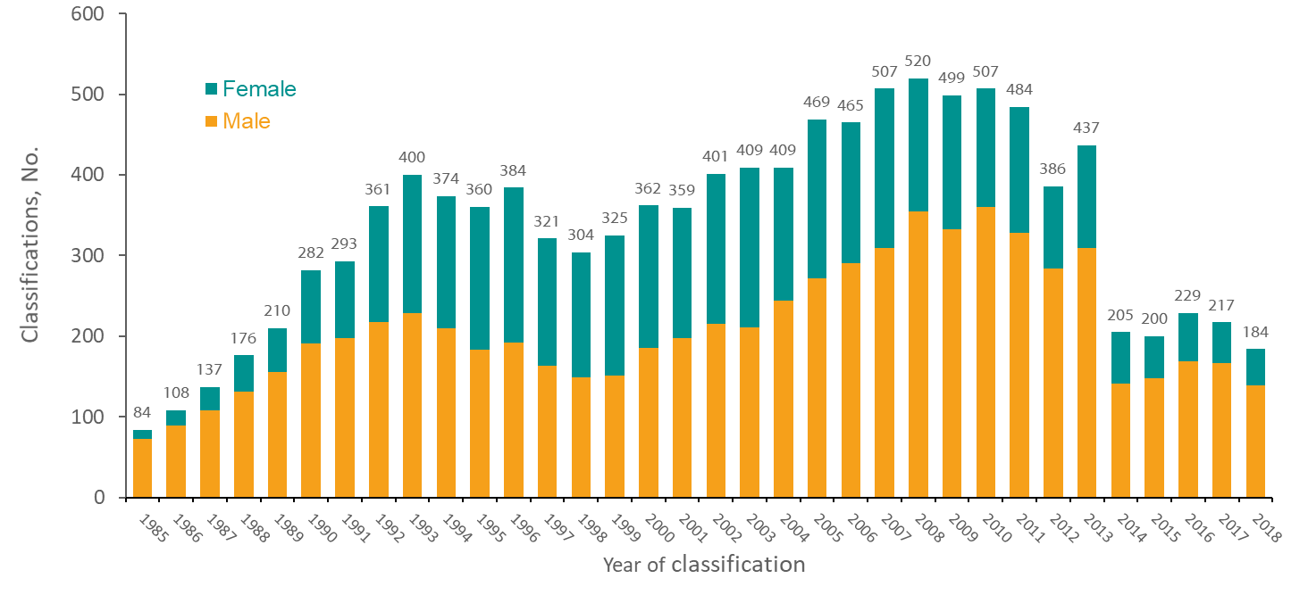
Stage 3 (AIDS) Classifications among Adolescents Aged 13–19 Years with Diagnosed HIV Infection, by Sex at Birth and Year of Classification, 1985–2018—United States and 6 Dependent Areas
Notes:
This slide presents from 1985 through 2018 in the United States and 6 dependent areas the number of adolescents aged 13–19 years with diagnosed HIV infection classified as stage 3 (AIDS) by sex at birth.
From 1985 through 2018, 11,368 adolescents aged 13–19 years had HIV infection that was classified as stage 3 (AIDS) in the United States and 6 dependent areas. In earlier years, most stage 3 (AIDS) classifications among adolescents were in males; over time, the male-to-female ratio decreased. In 2018, 184 adolescents were classified as stage 3 (AIDS); of these, 139 (76%) were male and 45 (24%) were female.

Slide 10
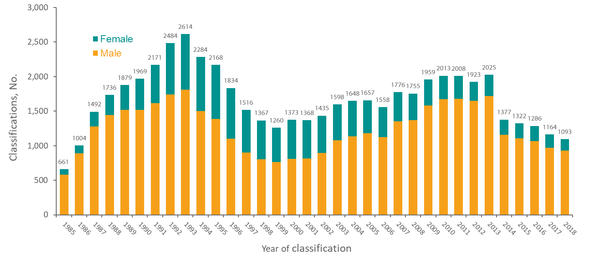
Stage 3 (AIDS) Classifications among Young Adults Aged 20–24 Years with Diagnosed HIV Infection, by Sex at Birth and Year of Classification, 1985–2018—United States and 6 Dependent Areas
Notes:
This slide presents from 1985 through 2018 in the United States and 6 dependent areas the number of young adults aged 20–24 years with diagnosed HIV infection classified as stage 3 (AIDS) by sex at birth.
From 1985 through 2018, a total of 56,777 young adults aged 20–24 years had HIV infection that was classified as stage 3 (AIDS) in the United States and 6 dependent areas. In 1985, 88% of stage 3 (AIDS) in young adults aged 20–24 years were in males. The percentage of stage 3 (AIDS) classifications in females peaked in 1993 at 31% and has decreased since that time. In 2018, 15% of the 1,093 stage 3 (AIDS) classifications in young adults were in females.

Slide 11
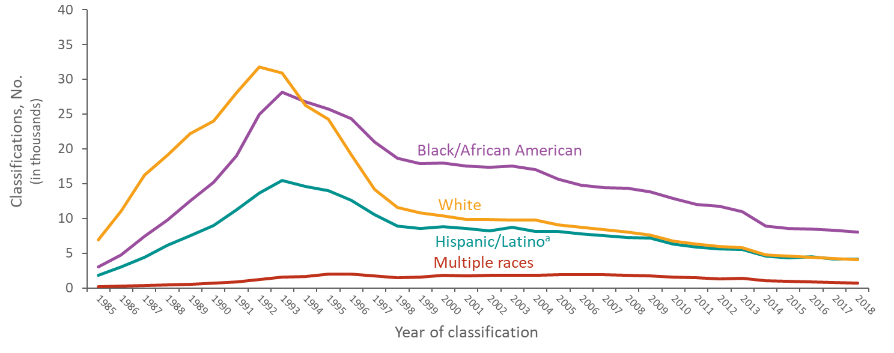
Stage 3 (AIDS) Classifications among Adults and Adolescents with Diagnosed HIV Infection, by Race/Ethnicity and Year of Classification, 1985–2018—United States and 6 Dependent Areas
ª Hispanics/Latinos can be of any race.
Notes:
This slide presents from 1985 through 2018 in the United States and 6 dependent areas trends in the numbers of diagnosed HIV infections classified as stage 3 (AIDS) among adults and adolescents by race/ethnicity. During the early 1990’s the numbers of HIV infections classified as stage 3 (AIDS) among whites, blacks/African Americans and Hispanics/Latinos increased, peaked during 1992–1993, and then decreased since that time. The annual number of stage 3 (AIDS) classifications in persons of multiple races has gradually increased since 1985, though in 2007, the number began to decrease. However, decreases were not consistent across races/ethnicities: stage 3 (AIDS) among blacks/African Americans surpassed whites for the first time in 1994 and has remained higher than all races/ethnicities since that time.
Hispanics/Latinos can be of any race.

Slide 12
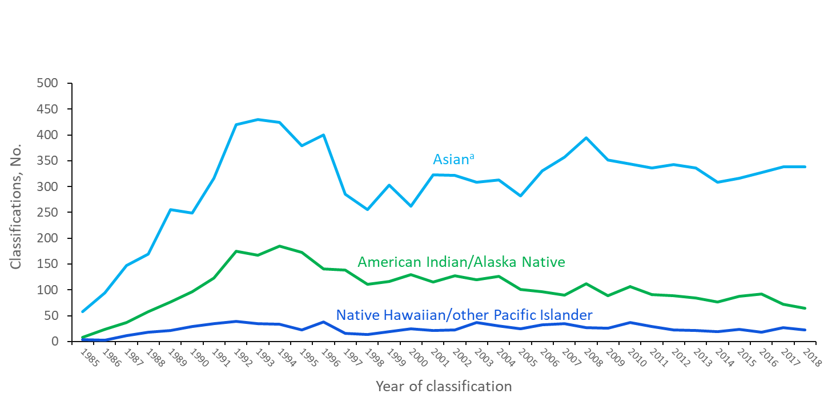
Stage 3 (AIDS) Classifications among Adults and Adolescents with Diagnosed HIV Infection, by Race/Ethnicity and Year of Classification, 1985–2018—United States and 6 Dependent Areas
ª Includes Asian/Pacific Islander legacy cases.
Notes:
This slide presents from 1985 through 2018 in the United States and 6 dependent areas trends in the numbers of stage 3 (AIDS) classifications among adults and adolescents. This slide shows data for only American Indians/Alaska Natives, Asians, and Native Hawaiians/other Pacific Islanders in order to focus on the trend lines for the populations with smaller numbers.
The annual number of stage 3 (AIDS) classifications for each race has increased since 1985. In 2018, each race accounted for 1% or less of stage 3 (AIDS) classifications overall.
The Asian category includes Asian/Pacific Islander legacy cases (cases that were diagnosed and reported under the pre-1997 Office of Management and Budget race/ethnicity classification system).

Slide 13
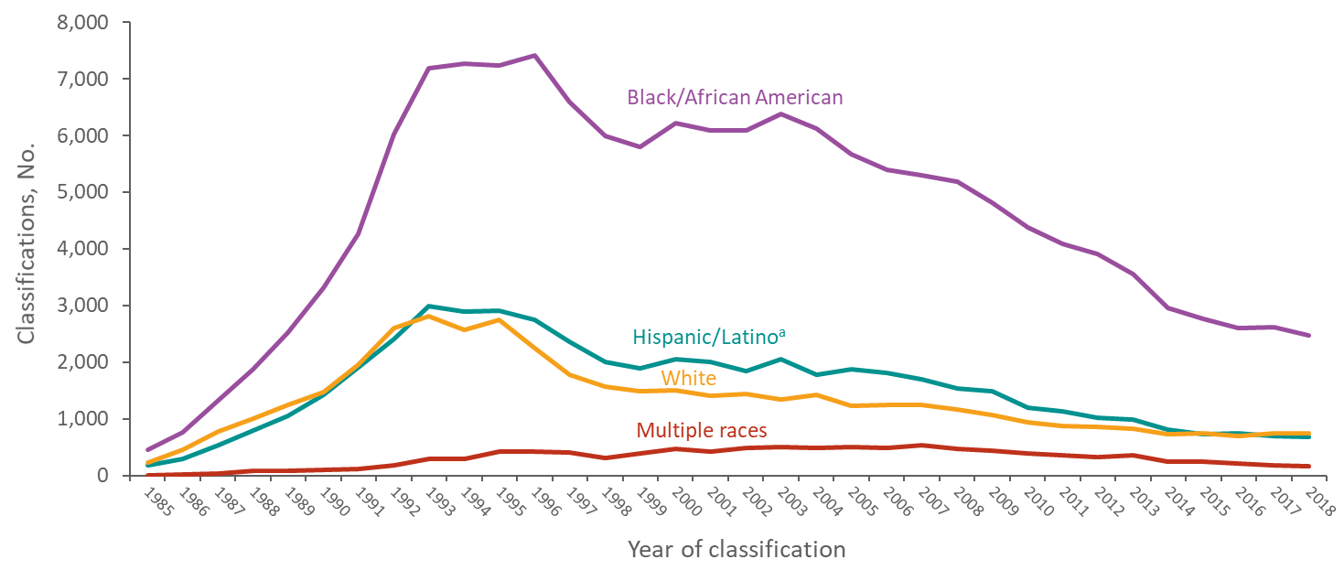
Stage 3 (AIDS) Classifications among Female Adults and Adolescents with Diagnosed HIV Infection, by Race/Ethnicity and Year of Classification 1985–2018—United States and 6 Dependent Areas
ª Hispanics/Latinos can be of any race.
Notes:
This slide presents from 1985 through 2018 in the United States and 6 dependent areas the numbers of HIV infections classified as stage 3 (AIDS) among female adults and adolescents by race/ethnicity. Black/African American females accounted for the largest numbers of stage 3 (AIDS) classifications each year among females, though the numbers have steadily decreased from 6,402 in 2003 to 2,612 in 2018. Annual numbers for White and Hispanic/Latino females, and females of multiple races, decreased between 2003 and 2018, although not as quickly as black/African American females.
Hispanics/Latinos can be of any race.

Slide 14
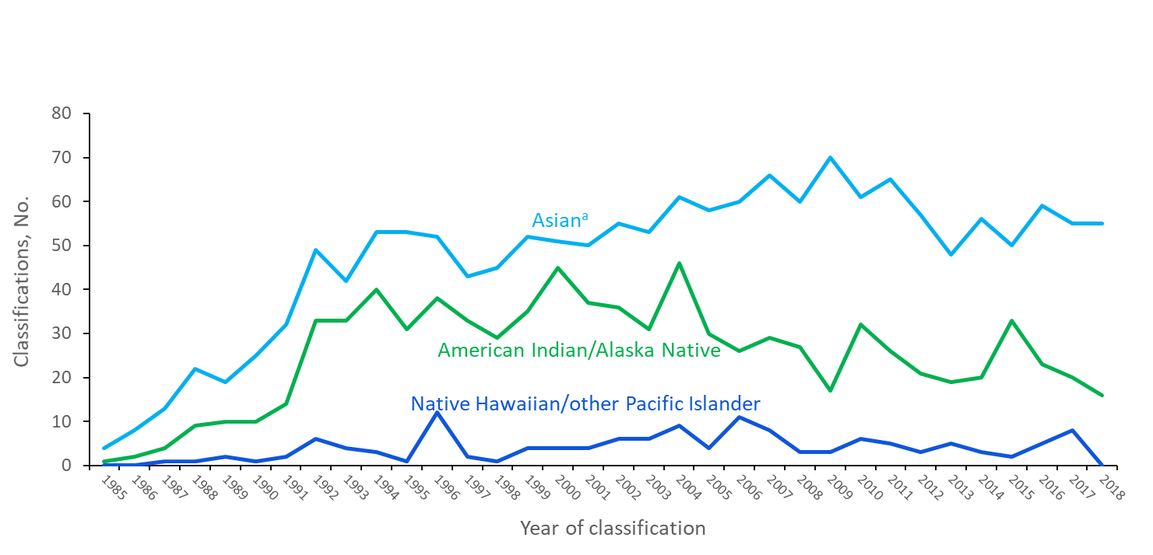
Stage 3 (AIDS) Classifications among Female Adults and Adolescents with Diagnosed HIV Infection, by Race/Ethnicity and Year of Classification 1985–2018—United States and 6 Dependent Areas
ª Includes Asian/Pacific Islander legacy cases.
Notes:
This slide presents from 1985 through 2018 in the United States and 6 dependent areas the numbers of HIV infections classified as stage 3 (AIDS) among female adults and adolescents by race/ethnicity. This slide shows data for only American Indians/Alaska Natives, Asians, and Native Hawaiians/other Pacific Islanders in order to focus on the trend lines for the populations with smaller numbers.
Since 1985, very few stage 3 (AIDS) classifications were among American Indian/Alaska Native, Asian, and Native Hawaiian/other Pacific Islander females. In 2018, each race accounted for less than 1% of stage 3 (AIDS) classifications among female adults and adolescents overall.
The Asian category includes Asian/Pacific Islander legacy cases (cases that were diagnosed and reported under the pre-1997 Office of Management and Budget race/ethnicity classification system).

Slide 15
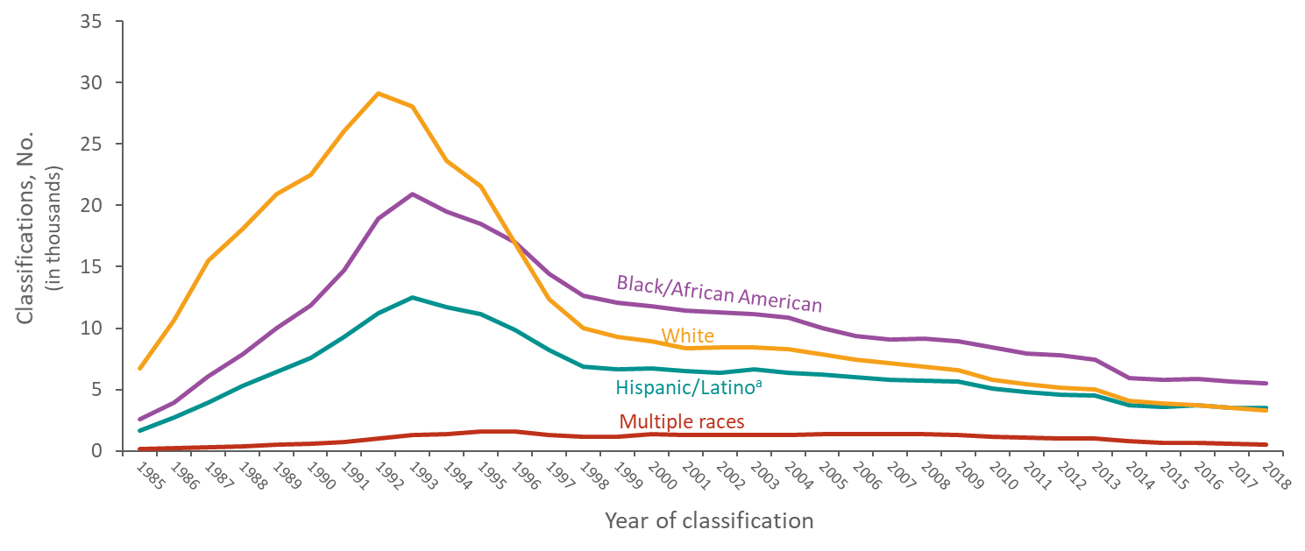
Stage 3 (AIDS) Classifications among Male Adults and Adolescents with Diagnosed HIV Infection, by Race/Ethnicity and Year of Classification 1985–2018—United States and 6 Dependent Areas
ª Hispanics/Latinos can be of any race.
Notes:
This slide presents from 1985 through 2018 in the United States and 6 dependent areas the numbers of HIV infections classified as stage 3 (AIDS) among male adults and adolescents by race/ethnicity. During the early 1990’s the numbers of HIV infections classified as stage 3 (AIDS) among white, black/African American and Hispanic/Latino males increased, peaked during 1992–1993, and then decreased since that time. The annual number of stage 3 (AIDS) classifications in males of multiple races has gradually increased since 1985, though in 2009, the number began to decrease.
Hispanics/Latinos can be of any race.

Slide 16
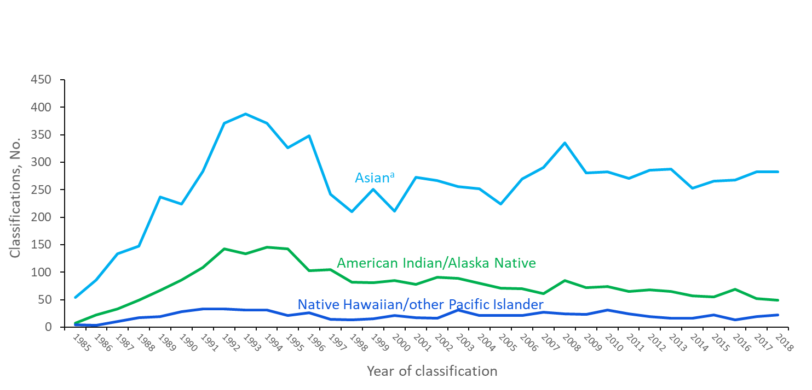
Stage 3 (AIDS) Classifications among Male Adults and Adolescents with Diagnosed HIV Infection, by Race/Ethnicity and Year of Classification 1985–2018—United States and 6 Dependent Areas
ª Includes Asian/Pacific Islander legacy cases.
Notes:
This slide presents from 1985 through 2018 in the United States and 6 dependent areas the numbers of HIV infections classified as stage 3 (AIDS) among male adults and adolescents by race/ethnicity. This slide shows data for only American Indians/Alaska Natives, Asians, and Native Hawaiians/other Pacific Islanders in order to focus on the trend lines for the populations with smaller numbers.
Since 1985, very few stage 3 (AIDS) classifications were among American Indian/Alaska Native, Asian, Native Hawaiian/other Pacific Islander males. In 2018, Asian males accounted for 2% of all stage 3 (AIDS) classifications among male adults and adolescents. American Indian/Alaska Native and Native Hawaiian/other Pacific Islander males each accounted for less than 1% of stage 3 (AIDS) classifications among male adults and adolescents overall.
The Asian category includes Asian/Pacific Islander legacy cases (cases that were diagnosed and reported under the pre-1997 Office of Management and Budget race/ethnicity classification system).

Slide 17
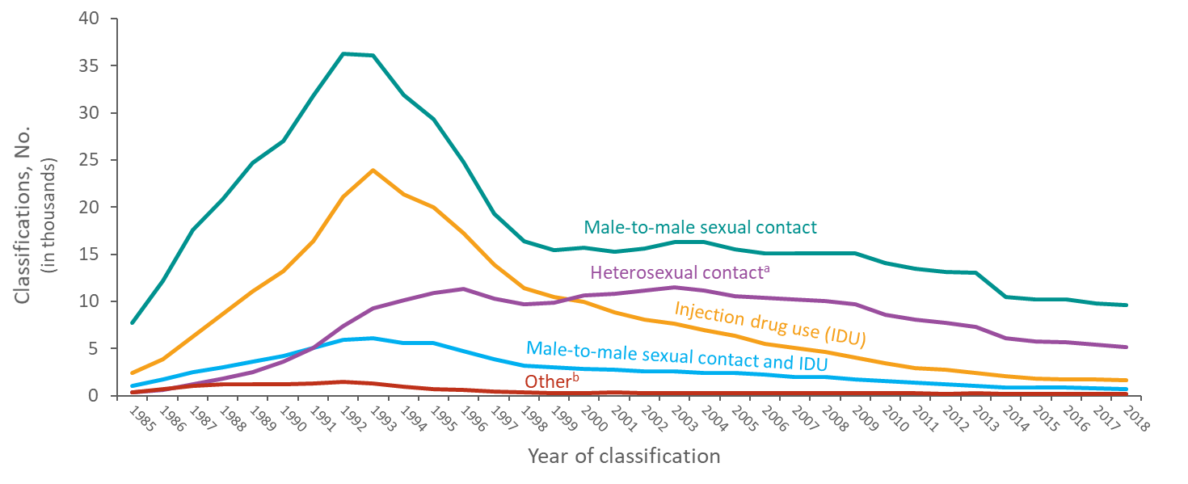
Stage 3 (AIDS) Classifications among Adults and Adolescents with Diagnosed HIV Infection, by Transmission Category and Year of Classification, 1985–2018 United States and 6 Dependent Areas
Note. Data have been statistically adjusted to account for missing transmission category.
ª Heterosexual contact with a person known to have, or to be at high risk for, HIV infection.
^{b} Includes hemophilia, blood transfusion, perinatal exposure, and risk factor not reported or not identified.
Notes:
This slide presents from 1985 through 2018 in the United States and 6 dependent areas the numbers of HIV infections classified as stage 3 (AIDS) among adults and adolescents by transmission category. Despite decreases, the number of HIV infections classified as stage 3 (AIDS) among persons with infection attributed to male-to-male sexual contact continues to represent the highest number of stage 3 (AIDS) classifications each year. Stage 3 (AIDS) classifications among persons with HIV infection attributed to injection drug use peaked in 1993 and have continued to decline since then. Stage 3 (AIDS) classifications among persons with HIV infection attributed to heterosexual contact increased through the mid-1990s and then remained stable until classifications started to decrease in 2004. Stage 3 (AIDS) among persons with HIV infection attributed to heterosexual contact surpassed the number of those attributed to injection drug use for the first time in 2000 and have continued to account for the second highest number of infections classified as stage 3 (AIDS) annually since that time.
Data have been statistically adjusted to account for missing transmission category.
Heterosexual contact is with a person known to have, or to be at high risk for, HIV infection.
The “Other” category includes hemophilia, blood transfusion, perinatal exposure, and risk factor not reported or not identified.

Slide 18
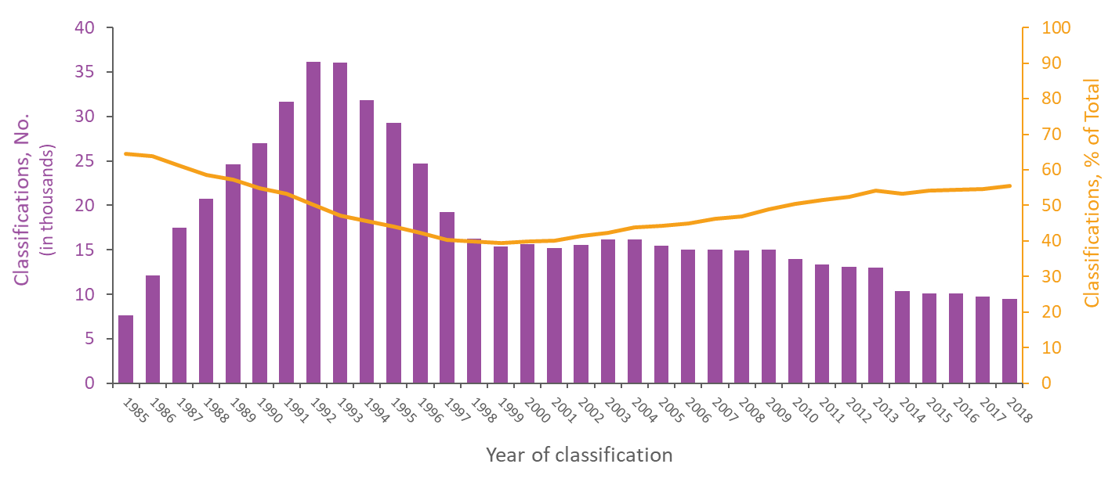
Stage 3 (AIDS) Classifications among Male Adults and Adolescents with Diagnosed HIV Infection Attributed to Male-to-Male Sexual Contact, 1985–2018 United States and 6 Dependent Areas
Note. Data have been statistically adjusted to account for missing transmission category. Data on males with diagnosed HIV infection attributed to male-to-male sexual contact do not include males with infection attributed to male-to-male sexual contact and injection drug use.
Notes:
This slide presents from 1985 through 2018 in the United States and 6 dependent areas the numbers and percentages of classifications of stage 3 (AIDS) among male adults and adolescents with diagnosed HIV infection attributed to male-to-male sexual contact. The number of stage 3 (AIDS) classifications among adults and adolescents with HIV infection attributed to male-to-male sexual contact peaked in 1992 and steadily decreased until 1999. Stage 3 (AIDS) classifications among male adults and adolescents with HIV infection attributed to male-to-male sexual contact have decreased since that time.
The line in this graph represents the percentages of all stage 3 (AIDS) classifications among male adults and adolescents with HIV infection attributed to male-to-male sexual contact. In 1985, stage 3 classifications among persons with HIV attributed to male-to-male sexual contact accounted for 65% of classifications among male adults and adolescents, but by 1997, accounted for 40%. In 2018, males with HIV attributed to male-to-male sexual contact accounted for 56% of all stage 3 (AIDS) among adults and adolescents.
Data have been statistically adjusted to account for missing transmission category.
Data on males with diagnosed HIV infection attributed to male-to-male sexual contact do not include males with infection attributed to male-to-male sexual contact and injection drug use.

Slide 19
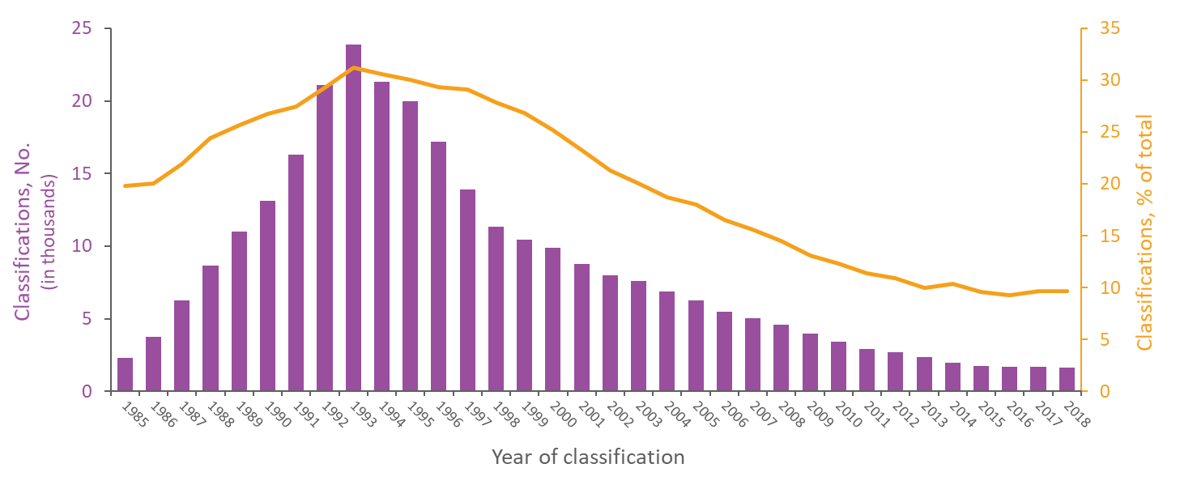
Stage 3 (AIDS) Classifications among Adults and Adolescents with Diagnosed HIV Infection Attributed to Injection Drug Use, 1985–2018—United States and 6 Dependent Areas
Note. Data have been statistically adjusted to account for missing transmission category. Data on diagnosed HIV infection attributed to injection drug use do not include males with infection attributed to male-to-male sexual contact and injection drug use.
Notes:
This slide presents from 1985 through 2018 in the United States and 6 dependent areas the numbers and percentages of HIV infections classified as stage 3 (AIDS) among adults and adolescents with diagnosed HIV attributed to injection drug use (IDU). The number of stage 3 (AIDS) classifications among adults and adolescents with HIV infection attributed to IDU peaked in 1993 and steadily decreased. The greatest number of stage 3 (AIDS) classifications among adults and adolescents with HIV infection attributed to IDU was 23,914 in 1993.
The line in this graph represents the percentages of all stage 3 (AIDS) classifications among adults and adolescents with HIV infection attributed to IDU. The percentages ranged from a minimum of 9% to a maximum of 31%: 20% in 1985 with a gradual increase through 1993; 31% in 1993; gradual decrease from 1994-onward; and approximately 10% in 2018.
Data have been statistically adjusted to account for missing transmission category.
Data on diagnosed HIV infection attributed to injection drug use do not include males with infection attributed to male-to-male sexual contact and injection drug use.

Slide 20
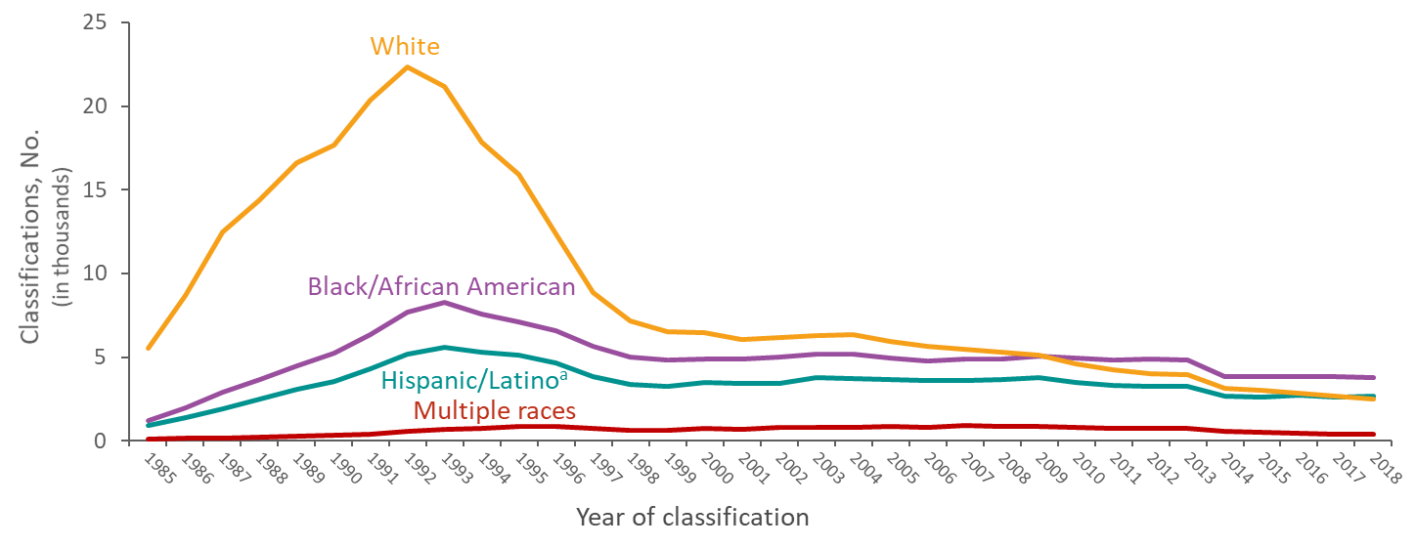
Stage 3 (AIDS) Classifications among Male Adults and Adolescents with Diagnosed HIV Infection Attributed to Male-to-Male Sexual Contact, by Race/Ethnicity and Year of Classification, 1985–2018—United States and 6 Dependent Areas
Note. Data have been statistically adjusted to account for missing transmission category. Data do not include males with HIV infection attributed to male-to-male sexual contact and injection drug use.
ª Hispanics/Latinos can be of any race.
Notes:
This slide presents from 1985 through 2018 in the United States and 6 dependent areas trends the numbers of stage 3 (AIDS) classifications among male adults and adolescents with diagnosed HIV infection attributed to male-to-male sexual contact by race/ethnicity.
Overall, stage 3 (AIDS) classifications among males with diagnosed HIV infection attributed to male-to-male sexual contact have remained relatively stable since 1999, though whites generally had higher numbers of stage 3 (AIDS) classifications each year than persons of other races/ethnicities. However, the number of stage 3 (AIDS) classifications among black/African American males surpassed that of white males for the first time in 2010 and has remained higher than all races/ethnicities since that time. The number of stage 3 (AIDS) classifications among Hispanic/Latino males surpassed that of white males for the first time in 2018. Stage 3 (AIDS) classifications among persons of multiple races have declined since 2009.
Data have been statistically adjusted to account for missing transmission category. Data on males with diagnosed HIV infection attributed to male-to-male sexual contact do not include males with infection attributed to male-to-male sexual contact and injection drug use.
Hispanics/Latinos can be of any race.

Slide 21
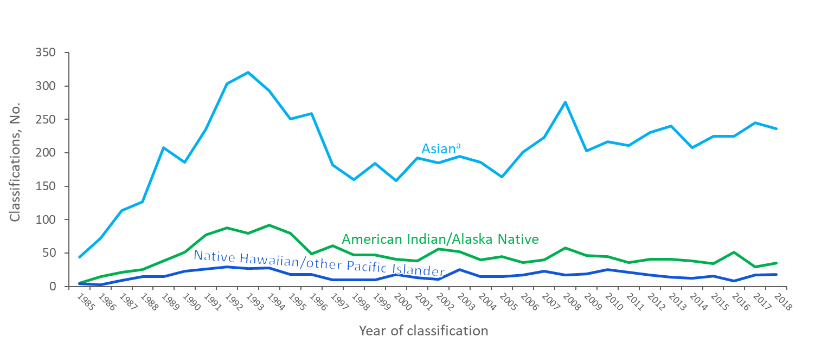
Stage 3 (AIDS) Classifications among Male Adults and Adolescents with Diagnosed HIV Infection Attributed to Male-to-Male Sexual Contact, by Race/Ethnicity and Year of Classification, 1985–2018—United States and 6 Dependent Areas
Note. Data have been statistically adjusted to account for missing transmission category. Data do not include males with HIV infection attributed to male-to-male sexual contact and injection drug use.
ª Includes Asian/Pacific Islander legacy cases.
Notes:
This slide presents from 1985 through 2018 in the United States and 6 dependent areas trends among male adults and adolescents with diagnosed HIV infection attributed to male-to-male sexual contact. This slide shows data for only American Indians/Alaska Natives, Asians, and Native Hawaiians/other Pacific Islanders in order to focus on the trend lines for the populations with smaller numbers.
Stage 3 (AIDS) classifications among Asian male adults and adolescents with diagnosed HIV infection attributed to male-to-male sexual contact have slowly increased since 1999, while stage 3 (AIDS) classifications among American Indians/Alaska Natives and Native Hawaiians/other Pacific Islander males have remained stable.
Data have been statistically adjusted to account for missing transmission category. Data on males with diagnosed HIV infection attributed to male-to-male sexual contact do not include males with infection attributed to male-to-male sexual contact and injection drug use.
The Asian category includes Asian/Pacific Islander legacy cases (cases that were diagnosed and reported under the pre-1997 Office of Management and Budget race/ethnicity classification system).

Slide 22
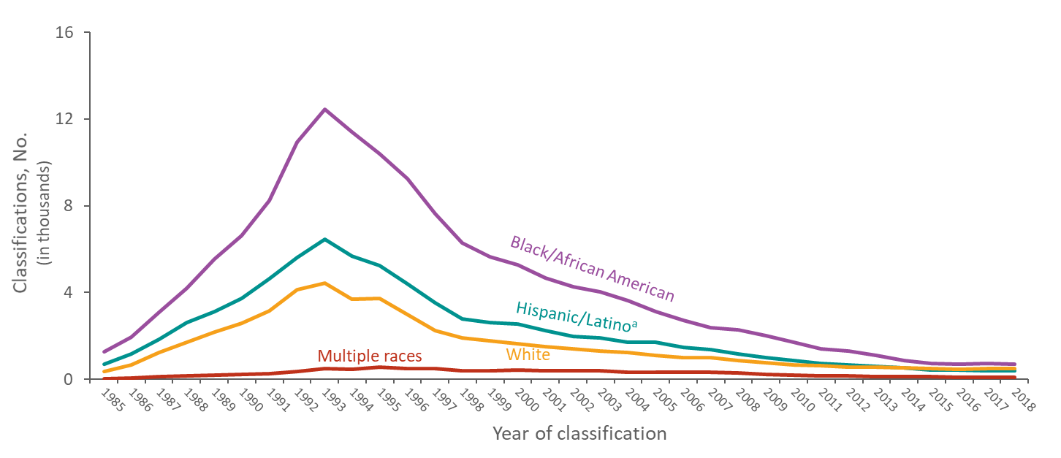
Stage 3 (AIDS) Classifications among Adults and Adolescents with Diagnosed HIV Infection Attributed to Injection Drug Use, by Race/Ethnicity and Year of Classification, 1985–2018—United States and 6 Dependent Areas
Note. Data have been statistically adjusted to account for missing transmission category. Data do not include males with HIV infection attributed to male-to-male sexual contact and injection drug use..
ª Hispanics/Latinos can be of any race.
Notes:
This slide presents from 1985 through 2018 in the United States and 6 dependent areas the racial/ethnic trends in diagnoses of HIV infection classified as stage 3 (AIDS) among adults and adolescents with diagnosed HIV infection attributed to injection drug use (IDU). Rates by race and ethnicity, important for understanding the impact of HIV on racial/ethnic groups, are not presented for persons with diagnosed HIV infection attributed to IDU because of the absence of denominator data from the U.S. Census Bureau (i.e., the denominator data used to compute rates come from the U.S. Census Bureau, but the U.S. Census Bureau does not collect data on IDU).
Noteworthy is the decline from 1993 through 2018 in stage 3 (AIDS) classifications among black/African American, Hispanic/Latino, and white PWID. Despite this decline, the largest number of stage 3 (AIDS) classifications among persons with diagnosed HIV infection attributed to IDU each year was in blacks/African Americans. The second largest number of stage 3 (AIDS) classifications among persons with diagnosed HIV infection attributed to IDU was in Hispanics/Latinos, followed by whites, except from 2014 to 2018 when whites surpassed Hispanics/Latinos. Stage 3 (AIDS) classifications among persons of multiple races have very few cases every year.
Data have been statistically adjusted to account for missing transmission category.
Data do not include males with HIV infection attributed to male-to-male sexual contact and injection drug use.
Hispanics/Latinos can be of any race.

Slide 23
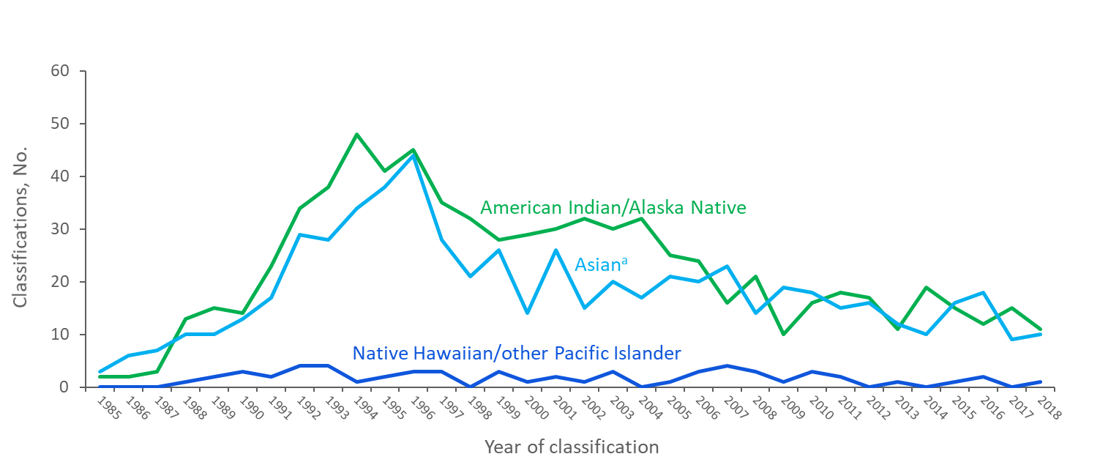
Stage 3 (AIDS) Classifications among Adults and Adolescents with Diagnosed HIV Infection Attributed to Injection Drug Use, by Race/Ethnicity and Year of Classification, 1985–2018—United States and 6 Dependent Areas
Note. Data have been statistically adjusted to account for missing transmission category. Data do not include males with HIV infection attributed to male-to-male sexual contact and injection drug use.
ª Includes Asian/Pacific Islander legacy cases.
Notes:
This slide presents from 1985 through 2018 in the United States and 6 dependent areas the racial/ethnic trends in diagnoses of HIV infection classified as stage 3 (AIDS) among adults and adolescents with diagnosed HIV infection attributed to injection drug use (IDU). This slide shows data for only American Indians/Alaska Natives, Asians, and Native Hawaiians/other Pacific Islanders in order to focus on the trend lines for the populations with smaller numbers. Rates by race and ethnicity, important for understanding the impact of HIV on racial/ethnic groups, are not presented for persons with diagnosed HIV infection attributed to IDU because of the absence of denominator data from the U.S. Census Bureau (i.e., the denominator data used to compute rates come from the U.S. Census Bureau, but the U.S. Census Bureau does not collect data on IDU). Since 1985, very few stage 3 (AIDS) classifications among persons with diagnosed HIV infection attributed to IDU were in American Indians/Alaska Natives, Asians, and Native Hawaiians/other Pacific Islanders.
Data have been statistically adjusted to account for missing transmission category.
Data do not include males with HIV infection attributed to male-to-male sexual contact and injection drug use.
The Asian category includes Asian/Pacific Islander legacy cases (cases that were diagnosed and reported under the pre-1997 Office of Management and Budget race/ethnicity classification system).

Slide 24
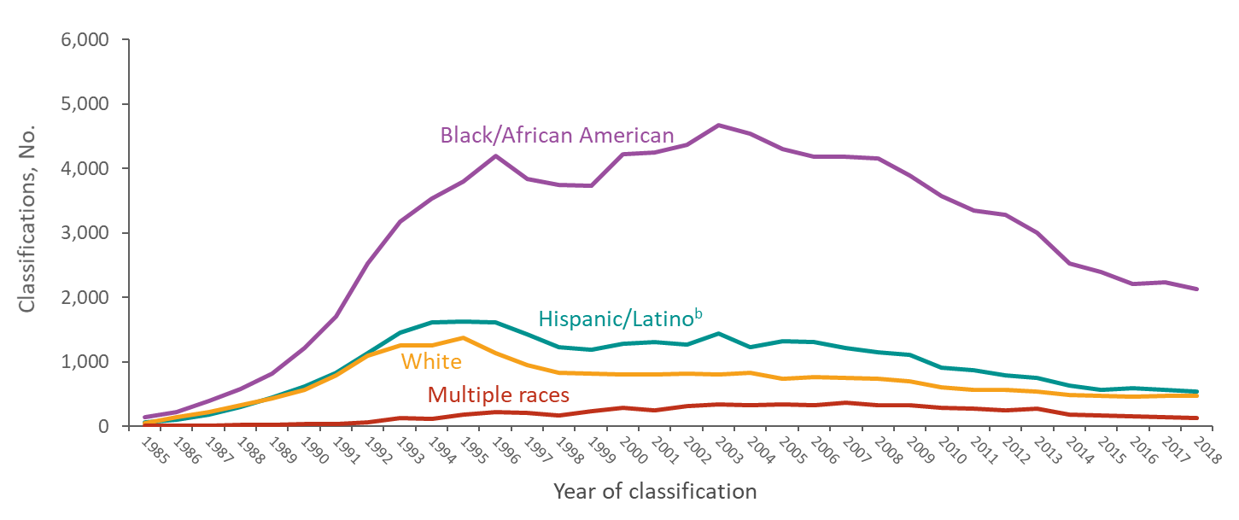
Stage 3 (AIDS) Classifications among Female Adults and Adolescents with Diagnosed HIV Infection Attributed to Heterosexual Contactª, by Race/Ethnicity and Year of Classification, 1985–2018 United States and 6 Dependent Areas
Note. Data have been statistically adjusted to account for missing transmission category.
ª Heterosexual contact with a person known to have, or to be at high risk for, HIV infection.
^{b} Hispanics/Latinos can be of any race.
Notes:
This slide presents from 1985 through 2018 in the United States and 6 dependent areas trends in the numbers of stage 3 (AIDS) classifications among female adults and adolescents whose diagnosed HIV infection was attributed to heterosexual contact by race/ethnicity.
Black/African American females are disproportionately affected by stage 3 (AIDS). The annual number of stage 3 (AIDS) classifications in black/African American females continued to increase after the introduction of highly active antiretroviral therapies in 1996, while stage 3 (AIDS) classifications among females of other races/ethnicities stabilized. Since 2003, the numbers of stage 3 (AIDS) classifications among black/African American females has slowly decreased, although these numbers are still much higher than those of other races/ethnicities.
Data have been statistically adjusted to account for missing transmission category.
Heterosexual contact is with a person known to have, or to be at high risk for, HIV infection.
Hispanics/Latinos can be of any race.

Slide 25
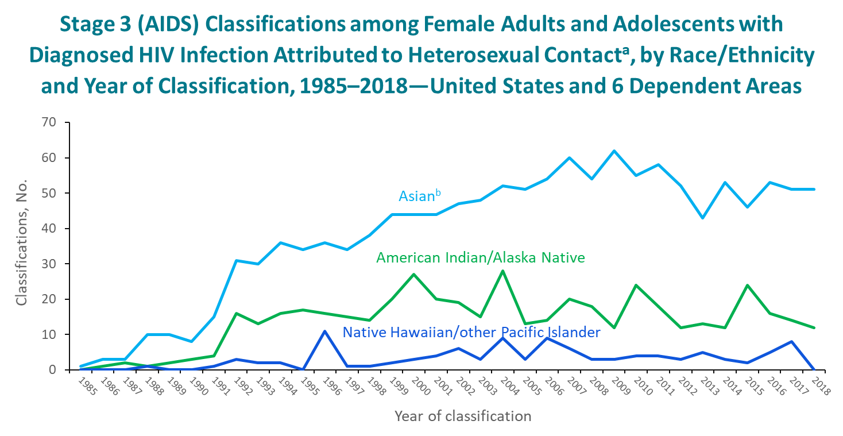
Note. Data have been statistically adjusted to account for missing transmission category.
ª Heterosexual contact with a person known to have, or to be at high risk for, HIV infection
^{b} Includes Asian/Pacific Islander legacy cases.
Notes:
This slide presents from 1985 through 2018 in the United States and 6 dependent areas trends in the numbers of stage 3 (AIDS) classifications among female adults and adolescents whose diagnosed HIV infection was attributed to heterosexual contact by race/ethnicity. This slide shows data for only American Indians/Alaska Natives, Asians, and Native Hawaiians/other Pacific Islanders in order to focus on the trend lines for the populations with smaller numbers.
Stage 3 (AIDS) classifications in females with diagnosed HIV infection attributed to heterosexual contact among Asians have gradually increased since 1992, while stage 3 (AIDS) classifications among American Indians/Alaska Natives and Native Hawaiians/other Pacific Islanders have more slowly increased. Since 1985, very few stage 3 (AIDS) classifications among females with diagnosed HIV infection attributed to heterosexual contact were in American Indians/Alaska Natives, Asians, and Native Hawaiians/other Pacific Islanders.
Data have been statistically adjusted to account for missing transmission category.
Heterosexual contact is with a person known to have, or to be at high risk for, HIV infection.
The Asian category includes Asian/Pacific Islander legacy cases (cases that were diagnosed and reported under the pre-1997 Office of Management and Budget race/ethnicity classification system).

Slide 26
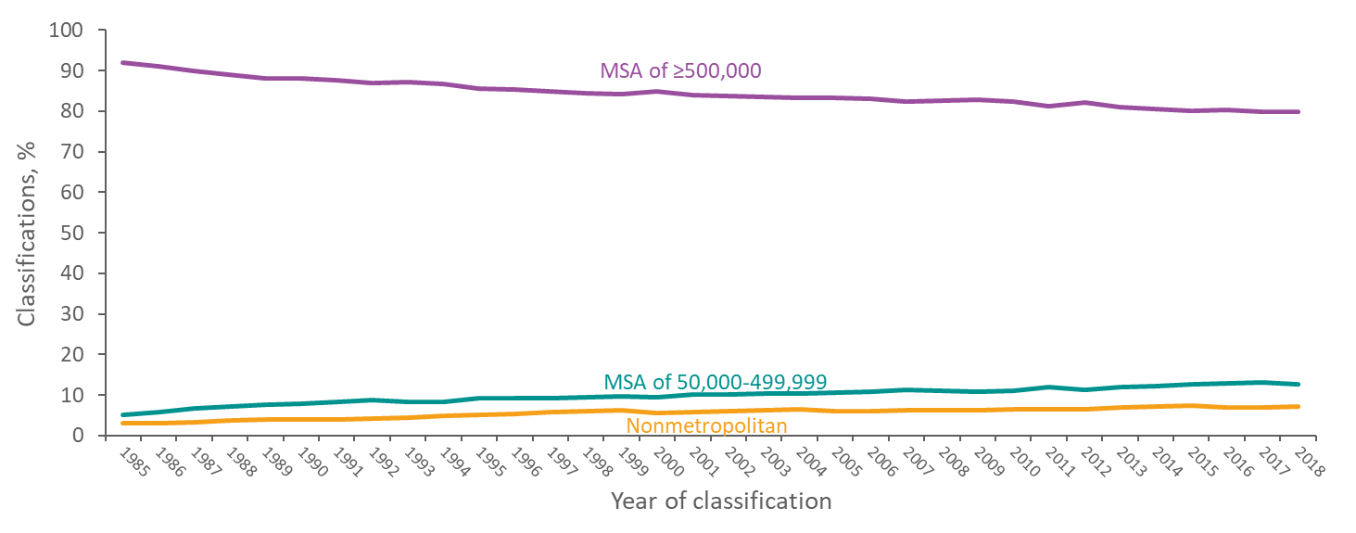
Stage 3 (AIDS) Classifications among Adults and Adolescents with Diagnosed HIV Infection, by Population of Area of Residence and Year of Classification 1985–2018—United States
Note. Data exclude persons whose county of residence is unknown.
Notes:
This slide presents from 1985 through 2018 in the United States percentages of HIV infections classified as stage 3 (AIDS) among adults and adolescents by population of area of residence. Those residing in areas with populations of 500,000 or more has decreased slowly since 1985. In 1985, 92% of all stage 3 (AIDS) classifications among adults and adolescents were in areas with populations of 500,000 or more, and in 2018, 80% of stage 3 (AIDS) classifications among adults and adolescents were in these areas. The decreasing trend in stage 3 (AIDS) classifications in the largest MSAs reflects the national trend of less immunosuppression at diagnosis, and a decreasing trend in the duration between the time of initial infection and diagnosis.
The inverse relationship between trends in areas with populations of 500,000 or more and less densely populated areas is in general due to introduction of HIV into heavily urbanized areas before introduction into suburban and rural areas. With less experience with HIV infection, residents of and clinicians in less urbanized areas may lag behind their more urban counterparts with respect to awareness of individual HIV risk and benefits of prevention steps such as routine HIV testing and PrEP access. Variations in population growth rates by area and population size also affect trends in percentage of infections by area.
MSA stands for metropolitan statistical area.
Data exclude persons whose county of residence is unknown.

Slide 27
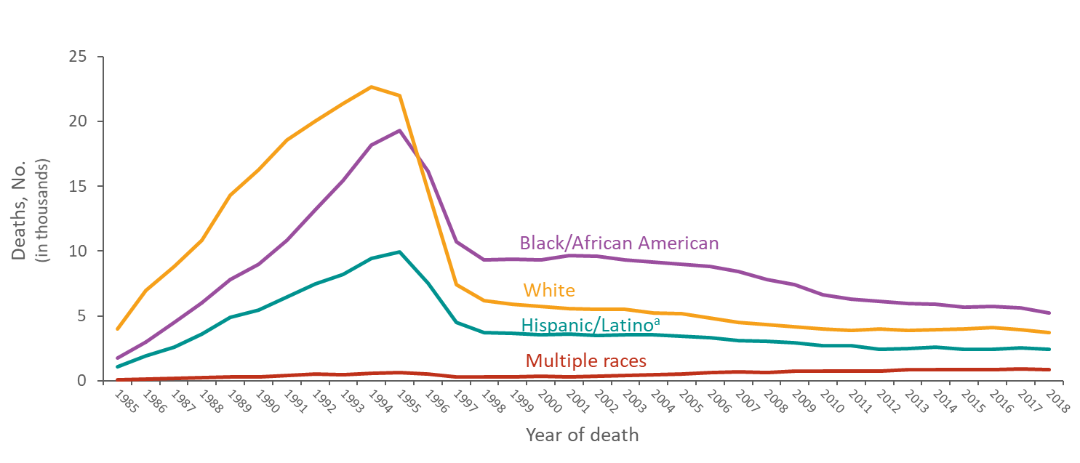
Deaths of Adults and Adolescents with Diagnosed HIV Infection Ever Classified as Stage 3 (AIDS), by Race/Ethnicity and Year of Classification, 1985–2018 United States and 6 Dependent Areas
Note. Deaths of persons with diagnosed HIV may be due to any cause.
ª Hispanics/Latinos can be of any race.
Notes:
This slide presents from 1985 through 2018 in the United States and 6 dependent areas trends in numbers of deaths of adults and adolescents with diagnosed HIV infection ever classified as stage 3 (AIDS) by race/ethnicity. The overall declines in deaths of persons with stage 3 (AIDS) are due to breakthroughs in early detection of HIV infection, improved screening technologies, advances in antiretroviral and combination drug therapies, prophylactic medications against opportunistic infections, and HIV prevention awareness campaigns.
For the first time in 1996, the number of deaths of adult and adolescent blacks/African Americans with stage 3 (AIDS) exceeded that of whites; since that time, the annual number of deaths of blacks/African Americans with stage 3 (AIDS) has continued to be higher than that of all other races/ethnicities. Increases since 2000 in the number of deaths for persons categorized as being of multiple races may reflect a change in U.S. federal policy allowing for the collection and reporting of data for persons using one or more race designations. For more information refer to the Office of Management and Budget’s 1997 Revisions to the standards for the classification of federal data on race and ethnicity at https://orwh.od.nih.gov/toolkit/other-relevant-federal-policies/OMB-standards.
Deaths of persons with stage 3 (AIDS) may be due to any cause (may not be HIV-related). Persons with stage 3 (AIDS) who have died are classified as adult or adolescent based on age at death.
Hispanics/Latinos can be of any race.

Slide 28
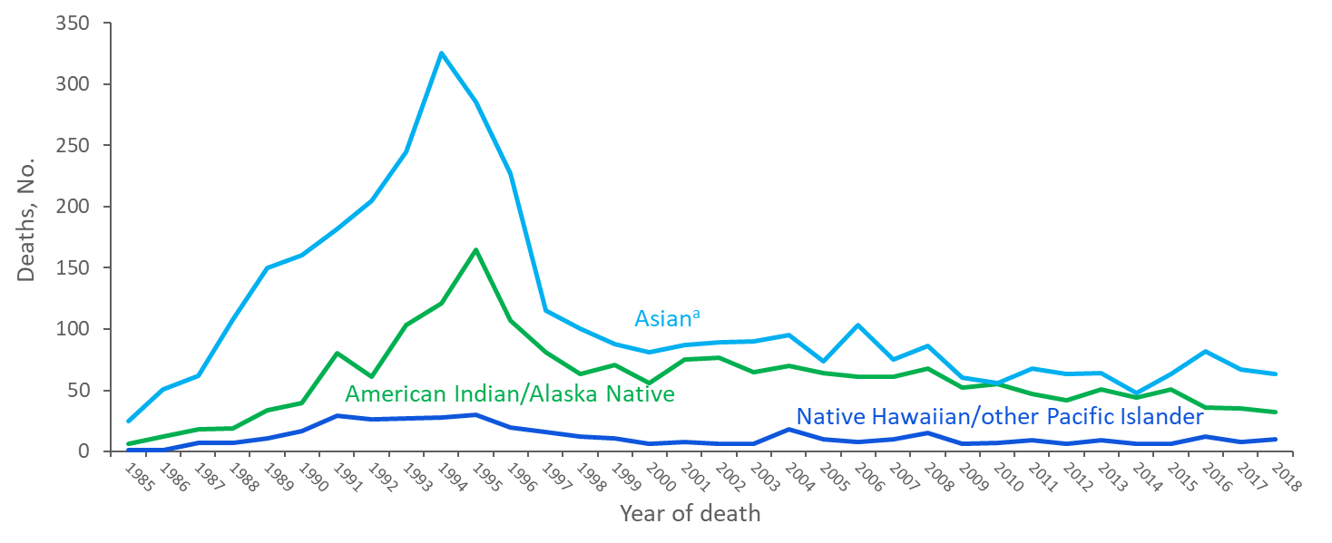
Deaths of Adults and Adolescents with Diagnosed HIV Infection Ever Classified as Stage 3 (AIDS), by Race/Ethnicity and Year of Classification, 1985–2018 United States and 6 Dependent Areas
Note. Deaths of persons with diagnosed HIV may be due to any cause.
ª Includes Asian/Pacific Islander legacy cases.
Notes:
This slide presents from 1985 through 2018 in the United States and 6 dependent areas trends in the numbers of deaths of adults and adolescents with diagnosed HIV infection ever classified as stage 3 (AIDS) by race/ethnicity. This slide shows data for only American Indians/Alaska Natives, Asians, and Native Hawaiians/other Pacific Islanders in order to focus on the trend lines for the populations with smaller numbers.
The overall declines in deaths of persons with stage 3 (AIDS) are due to breakthroughs in early detection of HIV infection, improved screening technologies, advances in antiretroviral and combination drug therapies, prophylactic medications against opportunistic infections, and HIV prevention awareness campaigns. Since the rapid decline in deaths from 1996–1998, the numbers of deaths remained relatively stable for American Indians/Alaska Natives, Asians, and Native Hawaiians/other Pacific Islanders. Deaths of persons with stage 3 (AIDS) may be due to any cause (may not be HIV-related). Persons with stage 3 (AIDS) who have died are classified as adult or adolescent based on age at death.
The Asian category includes Asian/Pacific Islander legacy cases (cases that were diagnosed and reported under the pre-1997 Office of Management and Budget race/ethnicity classification system).

Slide 29
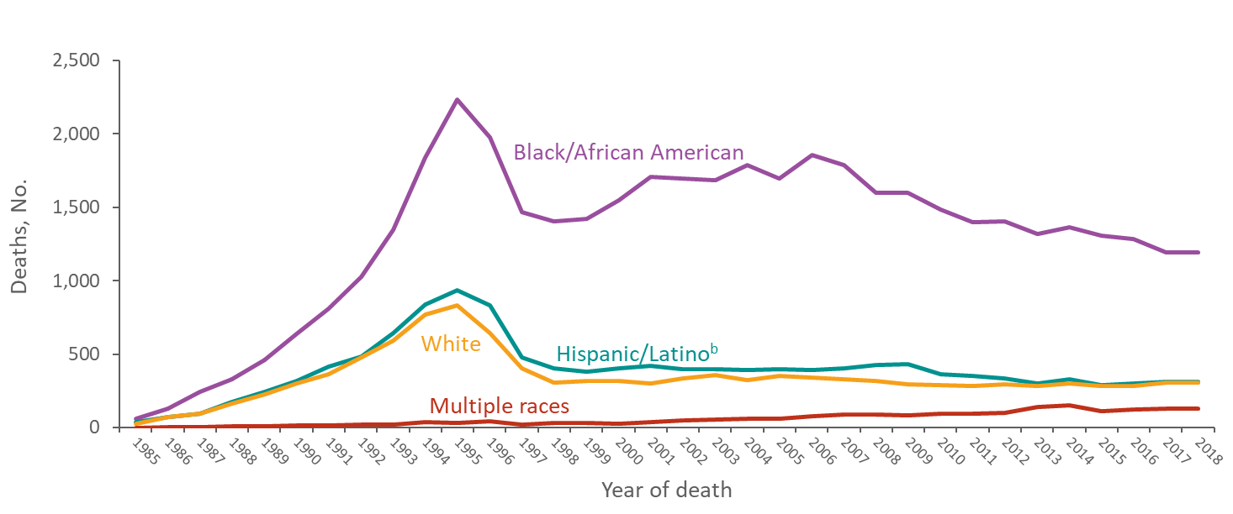
Deaths of Female Adults and Adolescents with Stage 3 (AIDS), among Females Diagnosed with HIV Infection Attributed to Heterosexual Contactª, by Race/Ethnicity and Year of Classification, 1985–2018—United States and 6 Dependent Areas
Note. Deaths of persons with diagnosed HIV may be due to any cause. Data have been statistically adjusted to account for missing transmission category.
ª Heterosexual contact with a person known to have, or to be at high risk for, HIV infection
^{b} Hispanics/Latinos can be of any race.
Notes:
This slide presents from 1985 through 2018 in the United States and 6 dependent areas trends in the numbers of deaths of female adults and adolescents with diagnosed HIV infection ever classified as stage 3 (AIDS) whose HIV infection was attributed to heterosexual contact by race/ethnicity.
Annual number of deaths in females with diagnosed HIV infection attributed to heterosexual contact among black/African Americans, whites and persons of multiple races gradually increased from 1998 to 2006, while deaths among Hispanic/Latino females remained relatively stable. Since 2006, the annual numbers of deaths among black/African American, Hispanic/Latino, and white females has decreased, while the annual numbers of deaths in females among persons of multiple races have increased.
Deaths of persons with stage 3 (AIDS) may be due to any cause (may not be HIV-related). Persons with stage 3 (AIDS) who have died are classified as adult or adolescent based on age at death. Data have been statistically adjusted to account for missing transmission category.
Heterosexual contact is with a person known to have, or to be at high risk for, HIV infection.
Hispanics/Latinos can be of any race.

Slide 30
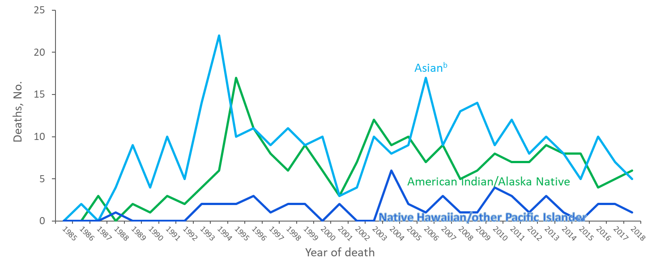
Deaths of Persons with Stage 3 (AIDS) among Female Adults and Adolescents with Diagnosed HIV Infection Attributed to Heterosexual Contactª, by Race/Ethnicity and Year of Classification, 1985–2018—United States and 6 Dependent Areas
Note. Deaths of persons with diagnosed HIV may be due to any cause. Data have been statistically adjusted to account for missing transmission category.
ª Heterosexual contact with a person known to have, or to be at high risk for, HIV infection.
^{b} Includes Asian/Pacific Islander legacy cases.
Notes:
This slide presents from 1985 through 2018 in the United States and 6 dependent areas trends in the numbers of deaths of female adults and adolescents with diagnosed HIV infection ever classified as stage 3 (AIDS) whose HIV infection was attributed to heterosexual contact by race/ethnicity. This slide shows data for only American Indians/Alaska Natives, Asians, and Native Hawaiians/other Pacific Islanders in order to focus on the trend lines for the populations with smaller numbers.
Since 1997, the annual number of deaths in females with diagnosed HIV infection attributed to heterosexual contact have remained relatively stable.
Deaths of persons with stage 3 (AIDS) may be due to any cause (may not be HIV-related). Persons with stage 3 (AIDS) who have died are classified as adult or adolescent based on age at death. Data have been statistically adjusted to account for missing transmission category.
Heterosexual contact is with a person known to have, or to be at high risk for, HIV infection.
The Asian category includes Asian/Pacific Islander legacy cases (cases that were diagnosed and reported under the pre-1997 Office of Management and Budget race/ethnicity classification system).

Slide 31
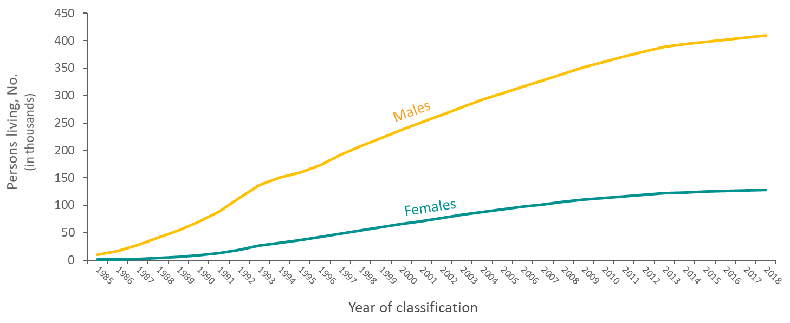
Adults and Adolescents Living with Diagnosed HIV Infection Ever Classified as Stage 3 (AIDS), by Sex at Birth and Year of Classification, 1985–2018 United States and 6 Dependent Areas
Notes:
This slide presents from 1985 through 2018 in the United States and 6 dependent areas trends in the numbers of adults and adolescents living with diagnosed HIV infection ever classified as stage 3 (AIDS) by sex at birth. The increase is due primarily to the widespread use of highly active antiretroviral therapy, introduced in 1996, which has delayed the progression of HIV infection to death. At the end of 2018, approximately 538,021 adults and adolescents were living with HIV infection ever classified as stage 3 (AIDS); of these, 76% were male and 24% were female.
Persons living with HIV infection ever classified as stage 3 (AIDS) are classified as adult or adolescent based on age at the end of the specified year.

Slide 32
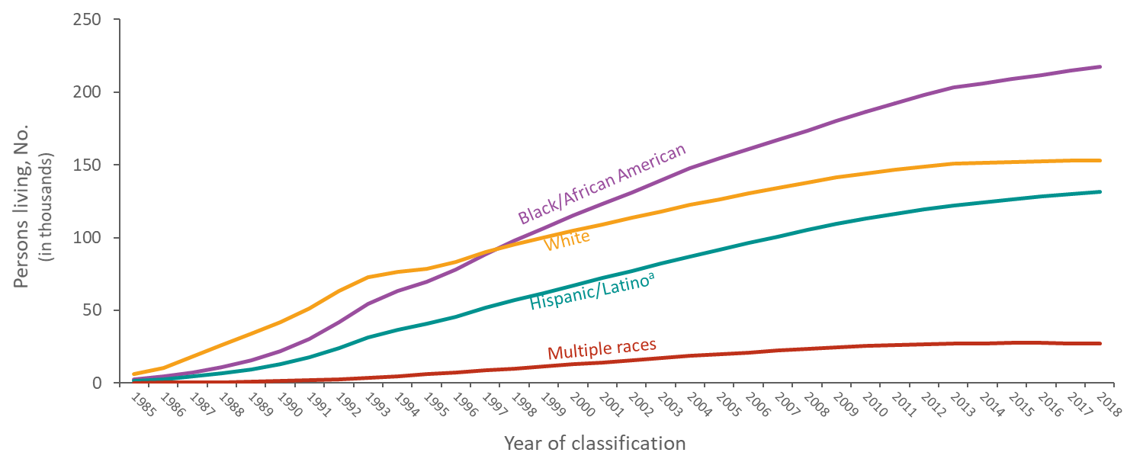
Adults and Adolescents Living with Diagnosed HIV Infection Ever Classified as Stage 3 (AIDS), by Race/Ethnicity and Year of Classification, 1985–2018 United States and 6 Dependent Areas
Note. Unknown race/ethnicity is not displayed because it comprises less than 1% of cases.
ª Hispanics/Latinos can be of any race.
Notes:
This slide presents from 1985 through 2018 in the United States and 6 dependent areas trends in the numbers of adults and adolescents living with diagnosed HIV infection ever classified as stage 3 (AIDS) by race/ethnicity.
From 1985 through 2018, the number of blacks/African Americans living with infection ever classified as stage 3 (AIDS) increased from 2,704 to 217,388. At the end of 1998, the number of blacks/African Americans living with infection ever classified as stage 3 (AIDS) exceeded the number of whites for the first time. From 1985 through 2018, the number of whites living with infection ever classified as stage 3 (AIDS) increased from 6,434 to 153,165; the number of Hispanics/Latinos increased from 1,556 to 131,620; the number of persons of multiple races increased from 172 to 27,140.
Hispanics/Latinos can be of any race.
Unknown race/ethnicity is not displayed because it comprises less than 1% of cases.

Slide 33
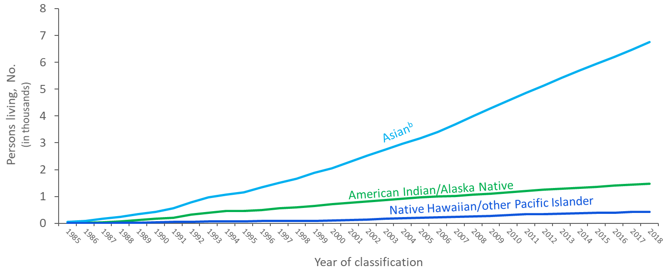
Adults and Adolescents Living with Diagnosed HIV Infection Ever Classified as Stage 3 (AIDS), by Race/Ethnicity and Year of Classification, 1985–2018 United States and 6 Dependent Areas
Note. Unknown race/ethnicity is not displayed because it comprises less than 1% of cases.
ª Includes Asian/Pacific Islander legacy cases.
Notes:
This slide presents from 1985 through 2018 in the United States and 6 dependent areas trends in the numbers of adults and adolescents living with diagnosed HIV infection ever classified as stage 3 (AIDS) by race/ethnicity. This slide shows data for only American Indians/Alaska Natives, Asians, and Native Hawaiians/other Pacific Islanders in order to focus on the trend lines for the populations with smaller numbers.
From 1985 through 2018, the number of Asians increased from 50 to 6,752; the number of American Indians/Alaska Natives increased from 3 to 1,484; and the number of Native Hawaiians/other Pacific Islanders increased from 3 to 432.
The Asian category includes Asian/Pacific Islander legacy cases (cases that were diagnosed and reported under the pre-1997 Office of Management and Budget race/ethnicity classification system).
Unknown race/ethnicity is not displayed because it comprises less than 1% of cases.

Slide 34
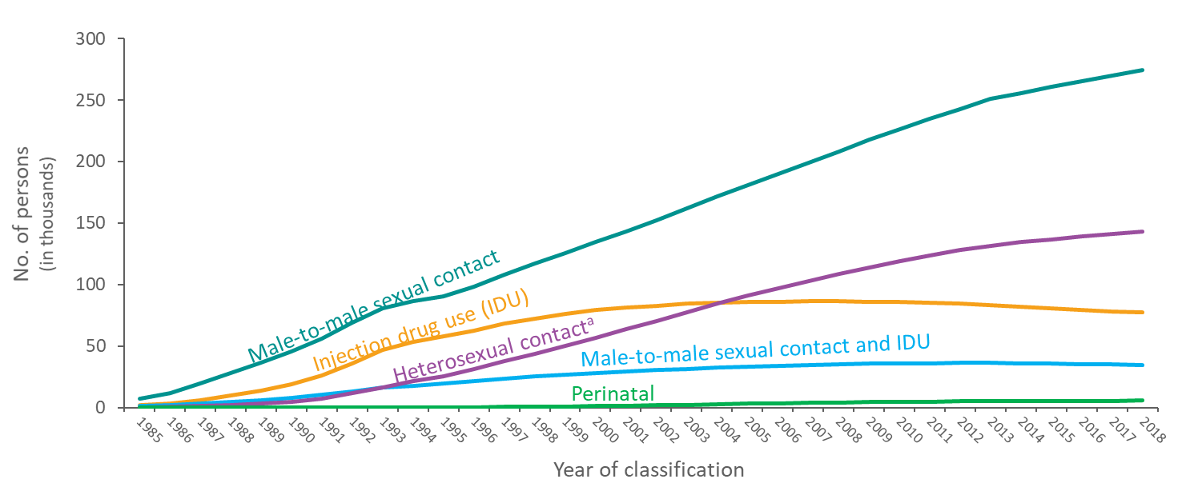
Adults and Adolescents Living with Diagnosed HIV Infection Ever Classified as Stage 3 (AIDS), by Transmission Category and Year of Classification 1985–2018—United States and 6 Dependent Areas
Note. Data have been statistically adjusted to account for missing transmission category. “Other” transmission category not displayed as it comprises 1% or less of cases.
ª Heterosexual contact with a person known to have, or to be at high risk for, HIV infection.
Notes:
This slide presents from 1985 through 2018 in the United States and 6 dependent areas trends in the numbers of adults and adolescents living with diagnosed HIV infection ever classified as stage 3 (AIDS) by transmission category. While increases have occurred for all transmission categories, persons with HIV infection attributed to male-to-male sexual contact have continued to account for the largest numbers of persons living with stage 3 (AIDS). The “Other” transmission category is not displayed as it comprises less than 1% of cases. The category includes hemophilia, blood transfusion, and risk factor not reported or not identified.
Data have been statistically adjusted to account for missing transmission category. Persons living with stage 3 (AIDS) are classified as adult or adolescent based on age at the end of the specified year.
Heterosexual contact is with a person known to have, or to be at high risk for, HIV infection.
Perinatal exposure includes persons who were exposed to HIV perinatally, but were aged 13 years and older at the end of the specified year.

Slide 35
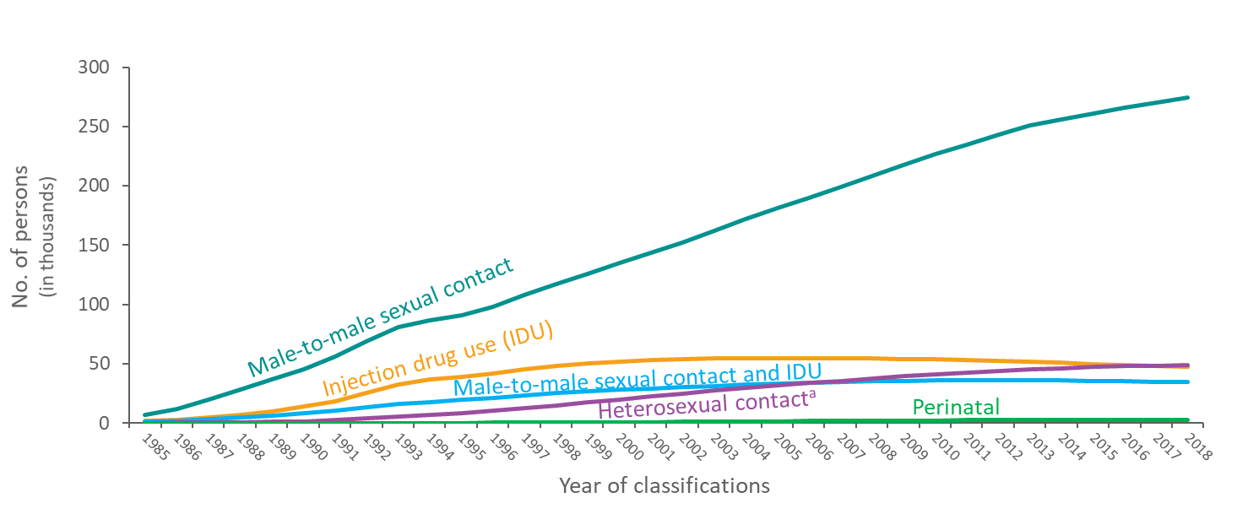
Male Adults and Adolescents Living with Diagnosed HIV Infection Ever Classified as Stage 3 (AIDS), by Transmission Category and Year of Classification, 1985–2018 United States and 6 Dependent Areas
Note. Data have been statistically adjusted to account for missing transmission category. “Other” transmission category not displayed as it comprises 1% or less of cases.
ª Heterosexual contact with a person known to have, or to be at high risk for, HIV infection.
Notes:
This slide presents from 1985 through 2018 in the United States and 6 dependent areas trends in the numbers of male adults and adolescents living with diagnosed HIV infection ever classified as stage 3 (AIDS) by transmission category. While increases have occurred for all transmission categories, males with diagnosed HIV infection attributed to male-to-male sexual contact have continued to account for the largest numbers of males living with stage 3 (AIDS). The “Other” transmission category is not displayed as it comprises less than 1% of cases. The category includes hemophilia, blood transfusion, and risk factor not reported or not identified.
Data have been statistically adjusted to account for missing transmission category. Persons living with stage 3 (AIDS) are classified as adult or adolescent based on age at the end of the specified year.
Heterosexual contact is with a person known to have, or to be at high risk for, HIV infection.
Perinatal exposure includes persons who were exposed to HIV perinatally, but were aged 13 years and older at the end of the specified year.

Slide 36
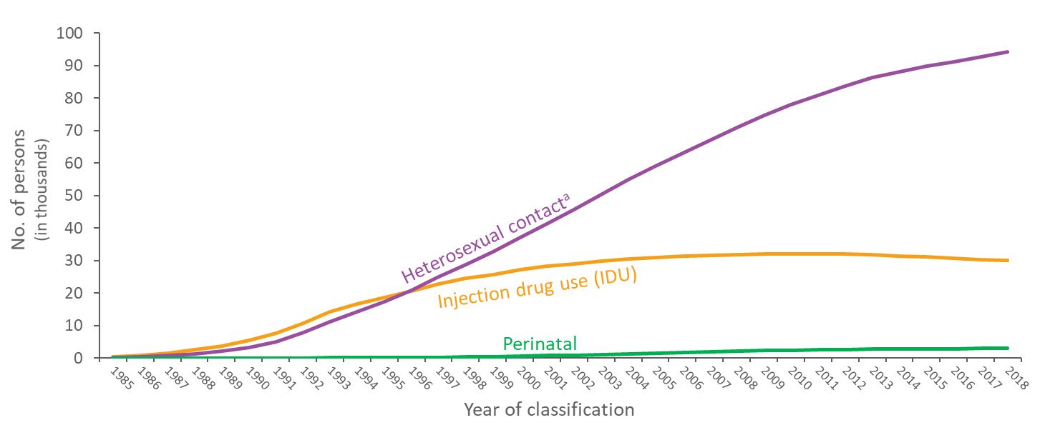
Female Adults and Adolescents Living with Diagnosed HIV Infection Ever Classified as Stage 3 (AIDS), by Transmission Category and Year of Classification, 1985–2018 United States and 6 Dependent Areas
Note. Data have been statistically adjusted to account for missing transmission category. “Other” transmission category not displayed as it comprises 1% or less of cases.
ª Heterosexual contact with a person known to have, or to be at high risk for, HIV infection.
Notes:
This slide presents from 1985 through 2018 in the United States and 6 dependent areas trends in the numbers of female adults and adolescents living with diagnosed HIV infection ever classified as stage 3 (AIDS) by transmission category. While increases have occurred for all transmission categories, the largest increase during this time has been among females with diagnosed HIV infection attributed to heterosexual contact. The “Other” transmission category is not displayed as it comprises less than 1% of cases. The category includes hemophilia, blood transfusion, and risk factor not reported or not identified.
Data have been statistically adjusted to account for missing transmission category. Persons living with stage 3 (AIDS) are classified as adult or adolescent based on age at the end of the specified year.
Heterosexual contact is with a person known to have, or to be at high risk for, HIV infection.
Perinatal exposure includes persons who were exposed to HIV perinatally, but were aged 13 years and older at the end of the specified year.

Slide 37
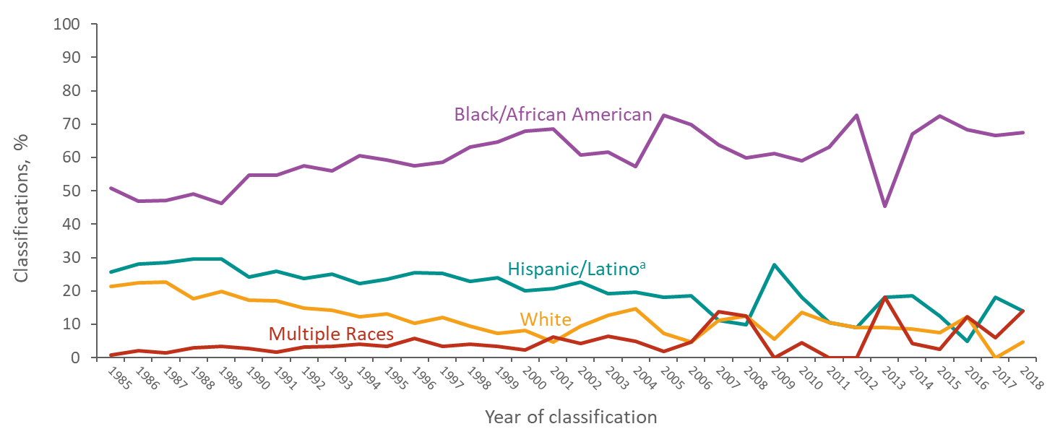
Stage 3 (AIDS) Classifications among Children Aged <13 Years with Diagnosed HIV Infection, by Race/Ethnicity and Year of Classification, 1985–2018 United States and 6 Dependent Areas
ª Hispanics/Latinos can be of any race.
Notes:
This slide presents from 1985 through 2018 in the United States and 6 dependent areas the percentages in the numbers of stage 3 (AIDS) classifications among children aged less than 13 years. Black/African American children have been disproportionately affected by stage 3 (AIDS) compared to children of other races and ethnicities. Although the percentages of stage 3 (AIDS) classifications among children have varied over the years for each race/ethnicity, the percentage of black/African American children with HIV infection classified as stage 3 (AIDS) has been consistently higher than that of any other race/ethnicity. Implementation of CD4-based criteria for stage 3 (AIDS) among children aged less than 13 years resulted in a large increase in the num­ber of stage 3 (AIDS) classifications among pediatric cases diagnosed during 2014. Before implementation of the 2014 revised case definition, an opportunistic illness (OI) diagnosis was required for a pediatric case to meet the criteria for stage 3 classification.
Hispanics/Latinos can be of any race.
Please use caution when interpreting trend data for children aged less than 13 years with diagnosed HIV infection: the numbers are small.

Slide 38
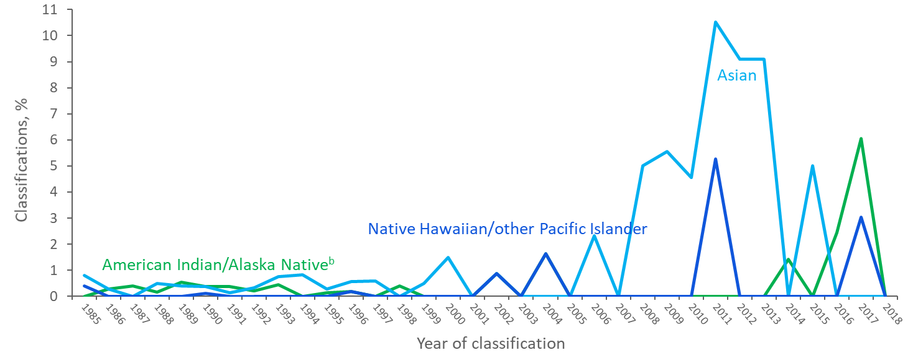
Stage 3 (AIDS) Classifications among Children Aged <13 Years with Diagnosed HIV Infection, by Race/Ethnicity and Year of Classification, 1985–2018 United States and 6 Dependent Areas
^{b} Includes Asian/Pacific Islander legacy cases.
Notes:
This slide presents from 1985 through 2018 in the United States and 6 dependent areas the percentages in the numbers of stage 3 (AIDS) classifications among children aged less than 13 years. This slide shows data for only American Indians/Alaska Natives, Asians, and Native Hawaiians/other Pacific Islanders in order to focus on the trend lines for the populations with smaller numbers.
The annual percentages of stage 3 (AIDS) classifications among children have remained relatively stable. Although the percentages of stage 3 (AIDS) classifications among children have varied, more variability is seen in more recent years. Implementation of CD4-based criteria for stage 3 (AIDS) among children aged less than 13 years resulted in a large increase in the num­ber of stage 3 (AIDS) classifications among pediatric cases diagnosed during 2014. Before implementation of the 2014 revised case definition, an opportunistic illness (OI) diagnosis was required for a pediatric case to meet the criteria for stage 3 classification.
Please use caution when interpreting trend data for children aged less than 13 years with diagnosed HIV infection: the numbers are small.
The Asian category includes Asian/Pacific Islander legacy cases (cases that were diagnosed and reported under the pre-1997 Office of Management and Budget race/ethnicity classification system).

Slide 39
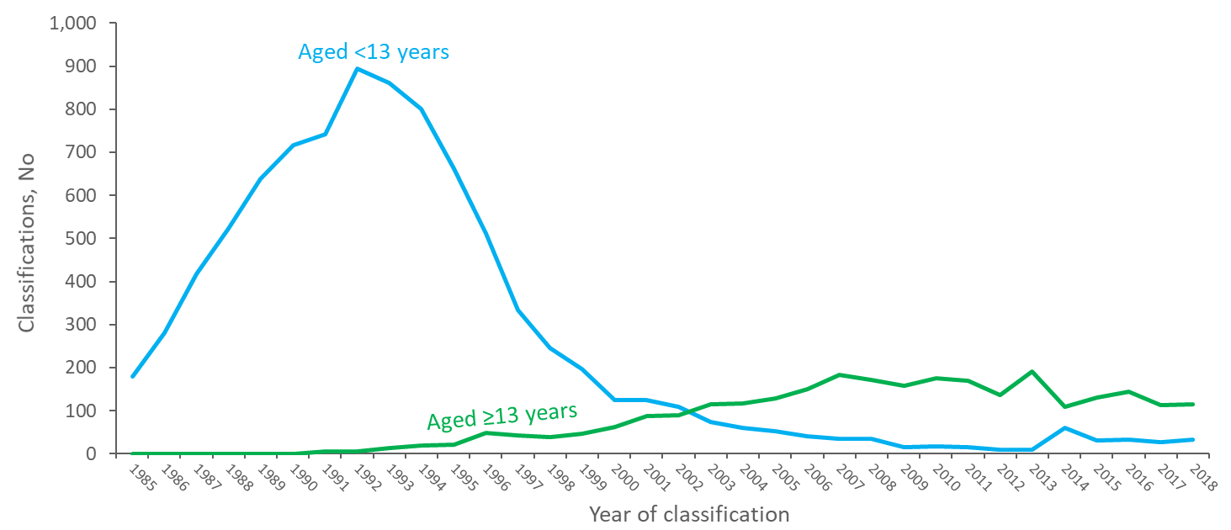
Stage 3 (AIDS) Classifications among Persons with Perinatally Acquired HIV Infection 1985–2018—United States and 6 Dependent Areas
Notes:
This slide presents from 1985 through 2018 in the United States and 6 dependent areas the numbers of stage 3 (AIDS) classifications among persons with perinatally acquired HIV infection. The number of persons less than 13 years of age with diagnosed perinatally acquired HIV infection classified as stage 3 (AIDS) has been decreasing since 1992, although in 2014, stage 3 (AIDS) classifications in children less than 13 years increased to 61. The increase in 2014 may be attributed to the revision to the HIV surveillance case definition in 2014. There have been gradual increases in stage 3 (AIDS) classifications among persons with diagnosed perinatally acquired HIV infection after a person has aged to adolescence or adulthood. This may be an indication of successful treatment and care.
Please use caution when interpreting trend data for children aged less than 13 years with diagnosed HIV infection: the numbers are small.

