Slide 1
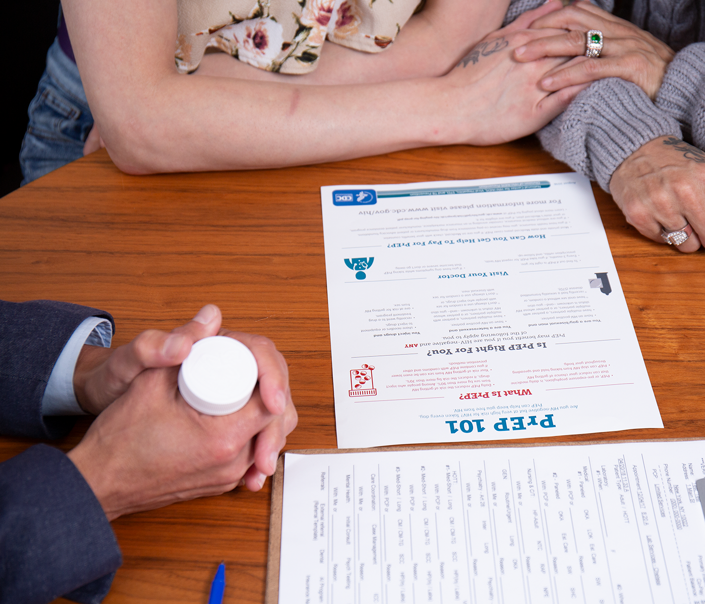
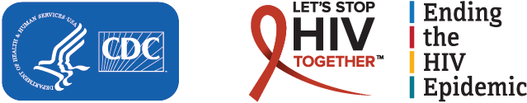
Prescribing
Pre-Exposure Prophylaxis (PrEP)
A Guide for Health Care Providers 2023
Notes:
Speaker’s Notes:
Welcome to this presentation on prescribing HIV pre-exposure prophylaxis or PrEP.

Slide 2

Overview
Why do we need pre-exposure prophylaxis (PrEP)?
Evaluating PrEP’s safety and efficacy
Who can prescribe PrEP?
Who can benefit from PrEP?
What to know before prescribing PrEP
Guidelines for prescribing PrEP
Are there considerations for special populations?
Review
Notes:
Speaker’s Notes:
This slide gives an overview of the topics that will be covered in this presentation:
Why do we need pre-exposure prophylaxis (PrEP)?
Evaluating PrEP’s safety and efficacy
Who can prescribe PrEP?
Who can benefit from PrEP?
What to know before prescribing PrEP
Guidelines for prescribing PrEP
Are there considerations for special populations?
Review.

Slide 3
Why do we need PrEP?
Notes:
Speaker’s Notes:
Let’s begin by reviewing what PrEP is and why we need it.

Slide 4
Current HIV Prevention Options
Use PrEP
Identify and Treat STIs
Use PEP
Adopt Treatment as Prevention (U=U)
Use Condoms
Address Sexual Risk Factors
Address Drug Use Risk Factors
Address Post-Natal Risk Factors
Person Without HIV
Pharmaceutical
Non-Pharmaceutical
PEP: post-exposure prophylaxis
PrEP: pre-exposure prophylaxis
STI: sexually transmitted infection
U=U: Undetectable = Untransmittable
Notes:
Speaker’s Notes:
Pre-exposure prophylaxis, or PrEP, is one of several pharmaceutical and non-pharmaceutical methods available to protect people without HIV in clinical practice.
Other pharmaceutical methods include:
Using post-exposure prophylaxis (PEP), which is the use of antiretroviral medication to prevent HIV infection in a person without HIV who has had a specific high-risk exposure to HIV; and
Adopting treatment as prevention, which is when people with HIV take antiretroviral medication to reduce the amount of virus in their bodies to undetectable levels to prevent transmitting the virus to others. This is also known as Undetectable = Untransmittable or U=U.
Other non-pharmaceutical methods include:
Making changes to manage risk factors for getting or transmitting HIV during and after pregnancy or through sex or injection drug use; and
Using condoms during sex.
Finally, identifying and treating sexually transmitted infections (STIs) is important to help avoid HIV transmission because certain STIs can increase the HIV viral load and genital HIV shedding, which may increase the risk of sexual and perinatal HIV transmission.

Slide 5
What Is PrEP?
Injectable PrEP
Oral PrEP
PrEP is the use of antiretroviral medications by people without HIV to protect themselves from getting HIV
PrEP is recommended for adults and adolescents weighing at least 35 kg (77 lb) who are at risk of getting HIV
Cabotegravir (CAB) 600 mg injection (brand name Apretude®)
Emtricitabine (F) 200 mg in combination with tenofovir disoproxil fumarate (TDF) 300 mg (F/TDF – brand name Truvada®
or generic equivalent)
Emtricitabine (F) 200 mg in combination with tenofovir alafenamide (TAF) 25 mg
(F/TAF – brand name Descovy®)*
*F/TAF is not approved for use by women or other people who could get HIV through receptive vaginal sex
Notes:
Speaker’s Notes:
PrEP is the use of antiretroviral medications by people without HIV to protect themselves from getting HIV.
PrEP is recommended for adults or adolescents weighing at least 35 kg (77 lb) who are at risk of getting HIV through sex or injection drug use.
The U.S. Food and Drug Administration (FDA) has approved three medications for use as PrEP.¹⁻⁴
Two medications are taken orally and consist of two drugs combined in a single oral tablet used daily or as prescribed¹⁻³:
Emtricitabine (F) 200 mg in combination with tenofovir disoproxil fumarate (TDF) 300 mg, also known as F/TDF and available as Truvada® or generic equivalent.
Emtricitabine (F) 200 mg in combination with tenofovir alafenamide (TAF) 25 mg, also known as F/TAF and available as Descovy®. Note that F/TAF is not approved for use by women or other people who could get HIV through receptive vaginal sex.
The third medication is an injectable formulation—cabotegravir 600 mg—given every 2 months as an intramuscular injection by a health care provider. It is abbreviated as CAB and available as Apretude®.⁴
References:
¹ Truvada. Prescribing information. Gilead; 2020. Accessed January 20, 2023. https://www.gilead.com/~/media/Files/pdfs/medicines/hiv/truvada/truvada_pi.pdf
² Emtricitabine and tenofovir disoproxil fumarate tablets. Prescribing information. Teva Pharmaceuticals; 2020. Accessed January 20, 2023. https://www.tevahivgenerics.com/globalassets/emtricitabine/pdfs/tg-42450_emtricitabine-and-tenofovir-disoproxil-fumarate-tablets-promo-pi-for-use-electronically.pdf
³ Descovy. Prescribing information. Gilead; 2020. Accessed January 20, 2023. https://www.gilead.com/-/media/files/pdfs/medicines/hiv/descovy/descovy_pi.pdf
⁴ Apretude. Prescribing information. ViiV Healthcare; 2022. Accessed January 20, 2023. https://gskpro.com/content/dam/global/hcpportal/en_US/Prescribing_Information/Apretude/pdf/APRETUDE-PI-PIL-IFU.PDF

Slide 6
Evaluating PrEP’s efficacy and safety
Notes:
Speaker’s Notes:
Let’s take a look at the clinical evidence for PrEP’s efficacy and safety.

Slide 7
PrEP’s Efficacy
Multiple studies have demonstrated that PrEP is highly effective when taken as prescribed.^{1,2}
Transmission Route | Effectiveness Estimate | Interpretation
Sexual | ~99% | Very high levels of adherence to PrEP provide maximum effectiveness
Injection drug use | at least 74% | This estimate is based on tenofovir alone and not necessarily when taken daily The effectiveness may be greater for the two-drug oral therapy and if used daily
¹ Centers for Disease Control and Prevention. Effectiveness of prevention strategies to reduce the risk of acquiring or transmitting HIV. Updated June 17, 2022. Accessed January 20, 2023. https://www.cdc.gov/hiv/risk/estimates/preventionstrategies.html
² Centers for Disease Control and Prevention, US Public Health Service. Preexposure prophylaxis for the prevention of HIV infection in the United States—2021 update—a clinical practice guideline. Published December 2021. Accessed January 20, 2023. https://www.cdc.gov/hiv/pdf/risk/prep/cdc-hiv-prep-guidelines-2021.pdf
Notes:
Speaker’s Notes:
PrEP has been demonstrated in multiple studies to be highly effective when taken as prescribed. Summaries of these studies and their results are available online, on U.S. Centers for Disease Control and Prevention’s (CDC’s) HIV Risk and Prevention Estimates page¹ on CDC.gov and in the Preexposure Prophylaxis for the Prevention of HIV Infection in the United States—2021 Update—A Clinical Practice Guideline.²
PrEP’s effectiveness varies between transmission routes. When taken as prescribed, PrEP reduces the risk of getting HIV from sex by about 99% and from injection drug use by at least 74%.
It should be noted that the estimated effectiveness for people who inject drugs is based on tenofovir alone, taken consistently. The effectiveness of two-drug oral therapies containing tenofovir may be higher. PrEP’s effectiveness is highly dependent on PrEP adherence, with missed doses leading to decreased effectiveness.
References:
¹ Centers for Disease Control and Prevention. Effectiveness of prevention strategies to reduce the risk of acquiring or transmitting HIV. Updated June 17, 2022. Accessed January 20, 2023. https://www.cdc.gov/hiv/risk/estimates/preventionstrategies.html
² Centers for Disease Control and Prevention, US Public Health Service. Preexposure prophylaxis for the prevention of HIV infection in the United States—2021 update—a clinical practice guideline. Published December 2021. Accessed January 20, 2023. https://www.cdc.gov/hiv/pdf/risk/prep/cdc-hiv-prep-guidelines-2021.pdf

Slide 8


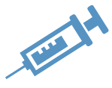

PrEP Side Effects and Safety
Side Effects | F/TDF (oral PrEP) | F/TAF (oral PrEP) | CAB (injectable PrEP)
Start-up Syndrome | <10% of patients Headache, nausea, abdominal discomfort lasting <1 month¹ | <10% of patients Headache, nausea, abdominal discomfort lasting <1 month¹ | No reported start-up syndrome¹
Kidney Safety | Small decrease in creatinine clearance Resolves after stopping drug² | Less risk of kidney-related side effects³ | No reported risk of kidney-related side effects¹
Bone Safety | Small decreases in bone mineral density Not associated with fractures⁴ | No reported bone safety issues¹ | No reported bone safety issues¹
Injection Site Reactions | N/A | N/A | Pain, tenderness, local skin swelling Typically, mild/moderate, brief⁵
Weight and Lipids | No reported effects on weight or lipid levels¹ | Weight gain Increased triglycerides³ | No reported effects on weight or lipid levels¹
Overall Safety
All three types of PrEP are generally well tolerated, with side effects that are usually
mild/moderate, manageable, and temporary¹
¹ Centers for Disease Control and Prevention, US Public Health Service. Preexposure prophylaxis for the prevention of HIV infection in the United States—2021 update—a clinical practice guideline. Published December 2021. Accessed January 20, 2023. https://www.cdc.gov/hiv/pdf/risk/prep/cdc-hiv-prep-guidelines-2021.pdf
² Mugwanya KK, Wyatt C, Celum C, et al. Changes in glomerular kidney function among HIV-1-uninfected men and women receiving emtricitabine-tenofovir disoproxil fumarate preexposure prophylaxis: a randomized clinical trial. JAMA Intern Med. 2015;175(2):246-254. doi: 10.1001/jamainternmed.2014.6786
³ Mayer KL, Molina, J-M, Thompson, MA, et al. Emtricitabine and tenofovir alafenamide vs emtricitabine and tenofovir disoproxil fumarate for HIV pre-exposure prophylaxis (DISCOVER): primary results from a randomised, double-blind, multicentre, active-controlled, phase 3, non-inferiority trial. Lancet. 2020;396(10246):239-254. doi: 10.1016/S0140-6736(20)31065-5
⁴ Grohskopf LA, Chillag KL, Gvetadze R, et al. Randomized trial of clinical safety of daily oral tenofovir disoproxil fumarate among HIV-uninfected men who have sex with men in the United States. J Acquir Immune Defic Syndr. 2013;64(1):79-86. doi: 10.1097/QAI.0b013e31828ece33
⁵ Landovitz RJ, Li S, Grinsztejn B, et al. Safety, tolerability, and pharmacokinetics of long-acting injectable cabotegravir in low-risk HIV-uninfected individuals: HPTN 077, a phase 2a randomized controlled trial. PLoS Med. 2018;15(11):e1002690. doi: 10.1371/journal.pmed.1002690
Notes:
Speaker’s Notes:
All three types of PrEP are generally well tolerated, with side effects that are usually mild to moderate in severity, manageable, and temporary.¹
Less than 10% of patients initiating oral PrEP with F/TDF or F/TAF report experiencing start-up syndrome. This typically consists of headache, nausea, and abdominal discomfort and does not last longer than 1 month. The symptoms can usually be managed with over-the-counter medications.¹
No start-up syndrome has been reported for patients starting CAB injections for PrEP. If a patient is concerned about side effects, an optional 4-week lead-in period of daily oral CAB can be prescribed before the patient receives their first injection.¹
Regarding kidney safety, in a randomized clinical trial, the use of F/TDF for PrEP was associated with a small decrease in creatinine clearance that did not get worse and that returned to normal levels once patients stopped using the drug.²
F/TAF is associated with lower risk of kidney-related side effects.³
No risk of kidney-related side effects has been reported for CAB.¹
All patients starting oral PrEP should have their creatinine clearance checked and then monitored while they use the drug.¹
In a randomized trial measuring the clinical safety of F/TDF in men who have sex with men, F/TDF was observed to be associated with a small decrease in bone mineral density. This decrease was not associated with increased fractures.⁴
There are no reported bone safety issues for F/TAF or CAB.¹
Injection site reactions are common in patients receiving CAB injections and typically include pain, tenderness, and skin swelling at the injection site. These reactions are typically mild to moderate, last a few days after the injection, and can be managed with over-the-counter pain medications. They usually decrease in severity after the first two or three injections.⁵
Weight gain and increased triglyceride levels have been observed in patients using F/TAF.³ Weight and lipid levels should be monitored in patients using this drug.¹
F/TDF and CAB have not been reported to affect weight or lipid levels.¹
References:
¹ Centers for Disease Control and Prevention, US Public Health Service. Preexposure prophylaxis for the prevention of HIV infection in the United States—2021 update—a clinical practice guideline. Published December 2021. Accessed January 20, 2023. https://www.cdc.gov/hiv/pdf/risk/prep/cdc-hiv-prep-guidelines-2021.pdf
² Mugwanya KK, Wyatt C, Celum C, et al. Changes in glomerular kidney function among HIV-1-uninfected men and women receiving emtricitabine-tenofovir disoproxil fumarate preexposure prophylaxis: a randomized clinical trial. JAMA Intern Med. 2015;175(2):246-254. doi: 10.1001/jamainternmed.2014.6786
³ Mayer KL, Molina, J-M, Thompson, MA, et al. Emtricitabine and tenofovir alafenamide vs emtricitabine and tenofovir disoproxil fumarate for HIV pre-exposure prophylaxis (DISCOVER): primary results from a randomised, double-blind, multicentre, active-controlled, phase 3, non-inferiority trial. Lancet. 2020;396(10246):239-254. doi: 10.1016/S0140-6736(20)31065-5
⁴ Grohskopf LA, Chillag KL, Gvetadze R, et al. Randomized trial of clinical safety of daily oral tenofovir disoproxil fumarate among HIV-uninfected men who have sex with men in the United States. J Acquir Immune Defic Syndr. 2013;64(1):79-86. doi: 10.1097/QAI.0b013e31828ece33
⁵ Landovitz RJ, Li S, Grinsztejn B, et al. Safety, tolerability, and pharmacokinetics of long-acting injectable cabotegravir in low-risk HIV-uninfected individuals: HPTN 077, a phase 2a randomized controlled trial. PLoS Med. 2018;15(11):e1002690. doi: 10.1371/journal.pmed.1002690

Slide 9
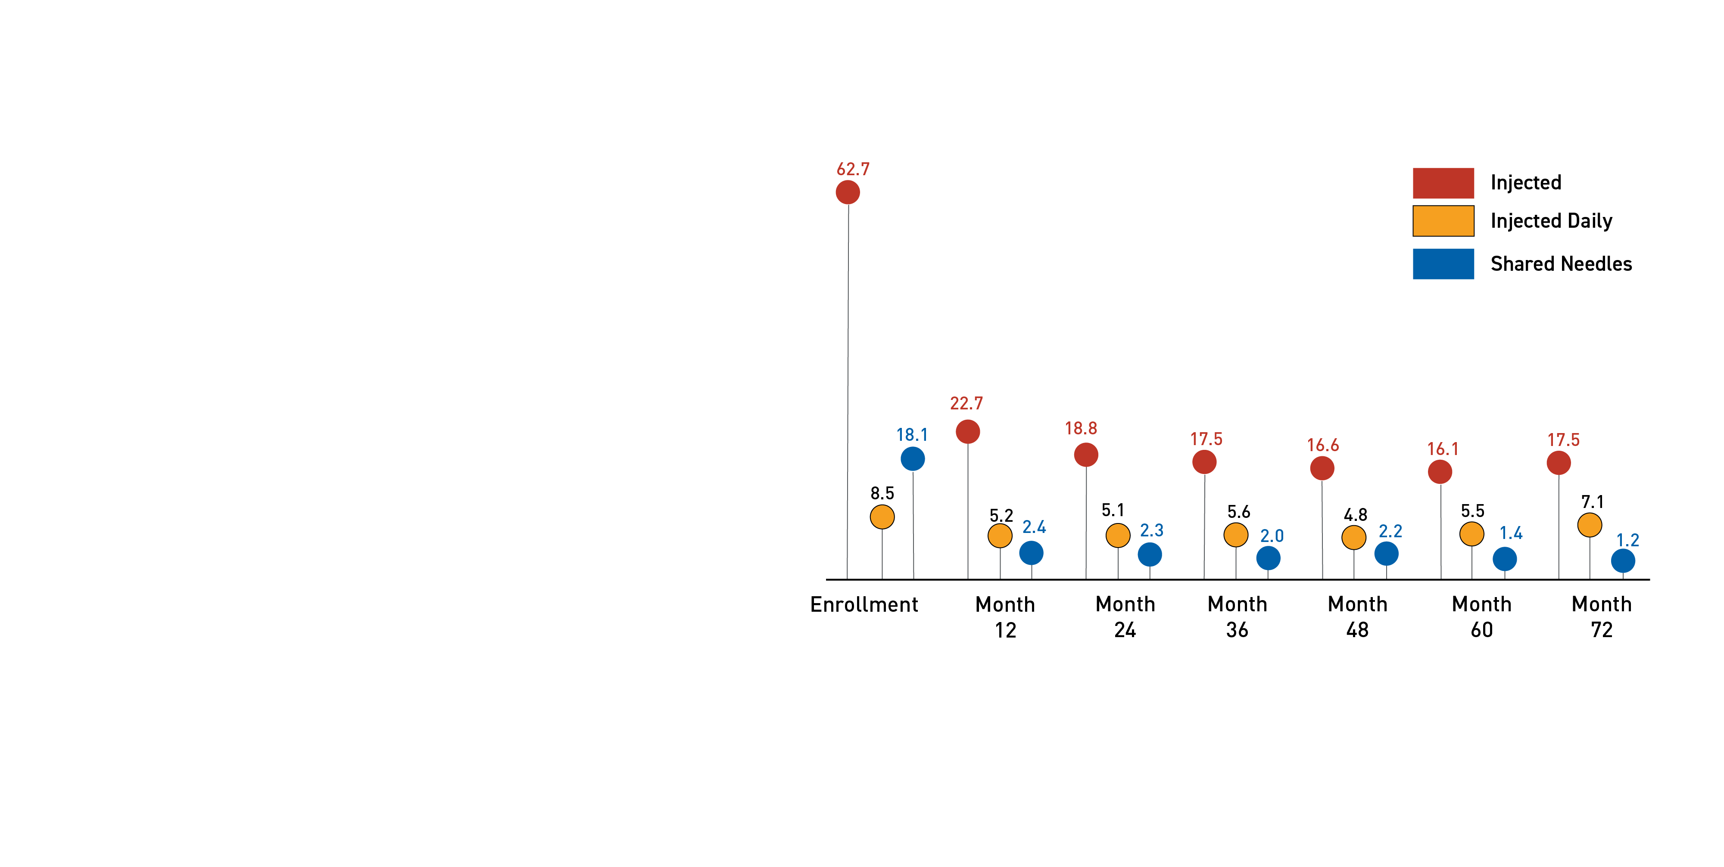
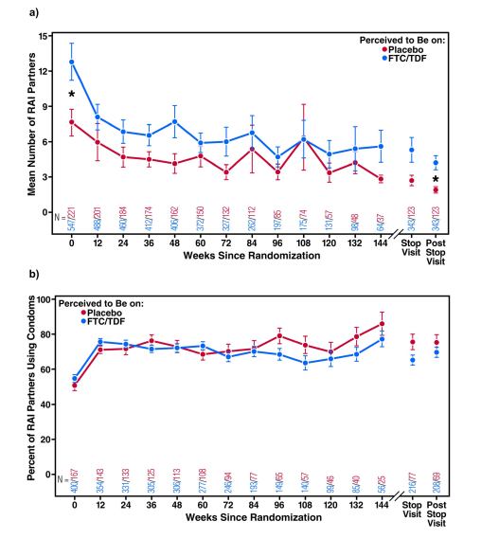
No Evidence of Increases in Behavioral Risk in Clinical Trials
Sexual risk (men who have sex with men)¹
Injection risk²
RAI: receptive anal intercourse
FTC/TDF: emtricitabine/tenofovir disoproxil fumarate
¹ Marcus JL, Glidden DV, Mayer KH, et al. No evidence of sexual risk compensation in the iPrEx trial of daily oral HIV preexposure prophylaxis. PloS One. 2013;8(12):e81997. doi: 10.1371/journal.pone.0081997
² Martin M, Vanichseni S, Suntharasamai P, et al. Risk behaviors and risk factors for HIV infection among participants in the Bangkok tenofovir study, and HIV pre-exposure prophylaxis trial among people who inject drugs. PloS One. 2014;9(3):e92809. doi: 10.1371/journal.pone.0092809
Notes:
Speaker’s Notes:
These data from clinical trials suggest that there is no increase in behavioral risk with use of PrEP.
The charts on the left show that among at-risk men who have sex with men, the number of sex partners and the incidence of condom use were similar whether the participants perceived they were prescribed PrEP or placebo.¹
The chart on the right presents the results of the Bangkok Tenofovir Study, which showed a general decrease in HIV acquisition due to parenteral drug use when PrEP was included in the HIV prevention strategy.²
References:
¹ Marcus JL, Glidden DV, Mayer KH, et al. No evidence of sexual risk compensation in the iPrEx trial of daily oral HIV preexposure prophylaxis. PloS One. 2013;8(12):e81997. doi: 10.1371/journal.pone.0081997
² Martin M, Vanichseni S, Suntharasamai P, et al. Risk behaviors and risk factors for HIV infection among participants in the Bangkok tenofovir study, and HIV pre-exposure prophylaxis trial among people who inject drugs. PloS One. 2014;9(3):e92809. doi: 10.1371/journal.pone.0092809

Slide 10
Who can prescribe PrEP?
Notes:
Speaker’s Notes:
Let’s review who can prescribe PrEP.

Slide 11
Who Are PrEP Providers?
Primary Care
Providers
Sexually Transmitted Infection (STI) Clinic Providers
People at risk of HIV through sex or injection drug use
Substance Use
Disorder Treatment
Providers
HIV Care
Providers
Notes:
Speaker’s Notes:
Any licensed prescriber can prescribe PrEP to people who don’t have HIV and are at risk of getting HIV through sex or injection drug use. In some states, pharmacists can provide PrEP once prescribed by a clinician.
PrEP providers include primary care providers, providers who work at sexually transmitted infection (STI) clinics, HIV care providers, and substance use disorder treatment providers.

Slide 12
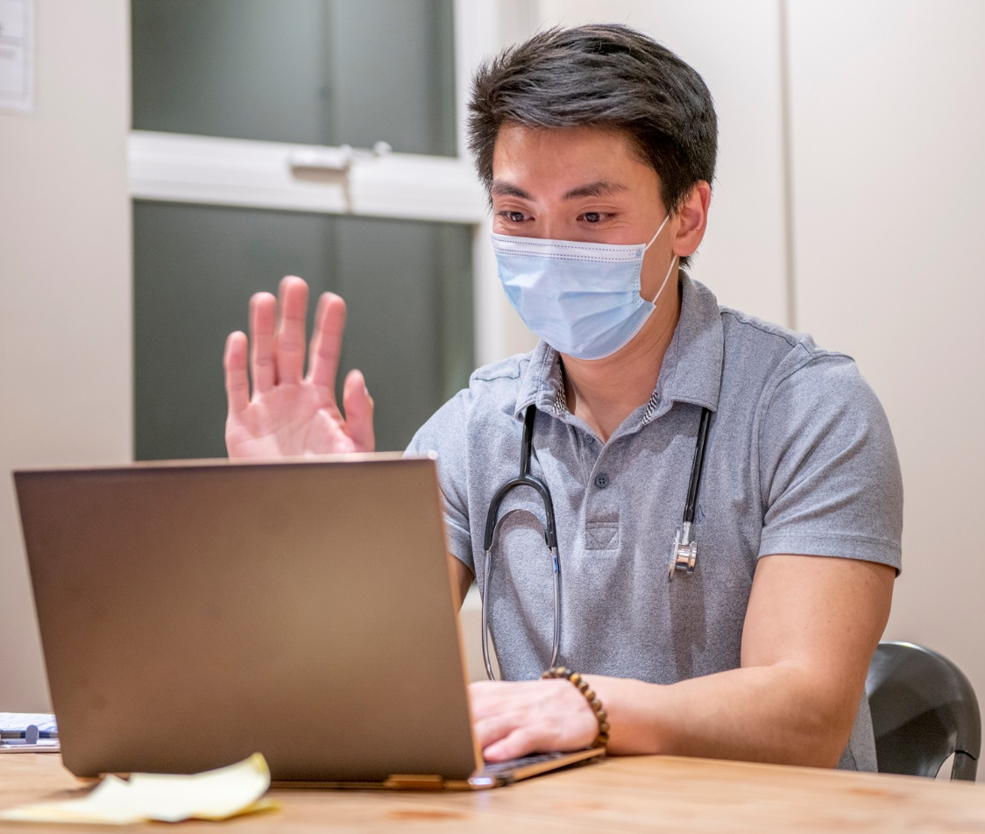
PrEP Is Appropriate for Primary Care
You do not need to be an infectious disease or HIV specialist to prescribe PrEP. Any licensed prescriber can provide PrEP.¹
PrEP can be easily integrated into primary care practice, similar to other regularly prescribed preventive measures² :
    Metformin for pre-diabetes
    Statins for cardiovascular disease
    Oral contraceptives for pregnancy
Making PrEP part of primary care can improve access for all who could benefit, and help address disparities
¹ Centers for Disease Control and Prevention, US Public Health Service. Preexposure prophylaxis for the prevention of HIV infection in the United States—2021 update: a clinical practice guideline. Published December 2021. Accessed January 20, 2023. https://www.cdc.gov/hiv/pdf/risk/prep/cdc-hiv-prep-guidelines-2021.pdf
² Calabrese SK, Krakower DS, Mayer KH. Integrating HIV preexposure prophylaxis (PrEP) into routine preventive health care to avoid exacerbating disparities. Am J Public Health. 2017;107(12):1883-1889. doi: 10.2105/AJPH.2017.304061
.
Notes:
Speaker’s Notes:
PrEP can be prescribed by any licensed prescriber.¹ The prescriber does not have to be an infectious disease or HIV specialist.
PrEP is a preventive measure for HIV that can be readily integrated into primary care, as providers are already regularly prescribing other preventive interventions, such as metformin for patients at risk for diabetes, statins for those at risk for cardiovascular disease, and other medications, as shown here.
In fact, making PrEP available in primary settings as part of routine preventive health care can improve access for all people who could benefit, and help address existing disparities in PrEP use.
References:
¹ Centers for Disease Control and Prevention, US Public Health Service. Preexposure prophylaxis for the prevention of HIV infection in the United States—2021 update: a clinical practice guideline. Published December 2021. Accessed January 20, 2023. https://www.cdc.gov/hiv/pdf/risk/prep/cdc-hiv-prep-guidelines-2021.pdf
² Calabrese SK, Krakower DS, Mayer KH. Integrating HIV preexposure prophylaxis (PrEP) into routine preventive health care to avoid exacerbating disparities. Am J Public Health. 2017;107(12):1883-1889. doi: 10.2105/AJPH.2017.304061

Slide 13
Who can benefit from PrEP?
Notes:
Speaker’s Notes:
Now that we’ve covered an introduction to what PrEP is and the PrEP medications available, let’s move on to discuss who can benefit from PrEP.

Slide 14

Who Is PrEP For?
PrEP is for adults and adolescents without HIV who are at risk of getting HIV from sex or injection drug use.
CDC’s PrEP guideline includes telling all sexually active adults and adolescents that PrEP can protect them from getting HIV as a graded recommendation (IIIB)
Giving patients information about PrEP:
Increases the number of people who know about PrEP and equips them to share the information with their social networks and family members
Helps patients overcome embarrassment and stigma so they can respond accurately to risk assessment questions
PrEP can be prescribed to any adult or adolescent patient who asks for it, even if they do not report HIV risk factors, as part of their comprehensive prevention plan
Centers for Disease Control and Prevention, US Public Health Service. Preexposure prophylaxis for the prevention of HIV infection in the United States—2021 update: a clinical practice guideline. Published December 2021. Accessed January 20, 2023. https://www.cdc.gov/hiv/pdf/risk/prep/cdc-hiv-prep-guidelines-2021.pdf
Notes:
Speaker’s Notes:
PrEP is for adults and adolescents without HIV who are at risk for getting HIV from sex or injection drug use.
CDC’s PrEP guideline, issued in 2021, includes telling all sexually active adults and adolescents about PrEP as a graded recommendation (IIIB).
Giving patients information about PrEP equips them to not only take steps to protect themselves from HIV but also to share that information with their social networks and family members who may benefit from PrEP.
Additionally, starting the conversation about PrEP can help patients overcome embarrassment and stigma so that they can respond accurately to risk assessment questions.
PrEP can be prescribed to any adult or adolescent patient who asks for it, even if they do not report HIV risk factors, as part of their comprehensive prevention plan.
Reference:
Centers for Disease Control and Prevention, US Public Health Service. Preexposure prophylaxis for the prevention of HIV infection in the United States—2021 update: a clinical practice guideline. Published December 2021. Accessed January 20, 2023. https://www.cdc.gov/hiv/pdf/risk/prep/cdc-hiv-prep-guidelines-2021.pdf

Slide 15
What to know before prescribing PrEP
Notes:
Speaker’s Notes:
Now that we’ve established that any licensed prescriber can prescribe PrEP and that PrEP is appropriate for primary care, let’s talk a little about what prescribers should know before prescribing PrEP.

Slide 16
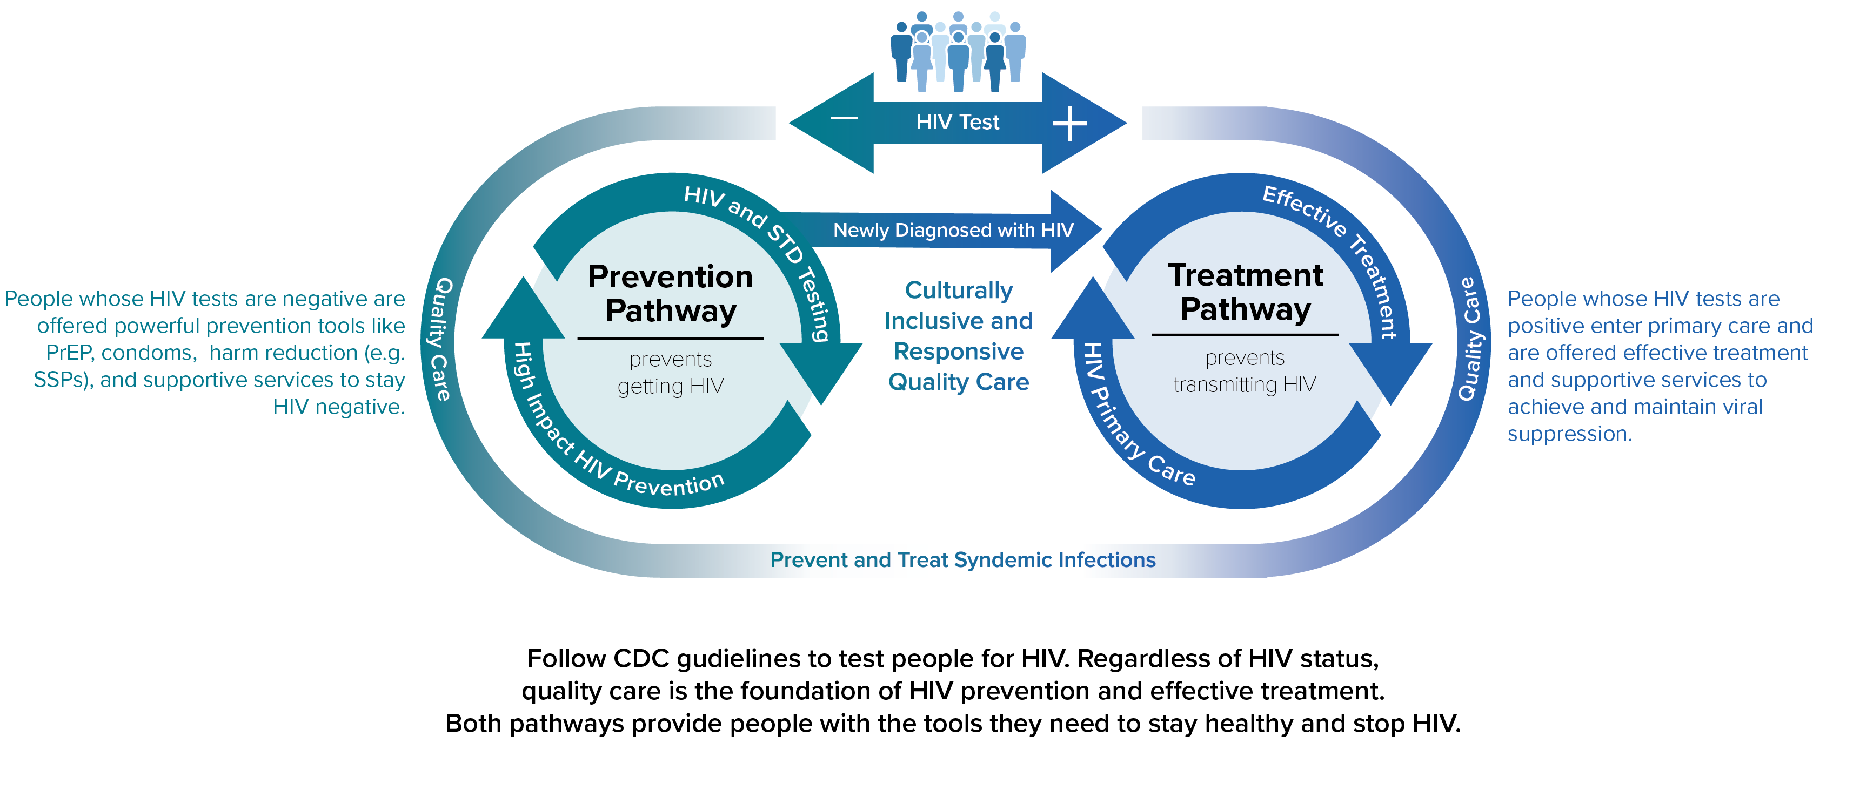
Status-Neutral HIV Prevention and Care Continuum
SSP: syringe services program
  The White House. National HIV/AIDS strategy for the United States 2022–2025. p. 34. Published 2021. Accessed January 20, 2023. https://www.whitehouse.gov/wp-content/uploads/2021/11/National-HIV-AIDS-Strategy.pdf
Notes:
Speaker’s Notes:
PrEP is one method individuals can use to protect themselves from HIV.
Thus, PrEP is a type of prevention service and falls within the prevention pathway of CDC’s status-neutral approach to HIV prevention and care, as indicated by the orange arrow.
Reference:
The White House. National HIV/AIDS strategy for the United States 2022–2025. p. 34. Published 2021. Accessed January 20, 2023. https://www.whitehouse.gov/wp-content/uploads/2021/11/National-HIV-AIDS-Strategy.pdf

Slide 17

The Importance of Taking a Sexual History
Recommended for all adult and adolescent patients as part of primary care
Providers can introduce the discussion by emphasizing that it is routine and confidential
Helps identify patients’ sexual health needs, including need for PrEP
“
Taking a brief sexual
history is routine.
“
Everything you say is confidential.
A comprehensive sexual history is not required for PrEP
Centers for Disease Control and Prevention, US Public Health Service. Preexposure prophylaxis for the prevention of HIV infection in the United States—2021 update—a clinical practice guideline. Published December 2021. Accessed January 20, 2023. https://www.cdc.gov/hiv/pdf/risk/prep/cdc-hiv-prep-guidelines-2021.pdf
Notes:
Speaker’s Notes:
Obtaining a sexual history is recommended for all adult and adolescent patients as part of ongoing primary care. Taking a sexual history from all patients is important to identify their sexual health needs, including whether they are sexually active and could benefit from PrEP. However, a comprehensive sexual history is not required for PrEP.
Providers can introduce the discussion about a patient’s sexual history by emphasizing that these are routine questions and that everything they talk about will be kept confidential between patient and provider.
Reference:
Centers for Disease Control and Prevention, US Public Health Service. Preexposure prophylaxis for the prevention of HIV infection in the United States—2021 update—a clinical practice guideline. Published December 2021. Accessed January 20, 2023. https://www.cdc.gov/hiv/pdf/risk/prep/cdc-hiv-prep-guidelines-2021.pdf

Slide 18
The 5 “Ps” of the Sexual History
PARTNERS
PRACTICES
PROTECTION from STIs
PAST HISTORY of STIs
PREGNANCY INTENTION
  CDC. A guide to taking a sexual history. Published 2021. Accessed January 20, 2023. https://www.cdc.gov/std/treatment/sexualhistory.pdf
Notes:
Speaker’s Notes:
Taking a sexual history can most easily be accomplished by using the 5 “Ps”:
Partners (to determine the number and gender[s] of sex partners).
Practices (to guide assessment of risk, recommend risk-reduction strategies, and identify need for STI testing).
Protection from STIs (to identify the appropriate level of risk-reduction counseling).
Past history of STIs (to evaluate risk factors for HIV acquisition or transmission, as a history of STIs can place patients at greater risk now).
Pregnancy intention (to allow discussion of HIV transmission prevention).
Reference:
CDC. A guide to taking a sexual history. Published 2021. Accessed January 20, 2023. https://www.cdc.gov/std/treatment/sexualhistory.pdf

Slide 19
Examples of Brief Risk-Assessment Questions
First, start the conversation: Inform all adult and adolescent patients who may be at risk for HIV through sex or injection drug use about PrEP
Then, assess behavior:
Sexual Behavior:
Drug Injection Behavior:
In the past 6 months, how many
partners have you had sex with?
Have you ever injected drugs
that were not prescribed for you?
?
?
What are the genders of your
sexual partners?
?
If YES:
Do you use condoms consistently?
When did you last inject drugs?
?
?
Did any of your partners have HIV?
Do you ever inject using works
that were used by another person?
?
?
Centers for Disease Control and Prevention, US Public Health Service. Preexposure prophylaxis for the prevention of HIV infection in the United States—2021 update—a clinical practice guideline. Published December 2021. Accessed January 20, 2023. https://www.cdc.gov/hiv/pdf/risk/prep/cdc-hiv-prep-guidelines-2021.pdf
Notes:
Speaker’s Notes:
It is important to talk to all patients who may be at risk of HIV through sex or injection drug use.
Starting the conversation by informing patients about PrEP helps them respond openly to questions about their sexual and drug use behaviors.
Once you have introduced PrEP, begin to ask patients about their behaviors. As when taking a sexual history, affirm that these questions are routine and that the information they share will be kept confidential.
Be sure to use everyday language that your patients are likely to understand, such as the examples shown on the slide.
Reference:
Centers for Disease Control and Prevention, US Public Health Service. Preexposure prophylaxis for the prevention of HIV infection in the United States—2021 update—a clinical practice guideline. Published December 2021. Accessed January 20, 2023. https://www.cdc.gov/hiv/pdf/risk/prep/cdc-hiv-prep-guidelines-2021.pdf

Slide 20
Guidelines for prescribing PrEP
Notes:
Speaker’s Notes:
Now, let’s cover guidelines for prescribing PrEP.

Slide 21
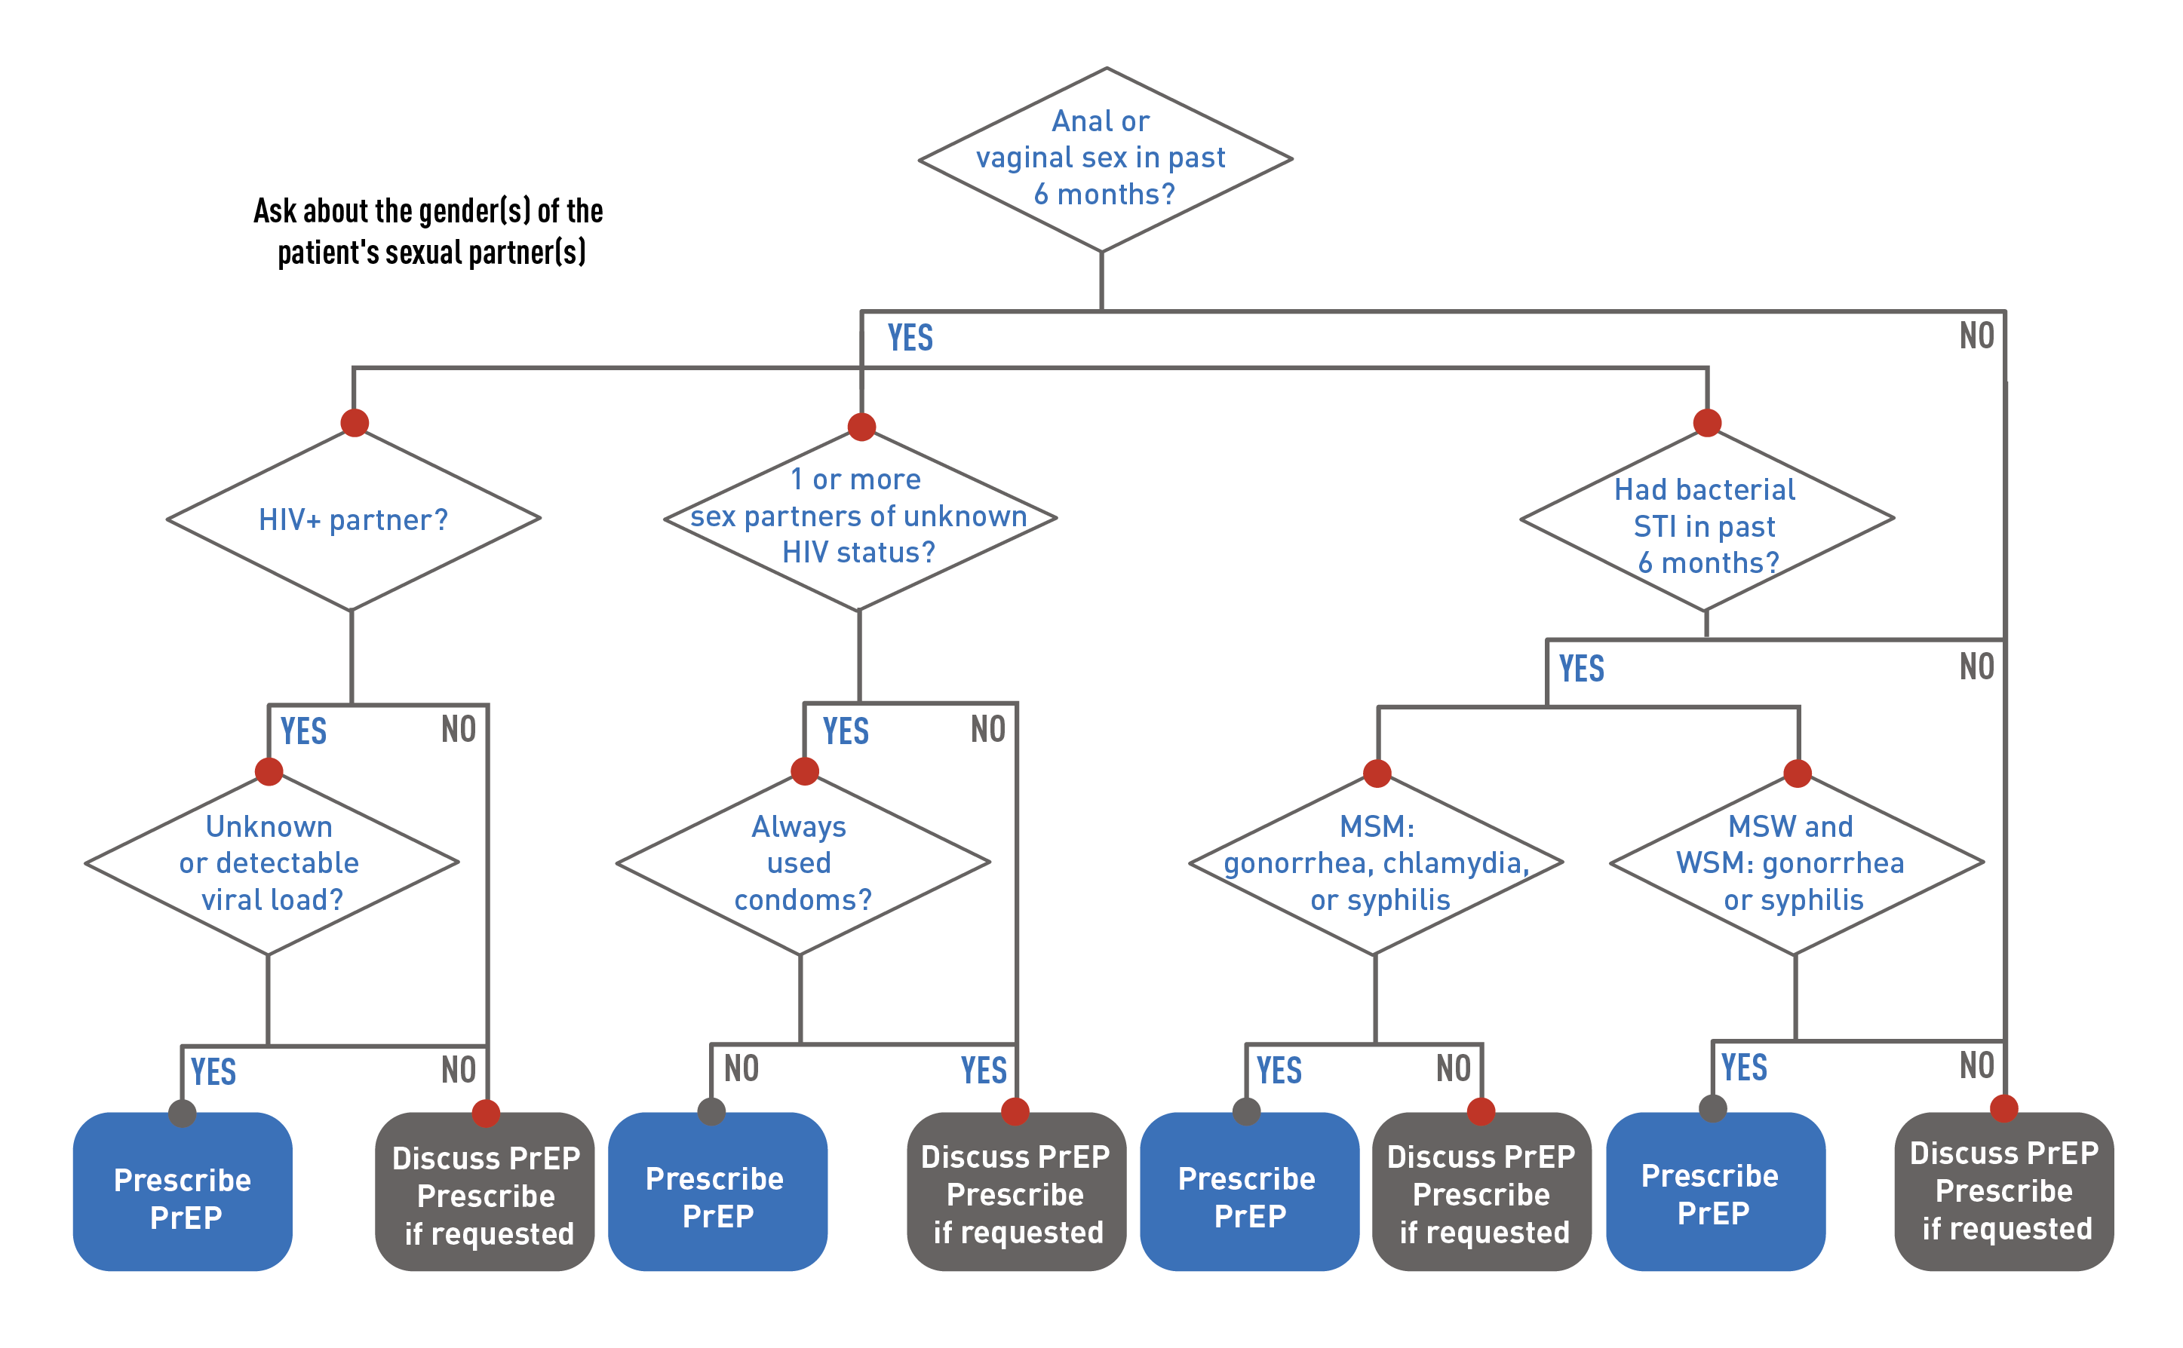
Assessing a Sexually Active Patient for PrEP
Note: MSM, men who have sex with men; MSW, men who have sex with women; STI, sexually transmitted infection; WSM, women who have sex with men.
Centers for Disease Control and Prevention, US Public Health Service. Preexposure prophylaxis for the prevention of HIV infection in the United States—2021 update: a clinical practice guideline. Published December 2021. Accessed January 20. 2023. https://www.cdc.gov/hiv/pdf/risk/prep/cdc-hiv-prep-guidelines-2021.pdf
Notes:
Speaker’s Notes:
This slide presents CDC’s recommended algorithm for assessing a sexually active patient for PrEP. This algorithm includes a brief set of questions designed to assess key risk factors for getting HIV.
PrEP should be prescribed for patients who:
Have a sexual partner with HIV who has an unknown or detectable viral load.
Have one or more sexual partners of unknown HIV status and has not consistently used condoms.
Have had a bacterial STI in the past 6 months.
It is important to note that patients may request PrEP to protect themselves from HIV but not feel comfortable reporting HIV risk factors because they anticipate receiving stigmatizing responses in health care settings. For this reason, patients who request PrEP should be offered it, regardless of their risk assessment responses.
References:
Centers for Disease Control and Prevention, US Public Health Service. Preexposure prophylaxis for the prevention of HIV infection in the United States—2021 update: a clinical practice guideline. Published December 2021. Accessed January 20, 2023. https://www.cdc.gov/hiv/pdf/risk/prep/cdc-hiv-prep-guidelines-2021.pdf

Slide 22
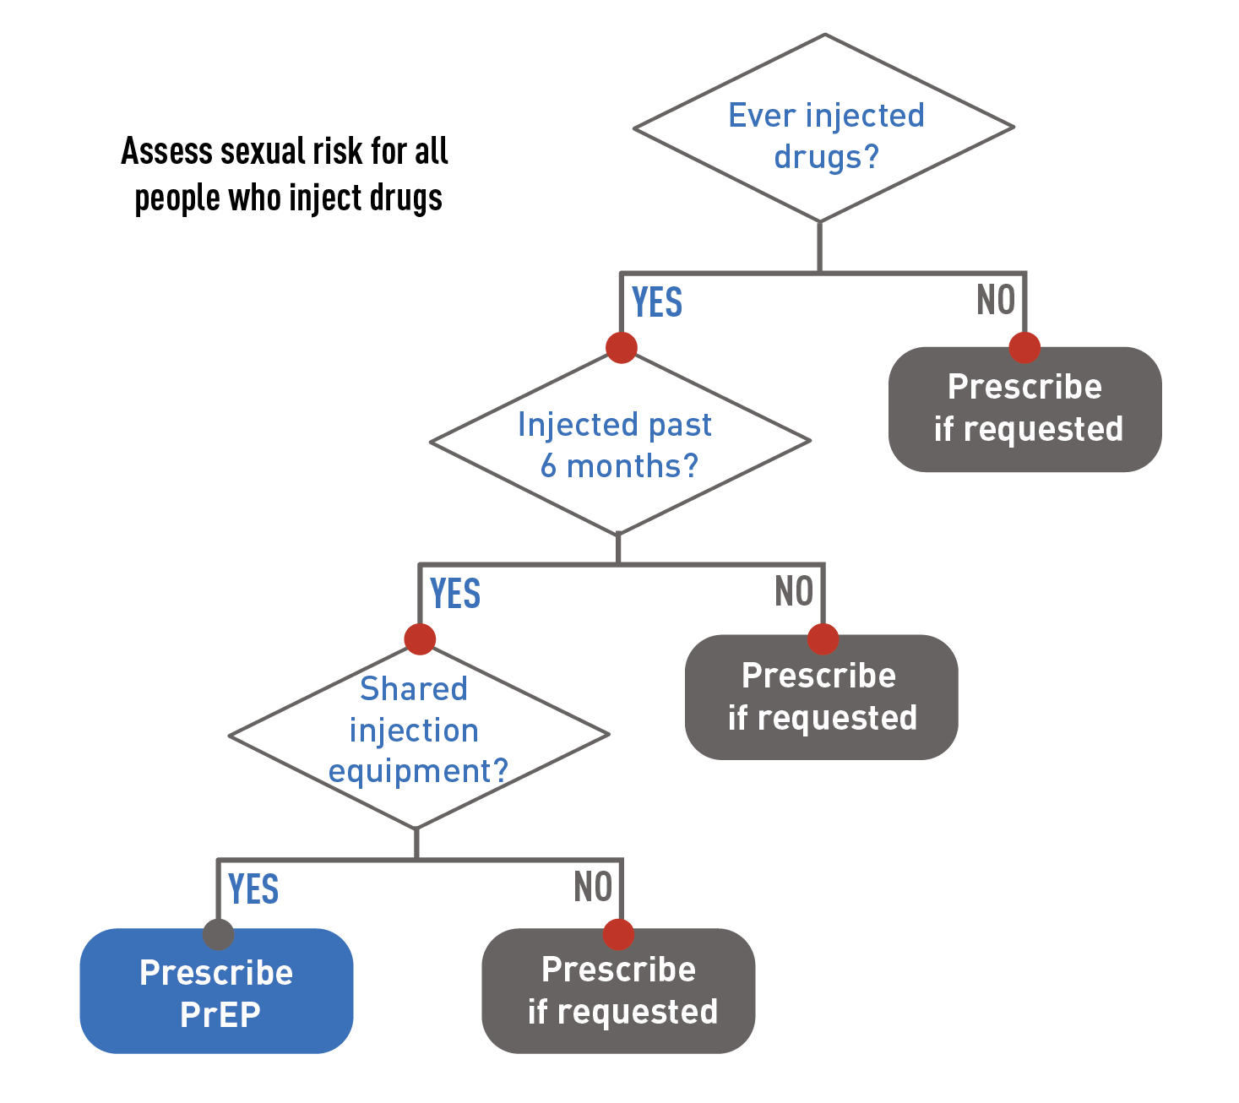
Assessing a Patient Who Injects Drugs for PrEP
Centers for Disease Control and Prevention, US Public Health Service. Preexposure prophylaxis for the prevention of HIV infection in the United States—2021 update: a clinical practice guideline. Published December 2021. Accessed January 20, 2023. https://www.cdc.gov/hiv/pdf/risk/prep/cdc-hiv-prep-guidelines-2021.pdf
Notes:
Speaker’s Notes:
This slide presents CDC’s recommended algorithm for assessing a patient who injects drugs for PrEP and includes questions about injection practices that are risk factors for getting HIV.
PrEP should be prescribed for patients who have injected drugs within the past 6 months and shared their injection equipment.
Keep in mind that patients may ask for PrEP to protect themselves from HIV but feel uncomfortable reporting HIV risk factors because they may expect to experience stigma and discrimination in health care settings. Therefore, patients who request PrEP should be offered it, regardless of their risk assessment responses.
Reference:
Centers for Disease Control and Prevention, US Public Health Service. Preexposure prophylaxis for the prevention of HIV infection in the United States—2021 update: a clinical practice guideline. Published December 2021. Accessed March 31, 2022. https://www.cdc.gov/hiv/pdf/risk/prep/cdc-hiv-prep-guidelines-2021.pdf

Slide 23
Baseline Laboratory Testing
REQUIRED
HIV test (antigen/antibody test,
preferably laboratory based)
to confirm negative status
Hepatitis B screening (F/TAF and F/TDF) because active infection is a potential safety issue
!
Kidney function
F/TDF: Estimated creatinine
clearance
(must be >60 mL/min)
F/TAF: Estimated creatinine
clearance
(must be >30 mL/min)
CAB: Not required
Lipid profile (triglyceride and cholesterol levels) for patients prescribed F/TAF, as this medication may be associated with triglyceride elevation
!
STI tests for chlamydia, gonorrhea, and syphilis for all sexually active adults
F/TDF: emtricitabine/tenofovir disoproxil fumarate (Truvada® or generic equivalent)
F/TAF: emtricitabine/tenofovir alafenamide (Descovy®)
CAB: cabotegravir (Apretude®)
Centers for Disease Control and Prevention, US Public Health Service. Preexposure prophylaxis for the prevention of HIV infection in the United States—2021 update—a clinical practice guideline. Published December 2021. Accessed January 20, 2023. https://www.cdc.gov/hiv/pdf/risk/prep/cdc-hiv-prep-guidelines-2021.pdf
Notes:
Speaker’s Notes:
Baseline laboratory testing should be performed prior to starting PrEP with either oral medication—emtricitabine/tenofovir disoproxil fumarate (F/TDF; brand name Truvada® or generic equivalent) or emtricitabine/tenofovir alafenamide (F/TAF; brand name Descovy®) or injectable medication—cabotegravir (CAB; brand name Apretude®).¹
An HIV test to confirm the patient does not have HIV is required. Laboratory-based antigen/antibody tests are the preferred method but, at a minimum, providers should document a negative antibody test within the week before the patient initiates PrEP use.¹
If a patient is re-initiating PrEP use and used oral PrEP within the last 3 months or injectable PrEP within the last 12 months, testing should include an antigen/antibody test and a qualitative or quantitative HIV-1 RNA test.
Oral rapid HIV tests should not be used to screen PrEP candidates for HIV because they are less sensitive than blood tests and may not detect recent HIV infection.
Any patient with a reactive test result indicating that they have HIV should be linked to HIV care and treatment.
Acute HIV should be suspected if the patient reports a recent exposure. Ask all PrEP candidates with a negative or indeterminate HIV test result about whether they have experienced any signs of symptoms of viral infection in the month prior or on the day of evaluation.
Kidney function must be assessed for all patients initiating oral PrEP.¹
When used as PrEP, TDF can cause decreases in kidney function that are generally small, usually remain within the normal range, and are of no known clinical significance.^{2,3} These decreases typically reverse when the patient stops PrEP.^{4,5}
Occasional cases of acute kidney failure, including Fanconi syndrome, have occurred.⁶⁻⁹
Kidney function should be assessed using the Cockcroft-Gault formula and the patient’s serum creatinine value to calculate an estimated creatinine clearance (eCrCl).
F/TDF is approved for use in people with eCrCl >60 mL/min, and F/TAF is approved for use in people with eCrCl >30 mL/min.
Kidney function does not need to be assessed for patients being prescribed injectable PrEP.
Additional baseline laboratory testing prior to PrEP initiation includes:
Hepatitis B (HBV) screening: All patients being prescribed oral PrEP should be screened for HBV. In people with active HBV, stopping oral PrEP medication can result in a rebound of HBV replication, leading to liver damage. HIV infection is not a contraindication to oral PrEP, but patients with active HIB infection should be educated about the risks of stopping PrEP so that their liver function can be monitored closely for reactivation of HBV replication if they stop oral PrEP.¹
Lipid profile: In the DISCOVER clinical trial comparing F/TDF and F/TAF for PrEP, participants taking F/TAF showed higher rates of triglyceride elevation and weight gain.¹⁰ All patients using F/TAF should have their cholesterol and triglyceride levels measured and be prescribed lipid-lowering medications if indicated.¹
STI tests: All PrEP candidates should be screened for chlamydia, gonorrhea, and syphilis.¹
References:
¹ Centers for Disease Control and Prevention, US Public Health Service. Preexposure prophylaxis for the prevention of HIV infection in the United States—2021 update—a clinical practice guideline. Published December 2021. Accessed January 20, 2022. https://www.cdc.gov/hiv/pdf/risk/prep/cdc-hiv-prep-guidelines-2021.pdf
² Martin M, Vanichseni S, Suntharasamai P, et al. Renal function of participants in the Bangkok tenofovir study—Thailand, 2005–2012. Clin Infect Dis. 2014;59(5):716-724. doi: 10.1093/cid/ciu355
³ Mugwanya KK, Wyatt C, Celum C, et al. Changes in glomerular kidney function among HIV-1– uninfected men and women receiving emtricitabine–tenofovir disoproxil fumarate preexposure prophylaxis: a randomized clinical trial. JAMA Intern Med. 2015;175(2):246-254. doi: 10.1001/jamainternmed.2014.6786
⁴ Emtricitabine and tenofovir disoproxil fumarate. Prescribing information. Teva Pharmaceuticals; 2020. Accessed January 20, 2023. https://www.tevahivgenerics.com/globalassets/emtricitabine/pdfs/tg-42450_emtricitabine-and-tenofovir-disoproxil-fumarate-tablets-promo-pi-for-use-electronically.pdf
⁵ Truvada. Prescribing information. Gilead Sciences; 2020. Accessed January 20, 2023. https://www.gilead.com/~/media/Files/pdfs/medicines/hiv/truvada/truvada_pi.pdf
⁶ Antoni G, Tremblay C, Charreau I. On-demand PrEP with TDF/FTC remains highly effective among MSM with infrequent sexual intercourse: a sub-study of the ANRS IPERGAY trial. Paper presented at: International AIDS Society Conference on HIV Science; July 2017; Paris, France.
⁷ Saag MS, Benson CA, Gandhi RT, et al. Antiretroviral drugs for treatment and prevention of HIV infection in adults: 2018 recommendations of the International Antiviral Society-USA Panel. JAMA. 2018;320(4):379-396. doi: 10.1001/jama.2018.8431
⁸ Mugwanya KK, Wyatt C, Celum C, et al. Reversibility of glomerular renal function decline in HIV-uninfected men and women discontinuing emtricitabine-tenofovir disoproxil fumarate pre-exposure prophylaxis. J Acquir Immune Defic Syndr. 2016 Apr;71(4):374-380. doi: 10.1097/QAI.0000000000000868
⁹ Tang EC, Vittinghoff E, Anderson PL, et al. Changes in kidney function associated with daily tenofovir disoproxil fumarate/emtricitabine for HIV preexposure prophylaxis use in the United States Demonstration Project. J Acquir Immune Defic Syndr. 2018 Feb;77(2):193-198. doi: 10.1097/QAI.0000000000001566
¹⁰ Mayer KH, Molina J-M, Thompson MA, et al. Emtricitabine and tenofovir alafenamide vs emtricitabine and tenofovir disoproxil fumarate for HIV pre-exposure prophylaxis (DISCOVER): primary results from a randomised, double-blind, multicentre, active-controlled, phase 3, non-inferiority trial. Lancet. 2020;396(10246):239-254. doi: 10.1016/SO140-6736(20)31065-5

Slide 24
Ongoing Assessments for Patients Using Oral PrEP
At least every 3 months:
Repeat HIV testing and assess for signs or symptoms of acute infection
Provide a prescription or refill authorization of daily oral PrEP medication for ≤90 days
Assess and provide support for medication adherence and
risk-reduction behaviors
Test sexually active patients with signs or symptoms of STIs and screen asymptomatic men who have sex with men and are at high risk for recurrent bacterial STIs
Provide access to sterile needles/syringes and substance use disorder treatment services for people who inject drugs
Respond to questions and provide new information
At least every 6 months:
Monitor eCrCl for patients who are ≥50 years or had an eCrCl
<90 mL/min when they started oral PrEP
  Monitor more frequently or perform additional tests if there are other threats to kidney safety
Screen sexually active people for STIs:
  Syphilis for all PrEP users
  Gonorrhea for all PrEP users
  Chlamydia for men who have sex with men and transgender women, even if asymptomatic
Assess interest in continuing or discontinuing PrEP
At least every 12 months:
Monitor eCrCl for all patients continuing on PrEP medication
For patients using F/TAF, monitor triglyceride and cholesterol levels and weight
Screen heterosexually active people for chlamydia, even if asymptomatic
  Centers for Disease Control and Prevention, US Public Health Service. Preexposure prophylaxis for the prevention of HIV infection in the United States—2021 update—a clinical practice guideline. Published December 2021. Accessed January 20, 2023. https://www.cdc.gov/hiv/pdf/risk/prep/cdc-hiv-prep-guidelines-2021.pdf
Notes:
Speaker’s Notes:
The 2021 updated PrEP guideline from CDC and the US Public Health Service recommends the following schedule of assessments for patients taking oral PrEP medication. These recommendations reflect the minimum; providers should conduct additional assessments as warranted.
At least every 3 months:
Repeat HIV testing and assess for signs or symptoms of acute infection to confirm that patients are still HIV negative.
Provide a prescription or refill authorization of daily oral PrEP medication for no more than 90 days, until the next HIV test.
Assess and provide support for medication adherence and risk-reduction behaviors.
Test sexually active patients with signs or symptoms of STIs. Screen asymptomatic men who have sex with men and who are at high risk for recurrent bacterial STIs (oral, rectal, urine, blood). Examples of who should be screened include those with syphilis, gonorrhea, or chlamydia at prior visits or with multiple sex partners.
Provide access to sterile needles/syringes and substance use disorder treatment services for people who inject drugs.
Respond to any new questions from patients and provide them with any new information about PrEP use.
At least every 6 months:
Monitor eCrCl for patients who are over 50 years or who had an eCrCl under 90 mL/min when they started oral PrEP.
If there are other threats to kidney safety, such as hypertension or diabetes, kidney function may need to be monitored more often or checked using additional tests (e.g., urinalysis for proteinuria).
A rise in serum creatinine is not a reason to withhold PrEP if eCrCl remains at least 60 mL/min for F/TDF or at least 30 mL/min for F/TAF.
If eCrCl is declining steadily but still at acceptable levels for the type of oral PrEP medication being used, consider consulting with a nephrologist or evaluating other possible threats to kidney health.
Screen sexually active people for STIs:
Syphilis and gonorrhea for all PrEP users.
Chlamydia for men who have sex with men and transgender women, even if asymptomatic.
Assess patients’ interest in continuing or discontinuing PrEP.
At least every 12 months:
Monitor eCrCl for all patients continuing on PrEP medication.
Monitor triglyceride and cholesterol levels and weight for patients prescribed F/TAF for PrEP.
Screen heterosexually active people for chlamydia, even if asymptomatic.
Reference:
Centers for Disease Control and Prevention, US Public Health Service. Preexposure prophylaxis for the prevention of HIV infection in the United States—2021 update—a clinical practice guideline. Published December 2021. Accessed January 20, 2023. https://www.cdc.gov/hiv/pdf/risk/prep/cdc-hiv-prep-guidelines-2021.pdf

Slide 25
Ongoing Assessments for Patients Using Injectable PrEP
At visit 1 month after initial injection:
Test for HIV and assess for signs or symptoms of acute infection
Administer CAB injection
Respond to new questions
Provide medication adherence and behavioral risk-reduction support
At each bimonthly visit:
Test for HIV and assess for signs or symptoms of acute infection
Administer CAB injection
Provide access to sterile needles/syringes and substance use disorder treatment services for people who inject drugs
Respond to questions and provide any new information
Discuss the benefits of persistent CAB for PrEP use and adherence to scheduled injection visits
At least every 4 months (every other injection):
Screen men and transgender women who have sex with men for bacterial STIs
At least every 6 months:
Screen heterosexually active people for bacterial STIs
At least every 12 months:
Assess desire to continue PrEP
Screen heterosexually active people for chlamydia, even if asymptomatic
  Centers for Disease Control and Prevention, US Public Health Service. Preexposure prophylaxis for the prevention of HIV infection in the United States—2021 update—a clinical practice guideline. Published December 2021. Accessed January 20, 2023. https://www.cdc.gov/hiv/pdf/risk/prep/cdc-hiv-prep-guidelines-2021.pdf
Notes:
Speaker’s Notes:
The 2021 updated PrEP guideline from CDC and the US Public Health Service recommends the following schedule of assessments for patients taking injectable PrEP medication. These recommendations reflect the minimum; providers should conduct additional assessments as warranted.
At the visit 1 month after the initial injection, when the second injection is administered:
Test for HIV and assess for signs or symptoms of acute infection.
Administer the CAB injection.
Respond to any new questions.
Provide medication adherence and behavioral risk-reduction support, as needed.
At each bimonthly visit, beginning in month 3, when the third injection is administered:
Test for HIV and assess for signs or symptoms of acute infection.
Administer the CAB injection.
Provide access to sterile needles/syringes and substance use disorder treatment services for people who inject drugs.
Respond to new questions and provide any new information about CAB for PrEP.
Discuss the benefits of persistence CAB for PrEP use and adherence to scheduled injection visits.
At least every 4 months (or every other injection visit) beginning in month 3, when the third injection is administered:
Screen men and transgender women who have sex with men for bacterial STIs (oral, rectal, urine, blood).
At least every 6 months, beginning in month 7, when the fifth injection is administered:
Screen all heterosexually active people for bacterial STIs (vaginal, rectal, urine, as indicated; blood).
At least every 12 months, starting 12 months after the first injection:
Assess desire to continue PrEP injections.
Screen heterosexually active people for chlamydia (vaginal, urine), even if asymptomatic.
Reference:
Centers for Disease Control and Prevention, US Public Health Service. Preexposure prophylaxis for the prevention of HIV infection in the United States—2021 update—a clinical practice guideline. Published December 2021. Accessed January 20, 2023. https://www.cdc.gov/hiv/pdf/risk/prep/cdc-hiv-prep-guidelines-2021.pdf

Slide 26
Handling Unclear HIV Test Results
Take additional steps to confirm
HIV status:
  Assess whether the patient has taken their PrEP medication as prescribed.
  Wait a few days and then repeat testing on a new blood sample (HIV antigen/antibody test and nucleic acid amplification test).
  If the patient is found to have HIV, link them to HIV care and treatment. If the patient does not have HIV, PrEP can be continued.
Manage PrEP use while HIV status is being confirmed
Oral PrEP:
Continue oral PrEP medication or
Prescribe a third drug as post-exposure prophylaxis (PEP) for 28 days or
Stop oral PrEP medication for 1-2 weeks and re-test for HIV
Injectable PrEP:
Pause CAB injections
If the HIV test results continue to be unclear, contact the PrEPline (1-855-448-7737) to get advice and access to specialized testing.
  Centers for Disease Control and Prevention, US Public Health Service. Preexposure prophylaxis for the prevention of HIV infection in the United States—2021 update—a clinical practice guideline. Published December 2021. Accessed January 20, 2023. https://www.cdc.gov/hiv/pdf/risk/prep/cdc-hiv-prep-guidelines-2021.pdf
Notes:
Speaker’s Notes:
If a patient has an unclear HIV test result at a follow-up visit, providers can take the following steps to confirm the patient’s true HIV status:
Work with the patient to assess whether they have taken their PrEP medication as prescribed since the last negative HIV test.
Wait a few days and then draw a new blood specimen for repeat laboratory testing. This specimen should be tested using both an HIV antigen/antibody test and a nucleic acid amplification test.
If the repeat testing results show the patient has HIV, link them to HIV care and treatment. If the repeat testing results confirm that the patient does not have HIV, PrEP can be continued.
If the results are still unclear, contact the PrEPline (1-855-448-7737) to get further testing advice and to find a laboratory that can do specialized testing.
While HIV status is being confirmed, providers have the following antiretroviral management options:
For patients using oral PrEP:
Continue oral PrEP medication: Because PrEP is highly effective, it is unlikely that a patient who takes PrEP medication as prescribed will get HIV. If the patient does have HIV, continuing PrEP may help to suppress the virus but may also increase the probability that the patient will develop drug-resistant HIV. If this occurs, there are well-tolerated and highly effective treatment regimens available.
Prescribe a third drug as post-exposure prophylaxis (PEP) for 28 days: This option provides a fully suppressive treatment regimen without the need to diagnose the patient with HIV, which can be difficult to undo if further testing shows the patient does not have HIV. If the patient is found to have HIV, this regimen can be considered early antiretroviral initiation and be continued. This option is especially applicable for patients who may not have taken their daily oral PrEP medication as prescribed.
Stop oral PrEP medication for 1-2 weeks: If the patient has HIV, briefly stopping PrEP allows time for HIV replication to occur and increases the likelihood that an HIV test will detect the virus, if it is present. Note that stopping oral PrEP will leave the patient with less protection from HIV because oral PrEP levels wane over 7-10 days after the medication is stopped.
For patients using CAB injections:
Pause CAB injections until testing shows that the patient does not have HIV.
During the 1-2 weeks needed for additional HIV testing to determine HIV status, CAB is likely to remain at protective levels.
If the patient has HIV, start HIV treatment immediately.
If the patient does not have HIV, resume CAB injections every 2 months.
Reference:
Centers for Disease Control and Prevention, US Public Health Service. Preexposure prophylaxis for the prevention of HIV infection in the United States—2021 update—a clinical practice guideline. Published December 2021. Accessed January 20, 2023. https://www.cdc.gov/hiv/pdf/risk/prep/cdc-hiv-prep-guidelines-2021.pdf

Slide 27

Telehealth for PrEP Services (“Tele-PrEP”)
Conduct PrEP screening, initiation, or follow-up visits by phone or web-based consult
Continue regular HIV testing for patient safety
  Lab-only visits for HIV and other indicated testing (PREFERRED)
  If lab-only visits are not possible:
    Arrange for home-collected samples to be tested by labs with validated protocols, such as Molecular Testing Labs®
If prescribing oral PrEP, consider providing prescriptions for 90-day supplies to help patients minimize trips to the pharmacy and take their medication as prescribed
  Centers for Disease Control and Prevention, US Public Health Service. Preexposure prophylaxis for the prevention of HIV infection in the United States—2021 update—a clinical practice guideline. Published December 2021. Accessed January 20, 2023. https://www.cdc.gov/hiv/pdf/risk/prep/cdc-hiv-prep-guidelines-2021.pdf
Notes:
Speaker’s Notes:
The recent expansion of telehealth visits to replace some or all in-clinic visits has led to adaptations for PrEP provision, including the following procedures:
Conduct PrEP screening, initiation, or follow-up visits by phone or web-based consult with patients.
Continue regular HIV testing for patient safety. Lab-only visits for HIV testing and other indicated tests for the provision of PrEP are preferred. If lab-only visits are not possible, CDC recommends considering two additional options:
Some laboratories (such as Molecular Testing Labs®; https://moleculartestinglabs.com/) have validated protocols for testing home-collected samples for the panel of tests required for patients starting or continuing PrEP. This type of laboratory-conducted test is sensitive enough to detect recent HIV infection.
More information about testing home-collected samples and self-testing can be found on CDC’s website at cdc.gov/hiv/testing/self-testing.html.
Once HIV-negative status is confirmed, if prescribing oral PrEP, consider writing a prescription for a 90-day supply of medication rather than a 30-day supply with two refills. This will help patients minimize trips to the pharmacy and support them in taking their medication as prescribed.
Reference:
Centers for Disease Control and Prevention, US Public Health Service. Preexposure prophylaxis for the prevention of HIV infection in the United States—2021 update—a clinical practice guideline. Published December 2021. Accessed January 20, 2023. https://www.cdc.gov/hiv/pdf/risk/prep/cdc-hiv-prep-guidelines-2021.pdf

Slide 28

Covering the Cost of PrEP
Insurance coverage:
Oral PrEP:
Eligible patients can apply for Medicaid or Affordable Care Act (ACA) marketplace insurance programs.
To assist patients in choosing an ACA plan for PrEP coverage, visit: https://nastad.org/prep-access/preventive-service-coverage
Ready, Set, PrEP covers PrEP medication costs to patients without insurance coverage, regardless of income: readysetprep.hiv.gov
Gilead Sciences’ Advancing Access® program assists eligible patients with medication costs: gileadadvancingaccess.com
Injectable PrEP:
Some states have PrEP assistance programs. Some cover medication, some cover clinical visits and lab costs, and some cover both: nastad.org/prepcost-resources/prep-assistance-programs
ViiVConnect offers a medication assistance program: viivconnect.com
Notes:
Speaker’s Notes:
Most insurance plans and state Medicaid programs cover oral PrEP. Prior authorization may be required. Have patients consult with staff, such as social workers and benefits managers, who can aid them in addressing PrEP insurance concerns.
Uninsured patients can be assisted to apply for Medicaid or Affordable Care Act (ACA) marketplace insurance programs if they are eligible. To assist patients in choosing an ACA plan for PrEP coverage, visit NASTAD’s website.
For injectable PrEP, ViiVConnect offers a medication assistance program to help patients pay for their injections. Visit viivconnect.com for more information.
Various programs are available to help patients pay for oral PrEP medication, co-pays, and clinical visits and lab costs:
Ready, Set, PrEP makes PrEP medication available at no cost to patients without HIV who have a prescription but no insurance coverage for PrEP medication, regardless of income. To learn more, call toll-free 1-855-447-8410 or visit https://readysetprep.hiv.gov/.
The Gilead Sciences Advancing Access® program offers eligible patients assistance with medication costs. For more information, visit https://www.gileadadvancingaccess.com/.
Some states have their own PrEP assistance programs. Some cover medication, some cover clinical visits and lab costs, and some cover both. To learn more, visit NASTAD’s website.

Slide 29


Discontinuing PrEP
Discuss how to safely discontinue and restart PrEP use with patients, both when they start using PrEP and when they discontinue it
Oral PrEP
Injectable PrEP
Protection from HIV will wane over
7-10 days
Assess patients’ ongoing HIV risk factors
Discuss other prevention methods if HIV exposure is anticipated
(e.g., PEP)
CAB levels slowly wane over many months,
which is known as the tail phase
Counsel patients about the risk of developing drug-resistant HIV during the tail phase
Assess ongoing risk for HIV and prescribe daily oral PrEP or other prevention methods if HIV exposure is anticipated
Continue follow-up visits quarterly for 12 months and conduct HIV testing
Centers for Disease Control and Prevention, US Public Health Service. Preexposure prophylaxis for the prevention of HIV infection in the United States—2021 update—a clinical practice guideline. Published December 2021. Accessed January 20, 2023. https://www.cdc.gov/hiv/pdf/risk/prep/cdc-hiv-prep-guidelines-2021.pdf
Notes:
Speaker’s Notes:
How to safely discontinue and restart PrEP should be discussed with patients both when they start PrEP and when they discontinue it.
The protection provided by daily oral PrEP wanes over 7 to 10 days after patients discontinue its use.
Because some patients have acquired HIV soon after stopping oral PrEP, providers should assess ongoing risks for HIV and discuss other prevention methods if HIV exposure is anticipated, including PEP.
For injectable PrEP, CAB levels slowly wane over many months after injections are discontinued.
At some point during this tail phase, CAB levels will fall below a protective threshold and persist for some time at nonprotective levels.
For these reasons, patients discontinuing CAB injections who may be at ongoing risk should be provided with another highly effective HIV-prevention method during the months following their last injection.
Providers should counsel patients about the risk of developing drug-resistant HIV during the tail phase after CAB injections are stopped or when injections are missed.
Additionally, providers should assess patients’ ongoing risk for HIV exposure and prescribe daily oral PrEP within 8 weeks after the last CAB injection or other prevention methods if HIV exposure is anticipated, including PEP.
Finally, providers should continue follow-up visits quarterly for 12 months and conduct antigen/antibody and HIV-1 RNA tests at each visit.
References:
Centers for Disease Control and Prevention, US Public Health Service. Preexposure prophylaxis for the prevention of HIV infection in the United States—2021 update—a clinical practice guideline. Published December 2021. Accessed January 20, 2023. https://www.cdc.gov/hiv/pdf/risk/prep/cdc-hiv-prep-guidelines-2021.pdf

Slide 30
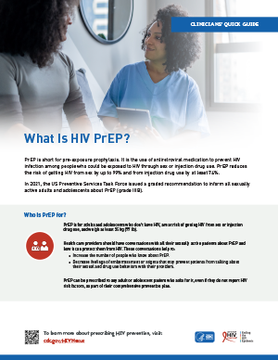
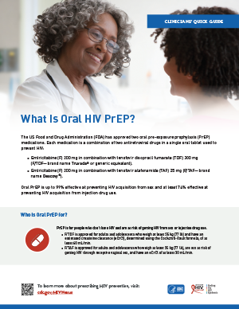
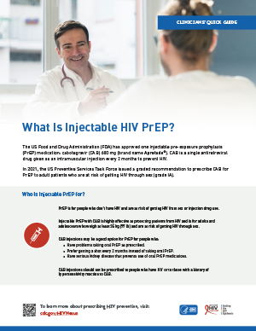
Resources Are Available to Support Prescribing PrEP
Any licensed prescriber can provide PrEP.¹ Resources can be accessed from CDC:
Comprehensive guidelines for prescribing PrEP:
A Clinical Practice Guideline²
Clinical Providers’ Supplement³
Clinicians’ Quick Guides on PrEP:
What Is HIV PrEP? ¹
What Is Oral HIV PrEP?⁴
What Is Injectable HIV PrEP?⁵
These resources can be accessed at: cdc.gov/HIVNexus
¹ Centers for Disease Control and Prevention. What Is HIV PrEP?. Updated August 2022. Accessed January 20, 2023. https://www.cdc.gov/stophivtogether/library/topics/prevention/brochures/cdc-lsht-prevention-brochure-clinicians-quick-guide-what-is-hiv-prep.pdf
² Centers for Disease Control and Prevention, US Public Health Service. Preexposure prophylaxis for the prevention of HIV infection in the United States—2021 update: a clinical practice guideline. Published December 2021. Accessed January 20, 2023. https://www.cdc.gov/hiv/pdf/risk/prep/cdc-hiv-prep-guidelines-2021.pdf
³ Centers for Disease Control and Prevention, US Public Health Service. Preexposure prophylaxis for the prevention of HIV infection in the United States—2021 update: clinical providers’ supplement. Published December 2021. Accessed January 20, 2023. https://www.cdc.gov/hiv/pdf/risk/prep/cdc-hiv-prep-provider-supplement-2021.pdf
⁴ Centers for Disease Control and Prevention. What Is Oral HIV PrEP?. Updated August 2022. Accessed January 20, 2023. http://www.cdc.gov/stophivtogether/library/topics/prevention/brochures/cdc-lsht-prevention-brochure-clinicians-quick-guide-what-is-oral-hiv-prep.pdf
⁵ Centers for Disease Control and Prevention. What Is Injectable HIV PrEP?. Updated August 2022. Accessed January 20, 2023. https://www.cdc.gov/stophivtogether/library/topics/prevention/brochures/cdc-lsht-prevention-brochure-clinicians-quick-guide-what-is-injectable-hiv-prep.pdf
Notes:
Speaker’s Notes:
PrEP can be prescribed by any licensed prescriber.¹ There are a variety of resources available where providers can access guidelines and advice for prescribing PrEP from CDC.
CDC has published detailed guidelines and resources for prescribing PrEP. These include A Clinical Practice Guideline,² which contains the guidelines providers should follow when prescribing PrEP, and a Clinical Providers’ Supplement,³ which includes additional tools for PrEP providers, including a provider/patient checklist and patient information sheets.
CDC has developed Clinicians’ Quick Guides on PrEP, which offer health care providers an overview of the latest information on prescribing PrEP for HIV prevention to their patients and increasing PrEP use by people who could benefit from it.
What Is HIV PrEP? ¹
What Is Oral HIV PrEP? ⁴
What Is Injectable HIV PrEP?⁵
References:
¹ Centers for Disease Control and Prevention. What Is HIV PrEP?. Updated August 2022. Accessed January 20, 2023. https://www.cdc.gov/stophivtogether/library/topics/prevention/brochures/cdc-lsht-prevention-brochure-clinicians-quick-guide-what-is-hiv-prep.pdf
² Centers for Disease Control and Prevention, US Public Health Service. Preexposure prophylaxis for the prevention of HIV infection in the United States—2021 update: a clinical practice guideline. Published December 2021. Accessed January 20, 2023. https://www.cdc.gov/hiv/pdf/risk/prep/cdc-hiv-prep-guidelines-2021.pdf
³ Centers for Disease Control and Prevention, US Public Health Service. Preexposure prophylaxis for the prevention of HIV infection in the United States—2021 update: clinical providers’ supplement. Published December 2021. Accessed January 20, 2023. https://www.cdc.gov/hiv/pdf/risk/prep/cdc-hiv-prep-provider-supplement-2021.pdf
⁴ Centers for Disease Control and Prevention. What Is Oral HIV PrEP?. Updated August 2022. Accessed January 20, 2023. https://www.cdc.gov/stophivtogether/library/topics/prevention/brochures/cdc-lsht-prevention-brochure-clinicians-quick-guide-what-is-oral-hiv-prep.pdf
⁵ Centers for Disease Control and Prevention. What Is Injectable HIV PrEP?. Updated August 2022. Accessed January 20, 2023. https://www.cdc.gov/stophivtogether/library/topics/prevention/brochures/cdc-lsht-prevention-brochure-clinicians-quick-guide-what-is-injectable-hiv-prep.pdf

Slide 31
Resources Are Available to Support Prescribing PrEP (cont’d 1)
Additional prescribing advice can be obtained from the
National Clinician Consultation Center PrEPline:
855-448-7737 (9:00 AM – 8:00 PM EST)
Notes:
Speaker’s Notes:
Providers who have questions or would like additional prescribing advice can call the National Clinician Consultation Center PrEPline at 855-448-7737. The PrEPline is staffed from 9:00 AM to 8:00 PM Eastern time.

Slide 32
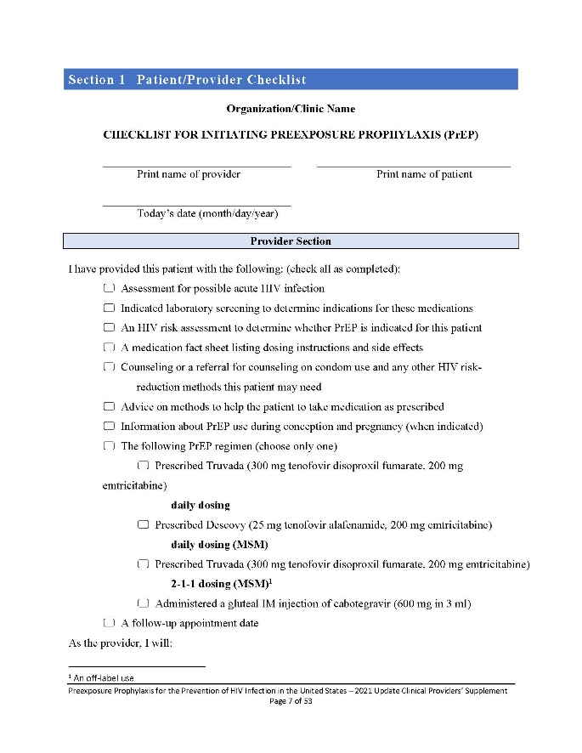
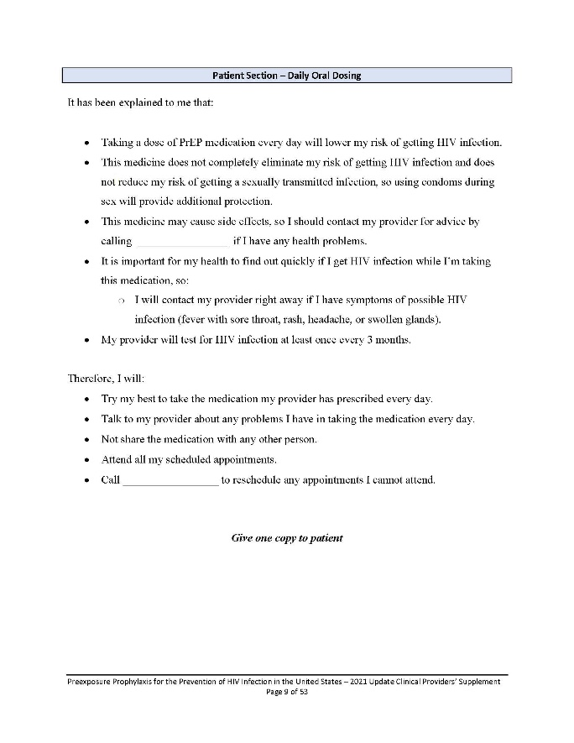
Patient and Provider Checklist for Initiating PrEP
The checklist is available in the Clinical Providers’ Supplement that accompanies the updated PrEP guideline and includes:
Services provided to PrEP patients
Follow-up recommendations for
PrEP patients
Patient actions to maximize PrEP efficacy and safety
Centers for Disease Control and Prevention, US Public Health Service. Preexposure prophylaxis for the prevention of HIV infection in the United States—2021 update—clinical providers’ supplement. Published December 2021. Accessed January 20, 2023. https://www.cdc.gov/hiv/pdf/risk/prep/cdc-hiv-prep-provider-supplement-2017.pdf
Notes:
Speaker’s Notes:
CDC has made available a patient and provider checklist to help document the services providers deliver to patients initiating PrEP, as well as follow-up recommendations and actions to maximize the safety and efficacy of PrEP.
This checklist is available in the clinical providers supplement to the 2021 PrEP guidelines, available from the PrEP Frequently Asked Questions (FAQs) page on CDC’s HIV Nexus website: cdc.gov/HIVNexus.
Reference:
Centers for Disease Control and Prevention, US Public Health Service. Preexposure prophylaxis for the prevention of HIV infection in the United States—2021 update—clinical providers’ supplement. Published December 2021. Accessed January 20, 2023. https://www.cdc.gov/hiv/pdf/risk/prep/cdc-hiv-prep-provider-supplement-2017.pdf

Slide 33
Are there considerations for special populations?
Notes:
Speaker’s Notes:
Let’s now discuss how PrEP is prescribed and what prescribing resources are available.

Slide 34

2-1-1 Oral PrEP Dosing for Men Who Have Sex With Men
F/TDF can be prescribed off-label* using 2-1-1 dosing for adult men who have sex with men who:
  Request non-daily dosing
  Have sex infrequently
  Can anticipate sex at least 2 hours in advance
In 2-1-1 dosing, the patient takes F/TDF doses based on when they plan to have sex:
  Two pills 2-24 hours before sex
  One pill 24 hours after the first two-pill dose
  One pill 48 hours after the first two-pill dose
*2-1-1 dosing is not approved by the FDA and is not recommended by CDC.
  Centers for Disease Control and Prevention, US Public Health Service. Preexposure prophylaxis for the prevention of HIV infection in the United States—2021 update—a clinical practice guideline. Published December 2021. Accessed January 20, 2023. https://www.cdc.gov/hiv/pdf/risk/prep/cdc-hiv-prep-guidelines-2021.pdf
Notes:
Speaker’s Notes:
Health care providers can prescribe F/TDF off-label using 2-1-1 dosing for adult men who have sex with men who request non-daily dosing, have sex infrequently (for example, less often than once a week), and can anticipate or delay sex to permit the first two-pill dose at least 2 hours prior to sex.
2-1-1 dosing is also known as event-driven, intermittent, or on-demand PrEP.
When using 2-1-1 dosing, the patient takes F/TDF doses based on when they plan to have sex:
Two pills 2-24 hours before sex.
One pill 24 hours after the first two-pill dose.
One pill 48 hours after the first two-pill dose.
If a patient continues to have sex during a 2-1-1 dosing period, the patient should take additional doses as follows:
If the patient has sex the day after completing the 2-1-1 doses, take one pill per day until 48 hours after the last sexual event.
If a gap of fewer than 7 days occurs between the last pill and the next time they have sex, resume one pill daily.
If a gap of 7 days or more occurs between the last pill and the last time they have sex, start again with two pills.
2-1-1 dosing should not be prescribed for patients who might have problems adhering to a complex dosing regimen, such as adolescent patients and patients with an active substance use disorder.
Note that 2-1-1 dosing is not approved by the FDA and is not recommended by CDC. CAB injections may be appropriate for people who have problems taking oral PrEP as prescribed.
Reference:
Centers for Disease Control and Prevention, US Public Health Service. Preexposure prophylaxis for the prevention of HIV infection in the United States—2021 update—a clinical practice guideline. Published December 2021. Accessed January 20, 2023. https://www.cdc.gov/hiv/pdf/risk/prep/cdc-hiv-prep-guidelines-2021.pdf

Slide 35
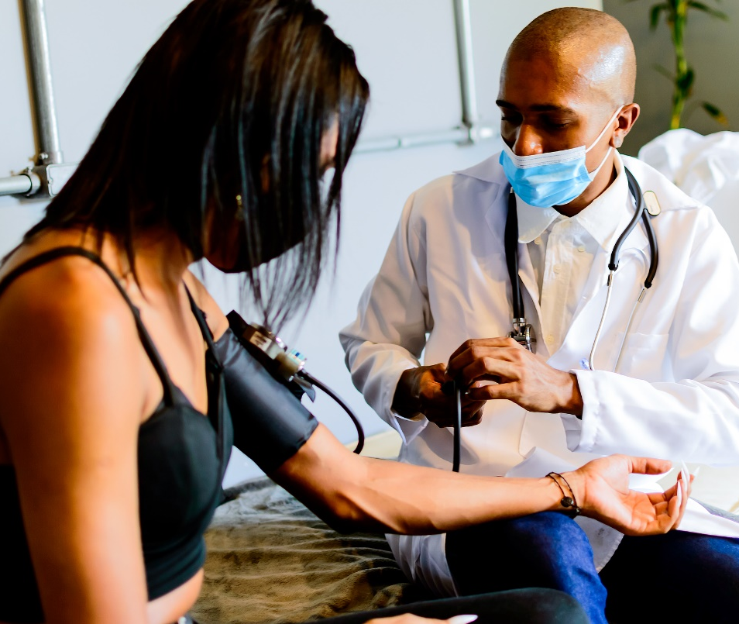
PrEP for Transgender People
Transgender and nonbinary people who use gender-affirming hormones and have HIV risk factors can use PrEP
There is no evidence or clinical studies of potential drug interactions between different classes and combinations of antiretroviral medications and gender-affirming hormone therapy used by transgender people¹⁻³
There are three PrEP regimens approved for transgender women and other people assigned male at birth: daily oral F/TDF, daily oral F/TAF, and CAB injections every two months⁴
There are two PrEP regimens approved for transgender men and other people assigned female at birth who may have receptive vaginal sex: daily oral F/TDF and CAB injections every two months⁴
Transgender men and nonbinary people who engage in receptive vaginal sex should not use daily oral F/TAF for PrEP; F/TAF is not approved for people assigned female at birth who are at risk of getting HIV through receptive vaginal sex⁴
¹ Deutsch MB, Glidden DV, Sevelius J, et al. HIV pre-exposure prophylaxis in transgender women: a subgroup analysis of the iPrEx trial. Lancet HIV. 2015;2(12):e512-e519. doi: 10.1016/S2352-3018(15)00206-4
² Grant RM, Anderson PL, McMahan V, et al. Uptake of pre-exposure prophylaxis, sexual practices, and HIV incidence in men and transgender women who have sex with men: a cohort study. Lancet Infect Dis. 2014;14(9):820-829. doi: 10.1016/S1473-3099(14)70847-3
³ Grant RM, Pellegrini M, Defechereux PA, et al. Sex hormone therapy and tenofovir diphosphate concentration in dried blood spots: primary results of the interactions between antiretrovirals and transgender hormones study. Clin Infect Dis. 2021;73(7):e2117-e2123. doi: 10.1093/cid/ciaa1160.
⁴ Centers for Disease Control and Prevention, US Public Health Service. Preexposure prophylaxis for the prevention of HIV infection in the United States—2021 update: a clinical practice guideline. Published December 2021. Accessed January 20, 2023. https://www.cdc.gov/hiv/pdf/risk/prep/cdc-hiv-prep-guidelines-2021.pdf
⁵ Descovy. Prescribing information. Gilead; 2020. Accessed January 20, 2023. https://www.gilead.com/-/media/files/pdfs/medicines/hiv/descovy/descovy_pi.pdf
Notes:
Speaker’s Notes:
Transgender and nonbinary people who use gender-affirming hormones and have HIV risk factors can use PrEP.
Although clinical studies on whether PrEP interacts with the hormone therapy used by some transgender women are lacking, evidence accumulated from other studies suggests that no drug interactions occur.¹⁻³
There are three PrEP regimens approved for transgender women and other people assigned male at birth:
Daily oral F/TDF
Daily oral F/TAF
CAB injections every two months
There are two PrEP regimens approved for transgender men and other people assigned female at birth who may have receptive vaginal sex:
Daily oral F/TDF
CAB injections every two months
Transgender men and nonbinary people who engage in receptive vaginal sex should not use daily oral F/TAF (Descovy) for PrEP. Descovy is not approved for people assigned female at birth who are at risk of getting HIV through receptive vaginal sex.⁴
References:
¹ Deutsch MB, Glidden DV, Sevelius J, et al. HIV pre-exposure prophylaxis in transgender women: a subgroup analysis of the iPrEx trial. Lancet HIV. 2015;2(12):e512-e519. doi: 10.1016/S2352-3018(15)00206-4
² Grant RM, Anderson PL, McMahan V, et al. Uptake of pre-exposure prophylaxis, sexual practices, and HIV incidence in men and transgender women who have sex with men: a cohort study. Lancet Infect Dis. 2014;14(9):820-829. doi: 10.1016/S1473-3099(14)70847-3
³ Grant RM, Pellegrini M, Defechereux PA, et al. Sex hormone therapy and tenofovir diphosphate concentration in dried blood spots: primary results of the interactions between antiretrovirals and transgender hormones study. Clin Infect Dis. 2021;73(7):e2117-e2123. doi: 10.1093/cid/ciaa1160.
⁴ Centers for Disease Control and Prevention, US Public Health Service. Preexposure prophylaxis for the prevention of HIV infection in the United States—2021 update: a clinical practice guideline. Published December 2021. Accessed January 20, 2023. https://www.cdc.gov/hiv/pdf/risk/prep/cdc-hiv-prep-guidelines-2021.pdf
⁵ Descovy. Prescribing information. Gilead; 2020. Accessed January 20, 2023. https://www.gilead.com/-/media/files/pdfs/medicines/hiv/descovy/descovy_pi.pdf

Slide 36

PrEP Use During Conception, Pregnancy, and Breastfeeding
Benefits of PrEP Use
The risk of getting HIV is higher during conception, pregnancy, and breastfeeding^{1,2}
PrEP with F/TDF or CAB can help protect people* who are seeking to conceive or who are pregnant or breastfeeding and have a sexual partner with HIV^{3,4}
*Most research on PrEP use during conception, pregnancy, and breastfeeding has been conducted in cisgender women. No data are yet available about transgender men or qenderqueer or nonbinary individuals who have become pregnant and given birth while taking PrEP medication.⁴
Safety Profile
No difference in pregnancy outcomes⁵
No adverse effects among fetuses exposed to antiretroviral medications during pregnancy⁶
Limited drug exposure to antiretroviral medications through breast milk⁷⁻⁹
¹ Mugo NR, Heffron R, Donnell D, et al. Increased risk of HIV-1 transmission in pregnancy: a prospective study among African HIV-1-serodiscordant couples. AIDS. 2011;25(15):1887-1895. doi: 10.1097/QAD.0b013e32834a9338
² Thomson KA, Hughes J, Baeten JM, et al. Increased risk of HIV acquisition among women throughout pregnancy and during the postpartum period: a prospective per-coital act analysis among women with HIV-infected partners. J Infect Dis. 2018;218(1):16-25. doi: 10.1093/infdis/jiy113
³ Hoffman RM, Jaycocks A, Vardavas R, et al. Benefits of PrEP as an adjunctive method of HIV prevention during attempted conception between HIV-uninfected women and HIV-infected male partners. J Infect Dis. 2015;212(10):1534-1543. doi: 10.1093/infdis/jiv305
⁴ Centers for Disease Control and Prevention, US Public Health Service. Preexposure prophylaxis for the prevention of HIV infection in the United States—2021 update—a clinical practice guideline. Published December 2021. Accessed January 20, 2023. https://www.cdc.gov/hiv/pdf/risk/prep/cdc-hiv-prep-guidelines-2021.pdf
⁵ Dettinger JC, Kinuthia J, Pintye J, et al. Perinatal outcomes following maternal pre-exposure prophylaxis (PrEP) use during pregnancy: results from a large PrEP implementation program in Kenya. J Int AIDS Soc. 2019;22(9):e25378. doi: 10.1002/jia2.25378
⁶ The Antiretroviral Pregnancy Registry. Interim Report: 1 January 1989 through 31 July 2022. Published December 2022. Accessed January 20, 2023. http://apregistry.com/forms/exec-summary.pdf
⁷ Mugwanya KK, John-Stewart G, Baeten J. Safety of oral tenofovir disoproxil fumarate-based HIV pre-exposure prophylaxis use in lactating HIV-uninfected women. Exp Opin Drug Saf. 2017;16(7):867-871. doi: 10.1080/14740338.2017.1338271
⁸ Benaboud S, Pruvost A, Coffie PA, et al. Concentrations of tenofovir and emtricitabine in breast milk of HIV-1-infected women in Abidjan, Cote d’Ivoire, in the ANRS 12109 TEmAA Study, Step 2. Antimicrob Agents Chemother. 2011;55(3):1315-1317. doi: 10.1128/AAC.00514-10
⁹ Waitt C, Olagunju A, Nakalema S, et al. Plasma and breast milk pharmacokinetics of emtricitabine, tenofovir and lamivudine using dried blood and breast milk spots in nursing African mother–infant pairs. J Antimicrob Chemother.
2018;73(4):1013-1019. doi: 10.1093/jac/dkx507
Notes:
Speaker’s Notes:
Studies have shown that the risk of getting HIV is higher during conception (i.e., when people are having sex without condoms), pregnancy, and breastfeeding.^{1,2}
PrEP with F/TDF or CAB can help protect people who are seeking to conceive or who are pregnant or breastfeeding and have a sexual partner with HIV, especially if that partner’s viral load is unknown, is detectable, or cannot be documented as undetectable.^{3,4}
Note that only F/TDF and CAB are FDA approved for use by women and other people at risk of getting HIV through vaginal sex, including those who are pregnant or breastfeeding.⁴
F/TAF is not approved for use by women or other people who could get HIV through receptive vaginal sex
If the partner’s viral load is less than 200 copies/mL or undetectable, there is effectively no risk of transmitting HIV through sex.⁵ How much additional protection PrEP offers when the partner’s viral load is undetectable is unknown.⁴
However, PrEP may provide additional protection if the partner’s viral load is inconsistently undetectable or if there are multiple sexual partners.⁴
A recent study of 203 Kenyan women with prenatal PrEP use and 1,324 without prenatal PrEP use revealed no difference in pregnancy outcomes (preterm birth or low birthweight) and similar infant growth 6 weeks after birth.⁶
Data on the safety of PrEP during conception, pregnancy, and breastfeeding continue to be collected.⁴ CDC encourages providers to prospectively and anonymously submit information about any pregnancies during which PrEP is used to the Antiretroviral Pregnancy Registry. The registry can be accessed at http://apregistry.com/.
Data collected to date in the Antiretroviral Pregnancy Registry provide no evidence of adverse effects among fetuses exposed to antiretroviral medications during pregnancy.⁷
The effects of PrEP on babies exposed to these medications through breast milk have not been studied. However, studies of mothers with HIV who breastfeed while taking antiretroviral medications for HIV treatment suggest that babies have limited drug exposure through breast milk.⁸⁻¹⁰
References:
¹ Mugo NR, Heffron R, Donnell D, et al. Increased risk of HIV-1 transmission in pregnancy: a prospective study among African HIV-1-serodiscordant couples. AIDS. 2011;25(15):1887-1895. doi: 10.1097/QAD.0b013e32834a9338
² Thomson KA, Hughes J, Baeten JM, et al. Increased risk of HIV acquisition among women throughout pregnancy and during the postpartum period: a prospective per-coital act analysis among women with HIV-infected partners. J Infect Dis. 2018;218(1):16-25. doi: 10.1093/infdis/jiy113
³ Hoffman RM, Jaycocks A, Vardavas R, et al. Benefits of PrEP as an adjunctive method of HIV prevention during attempted conception between HIV-uninfected women and HIV-infected male partners. J Infect Dis. 2015;212(10):1534-1543. doi: 10.1093/infdis/jiv305
⁴ Centers for Disease Control and Prevention, US Public Health Service. Preexposure prophylaxis for the prevention of HIV infection in the United States—2021 update—a clinical practice guideline. Published December 2021. Accessed January 20, 2023. https://www.cdc.gov/hiv/pdf/risk/prep/cdc-hiv-prep-guidelines-2021.pdf
⁵ Panel on Treatment of HIV During Pregnancy and Prevention of Perinatal Transmission.. Recommendations for use of antiretroviral drugs during pregnancy and interventions to reduce perinatal HIV Transmission in the United States. Published 2022. Accessed January 20, 2023. https://clinicalinfo.hiv.gov/en/guidelines/perinatal/recommendations-arv-drugs-pregnancy-overview
⁶ Dettinger JC, Kinuthia J, Pintye J, et al. Perinatal outcomes following maternal pre-exposure prophylaxis (PrEP) use during pregnancy: results from a large PrEP implementation program in Kenya. J Int AIDS Soc. 2019;22(9):e25378. doi: 10.1002/jia2.25378
⁷ The Antiretroviral Pregnancy Registry. Interim Report: 1 January 1989 through 31 July 2022. Published December 2022. Accessed January 20, 2023. http://apregistry.com/forms/exec-summary.pdf
⁸ Mugwanya KK, John-Stewart G, Baeten J. Safety of oral tenofovir disoproxil fumarate-based HIV pre-exposure prophylaxis use in lactating HIV-uninfected women. Exp Opin Drug Saf. 2017;16(7):867-871. doi: 10.1080/14740338.2017.1338271
⁹ Benaboud S, Pruvost A, Coffie PA, et al. Concentrations of tenofovir and emtricitabine in breast milk of HIV-1-infected women in Abidjan, Cote d’Ivoire, in the ANRS 12109 TEmAA Study, Step 2. Antimicrob Agents Chemother. 2011;55(3):1315-1317. doi: 10.1128/AAC.00514-10
¹⁰ Waitt C, Olagunju A, Nakalema S, et al. Plasma and breast milk pharmacokinetics of emtricitabine, tenofovir and lamivudine using dried blood and breast milk spots in nursing African mother–infant pairs. J Antimicrob Chemother. 2018;73(4):1013-1019. doi: 10.1093/jac/dkx507

Slide 37

PrEP for Adolescents
Oral¹ and injectable² PrEP medications are approved by the FDA for use by adolescents without HIV who weigh at least 35 kg (77 lbs)
Adolescents should be offered the same prevention options as adults as part of their comprehensive sexual health care
Adolescents and young adults (aged 13 to 24) comprise about
21% of all new HIV infections in the United States³
¹ Tanner MR, Miele P, Carter W, et al. Preexposure prophylaxis for prevention of HIV acquisition among adolescents: clinical considerations, 2020. MMWR Recomm Rep. 2020;69(No. RR-3):1-12. doi: 10.15585/mmwr.rr6903a1
² FDA approves first injectable treatment for HIV pre-exposure prevention. U.S. Food & Drug Administration (FDA); December 20, 2021. Accessed January 20, 2023. https://www.fda.gov/news-events/press-announcements/fda-approves-first-injectable-treatment-hiv-pre-exposure-prevention
³ Centers for Disease Control and Prevention. Diagnoses of HIV infection in the United States and dependent areas, 2019. HIV Surveillance Report; vol 32. Published May 2021, Accessed January 20, 2023. https://www.cdc.gov/hiv/pdf/library/reports/surveillance/cdc-hiv-surveillance-report-2018-updated-vol-32.pdf
Notes:
Speaker’s Notes:
On May 15, 2018, the FDA expanded approval of F/TDF for PrEP in at-risk adolescents weighing at least 35 kg (77 lbs), in combination with safer sex practices, to reduce the risk of sexually acquired HIV-1 using the same fixed-dose previously prescribed to adults.¹
The FDA subsequently approved F/TAF for PrEP in adults and adolescents weighing at least 35 kg (77 lbs) in October 2019.²
Many adolescents and young adults aged 13-24 years old can benefit from PrEP. According to CDC, in 2019, people aged 13 to 24 years comprised 21% of all new HIV diagnoses in the United States—and 81% of those new diagnoses were among young men who have sex with men, many of whom could not, prior to this approval, access PrEP.³
The expanded indication for PrEP in adolescents was based on a single-arm, open label clinical trial called ATN 113, conducted by the Adolescent Medicine Trials Network for HIV/AIDS. The safety and tolerability profiles in this study group were comparable to those observed in previous adult PrEP studies.¹
References:
¹ U.S. Food and Drug Administration approves expanded indication for Truvada® (emtricitabine and tenofovir disoproxil fumarate) for reducing the risk of acquiring HIV-1 in adolescents–first agent indicated for uninfected adolescents at risk of acquiring HIV. Business Wire. May 15, 2018. Accessed January 20, 2023. https://www.businesswire.com/news/home/20180515006187/en/
² FDA approves second drug to prevent HIV infection as part of ongoing efforts to end the HIV epidemic. FDA. October 3, 2019. https://www.fda.gov/news-events/press-announcements/fda-approves-second-drug-prevent-hiv-infection-part-ongoing-efforts-end-hiv-epidemic
³ Centers for Disease Control and Prevention. Diagnoses of HIV infection in the United States and dependent areas, 2019. HIV Surveillance Report; vol 32. Published May 2021, Accessed January 20, 2023. https://www.cdc.gov/hiv/pdf/library/reports/surveillance/cdc-hiv-surveillance-report-2018-updated-vol-32.pdf

Slide 38
Review
Notes:
Speaker’s Notes:
Let’s review what we’ve learned so far.

Slide 39
Summary
PrEP can be easily integrated into
primary care settings
as it is similar to other preventative medications, such as statins for cardiovascular disease
PrEP—medication to prevent HIV—is for adults and adolescents at risk of getting HIV
Obtaining a brief sexual history from all patients ensures providers have the information they need, helps to reduce stigma and discomfort, and facilitates identifying teachable moments
Three PrEP medications are approved by the
U.S. Food and Drug Administration:
F/TDF (Truvada® or generic equivalent)
F/TAF (Descovy®)
CAB (Apretude®)
Resources are available
to help patients
pay for PrEP
Notes:
Speaker’s Notes:
Let’s review what we’ve covered in this presentation:
PrEP is a medication taken to prevent HIV and can be used by adults and adolescents at risk of getting HIV.
Obtaining a brief sexual history from each patient ensures that health care providers receive the information they need, helps to reduce stigma and discomfort, and facilitates identifying teachable moments.
Prescribing PrEP can be easily integrated into primary care settings.
In fact, PrEP is similar to other preventative medications, such as statins for people at risk of cardiovascular disease and metformin for people at risk of diabetes.
The U.S. Food and Drug Administration has approved three PrEP medications:
F/TDF, available as Truvada® or generic equivalent.
F/TAF, available as Descovy®.
CAB, available as Apretude®.
Resources are available to help your patients pay for PrEP.

Slide 40


Summary (cont’d 1)
PrEP should be considered
as part of a comprehensive
HIV-prevention plan and can be provided by any licensed prescriber
When taken as prescribed, PrEP is well tolerated and reduces the risk of getting HIV from sex by about 99% and from injection drug use by at least 74%
Three forms of PrEP medication
are available:
Oral F/TAF (Descovy®)
Oral F/TDF (Truvada® or generic equivalent)
Injectable CAB (Apretude®)
PrEP can be prescribed to any adult or adolescent patient who asks for it,
even if they don’t report specific risk factors for HIV
Notes:
Speaker’s Notes:
Health care providers should consider PrEP as one part of a patient’s comprehensive HIV-prevention plan, which should also include condom use and treatment for STIs.
Any licensed prescriber can provide PrEP. Specialization in infectious diseases or HIV care is not required.
PrEP is well tolerated and highly effective at preventing HIV transmission: 99% effective at preventing HIV transmission through sexual contact and at least 74% effective at preventing HIV transmission through injection drug use.
Three forms of PrEP medication can be prescribed:
Oral F/TAF (brand name Descovy®).
Oral F/TDF (brand name Truvada® or generic equivalent).
Injectable CAB (Apretude®).
PrEP can be prescribed to any adult or adolescent patient who asks for it, even if they don’t report specific risk factors for HIV. Patients may ask for PrEP to protect themselves but be unwilling to share more information about their behaviors with providers if they fear encountering stigma or discrimination.
Having conversations about PrEP with patients can help them overcome embarrassment about talking about their drug-injection and sexual behaviors. Additionally, providers should prioritize taking a sexual and substance use history from all patients. This information is essential to understand each patient’s risk of getting HIV, if PrEP might be right for them, and what other risk-reduction services should be offered. As presented earlier in this presentation, CDC has developed flowcharts and other resources to help with these conversations and assessments, all of which can be accessed on cdc.gov/HIVNexus.

Slide 41
Review
Which of the following statements is false?
A
B
C
D
Both oral and injectable PrEP medications are available
PrEP medications are generally well tolerated, and side effects are typically mild to moderate, manageable, and temporary
PrEP can only be prescribed by an infectious disease or HIV specialist
Telling all sexually active adults and adolescents that PrEP can protect them from getting HIV is a graded recommendation (IIIB) in the CDC PrEP guideline
Notes:
Speaker’s Notes:
Let’s take a moment to review. Which of the following statements is false?
A. Both oral and injectable PrEP medications are available.
B. PrEP medications are generally well tolerated, and side effects are typically mild to moderate, manageable, and temporary.
C. PrEP can only be prescribed by an infectious disease or HIV specialist.
D. Telling all sexually active adults and adolescents that PrEP can protect them from getting HIV is a graded recommendation (IIIB) in CDC PrEP guideline.

Slide 42
The Correct Answer is C
Which of the following statements is false?
A
B
C
D
Both oral and injectable PrEP medications are available
PrEP medications are generally well tolerated, and side effects are typically mild to moderate, manageable, and temporary
PrEP can only be prescribed by an infectious disease or HIV specialist
Telling all sexually active adults and adolescents that PrEP can protect them from getting HIV is a graded recommendation (IIIB) in CDC PrEP guideline
Notes:
Speaker’s Notes:
The correct answer is C. Any licensed prescriber can provide PrEP, and PrEP can be incorporated into primary care practice alongside other regularly prescribed preventive measures.

Slide 43
Review (cont’d 1)
For which of these patients is PrEP inappropriate?
A
B
C
D
E
A man who has sex with men who reports inconsistent condom use
A heterosexual woman in a
long-term monogamous marriage who asks for PrEP
A heterosexual man with multiple sex partners of unknown HIV status
A patient diagnosed with an acute STI
None of the above
Notes:
Speaker’s Notes:
For which of these patients is PrEP inappropriate:
A. A man who has sex with men who reports inconsistent condom use.
B. A heterosexual woman in a long-term monogamous marriage who asks for PrEP.
C. A heterosexual man with multiple sex partners of unknown HIV status.
D. A patient diagnosed with an acute STI.
E. None of the above.

Slide 44
The Correct Answer is E
For which of these patients is PrEP inappropriate?
A
B
C
D
E
A man who has sex with men who reports inconsistent condom use
A heterosexual woman in a
long-term monogamous marriage who asks for PrEP
A heterosexual man with multiple sex partners of unknown HIV status
A patient diagnosed with an acute STI
None of the above
Notes:
Speaker’s Notes:
The correct answer is E, none of the above.
Providers should tell all their sexually active patients about PrEP and how it can protect them from getting HIV.
PrEP should be prescribed to any patient who asks for it, including sexually active adults and adolescents who do not report risk factors for HIV.

