Slide 1

Leveraging Partner Services to Help Reduce HIV Transmission
A Guide for Health Care Providers
2022
Notes:
Speaker’s Notes:
Welcome to this presentation on leveraging Partner Services to help reduce HIV transmission.

Slide 2

Overview
What Is Partner Services?
The provider’s role in initiating
Partner Services
Review
Notes:
Speaker’s Notes:
This slide provides an overview of the topics that will be covered in this presentation:
What Is Partner Services?
The provider’s role in initiating Partner Services.
Review.

Slide 3
Learning Objectives
Upon completion of this presentation, health care providers will be able to:
Explain how Partner Services can help reduce HIV transmission
Have brief conversations with their patients about Partner Services
Play an active role in linking their patients to Partner Services
Understand how support services can improve their patients’ adherence to HIV treatment
Notes:
Speaker’s Notes:
Upon completing this presentation, health care providers will be able to:
Explain how Partner Services can help reduce HIV transmission.
Have brief conversations with their patients about Partner Services.
Play an active role in linking their patients to Partner Services.
Understand how support services can improve their patients’ adherence to HIV treatment.

Slide 4
What is Partner Services?
Notes:
Speaker’s Notes:
Let’s start by examining what Partner Services is and how it can benefit both patients and health care providers.

Slide 5
What Is Partner Services?
In 2018, Partner Services programs notified
18,588
partners of their potential HIV exposure, and tested
7,166
for HIV²
A function of local and state health departments, Partner Services has three goals¹:
  To provide services to people diagnosed with HIV or other sexually transmitted infections (STIs), including risk-reduction counseling and referrals for medical care and other services (e.g., psychosocial support and prevention interventions)
  To ensure that sexual and drug injection partners of people diagnosed with HIV or other STIs are notified of their potential exposure, provided with counseling and testing, treated or linked to medical care if needed, and provided with other appropriate referrals
  To reduce future rates of transmission by facilitating early diagnosis
16%
of partners with a documented HIV test result were newly diagnosed with HIV²
  ¹ Centers for Disease Control and Prevention. Partner Services for HIV and STDs: a guide for health care providers. Accessed August 16, 2021. https://www.cdc.gov/stophivtogether/library/topics/treatment/brochures/cdc-hiv-lsht-treatment-brochure-partner-services-provider.pdf
  ² Centers for Disease Control and Prevention. Partner Services annual report 2018. Published October 2020. Accessed August 16, 2021. https://www.cdc.gov/hiv/pdf/library/reports/cdc-hiv-partner-services-annual-report-2018.pdf
Notes:
Speaker’s Notes:
Partner Services is a function of local and state health departments and has three goals¹:
To provide services to people diagnosed with HIV or other sexually transmitted infections (STIs), including risk-reduction counseling and referrals for medical care and other services (e.g., psychosocial support and prevention interventions).
To ensure that sexual and drug injection partners of people diagnosed with HIV or other STIs are notified of their potential exposure, provided with counseling and testing, treated or linked to medical care if needed, and provided with other appropriate referrals.
To reduce future rates of transmission by facilitating early diagnosis.
In 2018, 16% of partners tested for HIV by Partner Services were newly identified as having HIV.² These individuals had no evidence of previous HIV diagnosis in the health department surveillance system, laboratory reports, medical records, or patient self-report.²
References:
¹ Centers for Disease Control and Prevention. Partner Services for HIV and STDs: a guide for health care providers. Accessed August 16, 2021. https://www.cdc.gov/stophivtogether/library/topics/treatment/brochures/cdc-hiv-lsht-treatment-brochure-partner-services-provider.pdf
² Centers for Disease Control and Prevention. Partner Services annual report 2018. Published October 2020. Accessed August 16, 2021. https://www.cdc.gov/hiv/pdf/library/reports/cdc-hiv-partner-services-annual-report-2018.pdf

Slide 6
How Does Partner Notification Work?
Notifying sexual or drug injection partners that they may have been exposed to an infectious disease is formally known as partner notification. Health departments use one of three methods to do this:
Health Department Tells Patient’s Partners (“Provider Referral”):
Your patient provides partner contact information to the health department
Partners are located by health department staff and made aware of their potential exposure
Partners are provided, or referred for, counseling, testing, treatment, and other services by the health department
Patient Tells Partners (“Self-Referral”):
Your patient takes on the responsibility of letting sexual or drug injection partners know that they have possibly been exposed
Your patient provides partners with the information about local services, including counseling and testing
Both the Patient and the Health Department Tell Partners (“Dual Referral”):
Your patient, with assistance from health department staff, lets partners know of their potential exposure
Health department staff are there to help your patient during the process and provide partners with information and access to counseling, testing, and other resources
  Centers for Disease Control and Prevention. Partner Services for HIV and STDs: a guide for health care providers. Accessed August 16, 2021. https://www.cdc.gov/stophivtogether/library/topics/treatment/brochures/cdc-hiv-lsht-treatment-brochure-partner-services-provider.pdf
Notes:
Speaker’s Notes:
Notifying sexual or drug injection partners that they may have been exposed to an infectious disease is formally known as partner notification.
Health departments typically use one of three methods of partner notification.
In the Provider Referral method, the health department tells your patient’s partners. Your patient provides contact information for their partners to the health department. Health department staff then contact partners, inform them of their potential exposure to HIV or STIs, and provide or make referrals to counseling, testing, treatment, and other services.
In the Self-Referral method, your patient takes full responsibility for letting their partners know of their potential exposure and for providing them with information about counseling and testing services.
In the Dual Referral method, your patient notifies their partners of their potential exposure with assistance from the health department. Health department staff support your patient and provide their partners with information about and access to counseling, testing, treatment, and other services.
Reference:
Centers for Disease Control and Prevention. Partner Services for HIV and STDs: a guide for health care providers. Accessed August 16, 2021. https://www.cdc.gov/stophivtogether/library/topics/treatment/brochures/cdc-hiv-lsht-treatment-brochure-partner-services-provider.pdf

Slide 7
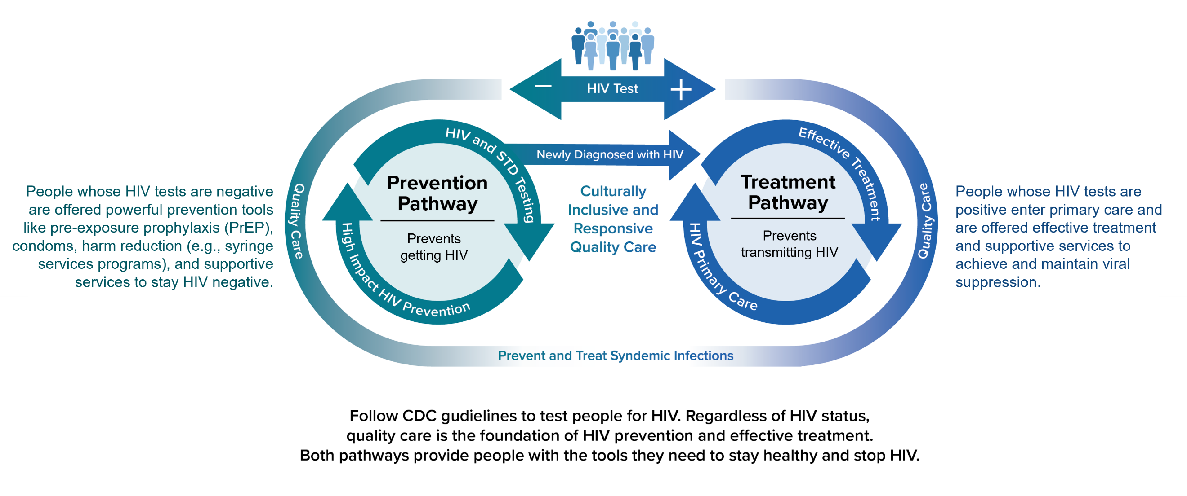
Status-Neutral HIV Prevention and Care Continuum
  The White House. National HIV/AIDS strategy for the United States 2022–2025. p. 34. Published 2021. Accessed February 2, 2022. https://www.whitehouse.gov/wp-content/uploads/2021/11/National-HIV-AIDS-Strategy.pdf
Notes:
Speaker’s Notes:
Partner Services contributes to the CDC’s status-neutral approach to HIV prevention and care in three main ways, as indicated by the orange arrows on the slide:
Partner Services can assist individuals who are newly diagnosed with HIV notify their sexual and drug injection partners of their potential exposure to HIV and provide their partners with access to HIV testing and other services, such as counseling.
If a partner is found to have HIV, Partner Services can link them to treatment and care to help them live healthy lives and reduce the risk of transmitting HIV.
If a partner has a negative HIV test, Partner Services can link them to prevention services, such as pre-exposure prophylaxis (PrEP).
Reference:
The White House. National HIV/AIDS strategy for the United States 2022–2025. p. 34. Published 2021. Accessed February 2, 2022. https://www.whitehouse.gov/wp-content/uploads/2021/11/National-HIV-AIDS-Strategy.pdf

Slide 8
Discussion Question
Which patients are candidates for Partner Services?
A
B
C
D
E
Patients with newly diagnosed HIV
Patients with HIV who indicate ongoing
high-risk behaviors
Patients with diagnosed syphilis, gonorrhea, or chlamydia
New patients referred to your practice with an STI
New patients referred to your practice with HIV
  Centers for Disease Control and Prevention. Sexually transmitted diseases treatment guidelines, 2015. MMWR Morb Mortal Wkly Rep. 2015;64(3):1-137. Accessed March 27, 2020. https://www.cdc.gov/mmwr/preview/mmwrhtml/rr6403a1.htm
Notes:
[***This slide is intended for use as a discussion prompt with the audience. The Speaker may pose the question to the audience to encourage audience engagement, or the Speaker may simply present the information. The answer to the question appears in the Speaker’s Notes on the next slide.***]
Speaker’s Notes:
Which of the following types of patients are candidates for Partner Services?
Patients with newly diagnosed HIV.
Patients with HIV who indicate ongoing high-risk behaviors.
Patients with diagnosed syphilis, gonorrhea, or chlamydia.
New patients referred to your practice with an STI.
New patients referred to your practice with HIV.
Reference:
Centers for Disease Control and Prevention. Sexually transmitted diseases treatment guidelines, 2015. MMWR Morb Mortal Wkly Rep. 2015;64(3):1-137. https://www.cdc.gov/mmwr/preview/mmwrhtml/rr6403a1.htm

Slide 9
The Correct Answer is A
Which patients are candidates for Partner Services?
A
B
C
D
E
Patients with newly diagnosed HIV
Patients with HIV who indicate ongoing
high-risk behaviors
Patients with diagnosed syphilis, gonorrhea, or chlamydia
New patients referred to your practice with an STI
New patients referred to your practice with HIV
  Centers for Disease Control and Prevention. Sexually transmitted diseases treatment guidelines, 2015. MMWR Morb Mortal Wkly Rep. 2015;64(3):1-137. Accessed March 27, 2020. https://www.cdc.gov/mmwr/preview/mmwrhtml/rr6403a1.htm
Notes:
[***This slide is intended for use as a discussion prompt with the audience. The Speaker may pose the question to the audience to encourage audience engagement, or the Speaker may simply present the information. The answer to the question appears in below in the Speaker’s Notes.***]
Speaker’s Notes:
If you chose “A”, you would be correct: All people with newly diagnosed or reported HIV should be offered HIV Partner Services at least once, at diagnosis or as soon as possible after diagnosis.
Reference:
Centers for Disease Control and Prevention. Sexually transmitted diseases treatment guidelines, 2015. MMWR Morb Mortal Wkly Rep. 2015;64(3):1-137. https://www.cdc.gov/mmwr/preview/mmwrhtml/rr6403a1.htm

Slide 10
The Correct Answer is A… and B, C, D, and E!
Which patients are candidates for Partner Services?
A
B
C
D
E
Patients with newly diagnosed HIV
Patients with HIV who indicate ongoing
high-risk behaviors
Patients with diagnosed syphilis, gonorrhea, or chlamydia
New patients referred to your practice with an STI
New patients referred to your practice with HIV
  Centers for Disease Control and Prevention. Sexually transmitted diseases treatment guidelines, 2015. MMWR Morb Mortal Wkly Rep. 2015;64(3):1-137. Accessed March 27, 2020. https://www.cdc.gov/mmwr/preview/mmwrhtml/rr6403a1.htm
Notes:
[***This slide is intended for use as a discussion prompt with the audience. The Speaker may pose the question to the audience to encourage audience engagement, or the Speaker may simply present the information. The answer to the question appears in below in the Speaker’s Notes.***]
Speaker’s Notes:
But patients who are newly diagnosed with HIV are not the only ones who can benefit from the support offered by Partner Services.
Partner Services should also be offered to:
Patients with HIV who indicate ongoing unsafe sexual or drug use behaviors.
Patients with diagnosed syphilis, gonorrhea, or chlamydia.
New patients referred to your practice with an STI.
New patients referred to your practice with HIV.
Reference:
Centers for Disease Control and Prevention. Sexually transmitted diseases treatment guidelines, 2015. MMWR Morb Mortal Wkly Rep. 2015;64(3):1-137. https://www.cdc.gov/mmwr/preview/mmwrhtml/rr6403a1.htm

Slide 11
Discussion Question 2
What is the primary role of Partner Services?
A
B
C
D
To provide confidential partner notification to people with HIV or other STIs and their sexual and drug injection partners
To identify patients with diagnosed STIs, such as syphilis, gonorrhea, or chlamydia
To provide local and state health departments with surveillance information to track down people spreading STIs
To teach vulnerable patients with HIV how to practice safer sex
Notes:
[***This slide is intended for use as a discussion prompt with the audience. The Speaker may pose the question to the audience to encourage audience engagement, or the Speaker may simply present the information. The answer to the question appears in the Speaker’s Notes on the next slide.***]
Speaker’s Notes:
Let’s review. What is the primary role of Partner Services?
To provide confidential partner notification to people with HIV or other STIs and their sexual and drug injection partners.
To identify patients with diagnosed STIs, such as syphilis, gonorrhea, or chlamydia.
To provide local and state health departments with surveillance information to track down people spreading STIs.
To teach vulnerable patients with HIV how to practice safer sex.

Slide 12
The Correct Answer is A (2)
What is the primary role of Partner Services?
A
B
C
D
To provide confidential partner notification to people with HIV or other STIs and their sexual and drug injection partners
To identify patients with diagnosed STIs, such as syphilis, gonorrhea, or chlamydia
To provide local and state health departments with surveillance information to track down people spreading STIs
To teach vulnerable patients with HIV how to practice safer sex
Notes:
[***This slide is intended for use as a discussion prompt with the audience. The Speaker may pose the question to the audience to encourage audience engagement, or the Speaker may simply present the information. The answer to the question appears below in the Speaker’s Notes.***]
Speaker’s Notes:
The correct answer is “A.” Partner Services programs reduce HIV transmission by confidentially assisting patients with HIV in notifying all their sexual and drug injection partners about their HIV status.

Slide 13
The provider’s role in initiating Partner Services
Notes:
Speaker’s Notes:
Now let’s discuss the role of health care providers in initiating Partner Services.

Slide 14
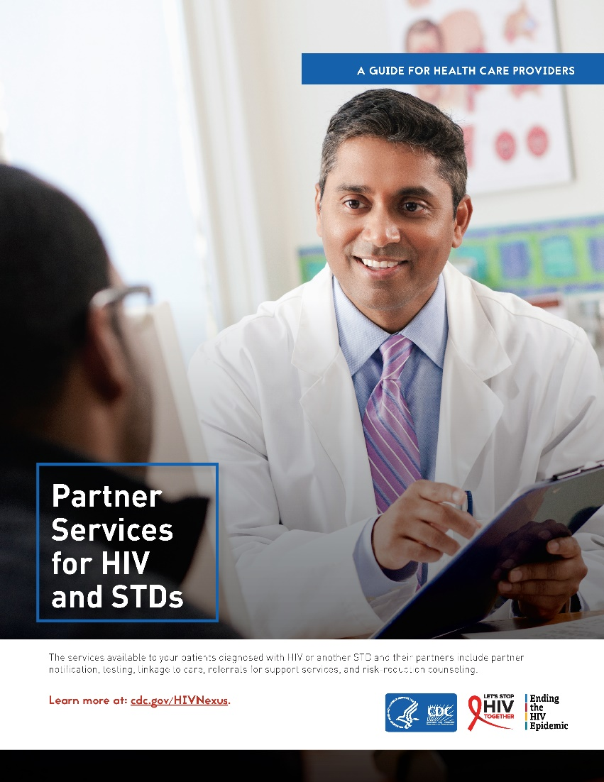
The Provider’s Role in Initiating Partner Services (2)
For Patients Being Tested for HIV or STIs
Talk with your patients about Partner Services and let them know that if they test positive for a reportable disease, they may be contacted by someone from the health department
Discuss how Partner Services can help your patients and their sexual or drug injection partners through early access to testing, treatment, and other services
Emphasize the importance of participating in the Partner Services process to help stop the transmission of HIV and STIs
Conduct brief discussions with your patients on how they can protect themselves and their partners from HIV and STIs
  Centers for Disease Control and Prevention. Partner Services for HIV and STDs: a guide for health care providers. Accessed August 16, 2021. https://www.cdc.gov/stophivtogether/library/topics/treatment/brochures/cdc-hiv-lsht-treatment-brochure-partner-services-provider.pdf
Notes:
Speaker’s Notes:
For patients being tested for HIV or STIs:
Talk with your patients about Partner Services and let them know that if they test positive for a reportable disease, they may be contacted by someone from the health department.
Discuss how Partner Services can help your patients and their sexual or drug injection partners through early access to testing, treatment, and other services.
Emphasize the importance of participating in the Partner Services process to help stop the transmission of HIV and STIs.
Conduct brief discussions with your patients on how they can protect themselves from HIV and STIs.
Reference:
Centers for Disease Control and Prevention. Partner Services for HIV and STDs: a guide for health care providers. Accessed August 16, 2021. https://www.cdc.gov/stophivtogether/library/topics/treatment/brochures/cdc-hiv-lsht-treatment-brochure-partner-services-provider.pdf

Slide 15
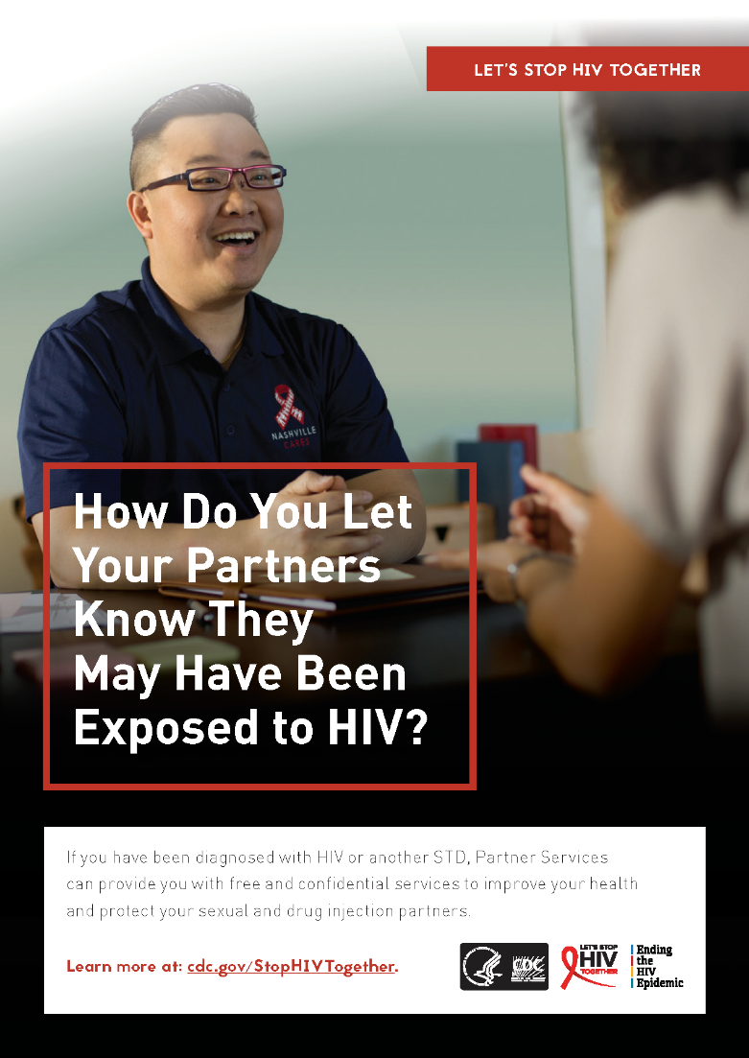
The Provider’s Role in Initiating Partner Services (cont’d 1)(3)
For People Newly Diagnosed With HIV
Partner Services can provide linkages to treatment and care,
risk-reduction counseling, and other services
  These linkages can supplement any arrangements you make to help your patients access these services.
Share that Partner Services can provide their sexual and drug injection partners who test positive with the same linkages to treatment and care. For partners who test negative, Partner Services can provide information on various HIV-prevention methods, including:
  pre-exposure prophylaxis (PrEP)
  condoms
  other sexual and drug-use options associated with lower risk of
  HIV transmission
Partner Services can also provide access to other services that can equip patients to access treatment and protect their sexual and drug injection partners from HIV
  Centers for Disease Control and Prevention. Partner Services for HIV and STDs: a guide for health care providers. Accessed August 16, 2021. https://www.cdc.gov/stophivtogether/library/topics/treatment/brochures/cdc-hiv-lsht-treatment-brochure-partner-services-provider.pdf
Notes:
Speaker’s Notes:
For people who are newly diagnosed with HIV, Partner Services can provide linkages to treatment and care, risk-reduction counseling, and other services. These linkages can supplement any arrangements you may make to help your patients access these services.
Share that Partner Services can provide their sexual and drug injection partners who test positive with the same linkages to treatment and care. For partners who test negative, Partner Services can provide information on various HIV-prevention methods, such as pre-exposure prophylaxis (PrEP), condoms, and other sexual and drug-use options.
In addition, Partner Services can provide access to other services that can equip patients to access treatment and protect their sexual and drug injection partners from HIV.
Reference:
Centers for Disease Control and Prevention. Partner Services for HIV and STDs: a guide for health care providers. Accessed August 16, 2021. https://www.cdc.gov/stophivtogether/library/topics/treatment/brochures/cdc-hiv-lsht-treatment-brochure-partner-services-provider.pdf

Slide 16
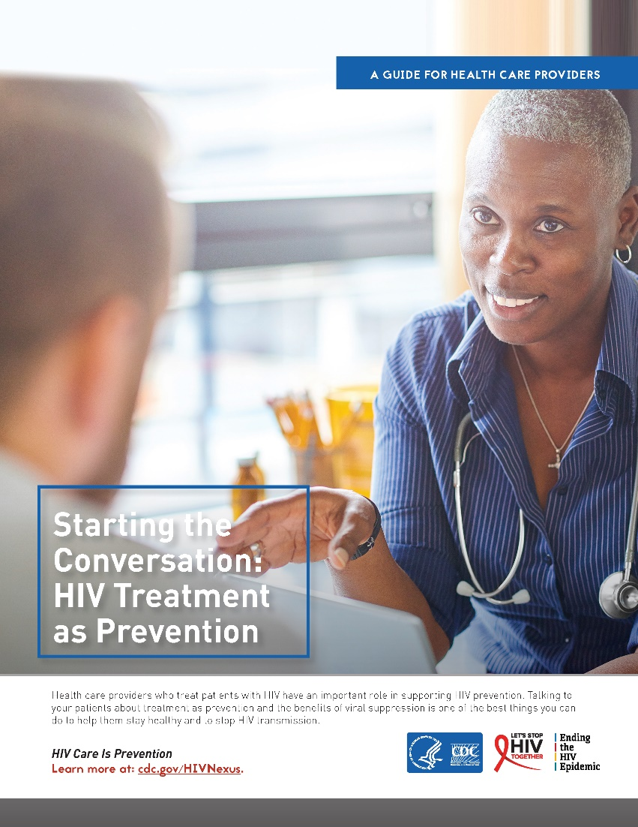
The Provider’s Role in Initiating Partner Services (cont’d 2)(4)
For Patients With HIV
If your patient with HIV presents with an STI, make them aware that they may be contacted by someone from the health department
If your patient with HIV informs you of behavior that places them at increased risk for transmitting HIV (e.g., sex without condoms when not virally suppressed or needle sharing during injection drug use), discuss:
  the importance of taking HIV medicine, or antiretroviral therapy, to
  treat HIV
  additional steps they can take to protect others from getting HIV, such as sexual or drug-use options associated with lower risk of HIV transmission
Refer any of your patients with HIV who present with an STI or need help notifying partners potentially at risk to Partner Services
  Centers for Disease Control and Prevention. Partner Services for HIV and STDs: a guide for health care providers. Accessed August 16, 2021. https://www.cdc.gov/stophivtogether/library/topics/treatment/brochures/cdc-hiv-lsht-treatment-brochure-partner-services-provider.pdf
Notes:
Speaker’s Notes:
If your patient with HIV presents with an STI, make them aware that they may be contacted by someone from the health department.
If your patient with HIV informs you of behavior that places them at increased risk for HIV (e.g., sex without condoms when not virally suppressed or needle sharing during injection drug use), discuss the importance of taking HIV medicine, or antiretroviral therapy, to treat HIV.
Refer any of your patients with HIV who present with an STI or need help notifying partners potentially at risk to Partner Services.
Reference:
Centers for Disease Control and Prevention. Partner Services for HIV and STDs: a guide for health care providers. Accessed August 16, 2021. https://www.cdc.gov/stophivtogether/library/topics/treatment/brochures/cdc-hiv-lsht-treatment-brochure-partner-services-provider.pdf

Slide 17
Beyond Partner Notification: Referrals to Support Services
In addition to partner notification, your patients with HIV may have unique medical needs and psychosocial or structural barriers that impact their antiretroviral therapy adherence and, thus, their ability to stay in care
HIV care providers can engage in brief conversations to uncover whether patients require referrals to and/or information about mental health, substance use, and other support resources (e.g., psychologists, addiction specialists, support groups, adherence counselors, case managers)
Notes:
Speaker’s Notes:
Patients with HIV may have unique medical needs and psychosocial or structural barriers that impact antiretroviral therapy adherence.
HIV care providers can engage in brief conversations to uncover whether patients require referrals to and/or information about mental health, substance use, and other support resources (e.g., psychologists, addiction specialists, support groups, adherence counselors, case managers).

Slide 18
Referrals to Support Services for People in HIV Care
Referrals to support services are an essential part of HIV care and transmission prevention:
Support services can help patients with HIV overcome personal, social, and structural challenges (e.g., poverty, mental illness, substance use, unstable housing) that make it difficult to access and stay in HIV treatment and care
Support services can facilitate earlier access to treatment, increase retention in care and adherence to treatment, and support people with HIV to use other services to prevent HIV transmission, such as
risk-reduction interventions and reproductive health services
Whereas some providers may have the resources and expertise to offer such support services onsite, others can make referrals to ensure their patients can access the services they need
  Centers for Disease Control and Prevention, Health Resources and Services Administration, National Institutes of Health, American Academy of HIV Medicine, Association of Nurses in AIDS Care, International Association of Providers of AIDS Care, National Minority AIDS Council, and Urban Coalition for HIV/AIDS Prevention Services. Recommendations for HIV prevention with adults and adolescents with HIV in the United States. Accessed August 16, 2021. https://stacks.cdc.gov/view/cdc/44064
Notes:
Speaker’s Notes:
Referrals to support services are an essential part of HIV care and transmission and are addressed in the Centers for Disease Control and Prevention’s current recommendations for HIV prevention.
Support services can help people with HIV overcome challenges that make it difficult to access and stay in HIV treatment and care. Such challenges can be personal, social, or structural and can include issues like poverty, mental illness, substance use, and unstable housing.
Support services can facilitate earlier access to HIV treatment, increase patients’ retention in care and adherence to HIV treatment, and support patients to use other services to prevent HIV transmission, including risk-reduction interventions, STI services, and reproductive health services.
Some health care providers may have the resources and expertise required to offer support services onsite. Others can make referrals to other agencies and providers who offer the necessary services.
Reference:
Centers for Disease Control and Prevention, Health Resources and Services Administration, National Institutes of Health, American Academy of HIV Medicine, Association of Nurses in AIDS Care, International Association of Providers of AIDS Care, National Minority AIDS Council, and Urban Coalition for HIV/AIDS Prevention Services. Recommendations for HIV prevention with adults and adolescents with HIV in the United States. Accessed August 16, 2021. https://stacks.cdc.gov/view/cdc/44064

Slide 19
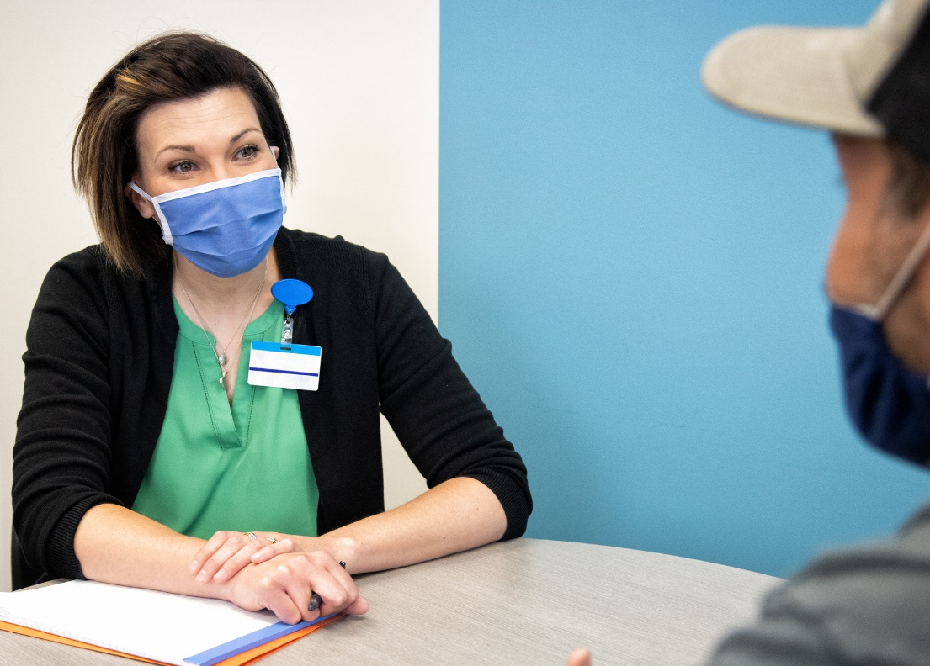
Examples of Support Services
Partner Services
Mental health services
Substance use treatment
Psychosocial support (e.g., support groups, counseling)
Housing/housing assistance
Transportation
Case management
Nutritional counseling
Food bank/home-delivered meals
Oral health
Notes:
Speaker’s Notes:
A very wide range of patient-support services is available, including:
Partner Services.
Mental health services.
Substance use treatment.
Psychosocial support (e.g., support groups, counseling).
Housing/housing assistance.
Transportation.
Case management.
Nutritional counseling.
Food bank/home-delivered meals.
Oral health.
Depending on the specific situation of each patient, referral to appropriate support services can positively affect many aspects of HIV prevention and care.

Slide 20
Review
Notes:
Speaker’s Notes:
Let’s take a moment to review what we’ve learned.

Slide 21
Summary
Providers have an important role to play in initiating the conversation about Partner Services with their patients and helping their patients access Partner Services, whether they are being tested for HIV or STIs or are newly diagnosed with HIV
Partner Services contributes to the HIV Prevention and Care Continuum in several ways, helping patients and their partners access HIV testing, treatment and care, and prevention services
In addition to partner notification, people with HIV may benefit from support services, such as substance use treatment, transportation assistance, and mental health services, to help them stay in care and achieve an undetectable viral load
Notes:
Speaker’s Notes:
Let’s review the material that was presented in this presentation:
Partner Services contributes to the HIV Prevention and Care Continuum in several ways, by helping patients and their partners access HIV testing, treatment and care, and prevention services.
Beyond partner notification, people with HIV may benefit from a variety of other support services to help them stay in care and achieve an undetectable viral load. These may include:
Substance use treatment.
Transportation.
Mental health services.
Health care providers have an important role to play in initiating conversations with their patients about Partner Services and facilitating access to Partner Services for patients who are being tested for HIV or STIs or who are newly diagnosed with HIV.

