Slide 1
2024 Annual HIV Testing Report
CDC-Funded HIV Testing in the United States, Puerto Rico, and US Virgin Islands, 2024
Division of HIV Prevention (DHP)
National Center for HIV, Viral Hepatitis, STD, and TB Prevention (NCHHSTP)
Centers for Disease Control and Prevention (CDC)
Notes:
These slides were prepared by the Translation & Evaluation Branch in the Division of HIV Prevention, National Center for HIV, Viral Hepatitis, STD, and TB Prevention (NCHHSTP), Centers for Disease Control and Prevention (CDC). These slides present data on CDC-funded HIV testing and prevention activities reported through the National HIV Prevention Program Monitoring and Evaluation (NHM&E) data reporting system, EvaluationWeb®, from January 1, 2024 to December 31, 2024.
Data presented in these slides include HIV test-level data from 59 state and local health departments and 133 community-based organizations (CBOs) directly funded by the CDC through 6 notices of funding opportunities (PS18-1802, PS20-2010, PS21-2102, PS22-2203, PS23-0073, and PS24-0047) and reported to CDC through EvaluationWeb as of March 17, 2025.
Note. This slide set is in the public domain. You may reproduce these slides without permission; however, citation as to source is appreciated.
Centers for Disease Control and Prevention. 2024 Annual HIV Testing Report: CDC-Funded HIV Testing in the United States, Puerto Rico, and US Virgin Islands, 2024. Atlanta: U.S. Department of Health and Human Services; 2026.
You are also free to adapt and revise these slides; however, you must remove the CDC name and logo if changes are made.

Slide 2
Data Source and Technical Notes
For more information on the data source, interpreting the data, and variable definitions, see the 2024 HIV Testing Report Technical Notes.
Data for all figures are available in the 2024 HIV Testing Report Data Release Tables.
Additional data and stratifications are available in the 2024 Testing Report Data Release Tables.
Notes:
For more information on the data source, interpreting the data, and variable definitions, see the 2024 HIV Testing Report Technical Notes.
Data for all figures are available in the 2024 HIV Testing Report Data Release tables.
Additional data and stratifications are available in the 2024 HIV Testing Report Data Release tables.

Slide 3
Trends in CDC-Funded HIV Testing Program Outcomes

Slide 4
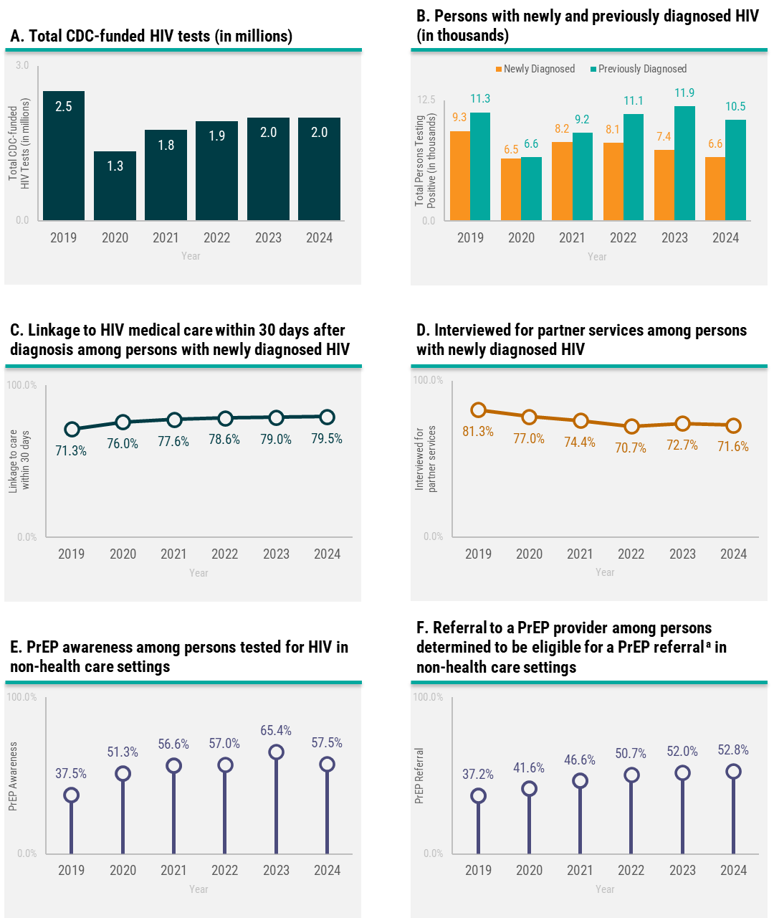
Trends in CDC-funded HIV testing program outcomes, 2019-2024*
ª Persons are eligible to be referred to a PrEP provider if they meet appropriate criteria for using PrEP, as defined locally or by CDC guidelines for PrEP.
Notes:
This slide presents trends from 2019 to 2024 of six CDC-funded HIV testing program outcomes:
total number of CDC-funded HIV tests
numbers of persons with newly and previously diagnosed HIV
percentage linked to HIV medical care within 30 days after diagnosis among persons with newly diagnosed HIV
percentage interviewed for partner services among persons with newly diagnosed HIV
percentage of PrEP awareness among persons tested for HIV in non-health care settings
percentage of referral to PrEP provider among persons determined to be eligible for a PrEP referral in non-health care settings.
Data notes and source
Abbreviations: PrEP, Pre-exposure prophylaxis
* Data from Mississippi were excluded in 2024 data due to incomplete data submission by deadline; 2019-2023 data include data from all states.
Data Source: 2019-2024 National HIV Prevention Program Monitoring & Evaluation data, reported through EvaluationWeb® as of March 17, 2025.

Slide 5
CDC-Funded HIV Testing

Slide 6
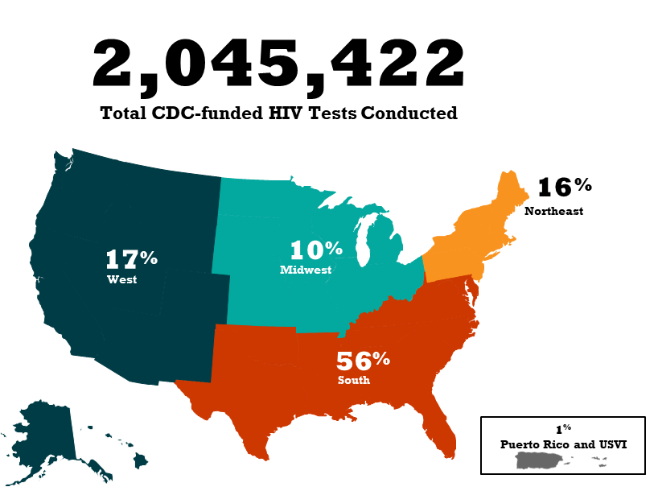
CDC-funded HIV testing, by US geographic region
Notes:
A total of 2,045,422 CDC-funded HIV tests were conducted in 2024 by 59 state and local health departments and 133 CBOs in the United States, Puerto Rico, and US Virgin Islands (USVI). The highest percentage of CDC-funded HIV tests were conducted in the South (56.2%) with 1,148,956 tests. There were 348,288 (17.0%) CDC-funded HIV tests conducted in the West, 333,070 (16.3%) in the Northeast, 201,665 (9.9%) in the Midwest, and 13,443 (0.7%) in Puerto Rico & USVI.
Data notes and source
Northeast includes Connecticut, Maine, Massachusetts, New Hampshire, New Jersey, New York, New York City, Pennsylvania, Philadelphia, Rhode Island, and Vermont.
Midwest includes Illinois, Chicago, Indiana, Iowa, Kansas, Michigan, Minnesota, Missouri, Nebraska, North Dakota, Ohio, South Dakota, and Wisconsin.
South includes Alabama, Arkansas, Delaware, District of Columbia, Florida, Georgia, Kentucky, Louisiana, Maryland, Baltimore, North Carolina, Oklahoma, South Carolina, Tennessee, Texas, Houston, Virginia, and West Virginia.
West includes Alaska, Arizona, California, Los Angeles, San Francisco, Colorado, Hawaii, Idaho, Montana, Nevada, New Mexico, Oregon, Utah, Washington, and Wyoming.
US territories includes Puerto Rico and the US Virgin Islands.
For additional data, see Table 1 in the 2024 HIV Testing Report Data Release Tables.
For more information on the data source, interpreting the data, and variable definitions, see the 2024 HIV Testing Report Technical Notes.
Data for all figures are available in 2024 HIV Testing Report Data Release Tables.
Data Source: 2024 National HIV Prevention Program Monitoring & Evaluation data, reported through EvaluationWeb® as of March 17, 2025.

Slide 7
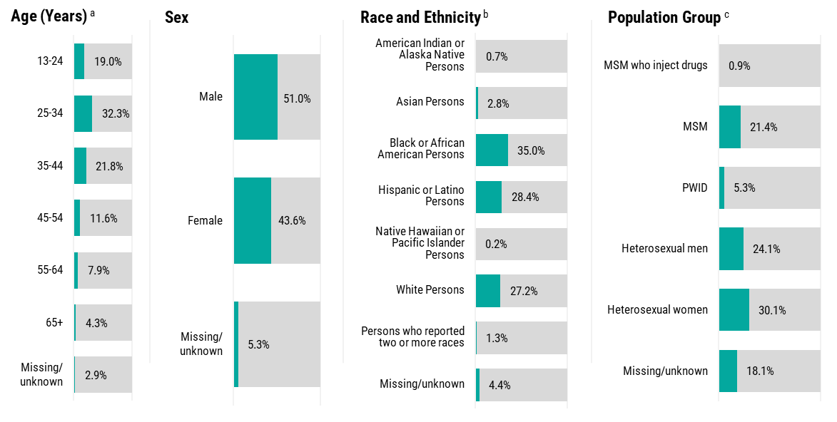
CDC-funded HIV testing, by demographic characteristics and population group, 2024
ª Age category “<13 years” is not shown in the figure.
^{b} All races are of non-Hispanic/Latino ethnicity. Persons of Hispanic/Latino ethnicity can be of any race.
^{c} HIV tests conducted in non-health care settings only. MSM includes men who reported male-to-male sexual contact in the past five years. PWID includes persons who reported injection drug use in the past five years. MSM who inject drugs includes men who reported both male-to-male sexual contact and injection drug use in the past five years. Population groups are mutually exclusive.
Notes:
Percentages of CDC-funded HIV testing, by demographic characteristics and population group, are provided on this slide.
Data notes and source
Abbreviations: MSM, gay, bisexual, and other men who have sex with men; PWID, persons who inject drugs
For additional data, see Table 1 and Appendix Table 1 in the 2024 HIV Testing Report Data Release Tables.
For more information on the data source, interpreting the data, and variable definitions, see the 2024 HIV Testing Report Technical Notes.
Data for all figures are available in 2024 HIV Testing Report Data Release Tables.
Data Source: 2024 National HIV Prevention Program Monitoring & Evaluation data, reported through EvaluationWeb® as of March 17, 2025.

Slide 8
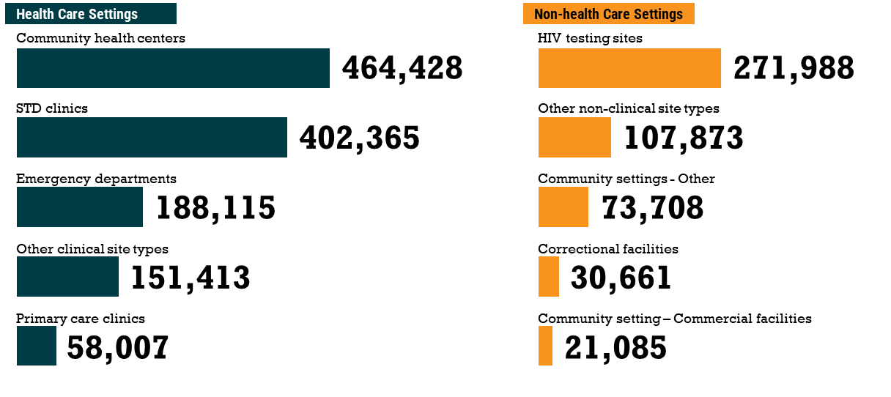
Number of CDC-funded HIV tests conducted, by setting and most frequently reported site types, 2024
Notes:
Overall, most of the CDC-funded HIV tests were conducted in health care settings (68.8%; N=1,407,494) compared to non-health care settings (28.5%; N=582,404). Tests were also conducted in mobile units (2.4%; N=49,335). Self-testing accounted for 0.2% (N=5,091) of CDC-funded HIV tests conducted by health departments and CBOs; this number excludes self-tests distributed through the CDC-led Together TakeMeHome program (PS22-2210).
Data notes and source
For additional data, see Table 3 and Appendix Table 2 in the 2024 HIV Testing Report Data Release Tables.
For more information on the data source, interpreting the data, and variable definitions, see the 2024 HIV Testing Report Technical Notes.
Data for all figures are available in 2024 HIV Testing Report Data Release Tables.
Data Source: 2024 National HIV Prevention Program Monitoring & Evaluation data, reported through EvaluationWeb® as of March 17, 2025.

Slide 9
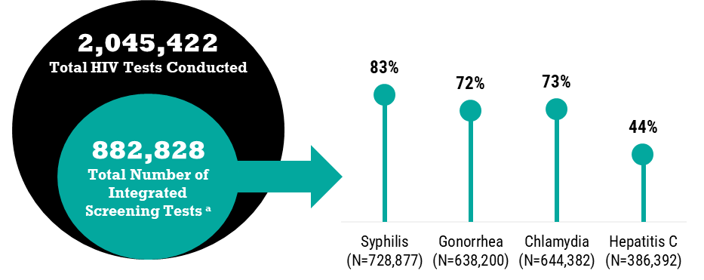
Number and percentage of HIV tests that were conducted concurrently with integrated screening tests, 2024 ª
ª Includes tests for syphilis, gonorrhea, chlamydia or hepatitis C conducted in conjunction with a CDC-funded HIV test.
Notes:
Of the 2,045,422 HIV tests conducted, 43.2% (N=882,828) had at least one concurrent sexually transmitted infection (STI) or hepatitis C test.
Data notes and source
For additional data, see Table 4 in the 2024 HIV Testing Report Data Release Tables.
For more information on the data source, interpreting the data, and variable definitions, see the 2024 HIV Testing Report Technical Notes.
Data for all figures are available in 2024 HIV Testing Report Data Release Tables.
Data Source: 2024 National HIV Prevention Program Monitoring & Evaluation data, reported through EvaluationWeb® as of March 17, 2025.

Slide 10
HIV Diagnoses

Slide 11
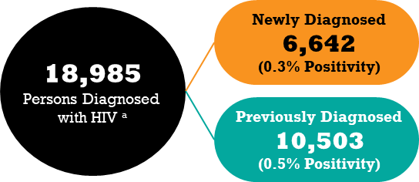
Number and percentage of persons with newly or previously diagnosed HIV, 2024 ª
ª Among persons with diagnosed HIV, unable to determine newly or previously diagnosed HIV status among 9.7% (N=1,840) of persons with diagnosed HIV.
Notes:
Of the 2,045,422 CDC-funded HIV tests conducted in 2024, 18,985 (0.9%) persons were identified with diagnosed HIV (including persons with unconfirmed preliminary positive rapid tests and persons with confirmed positive tests). Among persons with diagnosed HIV, 6,642 persons were identified with newly diagnosed HIV (0.3% positivity) and 10,503 persons were identified with previously diagnosed HIV (0.5% positivity).
Data notes and source
For additional data, see Tables 1-2 and Appendix Table 1 in the 2024 HIV Testing Report Data Release Tables.
For more information on the data source, interpreting the data, and variable definitions, see the 2024 HIV Testing Report Technical Notes.
Data for all figures are available in 2024 HIV Testing Report Data Release Tables.
Data Source: 2024 National HIV Prevention Program Monitoring & Evaluation data, reported through EvaluationWeb® as of March 17, 2025.

Slide 12
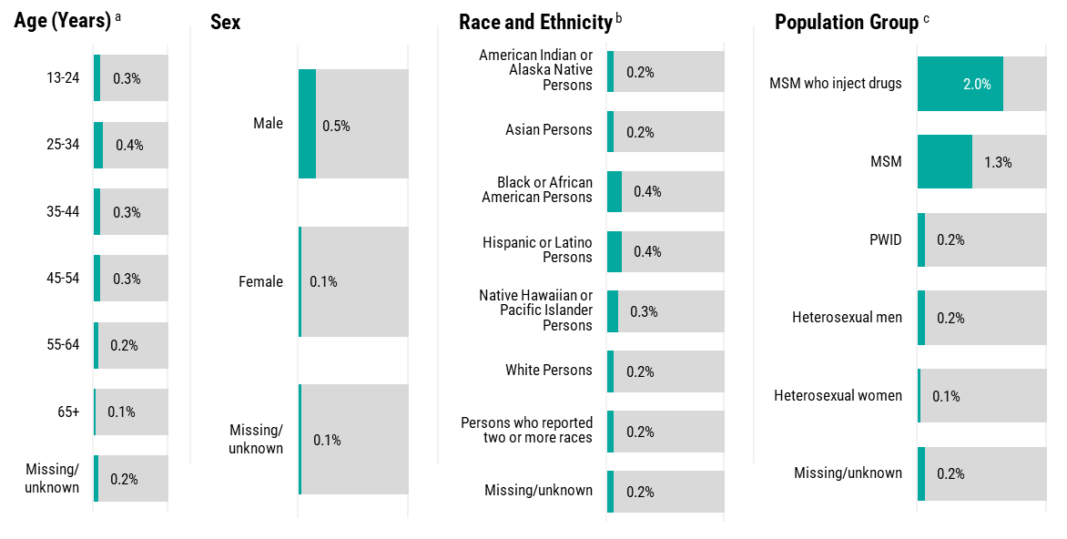
Newly diagnosed HIV positivity, by demographic characteristics and population group, 2024
ª Age category “<13 years” is not shown in the figure.
^{b} All races are of non-Hispanic/Latino ethnicity. Persons of Hispanic/Latino ethnicity can be of any race.
^{c} HIV tests conducted in non-health care settings only. MSM includes men who reported male-to-male sexual contact in the past five years. PWID includes persons who reported injection drug use in the past five years. MSM who inject drugs includes men who reported both male-to-male sexual contact and injection drug use in the past five years. Population groups are mutually exclusive.
Notes:
Newly diagnosed HIV positivity, by demographic characteristics and population group, are provided on this slide.
Data notes and source
Abbreviations: MSM, gay, bisexual, and other men who have sex with men; PWID, persons who inject drugs
For additional data, see Table 1 and Appendix Table 3 in the 2024 HIV Testing Report Data Release Tables. Data by US geographic region are shown in Table 1.
For more information on the data source, interpreting the data, and variable definitions, see the 2024 HIV Testing Report Technical Notes.
Data for all figures are available in 2024 HIV Testing Report Data Release Tables.
Data Source: 2024 National HIV Prevention Program Monitoring & Evaluation data, reported through EvaluationWeb® as of March 17, 2025.

Slide 13
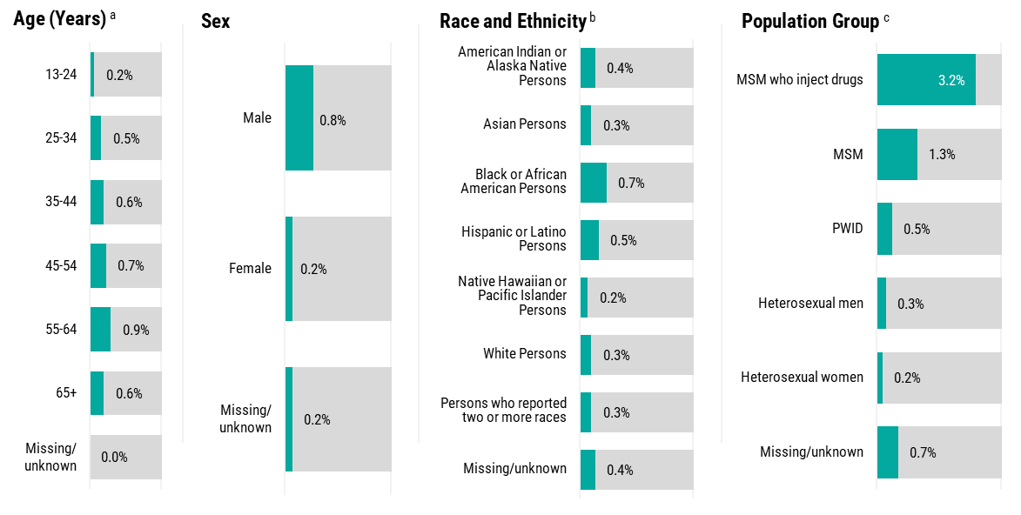
Previously diagnosed HIV positivity, by demographic characteristics and population group, 2024
ª Age category “<13 years” is not shown in the figure.
^{b} All races are of non-Hispanic/Latino ethnicity. Persons of Hispanic/Latino ethnicity can be of any race.
^{c} HIV tests conducted in non-health care settings only. MSM includes men who reported male-to-male sexual contact in the past five years. PWID includes persons who reported injection drug use in the past five years. MSM who inject drugs includes men who reported both male-to-male sexual contact and injection drug use in the past five years. Population groups are mutually exclusive.
Notes:
Percentages of previously diagnosed HIV positivity, by demographic characteristics and population group, are provided on this slide.
Data notes and source
Abbreviations: MSM, gay, bisexual, and other men who have sex with men; PWID, persons who inject drugs
For additional data, see Table 2 and Appendix Table 5 in the 2024 HIV Testing Report Data Release Tables. Data by US geographic region are shown in Table 2.
For more information on data sources, data collection and reporting practices, and variable definitions, see the 2024 HIV Testing Report Technical Notes.
Data for all figures are available in 2024 HIV Testing Report Data Release tables.
Data Source: 2024 National HIV Prevention Program Monitoring & Evaluation data, reported through EvaluationWeb® as of March 17, 2025.

Slide 14
Linkage to HIV Medical Care Within 30 Days after Diagnosis

Slide 15
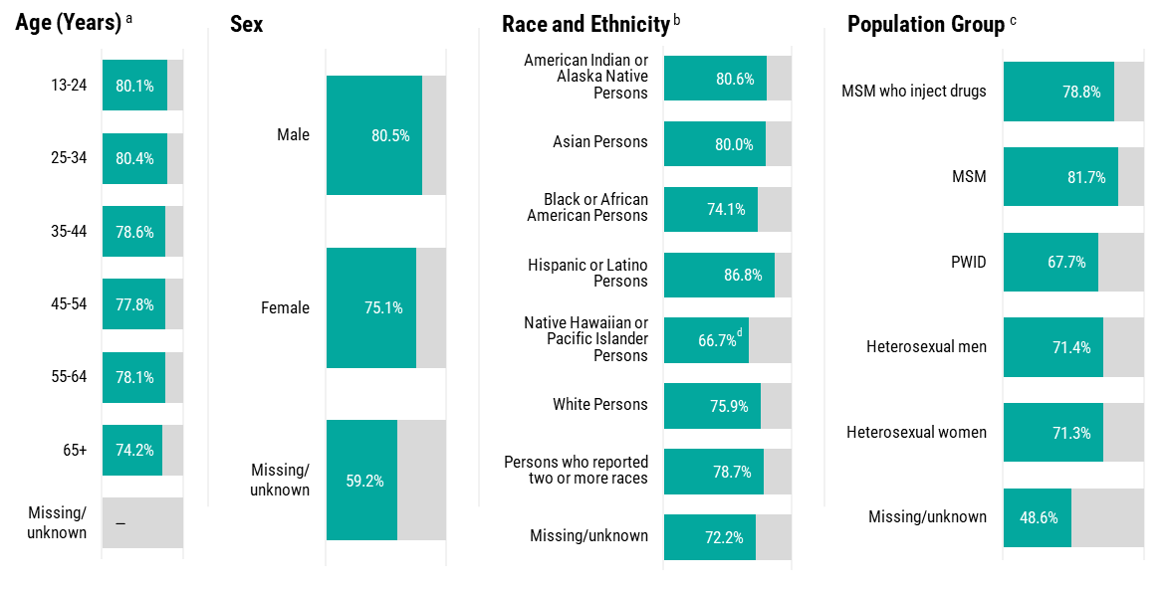
Percentage of persons with newly diagnosed HIV who were linked to HIV medical care within 30 days after diagnosis, by demographic characteristics and population group, 2024
— Data suppressed due to small sample sizes (i.e., numerator <5).
ª Age category “<13 years” is not shown in the figure.
^{b} All races are of non-Hispanic/Latino ethnicity. Persons of Hispanic/Latino ethnicity can be of any race.
^{c} HIV tests conducted in non-health care settings only. MSM includes men who reported male-to-male sexual contact in the past five years. PWID includes persons who reported injection drug use in the past five years. MSM who inject drugs includes men who reported both male-to-male sexual contact and injection drug use in the past five years. Population groups are mutually exclusive.
^{d} Data should be interpreted with caution due to small sample sizes (i.e., numerator <12).
Notes:
Of the 6,642 persons with newly diagnosed HIV for whom linkage to care data were available (N=5,915), 4,701 (79.5%) were linked to HIV medical care within 30 days after diagnosis.
Percentages of persons with newly diagnosed HIV who were linked to HIV medical care within 30 days after diagnosis, by demographic characteristics and population group, are provided on this slide.
Data notes and source
Abbreviations: MSM, gay, bisexual, and other men who have sex with men; PWID, persons who inject drugs
For additional data, see Table 1 and Appendix Table 3 in the 2024 HIV Testing Report Data Release Tables. Data by US geographic region are shown in Table 1.
For more information on the data source, interpreting the data, and variable definitions, see the 2024 HIV Testing Report Technical Notes.
Data for all figures are available in 2024 HIV Testing Report Data Release Tables.
Data Source: 2024 National HIV Prevention Program Monitoring & Evaluation data, reported through EvaluationWeb® as of March 17, 2025.

Slide 16
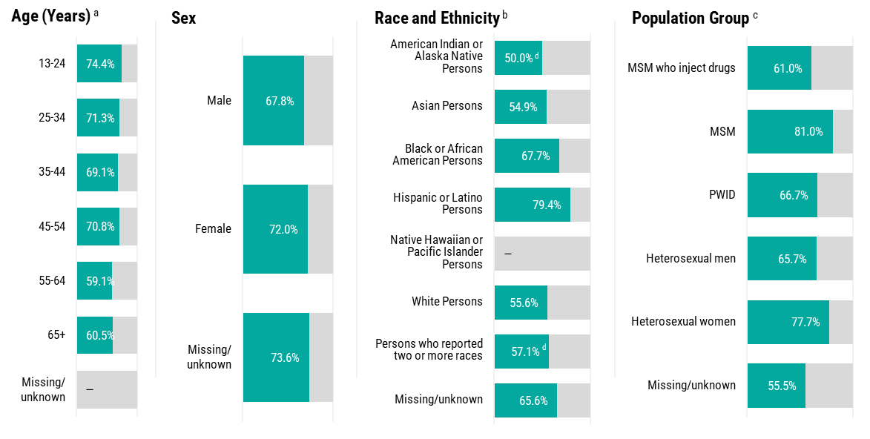
Percentage of persons with previously diagnosed HIV and not in HIV medical care who were linked to HIV medical care within 30 days of the current positive HIV test, by demographic characteristics and population group, 2024
— Data suppressed due to small sample sizes (i.e., numerator <5).
ª Age category “<13 years” is not shown in the figure.
^{b} All races are of non-Hispanic/Latino ethnicity. Persons of Hispanic/Latino ethnicity can be of any race.
^{c} HIV tests conducted in non-health care settings only. MSM includes men who reported male-to-male sexual contact in the past five years. PWID includes persons who reported injection drug use in the past five years. MSM who inject drugs includes men who reported both male-to-male sexual contact and injection drug use in the past five years. Population groups are mutually exclusive.
^{d} Data should be interpreted with caution due to small sample sizes (i.e., numerator <12).
Notes:
Of the 3,424 persons with previously diagnosed HIV and not in HIV care for whom linkage to care data were available (N=3,203), 2,204 (68.8%) were linked to HIV medical care within 30 days after the current positive HIV test.
Percentages of persons with previously diagnosed HIV who were linked to HIV medical care within 30 days after diagnosis, by demographic characteristics and population group, are provided on this slide.
Data notes and source
Abbreviations: MSM, gay, bisexual, and other men who have sex with men; PWID, persons who inject drugs
For additional data, see Table 2 and Appendix Table 5 in the 2024 HIV Testing Report Data Release Tables. Data by US geographic region are shown in Table 2.
For more information on the data source, interpreting the data, and variable definitions, see the 2024 HIV Testing Report Technical Notes.
Data for all figures are available in 2024 HIV Testing Report Data Release Tables.
Data Source: 2024 National HIV Prevention Program Monitoring & Evaluation data, reported through EvaluationWeb® as of March 17, 2025.

Slide 17
Partner Services

Slide 18
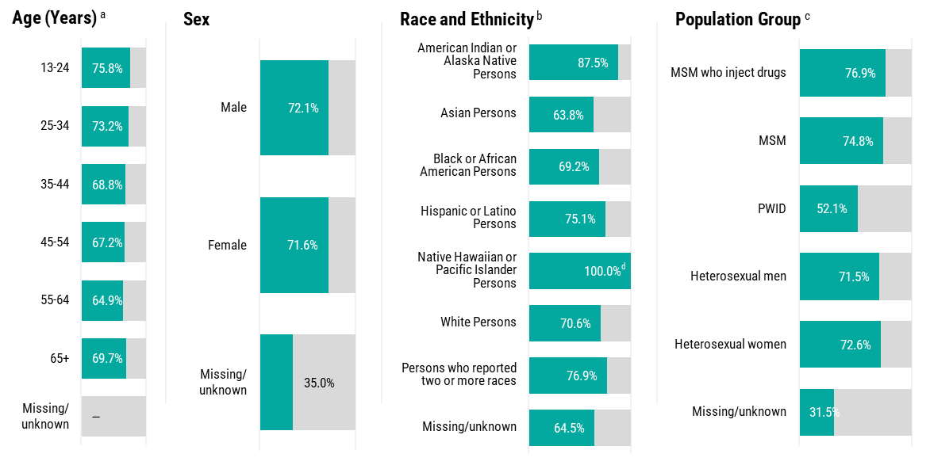
Percentage of persons with newly diagnosed HIV who were interviewed for partner services, by demographic characteristics and population group, 2024
— Data suppressed due to small sample sizes (i.e., numerator <5).
ª Age category “<13 years” is not shown in the figure.
^{b} All races are of non-Hispanic/Latino ethnicity. Persons of Hispanic/Latino ethnicity can be of any race.
^{c} HIV tests conducted in non-health care settings only. MSM includes men who reported male-to-male sexual contact in the past five years. PWID includes persons who reported injection drug use in the past five years. MSM who inject drugs includes men who reported both male-to-male sexual contact and injection drug use in the past five years. Population groups are mutually exclusive.
^{d} Data should be interpreted with caution due to small sample sizes (i.e., numerator <12).
Notes:
Among 6,642 persons with newly diagnosed HIV for whom data were available (N=4,199), 3,008 (71.6%) were interviewed for partner services.
Percentages of persons with newly diagnosed HIV who were interviewed by partner services, by demographic characteristics and population group, are provided on this slide.
Data notes and source
Abbreviations: MSM, gay, bisexual, and other men who have sex with men; PWID, persons who inject drugs
For additional data, see Table 5 and Appendix Table 4 in the 2024 HIV Testing Report Data Release Tables. Data by US geographic region are shown in Table 5.
For more information on the data source, interpreting the data, and variable definitions, see the 2024 HIV Testing Report Technical Notes.
Data for all figures are available in 2024 HIV Testing Report Data Release Tables.
Data Source: 2024 National HIV Prevention Program Monitoring & Evaluation data, reported through EvaluationWeb® as of March 17, 2025.

Slide 19
Pre-Exposure Prophylaxis (PrEP)

Slide 20
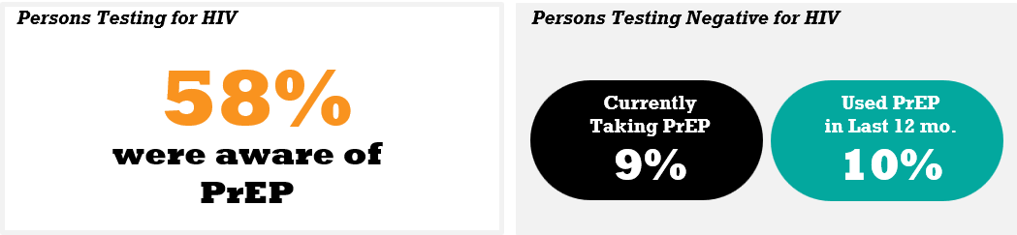
Percentage of persons aware of PrEP, ª percentage of persons currently taking PrEP, ^{b} and percentage of persons who have used PrEP in the last 12 months,^{b} in non-health care settings, 2024
ª Among all persons testing for HIV.
^{b} Among persons testing negative for HIV.
Notes:
Among persons tested for HIV in non-health care settings (N=582,404) for whom PrEP awareness data were available (N=540,262), 57.5% (N=310,447) had ever heard of PrEP.
Among persons testing negative for HIV in non-health care settings (N=575,557) and for whom current PrEP use data were available (N=439,837), 8.9% (N=39,160) were currently taking PrEP.
Among those testing negative for HIV (N=575,557) and for whom PrEP use data in the last 12 months were available (N=436,871), 10.1% (N=44,098) had taken PrEP in the last 12 months.
Data notes and source
Abbreviations: PrEP, pre-exposure prophylaxis
For additional data, see Table 6 and Appendix Table 6 in the 2024 HIV Testing Report Data Release. Data by US geographic region are shown in Table 6.
For more information on the data source, interpreting the data, and variable definitions, see the 2024 HIV Testing Report Technical Notes.
Data for all figures are available in 2024 HIV Testing Report Data Release Tables.
Data Source: 2024 National HIV Prevention Program Monitoring & Evaluation data, reported through EvaluationWeb® as of March 17, 2025.

Slide 21
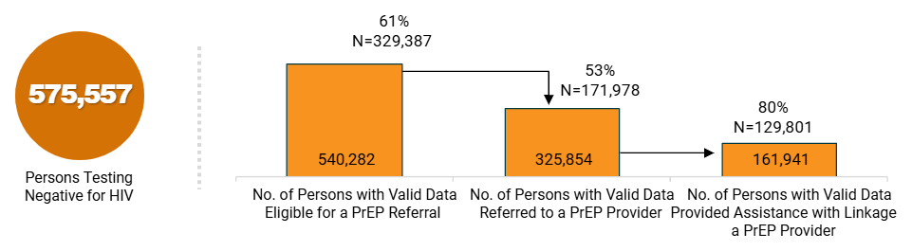
Cascade of eligibility for a PrEP referral, referred to a PrEP provider, and provided assistance with linkage to a PrEP provider among persons testing negative for HIV, in non-health care settings, 2024
Notes:
Among persons who tested negative for HIV in non-health care settings (N=575,557) and for whom PrEP eligibility data were available (N=540,282), 61.0% (n=329,387) were determined to be eligible for a PrEP referral.
Among those determined to be eligible for a PrEP referral (N=329,387) and for whom PrEP referral data were available (N=325,854), 52.8% (N=171,978) were referred to a PrEP provider.
Among those referred to a PrEP provider (N=171,978) and for whom linkage assistance data were available (N=161,941), 80.2% (N=129,801) were provided assistance with linkage to a PrEP provider.
Data notes and source
Abbreviations: PrEP, pre-exposure prophylaxis
For additional data, see Table 7 and Appendix Table 7 in the 2024 HIV Testing Report Data Release Tables. Data by US geographic region are shown in Table 7.
For more information on the data source, interpreting the data, and variable definitions, see the 2024 HIV Testing Report Technical Notes.
Data for all figures are available in 2024 HIV Testing Report Data Release Tables.
Data Source: 2024 National HIV Prevention Program Monitoring & Evaluation data, reported through EvaluationWeb® as of March 17, 2025.

Slide 22
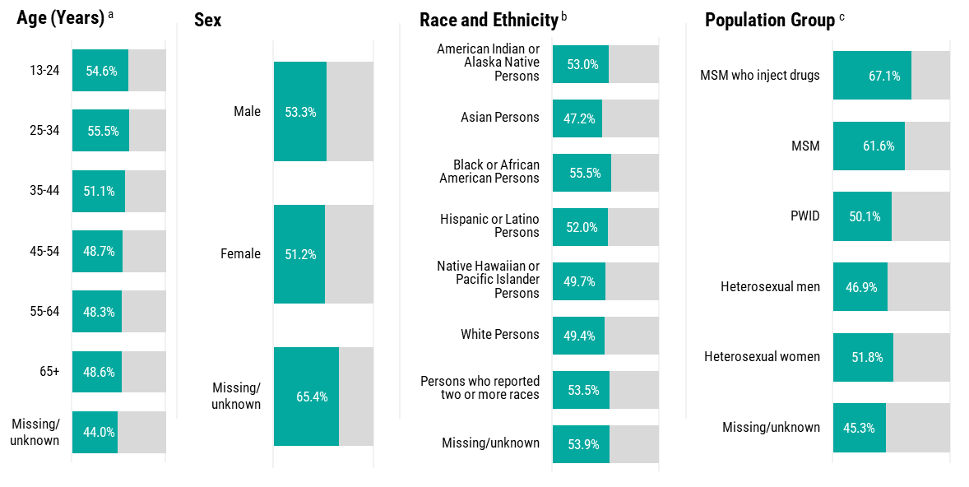
Percentage of persons referred to a PrEP provider among those eligible for referral in non-health care settings, by demographic characteristics and population group, 2024
ª Age category “<13 years” is not shown in the figure.
^{b} All races are of non-Hispanic/Latino ethnicity. Persons of Hispanic/Latino ethnicity can be of any race.
^{c} MSM includes men who reported male-to-male sexual contact in the past five years. PWID includes persons who reported injection drug use in the past five years. MSM who inject drugs includes men who reported both male-to-male sexual contact and injection drug use in the past five years. Population groups are mutually exclusive.
Notes:
Percentages of PrEP referrals, by demographic characteristics and population group, are provided on this slide.
Data notes and source
Abbreviations: MSM, gay, bisexual, and other men who have sex with men; PWID, persons who inject drugs
For additional data, see Table 7 and Appendix Table 7 in the 2024 HIV Testing Report Data Release Tables. Data by US geographic region are shown in Table 7.
For more information on the data source, interpreting the data, and variable definitions, see the 2024 HIV Testing Report Technical Notes.
Data for all figures are available in 2024 HIV Testing Report Data Release Tables.
Data Source: 2024 National HIV Prevention Program Monitoring & Evaluation data, reported through EvaluationWeb® as of March 17, 2025.

Slide 23
Acknowledgments
Publication of this report would not have been possible without the hard work and dedication of state and local health departments and community-based organizations that collected and submitted the HIV test-level data, as well as the Project Officers in the Program Development and Implementation Branch.

Slide 24
Translation & Evaluation Branch
Division of HIV Prevention (DHP)
National Center for HIV, Viral Hepatitis, STD, and TB Prevention (NCHHSTP)
TEB_Evaluation@cdc.gov

