Slide 1
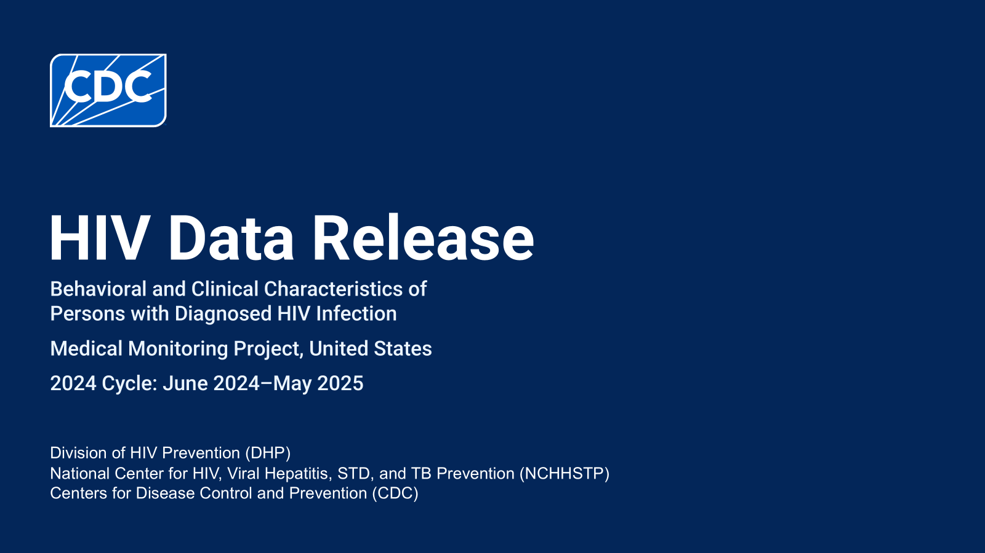

Slide 2


Slide 3
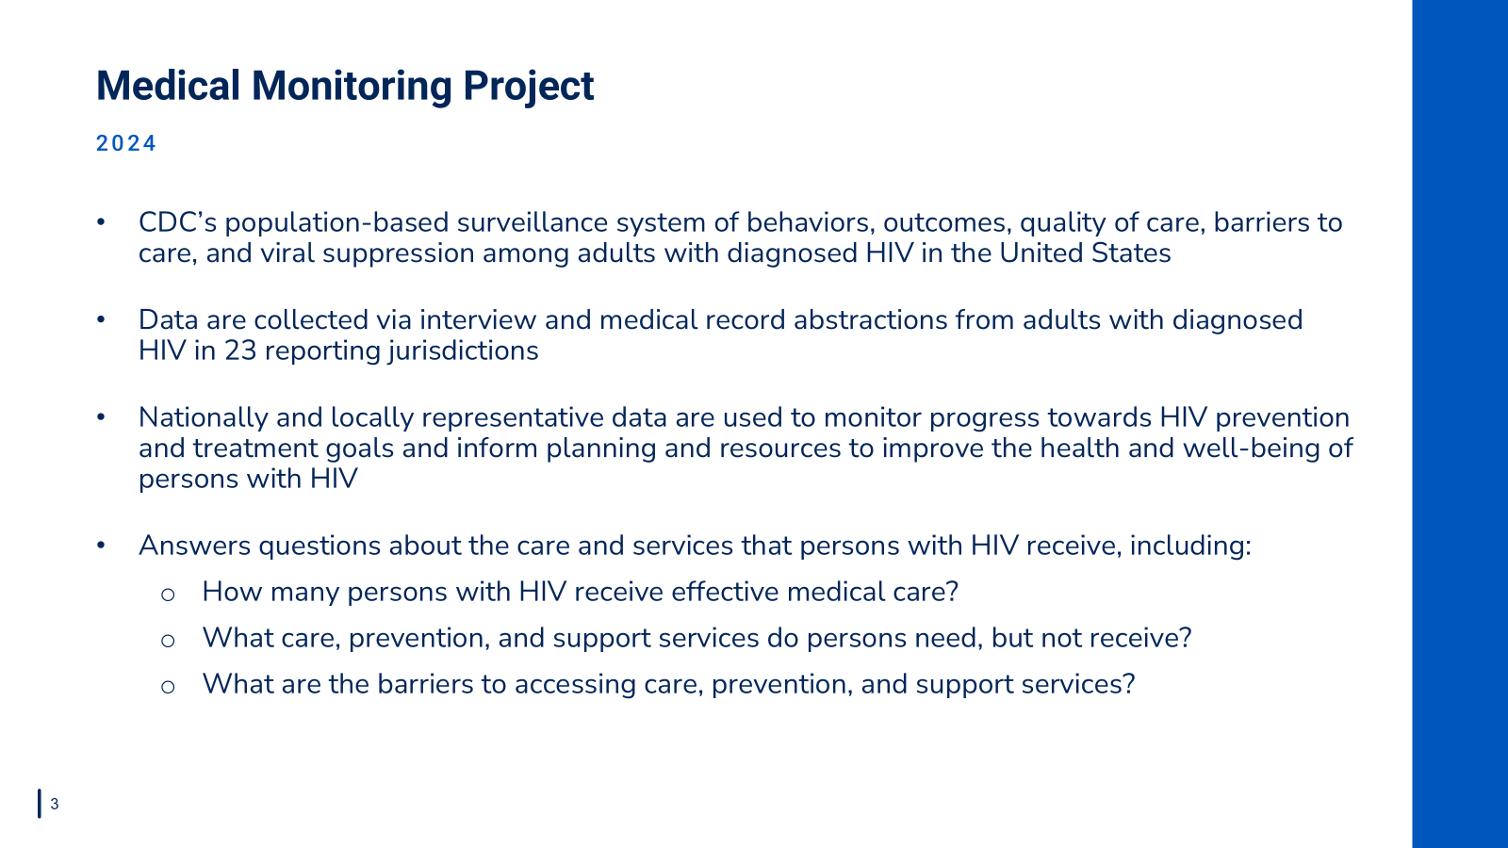

Slide 4
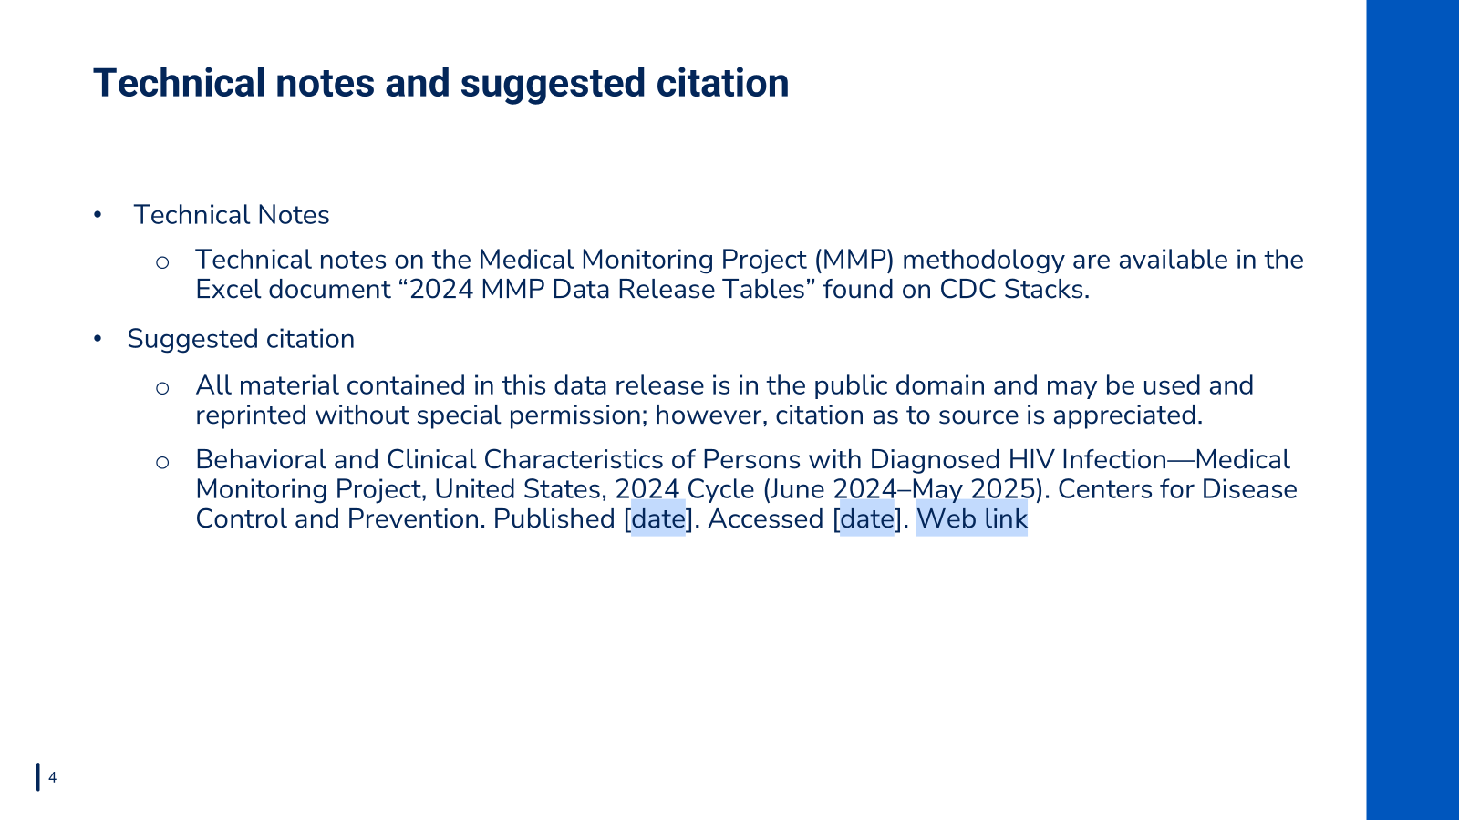

Slide 5


Slide 6
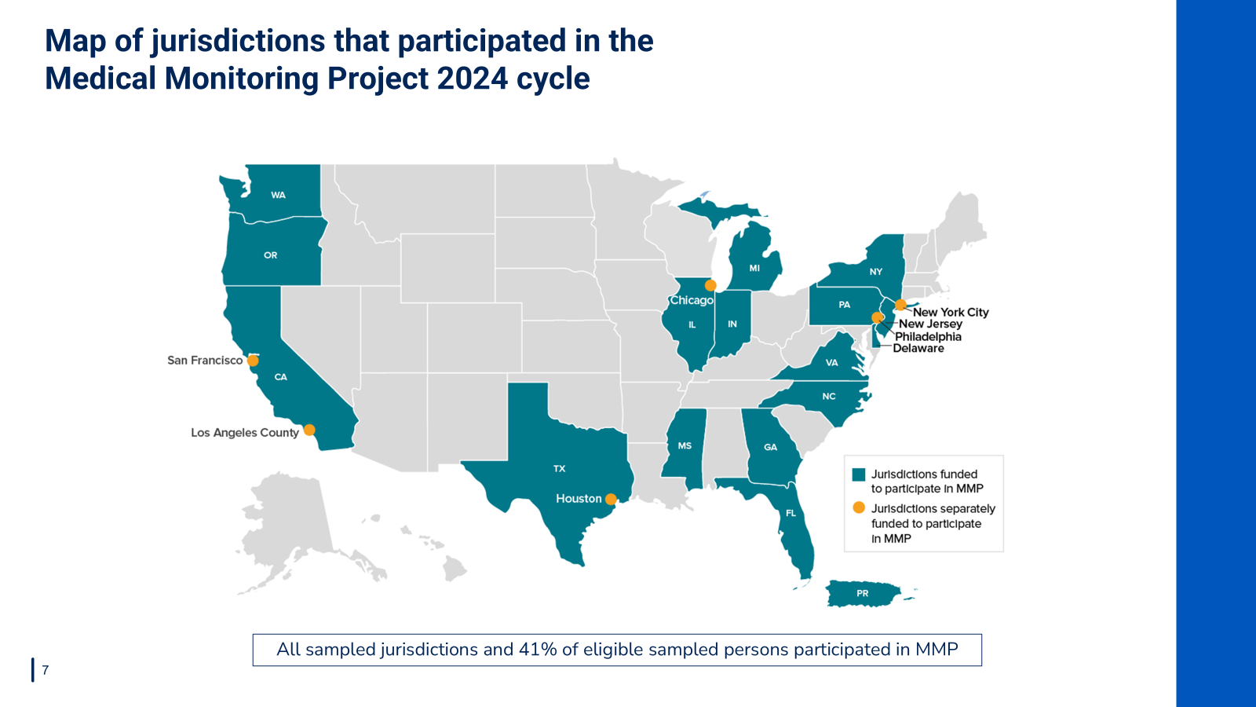
Notes:
The population of inference was adults with diagnosed HIV (aged ≥18 years) living in the United States. During the 2024 cycle, a total of 16 states, including 6 separately funded jurisdictions within those states, and 1 territory sampled for MMP participated. In total, 9,700 persons were sampled from the National HIV Surveillance System and 3,784 participated. Adjusted for eligibility, the response rate was 41%. For more information on data methods, please refer to the technical notes.

Slide 7


Slide 8
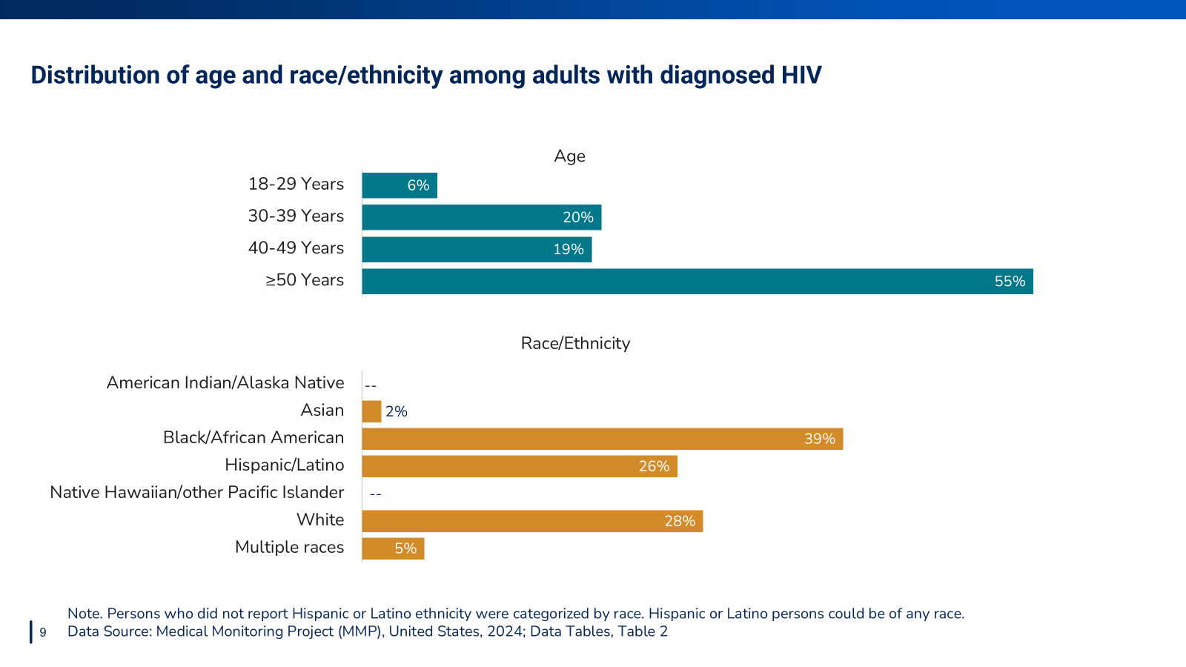
Notes:
Nearly three-quarters (74%) of adults with diagnosed HIV were aged at least 40 years.
An estimated 39% identified as Black or African American, 28% identified as White, 26% identified as Hispanic or Latino, 5% identified as multiracial, and 2% identified as Asian.

Slide 9
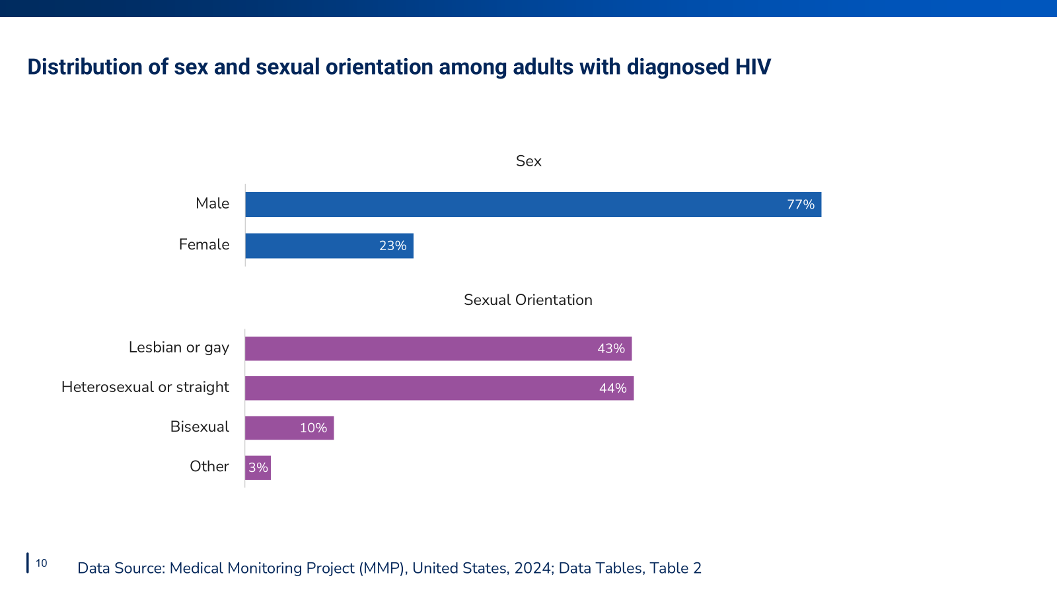
Notes:
An estimated 77% were male. Approximately 43% identified as lesbian or gay; 44% as heterosexual or straight; 10% as bisexual; and 3% as another sexual orientation (i.e., not lesbian or gay, straight, or bisexual).

Slide 10


Slide 11
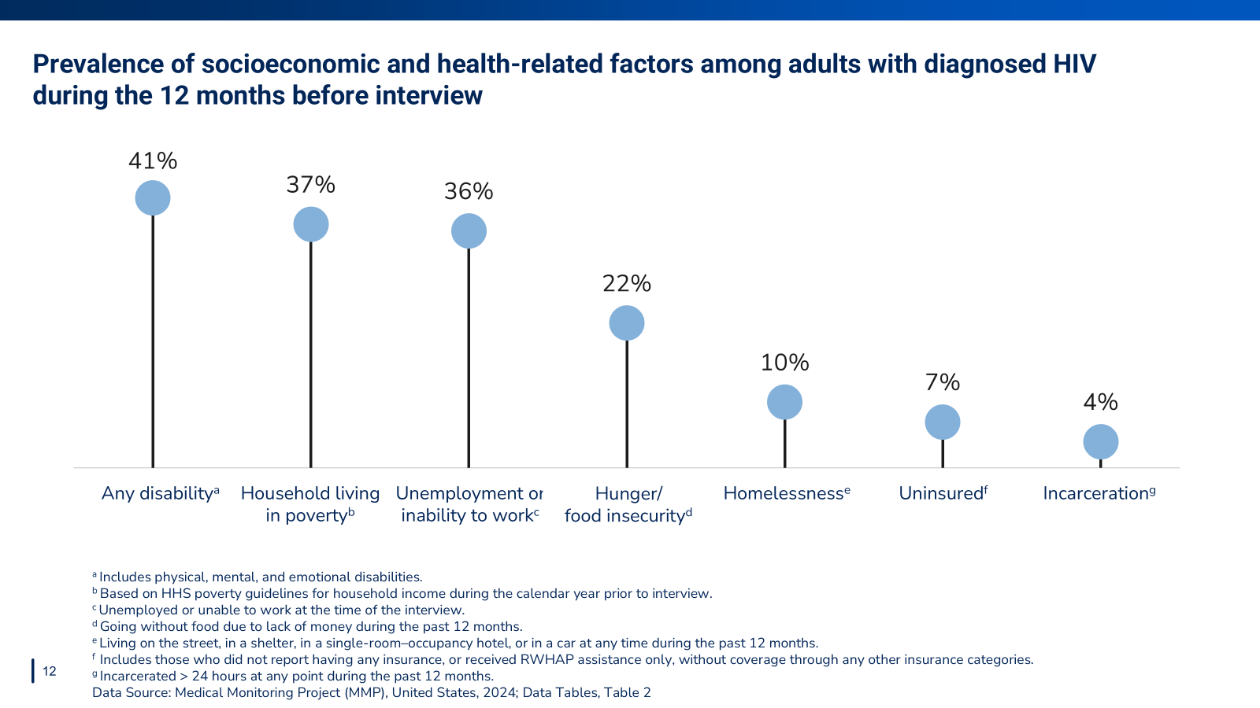
Notes:
The estimated prevalence of persons living with a disability was 41%. Approximately 37% had household incomes below the federal poverty threshold, 36% were unemployed or unable to work, 22% experienced hunger or food insecurity,10% experienced homelessness, 7% were uninsured, and 4% were recently incarcerated.

Slide 12
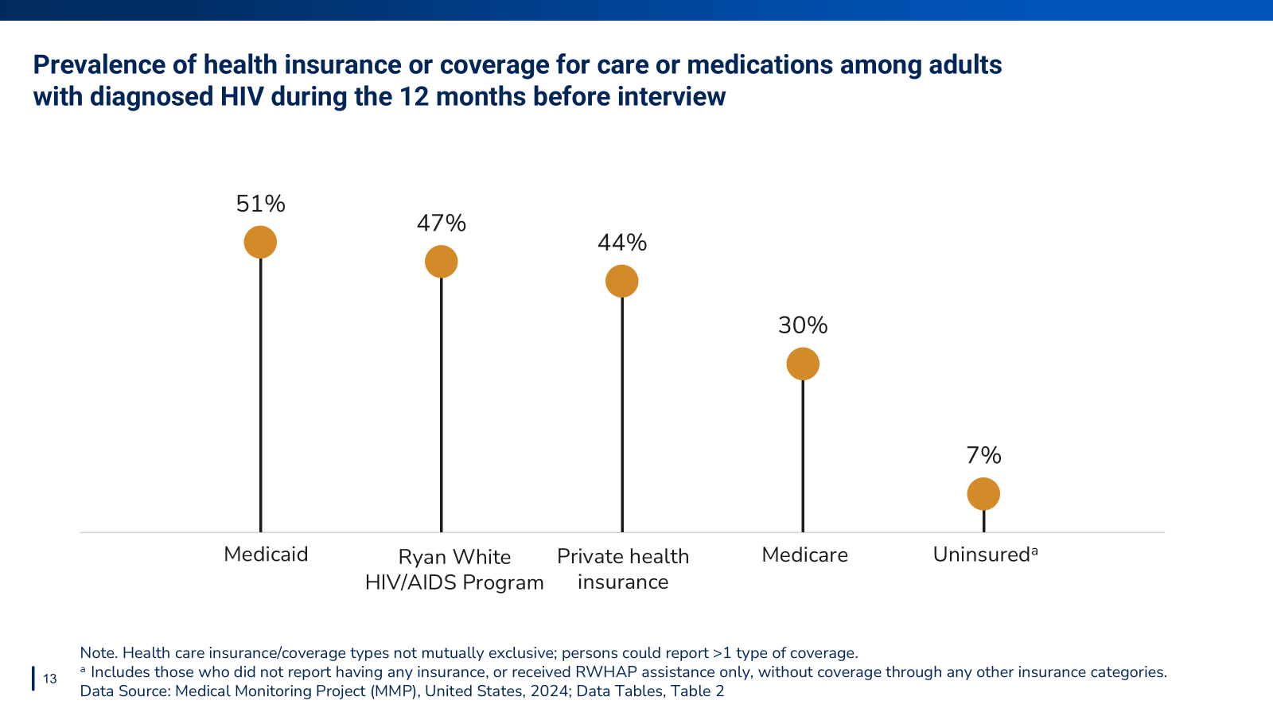
Notes:
An estimated 51% had Medicaid, 47% had coverage through the Ryan White HIV/AIDS Program (RWHAP), 44% had private health insurance, and 30% had Medicare. An estimated 7% were uninsured, including those who received RWHAP assistance only.

Slide 13
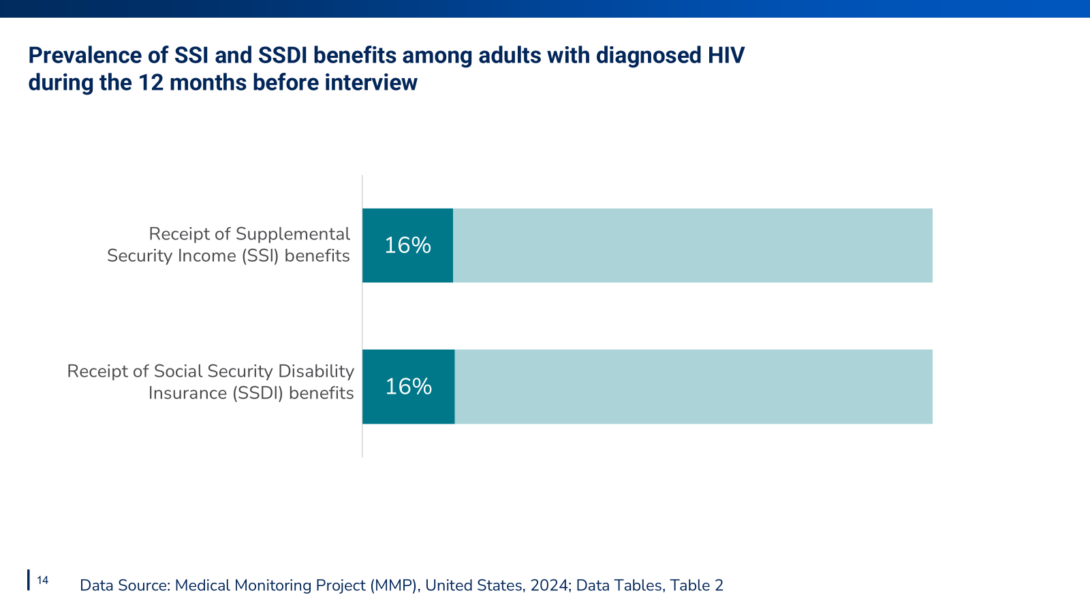
Notes:
An estimated 16% received Supplemental Security Income (SSI), and 16% received Social Security Disability Insurance (SSDI).

Slide 14
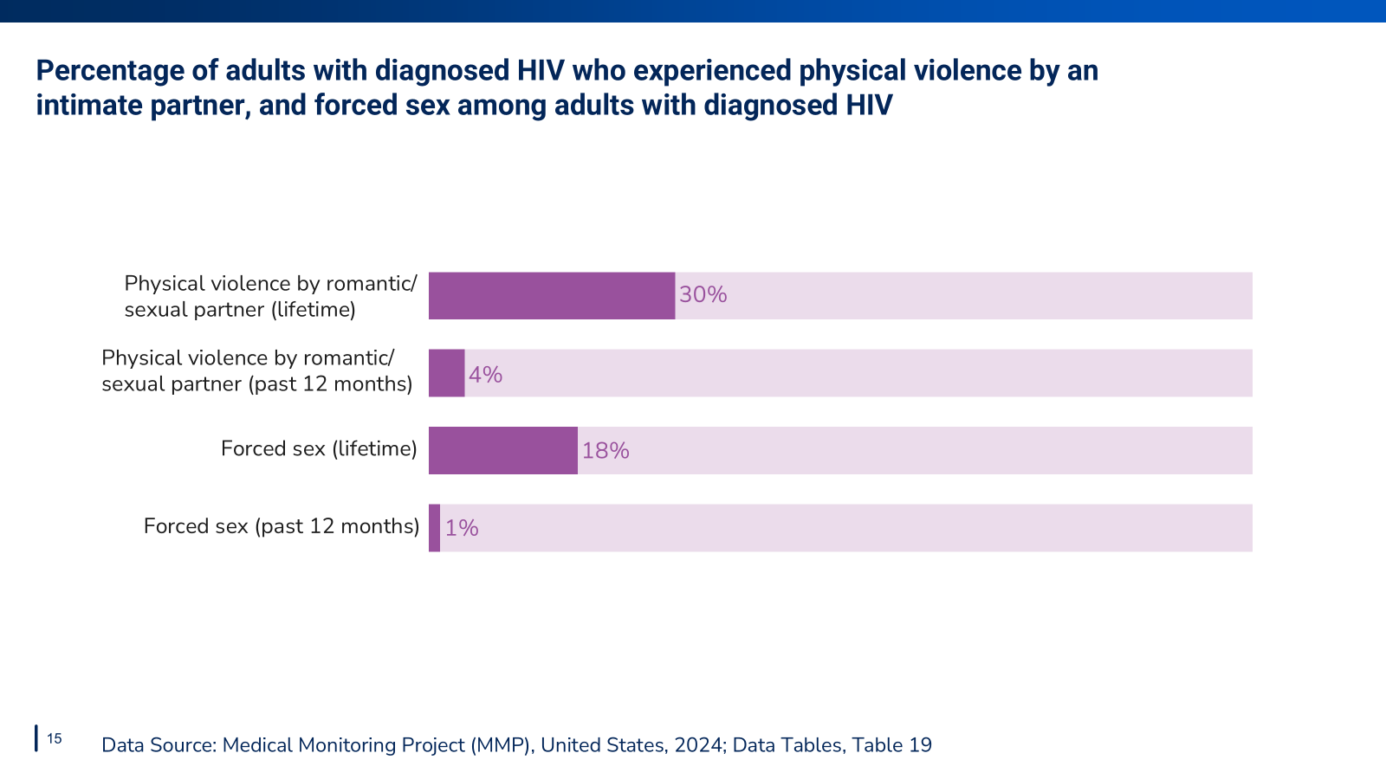
Notes:
An estimated 30% of persons had ever been physically hurt by a romantic or sexual partner, including 4% who experienced this in the past 12 months. An estimated 18% of persons had ever been threatened with harm or physically forced to have unwanted sex, including 1% who experienced this in the past 12 months.

Slide 15


Slide 16
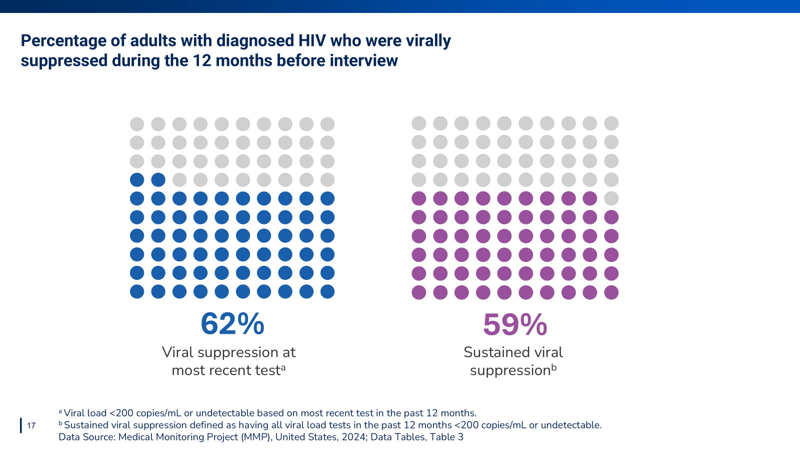
Notes:
Viral suppression means that a person with HIV can live a normal lifespan and will not transmit HIV to others.
62% of adults with diagnosed HIV were virally suppressed at their most recent test
59% of adults with diagnosed HIV were virally suppressed at all tests during the past 12 months

Slide 17
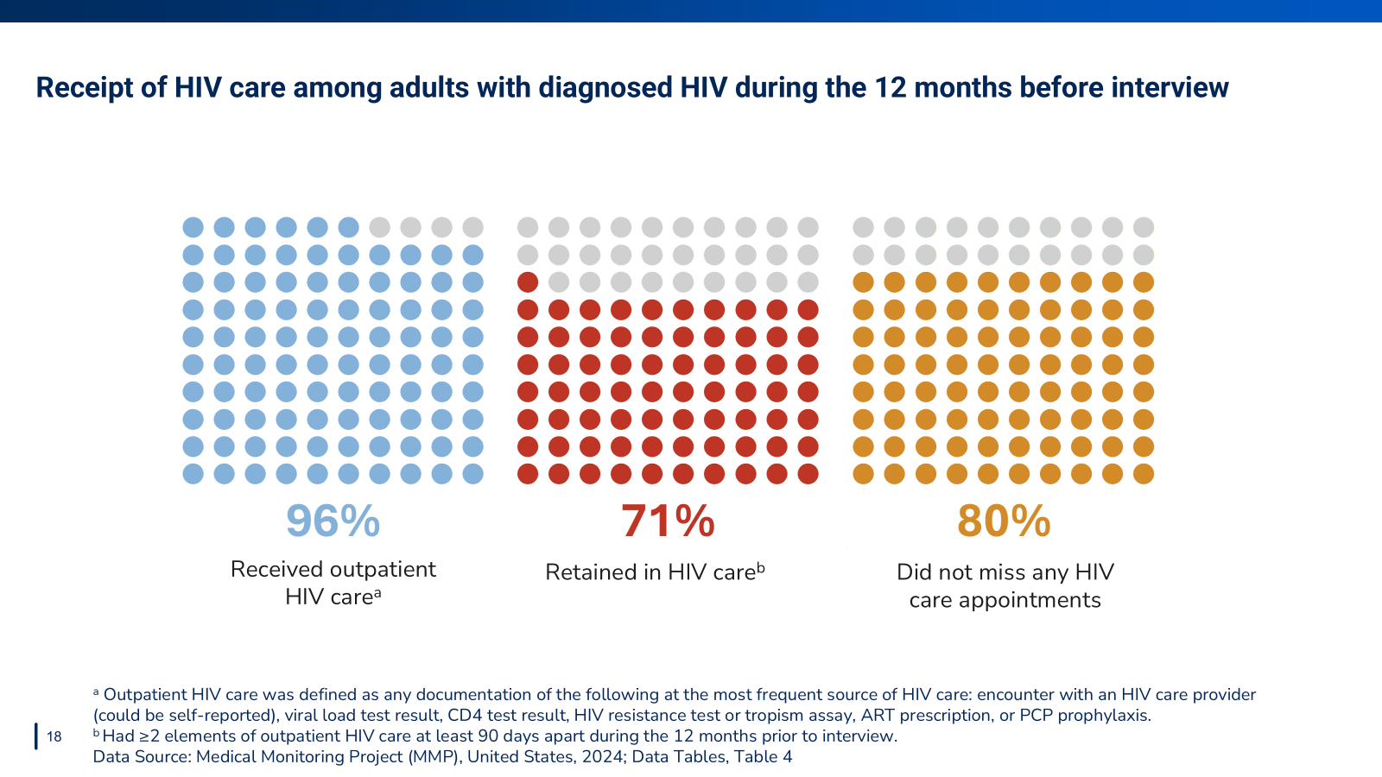
Notes:
During the past 12 months,
96% received outpatient HIV care
71% were retained in care
80% did not miss any HIV care appointments

Slide 18
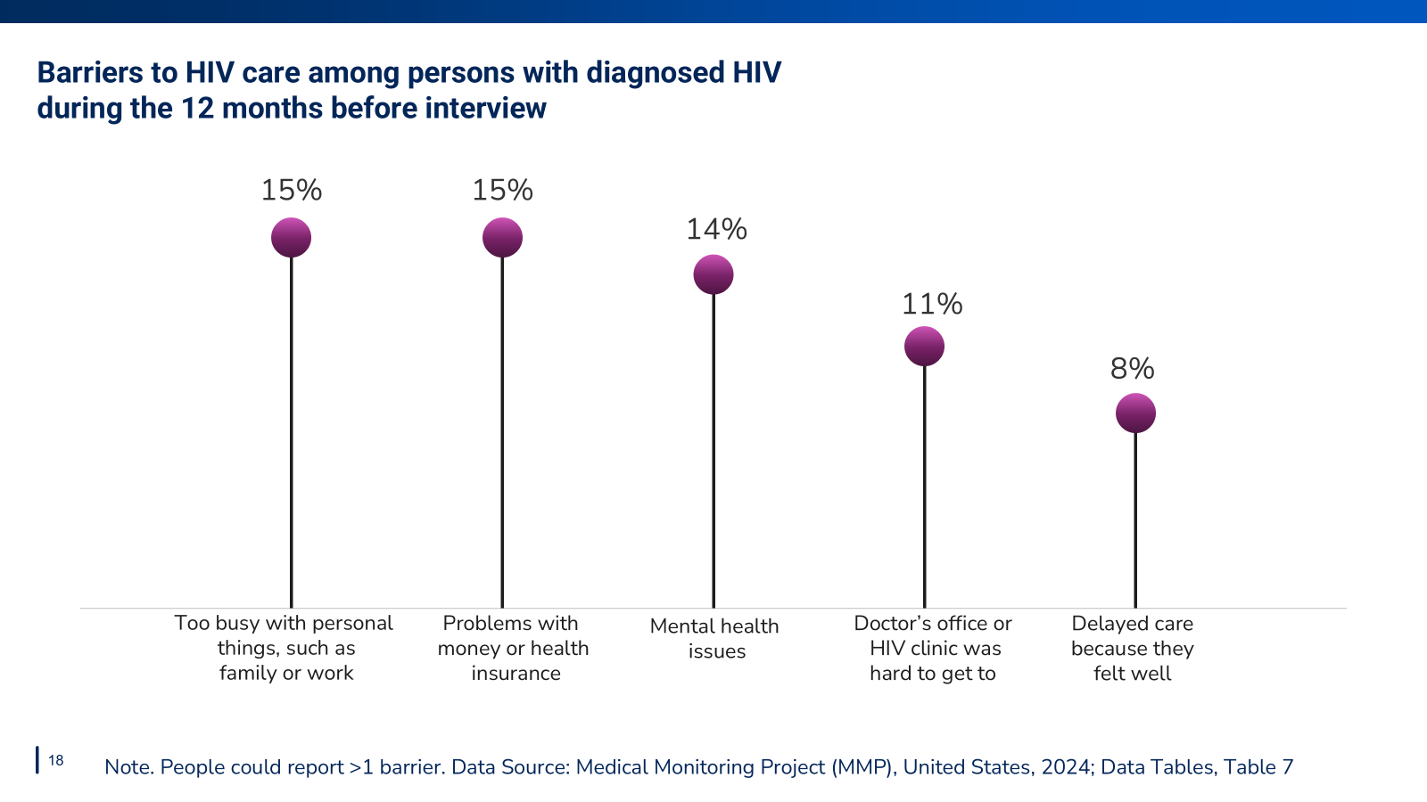
Notes:
Commonly reported barriers to HIV care included: being too busy with personal things like family or work (15%), problems with money or health insurance (15%), and mental health issues (14%).

Slide 19
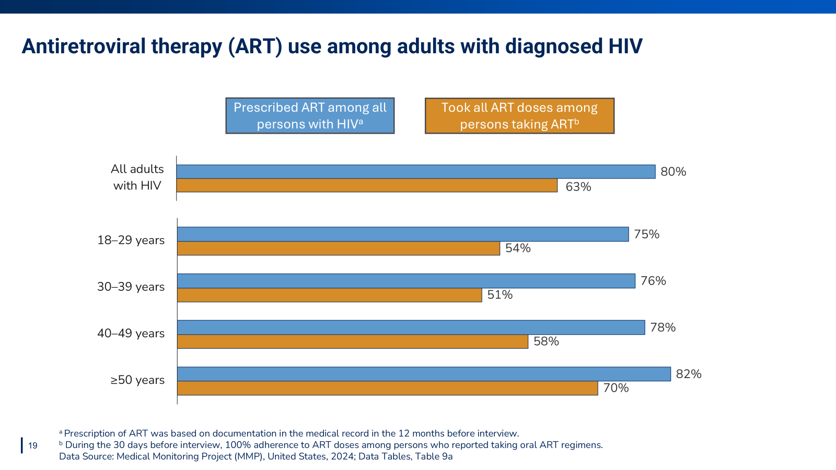
Notes:
Being prescribed antiretroviral therapy and taking all prescribed doses are essential precursors to optimal health among persons with HIV. Prescription of ART during the past 12 months was highest among those 50 years and over (82%), as was 100% adherence to ART dose during the past 30 days among those taking oral ART regimens (70%). Those aged 18-29 years had the lowest prescription of ART (75%). The 30-39 year age group reported the lowest adherence to ART (51%). These data illustrate substantial need for improvement among all age groups, but particularly among certain groups of younger persons with HIV.

Slide 20
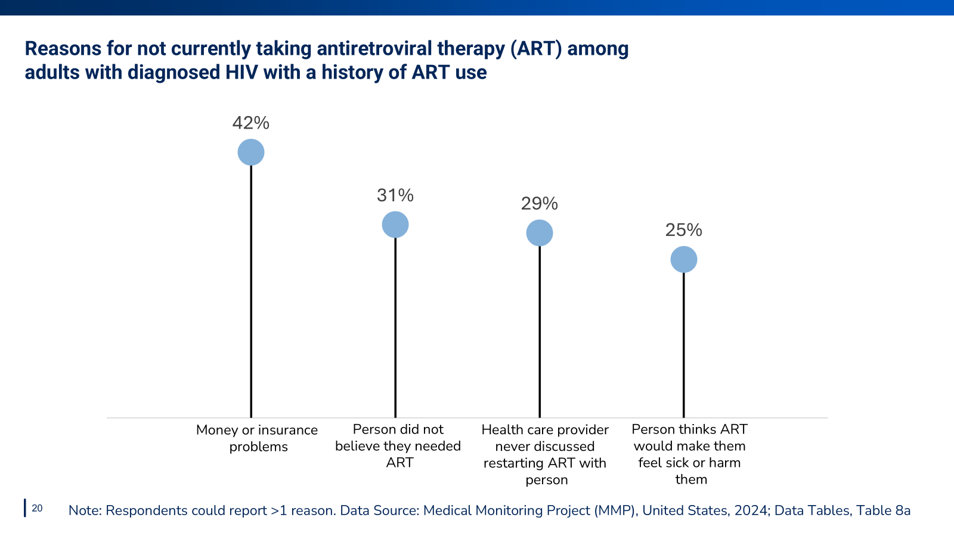
Notes:
Among those with a history of ART use but who were not currently taking ART, 42% were not taking ART due to money or insurance problems, 31% because the person did not believe they needed ART, 29% were not taking ART because the health care provider never discussed restarting ART with the person, and 25% because the person thought ART would make them feel sick or harm them.

Slide 21
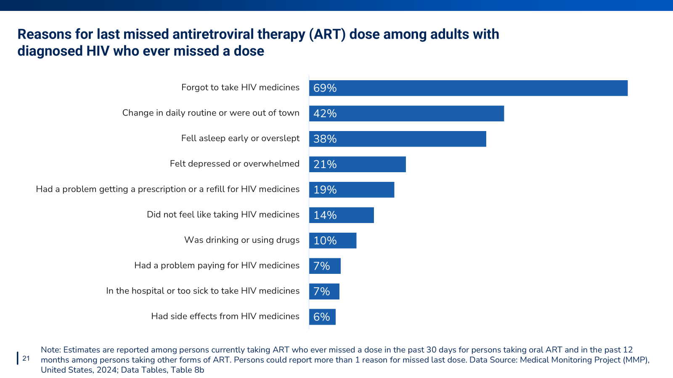
Notes:
Commonly reported reasons for the most recent missed antiretroviral dose among those who ever missed a dose included: forgetting to take medicines (69%), change in routine or being out of town (42%), and falling asleep early or oversleeping (38%).

Slide 22


Slide 23
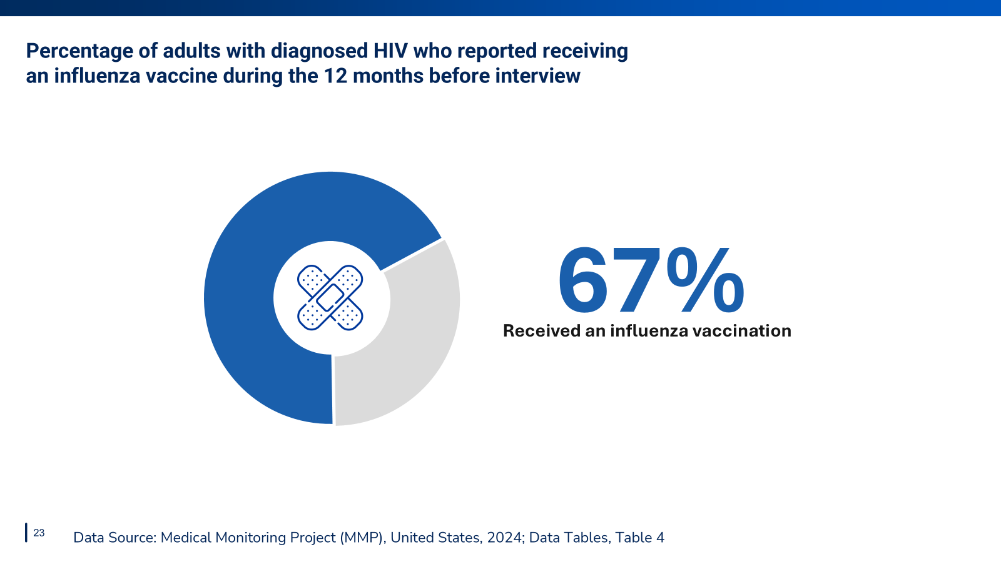
Notes:
67% reported receiving an influenza vaccination during the past 12 months

Slide 24
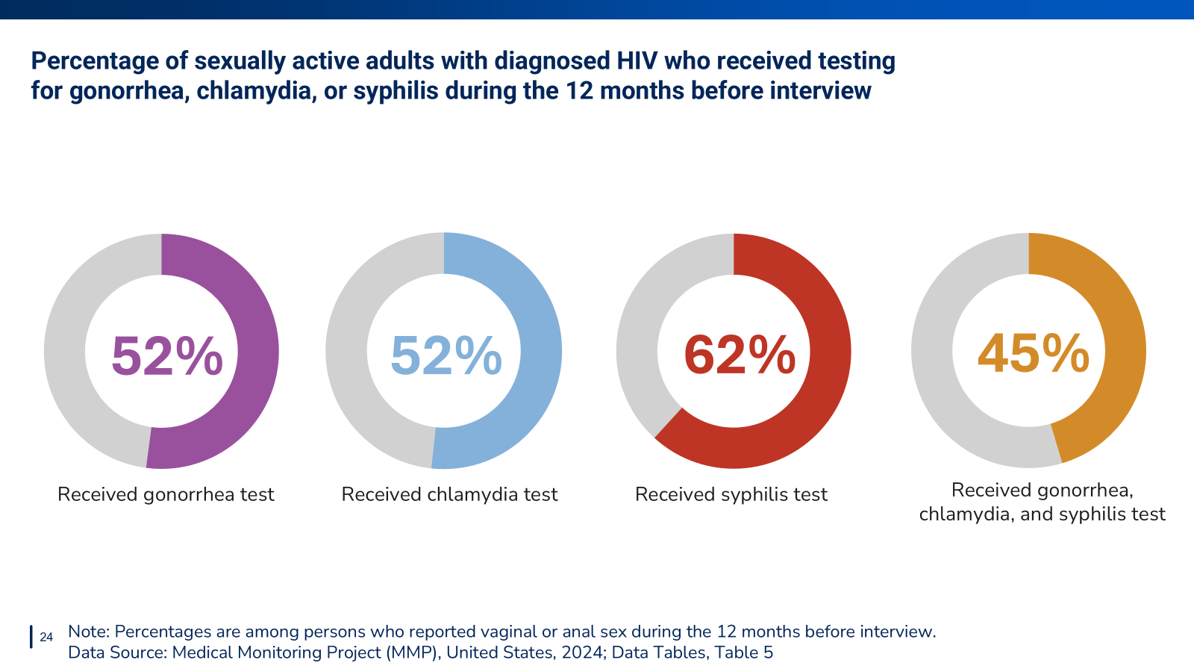
Notes:
Among sexually active persons with HIV, an estimated 52% were tested for gonorrhea, 52% for chlamydia, 62% for syphilis, and 45% for all 3 infections during the past 12 months.

Slide 25
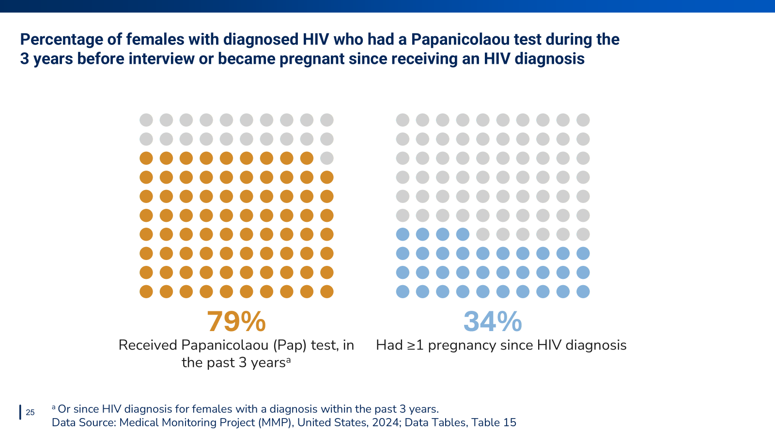
Notes:
Among females with diagnosed HIV, 79% received a Pap test during the last 3 years (or since HIV diagnosis for women with a diagnosis <3 years ago) and 34% had ≥1 pregnancy since HIV diagnosis.

Slide 26
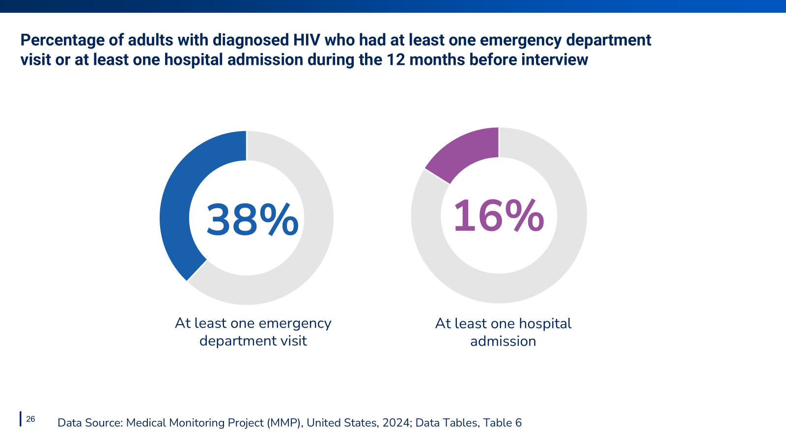
Notes:
Many people with HIV had at least one visit to the emergency department or hospital admission during the past 12 months:
38% had at least one visit to the emergency department
16% had at least one hospital admission

Slide 27


Slide 28
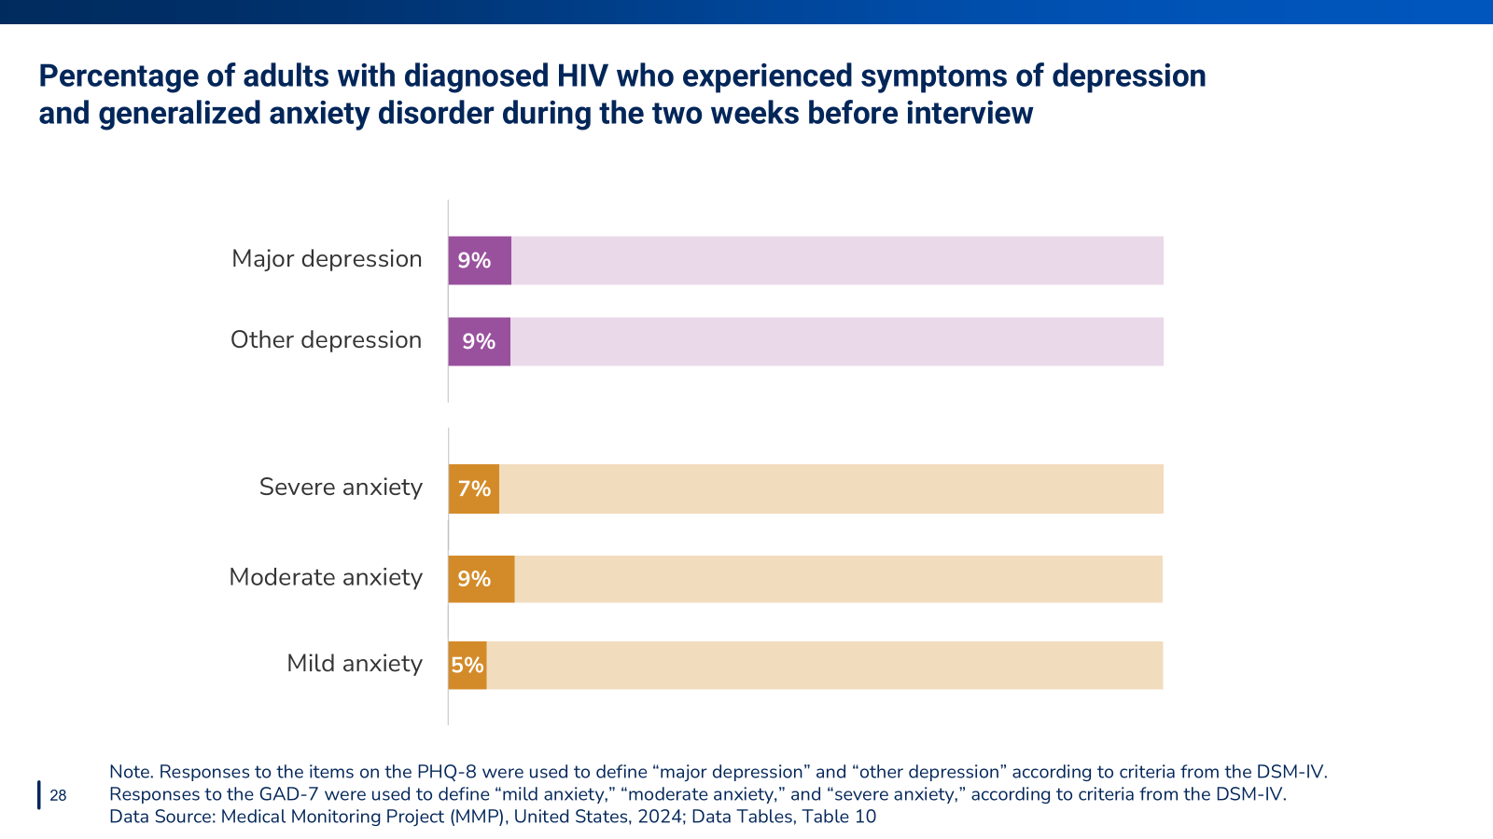
Notes:
Of adults with diagnosed HIV, during the past 2 weeks:
18% had symptoms of major or other depression
16% had symptoms of moderate to severe anxiety

Slide 29
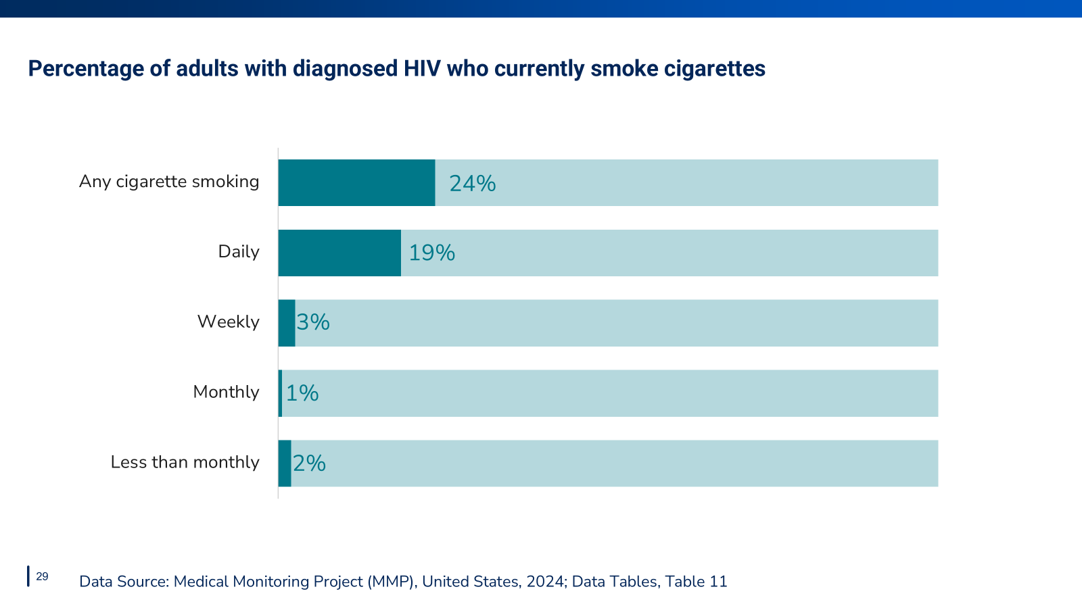
Notes:
The estimated prevalence of current smoking was 24%: 19% of persons smoked daily, 3% weekly, 1% monthly, and 2% less than monthly.

Slide 30
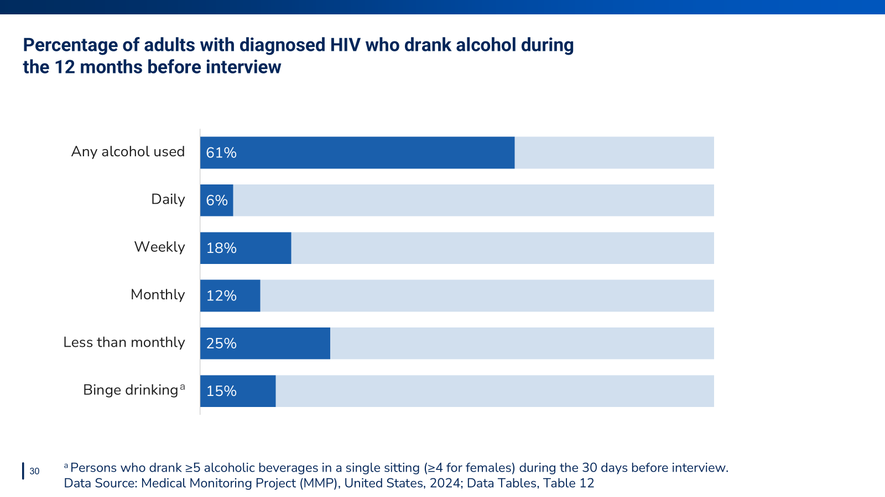
Notes:
The estimated prevalence of alcohol use in the past 12 months was 61%: 6% of persons drank alcohol daily, 18% weekly, 12% monthly, and 25% less than monthly. An estimated 15% of persons engaged in binge drinking during the past 30 days.

Slide 31
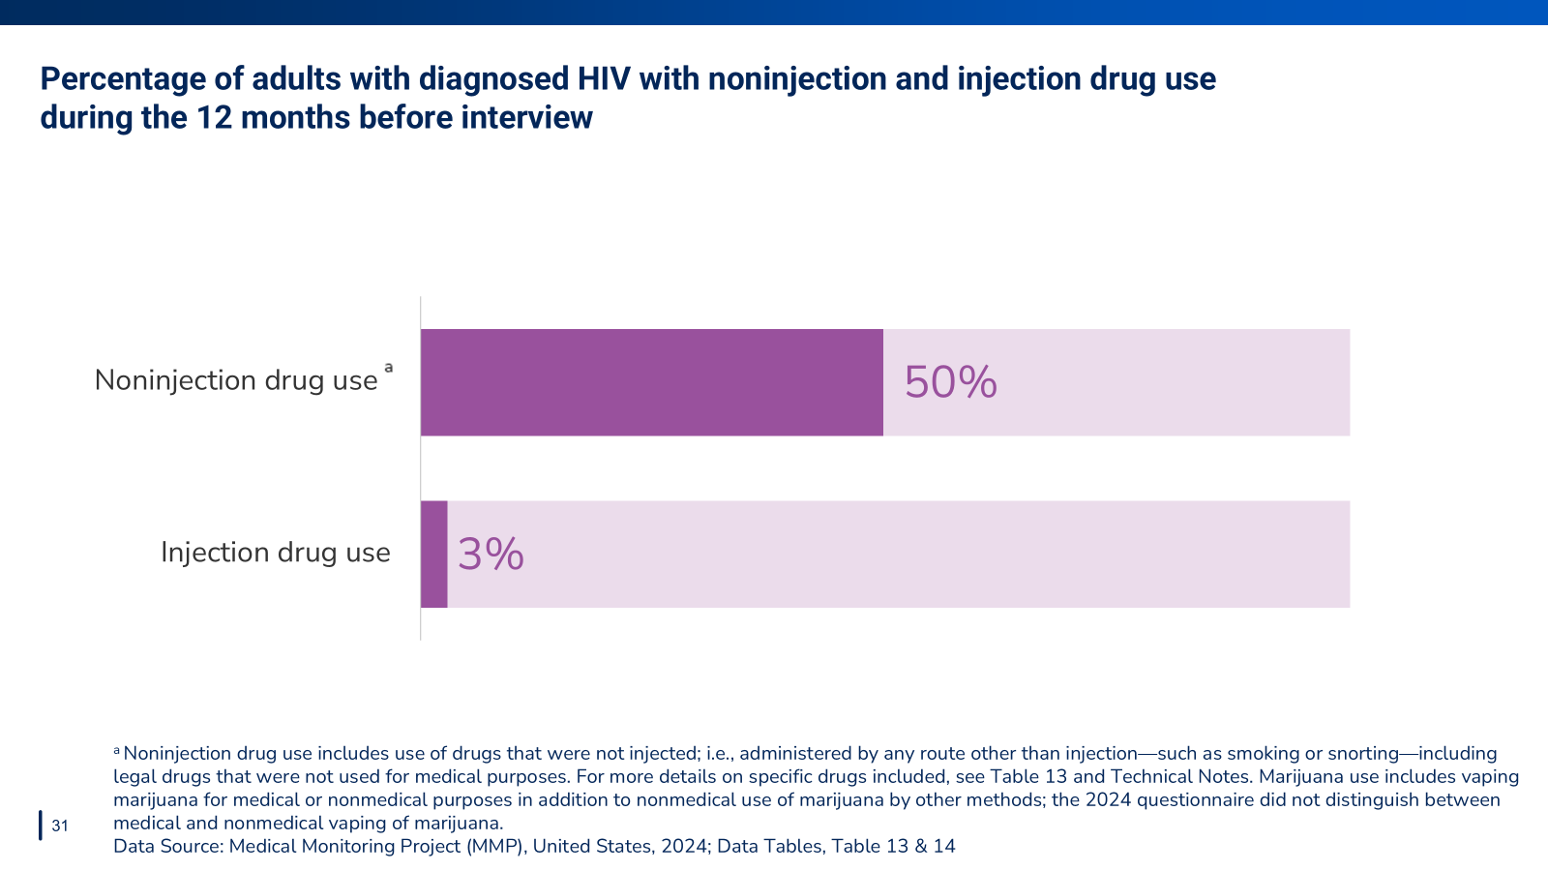
Notes:
An estimated 50% of persons used noninjection drugs for nonmedical purposes. An estimated 3% of persons used injection drugs for nonmedical purposes.

Slide 32
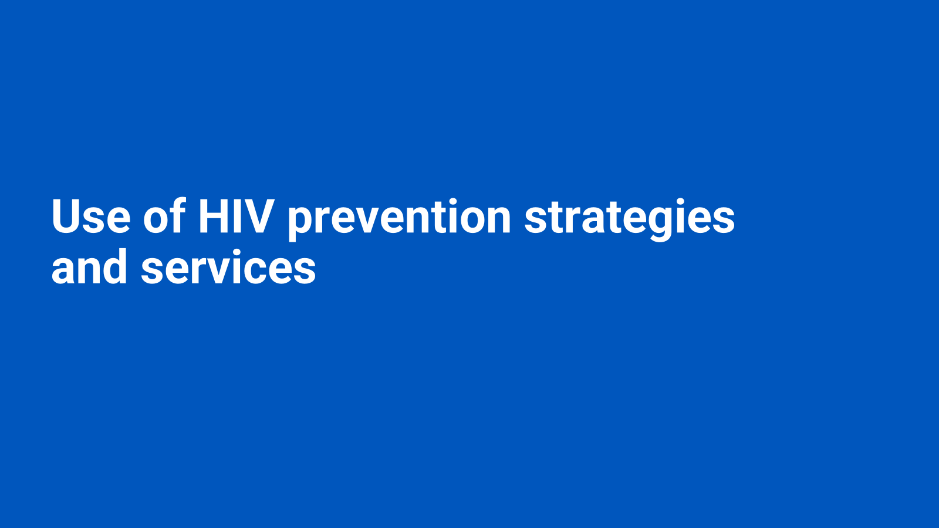

Slide 33
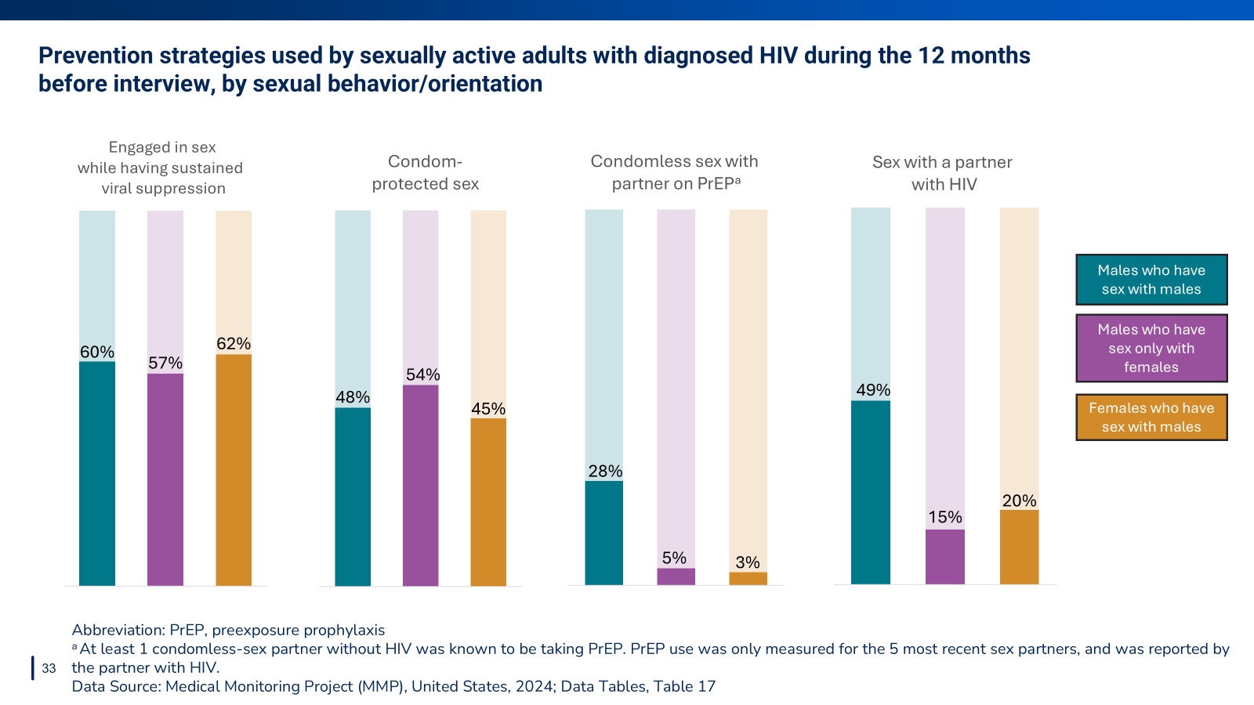
Notes:
Many people with HIV use a variety of prevention services. For instance, among sexually active males who have sex with males (MSM), 60% engaged in sex while having sustained viral suppression, 48% had condom-protected sex, 28% had condomless sex with a partner on PrEP, and 49% had sex with a partner with HIV.

Slide 34
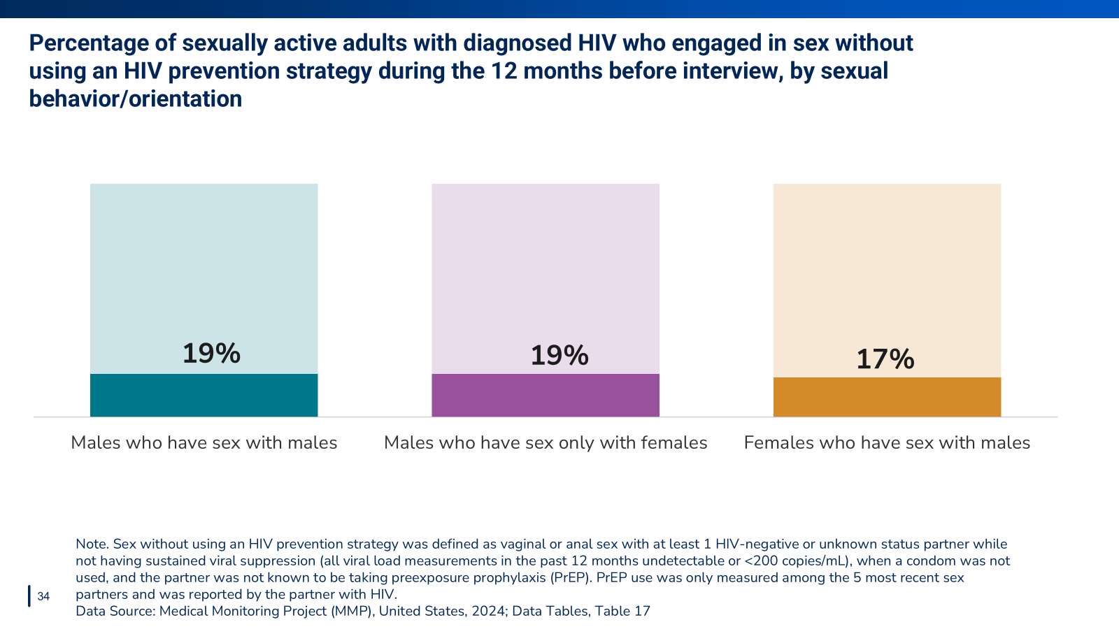
Notes:
Among sexually active persons, 19% of MSM, 19% of MSF, and 17% of FSM engaged in sex without using any HIV prevention strategy during the past 12 months.

Slide 35
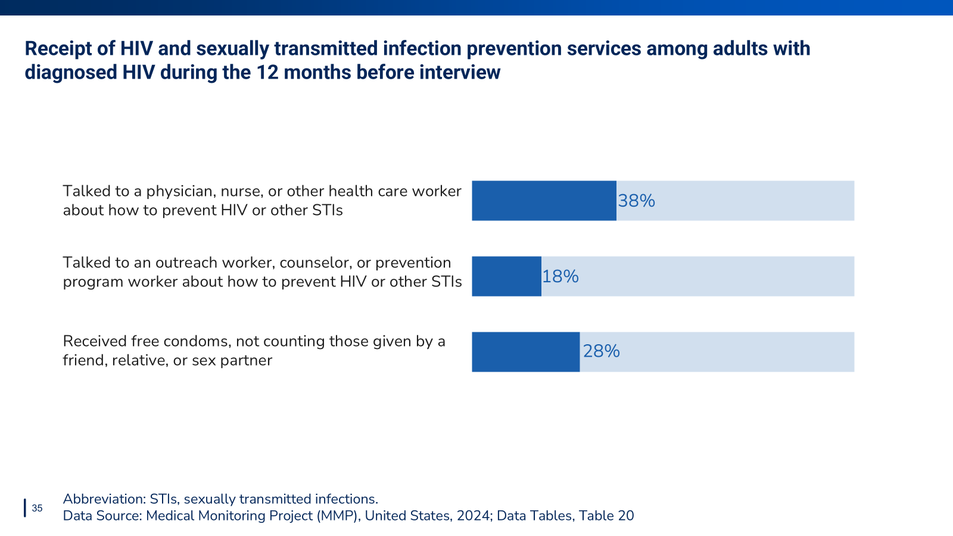
Notes:
During the past 12 months,
38% talked to a physician, nurse, or other health care worker about how to prevent HIV or other STIs.
18% talked to an outreach worker, counselor, or prevention program worker about how to prevent HIV or other STIs.
28% received free condoms, not counting those given by a friend, relative, or sex partner

Slide 36


Slide 37
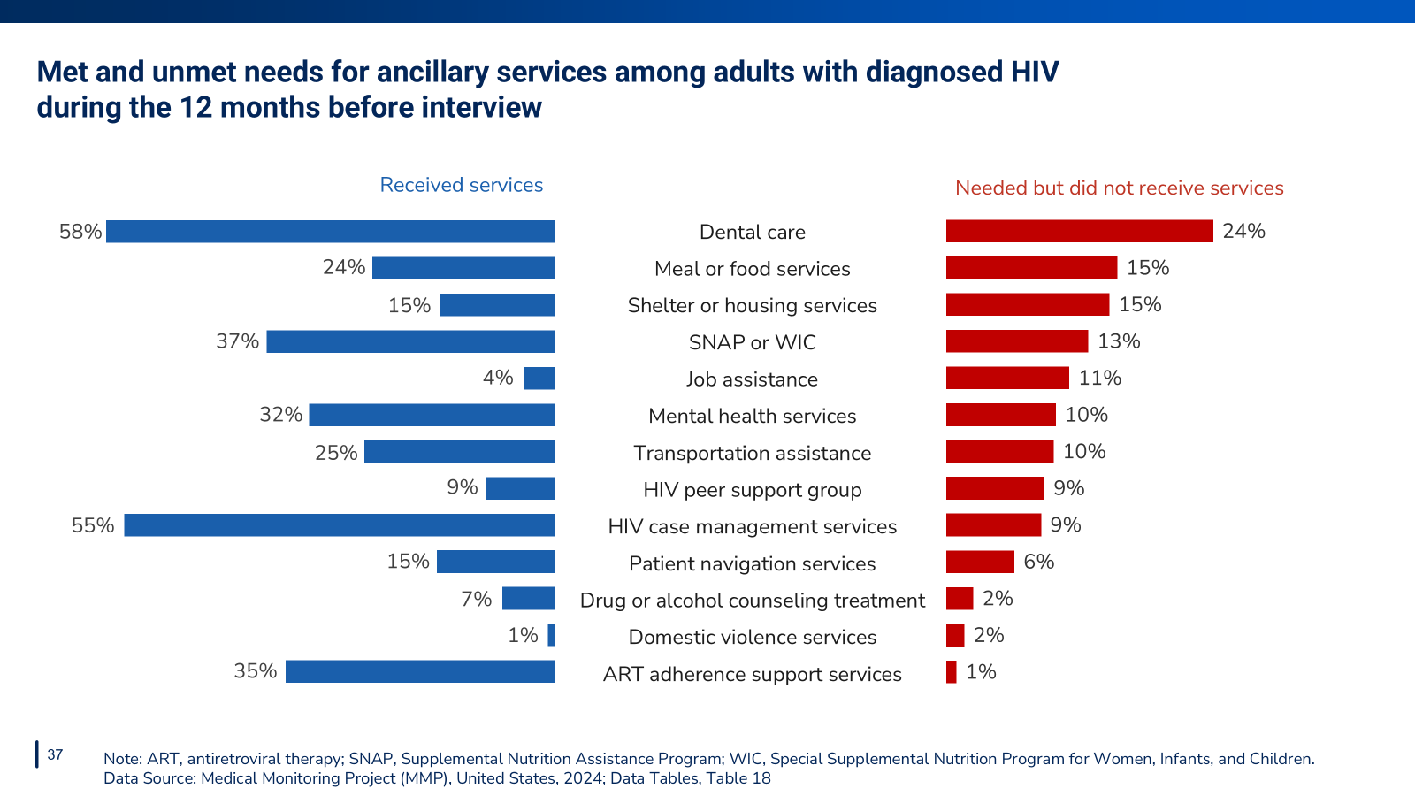
Notes:
During the past 12 months,
The most commonly received ancillary services among all persons with diagnosed HIV included: dental care (58%), HIV case management (55%), and SNAP/WIC (37%).
The most commonly reported unmet needs for ancillary services among all persons with diagnosed HIV included: dental care (24%), meal or food services (15%), and shelter or housing services (15%).

Slide 38
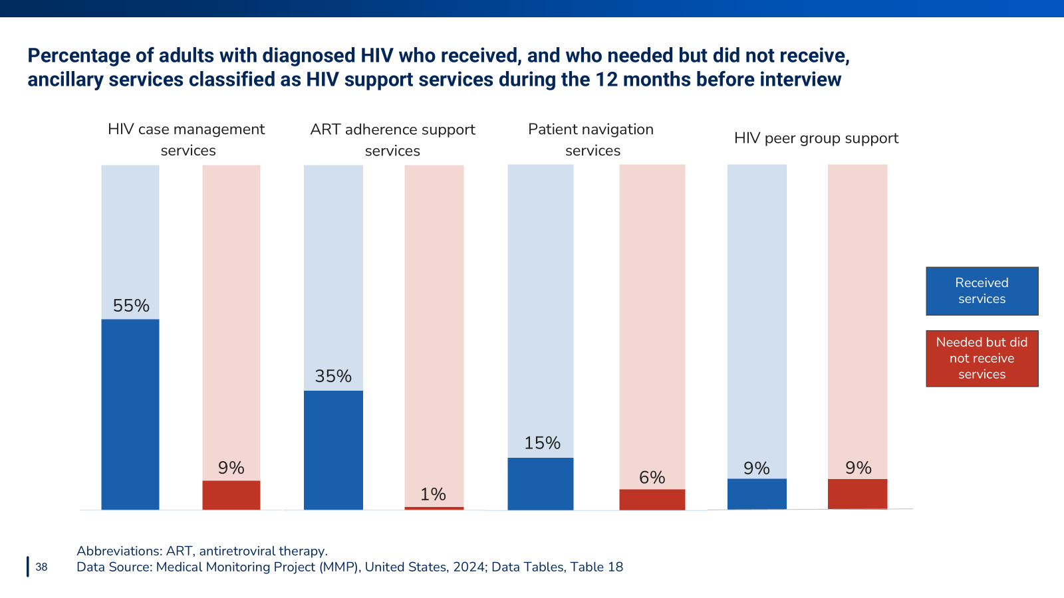
Notes:
Among all HIV support services, the most commonly reported service received in the 12 months before interview was HIV case management (55%). HIV peer support and HIV case management services were the most commonly needed but not received services (9%).

Slide 39
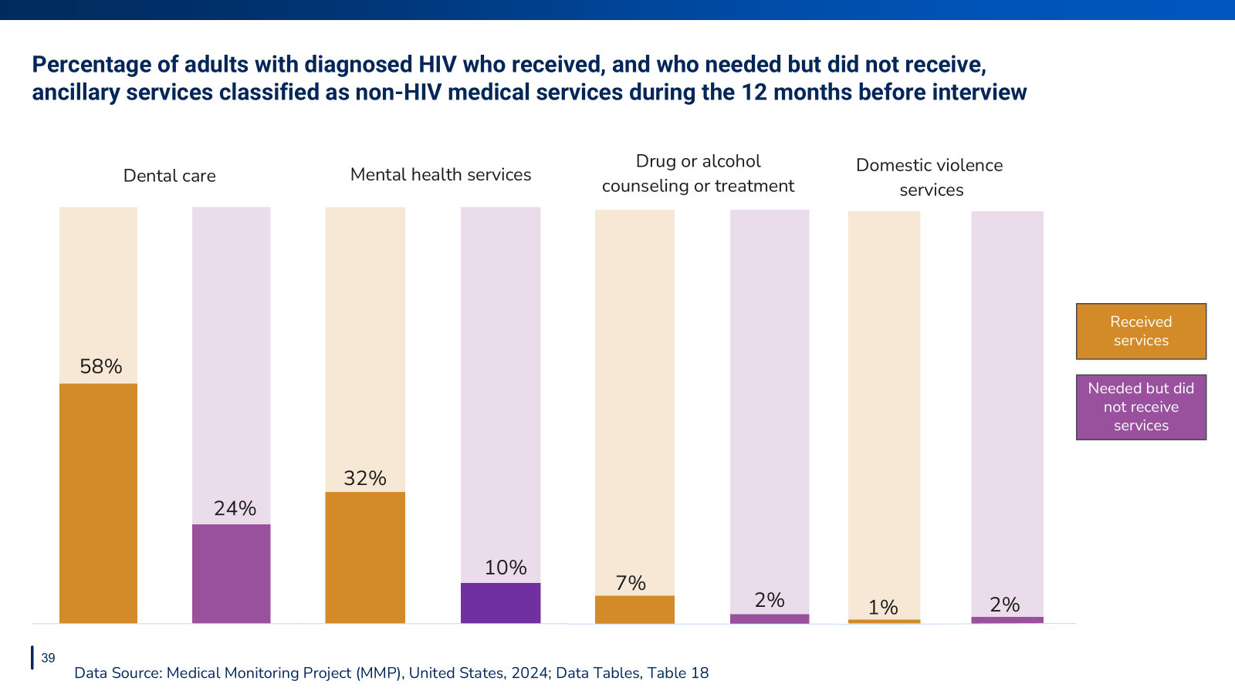
Notes:
Among all non-HIV medical services, the most commonly reported service received in the 12 months before interview was dental care (58%). Dental care was also the most commonly needed but not received service (24%).

Slide 40
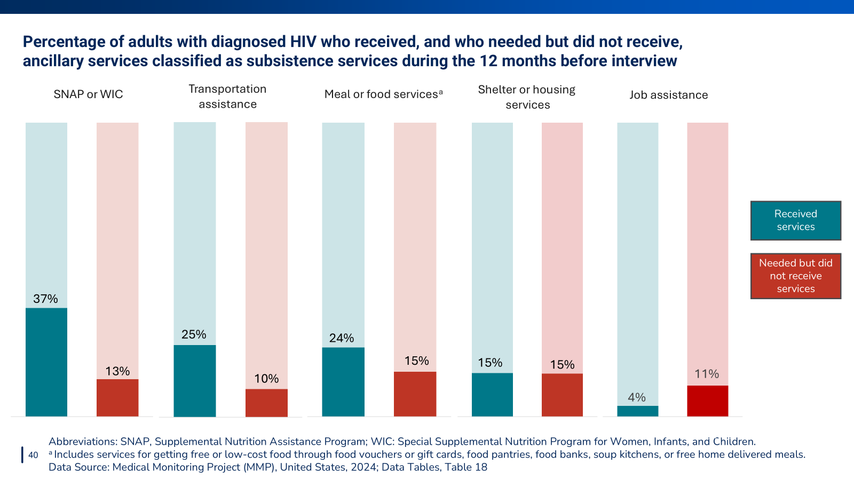
Notes:
Among all services related to subsistence, the most commonly reported service received in the 12 months before interview was SNAP or WIC (37%). The most commonly needed but not received services included meal/food services (15%) and shelter or housing services (15%).

Slide 41


Slide 42
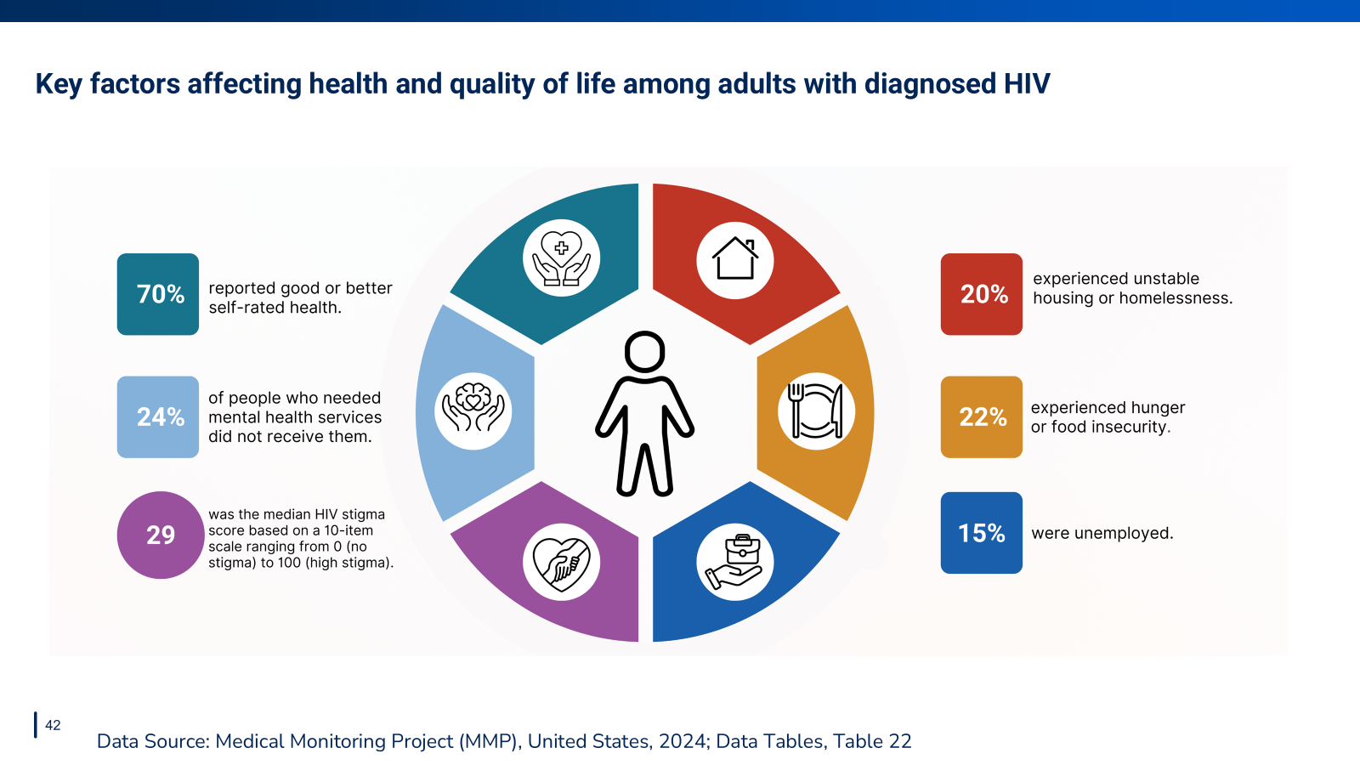
Notes:
Aspects of physical, mental, and emotional health—such as structural factors, including unstable housing or homelessness, hunger or food insecurity, and unemployment—and HIV stigma all continue to negatively impact people with HIV in the U.S.

Slide 43
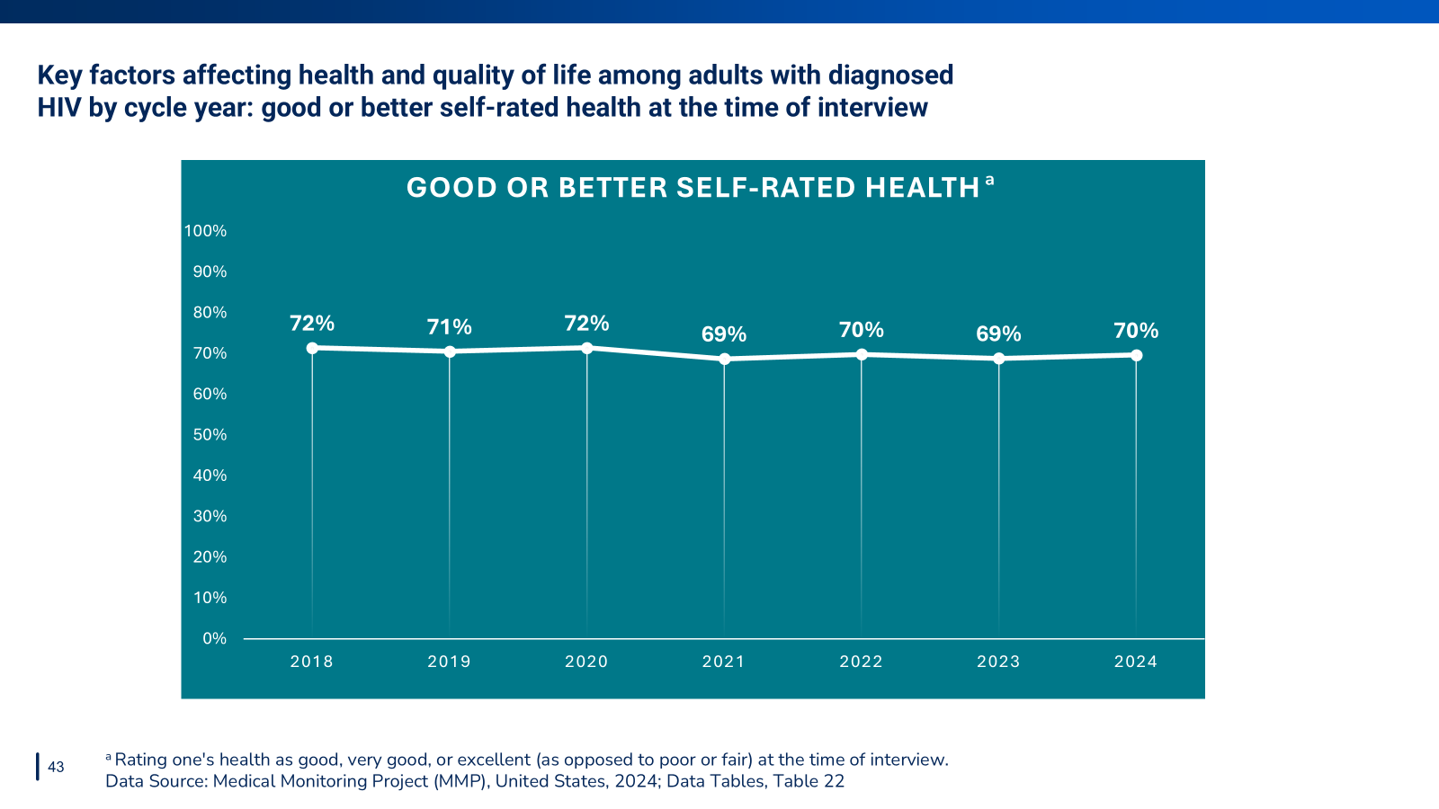
Notes:
In the 2024 cycle, an estimated 70% reported having good or better self-rated health.

Slide 44
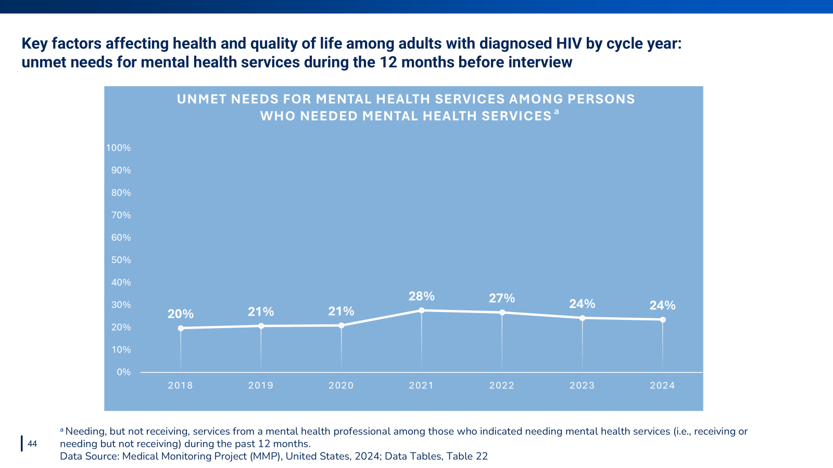
Notes:
Among those who needed mental health services, 24% reported unmet needs during the 2024 cycle.

Slide 45
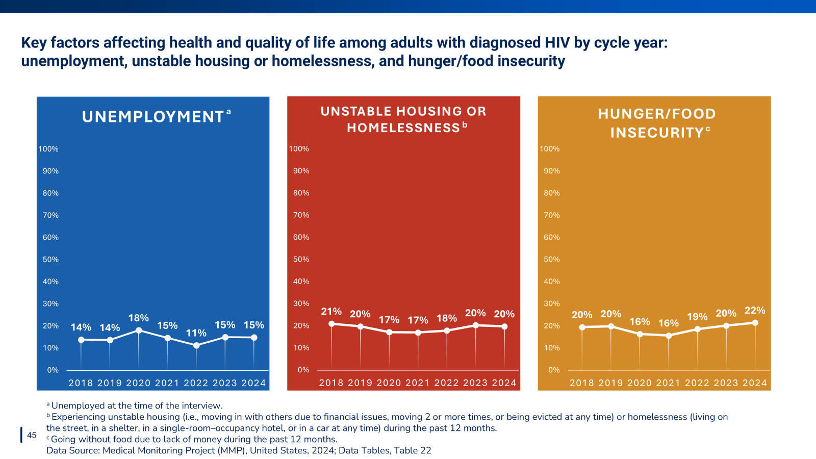
Notes:
In the 2024 cycle, 15% reported current unemployment, 20% reported unstable housing or homelessness, and 22% reported hunger/food insecurity.

Slide 46
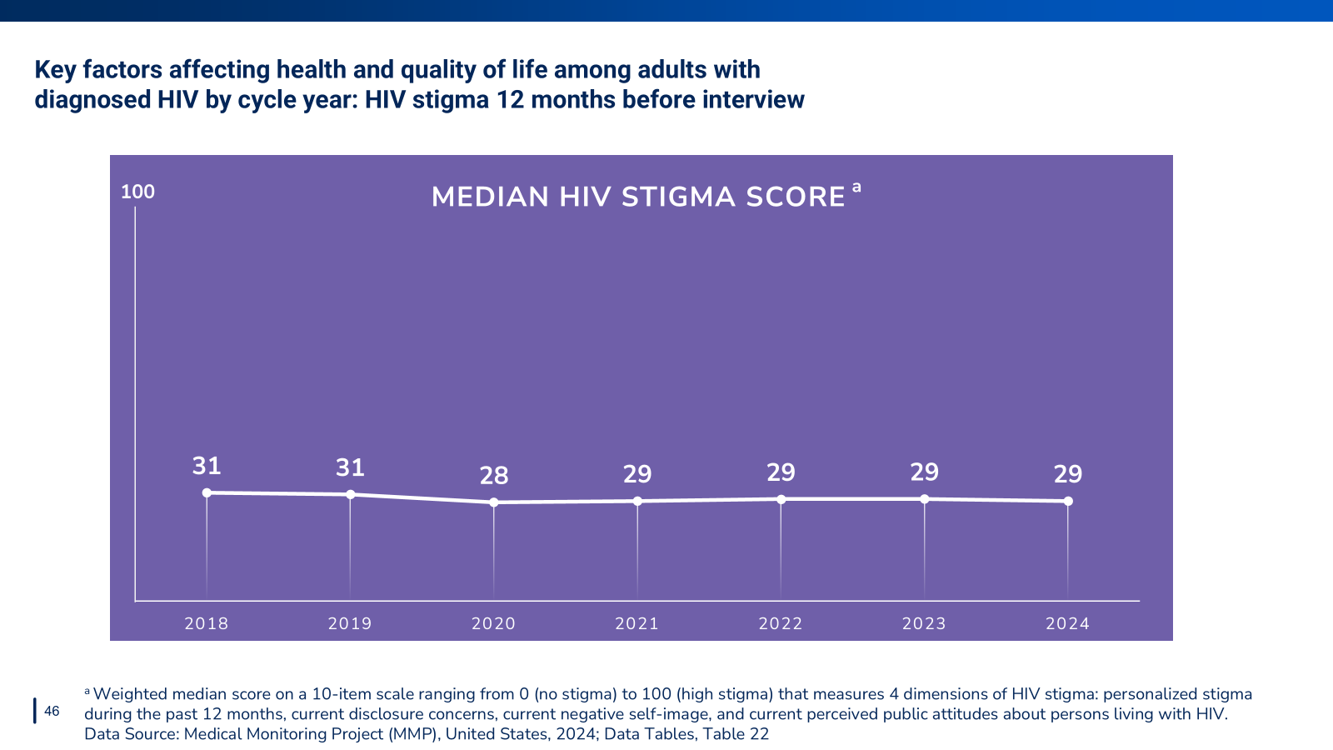
Notes:
During the 2024 cycle, the median HIV stigma score was 29.

Slide 47
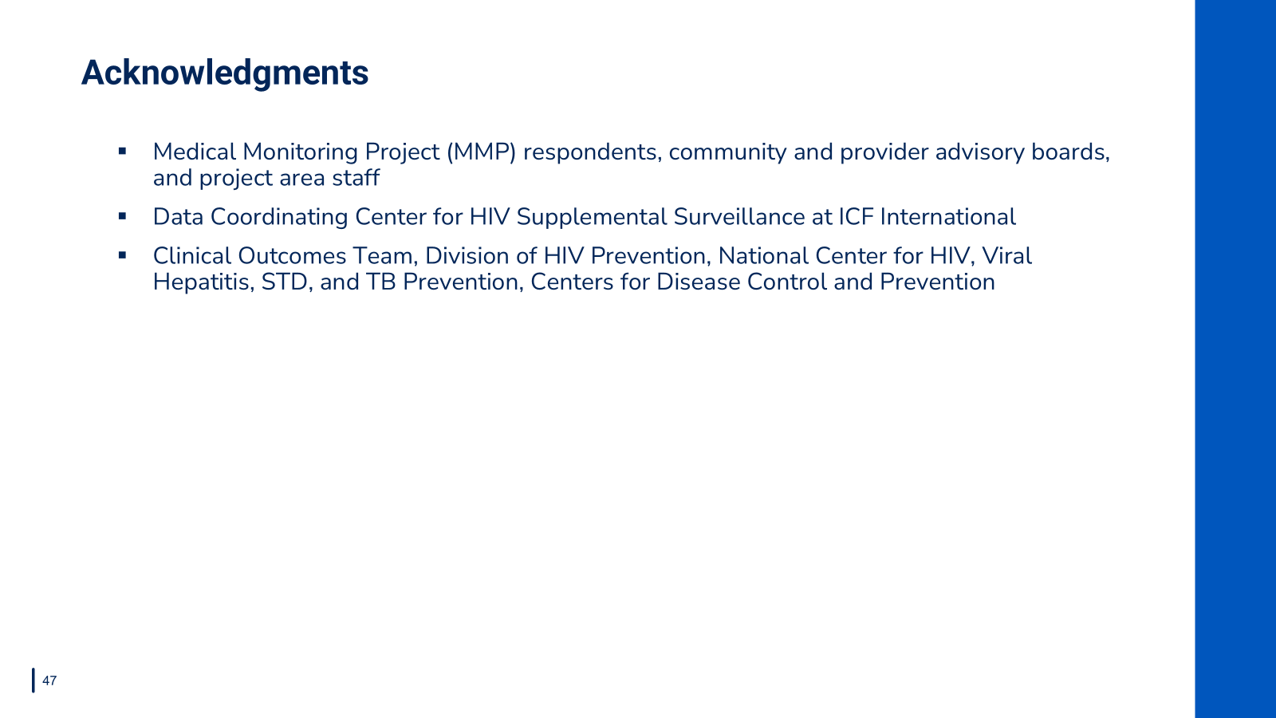

Slide 48
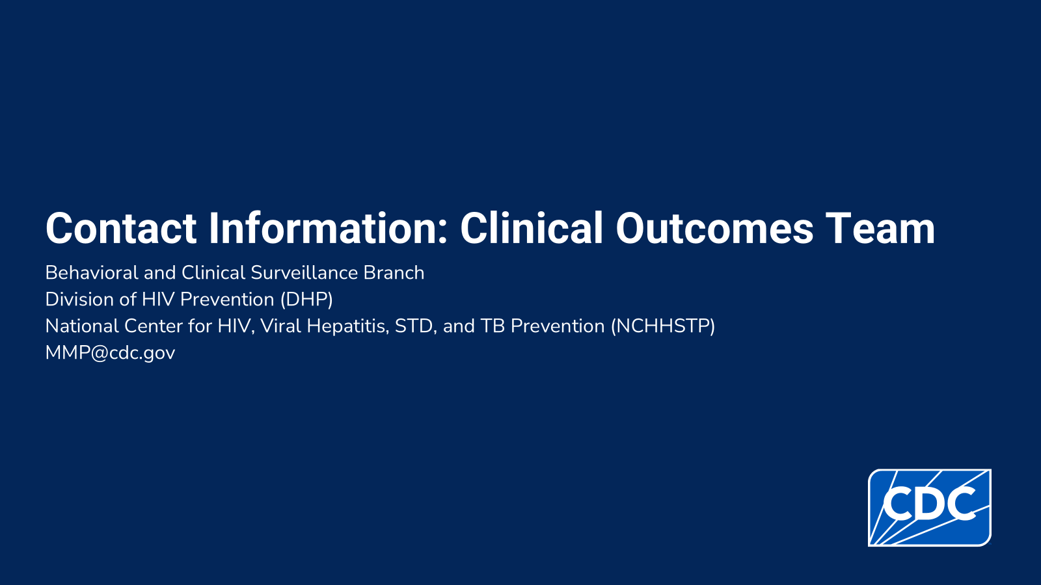

Slide 49


