Slide 1



U.S. Centers for Disease Control and Prevention
Social Determinants of Health and Selected Care Outcomes among Adults with HIV Diagnosed during 2023 in the United States and Puerto Rico
Notes:
These slides were prepared by the Division of HIV Prevention, National Center for HIV, Viral Hepatitis, STD, and TB Prevention (NCHHSTP), Centers for Disease Control and Prevention (CDC). These slides present county-level data on persons with HIV in the United States based on cases of HIV reported to CDC’s National HIV Surveillance System (NHSS) through January 2025.
Note. This slide set is in the public domain. You may reproduce these slides without permission; however, citation as to source is appreciated.
Centers for Disease Control and Prevention. Social Determinants of Health and Selected Care Outcomes among Adults with HIV Diagnosed during 2023 in the United States and Puerto Rico. Atlanta: U.S. Department of Health and Human Services; 2025.
You are also free to adapt and revise these slides; however, you must remove the CDC name and logo if changes are made.

Slide 2

Data Sources and Technical Notes
For more information on data sources, data collection and reporting practices, and case definitions, see National HIV Surveillance System (NHSS) Technical Notes, available at https://www.cdc.gov/hiv-data/nhss/index.html
For more information on social determinants of health (SDOH) definitions and data specifications, see Social Determinants of Health Report Technical Notes, available at https://www.cdc.gov/hiv-data/nhss/sdoh-hiv-diagnoses-and-selected-care-outcomes-2025.html
For more information on diagnoses, see HIV Surveillance Report Technical Notes, available at https://www.cdc.gov/hiv-data/nhss/hiv-diagnoses-deaths-and-prevalence-2025.html
For more information on linkage to HIV medical care within 1 month and viral suppression within 6 months of HIV diagnosis, see Monitoring HIV Prevention and Care Outcomes Report Technical Notes, available at https://www.cdc.gov/hiv-data/nhss/national-hiv-prevention-and-care-objectives-2025.html
For the definitions of SDOH indicator variables used in this report, see the U.S. Census Bureau’s American Community Survey, available at https://www2.census.gov/programs-surveys/acs/tech_docs/subject_definitions/2023_ACSSubjectDefinitions.pdf
Notes:
Data are presented for geocoded HIV surveillance data that have been linked with SDOH indicator variables from the U.S. Census Bureau’s 2019–2023 American Community Survey (ACS). HIV surveillance data are geocoded to the county level by address of residence at the time of diagnosis and linked to county-level SDOH data from the ACS.
Data were limited to adults aged ≥ 18 years to align with the population in the ACS from which SDOH indicator variables were collected.
For more information on data sources, data collection and reporting practices, and case definitions, see the National HIV Surveillance System (NHSS) Technical Notes, available at https://www.cdc.gov/hiv-data/nhss/index.html.
For more information on SDOH definitions and data specifications , see the Social Determinants of Health Report Technical Notes at https://www.cdc.gov/hiv-data/nhss/sdoh-hiv-diagnoses-and-selected-care-outcomes-2025.html.
For more information on diagnoses; see HIV Surveillance Report Technical Notes at https://www.cdc.gov/hiv-data/nhss/hiv-diagnoses-deaths-and-prevalence-2025.html.
For more information on linkage to HIV medical care and viral suppression, see the Monitoring HIV Prevention and Care Outcomes Report Technical Notes , available at https://www.cdc.gov/hiv-data/nhss/national-hiv-prevention-and-care-objectives-2025.html.
For the definitions of SDOH indicator variables used in this report, see the U.S. Census Bureau’s American Community Survey at https://www2.census.gov/programs-surveys/acs/tech_docs/subject_definitions/2023_ACSSubjectDefinitions.pdf.

Slide 3
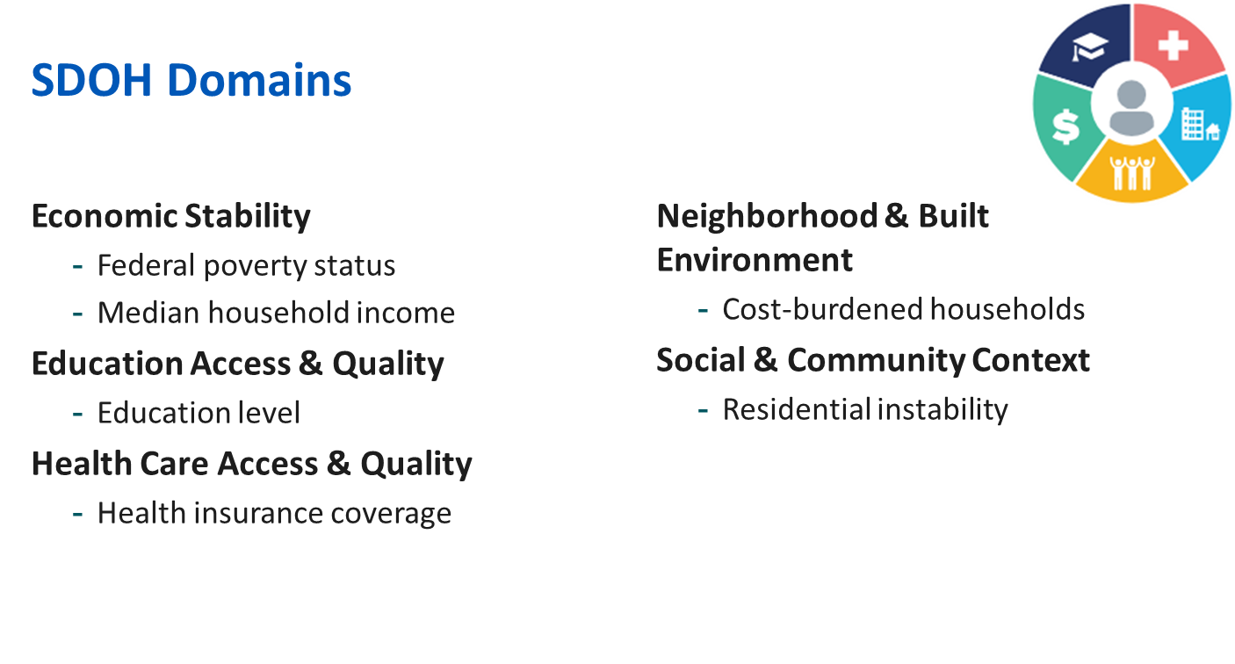
https://odphp.health.gov/healthypeople/priority-areas/social-determinants-health
Notes:
Healthy People 2030 sets data-driven national objectives in five key domains of SDOH: economic stability, education access and quality, healthcare access and quality, neighborhood and built environment, and social and community context.
For this report, at least 1 SDOH indicator was selected for each domain.
The following 6 SDOH indicators were selected for this report: federal poverty status, median household income, education level, health insurance coverage, cost-burdened household, and residential instability.
For more information on the domains, see Healthy People 2030 at https://odphp.health.gov/healthypeople/priority-areas/social-determinants-health.

Slide 4

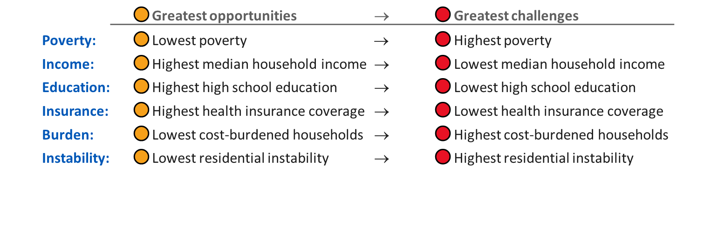
SDOH Categories
SDOH indicator variables were categorized by using empirically derived quartiles—ranging from counties with the greatest economic and social opportunities (denoted with orange circles) to counties with the greatest economic and social challenges (denoted with red circles):
Notes:
SDOH indicators were categorized into quartiles to assess levels of economic and social opportunities and challenges.
The categories range from greatest opportunities (orange circles) to greatest challenges (red circles).
Greatest opportunities: represents counties with favorable conditions such as low poverty rates, high household income, high educational attainment, high health insurance coverage, low cost-burdened households, and low residential instability.
Greatest challenges: represents counties with adverse conditions such as high poverty, low median income, low educational attainment, low health insurance coverage, high cost-burdened households, and high residential instability.

Slide 5
Federal Poverty Status

Slide 6
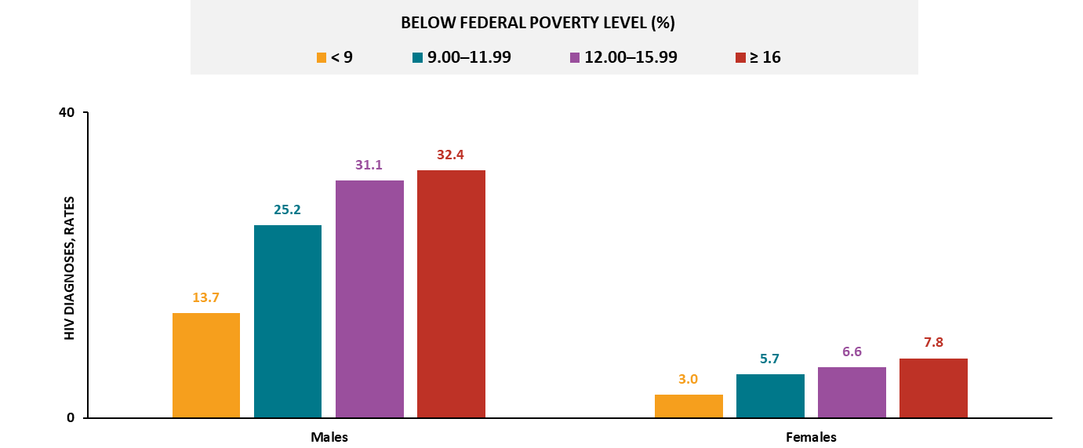
HIV diagnoses, by sex and federal poverty status, 2023—county level, United States and Puerto Rico
Note. Data are presented for persons aged ≥ 18 years. Rates are per 100,000 population.
Notes:
In 2023, in the United States and Puerto Rico, the highest HIV diagnosis rates by sex were among those residing in counties with the:
Highest poverty (≥16% residents lived below the federal poverty level): males and females
For both sexes, the rate of HIV diagnoses increased as the percentage of residents living below the federal poverty level increased.
Note.
For more information on data sources, data collection and reporting practices, and case definitions, see the National HIV Surveillance System (NHSS) Technical Notes, available at https://www.cdc.gov/hiv-data/nhss/index.html.
For more information on SDOH definitions and data specifications, see the Social Determinants of Health Report Technical Notes at https://www.cdc.gov/hiv-data/nhss/sdoh-hiv-diagnoses-and-selected-care-outcomes-2025.html.
For more information on diagnoses, see HIV Surveillance Report Technical Notes at https://www.cdc.gov/hiv-data/nhss/hiv-diagnoses-deaths-and-prevalence-2025.html.
For the definitions of SDOH indicator variables used in this report, see the U.S. Census Bureau’s American Community Survey at https://www2.census.gov/programs-surveys/acs/tech_docs/subject_definitions/2023_ACSSubjectDefinitions.pdf.

Slide 7
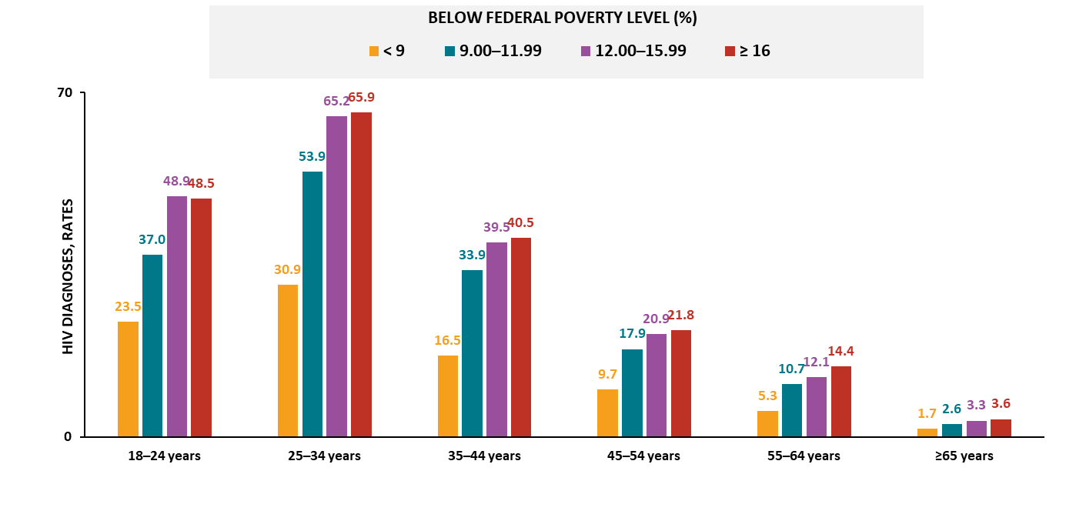
HIV diagnoses among males, by age and federal poverty status, 2023—county level, United States and Puerto Rico
Note. Data are presented for persons aged ≥ 18 years. Rates are per 100,000 population.
Notes:
In 2023, among males in the United States and Puerto Rico, the highest HIV diagnosis rates by age were among those residing in counties with the:
Highest poverty (≥16% residents lived below the federal poverty level): aged 25‒34, 35‒44, 45‒54, 55‒64, and ≥ 65 years
Second-highest poverty (12.00–15.99% below poverty level): aged 18‒24 years
For males in all age groups (except aged 18‒24 years), the rate of HIV diagnoses increased as the percentage of residents living below the federal poverty level increased.
Note.
For more information on data sources, data collection and reporting practices, and case definitions, see the National HIV Surveillance System (NHSS) Technical Notes, available at https://www.cdc.gov/hiv-data/nhss/index.html.
For more information on SDOH definitions and data specifications, see the Social Determinants of Health Report Technical Notes at https://www.cdc.gov/hiv-data/nhss/sdoh-hiv-diagnoses-and-selected-care-outcomes-2025.html.
For more information on diagnoses, see HIV Surveillance Report Technical Notes at https://www.cdc.gov/hiv-data/nhss/hiv-diagnoses-deaths-and-prevalence-2025.html.
For the definitions of SDOH indicator variables used in this report, see the U.S. Census Bureau’s American Community Survey at https://www2.census.gov/programs-surveys/acs/tech_docs/subject_definitions/2023_ACSSubjectDefinitions.pdf.

Slide 8
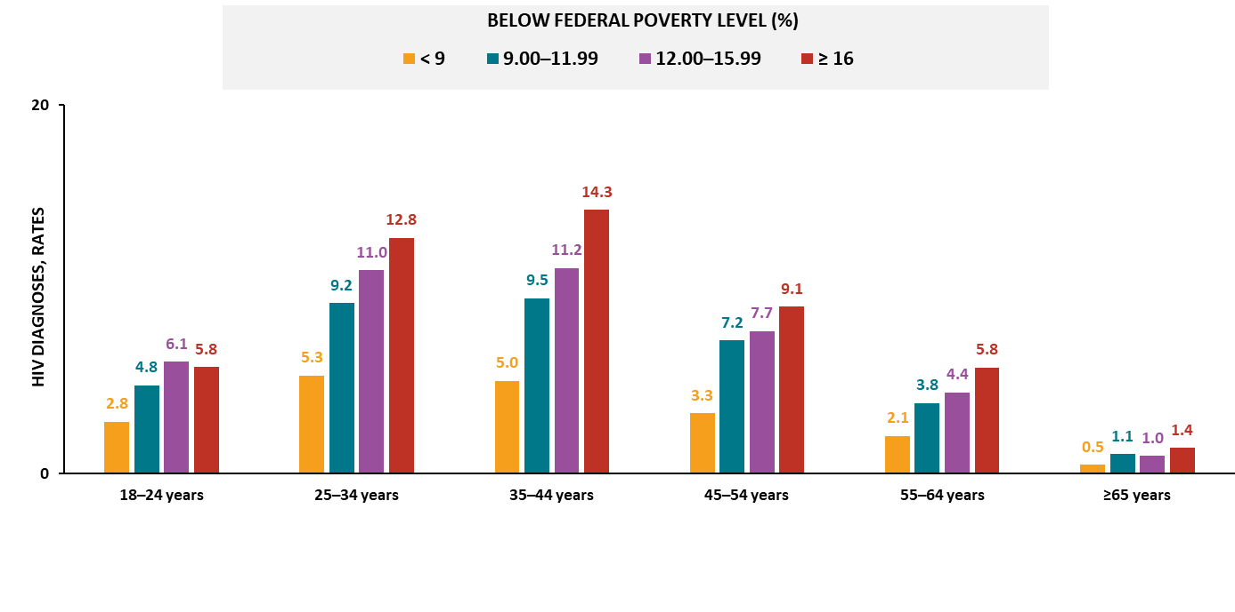
HIV diagnoses among females, by age and federal poverty status, 2023—county level, United States and Puerto Rico
Note. Data are presented for persons aged ≥ 18 years. Rates are per 100,000 population.
Notes:
In 2023, among females in the United States and Puerto Rico, the highest HIV diagnosis rates by age were among those residing in counties with the:
Highest poverty (≥16% residents lived below the federal poverty level): aged 25‒34, 35‒44, 45‒54, 55‒64, and ≥ 65 years
Second-highest poverty (12.00–15.99% below poverty level): aged 18‒24 years
For females in all age groups (except aged 18‒24 and ≥ 65 years), the rate of HIV diagnoses increased as the percentage of residents living below the federal poverty level increased.
Note.
For more information on data sources, data collection and reporting practices, and case definitions, see the National HIV Surveillance System (NHSS) Technical Notes, available at https://www.cdc.gov/hiv-data/nhss/index.html.
For more information on SDOH definitions and data specifications, see the Social Determinants of Health Report Technical Notes at https://www.cdc.gov/hiv-data/nhss/sdoh-hiv-diagnoses-and-selected-care-outcomes-2025.html.
For more information on diagnoses, see HIV Surveillance Report Technical Notes at https://www.cdc.gov/hiv-data/nhss/hiv-diagnoses-deaths-and-prevalence-2025.html.
For the definitions of SDOH indicator variables used in this report, see the U.S. Census Bureau’s American Community Survey at https://www2.census.gov/programs-surveys/acs/tech_docs/subject_definitions/2023_ACSSubjectDefinitions.pdf.

Slide 9
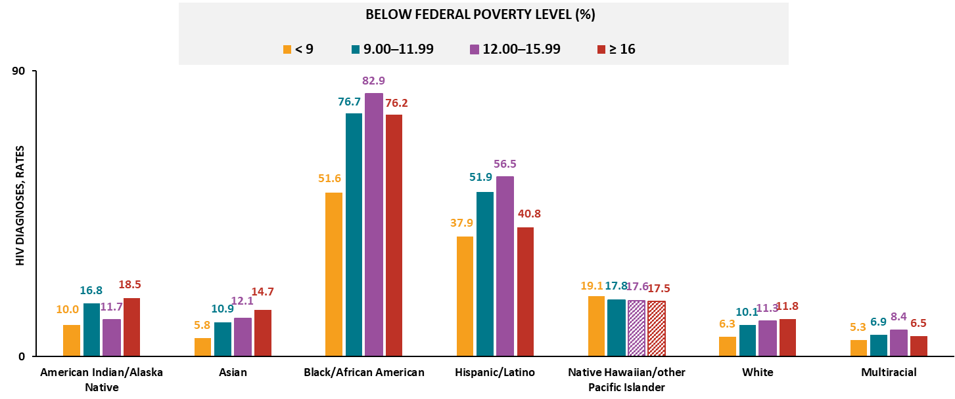
HIV diagnoses among males, by race/ethnicity and federal poverty status, 2023—county level, United States and Puerto Rico
Note. Data are presented for persons aged ≥ 18 years. Rates are per 100,000 population. Hispanic/Latino persons can be of any race. Striped bars indicate rates based on small numbers (i.e., less than 12 diagnoses) and should be interpreted with caution.
Notes:
In 2023, among males in the United States and Puerto Rico, the highest HIV diagnosis rates by race/ethnicity were among those residing in counties with the:
Highest poverty (≥16% residents lived below the federal poverty level): American Indian/Alaska Native, Asian, and White males
Second-highest poverty (12.00–15.99% below poverty level): Black/African American, Hispanic/Latino, and multiracial males
For Asian and White males, the rate of HIV diagnoses increased as the percentage of residents living below the federal poverty level increased.
Note.
Groups were excluded from findings if two or more quartiles contained small numbers.
Use caution when interpreting data for Native Hawaiian/other Pacific Islander persons due to small numbers.
For more information on data sources, data collection and reporting practices, and case definitions, see the National HIV Surveillance System (NHSS) Technical Notes, available at https://www.cdc.gov/hiv-data/nhss/index.html.
For more information on SDOH definitions and data specifications, see the Social Determinants of Health Report Technical Notes at https://www.cdc.gov/hiv-data/nhss/sdoh-hiv-diagnoses-and-selected-care-outcomes-2025.html.
For more information on diagnoses, see HIV Surveillance Report Technical Notes at https://www.cdc.gov/hiv-data/nhss/hiv-diagnoses-deaths-and-prevalence-2025.html.
For the definitions of SDOH indicator variables used in this report, see the U.S. Census Bureau’s American Community Survey at https://www2.census.gov/programs-surveys/acs/tech_docs/subject_definitions/2023_ACSSubjectDefinitions.pdf.

Slide 10
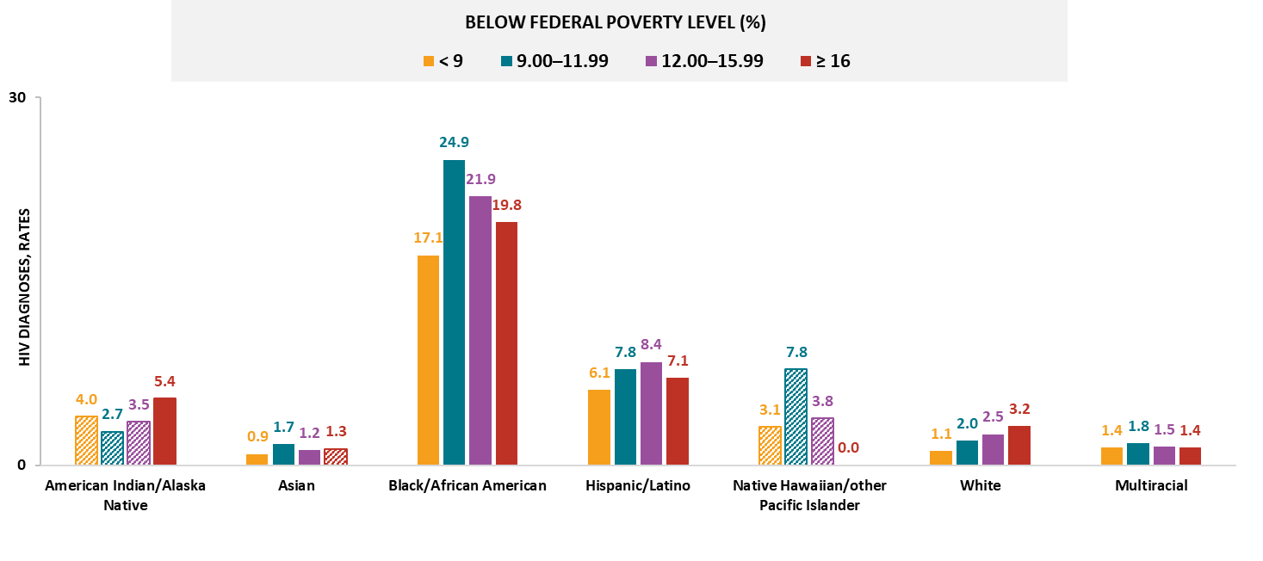
HIV diagnoses among females, by race/ethnicity and federal poverty status, 2023—county level, United States and Puerto Rico
Note. Data are presented for persons aged ≥ 18 years. Rates are per 100,000 population. Hispanic/Latino persons can be of any race. Striped bars indicate rates based on small numbers (i.e., less than 12 diagnoses) and should be interpreted with caution.
Notes:
In 2023, among females in the United States and Puerto Rico, the highest HIV diagnosis rates by race/ethnicity were among those residing in counties with the:
Highest poverty (≥16% residents lived below the federal poverty level): White females
Second-highest poverty (12.00–15.99% below poverty level): Hispanic/Latino females
Third-highest poverty (9.00-11.99% below poverty level): Asian, Black/African American, and multiracial females
For White females, the rate of HIV diagnoses increased as the percentage of residents living below the federal poverty level increased.
Note.
Groups were excluded from findings if two or more quartiles contained small numbers.
Use caution when interpreting data for American Indian/Alaska Native and Native Hawaiian/other Pacific Islander persons due to small numbers.
For more information on data sources, data collection and reporting practices, and case definitions, see the National HIV Surveillance System (NHSS) Technical Notes, available at https://www.cdc.gov/hiv-data/nhss/index.html.
For more information on SDOH definitions and data specifications, see the Social Determinants of Health Report Technical Notes at https://www.cdc.gov/hiv-data/nhss/sdoh-hiv-diagnoses-and-selected-care-outcomes-2025.html.
For more information on diagnoses, see HIV Surveillance Report Technical Notes at https://www.cdc.gov/hiv-data/nhss/hiv-diagnoses-deaths-and-prevalence-2025.html.
For the definitions of SDOH indicator variables used in this report, see the U.S. Census Bureau’s American Community Survey at https://www2.census.gov/programs-surveys/acs/tech_docs/subject_definitions/2023_ACSSubjectDefinitions.pdf.

Slide 11
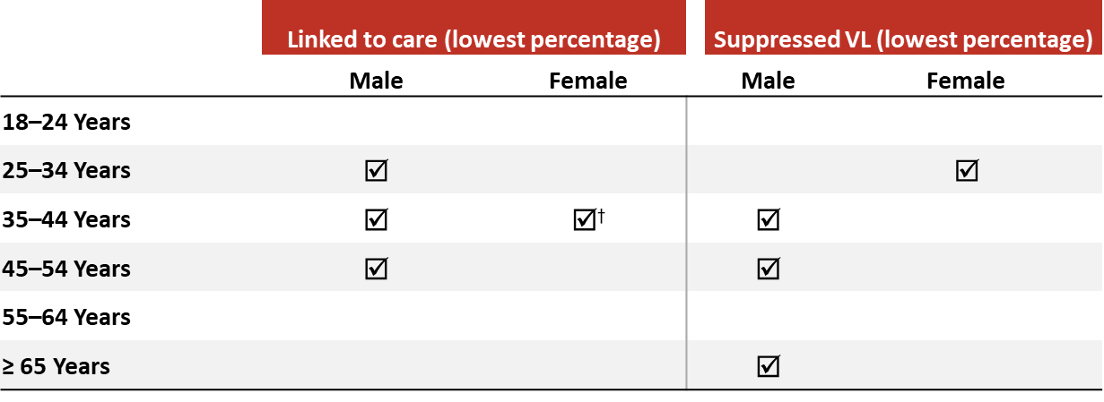
Linkage to HIV medical care within 1 month and viral suppression within 6 months of HIV diagnosis, by sex, age, and federal poverty status, 2023—county level, United States
In 2023, males and females residing in counties with the highest poverty had the least favorable outcomes by age:
Note. Data are presented for persons aged ≥ 18 years. Dagger (†) indicates the lowest percentage linked to care or lowest percentage with suppressed viral load was observed in the highest poverty quartile and in one or more additional quartiles.
Notes:
In 2023, in the United States, the lowest percentages of linkage to care within 1 month of diagnosis and viral suppression within 6 months of diagnosis, by sex and age among those residing in counties with the highest poverty (i.e., where 16% or more of the residents lived below the federal poverty level) were among the following:
Linkage to care:
Males: aged 25‒34, 35‒44, and 45‒54 years
Females: aged 35‒44 years
Viral suppression:
Males: aged 35‒44, 45‒54 and ≥ 65 years
Females: aged 25‒34 years
Note.
Linkage to care and viral suppression focus on SDOH extremes only (i.e., highest poverty) and not the overall values unless otherwise indicated.
Data not provided for states and associated jurisdictions that do not have laws requiring reporting of all CD4 and viral loads. Areas without laws: Idaho. Areas with lapse in reporting: Tennessee.
For more information on data sources, data collection and reporting practices, and case definitions, see the National HIV Surveillance System (NHSS) Technical Notes, available at https://www.cdc.gov/hiv-data/nhss/index.html.
For more information on SDOH definitions and data specifications, see the Social Determinants of Health Report Technical Notes at https://www.cdc.gov/hiv-data/nhss/sdoh-hiv-diagnoses-and-selected-care-outcomes-2025.html.
For more information on linkage to HIV medical care within one month and viral suppression within 6 months of HIV diagnosis, see the Technical Notes, available at https://www.cdc.gov/hiv-data/nhss/national-hiv-prevention-and-care-objectives-2025.html.
For the definitions of SDOH indicator variables used in this report, see the U.S. Census Bureau’s American Community Survey at https://www2.census.gov/programs-surveys/acs/tech_docs/subject_definitions/2023_ACSSubjectDefinitions.pdf.

Slide 12
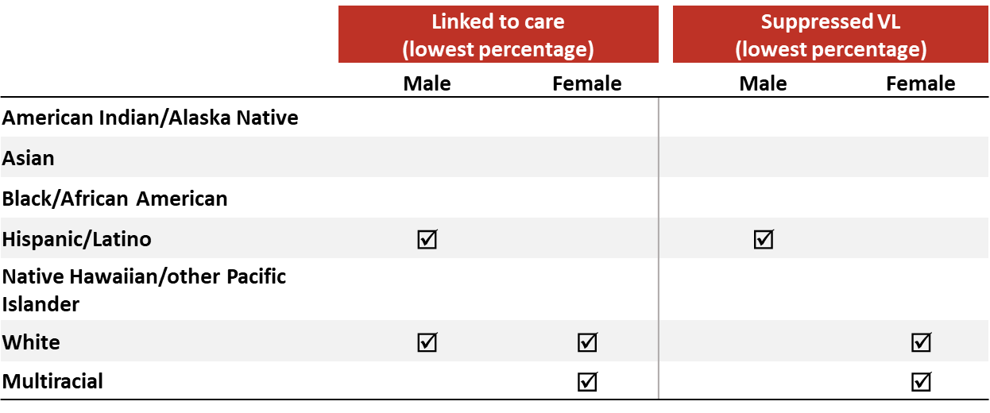
Linkage to HIV medical care within 1 month and viral suppression within 6 months of HIV diagnosis, by sex, race/ethnicity, and federal poverty status, 2023—county level, United States
In 2023, males and females residing in counties with the highest poverty had the least favorable outcomes by race/ethnicity:
Note. Data are presented for persons aged ≥ 18 years. Hispanic/Latino persons can be of any race.
Notes:
In 2023, in the United States, the lowest percentages of linkage to care within 1 month of diagnosis and viral suppression within 6 months of diagnosis, by sex and race/ethnicity, among those residing in counties with the highest poverty (i.e., where 16% or more of the residents lived below the federal poverty level) were among the following:
Linkage to care:
Males: Hispanic/Latino and White persons
Females: White and multiracial persons
Viral suppression:
Males: Hispanic/Latino persons
Females: White and multiracial persons
Note.
Linkage to care and viral suppression focus on SDOH extremes only (i.e., highest poverty) and not the overall values unless otherwise indicated.
Data not provided for states and associated jurisdictions that do not have laws requiring reporting of all CD4 and viral loads. Areas without laws: Idaho. Areas with lapse in reporting: Tennessee.
Use caution when interpreting data for American Indian/Alaska Native and Native Hawaiian/other Pacific Islander persons due to small numbers.
For more information on SDOH definitions and data specifications, see the Social Determinants of Health Report Technical Notes at https://www.cdc.gov/hiv-data/nhss/sdoh-hiv-diagnoses-and-selected-care-outcomes-2025.html.
For more information on data sources, data collection and reporting practices, and case definitions, see the National HIV Surveillance System (NHSS) Technical Notes, available at https://www.cdc.gov/hiv-data/nhss/index.html.
For more information on linkage to HIV medical care within one month and viral suppression within 6 months of HIV diagnosis, see the Technical Notes, available at https://www.cdc.gov/hiv-data/nhss/national-hiv-prevention-and-care-objectives-2025.html.
For the definitions of SDOH indicator variables used in this report, see the U.S. Census Bureau’s American Community Survey at https://www2.census.gov/programs-surveys/acs/tech_docs/subject_definitions/2023_ACSSubjectDefinitions.pdf.

Slide 13
Median Household Income

Slide 14
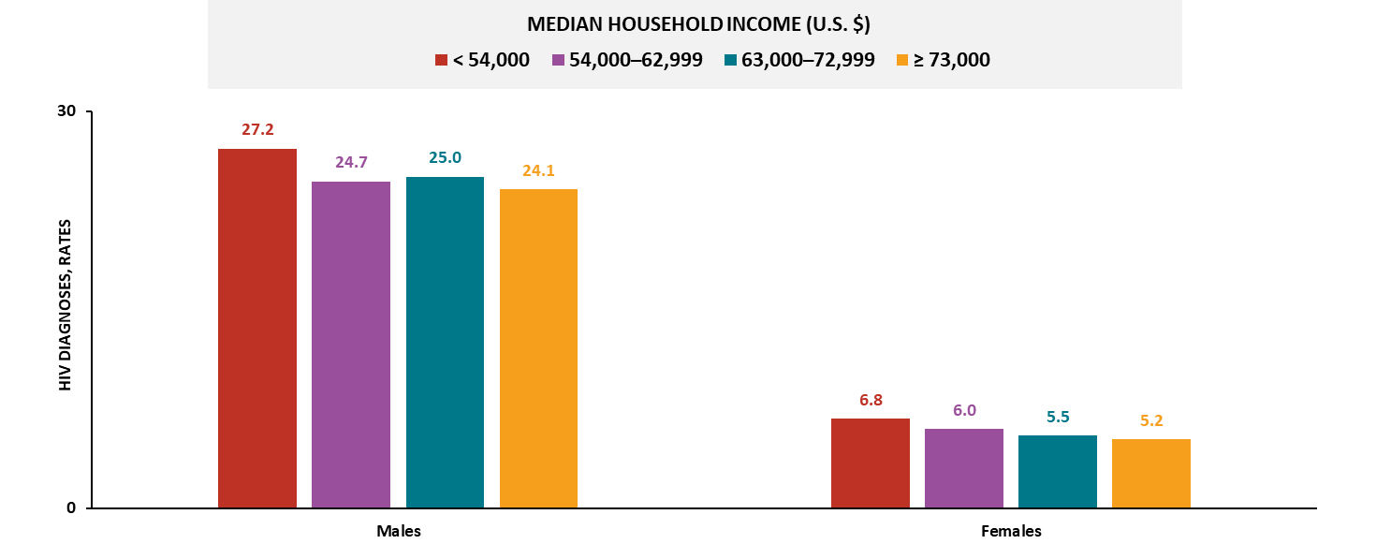
HIV diagnoses, by sex and median household income, 2023—county level, United States and Puerto Rico
Note. Data are presented for persons aged ≥ 18 years. Rates are per 100,000 population.
Notes:
In 2023, in the United States and Puerto Rico, the highest HIV diagnosis rates by sex were among those residing in counties with the:
Lowest income (median household income < $54,000): males and females
For females, the rate of HIV diagnoses decreased as the median household income increased.
Note.
For more information on data sources, data collection and reporting practices, and case definitions, see the National HIV Surveillance System (NHSS) Technical Notes, available at https://www.cdc.gov/hiv-data/nhss/index.html.
For more information on SDOH definitions and data specifications, see the Social Determinants of Health Report Technical Notes at https://www.cdc.gov/hiv-data/nhss/sdoh-hiv-diagnoses-and-selected-care-outcomes-2025.html.
For more information on diagnoses, see HIV Surveillance Report Technical Notes at https://www.cdc.gov/hiv-data/nhss/hiv-diagnoses-deaths-and-prevalence-2025.html.
For the definitions of SDOH indicator variables used in this report, see the U.S. Census Bureau’s American Community Survey at https://www2.census.gov/programs-surveys/acs/tech_docs/subject_definitions/2023_ACSSubjectDefinitions.pdf.

Slide 15
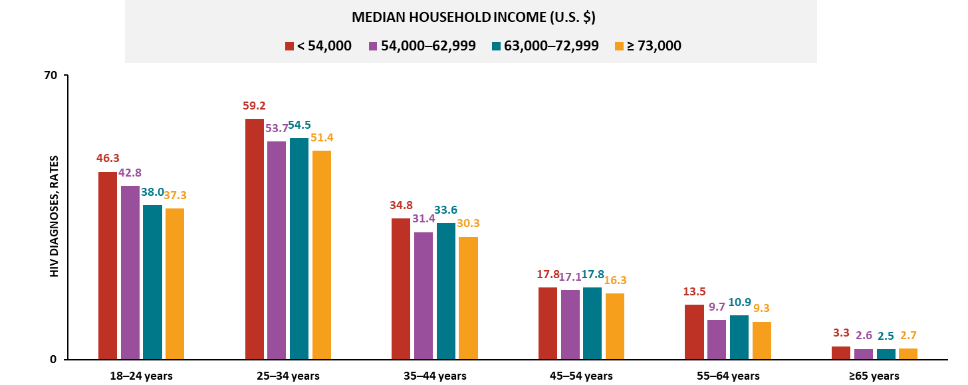
HIV diagnoses among males, by age and median household income, 2023—county level, United States and Puerto Rico
Note. Data are presented for persons aged ≥ 18 years. Rates are per 100,000 population.
Notes:
In 2023, among males in the United States and Puerto Rico, the highest HIV diagnosis rates by age were among those residing in counties with the:
Lowest income (median household income was < $54,000 a year): all age groups
Third-lowest income ($63,000–$72,999): aged 45‒54 years
For males aged 18‒24 years, the rate of HIV diagnoses decreased as the median household income increased.
Note.
For males aged 45‒54 years, the highest HIV diagnosis rate was the same in the lowest and third-lowest income quartiles.
For more information on data sources, data collection and reporting practices, and case definitions, see the National HIV Surveillance System (NHSS) Technical Notes, available at https://www.cdc.gov/hiv-data/nhss/index.html.
For more information on SDOH definitions and data specifications, see the Social Determinants of Health Report Technical Notes at https://www.cdc.gov/hiv-data/nhss/sdoh-hiv-diagnoses-and-selected-care-outcomes-2025.html.
For more information on diagnoses, see HIV Surveillance Report Technical Notes at https://www.cdc.gov/hiv-data/nhss/hiv-diagnoses-deaths-and-prevalence-2025.html.
For the definitions of SDOH indicator variables used in this report, see the U.S. Census Bureau’s American Community Survey at https://www2.census.gov/programs-surveys/acs/tech_docs/subject_definitions/2023_ACSSubjectDefinitions.pdf.

Slide 16
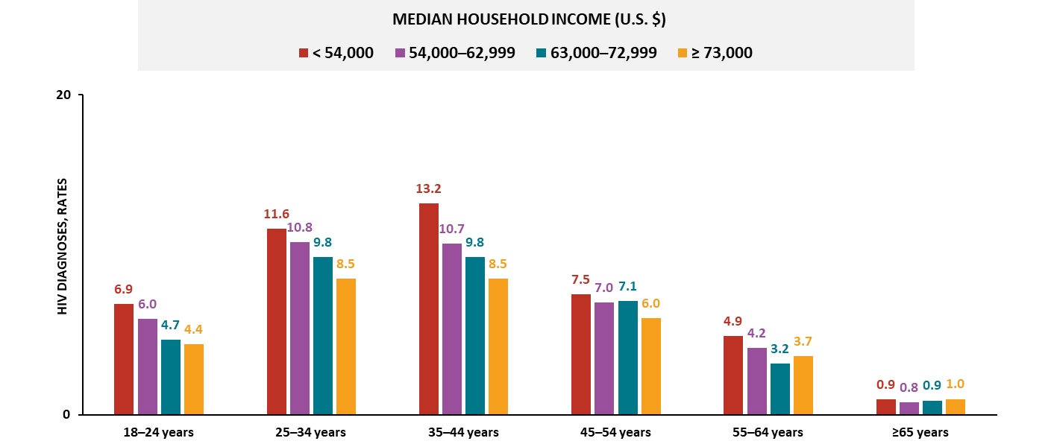
HIV diagnoses among females, by age and median household income, 2023—county level, United States and Puerto Rico
Note. Data are presented for persons aged ≥ 18 years. Rates are per 100,000 population.
Notes:
In 2023, among females in the United States and Puerto Rico, the highest HIV diagnosis rates by age were among those residing in counties with the:
Lowest income (median household income was < $54,000 a year): aged 18‒24, 25‒34, 35‒44, 45‒54, and 55‒64 years
Highest income (≥ $73,000): aged ≥ 65 years
For females aged 18‒24, 25‒34, and 35‒44 years, the rate of HIV diagnoses decreased as the median household income increased.
Note.
For more information on data sources, data collection and reporting practices, and case definitions, see the National HIV Surveillance System (NHSS) Technical Notes, available at https://www.cdc.gov/hiv-data/nhss/index.html.
For more information on SDOH definitions and data specifications, see the Social Determinants of Health Report Technical Notes at https://www.cdc.gov/hiv-data/nhss/sdoh-hiv-diagnoses-and-selected-care-outcomes-2025.html.
For more information on diagnoses, see HIV Surveillance Report Technical Notes at https://www.cdc.gov/hiv-data/nhss/hiv-diagnoses-deaths-and-prevalence-2025.html.
For the definitions of SDOH indicator variables used in this report, see the U.S. Census Bureau’s American Community Survey at https://www2.census.gov/programs-surveys/acs/tech_docs/subject_definitions/2023_ACSSubjectDefinitions.pdf.

Slide 17
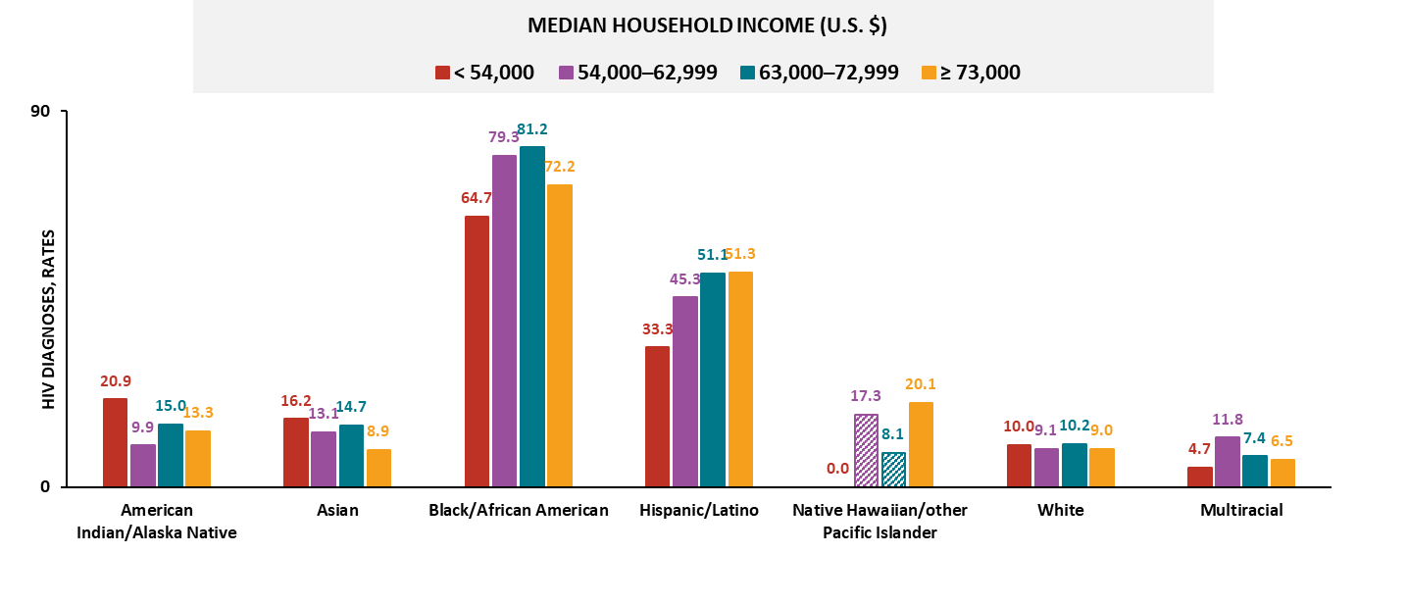
HIV diagnoses among males, by race/ethnicity and median household income, 2023—county level, United States and Puerto Rico
Note. Data are presented for persons aged ≥ 18 years. Rates are per 100,000 population. Hispanic/Latino persons can be of any race. Striped bars indicate rates based on small numbers (i.e., less than 12 diagnoses) and should be interpreted with caution.
Notes:
In 2023, among males in the United States and Puerto Rico, the highest HIV diagnosis rates by race/ethnicity were among those residing in counties with the:
Lowest income (median household income was < $54,000 a year): American Indian/Alaska Native and Asian males
Second-lowest income ($54,000–$62,999): multiracial males
Third-lowest income ($63,000–$72,999): Black/African American and White males
Highest income (≥ $73,000): Hispanic/Latino males
Note.
Groups were excluded from findings if two or more quartiles contained small numbers.
Use caution when interpreting data for Native Hawaiian/other Pacific Islander persons due to small numbers.
For more information on data sources, data collection and reporting practices, and case definitions, see the National HIV Surveillance System (NHSS) Technical Notes, available at https://www.cdc.gov/hiv-data/nhss/index.html.
For more information on SDOH definitions and data specifications, see the Social Determinants of Health Report Technical Notes at https://www.cdc.gov/hiv-data/nhss/sdoh-hiv-diagnoses-and-selected-care-outcomes-2025.html.
For more information on diagnoses, see HIV Surveillance Report Technical Notes at https://www.cdc.gov/hiv-data/nhss/hiv-diagnoses-deaths-and-prevalence-2025.html.
For the definitions of SDOH indicator variables used in this report, see the U.S. Census Bureau’s American Community Survey at https://www2.census.gov/programs-surveys/acs/tech_docs/subject_definitions/2023_ACSSubjectDefinitions.pdf.

Slide 18
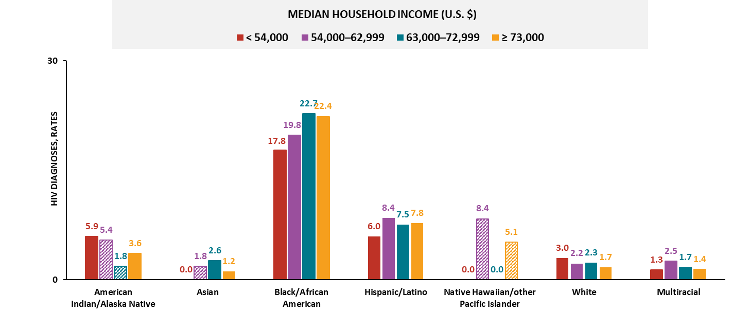
HIV diagnoses among females, by race/ethnicity and median household income, 2023—county level, United States and Puerto Rico
Note. Data are presented for persons aged ≥ 18 years. Rates are per 100,000 population. Hispanic/Latino persons can be of any race. Striped bars indicate rates based on small numbers (i.e., less than 12 diagnoses) and should be interpreted with caution.
Notes:
In 2023, among females in the United States and Puerto Rico, the highest HIV diagnosis rates by race/ethnicity were among those residing in counties with the:
Lowest income (median household income was < $54,000 a year): White females
Second-lowest income ($54,000–$62,999): Hispanic/Latino and multiracial females
Third-lowest income ($63,000–$72,999): Black/African American females
Note.
Groups were excluded from findings if two or more quartiles contained small numbers.
Use caution when interpreting data for American Indian/Alaska Native and Native Hawaiian/other Pacific Islander persons due to small numbers.
For more information on data sources, data collection and reporting practices, and case definitions, see the National HIV Surveillance System (NHSS) Technical Notes, available at https://www.cdc.gov/hiv-data/nhss/index.html.
For more information on SDOH definitions and data specifications, see the Social Determinants of Health Report Technical Notes at https://www.cdc.gov/hiv-data/nhss/sdoh-hiv-diagnoses-and-selected-care-outcomes-2025.html.
For more information on diagnoses, see HIV Surveillance Report Technical Notes at https://www.cdc.gov/hiv-data/nhss/hiv-diagnoses-deaths-and-prevalence-2025.html.
For the definitions of SDOH indicator variables used in this report, see the U.S. Census Bureau’s American Community Survey at https://www2.census.gov/programs-surveys/acs/tech_docs/subject_definitions/2023_ACSSubjectDefinitions.pdf.

Slide 19
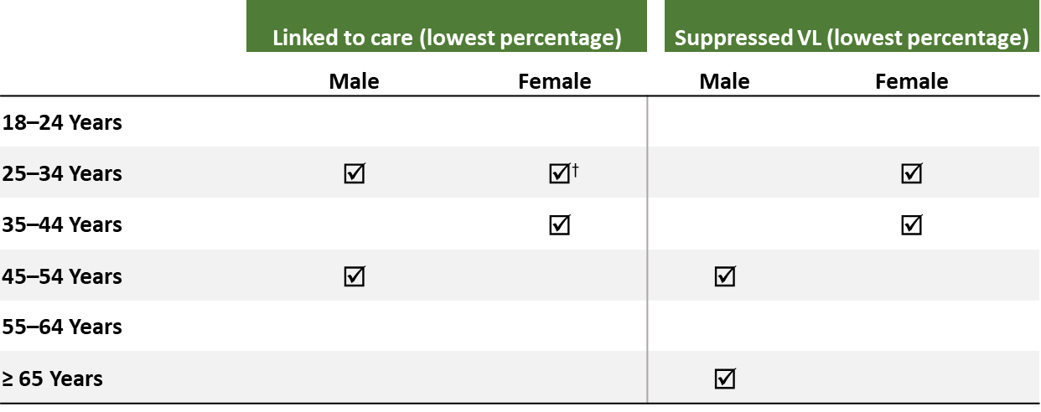
Linkage to HIV medical care within 1 month and viral suppression within 6 months of HIV diagnosis, by sex, age, and median household income, 2023—county level, United States
In 2023, males and females residing in counties with the lowest median household income had the least favorable outcomes by age:
Note. Data are presented for persons aged ≥ 18 years. Dagger (†) indicates the lowest percentage linked to care or lowest percentage with suppressed viral load was observed in the lowest median household income quartile and in one or more additional quartiles.
Notes:
In 2023, in the United States, the lowest percentages of linkage to care within 1 month of diagnosis and viral suppression within 6 months of diagnosis, by sex and age, among those residing in counties with the lowest income (i.e., where the median household income was less than $54,000 a year) were among the following:
Linkage to care:
Males: aged 25‒34 and 45‒54 years
Females: aged 25‒34 and 35‒44 years
Viral suppression:
Males: aged 45‒54 and ≥ 65 years
Females: aged 25‒34 and 35‒44 years
Note.
Linkage to care and viral suppression focus on SDOH extremes only (i.e., lowest income) and not the overall values unless otherwise indicated.
Data not provided for states and associated jurisdictions that do not have laws requiring reporting of all CD4 and viral loads. Areas without laws: Idaho. Areas with lapse in reporting: Tennessee.
For more information on data sources, data collection and reporting practices, and case definitions, see the National HIV Surveillance System (NHSS) Technical Notes, available at https://www.cdc.gov/hiv-data/nhss/index.html.
For more information on SDOH definitions and data specifications, see the Social Determinants of Health Report Technical Notes at https://www.cdc.gov/hiv-data/nhss/sdoh-hiv-diagnoses-and-selected-care-outcomes-2025.html.
For more information on linkage to HIV medical care within one month and viral suppression within 6 months of HIV diagnosis, see the Technical Notes, available at https://www.cdc.gov/hiv-data/nhss/national-hiv-prevention-and-care-objectives-2025.html.
For the definitions of SDOH indicator variables used in this report, see the U.S. Census Bureau’s American Community Survey at https://www2.census.gov/programs-surveys/acs/tech_docs/subject_definitions/2023_ACSSubjectDefinitions.pdf.

Slide 20
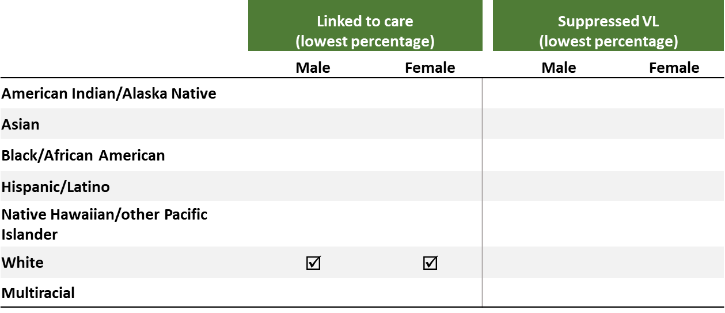
Linkage to HIV medical care within 1 month and viral suppression within 6 months of HIV diagnosis, by sex, race/ethnicity, and median household income, 2023—county level, United States
In 2023, males and females residing in counties with the lowest median household income had the least favorable outcomes by race/ethnicity:
Note. Data are presented for persons aged ≥ 18 years. Hispanic/Latino persons can be of any race.
Notes:
In 2023, in the United States, the lowest percentages of linkage to care within 1 month of diagnosis and viral suppression within 6 months of diagnosis, by sex and race/ethnicity, among those residing in counties with the lowest income (i.e., where the median household income was less than $54,000 a year) were among the following:
Linkage to care:
Males: White persons
Females: White persons
Viral suppression:
Males: no racial/ethnic groups
Females: no racial/ethnic groups
Note.
Linkage to care and viral suppression focus on SDOH extremes only (i.e., lowest income) and not the overall values unless otherwise indicated.
Data not provided for states and associated jurisdictions that do not have laws requiring reporting of all CD4 and viral loads. Areas without laws: Idaho. Areas with lapse in reporting: Tennessee.
Use caution when interpreting data for American Indian/Alaska Native and Native Hawaiian/other Pacific Islander persons due to small numbers.
For more information on data sources, data collection and reporting practices, and case definitions, see the National HIV Surveillance System (NHSS) Technical Notes, available at https://www.cdc.gov/hiv-data/nhss/index.html.
For more information on SDOH definitions and data specifications, see the Social Determinants of Health Report Technical Notes at https://www.cdc.gov/hiv-data/nhss/sdoh-hiv-diagnoses-and-selected-care-outcomes-2025.html.
For more information on linkage to HIV medical care within one month and viral suppression within 6 months of HIV diagnosis, see the Technical Notes, available at https://www.cdc.gov/hiv-data/nhss/national-hiv-prevention-and-care-objectives-2025.html.
For the definitions of SDOH indicator variables used in this report, see the U.S. Census Bureau’s American Community Survey at https://www2.census.gov/programs-surveys/acs/tech_docs/subject_definitions/2023_ACSSubjectDefinitions.pdf.

Slide 21
Education Level

Slide 22
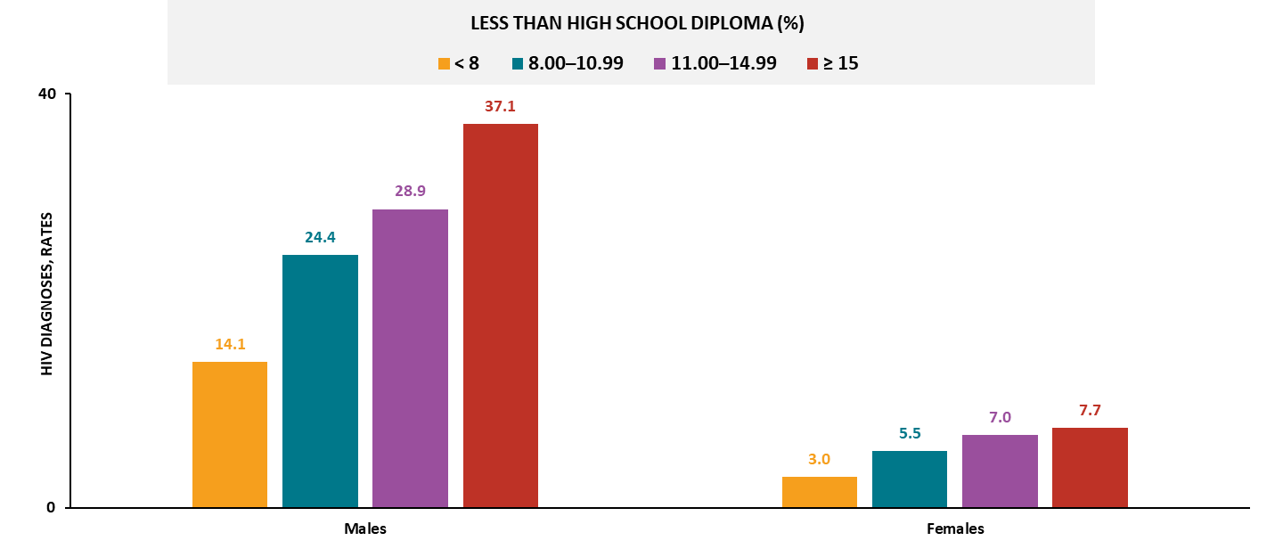
HIV diagnoses, by sex and education level, 2023—county level, United States and Puerto Rico
Note. Data are presented for persons aged ≥ 18 years. Rates are per 100,000 population.
Notes:
In 2023, in the United States and Puerto Rico, the highest HIV diagnosis rates by sex were among those residing in counties with the:
Lowest education (≥15% of the residents had less than a high school diploma): males and females
For both sexes, the rate of HIV diagnoses increased as the percentage of residents who had less than a high school diploma increased.
Note.
For more information on data sources, data collection and reporting practices, and case definitions, see the National HIV Surveillance System (NHSS) Technical Notes, available at https://www.cdc.gov/hiv-data/nhss/index.html.
For more information on SDOH definitions and data specifications, see the Social Determinants of Health Report Technical Notes at https://www.cdc.gov/hiv-data/nhss/sdoh-hiv-diagnoses-and-selected-care-outcomes-2025.html.
For more information on diagnoses, see HIV Surveillance Report Technical Notes at https://www.cdc.gov/hiv-data/nhss/hiv-diagnoses-deaths-and-prevalence-2025.html.
For the definitions of SDOH indicator variables used in this report, see the U.S. Census Bureau’s American Community Survey at https://www2.census.gov/programs-surveys/acs/tech_docs/subject_definitions/2023_ACSSubjectDefinitions.pdf.

Slide 23
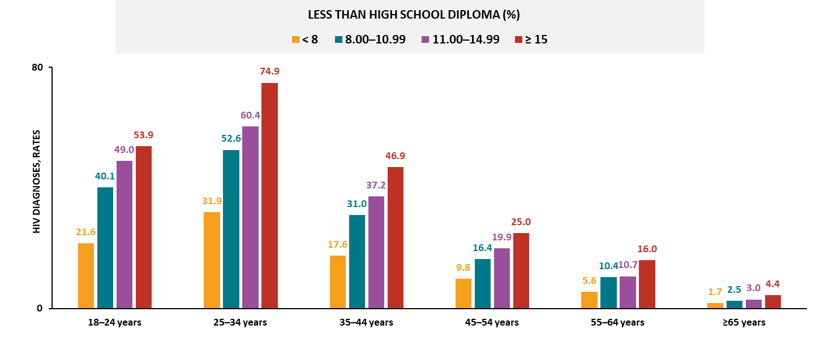
HIV diagnoses among males, by age and education level, 2023—county level, United States and Puerto Rico
Note. Data are presented for persons aged ≥ 18 years. Rates are per 100,000 population.
Notes:
In 2023, among males in the United States and Puerto Rico, the highest HIV diagnosis rates by age were among those residing in counties with the:
Lowest education (≥15% of the residents had less than a high school diploma): all age groups
For males in all age groups, the rate of HIV diagnoses increased as the percentage of residents who had less than a high school diploma increased.
Note.
For more information on data sources, data collection and reporting practices, and case definitions, see the National HIV Surveillance System (NHSS) Technical Notes, available at https://www.cdc.gov/hiv-data/nhss/index.html.
For more information on SDOH definitions and data specifications, see the Social Determinants of Health Report Technical Notes at https://www.cdc.gov/hiv-data/nhss/sdoh-hiv-diagnoses-and-selected-care-outcomes-2025.html.
For more information on diagnoses, see HIV Surveillance Report Technical Notes at https://www.cdc.gov/hiv-data/nhss/hiv-diagnoses-deaths-and-prevalence-2025.html.
For the definitions of SDOH indicator variables used in this report, see the U.S. Census Bureau’s American Community Survey at https://www2.census.gov/programs-surveys/acs/tech_docs/subject_definitions/2023_ACSSubjectDefinitions.pdf.

Slide 24
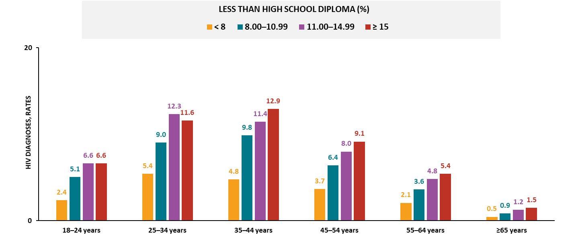
HIV diagnoses among females, by age and education level, 2023—county level, United States and Puerto Rico
Note. Data are presented for persons aged ≥ 18 years. Rates are per 100,000 population.
Notes:
In 2023, among females in the United States and Puerto Rico, the highest HIV diagnosis rates by age were among those residing in counties with the:
Lowest education (≥15% of the residents had less than a high school diploma): aged 18‒24, 35‒44, 45‒54, 55‒64, and ≥ 65 years
Second-lowest education (11.00–14.99% less than a high school diploma): aged 18‒24 and 25‒34 years
For females in all age groups (except aged 18‒24 and 25‒34 years), the rate of HIV diagnoses increased as the percentage of residents who had less than a high school diploma increased.
Note.
For females aged 18‒24 years, the highest HIV diagnosis rate was the same in the lowest and second-lowest education groups.
For more information on data sources, data collection and reporting practices, and case definitions, see the National HIV Surveillance System (NHSS) Technical Notes, available at https://www.cdc.gov/hiv-data/nhss/index.html.
For more information on SDOH definitions and data specifications, see the Social Determinants of Health Report Technical Notes at https://www.cdc.gov/hiv-data/nhss/sdoh-hiv-diagnoses-and-selected-care-outcomes-2025.html.
For more information on diagnoses, see HIV Surveillance Report Technical Notes at https://www.cdc.gov/hiv-data/nhss/hiv-diagnoses-deaths-and-prevalence-2025.html.
For the definitions of SDOH indicator variables used in this report, see the U.S. Census Bureau’s American Community Survey at https://www2.census.gov/programs-surveys/acs/tech_docs/subject_definitions/2023_ACSSubjectDefinitions.pdf.

Slide 25
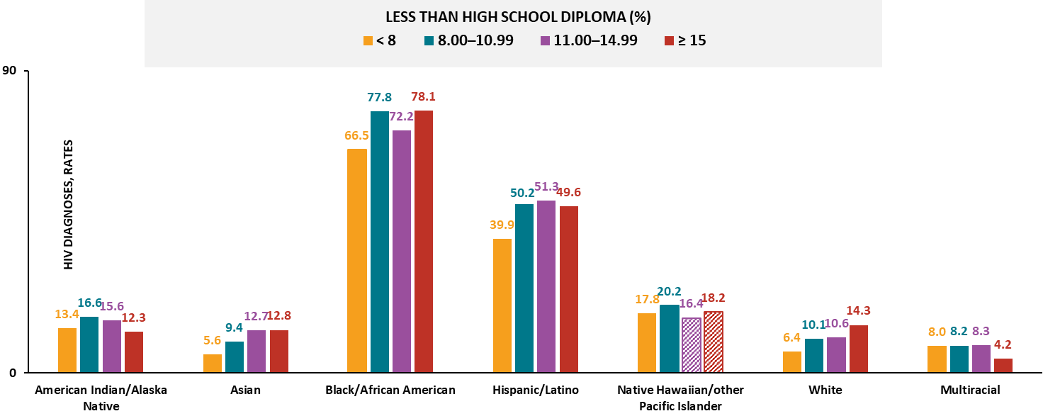
HIV diagnoses among males, by race/ethnicity and education level, 2023—county level, United States and Puerto Rico
Note. Data are presented for persons aged ≥ 18 years. Rates are per 100,000 population. Hispanic/Latino persons can be of any race. Striped bars indicate rates based on small numbers (i.e., less than 12 diagnoses) and should be interpreted with caution.
Notes:
In 2023, among males in the United States and Puerto Rico, the highest HIV diagnosis rates by race/ethnicity were among those residing in counties with the:
Lowest education (≥15% of the residents had less than a high school diploma): Asian, Black/African American, and White males
Second-lowest education (11.00–14.99% less than a high school diploma): Hispanic/Latino, multiracial males
Third-lowest education (8.00–10.99% less than a high school diploma): American Indian/Alaska Native males
For Asian and White males, the rate of HIV diagnoses increased as the percentage of residents who had less than a high school diploma increased.
Note.
Groups were excluded from findings if two or more quartiles contained small numbers.
Use caution when interpreting data for Native Hawaiian/other Pacific Islander persons due to small numbers.
For more information on data sources, data collection and reporting practices, and case definitions, see the National HIV Surveillance System (NHSS) Technical Notes, available at https://www.cdc.gov/hiv-data/nhss/index.html.
For more information on SDOH definitions and data specifications, see the Social Determinants of Health Report Technical Notes at https://www.cdc.gov/hiv-data/nhss/sdoh-hiv-diagnoses-and-selected-care-outcomes-2025.html.
For more information on diagnoses, see HIV Surveillance Report Technical Notes at https://www.cdc.gov/hiv-data/nhss/hiv-diagnoses-deaths-and-prevalence-2025.html.
For the definitions of SDOH indicator variables used in this report, see the U.S. Census Bureau’s American Community Survey at https://www2.census.gov/programs-surveys/acs/tech_docs/subject_definitions/2023_ACSSubjectDefinitions.pdf.

Slide 26
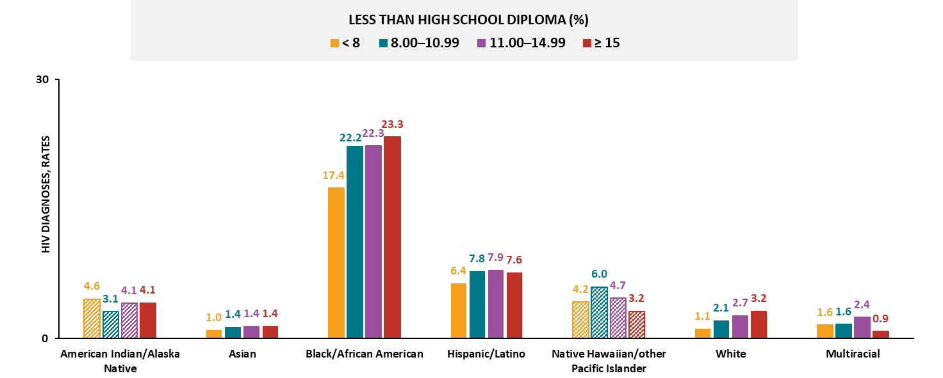
HIV diagnoses among females, by race/ethnicity and education level, 2023—county level, United States and Puerto Rico
Note. Data are presented for persons aged ≥ 18 years. Rates are per 100,000 population. Hispanic/Latino persons can be of any race. Striped bars indicate rates based on small numbers (i.e., less than 12 diagnoses) and should be interpreted with caution.
Notes:
In 2023, among females in the United States and Puerto Rico, the highest HIV diagnosis rates by race/ethnicity were among those residing in counties with the:
Lowest education (≥15% of the residents had less than a high school diploma): Asian, Black/African American and White females
Second-lowest education (11.00–14.99% less than a high school diploma): Asian, Hispanic/Latino and multiracial females
Third-lowest education (8.00–10.99% less than a high school diploma): Asian females
For Black/African American and White females, the rate of HIV diagnoses increased as the percentage of residents who had less than a high school diploma increased.
Note.
Groups were excluded from the findings if two or more quartiles contained small numbers. For Asian females, the highest HIV diagnosis rate was the same in the lowest, second-lowest, and third-lowest education quartiles.
Use caution when interpreting data for American Indian/Alaska Native and Native Hawaiian/other Pacific Islander persons due to small numbers.
For more information on data sources, data collection and reporting practices, and case definitions, see the National HIV Surveillance System (NHSS) Technical Notes, available at https://www.cdc.gov/hiv-data/nhss/index.html.
For more information on SDOH definitions and data specifications, see the Social Determinants of Health Report Technical Notes at https://www.cdc.gov/hiv-data/nhss/sdoh-hiv-diagnoses-and-selected-care-outcomes-2025.html.
For more information on diagnoses, see HIV Surveillance Report Technical Notes at https://www.cdc.gov/hiv-data/nhss/hiv-diagnoses-deaths-and-prevalence-2025.html.
For the definitions of SDOH indicator variables used in this report, see the U.S. Census Bureau’s American Community Survey at https://www2.census.gov/programs-surveys/acs/tech_docs/subject_definitions/2023_ACSSubjectDefinitions.pdf.

Slide 27
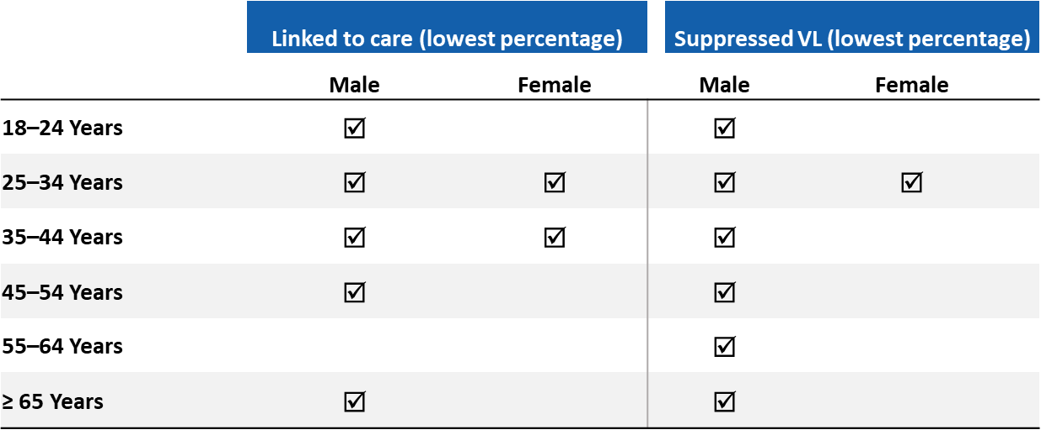
Linkage to HIV medical care within 1 month and viral suppression within 6 months of HIV diagnosis, by sex, age, and education level, 2023—county level, United States
In 2023, males and females residing in counties with the lowest high school education had the least favorable outcomes by age:
Note. Data are presented for persons aged ≥ 18 years.
Notes:
In 2023, in the United States, the lowest percentages of linkage to care within 1 month of diagnosis and viral suppression within 6 months of diagnosis, by sex and age, among those residing in counties with the lowest education (i.e., where 15% or more of the residents had less than a high school diploma) were among the following:
Linkage to care:
Males: all age groups (except aged 55‒64 years)
Females: aged 25‒34 and 35‒44 years
Viral suppression:
Males: all age groups
Females: aged 25‒34 years
Note.
Linkage to care and viral suppression focus on SDOH extremes only (i.e., lowest education) and not the overall values unless otherwise indicated.
Data not provided for states and associated jurisdictions that do not have laws requiring reporting of all CD4 and viral loads. Areas without laws: Idaho. Areas with lapse in reporting: Tennessee.
For more information on data sources, data collection and reporting practices, and case definitions, see the National HIV Surveillance System (NHSS) Technical Notes, available at https://www.cdc.gov/hiv-data/nhss/index.html.
For more information on SDOH definitions and data specifications, see the Social Determinants of Health Report Technical Notes at https://www.cdc.gov/hiv-data/nhss/sdoh-hiv-diagnoses-and-selected-care-outcomes-2025.html.
For more information on linkage to HIV medical care within one month and viral suppression within 6 months of HIV diagnosis, see the Technical Notes, available at https://www.cdc.gov/hiv-data/nhss/national-hiv-prevention-and-care-objectives-2025.html.
For the definitions of SDOH indicator variables used in this report, see the U.S. Census Bureau’s American Community Survey at https://www2.census.gov/programs-surveys/acs/tech_docs/subject_definitions/2023_ACSSubjectDefinitions.pdf.

Slide 28
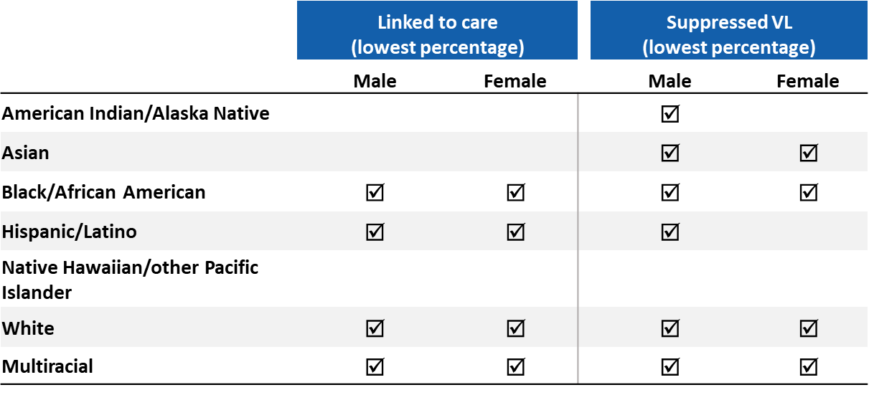
Linkage to HIV medical care within 1 month and viral suppression within 6 months of HIV diagnosis, by sex, race/ethnicity, and education level, 2023—county level, United States
In 2023, males and females residing in counties with the lowest high school education had the least favorable outcomes by race/ethnicity:
Note. Data are presented for persons aged ≥ 18 years. Hispanic/Latino persons can be of any race.
Notes:
In 2023, in the United States, the lowest percentages of linkage to care within 1 month of diagnosis and viral suppression within 6 months of diagnosis, by sex and race/ethnicity, among those residing in counties with the lowest education (i.e., where 15% or more of the residents had less than a high school diploma) were among the following:
Linkage to care:
Males: Black/African American, Hispanic/Latino, White, and multiracial persons
Females: Black/African American, Hispanic/Latino, White, and multiracial persons
Viral suppression:
Males: all racial/ethnic groups (except Native Hawaiian/other Pacific Islander) persons
Females: Asian, Black/African American, White, and multiracial persons
Note.
Linkage to care and viral suppression focus on SDOH extremes only (i.e., lowest education) and not the overall values unless otherwise indicated.
Data not provided for states and associated jurisdictions that do not have laws requiring reporting of all CD4 and viral loads. Areas without laws: Idaho. Areas with lapse in reporting: Tennessee.
Use caution when interpreting data for American Indian/Alaska Native and Native Hawaiian/other Pacific Islander persons due to small numbers.
For more information on data sources, data collection and reporting practices, and case definitions, see the National HIV Surveillance System (NHSS) Technical Notes, available at https://www.cdc.gov/hiv-data/nhss/index.html.
For more information on SDOH definitions and data specifications, see the Social Determinants of Health Report Technical Notes at https://www.cdc.gov/hiv-data/nhss/sdoh-hiv-diagnoses-and-selected-care-outcomes-2025.html.
For more information on linkage to HIV medical care within one month and viral suppression within 6 months of HIV diagnosis, see the Technical Notes, available at https://www.cdc.gov/hiv-data/nhss/national-hiv-prevention-and-care-objectives-2025.html.
For the definitions of SDOH indicator variables used in this report, see the U.S. Census Bureau’s American Community Survey at https://www2.census.gov/programs-surveys/acs/tech_docs/subject_definitions/2023_ACSSubjectDefinitions.pdf.

Slide 29
Health Insurance Coverage

Slide 30
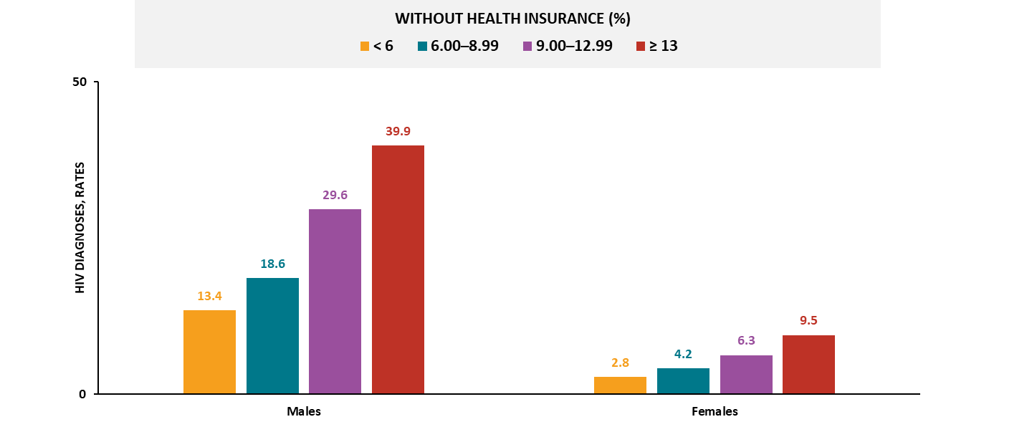
HIV diagnoses, by sex and health insurance coverage, 2023—county level, United States and Puerto Rico
Note. Data are presented for persons aged ≥ 18 years. Rates are per 100,000 population.
Notes:
In 2023, in the United States and Puerto Rico, the highest HIV diagnosis rates by sex were among those residing in counties with the:
Lowest insurance coverage (≥ 13% of the residents did not have health insurance coverage): males and females
For both sexes, the rate of HIV diagnoses increased as the percentage of residents who did not have health insurance coverage increased.
Note.
For more information on data sources, data collection and reporting practices, and case definitions, see the National HIV Surveillance System (NHSS) Technical Notes, available at https://www.cdc.gov/hiv-data/nhss/index.html.
For more information on SDOH definitions and data specifications, see the Social Determinants of Health Report Technical Notes at https://www.cdc.gov/hiv-data/nhss/sdoh-hiv-diagnoses-and-selected-care-outcomes-2025.html.
For more information on diagnoses, see HIV Surveillance Report Technical Notes at https://www.cdc.gov/hiv-data/nhss/hiv-diagnoses-deaths-and-prevalence-2025.html.
For the definitions of SDOH indicator variables used in this report, see the U.S. Census Bureau’s American Community Survey at https://www2.census.gov/programs-surveys/acs/tech_docs/subject_definitions/2023_ACSSubjectDefinitions.pdf.

Slide 31
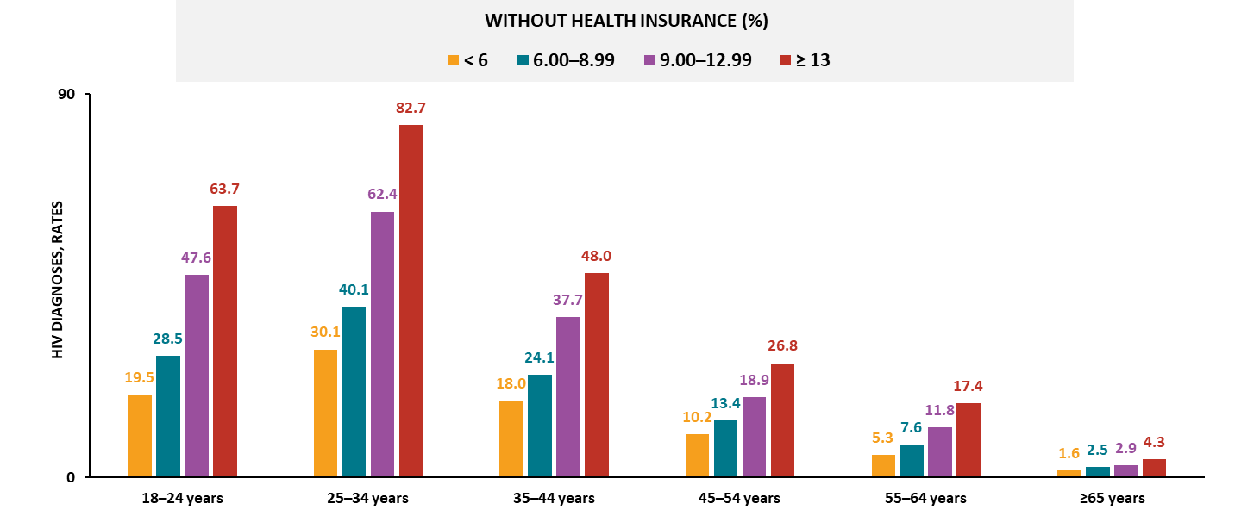
HIV diagnoses among males, by age and health insurance coverage, 2023—county level, United States and Puerto Rico
Note. Data are presented for persons aged ≥ 18 years. Rates are per 100,000 population.
Notes:
In 2023, among males in the United States and Puerto Rico, the highest HIV diagnosis rates by age were among those residing in counties with the:
Lowest insurance coverage (≥ 13% of the residents did not have health insurance coverage): all age groups
For males in all age groups, the rate of HIV diagnoses increased as the percentage of residents who did not have health insurance coverage increased.
Note.
For more information on data sources, data collection and reporting practices, and case definitions, see the National HIV Surveillance System (NHSS) Technical Notes, available at https://www.cdc.gov/hiv-data/nhss/index.html.
For more information on SDOH definitions and data specifications, see the Social Determinants of Health Report Technical Notes at https://www.cdc.gov/hiv-data/nhss/sdoh-hiv-diagnoses-and-selected-care-outcomes-2025.html.
For more information on diagnoses, see HIV Surveillance Report Technical Notes at https://www.cdc.gov/hiv-data/nhss/hiv-diagnoses-deaths-and-prevalence-2025.html.
For the definitions of SDOH indicator variables used in this report, see the U.S. Census Bureau’s American Community Survey at https://www2.census.gov/programs-surveys/acs/tech_docs/subject_definitions/2023_ACSSubjectDefinitions.pdf.

Slide 32
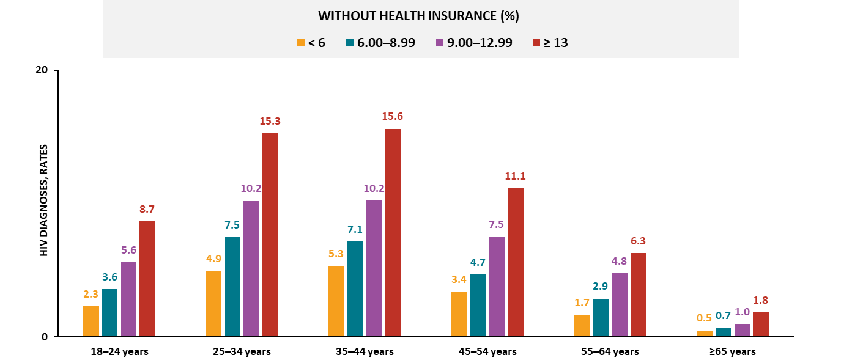
HIV diagnoses among females, by age and health insurance coverage, 2023—county level, United States and Puerto Rico
Note. Data are presented for persons aged ≥ 18 years. Rates are per 100,000 population.
Notes:
In 2023, among females in the United States and Puerto Rico, the highest HIV diagnosis rates by age were among those residing in counties with the:
Lowest insurance coverage (≥ 13% of the residents did not have health insurance coverage): all age groups
For females in all age groups, the rate of HIV diagnoses increased as the percentage of residents who did not have health insurance coverage increased.
Note.
For more information on data sources, data collection and reporting practices, and case definitions, see the National HIV Surveillance System (NHSS) Technical Notes, available at https://www.cdc.gov/hiv-data/nhss/index.html.
For more information on SDOH definitions and data specifications, see the Social Determinants of Health Report Technical Notes at https://www.cdc.gov/hiv-data/nhss/sdoh-hiv-diagnoses-and-selected-care-outcomes-2025.html.
For more information on diagnoses, see HIV Surveillance Report Technical Notes at https://www.cdc.gov/hiv-data/nhss/hiv-diagnoses-deaths-and-prevalence-2025.html.
For the definitions of SDOH indicator variables used in this report, see the U.S. Census Bureau’s American Community Survey at https://www2.census.gov/programs-surveys/acs/tech_docs/subject_definitions/2023_ACSSubjectDefinitions.pdf.

Slide 33
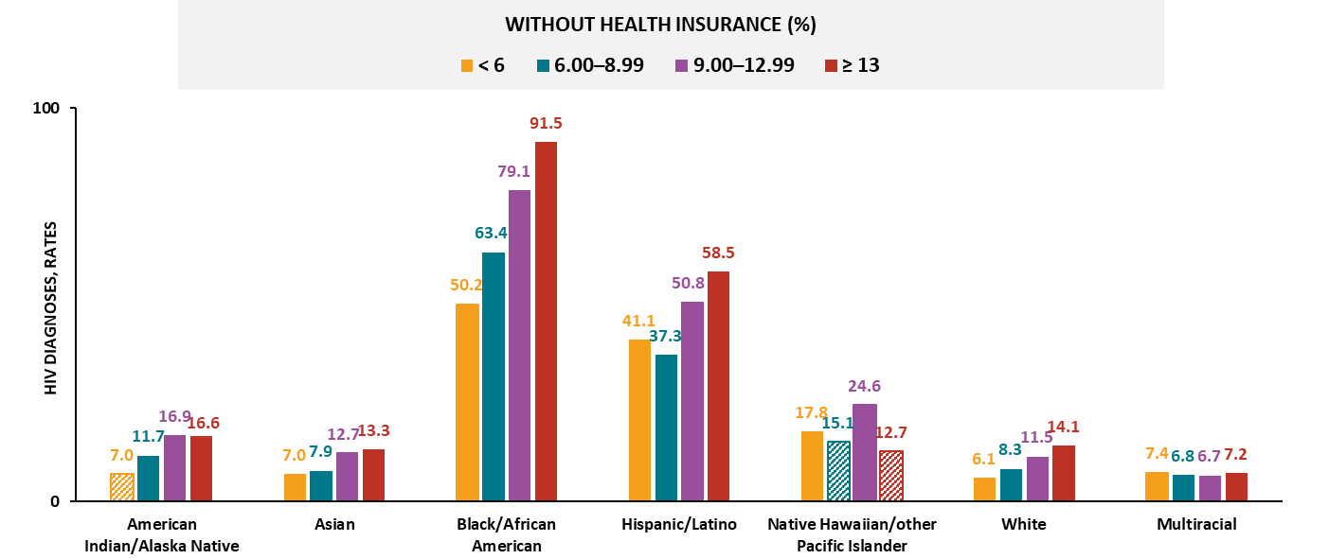
HIV diagnoses among males, by race/ethnicity and health insurance coverage, 2023—county level, United States and Puerto Rico
Note. Data are presented for persons aged ≥ 18 years. Rates are per 100,000 population. Hispanic/Latino persons can be of any race. Striped bars indicate rates based on small numbers (i.e., less than 12 diagnoses) and should be interpreted with caution.
Notes:
In 2023, among males in the United States and Puerto Rico, the highest HIV diagnosis rates by race/ethnicity were among those residing in counties with the:
Lowest insurance coverage (≥ 13% of the residents did not have health insurance coverage): Asian, Black/African American, Hispanic/Latino, and White males
Second-lowest insurance coverage (9.00‒12.99% no insurance coverage): American Indian/Alaska Native males
Highest insurance coverage (< 6% no insurance coverage): multiracial males
For Asian, Black/African American, and White males, the rate of HIV diagnoses increased as the percentage of residents who did not have health insurance coverage increased.
Note.
Groups were excluded from findings if two or more quartiles contained small numbers.
Use caution when interpreting data for Native Hawaiian/other Pacific Islander persons due to small numbers.
For more information on data sources, data collection and reporting practices, and case definitions, see the National HIV Surveillance System (NHSS) Technical Notes, available at https://www.cdc.gov/hiv-data/nhss/index.html.
For more information on SDOH definitions and data specifications, see the Social Determinants of Health Report Technical Notes at https://www.cdc.gov/hiv-data/nhss/sdoh-hiv-diagnoses-and-selected-care-outcomes-2025.html.
For more information on diagnoses, see HIV Surveillance Report Technical Notes at https://www.cdc.gov/hiv-data/nhss/hiv-diagnoses-deaths-and-prevalence-2025.html.
For the definitions of SDOH indicator variables used in this report, see the U.S. Census Bureau’s American Community Survey at https://www2.census.gov/programs-surveys/acs/tech_docs/subject_definitions/2023_ACSSubjectDefinitions.pdf.

Slide 34
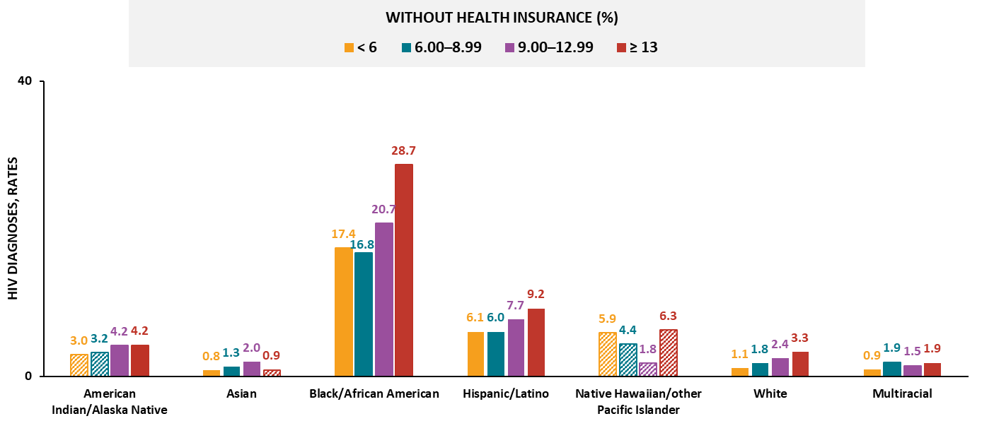
HIV diagnoses among females, by race/ethnicity and health insurance coverage, 2023—county level, United States and Puerto Rico
Note. Data are presented for persons aged ≥ 18 years. Rates are per 100,000 population. Hispanic/Latino persons can be of any race. Striped bars indicate rates based on small numbers (i.e., less than 12 diagnoses) and should be interpreted with caution.
Notes:
In 2023, among females in the United States and Puerto Rico, the highest HIV diagnosis rates by race/ethnicity were among females residing in counties with the:
Lowest insurance coverage (≥ 13% of the residents did not have health insurance coverage): Black/African American, Hispanic/Latino, White, and multiracial females
Second-lowest insurance coverage (9.00‒12.99% no insurance coverage): Asian females
Third-lowest insurance coverage (6.00‒8.99% no insurance coverage): multiracial females
For Black/African American females, the rate of HIV diagnoses increased as the percentage of residents who did not have health insurance coverage increased.
Note.
Groups were excluded from findings if two or more quartiles contained small numbers. For multiracial females, the highest HIV diagnosis rate was the same in the lowest and third-lowest insurance coverage quartiles.
Use caution when interpreting data for American Indian/Alaska Native and Native Hawaiian/other Pacific Islander persons due to small numbers.
For more information on data sources, data collection and reporting practices, and case definitions, see the National HIV Surveillance System (NHSS) Technical Notes, available at https://www.cdc.gov/hiv-data/nhss/index.html.
For more information on SDOH definitions and data specifications, see the Social Determinants of Health Report Technical Notes at https://www.cdc.gov/hiv-data/nhss/sdoh-hiv-diagnoses-and-selected-care-outcomes-2025.html.
For more information on diagnoses, see HIV Surveillance Report Technical Notes at https://www.cdc.gov/hiv-data/nhss/hiv-diagnoses-deaths-and-prevalence-2025.html.
For the definitions of SDOH indicator variables used in this report, see the U.S. Census Bureau’s American Community Survey at https://www2.census.gov/programs-surveys/acs/tech_docs/subject_definitions/2023_ACSSubjectDefinitions.pdf.

Slide 35
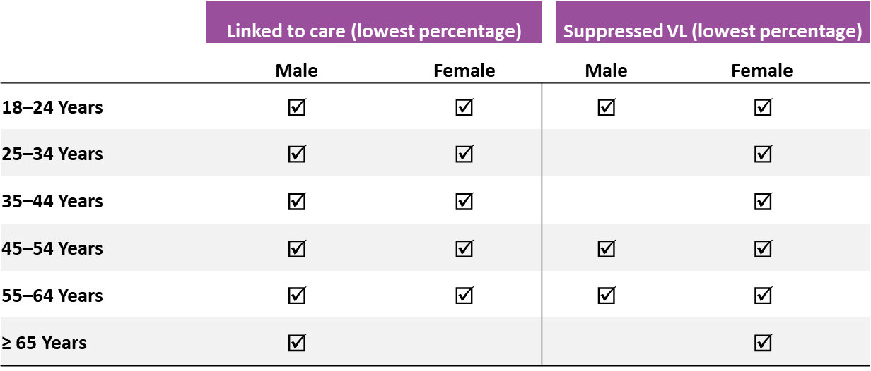
Linkage to HIV medical care within 1 month and viral suppression within 6 months of HIV diagnosis, by sex, age, and health insurance coverage, 2023—county level, United States
In 2023, males and females residing in counties with the lowest health insurance coverage had the least favorable outcomes by age:
Note. Data are presented for persons aged ≥ 18 years.
Notes:
In 2023, in the United States, the lowest percentages of linkage to care within 1 month of diagnosis and viral suppression within 6 months of diagnosis, by sex and age, among those residing in counties with the lowest insurance coverage (i.e., where 13% or more of the residents did not have health insurance coverage) were among the following:
Linkage to care:
Males: all age groups
Females: all age groups (except aged ≥ 65 years)
Viral suppression:
Males: aged 18‒24, 45‒54, and 55‒64 years
Females: all age groups
Note.
Linkage to care and viral suppression focus on SDOH extremes only (i.e., lowest insured) and not the overall values unless otherwise indicated.
Data not provided for states and associated jurisdictions that do not have laws requiring reporting of all CD4 and viral loads. Areas without laws: Idaho. Areas with lapse in reporting: Tennessee.
For more information on data sources, data collection and reporting practices, and case definitions, see the National HIV Surveillance System (NHSS) Technical Notes, available at https://www.cdc.gov/hiv-data/nhss/index.html.
For more information on SDOH definitions and data specifications, see the Social Determinants of Health Report Technical Notes at https://www.cdc.gov/hiv-data/nhss/sdoh-hiv-diagnoses-and-selected-care-outcomes-2025.html.
For more information on linkage to HIV medical care within one month and viral suppression within 6 months of HIV diagnosis, see the Technical Notes, available at https://www.cdc.gov/hiv-data/nhss/national-hiv-prevention-and-care-objectives-2025.html.
For the definitions of SDOH indicator variables used in this report, see the U.S. Census Bureau’s American Community Survey at https://www2.census.gov/programs-surveys/acs/tech_docs/subject_definitions/2023_ACSSubjectDefinitions.pdf.

Slide 36
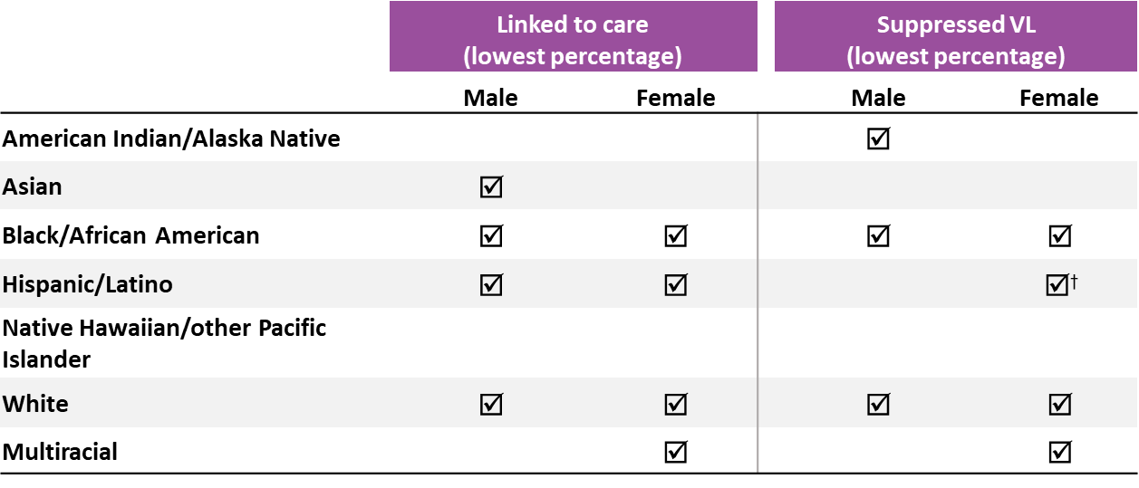
Linkage to HIV medical care within 1 month and viral suppression within 6 months of HIV diagnosis, by sex, race/ethnicity, and health insurance coverage, 2023—county level, United States
In 2023, males and females residing in counties with the lowest health insurance coverage had the least favorable outcomes by race/ethnicity:
Note. Data are presented for persons aged ≥ 18 years. Hispanic/Latino persons can be of any race. Dagger (†) indicates the lowest percentage linked to care or lowest percentage with suppressed viral load was observed in the lowest health insurance coverage quartile and in one or more additional quartiles.
Notes:
In 2023, in the United States, the lowest percentages of linkage to care within 1 month of diagnosis and viral suppression within 6 months of diagnosis, by sex and race/ethnicity, among those residing in counties with the lowest insurance coverage (i.e., where 13% or more of the residents did not have health insurance coverage) were among the following:
Linkage to care:
Males: Asian, Black/African American, Hispanic/Latino, and White persons
Females: Black/African American, Hispanic/Latino, White, and multiracial persons
Viral suppression:
Males: American Indian/Alaska Native, Black/African American, and White persons
Females: Black/African American, Hispanic/Latino, White, and multiracial persons
Note.
Linkage to care and viral suppression focus on SDOH extremes only (i.e., lowest insured) and not the overall values unless otherwise indicated.
Data not provided for states and associated jurisdictions that do not have laws requiring reporting of all CD4 and viral loads. Areas without laws: Idaho. Areas with lapse in reporting: Tennessee.
For more information on data sources, data collection and reporting practices, and case definitions, see the National HIV Surveillance System (NHSS) Technical Notes, available at https://www.cdc.gov/hiv-data/nhss/index.html.
For more information on SDOH definitions and data specifications, see the Social Determinants of Health Report Technical Notes at https://www.cdc.gov/hiv-data/nhss/sdoh-hiv-diagnoses-and-selected-care-outcomes-2025.html.
For more information on linkage to HIV medical care within one month and viral suppression within 6 months of HIV diagnosis, see the Technical Notes, available at https://www.cdc.gov/hiv-data/nhss/national-hiv-prevention-and-care-objectives-2025.html.
For the definitions of SDOH indicator variables used in this report, see the U.S. Census Bureau’s American Community Survey at https://www2.census.gov/programs-surveys/acs/tech_docs/subject_definitions/2023_ACSSubjectDefinitions.pdf.

Slide 37
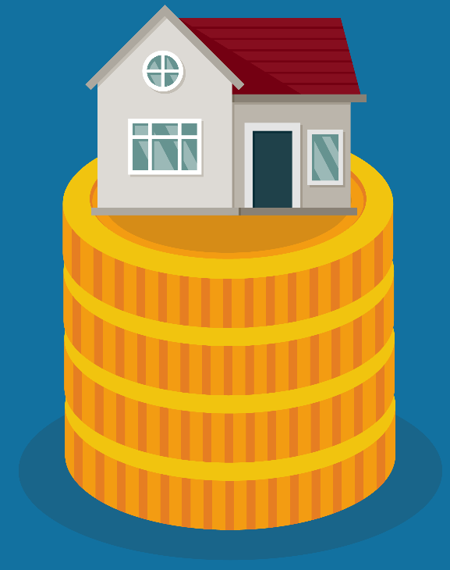
Cost-burdened Household

Slide 38
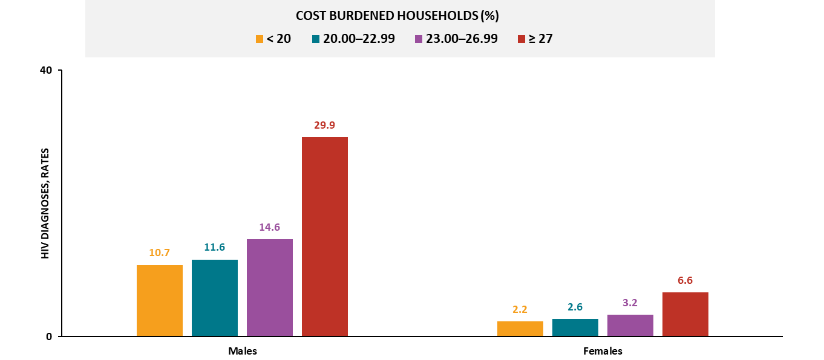
HIV diagnoses, by sex and cost-burdened households, 2023—county level, United States and Puerto Rico
Note. Data are presented for persons aged ≥ 18 years Rates are per 100,000 population.
Notes:
In 2023, in the United States and Puerto Rico, the highest HIV diagnosis rates by sex were among those residing in counties with the:
Highest cost-burdened households (27% or more of the residents spent ≥ 30% of household income on housing): males and females
For both sexes, the rate of HIV diagnoses increased as the percentage of residents living below the federal poverty level increased.
Note.
For more information on data sources, data collection and reporting practices, and case definitions, see the National HIV Surveillance System (NHSS) Technical Notes, available at https://www.cdc.gov/hiv-data/nhss/index.html.
For more information on SDOH definitions and data specifications, see the Social Determinants of Health Report Technical Notes at https://www.cdc.gov/hiv-data/nhss/sdoh-hiv-diagnoses-and-selected-care-outcomes-2025.html.
For more information on diagnoses, see HIV Surveillance Report Technical Notes at https://www.cdc.gov/hiv-data/nhss/hiv-diagnoses-deaths-and-prevalence-2025.html.
For the definitions of SDOH indicator variables used in this report, see the U.S. Census Bureau’s American Community Survey at https://www2.census.gov/programs-surveys/acs/tech_docs/subject_definitions/2023_ACSSubjectDefinitions.pdf.

Slide 39
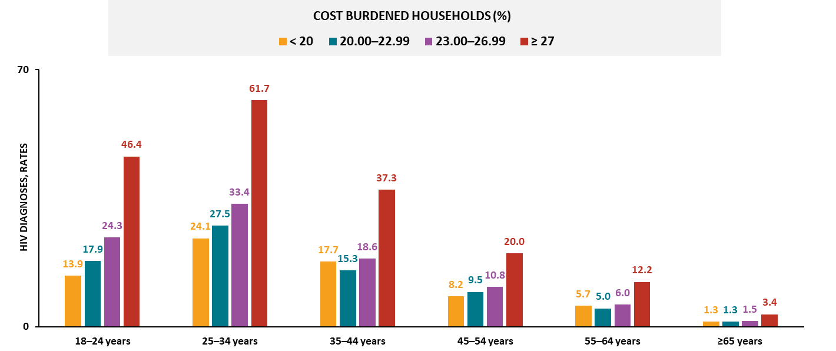
HIV diagnoses among males, by age and cost-burdened households, 2023—county level, United States and Puerto Rico
Note. Data are presented for persons aged ≥ 18 years. Rates are per 100,000 population.
Notes:
In 2023, among males in the United States and Puerto Rico, the highest HIV diagnosis rates by age were among those residing in counties with the:
Highest cost-burdened households (27% or more of the residents spent ≥ 30% of household income on housing): all age groups
For males in all age groups (except aged 35‒44 and 55‒64 years), the rate of HIV diagnoses increased as the percentage of residents spent ≥ 30% of household income on housing increased.
Note.
For more information on data sources, data collection and reporting practices, and case definitions, see the National HIV Surveillance System (NHSS) Technical Notes, available at https://www.cdc.gov/hiv-data/nhss/index.html.
For more information on SDOH definitions and data specifications, see the Social Determinants of Health Report Technical Notes at https://www.cdc.gov/hiv-data/nhss/sdoh-hiv-diagnoses-and-selected-care-outcomes-2025.html.
For more information on diagnoses, see HIV Surveillance Report Technical Notes at https://www.cdc.gov/hiv-data/nhss/hiv-diagnoses-deaths-and-prevalence-2025.html.
For the definitions of SDOH indicator variables used in this report, see the U.S. Census Bureau’s American Community Survey at https://www2.census.gov/programs-surveys/acs/tech_docs/subject_definitions/2023_ACSSubjectDefinitions.pdf.

Slide 40
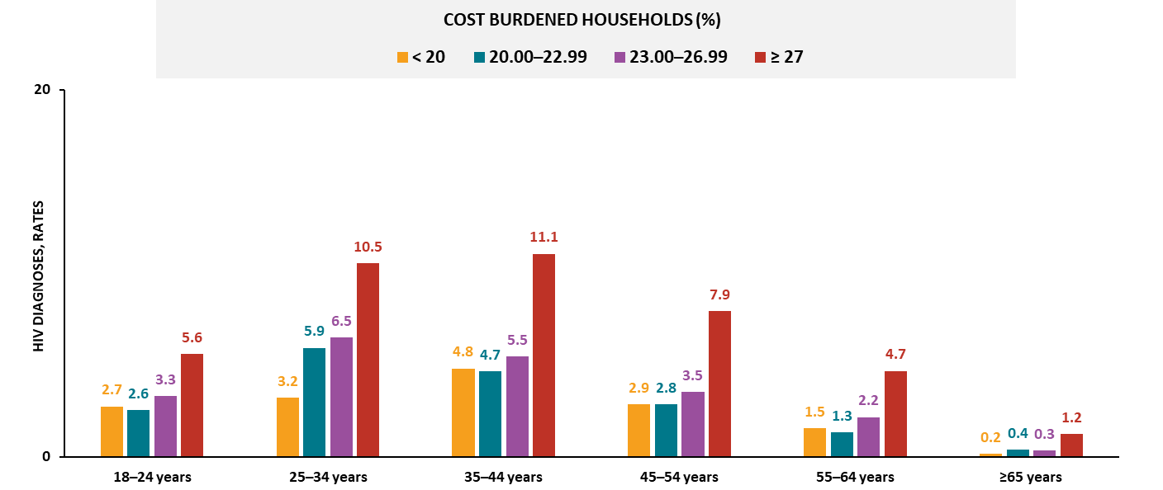
HIV diagnoses among females, by age and cost-burdened households, 2023—county level, United States and Puerto Rico
Note. Data are presented for persons aged ≥ 18 years. Rates are per 100,000 population.
Notes:
In 2023, among females in the United States and Puerto Rico, the highest HIV diagnosis rates by age were among those residing in counties with the:
Highest cost-burdened households (27% or more of the residents spent ≥ 30% of household income on housing): all age groups
For females aged 25‒34 years, the rate of HIV diagnoses increased as the percentage of residents spent ≥ 30% of household income on housing increased.
Note.
For more information on data sources, data collection and reporting practices, and case definitions, see the National HIV Surveillance System (NHSS) Technical Notes, available at https://www.cdc.gov/hiv-data/nhss/index.html.
For more information on SDOH definitions and data specifications, see the Social Determinants of Health Report Technical Notes at https://www.cdc.gov/hiv-data/nhss/sdoh-hiv-diagnoses-and-selected-care-outcomes-2025.html.
For more information on diagnoses, see HIV Surveillance Report Technical Notes at https://www.cdc.gov/hiv-data/nhss/hiv-diagnoses-deaths-and-prevalence-2025.html.
For the definitions of SDOH indicator variables used in this report, see the U.S. Census Bureau’s American Community Survey at https://www2.census.gov/programs-surveys/acs/tech_docs/subject_definitions/2023_ACSSubjectDefinitions.pdf.

Slide 41
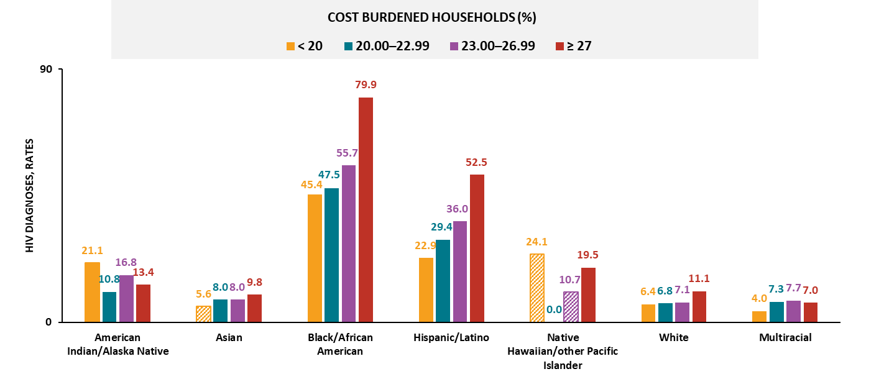
HIV diagnoses among males, by race/ethnicity and cost-burdened households, 2023—county level, United States and Puerto Rico
Note. Data are presented for persons aged ≥ 18 years. Rates are per 100,000 population. Hispanic/Latino persons can be of any race. Striped bars indicate rates based on small numbers (i.e., less than 12 diagnoses) and should be interpreted with caution.
Notes:
In 2023, among males in the United States and Puerto Rico, the highest HIV diagnosis rates by race/ethnicity were among those residing in counties with the:
Highest cost-burdened households (27% or more of the residents spent ≥ 30% of household income on housing): Asian, Black/African American, Hispanic/Latino, and White males
Second-highest cost-burdened households (23.00‒26.99% spent ≥ 30% on housing): multiracial males
Lowest cost-burdened households (< 20% spent ≥ 30% on housing): American Indian/Alaska Native males
For Black/African American, Hispanic/Latino, and White males, the rate of HIV diagnoses increased as the percentage of residents spent ≥ 30% of household income on housing increased.
Note.
Groups were excluded from findings if two or more quartiles contained small numbers.
Use caution when interpreting data for Native Hawaiian/other Pacific Islander persons due to small numbers.
For more information on data sources, data collection and reporting practices, and case definitions, see the National HIV Surveillance System (NHSS) Technical Notes, available at https://www.cdc.gov/hiv-data/nhss/index.html.
For more information on SDOH definitions and data specifications, see the Social Determinants of Health Report Technical Notes at https://www.cdc.gov/hiv-data/nhss/sdoh-hiv-diagnoses-and-selected-care-outcomes-2025.html.
For more information on diagnoses, see HIV Surveillance Report Technical Notes at https://www.cdc.gov/hiv-data/nhss/hiv-diagnoses-deaths-and-prevalence-2025.html.
For the definitions of SDOH indicator variables used in this report, see the U.S. Census Bureau’s American Community Survey at https://www2.census.gov/programs-surveys/acs/tech_docs/subject_definitions/2023_ACSSubjectDefinitions.pdf.

Slide 42
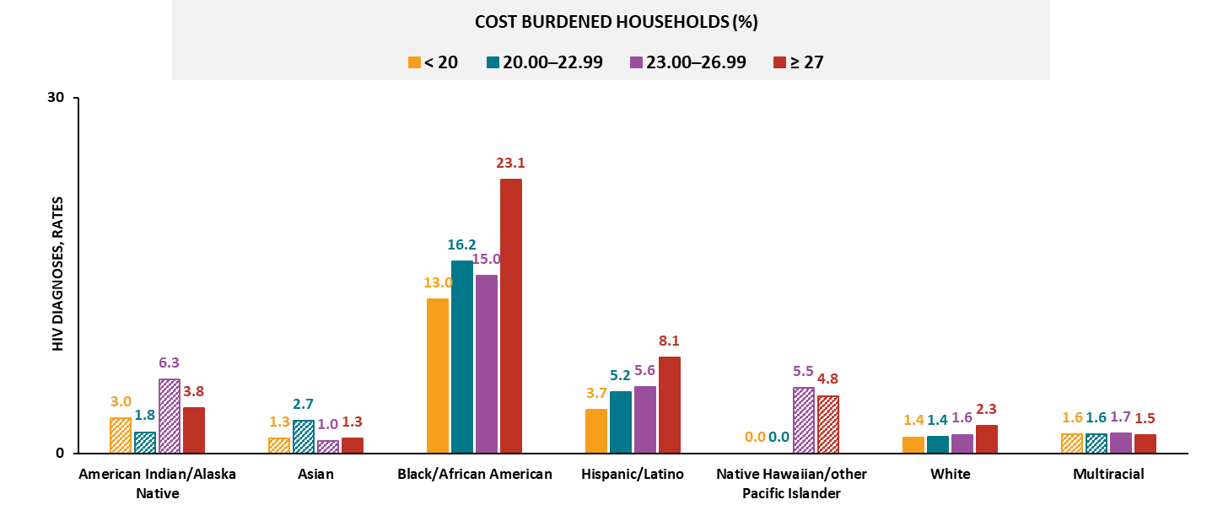
HIV diagnoses among females, by race/ethnicity and cost-burdened households, 2023—county level, United States and Puerto Rico
Note. Data are presented for persons aged ≥ 18 years. Rates are per 100,000 population. Hispanic/Latino persons can be of any race. Striped bars indicate rates based on small numbers (i.e., less than 12 diagnoses) and should be interpreted with caution.
Notes:
In 2023, among females in the United States and Puerto Rico, the highest HIV diagnosis rates by race/ethnicity were among those residing in counties with the:
Highest cost-burdened households (≥ 27% of the residents spent ≥ 30% of household income on housing): Black/African American, Hispanic/Latino, and White females
For Hispanic/Latino females, the rate of HIV diagnoses increased as the percentage of residents spent ≥ 30% of household income on housing increased.
Note.
Groups were excluded from findings if two or more quartiles contained small numbers.
Use caution when interpreting data for American Indian/Alaska Native, Asian, Native Hawaiian/other Pacific Islander, and multiracial persons due to small numbers.
For more information on data sources, data collection and reporting practices, and case definitions, see the National HIV Surveillance System (NHSS) Technical Notes, available at https://www.cdc.gov/hiv-data/nhss/index.html.
For more information on SDOH definitions and data specifications, see the Social Determinants of Health Report Technical Notes at https://www.cdc.gov/hiv-data/nhss/sdoh-hiv-diagnoses-and-selected-care-outcomes-2025.html.
For more information on diagnoses, see HIV Surveillance Report Technical Notes at https://www.cdc.gov/hiv-data/nhss/hiv-diagnoses-deaths-and-prevalence-2025.html.
For the definitions of SDOH indicator variables used in this report, see the U.S. Census Bureau’s American Community Survey at https://www2.census.gov/programs-surveys/acs/tech_docs/subject_definitions/2023_ACSSubjectDefinitions.pdf.

Slide 43
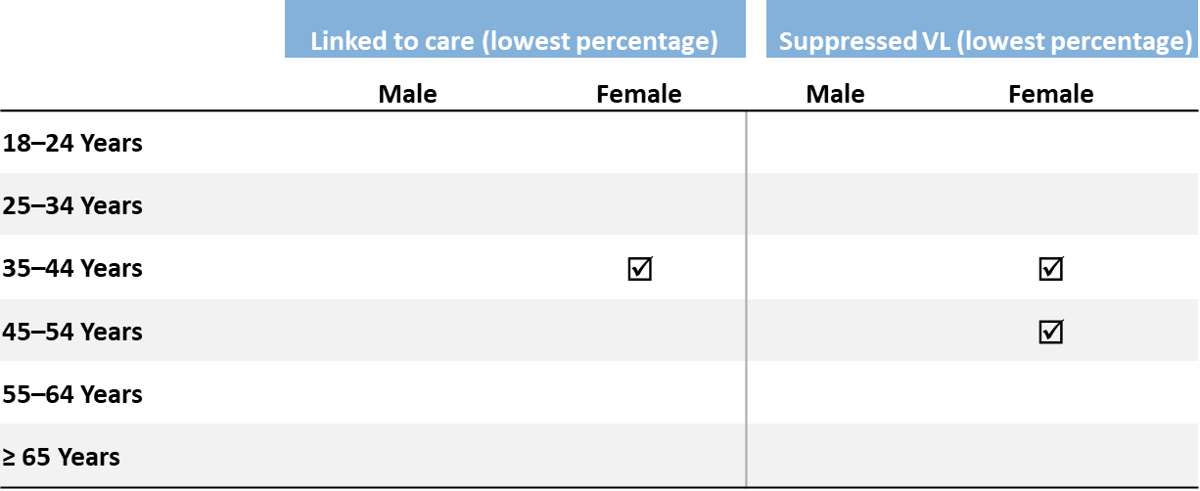
Linkage to HIV medical care within 1 month and viral suppression within 6 months of HIV diagnosis, by sex, age, and cost-burdened households, 2023—county level, United States
In 2023, males and females residing in counties with the highest cost-burdened households had the least favorable outcomes by age:
Note. Data are presented for persons aged ≥ 18 years.
Notes:
In 2023, in the United States, the lowest percentages of linkage to care within 1 month of diagnosis and viral suppression within 6 months of diagnosis, by sex and age, among those residing in counties with the highest cost-burdened households (i.e., where 27% or more of the residents spent ≥30% of household income on housing) were among the following:
Linkage to care:
Males: no age groups
Females: aged 35‒44 years
Viral suppression:
Males: no age groups
Females: aged 35‒44 and 45‒54 years
Note.
Linkage to care and viral suppression focus on SDOH extremes only (i.e., highest cost burden) and not the overall values unless otherwise indicated.
Data not provided for states and associated jurisdictions that do not have laws requiring reporting of all CD4 and viral loads. Areas without laws: Idaho. Areas with lapse in reporting: Tennessee.
For more information on data sources, data collection and reporting practices, and case definitions, see the National HIV Surveillance System (NHSS) Technical Notes, available at https://www.cdc.gov/hiv-data/nhss/index.html.
For more information on SDOH definitions and data specifications, see the Social Determinants of Health Report Technical Notes at https://www.cdc.gov/hiv-data/nhss/sdoh-hiv-diagnoses-and-selected-care-outcomes-2025.html.
For more information on linkage to HIV medical care within one month and viral suppression within 6 months of HIV diagnosis, see the Technical Notes, available at https://www.cdc.gov/hiv-data/nhss/national-hiv-prevention-and-care-objectives-2025.html.
For the definitions of SDOH indicator variables used in this report, see the U.S. Census Bureau’s American Community Survey at https://www2.census.gov/programs-surveys/acs/tech_docs/subject_definitions/2023_ACSSubjectDefinitions.pdf.

Slide 44
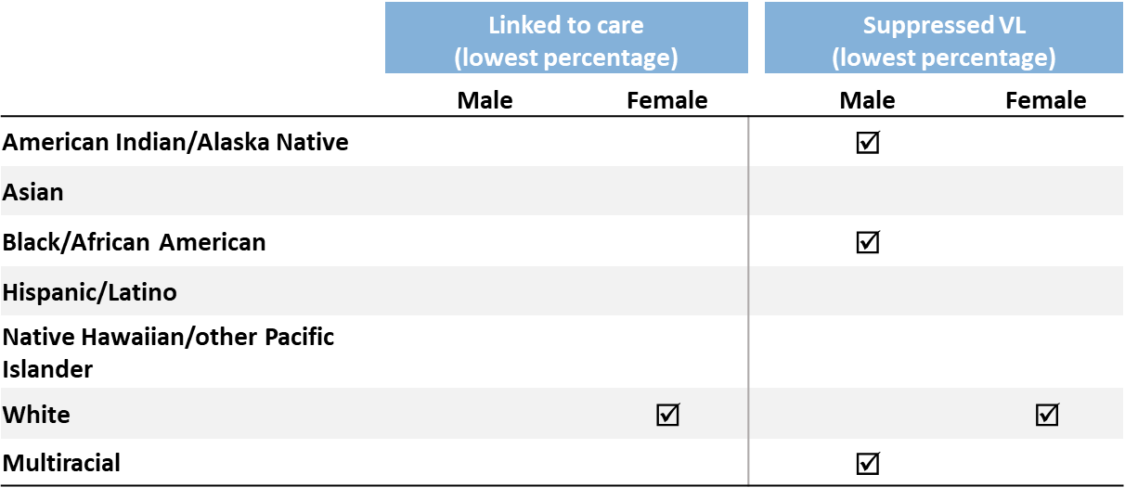
Linkage to HIV medical care within 1 month and viral suppression within 6 months of HIV diagnosis, by sex, race/ethnicity, and cost-burdened households, 2023—county level, United States
In 2023, males and females residing in counties with the highest cost-burdened households had the least favorable outcomes by race/ethnicity:
Note. Data are presented for persons aged ≥ 18 years. Hispanic/Latino persons can be of any race.
Notes:
In 2023, in the United States, the lowest percentages of linkage to care within 1 month of diagnosis and viral suppression within 6 months of diagnosis, by sex and race/ethnicity, among those residing in counties with the highest cost-burdened households (i.e., where 27% or more of the residents spent ≥30% of household income on housing) were among the following:
Linkage to care:
Males: no racial/ethnic groups
Females: White persons
Viral suppression:
Males: American Indian/Alaska Native, Black/African American, and multiracial persons
Females: White persons
Note.
Linkage to care and viral suppression focus on SDOH extremes only (i.e., highest cost burden) and not the overall values unless otherwise indicated.
Data not provided for states and associated jurisdictions that do not have laws requiring reporting of all CD4 and viral loads. Areas without laws: Idaho. Areas with lapse in reporting: Tennessee.
Use caution when interpreting data for American Indian/Alaska Native and Native Hawaiian/other Pacific Islander persons due to small numbers.
For more information on data sources, data collection and reporting practices, and case definitions, see the National HIV Surveillance System (NHSS) Technical Notes, available at https://www.cdc.gov/hiv-data/nhss/index.html.
For more information on SDOH definitions and data specifications, see the Social Determinants of Health Report Technical Notes at https://www.cdc.gov/hiv-data/nhss/sdoh-hiv-diagnoses-and-selected-care-outcomes-2025.html.
For more information on linkage to HIV medical care within one month and viral suppression within 6 months of HIV diagnosis, see the Technical Notes, available at https://www.cdc.gov/hiv-data/nhss/national-hiv-prevention-and-care-objectives-2025.html.
For the definitions of SDOH indicator variables used in this report, see the U.S. Census Bureau’s American Community Survey at https://www2.census.gov/programs-surveys/acs/tech_docs/subject_definitions/2023_ACSSubjectDefinitions.pdf.

Slide 45
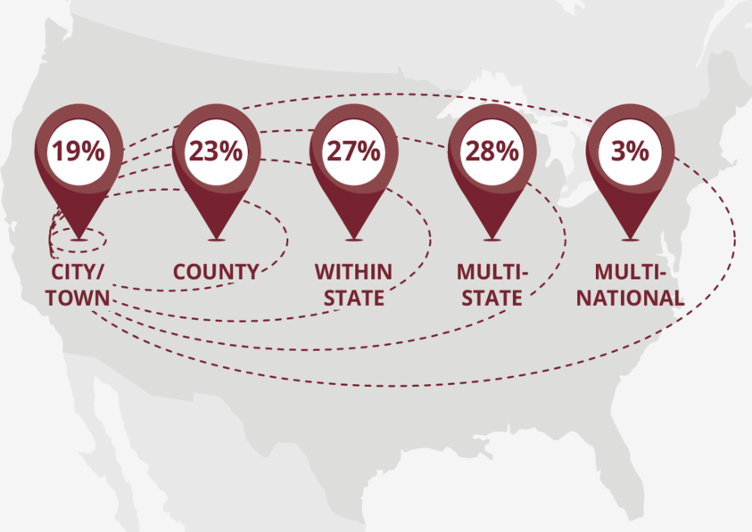
Residential Instability

Slide 46
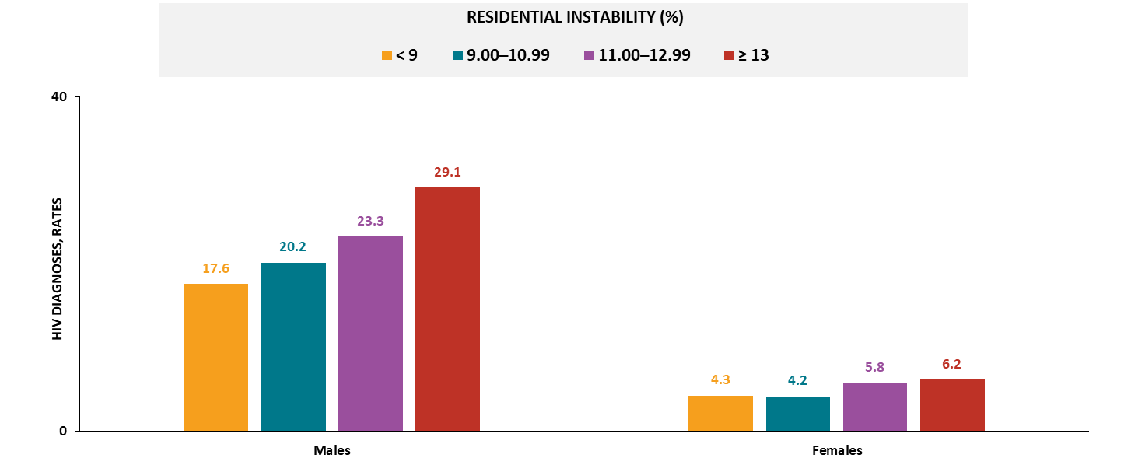
HIV diagnoses, by sex and residential instability, 2023—county level, United States and Puerto Rico
Note. Data are presented for persons aged ≥ 18 years. Rates are per 100,000 population.
Notes:
In 2023, in the United States and Puerto Rico, the highest HIV diagnosis rates by sex were among those residing in counties with the:
Highest residential instability (≥ 13% of the residents had moved in the past year): males and females
For males, the rate of HIV diagnoses increased as the percentage of residents who had moved in the past year increased.
Note.
For more information on data sources, data collection and reporting practices, and case definitions, see the National HIV Surveillance System (NHSS) Technical Notes, available at https://www.cdc.gov/hiv-data/nhss/index.html.
For more information on SDOH definitions and data specifications, see the Social Determinants of Health Report Technical Notes at https://www.cdc.gov/hiv-data/nhss/sdoh-hiv-diagnoses-and-selected-care-outcomes-2025.html.
For more information on diagnoses, see HIV Surveillance Report Technical Notes at https://www.cdc.gov/hiv-data/nhss/hiv-diagnoses-deaths-and-prevalence-2025.html.
For the definitions of SDOH indicator variables used in this report, see the U.S. Census Bureau’s American Community Survey at https://www2.census.gov/programs-surveys/acs/tech_docs/subject_definitions/2023_ACSSubjectDefinitions.pdf.

Slide 47
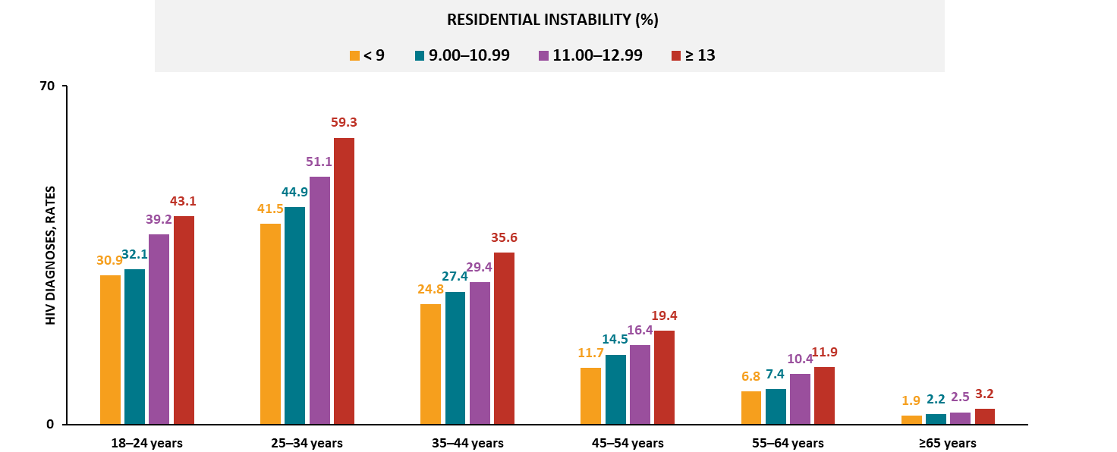
HIV diagnoses among males, by age and residential instability, 2023—county level, United States and Puerto Rico
Note. Data are presented for persons aged ≥ 18 years. Rates are per 100,000 population.
Notes:
In 2023, among males in the United States and Puerto Rico, the highest HIV diagnosis rates by age were among those residing in counties with the:
Highest residential instability (≥ 13% of the residents had moved in the past year): all age groups
For males in all age groups, the rate of HIV diagnoses increased as the percentage of residents who had moved in the past year increased.
Note.
For more information on data sources, data collection and reporting practices, and case definitions, see the National HIV Surveillance System (NHSS) Technical Notes, available at https://www.cdc.gov/hiv-data/nhss/index.html.
For more information on SDOH definitions and data specifications, see the Social Determinants of Health Report Technical Notes at https://www.cdc.gov/hiv-data/nhss/sdoh-hiv-diagnoses-and-selected-care-outcomes-2025.html.
For more information on diagnoses, see HIV Surveillance Report Technical Notes at https://www.cdc.gov/hiv-data/nhss/hiv-diagnoses-deaths-and-prevalence-2025.html.
For the definitions of SDOH indicator variables used in this report, see the U.S. Census Bureau’s American Community Survey at https://www2.census.gov/programs-surveys/acs/tech_docs/subject_definitions/2023_ACSSubjectDefinitions.pdf.

Slide 48
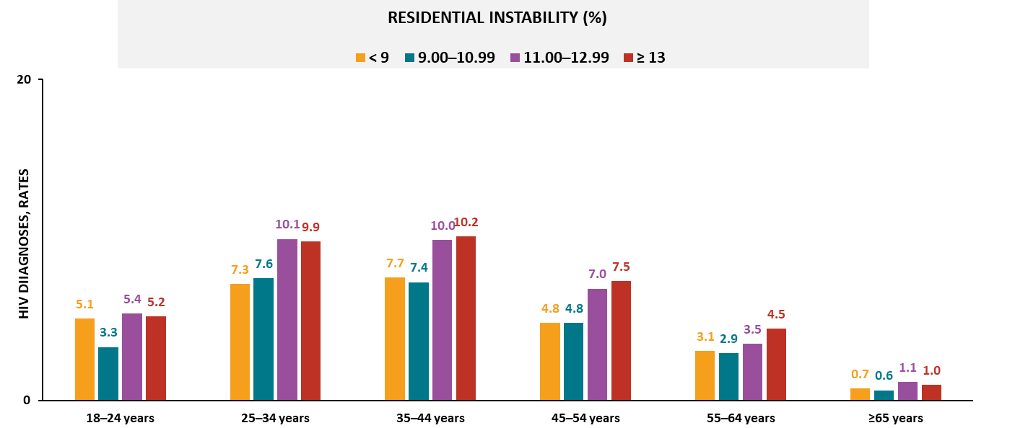
HIV diagnoses among females, by age and residential instability, 2023—county level, United States and Puerto Rico
Note. Data are presented for persons aged ≥ 18 years. Rates are per 100,000 population.
Notes:
In 2023, among females in the United States and Puerto Rico, the highest HIV diagnosis rates by age were among those residing in counties with the:
Highest residential instability (≥ 13% of the residents had moved in the past year): aged 35‒44, 45‒54, and 55‒64 years
Second-highest residential instability (11.00‒12.99% moved in past year): aged 18‒24, 25‒34, and ≥ 65 years
Note.
For more information on data sources, data collection and reporting practices, and case definitions, see the National HIV Surveillance System (NHSS) Technical Notes, available at https://www.cdc.gov/hiv-data/nhss/index.html.
For more information on SDOH definitions and data specifications, see the Social Determinants of Health Report Technical Notes at https://www.cdc.gov/hiv-data/nhss/sdoh-hiv-diagnoses-and-selected-care-outcomes-2025.html.
For more information on diagnoses, see HIV Surveillance Report Technical Notes at https://www.cdc.gov/hiv-data/nhss/hiv-diagnoses-deaths-and-prevalence-2025.html.
For the definitions of SDOH indicator variables used in this report, see the U.S. Census Bureau’s American Community Survey at https://www2.census.gov/programs-surveys/acs/tech_docs/subject_definitions/2023_ACSSubjectDefinitions.pdf.

Slide 49
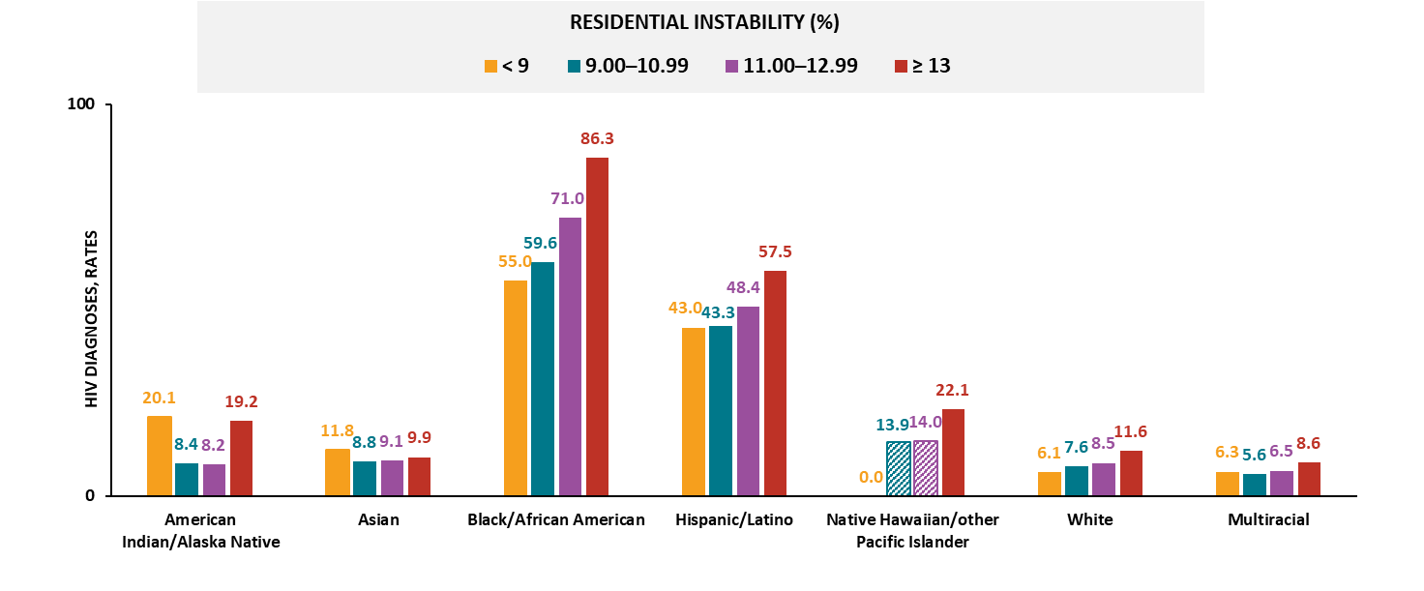
HIV diagnoses among males, by race/ethnicity and residential instability, 2023—county level, United States and Puerto Rico
Note. Data are presented for persons aged ≥ 18 years. Rates are per 100,000 population. Hispanic/Latino persons can be of any race. Striped bars indicate rates based on small numbers (i.e., less than 12 diagnoses) and should be interpreted with caution.
Notes:
In 2023, among males in the United States and Puerto Rico, the highest HIV diagnosis rates by race/ethnicity were among those residing in counties with the:
Highest residential instability (≥ 13% of the residents had moved in the past year): Black/African American, Hispanic/Latino, White, and multiracial males
Lowest residential instability (< 9% moved in the past year): American Indian/Alaska Native and Asian males
For Black/African American, Hispanic/Latino, and White males, the rate of HIV diagnoses increased as the percentage of residents who had moved in the past year increased.
Note.
Groups were excluded from findings if two or more quartiles contained small numbers.
Use caution when interpreting data for Native Hawaiian/other Pacific Islander persons due to small numbers.
For more information on data sources, data collection and reporting practices, and case definitions, see the National HIV Surveillance System (NHSS) Technical Notes, available at https://www.cdc.gov/hiv-data/nhss/index.html.
For more information on SDOH definitions and data specifications, see the Social Determinants of Health Report Technical Notes at https://www.cdc.gov/hiv-data/nhss/sdoh-hiv-diagnoses-and-selected-care-outcomes-2025.html.
For more information on diagnoses, see HIV Surveillance Report Technical Notes at https://www.cdc.gov/hiv-data/nhss/hiv-diagnoses-deaths-and-prevalence-2025.html.
For the definitions of SDOH indicator variables used in this report, see the U.S. Census Bureau’s American Community Survey at https://www2.census.gov/programs-surveys/acs/tech_docs/subject_definitions/2023_ACSSubjectDefinitions.pdf.

Slide 50
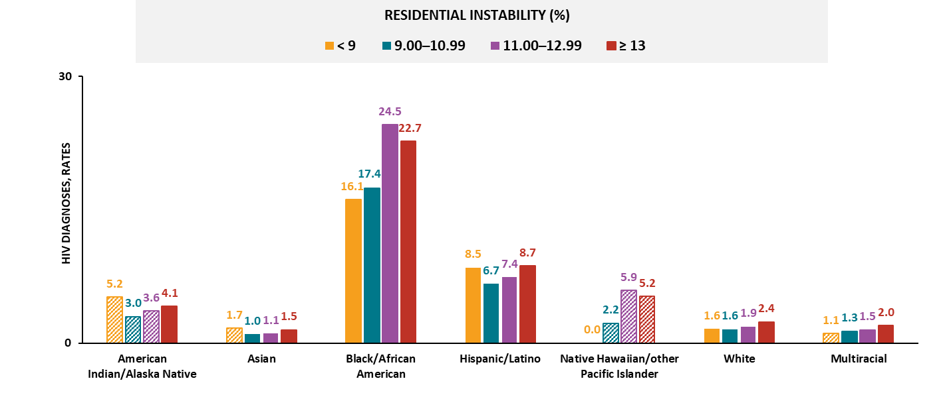
HIV diagnoses among females, by race/ethnicity and residential instability, 2023—county level, United States and Puerto Rico
Note. Data are presented for persons aged ≥ 18 years. Rates are per 100,000 population. Hispanic/Latino persons can be of any race. Striped bars indicate rates based on small numbers (i.e., less than 12 diagnoses) and should be interpreted with caution.
Notes:
In 2023, among females in the United States and Puerto Rico, the highest HIV diagnosis rates by race/ethnicity were among those residing in counties with the:
Highest residential instability (≥ 13% of the residents had moved in the past year): Hispanic/Latino, White, and multiracial females
Second-highest residential instability (11.00‒12.99% moved in the past year): Black/African American females
For multiracial females, the rate of HIV diagnoses increased as the percentage of residents who had moved in the past year increased.
Note.
Groups were excluded from findings if two or more quartiles contained small numbers.
Use caution when interpreting data for American Indian/Alaska Native and Native Hawaiian/other Pacific Islander persons due to small numbers.
For more information on data sources, data collection and reporting practices, and case definitions, see the National HIV Surveillance System (NHSS) Technical Notes, available at https://www.cdc.gov/hiv-data/nhss/index.html.
For more information on SDOH definitions and data specifications, see the Social Determinants of Health Report Technical Notes at https://www.cdc.gov/hiv-data/nhss/sdoh-hiv-diagnoses-and-selected-care-outcomes-2025.html.
For more information on diagnoses; see HIV Surveillance Report Technical Notes at https://www.cdc.gov/hiv-data/nhss/hiv-diagnoses-deaths-and-prevalence-2025.html.
For the definitions of SDOH indicator variables used in this report, see the U.S. Census Bureau’s American Community Survey at https://www2.census.gov/programs-surveys/acs/tech_docs/subject_definitions/2023_ACSSubjectDefinitions.pdf.

Slide 51
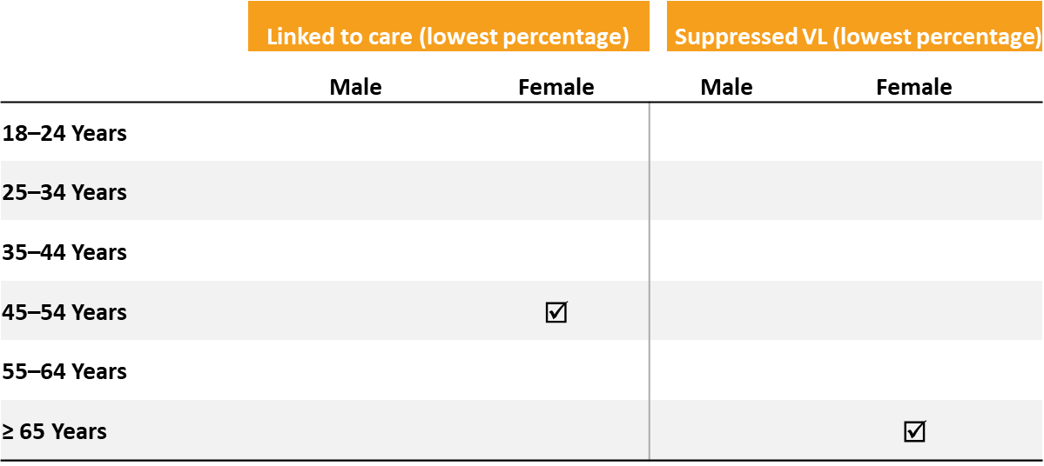
Linkage to HIV medical care within 1 month and viral suppression within 6 months of HIV diagnosis, by sex, age, and residential instability, 2023—county level, United States
In 2023, males and females residing in counties with the highest residential instability had the least favorable outcomes by age:
Note. Data are presented for persons aged ≥ 18 years.
Notes:
In 2023, in the United States, the lowest percentages of linkage to care within 1 month of diagnosis and viral suppression within 6 months of diagnosis, by sex and age, among those residing in counties with the highest residential instability (i.e., where 13% or more of the residents had moved in the past year) were among the following:
Linkage to care:
Males: no age groups
Females: aged 45‒54 years
Viral suppression:
Males: no age group
Females: aged ≥ 65 years
Note.
Linkage to care and viral suppression focus on SDOH extremes only (i.e., highest residential instability) and not the overall values unless otherwise indicated.
Data not provided for states and associated jurisdictions that do not have laws requiring reporting of all CD4 and viral loads. Areas without laws: Idaho. Areas with lapse in reporting: Tennessee.
For more information on data sources, data collection and reporting practices, and case definitions, see the National HIV Surveillance System (NHSS) Technical Notes, available at https://www.cdc.gov/hiv-data/nhss/index.html.
For more information on SDOH definitions and data specifications, see the Social Determinants of Health Report Technical Notes at https://www.cdc.gov/hiv-data/nhss/sdoh-hiv-diagnoses-and-selected-care-outcomes-2025.html.
For more information on linkage to HIV medical care within one month and viral suppression within 6 months of HIV diagnosis, see the Technical Notes, available at https://www.cdc.gov/hiv-data/nhss/national-hiv-prevention-and-care-objectives-2025.html.
For the definitions of SDOH indicator variables used in this report, see the U.S. Census Bureau’s American Community Survey at https://www2.census.gov/programs-surveys/acs/tech_docs/subject_definitions/2023_ACSSubjectDefinitions.pdf.

Slide 52
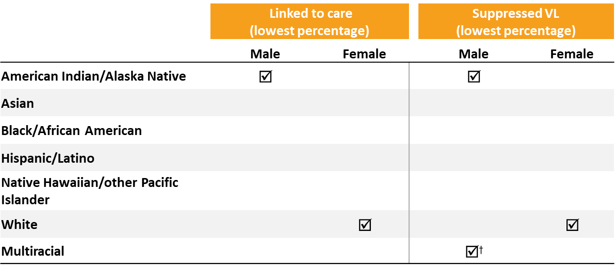
Linkage to HIV medical care within 1 month and viral suppression within 6 months of HIV diagnosis, by sex, race/ethnicity, and residential instability, 2023—county level, United States
In 2023, males and females residing in counties with the highest residential instability had the least favorable outcomes by race/ethnicity:
Note. Data are presented for persons aged ≥ 18 years. Hispanic/Latino persons can be of any race. Dagger (†) indicates the lowest percentage linked to care or lowest percentage with suppressed viral load was observed in the highest residential instability quartile and in one or more additional quartiles.
Notes:
In 2023, in the United States, the lowest percentages of linkage to care within 1 month of diagnosis and viral suppression within 6 months of diagnosis, by sex and race/ethnicity, among those residing in counties with the highest residential instability (i.e., where 13% or more of the residents had moved in the past year) were among the following:
Linkage to care:
Males: American Indian/Alaska Native persons
Females: White persons
Viral suppression:
Males: American Indian/Alaska Native and multiracial persons
Females: White persons
Note.
Linkage to care and viral suppression focus on SDOH extremes only (i.e., highest residential instability) and not the overall values unless otherwise indicated..
Data not provided for states and associated jurisdictions that do not have laws requiring reporting of all CD4 and viral loads. Areas without laws: Idaho. Areas with lapse in reporting: Tennessee.
Use caution when interpreting data for American Indian/Alaska Native and Native Hawaiian/other Pacific Islander persons due to small numbers.
For more information on data sources, data collection and reporting practices, and case definitions, see the National HIV Surveillance System (NHSS) Technical Notes, available at https://www.cdc.gov/hiv-data/nhss/index.html.
For more information on SDOH definitions and data specifications, see the Social Determinants of Health Report Technical Notes at https://www.cdc.gov/hiv-data/nhss/sdoh-hiv-diagnoses-and-selected-care-outcomes-2025.html.
For more information on linkage to HIV medical care within one month and viral suppression within 6 months of HIV diagnosis, see the Technical Notes, available at https://www.cdc.gov/hiv-data/nhss/national-hiv-prevention-and-care-objectives-2025.html.
For the definitions of SDOH indicator variables used in this report, see the U.S. Census Bureau’s American Community Survey at https://www2.census.gov/programs-surveys/acs/tech_docs/subject_definitions/2023_ACSSubjectDefinitions.pdf.

