Slide 1
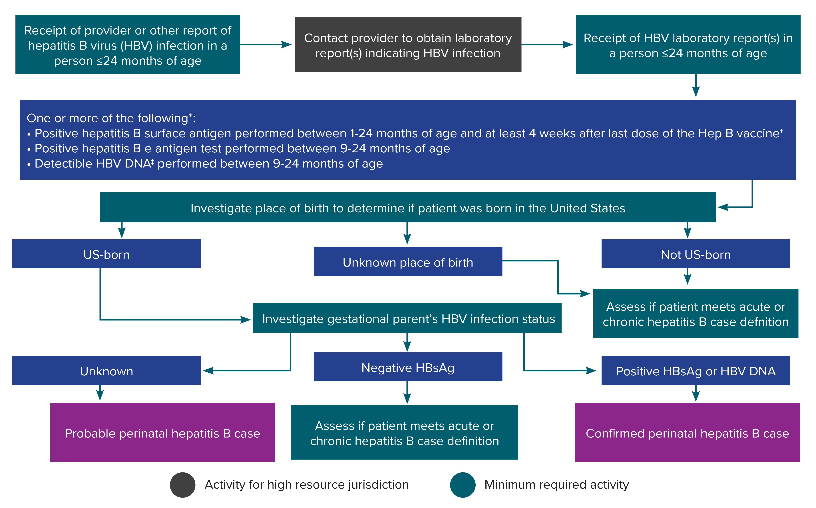
Figure 3-4. Process for perinatal hepatitis B case ascertainment and classification
*Surveillance programs should provide prevention programs with information on people who have positive test outcomes for post-test counseling and referral to care, as appropriate. HBsAg test results obtained from infants ≤1 month of age and hepatitis B e antigen and HBV DNA results obtained from those ≤9 months of age should not be used for classification. Cases among children <24 months of age who are known to have been exposed to HBV through health care (not perinatally) should be reported according to the 2012 acute and chronic hepatitis B case definitions.
†Positive HBsAg results obtained from infants ≤9 months of age who received hepatitis B vaccine should not be interpreted as positive due to the potential for transient HBsAg positivity.
‡Nucleic acid testing for HBV DNA, including qualitative, quantitative, and genotype testing.
Notes:
Figure 3-4 illustrates an approach for perinatal hepatitis B case ascertainment and classification. Recommended follow-up activities are color-coded based on if they are minimally required or are high resource.

